Slide 1
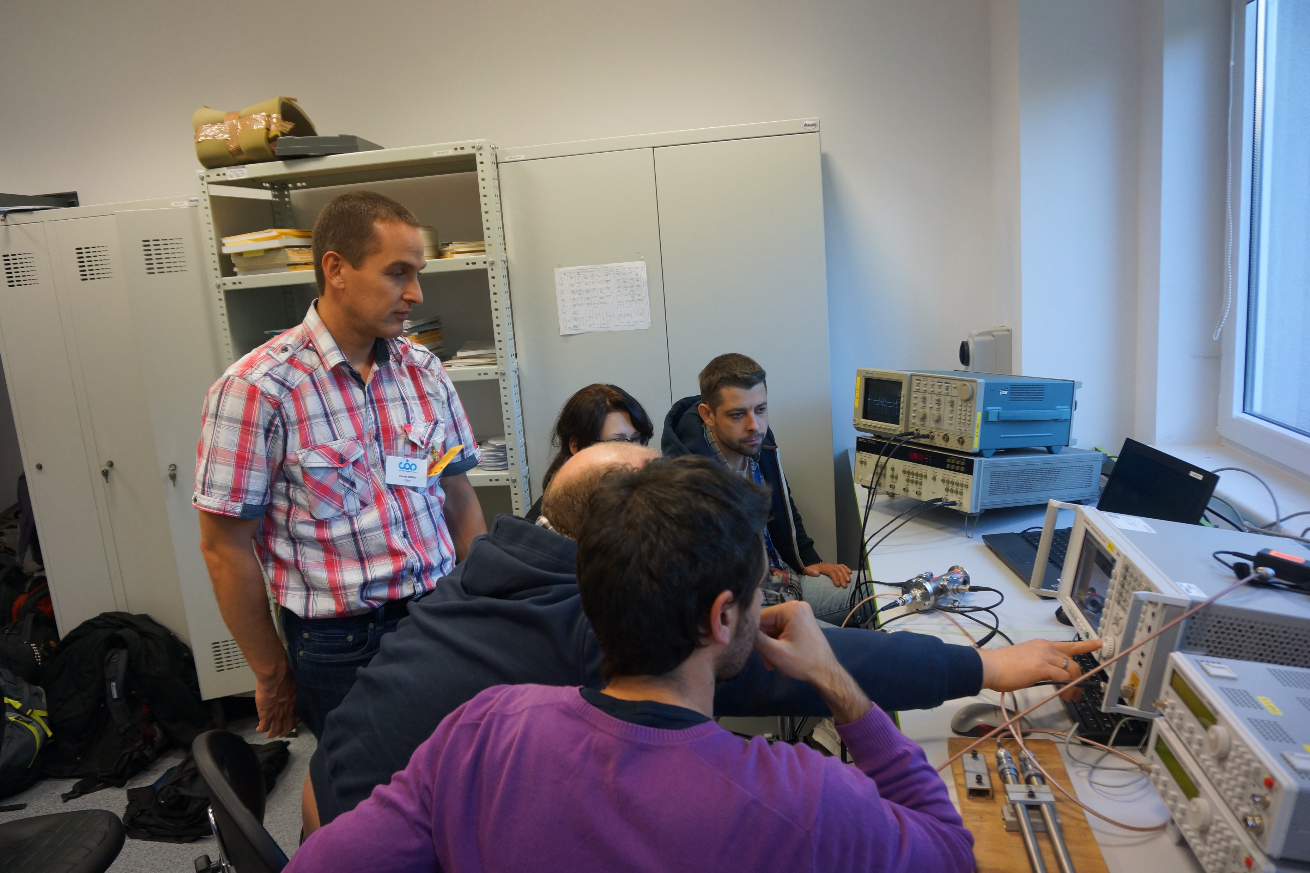
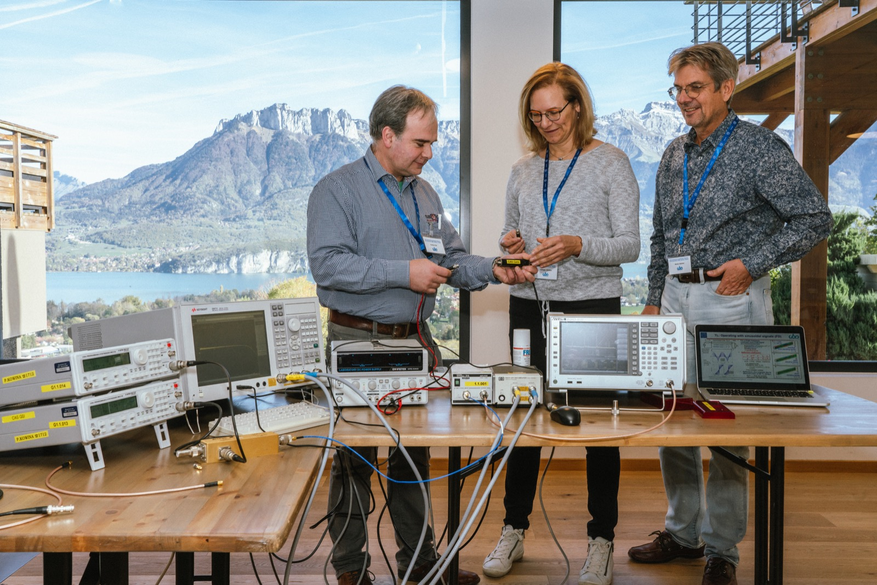
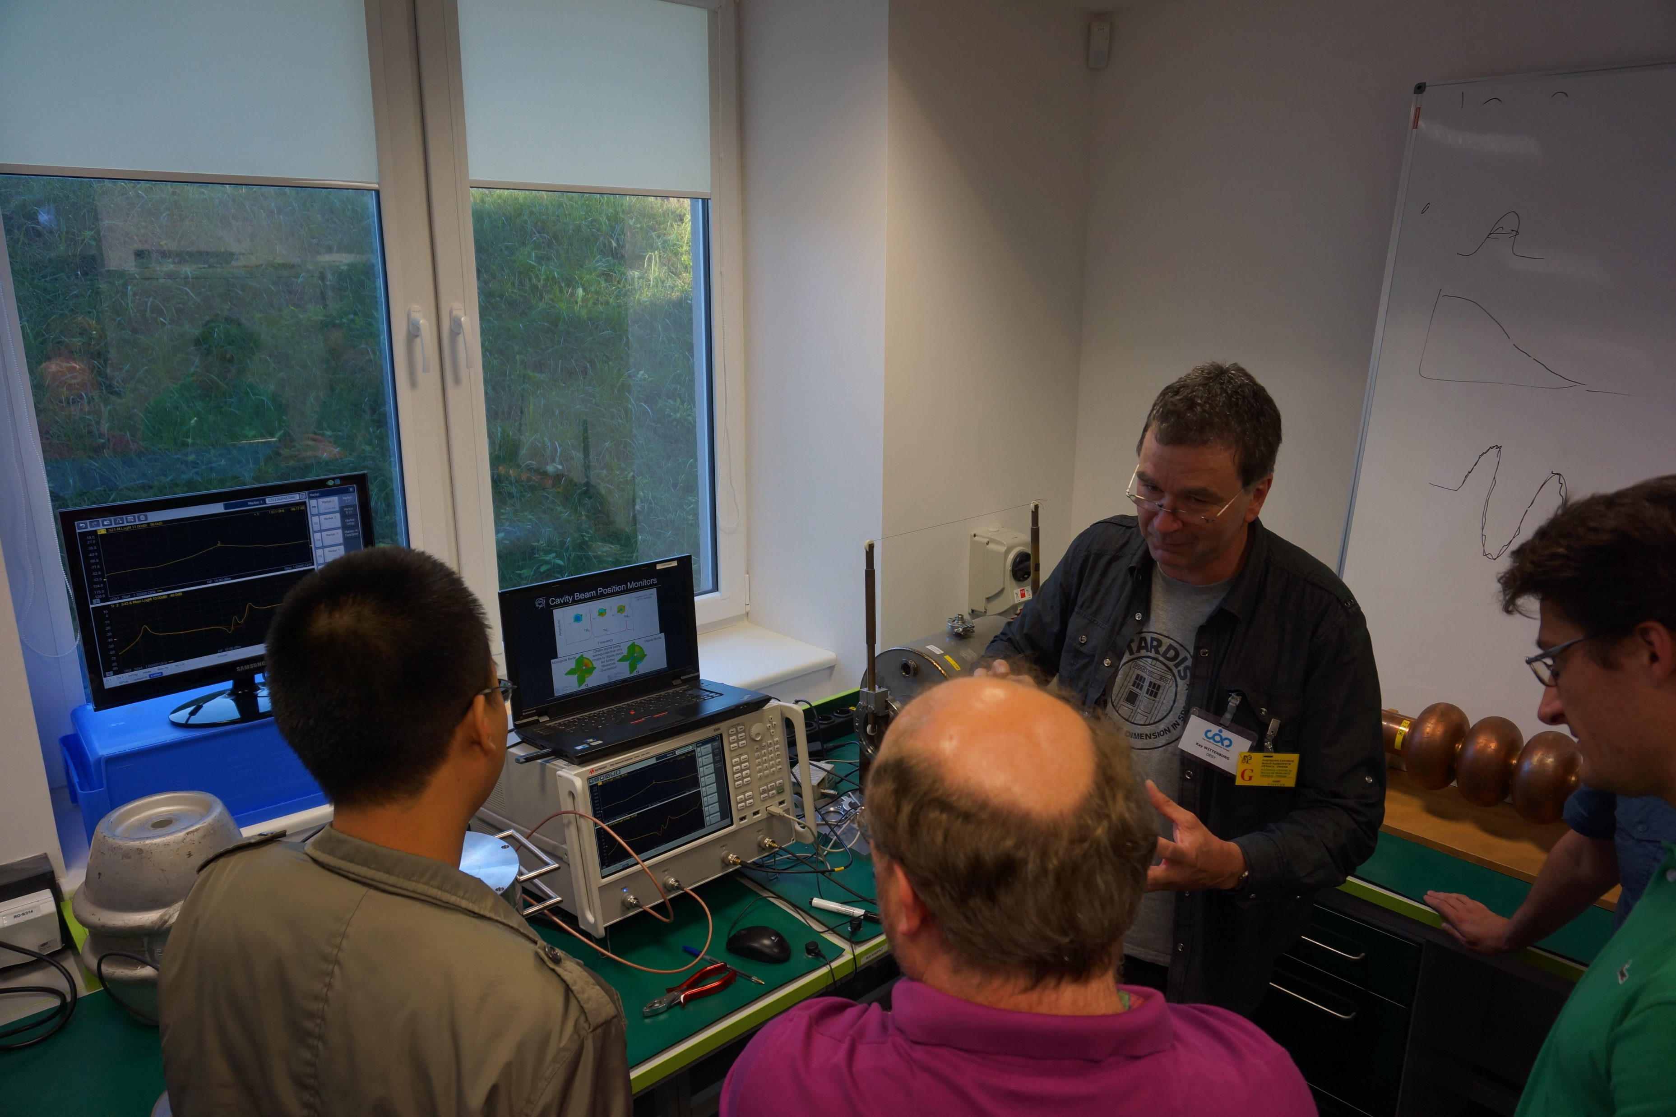
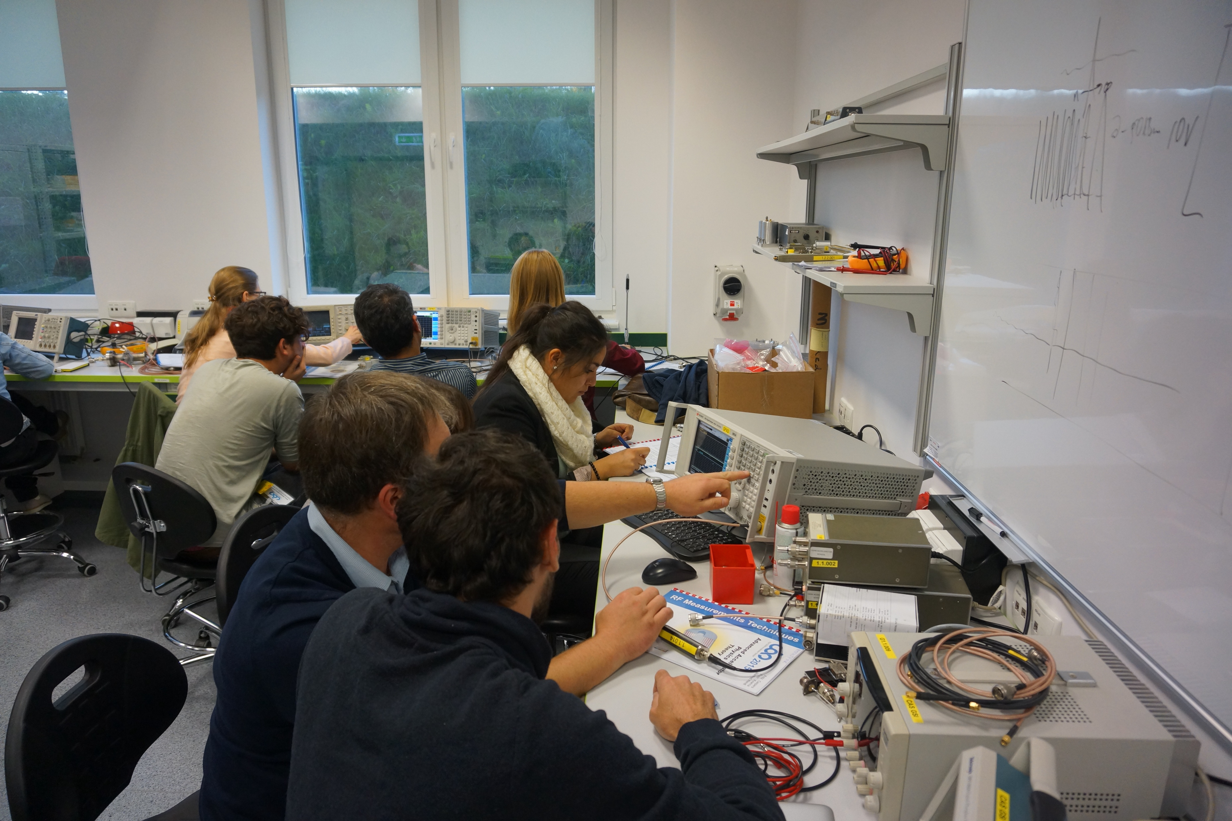
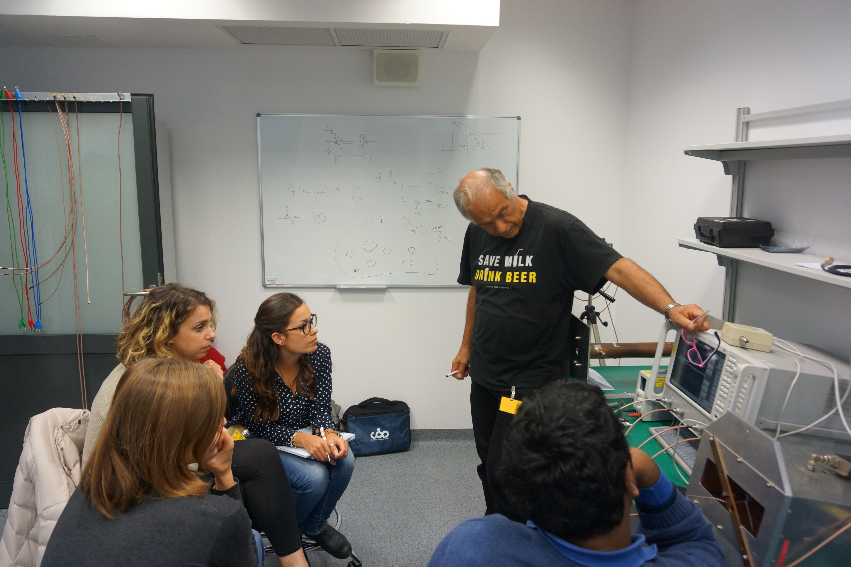
Hands-on RF Measurements – Teaser
Spin-off from the CAS Advanced Course afternoon hands-on sessions
  But…

Slide 2
Hands-on RF Measurements – Some Details
Much more students (>100), and fortunately also more instructors (10)
  Students: (large) spread in background knowledge and experience on RF measurements
    Teams of 4..5 students with a good spread
  Instructors: Professionals and (semi)-amateurs
    In RF you always are a student!
More experimental setups
  12 experimental tables with VNAs, SAs, oscilloscopes, RF generators and more
    Unfortunately located on different floors
  All students will execute each experiment
    Still, some changes, alterations on individual experiments may occur over the 2-weeks
  Additional after-hours experiments
    “Happy hour with Piotr” on request

Slide 3
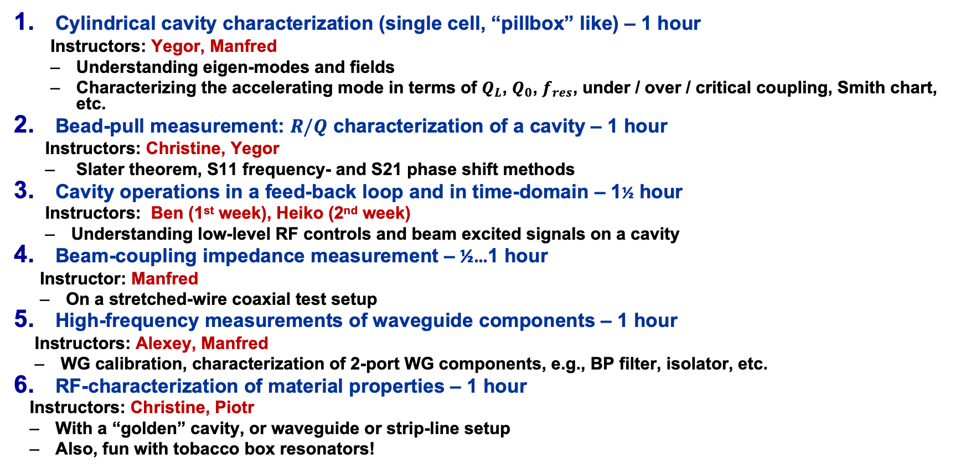
Hands-on RF Measurements – Block A, 1st floor (Harvard)
Cylindrical cavity characterization (single cell, “pillbox” like) – 1 hour
  Instructors: Yegor, Manfred
  Understanding eigen-modes and fields
  Characterizing the accelerating mode in terms of $Q_{L}$, $Q_{0}$, $f_{res}$, under / over / critical coupling, Smith chart, etc.
Bead-pull measurement: $R/Q$ characterization of a cavity – 1 hour
  Instructors: Christine, Yegor
  Slater theorem, S11 frequency- and S21 phase shift methods
Cavity operations in a feed-back loop and in time-domain – 1½ hour
  Instructors: Ben (1st week), Heiko (2nd week)
  Understanding low-level RF controls and beam excited signals on a cavity
Beam-coupling impedance measurement – ½…1 hour
  Instructor: Manfred
  On a stretched-wire coaxial test setup
High-frequency measurements of waveguide components – 1 hour
  Instructors: Alexey, Manfred
  WG calibration, characterization of 2-port WG components, e.g., BP filter, isolator, etc.
RF-characterization of material properties – 1 hour
  Instructors: Christine, Piotr
  With a “golden” cavity, or waveguide or strip-line setup
  Also, fun with tobacco box resonators!

Slide 4
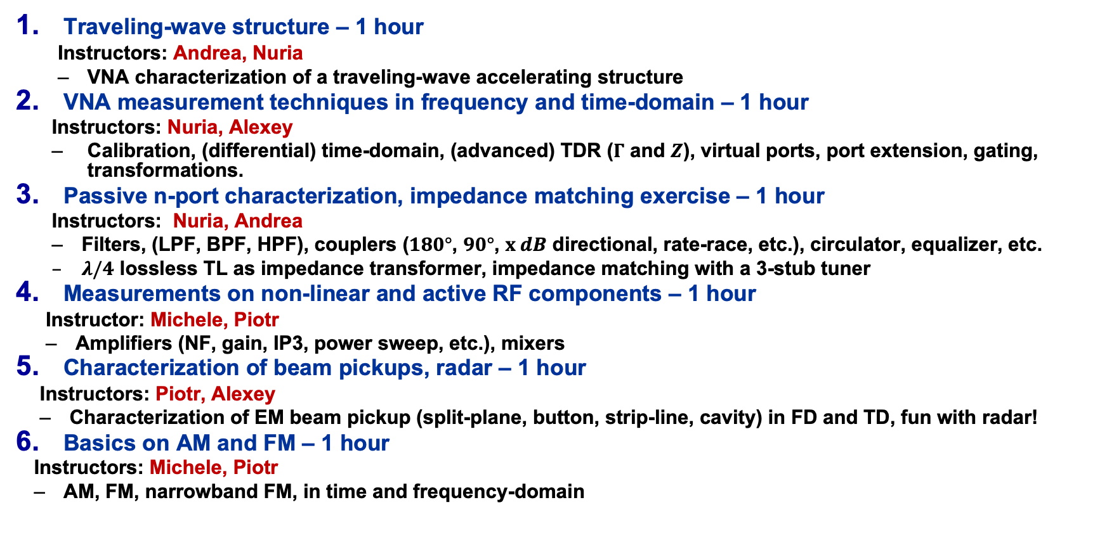
Hands-on RF Measurements – Block B, 2nd floor (Oxford)
Traveling-wave structure – 1 hour
  Instructors: Andrea, Nuria
  VNA characterization of a traveling-wave accelerating structure
VNA measurement techniques in frequency and time-domain – 1 hour
  Instructors: Nuria, Alexey
  Calibration, (differential) time-domain, (advanced) TDR ($Γ$ and $Z$), virtual ports, port extension, gating, transformations.
Passive n-port characterization, impedance matching exercise – 1 hour
  Instructors: Nuria, Andrea
  Filters, (LPF, BPF, HPF), couplers ($180°$, $90°$, $x dB$ directional, rate-race, etc.), circulator, equalizer, etc.
  $λ/4$ lossless TL as impedance transformer, impedance matching with a 3-stub tuner
Measurements on non-linear and active RF components – 1 hour
  Instructor: Michele, Piotr
  Amplifiers (NF, gain, IP3, power sweep, etc.), mixers
Characterization of beam pickups, radar – 1 hour
  Instructors: Piotr, Alexey
  Characterization of EM beam pickup (split-plane, button, strip-line, cavity) in FD and TD, fun with radar!
Basics on AM and FM – 1 hour
  Instructors: Michele, Piotr
  AM, FM, narrowband FM, in time and frequency-domain

Slide 5
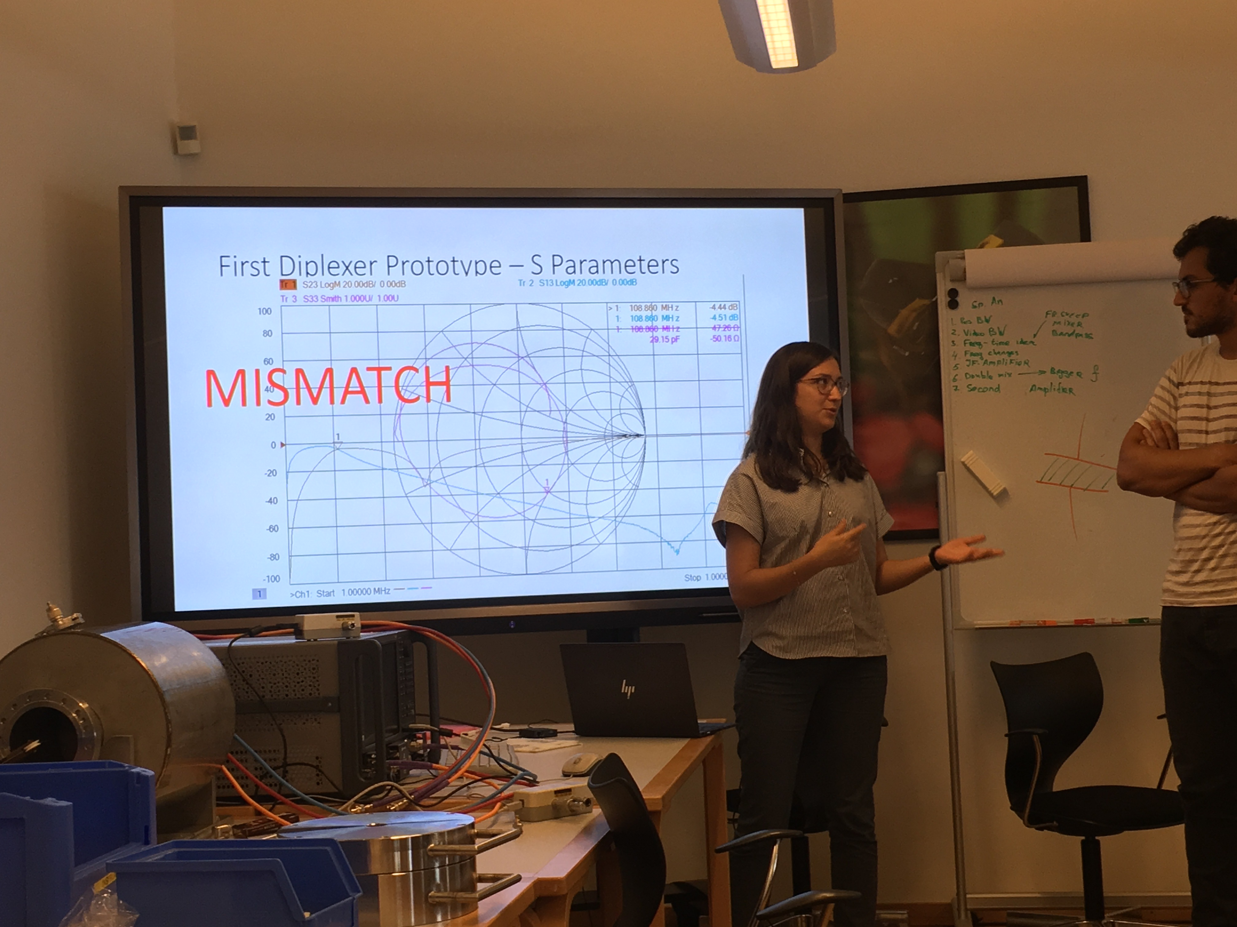
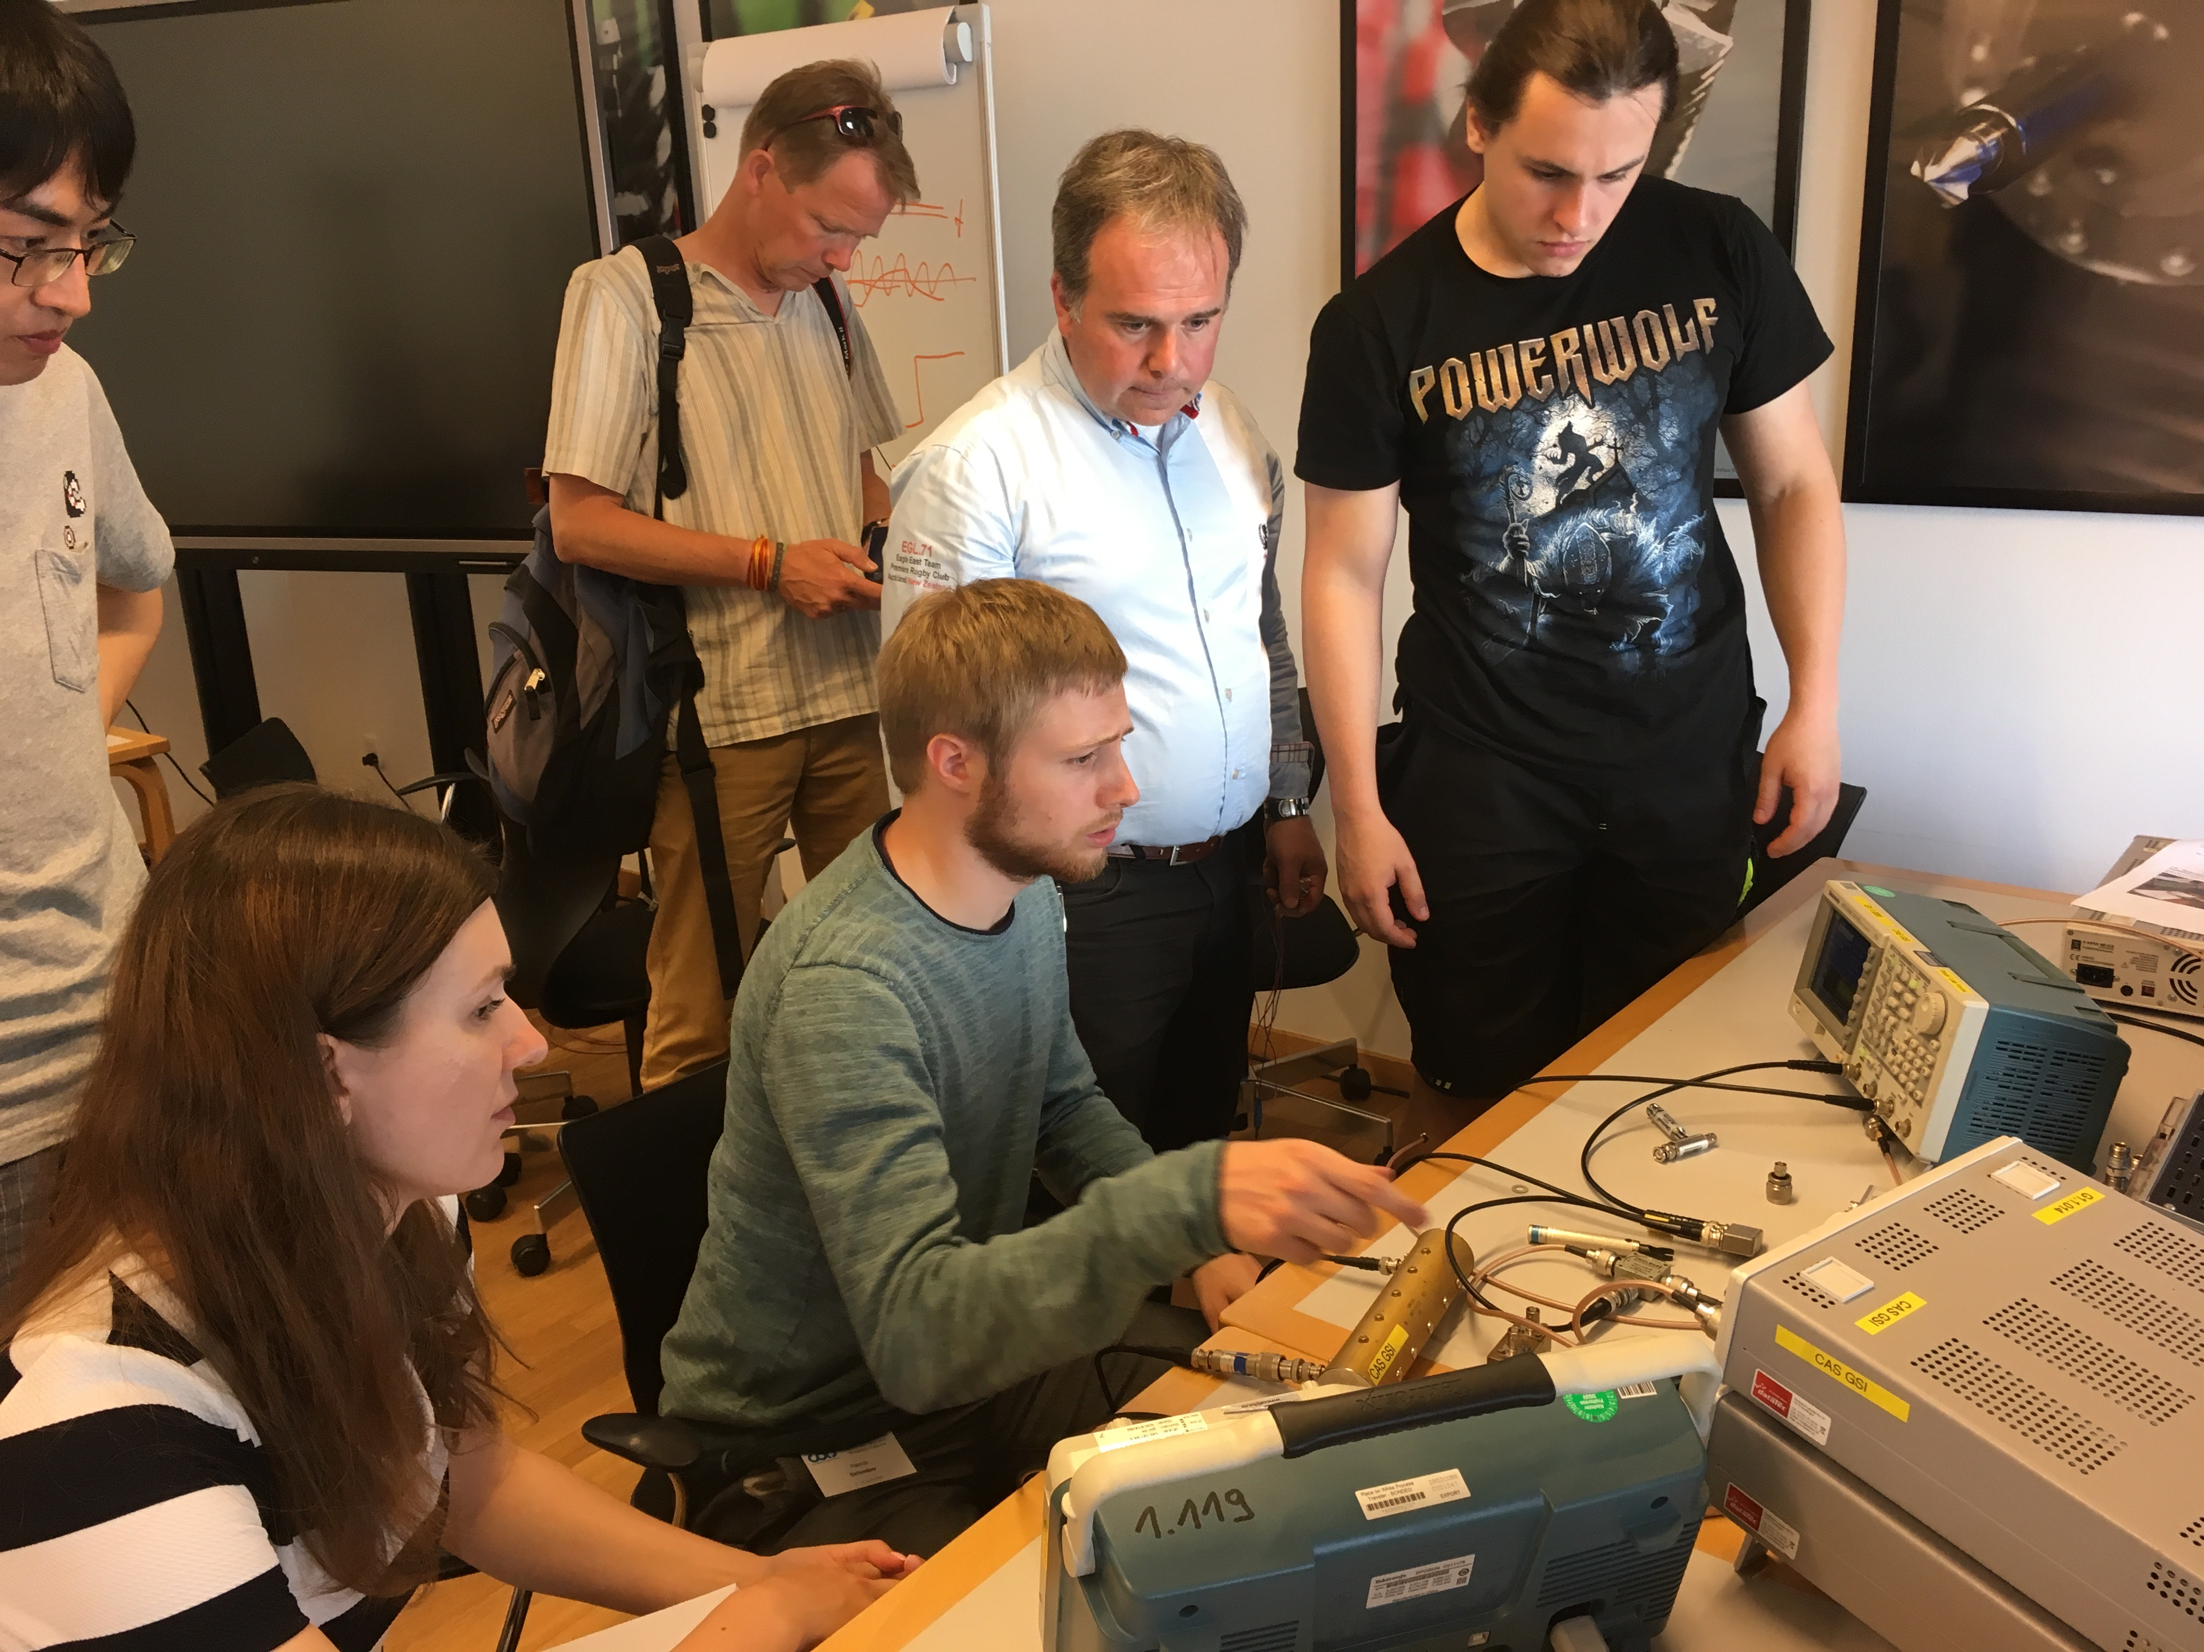
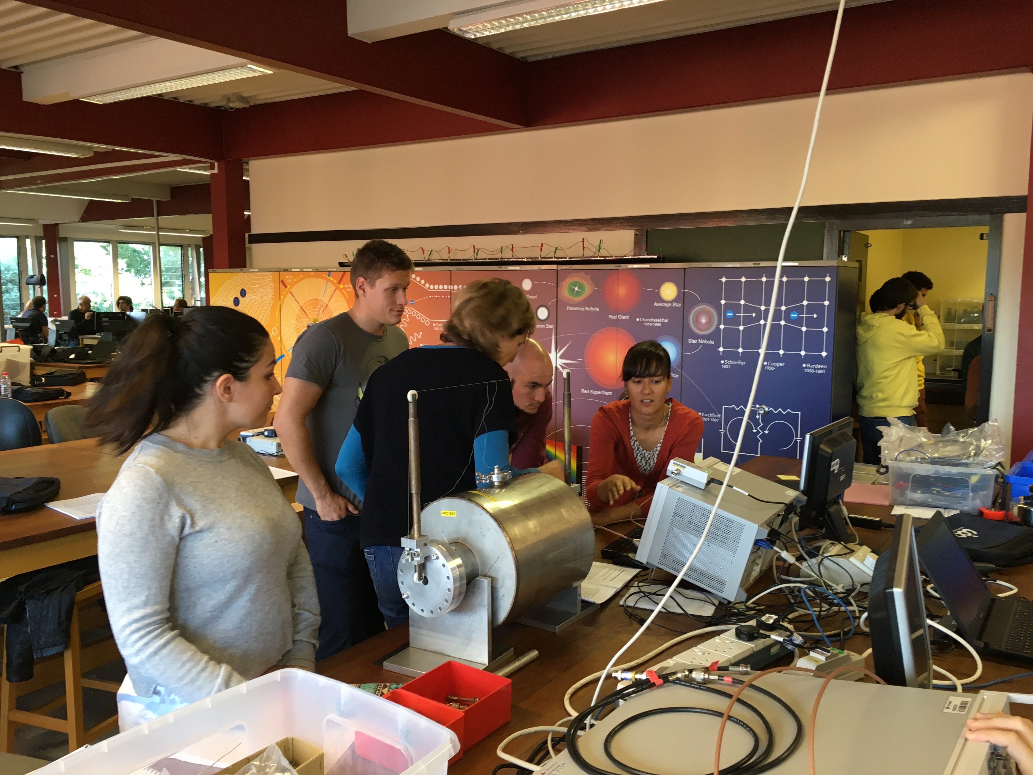
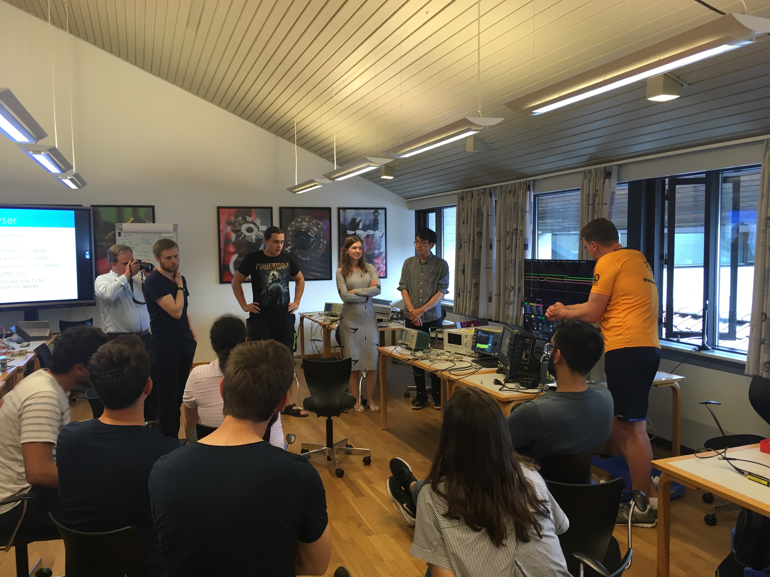
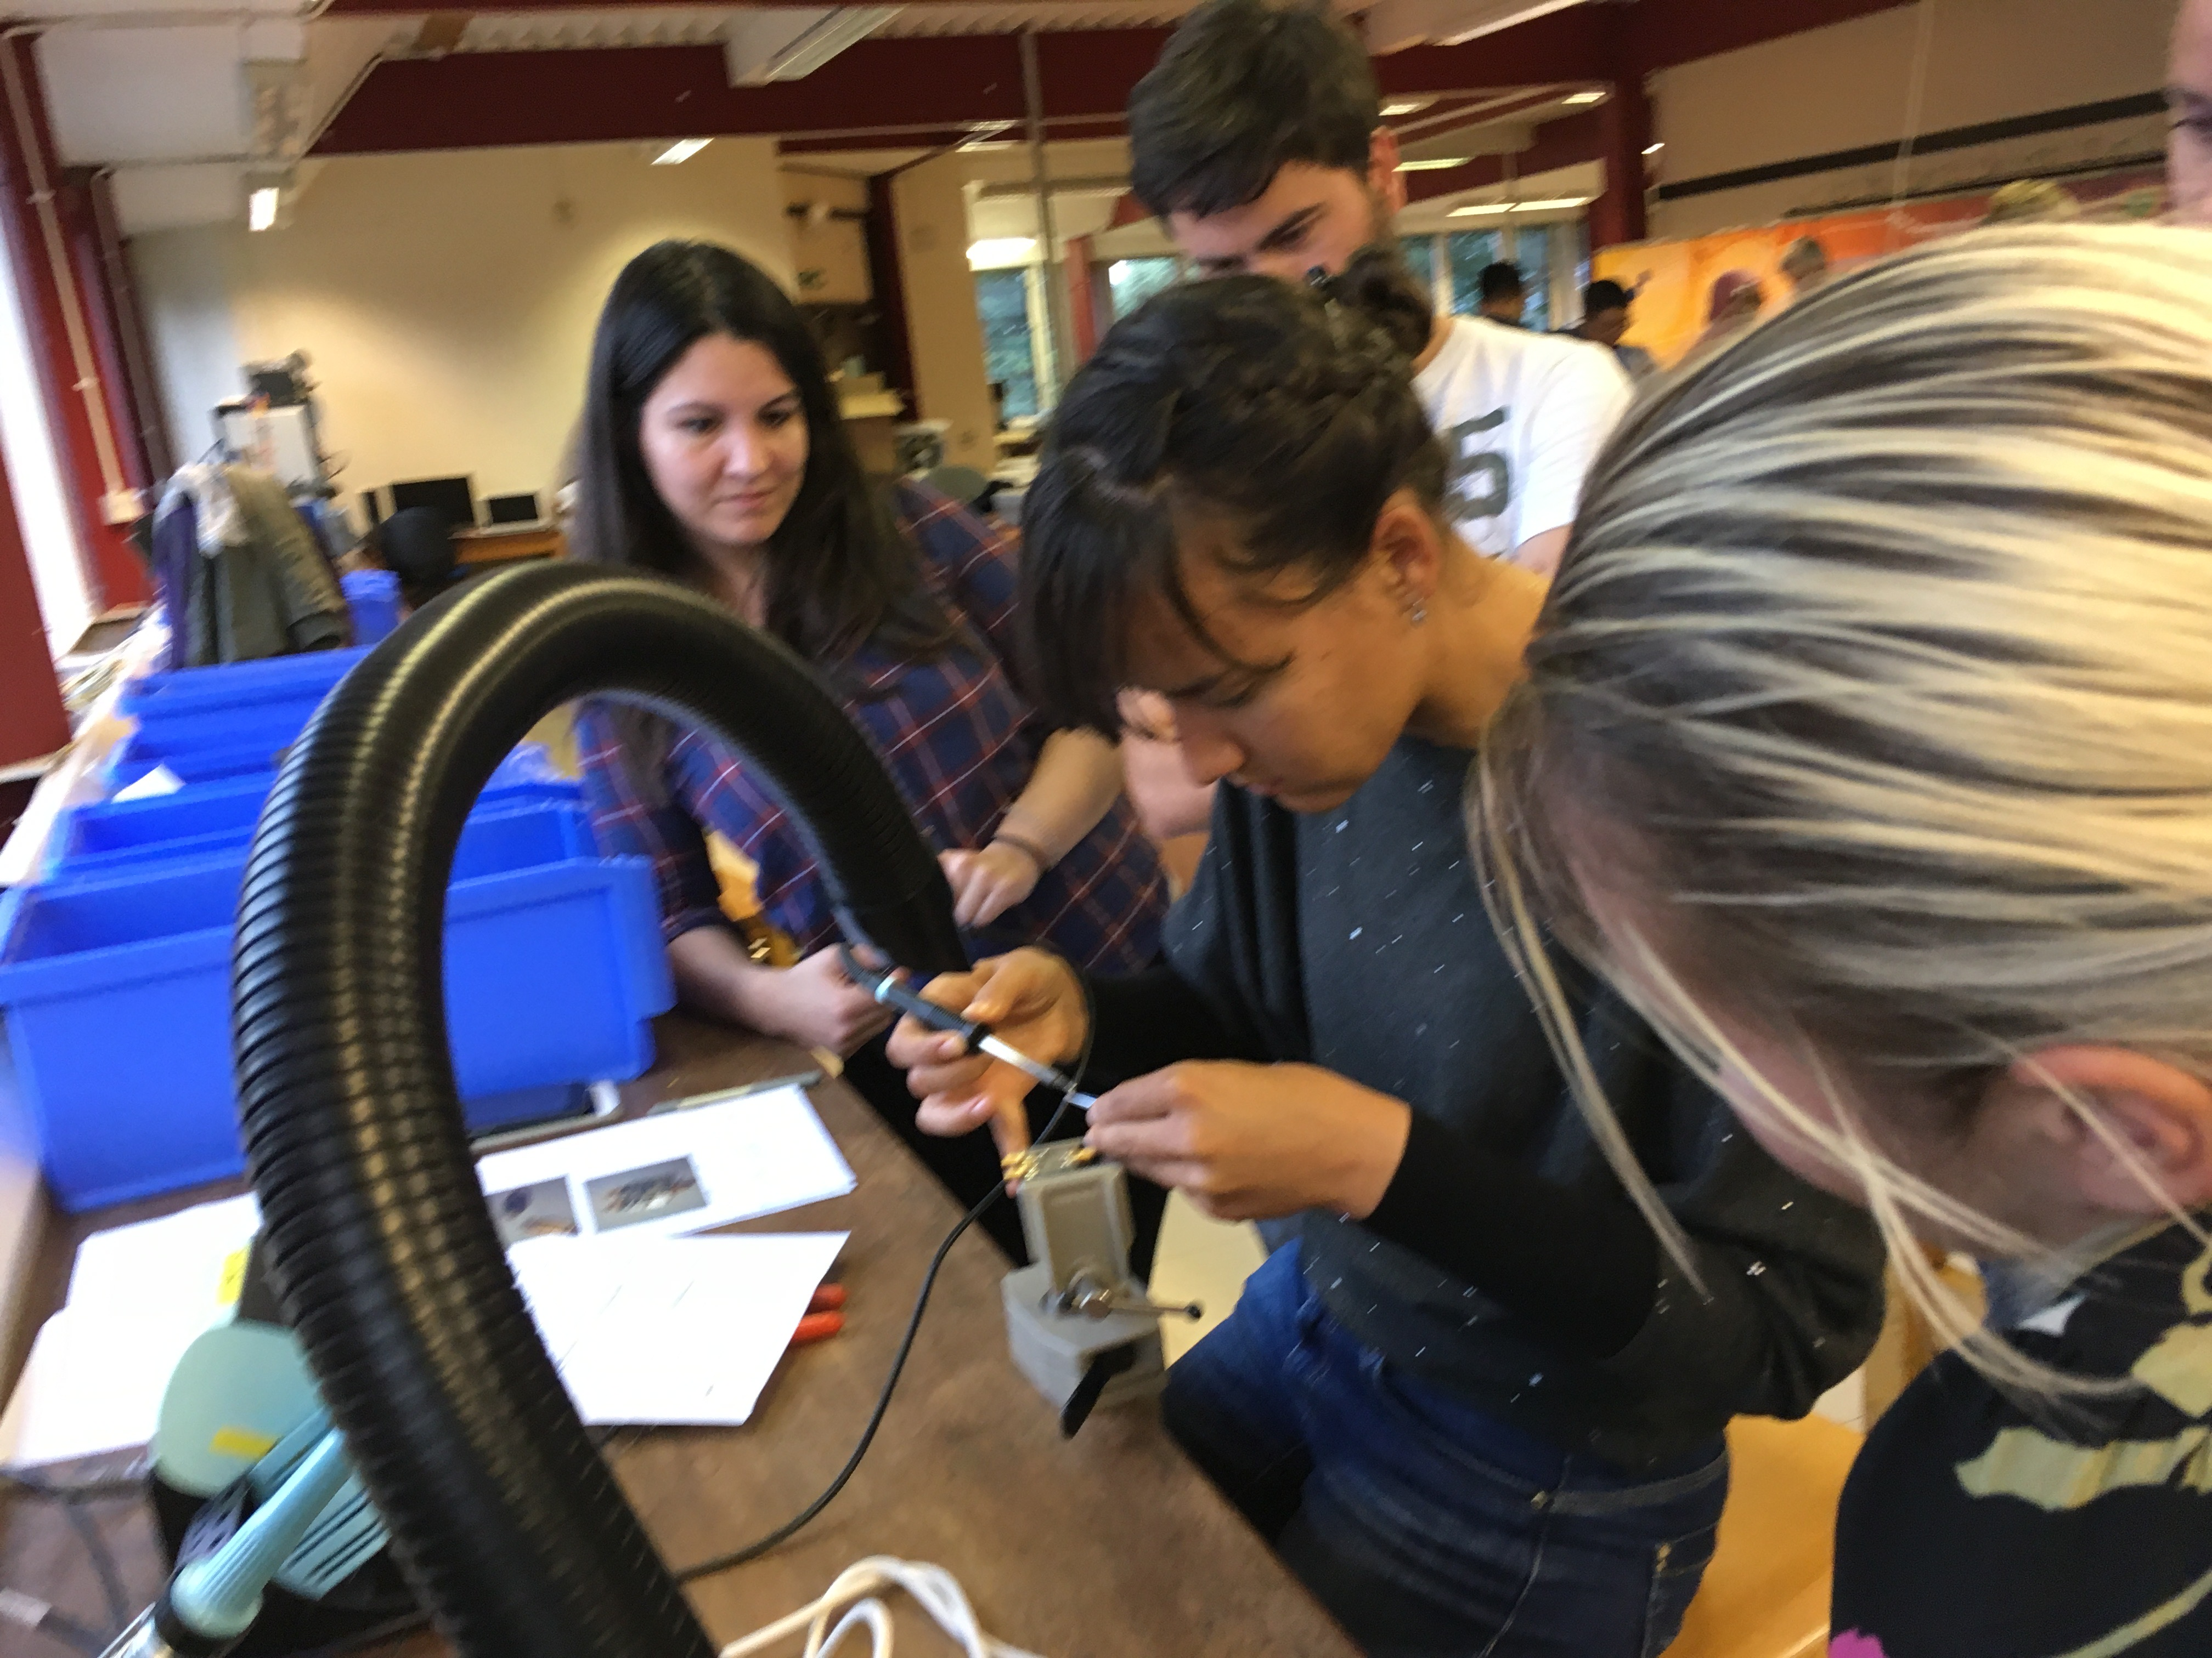
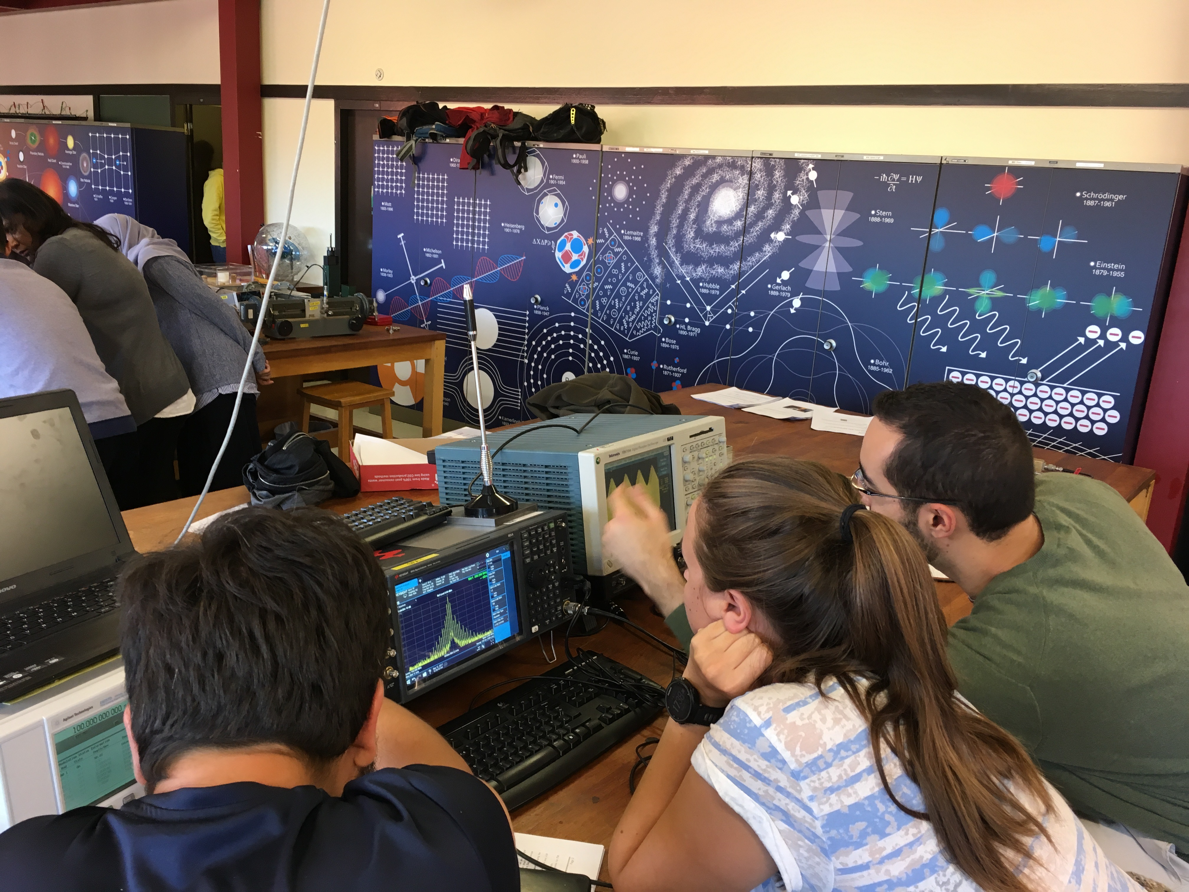
Learning by Doing

