Slide 1

2023 CAS course on “RF for Accelerators”
RF Measurements
– Only Part 2 –
Manfred Wendt – CERN

Slide 2
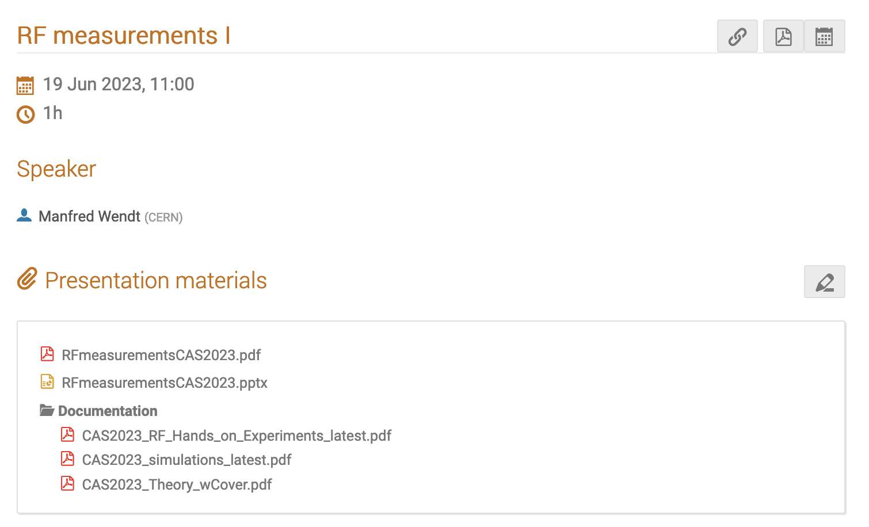
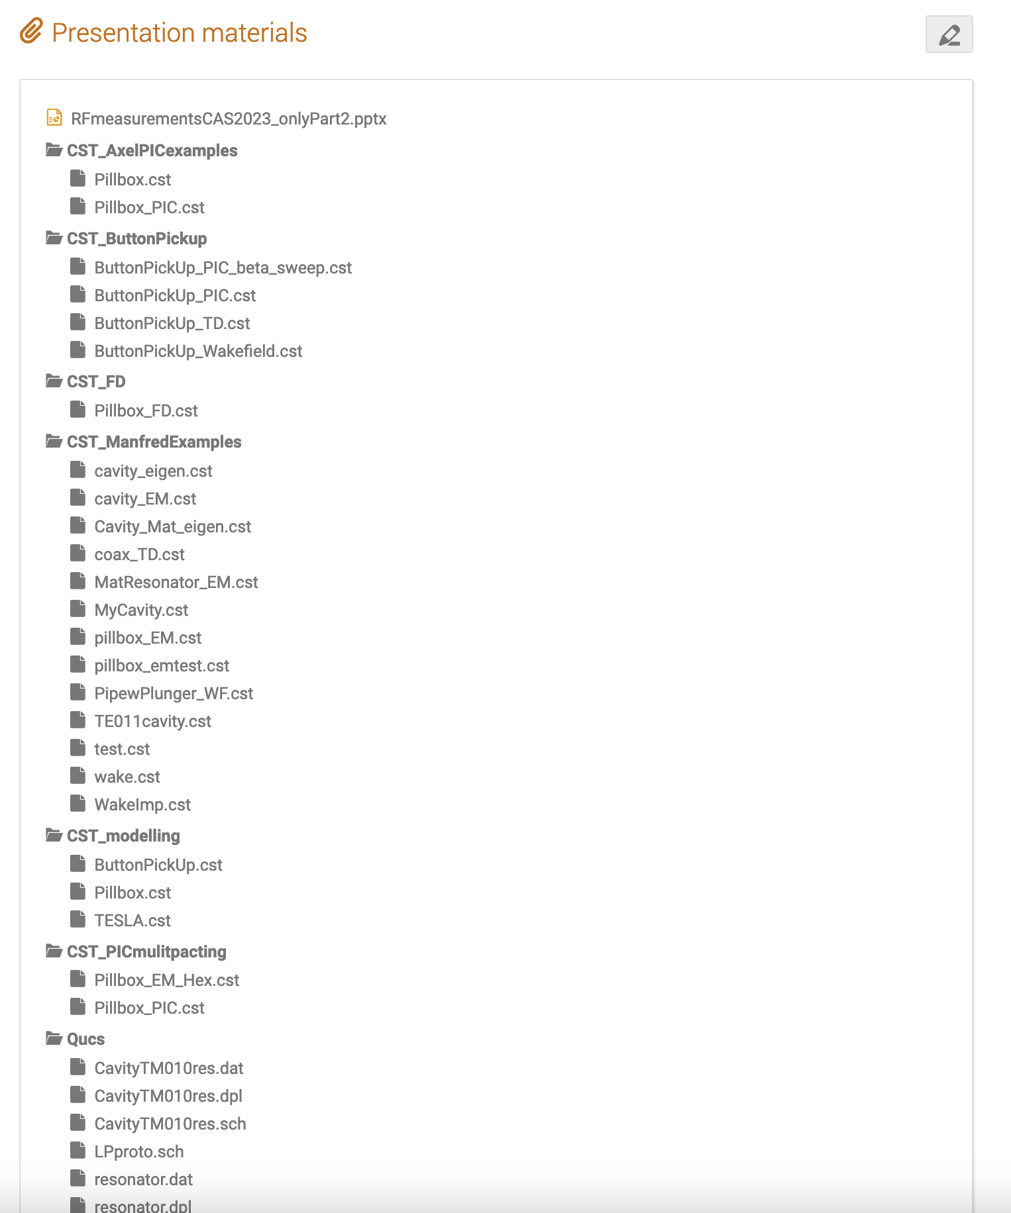
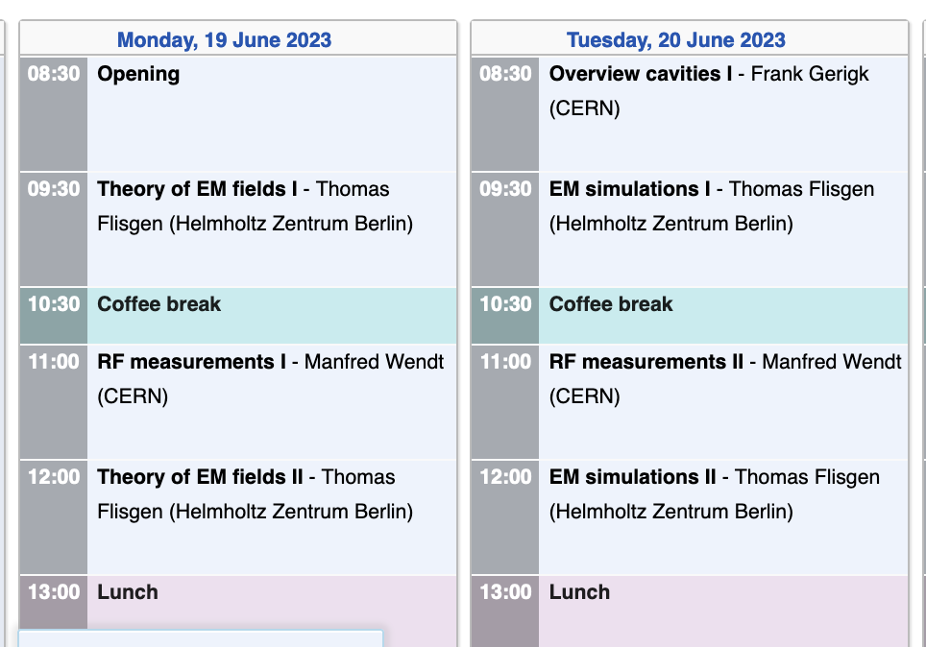
Documentation & Software Examples
CERNBox link:
https://cernbox.cern.ch/s/2OHukn46LDn1XOW
  Printed and updated documentation
  Software (CST and freeware)
  Software examples

Slide 3
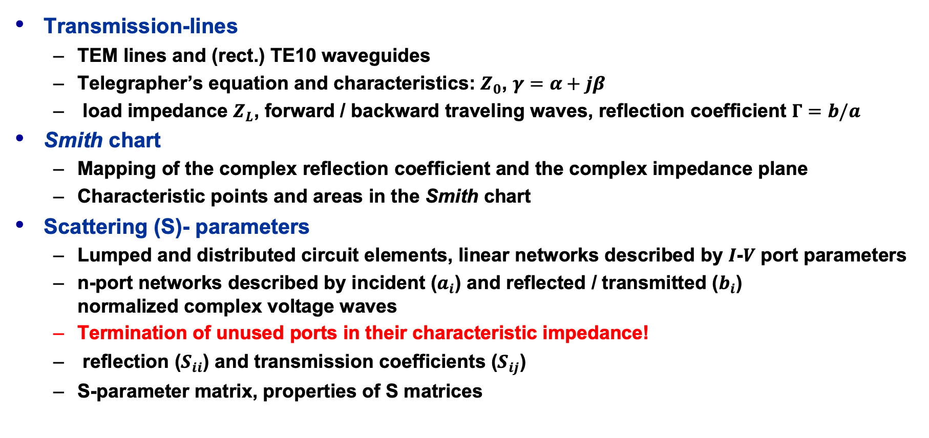
Summary Part 1
Transmission-lines
  TEM lines and (rect.) TE10 waveguides
  Telegrapher’s equation and characteristics: $Z_{0}$, $γ=α+jβ$
  load impedance $Z_{L}$, forward / backward traveling waves, reflection coefficient $Γ=b/a$
Smith chart
  Mapping of the complex reflection coefficient and the complex impedance plane
  Characteristic points and areas in the Smith chart
Scattering (S)- parameters
  Lumped and distributed circuit elements, linear networks described by $I$-$V$ port parameters
  n-port networks described by incident ($a_{i}$) and reflected / transmitted ($b_{i}$)
  normalized complex voltage waves
  Termination of unused ports in their characteristic impedance!
  reflection ($S_{ii}$) and transmission coefficients ($S_{ij}$)
  S-parameter matrix, properties of S matrices

Slide 4
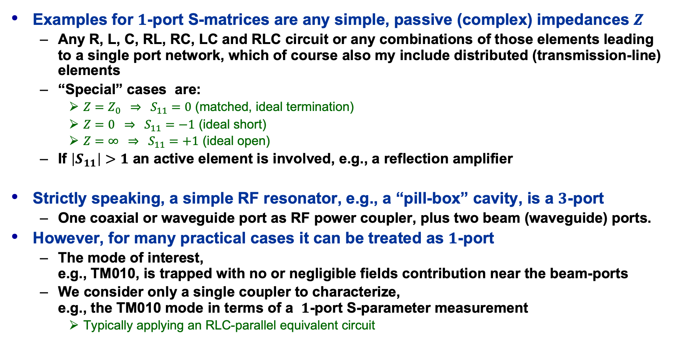


S-Matrix Examples – $1$-port
Examples for $1$-port S-matrices are any simple, passive (complex) impedances $Z$
  Any R, L, C, RL, RC, LC and RLC circuit or any combinations of those elements leading to a single port network, which of course also my include distributed (transmission-line) elements
  “Special” cases are:
    $Z=Z_{0} ⇒ S_{11}=0$ (matched, ideal termination)
    $Z=0 ⇒ S_{11}=−1$ (ideal short)
    $Z=∞ ⇒ S_{11}=+1$ (ideal open)
  If $\left|S_{11}\right|>1$ an active element is involved, e.g., a reflection amplifier
Strictly speaking, a simple RF resonator, e.g., a “pill-box” cavity, is a $3$-port
  One coaxial or waveguide port as RF power coupler, plus two beam (waveguide) ports.
However, for many practical cases it can be treated as $1$-port
  The mode of interest,
  e.g., TM010, is trapped with no or negligible fields contribution near the beam-ports
  We consider only a single coupler to characterize,
  e.g., the TM010 mode in terms of a $1$-port S-parameter measurement
    Typically applying an RLC-parallel equivalent circuit
$$\left(S\right)=S_{11}=Z$$

Slide 5






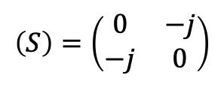






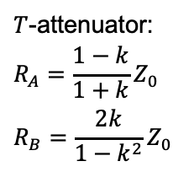



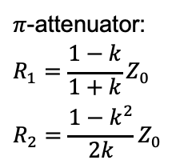



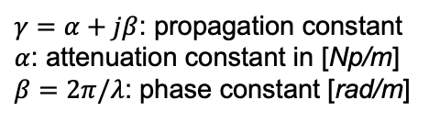
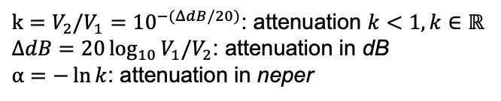






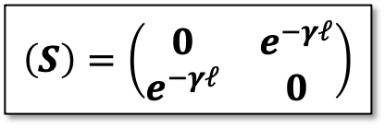
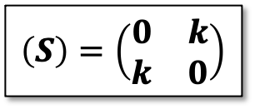







S-Matrix Examples – $2$-port
Ideal (matched: $Z=Z_{0}$) transmission-line of length $ℓ$
  For a lossless transmission-line:
  For a lossless line of length $ℓ=λ/4$:
Ideal attenuator
signal flow graph (SFG):
$$\left(S\right)=\left(\begin{matrix}0 & e^{−γℓ} \\ e^{−γℓ} & 0\end{matrix}\right)$$
$γ=α+jβ$: propagation constant
$α$: attenuation constant in [Np/m]
$β=2π/λ$: phase constant [rad/m]
port 1
port 2
$$a_{1}$$
$$e^{−γℓ}$$
$$b_{2}$$
$$α=0 ⇒ \left|S_{21}\right|=\left|S_{12}\right|=1$$
$$\left(S\right)=\left(\begin{matrix}0 & −j \\ −j & 0\end{matrix}\right)$$
$$b_{1}$$
$$e^{−γℓ}$$
$$a_{2}$$
SFG example: 3 dB attenuator
$$\left(S\right)=\left(\begin{matrix}0 & k \\ k & 0\end{matrix}\right)$$
$k=V_{2}/V_{1}={10}^{−(ΔdB/20)}$: attenuation $k<1, k∈ℝ$
$ΔdB=20\log_{10}{V_{1}/V_{2}}$: attenuation in dB
$α=−\ln{k}$: attenuation in neper
port 1
port 2
$$S_{21}=\frac{b_{2}}{a_{1}}=\frac{1}{\sqrt{2}}$$
$$a_{1}$$
$$k=1/\sqrt{2}$$
$$b_{2}$$
$T$-attenuator:
$$R_{A}=\frac{1−k}{1+k}Z_{0} \\ R_{B}=\frac{2k}{1−k^{2}}Z_{0}$$
$π$-attenuator:
$$R_{1}=\frac{1−k}{1+k}Z_{0} \\ R_{2}=\frac{1−k^{2}}{2k}Z_{0}$$
$$1$$
$$R_{A}$$
$$R_{A}$$
$$2$$
$$1$$
$$R_{2}$$
$$2$$
$$R_{1}$$
$$R_{1}$$
$$S_{12}=\frac{a_{2}}{b_{1}}=\frac{1}{\sqrt{2}}$$
$$R_{B}$$
$$b_{1}$$
$$k=1/\sqrt{2}$$
$$a_{2}$$
$$1’$$
$$2’$$
$$1’$$
$$2’$$

Slide 6
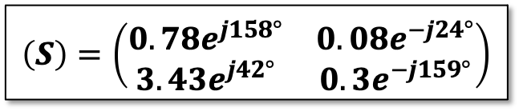

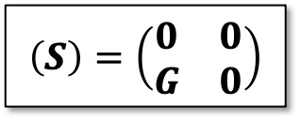









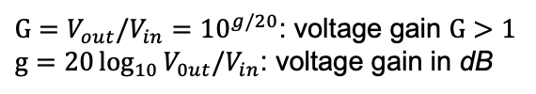
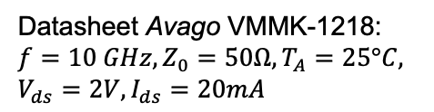

S-Matrix Examples – $2$-port
Ideal amplifier (gain stage)
Low-noise RF transistor
  Avago VMMK-1218
  E-pHEMT GaAs FET
    The S-parameters are different at other frequencies
    and operational conditions
    The transistor requires impedance matching networks at in- and output
port 2
port 1
$$a_{1}$$
$$G$$
$$b_{2}$$
$$\left(S\right)=\left(\begin{matrix}0 & 0 \\ G & 0\end{matrix}\right)$$
$G=V_{out}/V_{in}={10}^{g/20}$: voltage gain $G>1$
$g=20\log_{10}{V_{0ut}/V_{in}}$: voltage gain in dB
$$\left(S\right)=\left(\begin{matrix}0.78e^{j158°} & 0.08e^{−j24°} \\ 3.43e^{j42°} & 0.3e^{−j159°}\end{matrix}\right)$$
Datasheet Avago VMMK-1218:
$$f=10 GHz, Z_{0}=50Ω, T_{A}=25°C,$$
$$V_{ds}=2V, I_{ds}=20mA$$
port 1
port 2
$$a_{1}$$
$$3.43e^{j42°}$$
$$b_{2}$$
$$.78e^{j158°}$$
$$.3e^{−j159°}$$
$$b_{1}$$
$$.08e^{−j24°}$$
$$a_{2}$$

Slide 7




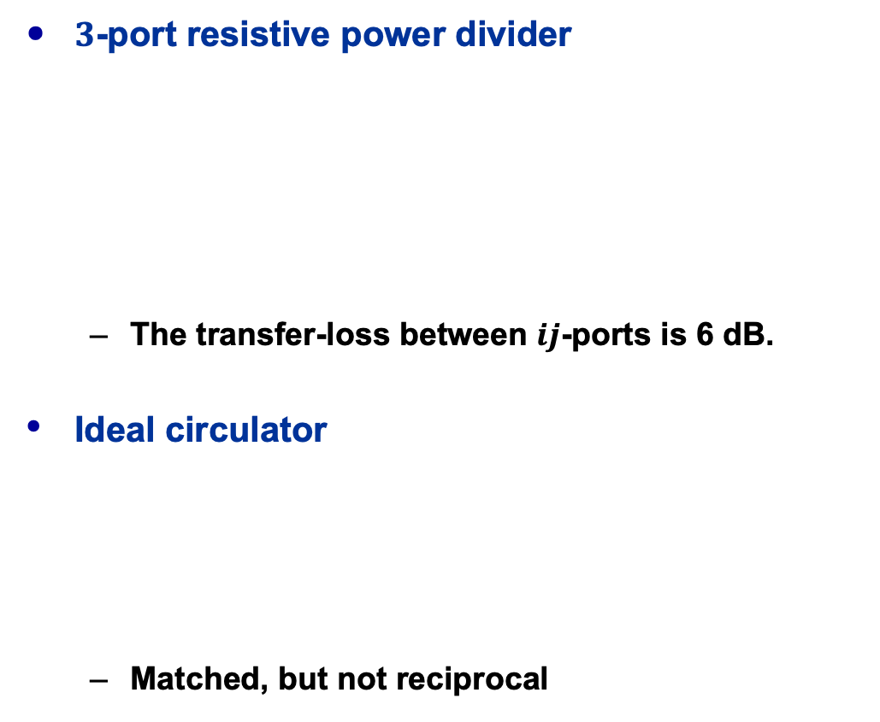












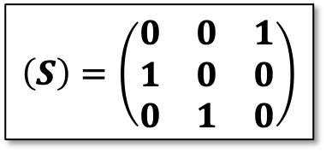
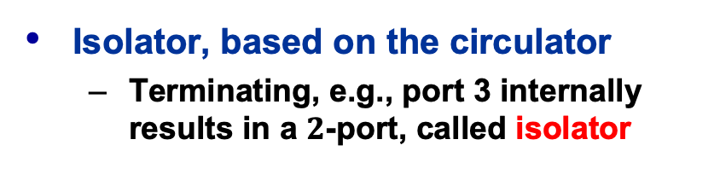


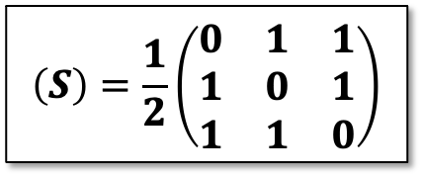




S-Matrix Examples – $3$-port
$3$-port resistive power divider
  The transfer-loss between $ij$-ports is 6 dB.
Ideal circulator
  Matched, but not reciprocal
port 1
port 2
$$a_{1}$$
$$b_{2}$$
$$\begin{matrix}b_{1}=\frac{1}{2}\left(a_{2}+a_{3}\right) \\ b_{2}=\frac{1}{2}\left(a_{1}+a_{3}\right) \\ b_{3}=\frac{1}{2}\left(a_{1}+a_{2}\right)\end{matrix}$$
$$Z_{0}/3$$
$$Z_{0}/3$$
$$\left(S\right)=\frac{1}{2}\left(\begin{matrix}0 & 1 & 1 \\ 1 & 0 & 1 \\ 1 & 1 & 0\end{matrix}\right)$$
$$b_{1}$$
$$a_{2}$$
$$Z_{0}/3$$
port 3
$$a_{3}$$
$$b_{3}$$
$$a_{2}$$
Isolator, based on the circulator
  Terminating, e.g., port 3 internally results in a $2$-port, called isolator
$$b_{2}$$
port 2
$$\left(S\right)=\left(\begin{matrix}0 & 0 & 1 \\ 1 & 0 & 0 \\ 0 & 1 & 0\end{matrix}\right)$$
$$\begin{matrix}b_{1}=a_{3} \\ b_{2}=a_{1} \\ b_{3}=a_{2}\end{matrix}$$
$$\left(S\right)=\left(\begin{matrix}0 & 0 \\ 1 & 0\end{matrix}\right)$$
$$b_{2}=a_{1}$$
port 1
port 3
port 1
port 2
$$a_{1}$$
$$b_{3}$$
$$a_{1}$$
$$b_{2}$$
$$b_{1}$$
$$a_{3}$$

Slide 8
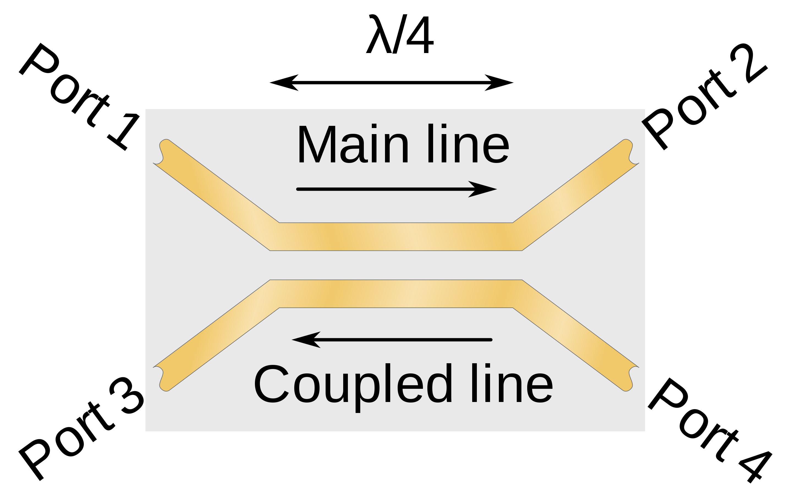

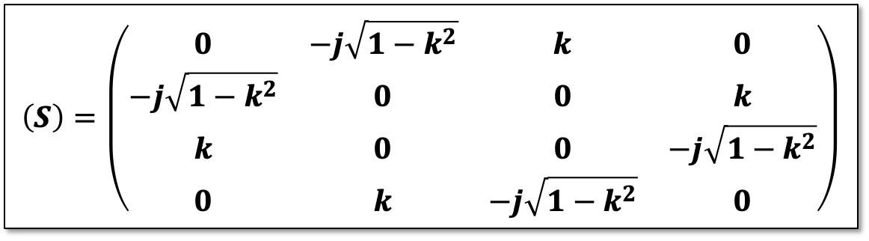



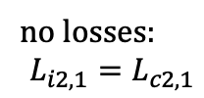
S-Matrix Example – $4$-port
Ideal directional coupler
  Operating at the center frequency
  Figures of merit (ideal, lossless):
    Coupling factor
    Insertion loss
    Coupling loss
  Coupler with losses, imperfections, etc.
    Isolation
    Directivity
coupling coefficient: $k=\left|\frac{b_{2}}{a_{1}}\right|; κdB=20\log_{10}{k}$
$$\left(S\right)=\left(\begin{matrix}0 & −j\sqrt{1−k^{2}} & k & 0 \\ −j\sqrt{1−k^{2}} & 0 & 0 & k \\ k & 0 & 0 & −j\sqrt{1−k^{2}} \\ 0 & k & −j\sqrt{1−k^{2}} & 0\end{matrix}\right)$$
port 1
port 2
transmitted
input
isolated
port 4
port 3
coupled
$$C_{3,1}=κdB=10\log_{10}\left(P_{3}/P_{1}\right) [dB]$$
$$L_{i2,1}=−10\log_{10}\left(P_{2}/P_{1}\right) [dB]$$
no losses:
$$L_{i2,1}=L_{c2,1}$$
$$L_{c2,1}=−10\log_{10}{[1−\left(P_{3}/P_{1}\right)] [dB]}$$
double-symmetry
$$I_{4,1}=−10\log_{10}\left(P_{4}/P_{1}\right) \left[dB\right];I_{3,2}=−10\log_{10}\left(P_{3}/P_{2}\right) \left[dB\right]$$
https://en.wikipedia.org/wiki/Power_dividers_and_directional_couplers
$$D_{3,4}=−10\log_{10}\left(P_{3}/P_{4}\right)=−10\log_{10}\left(P_{4}/P_{1}\right)+10\log_{10}\left(P_{3}/P_{1}\right) [dB]$$

Slide 9
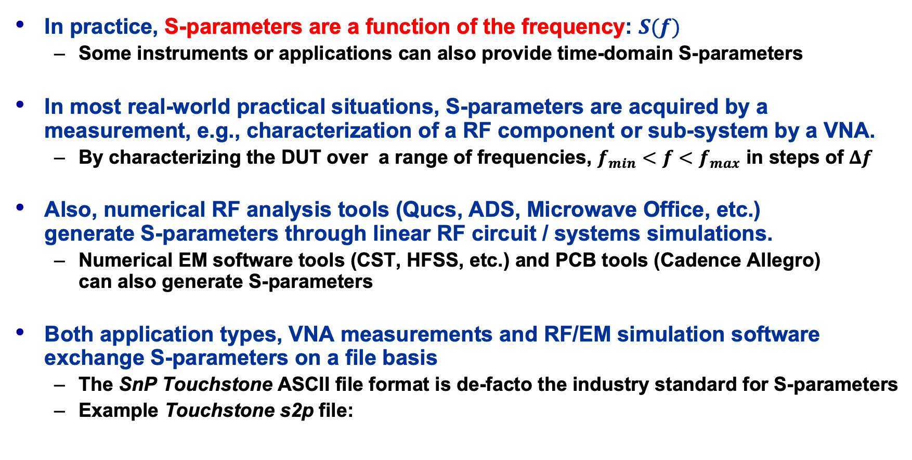
S-Parameters in Practice
In practice, S-parameters are a function of the frequency: $S(f)$
  Some instruments or applications can also provide time-domain S-parameters
In most real-world practical situations, S-parameters are acquired by a measurement, e.g., characterization of a RF component or sub-system by a VNA.
  By characterizing the DUT over a range of frequencies, $f_{min}<f<f_{max}$ in steps of $Δf$
Also, numerical RF analysis tools (Qucs, ADS, Microwave Office, etc.)
generate S-parameters through linear RF circuit / systems simulations.
  Numerical EM software tools (CST, HFSS, etc.) and PCB tools (Cadence Allegro)
  can also generate S-parameters
Both application types, VNA measurements and RF/EM simulation software exchange S-parameters on a file basis
  The SnP Touchstone ASCII file format is de-facto the industry standard for S-parameters
  Example Touchstone s2p file:

Slide 10
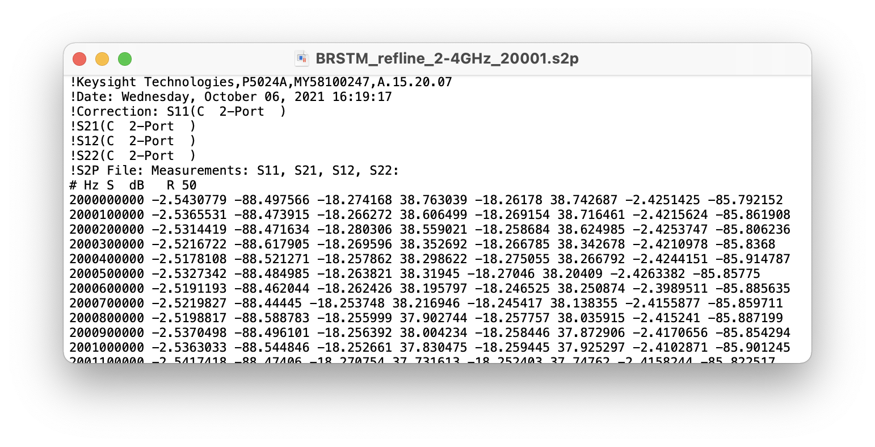

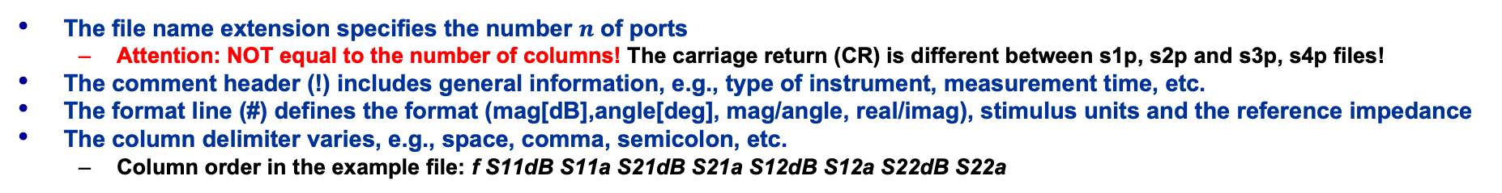



SnP Touchstone S-Parameter Files
$2$-port VNA file
! header
Touchstone v1.1 example file
v2.0 is different, file ext. *.ts
# format
frequency $f$
${|S}_{11}|$[dB]
${∠S}_{11}$[deg]
The file name extension specifies the number $n$ of ports
  Attention: NOT equal to the number of columns! The carriage return (CR) is different between s1p, s2p and s3p, s4p files!
The comment header (!) includes general information, e.g., type of instrument, measurement time, etc.
The format line (#) defines the format (mag[dB],angle[deg], mag/angle, real/imag), stimulus units and the reference impedance
The column delimiter varies, e.g., space, comma, semicolon, etc.
  Column order in the example file: f S11dB S11a S21dB S21a S12dB S12a S22dB S22a

Slide 11
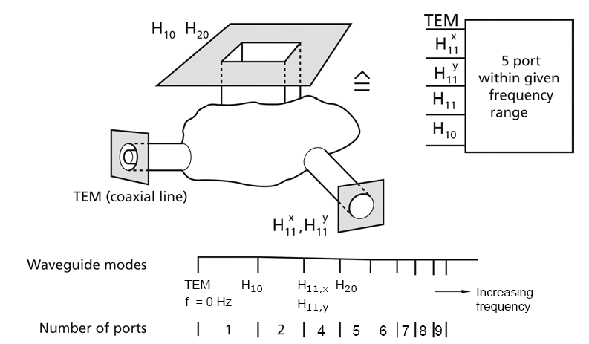




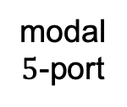

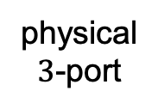
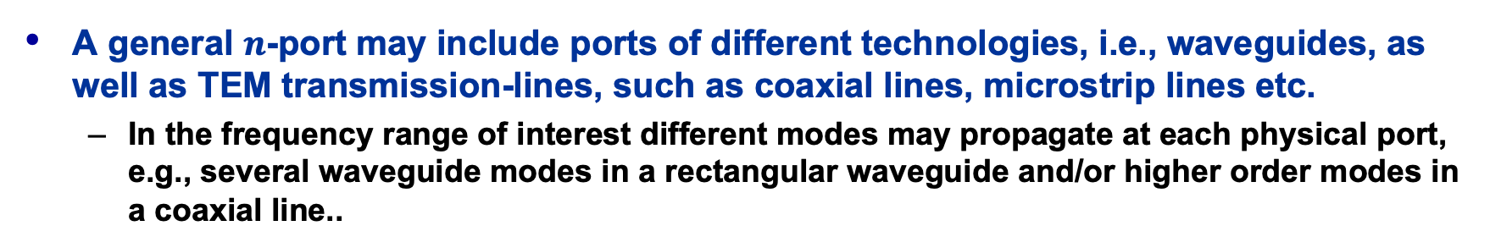

General $n$-Ports
A general $n$-port may include ports of different technologies, i.e., waveguides, as well as TEM transmission-lines, such as coaxial lines, microstrip lines etc.
  In the frequency range of interest different modes may propagate at each physical port, e.g., several waveguide modes in a rectangular waveguide and/or higher order modes in a coaxial line..
  Each EM-mode must then be represented
  by a distinct modal port.
    This is very important in EM-simulation
    to ensure the absorption of the energy for all modes!
  The number of modal ports needed
  generally, increases with frequency,
  as more waveguide modes can propagate.
$$H_{10}$$
$$H_{11}^{x}$$
modal
$5$-port
physical
$3$-port
$$H_{20}$$
$$H_{11}^{y}$$
$$TEM$$
$H_{11}^{x}, H_{11}^{y}$: $x, y$-polarization of the $E_{11}$ circular mode

Slide 12
S-Parameter Summary
The scattering (S) parameters are based on incident and reflected normalized complex voltage waves (power waves), defined at the ports of a RF network.
S-Parameters are used to characterize a linear, time-invariant RF component, circuit or sub-system as function of frequency under realistic operational conditions
  The S-parameters are given in a matrix notation, and have complex values
The characteristic of the S-matrix may provide additional details about the network, such as reciprocity, symmetry, losses.
Typically, the S-parameters matrix of a RF network is acquired by measurement characterization with a vector network analyzer (VNA), or by a numerical analysis, e.g., circuit analysis or electromagnetic simulation software
The S-parameter matrices of a set of networks can be converted to transfer (T) parameter matrices to enable a simple cascading of those networks
The number of logical, modal ports might be higher than the number of physical ports for a general RF network utilizing various transmission-line technologies.

Slide 13
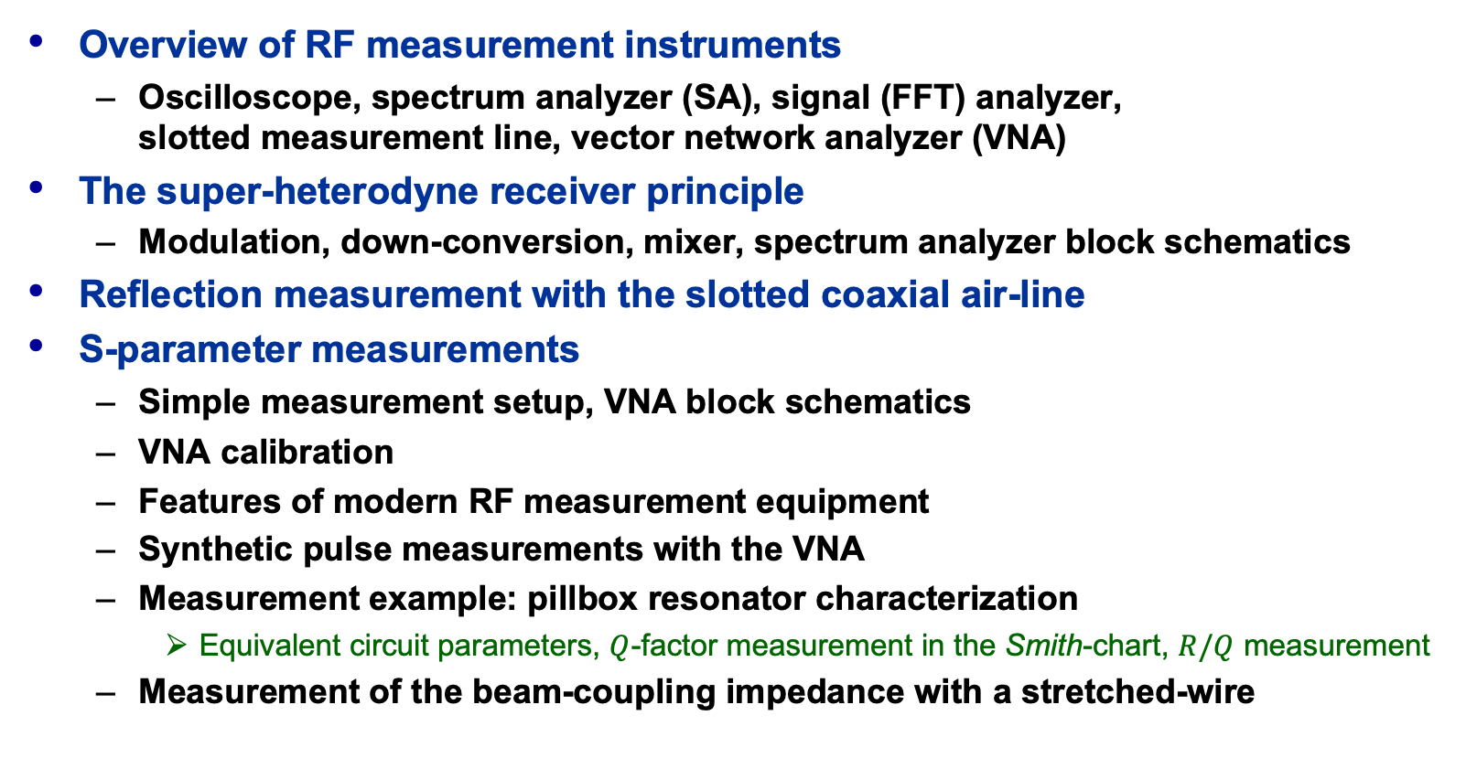
Part IV: RF Measurement Methods
Overview of RF measurement instruments
  Oscilloscope, spectrum analyzer (SA), signal (FFT) analyzer,
  slotted measurement line, vector network analyzer (VNA)
The super-heterodyne receiver principle
  Modulation, down-conversion, mixer, spectrum analyzer block schematics
Reflection measurement with the slotted coaxial air-line
S-parameter measurements
  Simple measurement setup, VNA block schematics
  VNA calibration
  Features of modern RF measurement equipment
  Synthetic pulse measurements with the VNA
  Measurement example: pillbox resonator characterization
    Equivalent circuit parameters, $Q$-factor measurement in the Smith-chart, $R/Q$ measurement
  Measurement of the beam-coupling impedance with a stretched-wire

Slide 14
RF Measurement Methods (1)
There are different options to observe RF signals
Here some typical measurement tools:
Oscilloscope: to observe signals in time-domain
  periodic signals
  burst and transient signals with arbitrary waveforms
  application: direct observation of signals from a beam pick-up,
  from a test generator, or from other sources
  visualizes the shape of a waveform, etc.
  limited performance for the evaluation of non-linear effects.

Slide 15
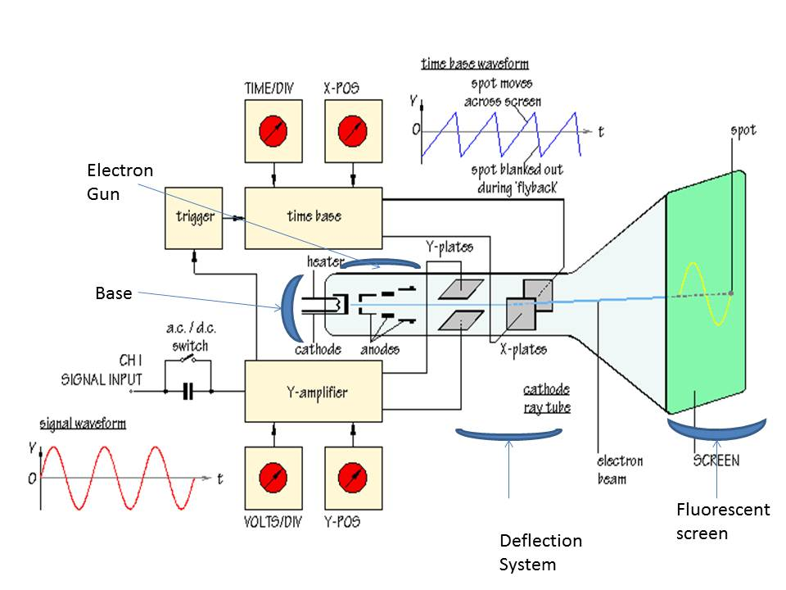
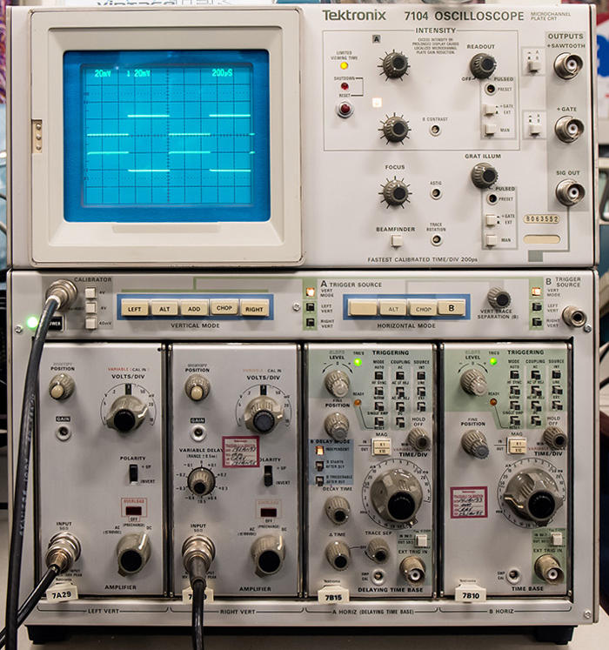
Cathode Ray Tube (CRT) Oscilloscope

Slide 16
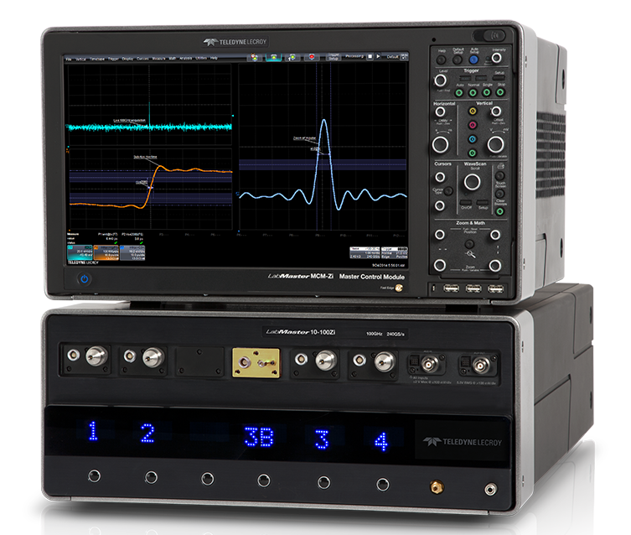
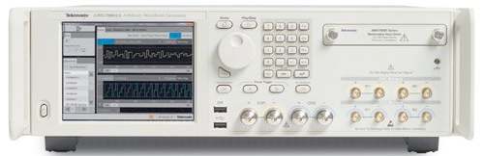
Today: Digital Storage Oscilloscope (DSO)
100 GHz bandwidth
240 GS/s oscilloscope
(LeCroy)
…and digital signal generator
(AWG: arbitrary waveform generator)
Device Under Test (DUT)
50 GS/s, 10-bit AWG (Tektronix)
Signal processing based on fast ADCs and DACs
  Similar “look and feel” as analog oscilloscopes, but better performance
    8…12-bit multi-GS/s ADCs, still, be aware of aliasing effects!
    Fast sampling oscilloscope require sufficient memory resources.
AWG or pulse generator & digital oscilloscope:
Time-domain (TD) test setup
  Device under test (DUT) characterization and trouble shooting
    Impulse, step, or arbitrary waveform (e.g., beam signal) as stimulus signal
    High impedance probe for measurements on the printed circuit board (PCB)

Slide 17
RF Measurements Methods (2)
Spectrum analyzer: to observe signals in a “frequency-domain like” fashion
  sweeps in equidistant steps through a given frequency range
  application: observation of spectrum from the beam, or from a signal generator or RF source, or the spectrum emitted from an antenna to locate EMI issues in the accelerator tunnel, etc.
    Also, DUT characterization in the laboratory, e.g., noise figure measurement on amplifiers (requires a noise source), intermodulation measurements on amplifiers (requires two RF generators).
  Requires periodic signals
  Assumes time-invariance of the measurement object (DUT) throughout the frequency sweep
  Large dynamic range!
RF detection (Schottky) diode (RF power meter)
  Supplies a rectified (video) output signal proportional to the RF signal level
  Delivers no frequency or phase information but operates over a very broad frequency range few MHz to many GHz, and up to 90 dB dynamic range.

Slide 18
RF Measurements Methods (3)
Vector signal analyzer (VSA), sometimes called FFT analyzer
  Acquires the RF signal, after down-conversion to an intermediate (IF) signal,
  in time-domain by fast sampling
  Further numerical treatment in digital signal processors (DSPs)
  Spectrum calculated using Fast Fourier Transform (FFT)
  Combines features of an oscilloscope and a spectrum analyzer:
  Signals can be observed directly in time-domain, or in a frequency-domain like fashion
  Contrary to the SA, also the spectrum of non-periodic signals
  and transients can be measured
  Application: Observation of tune sidebands, transient behavior of a phase locked loop, single pass beam signal spectrum, etc.
  Digital oscilloscopes and FFT analyzers share similar technologies, i.e., fast sampling and digital signal processing, and therefore can provide similar measurement options
    The digital oscilloscope directly digitizes the RF signal
    → limited dynamic range, large instantaneous bandwidth
    The FFT analyzer digitizes the down-converted IF signal
    → large dynamic range, but (still) limited instantaneous bandwidth

Slide 19
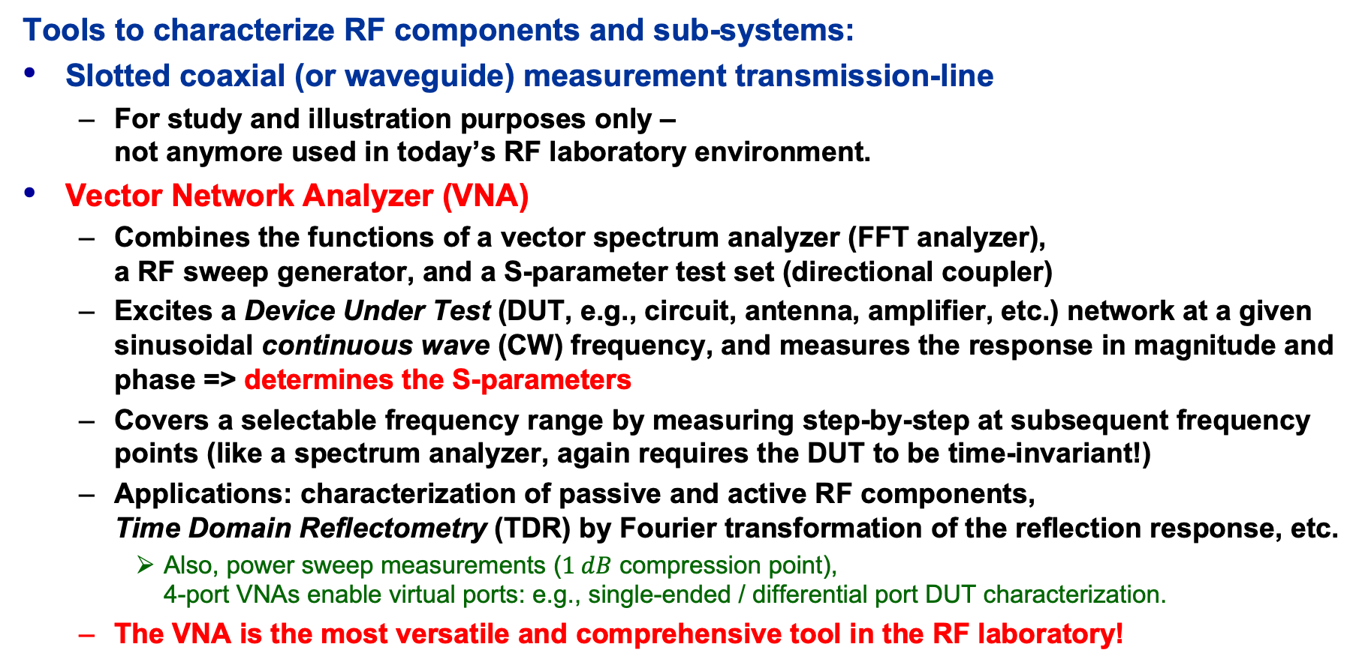
RF Measurements Methods (4)
Tools to characterize RF components and sub-systems:
Slotted coaxial (or waveguide) measurement transmission-line
  For study and illustration purposes only –
  not anymore used in today’s RF laboratory environment.
Vector Network Analyzer (VNA)
  Combines the functions of a vector spectrum analyzer (FFT analyzer),
  a RF sweep generator, and a S-parameter test set (directional coupler)
  Excites a Device Under Test (DUT, e.g., circuit, antenna, amplifier, etc.) network at a given sinusoidal continuous wave (CW) frequency, and measures the response in magnitude and phase => determines the S-parameters
  Covers a selectable frequency range by measuring step-by-step at subsequent frequency points (like a spectrum analyzer, again requires the DUT to be time-invariant!)
  Applications: characterization of passive and active RF components,
  Time Domain Reflectometry (TDR) by Fourier transformation of the reflection response, etc.
    Also, power sweep measurements ($1 dB$ compression point),
    4-port VNAs enable virtual ports: e.g., single-ended / differential port DUT characterization.
  The VNA is the most versatile and comprehensive tool in the RF laboratory!

Slide 20
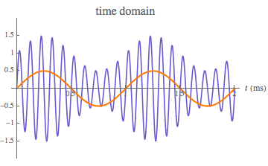
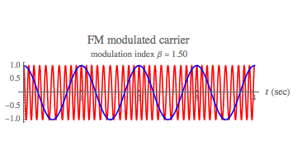
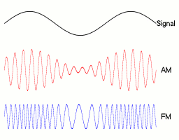
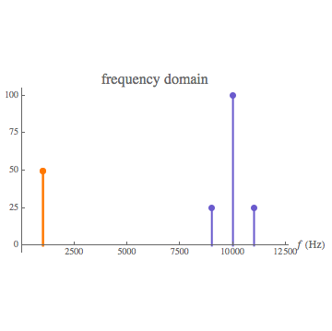
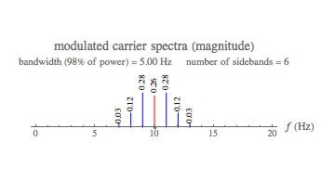
RF Signals & Modulation, without Math!
RF signals are continuous wave (CW),sinusoidal signals
  Often, a high frequency carrier is modulated with low frequency information
  Modulation appears “naturally” in ring accelerators as:
    Modulation is also provided through the LLRF system to the accelerating structures
AM: Betatron oscillations
FM: Synchrotron oscillations

Slide 21
A (too) simple Radio Receiver
broadband
low-noise RF amp
e.g., 87-108 MHz
tunable
narrowband
band-pass filter
RF amp
demodulator
audio amp
…or: How does a ”traditional” analog radio works?
  It was, and still is, difficult to make precisely tunable narrowband, band-pass filters
  for high frequencies (~100 MHz)!!
  high frequency low-noise amplifiers are expensive!
  high frequency demodulators are not trivial.
  direct detection of radio and RF signals is challenging!

Slide 22
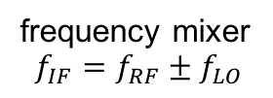
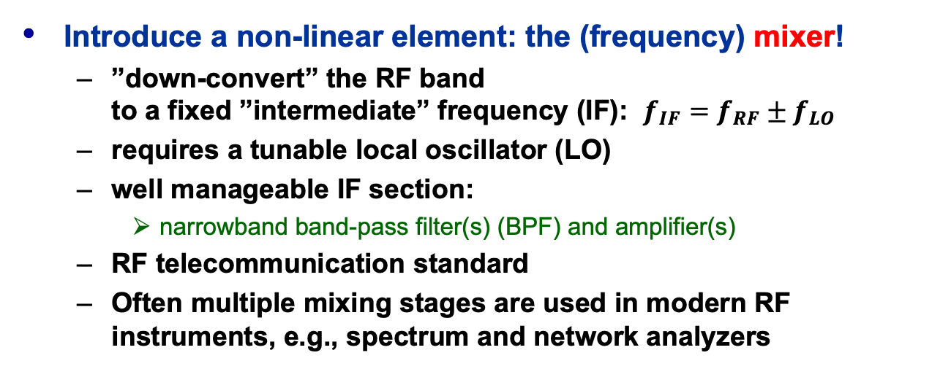



The Super-Heterodyne Receiver
frequency mixer
$$f_{IF}=f_{RF}±f_{LO}$$
audio amp
$$f_{RF}$$
$$f_{IF}$$
broadband
low-noise RF amp
e.g., 87-108 MHz
IF narrowband
band-pass filter
e.g., 10.7 MHz ± 90 kHz
$$f_{LO}$$
IF amp
demodulator,
e.g., FM PLL or
AM diode detector
Introduce a non-linear element: the (frequency) mixer!
  ”down-convert” the RF band
  to a fixed ”intermediate” frequency (IF): $f_{IF}=f_{RF}±f_{LO}$
  requires a tunable local oscillator (LO)
  well manageable IF section:
    narrowband band-pass filter(s) (BPF) and amplifier(s)
  RF telecommunication standard
  Often multiple mixing stages are used in modern RF instruments, e.g., spectrum and network analyzers
tunable
local oscillator (LO)
e.g., 97.7-118.7 MHz

Slide 23
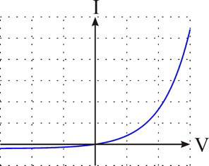


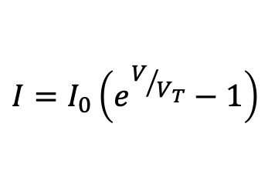

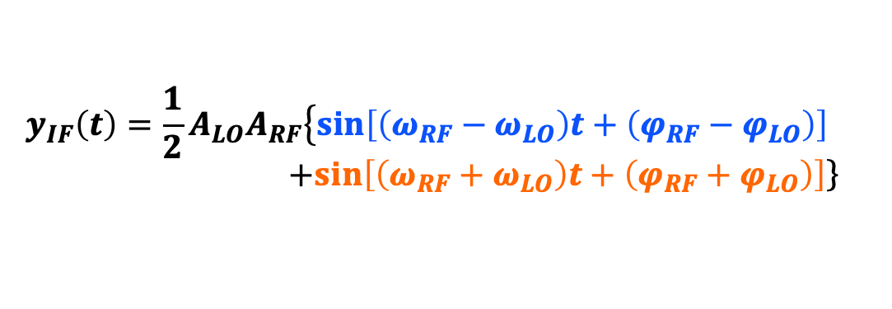













The RF Mixer as Down-Converter
RF
IF
$$y_{RF}\left(t\right)=A_{RF}\sin\left(ω_{RF}t+φ_{RF}\right)$$
$$y_{IF}\left(t\right)=y_{RF}\left(t\right)y_{LO}\left(t\right)$$
$$f_{IF}=f_{RF}±f_{LO}$$
LO
Ideal mixer:
Frequency conversion
  $f_{RF}≠f_{LO}$: heterodyne receiver
  $f_{RF}=f_{LO}$: homodyne, demodulator
Real-world mixer:
  Image frequency:
$$y_{LO}\left(t\right)=A_{LO}\sin\left(ω_{LO}t+φ_{LO}\right)$$
$$y_{IF}\left(t\right)={\frac{1}{2}A}_{LO}A_{RF}\left\{\sin\left[\left(ω_{RF}−ω_{LO}\right)t+\left(φ_{RF}−φ_{LO}\right)\right]\right. \\ +\left.\sin\left[\left(ω_{RF}+ω_{LO}\right)t+\left(φ_{RF}+φ_{LO}\right)\right]\right\}$$
upper sideband
$$A$$
$$f_{LO}$$
lower sideband
$I=f(V)$ of a Schottky diode
$$f$$
courtesy T. Schilcher
$$f_{LO}−f_{RF}$$
$$f_{IM}$$
$$f_{RF}$$
$$f_{LO}+f_{RF}$$
$$I=I_{0}\left(e^{V/{V_{T}}}−1\right)$$
$$f_{IF}={mf}_{RF}±{nf}_{LO}$$
$$ΔI=I_{0}e^{V/{V_{T}}}\left[\frac{ΔV}{V_{T}}+\frac{1}{2}{\left(\frac{ΔV}{V_{T}}\right)}^{2}+\frac{1}{6}{\left(\frac{ΔV}{V_{T}}\right)}^{3}+⋯\right]$$
$$f_{IM}=f_{LO}−f_{IF}$$

Slide 24

Simplified Spectrum Analyzer
based on the super-heterodyne principle
Switchable BW of the
IF filter and video BPF
(analog or digital)
allows to improve the
signal-to noise (S/N)-ratio
Today, the IF, demodulation, video and display sections
of a spectrum analyzer are realized digitally
  Requires an analog-digital converter (ADC) with sufficient dynamic range

Slide 25

Modern Spectrum (RF Signal) Analyzer

Slide 26













Reflection (VSWR) Measurement
V
$$VSWR=\frac{|V_{max}|}{|V_{min}|}$$
$$Z_{0}$$
$${R_{S}=Z}_{0}$$
DUT
$$Z_{X}$$
$$λ/2$$
$$z_{min}$$
$$|Γ|=\frac{VSWR−1}{VSWR+1}$$
$$ℓ$$
$$∠Γ=\frac{4π}{λ}z_{min}−π$$
Slotted coaxial air-line is used as standing wave detector
  Probes the radial electric field along the slotted line.
  Measurement of E-field minima's $E_{min}$ and maxima's $E_{max}$
  with a diode detector, thus detect $\left|V_{min}\right|$ and $\left|V_{max}\right|$ along the line.
  Evaluate the reflection coefficient $Γ$ of a DUT of unknown $Z_{X}$ at the end of the line
$$Z_{x}=Z_{0}\frac{1−Γ}{1+Γ}$$

Slide 27








How to measure S-Parameters?
$$Z_{S}=50 Ω$$
DUT
2-port
DUT = Device Under Test
4-port
detector
$$∝b_{2}$$
detector
$$∝a_{1}$$
Directional Coupler
detector
$$∝b_{1}$$
swap DUT
for $S_{22}$ and $S_{12}$
Performed in the “frequency domain”
  Single or swept frequency generator, stand-alone or as part of a VNA or SA
  Requires a directional coupler and RF detector(s) or receiver(s)
Evaluate $S_{11}$ and $S_{21}$ of a 2-port DUT
  Ensure $a_{2}=0$, i.e., the detector at port 2 offers a well-matched impedance
  Measure incident wave $a_{1}$ and reflected wave $b_{1}$
  at the directional coupler ports and compute for each frequency
  Measure transmitted wave $b_{2}$ at DUT port 2 and compute
Evaluate $S_{22}$ and $S_{12}$ of the 2-port DUT
  Perform the same methodology as above
  by exchanging the measurement equipment on the DUT ports
$$S_{11}={\left.\frac{b_{1}}{a_{1}}\right|}_{a_{2}=0}$$
$$S_{21}={\left.\frac{b_{2}}{a_{1}}\right|}_{a_{2}=0}$$

Slide 28








The Vector Network Analyzer (VNA)
RF
source
IF
A/D
X-switch
term
DAQ CTRL
Sig Proc
Display
IF $b_{1}$
IF $b_{2}$
directional
couplers
directional
couplers
LO
source
IF $a_{1}$
IF $a_{2}$
2-port VNA
  Simplified block schematic
Port 1
Port 2
$$a_{1}$$
$$b_{2}$$
DUT
cable
cable
$$b_{1}$$
$$a_{2}$$

Slide 29

Fun with the VNA!
The “look and feel” between VNAs vary between manufacturers and models
  Concepts and operation is still very similar

Slide 30

VNA Calibration (1)
Calibration is not necessary for pure frequency or phase measurements
Before calibrating the VNA measurement setup,
perform a brief measurement and chose appropriate VNA settings:
  Frequency range (center, span or start, stop)
  Number of frequency points
    Can be sometimes increased by rearranging the VNA memory (# of channels)
  IF filter bandwidth
  Output power level
Calibrate the setup, preferable with an electronic calibration system
if more than 2 ports are used!
  Each port and combination needs to be
  calibrated, with the cables attached
  Choose the appropriate connector type and sex
  The instrument establishes a correction matrix
  and displays the ”CAL” status.

Slide 31




VNA Calibration (2)
Calibration improves the measurement performance
  Return loss improvement by typically 20 dB. Enables mdB accuracy measurements!
  Full 2-port or 4-port calibration with manual calibration kits is prone to errors,
  better use electronic calibration systems.
  Change VNA settings will cause the instrument to inter- and extrapolate,
  and the calibration status becomes uncertain.
Cables are included in the calibration
  However, changing coaxial connector types not.
  Special VNA cables allows the adaption of different connector types and sex,
  without requiring a re-calibration of the setup!

Slide 32

RF Measurement Instrument Features
Modern VNAs (SAs, oscilloscopes, etc. as well) have many “features”
Hardware features, e.g.
  Automatic calibration system, down to DC
  4 and more ports
  Additional 2nd source, for downconverter / mixer measurements
  Integrated spectrum analyzer function
Software, control and data post processing options, e.g.
  Far too many to list all
  Sweep options, e.g., lin., log., segmented, in frequency or power
  iDFT (or iFFT), gating
  TDR, TDT for BP or LP step or impulse, segmented (advanced) TDR
    Only for linear, time-invariant systems!
  Port extension, virtual ports (4-port VNA), $Z_{0e}, Z_{0o}$ characterization, virtual baluns, etc.
  Data transformations, e.g., $Γ⇒Z$
  Noise figure measurements
  Measurements following telecommunication standards

Slide 33



Synthetic Pulse TD Measurements (1)
Based on an inverse discrete Fourier transformation (iDFT) option in the VNA
  Low-pass mode: Impulse or step response,
  relying on equidistant samples over the extrapolated (to DC) frequency range.
    The VNA does not measure at DC!
    Manually match frequency range and # of points for DC extrapolation, e.g., 1…1000 MHz -> 1001 points,
    to enable extrapolation exactly to DC, or let the instrument chose the extrapolation settings automatically
  Enables time-domain reflectometry (TDR)
    Very useful on portable VNAs, troubleshooting RF cable problems
  Band-pass response (no DC extrapolation)
  Allows time-domain gating and de-embedding of non-resonant sub-systems, e.g., measurements on a PCB
  Limited to linear systems
  Select the ”real” format for $S_{11}$ or $S_{21}$ for time-domain transformations (Keysight instruments)!
    or dB magnitude to detect small reflections in TDR analysis

Slide 34







Synthetic Pulse TD Measurements (2)
unlimited frequency range
truncated frequency range
FD
TD
FD
TD
$$rect\left(\frac{f}{Δf}\right)$$
$$\frac{\sin\left(Δfπt\right)}{πt}$$
smoothing window
functions
TD gate
markers
TDR impulse response
TDR step response

Slide 35




An Example – Pillbox* ${TM}_{010}$ Eigenmode
Characterize the accelerating ${TM}_{010}$ mode
of a cylindrical cavity with beam ports
  The ${TM}_{010}$ does not have to be the lowest frequency mode
Compare the measured values of $f_{res}$, $Q_{0}$ and $R/Q$
  with an analytical analysis of a perfect cylinder (no beam ports)
  with a numerical analysis
* normal conducting!

Slide 36





Excite the Modes while Measuring $S_{11}$
sliding capacitive pin antenna probes the E-field
rotating inductive loop antenna probes the H-field
$S_{11}$ measurement with tunable coupling antenna
  E-field on z-axis using a capacitive coupling pin
    Center pin, e.g., of semi-rigid coaxial cable
  H-field on the cavity rim using an inductive coupling loop
    Bend the center conductor to a closed loop connected to ground

Slide 37




Measurement of Frequency and Q-value
3dB here!
(only for critical coupling)
NOT here!
classical mistake!
Identify the correct (${TM}_{010}$) mode frequency
  Introduce a small perturbation, e.g., metallic rod or wire on the z-axis,
  and observe the shift of the mode frequencies
Calibrate the VNA and measure $S_{11}$
  Tune the coupling loop for critical coupling
  Display the resonant circle in the Smith chart using enough points!

Slide 38














The Equivalent Circuit of a Resonant Mode
$$Z_{input}=Z_{resonator}⇒$$
$$⇐Z_{shunt}$$
The generator may deliver power to $R_{sh}$ and to the beam, but also the beam can deliver power to $R_{sh}$ and $R_{g}$!
$$I_{L}$$
$$Z_{g}=R_{g}$$
$$Z_{0}$$
VNA reference plane after calibration
$$L$$
$$C$$
$$R=R_{sh}$$
$$I_{beam}$$
$$V_{0}$$
$$V_{beam}$$
The beam is usually considered as a current source with infinite source impedance.
Generator
here: VNA
Ideal transformer
(no parasitic elements hidden in the coupling loop)
here: coupling loop or pin
Beam
here: not present
^{Lossless resonator}
$${R=R}_{sh}:\text{shunt} \text{resistor}\text{, }\text{representing} \text{the} \text{losses} \text{of} \text{the} \text{resonator}$$
We have resonance condition, when
$$ωL=\frac{1}{ωC}$$
^{→ Resonance frequency:}
$$ω_{res}=2πf_{res}=\frac{1}{LC} ⟹ f_{res}=\frac{1}{2π\sqrt{LC}}$$

Slide 39











Useful Formulas of the Equivalent Circuit
Characteristic impedance ”R over Q”
Stored energy at resonance
Dissipated power
Q-factor
Shunt impedance (circuit definition)
Tuning sensitivity
Coupling parameter (shunt impedance
over generator or feeder impedance)
$$X=\frac{R}{Q}=ω_{res}L=\frac{1}{ω_{res}C}=\sqrt{L/C}$$
$$U=U_{e}+U_{m}=\frac{1}{4}{{|V}_{C}|}^{2}C+\frac{1}{4}{{|I}_{L}|}^{2}L$$
$V_{C}$ ... Voltage at the capacitor
$I_{L}$ … Current in the inductor
$$P=\frac{V^{2}}{2 R}$$
$$Q=\frac{R}{X}=\frac{ω_{res} U}{P}$$
$U$ ... stored energy
$P$ ... dissipated power over 1 period
$$R=\frac{V^{2}}{2 P}$$
$$\frac{R}{Q}=\frac{V^{2}}{{2ω}_{res} U}$$
$$\frac{Δf}{f}=\frac{1}{2} \frac{ΔC}{C}=−\frac{1}{2} \frac{ΔL}{L}$$
$$k^{2}=\frac{R}{R_{input}}$$
tune for critical coupling

Slide 40









The Quality Factor ($Q$-Factor)
The quality ($Q$) factor of a resonant circuit is defined as ratio of the stored energy $U$ over the energy dissipated $P$ in one oscillation cycle:
The $Q$-factor of an impedance loaded resonator:
  $Q_{0}$: unloaded Q-value of the unperturbed system
  $Q_{L}$: loaded Q-value, e.g., measured with the impedance of the connected generator
  $Q_{ext}$: external Q-factor, representing the effects of the external circuit
  (generator and coupling circuit)
Q-factor and bandwidth
  This is how we actually ”measure” the Q-factor!
$$Q=2π\frac{energy stored}{energy dissipated in 1 cycle}=\frac{ω_{res}U}{P}$$
tune $k$ for
critical coupling:
$$\frac{1}{Q_{L}}=\frac{1}{Q_{0}}+\frac{1}{Q_{ext}}$$
$$Q_{0}=Q_{ext}$$
$$Q=\frac{f_{res}}{f_{BW}}$$
$${⟹Q}_{0}=2 Q_{L}$$
$${with: f}_{BW}=f_{+3dB}−f_{−3dB}$$
With $Q_{L}$ being our
measured Q-value

Slide 41




















$Q$-factor from $S_{11}$ Measurement
arbitrary coupling (here: over-critical)
$ℑ\{Z\}(f)$
for a resonator
in critical coupling
critical coupling
$$Q_{L}=\frac{f_{res}}{f_{+3dB}−f_{−3dB}}$$
detuned
short
position
($Z=0$)
$$f_{1}$$
Y$=ℜ∓j$
$$f_{3}$$
$$f_{−3dB}$$
$$|ℜ\left\{Z\right\}|=|ℑ\left\{Z\right\}|$$
$$f_{3}=f_{5}$$
$$f_{5}$$
$$Q_{0}=\frac{2\sqrt{f_{+3dB}f_{−3dB}}}{f_{+3dB}−f_{−3dB}}$$
$$≅\frac{f_{+3dB}+f_{−3dB}}{f_{+3dB}−f_{−3dB}}$$
$$f_{res}$$
$$f_{res}$$
$$f_{4}=f_{6}$$
$$f_{6}$$
$$f_{+3dB}$$
match
($Γ=0$)
detuned
open
position
($Y=0$)
$$f_{4}$$
Correct for the uncompensated transmission-line effects
between calibration reference and the coupling loop
  Electrical length adjustment: ”straight” $ℑ\{Z\}(f)$
Adjust the locus circle to the detuned short location
  Phase offset
Verify no evanescent fields penetrating outside the beam ports
  i.e., no frequency shifts if the boundaries at the beam ports are altered
$$f_{2}$$
Frequency marker points in the Smith chart:
$f_{1,2} (f_{−3dB}, f_{+3dB})$: $|ℑ\left\{S_{11}\right\}|=max.$ to calculate $Q_{L}$
  $f_{3,4}$: $Y=ℜ∓j$ to calculate $Q_{ext}$
  $f_{5,6}$: $|ℜ\left\{Z\right\}|=|ℑ\left\{Z\right\}|$ to calculate $Q_{0}$

Slide 42








$R/Q$ Measurement – Slater’s Theorem
Remember from the equivalent circuit:
  $V_{acc}$ is based on the integrated longitudinal E-field component $E_{z}$ along the z-axis ($x=y=0$)
Based on Slater’s perturbation theorem:
  Resonance frequency shift due to a small perturbation object,
  expressed in longitudinal and transverse E and H field components
  $k$: coefficients proportional to the electric or magnetic polarizability of the perturbation object (here: only $k_{∥}^{E}$ for a longitudinal metallic object)
E-field characterization
along the z-axis
transit time related
$$\frac{R}{Q}=\frac{{V_{acc}^{2}}/{{2P}_{d}}}{{ω_{res}U}/{P_{d}}}=\frac{V_{acc}^{2}}{2ω_{res}U}$$
$$V_{acc}=\left|\int{E_{z}\left(z\right)\cos\left(\frac{ωz}{βc_{0}}\right)dz}\right|$$
with:
$$\frac{Δf}{f_{res}}=\frac{1}{U}\left[μ_{0}\left(k_{∥}^{H}{\left|H_{∥}\right|}^{2}+k_{⊥}^{H}{\left|H_{⊥}\right|}^{2}\right)−ε_{0}\left(k_{∥}^{E}{\left|E_{∥}\right|}^{2}+k_{⊥}^{E}{\left|E_{⊥}\right|}^{2}\right)\right]$$
$$k_{∥}^{E}=\frac{π}{3}l^{3}{\left[\sinh^{−1}\left(\frac{2}{3π}\frac{l}{a}\right)\right]}^{−1}$$
$$E\left(z\right)=E_{∥}(z)=\sqrt{U\frac{Δf\left(z\right)}{f_{res}}∙\frac{−1}{{k_{∥}^{E}ε}_{0}}}$$
with:
(metallic ellipsoid, e.g., syringe needle
of half length $l$ and radius $a$)

Slide 43






$R/Q$ Measurement - Bead Pull Method
E-field characterization by evaluating
  The frequency shift $Δf$ ($S_{11}$ reflection measurement with a single probe)
  or
  The phase shift $φ$ at $f_{res}$ ($S_{21}$ transmission measurement with 2 probes)
Exercise with a manual bead-pull through a known cavity
  requires: fishing wire, syringe needle, ruler and VNA
  Compare the measured $E_{z}$ at the maximum $f$ or $φ$ shift (in the center of the cavity)
  with the theoretical estimation (e.g., numerical computed value)
$$\frac{Δf}{f_{res}}=\frac{1}{2 Q_{0}}\tan{φ}$$

Slide 44

















Beam Coupling Impedance
The wake potential
  Lorenz force on $q_{2}$ by the wake field of $q_{1}$:
  Wake potential of a structure, e.g.,
  a discontinuity driven by $q_{1}$
$$\vec{F}=\frac{d\vec{p}}{dt}=q_{2}\left(\vec{E}+c_{0}{\vec{e}}_{z}×\vec{B}\right)$$
$$\vec{w}\left(x_{1},y_{1},x_{2},y_{2},s\right)=\frac{1}{q_{1}}\int_{−∞ (or 0)}^{+∞ (orL)}{dz{\left[\vec{E}(x_{2},y_{2},z,t)+c_{0}{\vec{e}}_{z}×\vec{B}(x_{2},y_{2},z,t)\right]}_{t=\left(s+z\right)/c}}$$
Beam coupling impedance
  Frequency domain representation of the wake potential
  Can be decomposed in longitudinal $Z_{∥}$ and transverse $Z_{⊥}$ components (Panofsky-Wenzel theorem)
  Resonant structures, $i^{th}$ mode:
$$q_{1}$$
$$q_{2}$$
$$y$$
$$Z\left(x_{1},y_{1},x_{2},y_{2},ω\right)=−\frac{1}{c_{0}}\int_{−∞}^{+∞}{ds\vec{ w}\left(x_{1},y_{1},x_{2},y_{2},s\right)e^{−jωs/c_{0}}}$$
$$x_{1},y_{1}$$
$$x_{2},y_{2}$$
$$z$$
$$s$$
$$−x$$
$$0$$
$$L$$
$$R_{sh,i}=Z_{∥,i}=\frac{2k_{loss,i}Q_{i}}{ω_{i}}$$

Slide 45














Stretched-Wire $Z_{∥}$ Measurement
Formulas:
  Normalized electrical length:
  Lumped impedance formula
  Log formula
  Improved log formula
  Transmission coefficient
  Circular beam pipe impedance
VNA
S21 meas.
$$Θ=2π\frac{L}{λ}$$
$$Z_{0}$$
$$Z_{0}$$
P1 P2
$$Z_{∥}=2Z_{pipe}\frac{1−S_{21}}{S_{21}}$$
$Θ≤1$
$$L<D_{pipe}$$
DUT
$$Z_{pipe}$$
$$Z_{∥}=−2Z_{pipe}\ln{S_{21}}$$
-10dB
-10dB
$$Z_{∥}=−2Z_{pipe}\ln{S_{21}\left(1+j\frac{\ln{S_{21}}}{2Θ}\right)}$$
$$R_{match}$$
$$R_{match}=Z_{pipe}−Z_{0}$$
stretched wire
REF
$$S_{21}=\frac{S_{21,DUT}}{S_{21,REF}}$$
-10dB
-10dB
$$Z_{pipe}=\frac{η_{0}}{2π\sqrt{ε_{r}}}\ln{\frac{D}{d}≅60 Ω}\ln{\frac{D_{pipe}}{d_{wire}}}$$
absorbing foam

Slide 46
Summary
No summary, just thank you for listening!
Also, a big THANK YOU to all the help from the hands-on instructors!
More THANKS to Dassault / CST, SIMUSERV (Frank)
and Computer Controls / Keysight
THANK YOU to my colleagues at CERN, in particular Joel D.!
Thank you!

Slide 47
Backup Slides

Slide 48
Refresher: Some TL Equations (1)
Characteristic impedance
  for a TEM transmission-line
    with losses
    lossless, non-magnetic media ($μ_{r}=1$)
Propagation constant
  for a TEM transmission-line
    attenuation constant
    phase constant
Equivalent circuit
TEM TL segment
$$L’$$
$$R’$$
$$γ=\sqrt{(R’+jωL’)(G’+jωC’)}$$
$$Z_{0}=\sqrt{\frac{R’+jωL’}{G’+jωC’}} [Ω]$$
$$γ=α+jβ=\sqrt{jωμ(σ+jωε)}$$
$$C’$$
$$G’$$
$$Δℓ$$
$$α=ω\sqrt{\frac{με}{2}\left(\sqrt{1+\frac{σ^{2}}{ω^{2}ε^{2}}}−1\right)} [\frac{Np}{m}]$$
$$Z_{0}≅\frac{\sqrt{μ_{0}ε_{0}ε_{r}}}{C’}=\frac{\sqrt{ε_{r}}}{cC’}=\frac{1}{v_{p}C’} [Ω]$$
$$Z_{0}≅\sqrt{\frac{L’}{C’}} [Ω]$$
$$β=ω\sqrt{\frac{με}{2}\left(\sqrt{1+\frac{σ^{2}}{ω^{2}ε^{2}}}+1\right)} [\frac{rad}{m}]$$
The characteristic impedance can be
calculated from 2D electrostatic equations
$$Z_{0}≅\frac{L’}{\sqrt{μ_{0}ε_{0}ε_{r}}}=\frac{cL’}{\sqrt{ε_{r}}}=v_{p}L’ [Ω]$$
$$β=\frac{2π}{λ_{g}} [\frac{rad}{m}]$$
$$β=ω\sqrt{L’C’}$$

Slide 49
Refresher: Some TL Equations (2)
Wave impedance
Speed of light
Phase velocity
  non-magnetic media ($μ_{r}=1$)
Wavelength
  non-magnetic media:
  ($μ_{r}=1$)
Electrical length
  for a TEM line of physical length $ℓ$
Permeability:
Permittivity:
in media
Characteristic impedance of free space
in free space
guide wavelength (in media)
$$η=\sqrt{\frac{μ}{ε}} [Ω]$$
$$η_{0}=\sqrt{\frac{μ_{0}}{ε_{0}}}≅120π \left[Ω\right]≅377 [Ω]$$
$$λ_{0}=λ=\frac{c}{f} [m]$$
$$λ_{g}=\frac{c}{f\sqrt{μ_{r}ε_{r}}}=\frac{λ_{0}}{\sqrt{μ_{r}ε_{r}}} [m]$$
$$λ_{g}≅\frac{c}{f\sqrt{ε_{r}}} [m]$$
$$c=\frac{1}{\sqrt{μ_{0}ε_{0}}}≅2.997925∙{10}^{8} [\frac{m}{s}]$$
$$θ=βℓ=2π\frac{ℓ}{λ_{g}} \left[rad\right]$$
$$θ=βℓ=360\frac{ℓ}{λ_{g}} \left[deg\right]$$
$$v_{p}=\frac{1}{\sqrt{L’C’}}=\frac{1}{\sqrt{με}}=\frac{1}{\sqrt{μ_{0}μ_{r}ε_{0}ε_{r}}}=\frac{c}{\sqrt{μ_{r}ε_{r}}} [\frac{m}{s}]$$
$$μ=μ_{0}μ_{r}$$
$$μ_{0}≅4π∙{10}^{−7} [H/m]$$
$$v_{p}≅\frac{c}{\sqrt{ε_{r}}} [\frac{m}{s}]$$
$$ε=ε_{0}ε_{r}$$
$$ε_{0}≅8.854∙{10}^{−12} [F/m]$$

Slide 50
Lossless Transmission-lines
Transmission-line terminated with an arbitrary impedance $Z$:
Lossless transmission-line:
$$Z_{in}=Z_{0}\frac{1+Γ_{in}}{1−Γ_{in}} with: Γ_{in}=Γe^{−2γℓ} and: Γ=\frac{Z−Z_{0}}{Z+Z_{0}}$$
$$Γ_{in}⇒$$
$$Γ⇒$$
$$Z_{in}=Z_{0}\left(\frac{Z\cosh{γℓ+Z_{0}\sinh{γℓ}}}{Z_{0}\cosh{γℓ+Z\sinh{γℓ}}}\right)=Z_{0}\frac{Z+Z_{0}\tanh{γℓ}}{Z_{0}+Z\tanh{γℓ}} \left[Ω\right]$$
$$Z_{in}⇒$$
$$Z_{0}, γ$$
$$Z$$
$$ℓ$$
  Popular applications
    Quarter-wave line:
    Terminated (matched) line:
    Open line:
    Shorted line:
$$α=0 ⇒$$
$$ℓ=\frac{λ}{4} ⇒ θ=\frac{π}{2} ⇒$$
$$Z_{in}=\frac{Z_{0}^{2}}{Z}$$
$$Z_{in}=Z_{0}\left(\frac{Z\cos{βℓ+jZ_{0}\sin{βℓ}}}{Z_{0}\cos{βℓ+jZ\sin{βℓ}}}\right) \left[Ω\right]$$
$$Z=Z_{0} ⇒$$
$$Z_{in}=Z_{0}$$
$$Z→∞ ⇒$$
$$Z_{in}=−jZ_{0}cot{βℓ}$$
$$Z=0 ⇒$$
$$Z_{in}=jZ_{0}tan{βℓ}$$

Slide 51

Lossless Transmission-lines
physical length $ℓ$ electrical length $θ=βℓ$ | $$0<ℓ<λ_{g}/4 \\ 0<θ<π/2$$ | $$λ_{g}/4<ℓ<λ_{g}/2 \\ π/2<θ<π$$ | $$λ_{g}/2<ℓ<3λ_{g}/4 \\ π<θ<3π/2$$ | $$3λ_{g}/4<ℓ<λ_{g} \\ 3π/2<θ<2π$$
lossless TL open | “capacitive” | “inductive” | “capacitive” | “inductive”
lossless TL shorted | “inductive” | “capacitive” | “inductive” | “capacitive”
$$Z_{in,open}=−jZ_{0}cot{βℓ}$$
$$Z_{in,short}=jZ_{0}tan{βℓ}$$
A lossless TL with open ($Z=0$) or shorted ($Z→∞$) termination can approximate a lumped reactive element (capacitor or inductor)
  A “capacitive” element has the form:
  An “inductive” element has the form:
    A more precise method follows a “T” or “$π$” $LCL$ or $CLC$ equivalent circuit of the lossless TL.
    In case of $θ≪1$, we can simplify $\tan{θ≅θ}$, etc.
    In practice it is useful to select a low $Z_{0}$ for a capacitive, or a high $Z_{0}$ for an inductive semi-lumped element approximation
inductive
$$Z_{C}=\frac{1}{jωC}=−j\frac{1}{ωC}$$
$$Z_{L}=jωL$$
capacitive

Slide 52

Navigation in the Smith Chart (1)
This is a “bilinear” transformation with the following properties:
Generalized circles are transformed into generalized circles
  circle $→$ circle
  straight line $→$ circle
  circle $→$ straight line
  straight line $→$ straight line
Angles are preserved locally
    a straight line is equivalent to a circle with infinite radius
    a circle is defined by 3 points
    a straight line is defined by 2 points

Slide 53

Navigation in the Smith Chart (2)
in red: impedance plane ($=z$)
in blue: admittance plane ($=y$)
Series L
Shunt L
Shunt C
 | Up | Down
Red circles | Series L | Series C
Blue circles | Shunt L | Shunt C
Series C

Slide 54



Navigation in the Smith Chart (3)
$$G$$
$$R$$
Toward load
Toward generator
Red arcs | Resistance $R$
Blue arcs | Conductance $G$
Con-centric circle | Transmission line going Toward load Toward generator

Slide 55














The Smith Chart – Basic Example (1)
incident wave $⇒$
reflected wave $⇐$
$$R=25 Ω$$
resistive
reactive
$$Z_{0}=50 Ω$$
$$Z=R+X_{L}$$
with: $X_{L}=jωL$
$ω=2πf$
$$L=10 nH$$
Complex impedance based on
lumped element components
Calculate $Z$ for a given frequency, e.g., $f=50 MHz$: $Z=\left(25+j6.28\right) Ω$
Calculate the normalized impedance $z=Z{/Z}_{0}=0.5+j0.126$
  Locate $z$ in the Smith chart
  Retrieve $Γ=0.34∠161°=0.34e^{j2.81}$
Repeat for other frequencies…

Slide 56








The Smith Chart – Basic Example (2)
incident wave $⇒$
reflected wave $⇐$
$$R=25 Ω$$
$$Z_{0}=50 Ω$$
$$Z=R+{jX}_{L}$$
with: $X_{L}=ωL$
$$L=10 nH$$
…and for different component values and circuit combinations
incident wave $⇒$
reflected wave $⇐$
$$R=50 Ω$$
$$Z_{0}=50 Ω$$
$$Z=R+{jX}_{C}$$
with: $X_{C}=\frac{−1}{ωC}$
$$C=20 nH$$

Slide 57













The Smith Chart – TL Transformer (1)
$$Γ_{in}=Γe^{−j2βℓ}⇒$$
$$Γ⇒$$
incident wave $⇒$
The lossless transmission-line adds a phase delay of $2βℓ$, seen at its input, to the reflection coefficient at its output:
This results in a transformation of the impedance $Z$ at the end of the line to a different impedance $Z_{in}$ at the input of the line
  The Smith chart offers an effective, simple graphical way to calculate this transmission-line based impedance transformation
reflected wave $⇐$
$$Z_{in}⇒$$
$$Z_{0}, β$$
$$Z$$
$$ℓ$$
$$Γ_{in}=Γe^{−j2βℓ}$$
S-parameter of a lossless transmission-line:
  Phase delay (electrical length) of
  with: $β=\frac{2π}{λ_{g}}$
backward
transmission
coefficient S12
$$S=\left[\begin{matrix}0 & e^{−jβℓ} \\ e^{−jβℓ} & 0\end{matrix}\right]$$
forward
transmission
coefficient S21
$$θ=βℓ$$

Slide 58















The Smith Chart – TL Transformer (2)
$$Γ_{in}=0.58∠−54°⇒$$
$$Γ=0.58∠90°⇒$$
$$Z=\left(25+j43.4\right) Ω$$
@ $f=345 MHz$
$$z_{in}=1.02−j1.43⇒$$
$$z=0.5+j0.87⇒$$
$$R=25 Ω$$
$$Z_{in}=\left(50.8−j71.3\right) Ω⇒$$
$$Z_{0}=50 Ω$$
$$ℓ=\frac{λ}{5}$$
$$L=10 nH$$
Based on the previous example
Calculate the normalized impedance $z$ for
$f=345 MHz and$ locate the point in the Smith chart.
  Notice the corresponding value of $Γ$,
  and read the $λ$-length value on the rim
Add $ℓ=λ/5$ by rotating $Γ$ by $2βℓ=4π/5≡144°$
  From $0.125 λ$ to $0.325 λ$
    The phase is subtracted, therefore clockwise rotation!
Notice the value of $Γ_{in}$ and read the corresponding
value of the normalized impedance $z_{in}$
  Calculate the transformed impedance $Z_{in}@f=345 MHz$
  What is the equivalent circuit, and what are the component values?
    …and what is the physical length $ℓ$ of the transmission-line?
      assuming a coaxial cable as transmission-line with a dielectric constant of $ε_{r}=2.1$

Slide 59












The Smith Chart – TL Transformer (3)
impedance $z$
A transmission-line
of length
transforms a reflection $Γ$ at the end of the line to its input as
This results the unitless, normalized impedance $z$ at the end of the line to be transformed into:
at the beginning of the line
A short circuit at the end of the
$λ/4$-transformer is transformed
to an open, and vice versa
  This is the principle
  of the $λ/4$-resonator.
$$ℓ=λ/4≡βℓ=\frac{π}{2}$$
$$Γ$$
$$Γ_{in}=Γ e^{−j2βℓ}=Γ e^{−jπ}=−Γ$$
$$2βℓ \\ =π$$
$$z=0$$
$$2βℓ \\ =π$$
$$z→∞$$
$$z_{in}=1/z$$
$$Γ_{in}$$
impedance $1/z$
when adding a transmission-line
to some terminating impedance we rotate
clockwise through the Smith-Chart

Slide 60








Examples for Symmetry and Reciprocity
$π$-network
divider-network
1
2
1
2
$$Z_{a}$$
$$Z_{a}$$
$$Z_{b}$$
$$Z_{b}$$
$$Z_{b}$$
1’
2’
1’
2’
symmetry
$$(S_{π})=\frac{1}{Δ}\left(\begin{matrix}Z_{a}Z_{b}^{2}−Z_{0}^{2}(Z_{a}+2Z_{b}) & 2Z_{0}Z_{b}^{2} \\ 2Z_{0}Z_{b}^{2} & {Z_{a}Z_{b}^{2}−Z_{0}^{2}(Z_{a}+2Z}_{b})\end{matrix}\right)$$
with: $Δ=\left(Z_{a}+Z_{b}\right)[Z_{a}Z_{b}+Z_{0}(Z_{a}+2Z_{b})]$
$${(S}_{div})=\frac{1}{Δ}\left(\begin{matrix}Z_{a}Z_{b}−Z_{0}{(Z}_{0}−Z_{a}) & 2Z_{0}Z_{b} \\ 2Z_{0}Z_{b} & Z_{a}Z_{b}−Z_{0}(Z_{0}+Z_{a})\end{matrix}\right)$$
with: $Δ=Z_{0}\left(Z_{0}+Z_{a}\right)+Z_{b}(2Z_{0}+Z_{a})$
$S_{12}=S_{21}∧ S_{11}=S_{22} ⇒ reciprocal and symmetric$
$S_{12}=S_{21}∧ S_{11}≠S_{22} ⇒ reciprocal,but not symmetric$
Without prof: The S-matrix is always symmetric for reciprocal networks.

Slide 61










Numerical lossless / lossy Examples
$2$-port series-network
$4$-port ideal directional coupler
1
$$\left(S_{dc}\right)=\frac{1}{2}\left(\begin{matrix}0 & \sqrt{3} & j & 0 \\ \sqrt{3} & 0 & 0 & j \\ j & 0 & 0 & \sqrt{3} \\ 0 & j & \sqrt{3} & 0\end{matrix}\right)$$
2
$${(S}_{ser})=\frac{1}{2Z_{0}+Z}\left(\begin{matrix}Z & 2Z_{0} \\ 2Z_{0} & Z\end{matrix}\right)$$
$$Z$$
$$S_{11}=S_{22} ∧ S_{12}=S_{21}$$
1’
2’
$$Z=jωL=j10$$ | $$Z=R=10$$
$$\left|S_{11}\right|=\sqrt{1−{\left|S_{12}\right|}^{2}}$$
$$\frac{1}{\sqrt{101}}=\sqrt{1−{\left(\frac{10}{\sqrt{101}}\right)}^{2}}$$ | $$\frac{1}{11}≠\sqrt{1−{\left(\frac{10}{11}\right)}^{2}}$$
$$∠S_{11}−∠S_{12}=∠S_{21}−∠S_{22}−π$$
$$\tan^{−1}\left(10\right)+\tan^{−1}{\frac{1}{10}=}−\tan{\frac{1}{10}}−\tan\left(10\right)−π$$ | $$0−0≠0−0−π$$
$⇒$ lossless | $⇒$ lossy
It is evident, this ideal $4$-port coupler is symmetric and reciprocal
It also is matched:
But is it lossless or lossy?
$S_{ij}=S_{ji}∧ S_{ii}=S_{jj}$
$S_{ii}=0$

Slide 62








Numerical lossless / lossy Examples
$2$-port series-network
$4$-port ideal directional coupler
$$\left(S_{dc}\right)=\frac{1}{2}\left(\begin{matrix}0 & \sqrt{3} & j & 0 \\ \sqrt{3} & 0 & 0 & j \\ j & 0 & 0 & \sqrt{3} \\ 0 & j & \sqrt{3} & 0\end{matrix}\right)$$
$$\left(S_{dc}\right)=\frac{1}{2}\left(\begin{matrix}0 & \sqrt{3} & j & 0 \\ \sqrt{3} & 0 & 0 & j \\ j & 0 & 0 & \sqrt{3} \\ 0 & j & \sqrt{3} & 0\end{matrix}\right)$$
$$\left(S_{dc}\right)=\frac{1}{2}\left(\begin{matrix}0 & \sqrt{3} & j & 0 \\ \sqrt{3} & 0 & 0 & j \\ j & 0 & 0 & \sqrt{3} \\ 0 & j & \sqrt{3} & 0\end{matrix}\right)$$
$$\left(S_{dc}\right)=\frac{1}{2}\left(\begin{matrix}0 & \sqrt{3} & j & 0 \\ \sqrt{3} & 0 & 0 & j \\ j & 0 & 0 & \sqrt{3} \\ 0 & j & \sqrt{3} & 0\end{matrix}\right)$$
1
$$\left(S_{dc}\right)=\frac{1}{2}\left(\begin{matrix}0 & \sqrt{3} & j & 0 \\ \sqrt{3} & 0 & 0 & j \\ j & 0 & 0 & \sqrt{3} \\ 0 & j & \sqrt{3} & 0\end{matrix}\right)$$
2
$${(S}_{ser})=\frac{1}{2Z_{0}+Z}\left(\begin{matrix}Z & 2Z_{0} \\ 2Z_{0} & Z\end{matrix}\right)$$
$$Z$$
$$S_{11}=S_{22} ∧ S_{12}=S_{21}$$
1’
2’
$${\left(S\right)}^{†}\left(S\right)=\left(I\right) ⇒\sum_{k=1}^{N}{S_{ki}S_{ki}^{∗}=1} ∧ \sum_{k=1}^{N}{S_{ki}S_{kj}^{∗}=0 ∀ i≠j}$$
$${\left(S\right)}^{†}\left(S\right)=\left(I\right) ⇒\sum_{k=1}^{N}{S_{ki}S_{ki}^{∗}=1} ∧ \sum_{k=1}^{N}{S_{ki}S_{kj}^{∗}=0 ∀ i≠j}$$
$$Z=jωL=j10$$ | $$Z=R=10$$
$$\left|S_{11}\right|=\sqrt{1−{\left|S_{12}\right|}^{2}}$$
$$\frac{1}{\sqrt{101}}=\sqrt{1−{\left(\frac{10}{\sqrt{101}}\right)}^{2}}$$ | $$\frac{1}{11}≠\sqrt{1−{\left(\frac{10}{11}\right)}^{2}}$$
$$∠S_{11}−∠S_{12}=∠S_{21}−∠S_{22}−π$$
$$\tan^{−1}\left(10\right)+\tan^{−1}{\frac{1}{10}=}−\tan{\frac{1}{10}}−\tan\left(10\right)−π$$ | $$0−0≠0−0−π$$
$⇒$ lossless | $⇒$ lossy
Multiply matrix columns by itself with the conjugate complex
  and test for $=1$
$$S_{11}S_{11}^{∗}+S_{21}S_{21}^{∗}+S_{31}S_{31}^{∗}+S_{41}S_{41}^{∗}=(0∙0+\sqrt{3}∙\sqrt{3}+j∙\left(−j\right)+0∙0)/2^{2}=1$$
$$S_{12}S_{12}^{∗}+S_{22}S_{22}^{∗}+S_{32}S_{32}^{∗}+S_{42}S_{42}^{∗}=(\sqrt{3}∙\sqrt{3}+0∙0+0∙0+j∙\left(−j\right))/2^{2}=1$$
$$S_{13}S_{13}^{∗}+S_{23}S_{23}^{∗}+S_{33}S_{33}^{∗}+S_{43}S_{43}^{∗}=(j∙\left(−j\right)+0∙0+0∙0+\sqrt{3}∙\sqrt{3})/2^{2}=1$$
$$S_{14}S_{14}^{∗}+S_{24}S_{24}^{∗}+S_{34}S_{34}^{∗}+S_{44}S_{44}^{∗}=(0∙0+j∙\left(−j\right)+\sqrt{3}∙\sqrt{3}+0∙0)/2^{2}=1$$

Slide 63





Numerical lossless / lossy Examples
$2$-port series-network
$4$-port ideal directional coupler
$$\left(S_{dc}\right)=\frac{1}{2}\left(\begin{matrix}0 & \sqrt{3} & j & 0 \\ \sqrt{3} & 0 & 0 & j \\ j & 0 & 0 & \sqrt{3} \\ 0 & j & \sqrt{3} & 0\end{matrix}\right)$$
1
$$\left(S_{dc}\right)=\frac{1}{2}\left(\begin{matrix}0 & \sqrt{3} & j & 0 \\ \sqrt{3} & 0 & 0 & j \\ j & 0 & 0 & \sqrt{3} \\ 0 & j & \sqrt{3} & 0\end{matrix}\right)$$
2
$${(S}_{ser})=\frac{1}{2Z_{0}+Z}\left(\begin{matrix}Z & 2Z_{0} \\ 2Z_{0} & Z\end{matrix}\right)$$
$$Z$$
$$S_{11}=S_{22} ∧ S_{12}=S_{21}$$
1’
2’
$${\left(S\right)}^{†}\left(S\right)=\left(I\right) ⇒\sum_{k=1}^{N}{S_{ki}S_{ki}^{∗}=1} ∧ \sum_{k=1}^{N}{S_{ki}S_{kj}^{∗}=0 ∀ i≠j}$$
$${\left(S\right)}^{†}\left(S\right)=\left(I\right) ⇒\sum_{k=1}^{N}{S_{ki}S_{ki}^{∗}=1} ∧ \sum_{k=1}^{N}{S_{ki}S_{kj}^{∗}=0 ∀ i≠j}$$
$$Z=jωL=j10$$ | $$Z=R=10$$
$$\left|S_{11}\right|=\sqrt{1−{\left|S_{12}\right|}^{2}}$$
$$\frac{1}{\sqrt{101}}=\sqrt{1−{\left(\frac{10}{\sqrt{101}}\right)}^{2}}$$ | $$\frac{1}{11}≠\sqrt{1−{\left(\frac{10}{11}\right)}^{2}}$$
$$∠S_{11}−∠S_{12}=∠S_{21}−∠S_{22}−π$$
$$\tan^{−1}\left(10\right)+\tan^{−1}{\frac{1}{10}=}−\tan{\frac{1}{10}}−\tan\left(10\right)−π$$ | $$0−0≠0−0−π$$
$⇒$ lossless | $⇒$ lossy
Multiply all different matrix columns with the conjugate complex
  and test for $=0$
$$S_{11}S_{12}^{∗}+S_{21}S_{22}^{∗}+S_{31}S_{32}^{∗}+S_{41}S_{42}^{∗}=(0∙\sqrt{3}+\sqrt{3}∙0+j∙0+0∙(−j))/2^{2}=0$$
$$S_{11}S_{13}^{∗}+S_{21}S_{23}^{∗}+S_{31}S_{33}^{∗}+S_{41}S_{43}^{∗}=(0∙(−j)+\sqrt{3}∙0+j∙0+0∙\sqrt{3})/2^{2}=0$$
$$S_{11}S_{14}^{∗}+S_{21}S_{24}^{∗}+S_{31}S_{34}^{∗}+S_{41}S_{44}^{∗}=(0∙0+\sqrt{3}∙(−j)+j∙\sqrt{3}+0∙0)/2^{2}=0$$
$$S_{12}S_{13}^{∗}+S_{22}S_{23}^{∗}+S_{32}S_{33}^{∗}+S_{42}S_{43}^{∗}=(\sqrt{3}∙(−j)+0∙0+0∙0+j∙\sqrt{3})/2^{2}=0$$
$$S_{12}S_{14}^{∗}+S_{22}S_{24}^{∗}+S_{32}S_{34}^{∗}+S_{42}S_{44}^{∗}=(\sqrt{3}∙0+0∙(−j)+0∙\sqrt{3}+j∙0)/2^{2}=0$$
$$S_{13}S_{14}^{∗}+S_{23}S_{24}^{∗}+S_{33}S_{34}^{∗}+S_{43}S_{44}^{∗}=(j∙0+0∙(−j)+0∙\sqrt{3}+\sqrt{3}∙0)/2^{2}=0$$

Slide 64

















T-Parameters
Cascading e.g., $2$-port S-parameter files is important to characterize a larger RF system.
  Solution: Transfer (T) parameters, which directly relates the waves at input and output
  T-parameters enable cascaded $2$-port networks by simply multiplying their matrices:
  Relation between $2$-port T-parameters and S-parameters:
$$a_{1}^{(1)}$$
$$a_{2}^{(1)}$$
$$a_{1}^{(2)}$$
$$a_{2}^{(2)}$$
$$\left(T\right)=\left(\begin{matrix}T_{11} & T_{12} \\ T_{12} & T_{22}\end{matrix}\right) ⇒ \begin{matrix}b_{1}=T_{11}a_{2}+T_{12}b_{2} \\ a_{1}=T_{21}a_{2}+T_{22}b_{2}\end{matrix}$$
$$T^{(1)}$$
$$T^{(2)}$$
$$b_{1}^{(1)}$$
$$b_{2}^{(1)}$$
$$b_{1}^{(2)}$$
$$b_{2}^{(2)}$$
$$\left(T\right)=\left(T^{(1)}\right)\left(T^{(2)}\right)⋯\left(T^{\left(N\right)}\right)=\prod_{i=1}^{N}{\left(T^{\left(i\right)}\right)}$$
$$\left(T\right)=\frac{1}{S_{21}}\left(\begin{matrix}−det⁡(S) & S_{11} \\ −S_{22} & 1\end{matrix}\right)$$
$$\left(S\right)=\frac{1}{T_{22}}\left(\begin{matrix}T_{12} & det⁡(T) \\ 1 & −T_{21}\end{matrix}\right)$$
with: $\det\left(S\right)=S_{11}S_{22}−S_{12}S_{21}$
with: $\det\left(T\right)=T_{11}T_{22}−T_{12}T_{21}$

Slide 65

















ABCD-Parameters
Also called “chain” parameters, used for cascading networks based on V and I
  Useful for chaining a mix of lumped elements and transmission-lines
  Chaining 2-port ABCD-parameter networks:
  Relation between $2$-port ABCD-parameters and S-parameters:
$$I_{1}^{(1)}$$
$${−I}_{2}^{(1)}$$
$$I_{1}^{(2)}$$
$${−I}_{2}^{(2)}$$
$$\left(ABCD\right)=\left(\begin{matrix}A & B \\ C & D\end{matrix}\right) ⇒ \begin{matrix}V_{1}=AV_{2}−BI_{2} \\ I_{1}=CV_{2}−DI_{2}\end{matrix}$$
$${ABCD}^{(1)}$$
$${ABCD}^{(2)}$$
$$V_{1}^{(1)}$$
$$V_{2}^{(1)}$$
$$V_{1}^{(2)}$$
$$V_{2}^{(2)}$$
$$\left(ABCD\right)=\left({ABCD}^{(1)}\right)\left({ABCD}^{(2)}\right)⋯\left({ABCD}^{\left(N\right)}\right)=\prod_{i=1}^{N}{\left({ABCD}^{\left(i\right)}\right)}$$
$$S_{11}=\frac{A+B/Z_{0}−CZ_{0}−D}{A+B/Z_{0}+CZ_{0}+D}$$
$$S_{12}=\frac{2(AD−BC)}{A+B/Z_{0}+CZ_{0}+D}$$
$$S_{21}=\frac{2}{A+B/Z_{0}+CZ_{0}+D}$$
$$S_{11}=\frac{−A+B/Z_{0}−CZ_{0}+D}{A+B/Z_{0}+CZ_{0}+D}$$

Slide 66



Quiz (1)
$$R_source$$
$$Z_0$$
$$R_load$$
When do no signal reflections occur at the end of a transmission-line?
  R_source = R_load
  R_source = Z_0
  Z_0 = R_load
  R_source = Z_0 = R_load
The Smith chart transforms the complex impedance plane
onto the complex Gamma (reflection coefficient) plane within the unit circle.

Slide 67
Quiz (2)
Smith chart
(simplified)
A
Prompts |  | Possible Answers
Point A | A5 | Gamma = +1, z -> infinity
Point B | B4 | Gamma = -j
Point C | C1 | Gamma = 0, z = 1, match
Point D | D3 | Point in the capacitive half plane
Point E | E6 | Gamma = +j
 |  | Gamma = -1, z = 0
 |  | Point in the inductive half plane
E
D
C
B

Slide 68
Quiz (3)
Smith chart
(simplified)
Trace with marker points in the simplified Smith chart for an RL series impedance
  Frequency f at point B > frequency f at point A
  Frequency f at point B < frequency f at point A
  There is no frequency related to points A and B
  Frequency f at point A = frequency f at point B
A
B

Slide 69
Quiz (4)
Select all correct answers
  Y- and Z-parameters of electrical networks require a reference impedance Z_0
  Scattering parameters of RF networks are based on
  normalize complex voltage waves incident and reflected / transmitted at their ports
  DUT stands for “Device Under Test”, as acronym for the RF network to be characterized
  S-parameters are only defined for a reference impedance of Z_0 = 50 Ohm.
  Unused ports in a S-parameter measurement setup
  always need to be terminated in their characteristic port impedance

Slide 70
Quiz (5)
Prompts |  | Possible Answers
matched | A4 | S_ii = S_ij
symmetric | B3 | (S*)ˆT = (i)
reciprocal | C5 | S_ij = S_ji and S_ii = S_jj
passive and lossless | D2 | S_ii = 0
 |  | Gamma = +j
 |  | S_ij = S_ji

Slide 71
Quiz (6)
port 1
port 2
$$a_{1}$$
$$a_{2}$$
$2$-port
$$b_{1}$$
$$b_{2}$$
Mark all correct answers for the S-parameters of a 2-port RF network
  a_1 and b_1 are independent parameters
  S_11 is the input reflection coefficient
  a_1 and a_2 are the incident waves at port 1 and port 2, respectively.
  b_1 and b_2 are the transmitted waves between port 1 and port 2, and vice versa.
  S_21 and S_12 are the forward and reverse transmission gains.
  To characterize the S-parameters at port 2, port 1 needs to be terminated
  in its characteristic port impedance.

