Slide 1



RF for Accelerators
RF power transport
eric.montesinos@cern.ch
CAS course on "RF for Accelerators",
18 June - 01 July 2023, Berlin Germany

Slide 2

Copyright statement and speaker’s release for video publishing
The author consents to the photographic, audio and video recording of this lecture at the CERN Accelerator School. The term “lecture” includes any material incorporated therein including but not limited to text, images and references.
The author hereby grants CERN a royalty-free license to use his image and name as well as the recordings mentioned above, in order to post them on the CAS website.
The material is used for the sole purpose of illustration for teaching or scientific research. The author hereby confirms that to his best knowledge the content of the lecture does not infringe the copyright, intellectual property or privacy rights of any third party. The author has cited and credited any third-party contribution in accordance with applicable professional standards and legislation in matters of attribution.

Slide 3
Outlook
RF power transport basics
Waveguides
Coaxial lines
Circulator
Fundamental Power Couplers

Slide 4

RF Power Lines
Purpose
Transmission of RF power of several kW up to several MW at frequencies from the MHz to GHz range
The RF power generated by an RF generator must be transported and distributed to a load or cavity or a number of loads or cavities
Requirements
low loss, low reflections, high reliability, adjustment of phase and amplitude, …
DUT
(Device Under Test)

Slide 5
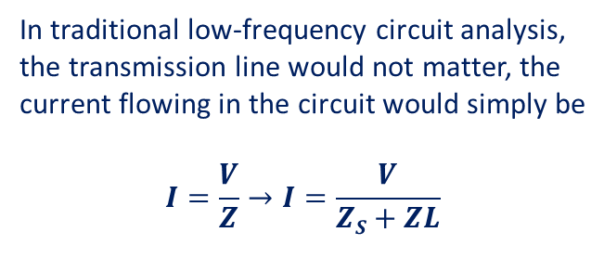
Introduction to Transmission Lines
The way to connect the Device Under Test (DUT), that can be an RF cavity, a kicker, a pick-up, an oscilloscope… is through a Transmission Line
If you plug your laptop charger into a wall outlet, the chord (transmission line) that connects the power to the charger is 3 meters long, the power is supplied at 50 Hz, should transmission line effects be taken into account?
The wavelength at 50 Hz is 6’000 km (6 million meters) the transmission line in this case is 3/6’000’000 = 0.0000005 wavelengths long, so the transmission line is very short relative to a wavelength, and therefore will not have much impact on the device
L
Z_{S}
V
Z_{L}
In traditional low-frequency circuit analysis, the transmission line would not matter, the current flowing in the circuit would simply be
$$I=\frac{V}{Z}→I=\frac{V}{ZS+ZL}$$

Slide 6
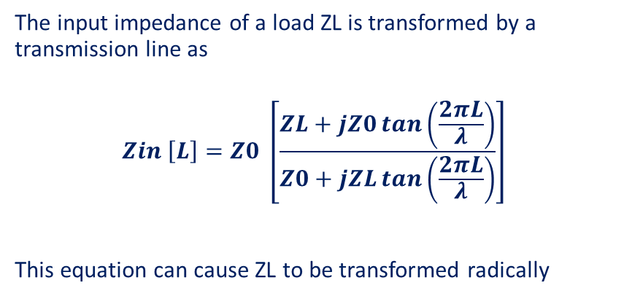
Introduction to Transmission Lines
L
In the high frequency case, the length L of the transmission line can significantly affect the results, to determine the current that flows in the circuit, we would need to know what the input impedance Zin is viewed from the terminals of the transmission line
The best RF power source can be connected to the best DUT, but if it is done with a wrong length of wrong impedance transmission line at high frequencies, the system will not work properly
Z_{S}
V
Z_{in} ?
Z₀
Z_{L}
The input impedance of a load ZL is transformed by a transmission line as
$$Zin \left[L\right]=Z0 \left[\frac{ZL+jZ0\tan\left(\frac{2πL}{λ}\right)}{Z0+jZL\tan\left(\frac{2πL}{λ}\right)}\right]$$
This equation can cause ZL to be transformed radically

Slide 7
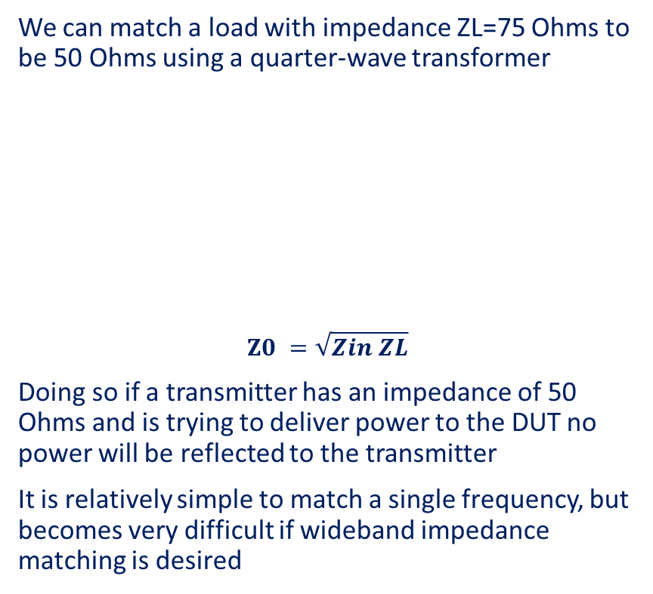
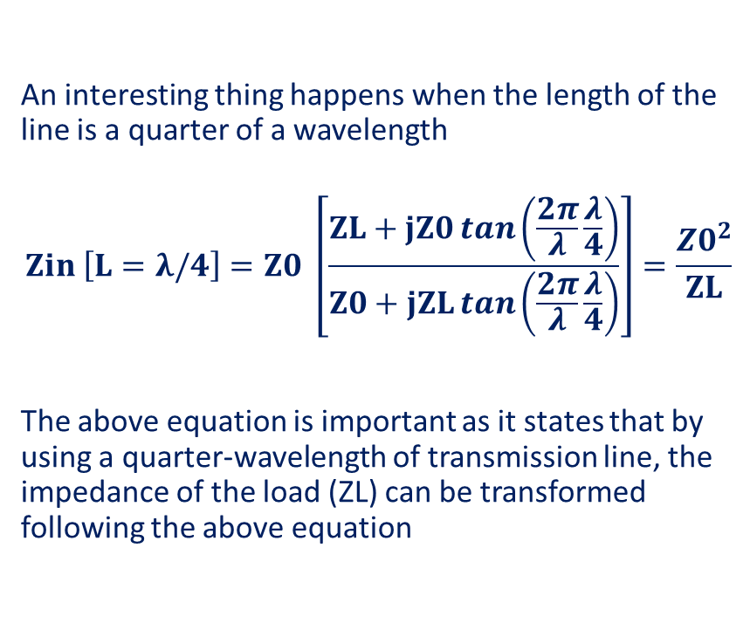
Introduction to Transmission Lines
An interesting thing happens when the length of the line is a quarter of a wavelength
$$Zin \left[L=λ/4\right]=Z0 \left[\frac{ZL+jZ0\tan\left(\frac{2π}{λ}\frac{λ}{4}\right)}{Z0+jZL\tan\left(\frac{2π}{λ}\frac{λ}{4}\right)}\right]=\frac{{Z0}^{2}}{ZL}$$
The above equation is important as it states that by using a quarter-wavelength of transmission line, the impedance of the load (ZL) can be transformed following the above equation
We can match a load with impedance ZL=75 Ohms to be 50 Ohms using a quarter-wave transformer
$$Z0 =\sqrt{Zin ZL}$$
Doing so if a transmitter has an impedance of 50 Ohms and is trying to deliver power to the DUT no power will be reflected to the transmitter
It is relatively simple to match a single frequency, but becomes very difficult if wideband impedance matching is desired
L = λ/4
Z_{S} = 50 Ω
V
Z_{in} = 50 Ω
Z₀ = 61.2 Ω
Z_{L} = 75 Ω

Slide 8
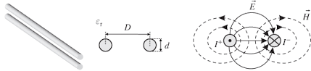
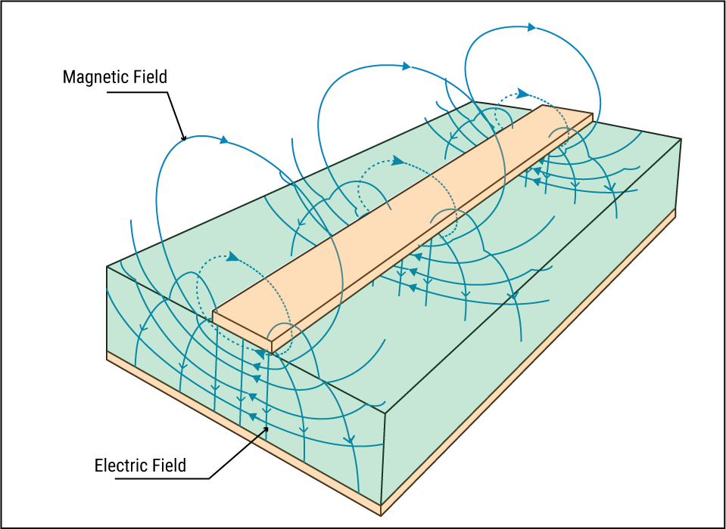
Transmission line families
Two-wire lines
often used for indoor antenna, radio or TV
Radiation to the environment, cannot be used for high power Transportation
Strip-lines
often used for microwave integrated circuits
Radiation to the environment and limited power capability, cannot be used for high power transportation

Slide 9
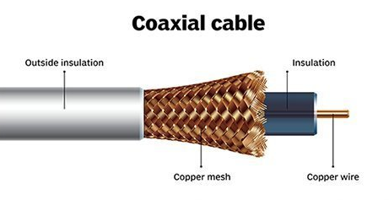
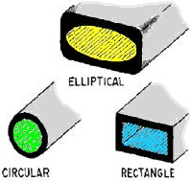
Transmission line families
Coaxial lines
often used for power RF transmission and connection of RF components
High loss above a certain frequency due to heating of inner conductor and dielectric material and limited power capability at higher frequencies due to small dimensions
Waveguides (rectangular, cylindrical, elliptical)
often used for high power RF transmission (mostly rectangular)
Waveguide plumbing, rigidity

Slide 10
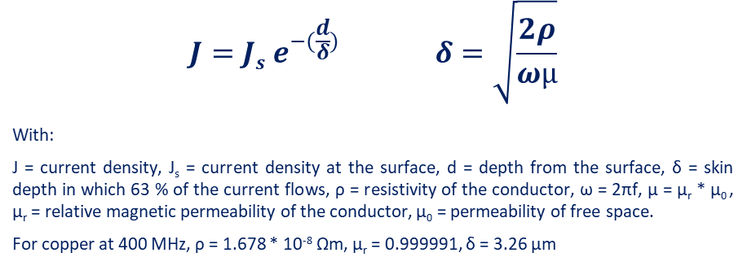
RF flowing only through first layers of the material
RF needs only few µm of good electrical layer to flow along
at the surface, conductivity is 100%
at one skin depth, it is decreased to 36.8%
at two skin depths, 13.5%
at three skin depths, 5.0%
at four, 1.8%
at five, 0.7%
When d = 5 x δ,
more than 99 % of the current flows in the conductor
δ
at d = δ ; J = J_{s}/e
RF current is flowing through only the first layers of a plain cable
$$J=Js e^{−(\frac{d}{δ})} δ=\sqrt{\frac{2ρ}{ωµ}}$$
With:
J = current density, J_{s} = current density at the surface, d = depth from the surface, δ = skin depth in which 63 % of the current flows, ρ = resistivity of the conductor, ω = 2πf, µ = µ_{r} * µ₀ , µ_{r} = relative magnetic permeability of the conductor, µ₀ = permeability of free space.
For copper at 400 MHz, ρ = 1.678 * 10⁻⁸ Ωm, µ_{r} = 0.999991, δ = 3.26 µm

Slide 11
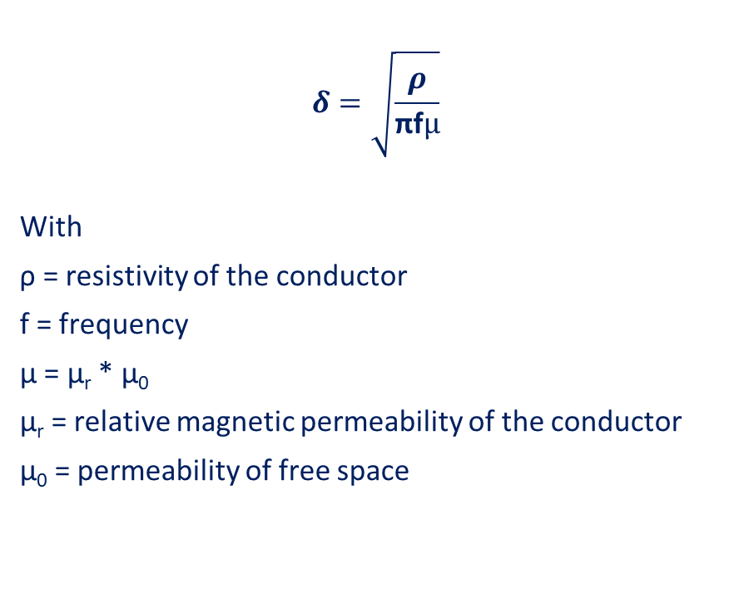
Skin depth effect
δ
$$δ=\sqrt{\frac{ρ}{\text{π}\text{f}µ}}$$
With
ρ = resistivity of the conductor
f = frequency
µ = µ_{r} * µ₀
µ_{r} = relative magnetic permeability of the conductor
µ₀ = permeability of free space
material | Ρ [nΩm] | µ_{r} | δ @ 200 MHz [μm] | 5 x δ @ 200 MHz [μm]
Gold | 24.4 | 1 | 5.56 | 27.8
Silver | 15.9 | 1 | 4.49 | 22.5
Copper | 17.2 | 1 | 4.67 | 23.4
Aluminium | 28.2 | 1 | 5.97 | 29.9
Tin | 109 | 1 | 11.75 | 58.8
Lead | 220 | 1 | 16.70 | 83.5

Slide 12
Outlook
RF power transport basics
Waveguides
Coaxial lines
Circulator
Fundamental Power Couplers

Slide 13
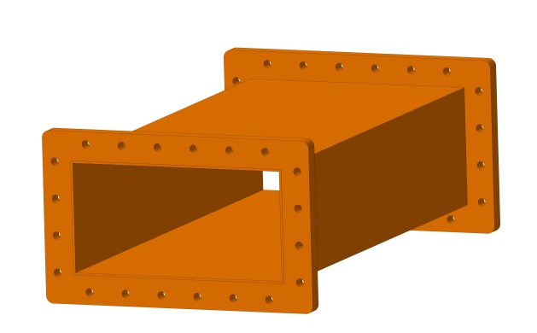
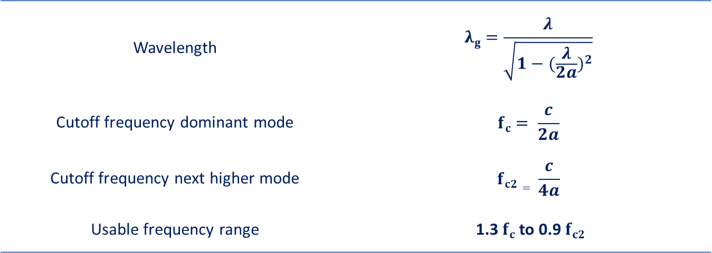
Rectangular waveguides
The main advantage of waveguides is that waveguides support propagation with low loss
b
a
Wavelength | $$λg=\frac{λ}{\sqrt{1−{(\frac{λ}{2a})}^{2}}}$$
Cutoff frequency dominant mode | $$fc= \frac{c}{2a}$$
Cutoff frequency next higher mode | $$fc2= \frac{c}{4a}$$
Usable frequency range | 1.3 $fc$to 0.9 $fc2$

Slide 14
Rectangular waveguides
Waveguides are usable over certain frequency ranges
  For very lower frequencies the waveguide dimensions become impractically large
  For very high frequencies the dimensions become impractically small & the manufacturing tolerance becomes a significant portion of the waveguide size
b
a
Waveguide name |  |  | Recommended frequency band of operation (GHz) | Cutoff frequency of lowest order mode (GHz) | Cutoff frequency of next mode (GHz) | Inner dimensions of waveguide opening (inch) | Inner dimensions of waveguide opening (mm)
EIA | RCSC | IEC
WR2300 | WG0.0 | R3 | 0.32 — 0.45 | 0.257 | 0.513 | 23.000 × 11.500 | 584.2 x 292.1
WR1150 | WG3 | R8 | 0.63 — 0.97 | 0.513 | 1.026 | 11.500 × 5.750 | 292.1 x 146
WR340 | WG9A | R26 | 2.20 — 3.30 | 1.736 | 3.471 | 3.400 × 1.700 | 86.1 x 43.2
WR75 | WG17 | R120 | 10.00 — 15.00 | 7.869 | 15.737 | 0.750 × 0.375 | 19.05 x 9.52
WR10 | WG27 | R900 | 75.00 — 110.00 | 59.015 | 118.03 | 0.100 × 0.050 | 2.54 x 1.27
WR3 | WG32 | R2600 | 220.00 — 330.00 | 173.571 | 347.143 | 0.0340 × 0.0170 | 0.86 x 0.43

Slide 15
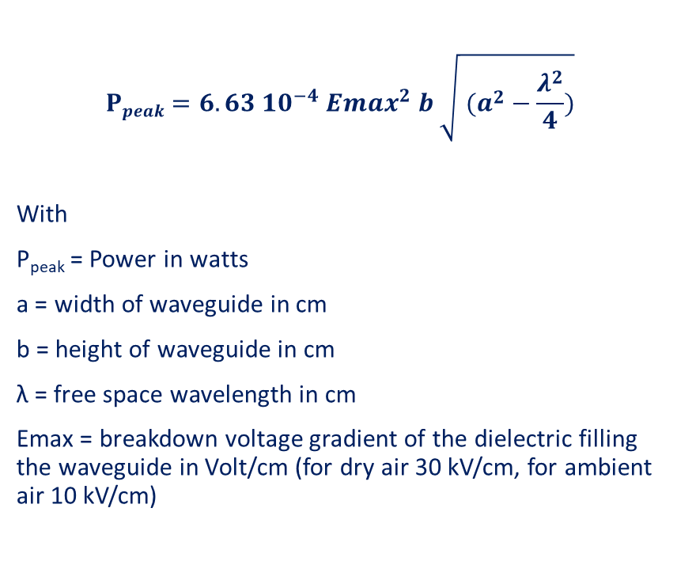
Rectangular waveguides, Maximum Power handling
Theoretical for straight WG, in in practice consider the limit being 10 % of this value
$$Ppeak=6.63 {10}^{−4} {Emax}^{2} b \sqrt{ (a^{2}−\frac{λ^{2}}{4})}$$
With
P_{peak} = Power in watts
a = width of waveguide in cm
b = height of waveguide in cm
λ = free space wavelength in cm
Emax = breakdown voltage gradient of the dielectric filling the waveguide in Volt/cm (for dry air 30 kV/cm, for ambient air 10 kV/cm)
WR2300
WR2100
WR1800
WR1500
WR1150
WR975

Slide 16
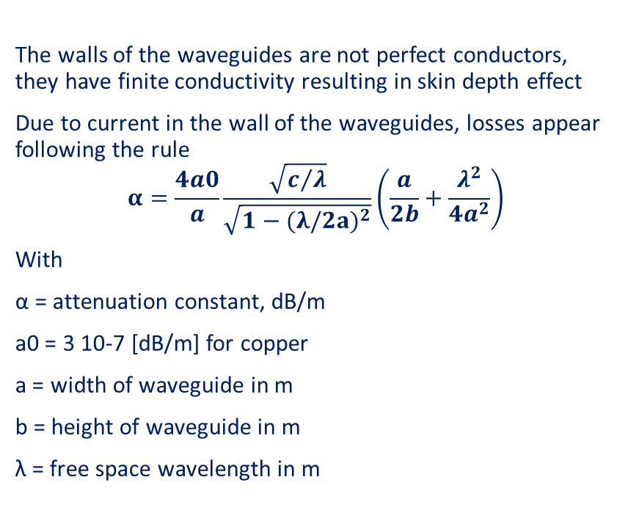
Rectangular waveguides, Attenuation
The walls of the waveguides are not perfect conductors, they have finite conductivity resulting in skin depth effect
Due to current in the wall of the waveguides, losses appear following the rule
$$α=\frac{4a0}{a}\frac{\sqrt{c/λ}}{\sqrt{1−{(λ/2a)}^{2}}}\left(\frac{a}{2b}+\frac{λ^{2}}{{4a}^{2}}\right)$$
With
α = attenuation constant, dB/m
a0 = 3 10-7 [dB/m] for copper
a = width of waveguide in m
b = height of waveguide in m
λ = free space wavelength in m
WR975
WR1150
Attenuation factors of waveguides made from different material normalized to a waveguide of same size made of copper
Copper | 1.00
Silver | 0.98
Aluminium | 1.30
Brass | 2.05
WR1500
WR2100
WR2300

Slide 17
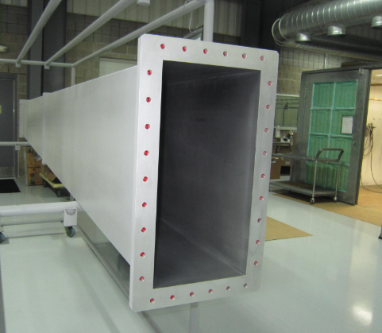
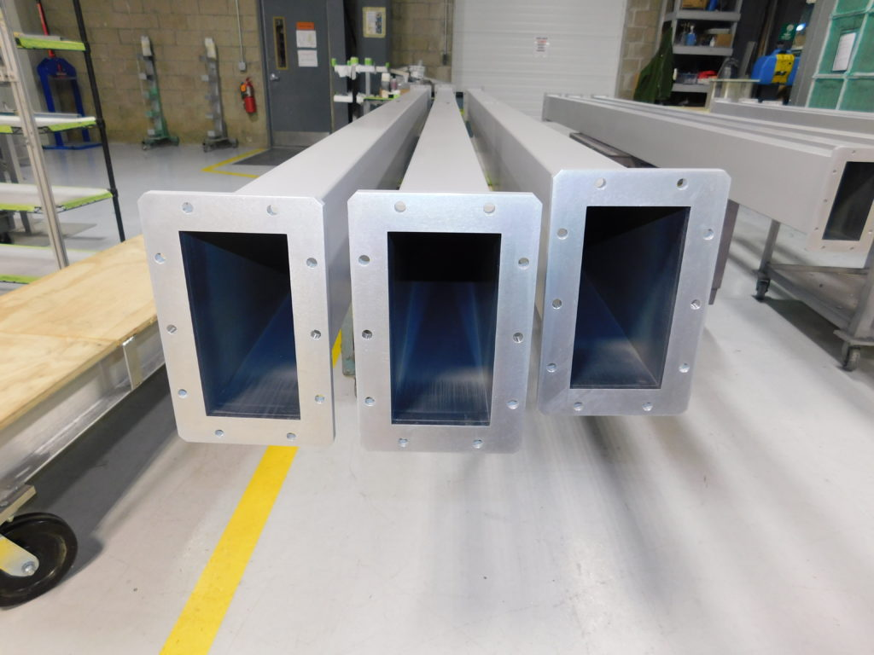
Rectangular waveguides
MEGA industries, straight waveguides

Slide 18
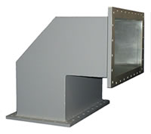
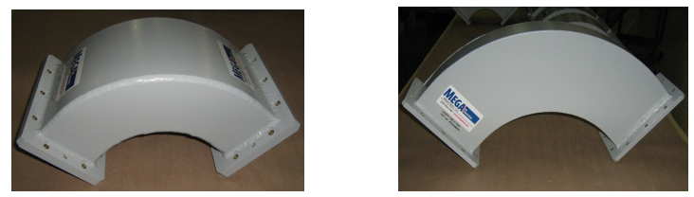
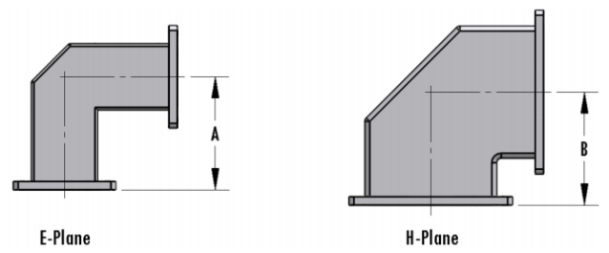
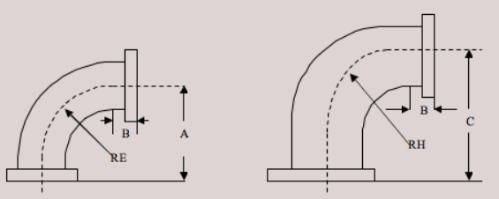
Rectangular waveguides
Mega Industries Miter Bends
Mega Industries Sweep Bends

Slide 19
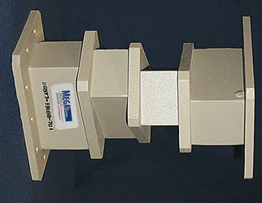
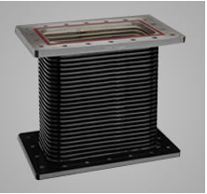
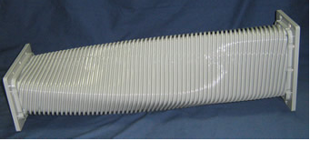
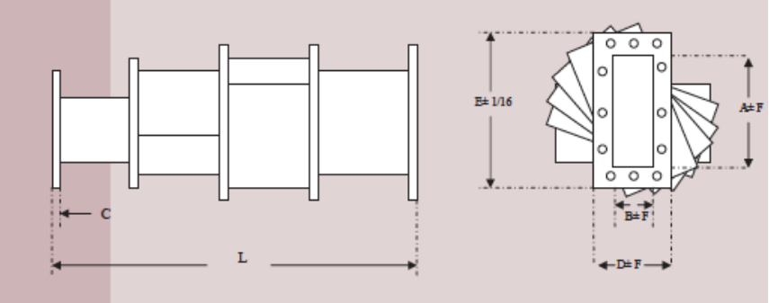
Rectangular waveguides
Mega Industries Flexible and Flexible twist waveguide
Mega Industries Step Twist waveguide

Slide 20
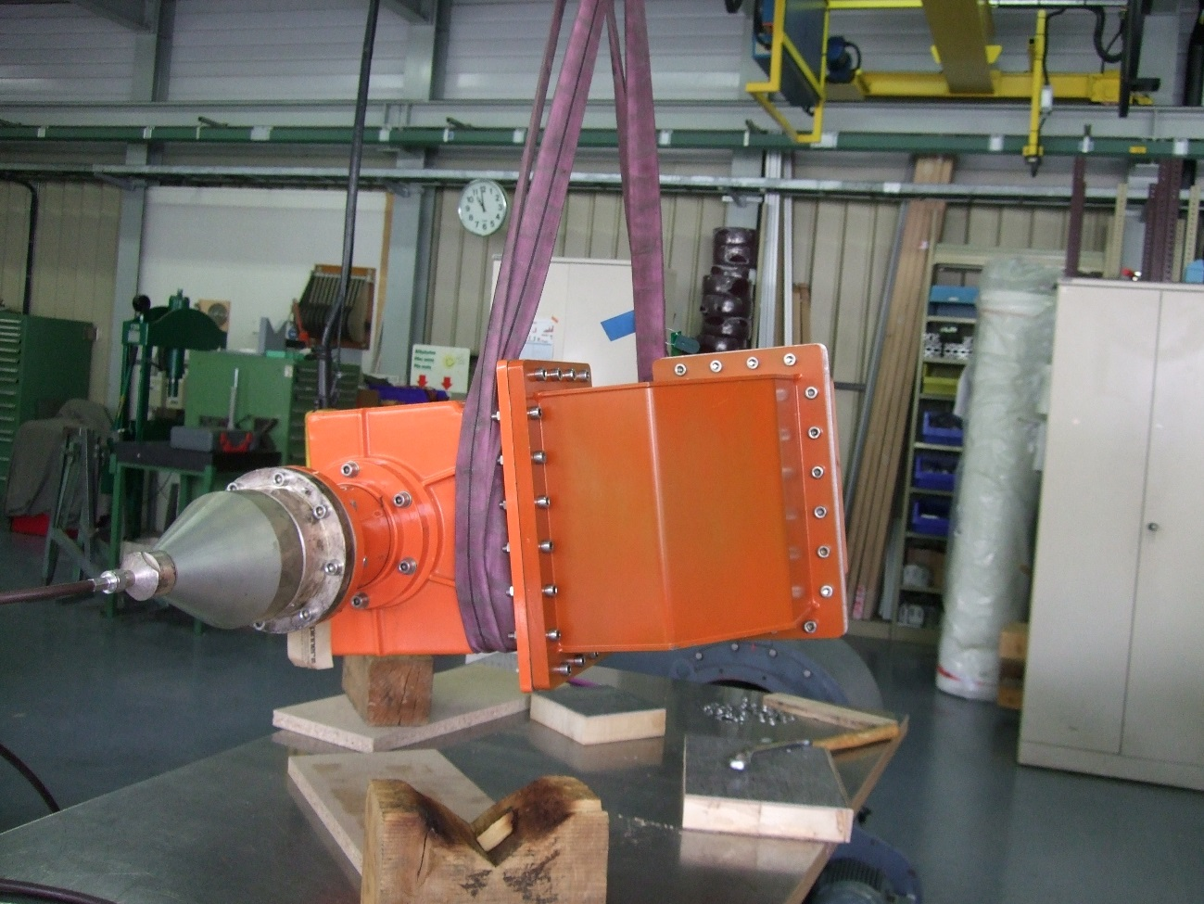
Rectangular waveguides
Adaptor from WR 1150 to N

Slide 21
Distribution with rectangular waveguides
If you wish to use a high-power klystron to drive several cavities, you will need to distribute the power
There are two main distribution schemes with rectangular waveguides, linear distribution and tree like distribution
Combination of both are possible, the layout depending on the requirements, such as power capability, isolation between cavities, weight, available space, assembly processes, etc…

Slide 22
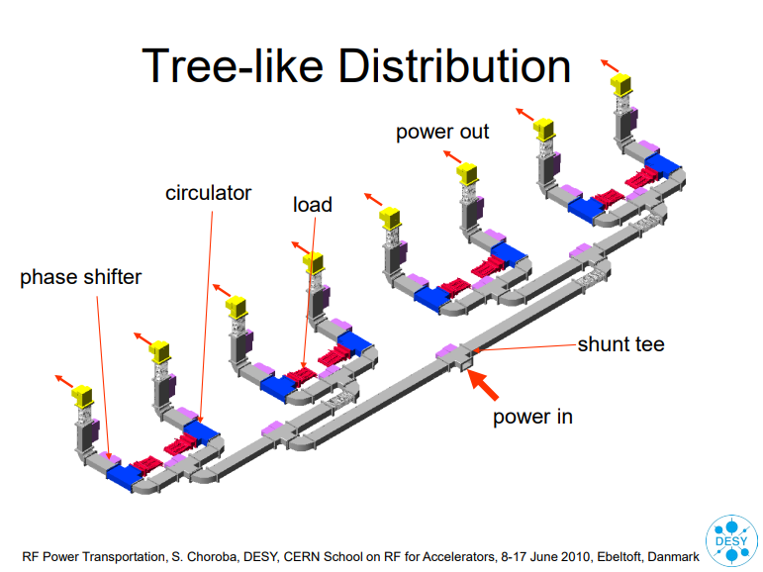
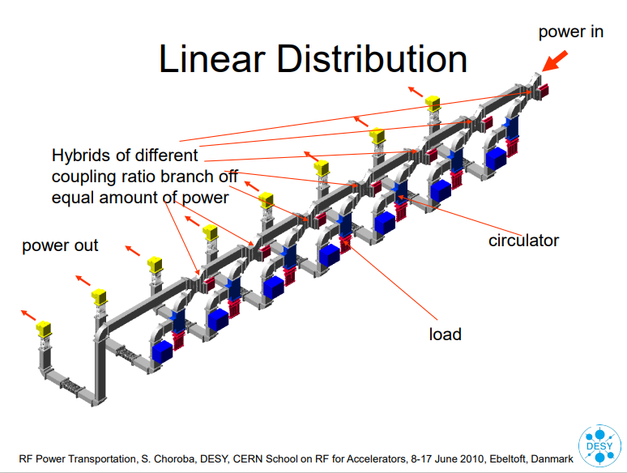
Distribution with rectangular waveguides

Slide 23
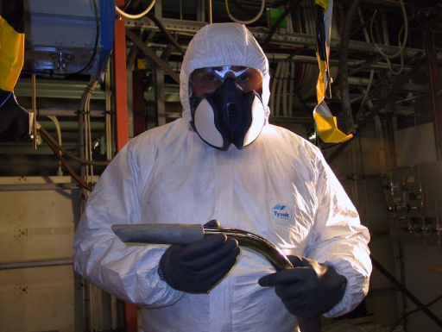
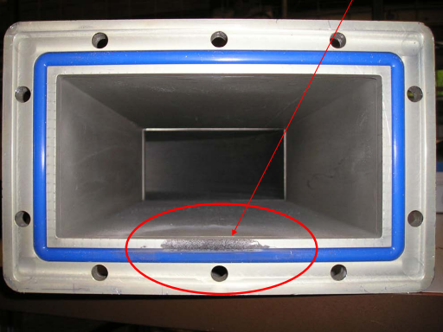

Rectangular waveguides
Staff for opening and cleaning SF6 filled
waveguide must use protection clothes
Damaged Waveguide due to bad Connection of
two Waveguide Flanges

Slide 24
Outlook
RF power transport basics
Waveguides
Coaxial lines
Circulator
Fundamental Power Couplers

Slide 25
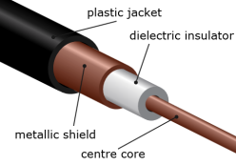

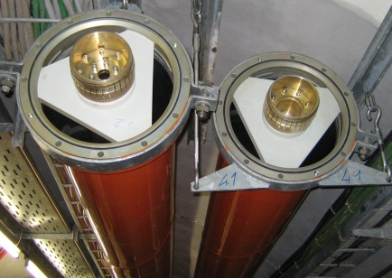
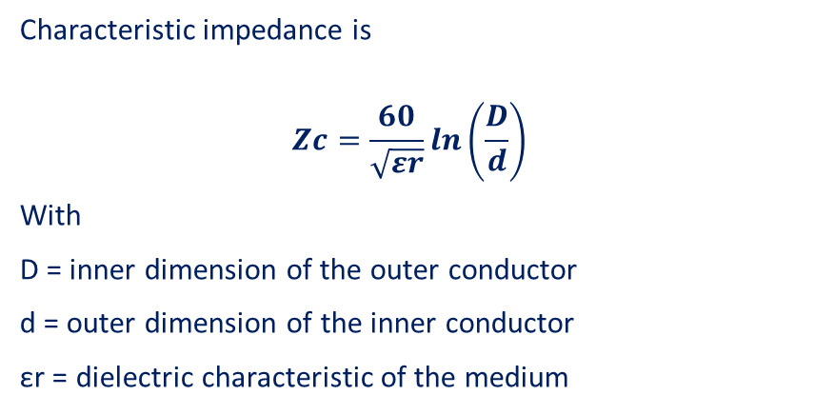
Coaxial Lines
Coaxial cables are often with PTFE foam to keep concentricity
Characteristic impedance is
$$Zc=\frac{60}{\sqrt{εr}}\ln\left(\frac{D}{d}\right)$$
With
D = inner dimension of the outer conductor
d = outer dimension of the inner conductor
εr = dielectric characteristic of the medium
Flexible lines have spacer helicoidally placed all along the line
Size | Outer conductor |  | Inner conductor
 | Outer diameter | Inner diameter | Outer diameter | Inner diameter
7/8" | 22.2 mm | 20 mm | 8.7 mm | 7.4 mm
1 5/8" | 41.3 mm | 38.8 mm | 16.9 mm | 15.0 mm
3 1/8" | 79.4 mm | 76.9 mm | 33.4 mm | 31.3 mm
4 1/2" | 106 mm | 103 mm | 44.8 mm | 42.8 mm
6 1/8" | 155.6 mm | 151.9 mm | 66.0 mm | 64.0 mm
Rigid lines are made of two rigid tubes maintained concentric with supports

Slide 26
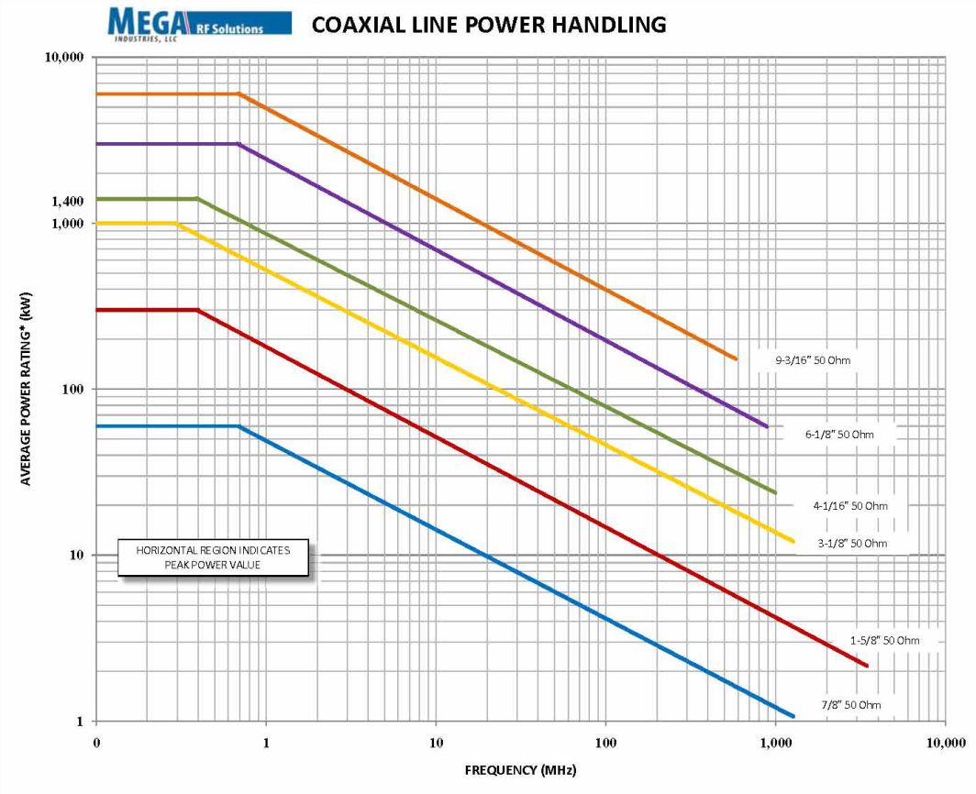
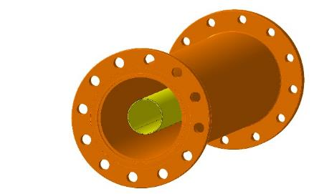
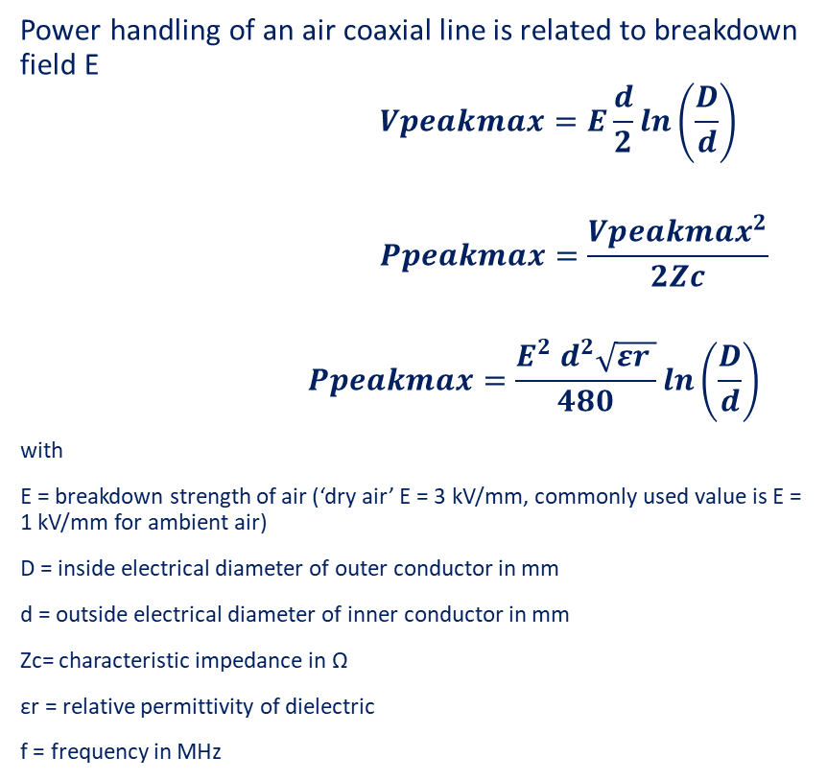
Coaxial lines Maximum Power handling
Power handling of an air coaxial line is related to breakdown field E
$$Vpeakmax=E\frac{d}{2}\ln\left(\frac{D}{d}\right)$$
$$Ppeakmax=\frac{{Vpeakmax}^{2}}{2Zc}$$
$$Ppeakmax=\frac{{E^{2} d}^{2}\sqrt{εr }}{480}\ln\left(\frac{D}{d}\right)$$
with
E = breakdown strength of air (‘dry air’ E = 3 kV/mm, commonly used value is E = 1 kV/mm for ambient air)
D = inside electrical diameter of outer conductor in mm
d = outside electrical diameter of inner conductor in mm
Zc= characteristic impedance in Ω
εr = relative permittivity of dielectric
f = frequency in MHz
Valid only for straight Lines, in case of elbows, reduce at minimum by – 30 %
d
D

Slide 27
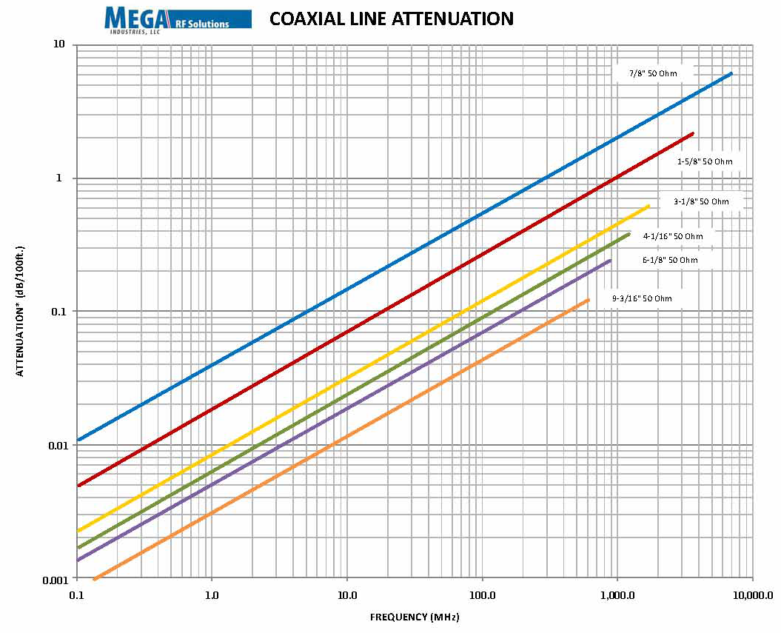
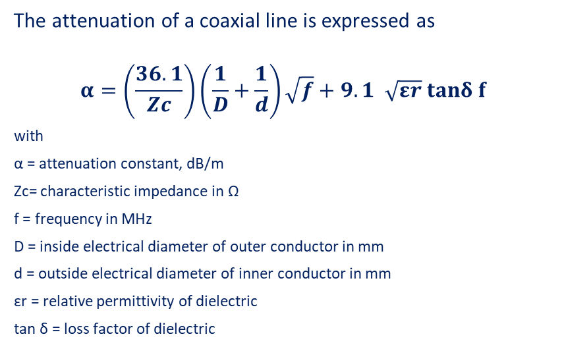
Coaxial lines Attenuation
The attenuation of a coaxial line is expressed as
$$α=\left(\frac{36.1}{Zc}\right)\left(\frac{1}{D}+\frac{1}{d}\right)\sqrt{f}+9.1 \sqrt{εr} tanδ f$$
with
α = attenuation constant, dB/m
Zc= characteristic impedance in Ω
f = frequency in MHz
D = inside electrical diameter of outer conductor in mm
d = outside electrical diameter of inner conductor in mm
εr = relative permittivity of dielectric
tan δ = loss factor of dielectric
Material | ε_{r} | tan δ | Breakdown MV/m
Air | 1.00006 | 0 | 3
Alumina 99.5% | 9.5 | 0.00033 | 12
PTFE | 2.1 | 0.00028 | 100

Slide 28
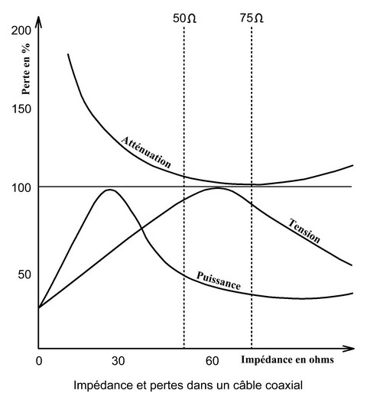
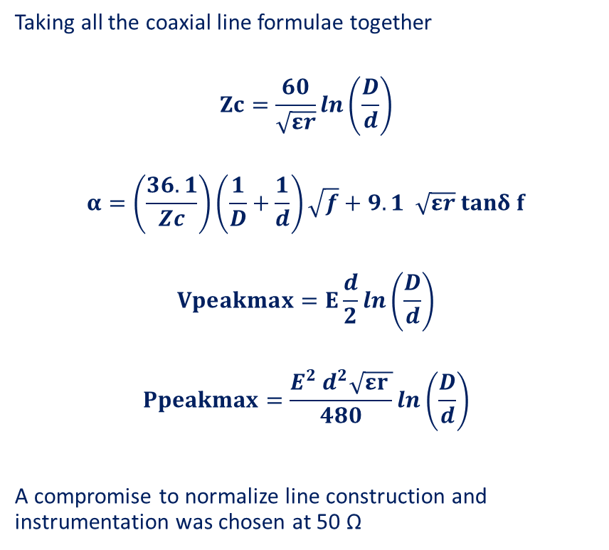
Why 50 Ohms lines ?
50 Ω
Best compromise (power)
75 Ω
Best for losses (Radio)
Taking all the coaxial line formulae together
$$Zc=\frac{60}{\sqrt{εr}}\ln\left(\frac{D}{d}\right)$$
$$α=\left(\frac{36.1}{Zc}\right)\left(\frac{1}{D}+\frac{1}{d}\right)\sqrt{f}+9.1 \sqrt{εr} tanδ f$$
$$Vpeakmax=E\frac{d}{2}\ln\left(\frac{D}{d}\right)$$
$$Ppeakmax=\frac{{E^{2} d}^{2}\sqrt{εr }}{480}\ln\left(\frac{D}{d}\right)$$
A compromise to normalize line construction and instrumentation was chosen at 50 Ω
60 Ω
Best for voltage
30 Ω
Best for power

Slide 29
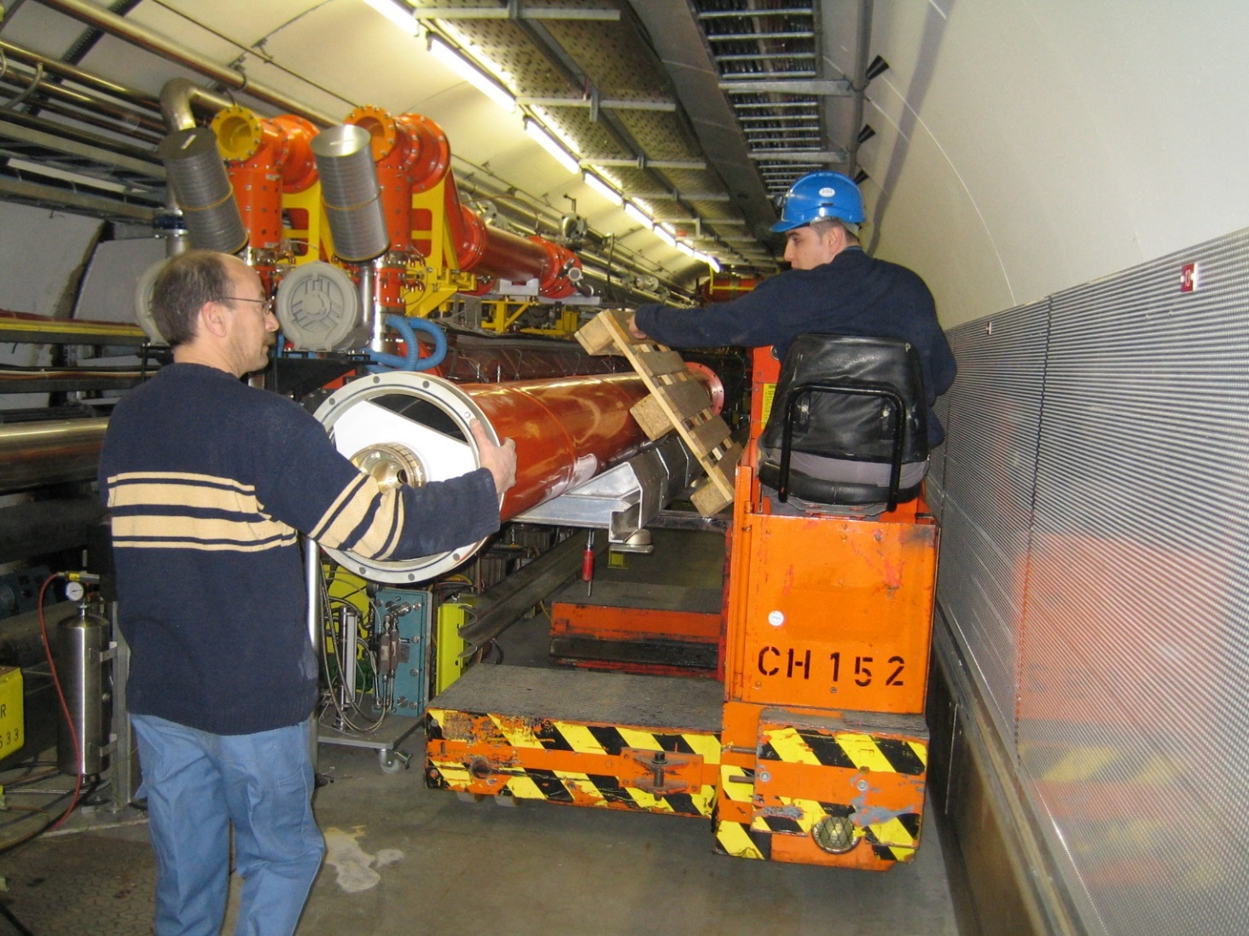
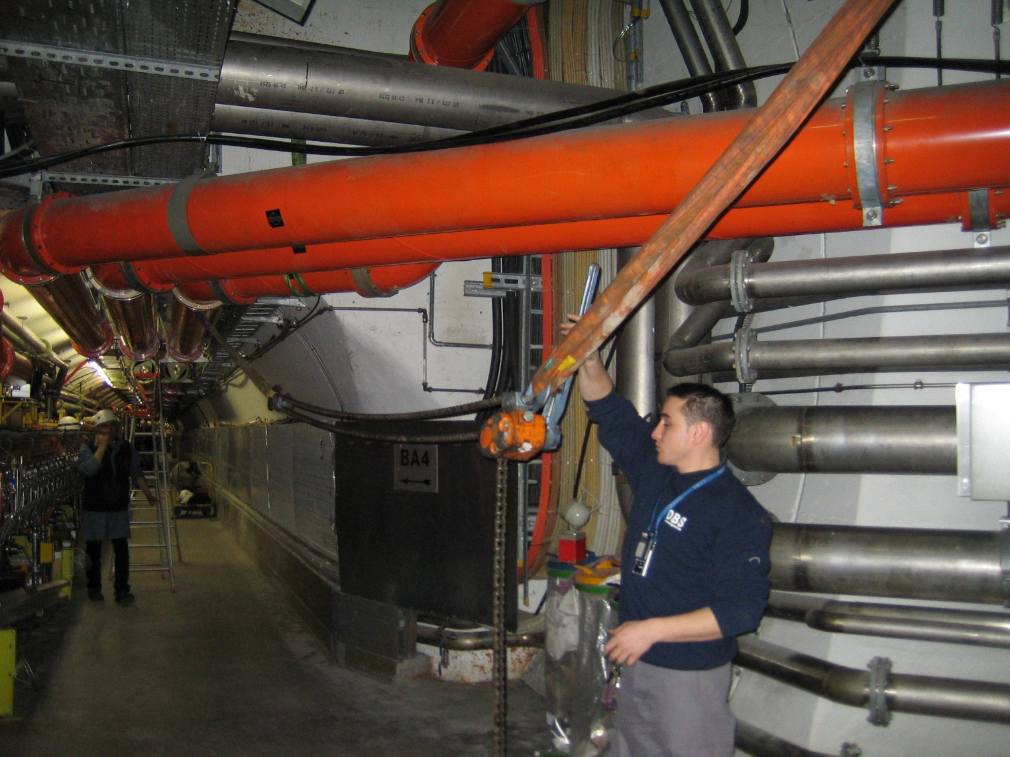
Coaxial Lines
Transporting a piece of 5 meters
of a 345 mm Coaxial Line
Using a crane to join two 345 mm Coaxial Line

Slide 30
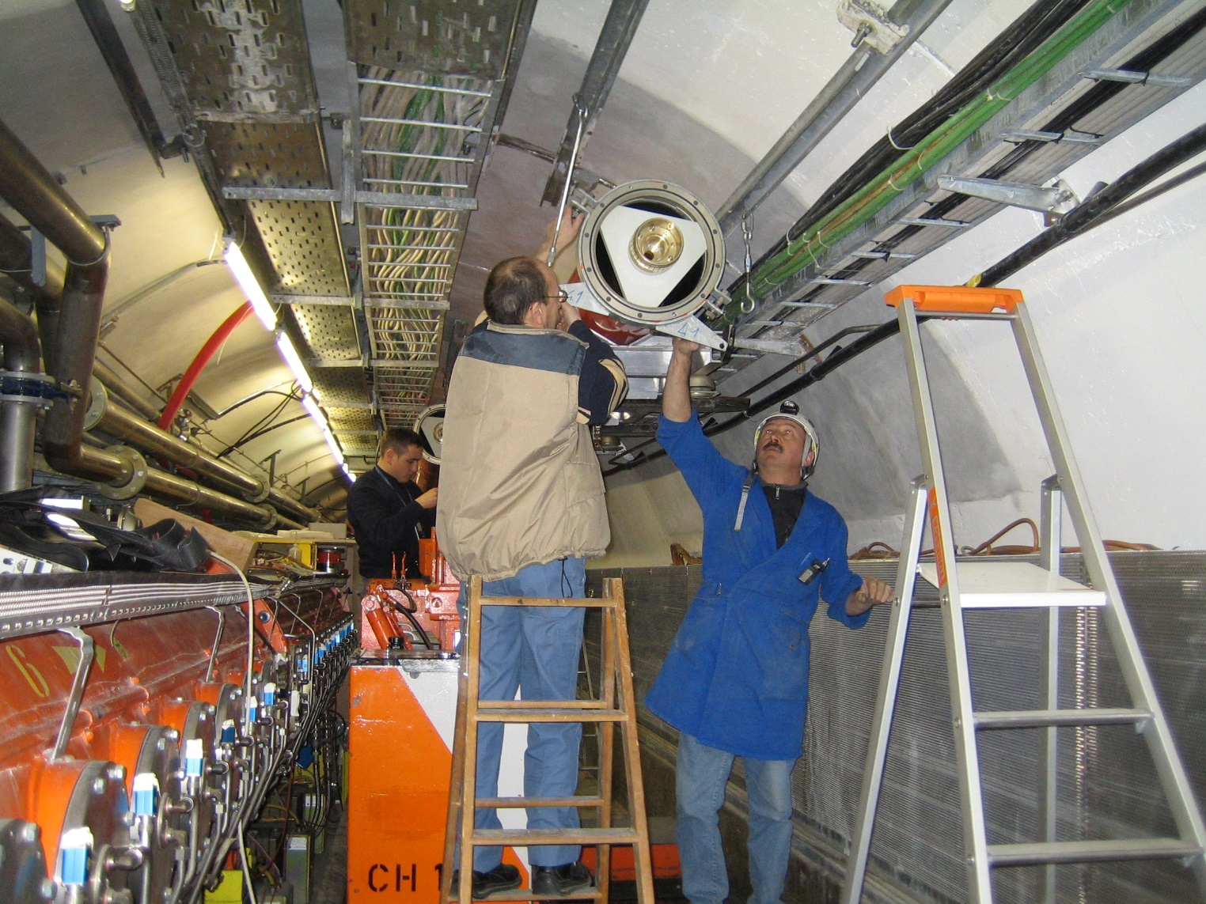

Coaxial Lines
345 mm Coaxial Line
Installed suspended from the ceiling
The supporting system is made to allow for movements due to thermal expansion

Slide 31
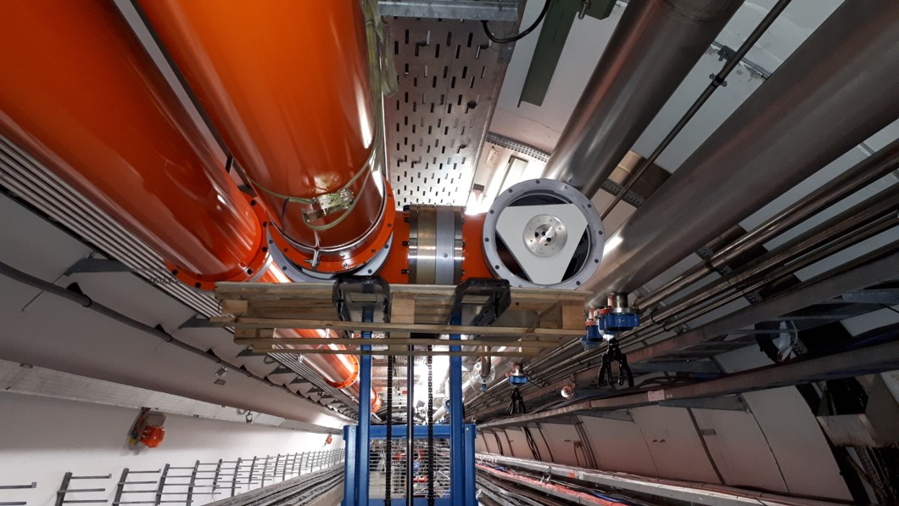
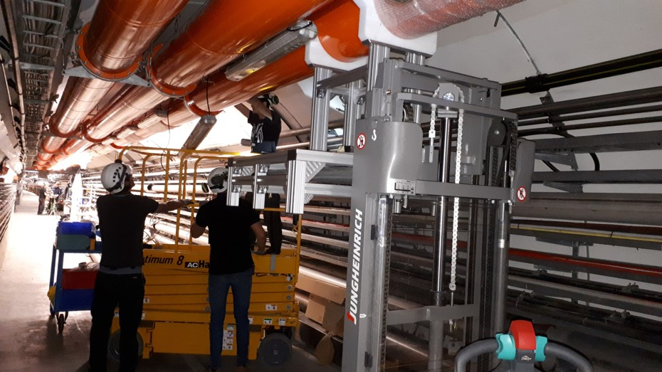
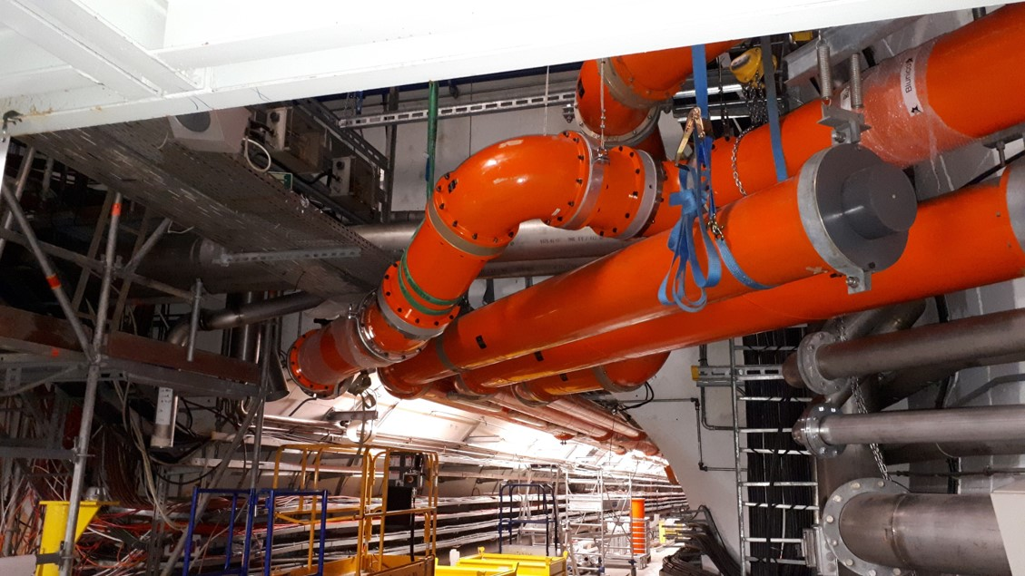
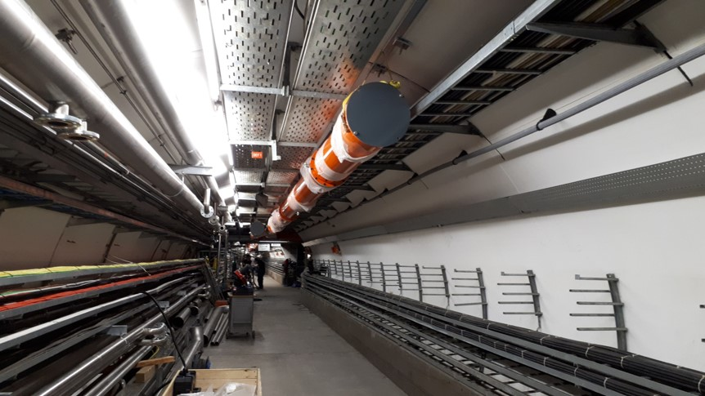
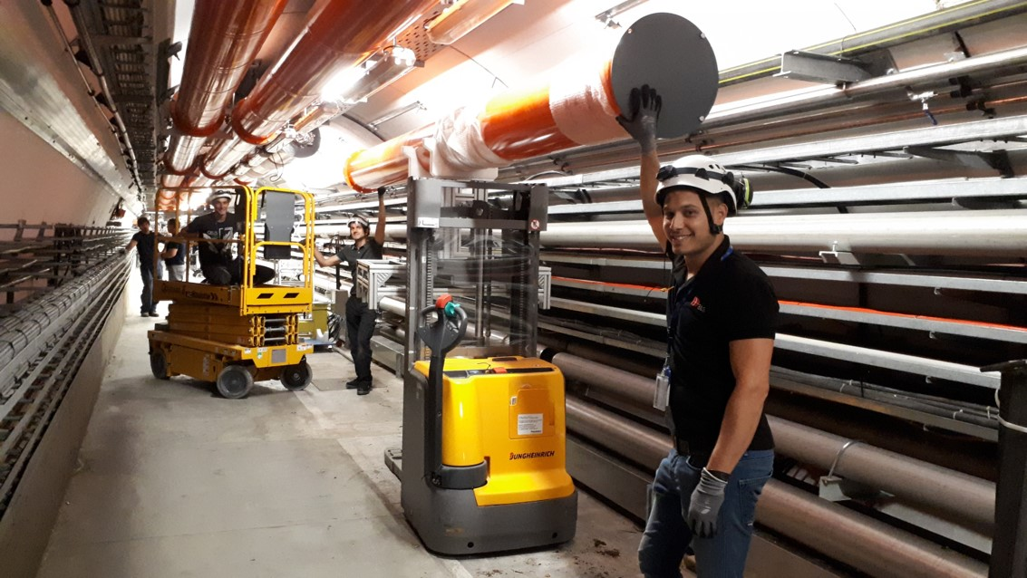
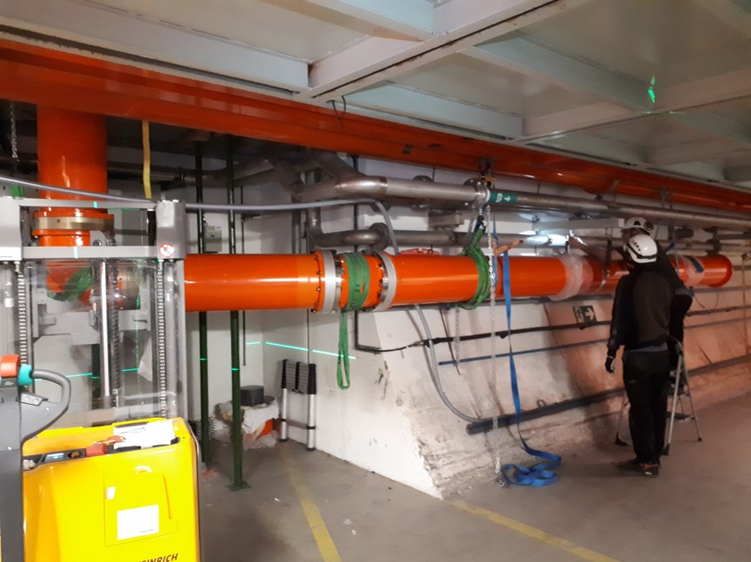
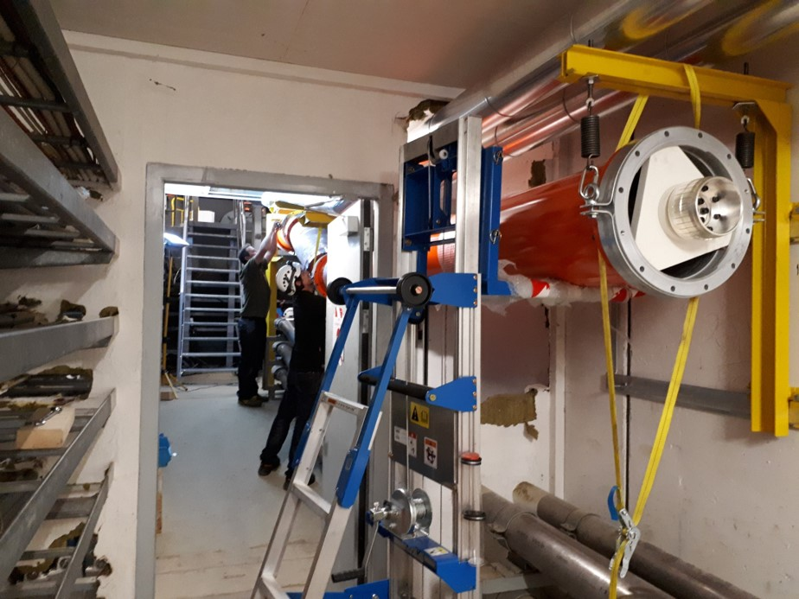
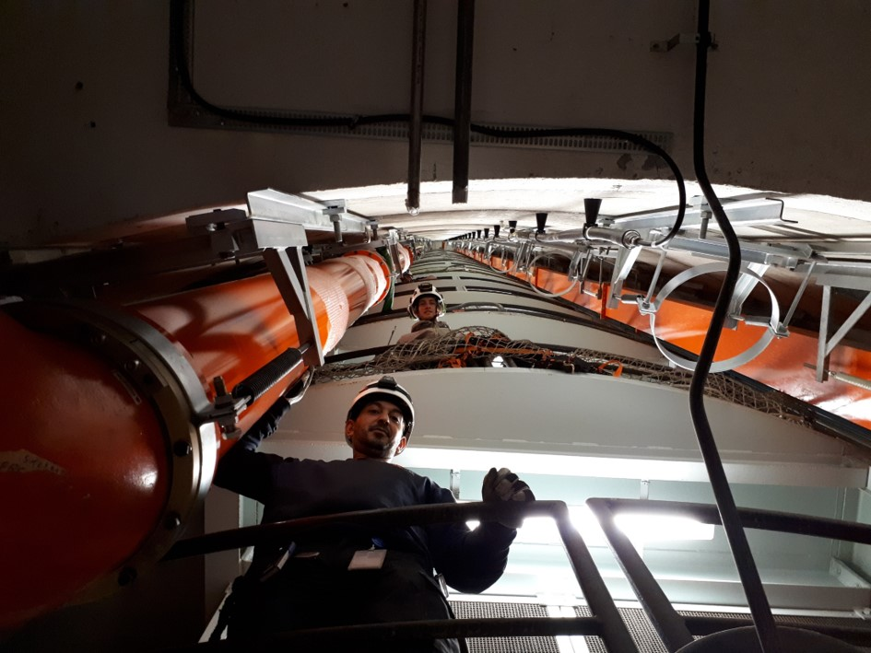






Coaxial Lines
Installation of 500 meters of 345 mm Coaxial Line
during the LHC Injector Upgrade project

Slide 32


Slide 33


Coaxial Lines
Traces of arcs
Arcs in the vicinity of the rod of ceramic
Arcs in the vicinity of the triangular ceramic

Slide 34
Outlook
RF power transport basics
Waveguides
Coaxial lines
Circulator
Fundamental Power Couplers

Slide 35



Mismatch
V _{forward}
V _{transmitted}
V _{reflected}
DUT
(Device Under Test)
Transmission Lines
RF Power

Slide 36







Reflection from Device Under Test (DUT)
Standing Wave Ration SWR is a measure of impedance matching of DUT
A wave is partly reflected when a transmission line is terminated with other than a pure resistance equal to its characteristic impedance
The reflection coefficient is defined by
$$Г=\frac{Vr}{Vf}$$
V_{f}
DUT
(Device Under Test)
Z $≠$ Z_{c}
DUT
(Device Under Test)
Z $=open or short$
Line = Z_{c}
DUT
(Device Under Test)
Z_{c}
Z_{c}
$Г=$ 0 | when the line is perfectly matched, no reflection
V_{r}
$Г=$ -1 | when the line is short-circuited complete negative reflection
$Г=$ 0 | when the line is perfectly matched, no reflection
$Г=$ 1 | when the line is open-circuited complete positive reflection

Slide 37


Reflection from Device Under Test (DUT)
At some points along the line the forward and reflected waves are exactly in phase
$\left|Vmax\right|$ $=\left|Vf\right|+\left|Vr\right|=\left|Vf\right|+\left|ГVf\right|=\left(1+\left|Г\right|\right) \left|Vf\right|$
full reflection
$\left|Vmax\right|$ $=2 \left|Vf\right|$
At other points they are 180° out of phase
$\left|Vmin\right|$ $=\left|Vf\right|−\left|Vr\right|=\left|Vf\right|−\left|ГVf\right|=\left(1−\left|Г\right|\right) \left|Vf\right|$
full reflection
$\left|Vmin\right|$ $=0$
The Voltage Standing Wave Ratio is equal to
$$VSWR=\frac{\left|Vmax\right|}{\left|Vmin\right|}=\frac{1+\left|Г\right|}{1−\left|Г\right|}$$
V_{f}
DUT
(Device Under Test)
Z $=open or short$
Line = Z_{c}
DUT
(Device Under Test)
Z_{c}
Z_{c}
V_{r}

Slide 38
Reflection from Load
In case of full reflection Vmax = 2 Vf (Pmax equivalent to 4 Pf)
RF power amplifiers will not like this reflected wave
  Klystron output cavity disturbed
  Grid tube, IOT and Transistor voltage capability
Swift protection if Pr > Prmax
  system NOT operational (not always possible)
P_{f}
DUT
P_{r}
Swift protection if P_{r} > Prmax

Slide 39
Circulator
1
2
V_{f} →
V_{f} →
← V_{r}
3
In order to protect our lines and our amplifiers from the reflected power a possible device is a Circulator
It is a passive non-reciprocal three-port device
The signal entering any port is transmitted only to the next port in rotation, an RF signal experiences a low loss in the direction of the arrow and high loss in reverse direction while propagating through the Circulator
The best place to insert it is close to the reflection source
If full reflection lines between circulator and DUT shall sustain V_{max} = 2 V_{f} (P_{max} equivalent to 4 P_{f})
A load of P_{f} is needed on port 3 to absorb P_{r}
System remains operational at all time
In case of full reflection
there will be 2 V_{f} along the line
(4 P_{f})
V_{r}
↓
Load
4 P_{f}
DUT
P_{f}
P_{f}

Slide 40

Circulator
1
2
Reflected signal from 3 is circulated back to 1
3
Isolation from 2-1 depends on 3 termination VSWR
Reverse power flows from 2 to 3
VSWR
The most misunderstood concept of circulators is that of isolation
Circulators do not provide isolation until one of the ports is terminated
Then the isolation between the other two ports (in the direction opposing the direction of circulation) is approximately equal to the return loss due to any mismatch on the terminated port
So, a very good load is needed on port 3 in order to guaranty a good isolation at port 1
Load on 3 absorb most of the signal coming from 2

Slide 41


Circulator
Basically, a circulator shall provide
  low loss
  high isolation
  low reflection
The crucial high-power requirements for a circulator are to
  Handle full peak and average power
  Handle forward power and reverse power up to 100% reflection and at any phase
  Consider worst case operating conditions

Slide 42
Circulator
High-Power Design Aspects | Peak Power | Average Power
Characteristic | high voltage & E field high current & H field | Losses in ferrites, dielectrics & conductors → power dissipation → heating
Risk | Electrical breakdown (arcing) in air gaps between ferrites and at edges & corners Burning at poor electrical contacts | Overheating & burning of materials Reduced el. breakdown capability at overheated surfaces Thermo-mechanical stress Thermal drift of ferrite properties
Solution | Elaborated design by 3D EM sim., covering detailed E field analysis Proper design margins x avoid sharp edges Well defined electrical contacts Gas pressurization, if required | Careful 3D thermal modeling based on the simulated EM power loss Low ferrite loss by material and bias Good el. conductors, low loss dielectrics Good thermal bonding of ferrites Adequate cooling of hot spots/areas Thermal compensation (TCU)

Slide 43

Circulator
High-Power handling requirements | Characteristic Peak Power max. E field | Maximum Power Loss max. H field
Design criterion for power capability | $$Pc={(\sqrt{Pfwd1}+\sqrt{Prev2}+\sqrt{Prev3})}^{2}$$ $\sim 4 Pfwd1$ with $Prev2=Pfwd1$ and $Prev3=0$ as Return Loss > 30 dB | $\sim 3 insertion loss (1−way)$ for a 3-port circulator operated into a short
Note | In the simulation of a circulator with matched terminations, we have to consider 4 times the forward power to calculate max. E field strength A bad dummy load would increase Pc significantly: factor 4.4 for RL = 20dB factor 9 for RL = 0dB The circulator is usually not designed to withstand these conditions! | The maximum ferrite power loss is more than 2 times the insertion loss as expected for the FWD and REV wave, due to the resonant pattern in the 3-port junction Ferrite power loss varies between 1 and 3 times insertion loss as the short phase is shifted by 180° (2- way)

Slide 44
Outlook
RF power transport basics
Waveguides
Coaxial lines
Circulator
Fundamental Power Couplers

Slide 45
Power Couplers
The Power Coupler has to transfer the RF power of the generator into the cavity ensuring the beam vacuum integrity
In addition, with SRF cavities, Power Couplers have to cope with specific requirements such as cold to warm transition and integration with the cryomodule
Several names for the same device
FPC : Fundamental Power Coupler
MPC : Main Power Coupler
MC : Main Coupler
PC : Power Coupler
Coupler
Proceedings of the 1995 Workshop on RF Superconductivity - MARK S. CHAMPION
… When particle accelerators make use of radiofrequency cavities, either superconducting or normal conducting, it is often the cavities themselves that receive the most attention. However, the cavities are of little value without rf input couplers, which are usually more difficult to realize than is foreseen. There are many, sometimes conflicting, requirements placed on the couplers…

Slide 46




Fundamental Power Coupler FPC
SPL FPC
The Fundamental Power Coupler (FPC) is the connecting part between the RF transmission line and the RF cavity
The FPC a specific piece of transmission line that provides the vacuum barrier for the beam vacuum, with one side at high pressure and the other side under beam vacuum pressure, that also enables RF power to feed the cavity
FPC are one of the most critical parts of the RF cavity system in an accelerator
A good RF design, a good mechanical design and a high-quality fabrication are essential for an efficient and reliable operation
Even if not technical, the cost must be taken into consideration as FPC can easily become very expensive
LHC FPC
L4 FPC window
HL-LHC FPC
Various CERN FPC

Slide 47
Overview of the CERN power couplers since the 2000’s
LHC 400 MHz, 500 kW CW SW
SPS 2.0 200 MHz, 750 kW CW TW
SPL 2.0 704 MHz, 900 kWp 10 % SW
SPL 3.0 704 MHZ, 1000 kWp 10 % SW
Linac4 352 MHz, 1000 kWp 10 % SW
Crab DQW 400 MHz, 100 kW CW SW
Crab RFD 400 MHz, 100 kW CW SW
ESRF 352 MHz, 200 kW CW SW
SOLEIL 352 MHz, 200 kW CW SW
APS 1.0 352 MHz, 200 kW CW SW
SPS LIU 200 MHz, 800 kW CW TW
HG (SPL 3.0) 704 MHz, 1500 kWp 10 % SW
LHC 2.0 400 MHz, 500 kW CW SW
APS 2.0 352 MHz, 250 kW CW SW

Slide 48

Example of a design
Ceramics
  Ceramic material
  Metallization
  Window families
    Disk
    Cylindrical
    Coaxial disk
  Two windows
  Single window
  Solutions proposed
Antenna
  Adjustable coupler
  Antenna shape
Outer Antenna line
  Copper for RF
  Stainless steel
  Bad coating
  RF & vacuum seal
Protection of the FPC
Cryomodule integration
Orientation of the FPC
Inner antenna cooling
WG to coax
Multipacting
  Ti sputtering
  DC polarisation
Simulation and proposed solution
  Cylindrical Design
  Coaxial disk
  Disk
Construction
Clean room
  Clean process study
  Mock-ups
  Preparation for assembly
  Assembly in ISO 5
  Assembly in ISO 4
FPC test boxes
FPC test benches
  In clean room
  Resonant ring
RF conditioning
  Ceramic cracks
  Conditioning process
  VCA
  Pulses
  Ramping
  Repetition rate
  TW and SW mode
  Automated process
  Processing time
  Summary
First test results
  Arcing
Restart from step #1

Slide 49

Ceramic
This is the most important device of a FPC
It ensures the vacuum leak tightness of the FPC, and of the entire machine!
Any leak on the window immediately leads into degradation of the cavity and of the machine
It is commonly a ceramic brazed with metal

Slide 50
Ceramic material
Most of the windows are built with an Al2O3 ceramic
A very important parameter is the purity of the ceramic
A too pure ceramic will be with very few losses, that is perfect for RF power, but will be very difficult to braze as the metallization will not adhere
A ceramic with impurities will be much easier to braze, but will have a lot of losses that will induce a difficult cooling
 | Purity | RF losses | Brazing
Al₂O₃ | 99.9 % | Very Low | Very difficult
Al₂O₃ | 97.6 % | Medium | Medium
Al₂O₃ | 95 % | Higher | Easier
CERN published a reference document in 1996 (10 pages) explaining all the parameters that a ceramic for RF window shall fulfil
http://cds.cern.ch/record/91419?ln=fr
It is still in use, and all our ceramics are the Al2O3 - 97.6 % purity ones
In view of future machine, we push R&D to move to 99.9 % purity, having less losses, allowing for more power

Slide 51

Metallization
Before brazing the metallic line, the window has to be metallized
The most common medium used is a Molly-Manganese deposition on the surfaces to be brazed
It is often painted by hands
This paint is very sensible and must be kept in movement at any time, under a controlled temperature and humidity
The metallic lines will be brazed onto that MoMn support, it is of the highest importance
A default in the metallization of the ceramic, one can easily understand that it will not be possible to braze any metallic part onto it

Slide 52



Window families
Disk windows
SPS, 800 MHz
150 KW CW
Linac4, 352 MHz
1 MW 10 % duty
LHC 2, 400 MHz
1 MW (expected) CW
Cylindrical windows
LHC, 400 MHz
500 kW CW
ESRF/SOLEIL/APS, 352 MHz
250 kW CW
SPL, 704 MHz
1 MW 5 % duty
Coaxial disk windows
HL-LHC Crab, 400 MHz
100 KW CW
SPL 2.0, 704 MHz
1 MW 5 % duty
SPL 3.0, 704 MHz
2 MW (expected) 5 % duty

Slide 53

Disk windows
Robust and compact (in length) design
  12 kg ceramic
  400 mm diameter
  25 mm thickness
As simple as possible
  1-2-3-4 : Ceramic assembly
  5 : spacer
  6 : Helicoflex seal
  7-8 : Stainless Steel flanges
Massive stainless Steel flanges, not copper plated
More difficult design than it looks like
  Copper ring of 1.25 mm thickness machined from massive copper
  Two shapes, cylindrical and rectangular, with integrated screws

Slide 54




Disk windows
Robust and compact (in length) design
  12 kg ceramic
  400 mm diameter
  25 mm thickness
As simple as possible
  1-2-3-4 : Ceramic assembly
  5 : spacer
  6 : Helicoflex seal
  7-8 : Stainless Steel flanges
Massive stainless Steel flanges, not copper plated
More difficult design than it looks like
  Copper ring of 1.25 mm thickness machined from massive copper
  Two shapes, cylindrical and rectangular, with integrated screws

Slide 55



Cylindrical window
Solid copper rings directly brazed to the ceramic to lower the RF losses and increase the thermal capability
Long and difficult process to make the ceramic reliable
more than six years studying different ways to braze the solid copper rings to the ceramic
we had to fight against semi-cracks developing with time
Finally, powers up to 575 kW cw @ 400 MHz full reflection all phases were achieved for some hours, local peak power of 2.3 MW SW
D
E
LHC process
Braze a solid copper collar to the metallised ceramic
Two EB welding (D+E) for metallic continuity

Slide 56


Coaxial disk
Simplest way to make a window with
  An inner tube of copper, maximum 1.5 mm thickness due to brazing limitation
  A coaxial disk ceramic
  A titanium flange
All dimensions must be pre-machined keeping some additional material, and each set of components must be final machining taking into account each ceramic real sizes

Slide 57

Coaxial disk
Simplest way to make a window with
  An inner tube of copper, maximum 1.5 mm thickness due to brazing limitation
  A coaxial disk ceramic
  A titanium flange
All dimensions must be pre-machined keeping some additional material, and each set of components must be final machining taking into account each ceramic real sizes

Slide 58


Arcing in FPC

Slide 59


Arcing along ceramic on the air side

Slide 60

Arcing along ceramic on the air side
Black deposit
Gold & Copper from upper collar
Copper from lower collar

Slide 61

FPC ceramic crack

Slide 62
RF processing or FPC conditioning

Slide 63

Outer antenna line
In order to ensure thermal shielding between the FPC and the cavity the outer antenna can be with thermal anchor(s) or with a Double walled Tube
From an RF point a view, it is a simple outer conductor tube of the coaxial line
Its mechanical contraction must be perfectly pre-calculated, because this will give the coupling value (Q_{ext})

Slide 64



Outer antenna line
With SRF cavities, we usually have
  A thin Stainless-Steel support, being the good thermal insulator
  Onto which we add a thin layer of few µm of copper, being the RF conductor with minimum RF losses and as being very thin, not transmitting so well the thermal losses to the cryogenic system
  As Copper is not adhering to Stainless-Steel, in between we have an additional layer, that we selected to be gold for both deposition and RF properties
Stainless Steel + gold + copper

Slide 65

Outer antenna line
Since LEP time, as we experienced a lot of difficulties with this component
This copper coating is one of the key processes for all the couplers over the world, but the fabrication is difficult as the process is very strict
A FPC outer line with its copper layer peeling from the Stainless-Steel support. More than one year of work lost in a few second, more than half a year to repair

Slide 66
Cryomodule integration requirements
Minimal
distance
The string of cavities will be connected together
After that, the beam vacuum should remain closed until installation into the machine
Very important decision for the design of the coupler
→ imposes a short distance from the ceramic to the beam axis …

Slide 67

Cryomodule integration requirements

Slide 68


Cryomodule integration requirements
https://youtu.be/eI5M_LAO-xE
Another alternative is to have a box type cryomodule, that enables to close the beam vacuum with ‘other (longer)’ distance from the ceramic to the beam axis

Slide 69



Clean room
Especially for SRF cavities, none of the peripherals should pollute the cavity
Specific clean room assembly processes must be applied, they have to be carefully studied in order to guaranty the minimum pollution due to FPC or HOM couplers assembly onto the cavity
We developed specific tooling, recently 3D printed with accura 25 ® (Polypropylene-like) as being qualified particle free for ISO 4 clean room
The use of robot is also a key for success
As soon as per the design phase, FPC and HOM couplers also have to take into consideration clean room assembly, this will ease the entire work

Slide 70
Clean room – preparation prior to assembly

Slide 71






Clean room – assembly in ISO 5

Slide 72





Clean room – assembly in ISO 4

Slide 73
References
Reference Data for Radio Engineers (ISBN 0-672-22753-3)
HÜTTE des ingenieurs taschenbuch (Berlin 1955 edition)
Taschenbuch der Hochfrequenz-technik (Berlin-Heidelberg-New York 1968 edition)
RF power transportation, Stefan Choroba, DESY, CAS 2011
https://cas.web.cern.ch/sites/default/files/lectures/ebeltoft-2010/choroba-1.pdf
Practical power capability of rectangular waveguides, Stefan Doebert, CERN, https://indico.cern.ch/event/245685/contributions/1565266/attachments/421127/584776/waveguidelimits.pdf
MEGA Industries, Waveguides and Coaxial lines Catalog
https://www.megaind.com/wp-content/uploads/2020/06/Mega-Waveguide-Catalog-15.pdf
https://www.megaind.com/assets/files/catalogs%2FMega-Coaxial-Catalog.pdf
AFT Circulators, CWRF 2022, https://indico.cern.ch/event/1116404/contributions/5003545/
SRF tutorial on FPC and HOMC, Eric Montesinos, CERN, SRF conference 2021
https://indico.frib.msu.edu/event/38/attachments/159/1270/20210624_SRF_tutorial_FPC_Eric_Montesinos.pdf

