Slide 1
High Beta Cavities I and II
Breakdown and Multipactor

Slide 2
So far we looked at basic acceleration concepts:
Phase velocity
Periodic boundary conditions
Group velocity
Now we are going to look at the formalism which describes how much acceleration a beam gets in a radio frequency structure.
There may be some repetition of material covered in previous lectures - but I don’t want to let you out of my grip until I have introduced you to the loss factor!

Slide 3
We will look from the point of view of fields but especially are going to study how much energy you transfer to the beam from a certain stored energy in a standing wave cavity or power flow in a travelling wave cavity.
We approach this in steps:
dc gap
rf gap
We will focus on understanding the energy/power balance of the interaction.

Slide 4
Let’s start with a simple capacitor plate – electrostatic accelerator - to make sure we are familiar with all the relevant quantities in a simple case.
d [m] gap size, A [m²]area
Electric field:
cathode
anode
Energy gained by bunch:
charge q [C]
Stored energy in electric field:
- P [V]
ground
(big enough so we don’t have to worry about edge effects)

Slide 5
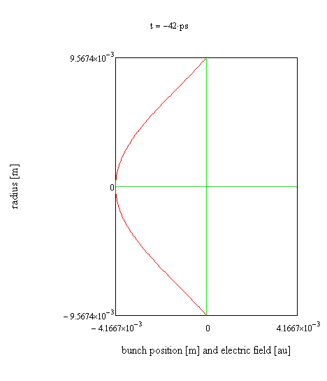
Beam crossing TM_{0,1,0} mode pillbox cavity
Beam (blue dot) travels with the speed of light.
x(t)=ct
Electric field (red line)

Slide 6
Fields change while the beam flies through the cavity. The beam does not see the peak electric field all the way through, which gives the transit time factor.
Electric field
Bunch
beam
Electric field
time evolving field
Definition of transit time factor
Field full and frozen

Slide 7
Transit time factor 2
denominator
numerator

Slide 8
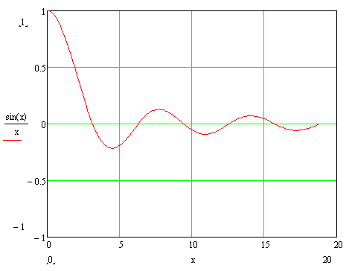
Transit time factor 3
phase rotates by full 360° during time beam takes to cross cavity

Slide 9
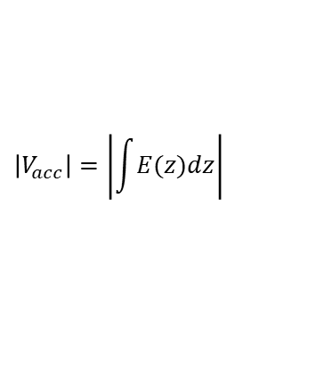
We will use the numerator again, which is the effective gap voltage:
$$\left|V_{acc}\right|=\left|\int{E(z)dz}\right|$$
The magnitude is the highest acceleration you get from the cavity.
Inside is a complex number, this is related to the relative phase of the beam and rf.
TM₀₁₀ mode

Slide 10
For the stored energy in a cavity we need to include both the electric and magnetic field:
Putting the two terms we can define:
Which has units of Ω.
R/Q – relates the amount of acceleration (squared) you get for a given amount of stored energy. If the electric fields are concentrated along the central axis of a cavity this term is large. You can use computer programs to get actual values.
The numerator and denominator both scale with field squared, so it is independent of field level. It turns out that this term is independent of frequency as well for scaled geometries.
Back to traveling wave…

Slide 11
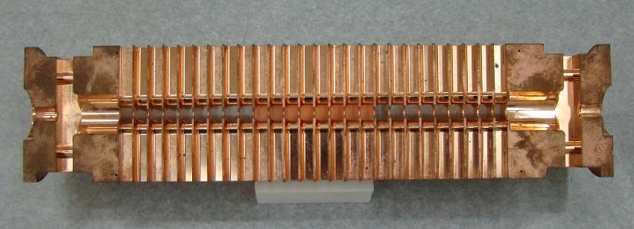
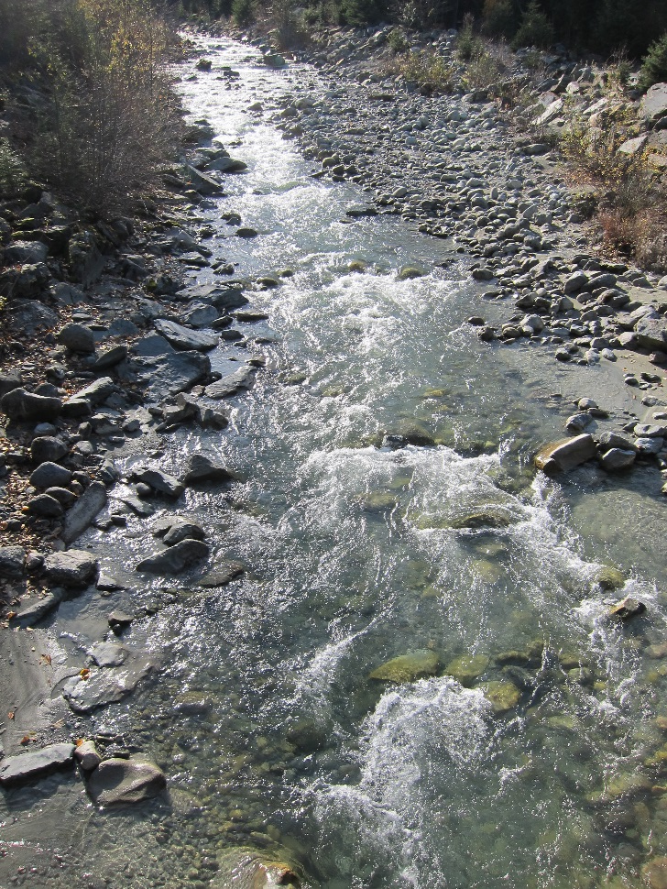
Group velocity
We now go from stored energy to power via group velocity:

Slide 12
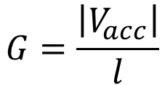
Quantities people use with group velocity mixed in
Ratio of acceleration to stored enery
Quality factor
Shunt impedance [MΩ]
Often the quantity used to optimize cavity design
We now go from stored energy to power via group velocity:
$$G=\frac{\left|V_{acc}\right|}{l}$$

Slide 13
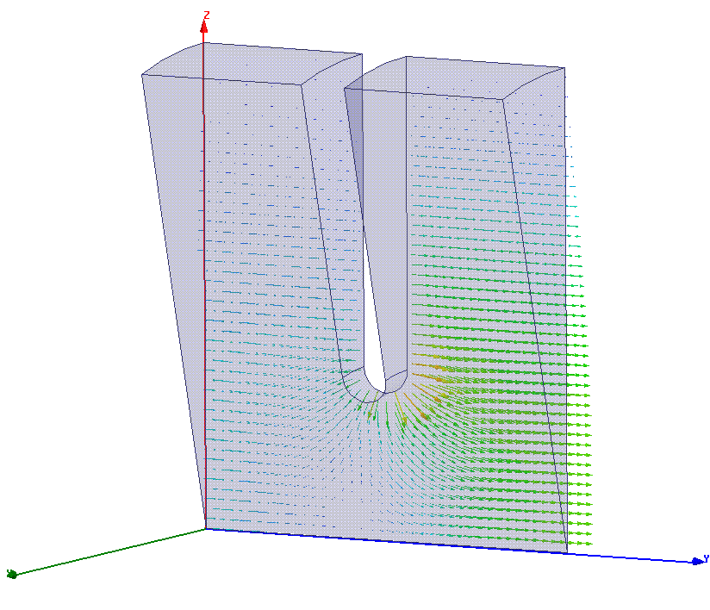
CLIC structure (approximate values):
R’=100 MΩ/m, Q=5500, v_{g}/c=1%

Slide 14
Digging deeper
Our goal now is to derive and understand the loss factor, k.
Accelerating a beam extracts energy from a cavity (and by the way that’s what we need to do to get high rf to beam efficiency).
The beam gains energy when you accelerate so the rf fields must loose energy.

Slide 15
Concept of beam loading
Beam has left this voltage
Before the bunch crosses the cavity, the
fields have a certain value.
After bunch crosses cavity, it has more energy so the fields must be lower.

Slide 16
Concepts we will use
Let’s consider the question:
“How much energy does a traversing beam leave behind in a particular mode of an empty cavity?”
and then superimpose the solution voltage on a filled cavity, which is how we normally think of acceleration.
In this section we will often consider the driven rf fields (driven by a klystron or whatever), consider the fields the beam leaves behind and add the two together to get our final answer – superposition of beam and rf fields.
Why are we going through this trouble? The energy/power balance of acceleration is crucial when considering high-efficiency acceleration. It also lays the theoretical groundwork for the wakefield formalism.

Slide 17
Concept of beam loading
Beam has left this voltage
Before bunch traverses cavity
it is empty
After bunch traverses cavity
it has left behind fields.

Slide 18
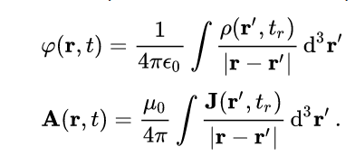


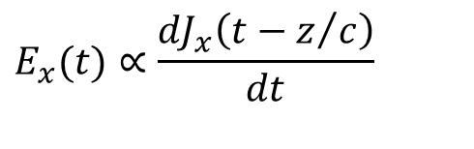
Discussion of physical meaning:
The charge interacting with the fields it makes itself is in direct analogy to the radiated electric field produced by a time varying current. Useful to think about the retarded potential in free space from an oscillating infinite sheet of current to simplify to plane waves. In the case here the sheet is in the xy plane, oscillating in the x direction so making plane waves that propagate in the z direction.
Solutions to Maxwell’s equations:
$$E_{x}(t)∝\frac{{dJ}_{x}\left(t−z/c\right)}{dt}$$
A charge crossing a cavity is similar, with the current broken down into a Fourier series corresponding to the cavity modes.

Slide 19
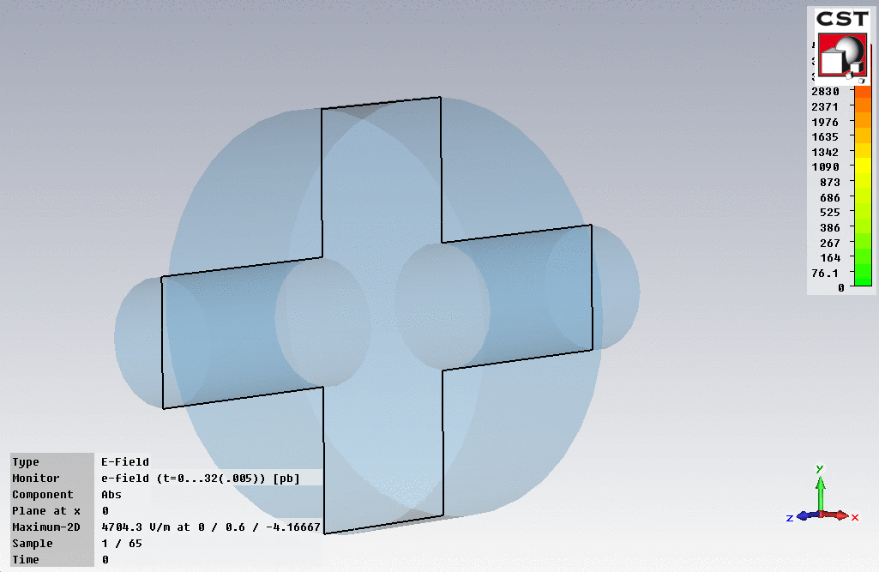
A charge passing through a cavity leaves behind it the cavity with voltage in it, and hence filled with energy. The beam loses the same amount of energy. The loses energy through interacting with an electric field, which in fact comes from itself.

Slide 20
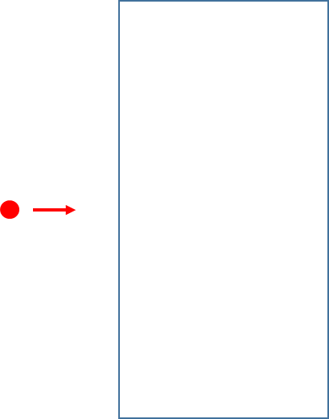
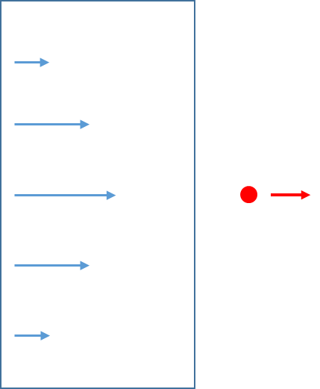
The fundamental theorem of beam loading
The fundamental theorem of beam loading says that the voltage seen by beam which has traversed a cavity is half the voltage it leaves behind, that is the one that a following witness bunch would see.
But why is this the case?
A non-rigorous way of seeing this, is that the cavity is empty when the beam enters and only full when it leaves – so on average it sees the cavity only half full (or half empty, like the proverbial glass!).
Let’s introduce a loss factor k which satisfies this factor of two. The voltage left is proportional to the charge q so:

Slide 21

The loss factor k
Let’s now consider conservation of energy, what the bunch loses the cavity gains:
Equations we will use
$$\frac{R}{Q}$$
is something that you can compute from eigenmode solver!
We now know how to compute k from know field patterns!

Slide 22

Now let’s look at a cavity that already has fields in it
Everybody’s first understanding is that the beam is just sees the accelerating fields that are there because we pump lots of microwaves into a cavity. But this is only true if the bunch charge is low, and we have negligible rf-to-beam efficiency.
So let’s now look at a cavity with field in it that gives V₀ and currents which are leaving fields which are non-negligible.
The essential insight is that a passing bunch reduces the fields inside a filled cavity in exactly the same way as an empty cavity - superposition:
V
$$V′$$
ΔV

Slide 23
Proving k through energy balance
Beam
Cavity
Before bunch passage
After bunch passage
Consistent!

Slide 24

Advanced topic. Imagine the beam comes in at a phase different from the maximum accelerating phase – off crest. A question of trigonometry!
ΔV
V
$$V′$$

