Slide 1
HOM Mitigation
Dealing with Higher Order Modes in Accelerating Structures
Nicoleta Baboi, DESY
CAS course on 'RF in Accelerators‘
Berlin, Germany
30 June 2023

Slide 2
Contents
1. Introduction
2. Avoid HOMs
3. Compensate HOM effects
4. Uses of HOMs
5. Summary

Slide 3
Contents
1. Introduction
2. Avoid HOMs
3. Compensate HOM effects
4. Uses of HOMs
5. Summary
  Wakefields
  HOMs
  Issues due to HOMs

Slide 4
1. Intro: What do you know about HOMs?
From this school only!
?

Slide 5

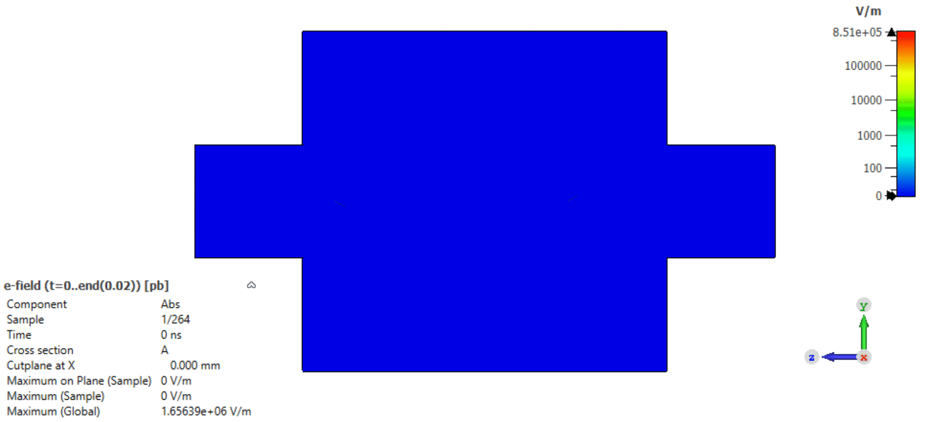
1. Intro: Wakefields
Brief reminder
Wake: definition from Merriam-Webster
(https://www.merriam-webster.com/dictionary/wake)
(among other meanings)
  1: the track left by a moving body
  (such as a ship) in a fluid (such as
  water); broadly: a track or path left
  2: aftermath (the period immediately
  following a usually ruinous event)
In an accelerator
  1: Electromagnetic “track” left behind
  by the beam
  2: “Usually ruinous”? → can be
  → one has to know the possible
  danger in order to avoid it
  ⇒ Know your wakefields
Courtesy of S.A. Udongwo

Slide 6
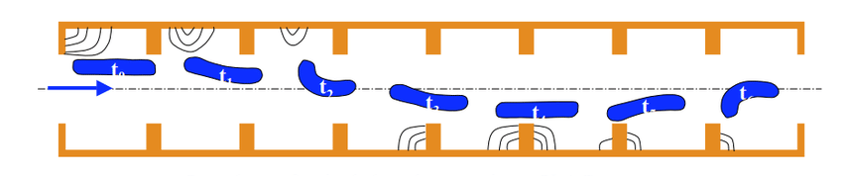
1. Intro: Wakefields
Brief reminder (2)
Different types:
  Geometrical, resistive wall, rugosity
  Longitudinal or transverse
  Short or long range
Short-range wakefields:
  effects within the bunch:
  increase in energy spread, emittance
  Often treated in time domain
Long-range wakefields:
  effects from bunch to bunch:
  increase of multi-bunch
  energy spread or emittance
  Usually treated in frequency domain
  → HOMs
see lecture on
“Impedances and wakefields”
by Andrea Mostacci
and many others!
Single bunch beam breakup
(“banana” effect)
W. Barletta, USPAS 2010
This lecture
  Long-range wakes/multi-bunch effects
  Geometrical wakes
  In accelerating structures

Slide 7
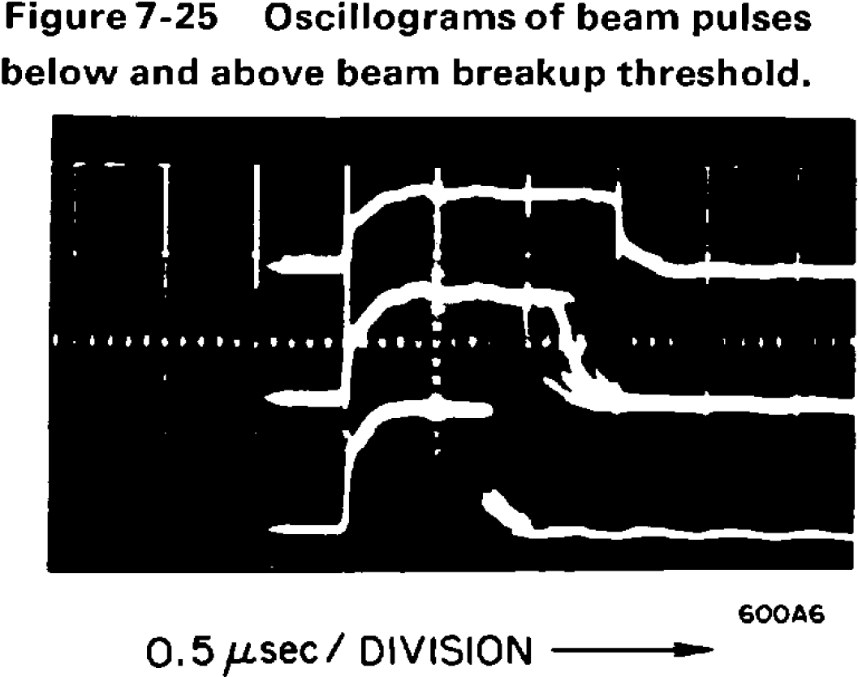
1. Intro: Wakefields
Why worry with long-range wakes?
Beam breakup observed at SLAC 1966
Found to be due to the beam interaction with one dipole mode
pulse cut for currents
above some
threshold
R.B. Neal (ed.), The Stanford two mile accelerator, 1968

Slide 8
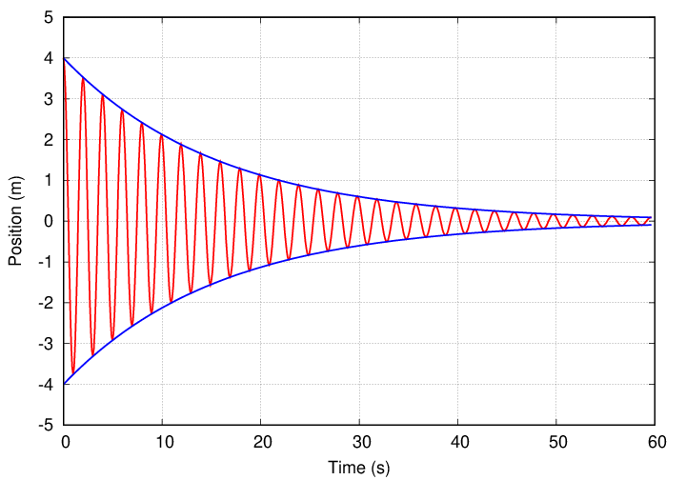
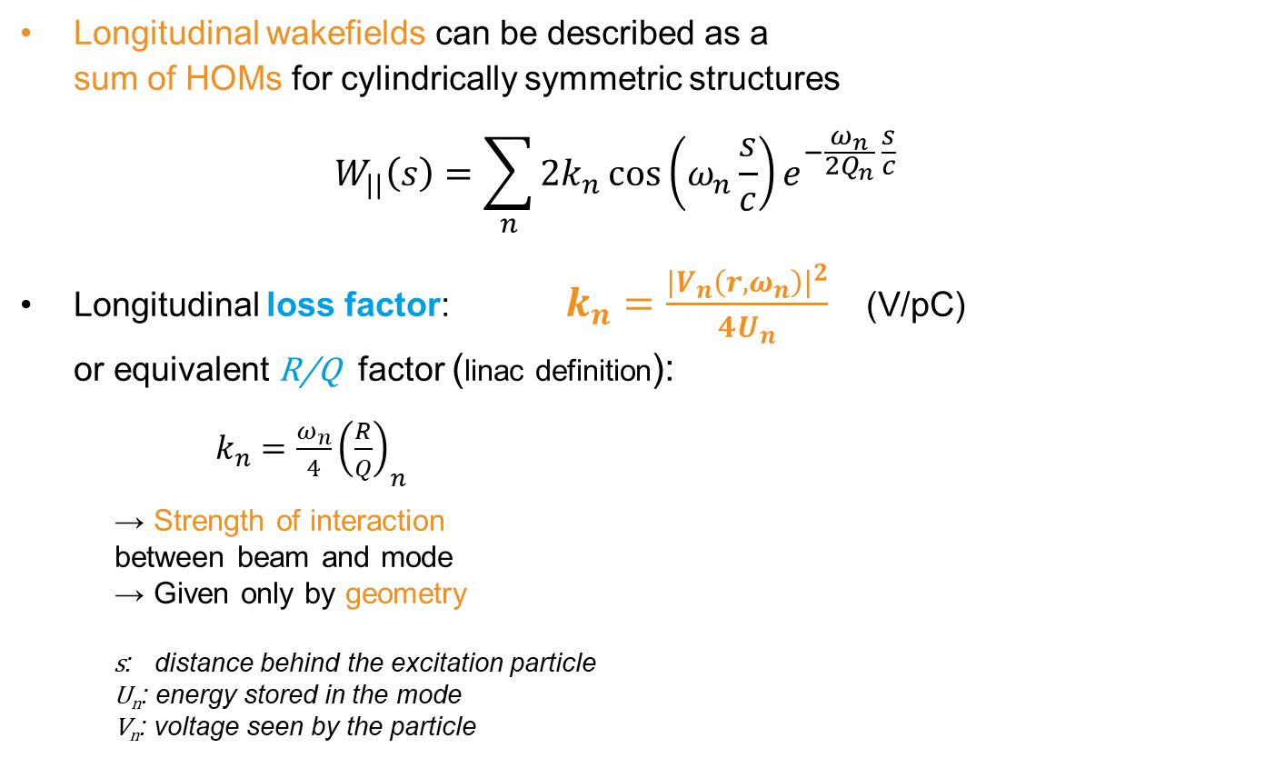
1. Intro: Higher Order Modes
Brief reminder: Longitudinal long-range wakefields
Longitudinal wakefields can be described as a
sum of HOMs for cylindrically symmetric structures
  $$W_{||}\left(s\right)=\sum_{n}{2k_{n}\cos\left(ω_{n}\frac{s}{c}\right)e^{−\frac{ω_{n}}{2Q_{n}} \frac{s}{c}}}$$
Longitudinal loss factor: $k_{n}=\frac{{\left|V_{n}\left(r, ω_{n}\right)\right|}^{2}}{4U_{n}}$ (V/pC)
or equivalent R/Q factor (linac definition):
  $k_{n}=\frac{ω_{n}}{4}{\left(\frac{R}{Q}\right)}_{n}$
  → Strength of interaction
  between beam and mode
  → Given only by geometry
    s: distance behind the excitation particle
    U_{n}: energy stored in the mode
    V_{n}: voltage seen by the particle
n = mode count
http://spiff.rit.edu/classes/phys283/lectures/damped/damped.html

Slide 9
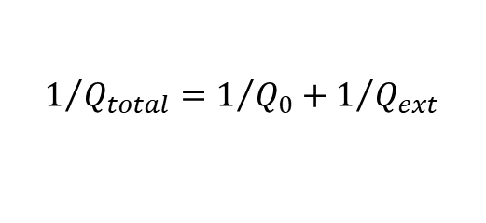
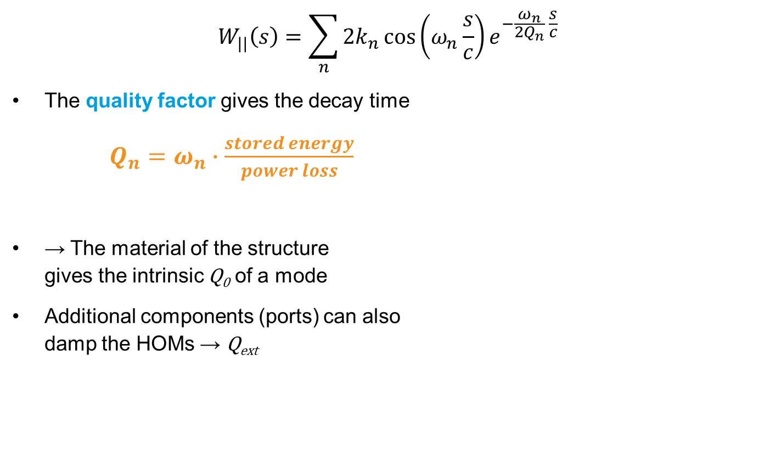
1. Intro: Higher Order Modes
Brief reminder: Longitudinal long-range wakefields (2)
$$W_{||}\left(s\right)=\sum_{n}{2k_{n}\cos\left(ω_{n}\frac{s}{c}\right)e^{−\frac{ω_{n}}{2Q_{n}} \frac{s}{c}}}$$
The quality factor gives the decay time
$Q_{n}=ω_{n}∙\frac{stored energy}{power loss}$
→ The material of the structure
gives the intrinsic Q₀ of a mode
Additional components (ports) can also
damp the HOMs → Q_{ext}
$$1/{Q_{total}=1/{Q_{0}+1/{Q_{ext}}}}$$
http://spiff.rit.edu/classes/phys283/lectures/damped/damped.html

Slide 10
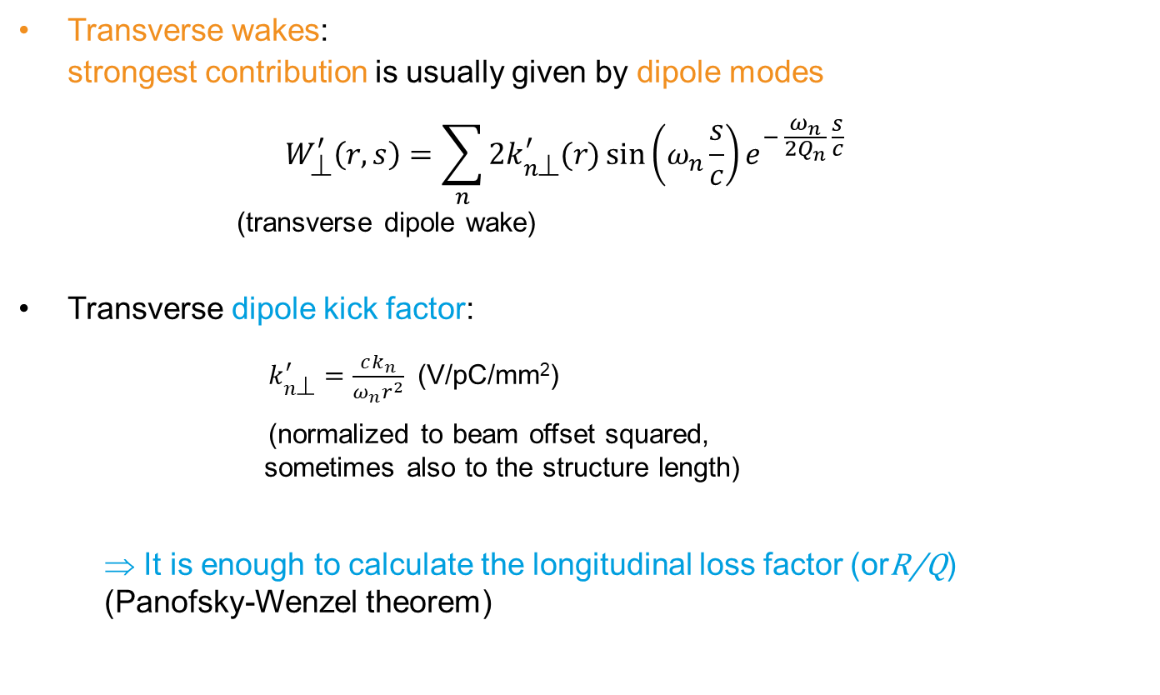
1. Intro: Higher Order Modes
Brief reminder: Transverse long-range wakefields
Transverse wakes:
strongest contribution is usually given by dipole modes
  $$W_{⊥}^{′}\left(r,s\right)=\sum_{n}{2k_{n⊥}^{′}(r)\sin\left(ω_{n}\frac{s}{c}\right)e^{− \frac{ω_{n}}{2Q_{n}} \frac{s}{c}}}$$
  (transverse dipole wake)
Transverse dipole kick factor:
        $k_{n⊥}^{′}=\frac{ck_{n}}{ω_{n}r^{2}}$ (V/pC/mm²)
        (normalized to beam offset squared,
        sometimes also to the structure length)
    ⇒ It is enough to calculate the longitudinal loss factor (orR/Q)
    (Panofsky-Wenzel theorem)

Slide 11
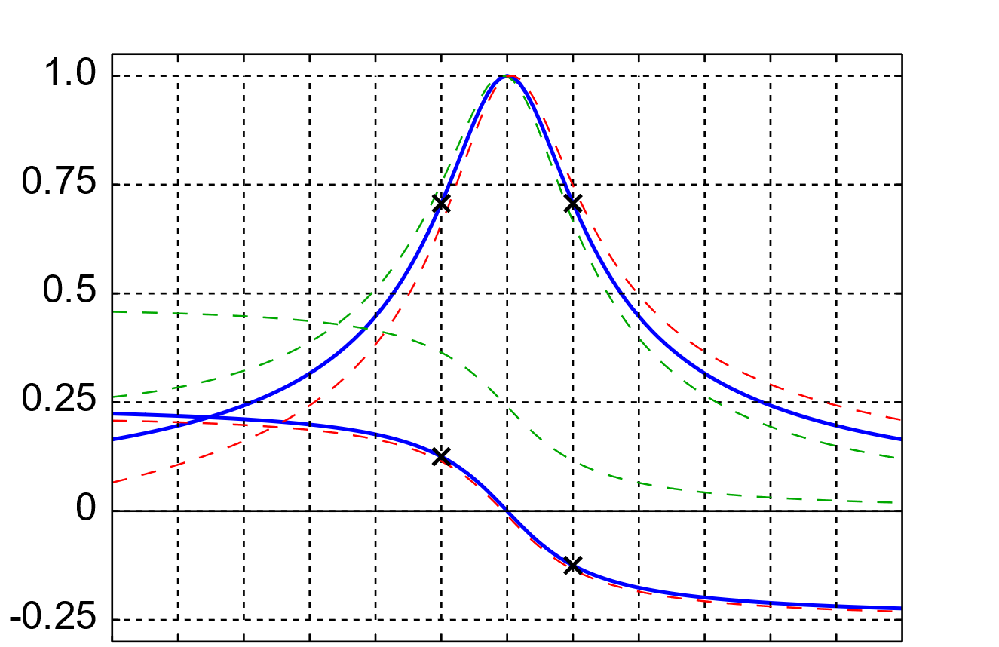
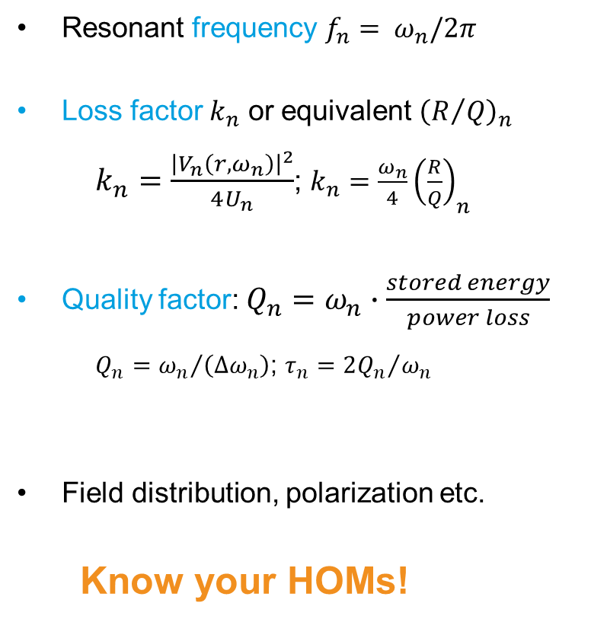
1. Intro: Higher Order Modes
Brief reminder: Characteristics of resonant modes
Resonant frequency $f_{n}= ω_{n}/2π$
Loss factor $k_{n}$ or equivalent ${\left(R/Q\right)}_{n}$
    $k_{n}=\frac{{\left|V_{n}\left(r, ω_{n}\right)\right|}^{2}}{4U_{n}}$; $k_{n}=\frac{ω_{n}}{4}{\left(\frac{R}{Q}\right)}_{n}$
Quality factor: $Q_{n}=ω_{n}∙\frac{stored energy}{power loss}$
    $Q_{n}={ω_{n}}/{\left(∆ω_{n}\right)}$; $τ_{n}={2Q_{n}}/{ω_{n}}$
Field distribution, polarization etc.
Know your HOMs!
http://spiff.rit.edu/classes/phys283/lectures/damped/damped.html
Δω_{n}
ω_{n}
https://en.wikipedia.org/wiki/Resonance
Notes:
Q0 vs. Qext!!
Dipoles, quads etc. -> always in pairs (polarizations)

Slide 12
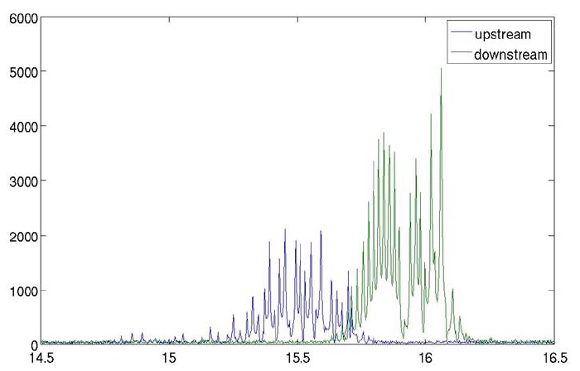
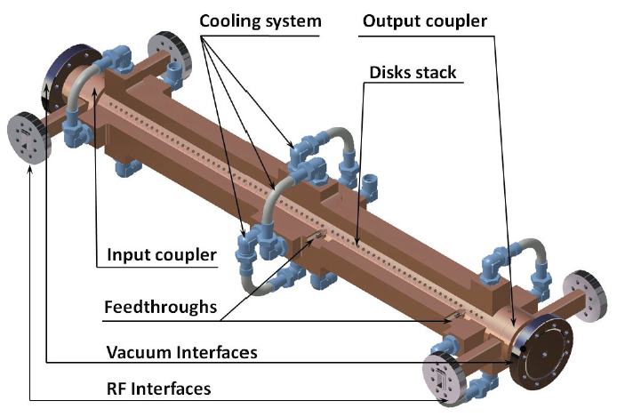
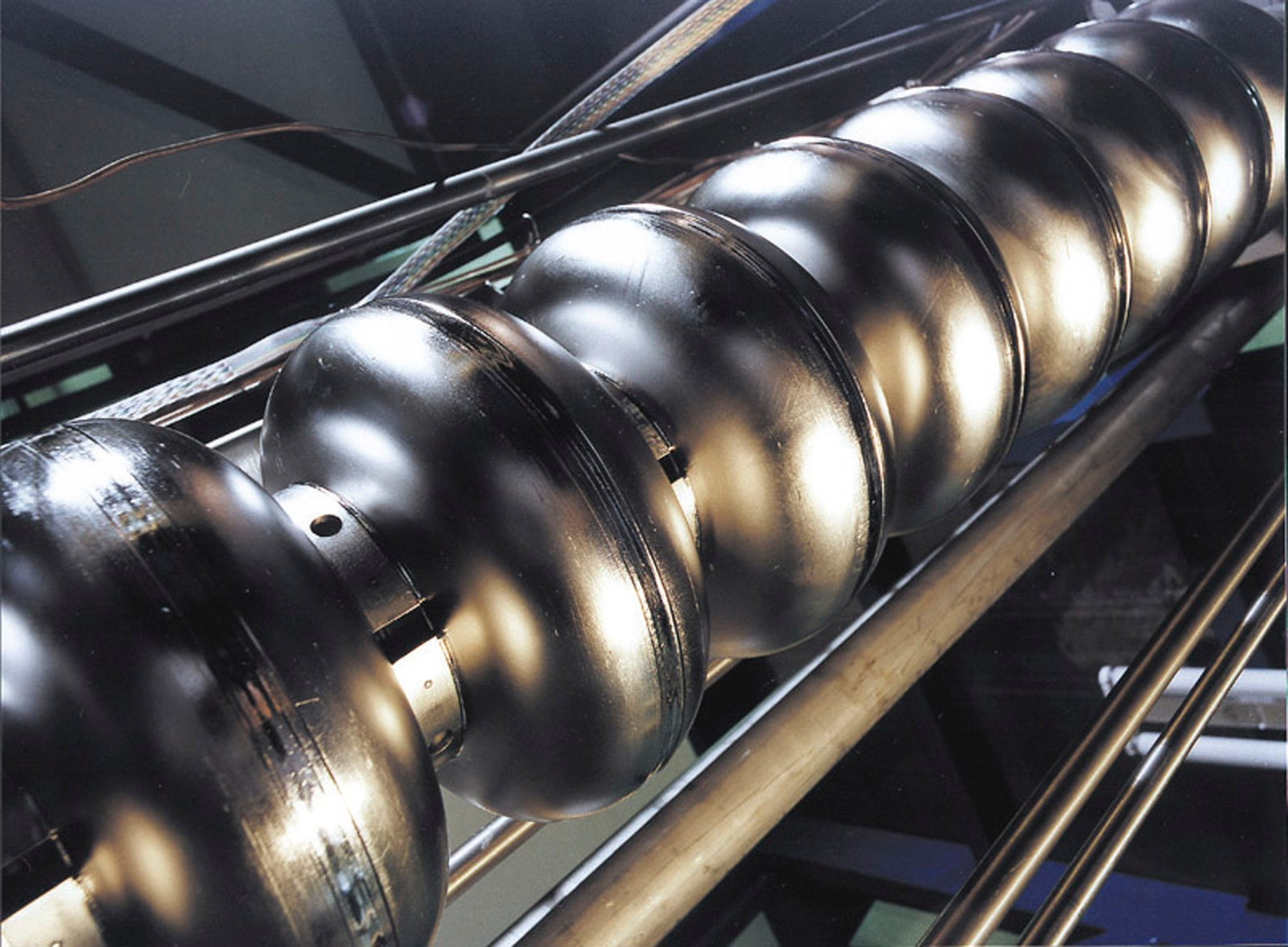
1. Intro: Higher Order Modes
Brief reminder: HOM spectra (examples)
X-band structure at the Swiss-FEL
TESLA cavity at FLASH/European XFEL
Beam excited spectrum
f (GHz)
M. Dehler, IBIC2013, WEBL3
DESY
J. Wei, HOMSC2018
Notes:
Show some mode geometries (TM010, TM110, TE111 etc.)

Slide 13
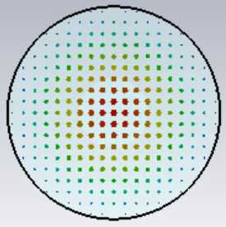
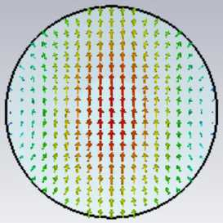
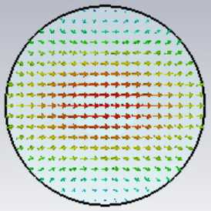
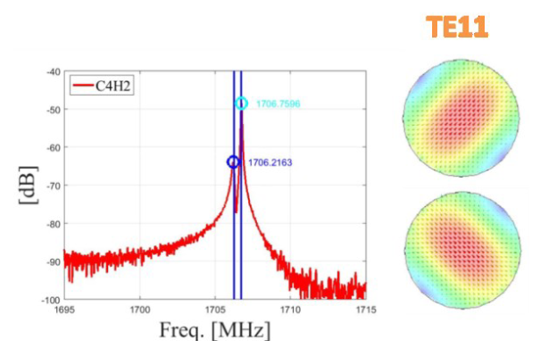
1. Intro: Higher Order Modes
Brief reminder: Dipole modes
Monopole modes:
  Always excited
Dipole, quadrupole modes etc.
  Excited only by off-axis beams
  Come in pairs (polarizations)
  with equal frequencies for
  circularly symmetric structures
Zoom into measured spectrum
(dipole mode)
  Frequency split due to asymmetries
  Polarization not always
  horizontal and vertical
TE₁₁₁
TESLA cavity
J. Wei, FEL Seminar, DESY, 20.08.2019
Notes:
Show some mode geometries (TM010, TM110, TE111 etc.)

Slide 14
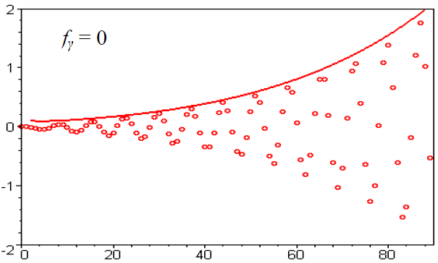
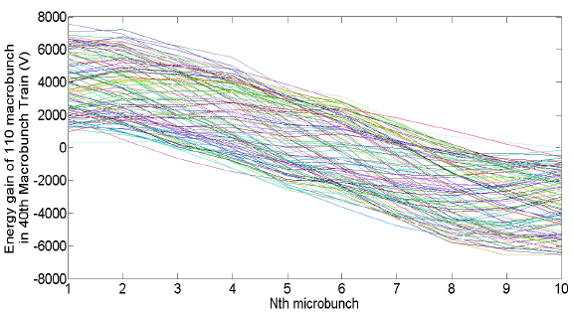
1. Intro: Issues due to HOMs
HOM effects on the beam
Transversely:
increase in multi-bunch emittance
Longitudinally:
increase in multi bunch energy spread
Bunch offset
C. Bohn, K. Ng, LINAC 2000
Extreme case: beam breakup
Chen Xu, AAC 2016
Worst effects at low energies

Slide 15
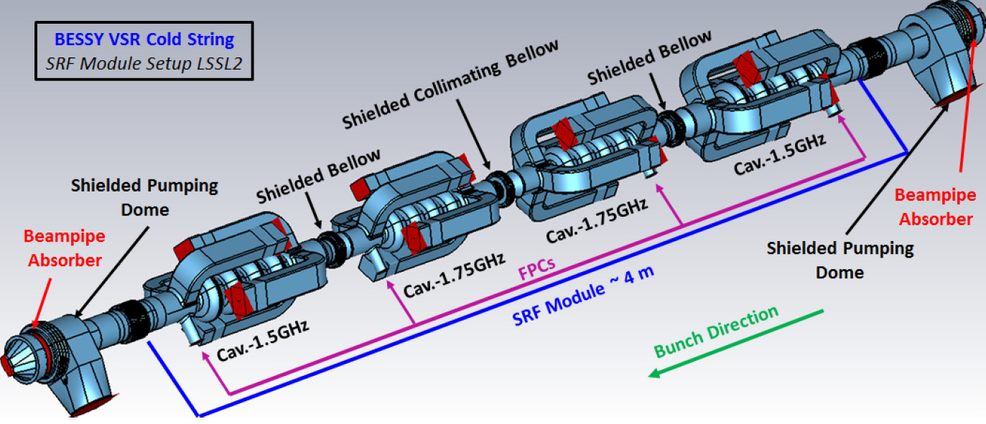
1. Intro: Issues due to HOMs
Further HOM effects
Power damped into the accelerating structures or other components
BESSY VSR: HOM power estimated: of the order of 1 kW propagating out of the cold string; tens of W in each HOM load
BESSY VSR cold string
A. Tsakanian, IPAC2018, WEPML048

Slide 16
1. Intro: HOM Mitigation
Ways to deal with HOMs
Avoid them
Compensate their effects
Use them
Notes:
We restrict here mainly to long range effects, from bunch to bunch

Slide 17
Contents
1. Introduction
2. Avoid HOMs
3. Compensate HOM effects
4. Uses of HOMs
5. Summary
Accelerating Structure Design
Accelerator Design

Slide 18
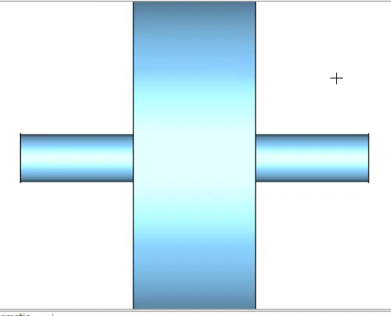
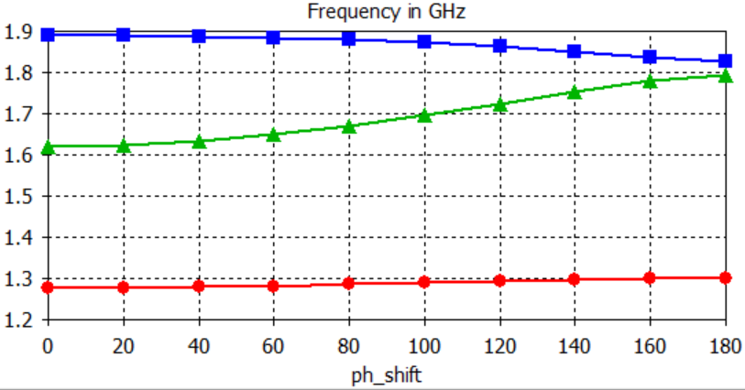
2. Avoid HOMs: Structure Design
Geometry
Optimize the cell geometry for low loss factors for HOMs, while aiming at high value for the accelerating mode
  Remember: the loss factor depends only on the geometry
For multi-cell structures pay
particular attention to the
quasi synchronous modes
Dispersion diagram of a TESLA cavity
(single cell simulation with periodic boundaries)
2nd dipole band
Courtesy of S.A. Udongwo
1st dipole band
“light line”
(v_{ph} = c)
accelerating
mode
fundamental band
Notes:
Basically what you want to maximize for the main mode, you want to minimize for the HOMs: lower R/Q, lower Q

Slide 19
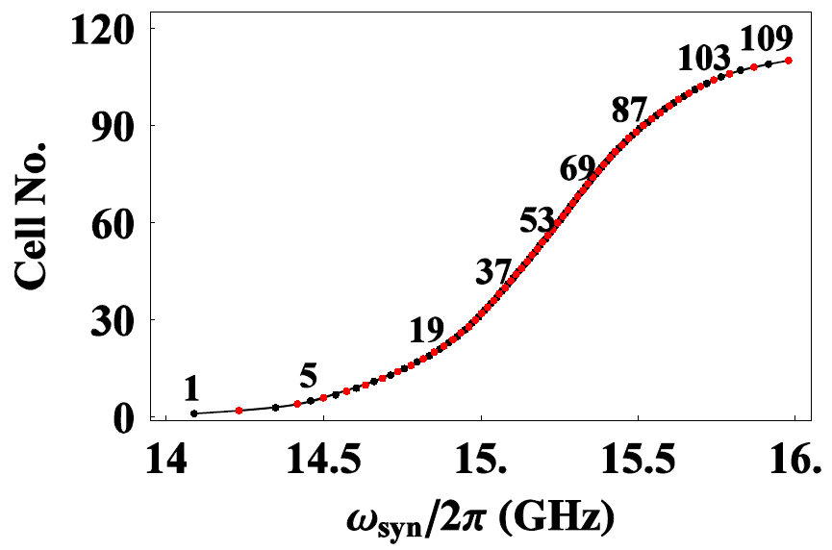
2. Avoid HOMs: Structure Design
Geometry (2)
Avoid to have HOMs with frequency matching a bunch harmonics
  That would give a resonant amplification along bunch train
Detune cells along (long) structure
  Vary cell dimensions along a NC structure
  ⇒ overall HOM effects decohere
Interleaving of cell frequencies
of a structure for CLIC
R.M. Jones, CAS 2010

Slide 20
2. Avoid HOMs: Structure Design
Material
Choose material of the cavity walls for low HOM quality factors Q₀.
However this is decided by the purpose of the cavity:
choice of technology, type of beam to be accelerated, etc.
This determines the Q₀ of the HOMs

Slide 21
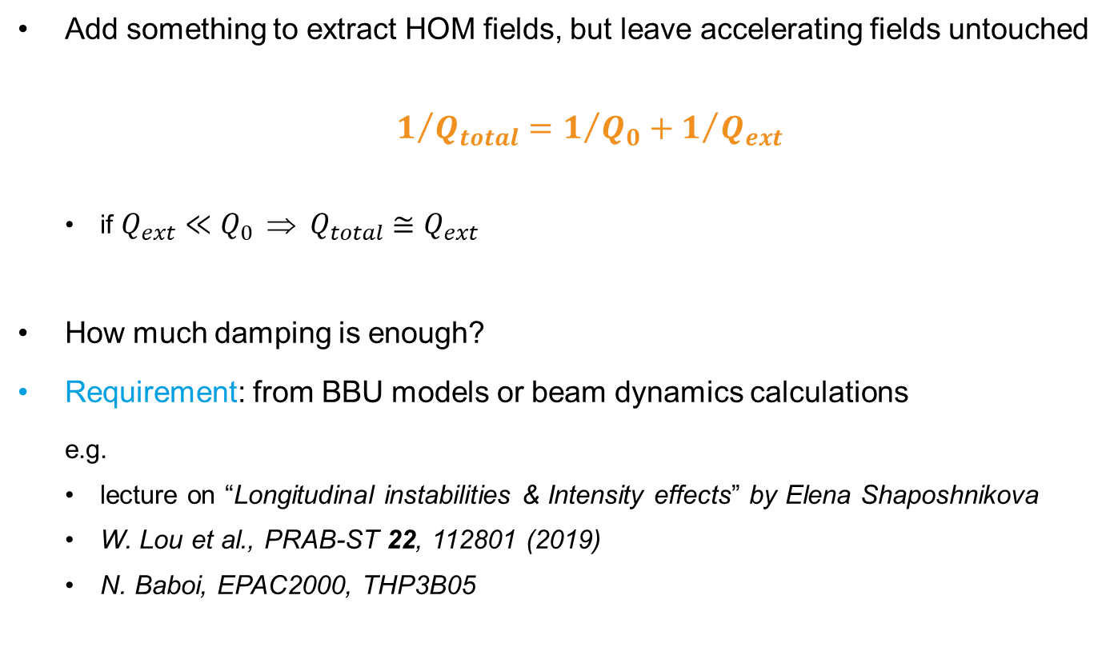
2. Avoid HOMs: Structure Design
HOM damping: Requirement
Add something to extract HOM fields, but leave accelerating fields untouched
  $1/{Q_{total}=1/{Q_{0}+1/{Q_{ext}}}}$
  if ${Q_{ext}≪Q_{0} \text{⇒} Q}_{total}≅Q_{ext}$
How much damping is enough?
Requirement: from BBU models or beam dynamics calculations
  e.g.
  lecture on “Longitudinal instabilities & Intensity effects” by Elena Shaposhnikova
  W. Lou et al., PRAB-ST 22, 112801 (2019)
  N. Baboi, EPAC2000, THP3B05

Slide 22
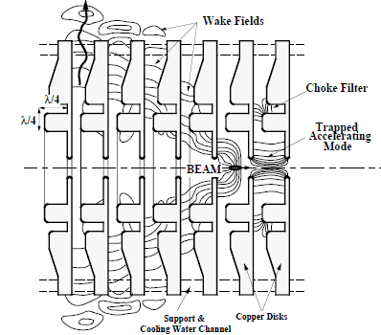
2. Avoid HOMs: Structure Design
HOM damping in each cell
Add ports in each cell: waveguides, couplers
Notch filter at the accelerating frequency
  Particularly good for trapped modes in detuned structures
HOM-free linear accelerating structure using choke mode cavity
Damped Detuned
Structure
R.M. Jones, CAS 2010
T. Shintake, PAC’95

Slide 23
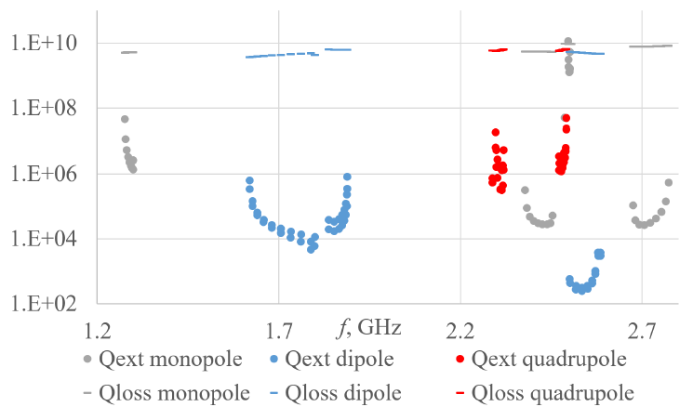
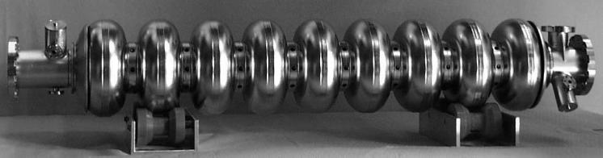
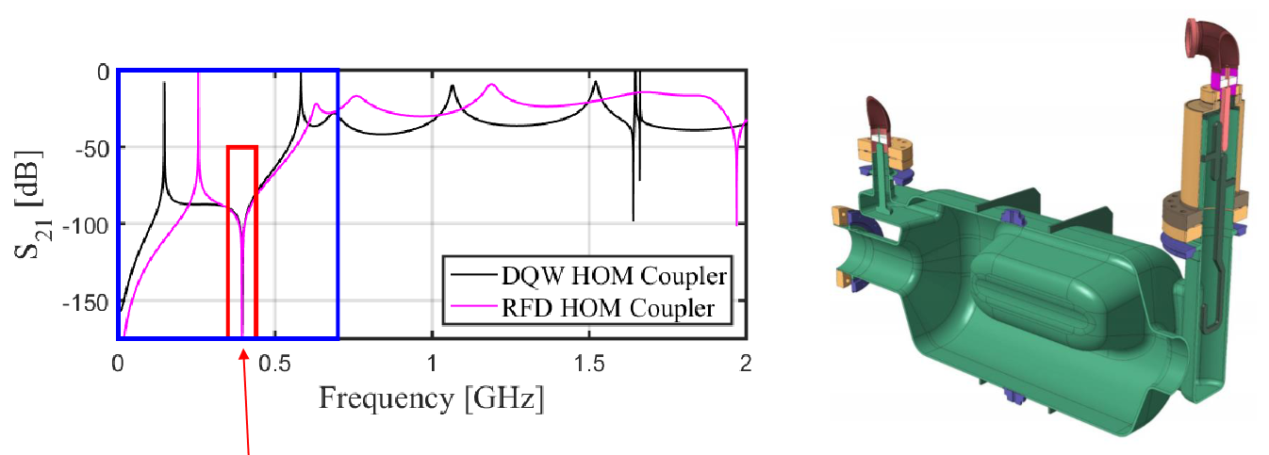
2. Avoid HOMs: Structure Design
HOM damping at end of structure
Add ports at the end of the accelerating structure: waveguides, couplers
Notch filter at the
accelerating
frequency
Q₀ and Q_{ext}
TESLA cavity used in MESA
HOM couplers
S. Glukhov, PhD thesis, TU Darmstadt, 2022
E. Montesinos, SRF2021
HL-LHC RFD HOM coupler

Slide 24
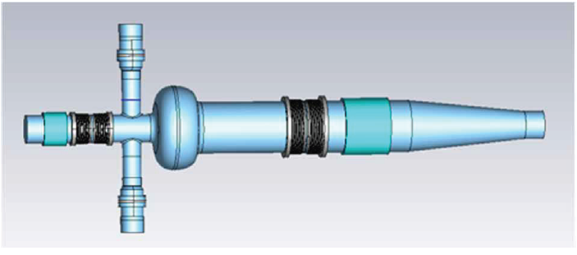
2. Avoid HOMs: Structure Design
HOM damping in the beam pipe
Damping materials:
HOM absorbers in the beam pipe
The accelerating frequency is
below the cut off of the beam pipe
591 MHz 1-cell SRF cavity at BNL
HOM absorbers
BESSY VSR cold string
R. Rimmer, eeFACT2022, WEXAS0101
A. Tsakanian, IPAC2018, WEPML048

Slide 25
2. Avoid HOMs: Accelerator design
Accelerator design
Design optics such that the HOM effects are not dramatic
  E.g. Recirculation Arcs Lattice Optimization in ERLs
  Add non-linear elements etc.
Choose bunch frequency (or design accelerator) such that the strongest HOMs are not at bunch multipoles, so that they do not add up coherently
  Often not a real option
S. Glukhov, PhD thesis, TU Darmstadt, 2022

Slide 26
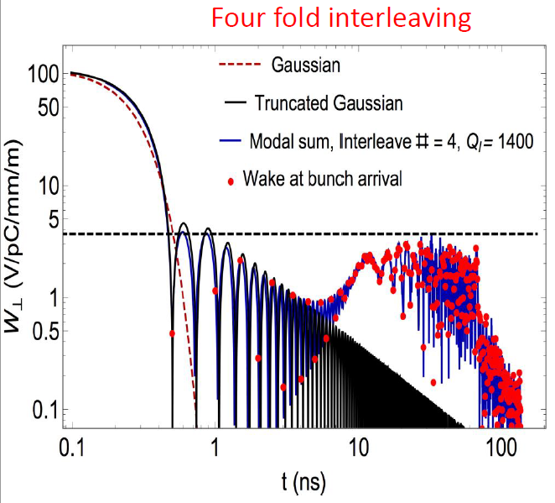
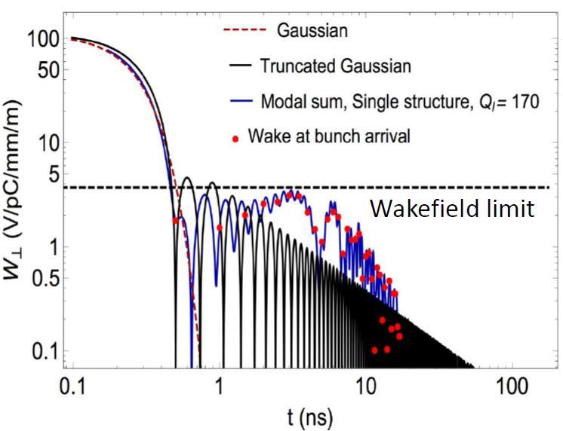
2. Avoid HOMs: Accelerator design
Structure interleaving
Make 2 or more slightly different designs (classes) for the accelerating structure such that the long-range wakefields do not add up coherently from structure to structure
Interleaving for CLIC structures
N. Joshi, EuCARD-2 Meeting, 2017

Slide 27
Contents
1. Introduction
2. Avoid HOMs
3. Compensate HOM effects
4. Uses of HOMs
5. Summary
Fast Feedbacks
Beam Alignment
Cavity detuning and retuning

Slide 28
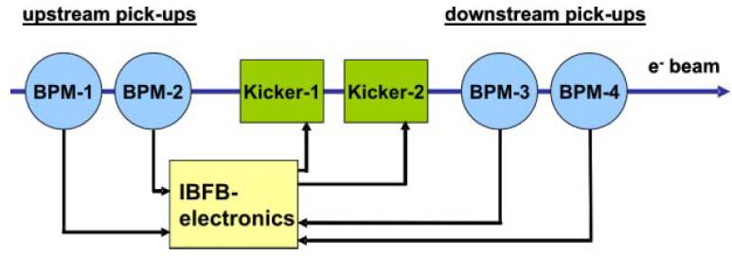
3. Compensate HOMs: Fast Feedbacks
Compensation of spread in bunch arrival time and beam offset
Longitudinal HOMs induce a variation of the bunch energy, and therefore the bunch arrival time (or beam phase)
  Measure beam arrival time, energy etc. → feedback to LLRF
Transverse HOMs induce a spread in the bunch orbit
(multi-bunch emittance growth)
  Fast orbit feedback
Accelerating Cavity
Beam Monitor
LLRF
Controller
V. Schlott, EPAC 2006, THPCH096

Slide 29
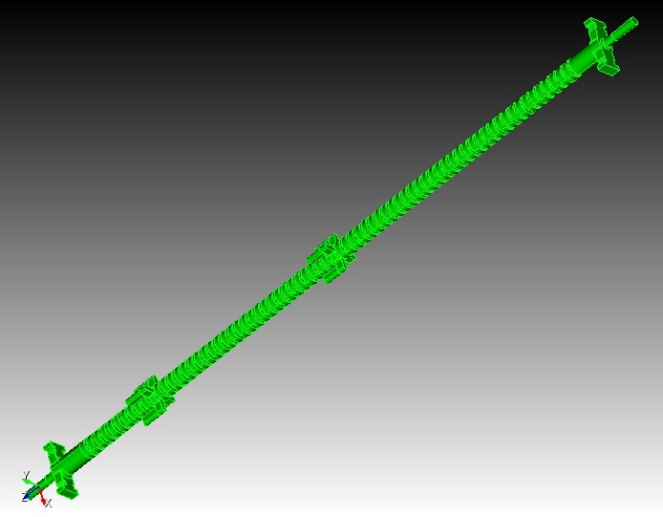
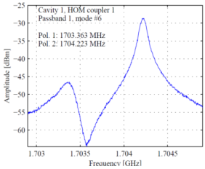
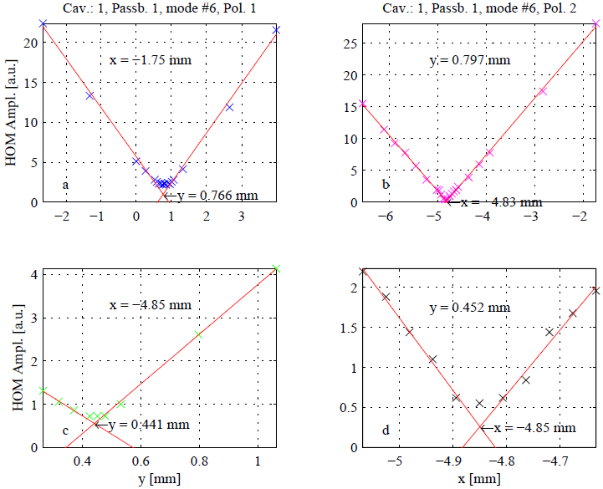
3. Compensate HOMs: Beam Alignment
Beam alignment to avoid transverse HOM excitation
Transverse effects mainly from dipole modes
The dipole fields depend only on the offset of the exciting bunch
⇒ Monitor dipole modes through couplers, and align the beam to minimize their strength
Dedicated alignment monitors
in a X-band structure
Amplitude of dipole mode signal versus
exciting bunch offset for a TESLA cavity
Wakefield
monitors
beam
N. Baboi, HOMSC2016
Beam offset [mm]
M. Dehler, PRST-AB 12, 062001 (2009)

Slide 30
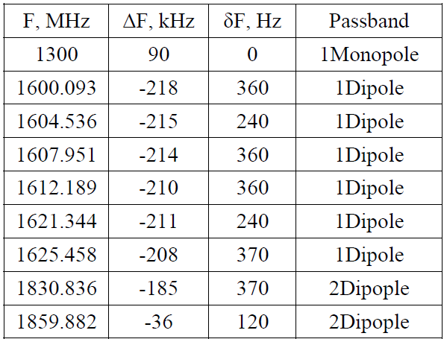
3. Compensate HOMs: Retuning
Cavity detuning and retuning
It may happen that one HOM unluckily hits a beam spectrum line
  ⇒ Resonant amplification of HOM field
Detune and retune the operating
mode back to the resonance
  HOMs move because of small
  inelastic deformation
Detuning and retuning a
1.3 GHz ILC-type cavity
N. Solyak, IPAC10, TUPEA020

Slide 31
Contents
1. Introduction
2. Avoid HOMs
3. Compensate HOM effects
4. Uses of HOMs
5. Summary
Diagnostic of Accelerating Structures
Diagnostic of Beam

Slide 32
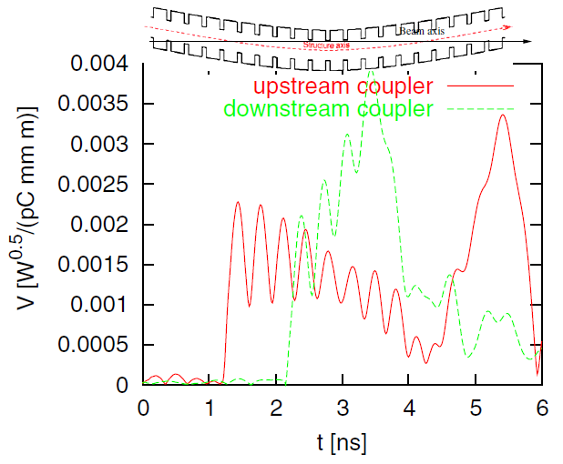
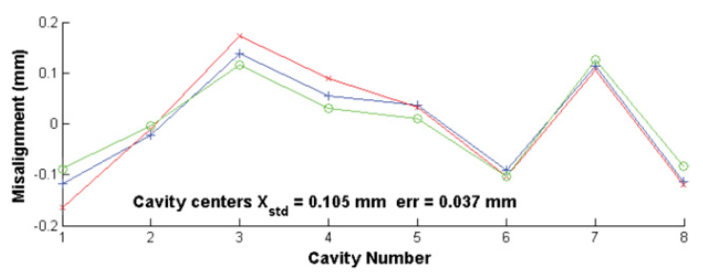
4. Use HOMs
Diagnostic of accelerating structures
Monitor HOMs through damping couplers
  Measure cell alignment
    Due to varying cell dimensions along detuned structure, the modes are localized in part of it giving information on different cells
  Monitor SC cavity alignment in cryo-module
    Monitor dipole mode
X-band rf structure with
integrated alignment monitors
Wakefield
monitors
Transverse offset of SC TESLA cavities
in cryo-module
S. Molloy, Meas. Sci. Technol. 18, 2314 (2007)
M. Dehler, PRST-AB 12, 062001 (2009)

Slide 33
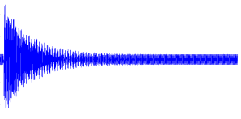
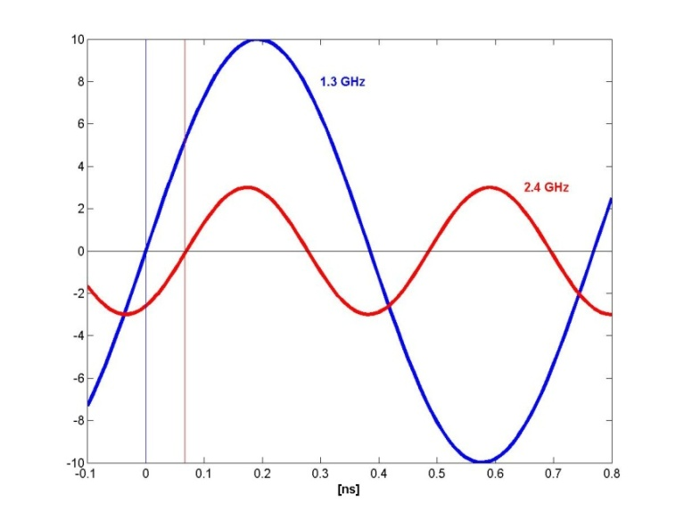
4. Use HOMs
Diagnostic of beam
Monitor selected HOMs (e.g. with downconverting electronics)
HOM
signal
BP filter
Mixer
ADC
Beam position measurement with
dipole modes (like with a cavity BPM)
RF phase measurement wrt to beam
accelerating RF field
beam excited
HOM
Phase difference
Beam offset [mm]
N. Baboi, HOMSC2016

Slide 34
Contents
1. Introduction
2. Avoid HOMs
3. Compensate HOM effects
4. Uses of HOMs
5. Summary

Slide 35
Summary
HOM mitigation
HOMs can decrease the beam
quality to an unacceptable degree
Avoid HOM excitation
  Design of accelerating structure
  Design of accelerator
Compensate excited HOMs
  Feedbacks
  Beam alignment
  Detune and retune cavity
Use the excited HOMs
  Measure the cell or cavity alignment
  Measure beam offset, beam phase
Only a selection of methods was shown
There are many more methods to mitigate HOMs
Know your HOMs!

Slide 36
Thank you!
Nicoleta Baboi
Machine Diagnostics and Instrumentation MDI
nicoleta.baboi@desy.de
+49 40 8998 3052

