Slide 1
Determination of radioactive ion beam production yields using 1.4- and 1.7-GeV protons
Simon Stegemann on behalf of the IS717 collaboration
ISCC meeting 2022, November 7th 2022

Slide 2
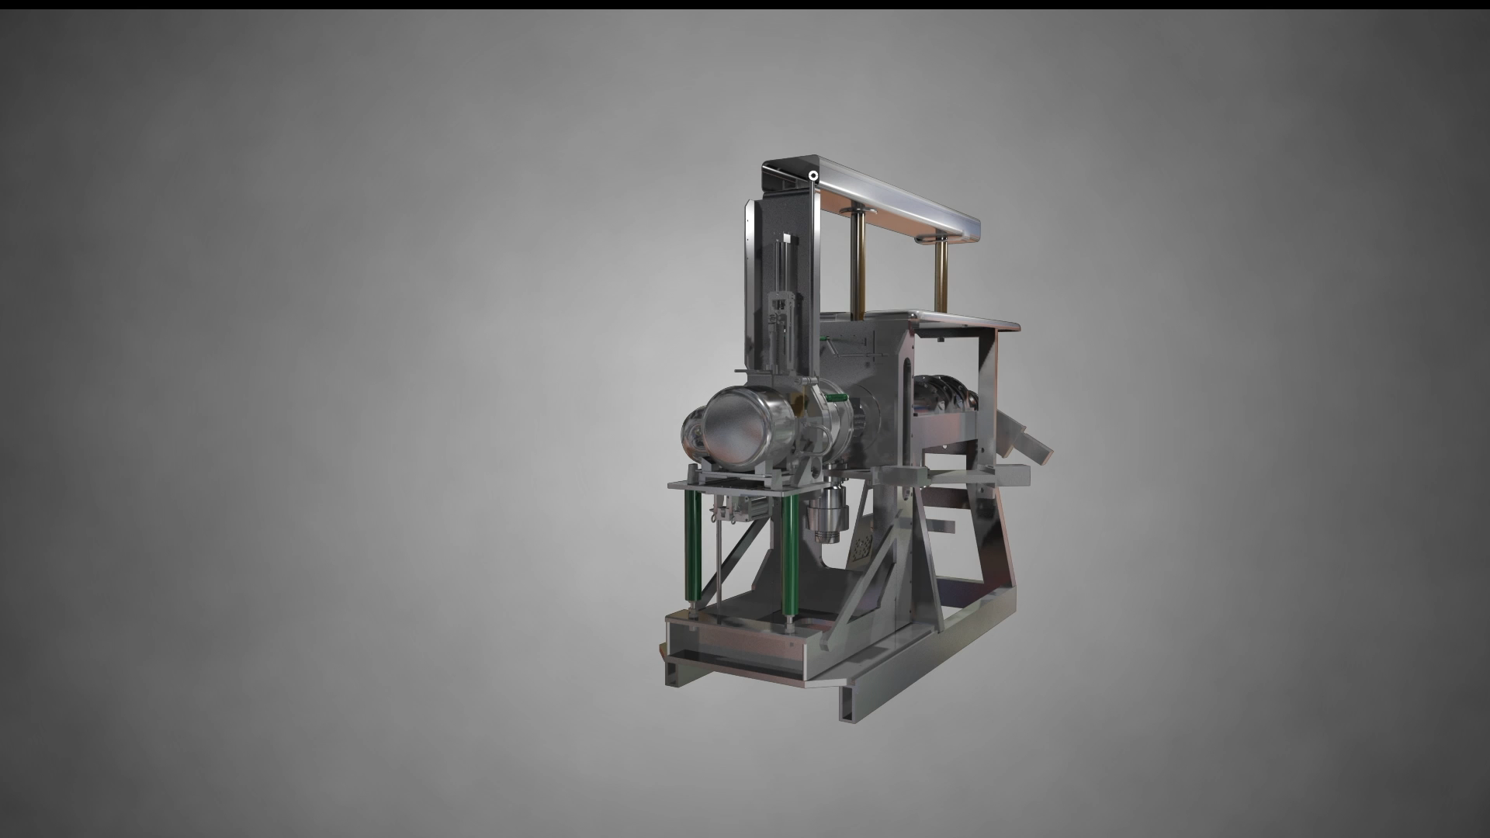

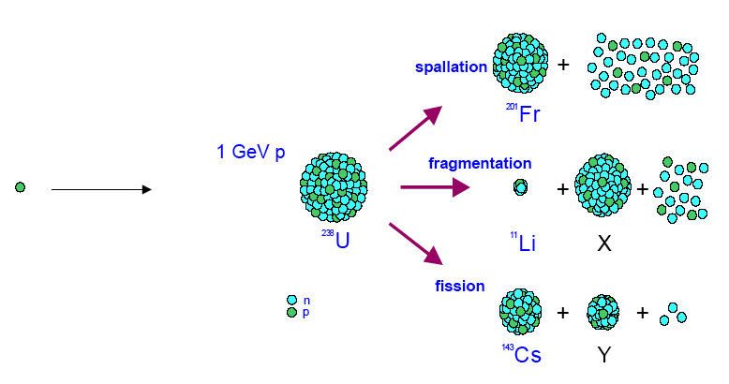
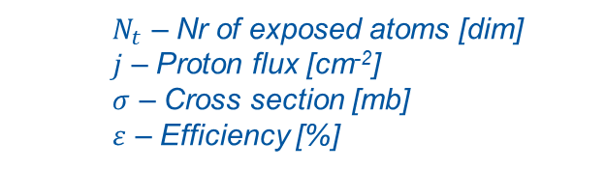


Adapted from
1.4-GeV Protons
Extraction optics
Mass separator
Target unit
$$Beam Intensity=σ∙j∙Νt∙ε$$
$$ε={ε_{diff}ε}_{eff}{ε_{is}ε_{sep}ε}_{trans}$$
$N_{t}$ – Nr of exposed atoms [dim]
$j$ – Proton flux [cm⁻²]
$σ$ – Cross section [mb]
$ε$ – Efficiency [%]

Slide 3
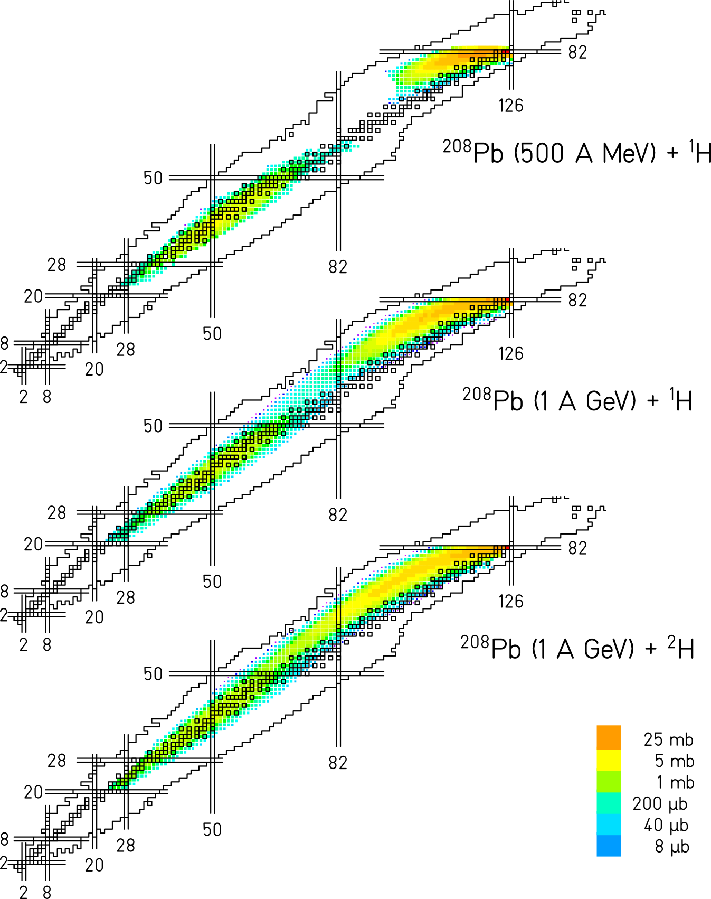
Increase in spallation residues when increasing proton (deuteron) energy on ²⁰⁸Pb measured in inverse kinematics at GSI
Increased yields of deep spallation products from spallation evaporation reactions
Residues close to valley of stability at A ~ 100 less affected (spallation fission products)
Proposal:
Verify expected gains in production yields in respective regions of the nuclear chart
K.-H. Schmidt, et al. Phys. Rev. ST Accel. Beams 10 (2007), 014701
L. Audouin, et al. Nuclear Physics A 768 (2006), 1–21.
T. Enqvist, et al. Nuclear Physics A 703 (2002), 435–465.
B. Fernández-Domínguez, et al. Nuclear Physics A 747 (2005), 227–267.
T. Enqvist, et al. Nuclear Physics A 686 (2001), 481–524.

Slide 4
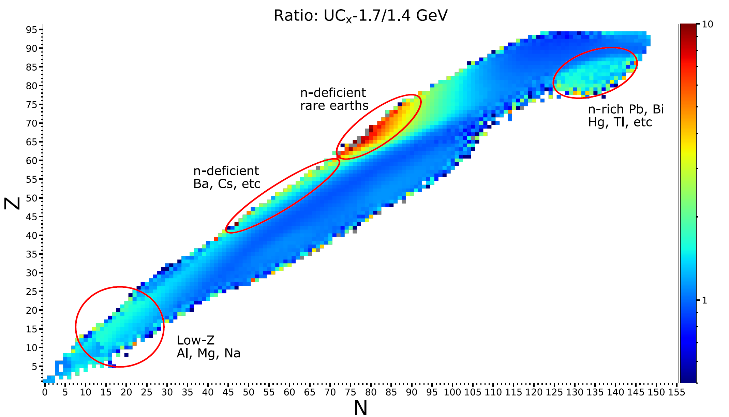
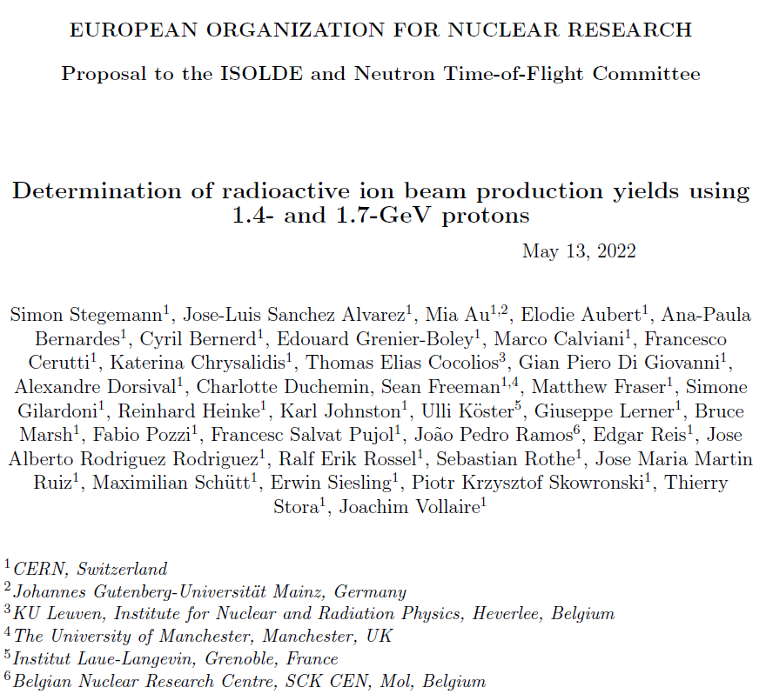
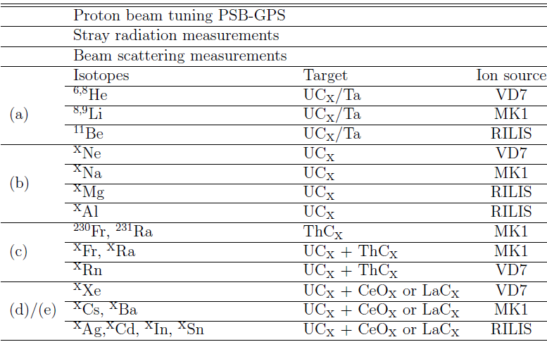
Experimental campaign

Slide 5
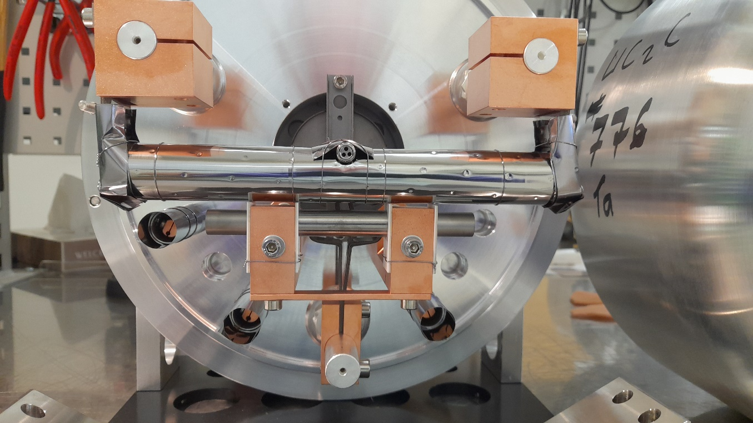
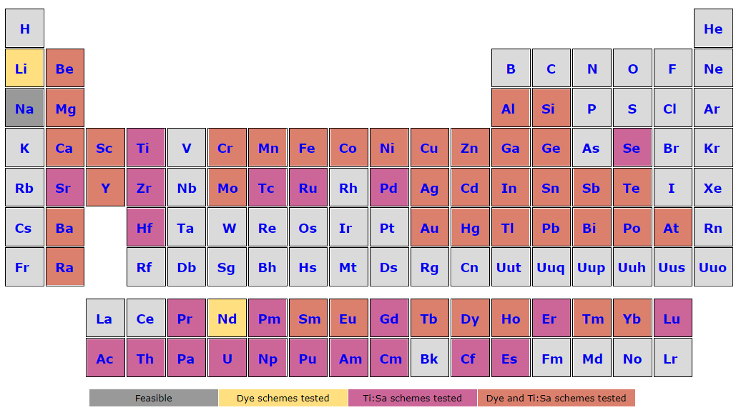
Target and ion source configuration
August 2022: 1st measurement campaign: UC_{x} target + Ta-surface (MK1) ion source
  Access to many surface ionized species of interest
Exploited four different laser ionization schemes
Neutron converter
(October 2022: LaC_{x} target + Ta-surface (MK1) ion source + Sn laser ionization)

Slide 6
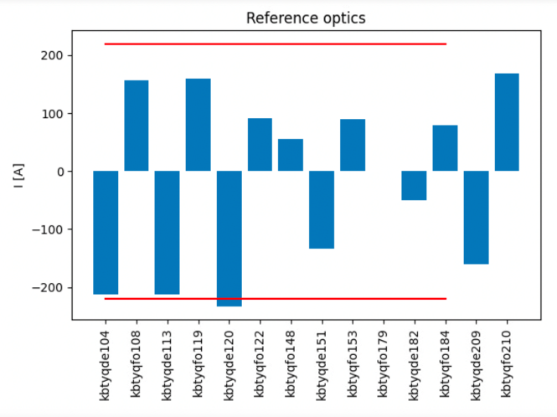
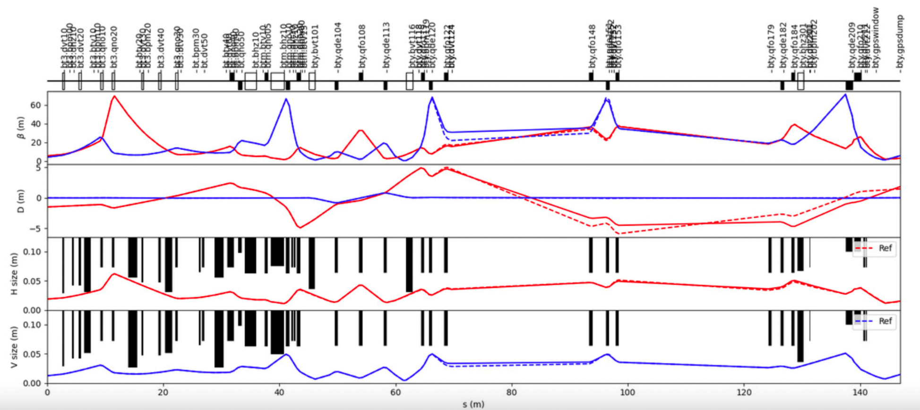
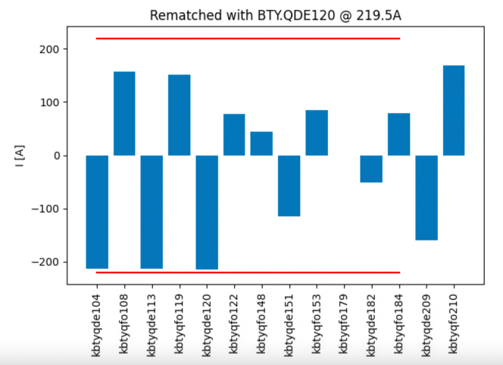
Rematched BTY-line optics at 1.7 GeV
Courtesy of Matthew Fraser
Limited to 1.7 GeV by power converter current in BTY vertical dipoles
Optics rematched to keep all quadrupole settings within power converter limits for 1.7 GeV

Slide 7
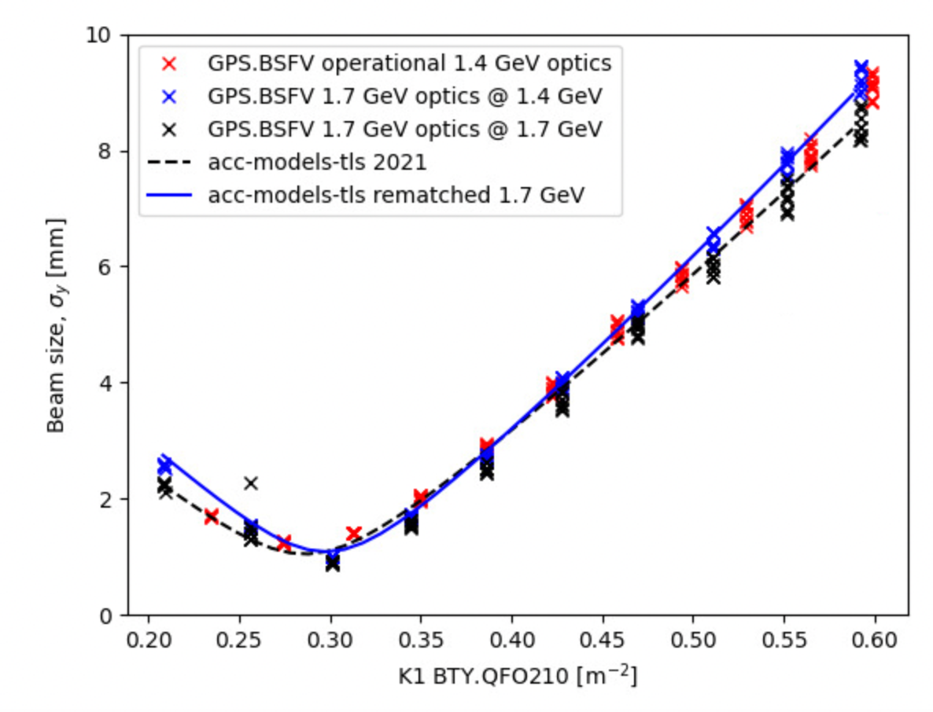
Rematched BTY-line optics at 1.7 GeV
Courtesy of Matthew Fraser
Beam size upstream of GPS target measured as a function of the last gradient of the last quadrupole using a SEM grid:
Example in vertical plane:

Slide 8
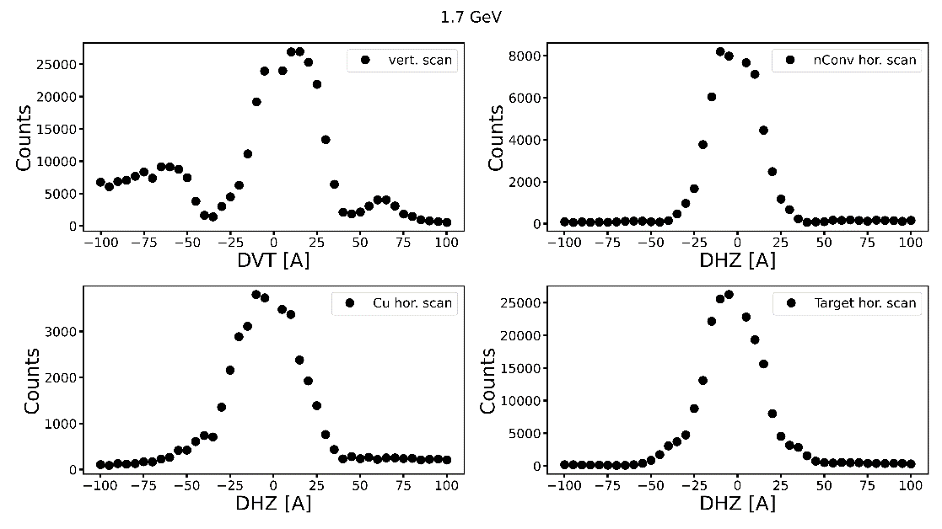
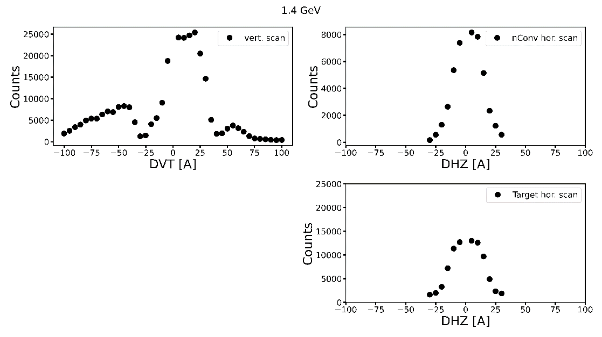
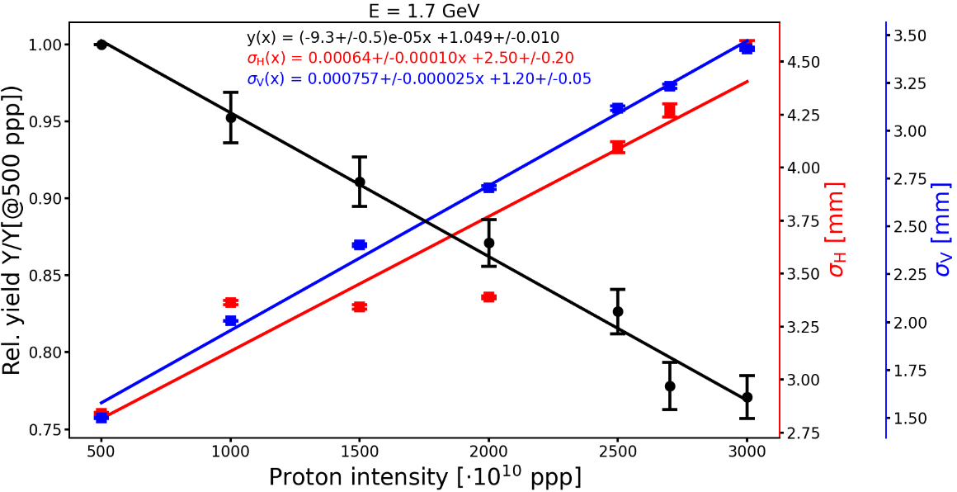
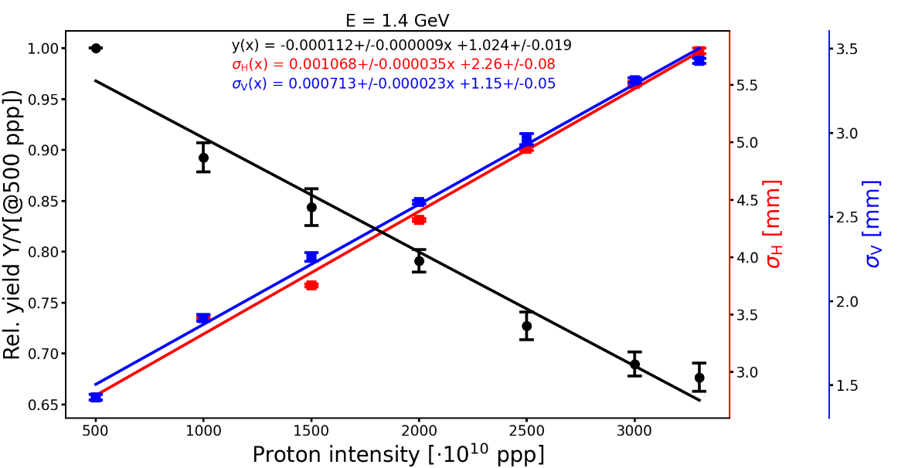
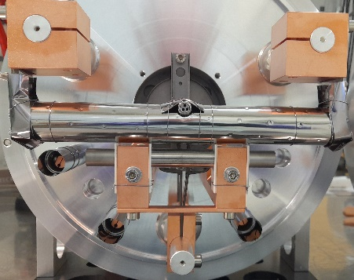
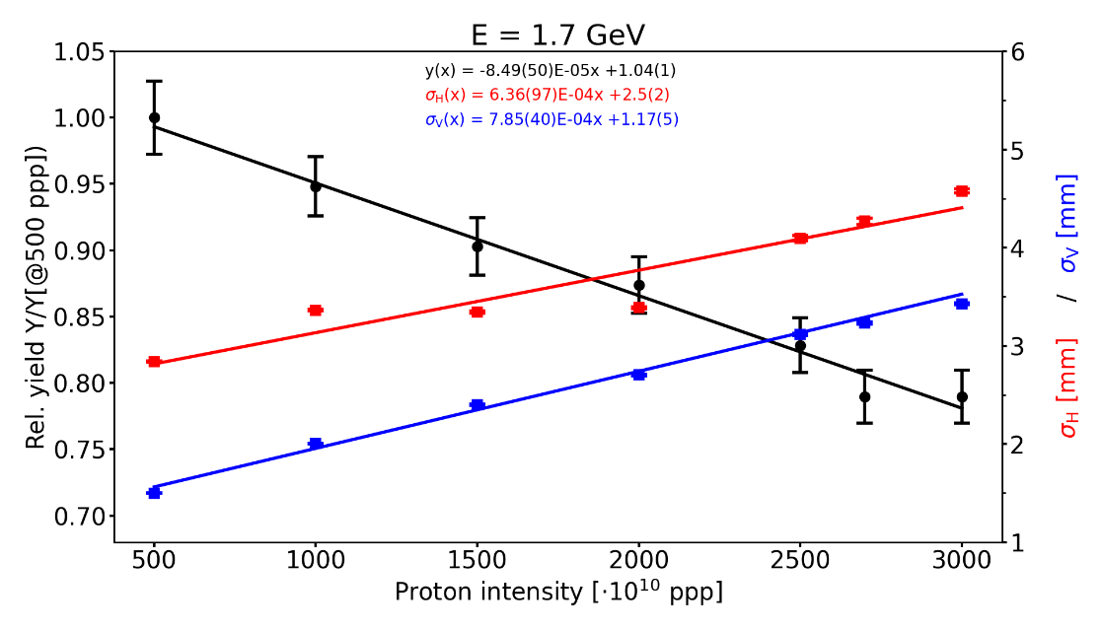
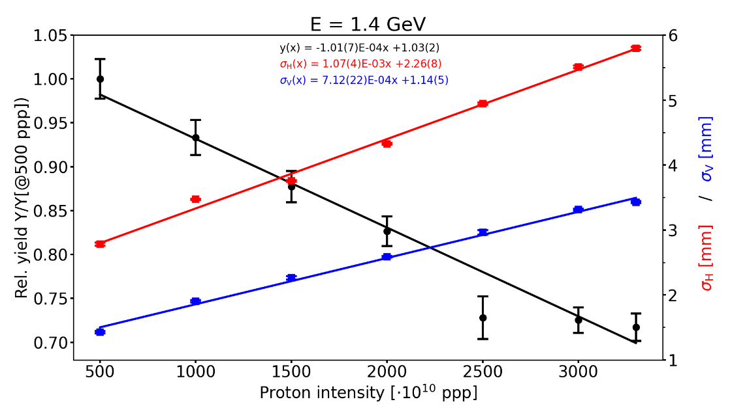
Proton characteristics

Slide 9

Preliminary results
DATA

Slide 10
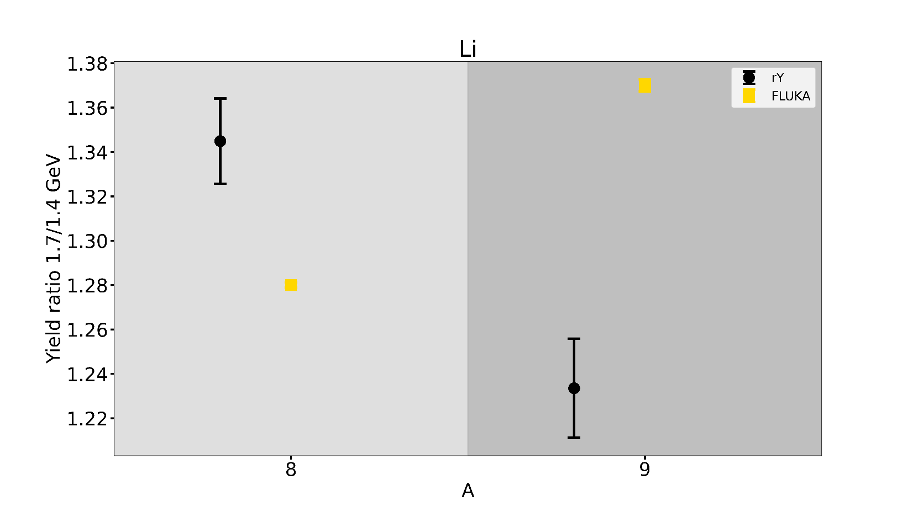
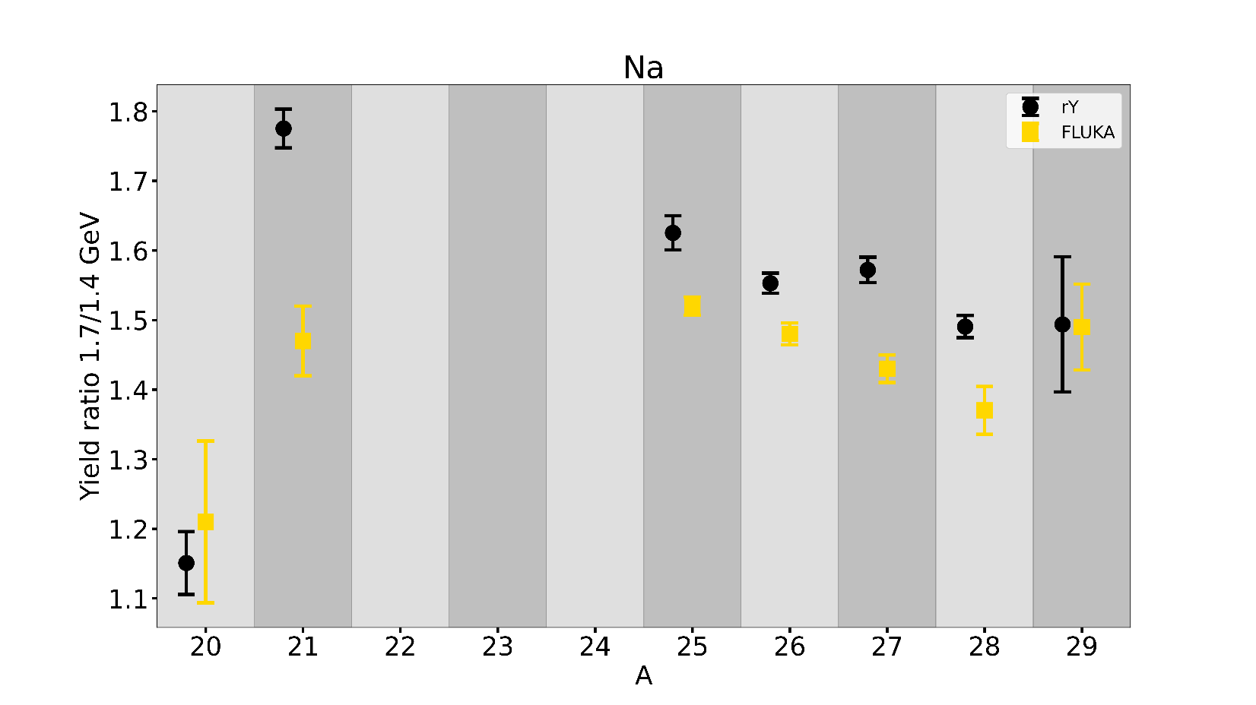
Preliminary results - UC_{x}
Preliminary
Preliminary

Slide 11
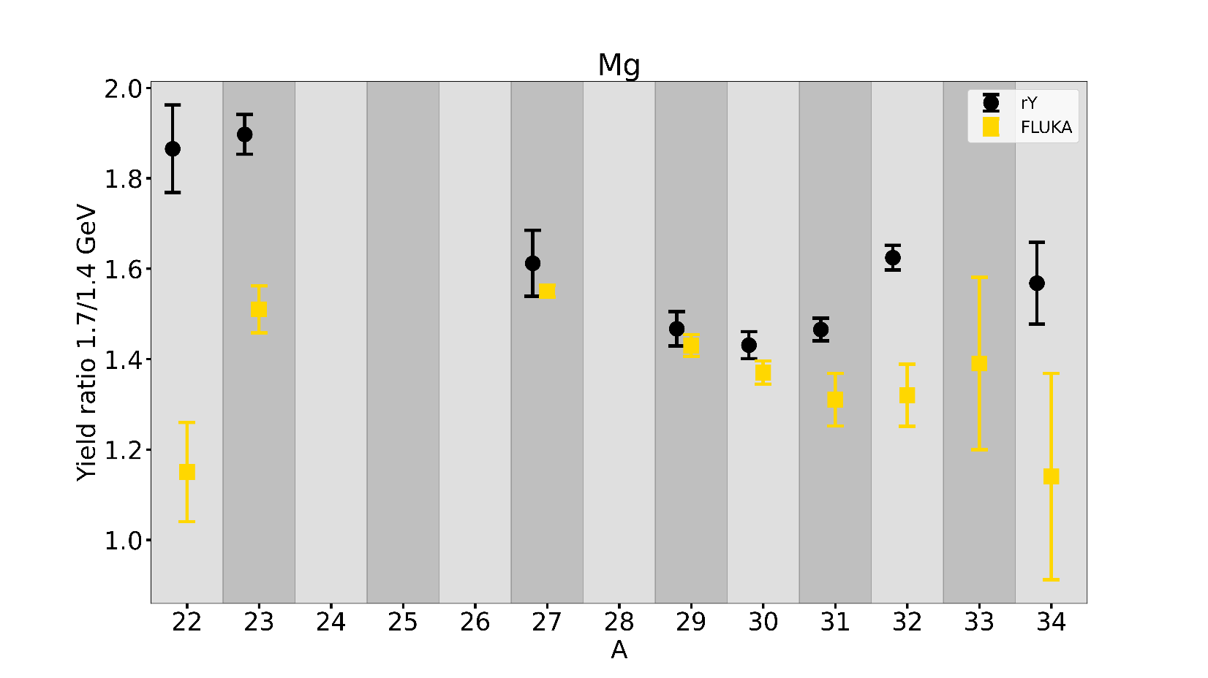
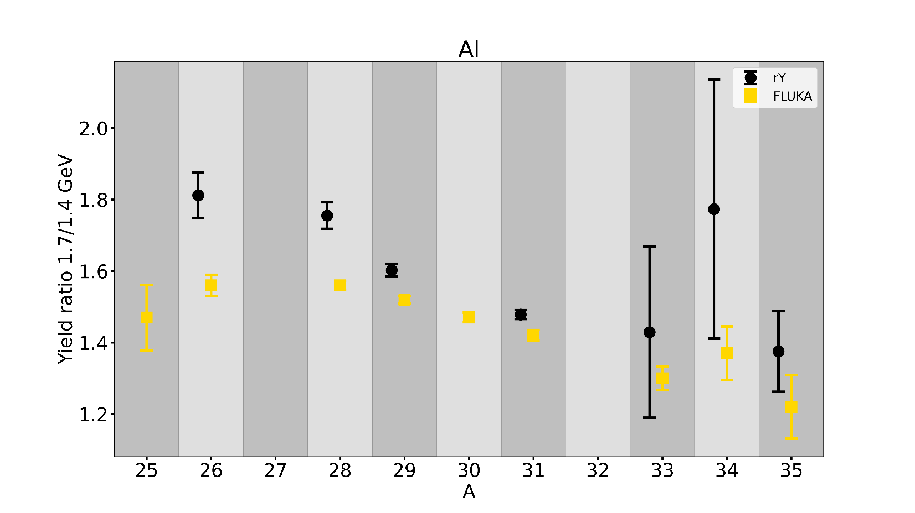
Preliminary results - UC_{x}
Preliminary
Preliminary

Slide 12
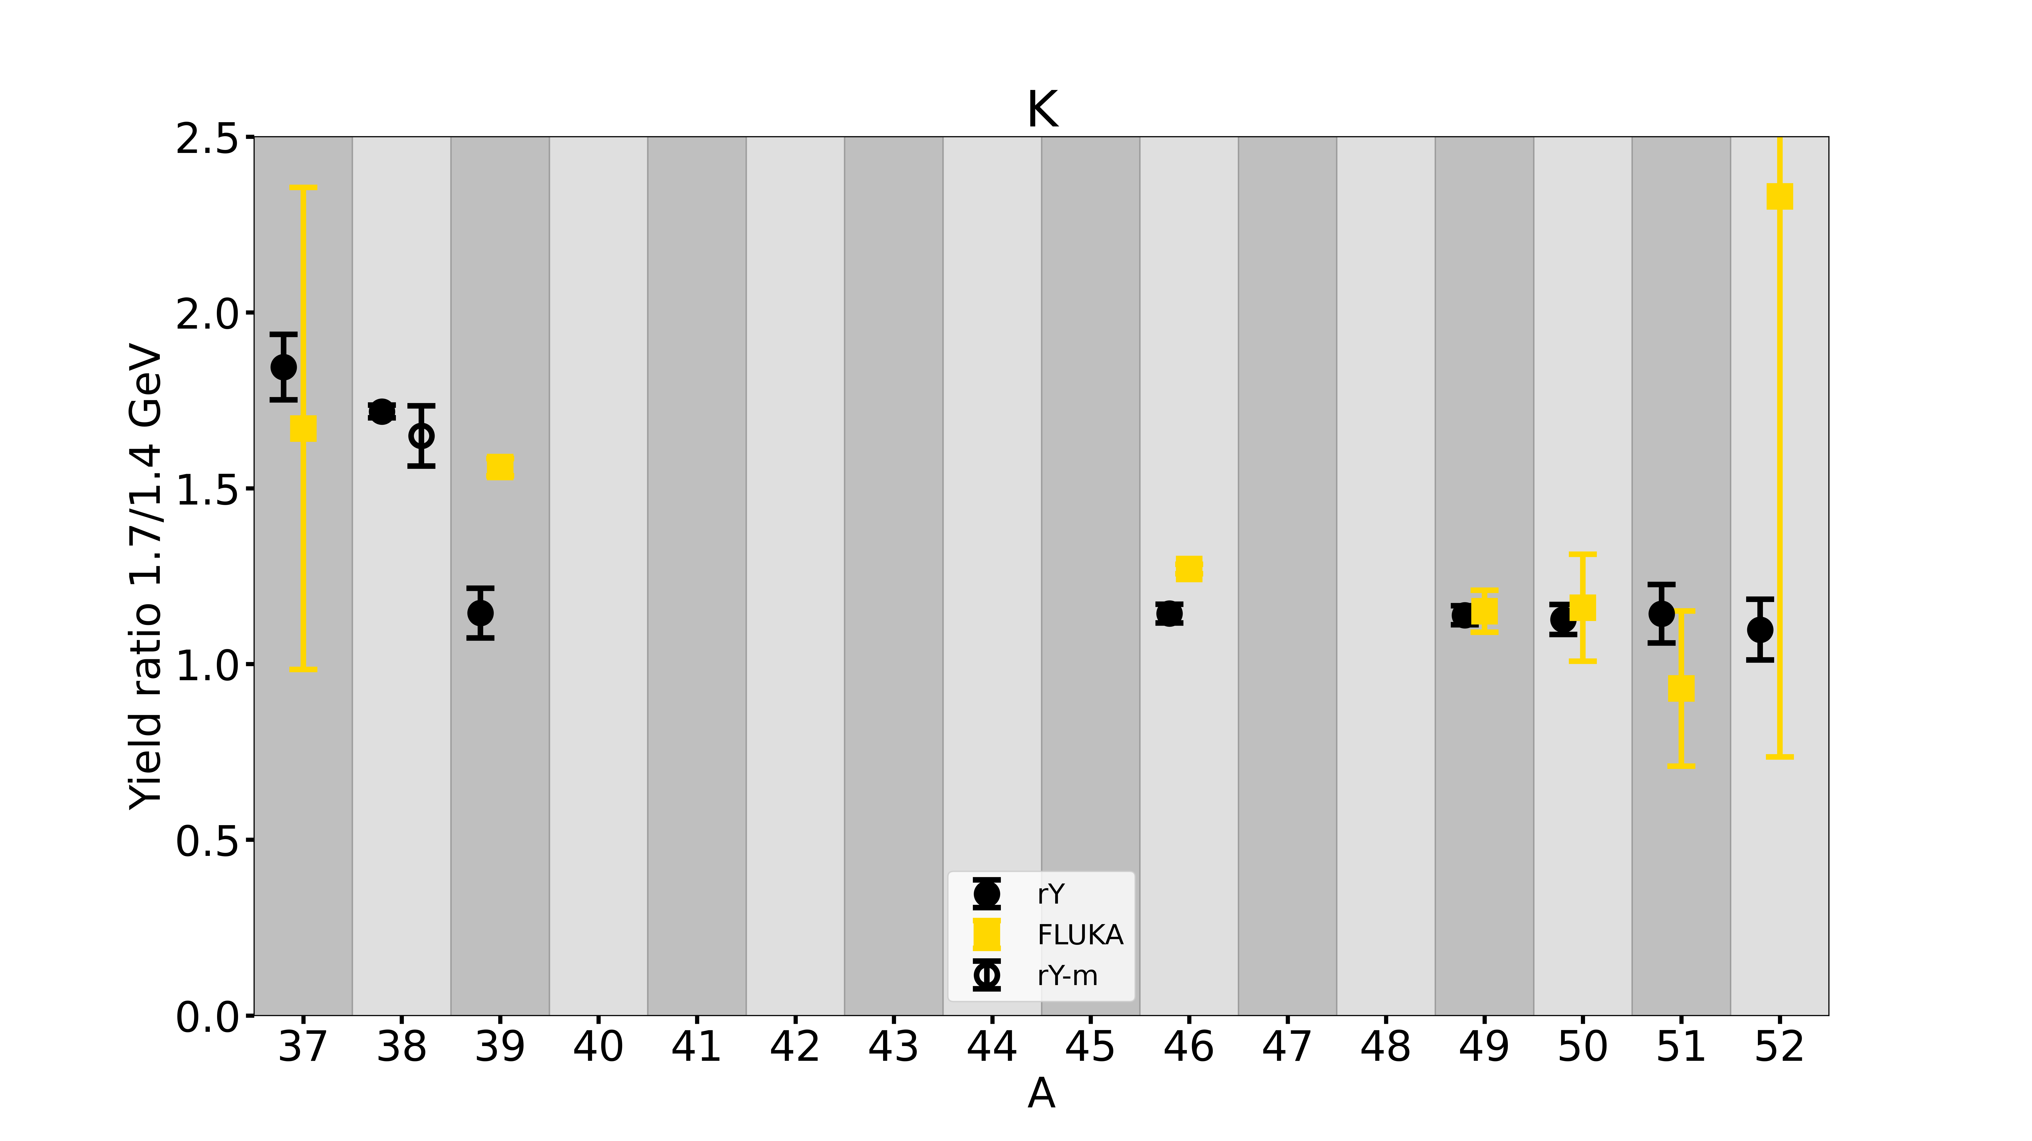
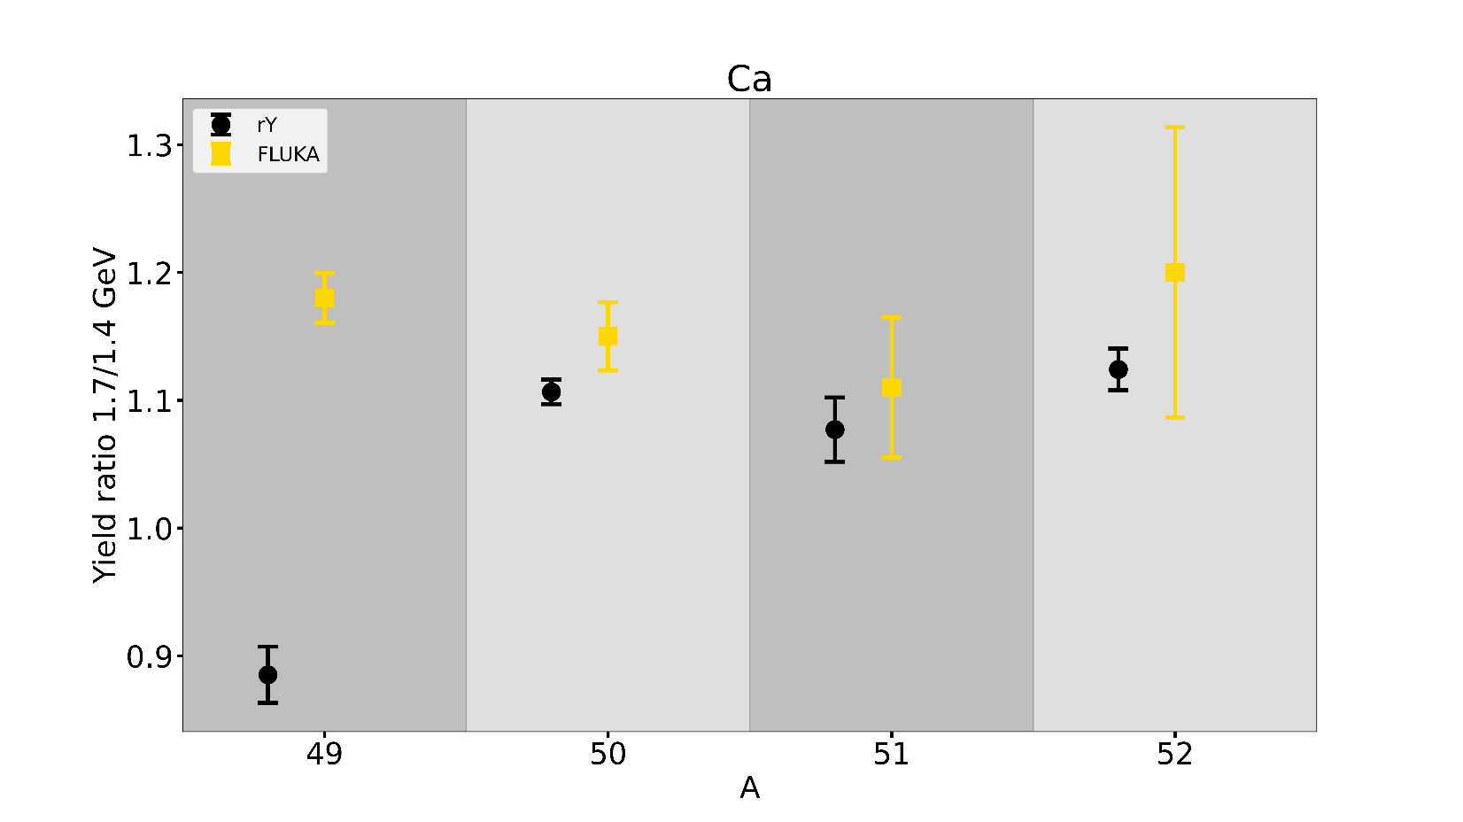
Preliminary results - UC_{x}
Preliminary
Preliminary

Slide 13
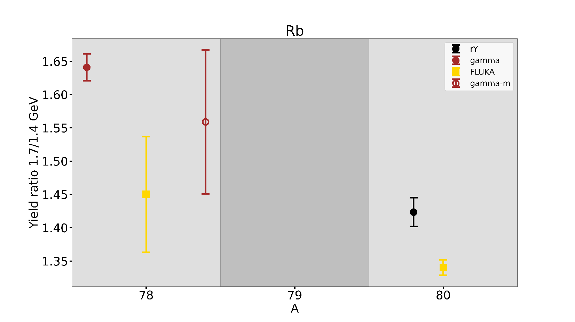
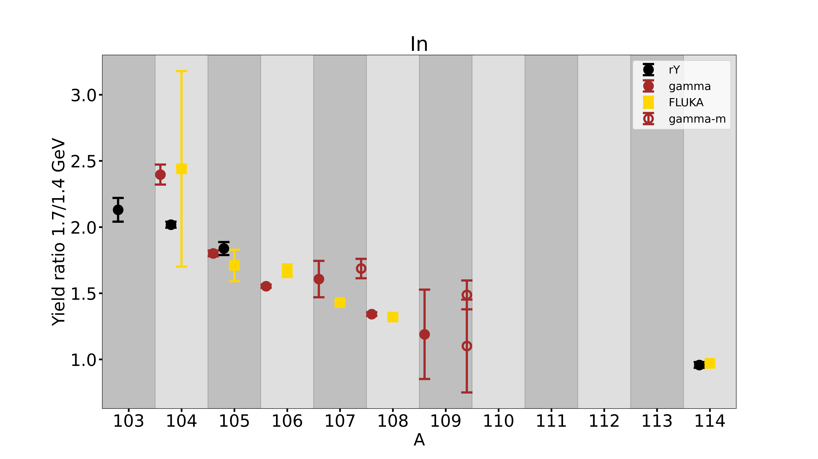
Preliminary results - UC_{x}
Preliminary
Preliminary

Slide 14
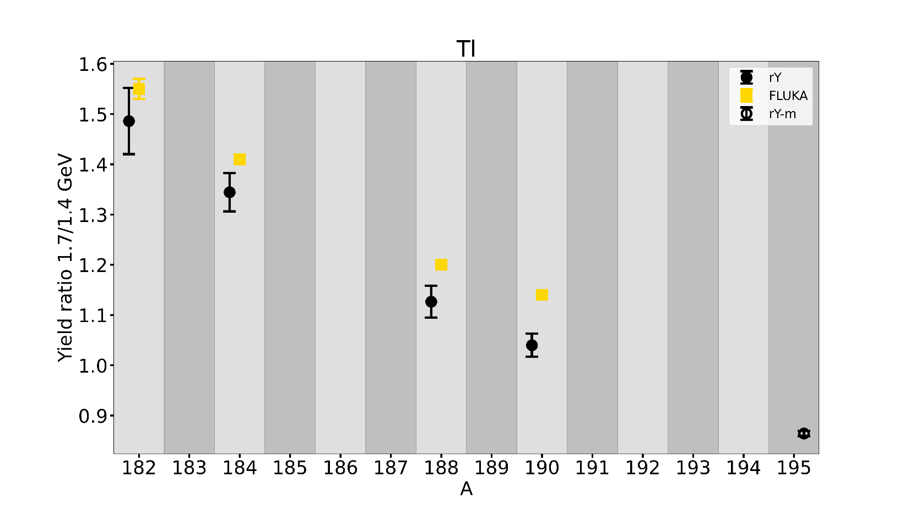
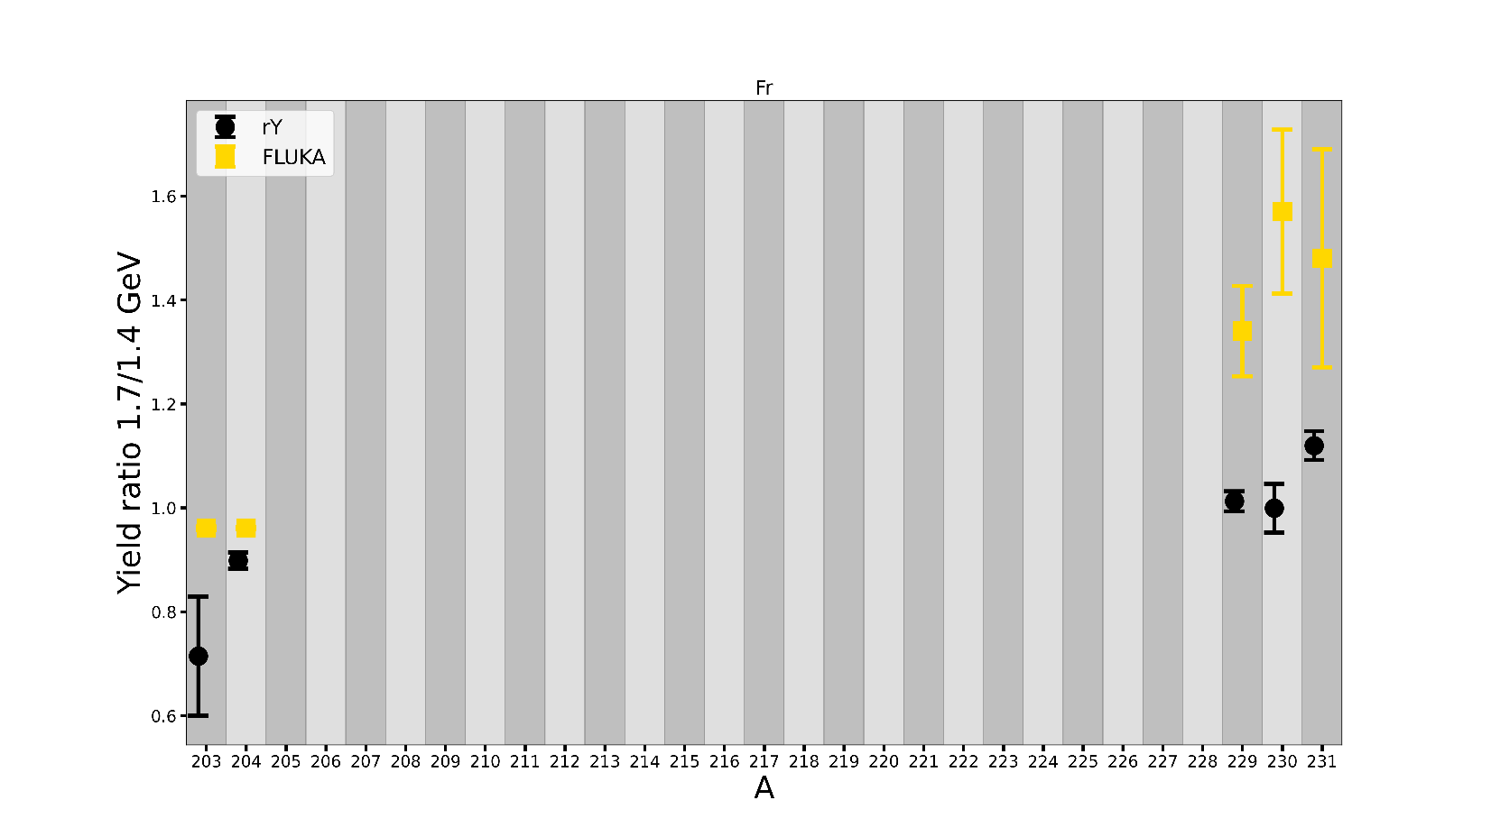
Preliminary results - UC_{x}
Preliminary
Preliminary

Slide 15
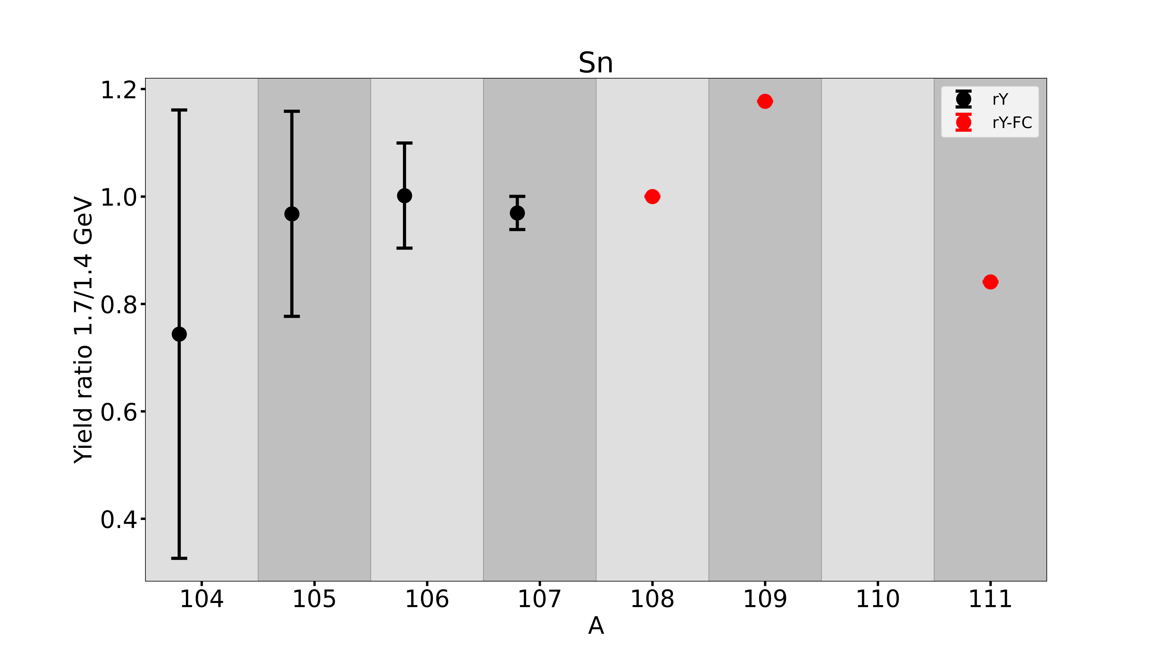
Preliminary results - LaC_{x}
Preliminary
Notes:
Heavy elements
N-deficient surface-Tl (rich impossible bc of Fr): same as with In: less N -> more gain
FLUKA predicts nicely the trend
Surface-Fr: Maybe a bit surprising:
~1 for n-rich and reduction for light Fr (maybe good for experiments)

Slide 16
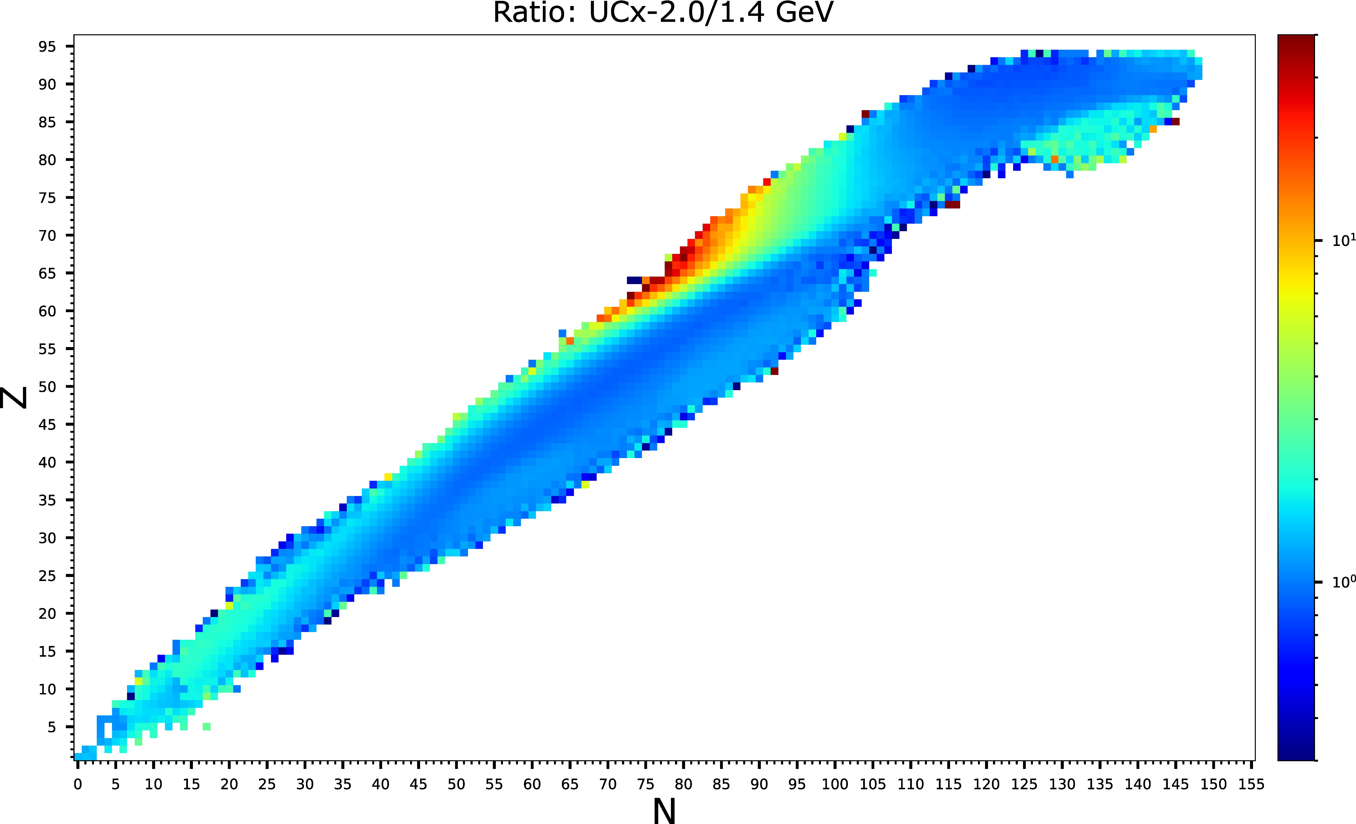
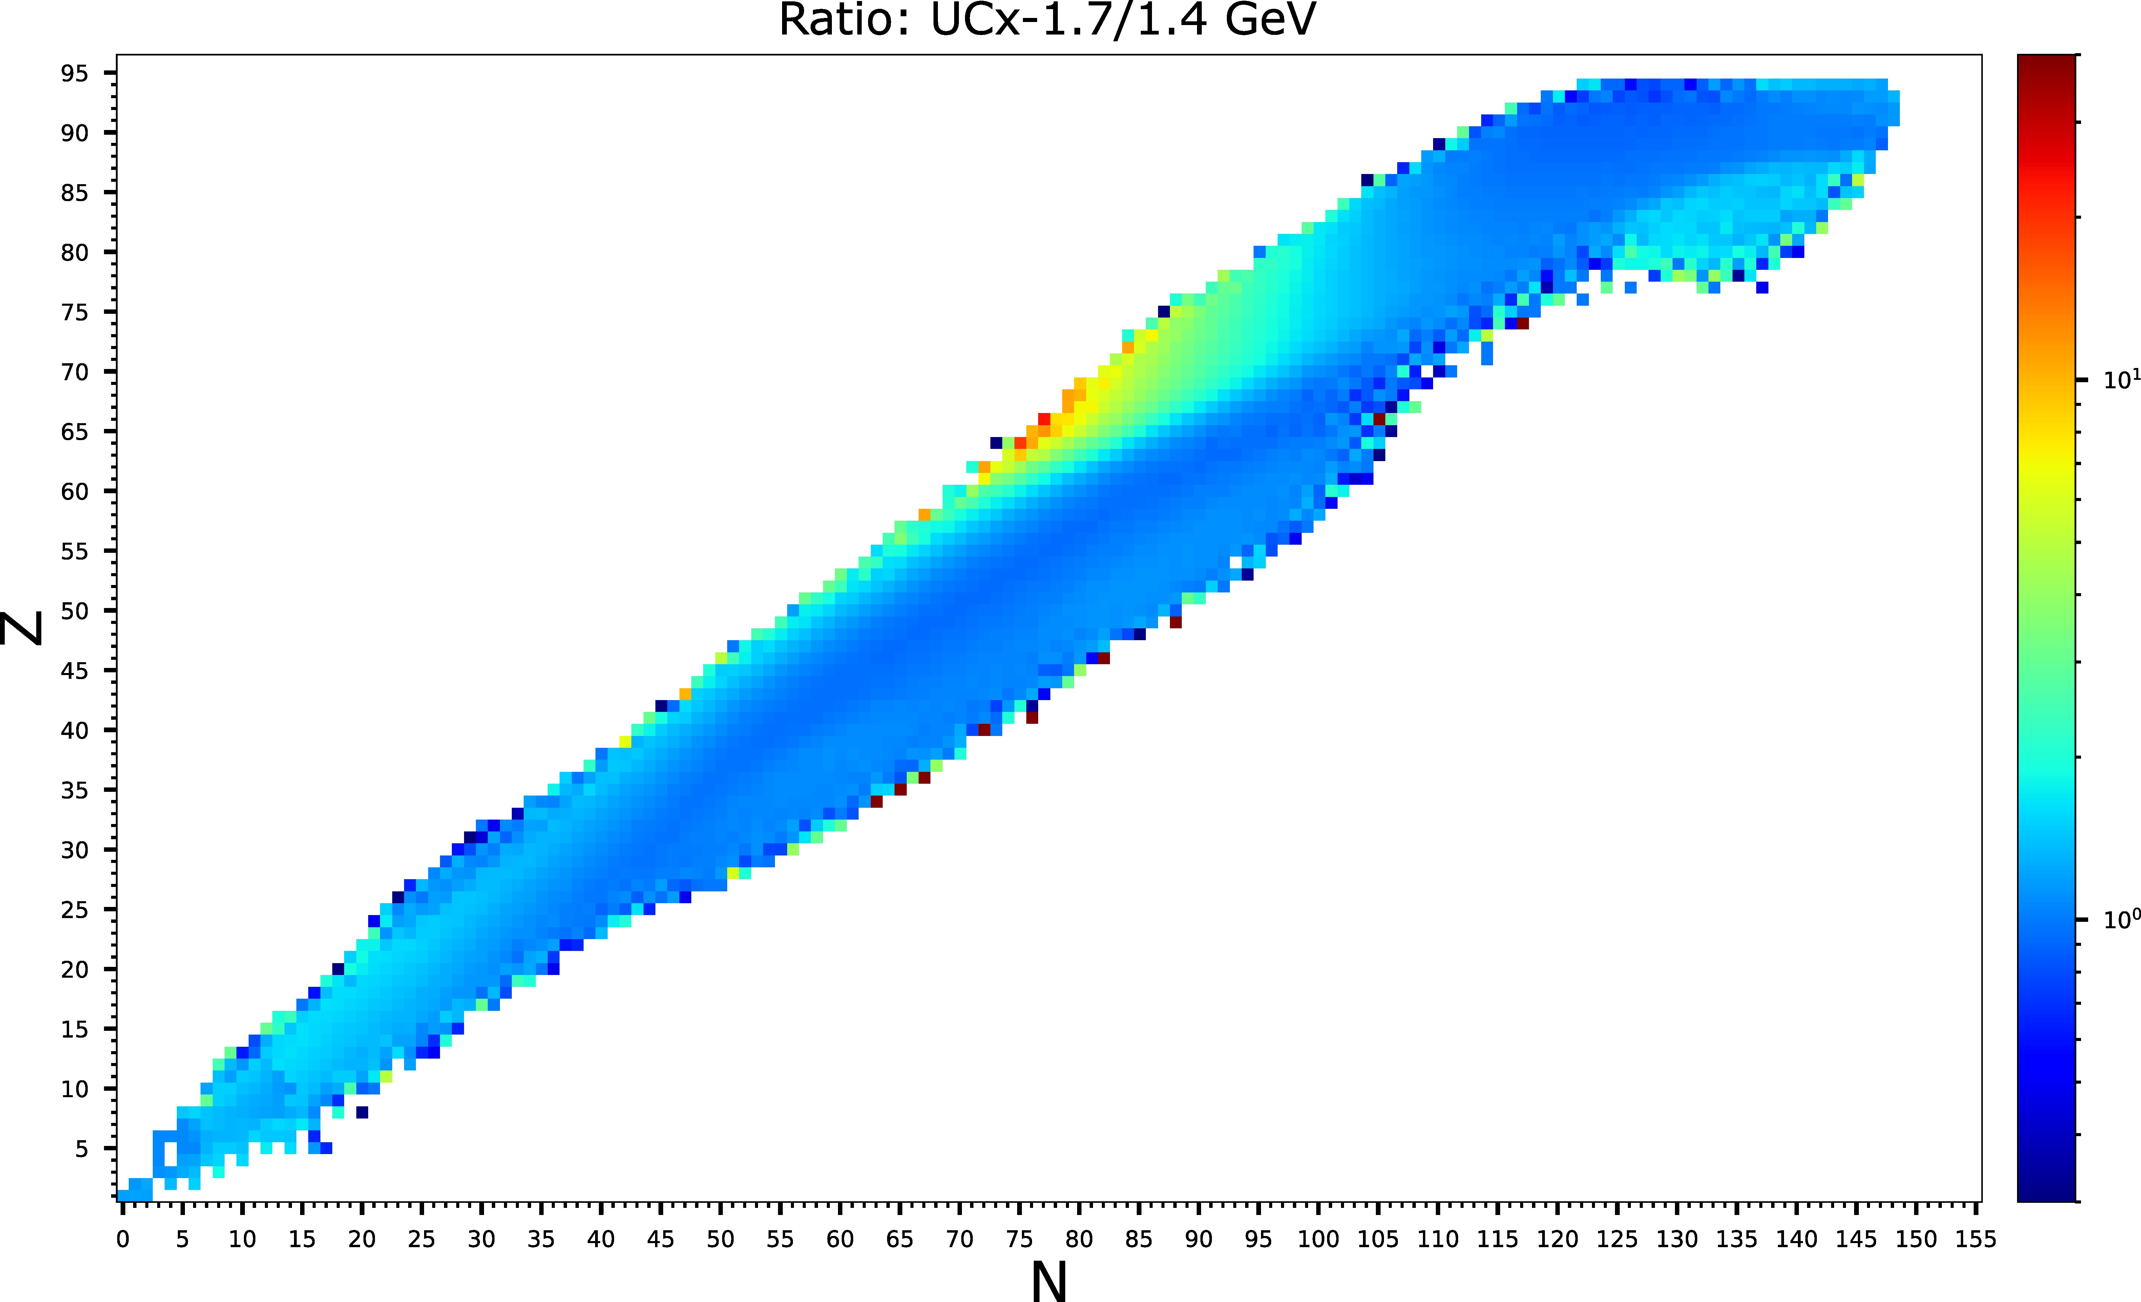
2.0 GeV - UCx
Rare-earth (not released from UCx)
Fact. ~2 n-rich
Hg, Au, Tl, Pb,…
Deep spallation (better prod. By lower Z targets)
~20% gains
Fact. ~2
Mg, Al, Na,…
FLUKA2017 v.1.0
Courtesy of Joao Pedro Ramos
FLUKA CERN v.4-2.2

Slide 17
Conclusions
Confirmed expected gains using 1.7-GeV compared to 1.4-GeV protons
Results agree well with MC predictions
Further study proton beam transport to ISOLDE
Outlook
Further data analysis from present beamtime
Exploring other regions in nuclear chart
Simulations for 2-GeV protons

Slide 18
Acknowledgements
ISOLDE operations team
ISOLDE target team
ISOLDE RILIS team
Sean Freeman
Joachim Vollaire
PSB operations team
SY-ABT-BTP
Gian Piero Di Giovanni
Matthew Alexander Fraser
Piotr Skowronski
Jose-Luis Sanchez-Alvarez

Slide 19
Thank you for your attention!
Questions, comments?

