Slide 1
A bit chaotic view on the
380 GeV CLIC power and Design studies
Alexej Grudiev (CERN)
CLIC towards Readiness Report 2025-26 meeting
8/11/2022

Slide 2
Outline
CLIC 380 power with new DR RF, 2021
Update for the new DB klystron (TS MBK) parameters, 2022
Possible further ways for power reduction
  DB complex magnets
  MB injector linacs
  MB main linac
MB injector complex layout and RF optimization
Standing wave damped distributed coupling structure – possible way to improve efficiency and/or gradient in main linac

Slide 3
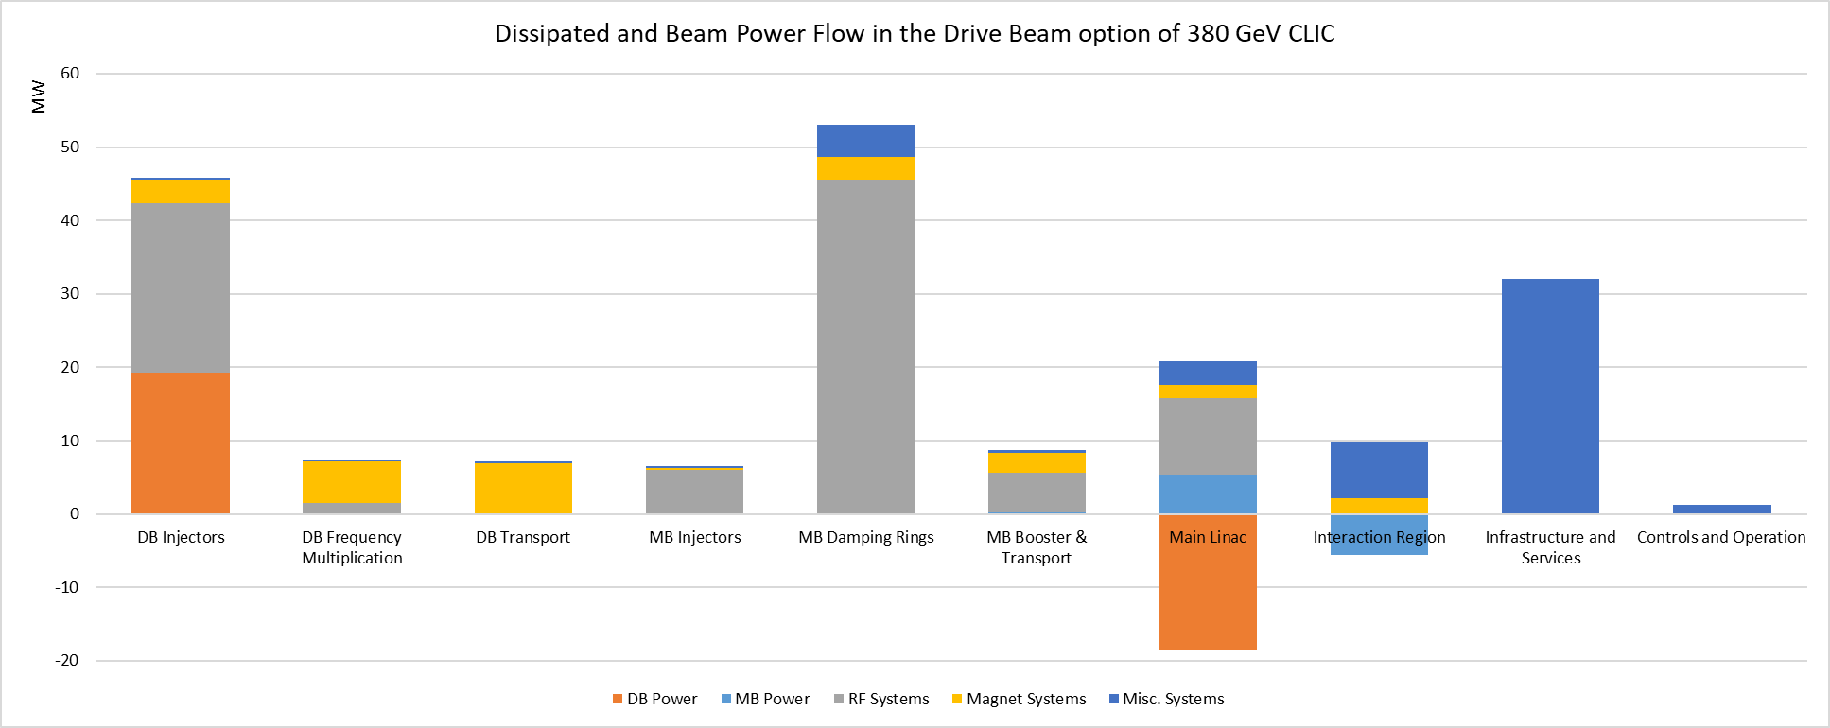
CLIC DRs (PIP design)
A lot of power dissipated in DR RF systems: 46 MW

Slide 4
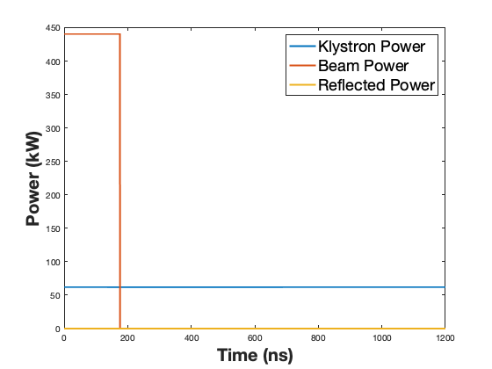
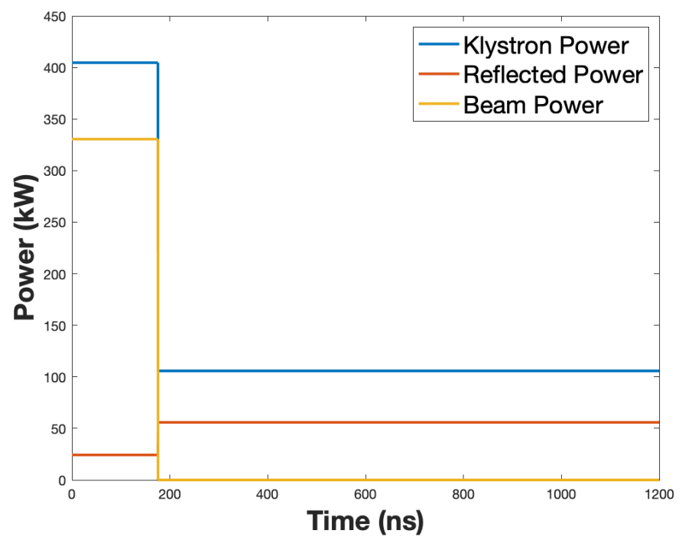
DR Comparison: PIP baseline vs new proposal
PIP baseline
New proposed design #1
Cavity type | ARES | BCC
Cavity R/Q [Ω] | 7.5 | 0.6
N of cavities | 32 | 24
Peak input power [kW/cavity] | 405 | 62.2
Total peak input power [MW] | 13 | 1.5
RF power match the average beam power => efficient
No klystron power modulation => no large bandwidth
Peak power requirements are SIGNIFICANTLY reduced => cost, size
Updated layout of the DR is required for the new DR RF system
Cryogenic system design is needed both for RF and wigglers -> power estimate

Slide 5
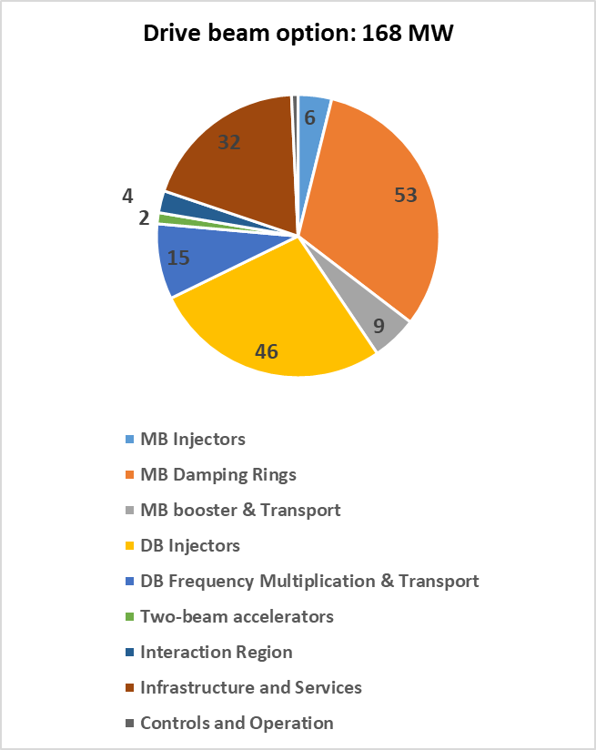
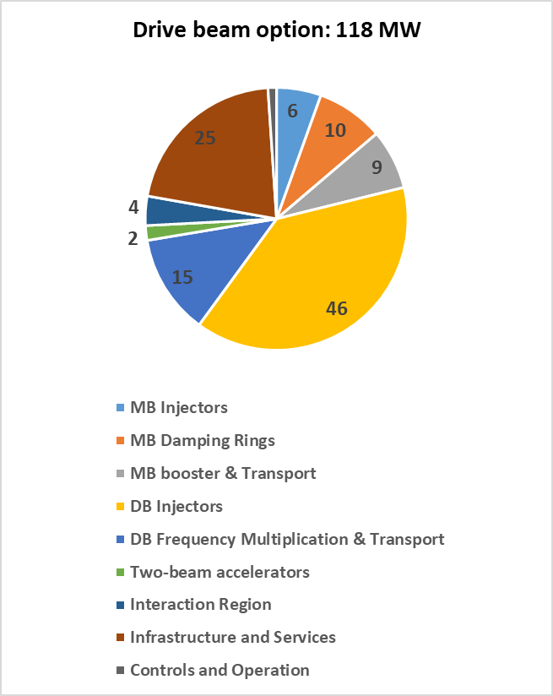
Comparison DR: PIP baseline vs new proposal
- 50 MW
- 43 MW
- 7 MW

Slide 6
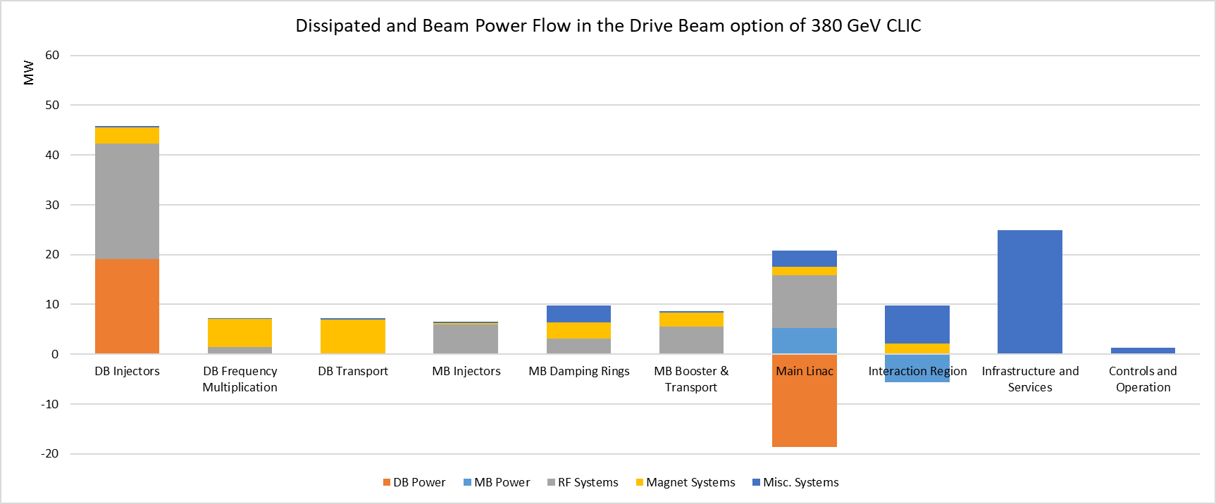
CLIC DRs: power reduction due to new design
Total power reduction due to new DR design: 50 MW

Slide 7
Drive beam injector complex
Largest power consumption is in DB injector:
23 MW is dissipated in RF system -> ☹
19 MW goes to the drive beam -> ☺

Slide 8
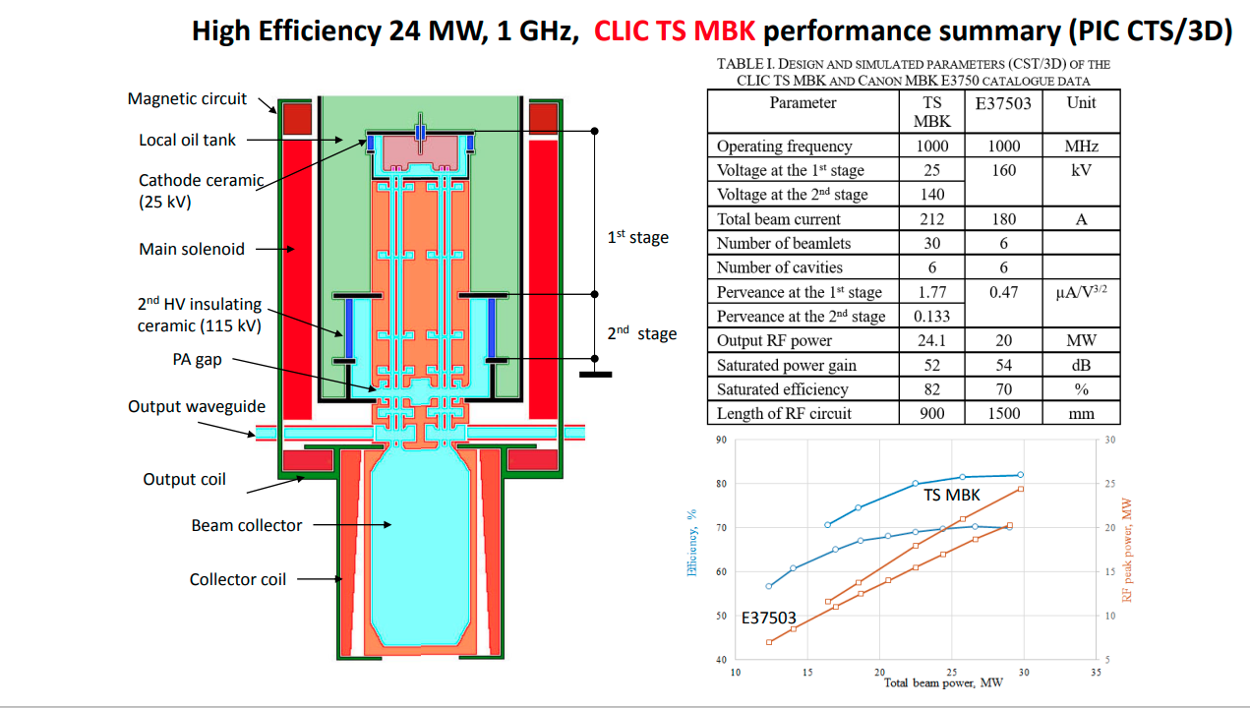
New ideas for CLIC 1GHz klystron for DB linac
Novel design Two-Stage (TS)
Multi-Beam Klystron (MBK)
2nd stage is not pulsed:
More efficient modulator
It has more power per klystron compared to PIP baseline: 20 MW -> 24 MW
Significant cost impact
It has higher Efficiency compared to PIP baseline: 70 % -> 82 %
Significant impact on power consumption
CLIC project meeting 15 June 2021 Igor Syratchev (cern.ch)

Slide 9
Step 1: Scaling AS from 20 to 24 MW
Nominal AS input power for FBL is lower than klystron power due to margins:
WG losses: 5%
Power margin for bunching (off crest operation): 3%
Power margin for operation and availability: 5%
All together ~10% less power available for FBL acceleration
RF acc. structure (AS) parameters for CLIC 380 | PIP 20 MW MBK | New 24MW TS-MBK
Beam current | 4.2 | 4.2
active length | 2.3 | 2.5
Peak input power for Full Beam Loading (FBL) | 18 | 21.5
Unloaded acc. Voltage | 7.92 | 9.45
Loaded acc. voltage | 4.08 | 4.875
Loaded acc gradient | 1.77 | 1.94
RF-to-beam Efficiency | 95 | 95
Linac parameters
Number of AS in DBL1 | 62 | 52
Number of AS in DBL2 | 398 | 333
Total number of AS (klystron, modulators) | 460 | 385
Total number of quads | 204 | 172
More power per klystron, modulator, AS unit => less AS, less quads (TBC by BD)
Updated BD design of the DBI linac is required for new configuration

Slide 10
Step 2: Applying higher efficiency 70 -> 82%
70% -> 82% is straightforward
However, it should be noted that there are several other efficiencies at similar level:
WG losses: 5% -> Efficiency : 95%
Modulator CW efficiency: 94%
Modulator Pulse efficiency: 86%
AS RF-to-beam efficiency: 95%
So, there is a limit to which point it make sense to push the klystron efficiency. Maybe we are approaching this limit !
See next slide

Slide 11
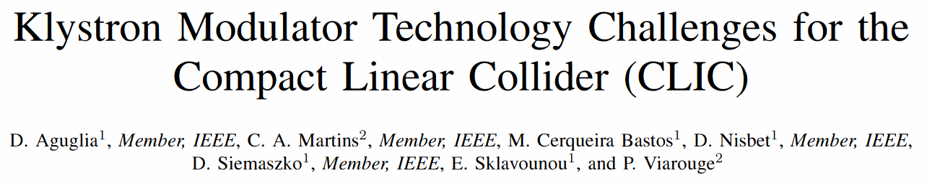
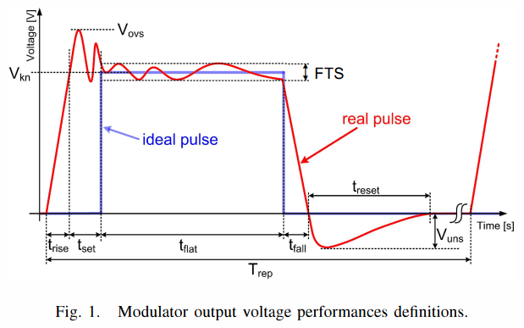
Step 3: Modulator pulse efficiency increase
Modulator pulse efficiency: Eff_{pulse} = t_{flat}/(t_{flat}+t_{set}+t_{rise})
Aguglia (2011) optimized for 3TeV case. 95% achieved (t_{flat}=140us, t_{set}=5us, t_{rise}=3us)
For 380 GeV, set and rise time are larger fraction of the pulse (t_{flat}= 48 us): Eff_{pulse}= 86% only
Igor said: TS MBK allow significant reduction of set time to practically zero: Eff_{pulse} = 94%
We need to check if Igor is right

Slide 12
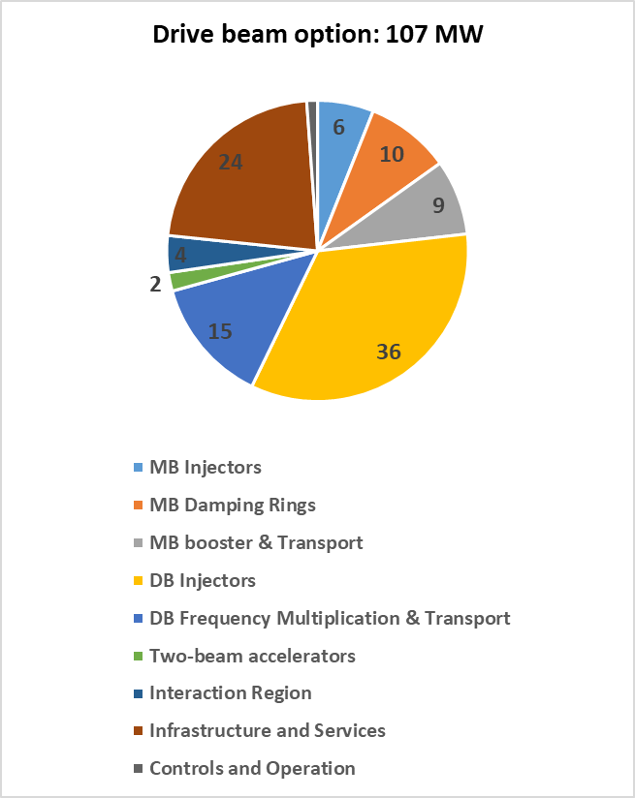
Comparison: 20MW MBK vs 24MW TS-MBK
- 11 MW
- 10 MW
- 1 MW

Slide 13
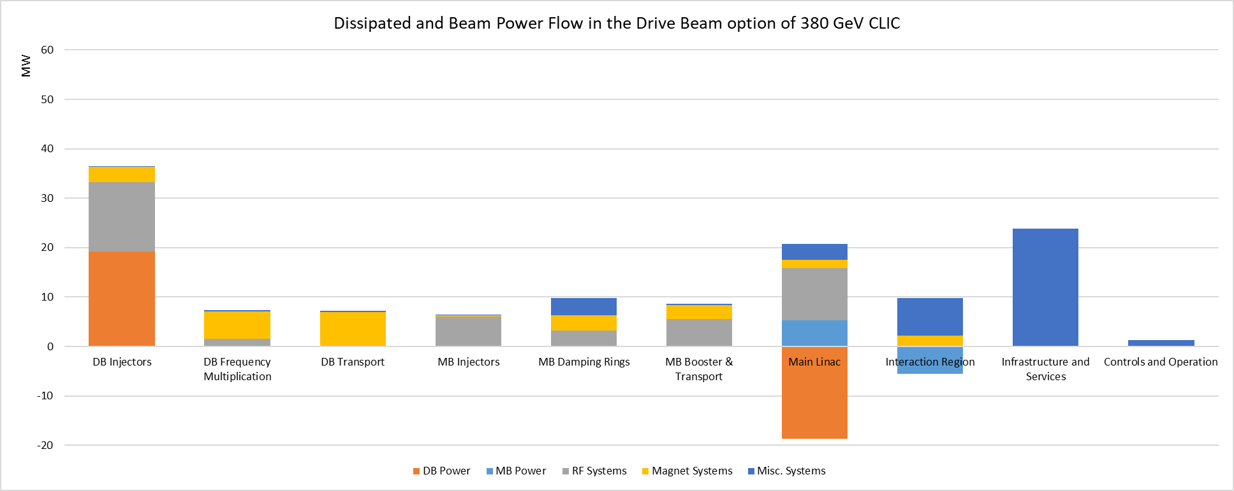
Power reduction due to TS MBK
Total power reduction due to TS MBK: 11 MW

Slide 14
Power consumption in DB magnets
Largest power consumptions is in DB injector:
14 MW is dissipated in RF system -> better than before
19 MW goes to the drive beam ☺
16 MW in the magnets: ~50/50 Quads/Dipoles

Slide 15
Power consumption in MB linac RF systems
11.5 MW - Dissipated Power in MBI linac RF systems
10.5 MW - Dissipated Power in MB linac RF systems

Slide 16
Potential area of power reduction
DB complex magnets 16 MW:
  Large aperture Quads and Dipoles -> potential power reduction by using PM or SC technology is possible
MB linacs share similar power consumption between the injector linacs 11.5 MW and X-band Two-Beam Accelerator (TBA): 10.5 MW
  Where as X-band TBA has been extensively optimized, MBI linacs might be possible to optimize further to reduce power and cost

Slide 17
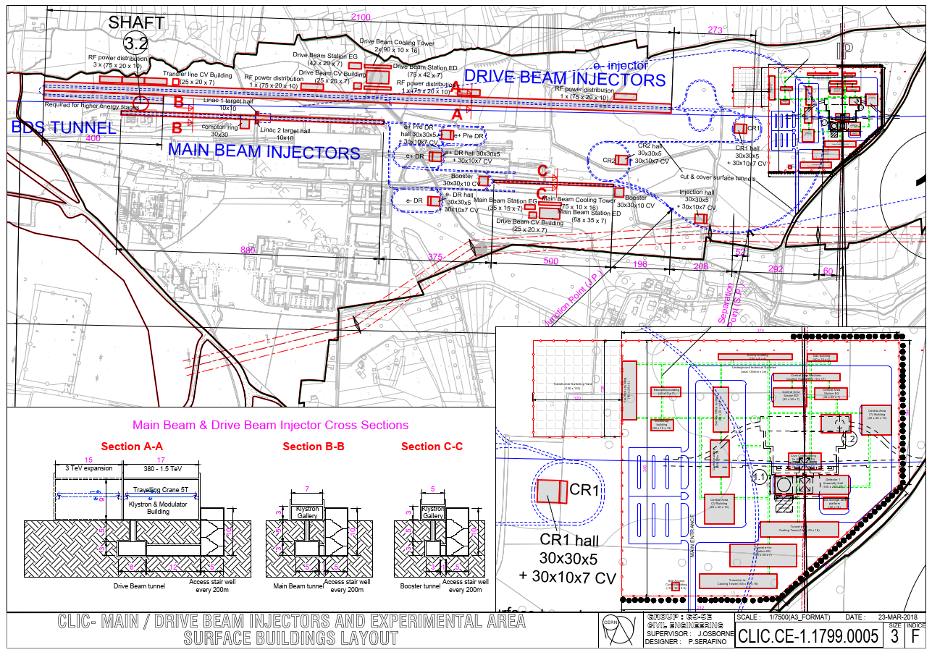
CDR MBI layout

Slide 18
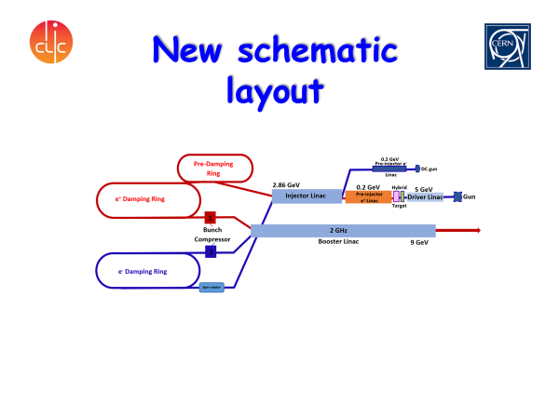
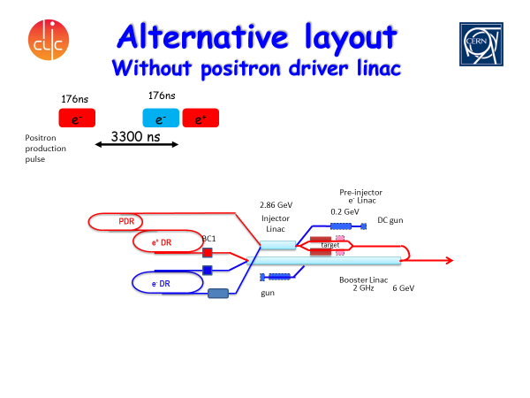
MBI layout for PIP and alternative
Steffen Doebert
Alternative layout with shorter total length of the linacs may reduce both cost and power. One possible layout proposed by Steffen, but not studied
Further optimization of accelerating structure and RF pulse compression system

Slide 19
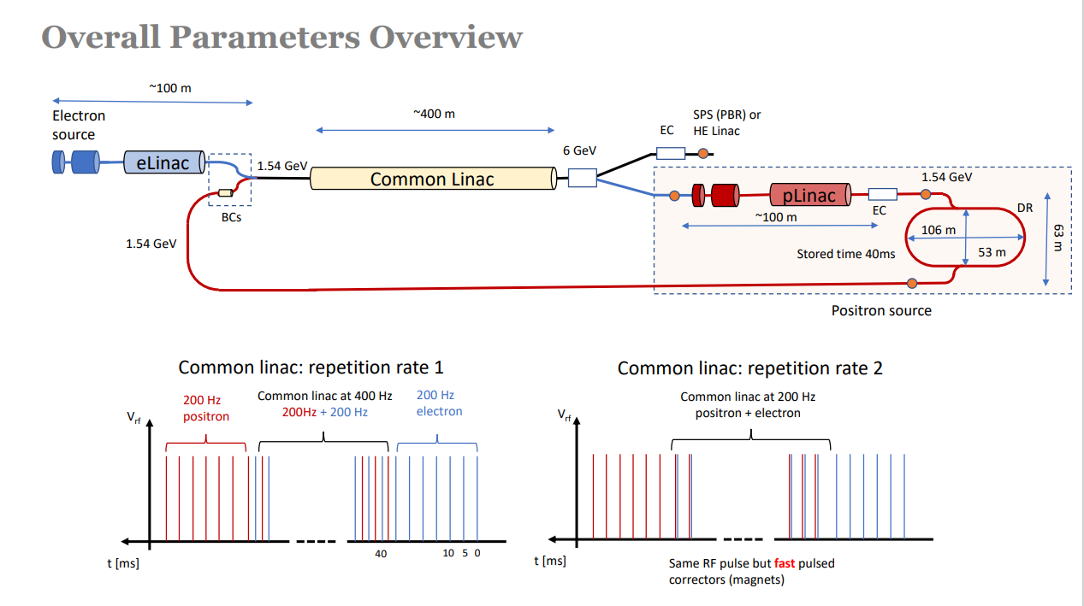
FCCee injector complex design collaboration
2 GHz
Injector complex optimization studies can be combined with on-going FCC-ee injector complex design studies

Slide 20
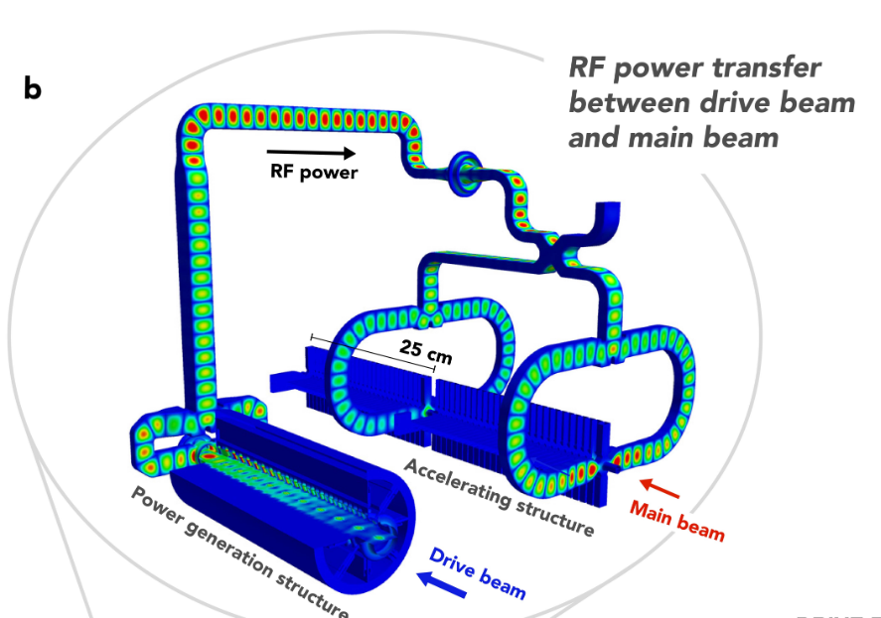
TBA RF system and power losses
Average (50 Hz) beam and dissipated power in SAS RF unit:
Beam power : 514 W
SAS losses : 603 W
RF loads : 328 W
WG network : 60 W
PETS : 10 W
AS RF-to-beam efficiency:
P_B/P_RF = 514/(514+603+328) = 35.6%

Slide 21
Possible way to improve MB AS efficiency
Recent work by Evan Ericson: rf development meeting (28 September 2022) · Indico (cern.ch)
Standing wave (SW) accelerating structure: power to RF loads -> 0
Single or few cells distributed coupling structures:
  higher gradient, OR
  higher shunt impedance design for same gradient
The main challenge is to provide required HOM damping performance combined with distributed coupling WG network

Slide 22
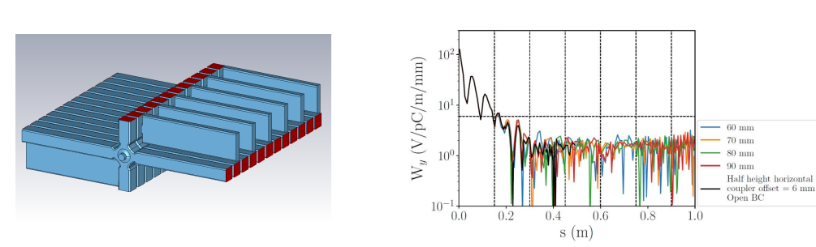
Wakefield damping and distributed power coupling
Each cell has individual power coupling WG in addition with 4 damping waveguides
It might be possible to satisfy HOM Damping requirement even for 1/3 ns
HOM Damping requirement are OK for 0.5 ns

Slide 23
RF-to-beam efficiency of SW AS
Evan’s work is done for 3TeV structure: aperture and MB current
Potentially high gradient limit was improved
RF-to-beam Efficiency was been increased from 28 -> 31 %
31% = SS Eff. * Pulse eff = 47% * 66%
Assuming 1/3 ns bunch spacing is possible from HOM damping point of view: SS Eff: 47% -> 57%; Pulse Eff.: 66% -> 80% => Eff. 31% => 46%
To access power efficiency improvements for CLIC 380, design of dedicated SW accelerating structure is required.
If the efficiency scales similarly (?) for CLIC380: 35% -> 39% -> 58%
Bunch spacing of 1/3 ns would require significant changes in the injector: 2 GHz -> 3 GHz

Slide 24
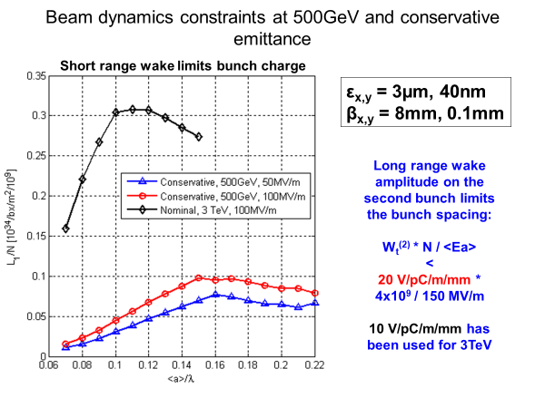
Luminosity per beam power optimization
For CDR and for staging Luminosity per beam power has been optimized:
  L/P ~ L_{bx}/N * RF2Befficiency
CLIC 3TeV, a/lambda = 0.11
CLIC 380GeV, a/lambda = 0.133
Maybe it is time to make this plots again?
For the shunt impedance the smaller aperture the better
Very old plot, 2010

Slide 25
Summary list of possible actions
New DR RF system should be integrated in DR BD layout and Cryo-power both for DR RF and for wigglers should be estimated
New DBI based on TS-MBK require revisiting modulator parameters and BD layout
Quads and dipoles in DB complex optimization using PM or SC technology may reduce Power consumption
MB injectors optimization (layout and RF) is important to reduce power and cost. Can profit from on-going FCCee injector design collaboration
MB X-band TBA is still the point where improving efficiency is important. Investigation of SW AS and revisiting Lbx/N versus RF-to-beam efficiency optimization should be considered even for 380 GeV.
Possibility to change from 2 to 3 GHz bunch spacing should be investigated. It has strong impact on RF-to-beam efficiency ☺ BUT also on the injector complex design☺?☹.
SRF cavity prototype
X-band SW cavity prototype

Slide 26
Backup slides

Slide 27
Summary
CLIC 380 GeV power estimate has been updated to include several possible changes
Increase in repetition rate from 50 to 100 Hz result in increase in power consumption by 68 MW from 168 to 236 MW
New design of the DRs demonstrates significant reduction of the power consumption by 50 MW from 168 to 118 MW
Using new Two Stage MBK results in 11 MW reduction in CLIC power consumption from 118 to 107 MW

Slide 28
Comparison of wall plug to beam efficiencies
 | PIP baseline | New DR | New TS MBK
DB klystron efficiency [%] | 70 | 70 | 82
DB modulator pulse efficiency [%] | 86 | 86 | 94
DB complex Wall plug to DB efficiency [%] | 31.8 | 31.8 | 37.6
DR wall plug to MB efficiency [%] | 7.9 | 56.7 | 56.7
CLIC Wall plug to MB efficiency [%] | 3.3 | 4.8 | 5.2

Slide 29
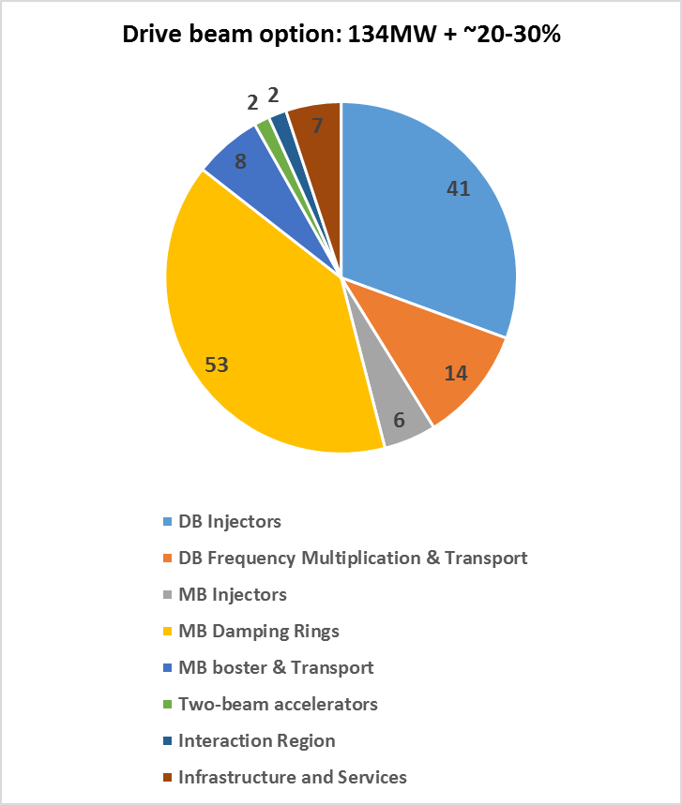
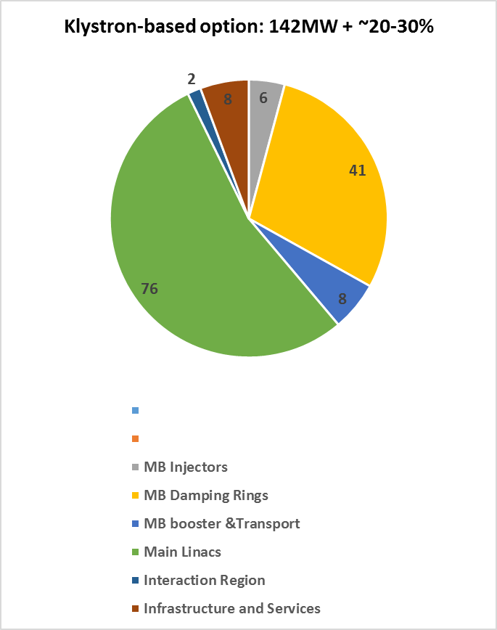
Comparison of Drive beam and Klystron options
Preliminary
2018

Slide 30
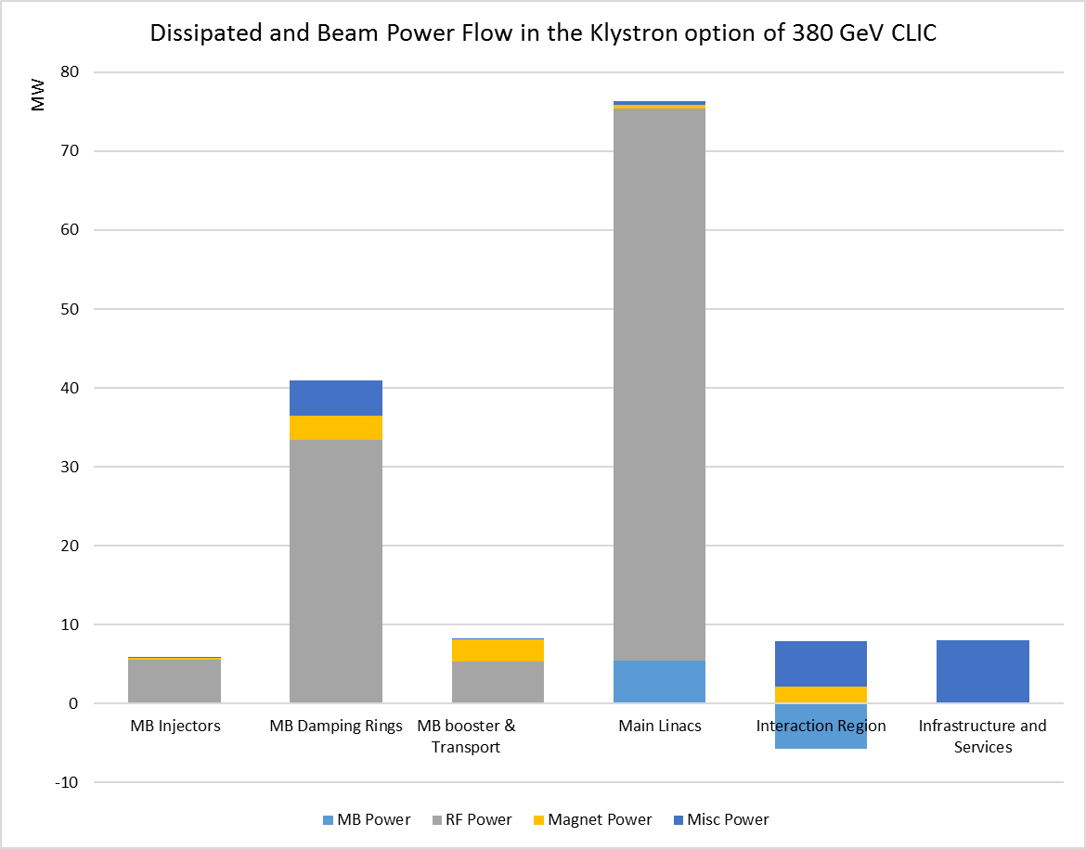
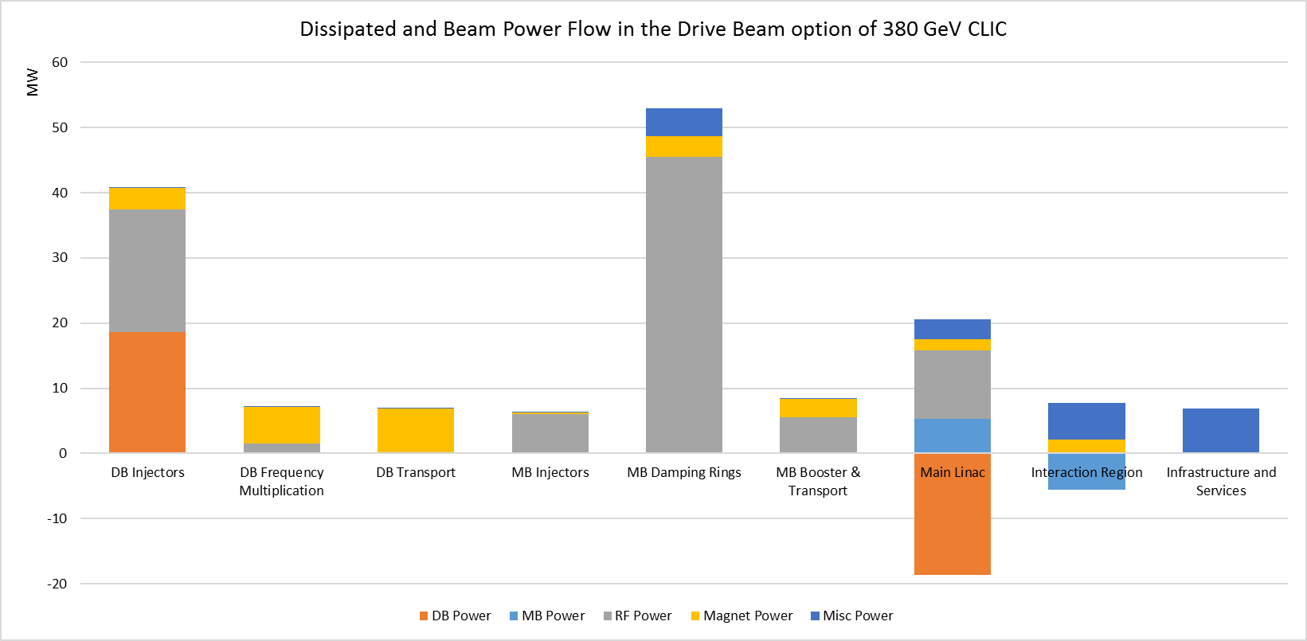
Comparing power flows:
Drive beam and
Klystron options
Overall plug to main beam efficiency: 4.1%
Overall plug to main beam efficiency: 4.2%
Preliminary
2018

Slide 31
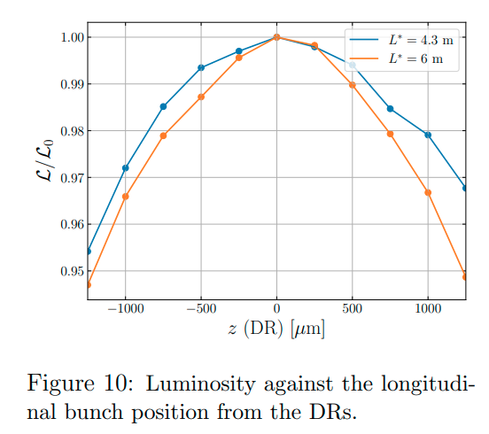
380 GeV CLIC DR parameters (PRAB22, 091601)
Parameter of DR |  | value | unit
Energy | E | 2.86 | GeV
Circumference | C | 373.7 | m
Revolution frequency | f₀ | 802 | kHz
RF frequency | f_{RF} | 2 | GHz
Harmonic number | h | 2493
Energy loss per turn | eV_{A} | 5.8 | MeV
RF voltage | V_{C} | 6.5 | MV
RF stable phase | φ | -26.8 | º
Bunch population | N_{e} | 5.7 | 1e9
Number of bunches per train | N_{b} | 352
Number of trains | N_{t} | 1
Peak beam current | I_{b} | 1.8 | A
1%
±400μm
Strict specifications on the bunch spacing variation: δφ_{b} < ±1º at 2 GHz (±400μm) for Luminosity loss < 1% (CLIC-Note-1138)
This is difficult to maintain due to strong transient beam loading effects caused by large difference between peak and average beam power values of 10.4 MW and 1.5 MW, respectively

Slide 32
Design philosophy for Ultra low R/Q RF cavity
Increase cavity aperture to reduce loss factor => reduce R/Q per cavity
Increase cavity length to reduce transit time factor => reduce R/Q per cavity
Optimize cavity wall shape to minimize H-field to reach largest stored energy per cavity under the H-field limit of 80 kA/m (100 mT, private communication, W. Venturini, 2021) => reduce number of cavities
R/Q per cavity x N of cavities must be below Total R/Q: 14.3 Ω
More details in: CLIC-note-1173, or in rf development meeting (22 September 2021)

Slide 33
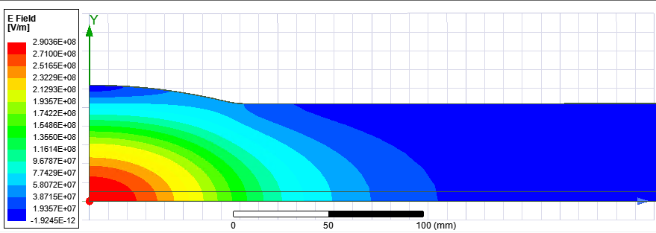
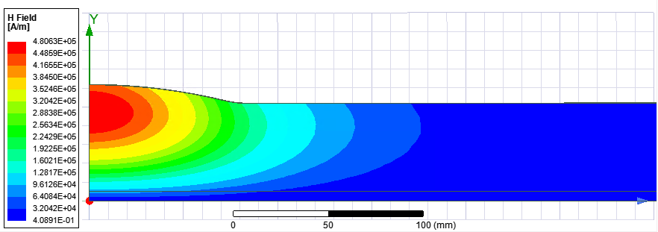
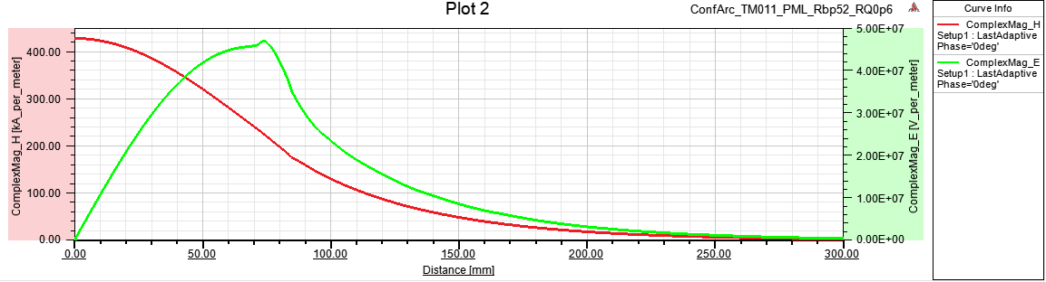
Design of the cavity for total R/Q=14.3Ω
TM011
a [mm] | 52
f [GHz] | 2
a/λ | 0.347
Lc [mm] (0.01Hmax) | ~520
Rarc [mm] | 307
Rcav [mm] | 61.95
R/Q [Ω] | 0.6
Emax/Vacc [1/m] | 31.6
Hmax/Vacc [mA/Vm] | 291
E- and H-fields for 144J
To get this design parameters,
two conditions must be met:
R/Q per cavity is 14.3Ω/Ncav
AND
Vmax per cavity is 6.5MV/Ncav
Hmax limit: 80kA/m
Vmax = 0.275 MV
Umax = 5.0 J
Emax = 8.7 MV/m
Ncav = 24

Slide 34
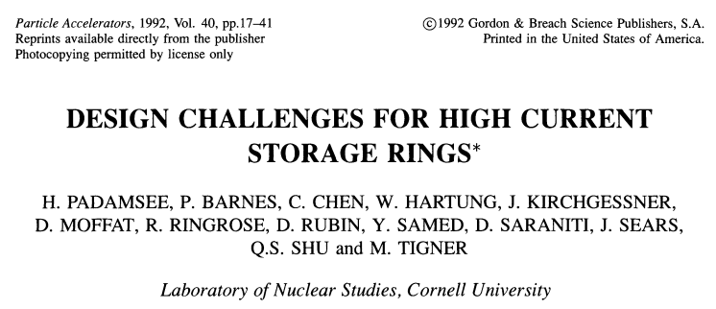
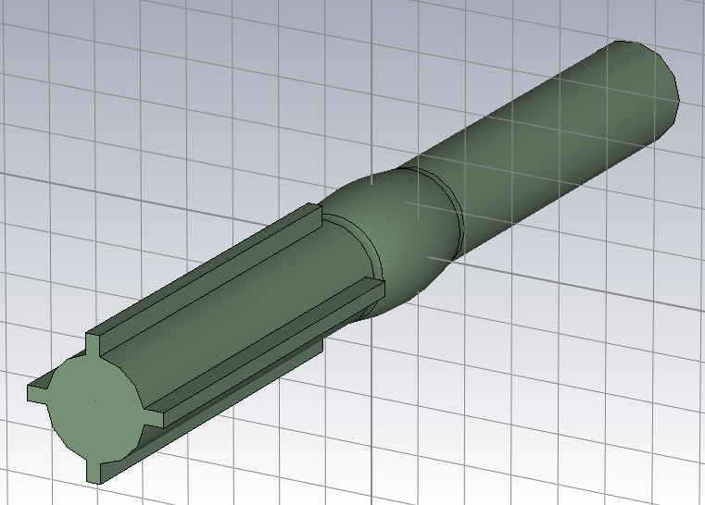
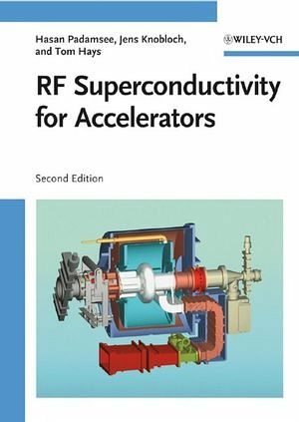
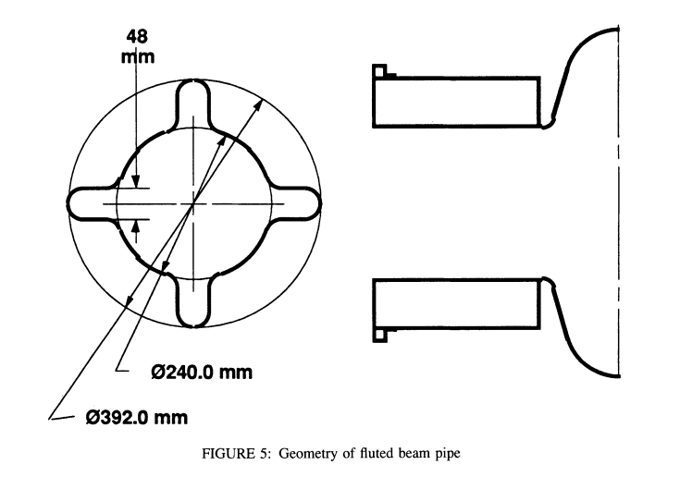
All LOM and HOMs damped
The magic flute helps to damp dipole LOM
One of the BCC beam pipes is ‘fluted’ using 4 longitudinal grooves to reduce TE11 WG mode cutoff from 1.69 GHz to lower value and let TE111 mode at f=1.59 GHz escape.

Slide 35
Summary table.More details : CLIC-note-1173, or in rf development meeting
Case | 1 | 2 | 3 | 4
Cavity R/Q [Ω] | 0.6 |  | 2.04
a [mm] | 52 |  | 50
Lc [mm] (0.01Hmax) | 520 |  | 500
Rarc [mm] | 307 |  | 160
Rcav [mm] | 61.95 |  | 63.55
Total R/Q [Ω] | 14.3 | 7.15 | 28.6 | 14.3
Bunch phase variation [º] @2GHz | 1 | 0.5 | 2 | 1
Ncav | 24 | 12 | 14 | 7
Cavity input power Pin [kW] | 60 | 120 | 103 | 206
Bmax [mT] | 100 | 200 | 100 | 200
Hmax [kA/m] | 80 | 160 | 80 | 160
Emax [MV/m] | 8.7 | 17.4 | 11.7 | 23.4
Cavity voltage Vc [MV] | 0.275 | 0.55 | 0.47 | 0.94
Cavity stored energy Uc [J] | 5.0 | 20.0 | 4.3 | 17.1

Slide 36
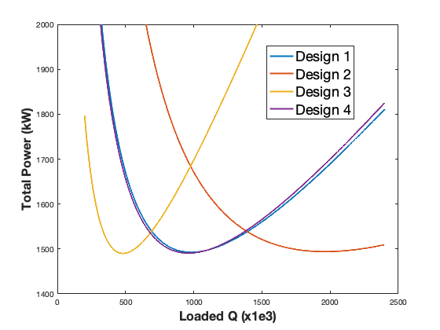
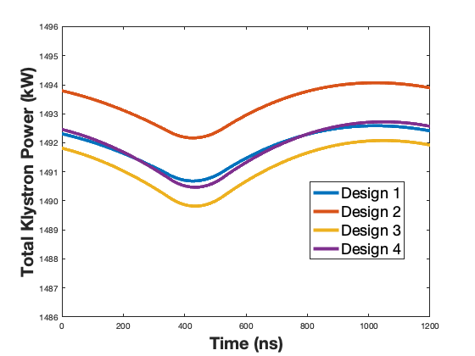
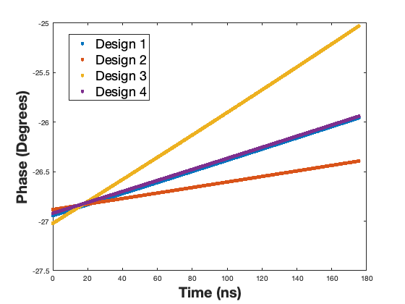
LLRF simulation results
Design | Δf (Hz) | Q_{L} | Peak power per klystron (kW) | Total peak power (MW) | φ_{b} | Δφ
1 | -514 | 983e3 | 62.2 | 1.49 | -26.8° | 0.99°
2 | -257 | 1962e3 | 125 | 1.49 | -26.8° | 0.49°
3 | -1020 | 496e3 | 107 | 1.49 | -26.8° | 1.99°
4 | -510 | 990e3 | 213 | 1.49 | -26.8° | 0.98°
T. Mastoridis
Due to the very high cavity filling time, the closed-loop response of the RF/LLRF system is slow.
In addition, there is a 350 ns delay in the RF loop. Very small klystron power modulation

Slide 37
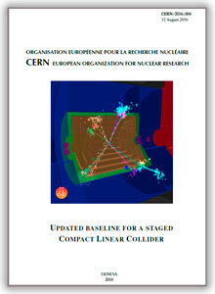
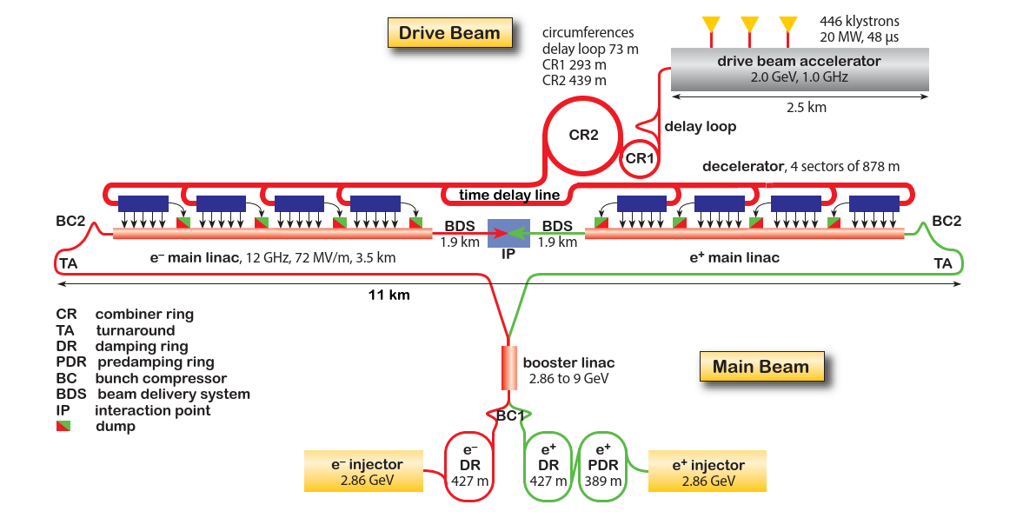
380 GeV CLIC layout and power consumption
Updated baseline for a Staged Compact Linear Collider, CERN-2016-004, 2016
Total power consumption of 380 GeV CLIC was estimated to be 252 MW
It was estimated using parameterized model [*] derived from the CDR power estimates at 3, 1.5 and 0.5 TeV stages and used for 1st stage optimization
* B. Jeanneret, CLIC Total Electrical power: a parametrization, CERN-ACC-Note-2013-0020, 2013

Slide 38

Power consumption estimate for Project Implementation Plan (PIP) in 2018
Motivations:
Parameterized model used in 2016 required verification at 380 GeV
Several changes in the design parameters had been made:
  Development of high efficiency klystrons
  (Pre-)Damping rings bunch-to-bunch spacing reduced from 1 ns to 0.5 ns
  Drive beam energy is reduced from 2.4 to 2.0 GeV
  Different design of the BDS at 380 GeV
Alternative klystron-based option of the first stage at 380 GeV needed power consumption estimate as well.
Assumptions
Project breakdown structure (PBS) of the costing tool has been used in order to insure the consistency of the power and the cost estimate
Expected Operating (not the specification) values have been consistently used for the RF and magnet systems

Slide 39
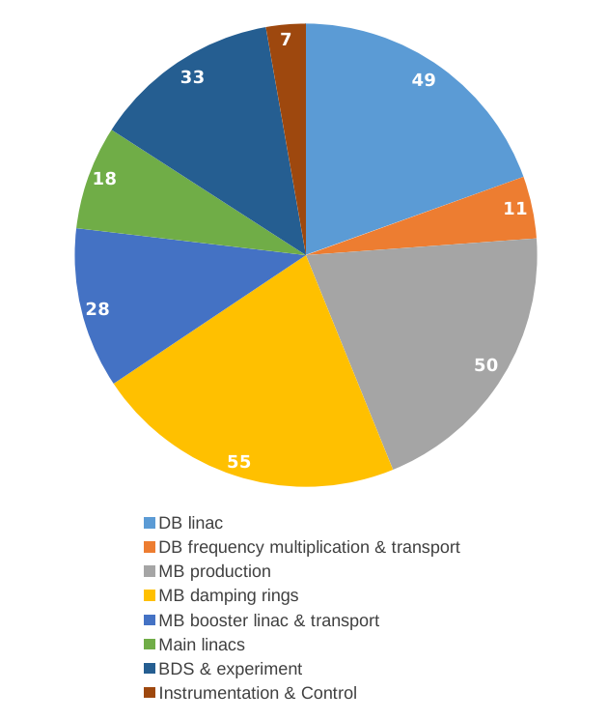
Comparison: 2016 vs 2018
252 MW
Significantly lower power consumption in the areas of MB injector, booster and transport as well as in the BDS has been found

Slide 40
Distribution of dissipated and beam powers

Slide 41
Power increase for operation mode at 100 Hz
To estimate increase in power consumption when go from 50 to 100 Hz
Pulsed RF and beam power is calculated: 55 MW
Addition EL and CV power is calculated: 13 MW
Total power increase: 68 MW
Total power consumption: 168+68= 236 MW
This estimate was mentioned in CLIC – Note – 1143: HIGH-LUMINOSITY CLIC STUDIES

Slide 42
CLIC DR summary of PIP baseline
Cavity type | ARES
Cavity R/Q [Ω] | 7.5
Number of cavities | 32
Cavity Q0 | 55000
BL compensation method | feedforward
Beam phase variation [º] | ~1
Peak input power [kW/cavity] | 405
Cavity power loss [kW] | ~50
Total peak input power [kW] | 12960
Strong transient beam loading effects cause:
Very high peak power
Larger klystron bandwidth
Strong peak power modulations on each turn
Inefficient due to most of average power lost
(NIMA V985, 164659, 2021)

Slide 43

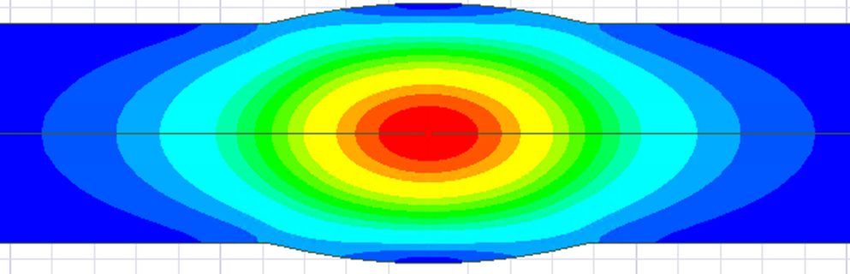
Novel cavity: Barrel Cell Cavity (BCC) geometry for ultra low R/Q
Rarc
Rcav
a
Beam axis
E-field
Large aperture => low R/Q
Long cell: ~λ => low transit time factor
Low field on the cavity wall
More details in: CLIC-note-1173,
or in rf development meeting (22 September 2021)

