Slide 1
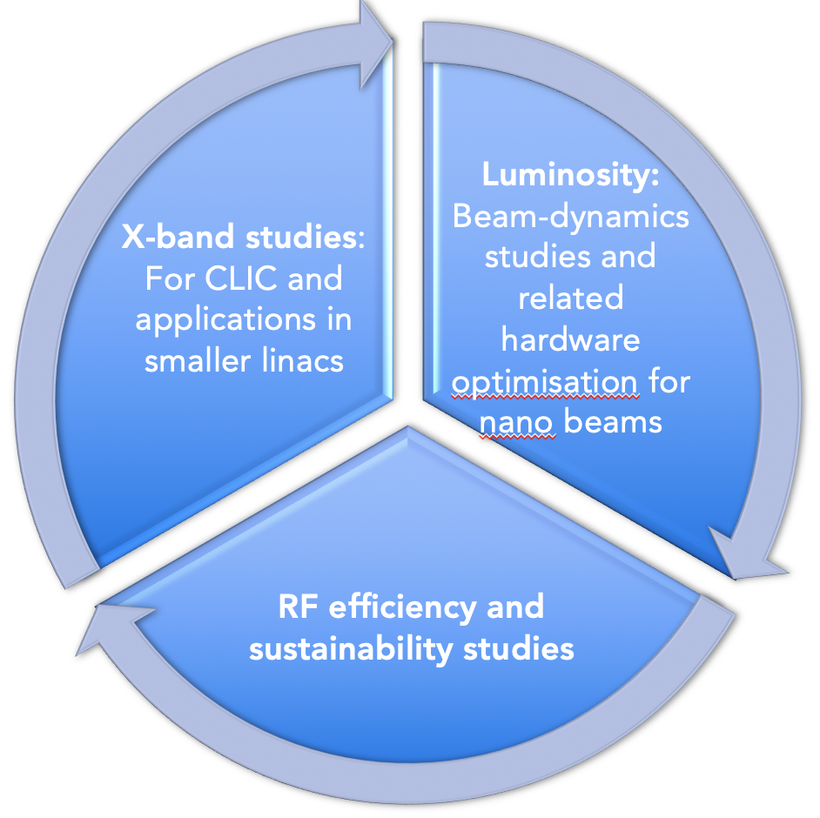
CLIC Project Readiness 2025-26
Project Readiness Report as a step toward a TDR – for next ESPP
Assuming ESPP in 2026, Project Approval ~ 2028, Project (tunnel) construction can start in ~ 2030.
Focusing on:
The X-band technology readiness for the 380 GeV CLIC initial phase - very important part driven by use in small compact accelerators
Optimizing the luminosity at 380 GeV – already implemented for Snowmass paper, further work to provide margins will continue
Improving the power efficiency for both the initial phase and at high energies, including more general sustainability studies

Slide 2

Indicative scenarios of future colliders [considered by ESG]
Proton collider
Construction/Transformation
Electron collider
Preparation / R&D
Original from ESG by UB
Updated July 25, 2022 by M.Narain (Snowmass summary)
Muon collider
2038 start physics
Japan
5 years
ILC: 250 GeV
2 ab⁻¹
500 GeV
4 ab⁻¹
1 TeV
≈ 4-5.4 ab⁻¹
20km tunnel
31km tunnel
40 km tunnel
2035 start physics
China
CepC: 90/160/240 GeV 100/6/20 ab⁻¹
100km tunnel
SppC: 75-125 TeV, 10-20 ab⁻¹
LHC HL-LHC (14TeV, 3 ab⁻¹)
(13.6TeV, 450 fb⁻¹ )
2048 start physics
100km tunnel, installation
FCC-ee: 90/160/250 GeV -150/10/5 ab⁻¹
350-365 GeV 1.7 ab⁻¹
installation
CERN
FCC hh: 100 TeV ≈ 30 ab⁻¹
29 km tunnel
50 km tunnel
2020
2030
2040
2050
2060
2070
2080
2090

Slide 3
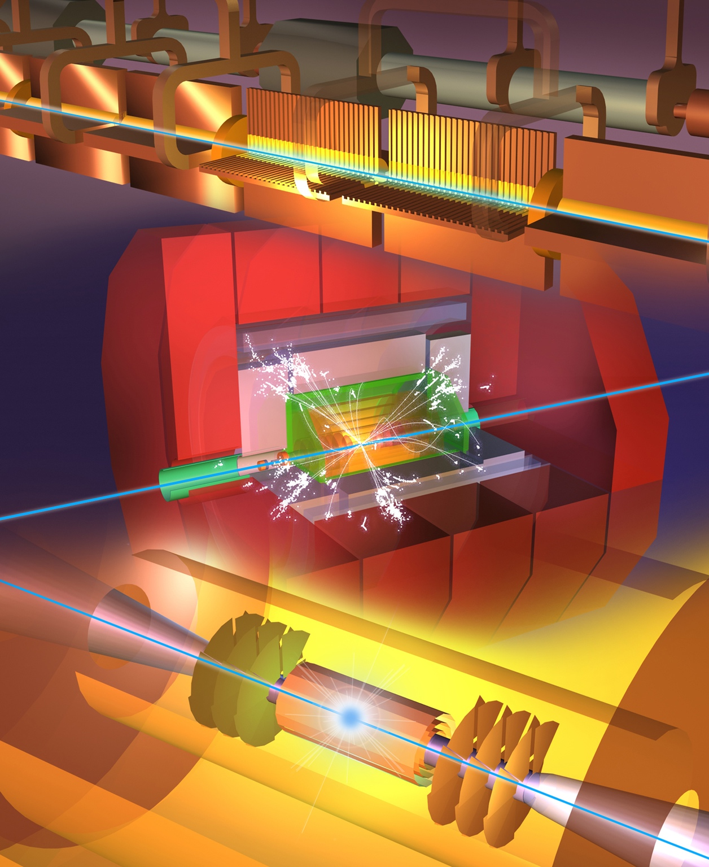
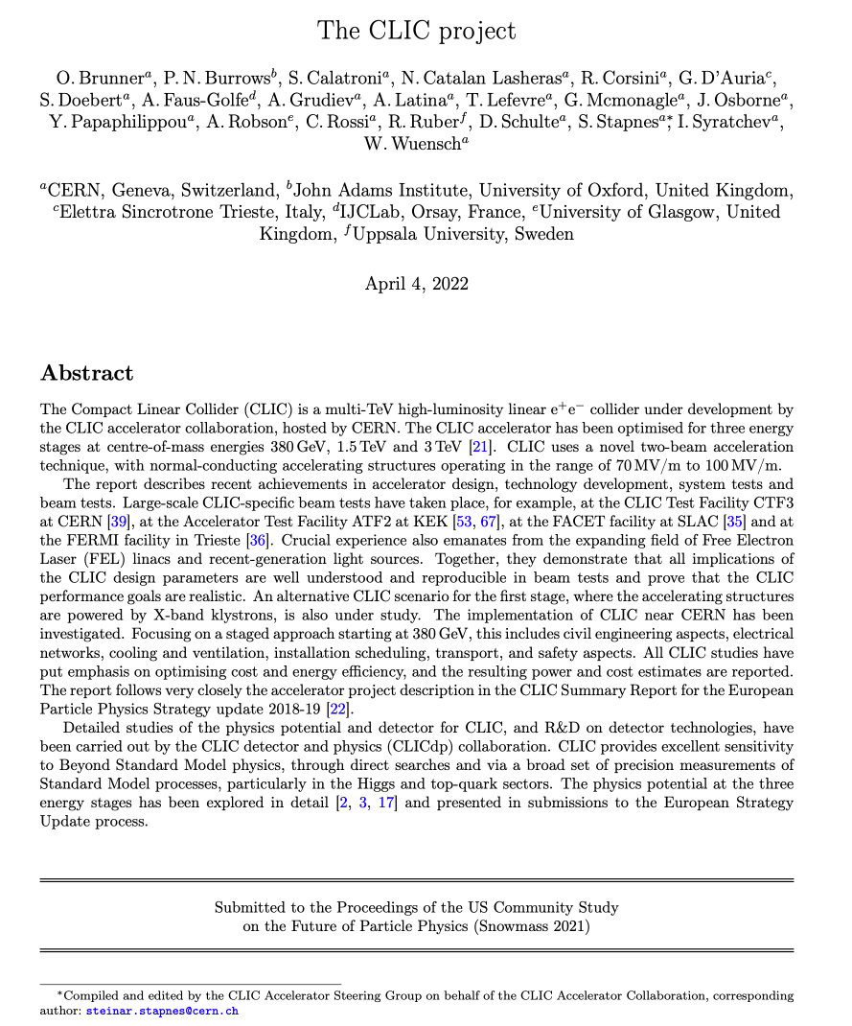
Status reports and studies
Several LoIs have been submitted on behalf of CLIC and CLICdp to the Snowmass process:
The CLIC accelerator study: Link
Beam-dynamics focused on very high energies: Link
The physics potential: Link
The detector: Link
Snowmass white paper:
https://arxiv.org/abs/2203.09186
Available at:
clic.cern/european-strategy
Broadly speaking: “Updated accelerator part of 2018 Summary Report”

Slide 4
CLIC Project Readiness 2025-26
Goals for the studies by ~2025, key improvements:
    Luminosity numbers, covering beam-dynamics, nanobeam, and positrons - at all energies. Performance risk reduction, system level studies
              Substantial progress already documented in Snowmass report and associated references, remains a focus for beamdynamics, nanobeam related technical developments and positron production studies
Energy/power: 380 GeV well underway, 3 TeV to be done, L-band klystrons
  In Snowmass report for 380 GeV
Sustainability issues, more work on running/energy models and carbon footprint
  Initial studied in Project Implementation Plan (PiP) 2018, just referred to briefly in Snowmass report
X-band progress – for CLIC, smaller machines, industry availability, including RF network
    Addressed by establishing improved baseline, CompactLight Design Study very important and many smaller setup. No complete documentation in PiP 2018 or Snowmass report 2022.
RF design optimization/development – including injectors, R&D for higher energies, gradient (cool/HTS/etc.), optimal beam parameters
    Links to power, nanobeam and beamdynamics
Cost update, only discuss changes wrt Project Implementation Plan in 2018
  Possible impact of sustainability optimization, inflation ?
Low cost klystron version – reoptimize for power, cost and fewer klystrons
CLIC versus ILC and C3 (maybe not needed in readiness report) – performances and upgrade scenarios

