Slide 1


WP5
Optical Fibers for Dosimetry, Beam Instrumentation and Detectors
Luca Weninger (UJM)
RADNEXT 2nd Annual Meeting – 9-10 May 2023
https://indico.cern.ch/e/radnext-2023
Notes:
Add UJM logo?

Slide 2
Outline
Radiation-Induced Attenuation (RIA)
  Basic mechanism
  Choosing an optical fiber
  Distributed dosimetry
  New ultra-low loss PSC optical fiber
Radiation-Induced Luminescence (RIL)
  Basic mechanism
  N-doped fiber repeatability study
  Fibers for proton beam monitoring
  10-decades dose rate linearity span
Notes:
Ultra-low dose rate measurements?

Slide 3
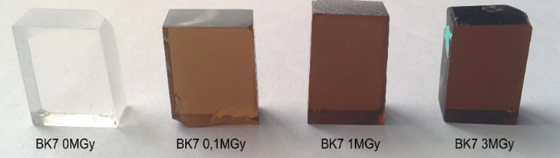
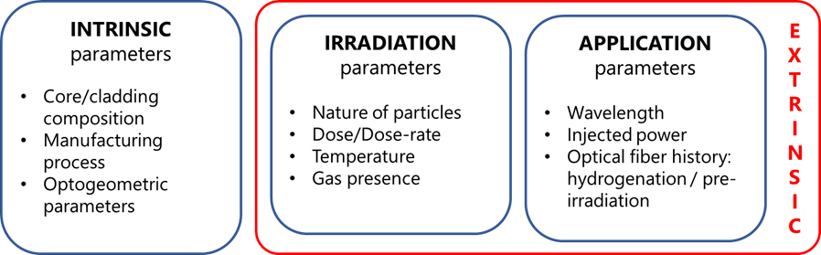
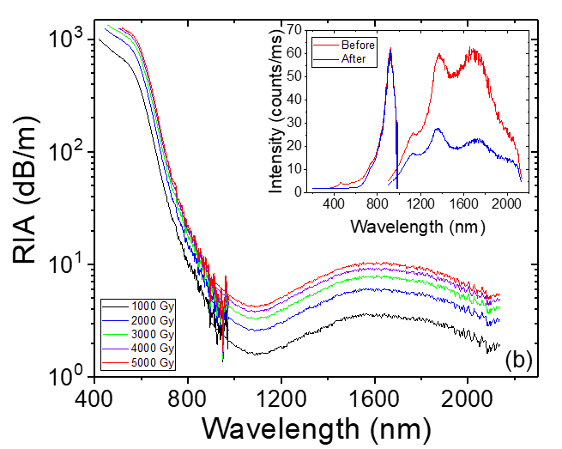
Radiation-Induced Attenuation (RIA)
RIA is a macroscopic change in the transmission characteristic of the optical fiber caused by the appearance of radiation-induced point defects inside its structure.
The point defects are mostly created via ionization within the silica amorphous glass.
The cumulative nature of RIA makes it a great candidate for total ionizing dose (TID) measurements.
Notes:
Maybe add Lumina? Instead of the Spectral RIA figure…

Slide 4
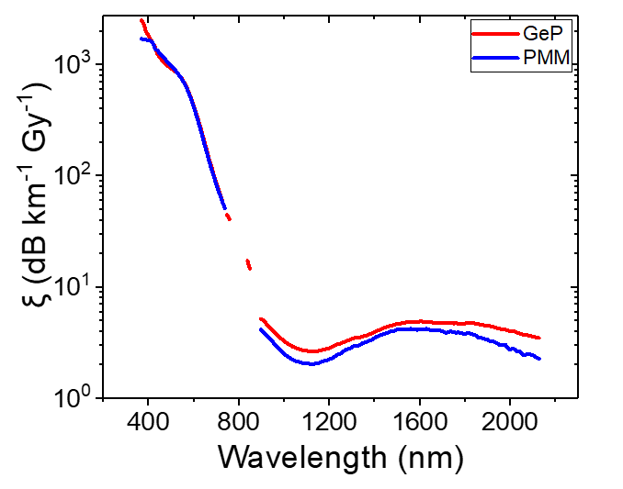
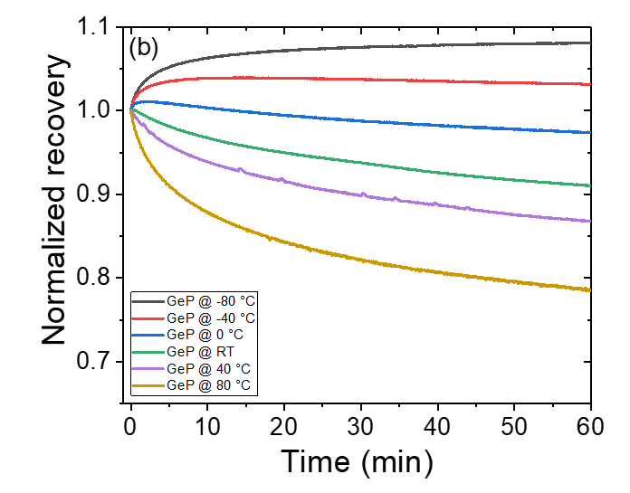
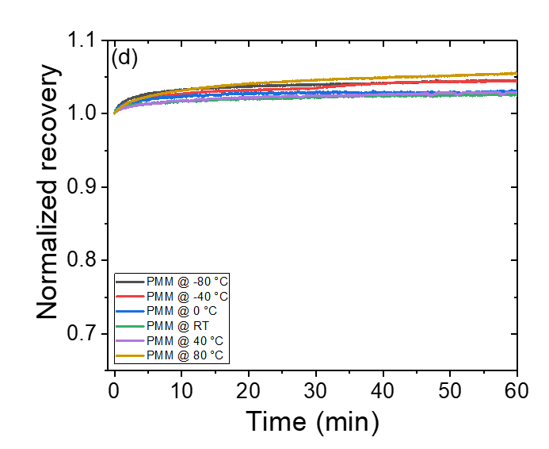
RIA-based dosimetry: Choosing an optical fiber
A good radiation-sensitive optical fiber should have:
High radiation sensitivity ξ (expressed in dB km⁻¹ Gy⁻¹)
Ideally, linear RIA increase with dose
Dose rate independence
Temperature independence
Compatibility with interrogation tools (wavelength)
Absence of recovery
To this day, P-doped optical fibers show the most promise for dosimetry applications, as they check all these ticks.
L. Weninger et al., IEEE TNS, Early Access 2023.
Notes:
Bigger Axes?

Slide 5
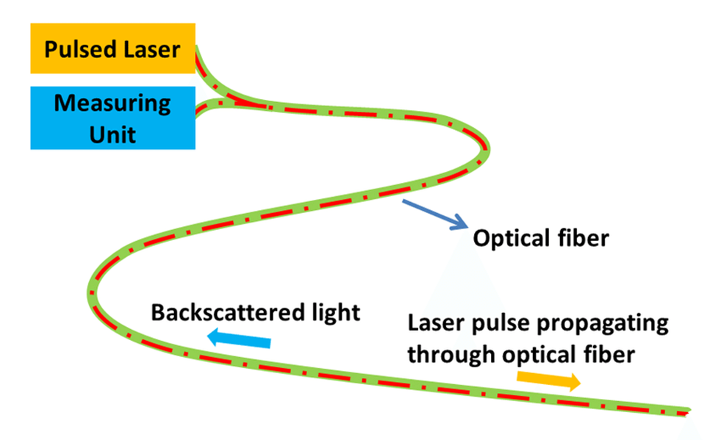
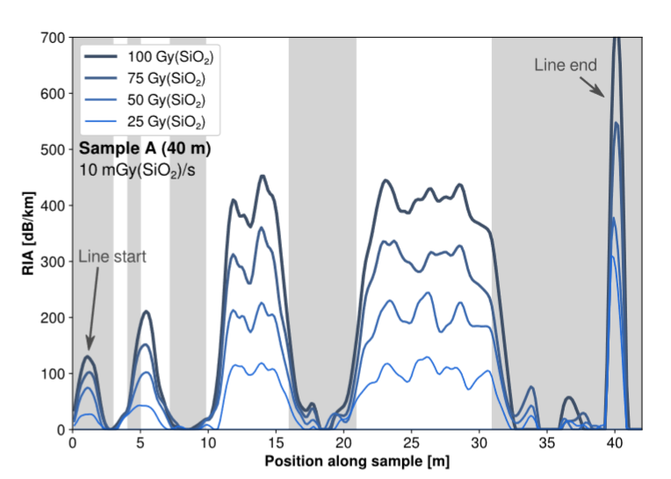
RIA-based dosimetry: Distributed dosimetry
Dosimeter performances criteria
Spatial resolution: point sensor or distributed sensor (cm to m resolution)
Sensing distance (point sensor to km range)
Detection threshold (min dose)
Operating dose range (min – max dose)
The most studied application to this day makes use of an Optical Time Domain Reflectometer (OTDR).
Implemented with a P-doped optical fiber, this technique has been shown to perform well under gamma, X-rays protons and mixed fields at CHARM.
Dose
A. Meyer et al., IEEE TNS, 2022.
D. Di Francesca et al., IEEE TNS, 2018
I. Toccafondo et al., JLT, 2017
Notes:
Cm is OFDR
Space-resolved dose measurement with a single OF

Slide 6
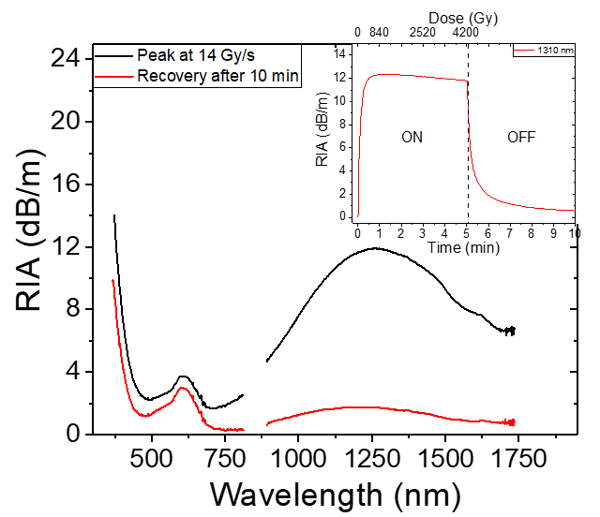
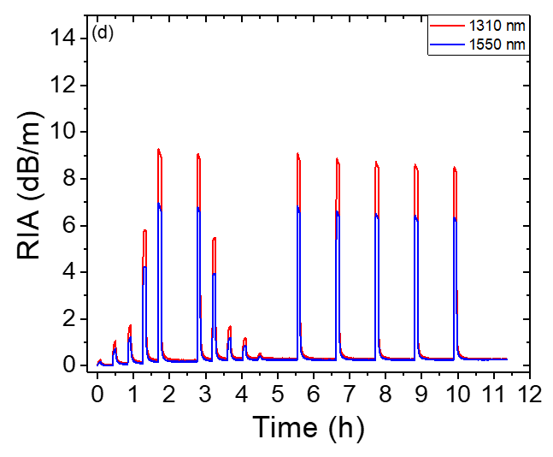
RIA-based radiation detection: New ultra-low loss PSC fiber
An ultra-low loss (ULL) pure-silica core (PSC) optical fiber has shown a peculiar RIA behavior under irradiation:
While PSC fibers are usually radiation resistant, the RIA sensitivity of this fiber is higher than any other fiber studied to date.
After irradiation, the losses in the IR return almost completely to a permanent level.
With these characteristics, this fiber could be implemented in a tunable (fiber length, injected power) and resettable radiation detector.

Slide 7
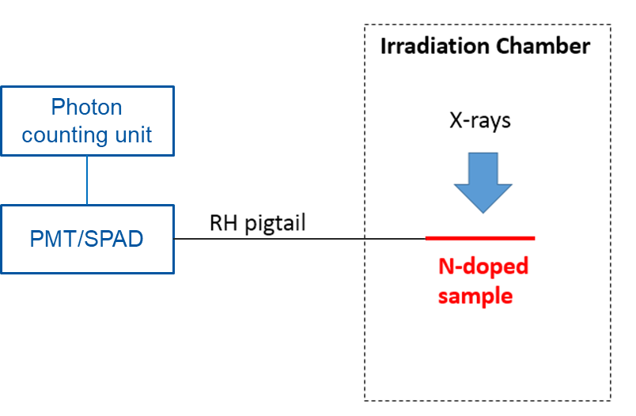
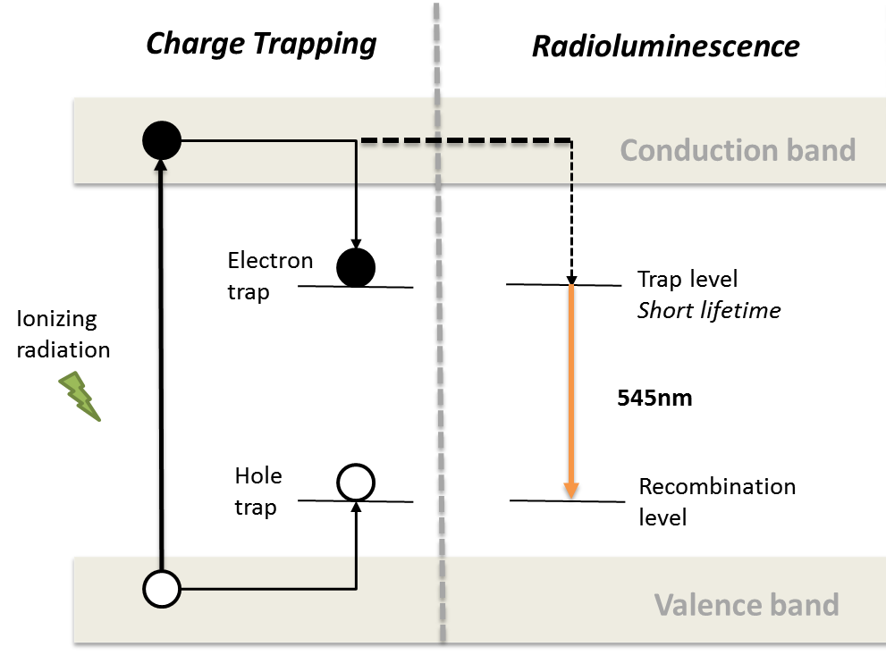
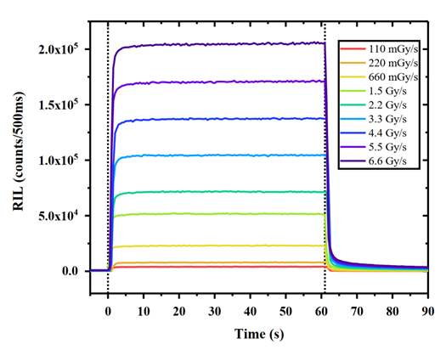
Radiation-Induced Luminescence
The presence of a recognizable light signal when the fiber is under irradiation makes RIL a good candidate for dose rate sensing.
A good radiation-luminescent optical fiber should have:
High quantum efficiency
Linear RIL increase with dose rate
TID independence
Temperature independence
Compatibility with interrogation tools (wavelength)
Among others, N-doped optical fibers have recently shown great promise, as they present a strong RIL signal combined with a good resistance to RIA.
ON
OFF

Slide 8
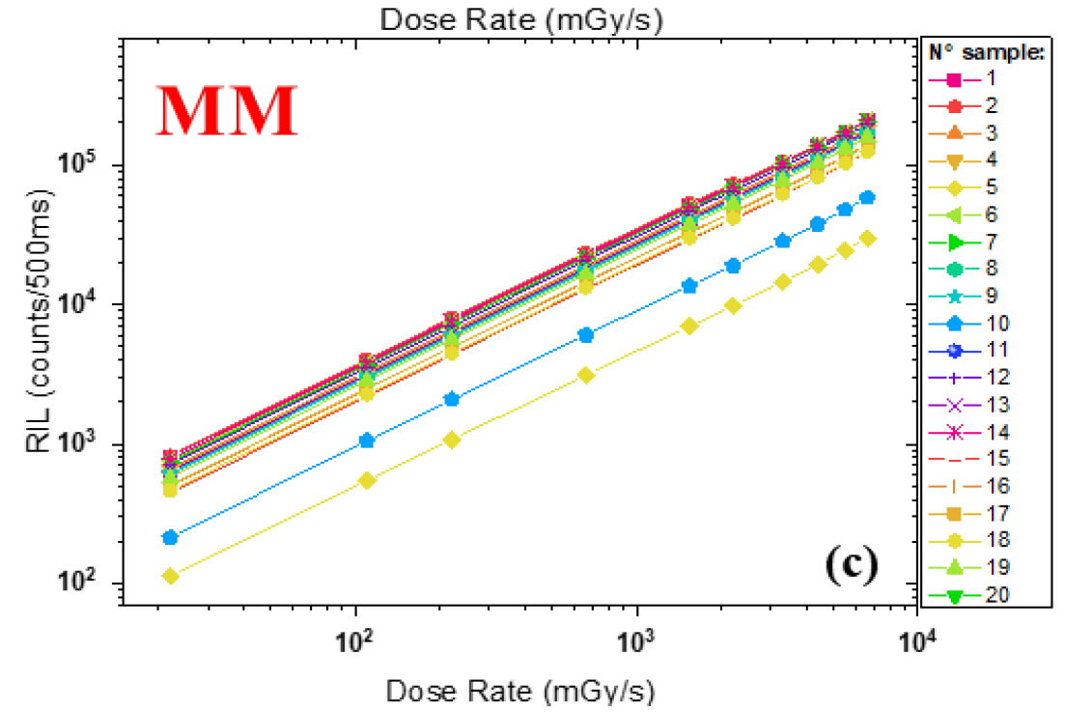
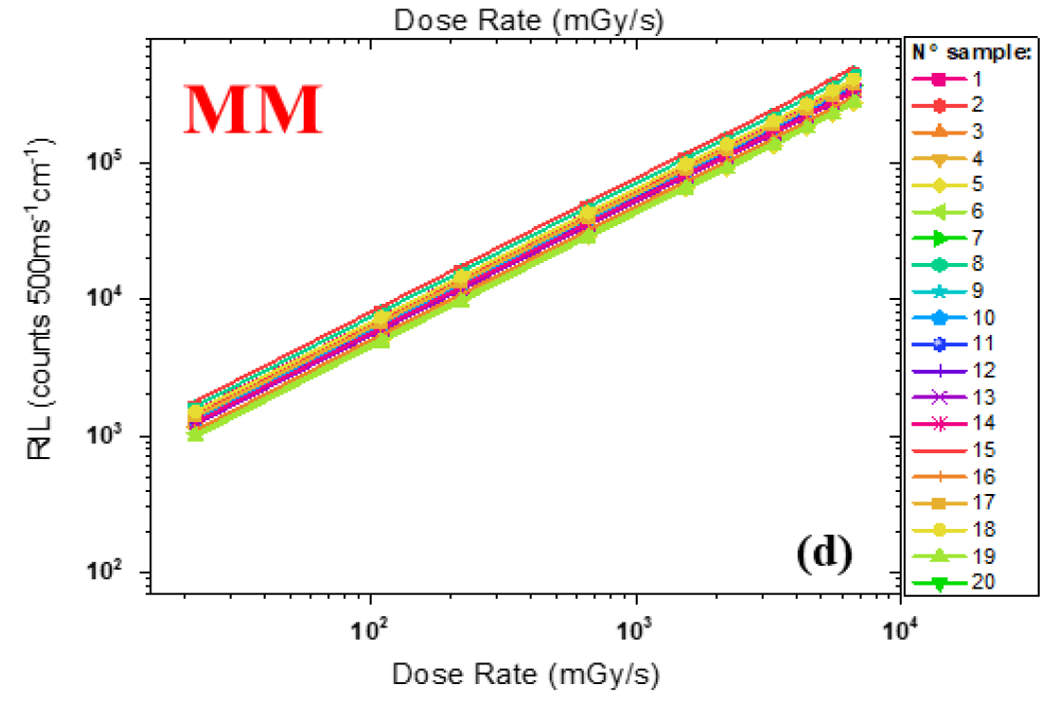
RIL-based dosimetry: N-doped fiber repeatability study
The reproducibility of dose rate RIL measurements with a N-doped fiber has been studied to evaluate the possibility to avoid the calibration of every single sample.
The solution showed its promise with a low dispersion over 20 different probes (4% for a single mode fiber, 25% for a multimode fiber).
In addition, a method to correct errors related to the estimation of the sample length and the losses in the splices between two samples has been proposed and validated.
F. Fricano et al., IEEE TNS, Early Access 2023.

Slide 9
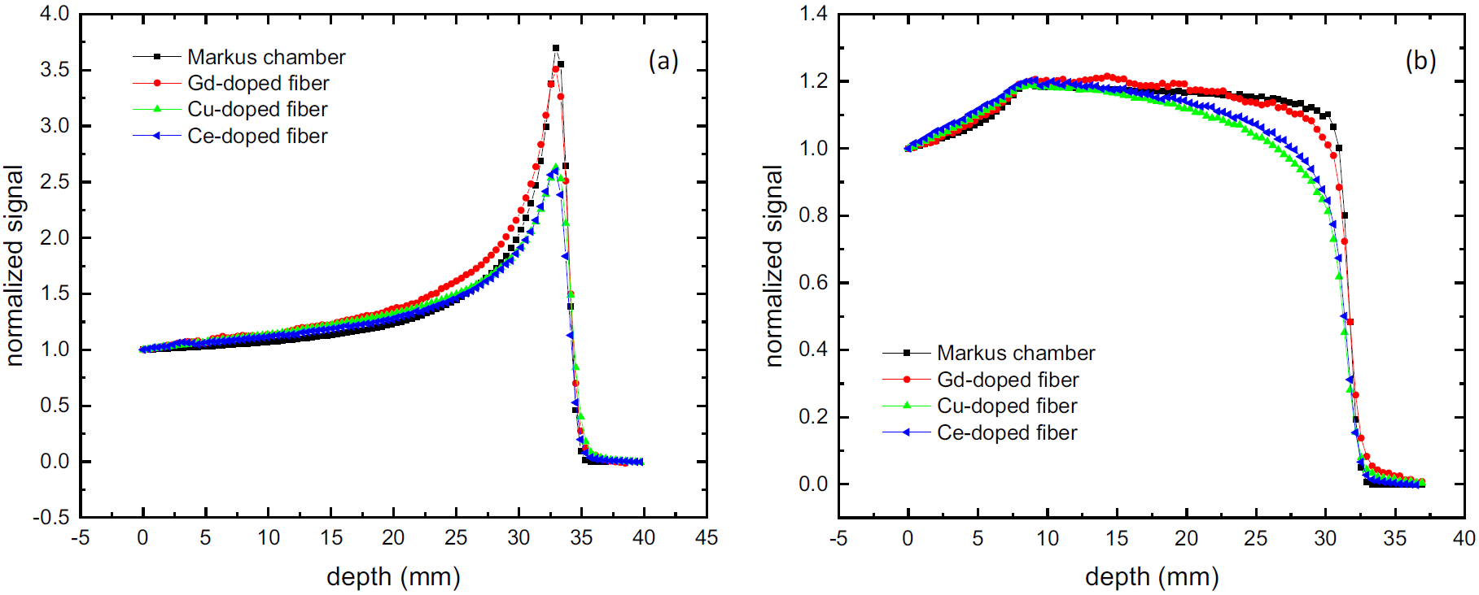
RIL-based dosimetry: Fibers for proton beam monitoring
Different fibers have been characterized at TRIUMF to monitor their 74 MeV proton beam.
The fiber showed promise as a beam monitor with limited quenching present at high energies.
The limited size of the fiber (~250 um) offers an interesting trade-off in terms of spatial resolution of the beam monitoring, compared to the reference Markus chamber.
Among the investigated fibers, the Gd-doped one was the best at reproducing both the raw Bragg peak and the spread-out Bragg peak of the proton beam.
Spread out Bragg Peak
Raw Bragg Peak
S. Girard et al., IEEE TNS, 2019.
C. Hoehr et al., Sci. Rep., 2019.

Slide 10
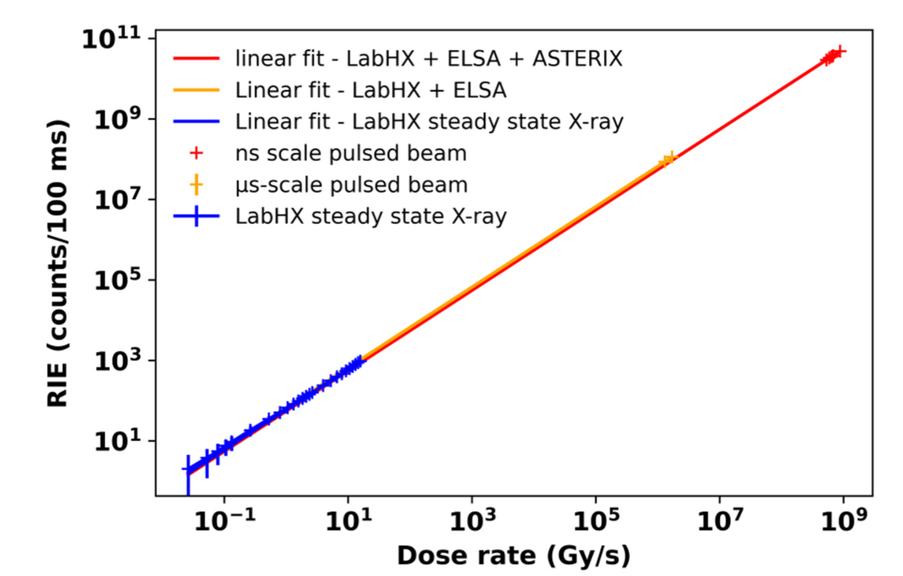
RIL-based dosimetry: 10-decades dose rate linearity span
The RIL response of a N-doped optical fiber has been shown to be linear across 10 decades of dose rates (0.01 Gy/s up to GGy/s).
This was measured across three different X-ray facilities: one continuous beam (LabHX) and two pulsed beams (ELSA and ASTERIX).
The RIL signal was shown to be linearly proportional to the dose rate regardless of the photon energy.
1 MeV
19 MeV
40 keV
J. Vidalot et al., Sensors, 2022.

Slide 11
Conclusions
Thanks to the advantages of fiber-based solutions (reduced size, weight, resistance to EM noise, etc.), optical fiber sensors for dose and dose rate are being investigated and implemented in many applications (space, medical, high energy physics, beam monitoring).
Future challenges concern the functionalization of these fibers to suit each specific application, from the drawing process to the perfection of the interrogation setup.
Overcoming these future challenges will be possible through a coupled simulation/experiments approach to identify and predict the basic mechanisms describing the radiation effects on fibers.

Slide 12
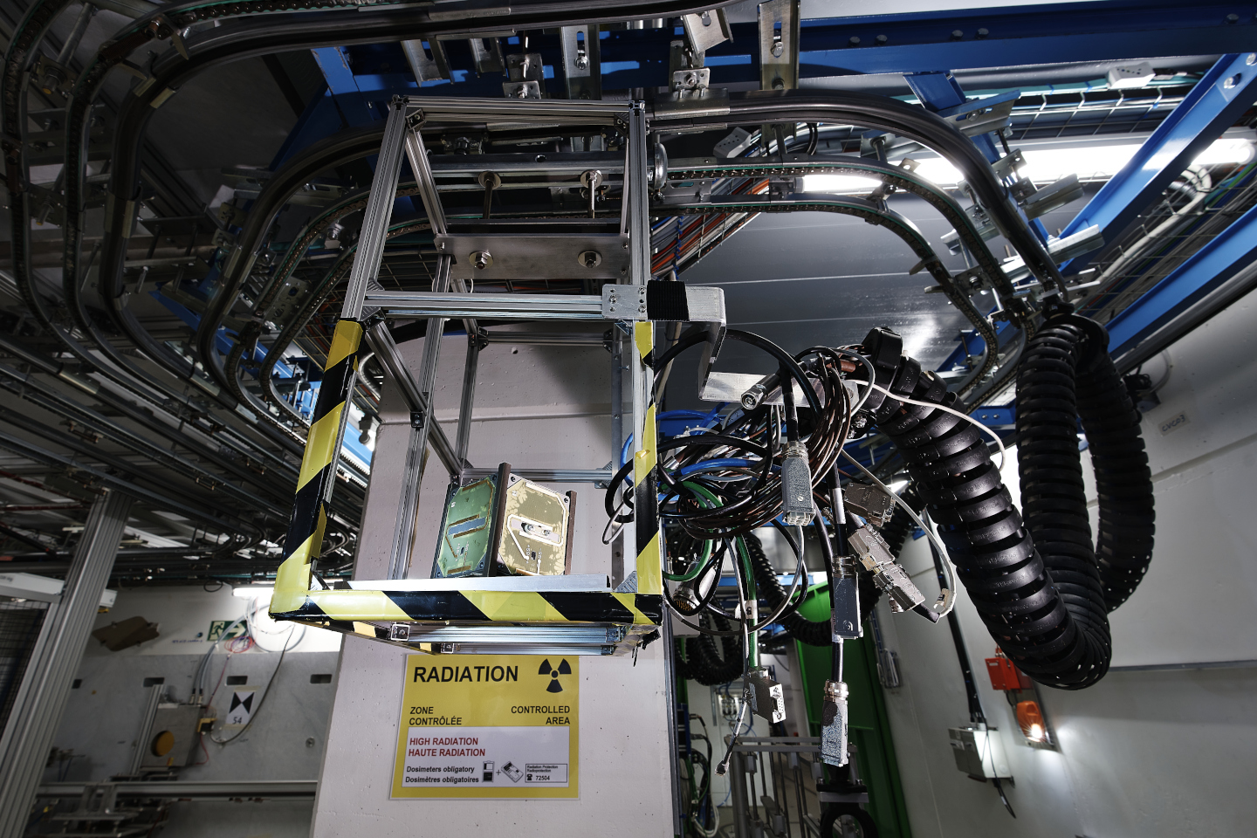
Thanks for your attention!
Image Source: CERN

Slide 13
RIL dependence on fiber length
At HIGH Dose rate/ TID ➔ Short lengths of fibers have to be used to reduce RIA issues.
At LOW Dose rate/TID ➔ Fiber length can be optimized to increase the RL level.

Slide 14
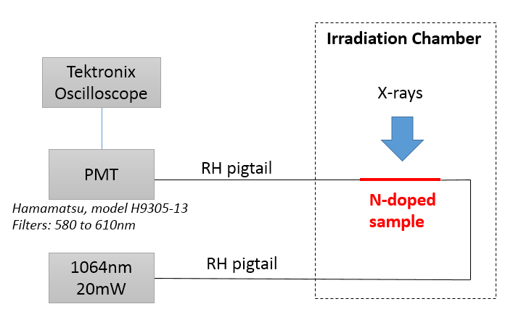
RIL-based dosimetry: Optically Stimulated Luminescence
By integrating the OSL signal after irradiation, its dose dependence of the OSL can be reconstructed and the fiber being calibrated if the OSL is dose rate independent

