Slide 1
Status and Outlook of WP04 “Roadmap and Pre-design of Future Irradiation Facilities”
P. Pelissou (CERN), F. Ravotti (CERN), S. Danzeca (CERN), R. Versaci (ELI BEAMLINES),
I. Zymak (ELI BEAMLINES)
RADNEXT 2nd Annual Meeting – 9th - 10th of May
https://indico.cern.ch/event/1213492/
Contact: pierre.pelissou@cern.ch

Slide 2

WP04-NA3 RADNEXT
Agenda
WP04 structure and members
Task 4.1
Task 4.2
Task 4.3
Task 4.4
WP04-NA3 Conclusion

Slide 3





1. WP04 structure and members
Main objective: Define long term scientific and industrial needs for irradiation facilities based on key parameters, considering inputs from relevant research groups and industrial community
Key tasks’ description:
- Task 4.1: WP Coordination and Communication
- Task 4.2: Identify limiting factors of current irradiation facilities and propose solutions for the upgrade of existing infrastructures and the development of future ones (D4.1 and D4.2, M20)
- Task 4.3: Investigate innovative solutions for current irradiation facilities (D4.3, M30)
- Task 4.4: Design study of new irradiation facilities (D4.4, M40)

Slide 4



2. WP04-NA3 Task 4.1 : WP Coordination and Communication
  Indico category available “WP4-NA3”
    WP4 RADNEXT Team Meeting on a weekly basis
    E-group created (radnext-na3) with the following email address:
    radnext-na3@cern.ch

Slide 5
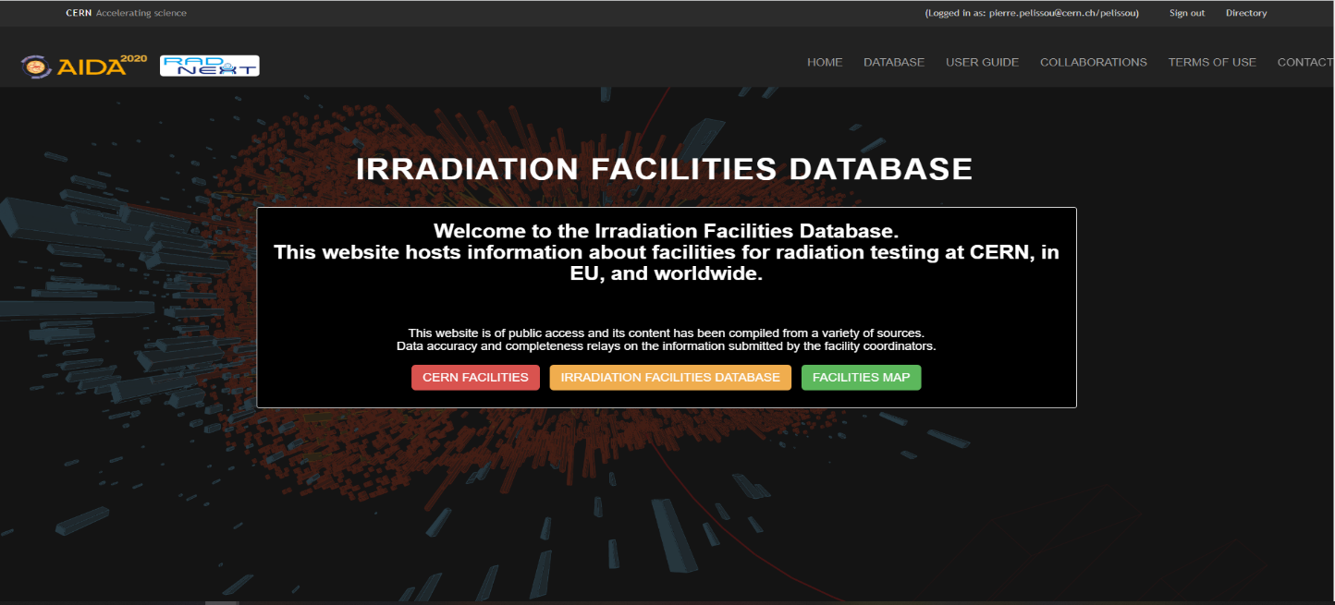
3. WP04-NA3 Task 4.2 : Key performance parameters for current and new facilities
Report D4.2: Updated international irradiation facility compendium
  Strong synergies with WP3 in order to retrieve facilities information and feedback:
    Consolidation of the radiation test facilities database
    Updates of important parameters and features
WP4
WP3 Task 3.3
RADNEXT facility coordinators
WP8
RADNEXT users
A unified entry point for CERN and worldwide irradiation facilities with an essential collection of information https://www.cern.ch/irradiation-facilities/

Slide 6
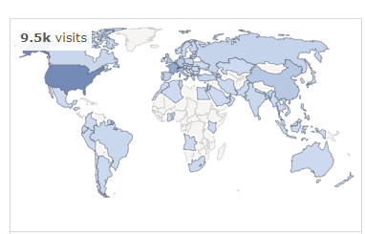
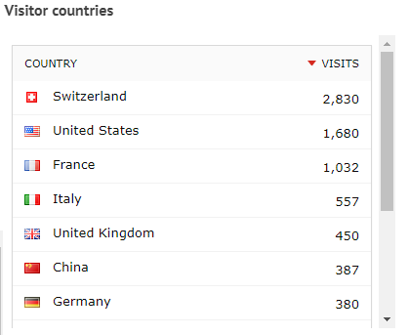
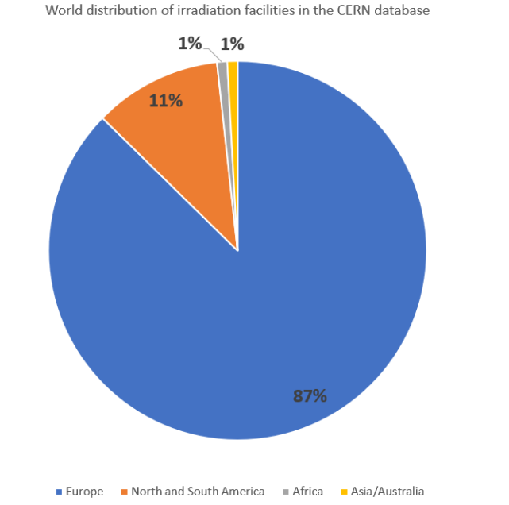
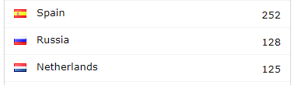
3. WP04-NA3 Task 4.2 : Key performance parameters for current and new facilities
A database platform dedicated to list essential features of irradiation facilities:
  Open source developed at CERN (EP dept.)
  List of infrastructures across application domains
  Information displayed under the responsibility of the facility coordinators
Today:
  Maintained through RADNEXT WP4
  234 valid facility entries (updated from November 2022 onwards)
  ∼ 9500 visits since launch
Europe
North and South America
Africa
Asia/Australia

Slide 7

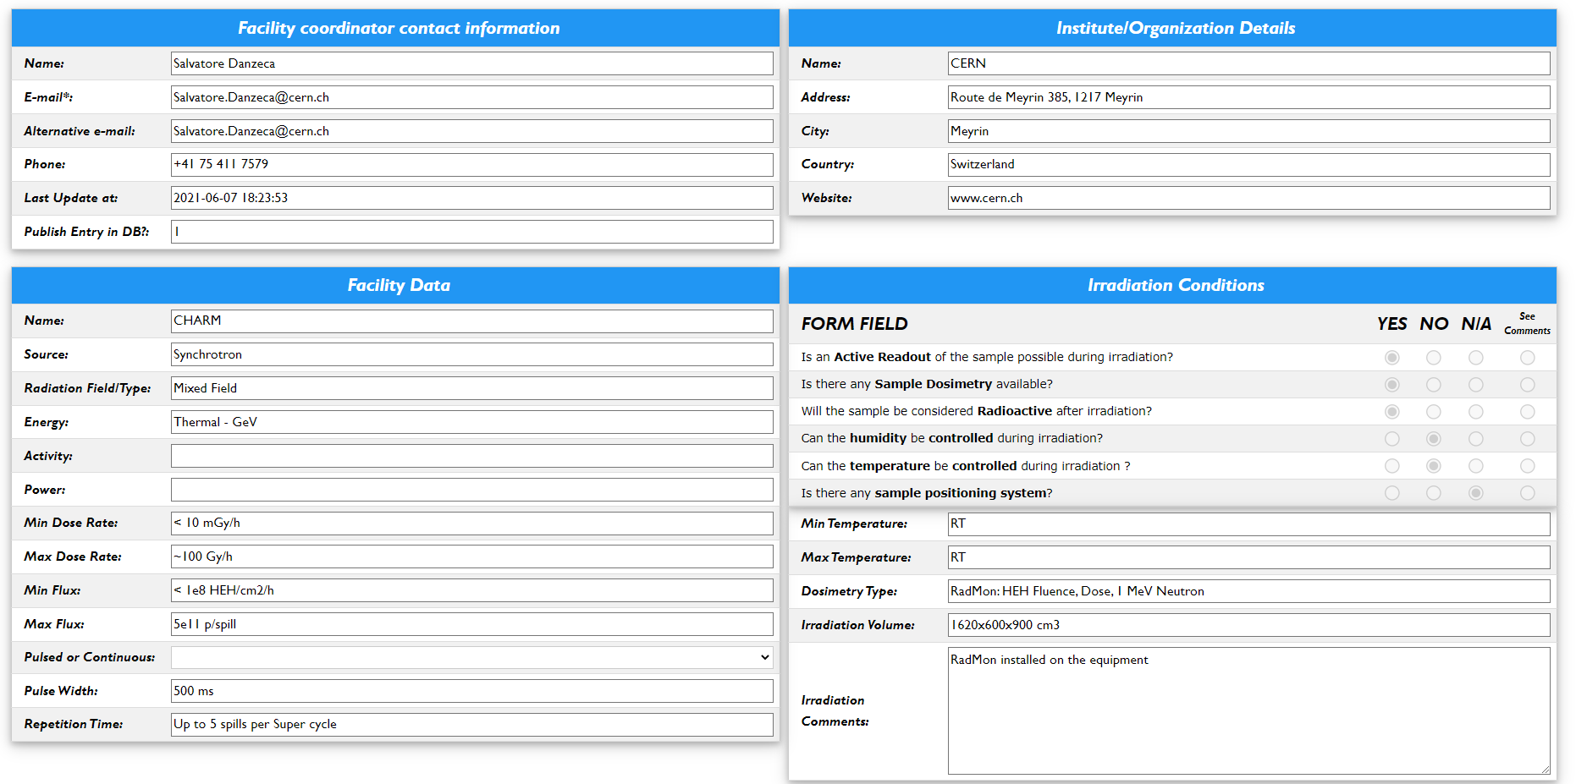
3. WP04-NA3 Task 4.2 : Key performance parameters for current and new facilities
  A dedicated window for each facility entry:
    - Contact information
    - Facility data, irradiation conditions, safety and accessibility
  Search functionalities:
  - Country, source type and radiation field/type
  Editing functionalities:
  - Protected by CERN authentication system
  - External “lightweight” accounts are supported
  USER MANUAL:
    - AIDA-2020-NOTE-2017-002

Slide 8
3. WP04-NA3 Task 4.2 : Key performance parameters for current and new facilities
Report D4.1: Determine Key Performance Indicators (KPI) and limiting factors for current facilities in view of future technological bottlenecks
  STEP 1: a questionnaire dedicated to RADNEXT users and beyond
  - Identify the current and future needs of users performing tests in worldwide irradiation facilities
  STEP 2: a questionnaire dedicated to RADNEXT facility coordinators
  - Assess the performance of RADNEXT irradiation facilities by means of 9 KPI
  STEP 3: Identify new facilities currently not adapted for radiation testing but that can be used for components qualification and system-level testing
Summary for RADECS 2023: “Bridge the gap between future users’ needs and radiation-test facilities performances”, P. Pelissou, I. Zymak, R. Versaci, F. Ravotti, S. Danzeca

Slide 9
3. WP04-NA3 Task 4.2 : Key performance parameters for current and new facilities
STEP 1: Identify technological limiting factors for available irradiation test facilities based on current industrial and scientific requests
  RADNEXT user's questionnaire focused on 4 use cases :
  - Sensors and Detectors
  - Electronic components
  - Electronic System and Tests
  - Materials
  As well as 5 radiation fields:
  - Heavy ions, protons, neutrons, mixed-field and photons

Slide 10
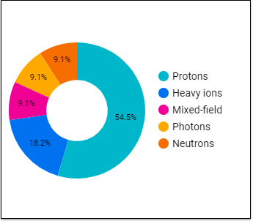
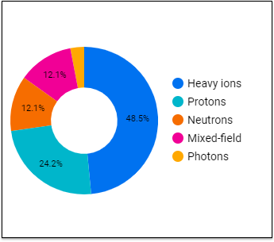
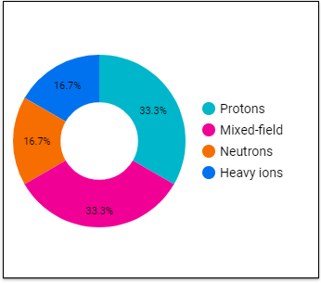
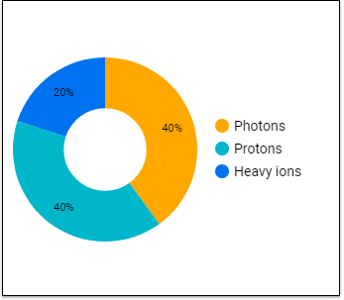
3. WP04-NA3 Task 4.2 : Key performance parameters for current and new facilities
Needs for radiation fields according to the use cases
Sensors and Detectors (11 replies)
Electronics Components (33 replies)
Electronics System Tests (12 replies)
Materials (5 replies)

Slide 11
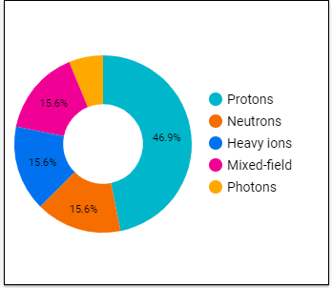
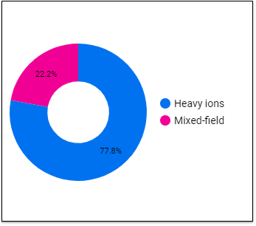
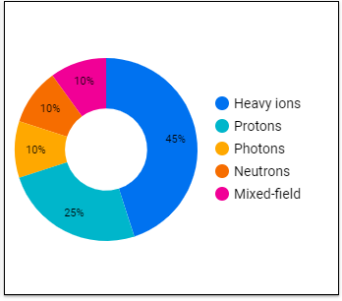
3. WP04-NA3 Task 4.2 : Key performance parameters for current and new facilities
Needs for radiation fields according to the work place of users
University/Research Institute (32 replies)
Space Agency/Aerospace (9 replies)
Industry (20 replies)

Slide 12
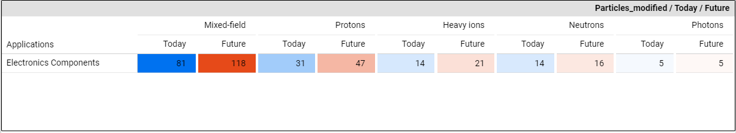
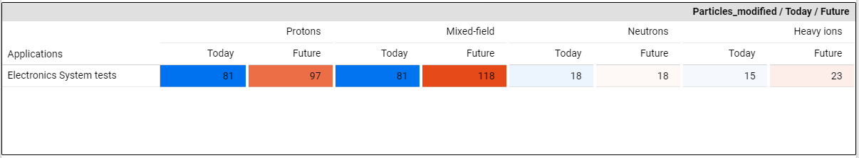
WP04-NA3 Task 4.2 : Key performance parameters for current and new facilities
Average number of days required to perform radiation tests per year
Electronic Components (33 replies)
Demand’s increase:
- Heavy ions: +32%
- Mixed-field: +31%
- Protons: +24%
Electronic System Tests (12 replies)
Demand’s increase:
- Mixed-field: +68%
- Heavy ions: +35%
- Protons: +16%

Slide 13
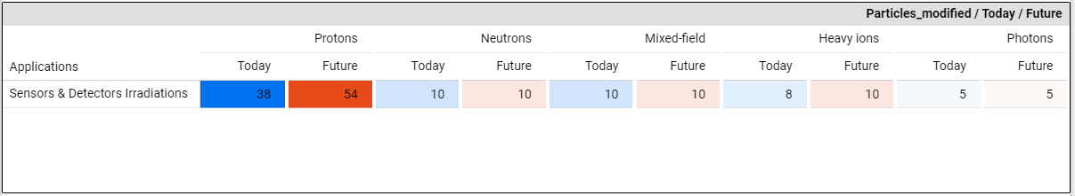
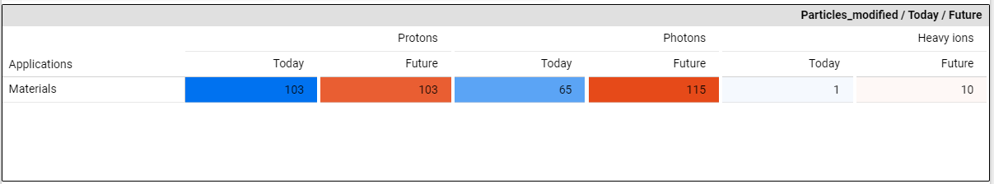
3. WP04-NA3 Task 4.2 : Key performance parameters for current and new facilities
Average number of days required to perform radiation tests per year
Sensors and Detectors (11 replies)
Demand’s increase:
- Protons: +30%
- Heavy ions: +20%
Materials (5 replies)
Demand’s increase:
- Heavy ions: +90%
- Photons: +43%

Slide 14
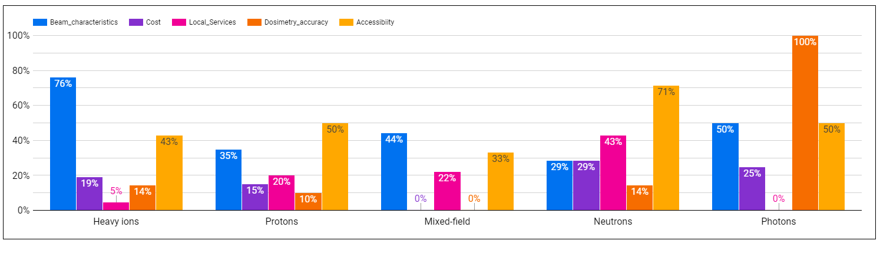
3. WP04-NA3 Task 4.2 : Key performance parameters for current and new facilities
Most important criteria to select a facility for users
Beam characteristics and availability prevailed in users’ selection of a given facility

Slide 15
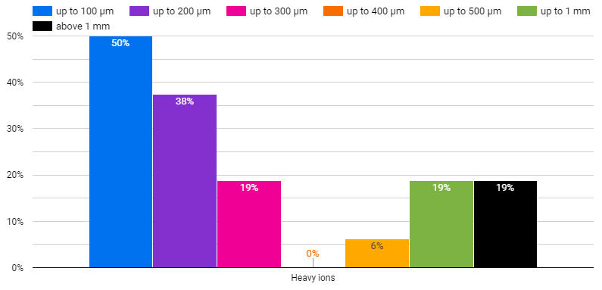
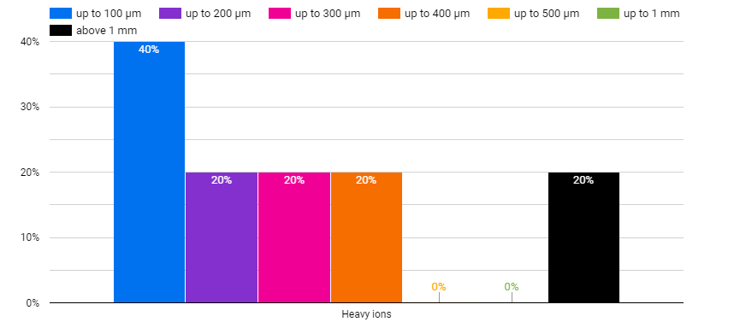
3. WP04-NA3 Task 4.2 : Key performance parameters for current and new facilities
Penetration depth required by users of heavy ions facility
Electronics Components (16 replies)
Electronics System and tests /Sensors and Detectors/Materials (5 replies)
Up to 100 µm
Above 1 mm
Up to 100 µm
Above 1 mm

Slide 16
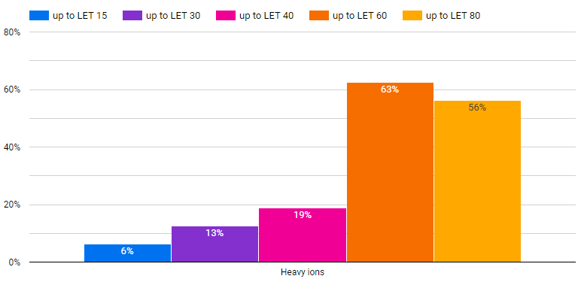
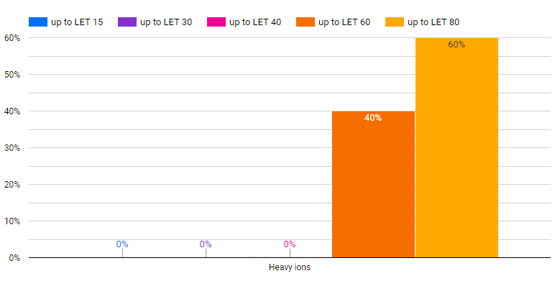
3. WP04-NA3 Task 4.2 : Key performance parameters for current and new facilities
LET range (MeVcm²/mg) required by users of heavy ions facility
Electronics Components (16 replies)
Electronics System and tests /Sensors and Detectors/Materials (5 replies)
Up to LET 15
Up to LET 60
Up to LET 15
Up to LET 60

Slide 17
3. WP04-NA3 Task 4.2 : Key performance parameters for current and new facilities
Takeaways:
Access to heavy ions and protons facilities should rise within the five coming years according to the needs expressed by the research and industrial sectors.
The demand for mixed-field facilities follows a similar tendency among users.
Among the use cases of interests for RADNEXT (electronics system tests and electronics components), the essential criteria are the beam characteristics, the accessibility of irradiation facilities and the local services provided by the personnel.
Focus on heavy ions’ beam:
Penetration depth’s outlooks tend to point towards lower values (up to 200 µm).
LET range usually varies from up to 60 or to 80 MeVcm²/mg.

Slide 18
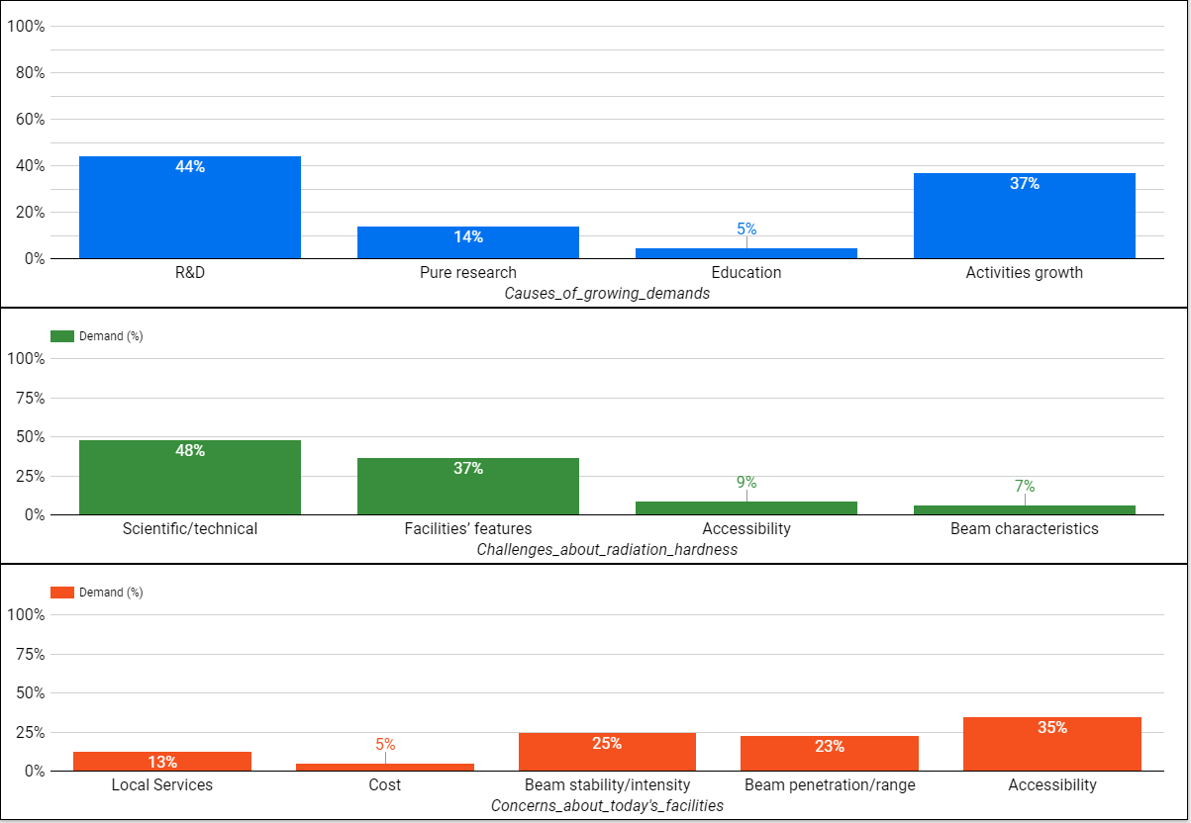
3. WP04-NA3 Task 4.2 : Key performance parameters for current and new facilities
Future needs of users
Development of the space market (New Space)
Emergence of new components with higher sensitivity and complexity
Mismatch between beam time availability and market’s needs
Limited range of beams energy/penetration depth
Accessibility in a reasonable geographical perimeter

Slide 19
3. WP04-NA3 Task 4.2 : Key performance parameters for current and new facilities
STEP 2: Identify operational issues and challenges for radiation testing coping with different applications and environments
  RADNEXT facility coordinators questionnaire focused 9 KPI :
  - High dose rate and flux
  - Large volumes and surfaces
  - High Energy/mixed-field energy
  - Intermediate energy field
  - High availability
  - Services & environmental control
  - Penetration in matter
  - Low cost per irradiation unit
  - Post irradiation services
  The facility coordinators have to assess each KPI according to the following scale :
  - Routinely = 3, with little effort = 2, with great effort = 1, impossible = 0

Slide 20
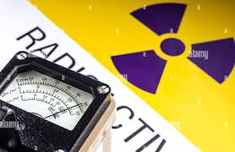
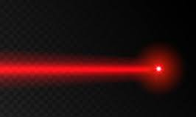

3. WP04-NA3 Task 4.2 : Key performance parameters for current and new facilities
Clear takeaway from our evaluation protocol: lack of high-energy beam or mixed-field energy that can be provided by a single facility (CHARM)
Deliver high dose rate/flux
Provide intermediate energy field
Propose lower cost offers per irradiation units
Apply for facility/external grants
Choose a fix cost per exposure unit/time

Slide 21
3. WP04-NA3 Task 4.2 : Key performance parameters for current and new facilities
STEP 3: Identify new facilities currently not adapted for radiation testing but that can be used for components qualification and system-level testing
  LPA facilities can offer unique beam characteristics, but some trade-offs mitigation is required:
  - Provides a radiation beam with ultra-short particle duration
  - Radiation is delivered with ultra-high particle flux (e.g. kA range electron currents) and ultra-high dose rates
  - The energy spread, beam pointing, divergence and pulse-to-pulse variation are relatively high compared to conventional sources
  LPA facility coordinators questionnaire focused to determine the current facilities suitability:
  - Requests are sent to more that 20 facilities/beamlines
  - Limited feedback so far, still collecting replies

Slide 22
3. WP04-NA3 Task 4.2 : Key performance parameters for current and new facilities
STEP 3: Identify new facilities currently not adapted for radiation testing but that can be used for components qualification and system-level testing
  Laser Plasma-based Accelerators (LPA) have reached a reasonable technology readiness level
  Several LPA facilities declare their readiness to radiation experiments and tests:
  - HZDR, Dresden – DARCO laser driven electron, proton/ions accelerators
  - ELI Beamlines ALFA (electron) and ELIMAIA (proton)

Slide 23
4. WP04-NA3 Task 4.3 : Future solutions for current irradiation facilities
Task Leader: Federico Ravotti (CERN) and Roberto Versaci (ELI)
  Study solutions for increasing the usability of the existing facilities:
  - Standardized mechanical supports,
  - Cabled and wireless solutions to have multi-users patch panel connectivity
  - Virtual access/3D views of the installations
  Propose techniques and methods to overcome technological bottlenecks in the short term:
  - Ion energies modulation and particle flux tuning in a wide dynamic range
  - Beam steering techniques
  Guide research groups and facilities coordinators in their efforts to fulfill the long-term requirements

Slide 24
5. WP04-NA3 Task 4.4 : Design study of new irradiation facilities
Task Leader: Federico Ravotti (CERN) and Roberto Versaci (ELI)
CERN
ELI BEAMLINES
  Propose new primary beam and mixed-field facilities
  Laser-based facility in their infancy for radiation production
  Study the beam parameters of such facilities due to a growing interest in operational parameters and beam availability:
  - Study the tools and dosimetry methods to assess the performances of LPA facilities
  - Select a pool of infrastructures to lead test campaigns
  - Evaluate the suitability to radiation tests according to the users’ needs

Slide 25
6. WP04-NA3 Conclusion
Task 4.2
A complete update of the international irradiation facility compendium:
  234 valid facility entries entry all around the world – ensure the durability of the available information
  Objective: Make this database a worldwide reference - your support matters
In-depth investigation of the current and future needs of irradiation facilities’ users:
  Collect relevant experiences on 4 use cases and 5 radiation fields
  Determine their future demand in the scope of radiation tests
Assessment of a pool of RADNEXT facilities:
  Identify the technological and logistics bottlenecks that must be tackled
Tasks 4.3 and 4.4: Ongoing
Implement a process based on set-ups and dosimetry tools to perform beam diagnosis and characterization of LPA facilities

Slide 26
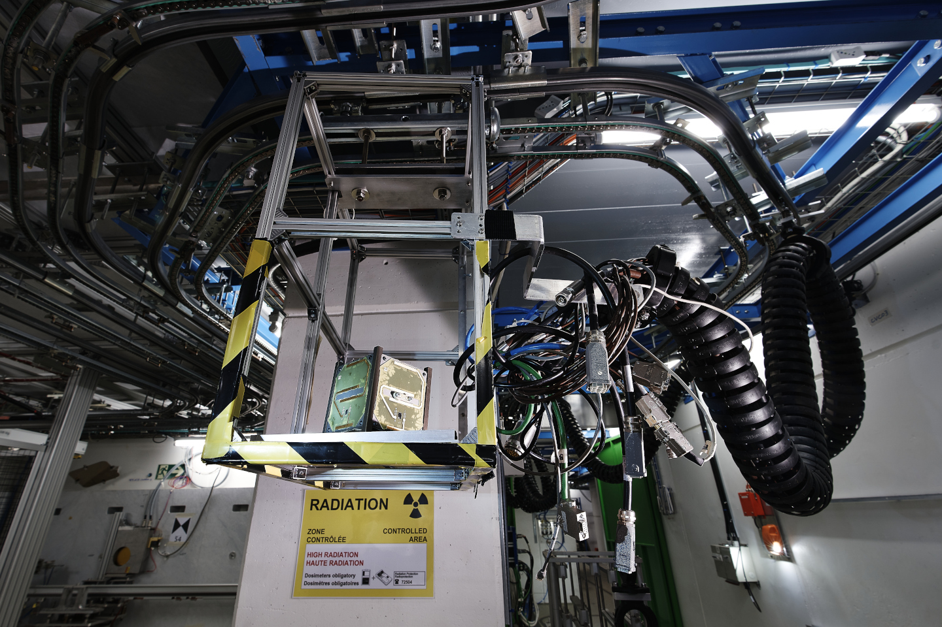
Thank you for your attention!
Image Source: CERN – CHARM facility

