Slide 1


WP5
Effects of Heavy Ions on Replacement Gate Memories
Marta Bagatin, University of Padova
RADNEXT 2nd Annual Meeting – 9-10 May 2023
https://indico.cern.ch/e/radnext-2023

Slide 2
Outline
Introduction and motivations
Experimental details
Results and discussion
Conclusions and future perspectives

Slide 3
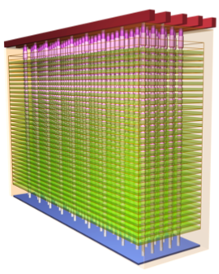
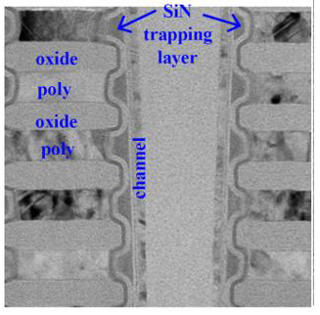
Introduction
Ionizing radiation causes a threshold voltage shift (ΔV_{th}) in Flash cells and this shift can be exploited to realize a particle detector
3D NAND Flash devices offer many advantages as an ionizing particle detector, compared to other memories
  ΔV_{th} can be extracted, in addition to the number of errors
  Non-volatility: low power, no data loss with SEFIs, passive detectors, etc…
  Capability of tracking particles in three dimensions, higher precision in determining the beam features, discrimination of errors due to radiation from other errors
3D NAND Flash exploit either FG cells (conductive polysilicon Floating Gate cells) or RG technology using Charge Trap (CT) cells
The purpose is to explore the feasibility of a high-LET particle detector based on 3D NAND Flash CT memories

Slide 4
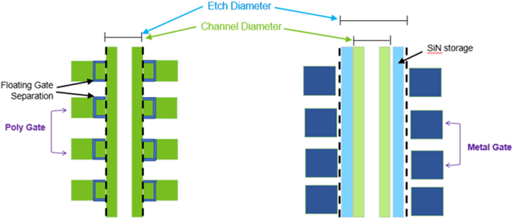
FG vs RG Cells
Floating Gate (FG)
Etch Process Diameter
Replacement Gate (RG)
Channel Diameter
Silicon-nitride storage layer
Floating Gate separation
Gate All Around structure: annular storage element between tunnel and blocking oxide
Channel poly Si
Poly Gate (word line)
Metal Gate (word line)
Polysilicon storage layer
Channel poly Si
FG storage elements (made of conductive polysilicon) are separated between cells
The cells are formed outside the pillar holes, so the diameter of the pillar etching is aligned with the final channel diameter of the string
  SiN storage layer is shared, continuous among CT cells
  The diameter of the pillar holes for etching can be larger than the channel diameter, advantageous for tall pillars
  The word line is formed by tungsten by replacing the sacrificial nitride films stacked originally (replacement gate technology)

Slide 5
Scaling of 3D NAND Flash
Two possible approaches to increase the density of 3D Flash array
  Act on xy plane: reduction of the cell feature size
  Act in z-direction: increase the number of stacked layers (preferred strategy, minimizes the technological and electrical issues associated with taller pillars)
Tier pitch is the word line period (distance between adjacent WLs)
Tier pitch scaling leads to higher electric fields between adjacent cells and therefore stronger disturbs

Slide 6
Devices and Irradiation Details
Devices under test
  Charge-trap based 3D NAND Flash: gate-last cell array with a Silicon Nitride layer spanning the whole vertical pillar, band-engineered tunnel oxide, high-k blocking oxide, and tungsten wordlines, Triple-Level Cells (3 bits per cell)
  Devices with two different tier pitches have been tested, with a difference of approximately 25%, Large Tier Pitch (LTP) and Small Tier Pitch (STP), and with the same number of layers overall
Heavy-ion irradiations (Transnational Access)
  Heavy-Ion Facility (HIF) in Louvain-la-Neuve, Belgium
  LET from 1.3 to 62.5 MeV·cm²/mg, fluences 10⁷ ions/cm²
  Devices irradiated unbiased with shorted pins (relevant conditions in non-volatile memories to study radiation effects on the cells)
  Cells were set up in all 8 logic levels (L0, L1, L2, …, L7) before irradiation (random pattern)
  Threshold voltage (V_{th}) distributions were read before and after exposure
  Reference devices were kept to account for possible effects not due to irradiation

Slide 7
Experimental Results: Cross Section
Cross-section data calculated considering the number of events leading to a ΔV_{th} above a certain value, instead of considering the number of read errors
  Equivalent to considering the number of cells that have lost more than a given number of electrons from the storage element (~some hundreds, varying with the tier pitch)
In this way we study the behavior of the cells with no dependence on the peripheral circuitry and the read-out scheme (e.g. read-retry modes)
Cell cross section (averaged on 4 blocks) in 3D CT NAND with Large and Small Tier Pitch (LTP, STP) programmed to L7 level

Slide 8
Experimental Results: Cross Section
σ for STP devices is larger than LTP
  Increase larger than 30% for a ~25% decrease in tier pitch
  Increase is more visible close to the threshold LET and at high LET, whereas it is less pronounced in the region where the cross sections rapidly increase
No clear saturation is visible
The maximum measured σ is in the order of some 10⁻¹⁰ cm² (per bit), corresponding to a circular area with a diameter of ~100 nm
Cell cross section (averaged on 4 blocks) in 3D CT NAND with Large and Small Tier Pitch (LTP, STP) programmed to L7 level

Slide 9
Experimental Results: Impact of Program Level
The higher the initial V_{th}, the larger the number of events
  Due to different electric fields in the tunnel and blocking oxides, consistent over the whole LET range
Behavior is similar to previous NAND Flash cells with FG architecture

Slide 10
Experimental Results: V_{th} distributions
V_{th} shift increases with increasing LET for both STP and LTP samples
  The amplitude of the tails varies, but the shapes are consistent across the two tier pitches
STP distributions have a larger variability
The two peaks observed in CT cells tend to be much less evident than in floating gate cells, due to the discrete nature of the charge storage and its reduced thickness

Slide 11
Discussion
Relative positions of kinks and peaks in the V_{th} distributions after exposure does not depend on tier pitch
  Top view is identical for the two types of devices (at normal incidence, the same percentage of ions hit the tunnel oxide, the blocking oxide, and the storage element in the STP, and the LTP devices). Previous work have shown that differences in this area between CT and FG cells lead to different V_{th} distributions features
Heavy-ion cross section increases by approximately the same amount as the tier pitch reduction
  The reduction in stored charge in STP cells leads to larger susceptibility (for a 25% reduction in TP, a 25% reduction in threshold LET is expected, just because of stored charge reduction)
  The electric field between adjacent cells is higher in STP cells compared to LTP. This is relevant as the storage layers is uninterrupted along the pillar (contrary to FG cells), and charge migration can potentially occur. This implies larger V_{th} distributions, which reduces noise margins and increases the heavy-ion sensitivity

Slide 12
Conclusion
The impact of the tier pitch on the response of 3D NAND Flash with replacement gate technology and Charge Trap cells has been studied
The single event effect cross section was studied, considering the number of cells experiencing a threshold voltage shift larger than a given value, to understand the effects related to the memory cells alone
Cross-section measurements show an increase more than inversely proportional to the reduction in tier pitch
  The increase has been primarily attributed to the reduction of stored charge, increased cell-to-cell electric fields, and increased variability in V_{th}
Future work will explore further technologies, compare them with previous FG data, and address the role of energy deposition variability through radiation transport simulations

Slide 13
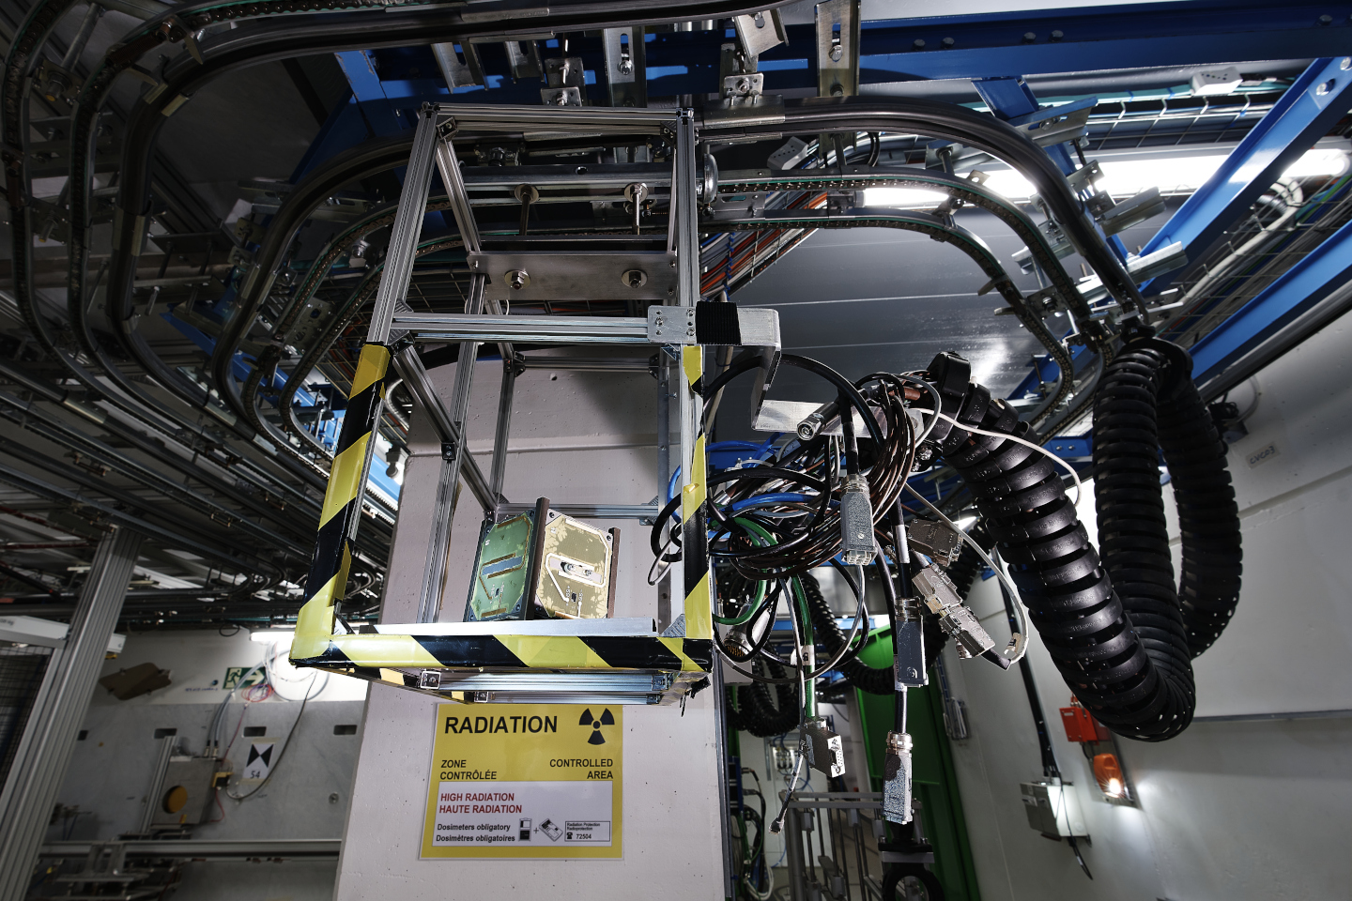
Thanks for your attention!
Image Source: CERN

