Slide 1


WP6, Objectives and outcomes of WP6 in the second year of RADNEXT: Methodologies for Radiation Test of Systems
Luigi DILILLO (IES/University of Montpellier)
Luis ENTRENA (UC3M)
RADNEXT 2nd Annual Meeting – 9-10 May 2023
https://indico.cern.ch/e/radnext-2023
RADNEXT 2nd Annual Meeting – 9-10 May 2023

Slide 2
Outline
Structure and members
Work Programme overview
Second year achievements and ongoing activity
Conclusions
RADNEXT 2nd Annual Meeting – 9-10 May 2023

Slide 3
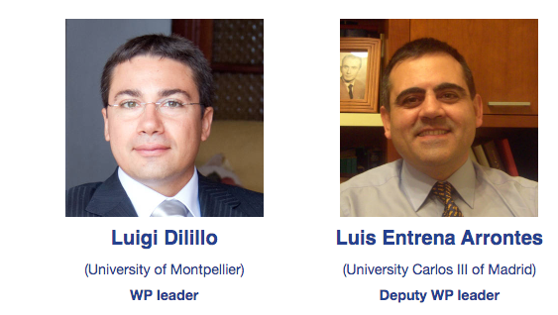
Structure and Members
Participants and associates
Université de Montpellier (UM/IES)
Katholieke Universiteit Leuven (KUL)
Universidad Carlos III de Madrid (UC3M)
European Organization for Nuclear Research (CERN)
German Space Agency (DLR)
Politecnico di Torino
National Centre for Nuclear Research (NCBJ)
RADNEXT 2nd Annual Meeting – 9-10 May 2023

Slide 4
Structure and Members
Participants and associates
Université de Montpellier (UM/LIRMM)
Katholieke Universiteit Leuven (KUL)
Universidad Carlos III de Madrid (UC3M)
European Organization for Nuclear Research (CERN)
German Space Agency (DLR)
Politecnico di Torino
National Centre for Nuclear Research (NCBJ)
Katholieke Universiteit Leuven (KUL)
  Recruitment of PhD student Levi MARIEN
  Change destination of a part of financing support (1PM)
European Organization for Nuclear Research (CERN)
  Recruitment of PhD student Ivan SLIPUKHIN
RADNEXT 2nd Annual Meeting – 9-10 May 2023

Slide 5
Work Programme Overview
Work package overview:
Standardization of system level radiation qualification methodology
Three operative tasks will focus on:
  Setup preparation and stimuli definition
  Pass/fail test
  Test with enhanced observability
The main goal will be the exploration of valid qualification procedures to be effective at system level. Its main added value is a reduced qualification cost and time, without significantly affecting the radiation hardness assurance level.
RADNEXT 2nd Annual Meeting – 9-10 May 2023

Slide 6
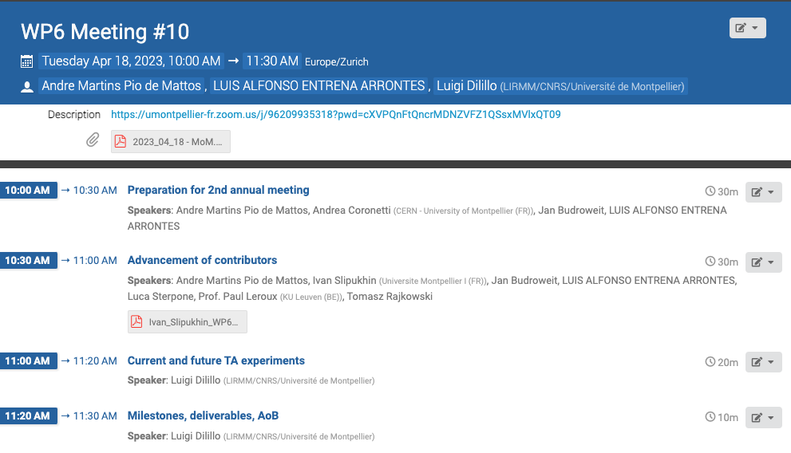
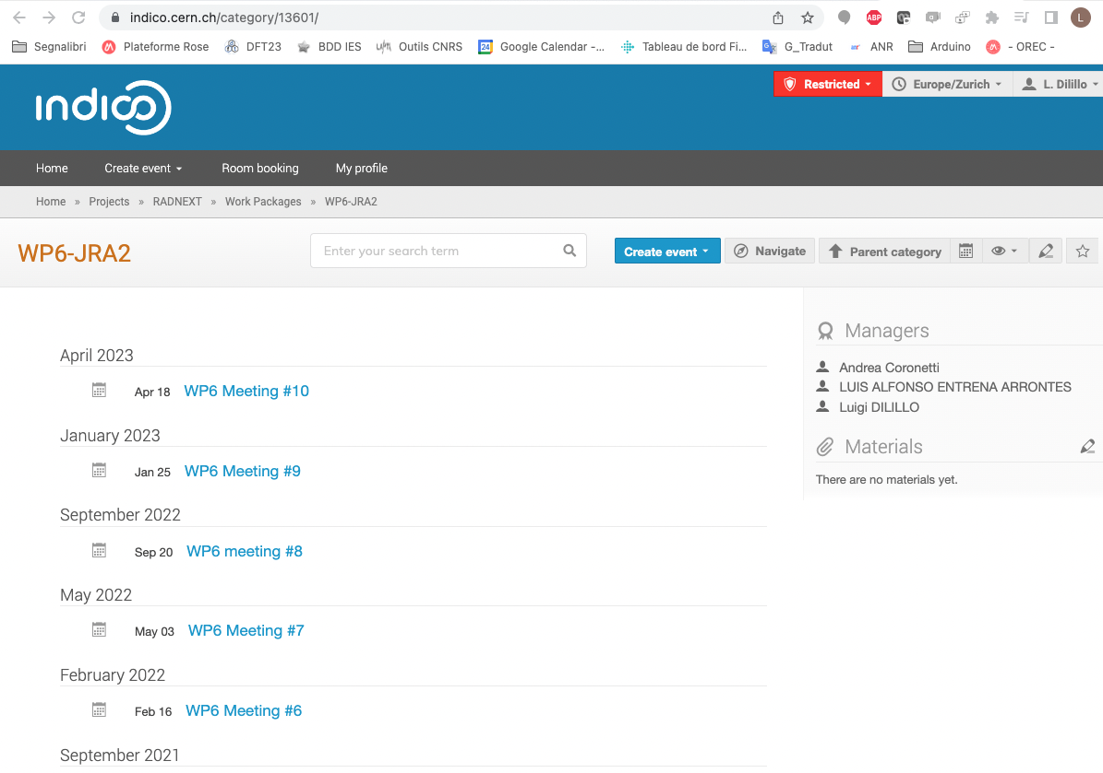
Second year achievements and ongoing activity
Regular meetings (10 in total) with all WP partners
    Established connections/collaboration among partners
    Introduction of new partner (NCBJ, Tomasz Rajkowski)
    Activity status
    Activity plans
RADNEXT 2nd Annual Meeting – 9-10 May 2023

Slide 7
Second year achievements and ongoing activity
Application to RADNEXT TA for probing irradiation test campaigns (PSI, ChipIR, PARTREC, CHARM)
    With more than one partner: direct exchanges and collaborations
    Checking and applying on the field methodologies and practices
Dissemination
    Several papers in international conferences (RADECS’23, ETS’22, DFTS’23, IWASI’23, REDW’22, REDW’23)
    Several papers in international journals (Electronics, Journal of Instrumentation, TNS)
Collaboration with other WPs
    WP8 dissemination (ETS’22)
Student exchange
    UM/IES ↔ UC3M: Andre M. P. Mattos, Pablo M. A. Delgado
RADNEXT 2nd Annual Meeting – 9-10 May 2023

Slide 8
Second year achievements and ongoing activity
Experiments performed at CHARM, ChipIr, and PSI.
  Development of test setups targeting enhanced observability
  Systems mainly based on:
      Xilinx Zynq-7000 SoC
      Microchip M2S010 SoC
Investigation of a SELs in a SRAM on-board PROBA-V satellite
Characterization of a fault-tolerant RISC-V SoC hosted on flash- and SRAM- based FPGAs
Characterization of GPUs
Characterization of FPGA SoCs, in which hard-core and soft-core are used
Characterization of a testing platform for targeting system-level testing at CHARM facility
RADNEXT 2nd Annual Meeting – 9-10 May 2023

Slide 9
Ongoing activities
Formalize the methodologies/experiences from test campaigns
Participations to test campaigns in new types of facilities
  TA submission for ESRF micro-beam (new type of facility)
  Test campaign with Laser attack
Elaboration of the next milestones
Cross WPs activity
RADNEXT 2nd Annual Meeting – 9-10 May 2023

Slide 10
Conclusions
New member and new PhD recruitment
Good partner interaction (UM/UC3M; UM/CERN)
Good ongoing scientific activity and dissemination
Starting milestone/deliverables elaboration
RADNEXT 2nd Annual Meeting – 9-10 May 2023

Slide 11
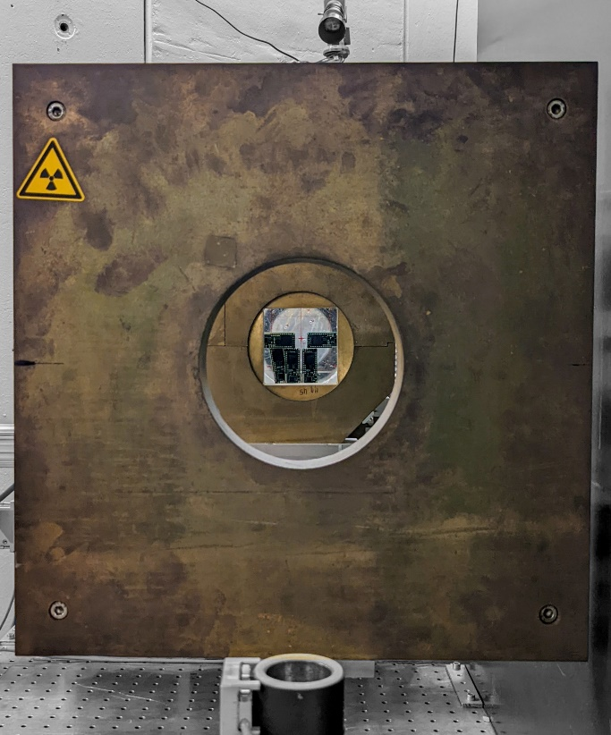
Thanks for your attention!
Image Source: IES/UM
RADNEXT 2nd Annual Meeting – 9-10 May 2023

