Slide 1


WP6, Results and Outcomes from Latest WP6 Test Campaigns in Radiation Facilities
André M. P. Mattos (IES/University of Montpellier)
Almudena Lindoso (UC3M)
RADNEXT 2nd Annual Meeting – 9-10 May 2023
https://indico.cern.ch/e/radnext-2023

Slide 2



Outline
IES/UM: Test Campaigns
  CHARM: RISC-V/SoC
    Power and logging challenges
  ChipIr: RISC-V/SoC/FPGA
  PSI: SRAM
    Setup, capabilities, and results
Conclusions
UC3M: Test Campaigns
  CHARM: SoC
  ChipIr:
    Microprocessors/SoC
    FPGAs
    GPUs
  UltraScale+
Publications
Conclusions

Slide 3
IES/UM: Test Campaigns

Slide 4
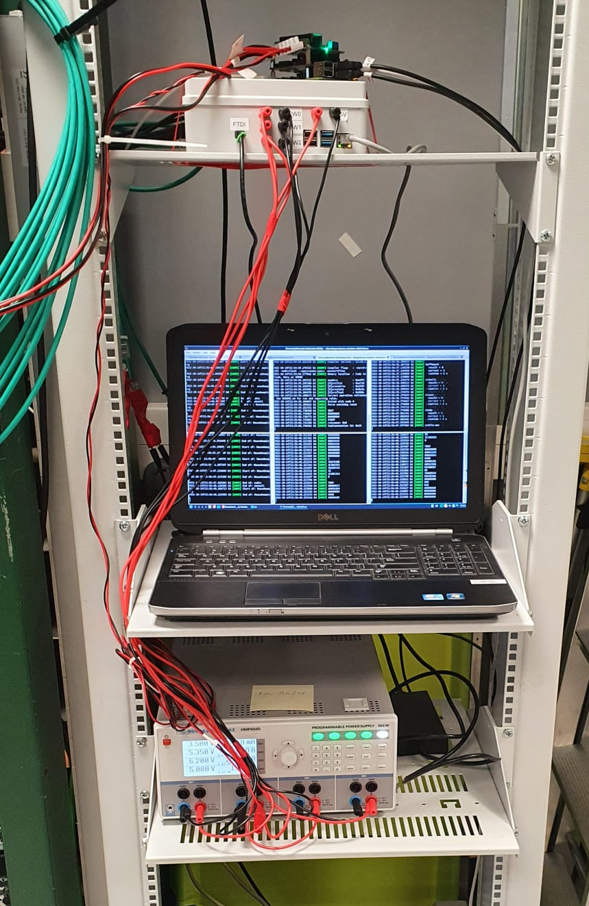
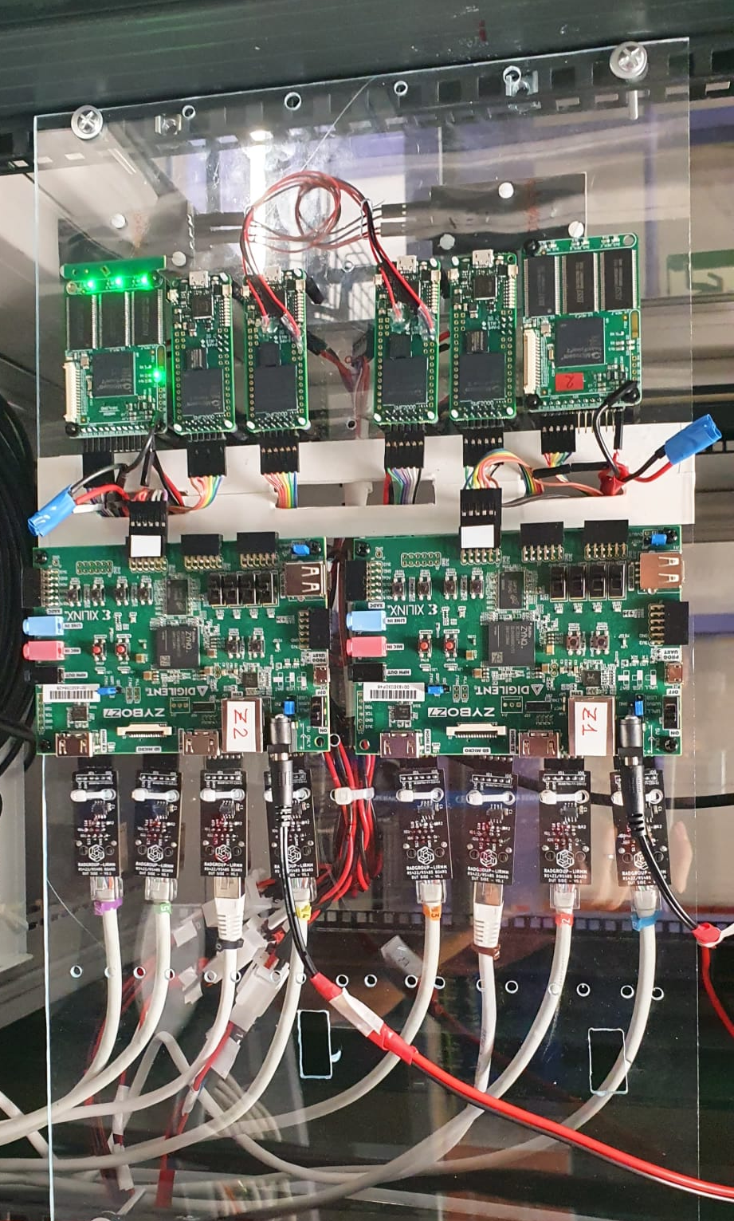
IES/UM: Test Campaigns
 | Source | Facility | Date | Experiment
1st year | Protons | PSI | 12/21* | SDRAM/HyperRAM
 | Heavy Ions | RADEF | 02/22 | SRAM
 | Neutrons | ChipIr | 05/22* | RISC-V/SoC/NoC
 | Protons | PARTREC | 06/22* | RISC-V/SoC
2nd year | Mixed-Field | CHARM | 10/22 | RISC-V/SoC
 | Neutrons | ChipIr | 11/22* | RISC-V/SoC
 | Protons | PSI | 12/22 | SRAM
 | Laser | ESTEC | 05/23 | SRAM
*Test campaigns through TA calls
CHARM
CHARM
Irradiation room
Control room

Slide 5
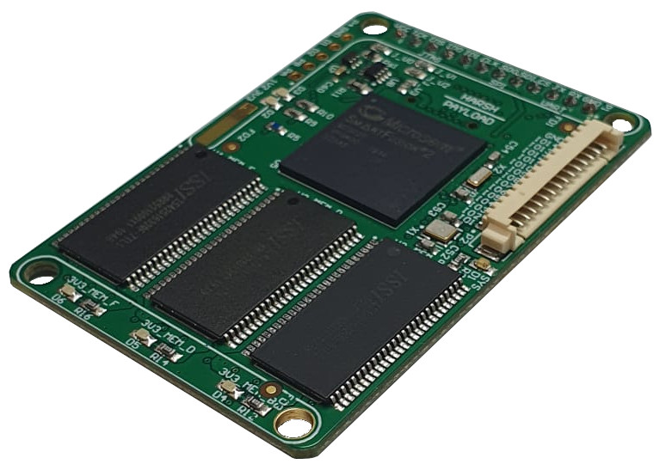
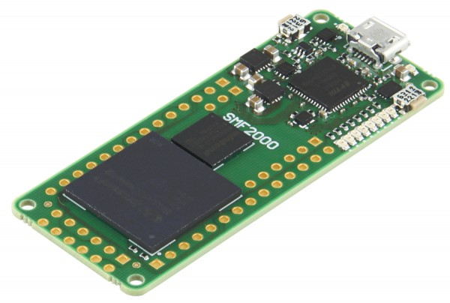
> CHARM: RISC-V/SoC
Characterization of a fault-tolerant RISC-V system-on-chip in flash-based FPGAs
  Two different board designs with same FPGA family, but different power regulators
  Both boards with external SEL protection and current monitoring
  External robust communication fixtures were used to extend the logging interfaces
  Similar setups and conditions, but two very distinct experimental characteristics
  Despite that, there is good correlation between results considering the useful operation time
HARSH:
M2S025
3x SDRAM
SMF2000:
M2S010
SDRAM
[1] [Under review] Douglas A. Santos, André M. P. Mattos, et. al., “Enhancing Fault Awareness and Reliability of a Fault-Tolerant RISC-V System-on-Chip”, Electronics, 2023.
[2] [Accepted] André M. P. Mattos, Douglas A. Santos, et. al., “Using HARV-SoC for Reliable Sensing Applications in Radiation Harsh Environments”, IWASI, 2023.

Slide 6
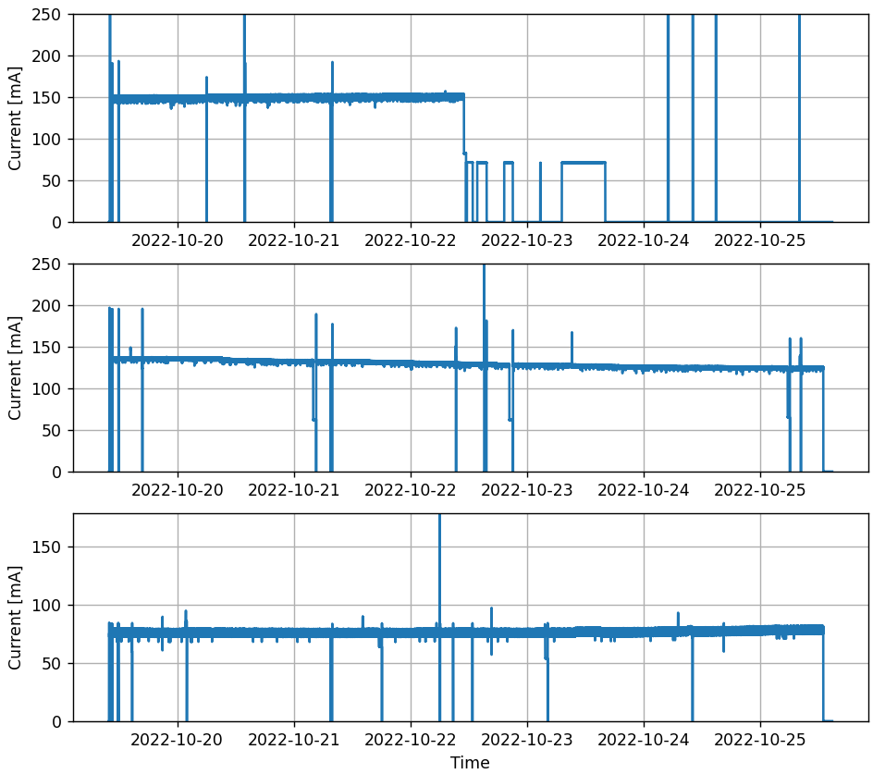
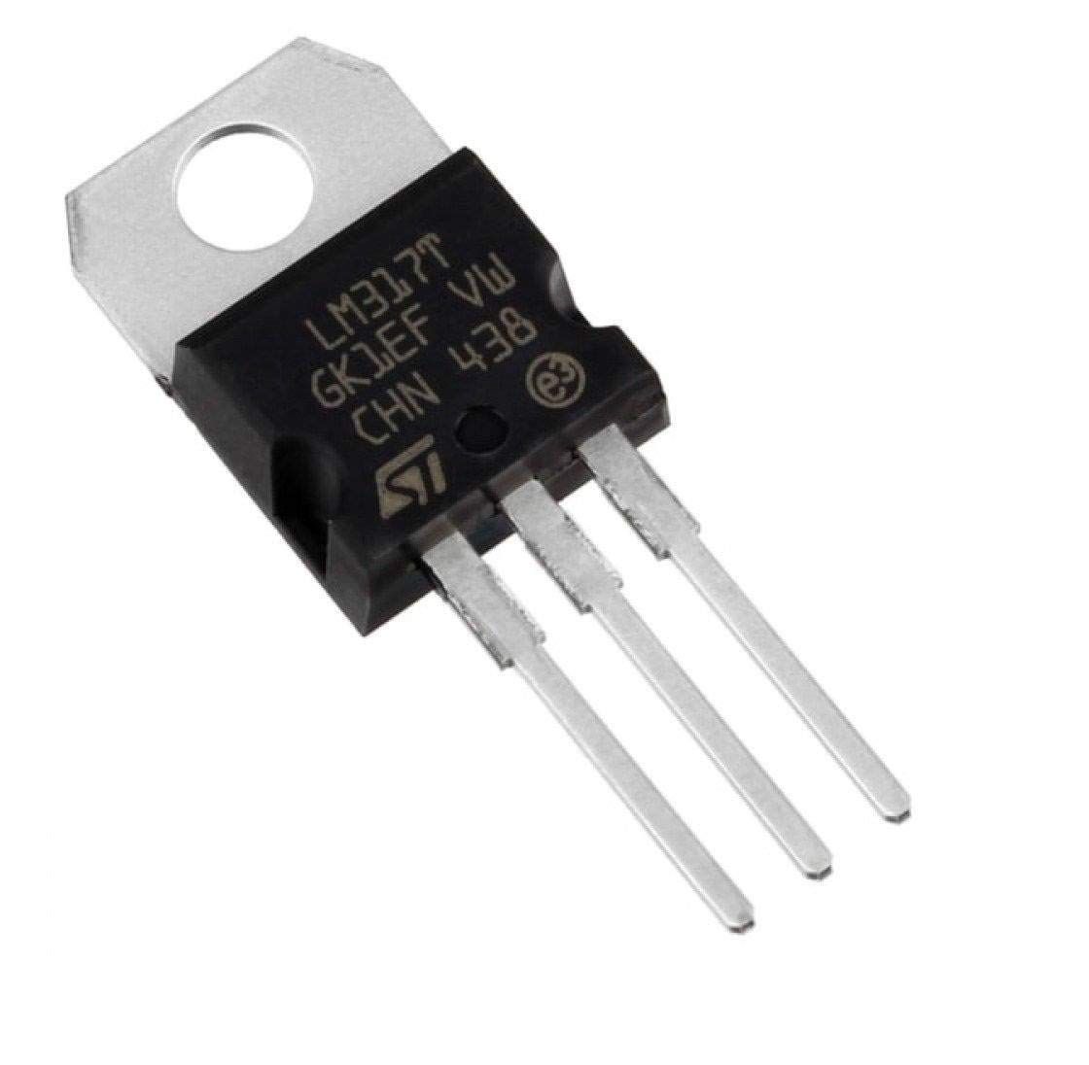
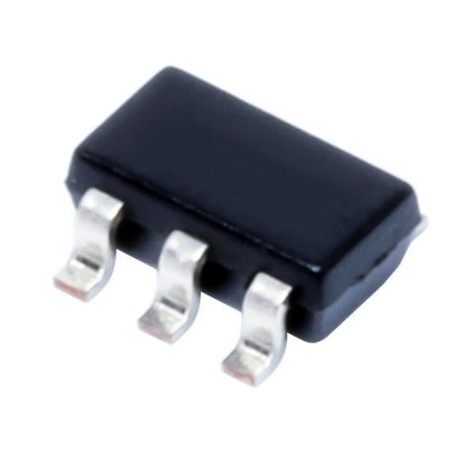
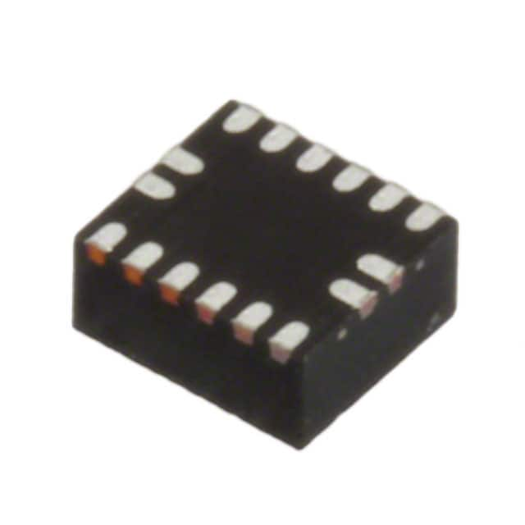
> CHARM: RISC-V/SoC >> Power regulators
TLV62565
~150mA
Limited
Unlimited
 | TLV62565 | EP53A7HQI | LM317
Device type | Switching regulator | Switching regulator | Linear regulator
Board critical TID | ~ 19 krad | > 36 krad | > 36 krad
# SELs | 1 | 1 | 1
# Transients | 1 | 7 | 6
Observations | After critical TID, it was not operational, but current limited. After 29 krad, it had unlimited consumption | Steady current increase (voltage decrease) ~ 6.5% | Steady current decrease (voltage increase) ~ 8.5%
SEL
EP53A7HQI
75 mA
80 mA
LM317
135 mA
124 mA
Transients

Slide 7
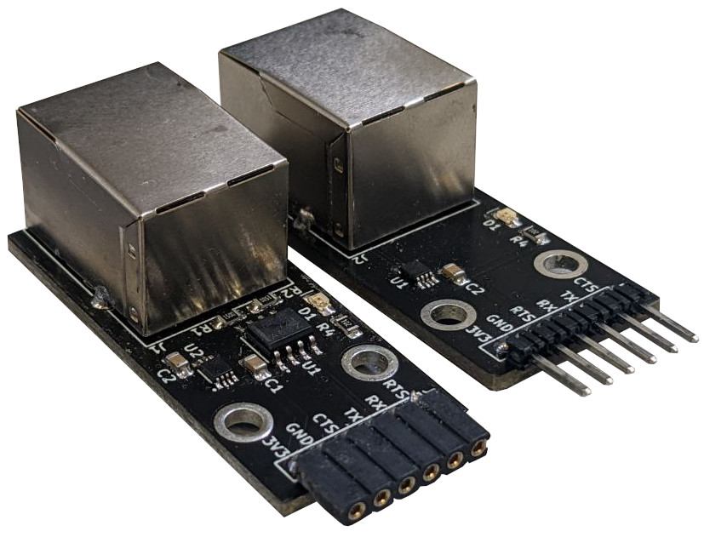
> CHARM: RISC-V/SoC >> Logging interface
Robust interface: UART ↔ RS-485
  UART with flow control
  RS-485 transceiver
  IO buffer
  Flexible and easy to use (transparent)
  RJ45 connector/cable for physical connection
    Robust and often available in patch panels
DUT
UART → RS-485
Irradiation room
Control room
≈
RS-485 → UART
 | ChipIr [Neutrons] | PARTREC [High-energy protons] | CHARM [Mixed-field]
High-level failures | None¹ | Desynchronization¹ | None²
Observation | Cable: 125m (with patch panel connections) Baud Rate: 3Mbauds | Only one occurrence: IO buffer caused the flow control to unsync data
UART → USB
HOST COMPUTER
¹Functional testing only (loopback) with direct irradiation, ²Only usage (no specific testing)

Slide 8
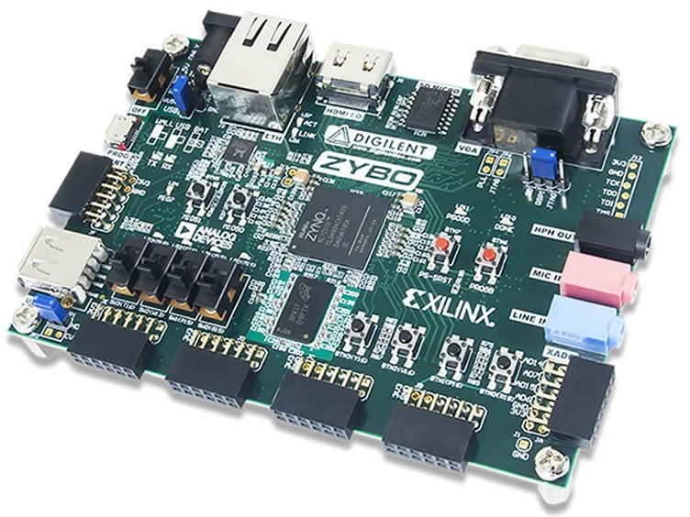
> ChipIr: RISC-V/SoC
Characterization of a fault-tolerant RISC-V system-on-chip in a SRAM-based FPGA
  Adaptation from the flash-based port
  External bitstream memory required
  Sensitive configuration memory
    Custom scrubbing and correction (alternative to the SEM IP) with integration to the SoC
Zybo:
 | SoC in Flash-based FPGA [Microchip] [M2S010] | SoC in SRAM-based FPGA [Xilinx] [Zynq-7010]
Total Fluence [n/cm²] | 1.80x10¹² | 5.83x10¹⁰
Mean Fluence to Failure [n/cm²] | 2.06x10¹⁰ | 3.60x10⁸
Cross Section [cm²] | 4.98x10‾¹¹ | 2.78x10‾⁹
Zynq-7000 family
Flash
SDRAM
~ 200x difference in robustness
[3] [Under review] Douglas A. Santos, Pablo M. Aviles, André M. P. Mattos, et. al., “Hybrid Hardening Approach for a Fault-Tolerant RISC-V System-on-Chip”, RADECS, 2023.

Slide 9
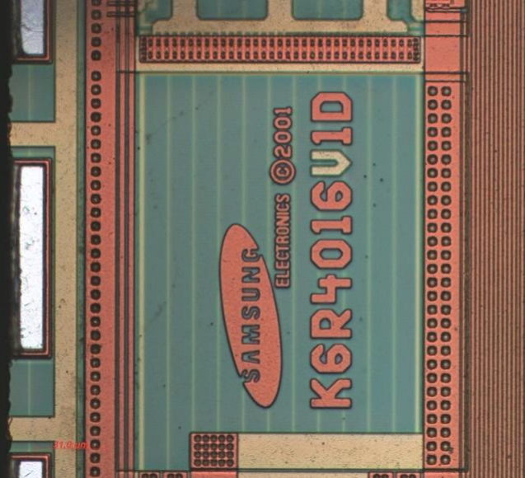
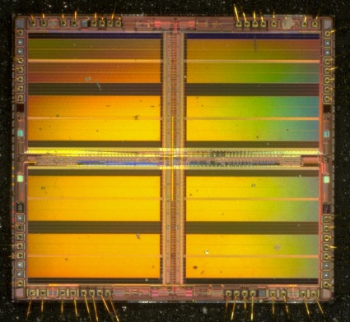
> PSI: SRAM
Investigation on radiation-induced single-event latch-ups in SRAM memories on-board PROBA-V mission
  Understanding the flight behavior and error rates
Utilization of an experimental approach attending the target environment
  RADEF: Heavy Ions
  PSI: Protons
  ESTEC: Laser (further investigation of the observed phenomena)
Development of an experimental setup for enhanced observability
[4] [Under review] André M. P. Mattos, Douglas A. Santos, et. al., “Investigation on Radiation-Induced Single-Event Latch-up in SRAM Memories on-Board PROBA-V”, RADECS, 2023.
[5] [Under review] André M. P. Mattos, Douglas A. Santos, et. al., “Instrumentation and Methodology for In-Depth Analysis of Single-Event Latch-up on Memory Devices”, Journal of Instrumentation, 2023.

Slide 10
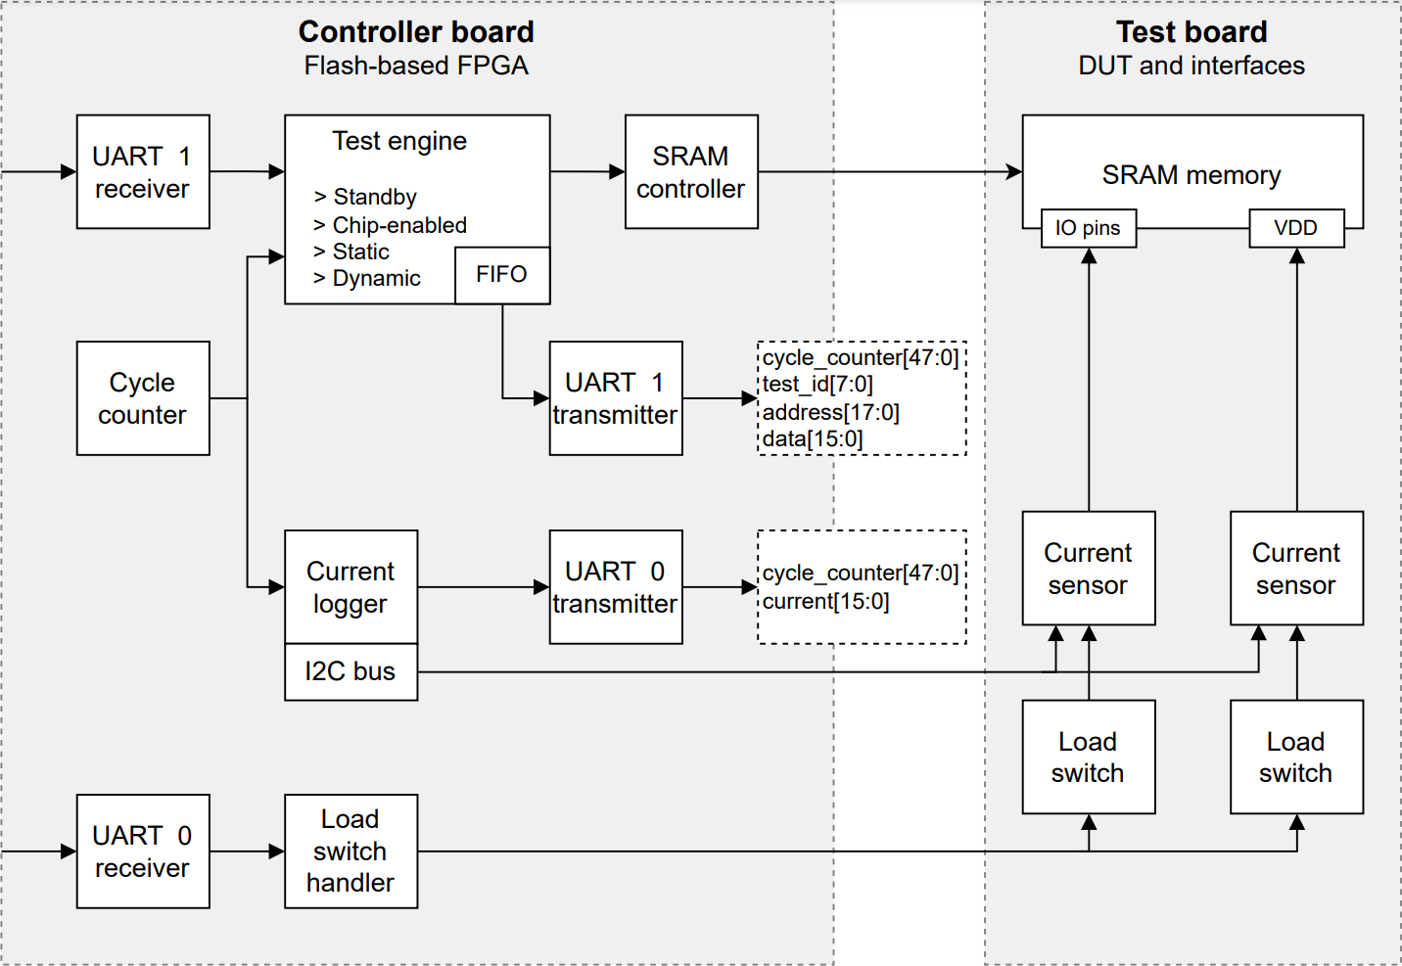
> PSI: SRAM >> Test Setup
Enhanced experimental setup
  Precise timing and current measurements
  Coherent monitoring between memory errors and current measurements
  Many test modes with realistic stimuli
  Robust and flexible test setup

Slide 11
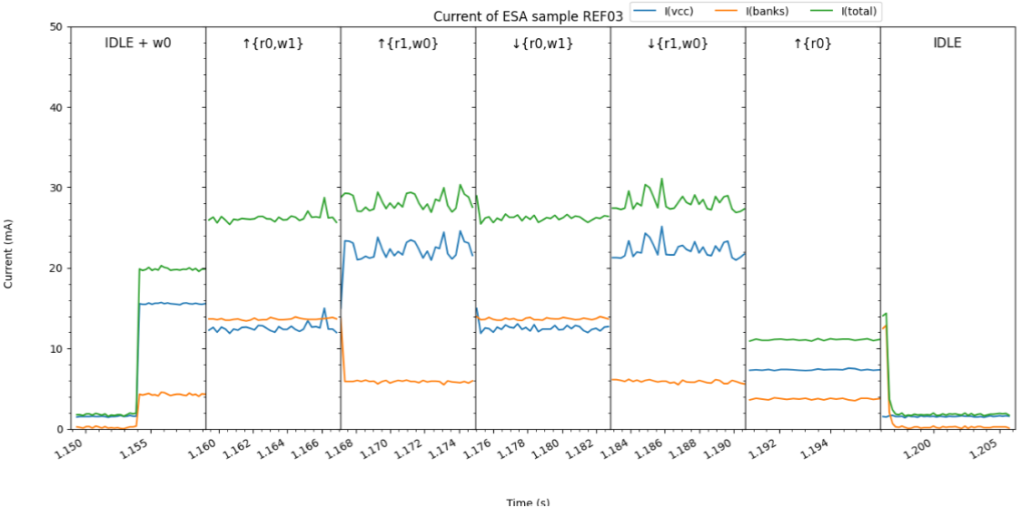
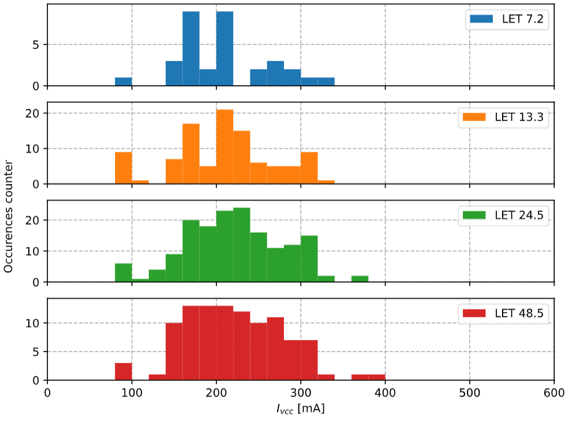
> PSI: SRAM >> Experimental features
Dynamic test: current behavior
  Correlation with each test operation within a dynamic test cycle
  Current values during SEL events
*Data from heavy ions experiment

Slide 12
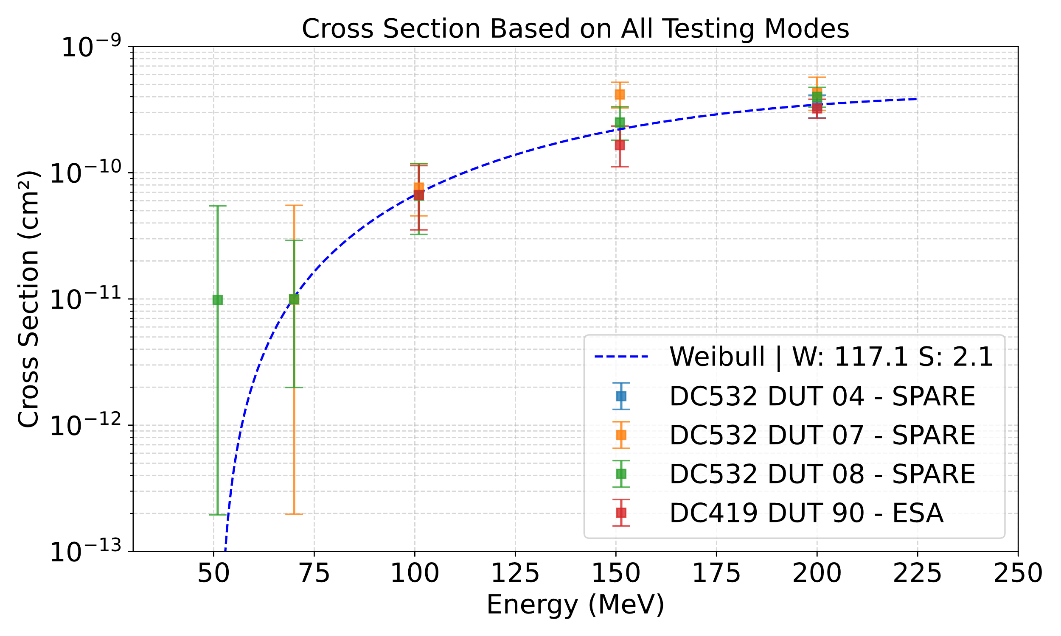
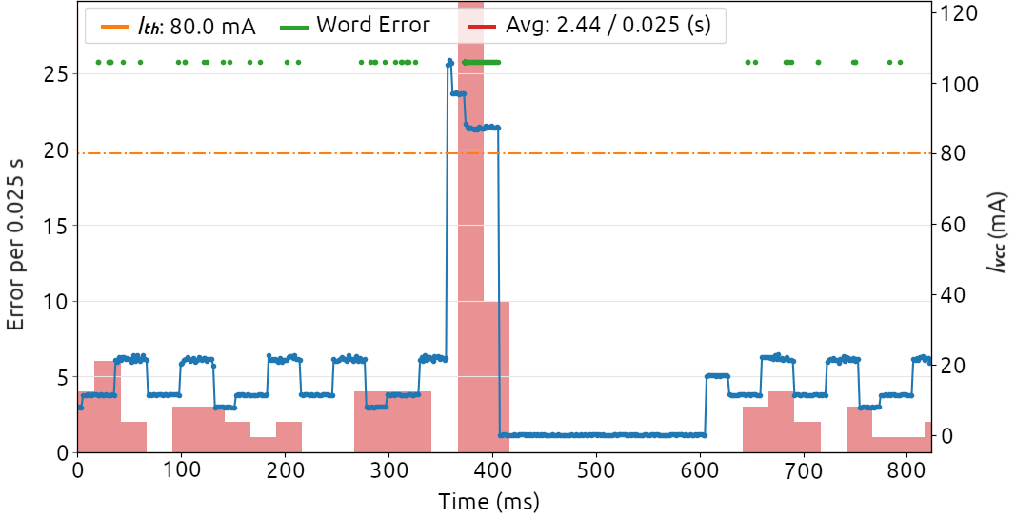
> PSI: SRAM >> Results
Error accumulation during SEL events
  Example within a dynamic test
  50ms “hold time” and 200ms “cut time”
Event cross sections
  Good correlation between lots
  Weibull fitting

Slide 13
Conclusions
Tests at CHARM presented many setup challenges to be addressed before the campaign
Tests at ChipIr provided more insights on the capabilities of Flash- and SRAM- based FPGAs for radiation testing
Tests at PSI allowed the elaboration of an enhanced setup and provided practical insights
We are currently working in the first WP6 milestone, which will summarize the setup preparation experience obtained in these first 2 years of the project
We intend to elaborate more publications using the acquired data and experience

Slide 14
UC3M: Test Campaigns

Slide 15
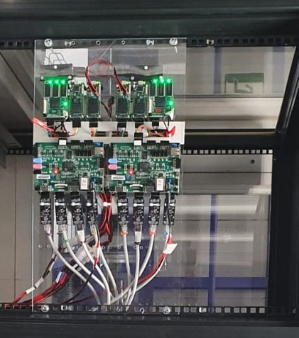
UC3M: Test Campaigns TA RADNEXT
 | Source | Facility | Date | Experiment
1st year | Protons | PSI | 12/21 | µp/FPGA/SoC
 | Neutrons | ChipIr (1/3) | 05/22 | µp/FPGA/SoC/GPUs
2nd year | Neutrons | ChipIr (2/3) | 09/22 | µp/FPGA/SoC/GPUs
 | Mixed field | CHARM | 10/22 | µp/SoC
 | Neutrons | ChipIr (3/3) | 11/22 | µp/FPGA/SoC/GPUs
3rd year | Protons | PARTREC | 09/23 | µp/FPGA/SoC
 | X-ray (microbeam) | ESREF | Under review | µp/FPGA/SoC/Memories
Completed
CHARM
2 commercial boards (zybo)
Microprocessor hardening techniques
Complex setup
After 6.31krad (~20 hours), board non responsive
CHARM

Slide 16
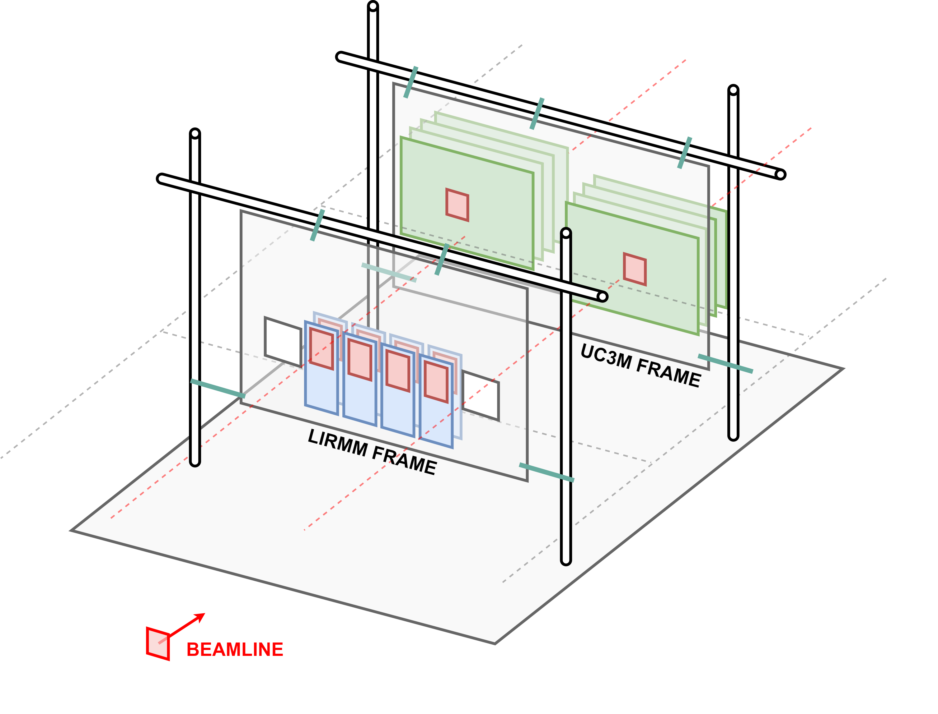
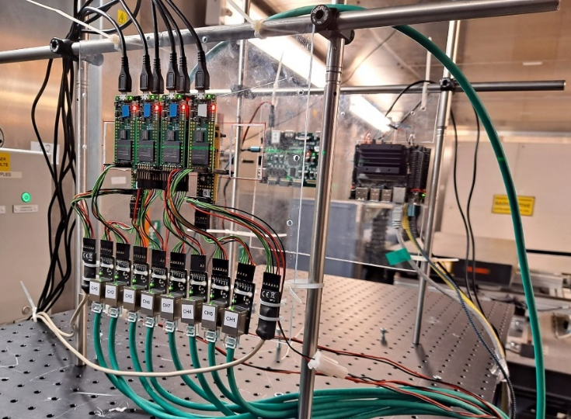
> ChipIr: Experimental setup
Several experiments
per board type
Experiments UC3M, complex COTS systems:
  8x SoC Xilinx Zynq-7000 (28 nm): Microprocessors, FPGA, SoC
  6x Jetson Nano (20 nm): Quad-core A57 & NVIDIA Maxwell GPU
  1x SoC Xilinx UltraScale+ (16 nm FinFET)
Experimental
Setup (May)
ChipIr

Slide 17
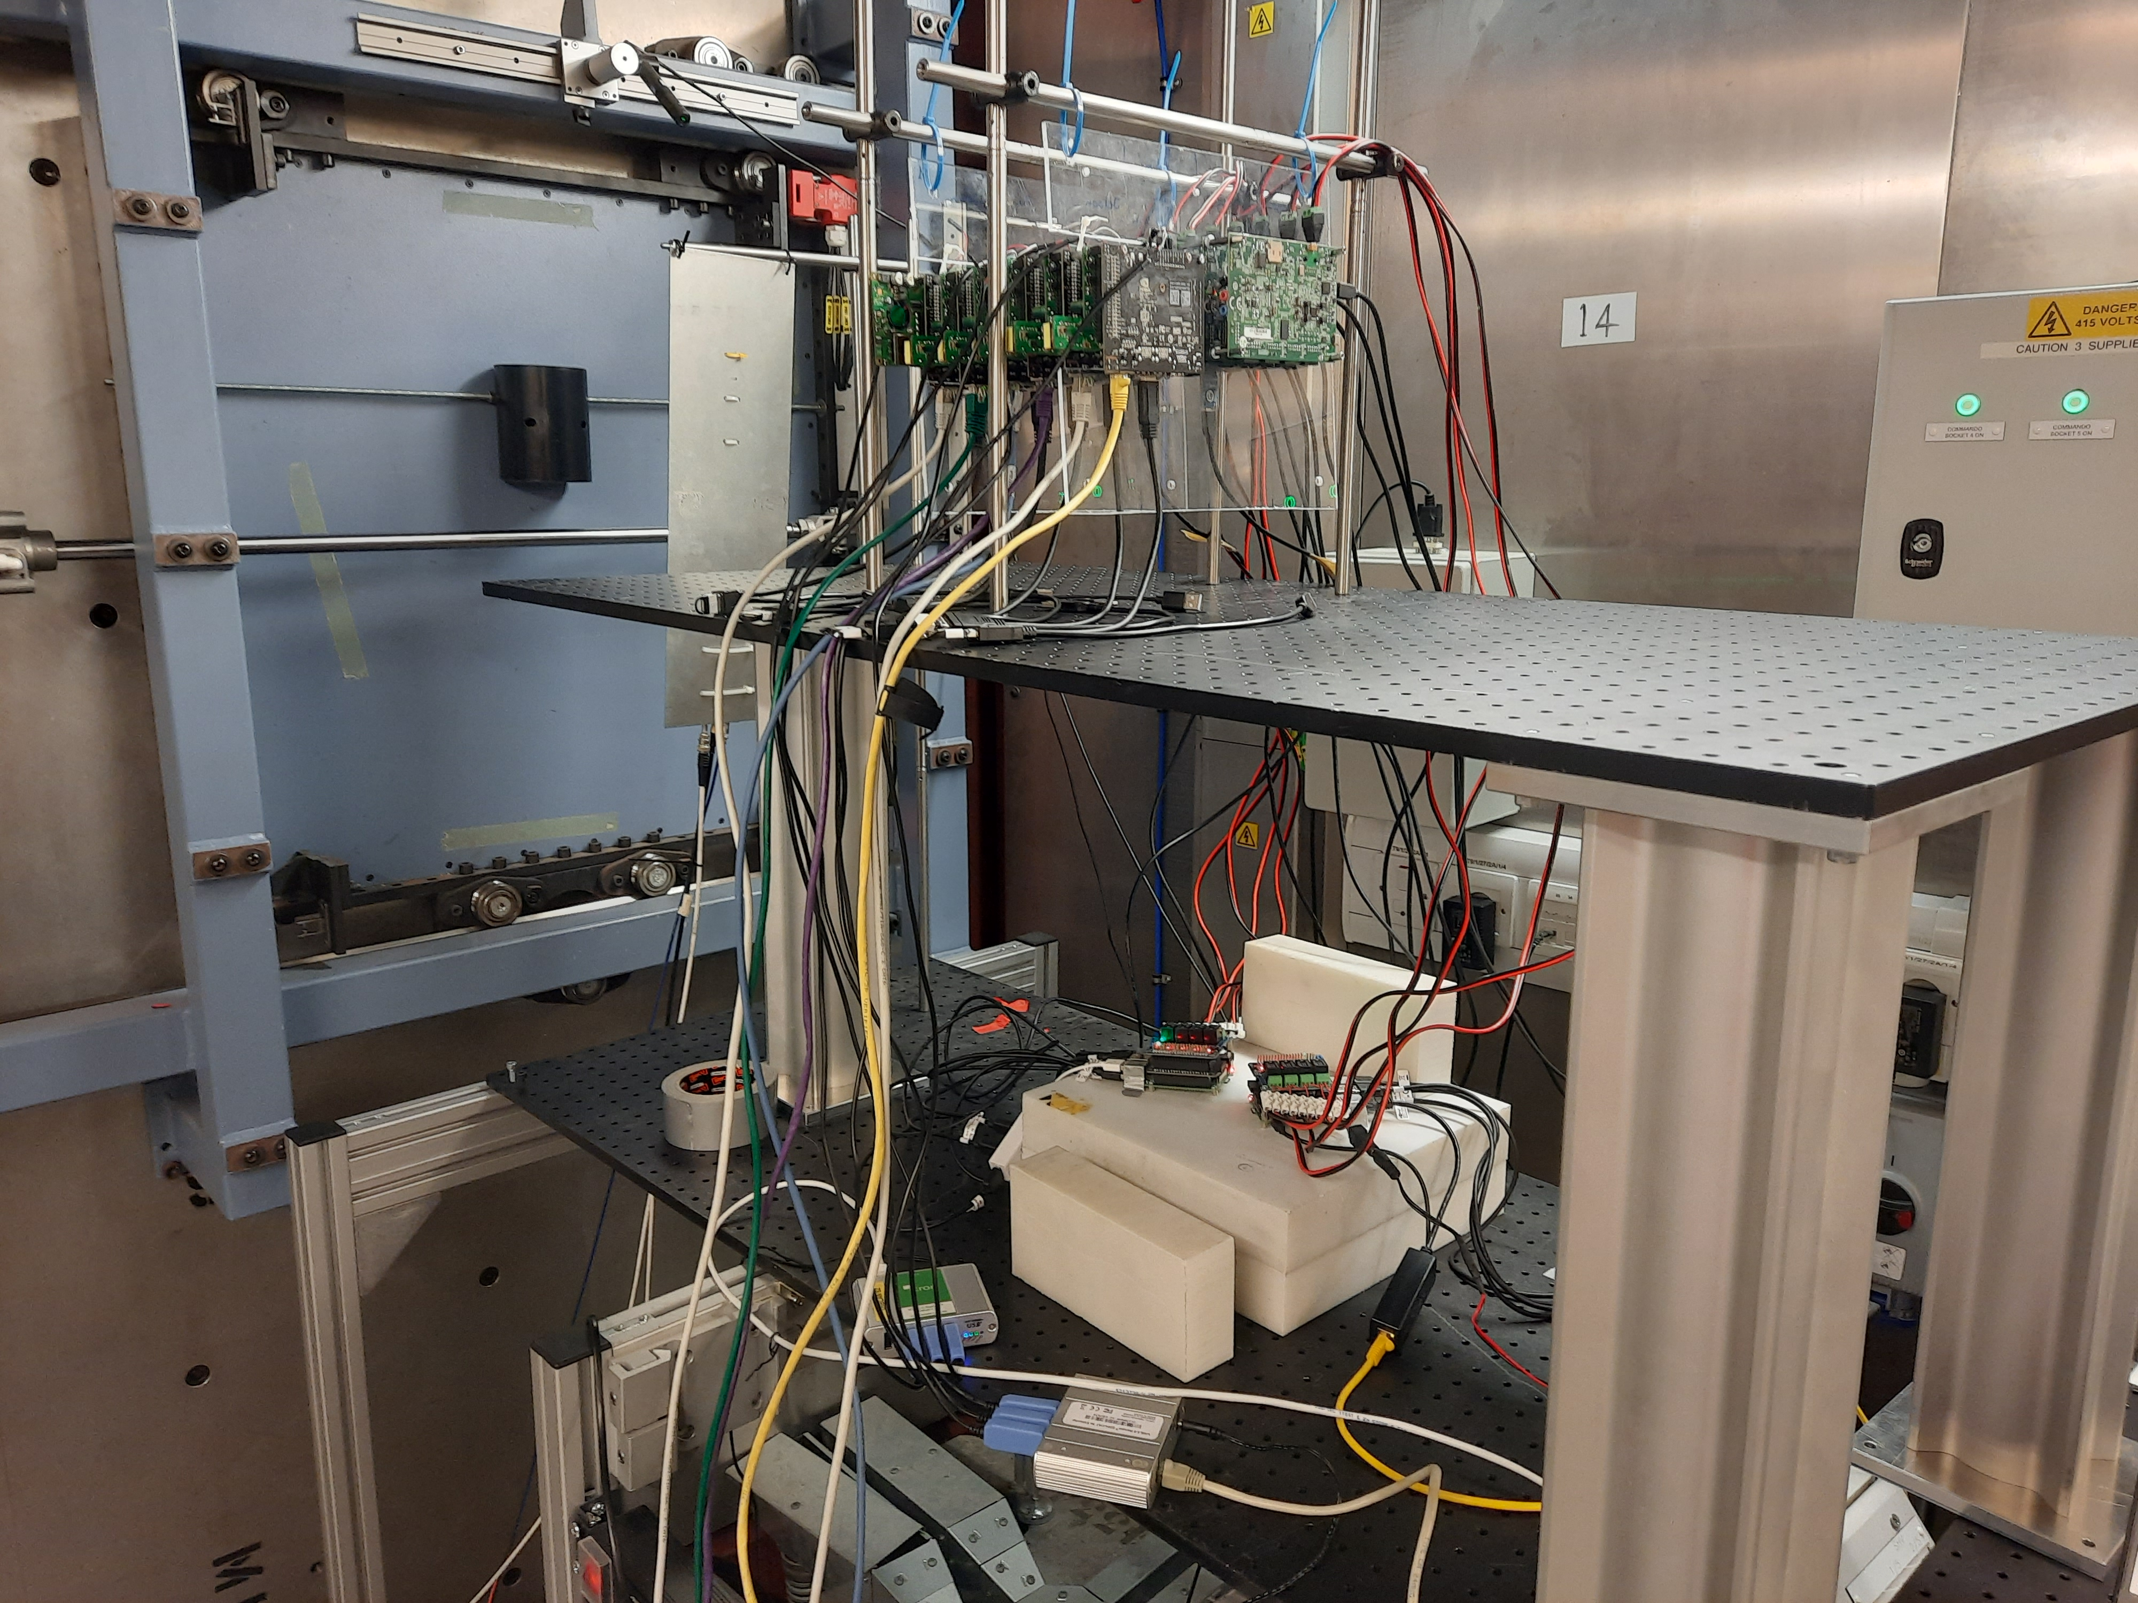
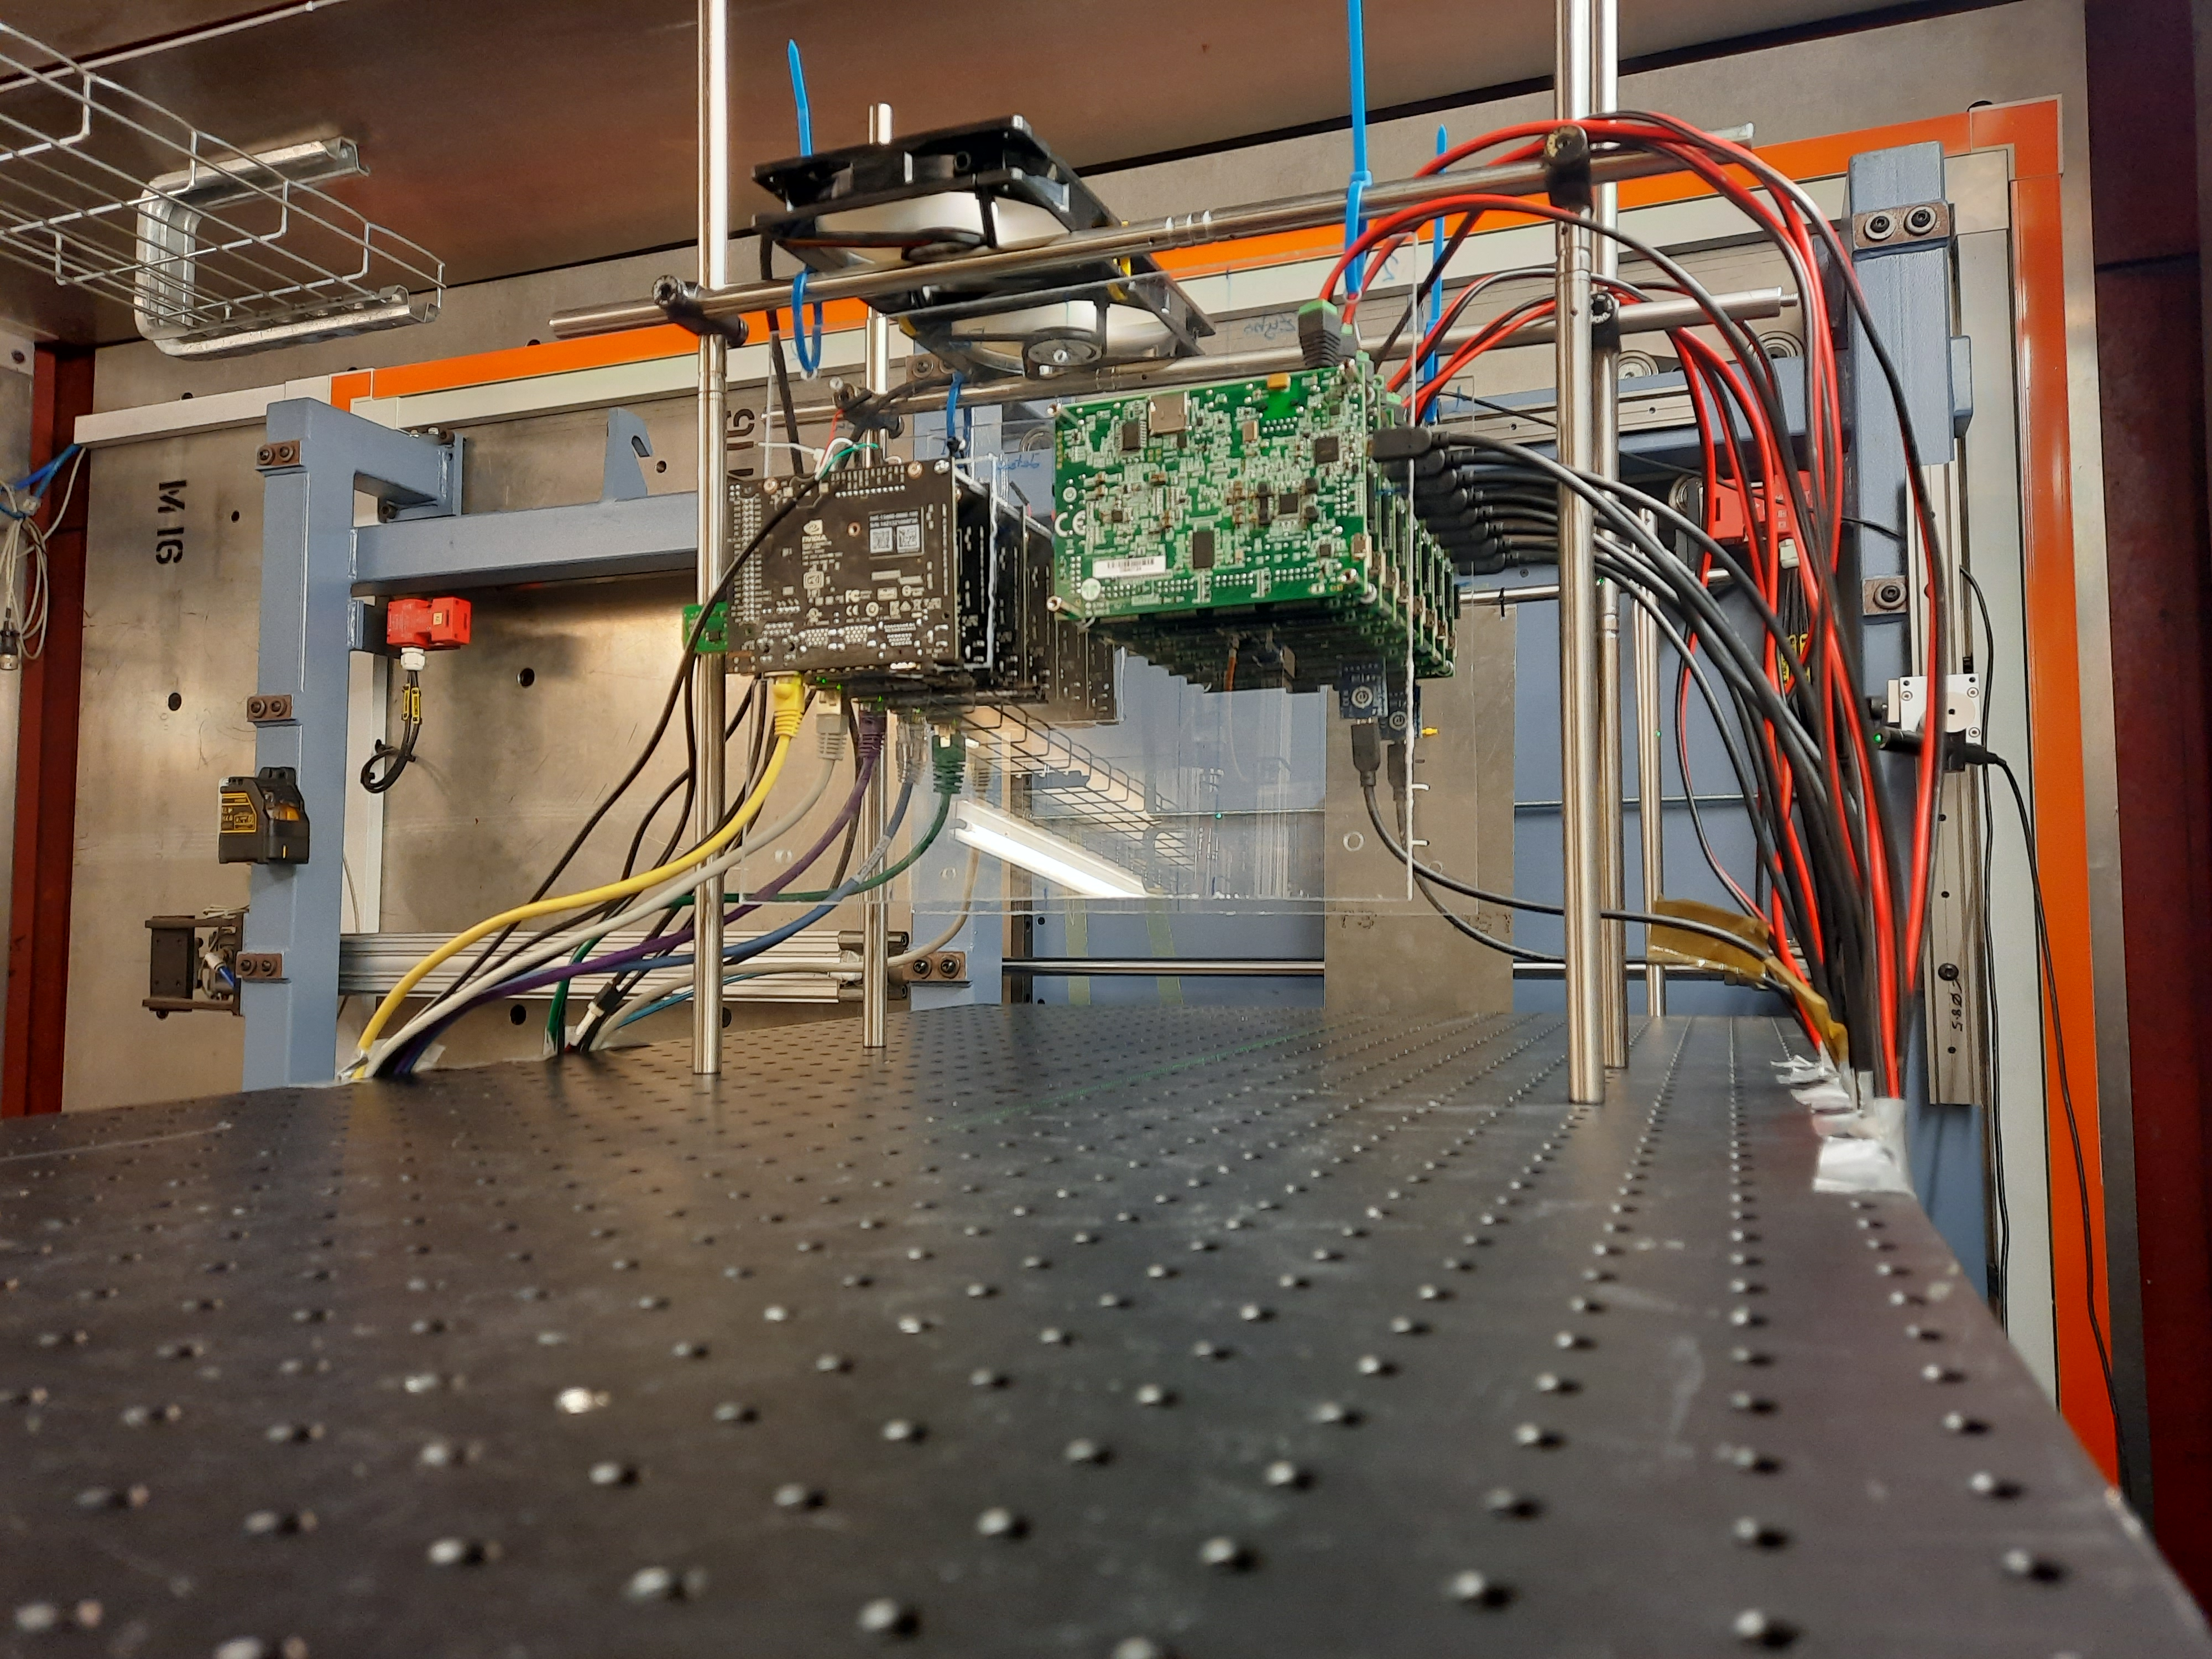
> ChipIr: Experimental setup
Experiments UC3M, complex COTS systems :
  8x SoC Xilinx Zynq-7000 (28 nm): Microprocessors, FPGA, SoC
  6x Jetson Nano (20 nm): Quad-core A57 & NVIDIA Maxwell GPU
  1x SoC Xilinx UltraScale+ (16 nm FinFET)
Experimental
Setup
(November)
6x Jetson
UltraScale+
8x Zybos
ChipIr
ChipIr

Slide 18
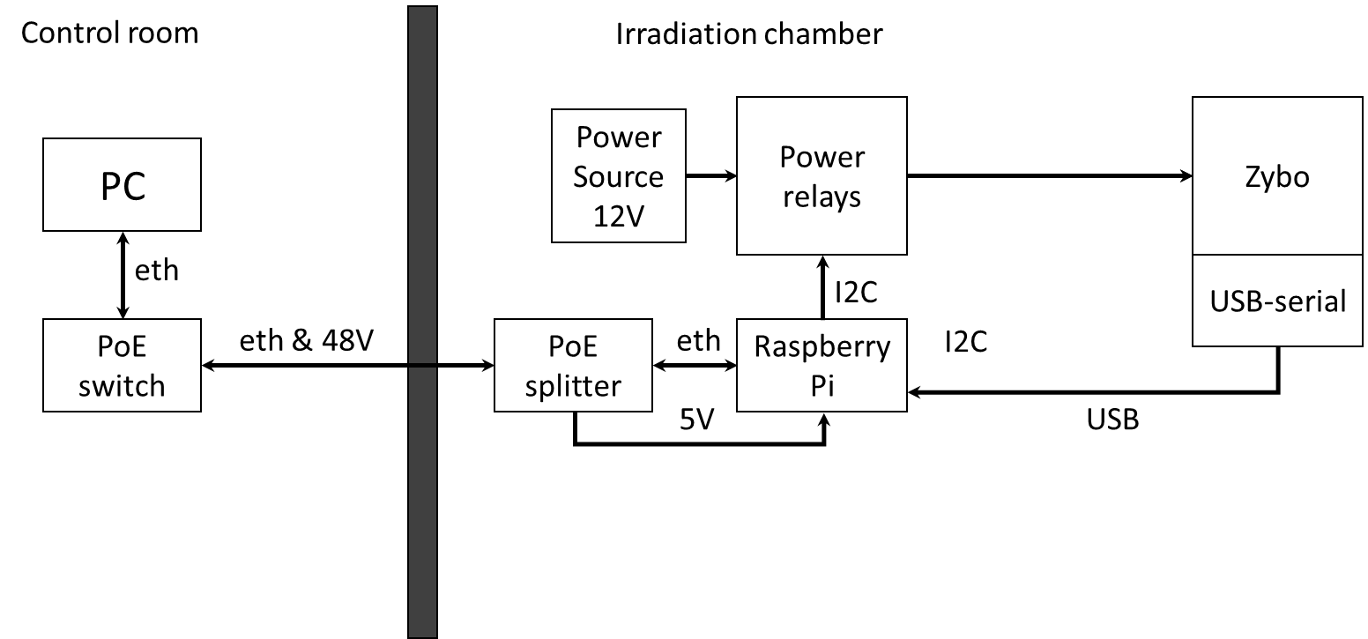
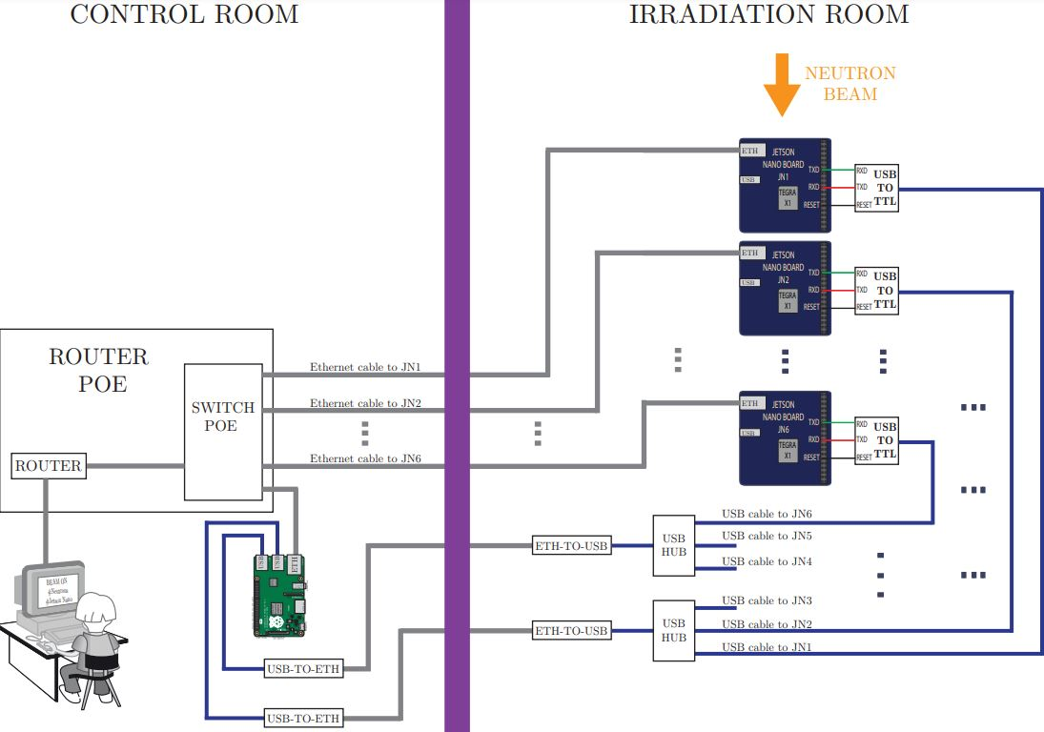

> ChipIr: Experimental setup
Zynq & UltraScale+: serial communication
GPU: Ethernet connection
External host (Raspberry Pi) to control the
experiments & Power cycles
UltraScale+: SEL detector
Zynq
UltraScale+
GPU

Slide 19
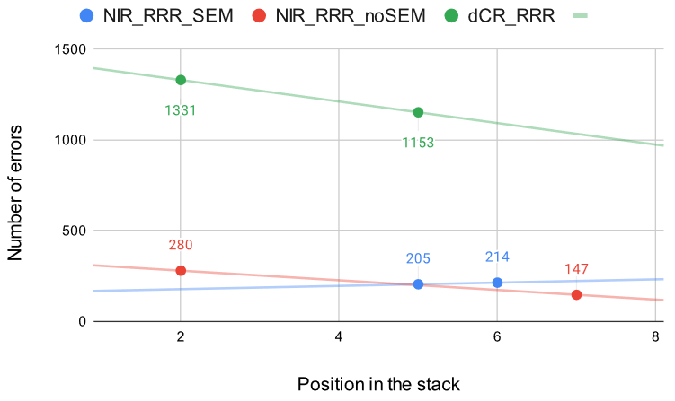
> ChipIr: Evaluation of events vs board location
Zynq 7000
3 Different hardening techniques
  PL
  SoC (PL+PS)
NIR_RRR_SEM behaves differently
  Includes Xilinx SEM IP:
  Detects & corrects PL errors
PL
Experiment | ∆ Errors (%)
dCR_RRR (PL) | - 13.37 (+3 positions)
NIR_RRR_noSEM (SoC) | - 47.50 (+5 positions)
NIR_RRR_SEM (SoC) | +4.21
SoC (PL+PS)
Board position | SEM corrections | PL+PS events
5 | 978 | 205
6 | 1119 | 214

Slide 20
> ChipIr: Cross-section
Comparison different particles/ different complex systems
Previous Results
RADECS DW 22
ChipIr experiments/benchmarks:
  FPGA: 3
  SoC: 1
  GPUs: 12
  Microprocessor: 3
    2 soft-core (RISC-V)
    1 hard-core (Cortex A9)
 | FPGA Zynq-7000 | Microprocessors Zynq-7000
Cross-section [cm²] Protons PSI | 4.42x10⁻¹⁰ | 1.38x10⁻⁹
Cross-section [cm²] Protons CNA | 1.86x10⁻¹⁰ | 5.61x10⁻¹⁰
Similar experiments
 | FPGA Zynq-7000 | Microprocessors Zynq-7000 | SoC Zynq-7000 | GPU Experiment 1 (6 benchmarks) | GPU Experiment 2 (12 benchmarks)
Total Fluence [n/cm²] | 2.72x10¹¹ | 2.57x10¹¹ | 3.38x10¹¹ | [1.51x10¹⁰ , 9.30x10¹⁰ ] | [3.56x10¹¹, 1.17x10¹² ]
Cross-section [cm²] Neutrons ChipIr | 1.38x10⁻⁹ | 9.64x10⁻⁹ | 1.28x10⁻⁸ | [9.68x10⁻⁹, 1.56x10⁻⁹ ] | [8.48x10⁻⁹, 3.53x10⁻⁹ ]
ChipIr

Slide 21
> ChipIr: Cross-section
Comparison CHARM/ChipIr complex system microprocessor-based hardening technique
  Based in:
P. M. Aviles, A. Lindoso, J. A. Belloch, M. Garcia-Valderas, Y. Morilla and L. Entrena, "Radiation Testing of a Multiprocessor Macrosynchronized Lockstep Architecture With FreeRTOS," in IEEE Transactions on Nuclear Science, vol. 69, no. 3, pp. 462-469, March 2022
doi: 10.1109/TNS.2021.3129164.
Microprocessor Hardening technique |  | CHARM | ChipIr
 | Fluence [particles/m²] | 5.67x10¹¹ | 2.57x10¹¹
 | Cross-section [cm²] (Total events) | 2.35x10⁻⁹ | 9.64x10⁻⁹
 | Cross-section [cm²] (Undetected errors) | 1.23x10⁻¹¹ | 5.84x10⁻¹¹
 | Error rate [errors/hour] | 114.12 | 105.13
 | Time [hours] | 11.66 | 23.56
Up to 2 orders
of magnitude
improvement

Slide 22
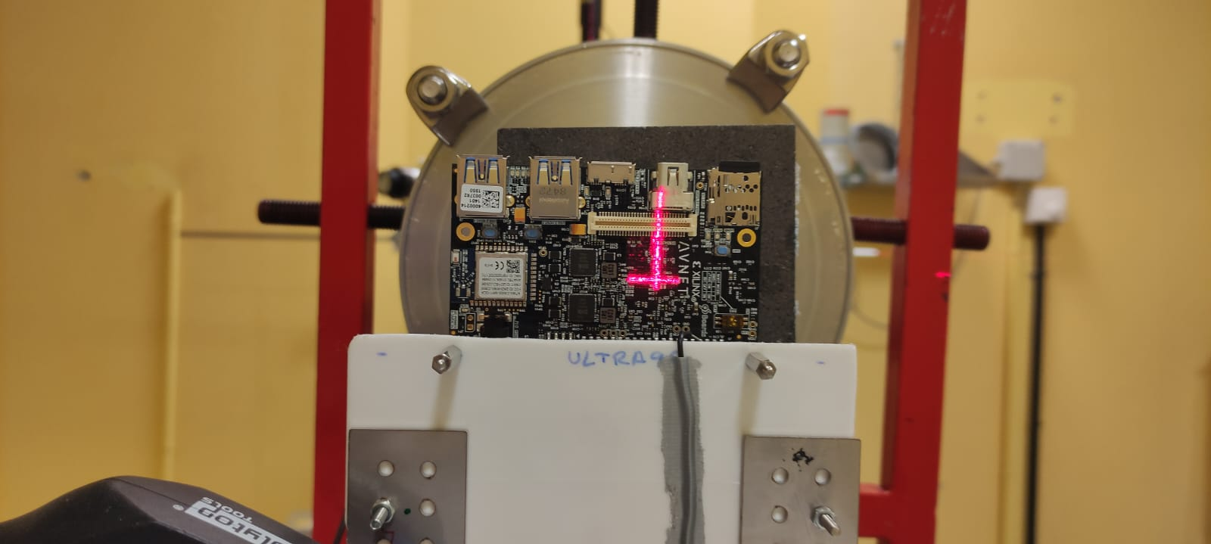
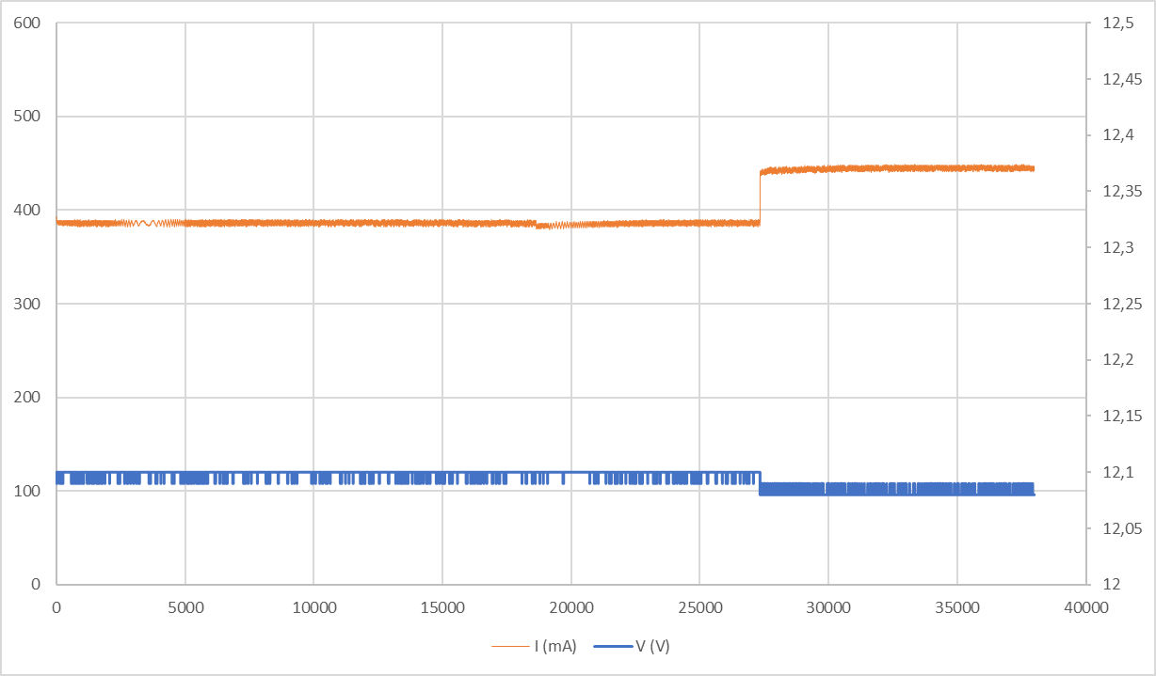
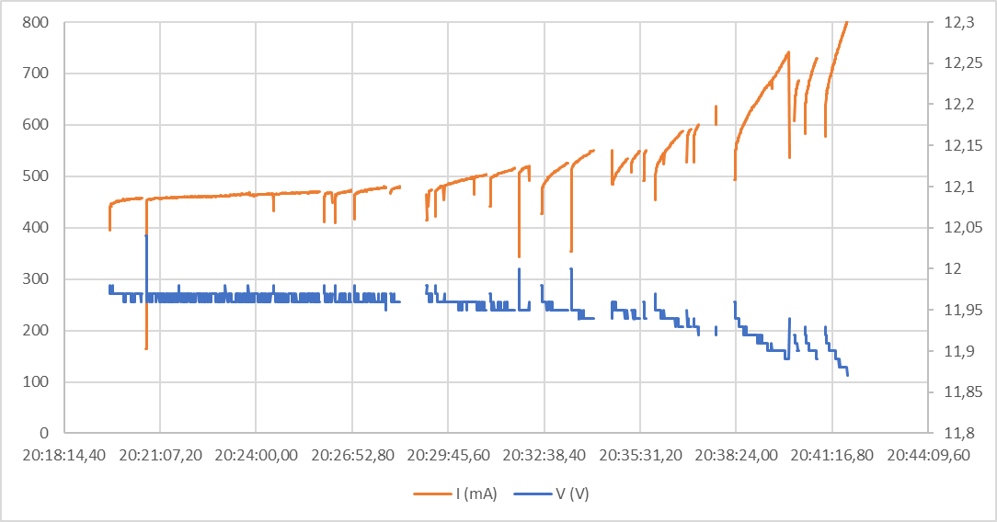
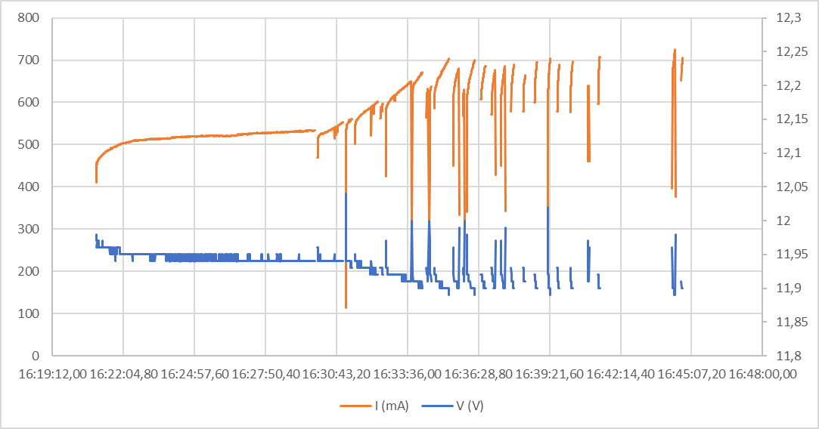
> ChipIr: SoC UltraScale+
Small number of events
Microlatchup (under SEL stablished limit=500 mA)
The same test was performed at CNA (15 MeV protons)
  Small number of events
    Flux was increased: TID effects observed (persistent current degradation)
  No SEL observed
Additional tests will be performed in the next TA campaigns (PARTREC)
CNA
ChipIr
CNA
CNA

Slide 23
Publications
RADECS 2022 Data Workshop: P. M. Aviles, L. A García-Astudillo, J.A. Belloch, L. Entrena, A. Lindoso, “Comparative of proton radiation data for 28 nm Zynq-7000 SoC”
IEEE TNS (Special issue RADECS 2022) : L. A. García-Astudillo, A. Lindoso, et al., "Evaluating Reduced Resolution Redundancy for Radiation Hardening in FPGA designs"
doi: 10.1109/TNS.2023.3268825
Under Review:
RADECS 2023
  D. A. Santos, P.M. Aviles, A.M.P. Mattos, M. Garcia-Valderas, L. Entrena, A. Lindoso, L. DiLillo, “Hybrid Hardening Approach for a Fault-Tolerant RISC-V System-on-Chip”
  G. Leon, J.M. Badia, J.A. Belloch, M. Garcia-Valderas, A. Lindoso, L. Entrena, “Analysing the influence of memory and workload on the reliability of GPUs under radiation”
Journal publications & conference communications in progress

Slide 24
Conclusions
Successful test of complex systems in different facilities
  SoC, hard-core & soft-core microprocessors, FPGA and GPUs
Combine different experiments/different boards & sensitivities for a radiation campaign
Challenges in testing complex devices:
  SoC
  GPUs
Comparison of irradiation campaigns results for different facilities/particles
Developing guidelines for non-expert end users

Slide 25
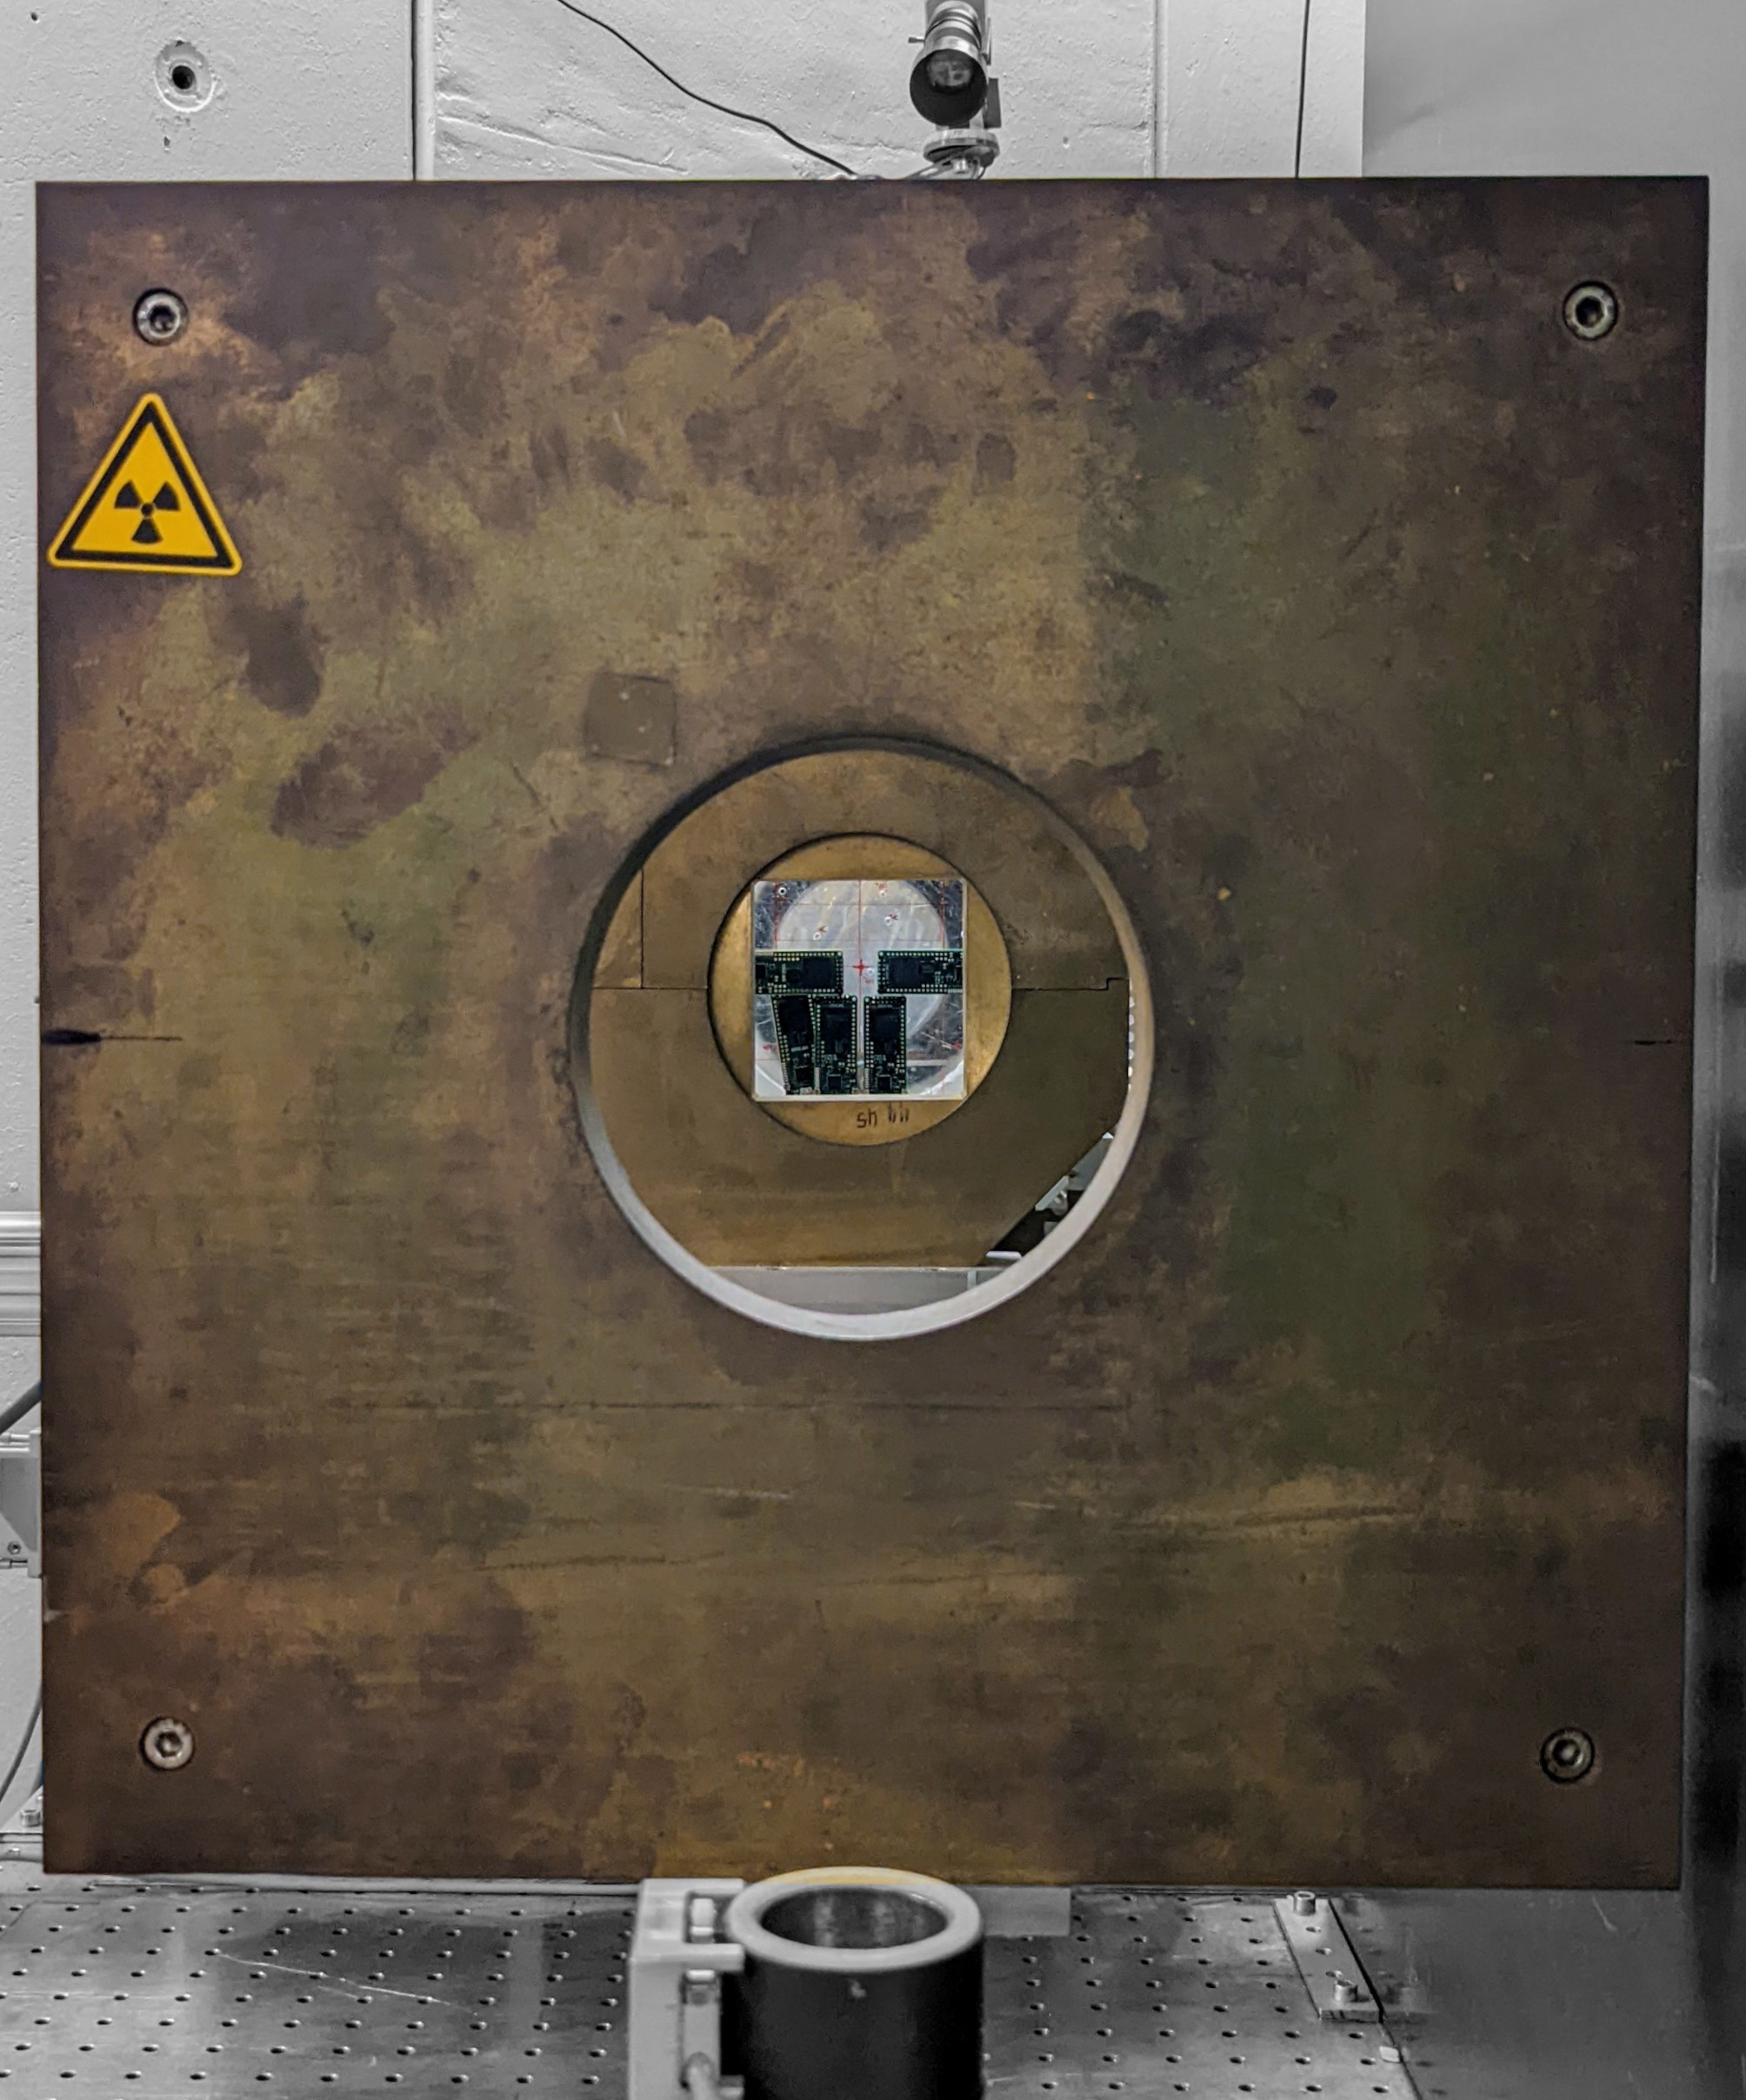
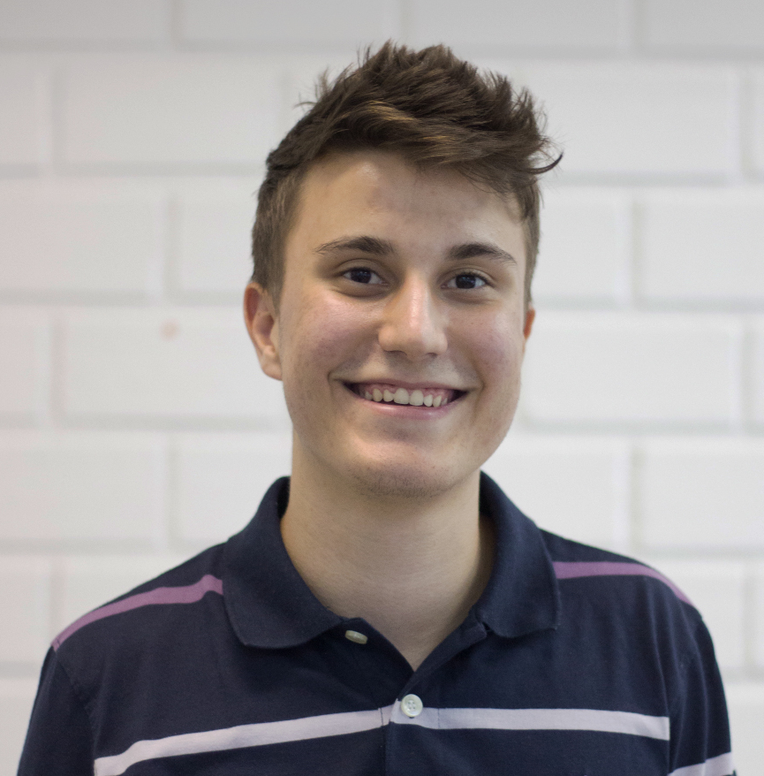
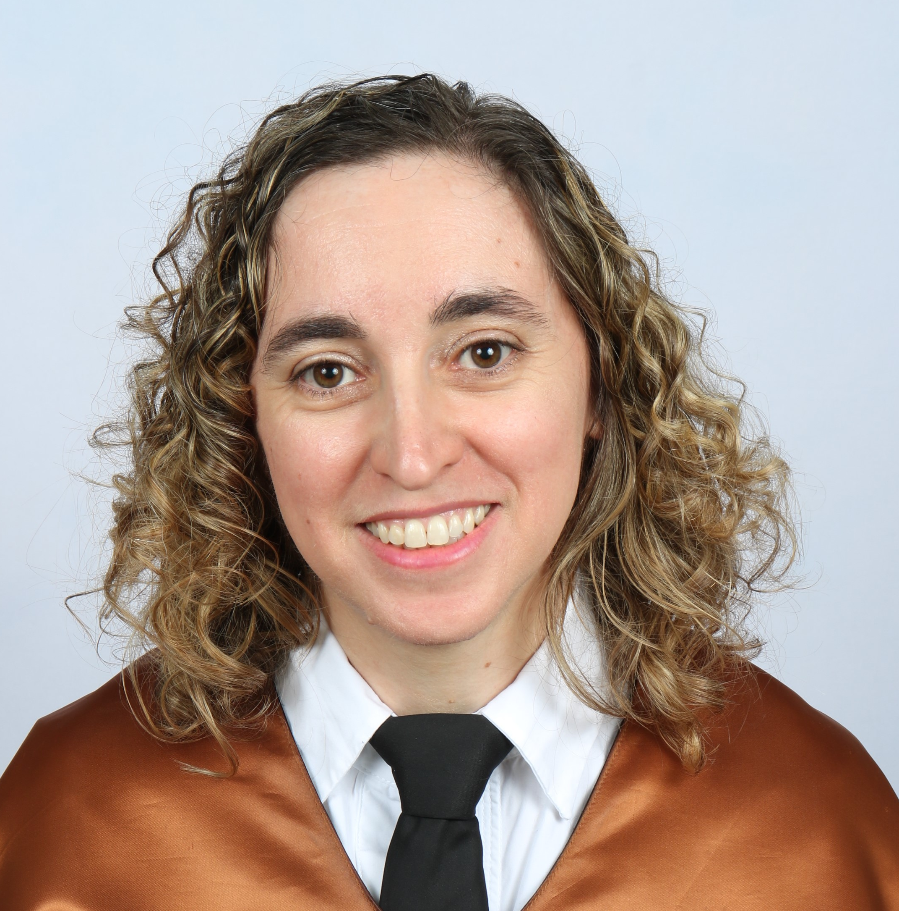
Thanks for your attention!
André M. P. Mattos (IES/UM):
andre.martins-pio-de-mattos@etu.umontpellier.fr
Almudena Lindoso (UC3M):
alindoso@ing.uc3m.es
Image Source: IES/UM

