Slide 1


WP6, Investigation of Proton-Induced Single Event Effects on the Zynq-7000 System on Chip for On-Board Computing Applications in Space Missions
Jan Budroweit (DLR)
RADNEXT 2nd Annual Meeting – 9-10 May 2023
https://indico.cern.ch/e/radnext-2023

Slide 2
Outline
Introduction
SEE Test Results
  ARM Caches
  XADC
  SEM IP-Core
Conclusion

Slide 3
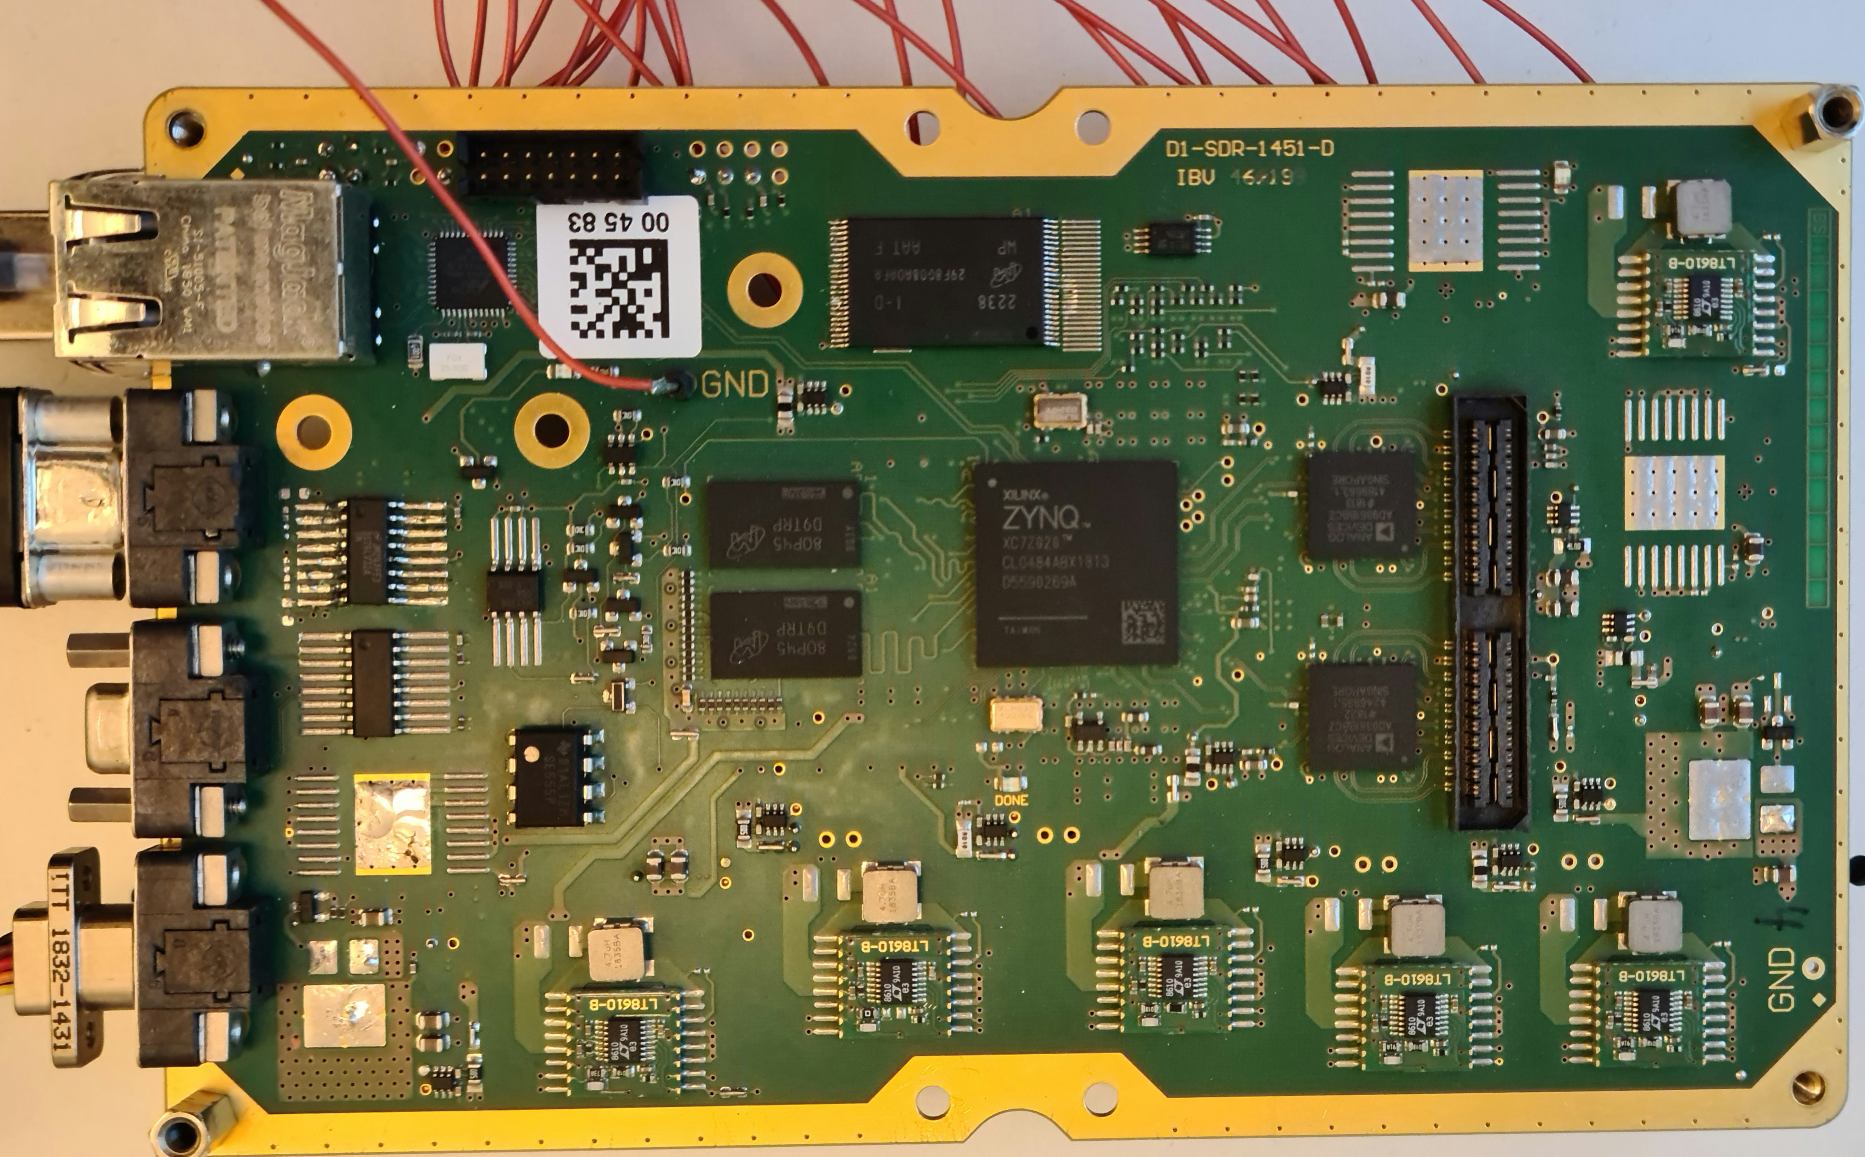
Introduction
DUT: Zynq-7000 (ZC7020)
Platform: Customized Software-Defined Radio (SDR)
Particles: Protons
Facilities: PSI, PARTREC
Energies: 230 MeV (PSI) and 184 MeV (PARTREC)
Flux: 0.5 to 5 E+7 #/cm²/s (depending on the experiment)
Objectives:
  Influence of ARM caches configuration while running a operating system
  Investigations of the integrated Xilinx XADC for system-integrated latch-up detection
  Investigation of the SEM-IP Core as mitigation mechanism for SEUs in the FPGA bitstream

Slide 4
SEE Test Results
ARM Caches
Methodology:
  Impact of SEEs while using and running an embedded Linux operating system
  Use of different cache configurations of the dual ARM core (L1i, L1d and L2)
  Tested while Linux is running and executing a dedicated program (matrix multiplication)
  Linux kernel GNU debugger (KGDB) used to trace failure after system crash
  Proton beam of PSI used at primary energy of 230 MeV and tailored flux (depending on the the cache configuration)

Slide 5
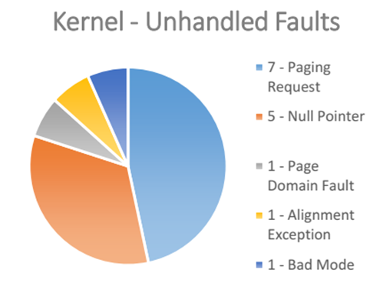
SEE Test Results
ARM Caches
Results:
  SEFI results:
    L1,L2 on: 1.92 x 10E-8 cm²/device
    L1 off, L2 on: 1.08 x 10E-9 cm²/device
    L1, L2 off: 1.52 x 10E-10 cm²/device
  SEFIs origin is different:
    Mostly happened by prefetch aborts (counter errors) – coming from L1
    When L1 is disable, errors are more diverse: unhandled paging request, null pointer references
    All caches disabled error occurred mainly by wrong addresses being accessed by the kernel
  No error observed in the data caches itself (by checking the matrix multiplication result)

Slide 6
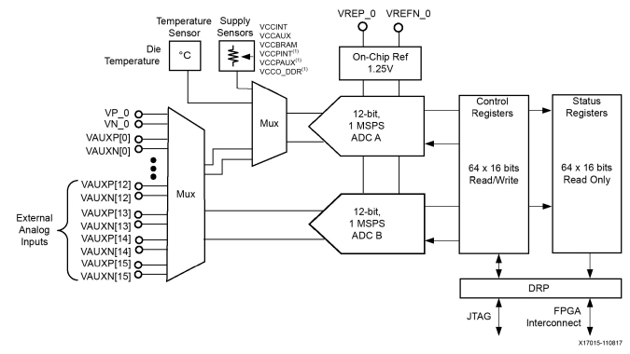
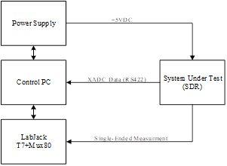
SEE Test Results
XADC
Methodology:
  XADC inputs connected to shunt-resistors and current sense amplifier in the SDR power domains
  Data being transmitted to host pc by RS422 interface
  ADC (12-bit) raw data used (no compression or additional data processing)
  Bare-metal code being used (all caches disabled)
  Voltages/Currents monitored with DAQ system in parallel

Slide 7
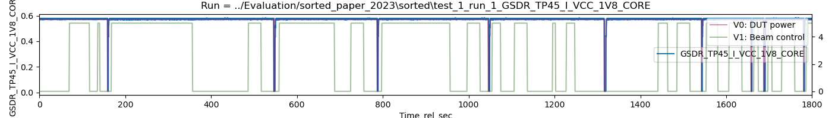
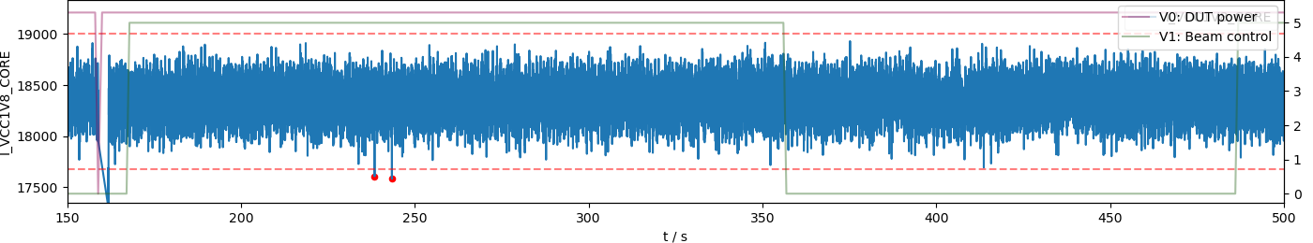
SEE Test Results
XADC
Results:
  No indication of SEUs in the ADC data

Slide 8
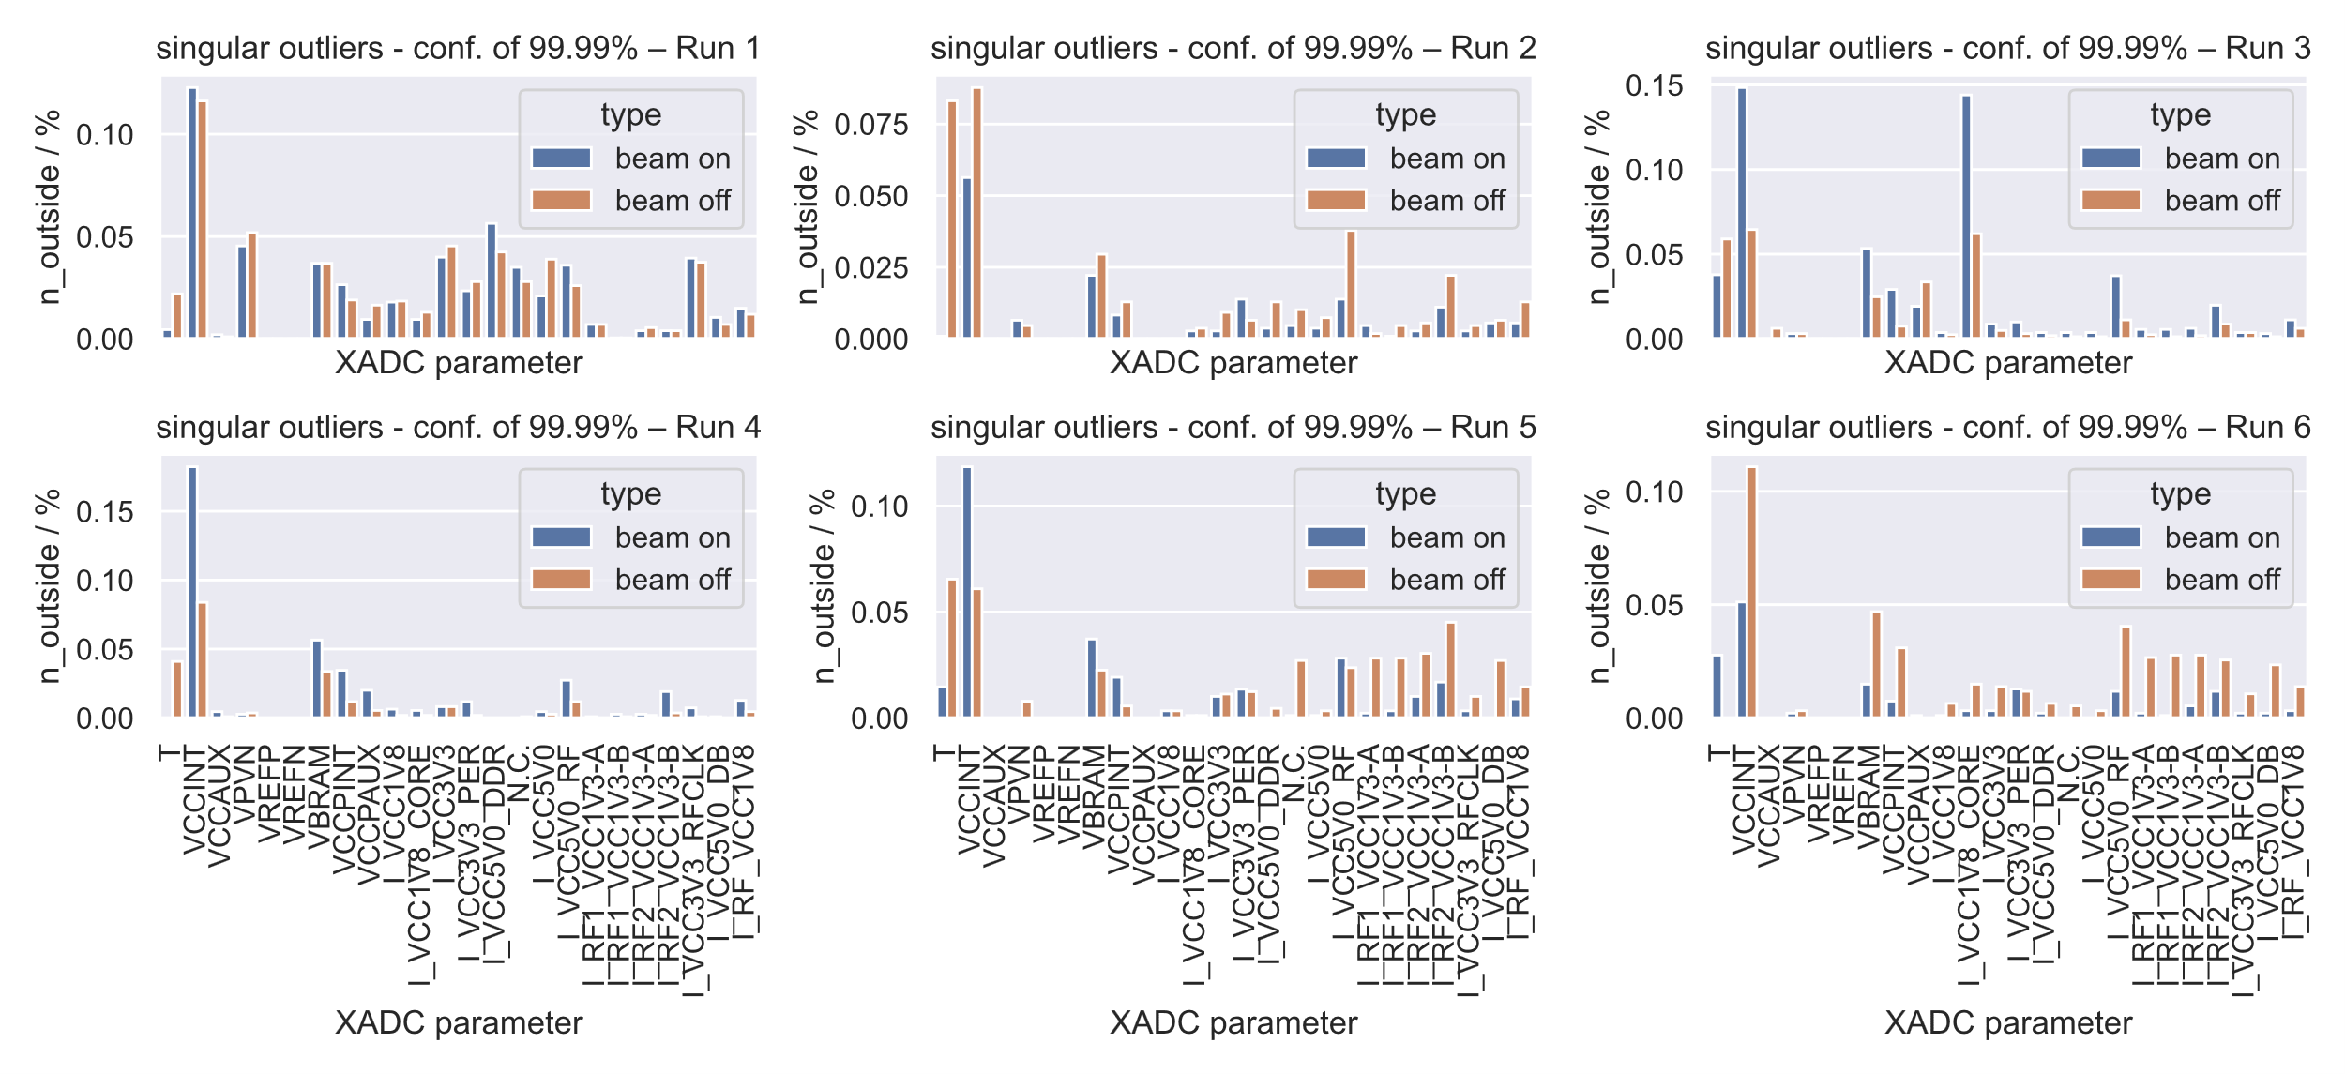
SEE Test Results
XADC
Results:
  No indication of SEUs in the ADC data

Slide 9
SEE Test Results
XADC
Results:
  No indication of SEUs in the ADC data
  12-bit are aligned to 16-bit samples (MSB), LSB of the data not noticed
  Calibration of the XADC enabled (smoothing of data)
  Deviation of the data due to dynamic load of the system (“noise”)
  Pulling the XADC inputs to ground would give better results

Slide 10
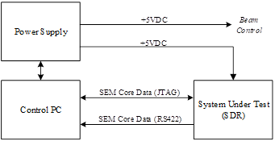
SEE Test Results
SEM-IP Core
Methodology :
  Testing the SEM-Core at different flux level
  Data from IP-Core being transmitted to host pc by RS422 interface (115200 baud)
  Read-out FPGA configuration with JTAG
  Further irradiation once the SEM-Core crashes to evaluate the SEUs in the CRAM (target fluence)
  Two bitstreams / configuration tested (max. and min.)
Flux [#/cm²/s] | 2nd run duration [s] | 2nd run Fluence [#/cm²]
0.5 E+7 | 60 | 30 E+7
1.0 E+7 | 30 | 30 E+7
5.0 E+7 | 15 | 75 E+7

Slide 11
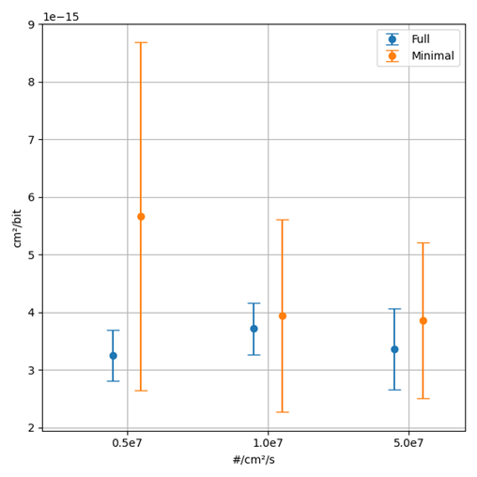
SEE Test Results
SEM-IP Core
Results :
  Flux dependency of SEM IP-Core

Slide 12
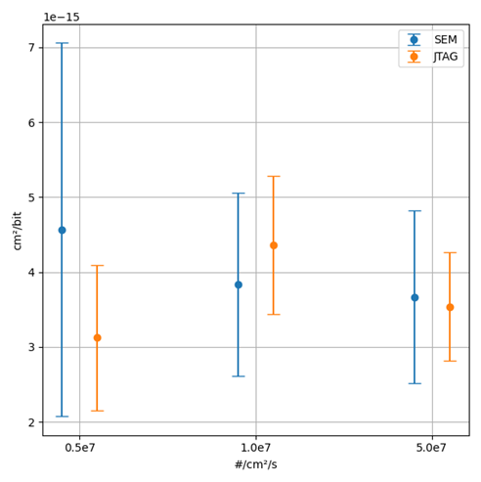
SEE Test Results
SEM-IP Core
Results :
  Flux dependency of SEM IP-Core
  SEM vs. JTAG-Readback

Slide 13
SEE Test Results
SEM-IP Core
Results :
  Flux dependency of SEM IP-Core
  SEM vs. JTAG-Readback
  Error classification
    “SED OK” - 1-bit ECC errors
    “DED” - 2-bit ECC errors
    “CRC” - non-correctable errors
  The duration of the first run shows a very high variance and degrades with increasing flux
  No significant difference in SEE cross-section has been observed
  CRAM completely checked independent of PL allocation
  Essential-bit mask could be used to improve performance
Flux [#/cm²/s] | SED OK | DED | CRC
0.5e+7 | 9.9e-8 | 7.0e-9 | 1.4e-9
1.0e+7 | 10.0e-8 | 7.0e-9 | 1.6e-9
5.0e+7 | 6.8e-8 | 4.5e-9 | 0.8e-9
Type | Duration [ms]
SED OK (1-bit) | 0.009±0.008
DED (2-bit) | 0.014±0.008
Flux [#/cm²/s] | Mean duration [s]
0.5e+7 | 77.7±65.0
1.0e+7 | 50.5±55.6
5.0e+7 | 16.9±34.3

Slide 14
Conclusion
Right use of ARM cache configuration can improve system crashes up 800%
Kernel always causes system crashes not the executed test program
  Wrong addressing, wrong register values, prefetch aborts (L1i), unhandled page requests, null pointer reference and processor crashes (all caches disabled)
The XADC is a nice solution for system-internal voltage/current monitoring instead of using additional ADCs
No SEE indication found, but uncertainties needs to be considered (calibration enabled, dynamic input to XADC)
SEM Core is a useful tool to detect an correct SEUs in the CRAM
Once the SEM Core cannot correct an error its stops operating an a reprogramming is required
Essential bit mask could be helpful but requires additional an dedicated memory
Further investigation on mapping the error reports to CRAM locations (decoding of addresses and logic).

Slide 15
Publications
M. Jaksch, J. Budroweit and F. Stehle, "Debugging Xilinx Zynq-7000 SoC Processor Caches during Linux System Execution under Proton Irradiation," 2022 IEEE Radiation Effects Data Workshop (REDW) (in conjunction with 2022 NSREC), Provo, UT, USA, 2022, pp. 1-4, doi: 10.1109/REDW56037.2022.9921631.
F. Stehle, J. Budroweit and F. Eichstaedt, "Investigation of the Xilinx SEM Core on a Zynq-based Software-Defined Radio under Proton Irradiation," 2023 IEEE Radiation Effects Data Workshop (REDW). Accepted Paper
F. Eichstaedt, J. Budroweit and F. Stehle, “Investigation of the Zynq-7000 Integrated XADC under Proton Irradiation," 2023 IEEE Radiation Effects Data Workshop (REDW). Accepted Paper

Slide 16
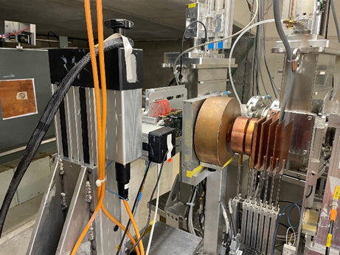
Thanks for your attention!
Image Source: DLR

