Slide 1


WP07-JRA3, Cumulative radiation effects on electronics - Overview of WP7
Vincent GIRONES (University of Montpellier)
RADNEXT 2nd Annual Meeting – 9-10 May 2023
https://indico.cern.ch/e/radnext-2023
Notes:
Hi Everyone,
I’m Vincent GIRONES from Montpellier University.
I will present you the work which is realized in this workpackage 7 of the RADNEXT project.
This workpackage is entitled « Cumulative radiation effects on electronics ».

Slide 2
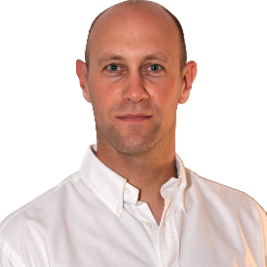







WP7 members
Université de Montpellier
ISAE-SUPAERO
Université de Liège
Université Jean Monnet Saint-Etienne
ATRON
Airbus Defence & Space
Jérôme Boch WPL
Vincent Goiffon Deputy WPL
Notes:
I’m the leader of this workpackage and Vincent Goiffon, from ISAE-SUPAERO is the Deputy workpakage leader.
6 RADNEXT partners are involved in workpackage 7:
Université de Montpellier
ISAE-SUPAERO in Toulouse
Université de Liege
Université Jean-Monnet in Saint Etienne
ATRON which is a french compagny that has a 3.5MeV electron accelerator
Airbus Defence and Space

Slide 3
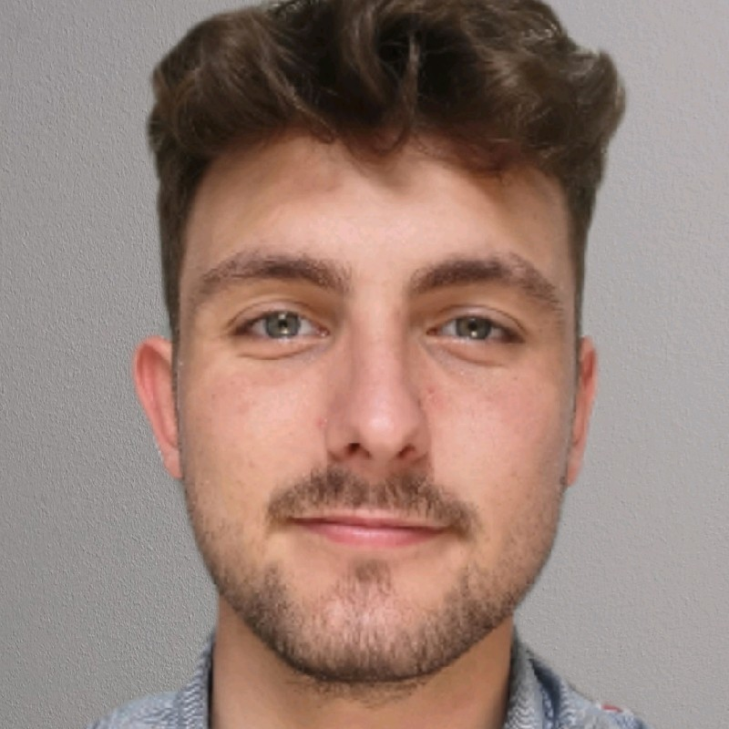

WP7 structure
The main objective is to understand the physical mechanisms behind the damage caused by TID and TNID and to propose test methodologies adapted to the use of electronic components and systems in radiative environment.
Two main technical tasks are studied:
Task 7.1: Coordination and communication
Task 7.2: The effects of ionizing dose (TID = Total Ionizing Dose)
This task began in month 1
PhD recruitment from October 2021 (36 months) at UM
Task 7.3: The effects of non-ionizing dose (TNID = Total Non-Ionizing Dose)
This task is just beginning
Postdoc recruitment from October 2022 (12 months) at ISAE-SUPAERO
Vincent GIRONES
Maxence GUENIN
Notes:
I present you in this slide a quick view of the structure of this workpackage.
The main objective of this workpackage 7 on cumulative effects is to understand the physical mechanisms leading to degradation and to propose test methodologies to test electronics devices at component and system levels.
In order to investigate cumulative effects, workpackage 7 is divided into 3 tasks.
The first task is dedicated to the coordination of the workpackage.
The task 2 is on Total Ionizing Dose.
And the task 3 is on Total Non-Ionizing Dose.
Workpackage 7 takes 46 months to complete.
The task on TID starts from the beginning of the project, and will run for the duration of the project.
I have been recruited as PhD on this task from October 2021.
The second task lasts a little over one year and begin now.
Maxence GUENIN has been recruited as postdoc on this task from October 2022.

Slide 4
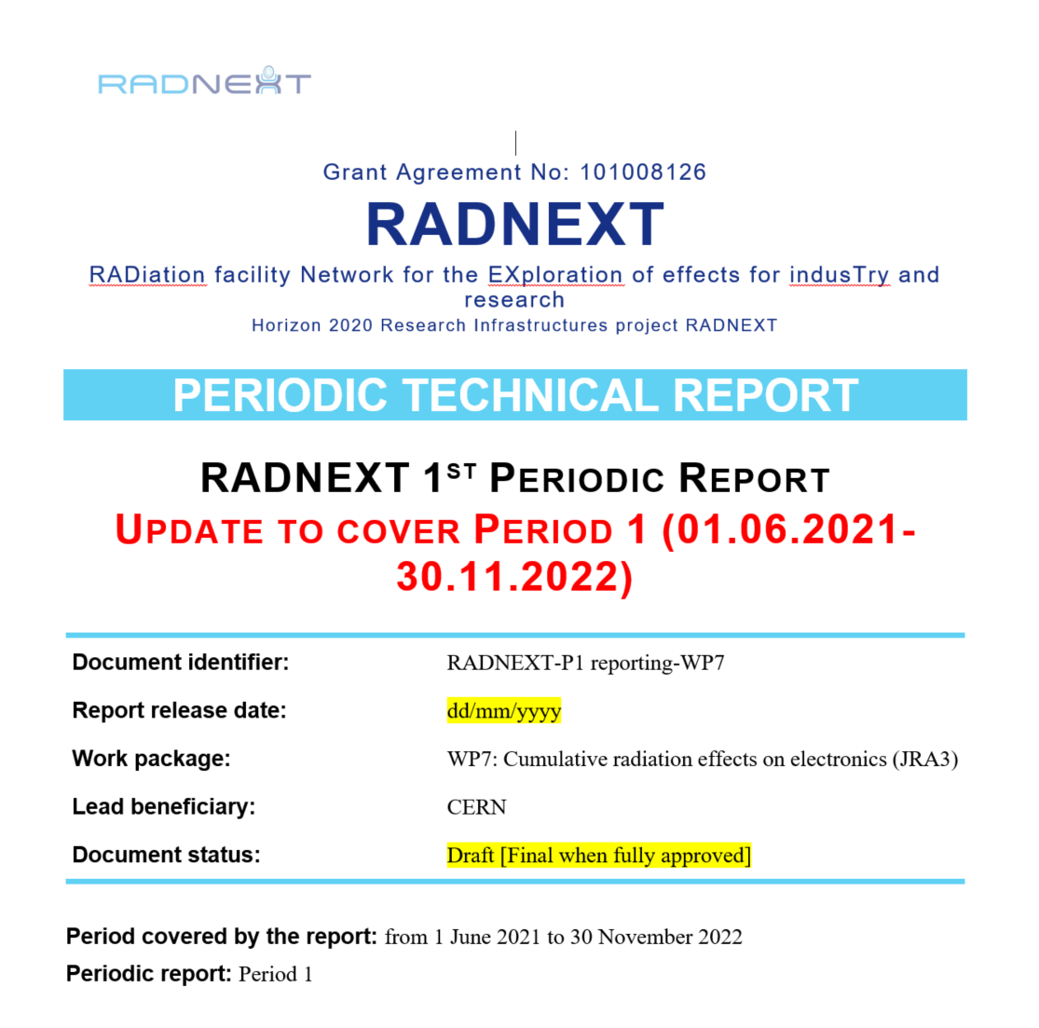
WP7 milestones, deliverables and reports
MS24 | X-ray ATRON Facility modelling | 2023/05/31
MS25 | Comparison of X-ray / cobalt experimental data | 2024/05/31
MS30 | Beginning of TNID irradiation campaign | 2024/05/31
D1 | Comparison of X-ray / cobalt experimental data | 2024/05/31
D2 | Published list of tested components against cumulative effects | 2024/05/31
D3 | Final TID results and guidelines for dose testing with X-ray facilities | 2025/03/31
D4 | Final TID results and guidelines for dose testing with X-ray facilities | 2025/03/31
The report on the first period was written in December 2022
Notes:
Milestones and deliverables are given in this slides.
In this WP we have defined 3 milestones and 4 deliverables.
For the next months, there is only one milestone planned.
The report on the first period was written in the end of 2022.

Slide 5
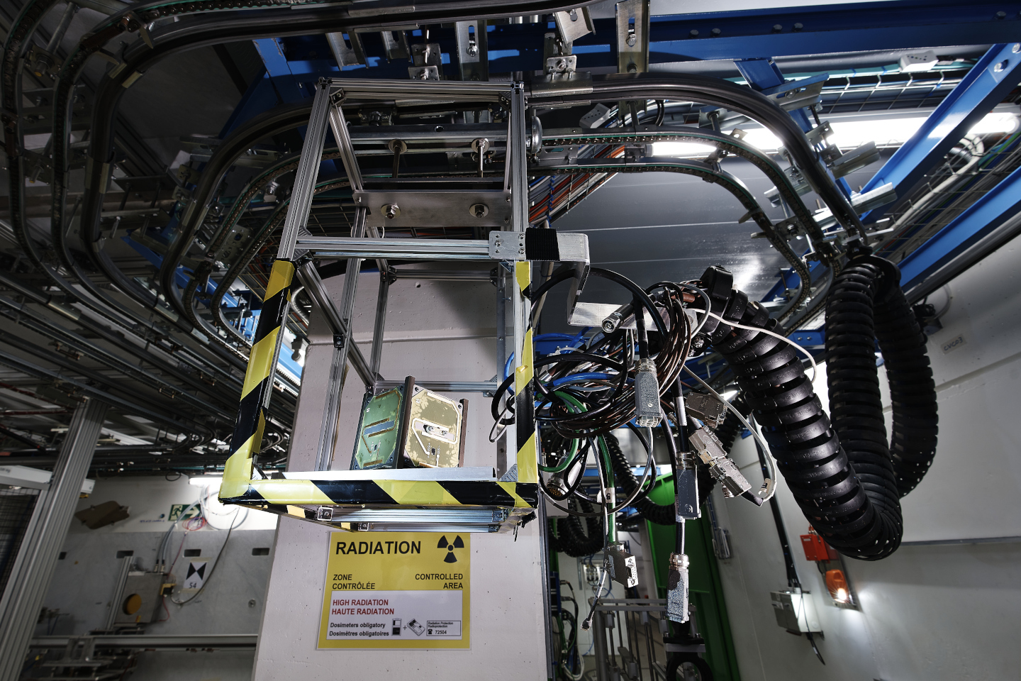
Thanks for your attention!
Image Source: CERN

