Slide 1




Work Package 8:
SEU cross-section prediction
CLEITON M. MARQUES
This project has received funding from the European Union's Horizon 2020 research and innovation programme under grant agreement No 101008126
https://indico.cern.ch/e/radnext-2023

Slide 2
Outline
Introduction
Circuit Level Modeling
Results
Next steps

Slide 3

Introduction
This PhD, in a framework of RADNEXT EU project, will develop and
apply approaches for modelling radiation effects on electronics.
Impact of circuit modelling and low energy particles
on Single-Event Effect rate prediction
WP8/JRA4
Complementary modelling tools
RADiation facility Network for the Exploration
of effects for indusTry and research
Notes:
RADNEXT infrastructure project with the objective of creating a network of facilities and end users for responding to the emerging needs of electronics component and system irradiation. This project combining different irradiation and simulation techniques for optimizing the radiation hardness assurance for systems

Slide 4
Introduction
Impact of circuit modelling and low energy particles
on Single-Event Effect rate prediction
Impact of low energy protons and neutrons on SEU rate prediction
D8.1 Simulation results of the importance of 1-10Mev energy range on the SER for neutrons
D8.3 Recommendation for simulating low energy protons
Circuit level modeling
D8.4 Simulation results and report on circuit modeling
Impact of layout and input vector on SET Cross Section calculation
Experimental part
Notes:
The goal is to investigate alternate simplistic models that can be used and identify its limitations.

Slide 5
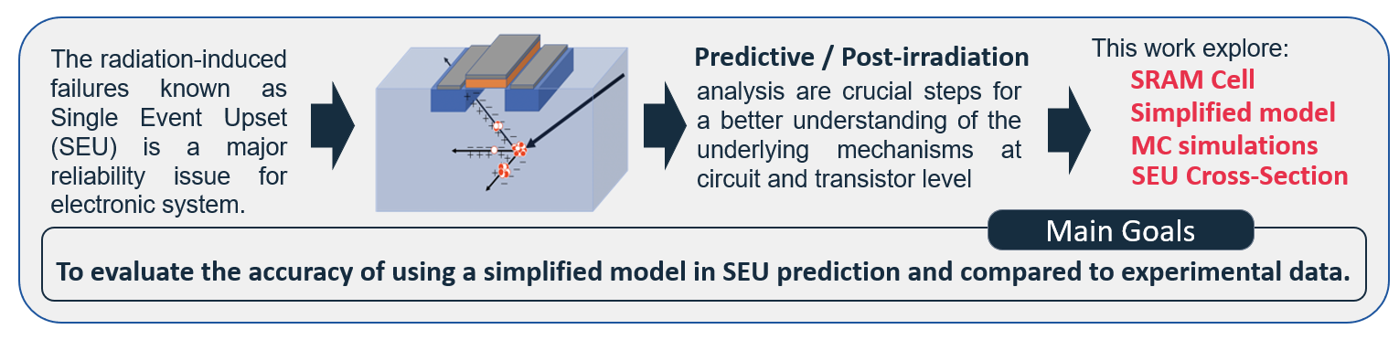
Circuit level modeling

Slide 6
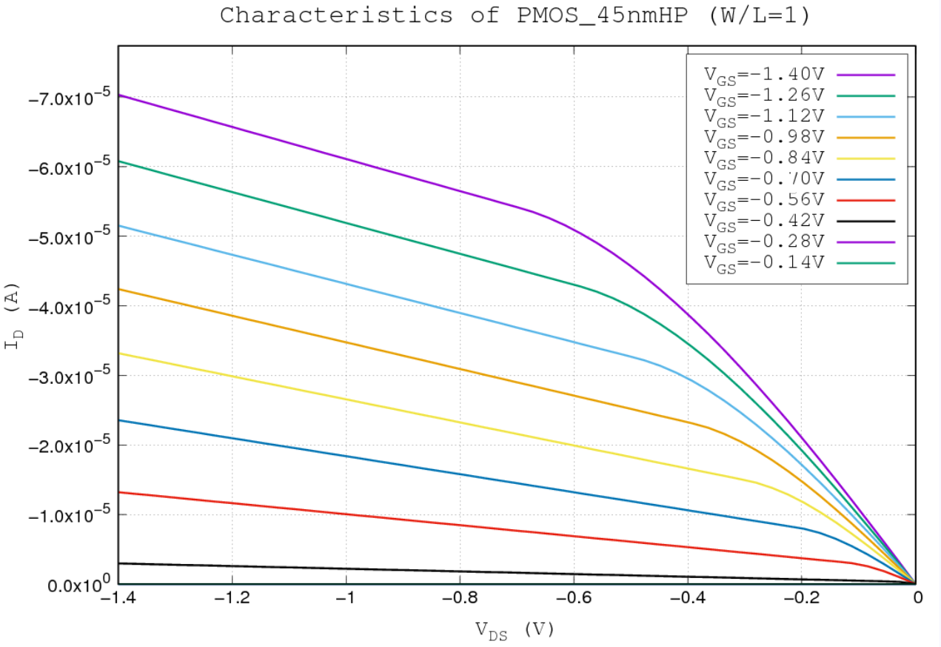
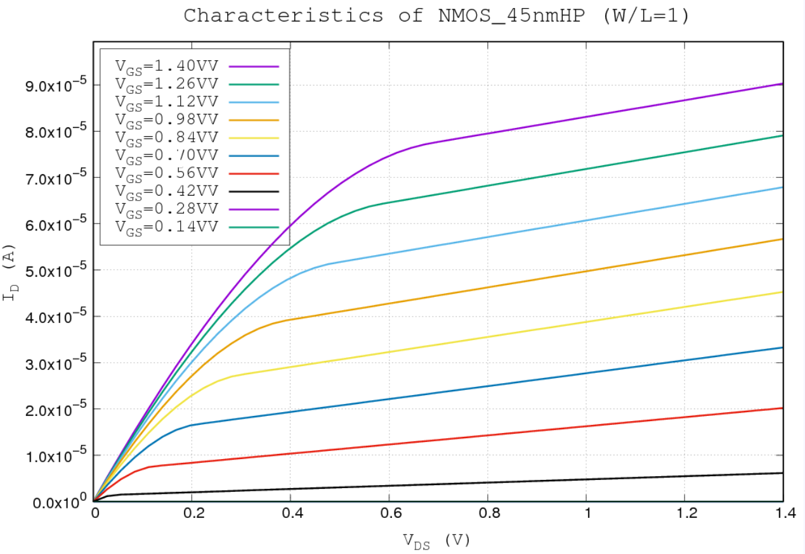
Circuit level modeling
The PredicSEE is an MC tool based on Simplified electrical model and aims to simulate radiation induced SEE in MOS technologies.
Use the diffusion-collection model.
Apply MC simulations to simulates the passage of ions, neutrons, or protons particles across the device.
The simplified model is defined based I_{DS} vs V_{DS} for different V_{GS}, replacing the structure of the transistor by a current source.

Slide 7
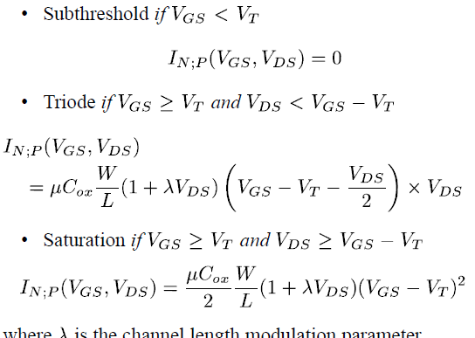
Circuit level modeling
To calculate the current associated with the transistor we use an analytical expression, which gives the three major regions of operation: subthreshold, triode, and saturation.

Slide 8
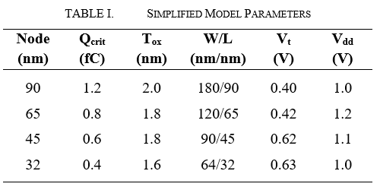
Circuit level modeling
There are different tools in literature to evaluate SEE. (G4SEE, FLUKA…)
Most part of these tools are dependent on the information contained in the PDK of the technology and depending on the type of analysis, the tool needs to solve complex transport and Poisson equations, making the simulation very CPU/Time consuming.
Protons / Neutrons
Ions
DHORIN
SRIM Tables

Slide 9
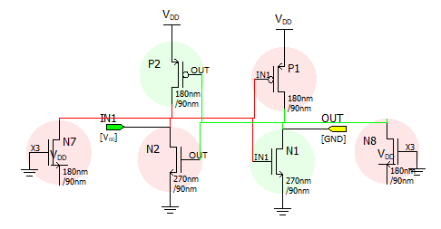
Circuit level modeling
Simulation Flow
Circuit implementation
Layout design
SEE Analysis
Cross Section Results
1
Notes:
The simulation has been performed using the Texas A&M Cyclotron Facility (TAMU) heavy ions 15-MeV/u database.

Slide 10
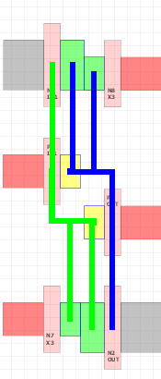
Circuit level modeling
Simulation Flow
Circuit implementation
Layout design
SEE Analysis
Cross Section Results
1
2
Notes:
The simulation has been performed using the Texas A&M Cyclotron Facility (TAMU) heavy ions 15-MeV/u database.

Slide 11
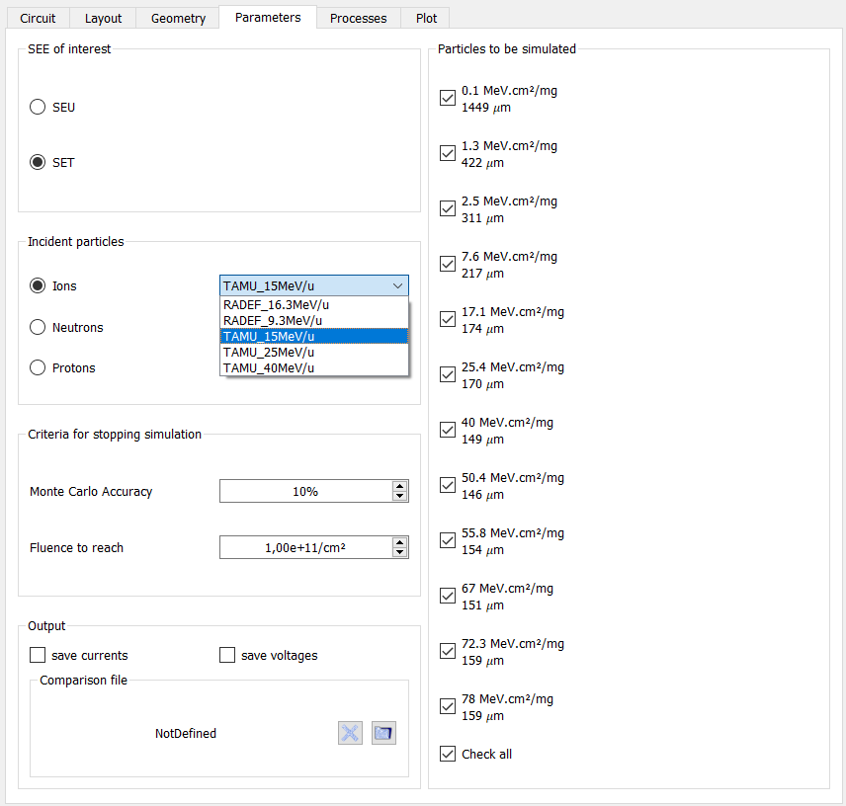
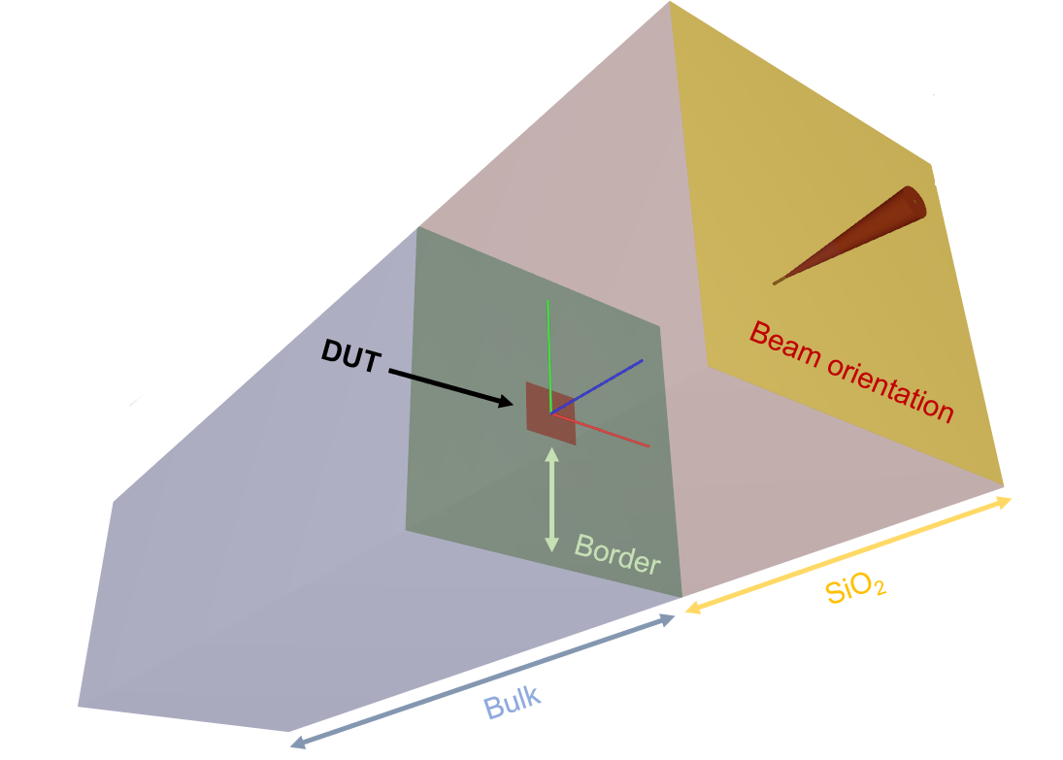
Circuit level modeling
Simulation Flow
Circuit implementation
Layout design
SEE Analysis
Cross Section Results
1
2
3
Notes:
The simulation has been performed using the Texas A&M Cyclotron Facility (TAMU) heavy ions 15-MeV/u database.

Slide 12

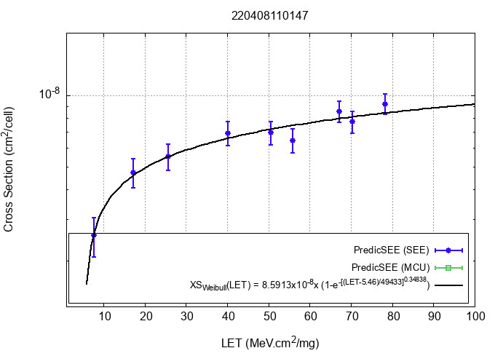
Circuit level modeling
4
Simulation Flow
Circuit implementation
Layout design
SEE Analysis
Cross Section Results
1
2
3
Notes:
The simulation has been performed using the Texas A&M Cyclotron Facility (TAMU) heavy ions 15-MeV/u database.

Slide 13
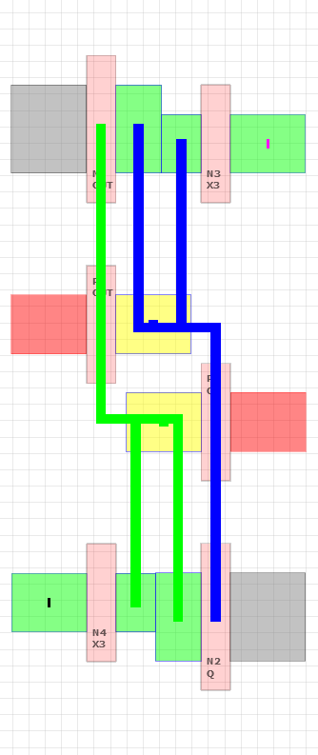
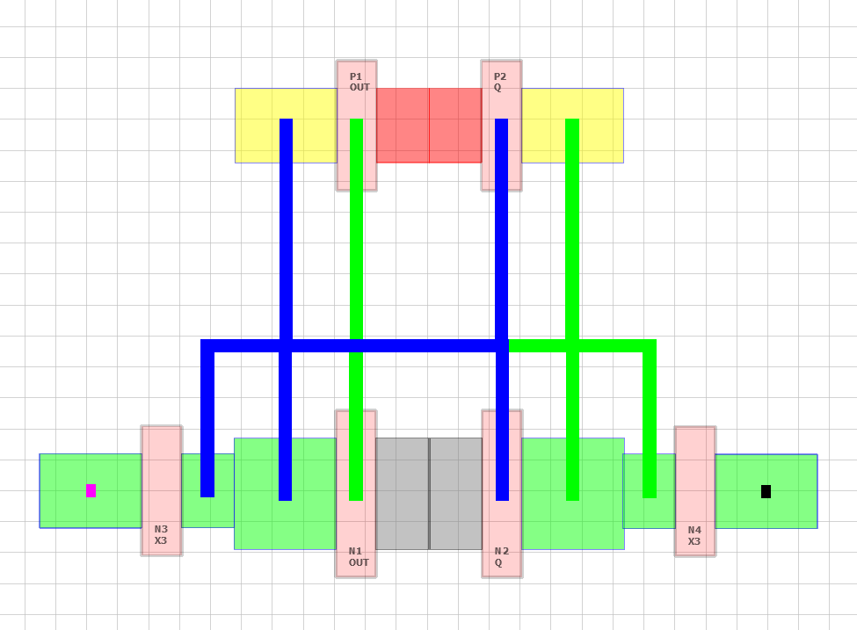
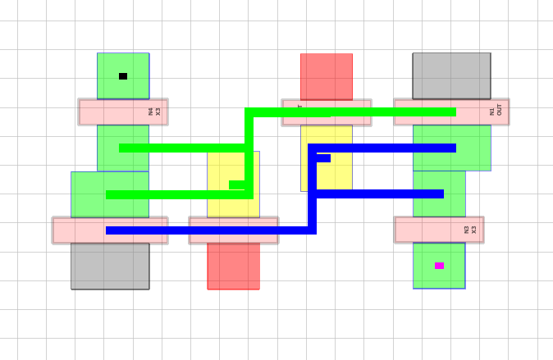
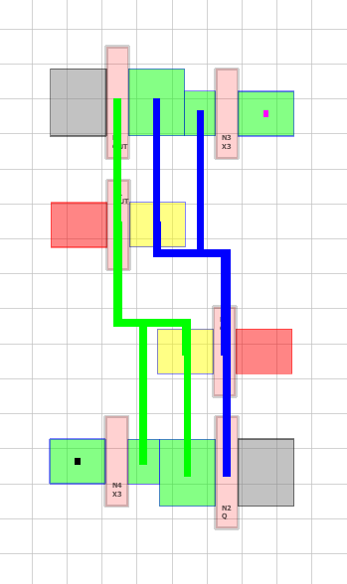
Technology | C_{out} (fF) | W/L (nm/nm) | P-Well doping (at/cm³) | N-Well doping (at/cm³) | Layout
90 nm | 1.20 | 180/90 | 1.43E18 | 1.94E18
65 nm | 0.72 | 120/65 | 1.87E18 | 2.54E18
45 nm | 0.53 | 90/45 | 2.44E18 | 3.24E18
32 nm | 0.36 | 64/32 | 3.10E18 | 4.2E18
Notes:
The simulation has been performed using the Texas A&M Cyclotron Facility (TAMU) heavy ions 15-MeV/u database.

Slide 14
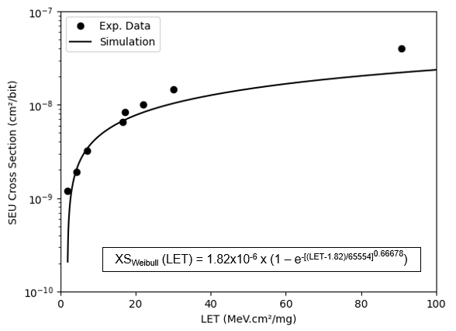
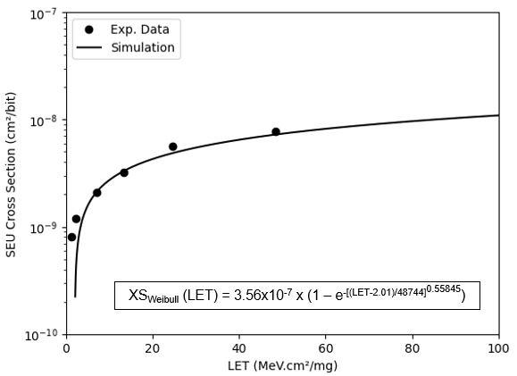
Results
Heavy ions SEU cross-section for 90 nm SRAM.
The experimental results are taken from [1].
Heavy ion SEU cross-section for 65 nm SRAM.
The experimental data are taken from [2].
~ 50%
Overall discrepancy of ~20%
Difference less than 15%
[1] G. M. Swift, et al, "Static Upset Characteristics of the 90nm Virtex-4QV FPGAs," 2008 IEEE Radiation Effects Data Workshop, 2008, pp. 98-105, doi: 10.1109/REDW.2008.25.
[2] J. Wang, et al, "Study of SEU Sensitivity of SRAM-Based Radiation Monitors in 65-nm CMOS," IEEE Trans. Nucl. Sci. (TNS), vol. 68, no. 5, pp. 913-920, May 2021, doi:10.1109/TNS.2021.3072328.

Slide 15
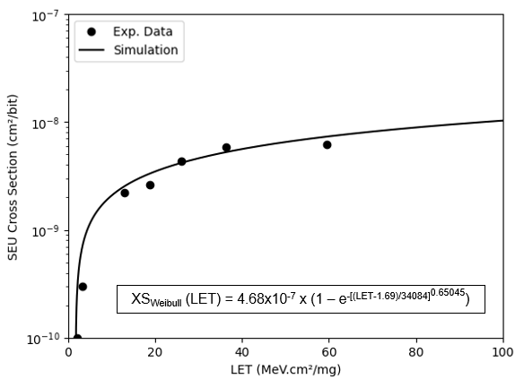
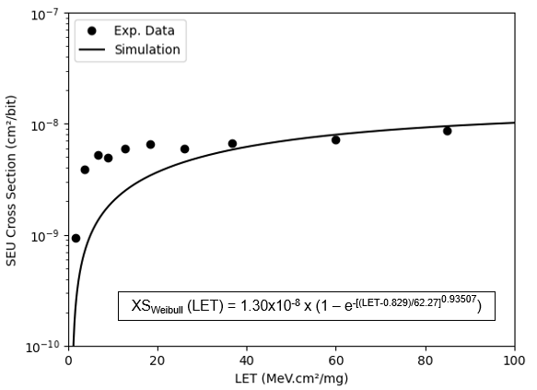
Results
Heavy ion SEU cross-section for 45 nm SRAM.
The experimental results are taken from [3].
Heavy ion SEU cross-section for 32 nm SRAM.
The experimental data are taken from [4].
~ 3 times
The divergence is ~10%
The discrepancy is ~10%
[3] C. Weulersse, et al, “Prediction of proton cross sections for SEU in
SRAMs and SDRAMs using the METIS engineer tool,” Mic. Rel., vol.
55, nos. 9–10, pp. 1491–1495, Aug. 2015, doi: 10.1016/j.microrel.2015.06.117
[4] S. Uznanski, et al, "Heavy Ion Characterization and Monte Carlo Simulation on 32nm CMOS Bulk Technology," IEEE Trans. Nucl. Sci. (TNS), vol. 58, no. 6, pp. 2652-2657, Dec. 2011, doi: 10.1109/TNS.2011.2170852.

Slide 16
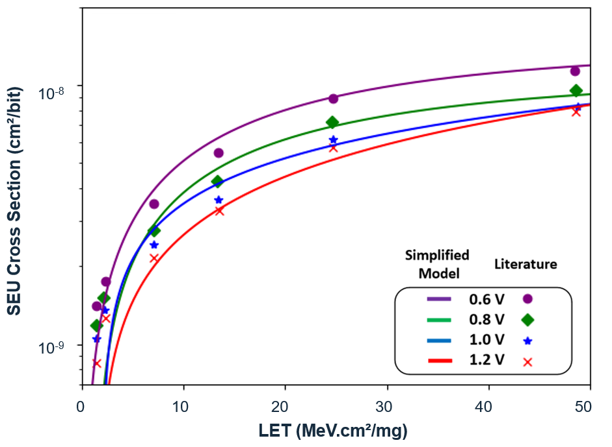
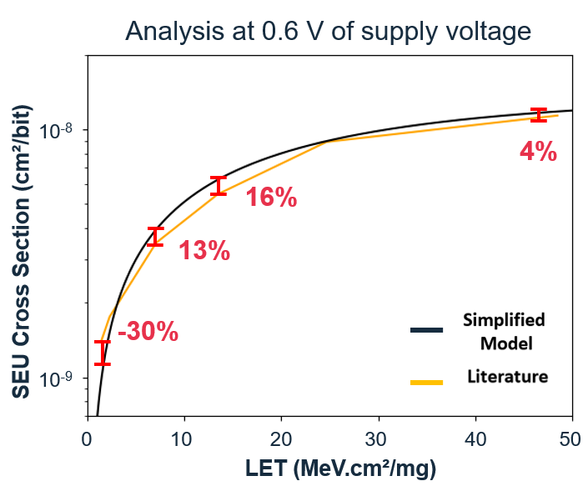
Results
Heavy ion SEU cross-section for 65 nm SRAM.
The experimental data are taken from [2].
Decreasing
Supply Voltage
Increasing
Cross Section

Slide 17
Conclusions
In this work, a framework based on a simplified electrical model using Monte Carlo simulations to predict the SEU cross-section of SRAM cells was proposed.
The standard 6T SRAM cell was the DUT of this study and was evaluated
at 90 nm, 65 nm, 45 nm, and 32 nm bulk-planar CMOS technology.
The results confirm a good agreement with the experimental data, showing that the proposed model can accurately predict the SEU mechanism.
Considering the voltage scaling, the simulations results reproduce the trends in the literature.

Slide 18
Conclusions
The most divergences found in the results can be explained by the following factors:
  The predictive SPICE models used to extract basic information from the technologies for not having access to the technology PDK of the DUT;
  The sizing of the cells that was standardized in the same ratio for the simulations, but which can vary a lot in commercial cells depending on the manufacturer and design requirements;
  The layout rules and the approach used in the simulations in relation to the tested commercial cells as there may be differences depending on the manufacturer.
The results show that the prediction for more consolidated technologies can be easily approximated, but for modern technologies the dependence of precise parameters increases.
Notes:
The results show that the prediction for more mature technologies can be easily approximated, while for more modern technologies the dependence on more precise parameters is necessary.

Slide 19
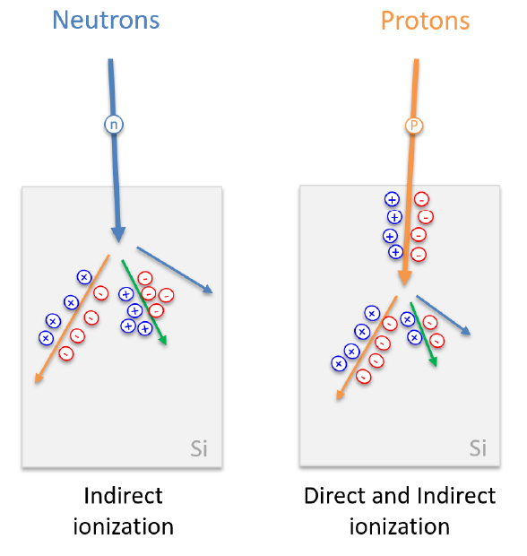
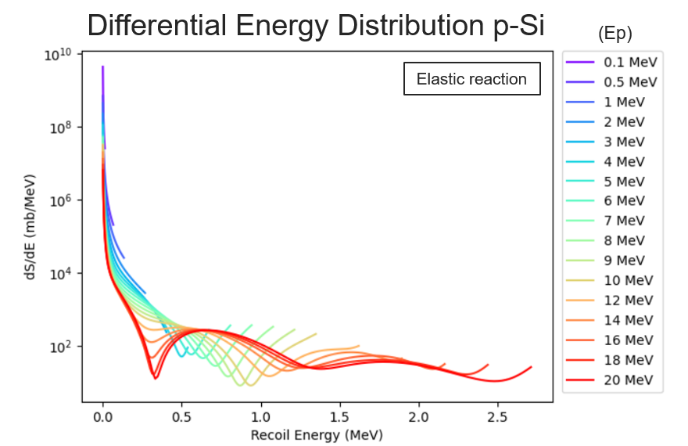
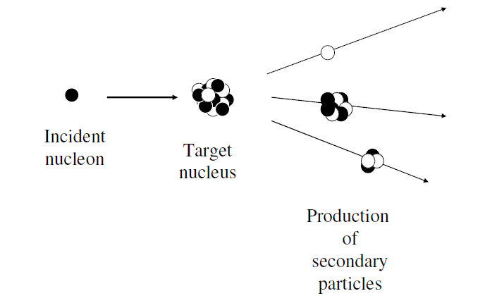
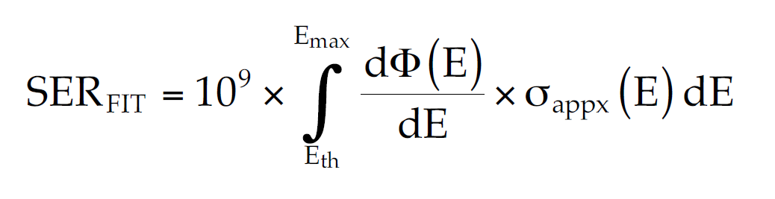
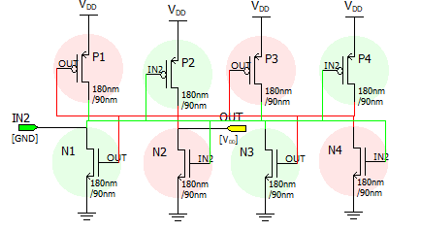
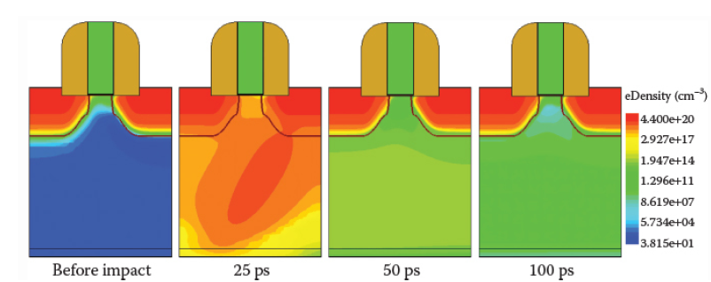
Next Steps
Evaluate the proton and neutron SEU Cross section prediction
DICE SRAM

Slide 20
Thank you all for the attention
Work Package 8:
SEU cross-section prediction
CLEITON M. MARQUES
This project has received funding from the European Union's Horizon 2020 research and innovation programme under grant agreement No 101008126
https://indico.cern.ch/e/radnext-2023

Slide 21
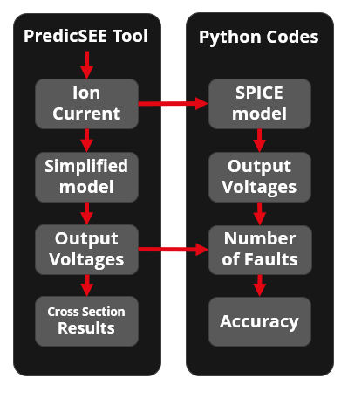
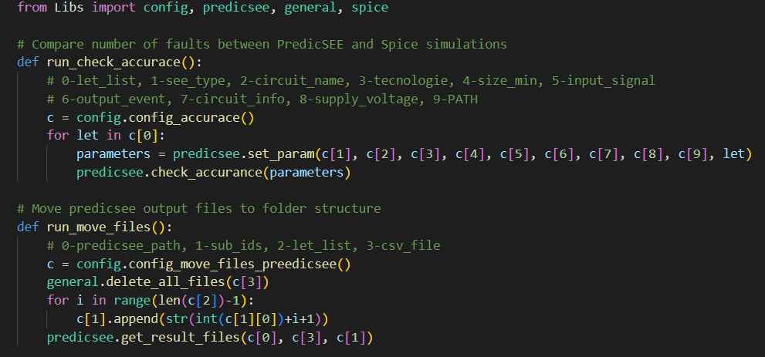
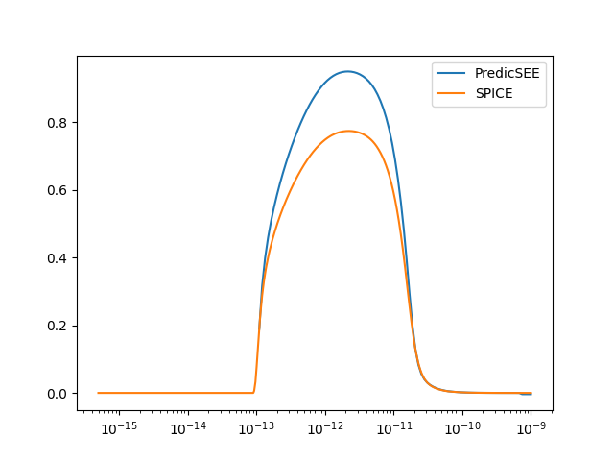
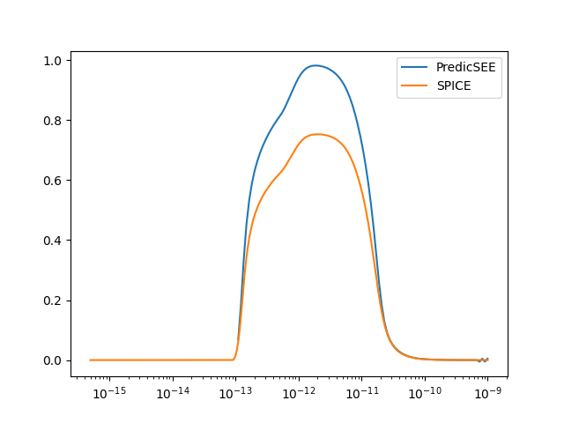
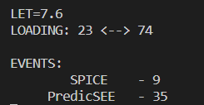
Extra
Voltage (V)
Voltage (V)
Time (s)
Time (s)

Slide 22
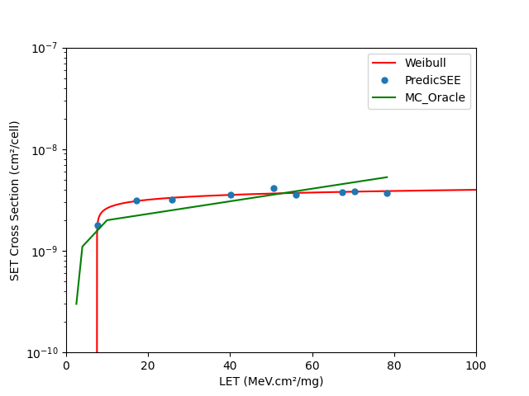
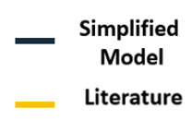
Extra
Faults using SPICE
Accuracy =
Simplified model accuracy compared to SPICE simulations
Faults using Model
Inverter 45 nm

Slide 23
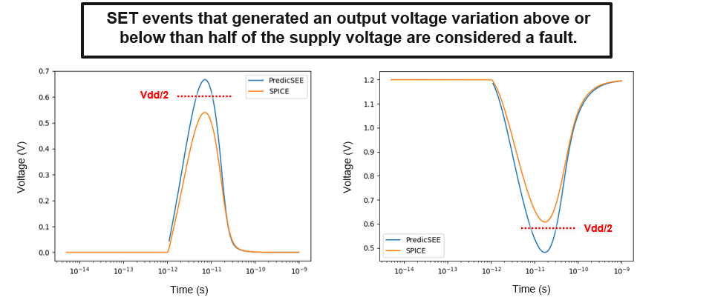
Extra

Slide 24
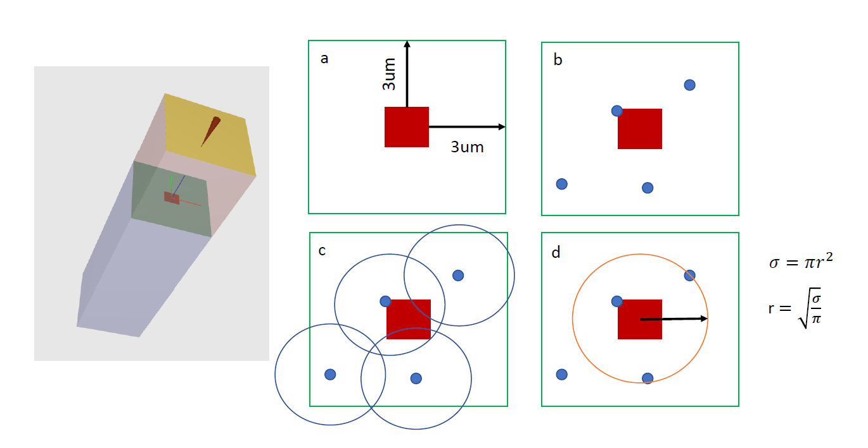
Extra

Slide 25
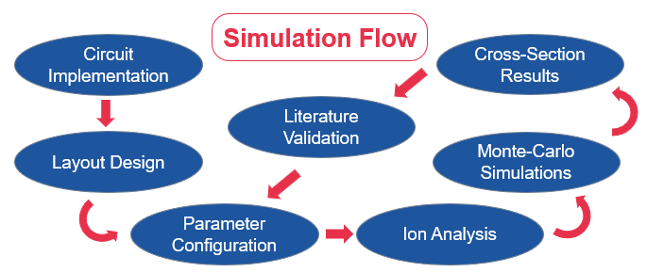
Extra

Slide 26
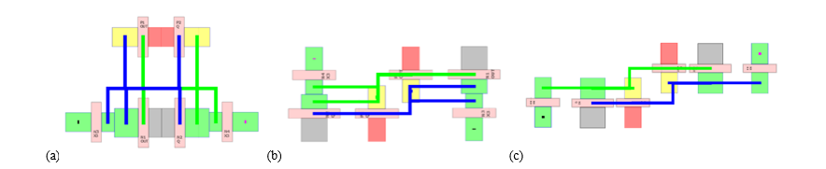
Extra
Three different layout designs that can be applied to 6T SRAM cell:
(a) “tall” design; (b) “thin” design; (c) “ultra-thin” design.

