Slide 1



WP10-TA
Laser-driven particle beams at CLPU
José-Manuel Álvarez on behalf of CLPU team
RADNEXT 2nd Annual Meeting – 9-10 May 2023
https://indico.cern.ch/e/radnext-2023

Slide 2
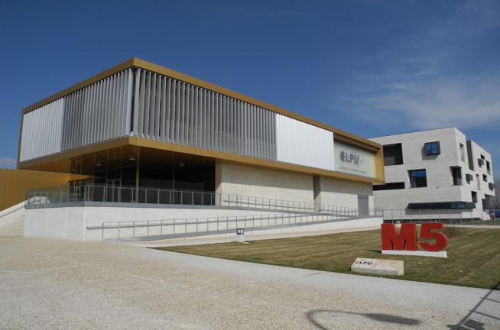
Outline
Part 1: Introduction
  High intensity laser facilities
  Laser plasma accelerator
  Applications - Space radiation
Part 2: CLPU
  Laser VEGA
  Transnational Access – WP10
  Conclusion

Slide 3
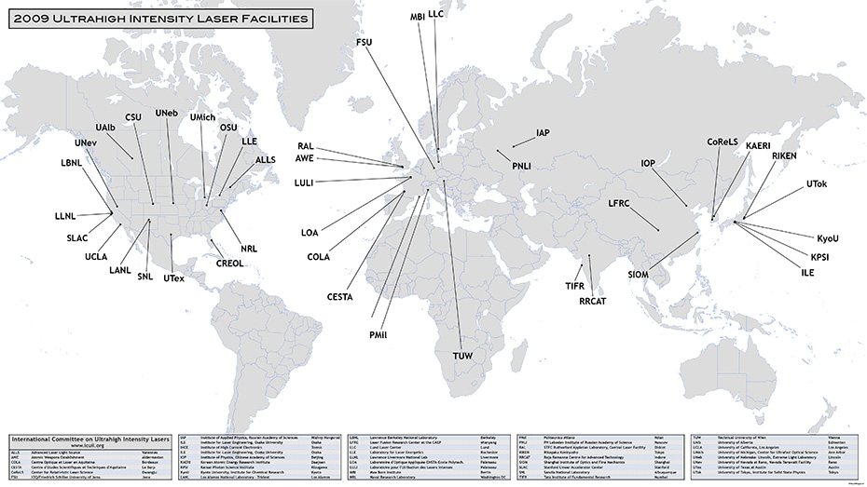
Intense Laser Labs World Wide
Image source “International Committee of Ultra-High Intensity Lasers” (ICUIL, www.icuil.org)

Slide 4
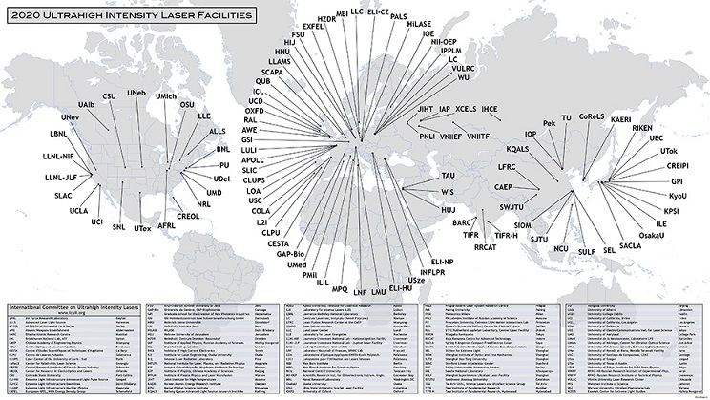
Intense Laser Labs World Wide
Image source “International Committee of Ultra-High Intensity Lasers” (ICUIL, www.icuil.org)

Slide 5
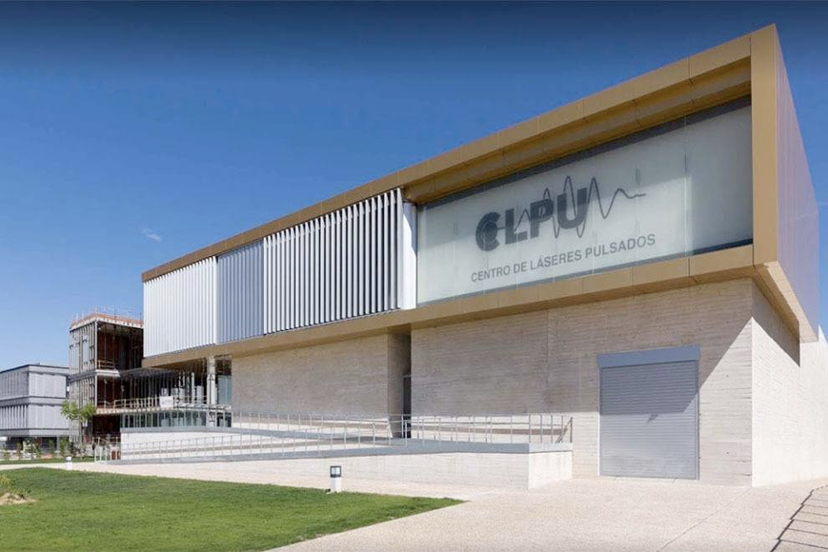
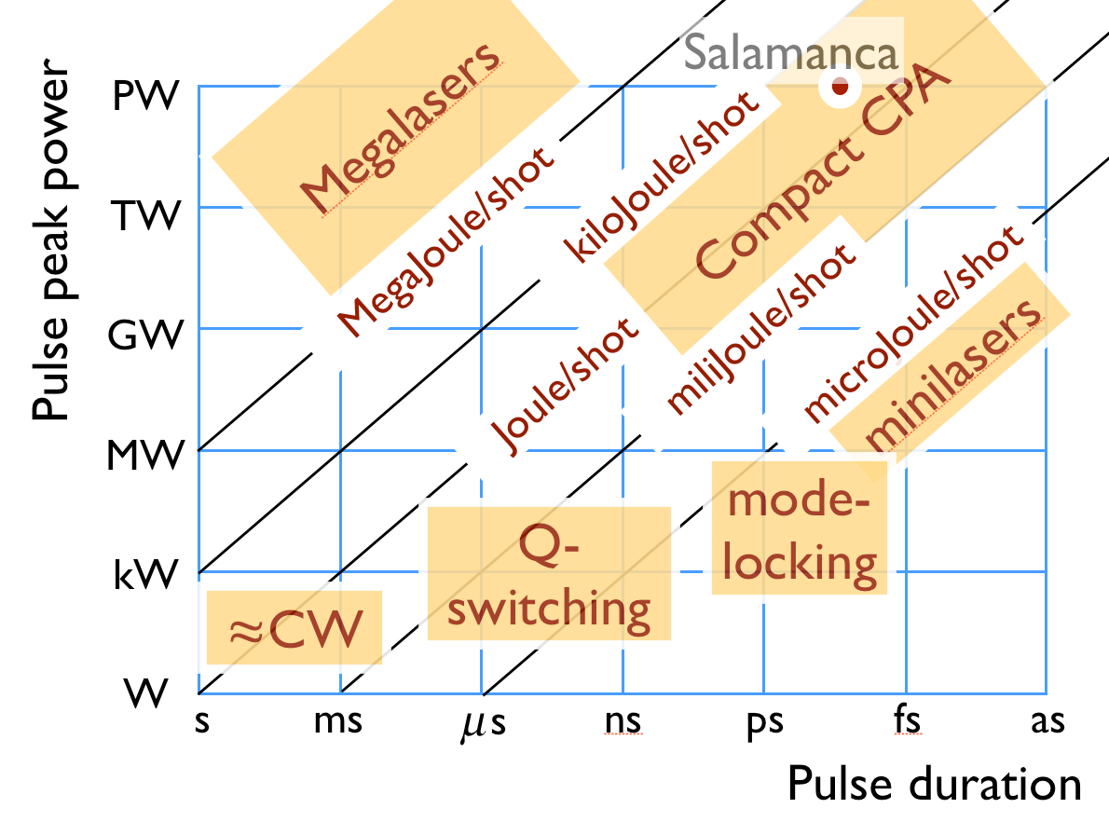

High intensity laser facilities

Slide 6
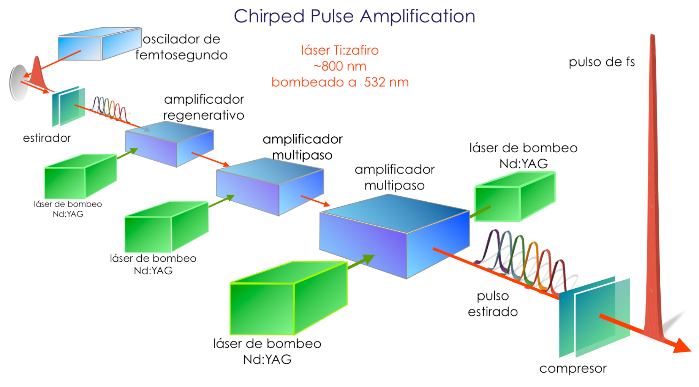
High intensity laser facilities
Nobel Prize in Physics (2018) to Arthur Ashkin, Donna Strickland and Gérard Mourou “for ground-breaking inventions in the field of laser physics”

Slide 7
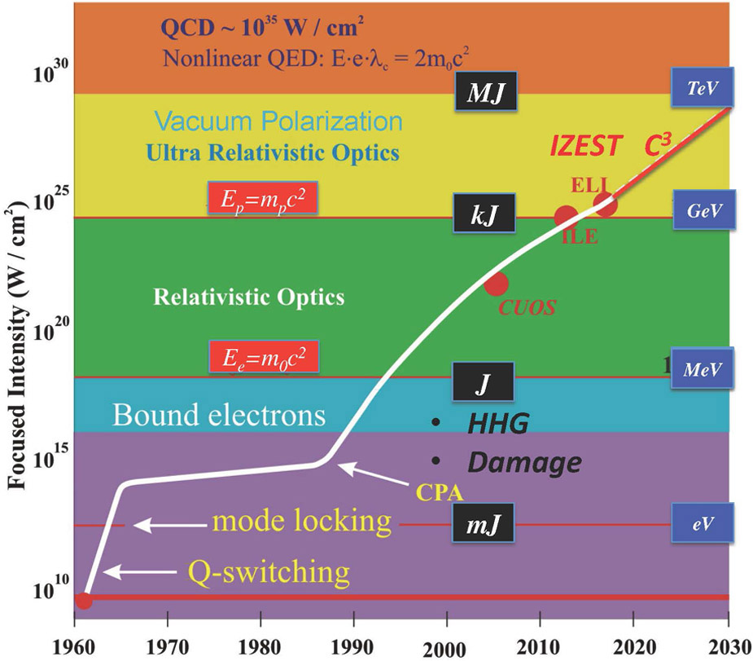
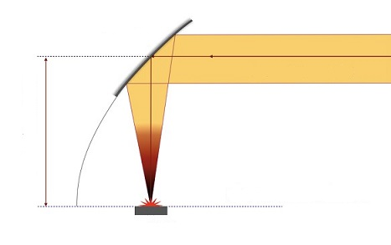
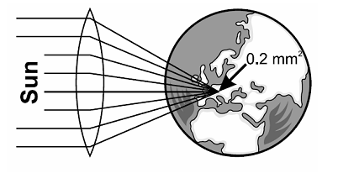
High intensity laser facilities
10²⁰ W/cm²
Intensity evolution since the first laser demonstration in 1960, with the different regimes of optics and electrodynamics.

Slide 8
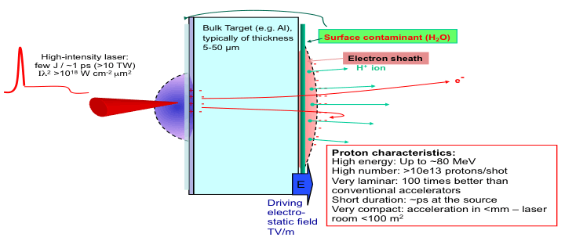

Laser-driven proton/ion acceleration using TNSA mechanism
In the Target Normal Sheath Acceleration (TNSA) mechanism the accelerating electrostatic field is located at the rear target surface of a solid target.

Slide 9
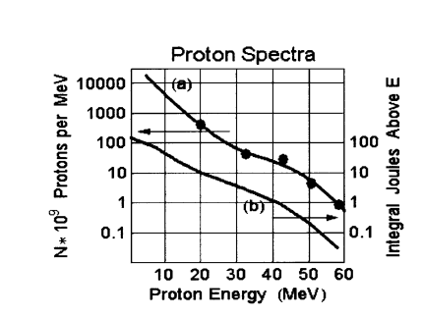
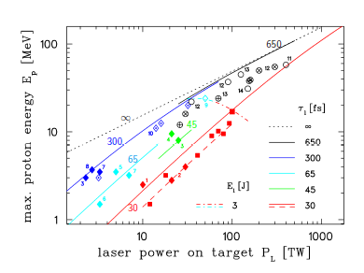
Multi-MeV protons from solid targets
Protons have been observed and characterized in a large number of laboratories and for different laser pulse regimes. Snavely et al, PRL 85 (2000) 2945
Experimental scaling of proton energy cut-off with laser power and pulse duration from Zeil et al. (2010), New J. Phys. 12, 045015.
Up to 94MeV protons observed at
Vulcan laser, Nat Commun 9, 724 (2018).

Slide 10
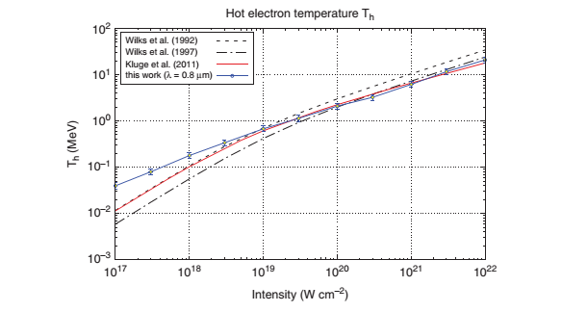
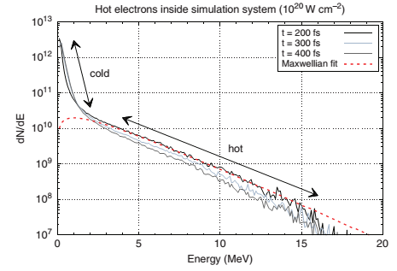
Electrons from solid targets
T. Liang et al., 2016
A Maxwellian fit yields a characteristic slope of T=2.1MeV

Slide 11
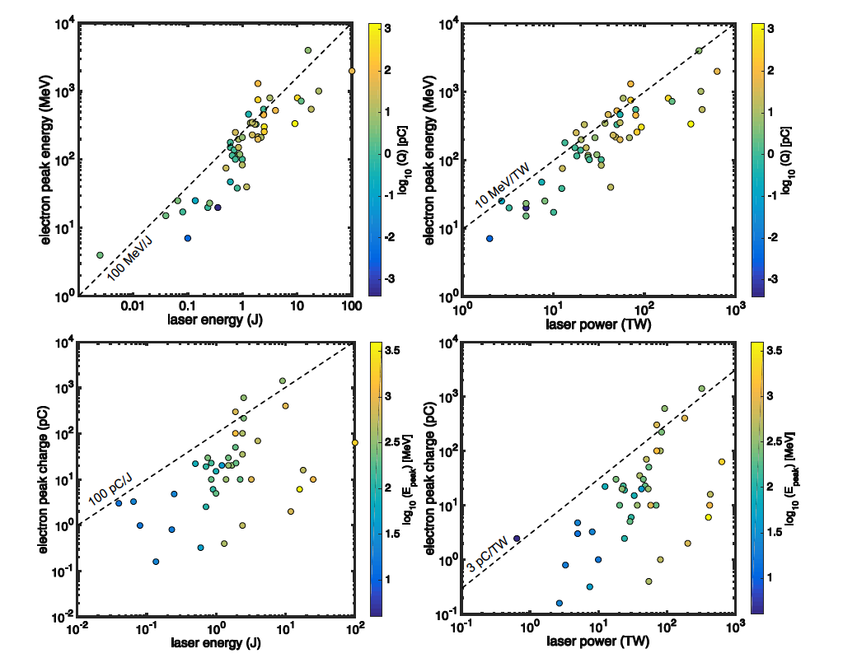
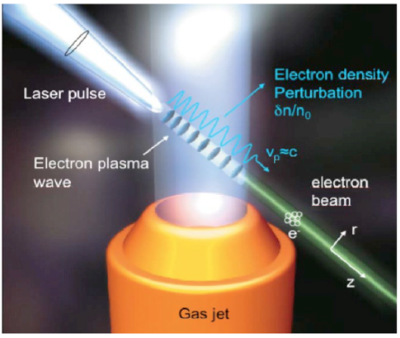
Laser Wakefield Acceleration - LWFA
Electron acceleration from a gas jet.
Image from Rev. in Mut. Res. 704 (1-3), 142, 2010
Data is based on 50+ publications on LWFA during the last 15-20 years from Wenz, J., & Karsch, S. (2020). Physics of Laser-Wakefield Accelerators (LWFA). arXiv: Accelerator Physics.
Experimental results for electron peak energy and charge.

Slide 12

Laser Wakefield Acceleration - LWFA
Laser wakefield accelerator is one of the plasma acceleration schemes that underpins the EuPRAXIA project.
EuPRAXIA envisions a beam energy of 1 to 5 gigaelectronvolts (GeV) and a beam quality (single pulse) equivalent to present RF-based linacs.
Electron acceleration from a gas jet.
Image from Rev. in Mut. Res. 704 (1-3), 142, 2010
Data is based on 50+ publications on LWFA during the last 15-20 years from Wenz, J., & Karsch, S. (2020). Physics of Laser-Wakefield Accelerators (LWFA). arXiv: Accelerator Physics.
Experimental results for electron peak energy and charge.

Slide 13

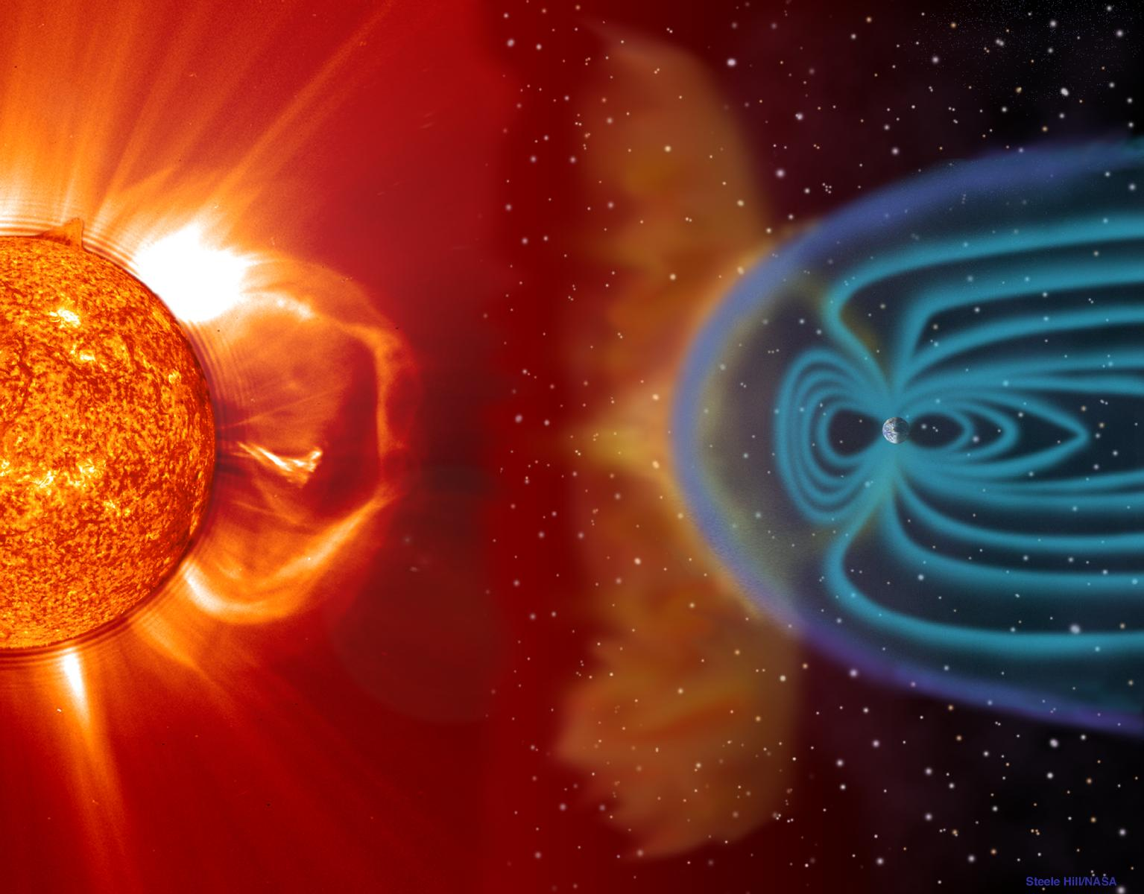

Applications - Space radiation
B. Hidding et al, (2013)
Van Allen radiation belt
Solar flares:
photons,
charged particles
Trapped protons & electrons

Slide 14
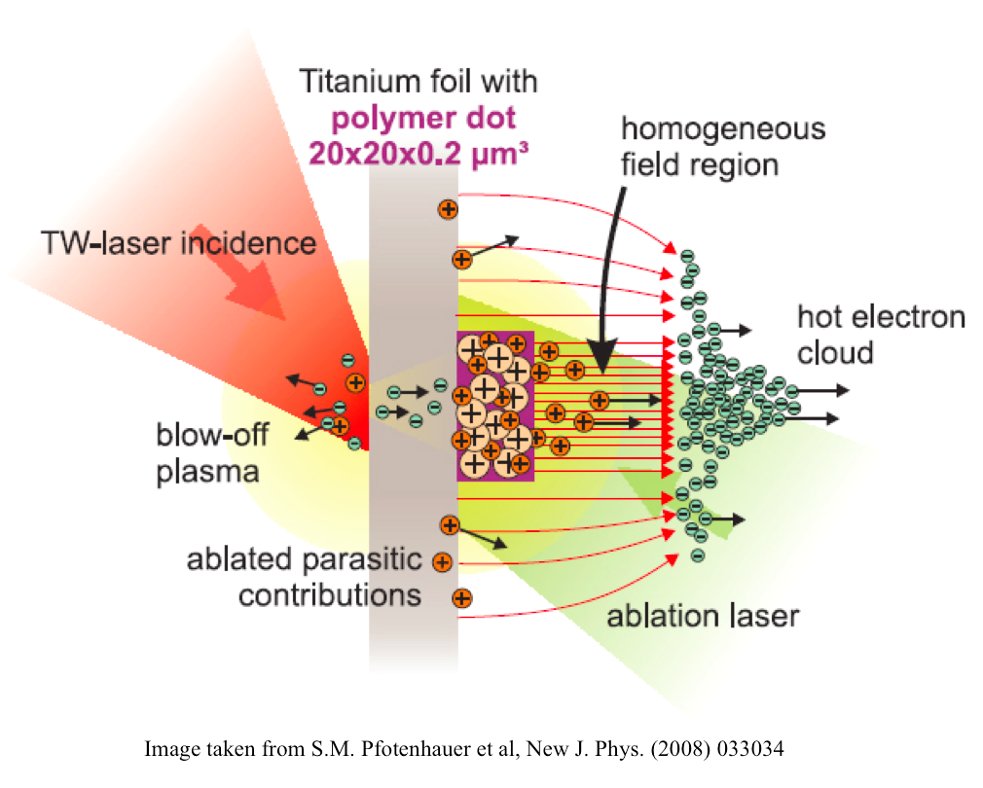
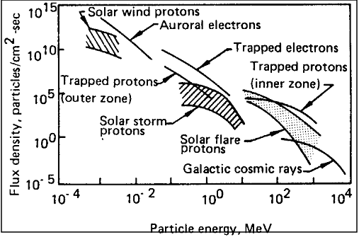
Applications - Space radiation
Schimmerling,.W and Curtis, S.B, NASA

Slide 15
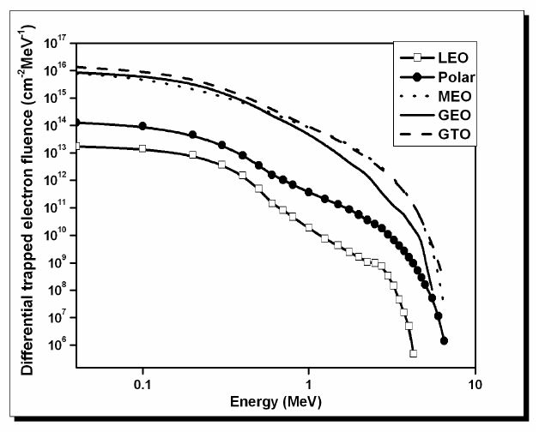
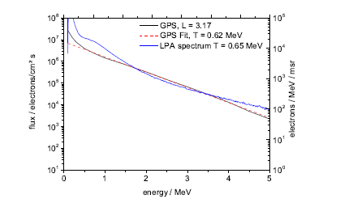
Applications - Space radiation
Trapped Particles Environment : Electron
S. Samwel et al.,International Journal of Astronomy and Astrophysics 01, 2006.
Reproduction of electron fluxes in the GPS orbit with laser-plasma-generated electron flux with T=0.65MeV. Hidding et al. (2013), ESA NPI Activity 4000102854

Slide 16
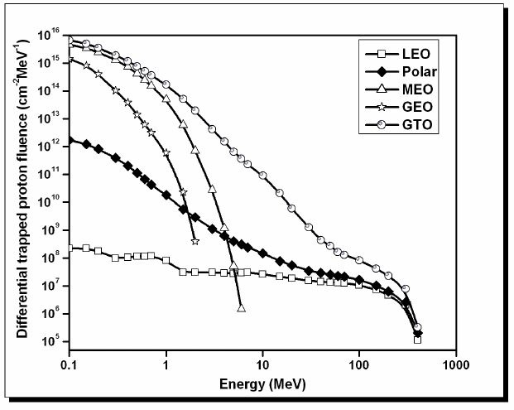
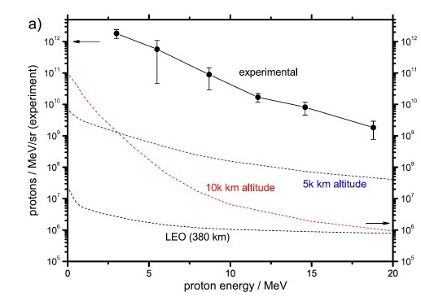
Applications - Space radiation
Trapped Particles Environment : Proton
S. Samwel et al.,International Journal of Astronomy and Astrophysics 01, (2006).
Hidding, B., et al. Laser-plasma-based Space Radiation Reproduction in the Laboratory. Sci Rep 7, 42354 (2017).

Slide 17
Outline
Part 1: Introduction
  High intensity laser facilities
  Laser plasma accelerator
  Applications - Space radiation
Part 2: CLPU
  Laser VEGA
  Transnational Access – WP10/TA2
  Conclusion

Slide 18
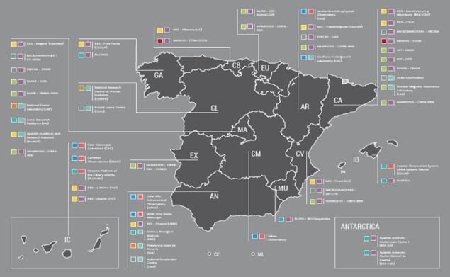
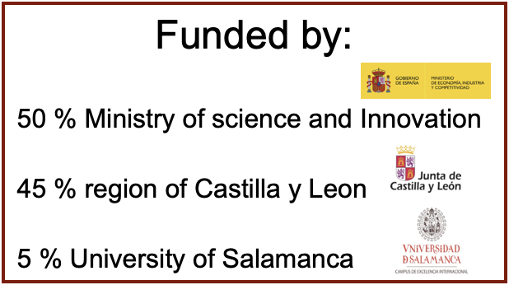
Centro de Láseres Pulsados - CLPU
CLPU is:
a user facility opened to national & international users
a ICTS Technical and Scientific unique Infrastructure
Radiactive authorized installation IRA-3254

Slide 19
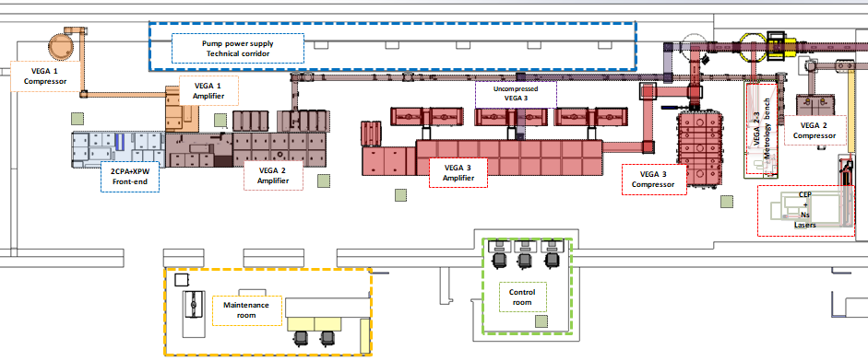
Laser VEGA overview
Slice from Cruz Mendez
  VEGA 3
    Energy 30 Joules
    Power 1 PW
    Rep rate 1 Hz
  VEGA 2
    Energy 6 Joules
    Power 200 TW
    Rep rate 10 Hz
Target Area close to compressor’s output.
Laminar flow cabinets with ISO Class 7 level.
Metrology bench installed between VEGA 2 and VEGA 3.
CEP and ns laser installed at the beginning of 2019 in the laser bay.
Uncompressed VEGA 3 output also indicated.

Slide 20
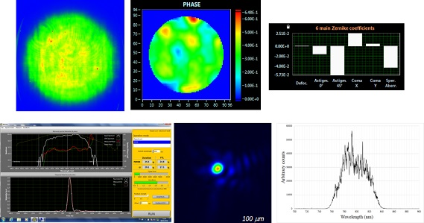
Array of data given to users from the metrology bench every day:
  Near field (image at compressor entrance)
  Far field (lens focal plane 2.1 m focal length)
  Wizzler temporal measurement (shape and phase)
  Sequoia temporal contrast measurement
  Wavefront+Strehl ratio measurement (Phasics)
  Output spectrum
Slice from Cruz Mendez

Slide 21
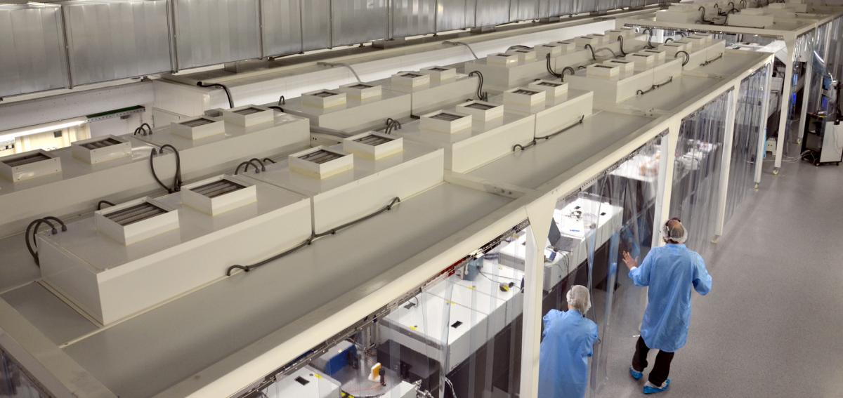
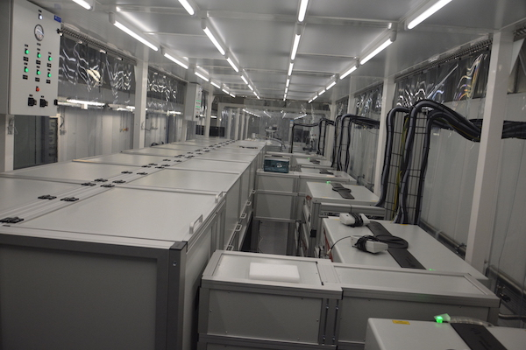
Laser VEGA

Slide 22
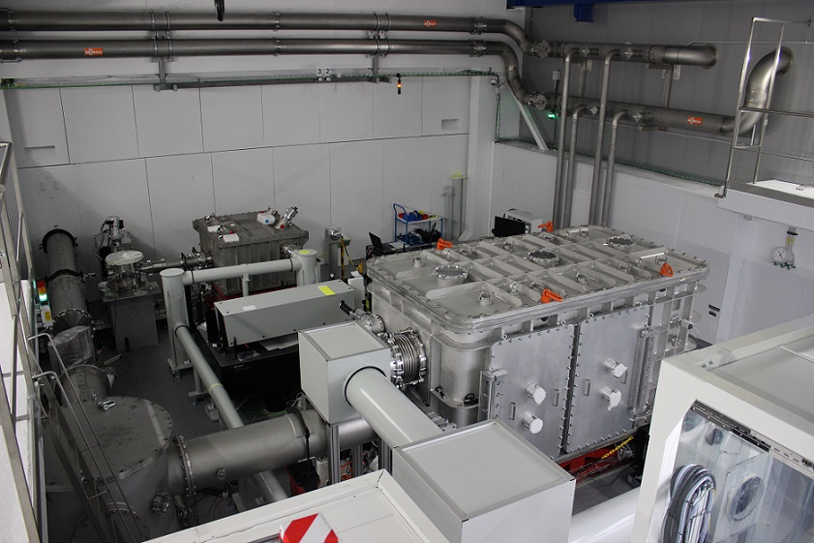
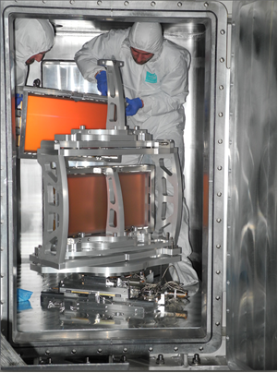
Laser VEGA

Slide 23
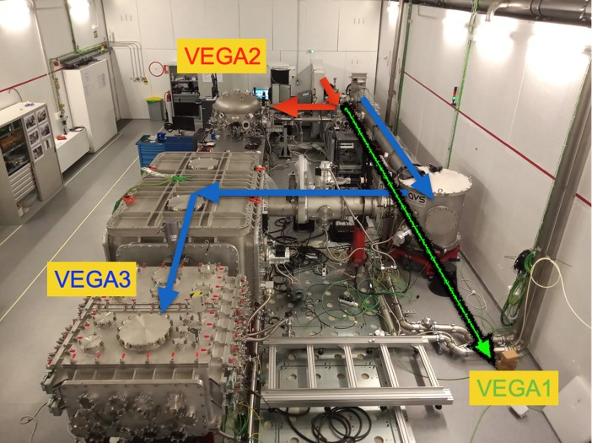
Transnational Access – WP10/TA2
Offered particle beams:
  Proton beam
    Energy 10-20 MeV
    Charge ~ nC/ps
    Divergence 0.3-0.4 rad (~ 20˚)
  Electron beam up to
    Energy 300-400 MeV
    Charge ~ pC/fs
      Divergence 10-20 mrad (~ 1˚)
Offered access time
  150 hours
  Number of projects ~ 3
  Number of Users ~ 6
Slice from Luca Volpe

Slide 24
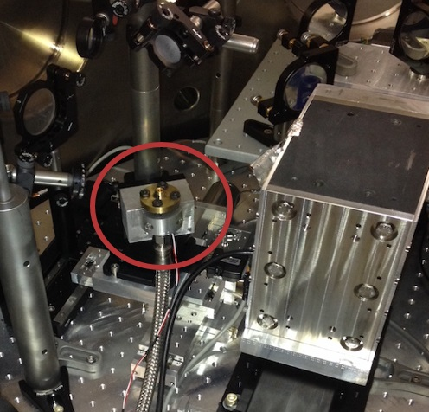
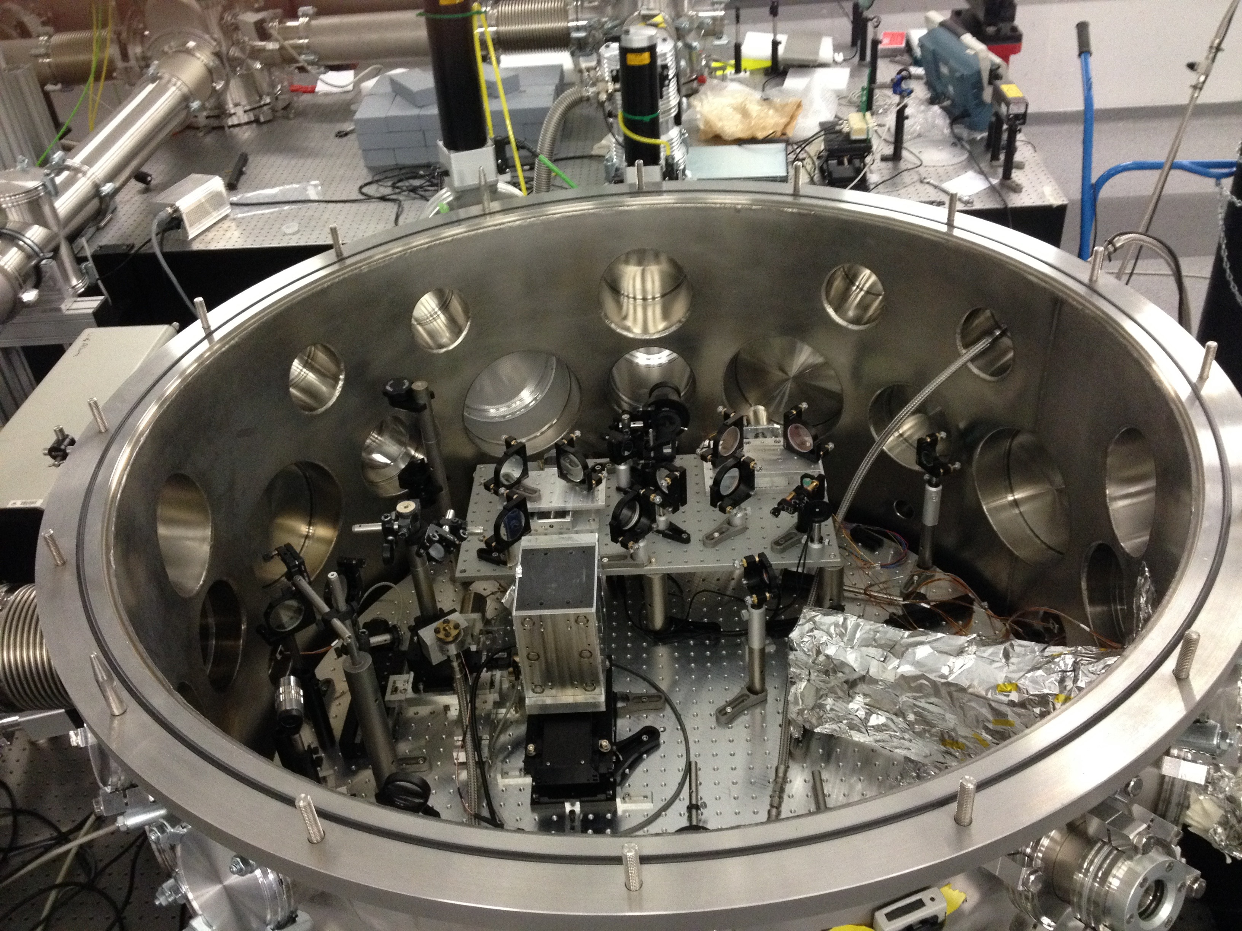
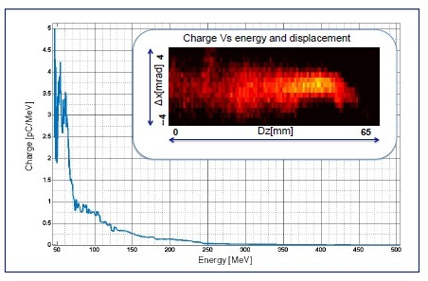
Interaction Chamber VEGA2
Typical non-monoenergetic electron spectrum measured with 1.2 tesla magnetic spectrometer; (in-sertion) ltered image of measured electron energy spectrum

Slide 25
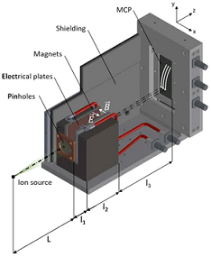
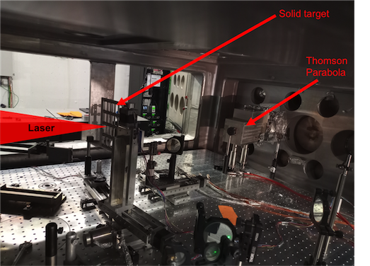
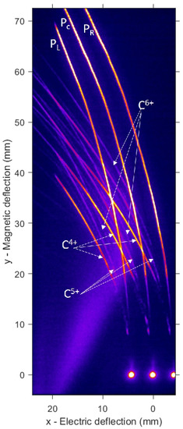
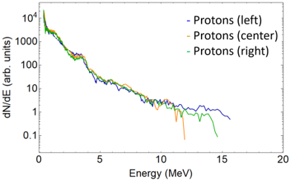
Interaction Chamber VEGA3
Salgado-López, C. et al. Angular-Resolved Thomson Parabola Spectrometer for Laser-Driven Ion Accelerators. Sensors 2022, 22, 3239. https://doi.org/10.3390/s22093239

Slide 26
Some requirements on the diagnostic systems
The proton/ions accelerated by laser-plasma typically present a broadband spectrum. The complete and accurate characterization of the whole spectrum requires to have a diagnostic system characterized by high sensitivity to appreciate the maximum achievable energy, but also to have a high dynamic range.
When a high intensity laser interacts with matter, intense electromagnetic waves (EMP) in the microwave-radiofrequency range are produced. This is a serious threat for any electronic device placed near the interaction point, leading to the disabling, or even to the damaging, of the deployed diagnostic systems.
The use of passive detectors generally solves the problem, but this is not a viable solution when aiming for an on-line characterization of a system working at high repetition rates.

Slide 27
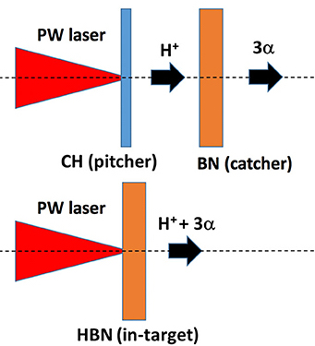

Transnational Access Campaign
CLPU has hosted one RADNEXT Campaign
TA04-55:Laser-driven Ion Sources for Applications
(PI Dimitri Batani)
The proton-boron fusion reaction
was explored to develop a high brightness laser-driven
alpha-particle source
The campaign was performed in marz 2023
with VEGA-3. CLPU offered the laser ion-acceleration set up.
Different setup where proposed:
(a) Pitcher-catcher configuration: TNSA proton produced from thin aluminium foil target (Pitcher)
interact on a solid thick B6Ca or B target (catcher).
(b) Directly irradiation of thick samples rich of Boron-nitride (BN) target.

Slide 28
Conclusion
During the past twenty years the progresses in laser-driven acceleration mechanisms led to the proposition to use them as an alternative source of energetic particles for many different applications.
Laser-driven source might cover the need of affordable and compact accelerators for electronics component irradiation.
The generation of particle beams with energy and quality (single pulse) equivalent to conventional accelerator is envisions (EuPRAXIA project).
The generation of broadband energy is much easier than the monoenergetic beams, early applications of the high intensity laser facilities for space radiation reproduction are possible.
The Spanish Laser Center (CLPU) is a high intensity laser facility with capability to contribute in this field, together with the community.

Slide 29
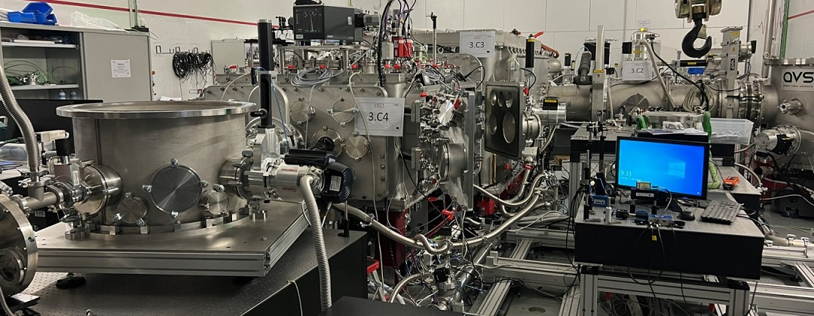
Thanks for your attention!

