Slide 1
WP2 – NA1 status and plans
Communication, Dissemination, Exploitation and Training
Ennio Capria (ESRF)

Slide 2
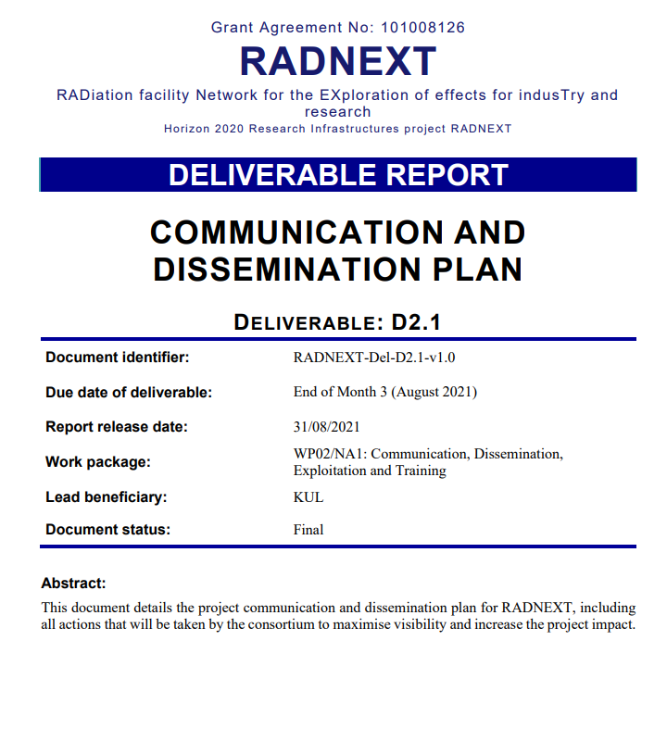
Deliverables
Deliverable D2.1: Communication and Dissemination plan
  Uploaded on European Commission portal on 31 August 2021
Deliverable D2.2: Exploitation and Data Management plan
  Uploaded on European Commission portal on 30 September 2021
Deliverable D2.3:
Intermediate report on Communication, Dissemination, Exploitation and Training
  Currently in progress (due end of May)

Slide 3
Milestones
Milestone | Deadline | Achieved?
MS8: Project website launched ➔ David | 31/08/2021 | Achieved
MS9: Appointing the Industrial Advisory Panel (IAP) | 30/11/2021 | Achieved
MS10: List of commercial components of interest | 31/05/2022 | Achieved
MS11: First RADNEXT-to-industry event finished | 31/05/2022 | Achieved
No new milestones to report since previous Annual Meeting.

Slide 4
Communication and dissemination

Slide 5
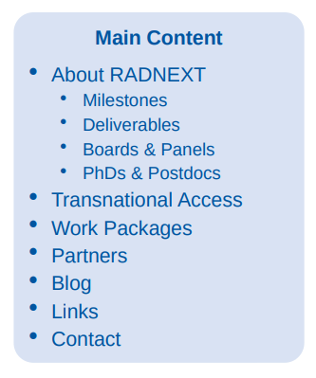
Communication and dissemination
Website
Primary gateway for both project members and users
➔ We are always looking for interesting blog posts. If you have any, please let us know! radnext-helpline@cern.ch

Slide 6
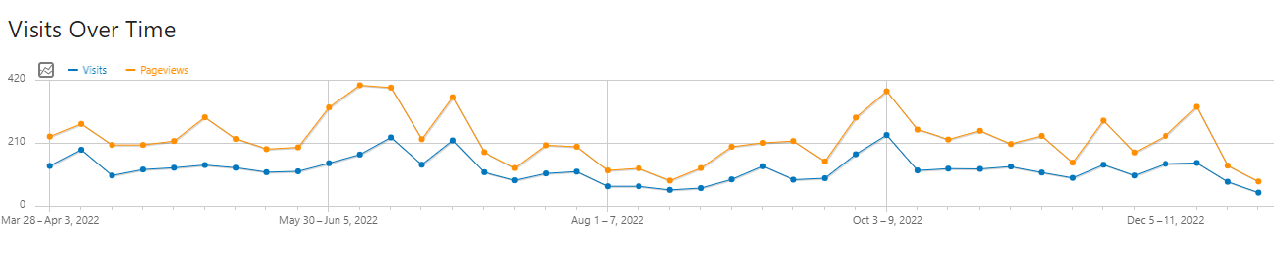


Communication and dissemination
Website statistics
2022
RADECS

Slide 7
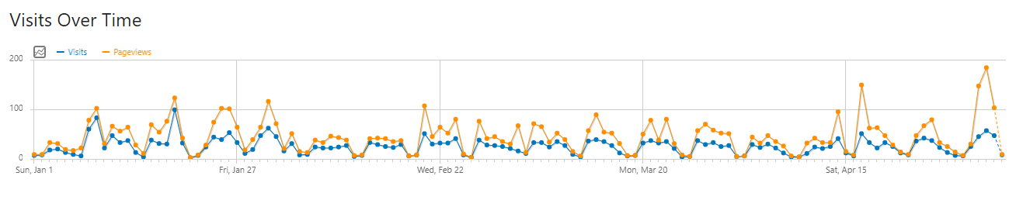


Communication and dissemination
Website statistics
2023 (so far)

Slide 8
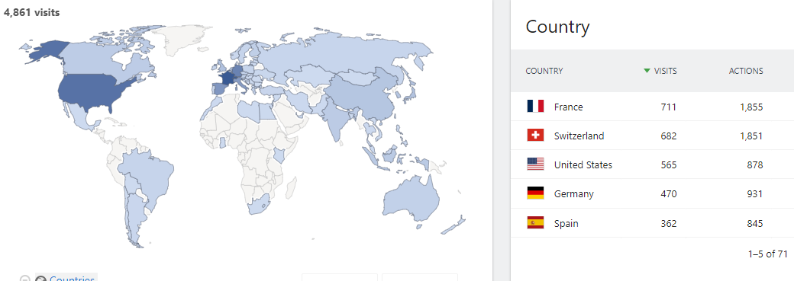
Communication and dissemination
Website statistics

Slide 9
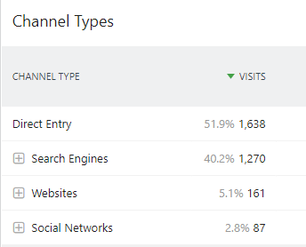
Communication and dissemination
Website statistics
Where do you users come from?

Slide 10
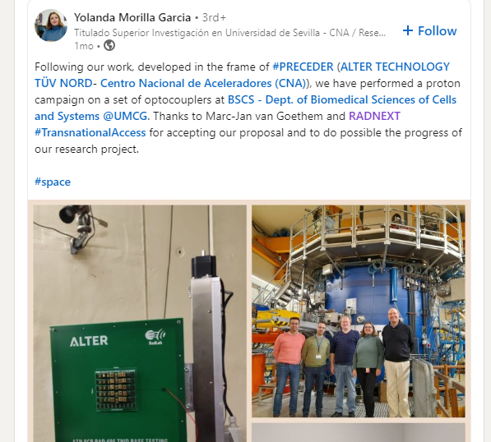
Communication and dissemination
LinkedIn
Already 1025 followers!
And a lot of activity on LinkedIn
  Regular posts about events (G-RADNEXT, SERESSA, webinars, exhibitor booths and fun games, …)
  Posts about calls for beam time proposals
  A lot of posts/tags by facility users after their irradiation experiments

Slide 11
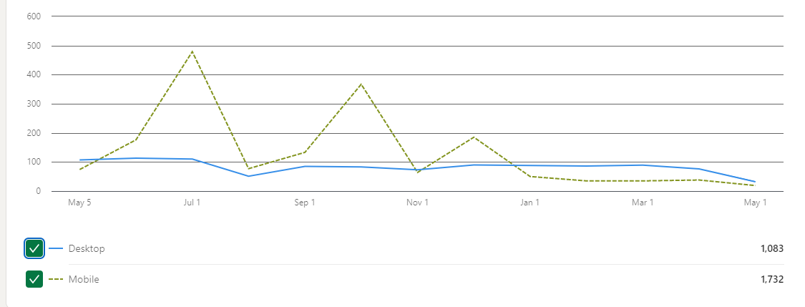
Communication and dissemination
LinkedIn statistics
Page views

Slide 12
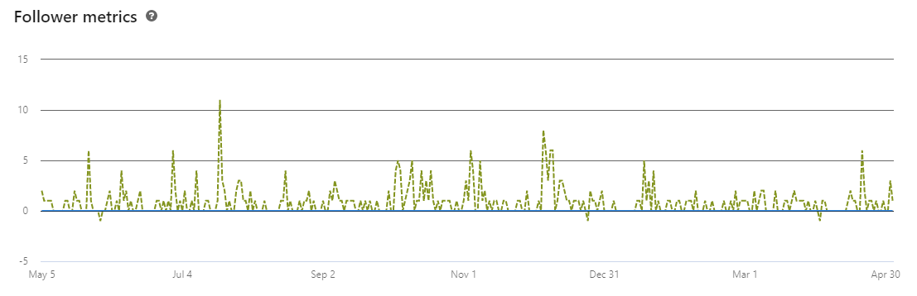
Communication and dissemination
LinkedIn statistics
NSREC
SERESSA
RADECS

Slide 13
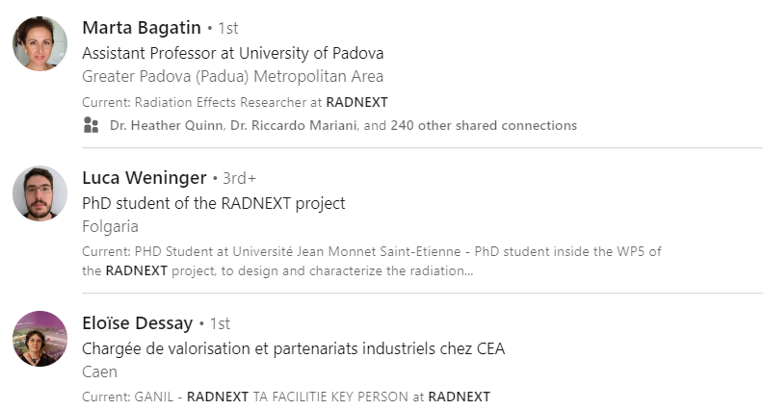
Communication and dissemination
LinkedIn
Add your RADNEXT membership on LinkedIn!
Currently: 24 employees
Guideline on how to do it is available

Slide 14
Communication and dissemination
LinkedIn
Help us increase our outreach
  Engage with our posts (like, share)
  Show that you are an ambassador of RADNEXT
  Promote posting/tagging/sharing by RADNEXT TA users
  ➔ If you have interesting content for the LinkedIn page (or website), please let us know! radnext-helpline@cern.ch

Slide 15
Communication and dissemination
Conferences and events
In 2022, RADNEXT was present at
Space Qualification Workshop by University of Wollongong (22-23 March)
G-RAD(NEXT) workshop (online, 4 May)
RADHARD Symposium 2022 (26 April, online)
NSREC (18-22 July, Provo)
RADECS (3-7 October, Venice)
SERESSA International School (5-9 December, Geneva)

Slide 16
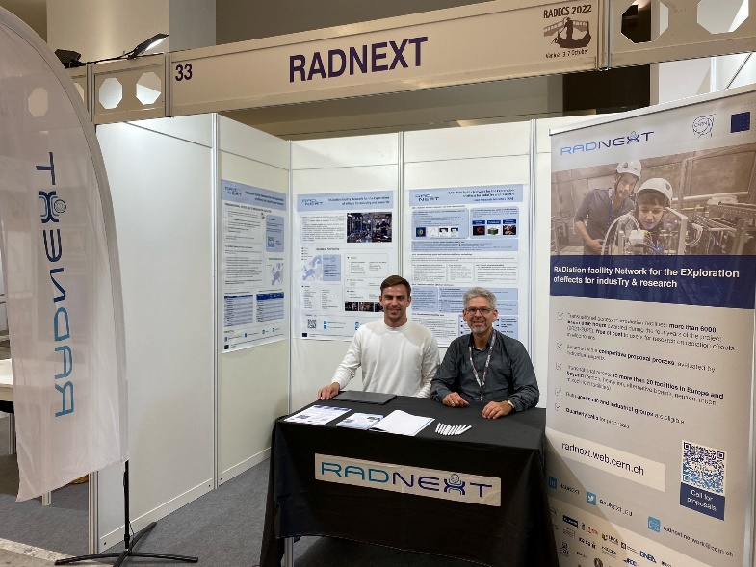
Communication and dissemination
Exhibitor booths
Several promotional materials were made:
Pens
Tablecloth
Posters
Flyers
Beachflag
Roll-up
Polos
…

Slide 17
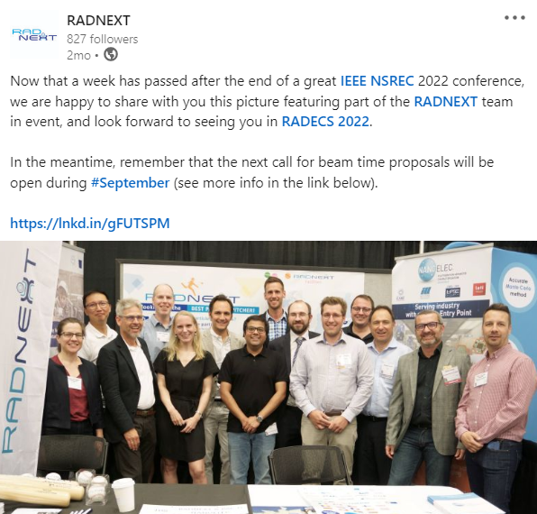
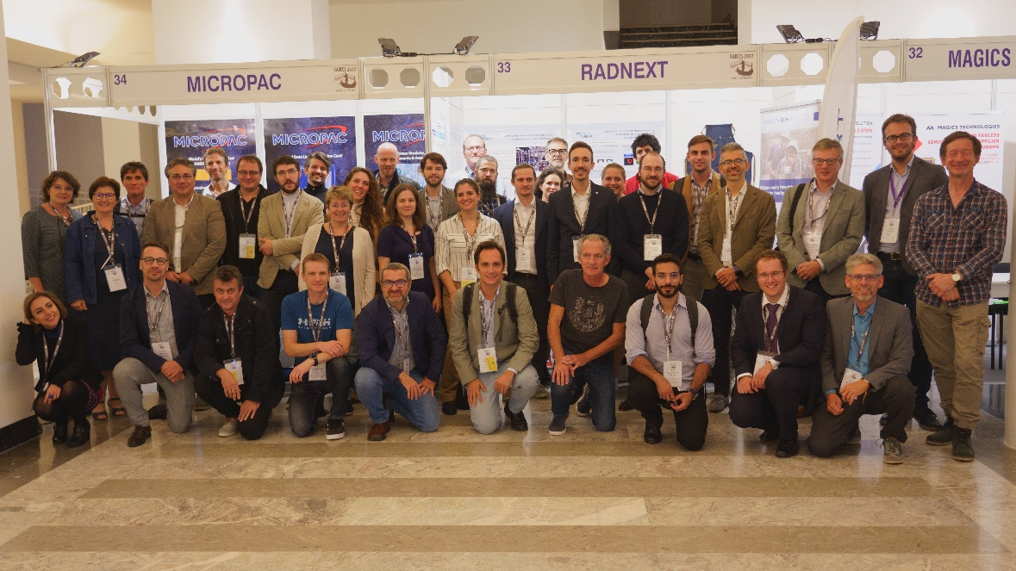
Communication and dissemination
Exhibitor booths
RADNEXT team at RADECS 2022
RADNEXT team at NSREC 2022

Slide 18
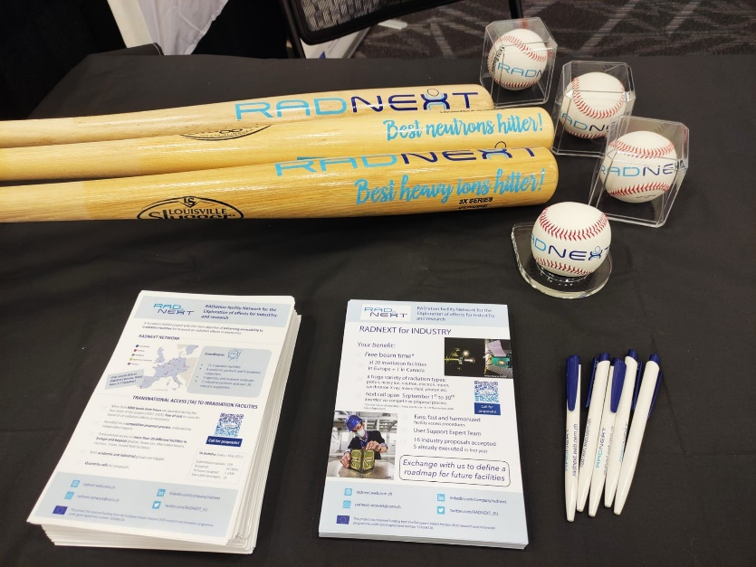
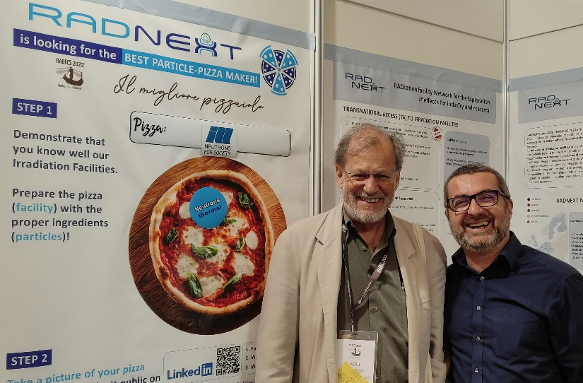
Communication and dissemination
Exhibitor booths + games
Special thanks to Pedro!
#BestParticlePitcher at NSREC
#BestParticlePizzaMaker at RADECS

Slide 19
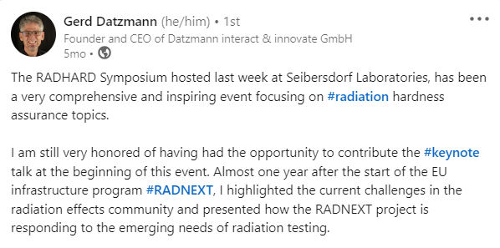
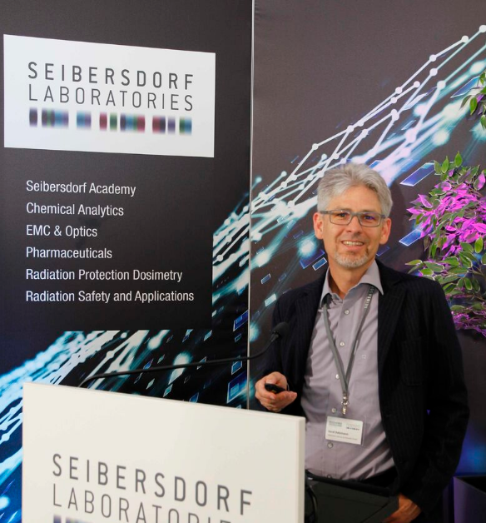
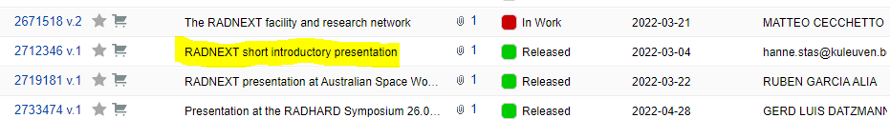
Communication and dissemination
Invited talks
Invited talks by RADNEXT project members
If you are giving a talk somewhere, please let us know so we can post about it on LinkedIn
+ don’t forget: short introductory presentation available (EDMS)

Slide 20
Communication and dissemination
Conferences and events
For 2023, RADNEXT presence at the following events is already foreseen:
Space Qualification Workshop (11-13 February)
EUCASS-CEAS (9-13 July, Lausanne)
NSREC (24-28 July, Kansas City)
RADECS (25-29 September, Toulouse)
G-RAD(NEXT) workshop (8-9 November, Geneva)

Slide 21
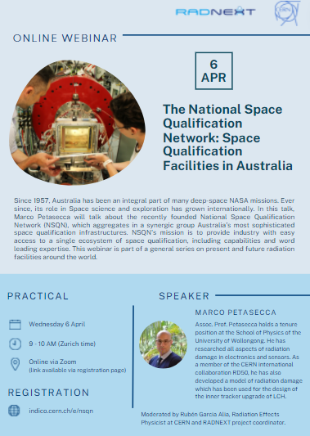
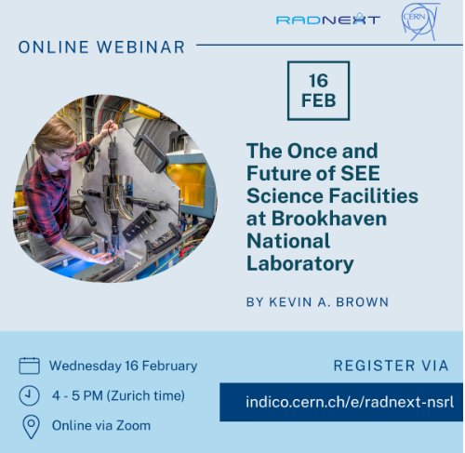
Communication and dissemination
Webinars
Webinar series on present and future irradiation facilties around the world:
16 February | The Once and Future of SEE Science Facilities at BNL – by Kevin A. Brown, Brookhaven National Laboratory
6 April | The National Space Qualification Network: Space Qualification facilities in Australia – by Marco Petasecca, University of Wollongong
22 June | Space and Terrestrial Considerations for Access to High Energy U.S. Proton Accelerators for the Electronics Community – by Kenneth A. LaBel, NASA
19 September | Thermal Neutron Effects in Electronic Components - by Robert Baumann and Paolo Rech, Universidade Federal do Rio Grande do Sul
13 December | A Guide to Japan for SEE Travelers - by Takahiro Makino (QST), Masanori Hashimoto (Kyoto University) and Daisuke Kobayashi

Slide 22

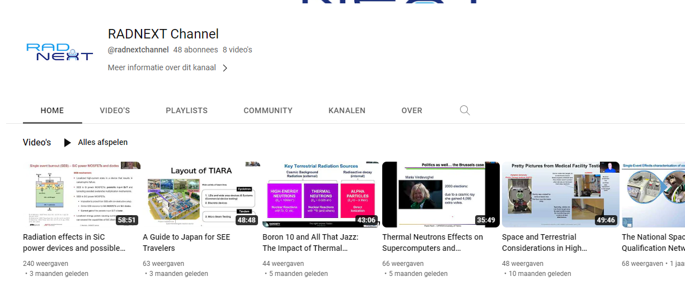
Communication and dissemination
Webinars
All webinars are recorded and can be re-watched on our YouTube channel

Slide 23
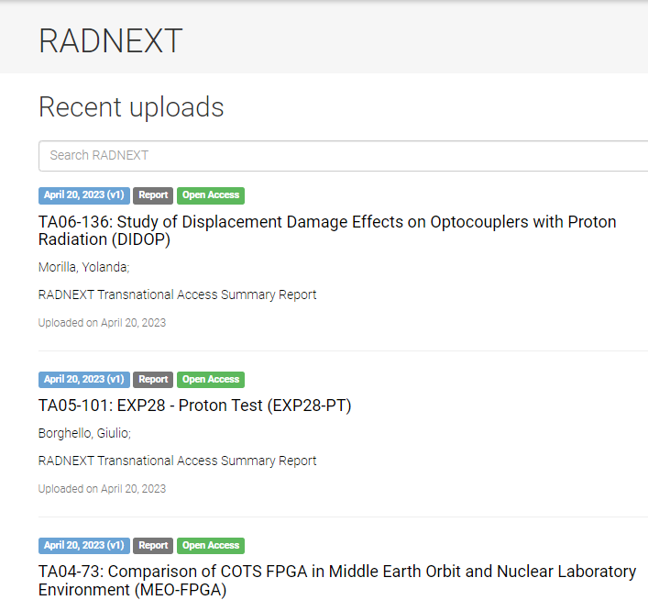
Communication and dissemination
Zenodo
Public RADNEXT community on Zenodo
https://zenodo.org/communities/radnext
All TA Summary Reports are stored here

Slide 24
Communication and dissemination
Future plans
As of Y3, we want to distribute an e-newsletter
  Up until now, we haven’t done so due to limited time
  Platform is already chosen: Spotler (shared account with 5 other projects at CERN)
  Goal is to send a newsletter every 3 months
  Future TA calls can also be distributed via Spotler
  Topics: updates and interesting news on the project, research results, TA calls but also anything useful/interesting/educational related to Radiation Effects and Radiation Environments
RADNEXT promotional video (with a focus on industry)
➔ Any other plans or ideas to increase our outreach are always welcome!

Slide 25
Exploitation and link to industry

Slide 26



Slide 27
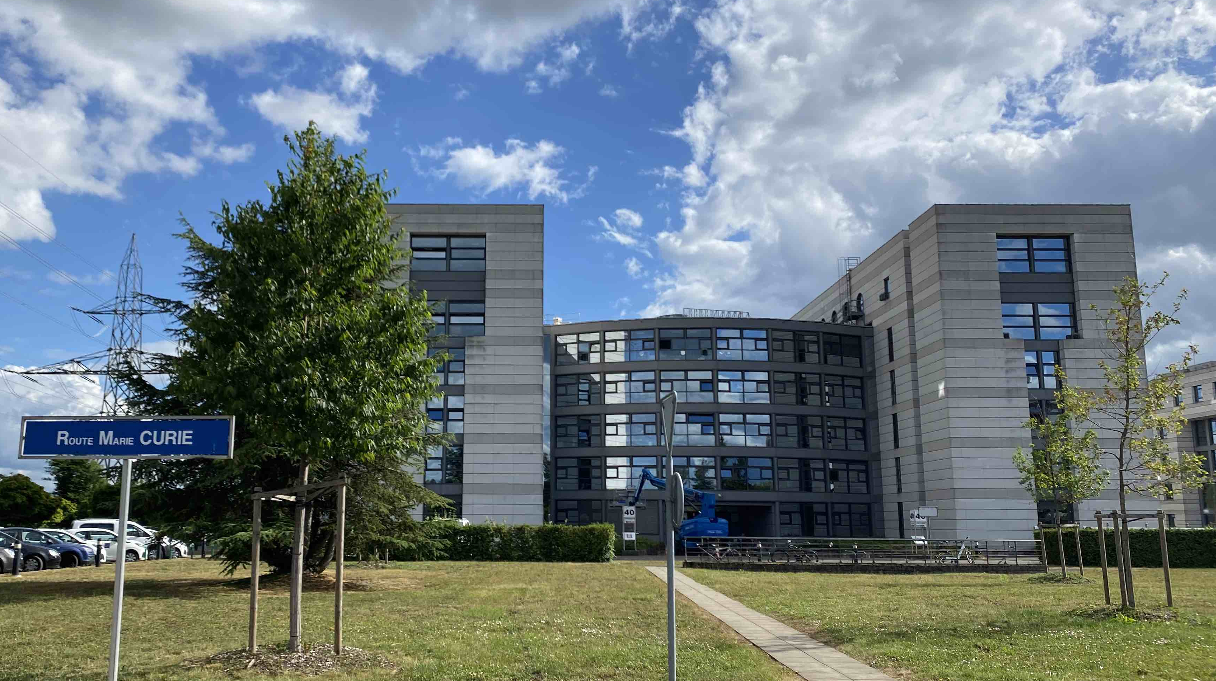
Format and Location
Location: CERN
In-person workshop
Date: November 8th – 9th , 2023
2-day event:
  Day 1: Afternoon session
  Day 2: Morning session
  Enabling traveling on same day
Attendance of the technical program is free of charge

Slide 28

Objectives
Engage the industrial community with RADNEXT
by proposing an event fully dedicated to industry
Collect needs, requirements and trends from the industrial stakeholders to better support them within the RADNEXT activities
Highlighting the results gained in TA and JRA of RADNEXT
Giving young professionals from industry and academia the opportunity to present their work
Offer networking opportunities between particants from industry, academia, irradiation facilities and space agencies
Source: G. Datzmann

Slide 29
Target Audience
Companies providing or using radiation testing services and consultancy
Facilities and research infrastructures providing access to users in the field of radiation testing or intending to provide access in the near future
Academics working in the field of radiation effects on semiconductors
Organizations involved in the standardization of testing methods and workflows
Source: G. Datzmann

Slide 30
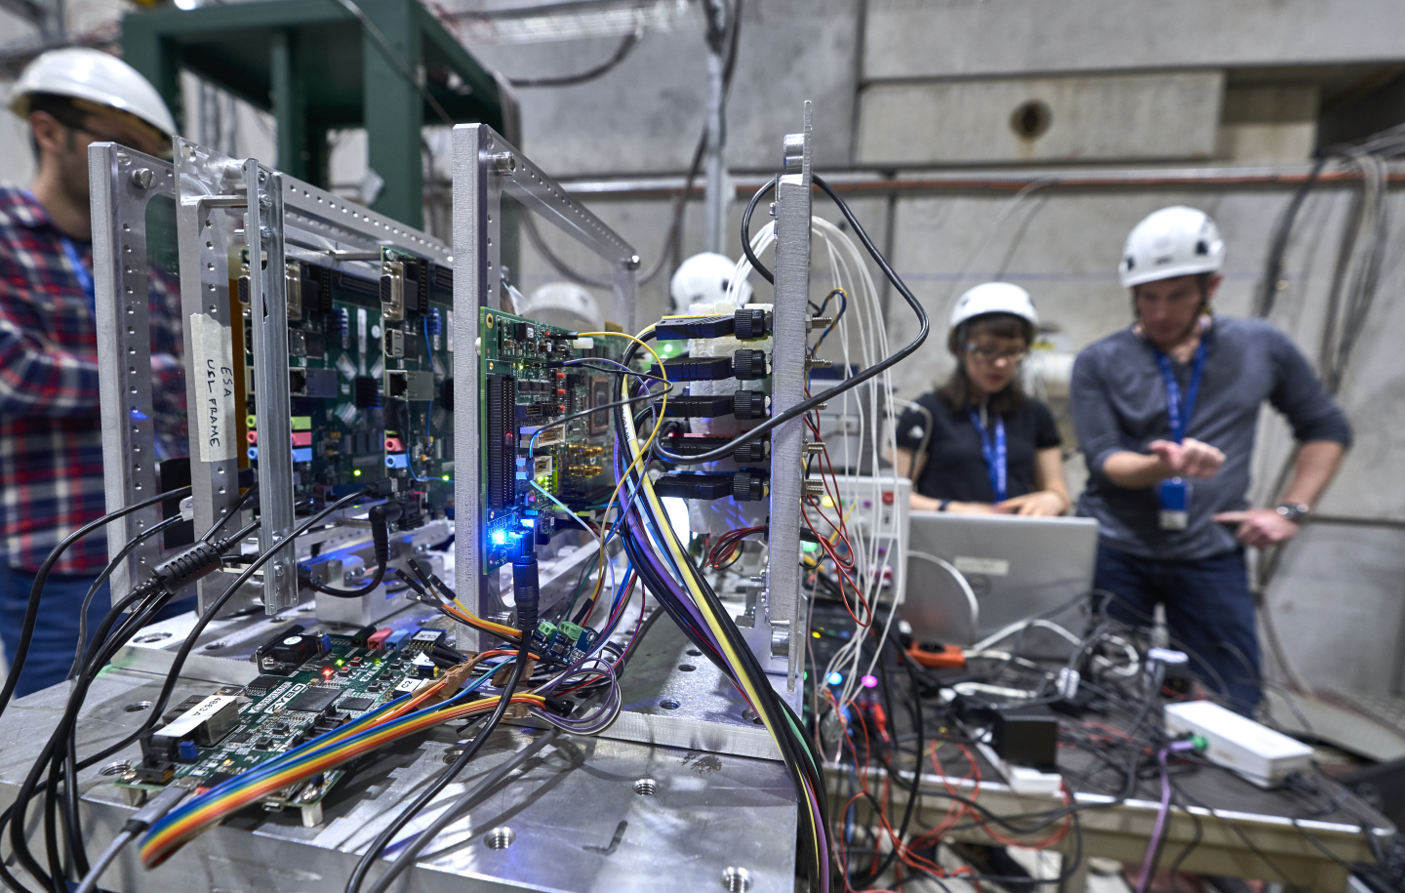
Topics / Content
Two invited keynote talks from renown experts
3 Oral Sessions:
Session 1: Industry-relevant results gained from RADNEXT TA (invited talks only)
Session 2: Young professionals from academia and industry (abstracts reviewed)
Session 3: Industry-relevant results gained from RADNEXT JRA (invited talks only)
Poster session (young professionals from industry and academia)
Discussions
Source: M. Brice
Social dinner
Site visit CERN

Slide 31
Tentative timetable
Day 1
Day 2
12:30
9:00
Introduction
Keynote talk
Keynote talk
Session 3:
Results from RADNEXT JRA
Session 1:
Results from RADNEXT TA
Discussion
Discussion
Poster session
Coffee break
Coffee break
Session 2:
Presentations
Young professionals
Wrap-up
13:20
Site visit CERN
Discussion
18:00
Social dinner
Changes may occur

Slide 32
Session 2: Young professionals
Format
5 talks with 15 min (total)
Q&A after the last talk
Poster session in the foyer of Building 40
Call for abstracts (lightweight process)
Abstracts reviewed by IAP/SAP
Submission via INDICO or E-mail
300 words max. (template-doc)
Submission process starts in May
Abstract Deadline: TBD

Slide 33
Promoting G-RADNEXT
Announcement at the RWG meeting 22.03.2023 (Renaud)
Announcement at the RADECS Steering committee in April (Francoise)
Announcement at the RADNEXT annual meeting in Seville (May)
At RADNEXT booths at NSREC and RADECS
Official Announcement via mailing lists
Regular LinkedIn posts
RADNEXT webpage
We need your support!
G-RADNEXT Flyers
Promoting the call for abstracts:
Young professionals

Slide 34

More information can be found on the Indico webpage
https://indico.cern.ch/event/1251241/
Thanks for your attention

Slide 35
Training activities

Slide 36
Training activities
➔ Overview will be presented by Ygor

Slide 37
Thank you!

