Slide 1


WP2: Update on training activities
Ygor Aguiar (CERN)
RADNEXT 2nd Annual Meeting – 9-10 May 2023
https://indico.cern.ch/e/radnext-2023

Slide 2
Introduction
Besides communication, dissemination and exploitation, WP2 also has a focus on training activities in the radiation effects domain with the main goals to :
  → educate people on the fundamentals related to radiation effects in electronics;
  → attract more engineers and scientists to the field.
WP2 relies on two important training modalities:
    Online training activities via webinars and a dedicated Massive Online Open Course (MOOC) on radiation effects in electronics, and;
    In-person training opportunities via the organization of international schools and workshops.

Slide 3
In-person training
SERESSA, the Radiation Effects International School

Slide 4
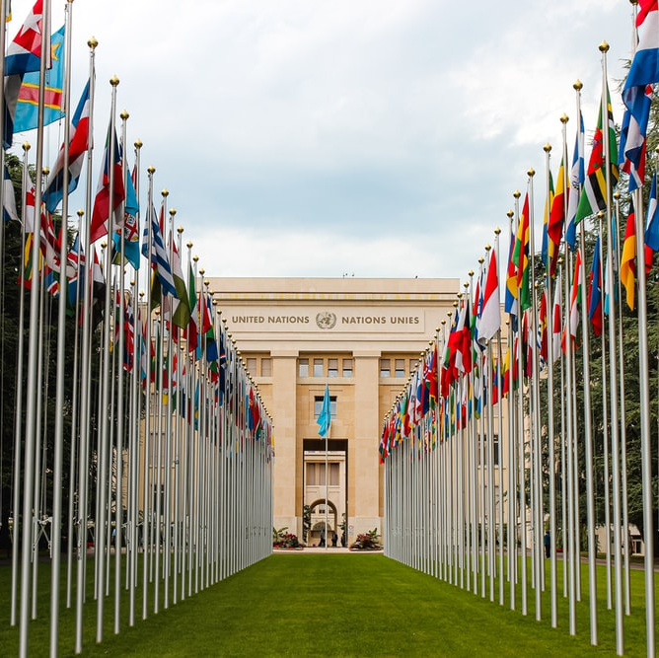




SERESSA 2022 – Geneva, Switzerland
*Pictures from Unsplash.
  General Chairs
    Ygor AGUIAR (CERN, Switzerland) and Raoul VELAZCO (CNRS-TIMA, France)
  Program Chair
    Jaime ESTELA (Spectrum Aerospace, Germany)
  Local Chair
    Rubén GARCÍA ALÍA (CERN, Switzerland)
  Poster Chairs
    Ygor AGUIAR (CERN, Switzerland) and Andrea CORONETTI (CERN, Switzerland)
24 lectures + 2 software trainings + 1 poster session
  USA 6, France 5, Germany 5, Switzerland 4, Italy 2, The Netherlands 1, Spain 1, Canada 1 and Brazil 1.
  Lecture material is available on Indico: https://indico.cern.ch/e/seressa2022
Supported by the CERN R2E project and RADNEXT European project
  Grant agreement No 101008126
  Thanks Pablo and Sabrina for the support from PMO.

Slide 5
Some statistics
Total of 152 participants
17% of woman
38% are MSc or PhD students
20+ countries:
  Switzerland – 29
  France – 28
  Germany – 19
  United States – 18
  Italy – 11

Slide 6
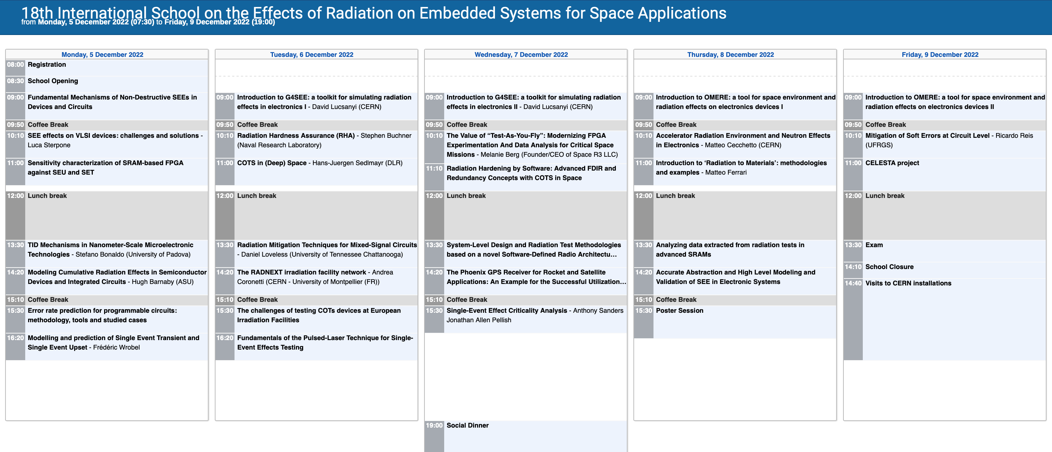
Technical Program

Slide 7
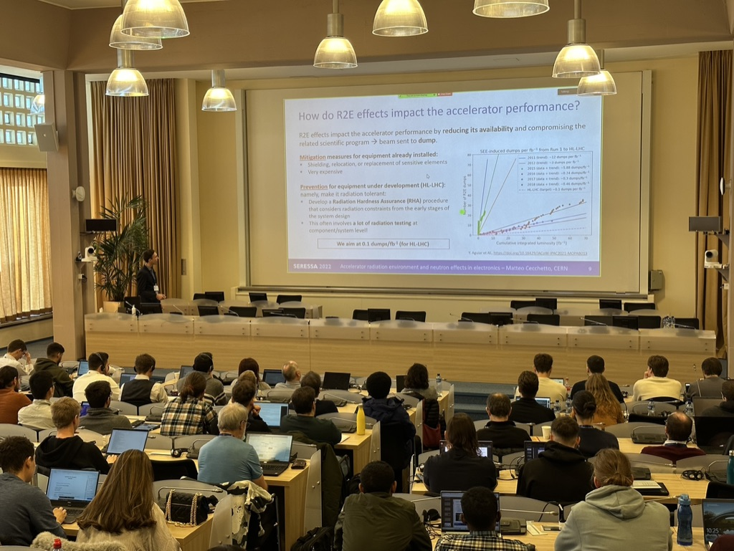
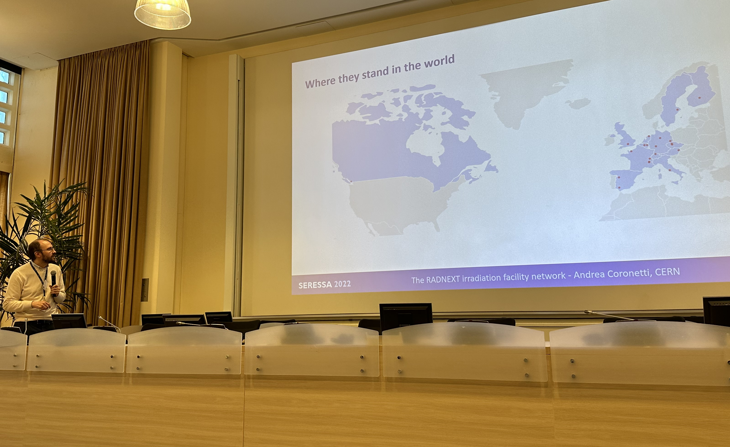
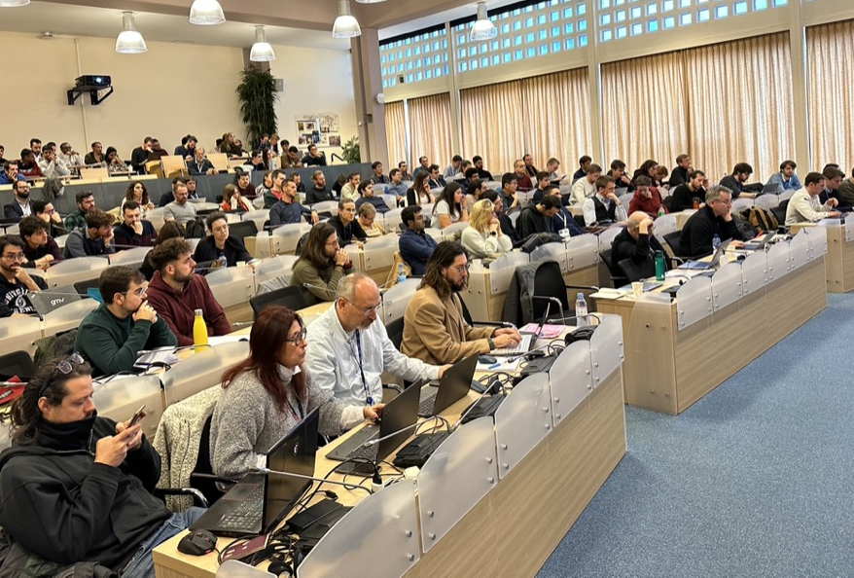
SERESSA 2022
Andrea Coronetti presenting RADNEXT during SERESSA.

Slide 8
On-line training
From webinars to a dedicated MOOC

Slide 9
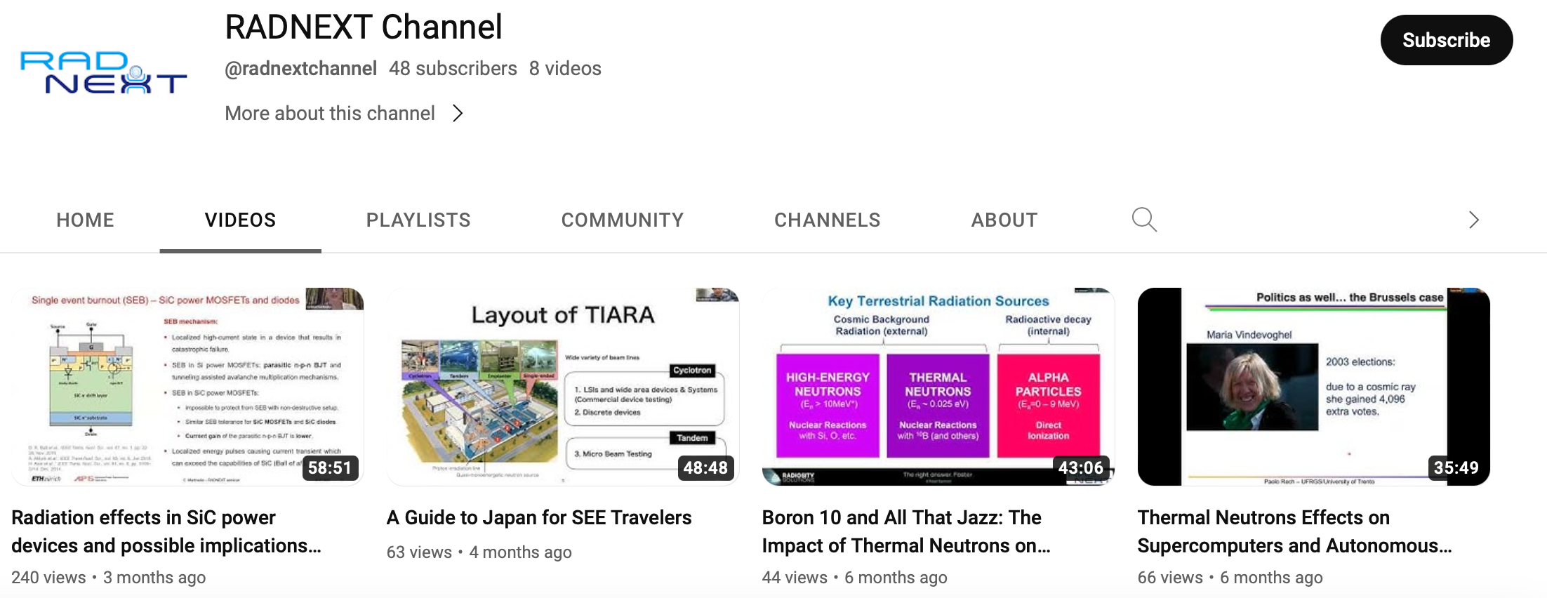

RADNEXT Webinar Series
Webinar series on present and future irradiation facilties around the world:
  7 webinars were organized with an average attendance of 70 participants
  Recorded videos available on RADNEXT YouTube Channel
  More information in Ennio’s talk and soon to be released in the Deliverable Report D2.3
  Stay tuned via our RADNEXT page on LinkedIn for the upcoming webinars.
Subscribe to our channel!

Slide 10
MOOC: RadiationX
Radiation Effects in Electronics: from accelerators to space

Slide 11
What is a MOOC?
Massive Open Online Course
Thousands of students
For anyone and free of charge!
Web-based course using online platforms such EdX, Coursera, …

Slide 12

RADNEXT MOOC
Radiation Effects in Electronics: from Accelerators to Space.
Very first MOOC on the topic
Duration: 5 weeks (self-paced), 5-7 hours per week
Target audience: undergraduate and graduate students in Physics or Engineering
Expected launch date: 03/2024
Support from MOOC design team of the KU Leuven Learning Lab
  Multimedia and design support
  30+ MOOCs developed or in development
  190+ countries reached
  More than 300k enrolments
  Average of 1000 participants per run

Slide 13
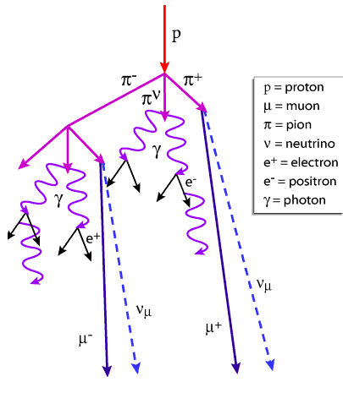
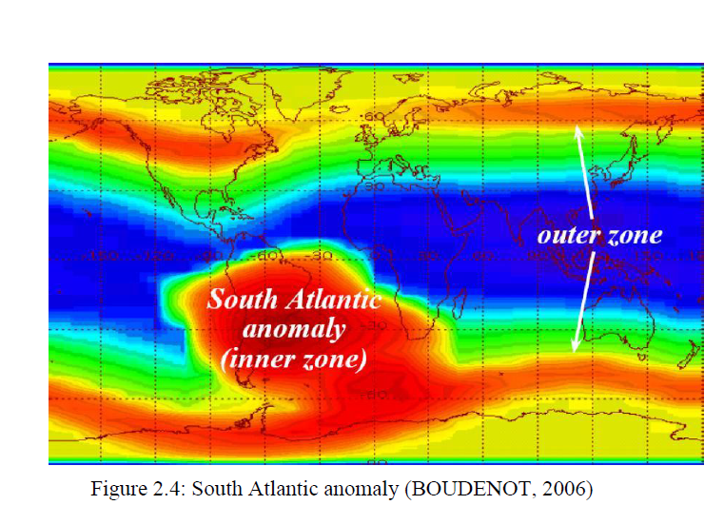
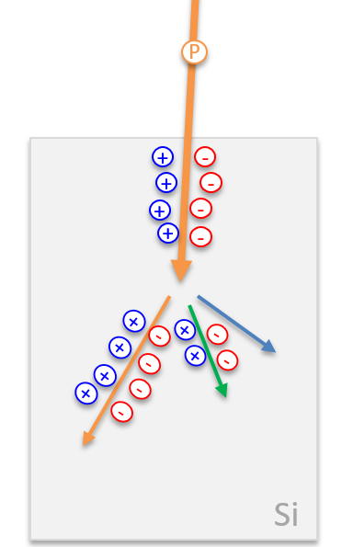
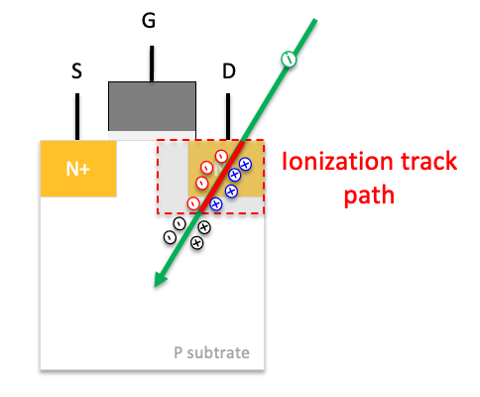
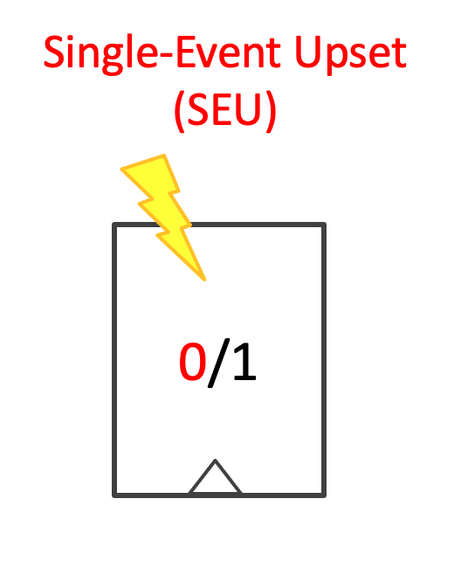
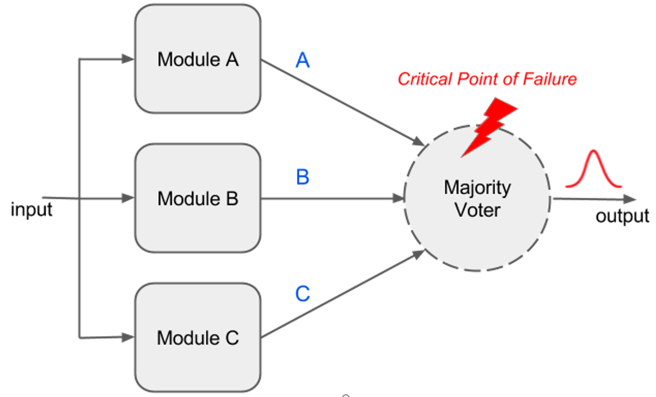
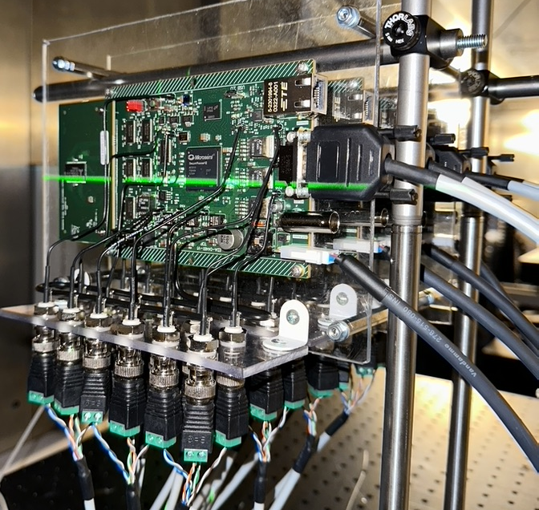
Preliminary proposed program
Module 1: Radiation Environment
  Space radiation
  Atmospheric radiation
  Artificial radiation environment (particle accelerators...)
Module 2: Particle Interaction
  Ionization (Direct and Indirect)
  Displacement
  Modelling codes I
Module 3: Radiation effects on electronics
  SEE
  TID and DD
  Modelling codes II
Module 4: Mitigation techniques
  Hardening by Process
  Hardening by Design
Module 5: Testing methodologies
  European Standards for Space Missions
  Guideline of best practices beyond standards

Slide 14
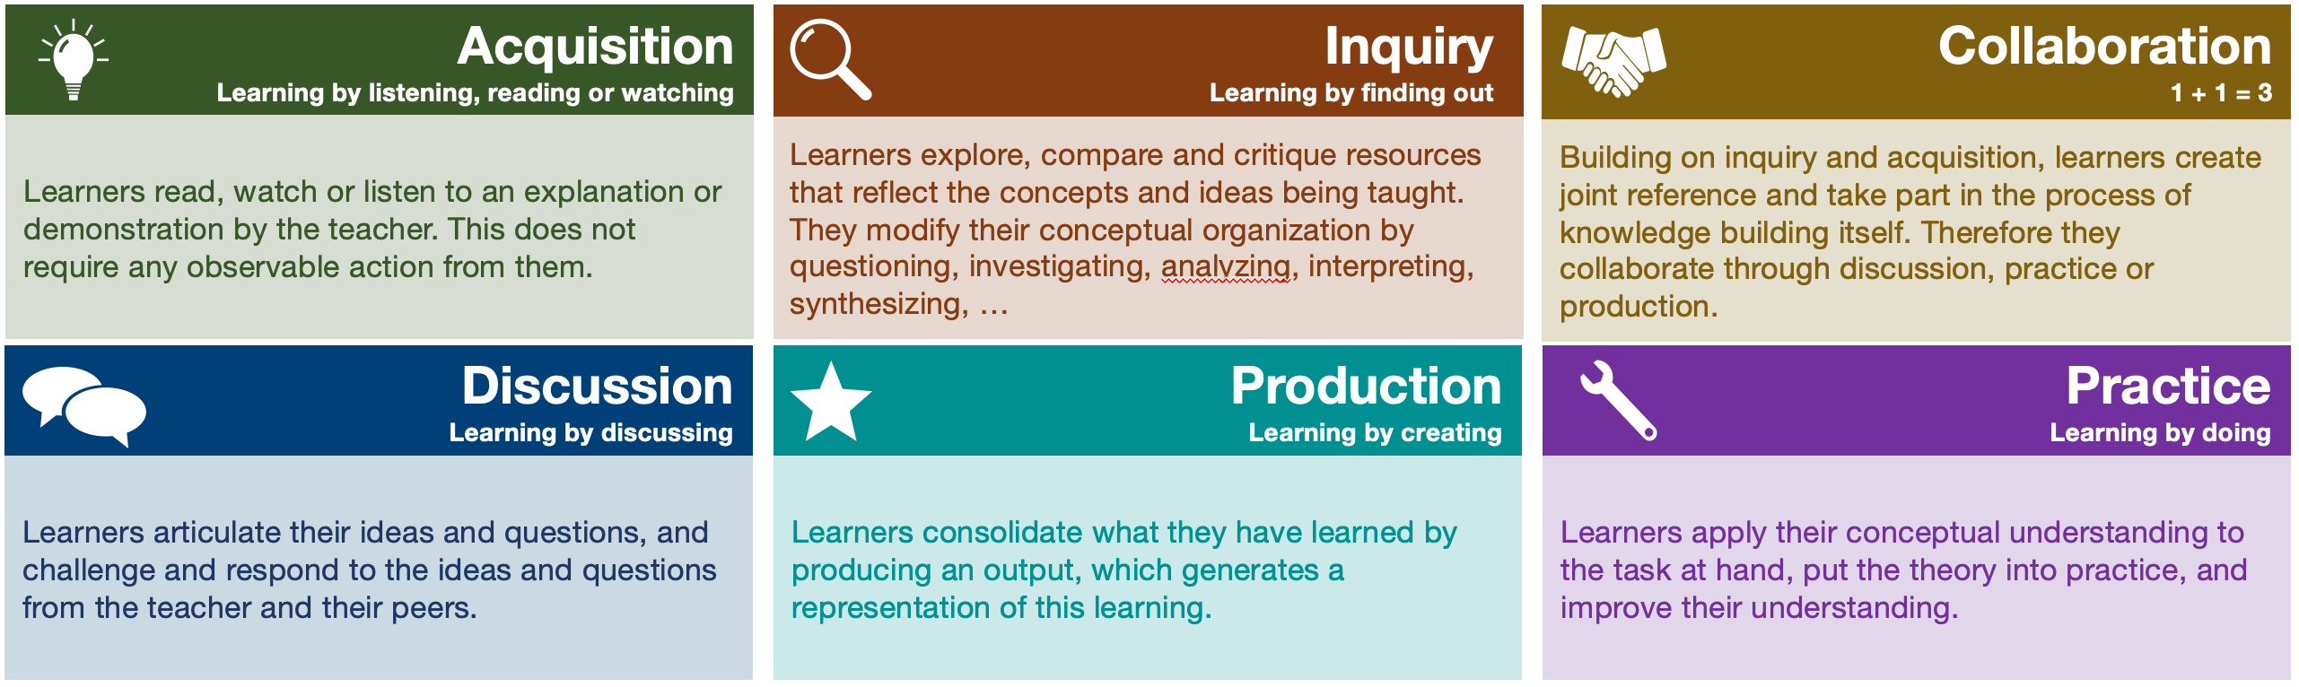
Learning activities

Slide 15

EdX platform
Launched in 2012 by Harvard and MIT
Several universities with proven reputation (MIT, Harvard, Berkeley, …)
4000+ courses and more than 110 million enrolments to this date
Two training modalities:
  Audit track (Free)
  Verified track (Paid)

Slide 16
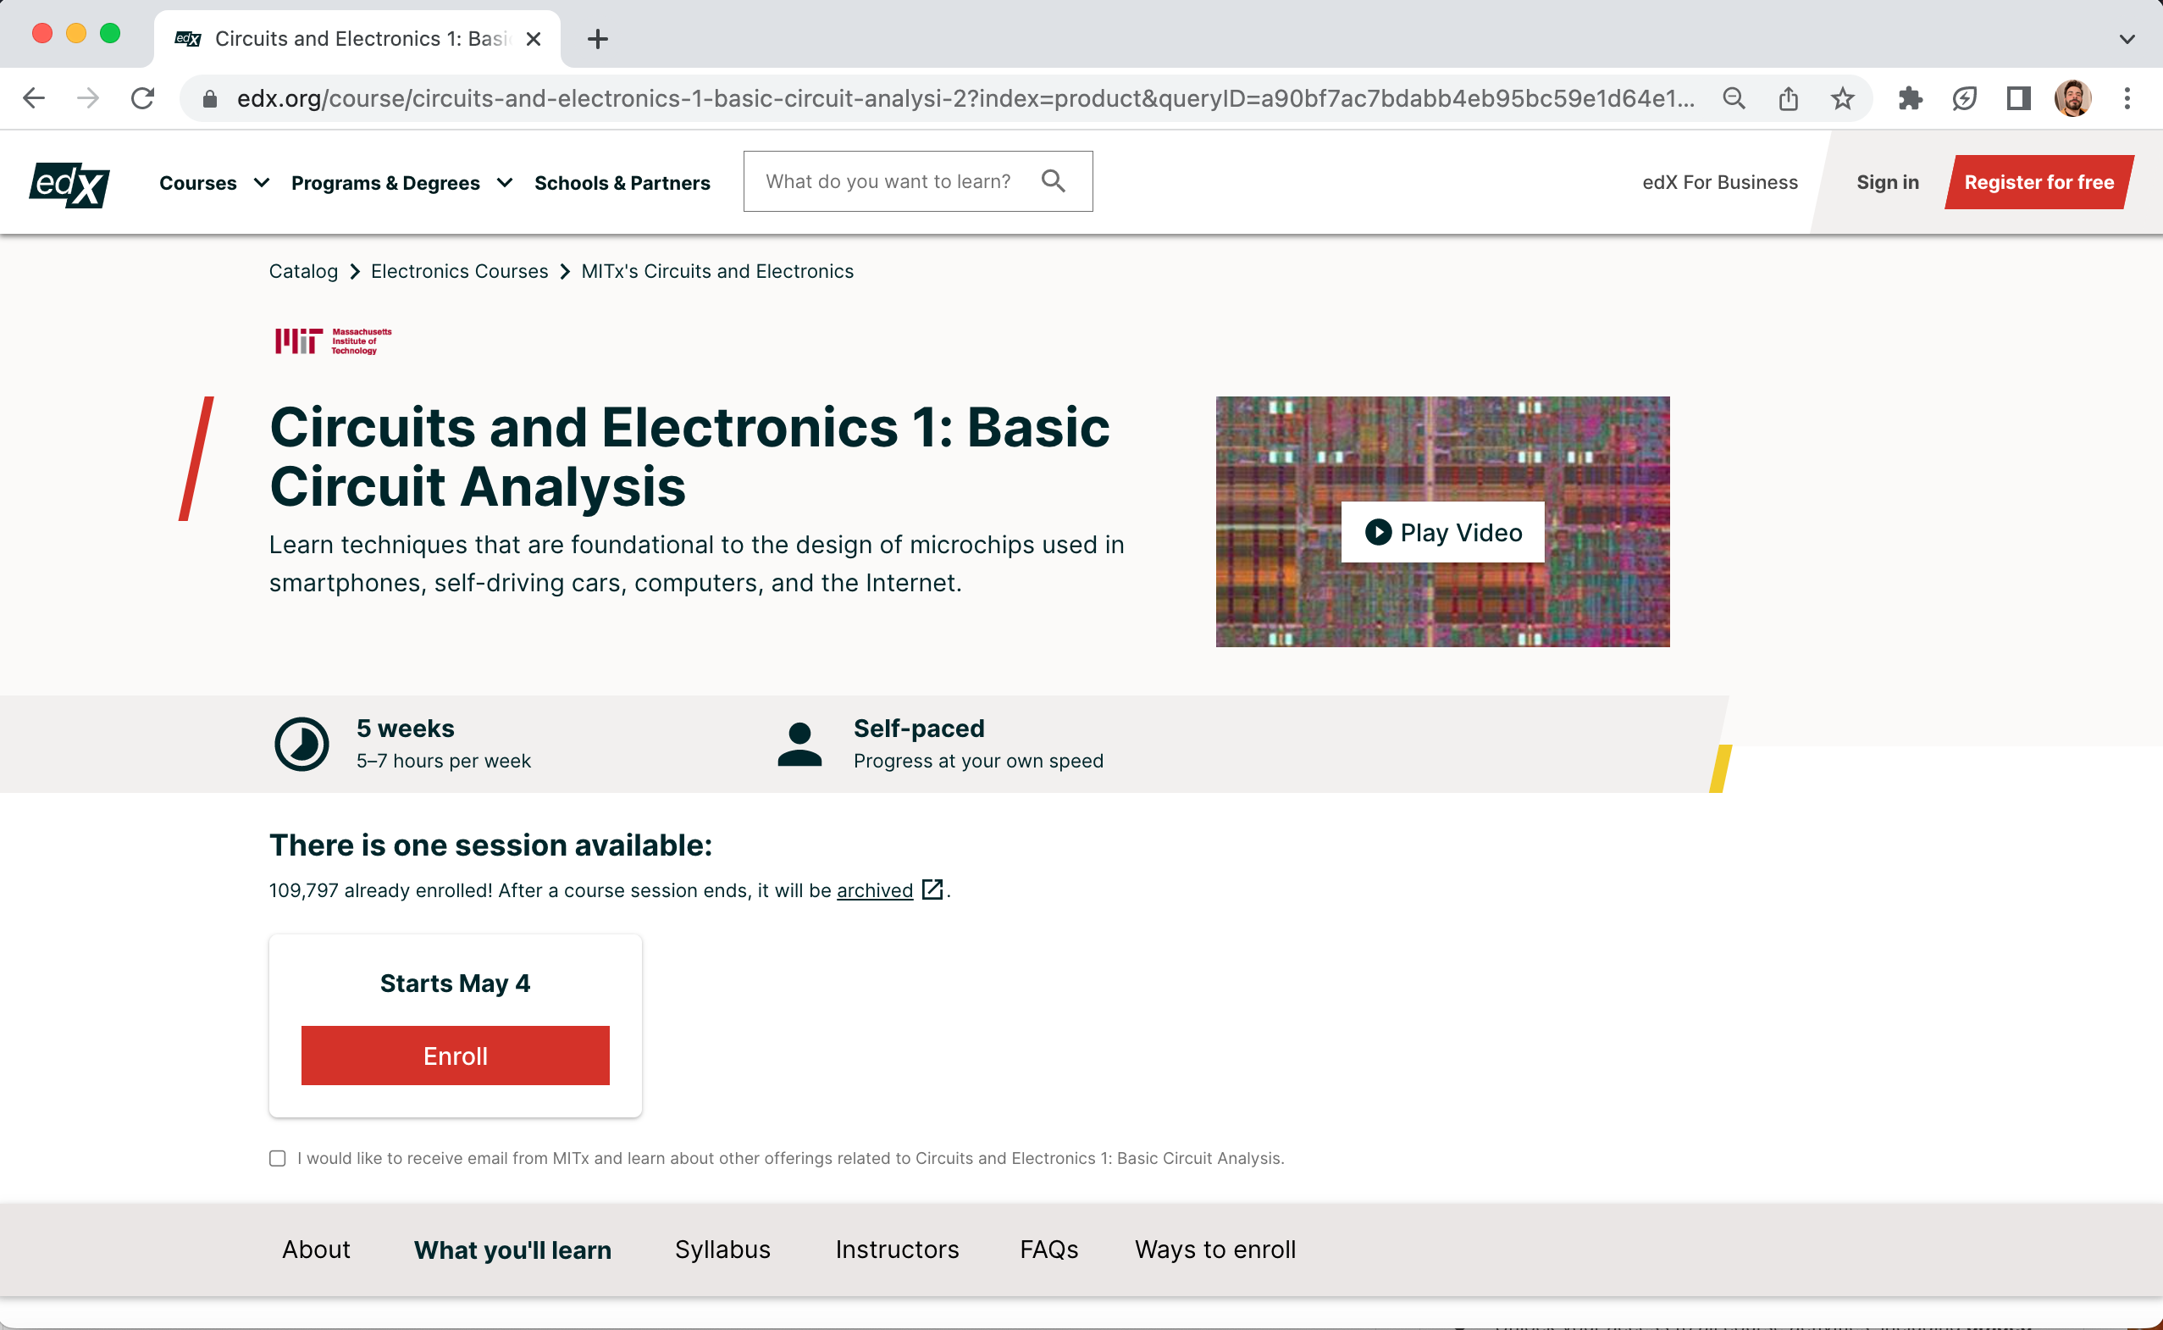
MOOC Example

Slide 17
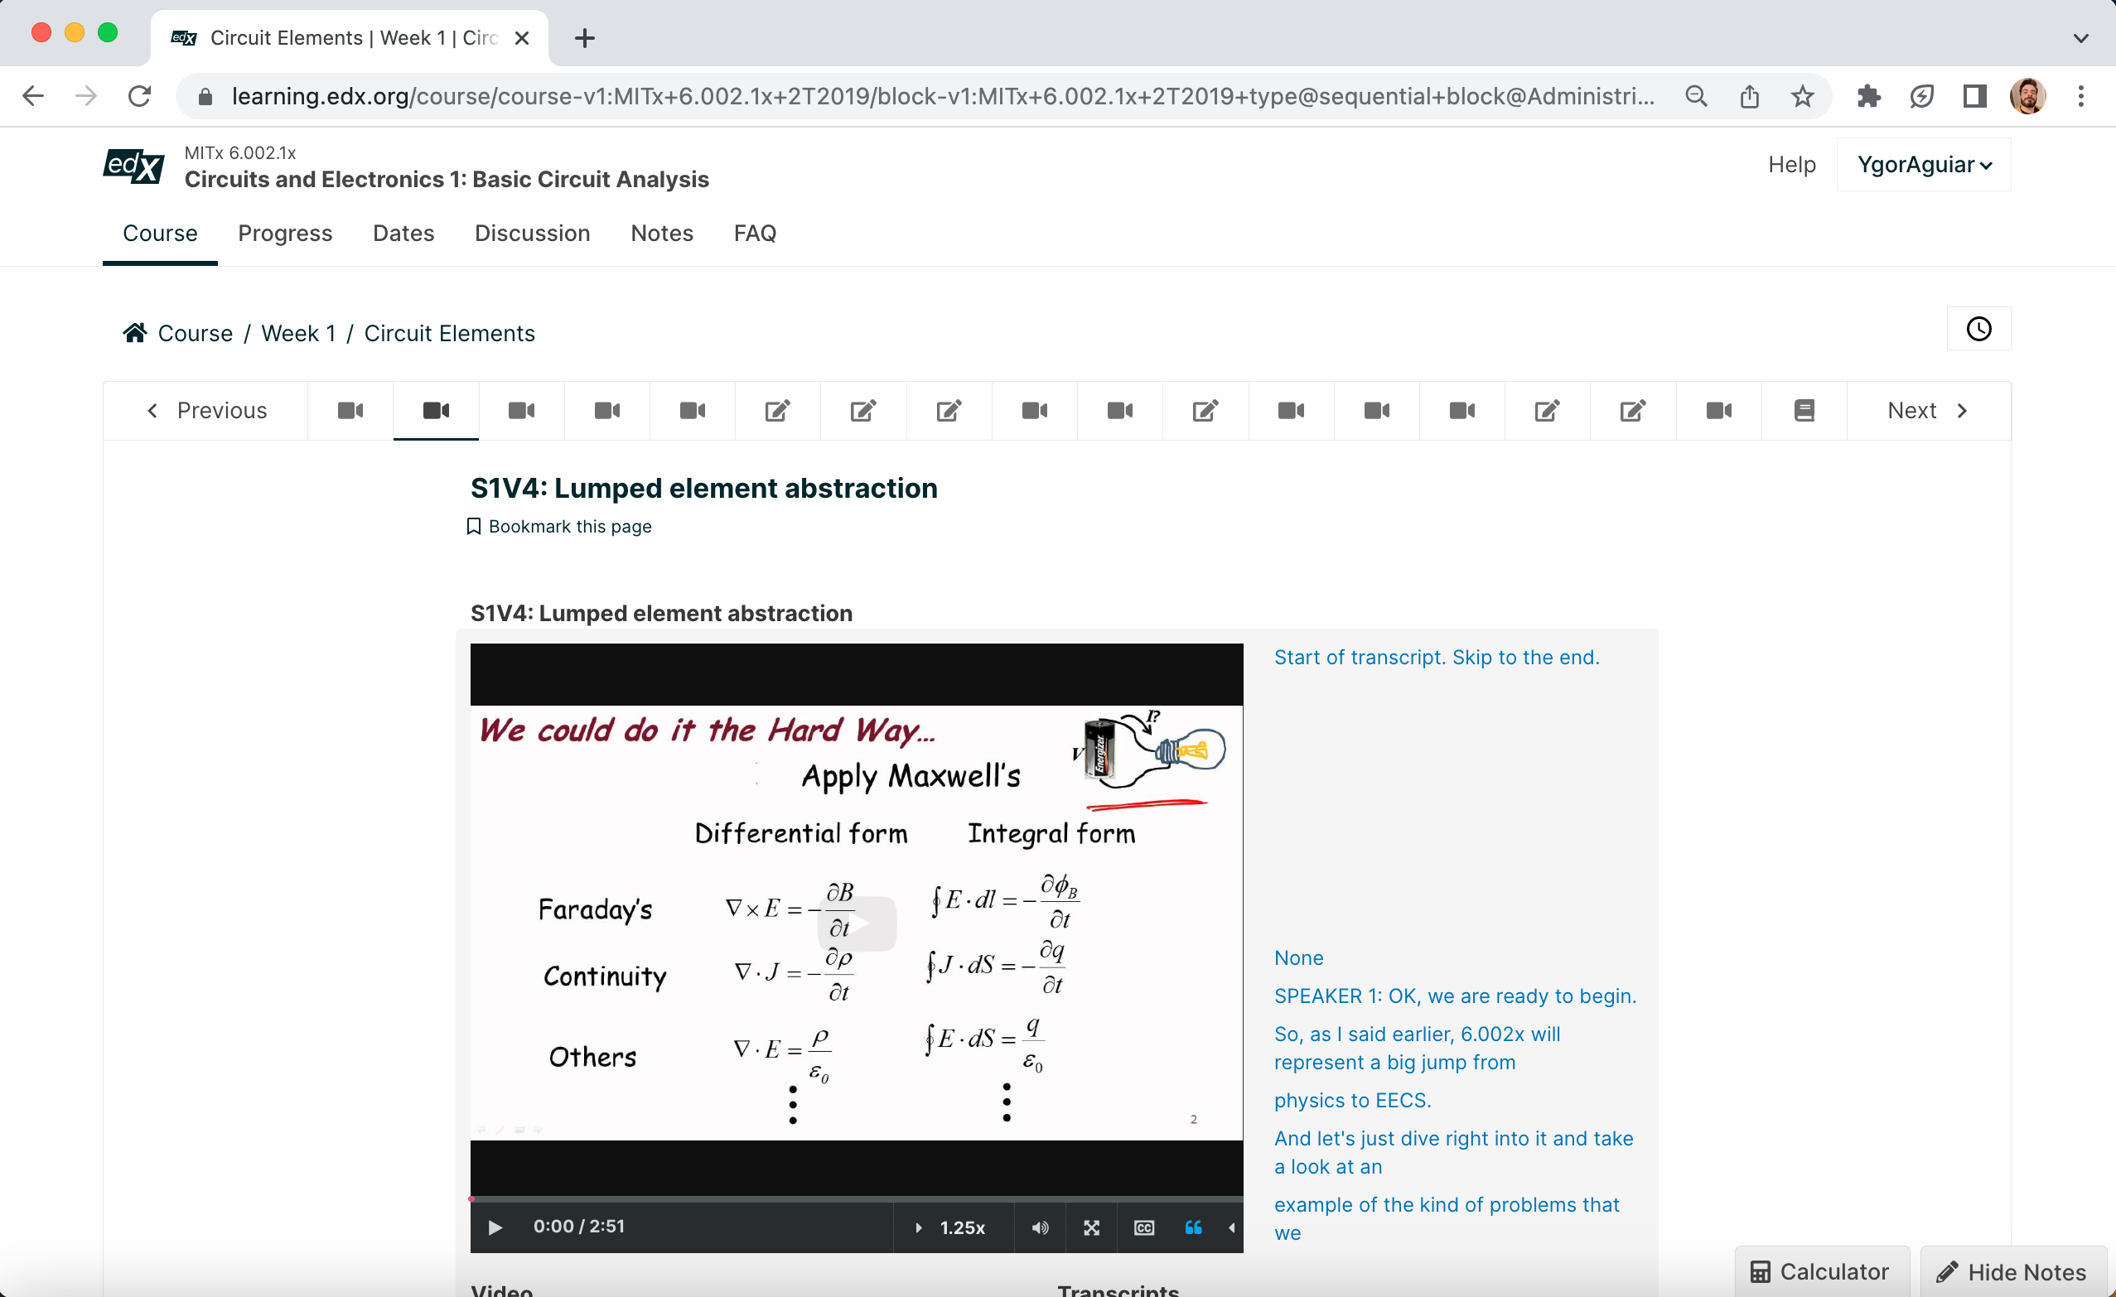
Learning material
Several types of content:
Video lectures
  Screencast and talking head
  Short videos up to 7min max
Interactive quizzes
  Multi-select, drag and drop, word cloud, text input…
Discussion forums
Module / Section
Learning Material

Slide 18
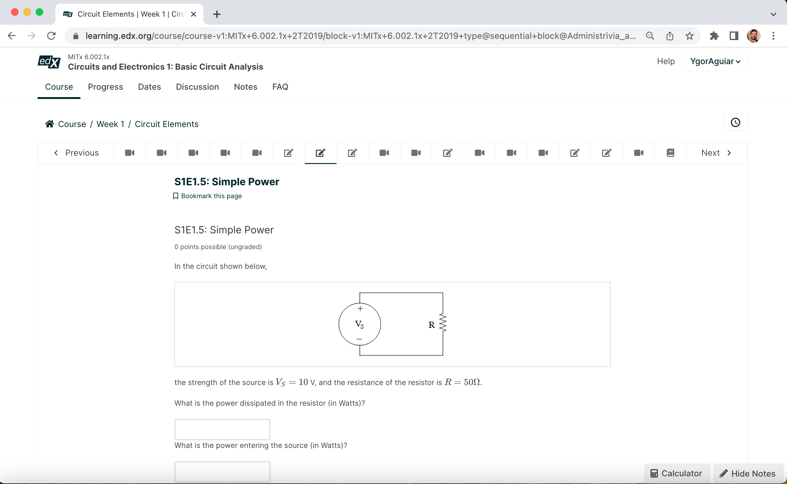
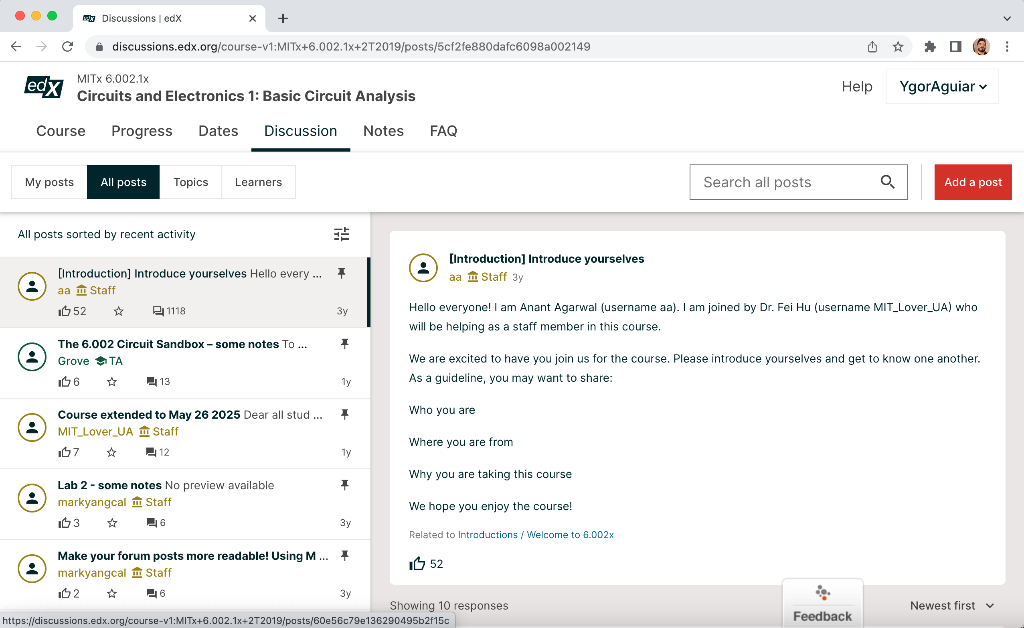
Learning material
Discussion Forum
Quiz

Slide 19










Month 1
Month 2
Month 3
Month 4
Month 5
Month 6
Month 7
Month 8
Month 9
Month 10
Month 11
Month 12
Month 3
DESIGN
Analyse
Design
TRAIN
Develop
BUILD
Implement
TEST
Evaluate

Slide 20
Conclusion
Training opportunities have been organized for on-line and in-person participation.
An international school on radiation effects was organized at CERN with more than 150 participants from more than 20 countries.
Webinar series exploring present and future facilities around the world has been proposed, recorded and uploaded on RADNEXT Youtube channel.
A Massive Open Online Course (MOOC) is under development for the EdX platform with the support of KU Leuven team.

Slide 21
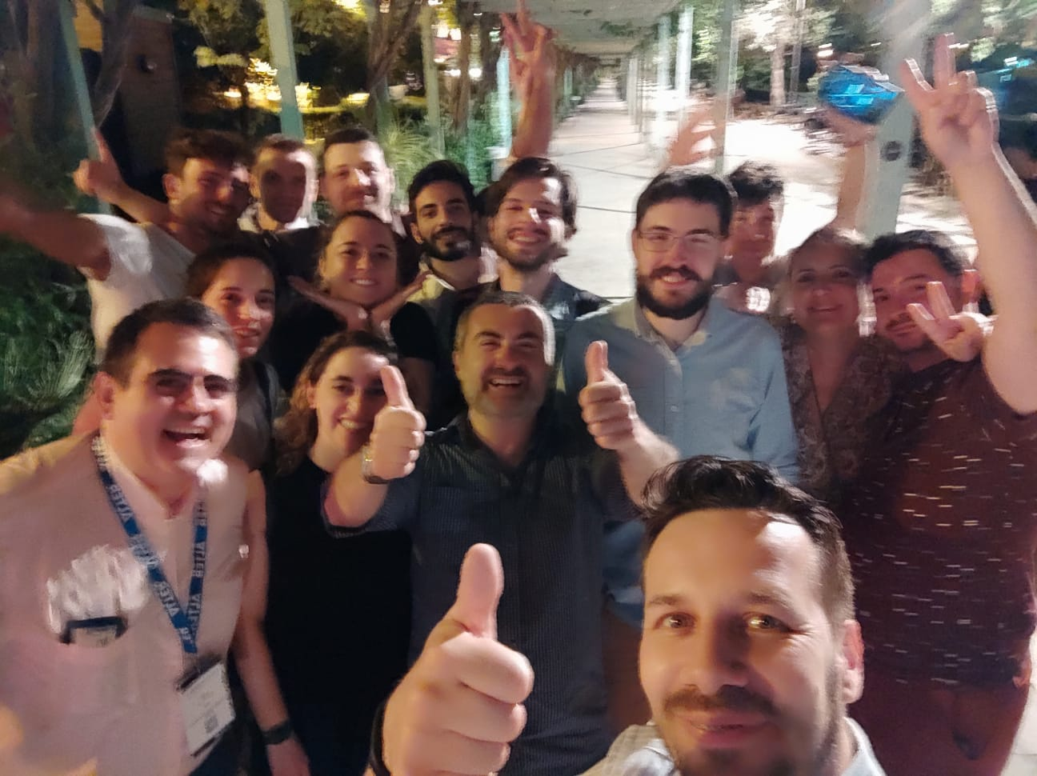
Thanks for your attention!
RADNEXT, Sevilla, España

