Slide 1


WP 3, Results of User Survey
Jochen Kuhnhenn (Fraunhofer INT) and Salvatore Fiore (CERN)
RADNEXT 2nd Annual Meeting – 9-10 May 2023
https://indico.cern.ch/e/radnext-2023

Slide 2
Outline
Motivation
Methods
Results
Conclusions

Slide 3
Motivation
So far no regular feedback channel was available for users to comment and judge on their experience with RADNEXT TA
Sporadic feedback occurred
  Via direct emails to TA coordinators or Rubén
  Via email to the User Support Expert team (USE)
Experience by users essential to optimize the process within RADNEXT for second half of the project, but also beyond
  Typical problems would be of general interest

Slide 4
Methods
Fraunhofer licensed Microsoft 365 “Forms” App was used to create the survey
  Remark: In compliance with European data protection and privacy regulations
Survey should be short and straight forward to motivate many responses
Survey consisted of 3 yes/no questions, 9 rated questions and one free form field
Survey was accessible via https://s.fhg.de/radnext-user-survey
Invitation was sent to 84 recipients
Started on 2023-04-20 18:00 and was closed 2023-05-07 16:00
In total 27 responses were given (1/SQRT(27) ~ 20%)

Slide 5
Results 1
Have at least one of your proposals been accepted by RADNEXT Transnational Access?
For your accepted proposal(s), have at least one been assigned beam time in one of the facilities?

Slide 6
Results 2
For your beam assigned proposal(s), have at least one been already executed?

Slide 7
Results 3 – Rating of aspects

Slide 8
Results 4 – Importance of aspects

Slide 9
Results 5 – General suggestions (15 answers)
“improve communication about the real beam time available”
“would be valuable to find a comparison table […] of the different facilities”
“Possibility to discuss before the assignment with different facilities”
“possibility to integrate figures in the proposals”
“Still have not been contacted by anyone after proposal acceptance.”
“financial support for travelling […] was never fulfilled.”
“the expected schedule for the selection outcome […] should be respected”
“i do not even know in a clear way if my proposal was awarded with beam time or not”
“No suggestions. Everything good so far!”
“My experience with RADNEXT was awesome. You folks are doing a great job!”

Slide 10
Conclusions
Free answers seem to be more negative than the overall ratings
Overall good or even very good feedback
  Communication is generally considered as a weaker aspect
  Several obviously very happy users, task of “enabling” projects clearly met
Most important is the free provision of beam time
Other forms of support (financial, technical, …) are ok but not necessary
Suggestions for TA process:
  Further improve communication and information about facilities

Slide 11
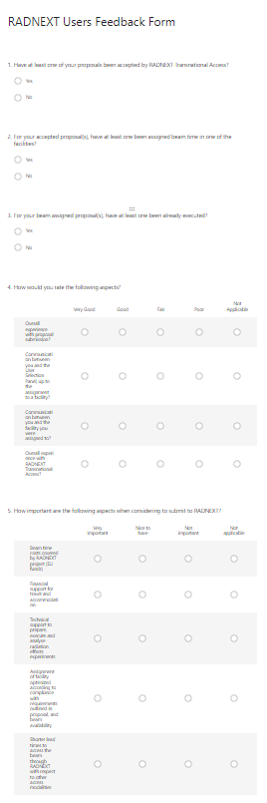
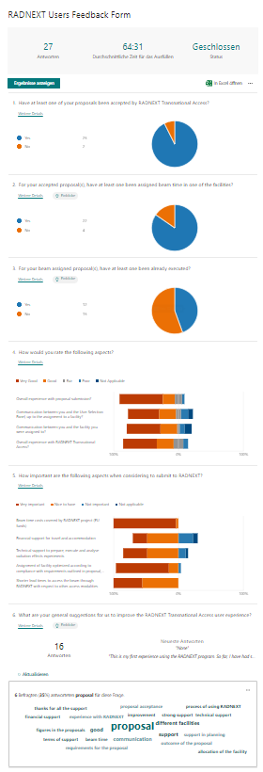
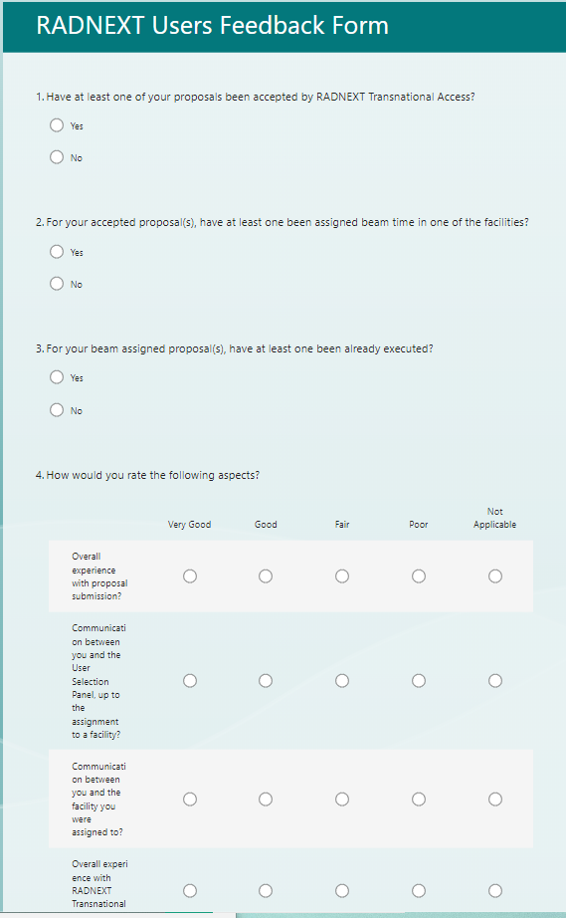
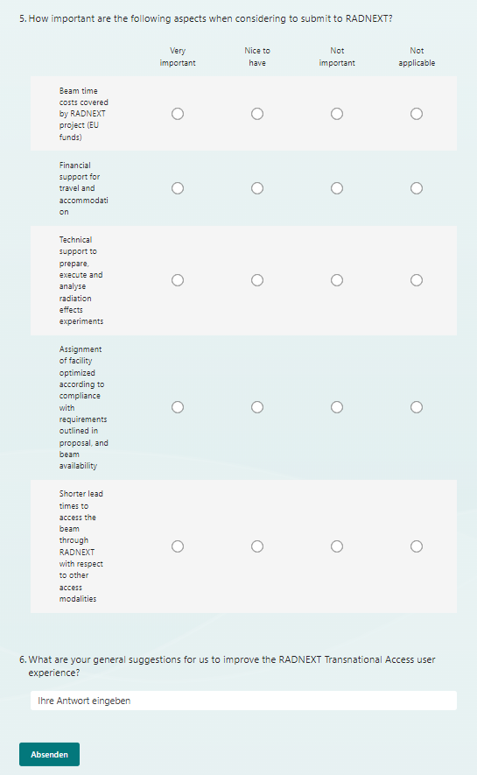
Thanks for your attention!

