Slide 1
Forward Physics Facility (FPF)
ARUP Introduction Meeting
Kincső Pál, John Osborne SCE-DOD-FS
Date: 21/10/2022

Slide 2
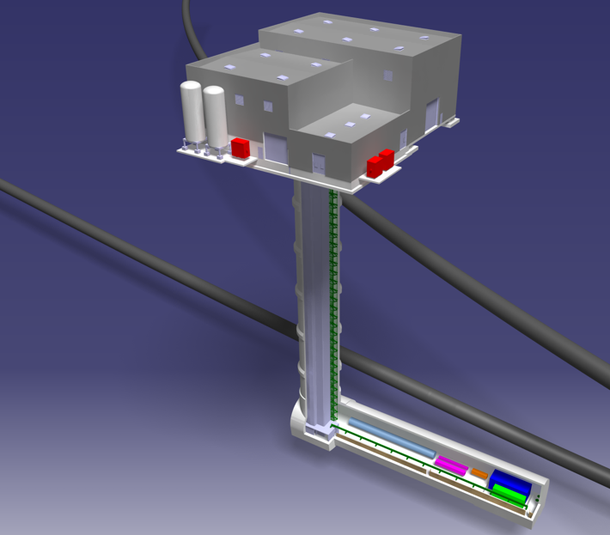
Outline
Proposed location
Proposed Design
Scope and Aims of the CE study

Slide 3
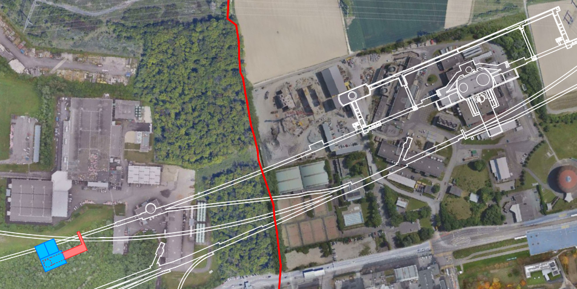


Forward Physics Facility
Proposed location
Location approx. 617m from ATLAS interaction point (IP1), on the French CERN site, 10m away from the LHC tunnel
ATLAS IP1
LHC
New facility
3

Slide 4
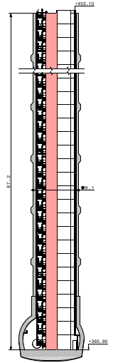
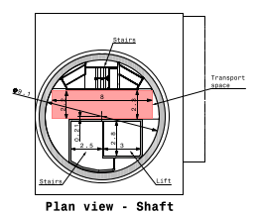
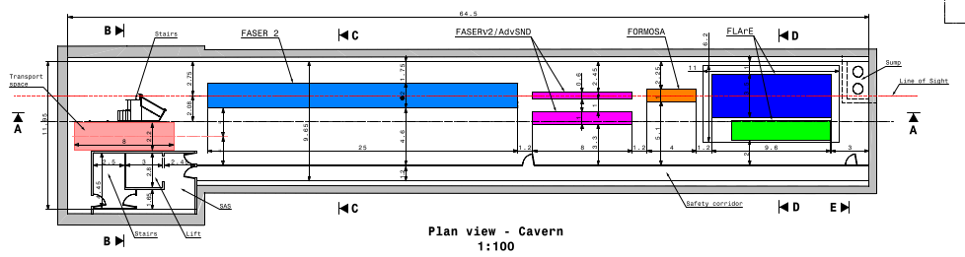
Forward Physics Facility
Proposed Design
An 88m deep access shaft with a 9.1m internal diameter
A 65m long and 9.65m wide experimental cavern
  Experiments centralized on the line of sight, 1.5m above the floor
  Floor is parallel to LoS, 1.25% fall
  Trench under the LAr detector to catch any escaped cold gas
  Safety corridor used as an emergency escape route
4

Slide 5
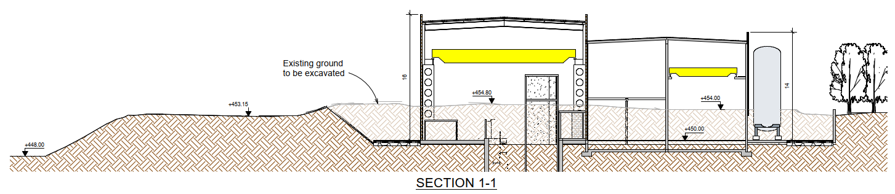
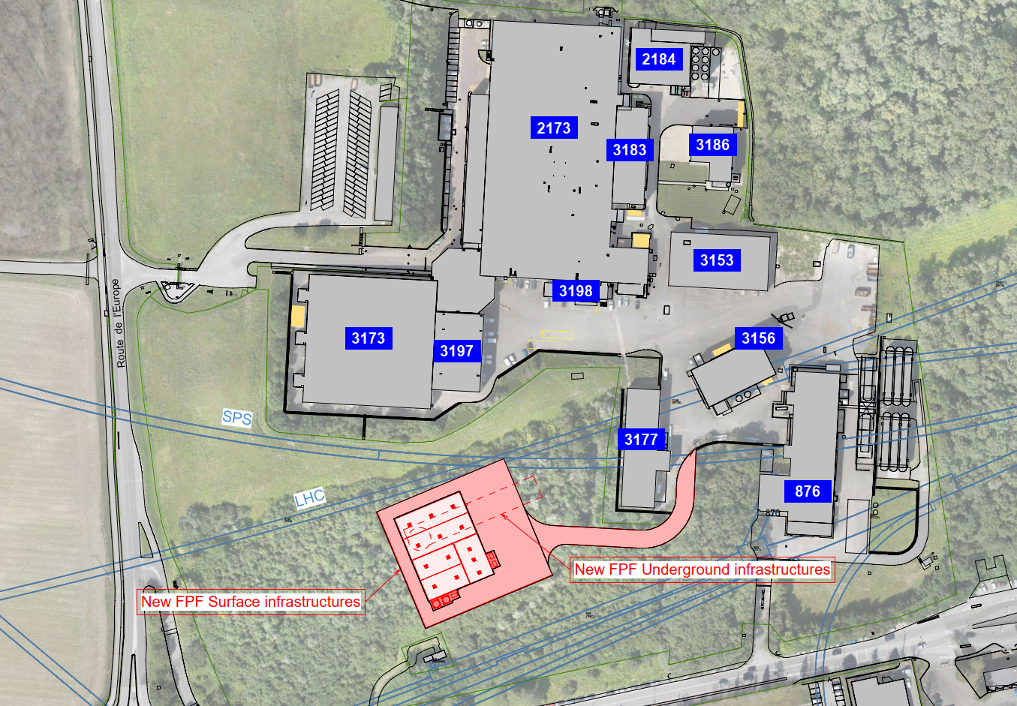
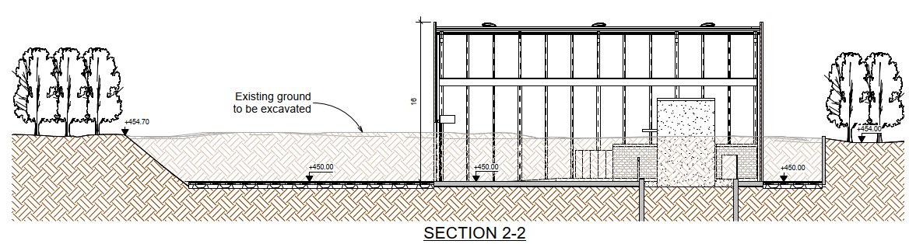
Forward Physics Facility
Proposed Design
Proposed surface buildings
  Access building
  Electrical building
  Cooling & Ventilation building
Site used as a spoil disposal area for previous CERN projects
Ground levels between 453-455m, approx. 7 m above the surrounding area
5

Slide 6
Scope and Aims of the CE study
Task 1: Civil Engineering Cost Estimate Review
  Delivery date: end of 2022
  Carry out a cost estimation review of the proposed CE cost (approx. 31m CHF) and provide comments or suggestions
Task 2: Interpretation of the soil investigations
  Delivery date: end of April 2023
6

Slide 7
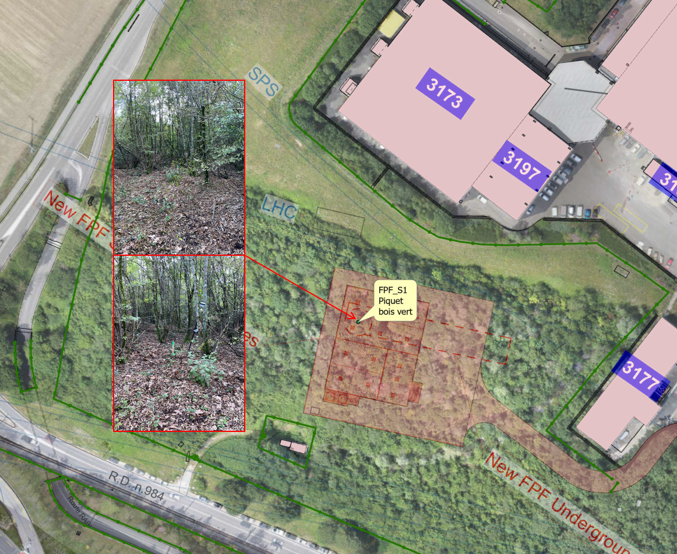
Site Investigation Works
New core will be drilled the full depth of the proposed shaft early in 2023
Position marked
7

Slide 8
Thank you!

