Slide 1
MQXFB Magnet
Optical feedthrough box :
Status and perspectives
Keziban KANDEMIR, Michael GUINCHARD, Sylvain MUGNIER.
EN-MME-EDM Mechanical measurement lab
Thanks to Hervé, Tavis and Nicolas (x2) and Patrick (SM18) for the support and the efficiency !

Slide 2
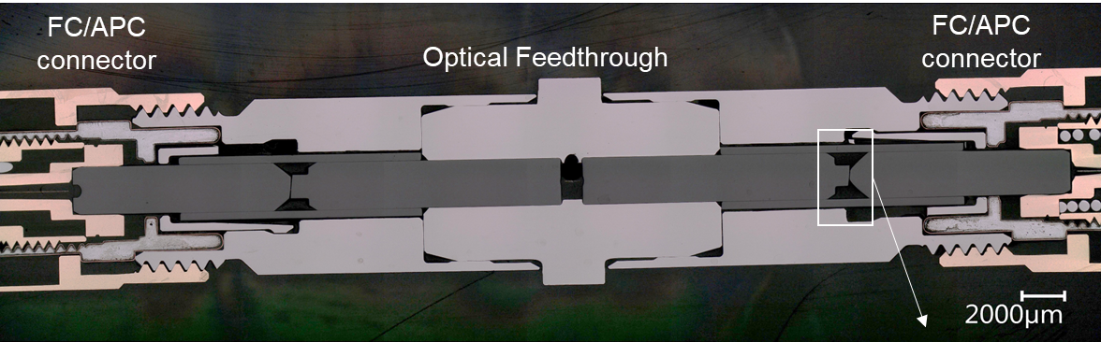
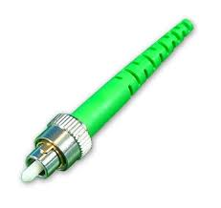
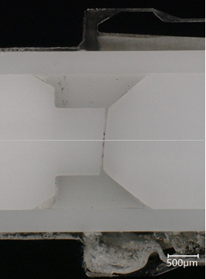
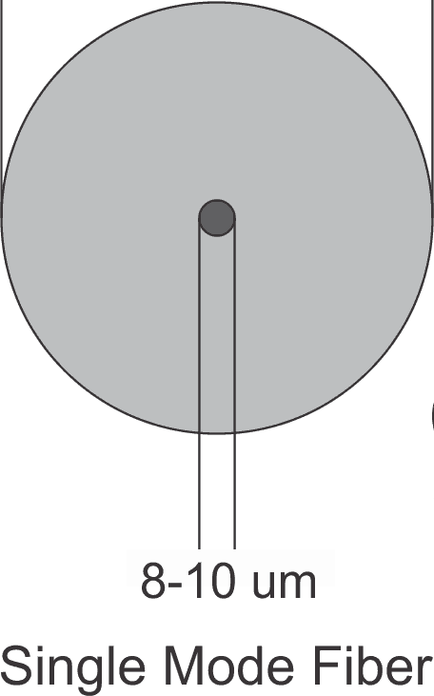
Optical feedthrough : A challenge…

Slide 3
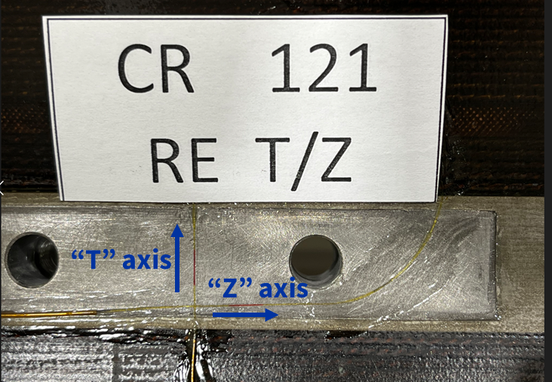
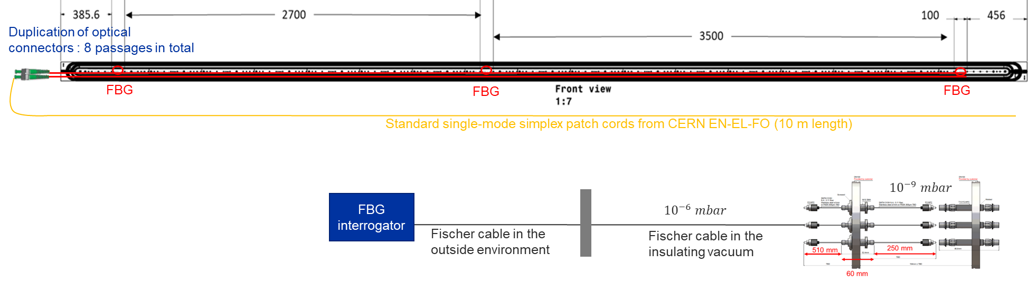
Introduction : Coil Instrumentation based on FBG
Magnet component | Number & Directions | Bridge configuration | Type
SHELL | 20 (Θ) 20 (Z) | SG Quarter bridge | Cr – Ni / Polyimide HBM LY11-6/350
COILS | 12 (Z) 12 (Θ) | FBG | FemtoSecond® 4 arrays with 6 FBG’s
RODS | 4 (Z) | SG Full bridges | Cr – Ni / Polyimide HBM LC11-3/350
Vacuum Vessel

Slide 4
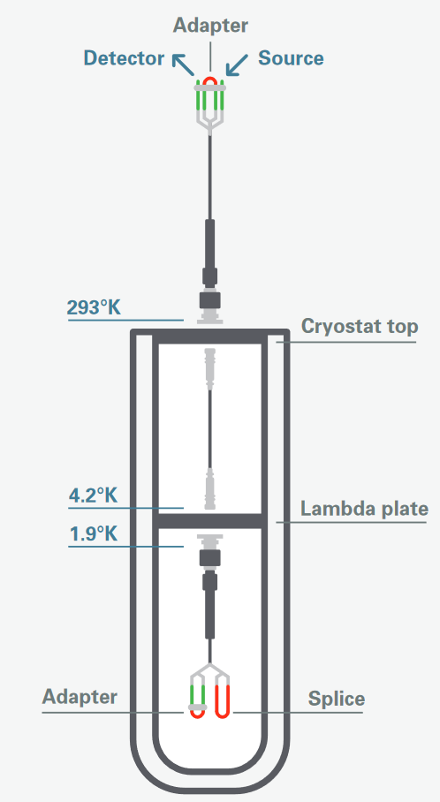
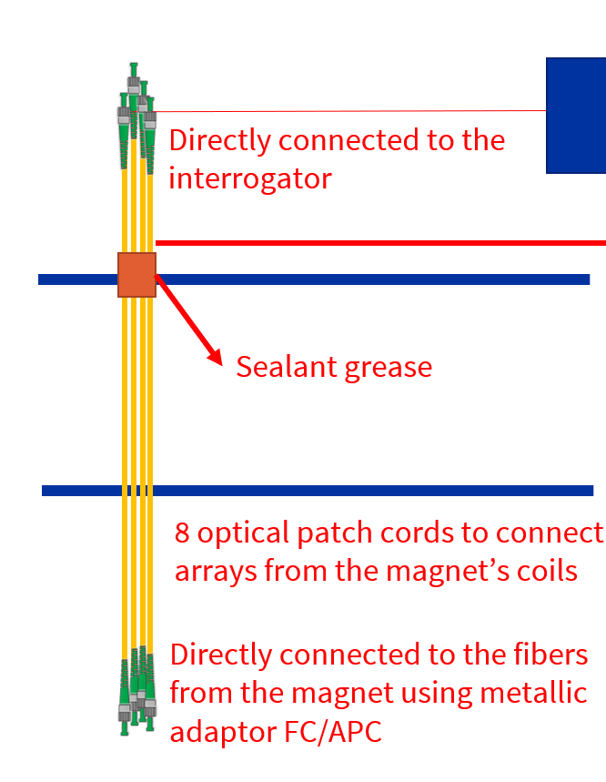

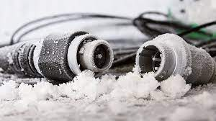


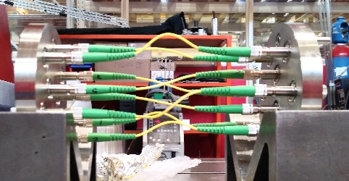
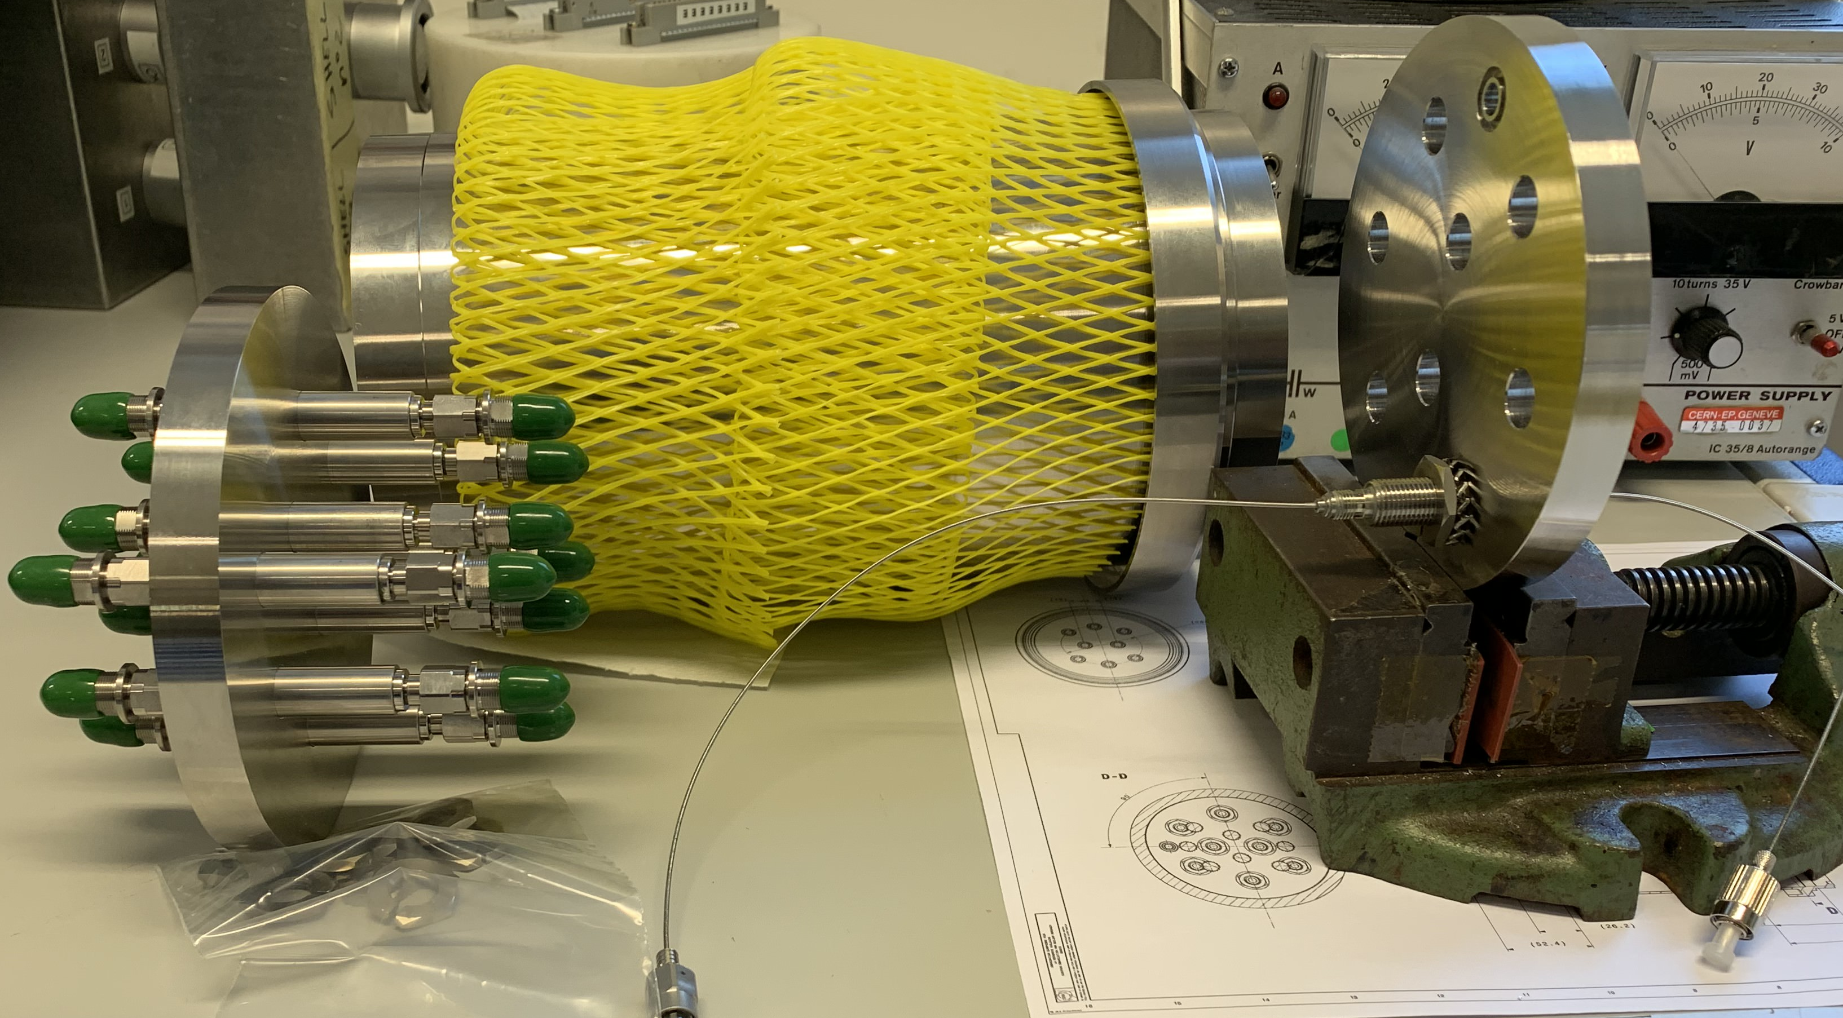

Introduction : MQXF story
 | Optical fiber performance
 | Loading | Cold temp. | Powering tests | RT after TC
MQXFS6b | 100% | 100% | 100% | 100%
MQXFS6c | 100% | 100% | 100% | 100%
MQXFS6d | 100% | 100% | 100% | 100%
MQXFS7a | 100% | 50% (1) | 50% (1) | 100%
MQXFS7b | 100% | 100% | 100% | 100%
MQXFS7c | 100% | 100% | 100% | 100%
MQXFS7d | 100% | 100% | 100% | 100%
MQXFBP1 | 100% | FAILED (1) | FAILED (1) | 100%
MQXFBP2 | 100% | 100% | 75% (2) | 100%
MQXFBP3 | 100% | 12% (1) | FAILED (1) | 50%
MQXFS7a
MQXFS7b; 7c; 7d
MQXFBP1: VACOM
MQXFBP2 and P3: SEDI-ATI
(1) Hardware optical line issues (connectors or feedthrough); (2) SPD tracking issues;

Slide 5
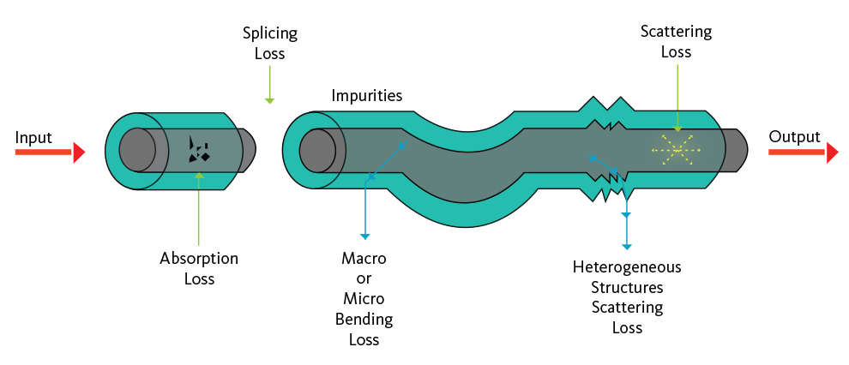
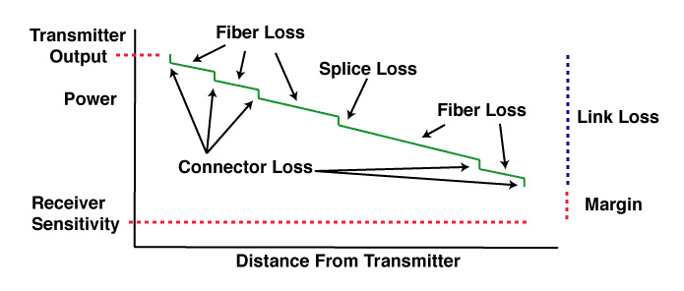
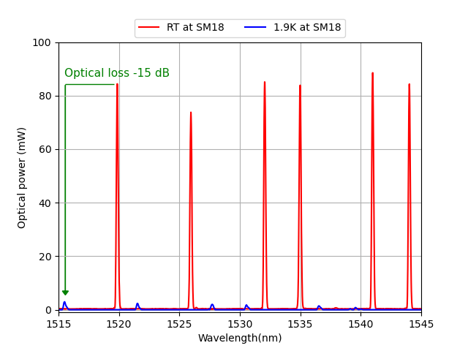
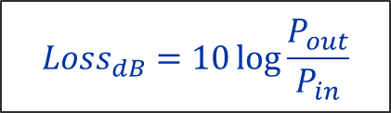
Introduction : Optical power budget
Loss in optical fiber performance
$${Loss}_{dB}=10\log{\frac{P_{out}}{P_{in}}}$$
How to improve our optical power budget :
Minimize the optical losses ;
Improve the dynamic of the optical interrogators ;
Improve the FBG design (high reflectivity gratings).
Effects on FBG measurements (MQXFBP2)

Slide 6
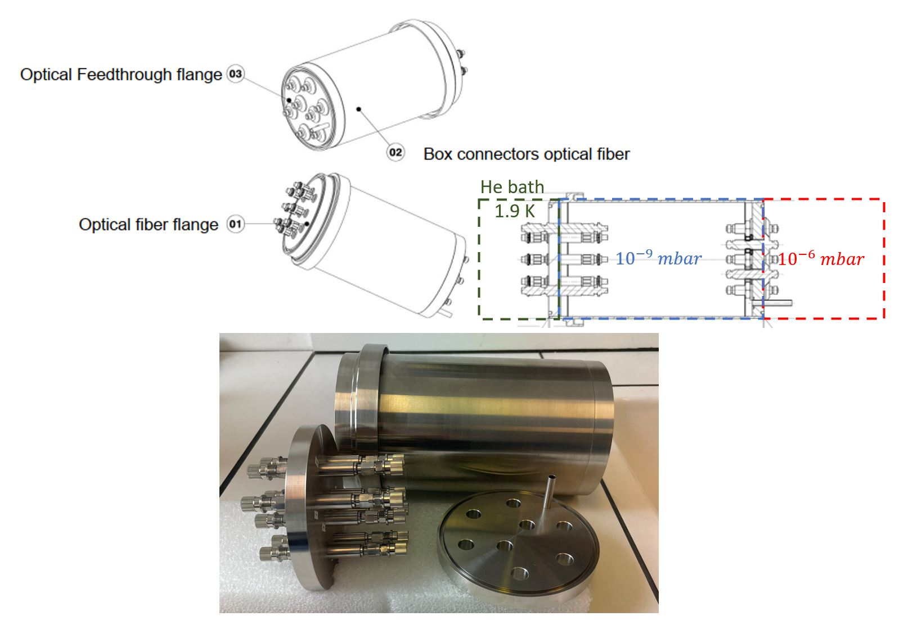
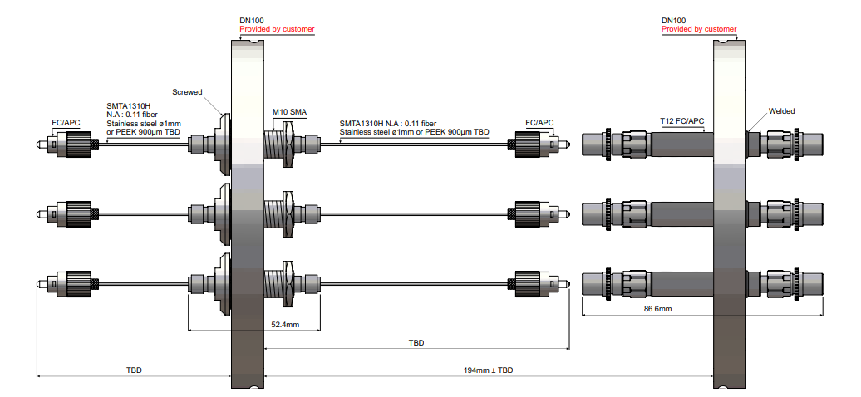


Introduction : Optical feedthrough box design
SEDI-ATI company
2 flanges:
Welded flange : 8 FC/APC connectors welded on it,
Patchcord flange : 8 optical patchcords with FC/APC connectors in the extremities screwed on it.
Optical fibers with stainless steel buffer.
1.9 K
RT
250 mm
60 mm
510 mm
Welded Flange
Patchcord Flange

Slide 7
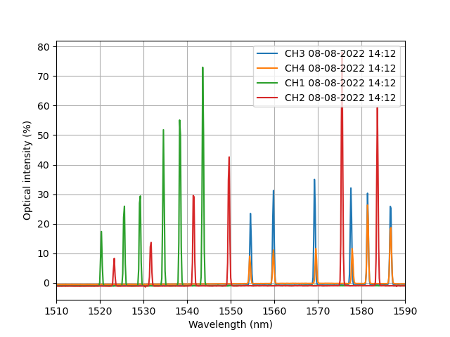
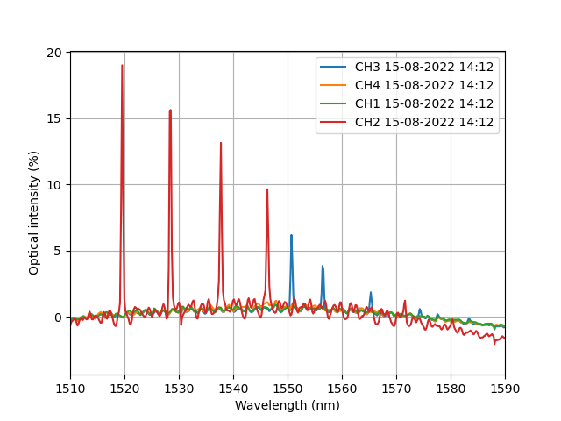
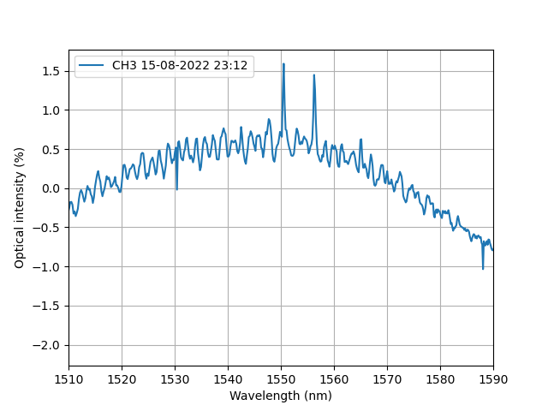
MQXFBP3 Failure analysis
Full spectra saved during cooldown for each optical fiber channels.
FBG peaks
4.5 K stable
RT
4.5 K (QLFA1_S_TT140 Magnet inlet temperature)
85 K (QLFA1_S_TT151)
Gradual optical losses during cool down were observed (only 2 FBGs remained operational at 4.5 K)
CO118 RE Z : -115 um/m
CO118 RE T : -297 um/m

Slide 8
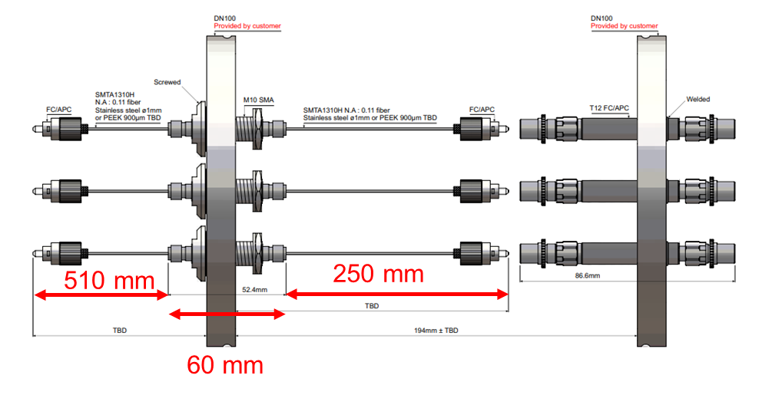
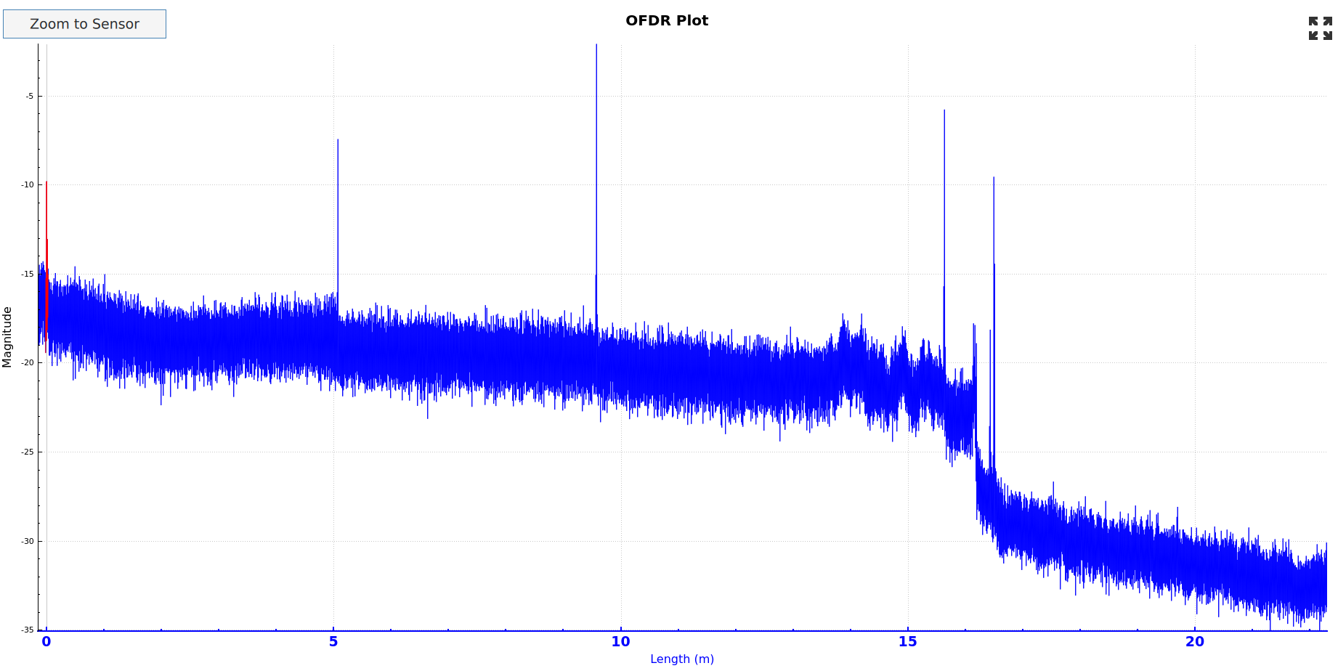
MQXFBP3 Failure analysis
Investigations with the Luna distributed strain sensing interrogator, based on optical frequency domain reflectometer (OFDR) done at 1.9 K
5m patchcords
Optical feedthrough box 0.82 m in total
4.8 m Fischer patchcords
6.5 m Fischer patchcords
Fischer to stainless steel optical fiber connection
Patchcord flange
Welded flange
Outside cryostat connections
Vacuum Vessel
Cold Mass
CH3 (CO118)

Slide 9
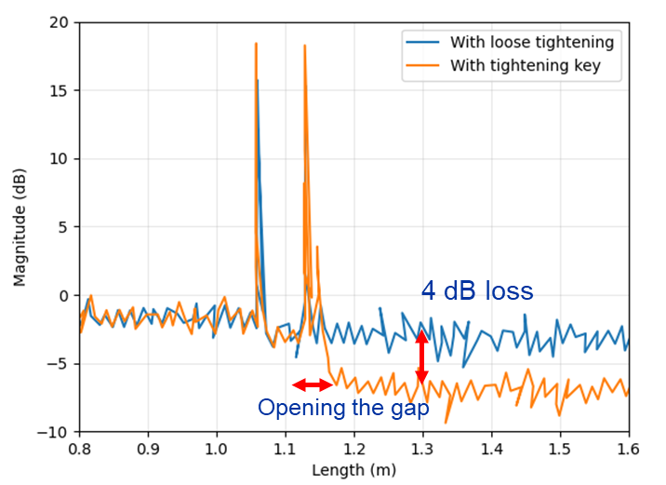
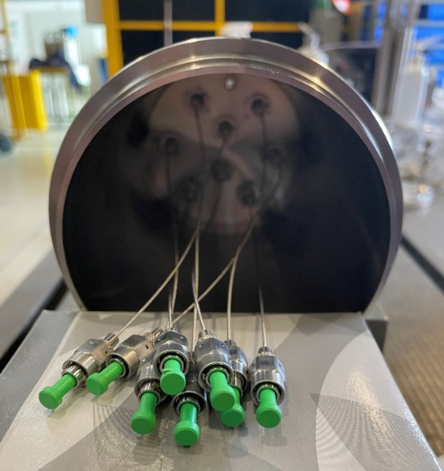
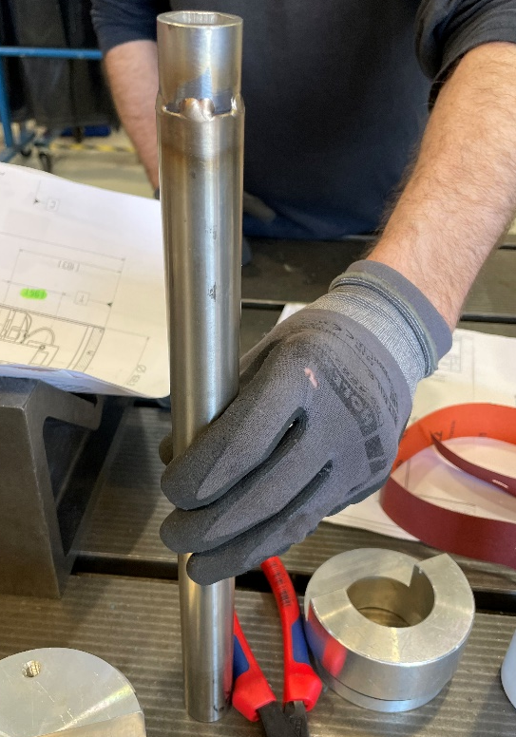
MQXFBP3 Failure analysis
Mounting operation story:
Wrong flange first welded; it was difficult to screw the patchcord lines;
A tooling was used to tighten the connectors.
Additional tests were performed afterward to quantify this effect :

Slide 10
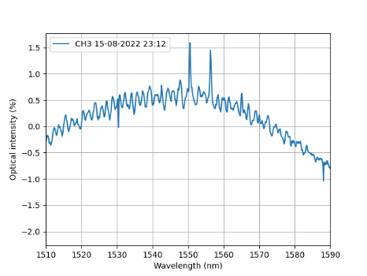

MQXFBP3 status
CO118 RE Z : -115 um/m
CO118 RE T : -297 um/m
4.5 K stable
Only one bi-axial measurements valid at 4.2 K
BUT :
Peaks were still visible for two coils during the steady state conditions at 80K;
Measurements at 80K are valid thanks to the thermal compensation :
Correction factor from BP2 was used to calculate the expected strain at 4.2 K and cross-checked with CO118 RE measurement :
 | Non compensated strain values at 77 K (um/m) | Compensated strain values at 77 K (um/m) | Expected strain values at 4.2 K (um/m)
CO117_RE_T_FBG | -2996 | -271 | -255
CO117_MI_T_FBG | -3088 | -363 | -341
CO117_LE_T_FBG | na | na | na
CO118_RE_T_FBG | -2974 | -249 | -234
CO118_MI_T_FBG | -3106 | -381 | -358
CO118_LE_T_FBG | -2974 | -249 | -234
CO117_RE_Z_FBG | -2922 | -197 | -181
CO117_MI_Z_FBG | -3020 | -295 | -271
CO117_LE_Z_FBG | -2940 | -215 | -198
CO118_RE_Z_FBG | -2860 | -135 | -124
CO118_MI_Z_FBG | -3055 | -330 | -304
CO118_LE_Z_FBG | -2900 | -175 | -161
1
➔CO118 RE T (measured) : -297 um/m
➔CO118 RE Z (measured) : -115 um/m

Slide 11
MQXFBP3 Status
Expected strain calculated by extrapolation from measurements at 80 K

Slide 12
MQXFBP3 Status
Expected strain calculated by extrapolation from measurements at 80 K

Slide 13
MQXFB02 solution

Slide 14
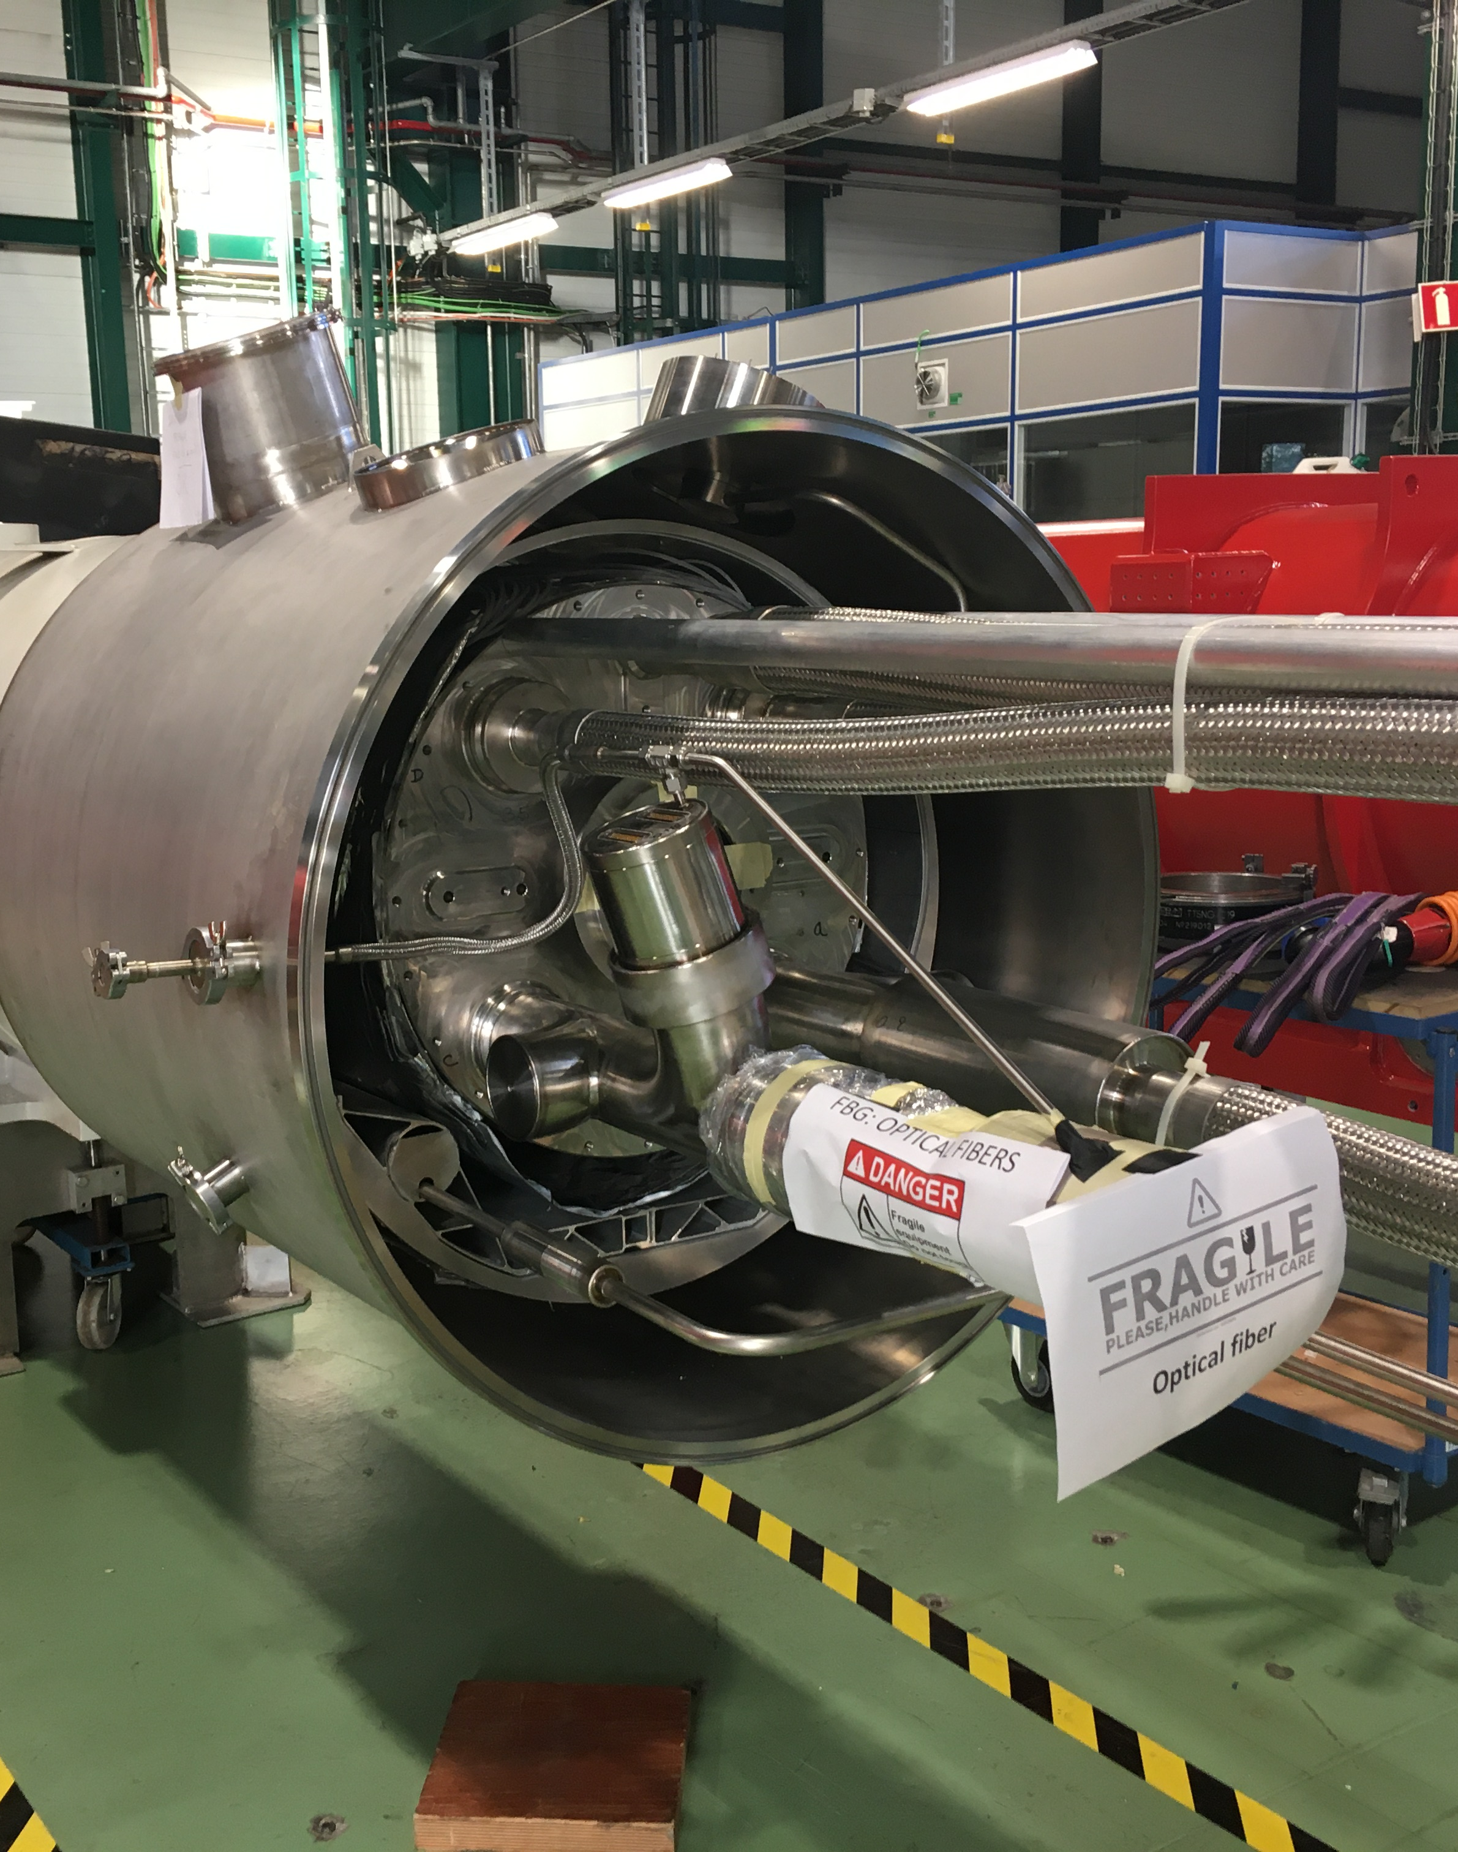
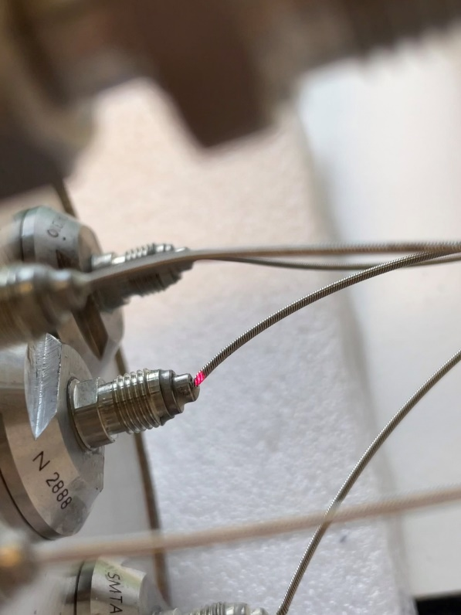
MQXFB02 solution
8 patchcord lines were replaced due to dismounting issues (on BP2)
Welded Flange successfully used in MQXFBP2

Slide 15
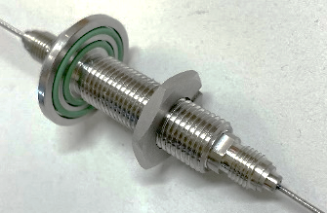
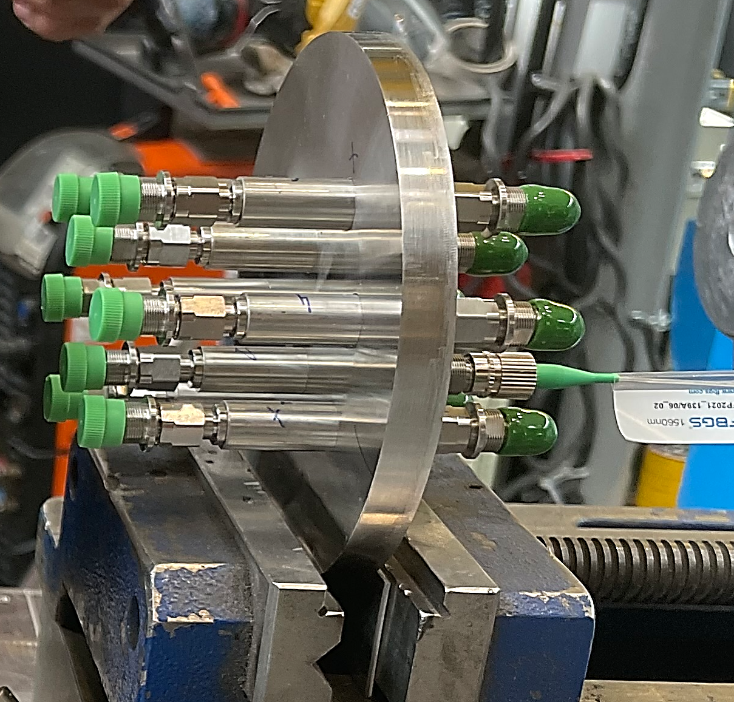
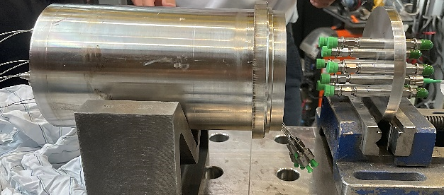
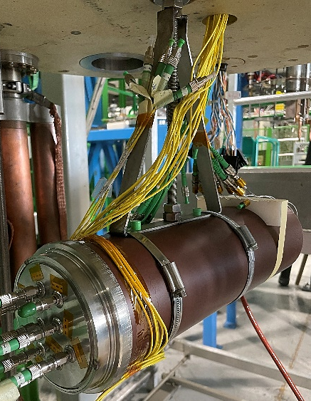
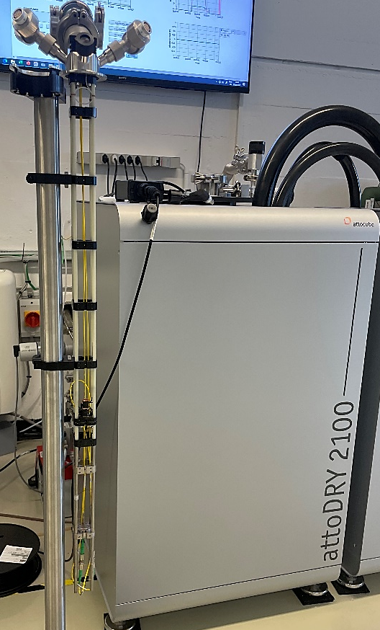
Testing plan prior to magnet installation
Patchcord lines testing down to 1.6 K
Welded flange
testing at RT
Full box testing after welding at RT
Full box testing at SM18 down to 4.2 K

Slide 16
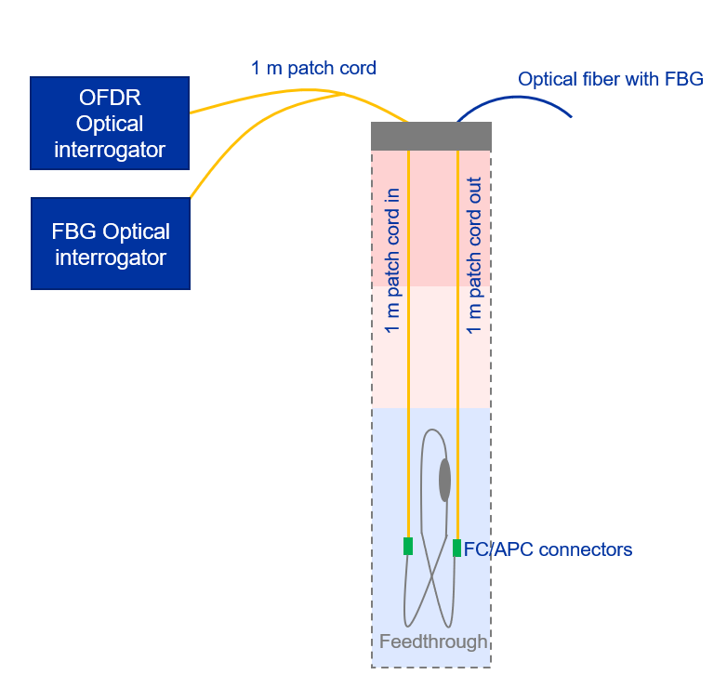
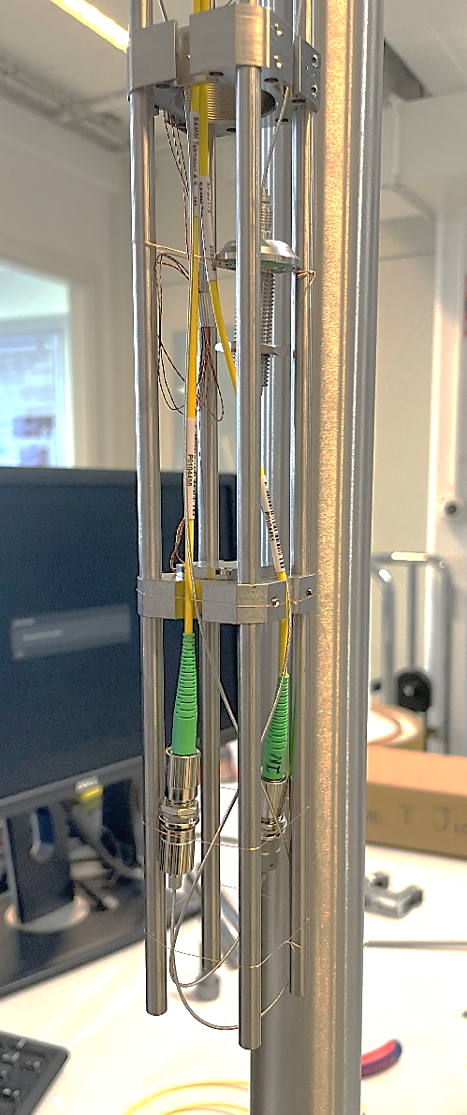
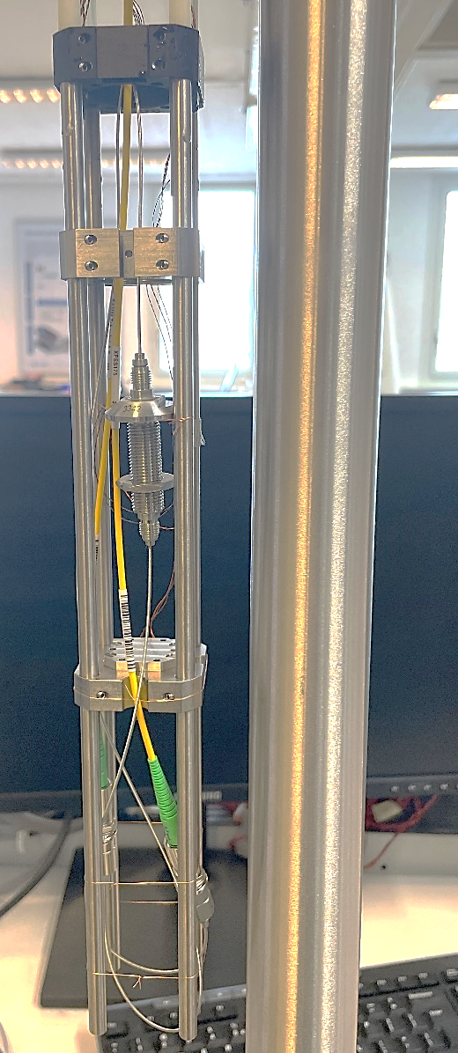
Patchcord lines testing
Distributed measurement with Rayleigh Backscattering sensing;
FBG connected at the out-patch cord: measurement with Bragg-meter.

Slide 17
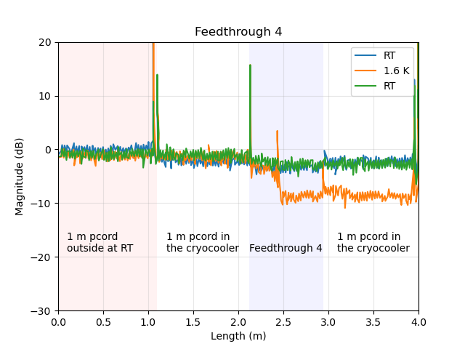
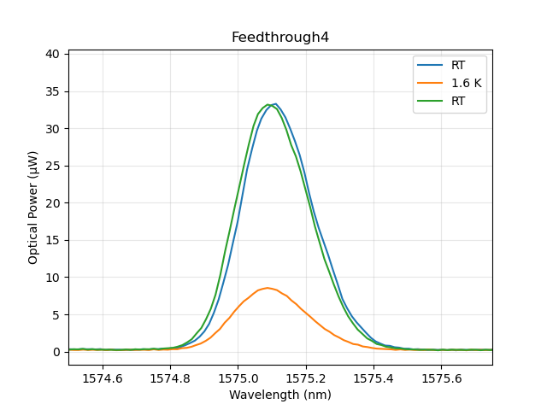





Patchcord lines testing
Feedthrough 4
Rayleigh backscattering distributed sensing
Fiber Brag grating measurement
$$P_{in}$$
$$A_{in}$$
$$A_{out}$$
$$P_{out}$$
Loss = -5.4 dB
Loss = -5.9 dB

Slide 18
Patchcord lines testing
patchcord line number | Measured loss at 1.6 K with RBS (dB) | Measured loss at 1.6 K with FBG (dB)
1 | Not tested | Not tested
2 | -3.1 | -3.0
3 | -4.4 | -4.9
4 | -5.4 | -5.9
5 | -4.6 | -4.5
6 | -8.7 | -9.8
7 | Not tested | Not tested
8 | Not tested | Not tested
Same loss observed between both measurements RBS and FBG interrogator.

Slide 19
Welded flange testing at RT
OFDR Optical interrogator
1 m patch cord
1 m patch cord
Optical fiber with FBG
FBG Optical interrogator
Measurements in two steps (Welded Flange and Welded Flange + Patchcord lines);
Distributed measurement with Rayleigh Backscattering sensing;
FBG connected at the out patch-cord: measurement with Bragg-meter.

Slide 20
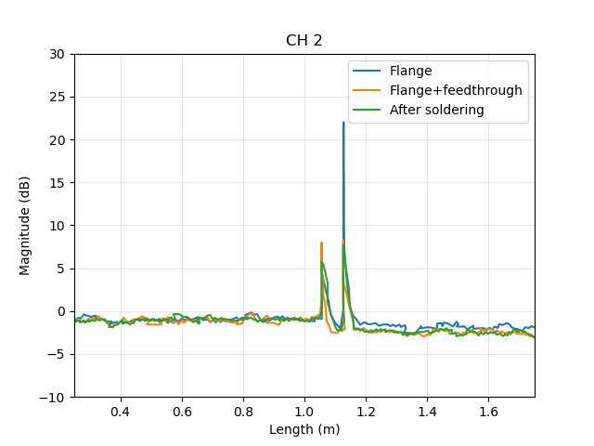
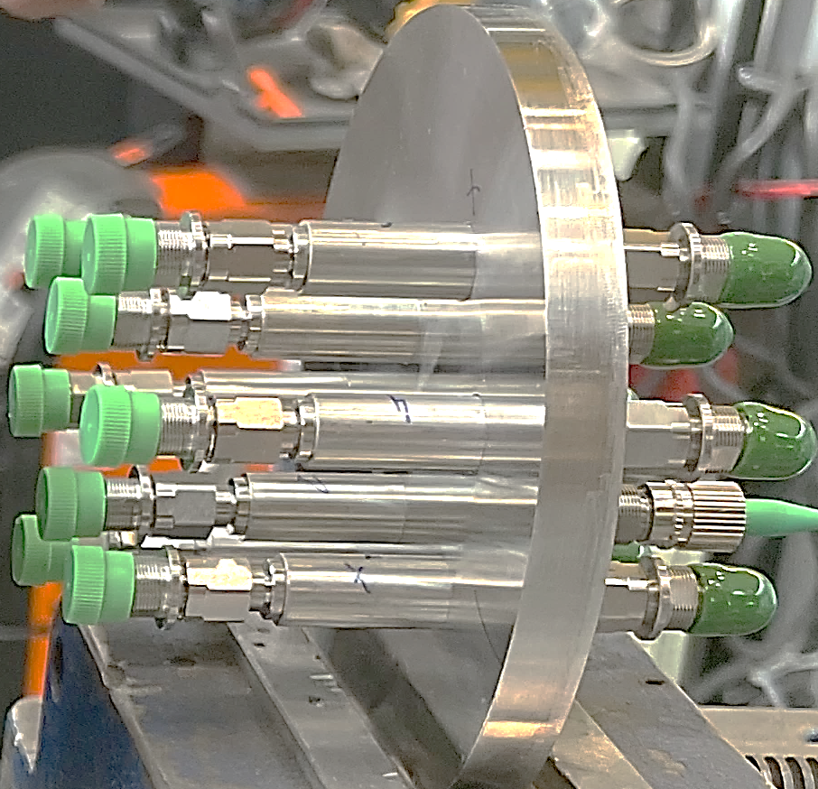
Welded flange testing at RT
Flange channel 2
Rayleigh backscattering distributed sensing
Study on the optical loss due to both connectors of the flange.
Welded Flange channel | Loss Welded Flange (dB) | Loss Welded Flange + patchcord lines (dB)
1 | -1.5 | -1.6
2 | -0.5 | -1.5
3 | -1.4 | -1.4
4 | -0.2 | -1.4
5 | -0.4 | -1.7
6 | Broken | Broken
7 | -1.2 | -1.0
8 | -1.2 | -1.2
Moving average over 5 gage pitches (5*0.65=3.25 mm).
$$P_{in}$$
$$P_{out}$$

Slide 21

Full box testing down to 4.5 K
Channel | Optical losses in dB at 4.2 K
1 | - 5
2 | - 9
3 | - 11
4 | - 9.5
5 | - 8
6 | -27
7 | - 8
8 | - 6

Slide 22
Summary of the testing plan
Patchcord lines testing down to 1.6 K
Welded flange
testing at RT
Full box testing after welding at RT
Full box testing at SM18 down to 4.2 K

Slide 23
Summary of the testing plan
Patchcord lines testing down to 1.6 K
Welded flange
testing at RT
Full box testing after 3 points welding at RT
Full box testing at SM18 down to 4.2 K
Optical losses in dB at 1.6 K | Optical losses in dB at RT | Optical losses in dB at RT | Optical losses in dB at 4.2 K
Not tested | -1.5 | -1.6 | - 5
-3.1 | -0.5 | -1.5 | - 9
-4.4 | -1.4 | -1.4 | - 11
-5.4 | -0.2 | -1.4 | - 9.5
-4.6 | -0.4 | -1.7 | - 8
-8.7 | Broken | Broken | -27
Not tested | -1.2 | -1.0 | - 8
Not tested | -1.2 | -1.2 | - 6
Better performance at cold comparing to MQXFBP2 ;
Green light for a complete welding and installation !

Slide 24
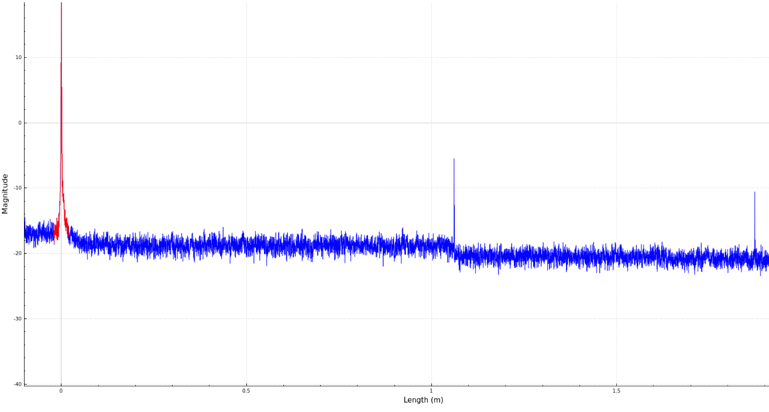

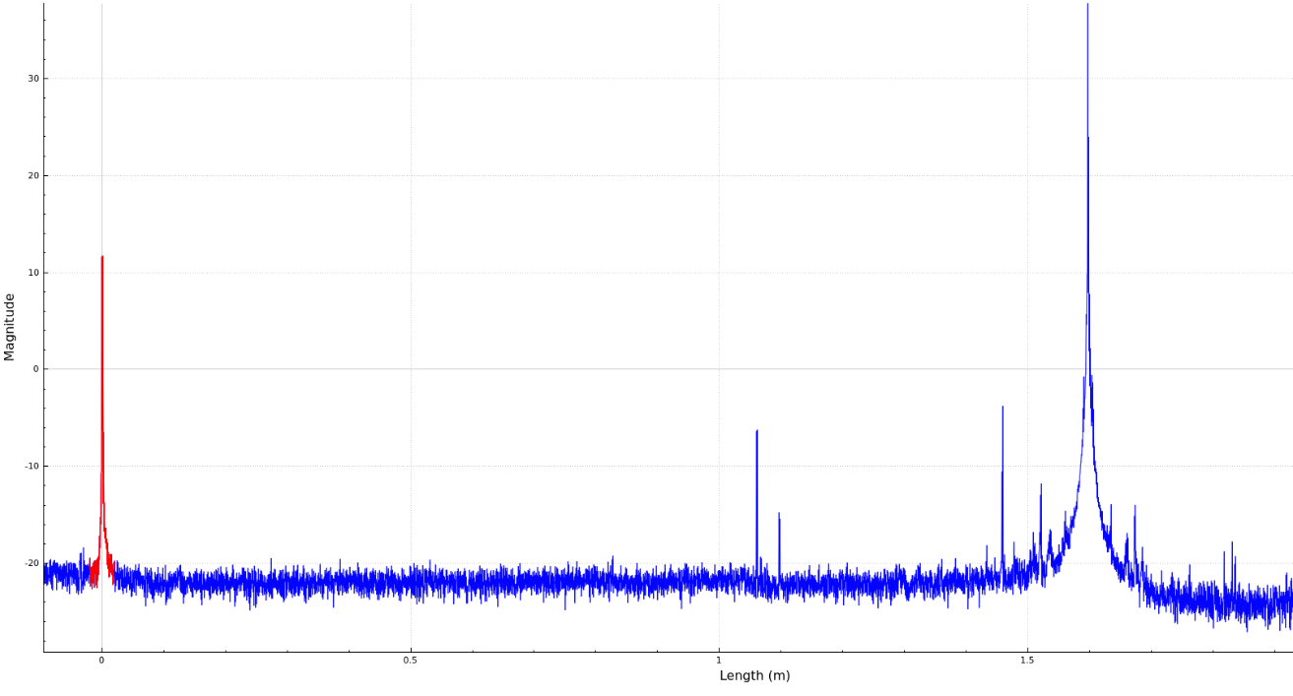
After welding…
Only two channels operational after complete welding of the box ;
Diagnostic with OFDR to confirm the position ;
Probably an issue related to the handling and not to the welding process ;
Solution implemented :
Patchcord lines from BP3 were extracted and tested at RT;
Spare patchcord lines were tested at RT;
The box from B02 was dismounted to replace the 6 not working patchcord lines with new one ;
A new batch of patchcord lines was ordered (delivery in December)

Slide 25
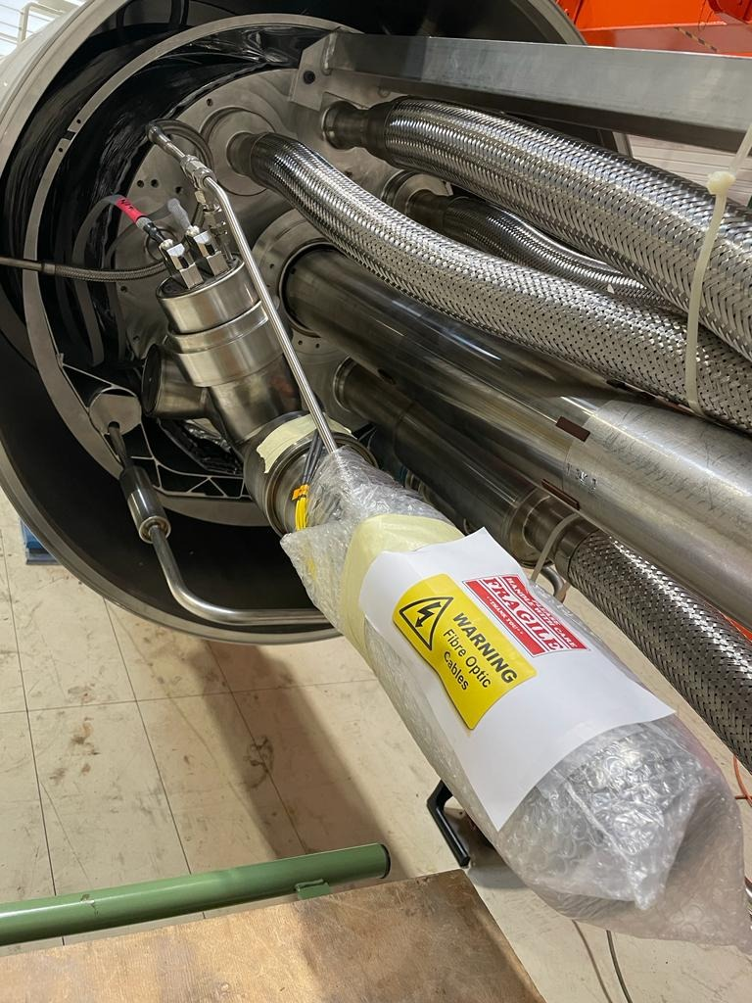

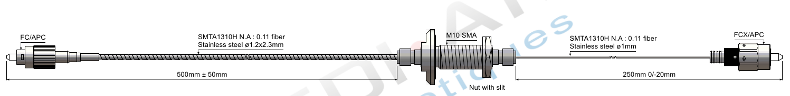
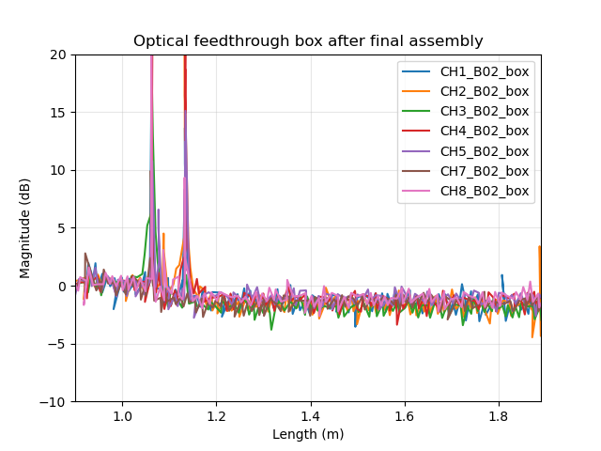
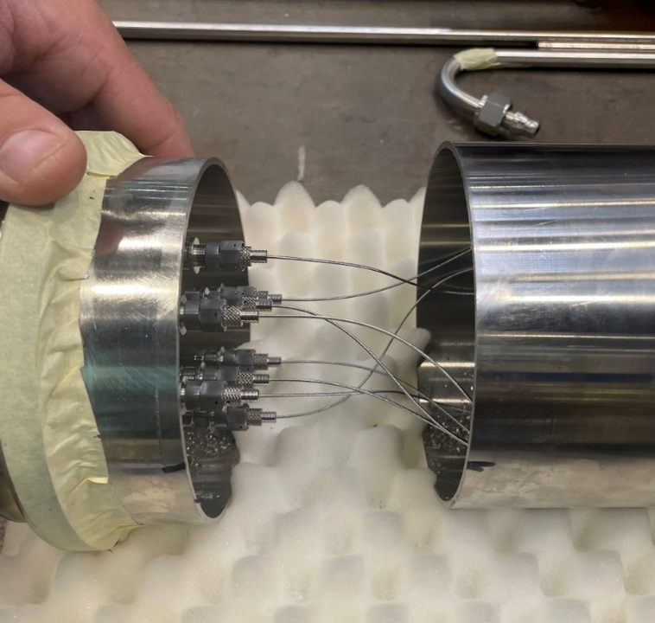
Today at SM18…
OFDR traces.

Slide 26
Our expectations at cold…
Optical lines | Optical losses Optical Feedthrough box Today @RT | Total Optical losses with FBG’s Today @RT | Optical losses Optical Feedthrough box (1) @4.2 K | Expected Total Optical losses with FBG’s (2) @1.9 K
Coil 121 In | - 6.5 dB | -12.5 dB | Not measured | -27.5 dB
Coil 121 Out | -1.3 dB | -3.1 dB | ≈ -8 dB | -18.2 dB
Coil 123 In | -1.8 dB | -2.7 dB | ≈ -5.5 dB | -17.7 dB
Coil 123 Out | -1.2 dB | -3.2 dB | ≈ -7.5 dB | -18.3 dB
Coil 124 In | -2.1 dB | -2.9 dB | ≈ -10.5 dB | -17.9 dB
Coil 124 Out | -1.6 dB | -3.5 dB | ≈ -9.5 dB | -18.5 dB
Coil 125 In | -0.6 dB | -3.2 dB | ≈ -8 dB | -18.2 dB
Coil 125 Out | -1.9 dB | -3.5 dB | ≈ -9 dB | -18.5 dB
: Optical losses measured with old pigtail lines during tests at SM18
: Total optical losses with FBG’s measured today @RT – 15 dB (MQXFBP2 experience)

Slide 27
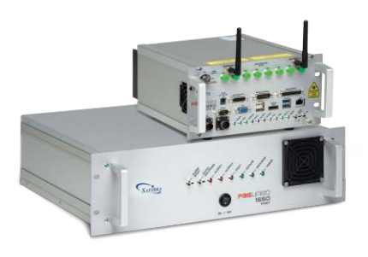
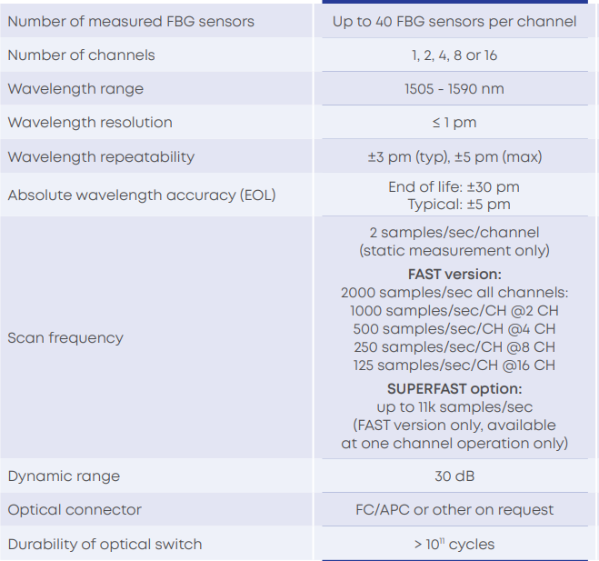
Our expectations at cold…
Optical lines | Optical losses Optical Feedthrough box Today @RT | Total Optical losses with FBG’s Today @RT | Optical losses Optical Feedthrough box (1) @4.2 K | Expected Total Optical losses with FBG’s (2) @1.9 K
Coil 121 In | - 6.5 dB | -12.5 dB | Not measured | -27.5 dB
Coil 121 Out | -1.3 dB | -3.1 dB | ≈ -8 dB | -18.2 dB
Coil 123 In | -1.8 dB | -2.7 dB | ≈ -5.5 dB | -17.7 dB
Coil 123 Out | -1.2 dB | -3.2 dB | ≈ -7.5 dB | -18.3 dB
Coil 124 In | -2.1 dB | -2.9 dB | ≈ -10.5 dB | -17.9 dB
Coil 124 Out | -1.6 dB | -3.5 dB | ≈ -9.5 dB | -18.5 dB
Coil 125 In | -0.6 dB | -3.2 dB | ≈ -8 dB | -18.2 dB
Coil 125 Out | -1.9 dB | -3.5 dB | ≈ -9 dB | -18.5 dB
: Optical losses measured with old pigtail line during tests at SM18
: Total optical losses with FBG’s measured today @RT – 15 dB (MQXFBP2 experience)

Slide 28
Conclusions and Next steps
MQXFBP3 :
Gradual optical losses during cool down were observed (only 2 FBGs remained operational at 4.5 K);
Thanks to RBS electronic a deepest study was performed to understand the exact location of the optical losses. The issue was confirmed in the box at the connection between the flange and the feedthrough line : this issue is probably explained by the tightenning procedure of the connectors during mounting operation;
MQXFB02 :
A full validation test campaign was performed in short delay in order to assess the optical losses of every sub-components of the OFB down to 1.8 K;
The complete OFB assembly (only tack welded) was also tested down to 4.2 K at SM18 with optical losses slightly better that the MQXFBP2 OFB ;
An issue after complete welding was observed– Same issue was observed after dismounting operation of BP2 (handling operation) ;
The MQXFBP2 OFB was fully repaired and tested at RT;
Expected optical losses at cold should be fine for a successful measurement.
Additional developments :

Slide 29
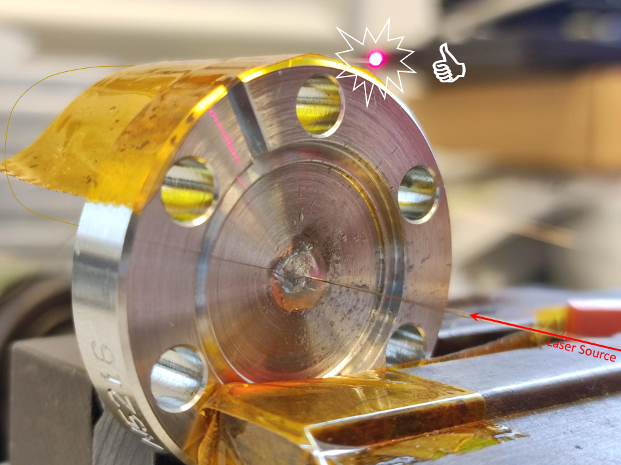
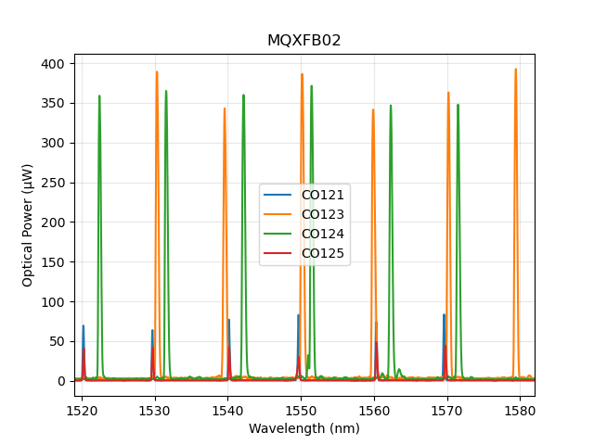


Two coils of MQXFB02 are equipped with high reflectivity FBG’s to improve the optical power budget at cold.
Copper coated fiber brazed (250 um) on a copper insert, brazed on a SS flange.
Already tested at${ 10}^{−12}$ mbars

