Slide 1
Coil bumpers
Susana Izquierdo Bermudez
02/11/2022

Slide 2
Introduction
Motivation: increase cold bore insulation from 0.2 mm to 0.5 mm to improve electrical and mechanical robustness
  Based on the updated thermal computations, we have enough margin reduce the annular space from 1.5 mm to 1.2 mm
  In the cold masses we disassembled, after the extraction of the cold bore the electrical insulation was damaged (not clear if it is the insertion or extraction, defects are in the first 2.3 m from the connection side (tube is inserted from the non-connection side EDMS 2727201)
Required actions on magnet side: decrease the height of the coil bumpers
Potential worries:
  Are the bumpers getting too thin, so brittle with higher risk to damage during the insertion of the cold bore?
  What is the sagitta of the beam screen when inserted in the coil? Are we getting close to the pole?
  Something else to worry about?

Slide 3
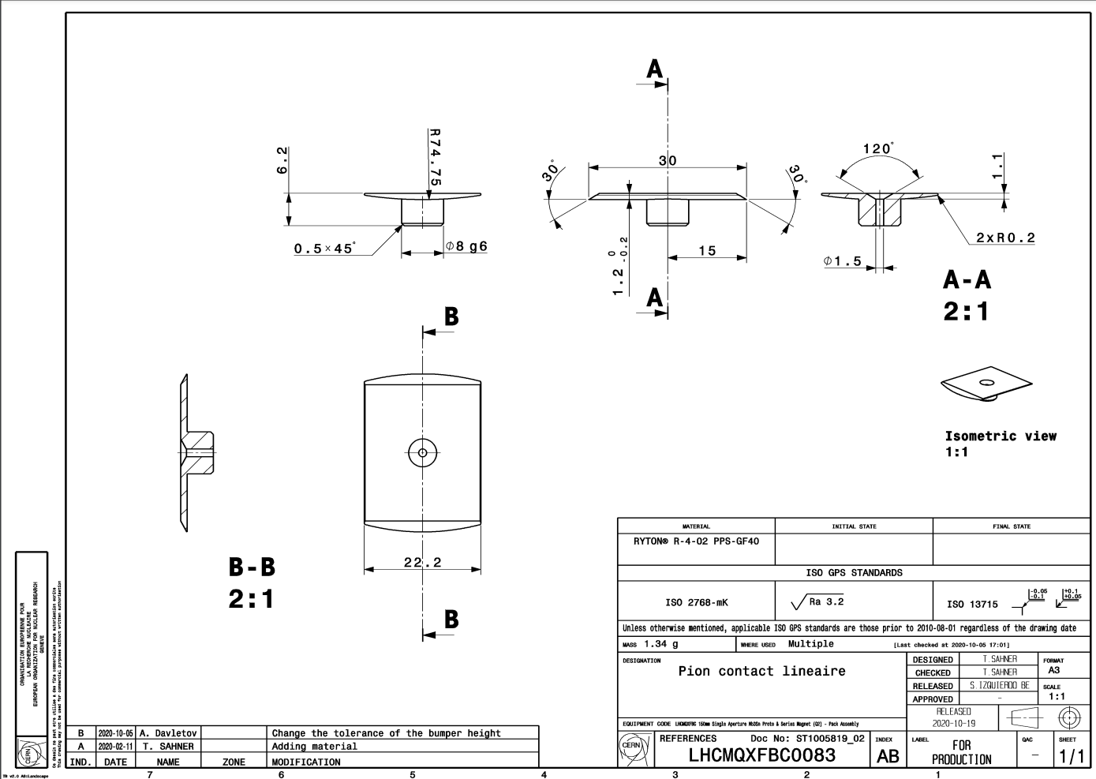
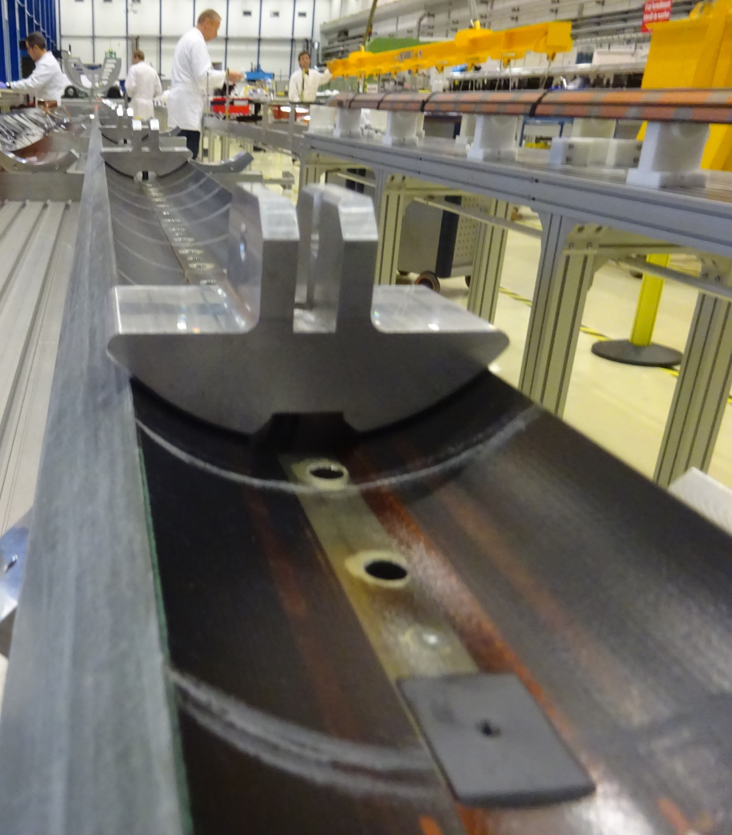
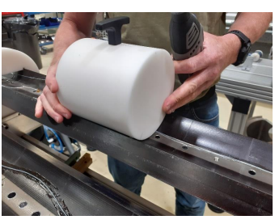
Coil bumpers
The bumper height is 1.2 +0/-0.2 mm
  Originally was 1.2 +-0.1mm but we changed it to be suer we were always in the safe side during the insertion
Once they are glued, we check with a go/no-go gauge that the relative distance pole to top of the bumper is not larger than 1.3 mm
So far, the cold bore insertion in all the magnets was very smooth

Slide 4
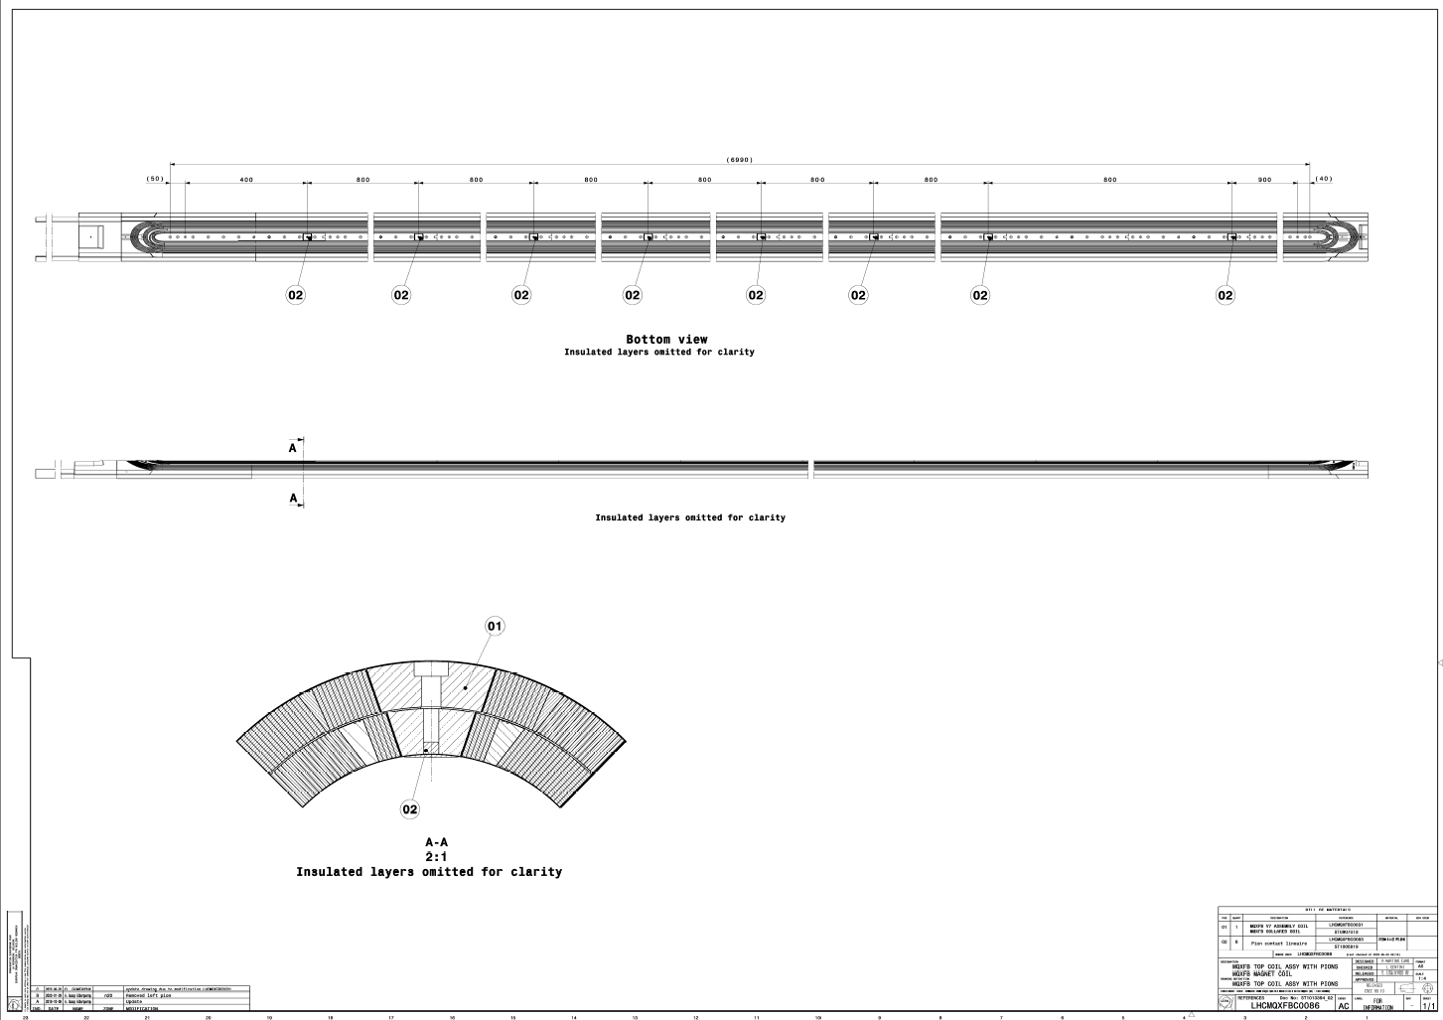
Coil bumpers in the coil

Slide 5

Coil bumpers in the coil

Slide 6
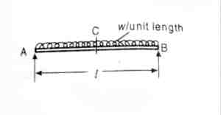
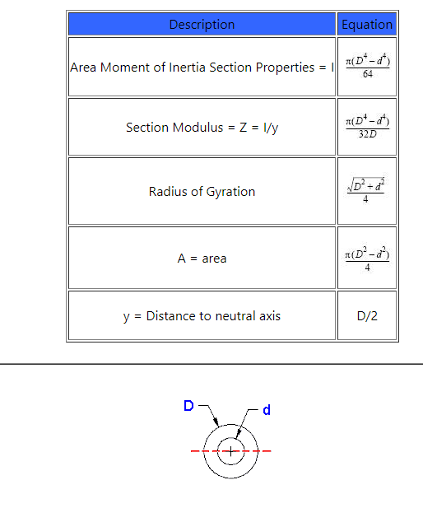

Sagitta
E = Young’s Modulus,
I = Moment of Inertia
W = weight per unit length
Yc = displacement in the middle
D | 144.7 | mm | 0.1447 | m
d | 136.7 | mm | 0.1367 | m
E | 193 | GPa | 1.93E+11 | Pa
I | 4378779.1 | mm^4 | 4.37878E-06 | m^4
W | 50 | kg/m | 50 | kg/m
l | 0.8 | m | 0.8 | m
disp middle | 0.0003944 | mm | 3.94429E-07 | m

Slide 7
