Slide 1




Isotopic Composition of the Light Cosmic Rays with HELIX
High Energy Light Isotope eXperiment
Keith McBride
11/12/2022
PIKIMO 2022 - Cincinnati

Slide 2
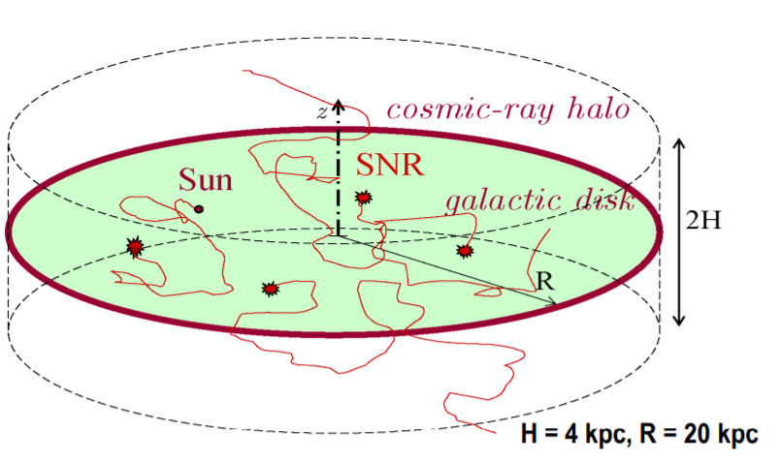
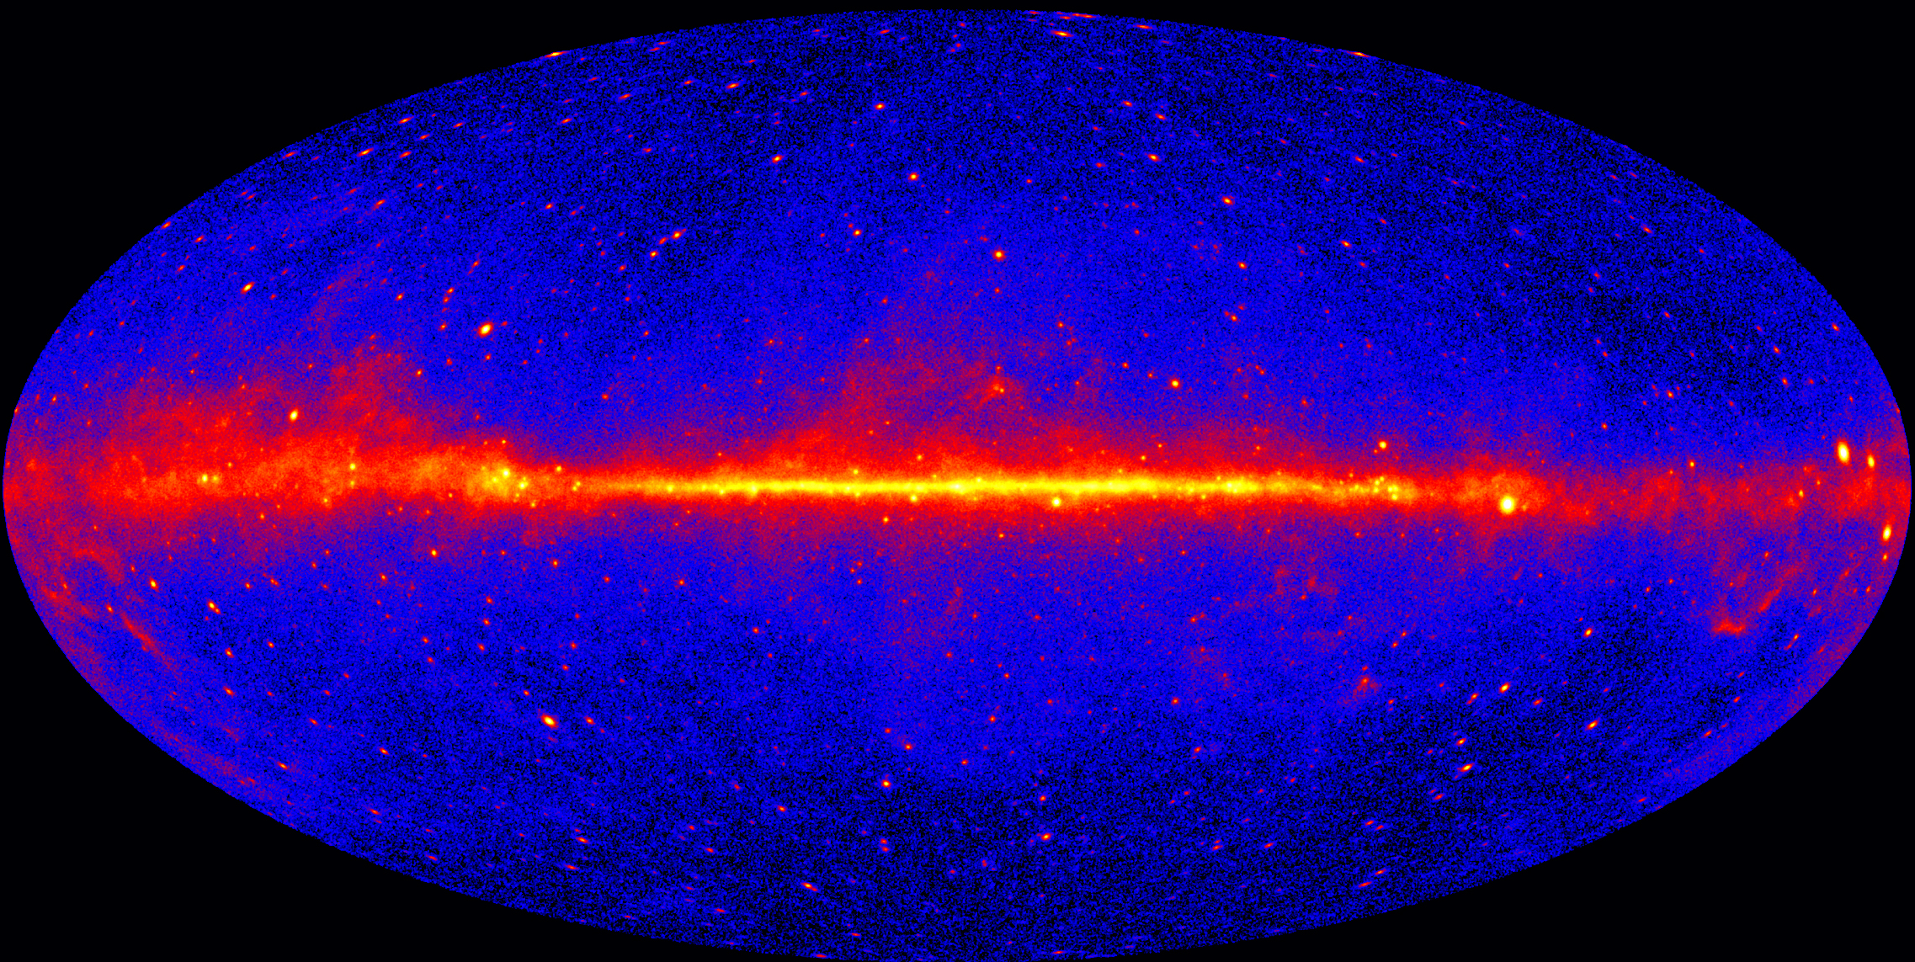
Introduction
Background on Galactic Cosmic Ray Propagation
The Galaxy in gamma rays
Disk
[1] Fermi $γ$-rays
>1 GeV
[2] Ptuskin slides 2013 Cargese
Mostly protons, but many kinds of nuclei
Diffusion-halo model, with some parameters not so well understood
Cosmic rays produce gamma rays and other cosmic rays when colliding with gas, the Interstellar Medium
How far do cosmic rays extend into the halo?

Slide 3
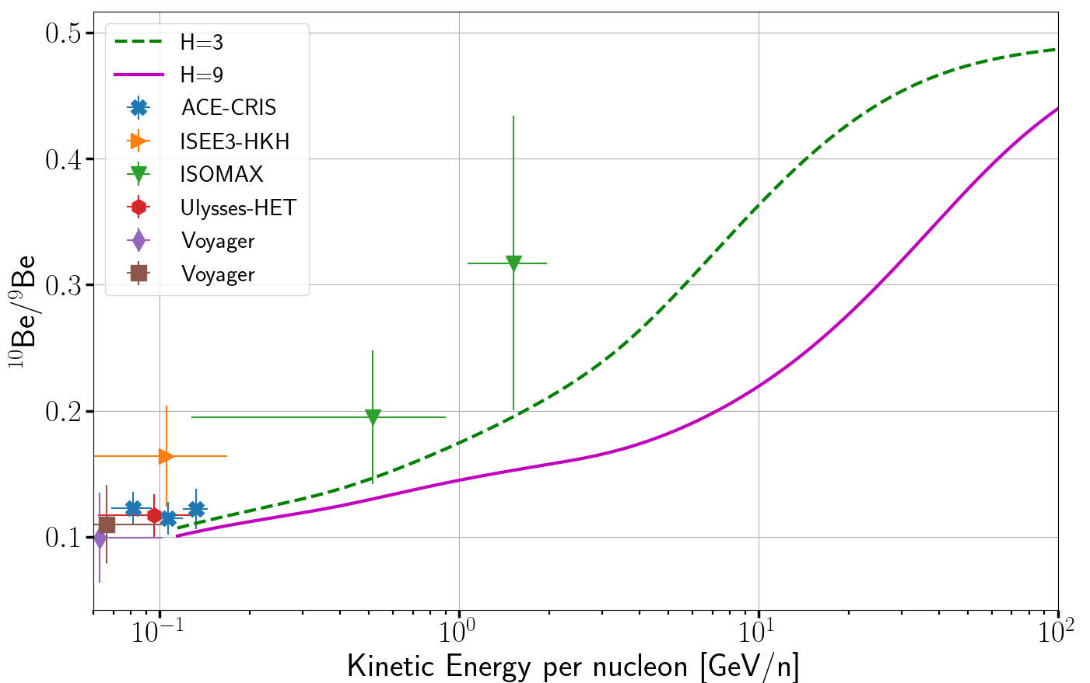
Beryllium Isotopes in GCRs
HELIX Science
¹⁰Be has half-life of 1.4 Myrs [3]
GALPROP sims with varying halo size [4]
Beryllium nuclei are secondary
  products of interactions during propagation
⁹Be is stable, ¹⁰Be is long-lived but unstable
Ratio is sensitive to time of GCR propagation
  Larger cosmic ray halo, H, longer timescale for diffusion into that halo
Until recently, very few intermediately high energy measurements…
HELIX is optimized for this kind of light nuclei measurement!
Data retrieved with [5]

Slide 4

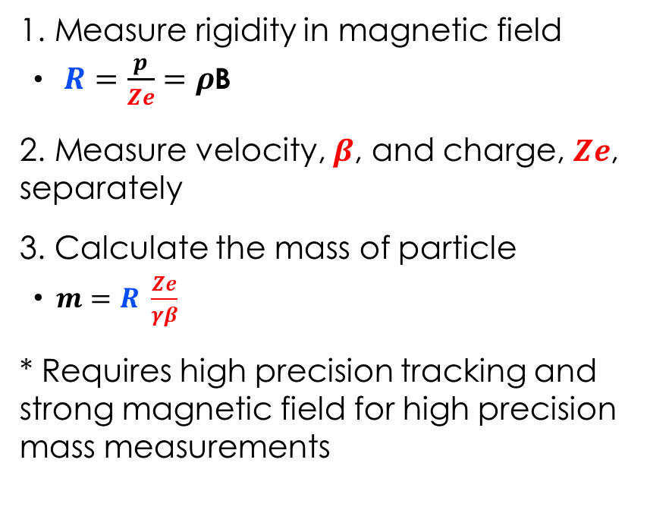
Magnet Spectrometers
HELIX Science
Cosmic ray
Detector
1. Measure rigidity in magnetic field
  $R=\frac{p}{Ze}=ρ$B
2. Measure velocity, $β$, and charge, $Ze$, separately
3. Calculate the mass of particle
  $m=R \frac{Ze}{γβ}$
* Requires high precision tracking and strong magnetic field for high precision mass measurements
$\vec{B}$
ρ
HELIX is this capable experiment
Tracking hit positions

Slide 5
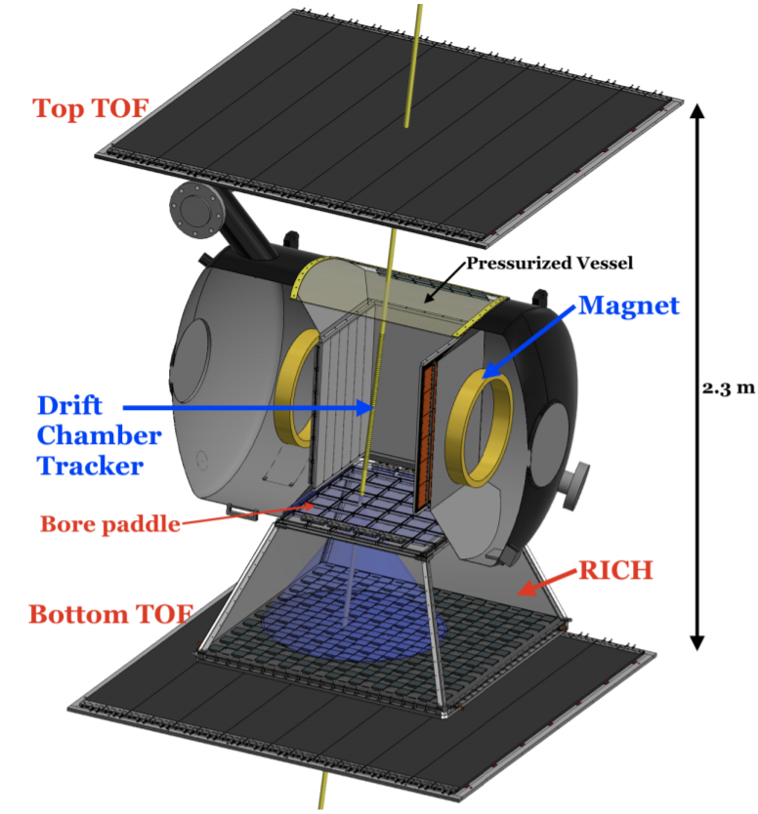
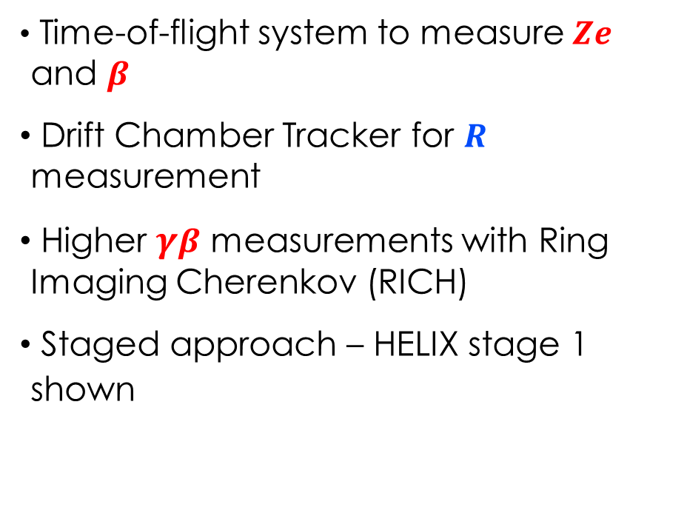
Measuring Mass with HELIX
HELIX Instrument
[6] Park, N. ICRC 2021
Time-of-flight system to measure $Ze$ and $β$
Drift Chamber Tracker for $R$ measurement
Higher $γβ$ measurements with Ring Imaging Cherenkov (RICH)
Staged approach – HELIX stage 1 shown

Slide 6
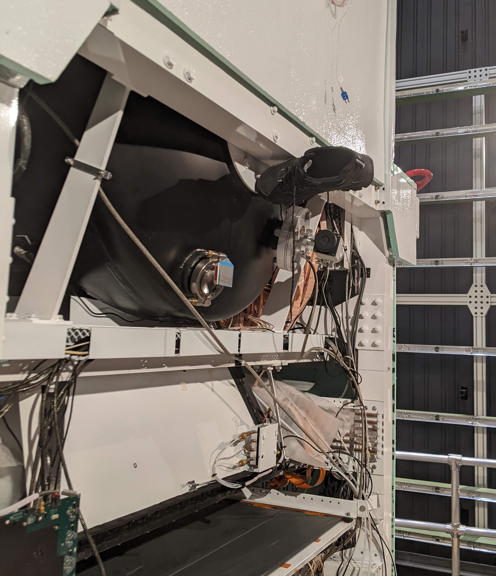
Superconducting magnet
HELIX Instrument
Thermal Vacuum Test, Jan 2022 at NASA Armstrong Test Facility
Good for levitating steel-toe boots and deflecting relativistic particles
  Binary measurement of magnet ON/OFF
Cryogen Operation, 4K
  1 Tesla field
Flown previously on successful HEAT balloon experiments [7]
  Proven flight heritage
Up to 7 days of hold time

Slide 7
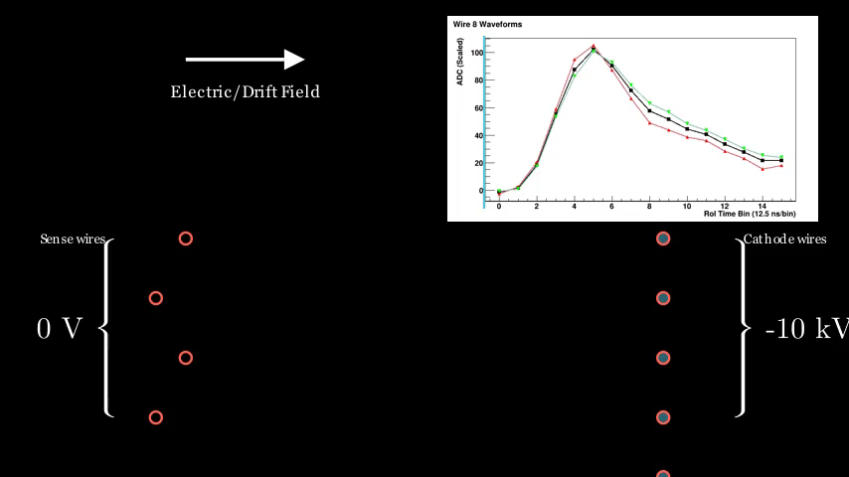

Drift Chamber Tracker
HELIX Instrument
  Measures the Rigidity, $R$
Gas-filled (CO₂ + Ar) tracker
  Charged nuclei leaves ionization trail
Detect ionization with wires
  Strong electric drift field, 1.3 kV/cm
  Induced current pulses map to distances
Staggering of sense wires to resolve Left/Right ambiguity

Slide 8
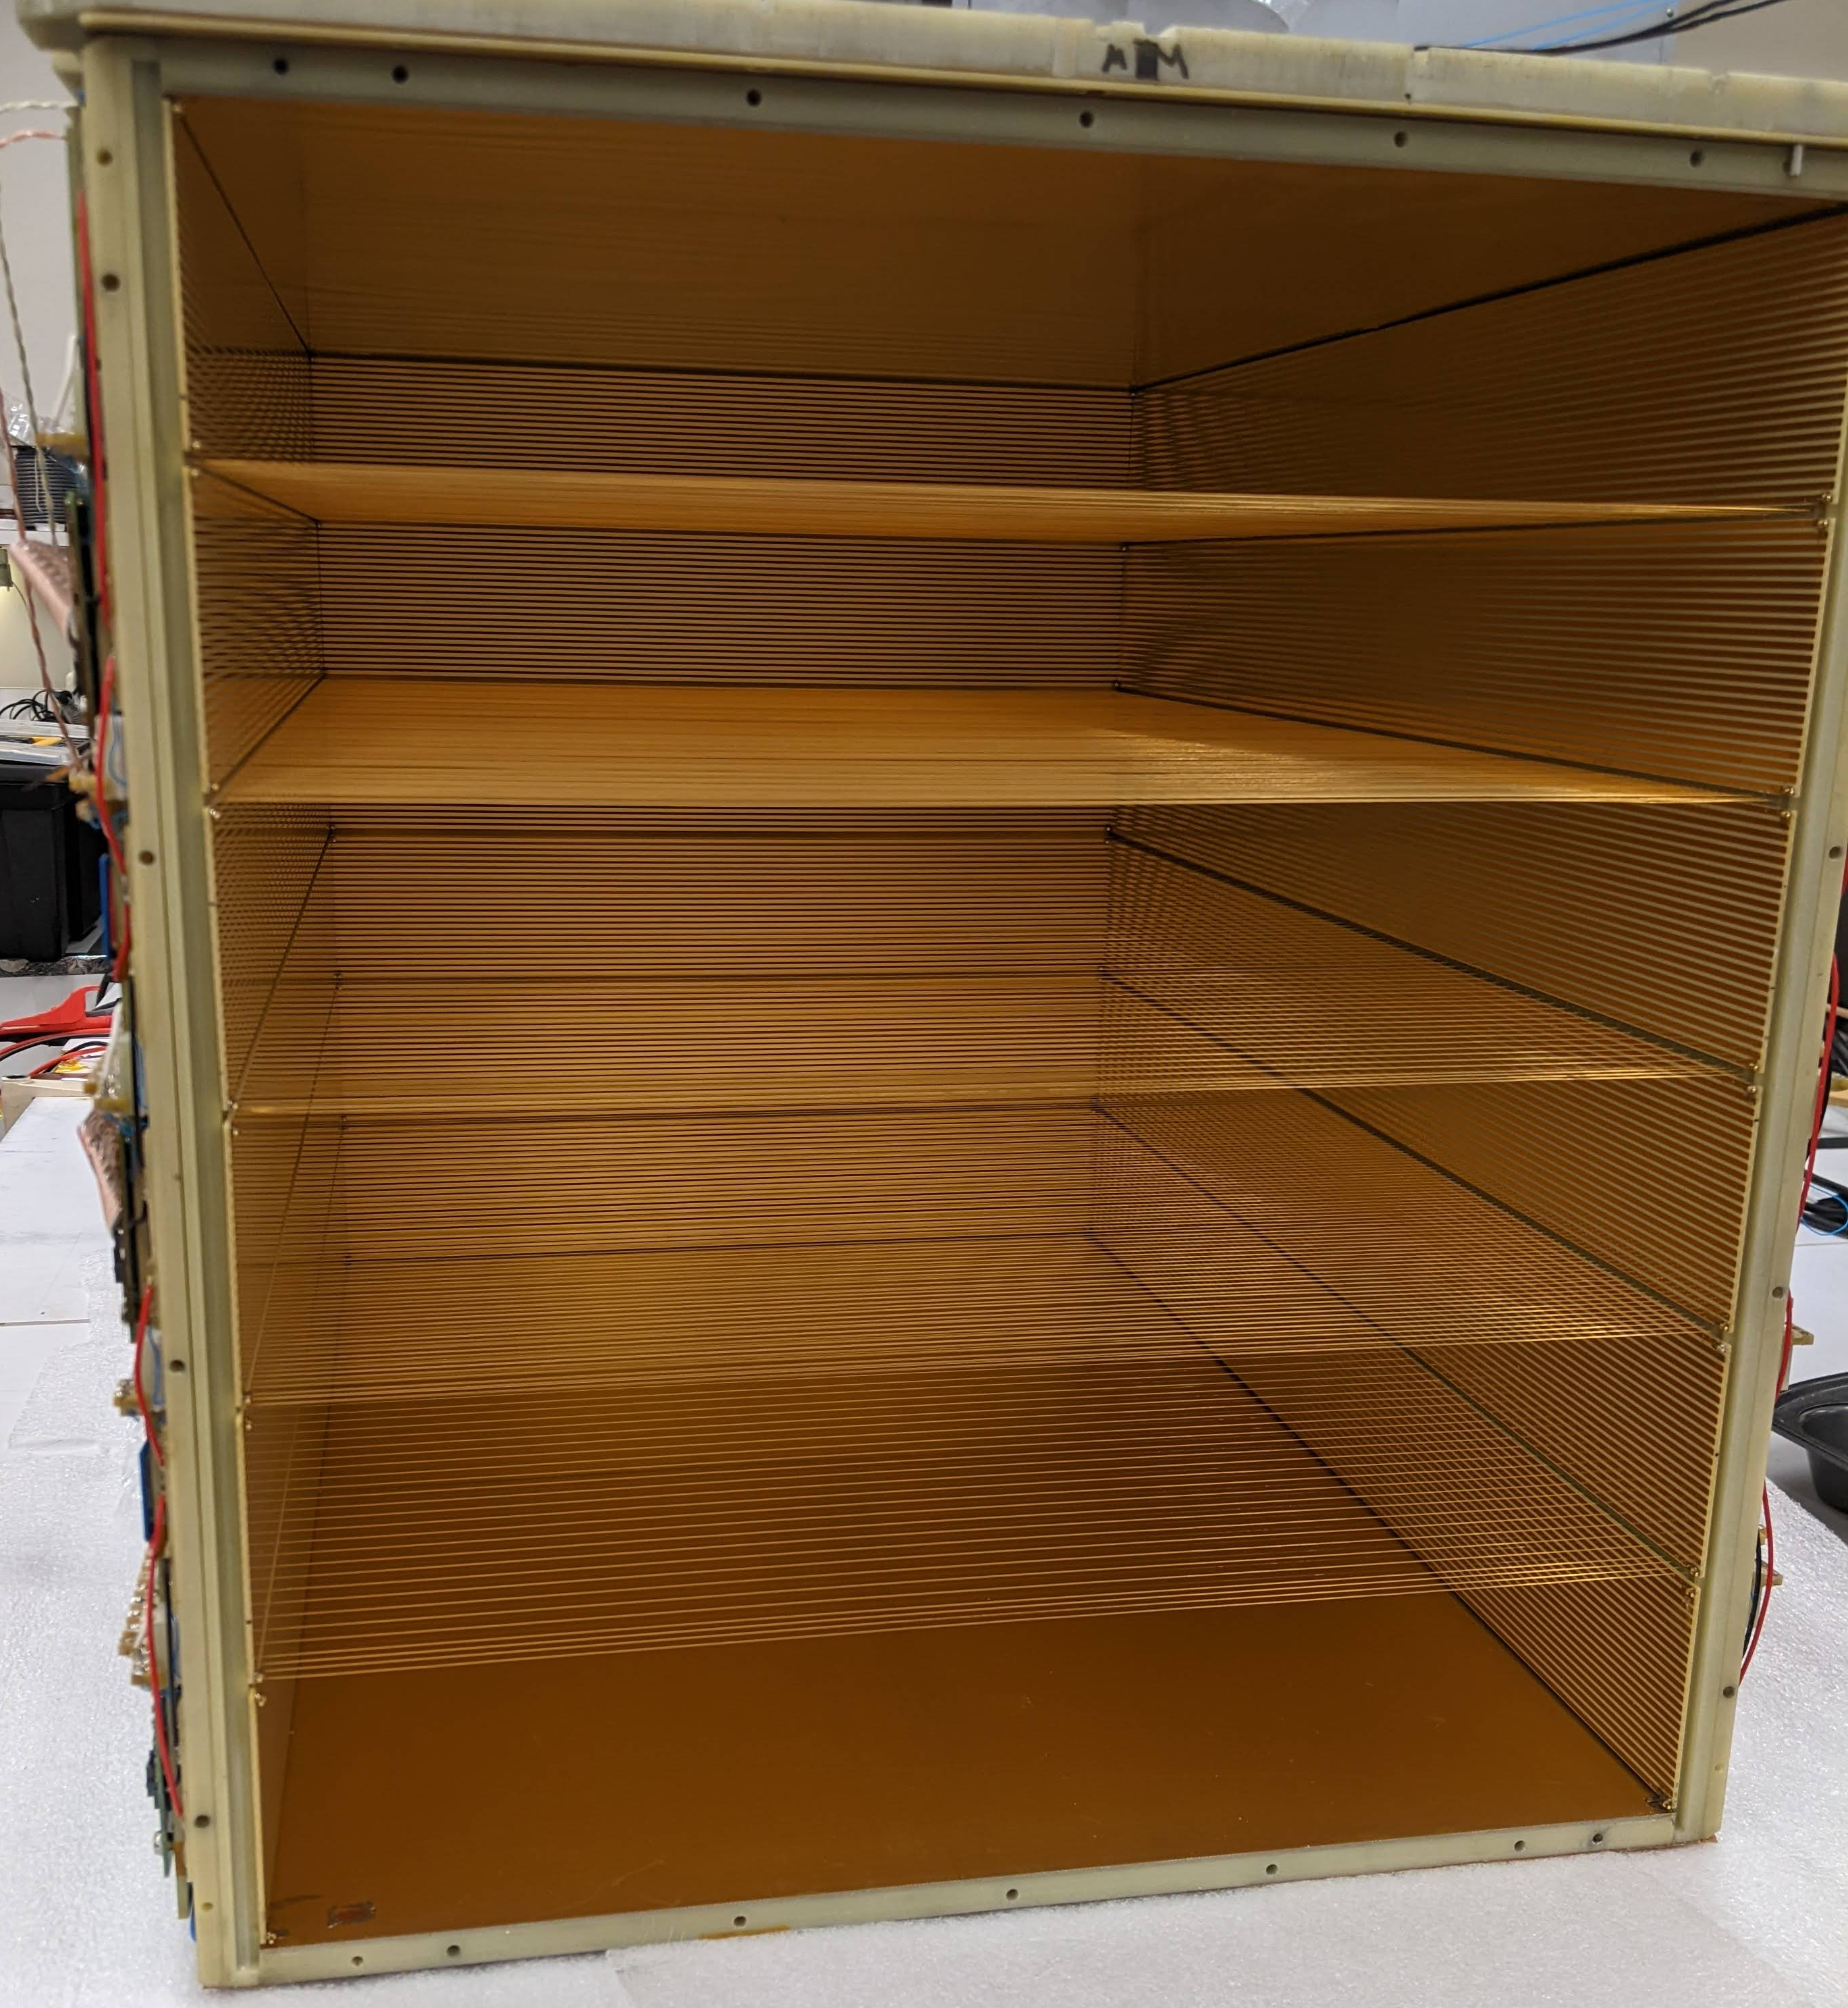
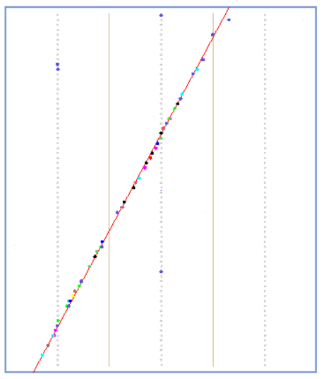


Drift Chamber Tracker
HELIX Instrument
  Measures the Rigidity, $R$
Inside the DCT
Detect ionization with sense wires
  3 separate sense wire planes
  216 sense wires total
Additional non-bending plane measurement along sense wire
  Readout per end of sense wires
Density and electric field contribute to resolution
  High voltage control system
  On track for better than 70μm resolution
DCT Bending Plane Display
58cm
$\vec{B}$
Example muon straight-through
$\vec{E_{d}}$

Slide 9
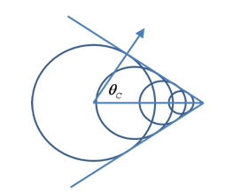
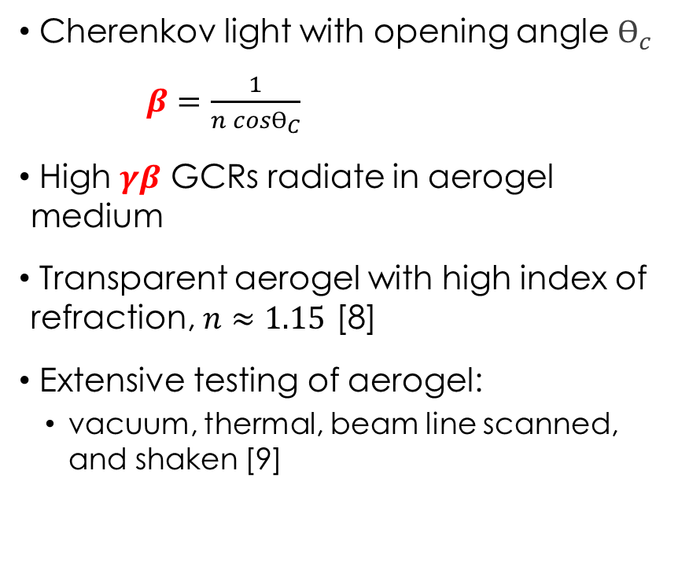

Ring-Imaging Cherenkov System
HELIX Instrument
  Measures the velocity, $β$
Light/wavefront
Charged particle
(cosmic ray)
Cherenkov light with opening angle $ϴ_{c}$
$β=\frac{1}{n cosϴ_{C}}$
High $γβ$ GCRs radiate in aerogel medium
Transparent aerogel with high index of refraction, $n≈1.15$ [8]
Extensive testing of aerogel:
  vacuum, thermal, beam line scanned, and shaken [9]
aerogel array
[10]
Silicon PhotoMultiplier (SiPM)
SiPM array

Slide 10
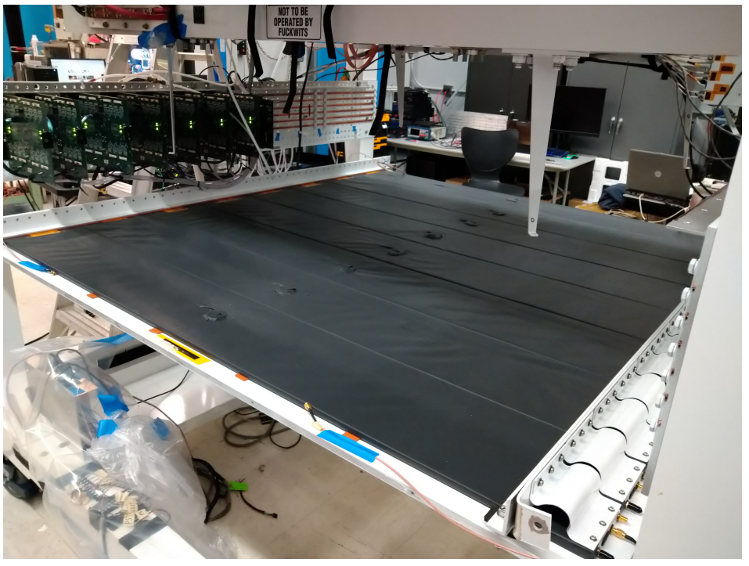
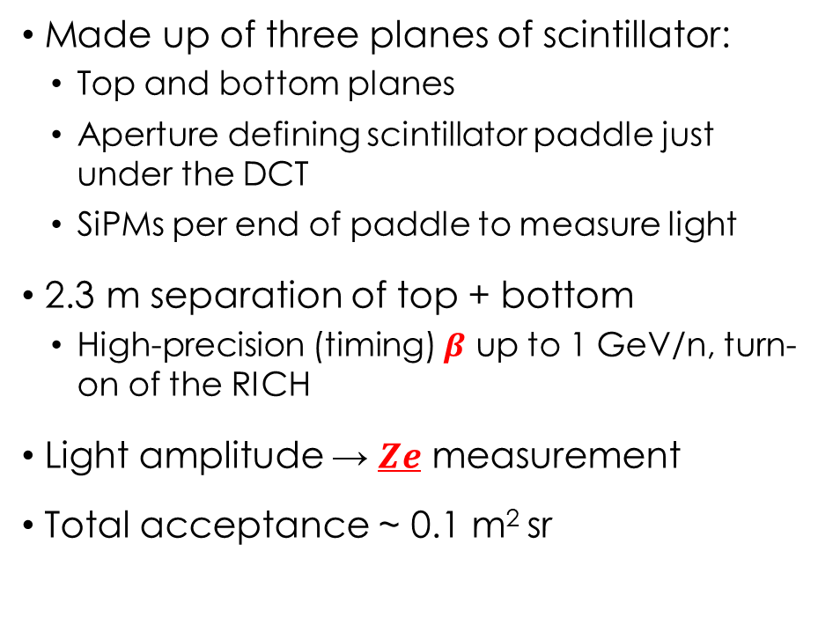
Time-Of-Flight
HELIX Instrument
  Measures the velocity, $β$, and charge, $Ze$
Bottom TOF installed on payload
Made up of three planes of scintillator:
  Top and bottom planes
  Aperture defining scintillator paddle just under the DCT
  SiPMs per end of paddle to measure light
2.3 m separation of top + bottom
  High-precision (timing) $β$ up to 1 GeV/n, turn-on of the RICH
Light amplitude → $Ze$ measurement
Total acceptance ~ 0.1 m² sr
1.6m

Slide 11
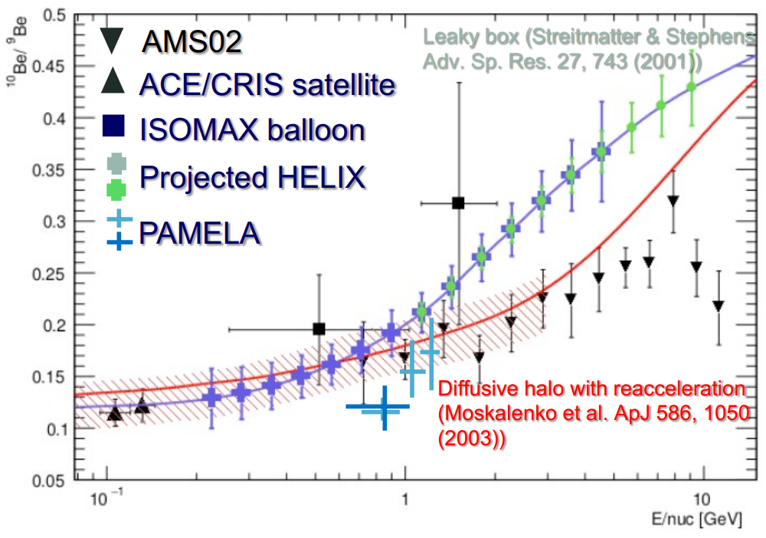
Expected HELIX performance
Conclusions
Targeting 2.5% mass resolution
HELIX will resolve Be isotopes:
  Stage 1: Up to E ~ 4 GeV/n [blue]
  Stage 2: Extends to 10 GeV/n [green]
Chemical and isotopic composition of several light nuclei
HELIX will significantly improve our understanding of GCR propagation
AMS data preliminary

Slide 12
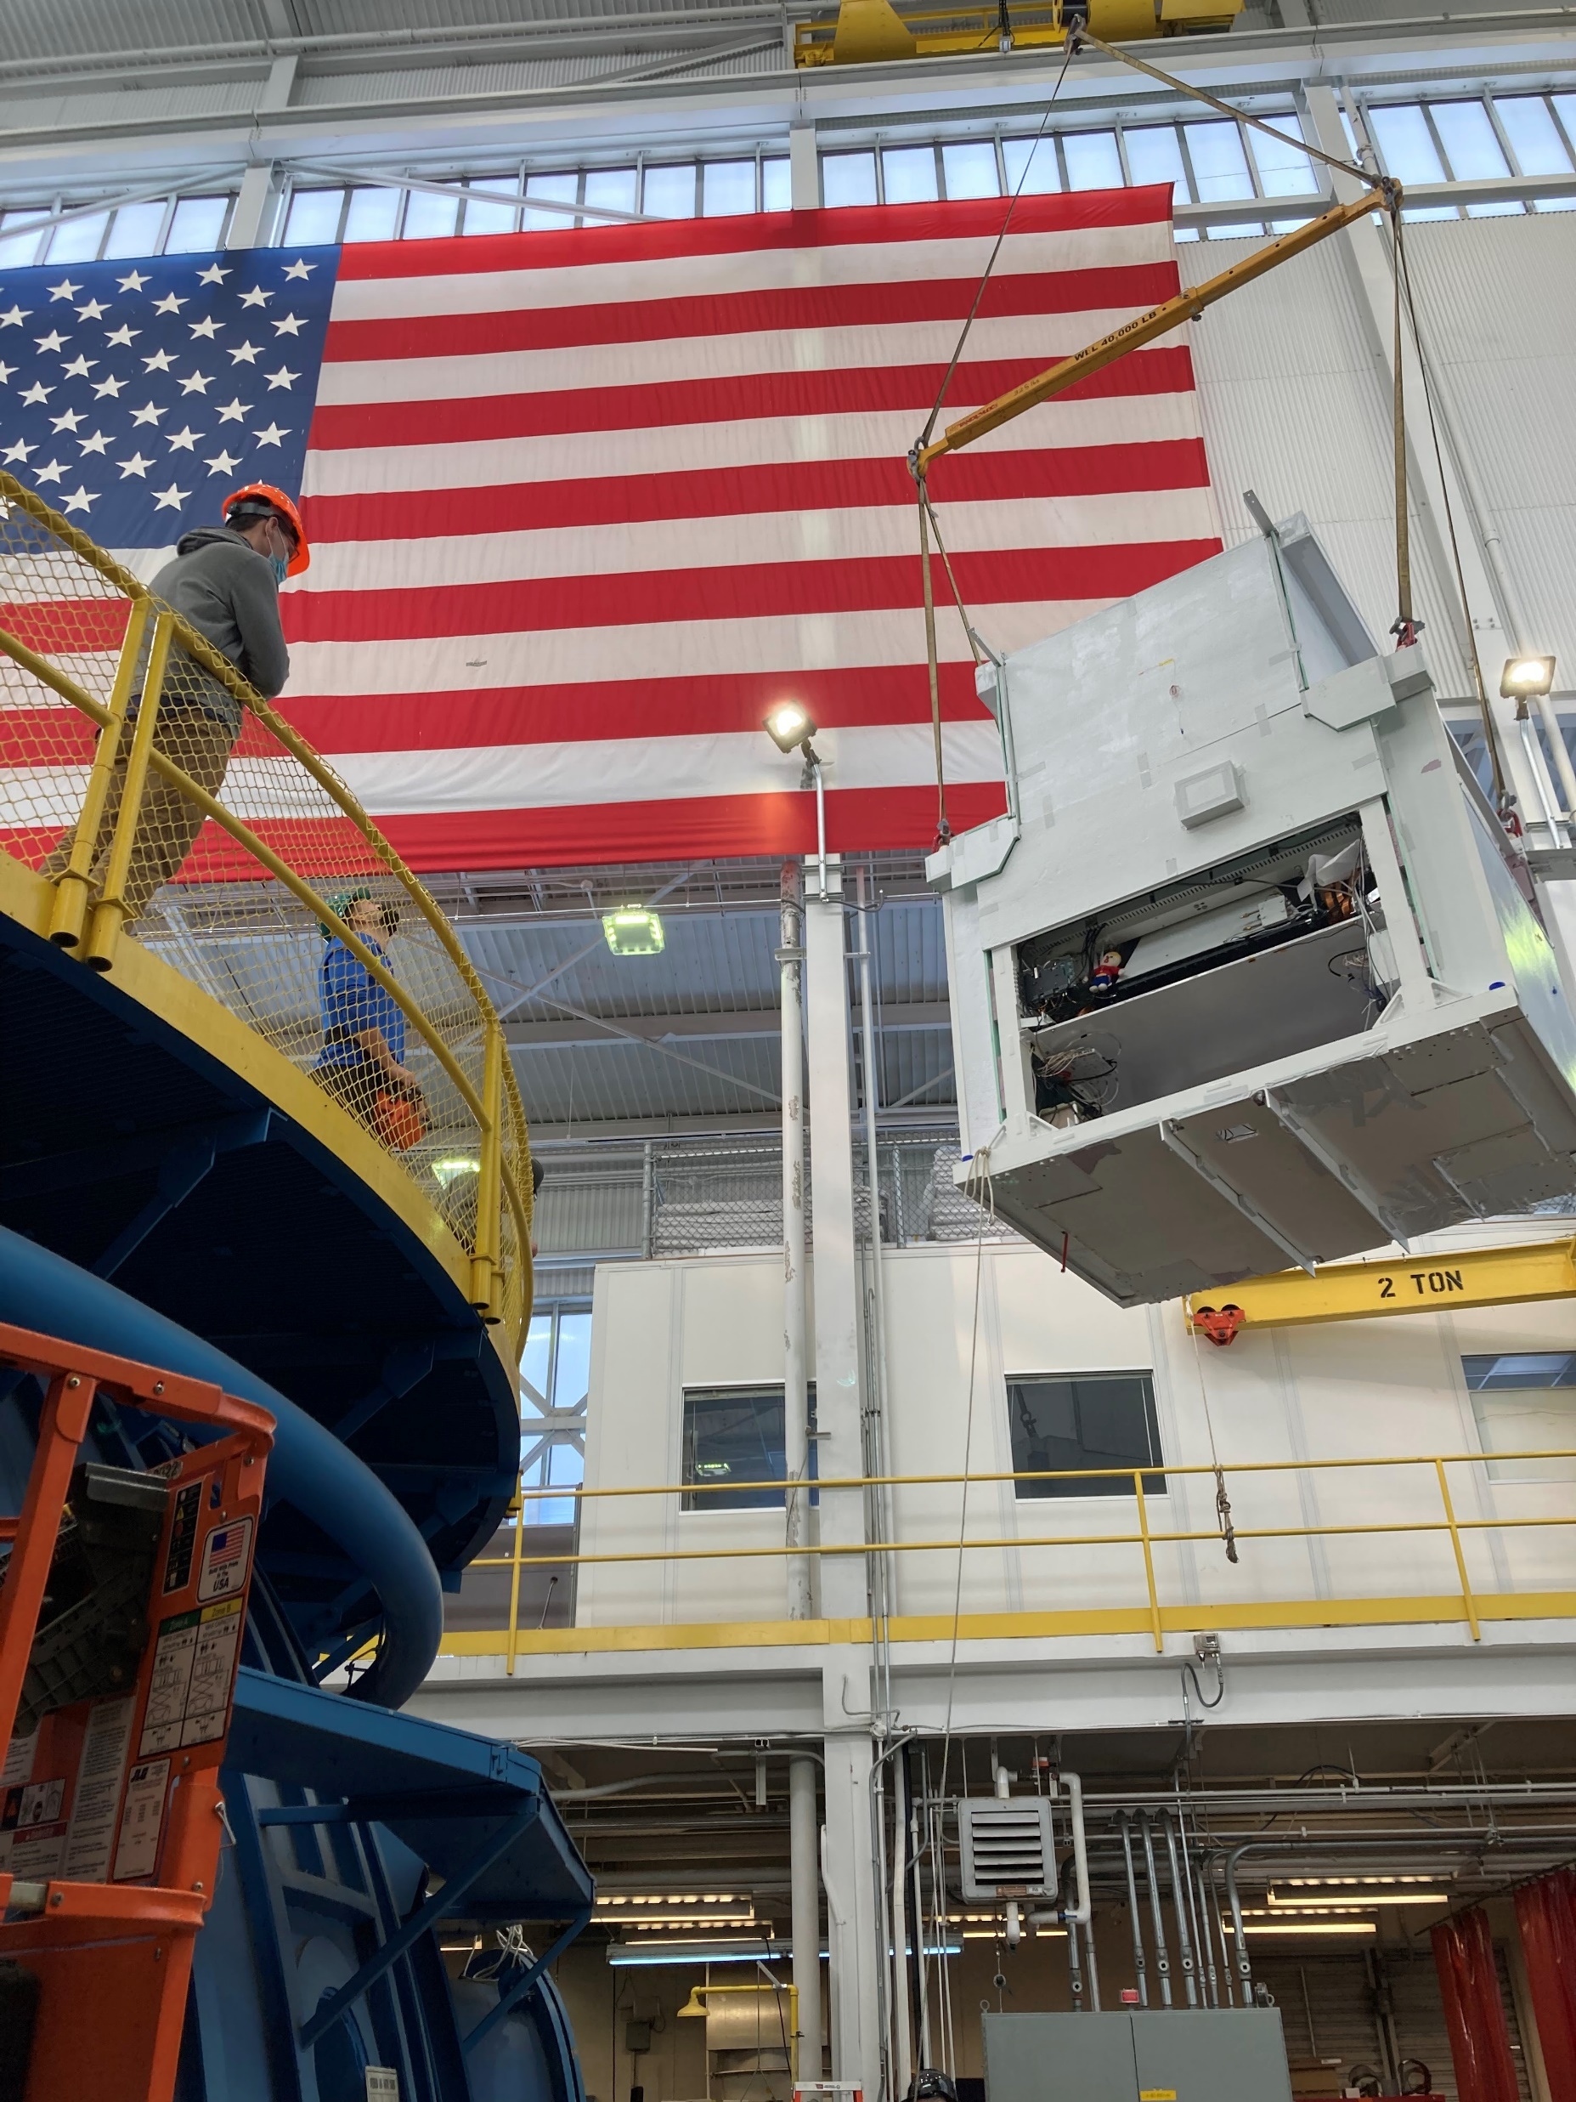
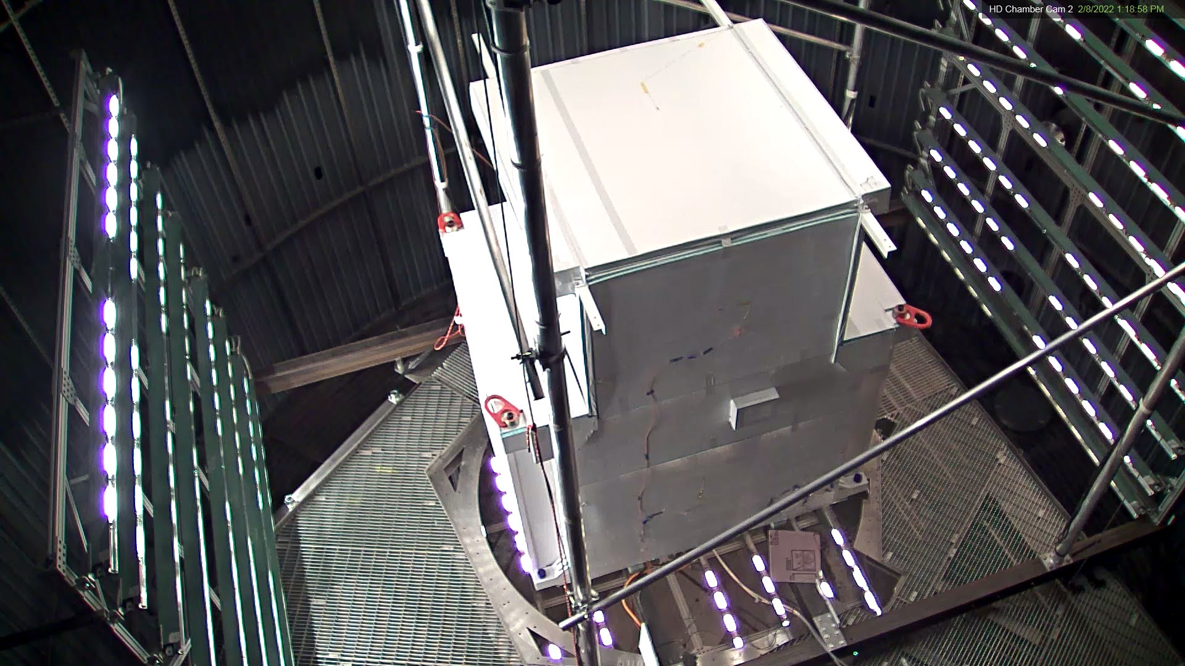
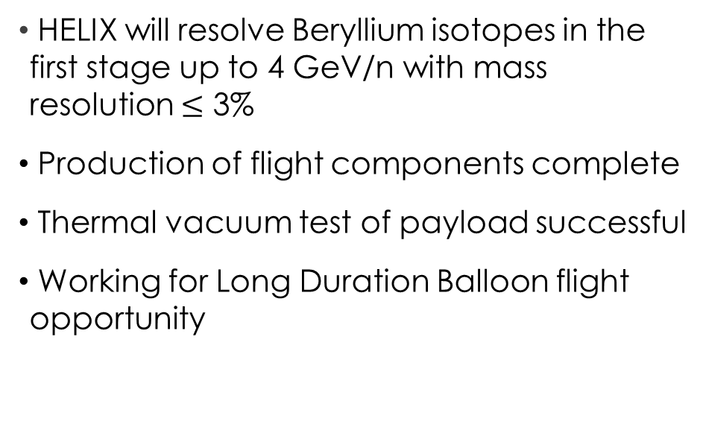
Conclusions
NASA Grant 80NSSC18K0232
HELIX will resolve Beryllium isotopes in the first stage up to 4 GeV/n with mass resolution $≤$ 3%
Production of flight components complete
Thermal vacuum test of payload successful
Working for Long Duration Balloon flight opportunity
Isotope measurements significantly improve our understanding of GCR propagation

Slide 13



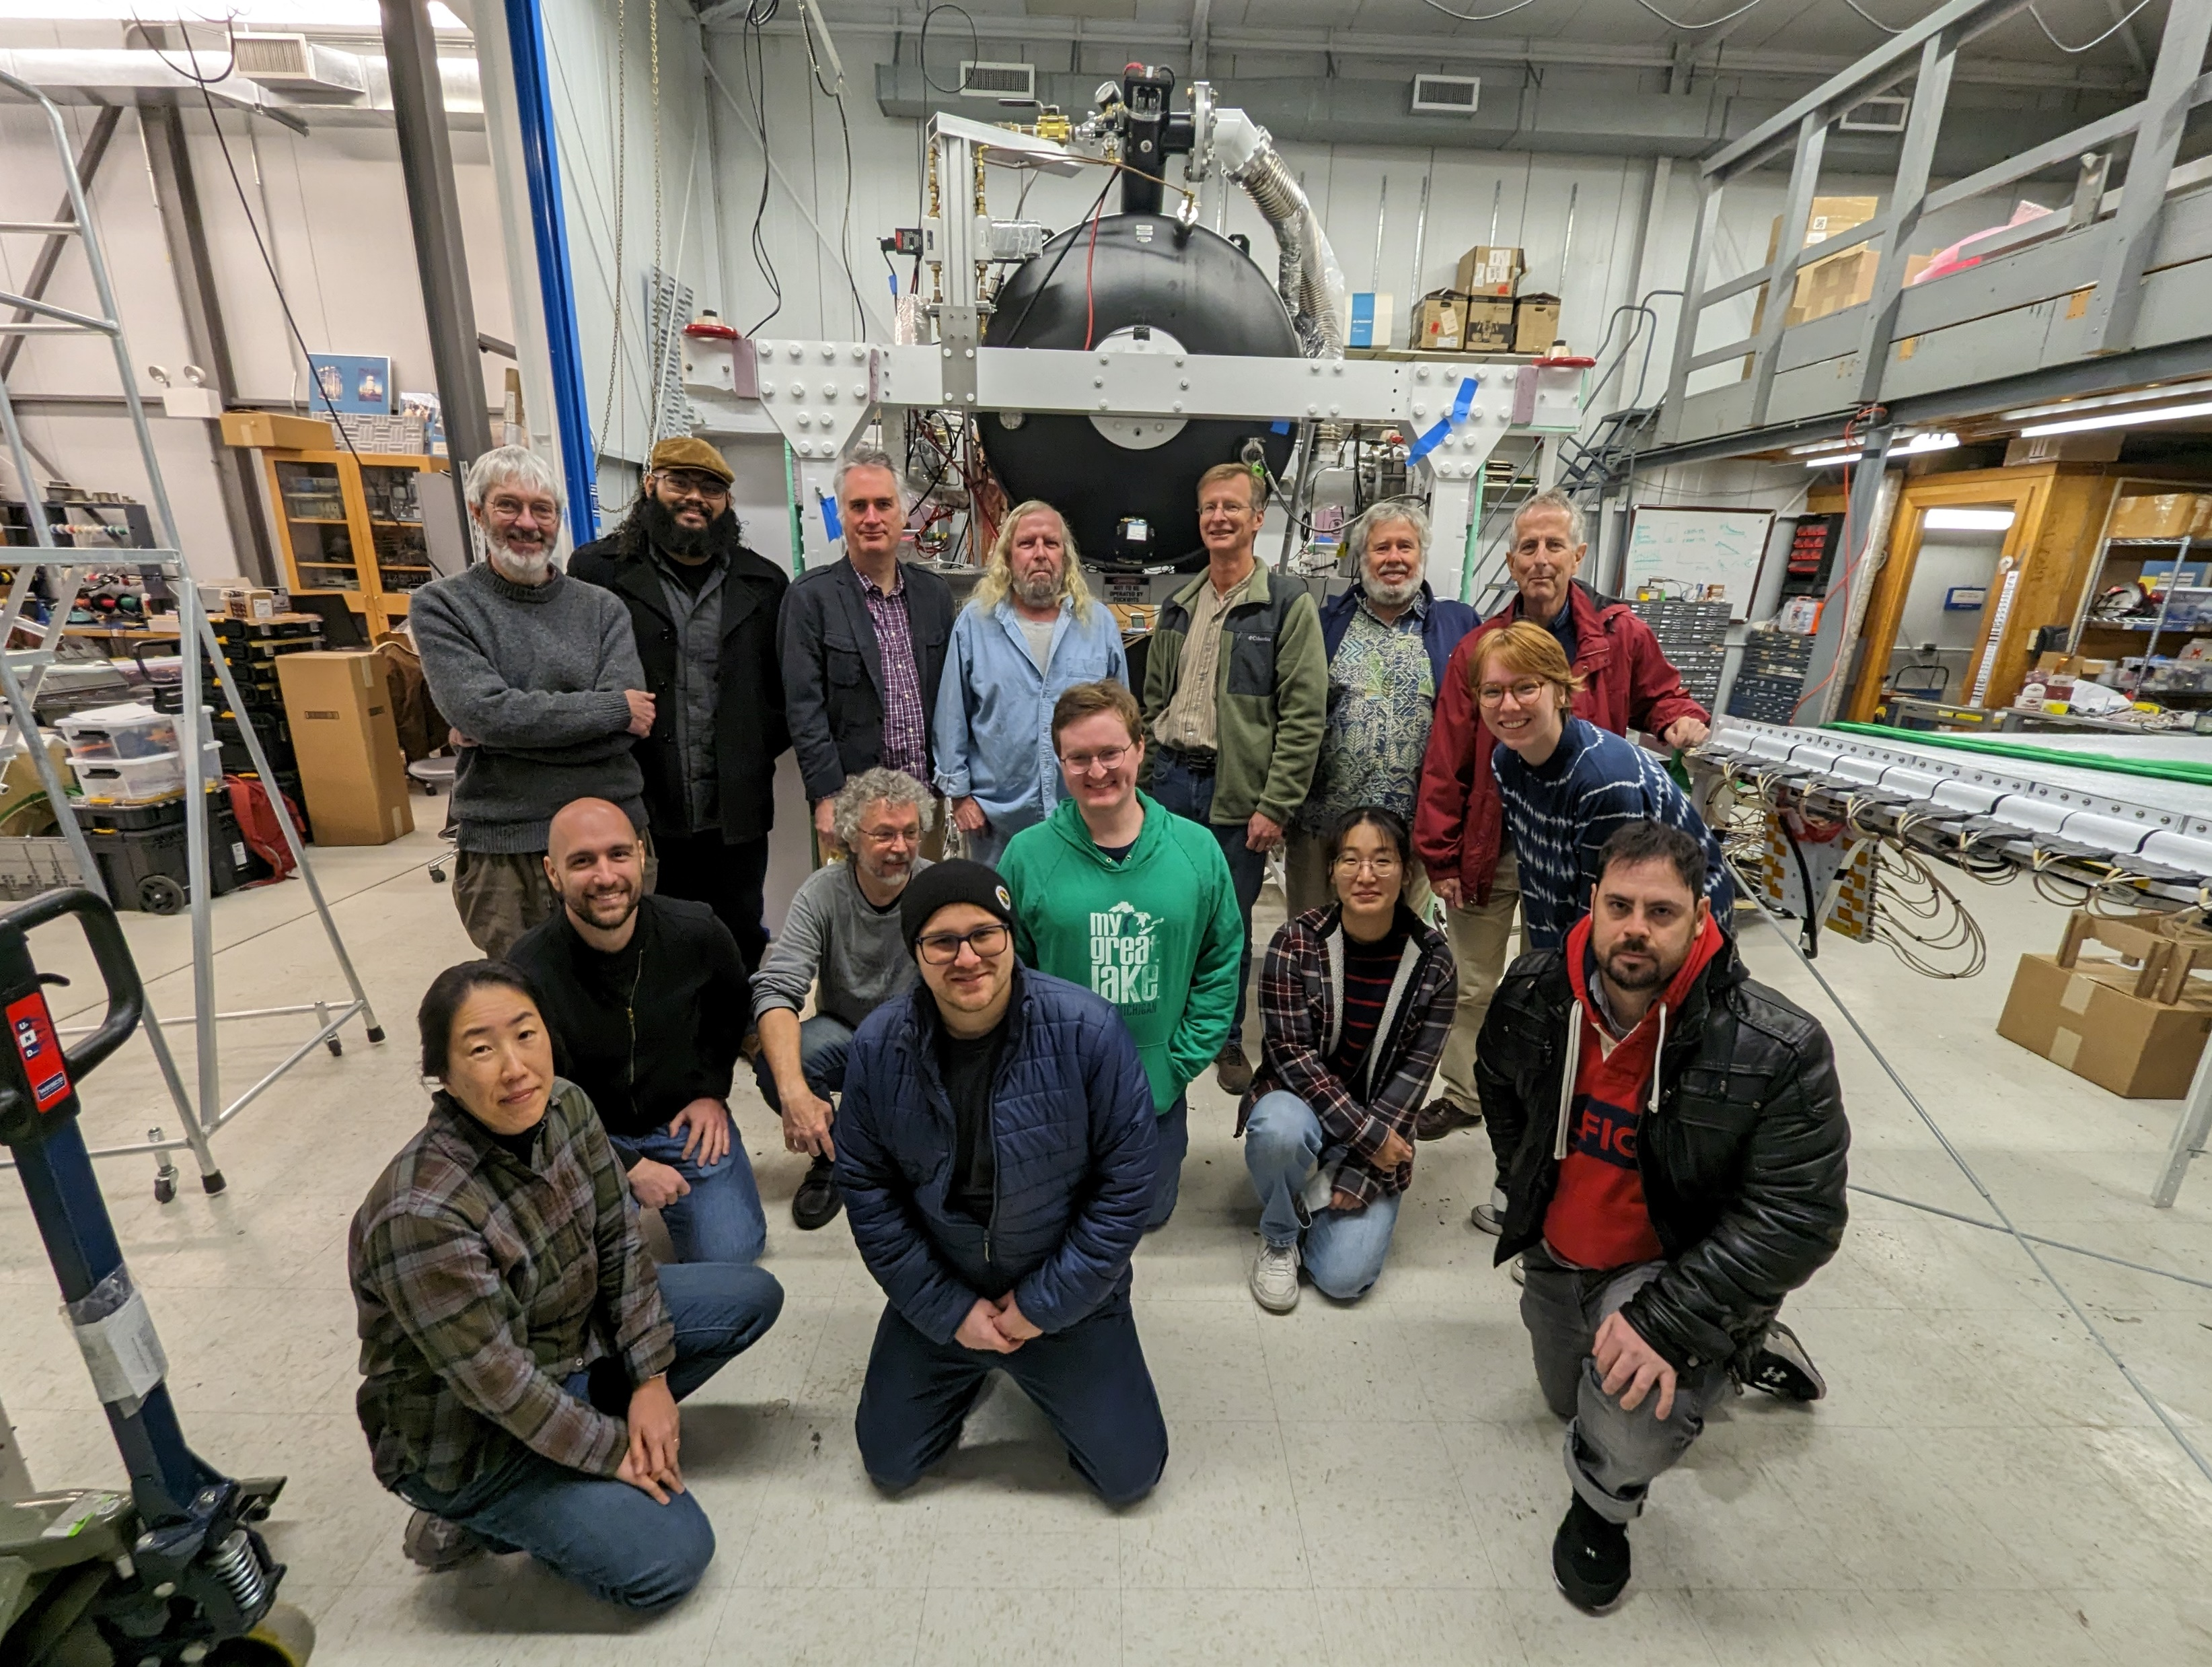






HELIX Collaboration
Introduction

Slide 14
Citations
[1] https://svs.gsfc.nasa.gov/11342
[2] http://www.issibern.ch/cargese2013/images/d/d6/PTUSKIN_Cargese2013.pdf
[3] Korschinek et. Al. (2010) NIM B Vol 268, 2: https://doi.org/10.1016/j.nimb.2009.09.020
[4] R. Trotta et al 2011 ApJ 729 106 https://doi.org/10.1088/0004-637x/729/2/106
[5] Maurin, D., Melot, F., and Taillet, R., \A database of charged cosmic rays,“ A&A, vol. 569, p. A32, 2014. [Online]. Available: https://doi.org/10.1051/0004-6361/201321344
[6] Park ICRC 2021 Berlin https://pos.sissa.it/395/091
[7] Nutter, S, et al. Detection of Cosmic-Ray Antiprotons with the HEAT-Pbar Instrument. Aug. 2001.
[8] Tabata et al. NIM A, 952 2020
[9] O’Brien ICRC 2021 Berlin https://pos.sissa.it/395/090
[10] Wisher ICRC 2019 Madison https://pos.sissa.it/395/090

Slide 15
Extra Stuff

Slide 16
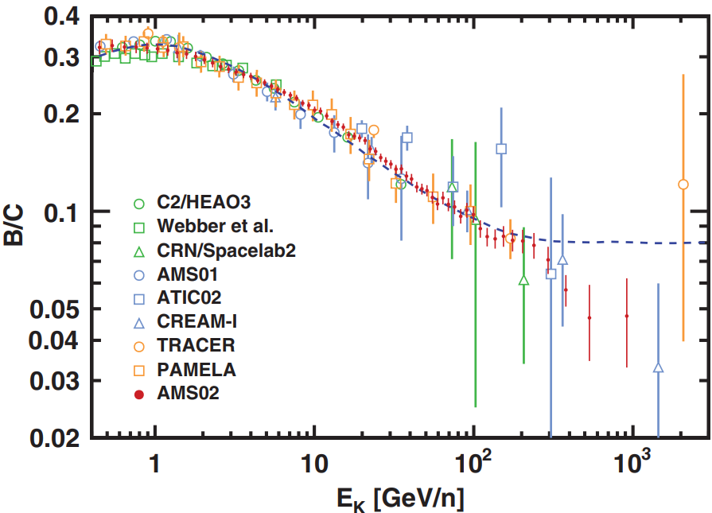
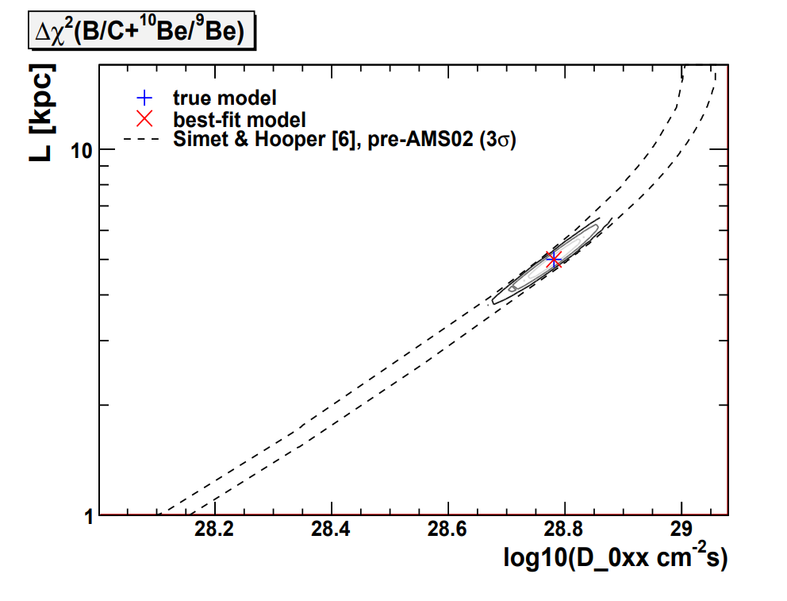
Isotopes Offer Insights
HELIX Science
    Galactic Cosmic Rays (GCRs)
Secondary-primary ratios are sensitive to the material pathlength
Degeneracy of diffusion coeff and halo size in models like GALPROP
Fig from [3]
Fig from [4]
    Need to measure unstable (clock) isotopes like ¹⁰Be at higher energies
    B and Be are secondary GCRs - byproducts of primaries (accelerated at sources)

Slide 17
Other systematic Uncertainties
Backup
New cross-section measurements at higher energies are needed
Isotopes produced above the HELIX payload in atmosphere during flight, relevant for interpreting the data as GCR fluxes
Isotope production during propagation in diffusion-halo models (or others) that include nuclear interaction networks, relevant for interpreting data in the context of the models
  See the proceeding by Neeraj Amin for NA61/SHINE from ICRC 2021
  And see the relevant paper by Maurin et. al. (2022) on the arxiv: arxiv:2203.00522

Slide 18
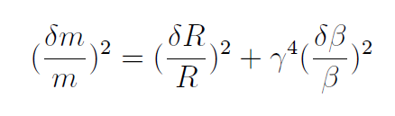
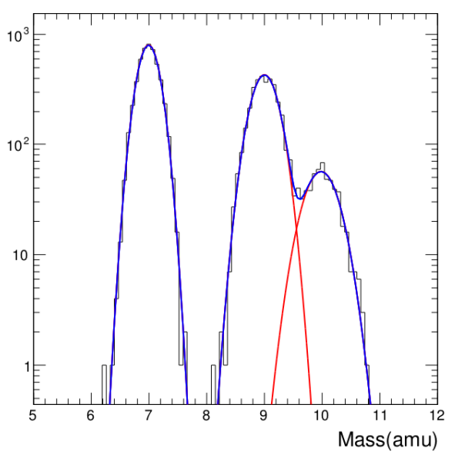
Mass Resolution with Magnet Spectrometers
HELIX Science
Challenge in confidently separating the close peaks of ⁹Be & ¹⁰Be
For beryllium isotopes, a good benchmark is 2.5% mass resolution
Resolve ¹⁰Be, shown in histogram
Z=4
HELIX is designed to meet this resolution goal

Slide 19
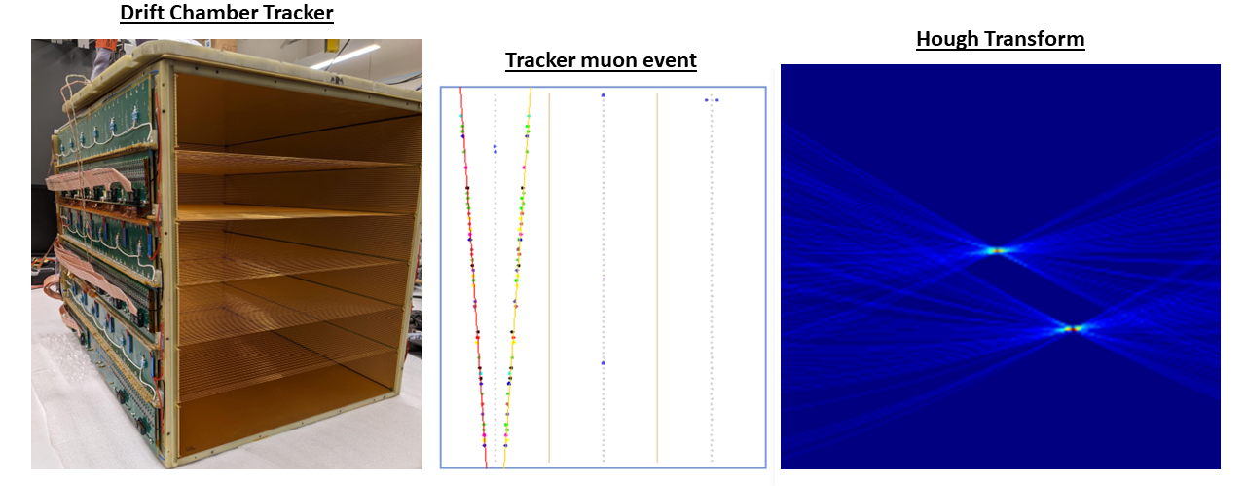
Tracker images
Backup

Slide 20
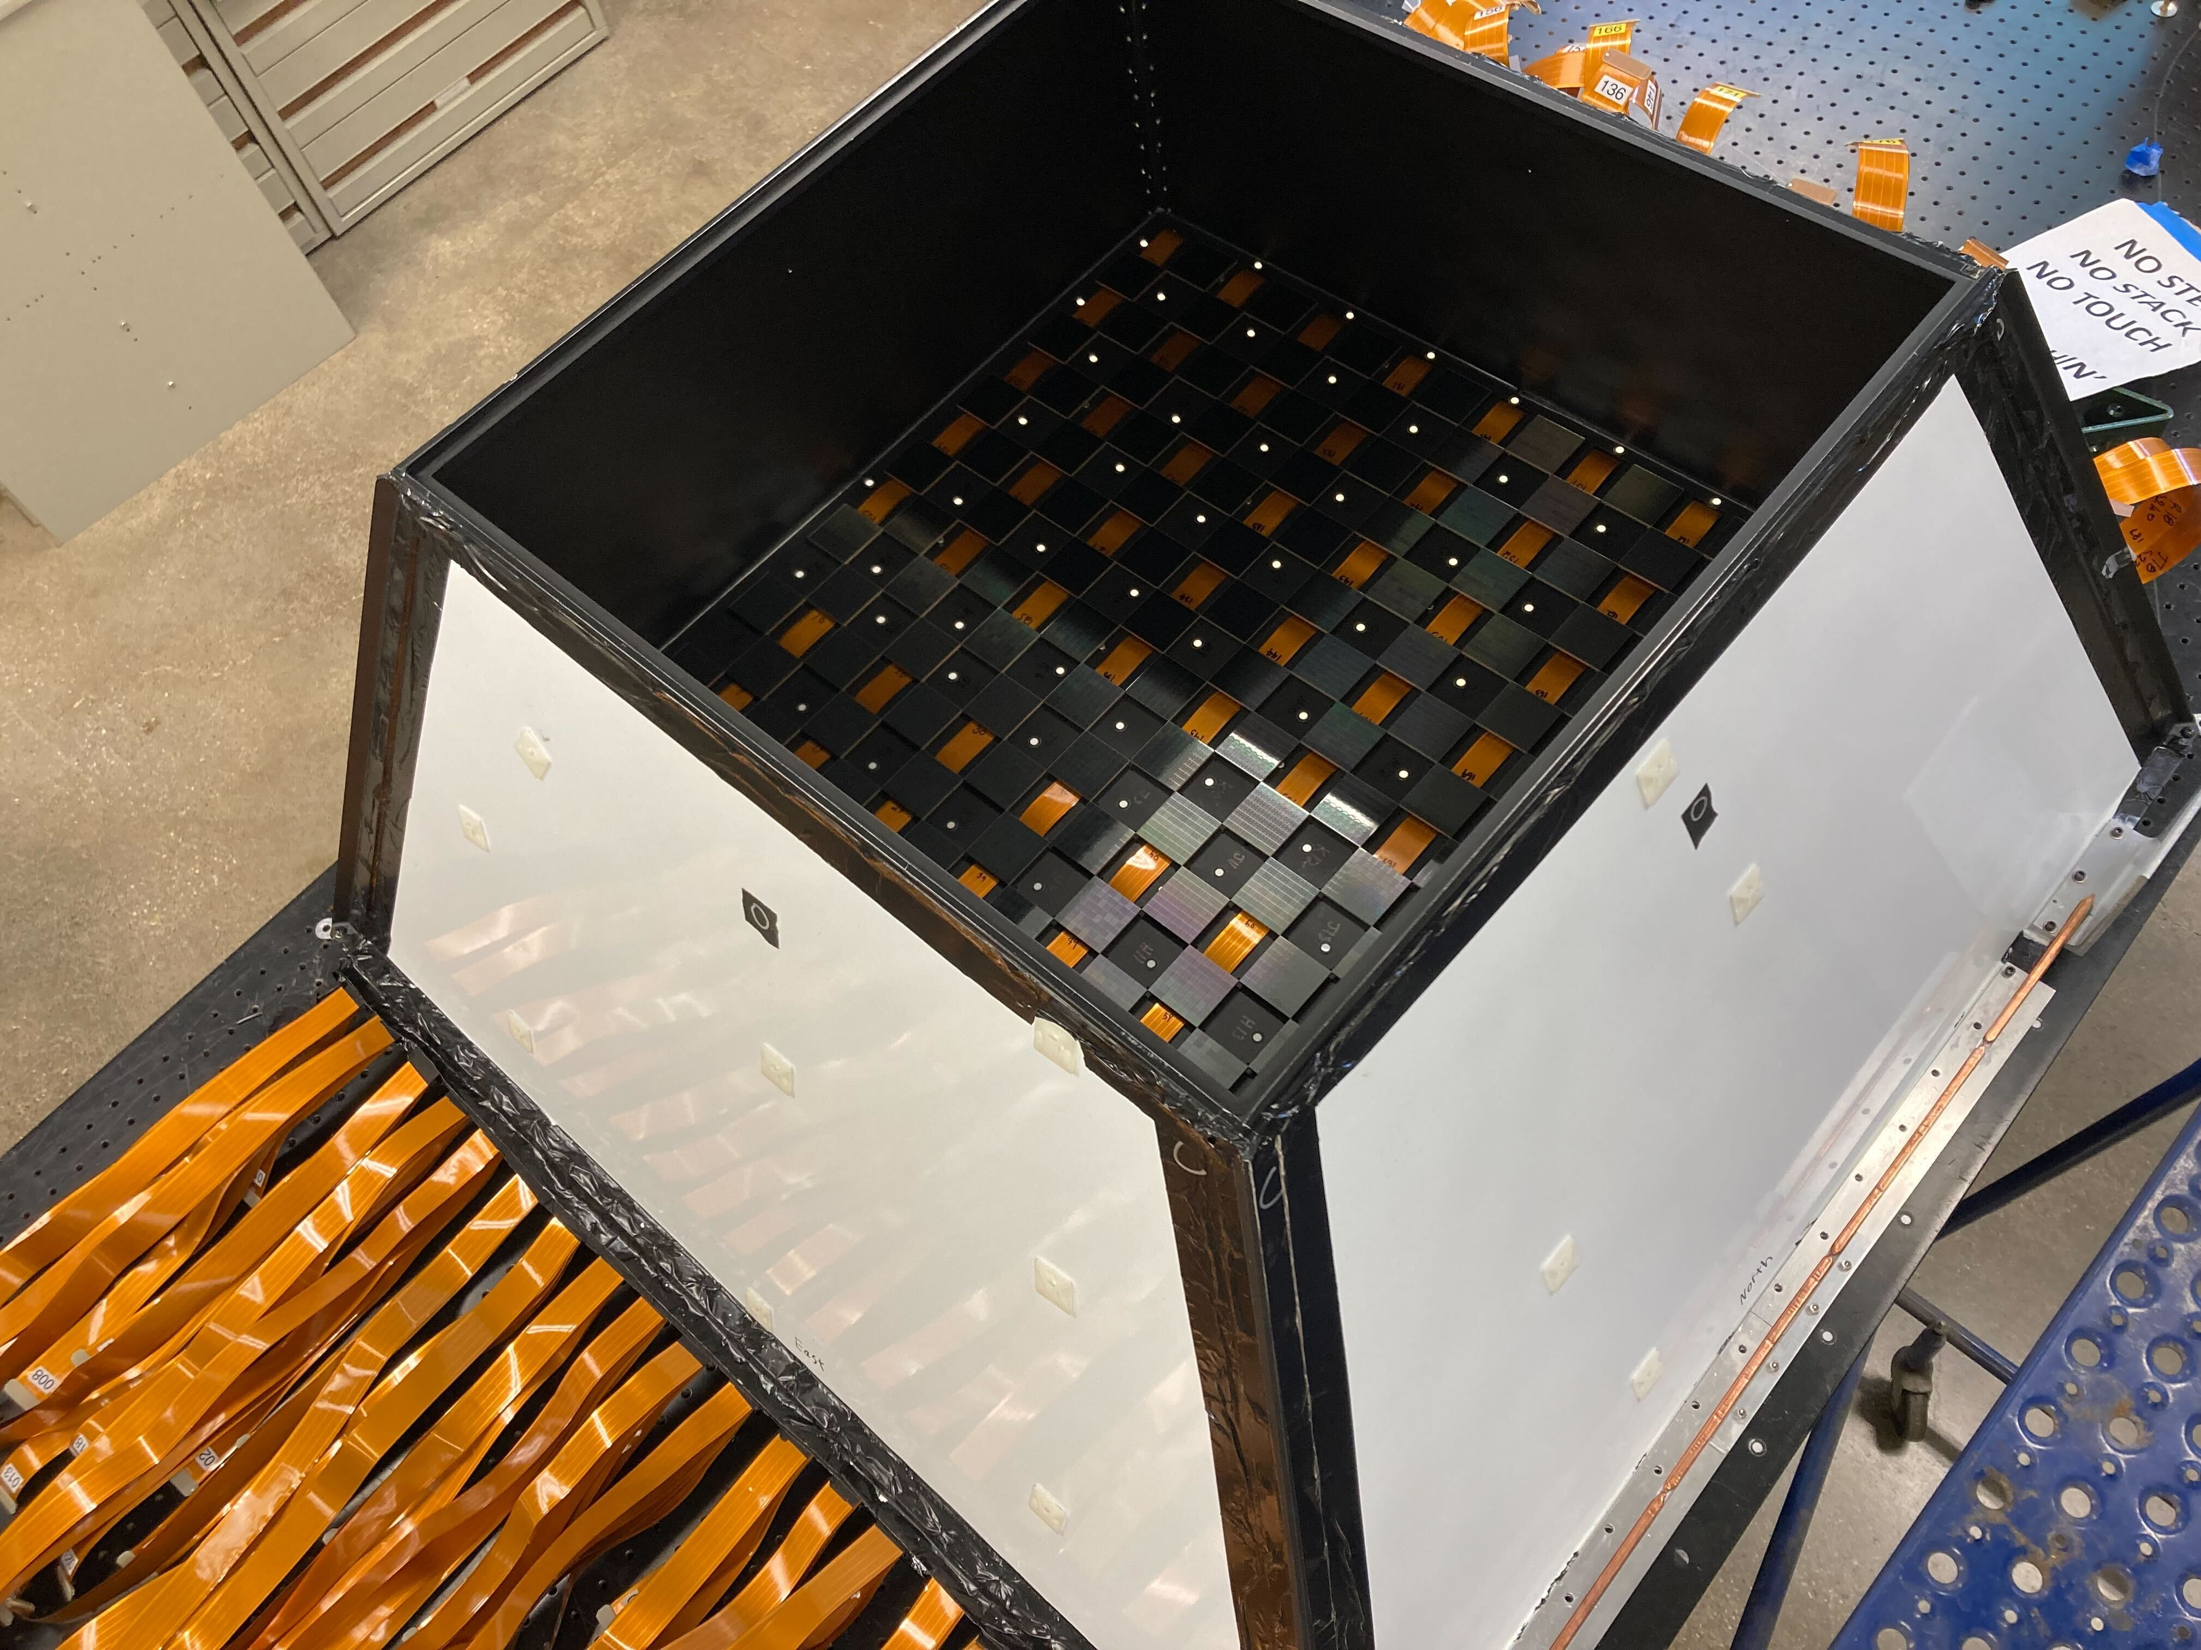
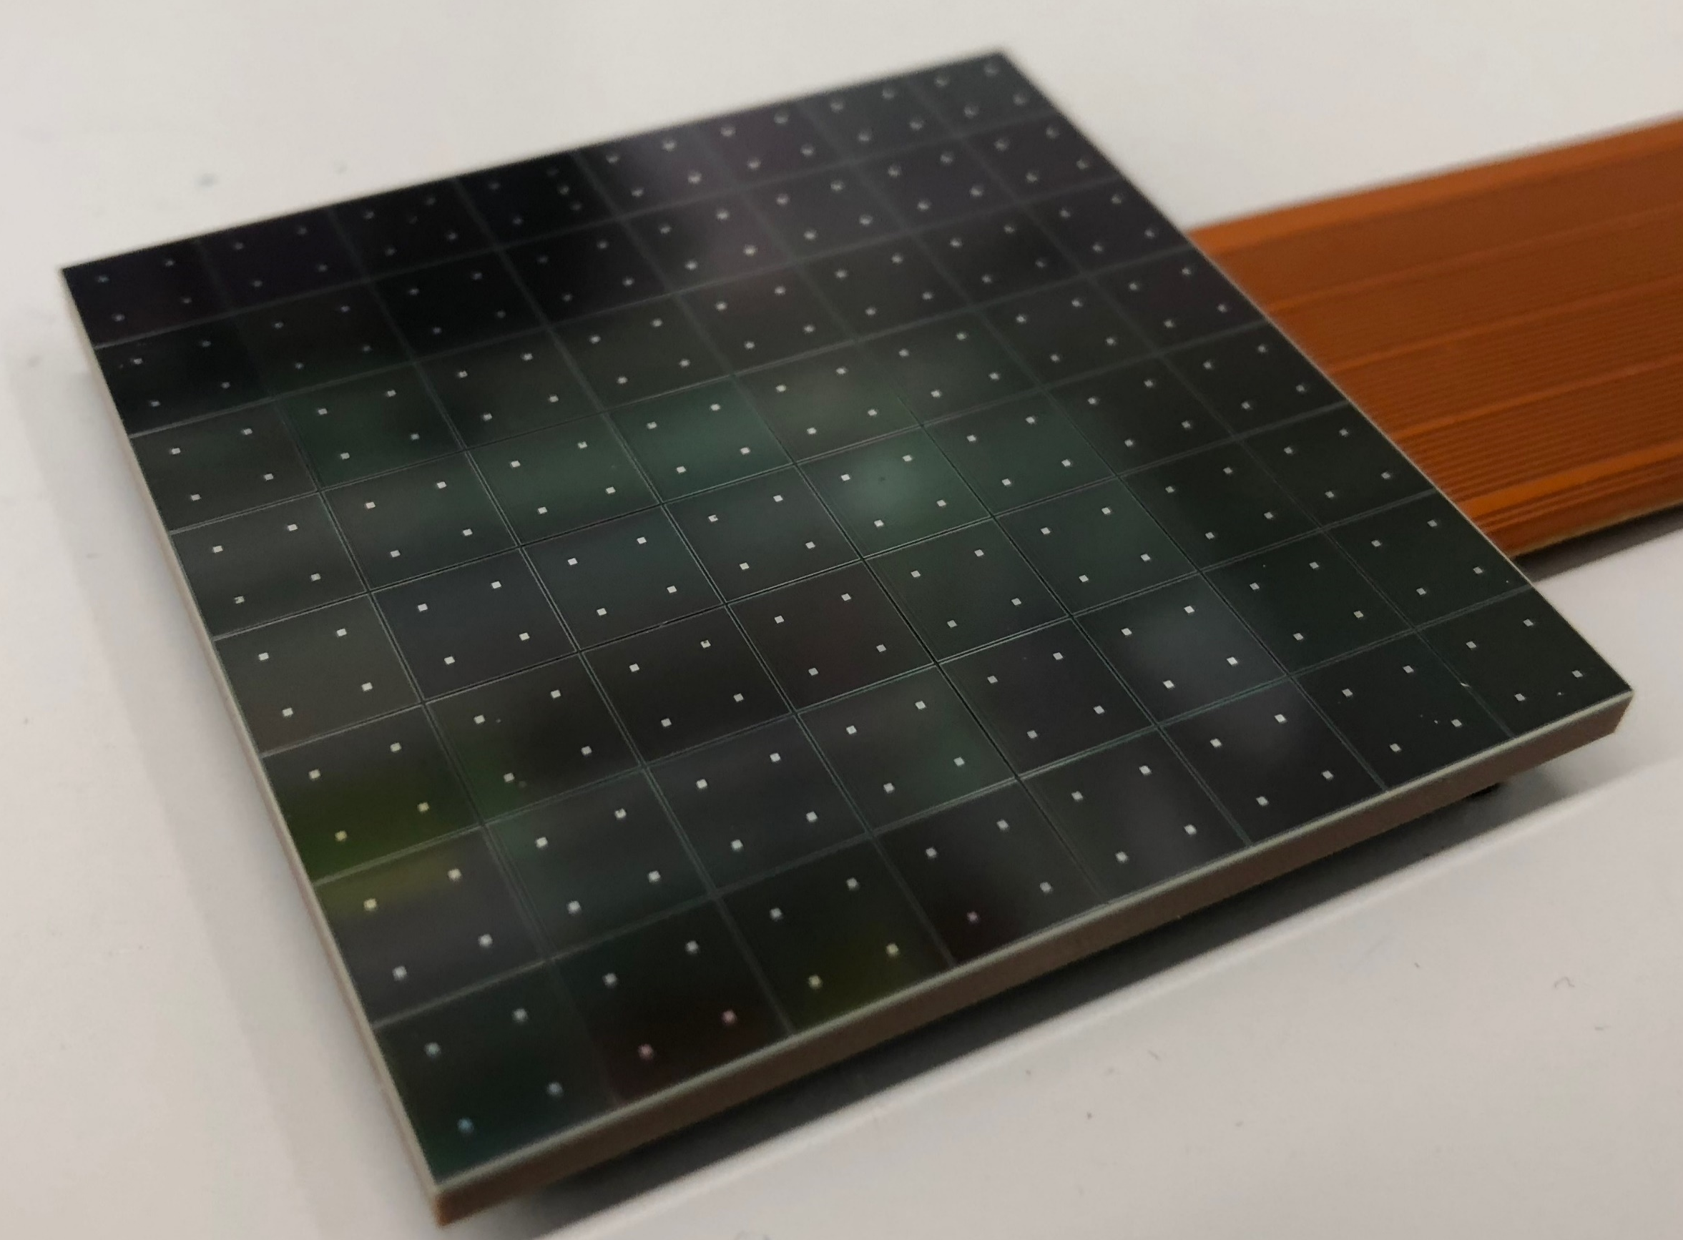

RICH Focal Plane
HELIX Instrument
  Measures the velocity, $β$
Stage 1 populated Focal Plane
Focal plane of SiPMs
1 m² area – half-filled in Stage 1
  200 SiPM arrays – 12,800 SiPMs
  Fully populated, 400 SiPM arrays in Stage 2
$$β=\frac{1}{n cosϴ_{C}}$$
SiPM array
$β$ resolution 0.1% ($Z$ >= 4)

Slide 21
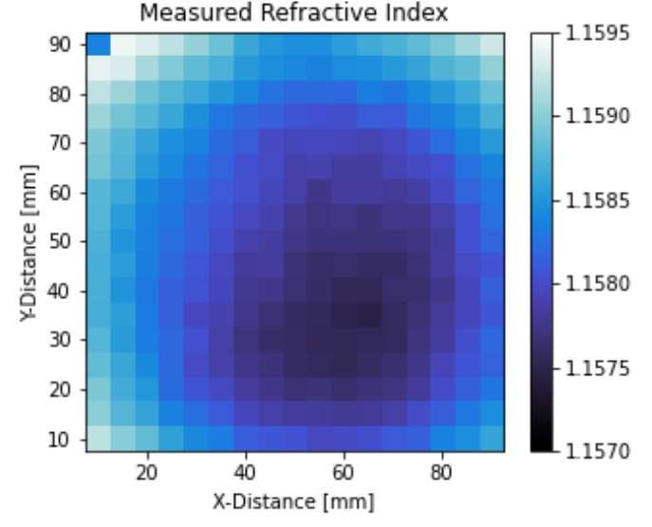
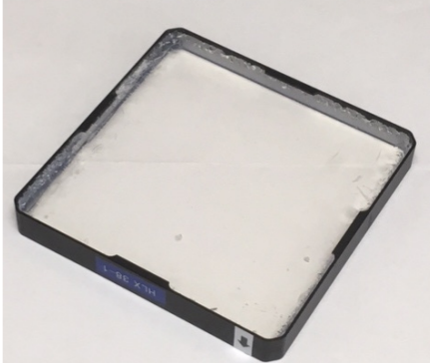
Aerogel measurements
Backup
Beam line scanned
  TRIUMF – electrons
  Using CCD to image Cherenkov ring
36 aerogel tiles
See O’Brien ICRC 2021 proceeding for more details
Aerogel
[5]

Slide 22
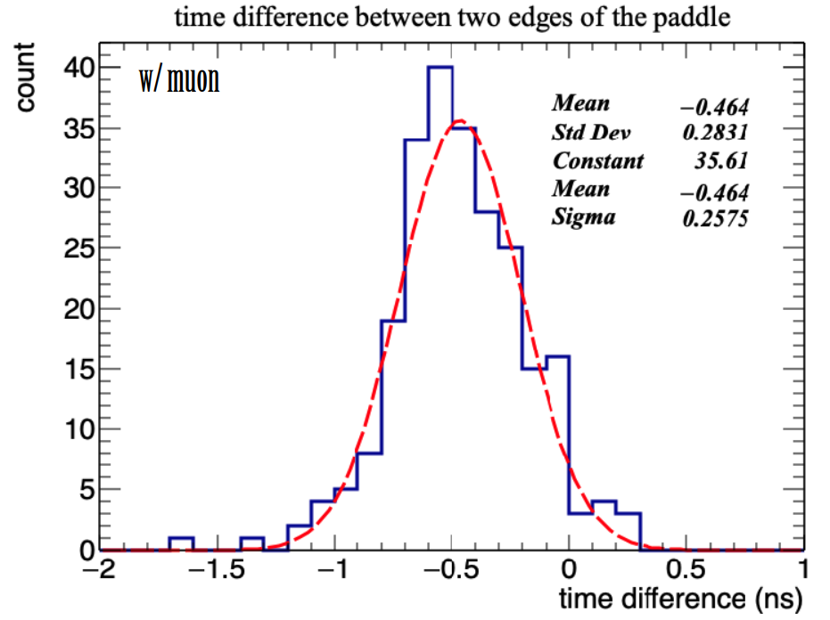
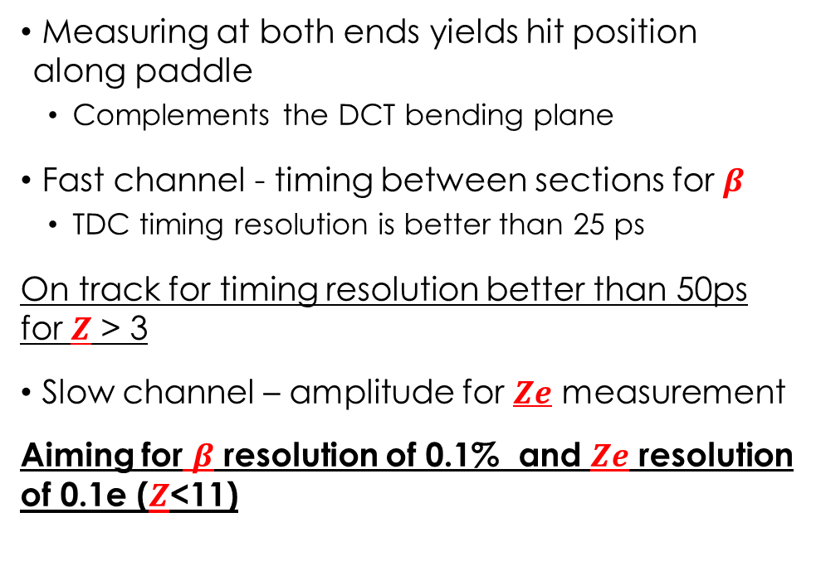
Time-Of-Flight Readout
HELIX Instrument
  Measures the velocity, $β$, and charge, $Ze$
Measuring at both ends yields hit position along paddle
  Complements the DCT bending plane
Fast channel - timing between sections for $β$
  TDC timing resolution is better than 25 ps
On track for timing resolution better than 50ps for $Z$ > 3
Slow channel – amplitude for $Ze$ measurement
Aiming for $β$ resolution of 0.1% and $Ze$ resolution of 0.1e ($Z$<11)
[3] Park, N. ICRC 2021

Slide 23
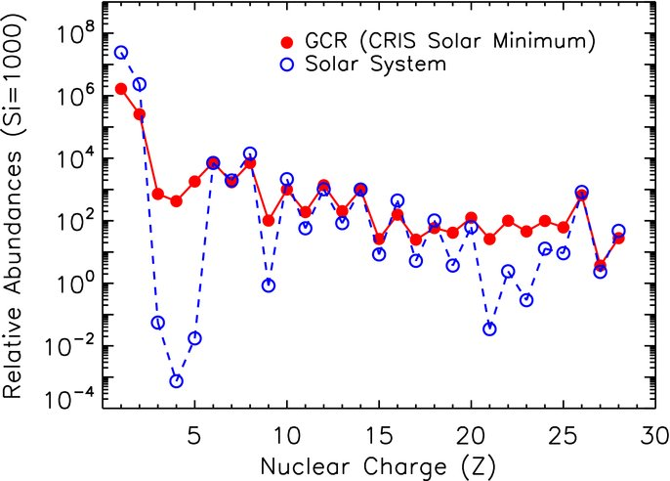
GCR Abundances
Sources accelerate He, C, O, Si and Fe (primary cosmic rays)
Overabundant in some elements
  Li, Be, B and F
  Sc, Mn, sub-iron
Spallation (high energy collisions) of primaries produces lighter elements
Wealth of precise data from AMS-02 on the GCR nuclei
Nuclei => Charge
Isotope => Mass
Li,Be,B
[4]

