Slide 1
Saw tooth energy shifts determination using RD and boosts measurements
Ivan Koop and Alexei Otboev, BINP, Novosibirsk, Russia
EPOL zoom meeting, October 27, 2022

Slide 2
Outline
Saw tooth energy shifts in the detectors, examples
Algorithm for disentangling of SR and of the coherent losses
MC simulation results
Boosts measurement statistics
Discussion and conclusion

Slide 3
Boosts responses to the RD-energy changes
By making such measurements, we can determine the energy shifts due to the saw tooth.
We have done MC simulation with a toy collider model. We assume head on collision when calculate the c.m. energy.
We introduced SR loss and the coherent losses which are proportional to a beam current. In principle, another power law degree can be used to approximate the current dependence of that shift.
We developed a simple algorithm for calculation of saw tooth energy shifts relative to the RD-energies in the collision point.
It is based on a successful parametrization of the description of energy loss - a power law for both types of losses.

Slide 4
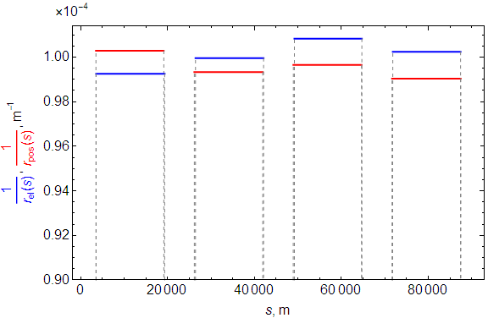
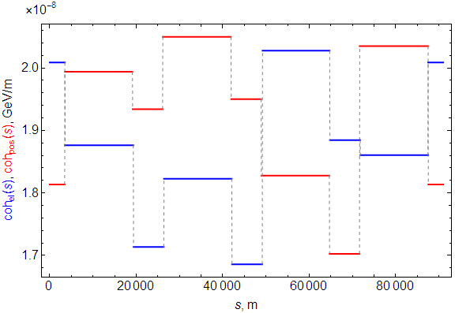
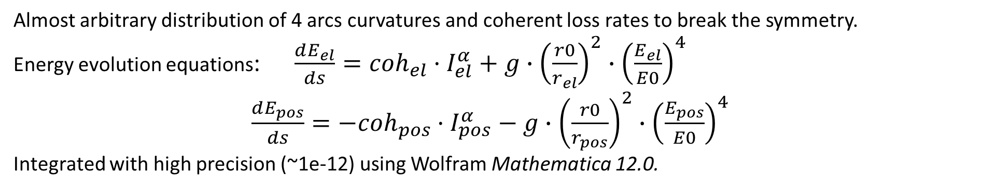
Orbit curvatures and coherent loss rates – an example with 4 arcs/ring
Almost arbitrary distribution of 4 arcs curvatures and coherent loss rates to break the symmetry.
Energy evolution equations: $\frac{dE_{el}}{ds}={coh}_{el}·I_{el}^{α}+g∙{\left(\frac{r0}{r_{el}}\right)}^{2}∙{\left(\frac{E_{el}}{E0}\right)}^{4}$
$\frac{dE_{pos}}{ds}=−{coh}_{pos}·I_{pos}^{α}−g∙{\left(\frac{r0}{r_{pos}}\right)}^{2}∙{\left(\frac{E_{pos}}{E0}\right)}^{4}$
Integrated with high precision (~1e-12) using Wolfram Mathematica 12.0.

Slide 5
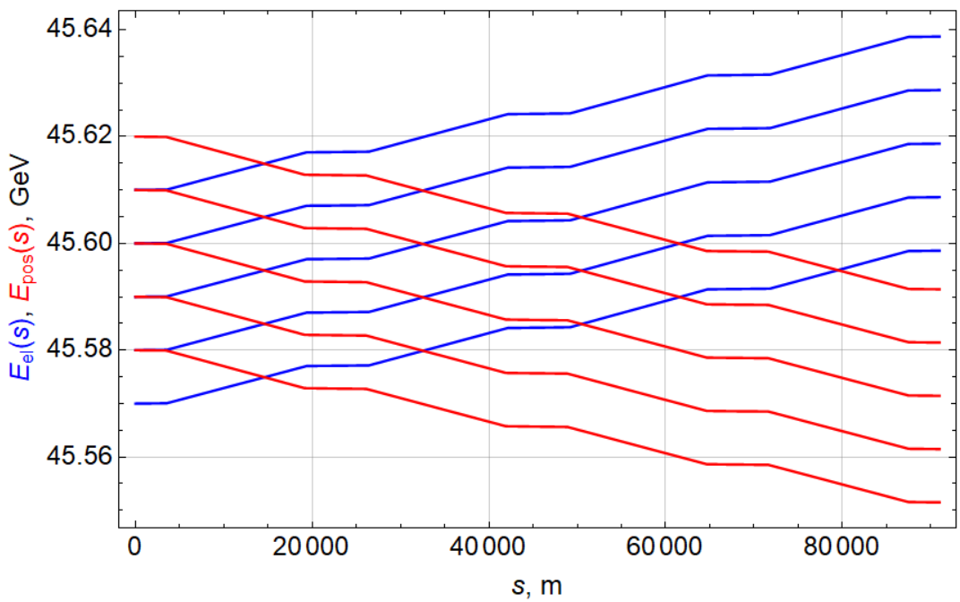
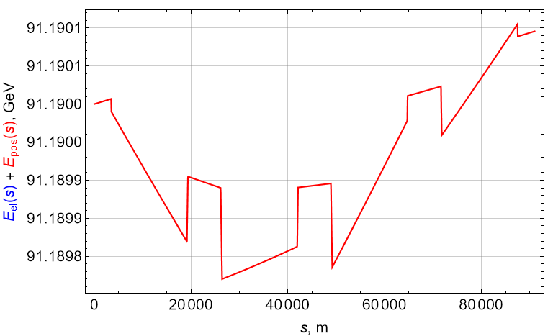
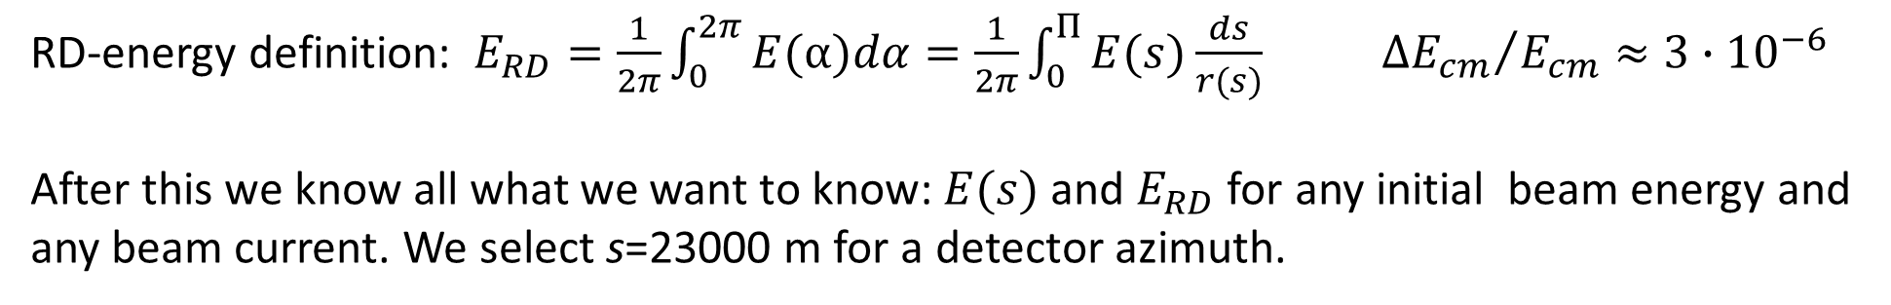
Beam energies and c.m. energy along a circumference starting from the RF-azimuth
RD-energy definition: $E_{RD}=\frac{1}{2π}\int_{0}^{2π}{E(α)dα=\frac{1}{2π}\int_{0}^{Π}{E(s)\frac{ds}{r(s)} }}$ ${ΔE_{cm}}/{E_{cm}}≈3∙{10}^{−6}$
After this we know all what we want to know: $E(s)$ and $E_{RD}$ for any initial beam energy and any beam current. We select s=23000 m for a detector azimuth.

Slide 6
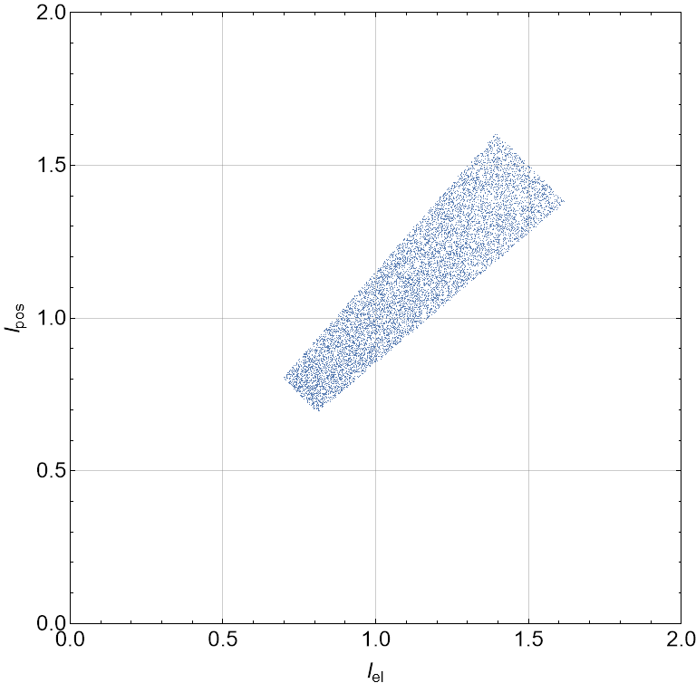
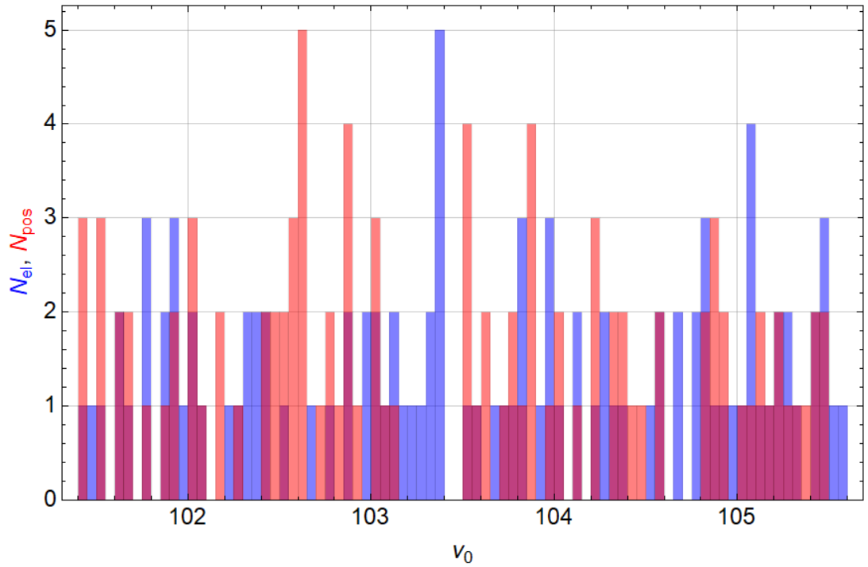
Ceeded beam currents and beam energies
Asymmetry in beam currents restricted by +-15%. Uniform/random energy distribution +-2%.

Slide 7
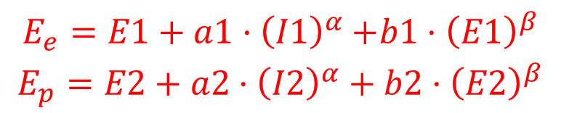
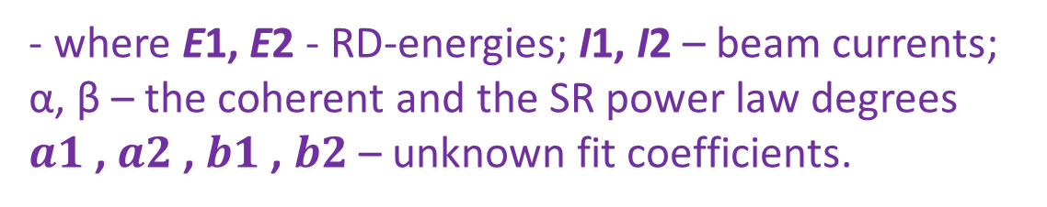
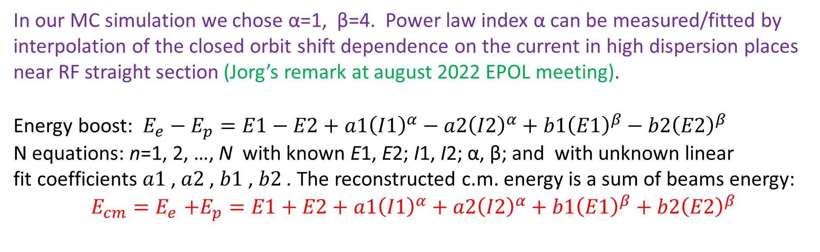
Algorithm for disentangling of SR and coherent losses
Two beam Energies in a detector $E_{e}$, $E_{p}$ depend on beam currents I1, I2 (coherent losses) and on SR losses. These dependences can be parametrized via simple power law:
$$\begin{matrix}E_{e}=E1+a1{·\left(I1\right)}^{α}+b1{·\left(E1\right)}^{β} \\ E_{p}=E2+a2·{\left(I2\right)}^{α}+b2·{\left(E2\right)}^{β}\end{matrix}$$
- where E1, E2 - RD-energies; I1, I2 – beam currents; α, β – the coherent and the SR power law degrees
$a1$, $a2$, $b1$, $b2$– unknown fit coefficients.
In our MC simulation we chose α=1, β=4. Power law index α can be measured/fitted by interpolation of the closed orbit shift dependence on the current in high dispersion places near RF straight section (Jorg’s remark at august 2022 EPOL meeting).
Energy boost: ${E_{e}−E}_{p}=E1−E2+a1{\left(I1\right)}^{α}−a2{\left(I2\right)}^{α}+b1{\left(E1\right)}^{β}−b2{\left(E2\right)}^{β}$
N equations: n=1, 2, …, N with known E1, E2; I1, I2; α, β; and with unknown linear
fit coefficients $a1$, $a2$, $b1$, $b2$. The reconstructed c.m. energy is a sum of beams energy:
$$E_{cm}{{=E}_{e}+E}_{p}=E1+E2+a1{\left(I1\right)}^{α}+a2{\left(I2\right)}^{α}+b1{\left(E1\right)}^{β}+b2{\left(E2\right)}^{β}$$

Slide 8
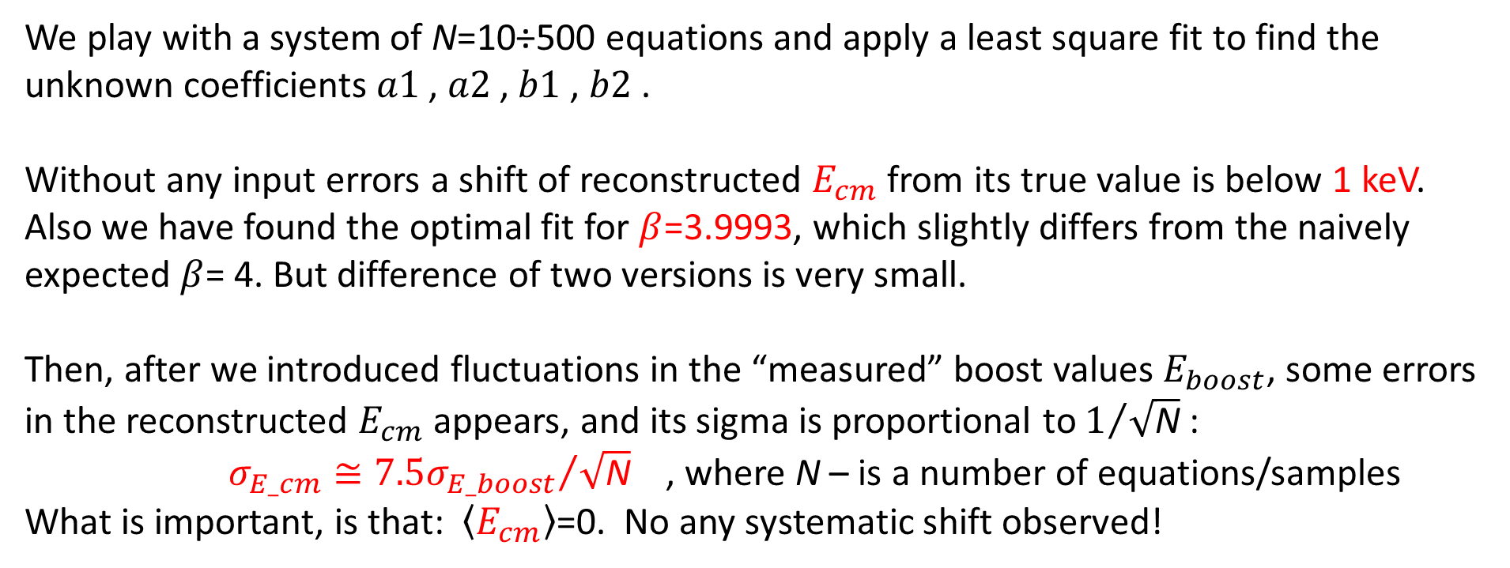
Solving a system of equations
Boost ${E_{e}−E}_{p}$ will be measured by muon pairs (Patric Janot talk at EPOL-2022). RD-energies E1, E2 also will be measured for each set of currents $I1$, $I2$ .
$a1{\left(I1\right)}^{α}−a2{\left(I2\right)}^{α}+b1{\left(E1\right)}^{β}−b2{\left(E2\right)}^{β}={E_{e}−E}_{p}+E2−E\text{1}≡E_{boost}+E2−E$1
We play with a system of N=10÷500 equations and apply a least square fit to find the unknown coefficients $a1$, $a2$, $b1$, $b2$.
Without any input errors a shift of reconstructed $E_{cm}$ from its true value is below 1 keV. Also we have found the optimal fit for $β$=3.9993, which slightly differs from the naively expected $β$= 4. But difference of two versions is very small.
Then, after we introduced fluctuations in the “measured” boost values $E_{boost}$, some errors in the reconstructed $E_{cm}$ appears, and its sigma is proportional to $1/{\sqrt{\text{N}}}$ :
$σ_{E_cm}≅{7.5σ_{E_boost}}/{\sqrt{\text{N}}}$ , where $\text{N}$ – is a number of equations/samples
What is important, is that: $\left\langle E_{cm}\right\rangle$=0. No any systematic shift observed!

Slide 9
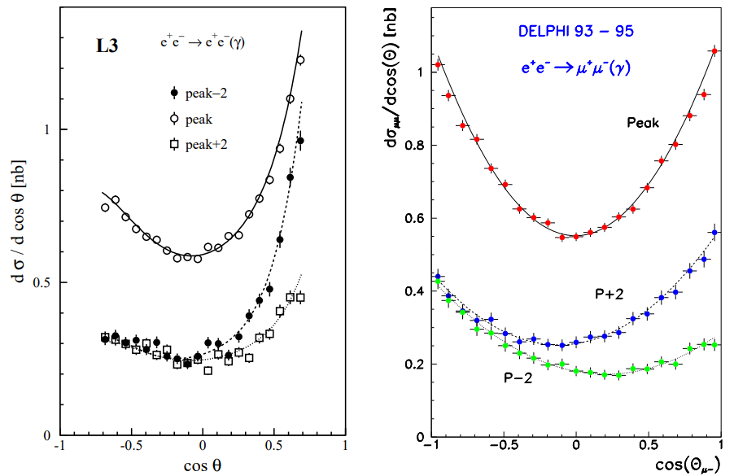
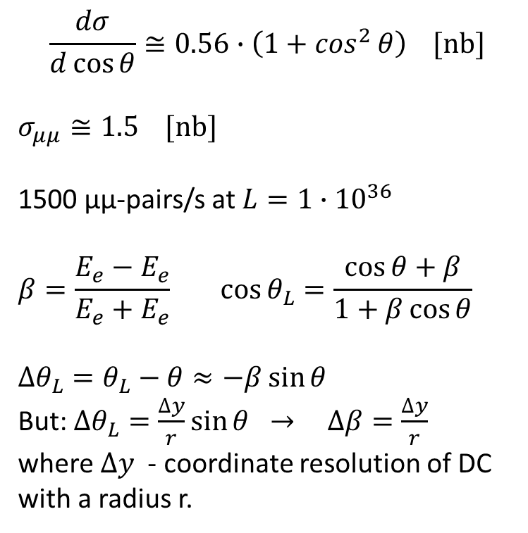
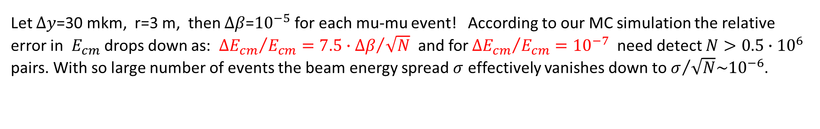
Muon pairs statistics
“Precision Electroweak Measurements on the Z Resonance”, CERN-PH-EP/2005-041 SLAC-R-774 hep-ex/0509008 7 Sept. 2005.
$$\frac{dσ}{d\cos{θ}}≅0.56∙\left(1+\cos^{2}{θ}\right) [nb]$$
$σ_{μμ}≅1.5 [nb]$
1500 μμ-pairs/s at $L=1∙{10}^{36}$
$$β{=\frac{E_{e}−E_{e}}{E_{e}+E_{e}}} \cos{θ_{L}=\frac{\cos{θ+β}}{1+β\cos{θ}}}$$
$$∆θ_{L}=θ_{L}−θ≈−β\sin{θ}$$
But: $∆θ_{L}=\frac{∆y}{r}\sin{θ}$ $→$ $∆β=\frac{∆y}{r}$
where $∆y$ - coordinate resolution of DC with a radius r.
Let $∆y$=30 mkm, r=3 m, then $∆β$=${10}^{−5}$ for each mu-mu event! According to our MC simulation the relative error in $E_{cm}$ drops down as: ${∆E_{cm}}/{E_{cm}={7.5∙∆β}/{\sqrt{N}}}$ and for ${∆E_{cm}}/{E_{cm}={10}^{−7}}$ need detect $N>0.5∙{10}^{6}$ pairs. With so large number of events the beam energy spread $σ$ effectively vanishes down to $σ/{\sqrt{N}\sim {10}^{−6}}$.

Slide 10
Conclusion
Our MC simulation of the reconstruction algorithm confirms its feasibility.
Still more detailed studies need to be done.

