Slide 1
Puma
Survey of existing elements
CMS BP new support 2 x AT401 AZ/AB
CMS BP new support 2 x AT401 AZ/AB
CMS BP new support 2 x AT401 AZ/AB
31.10.2022
Antje Behrens

Slide 2
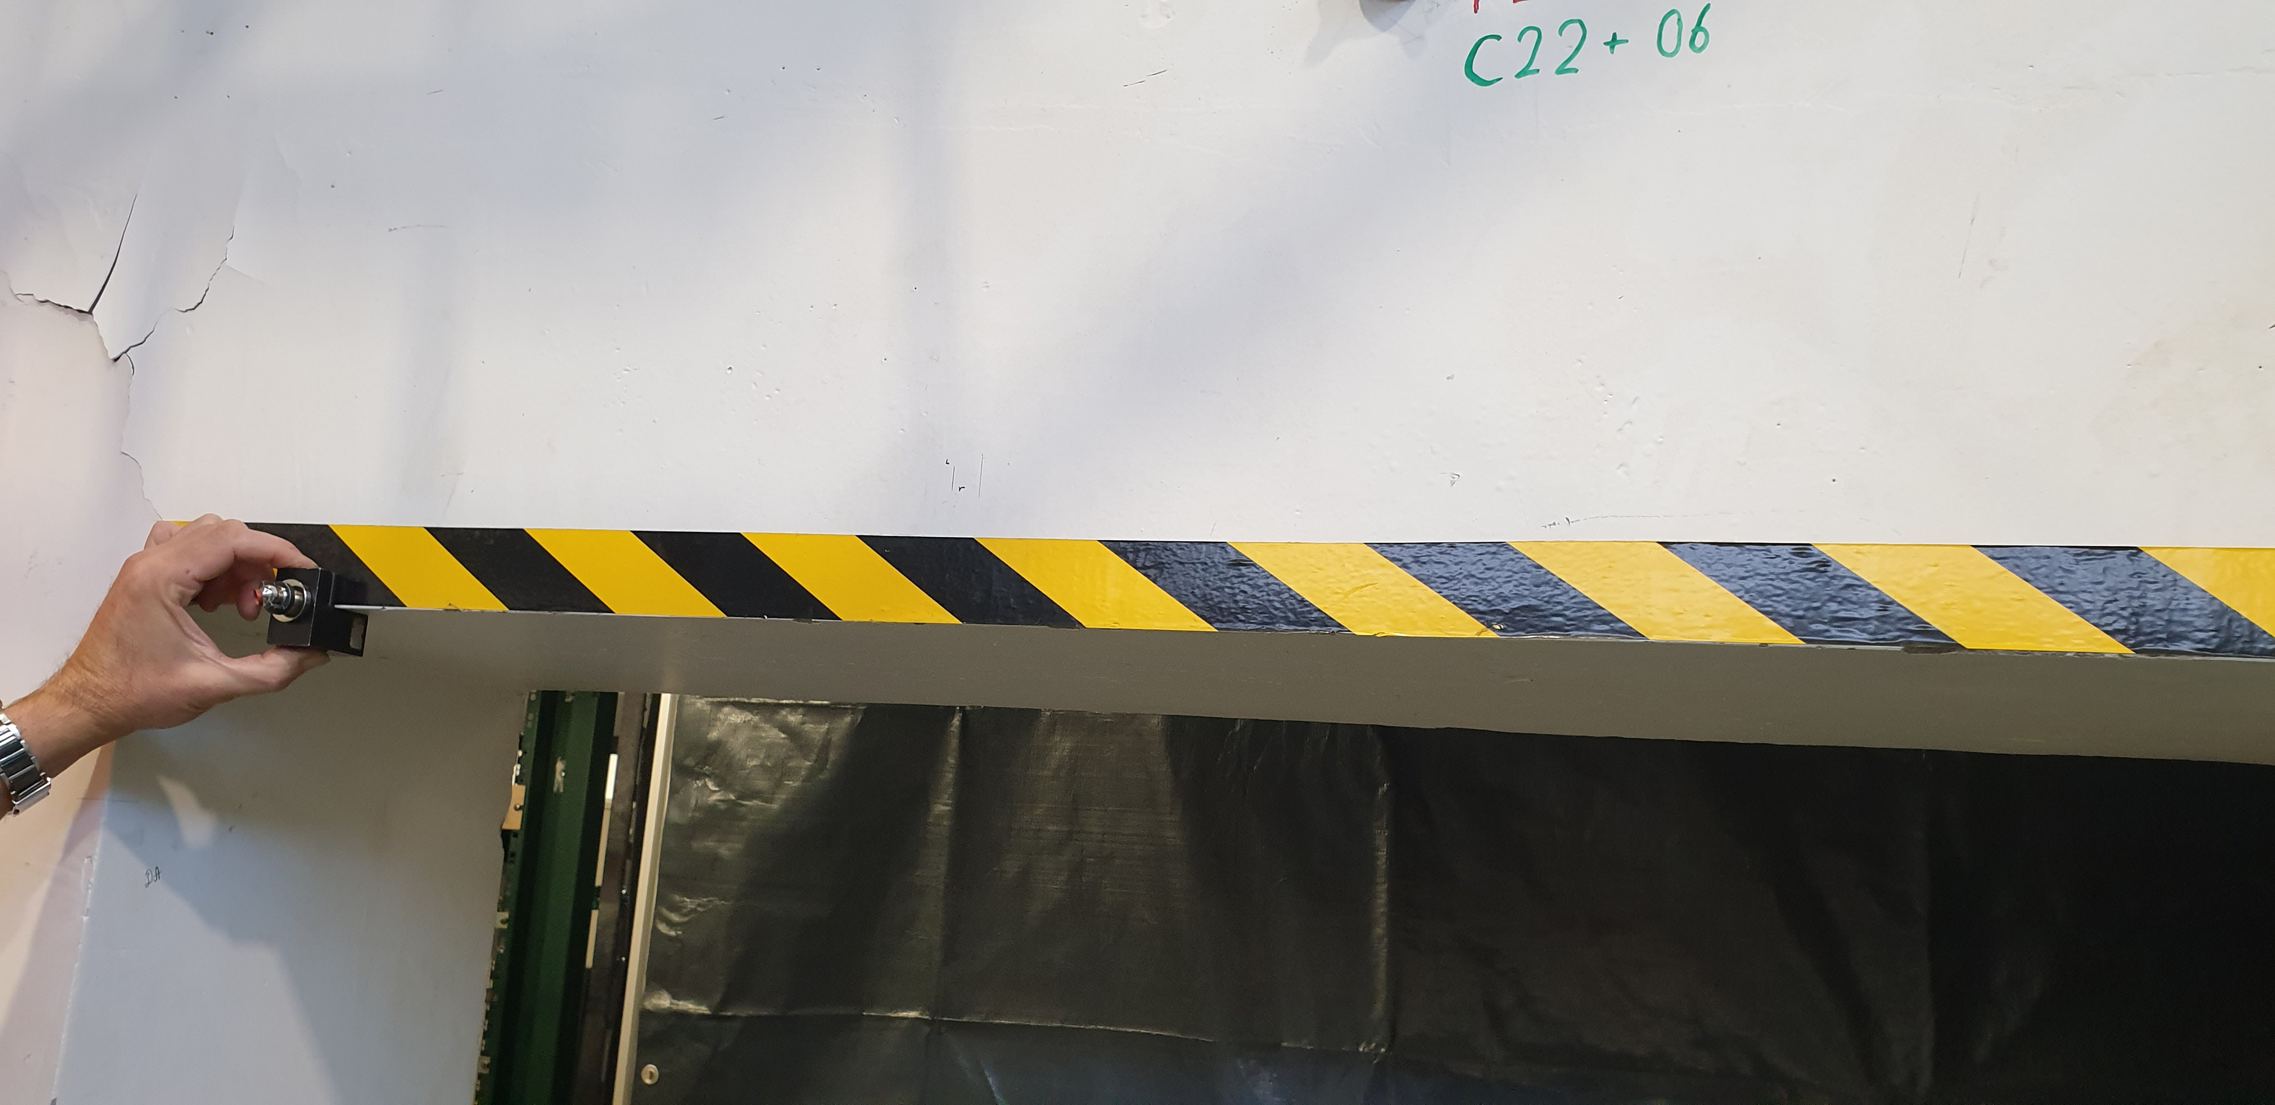
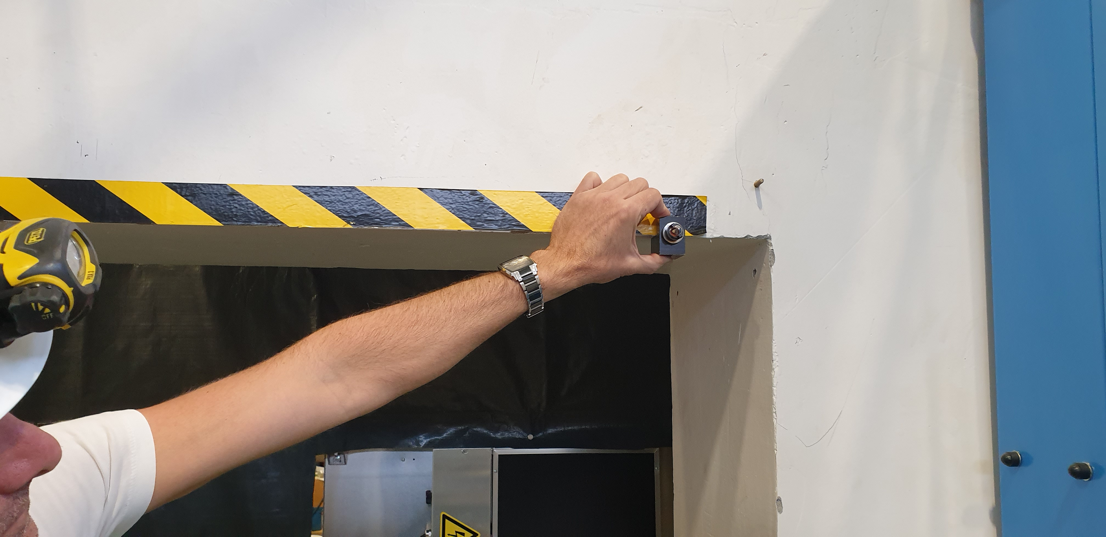
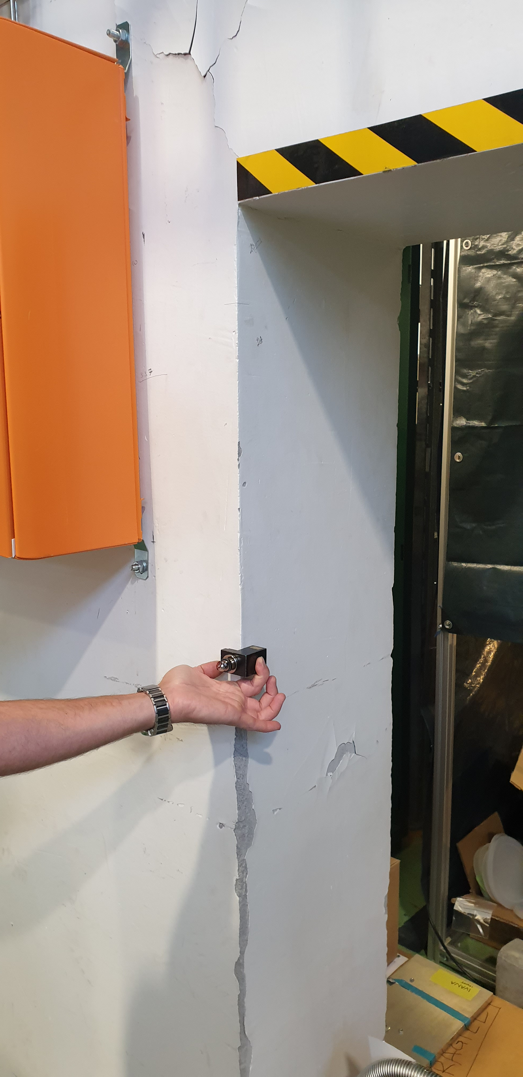
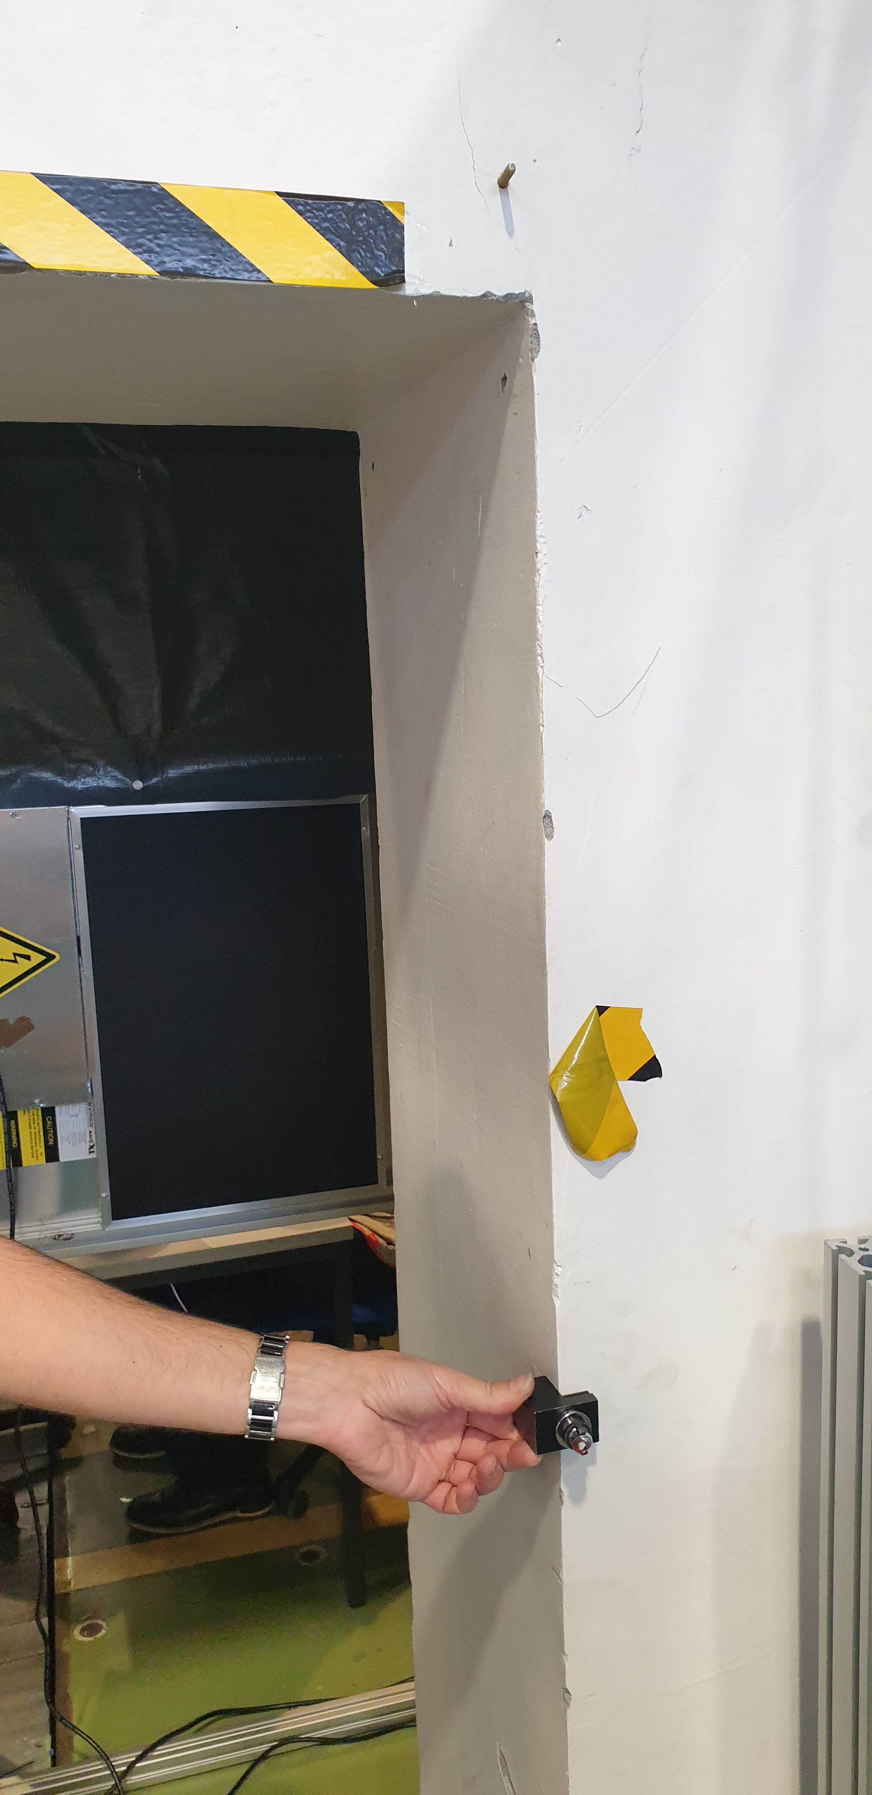
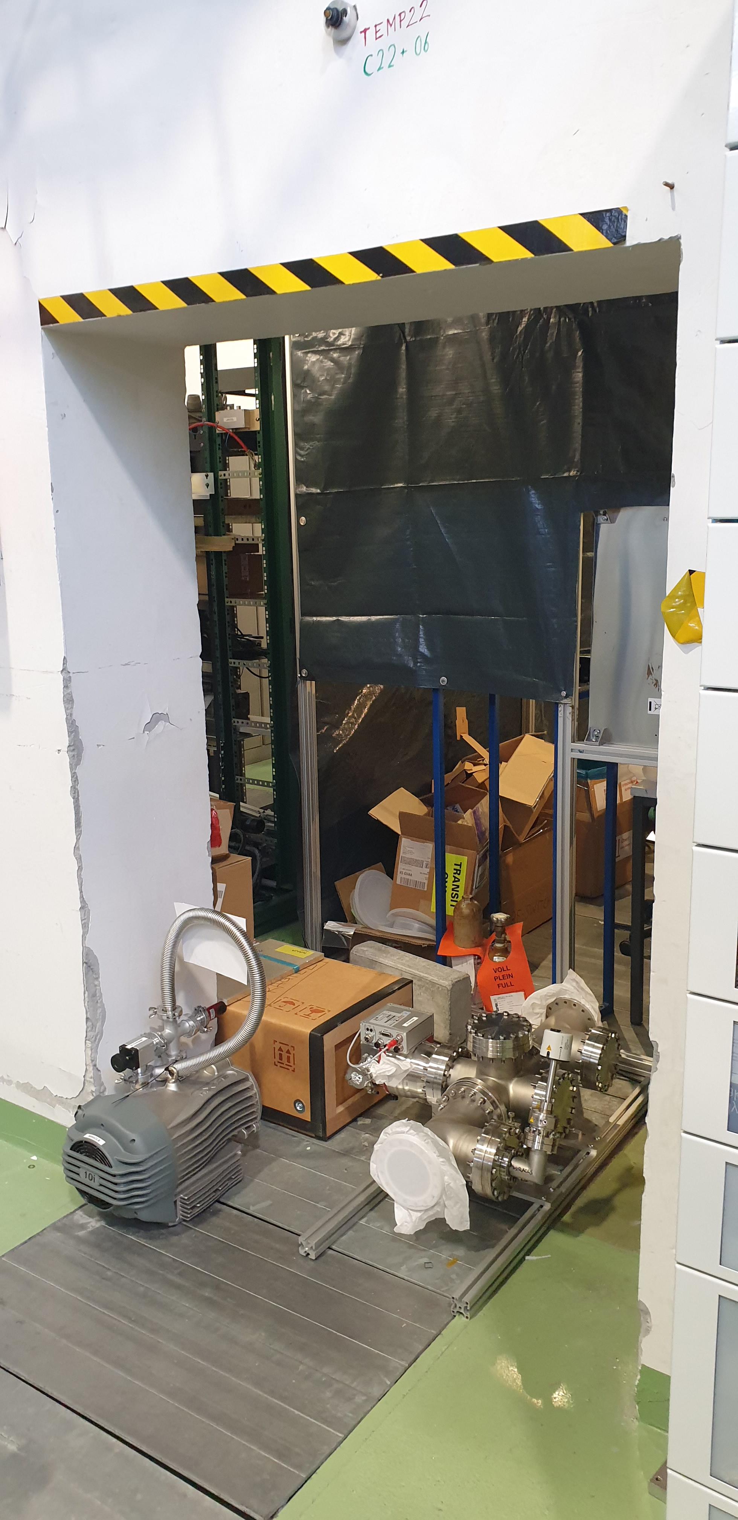
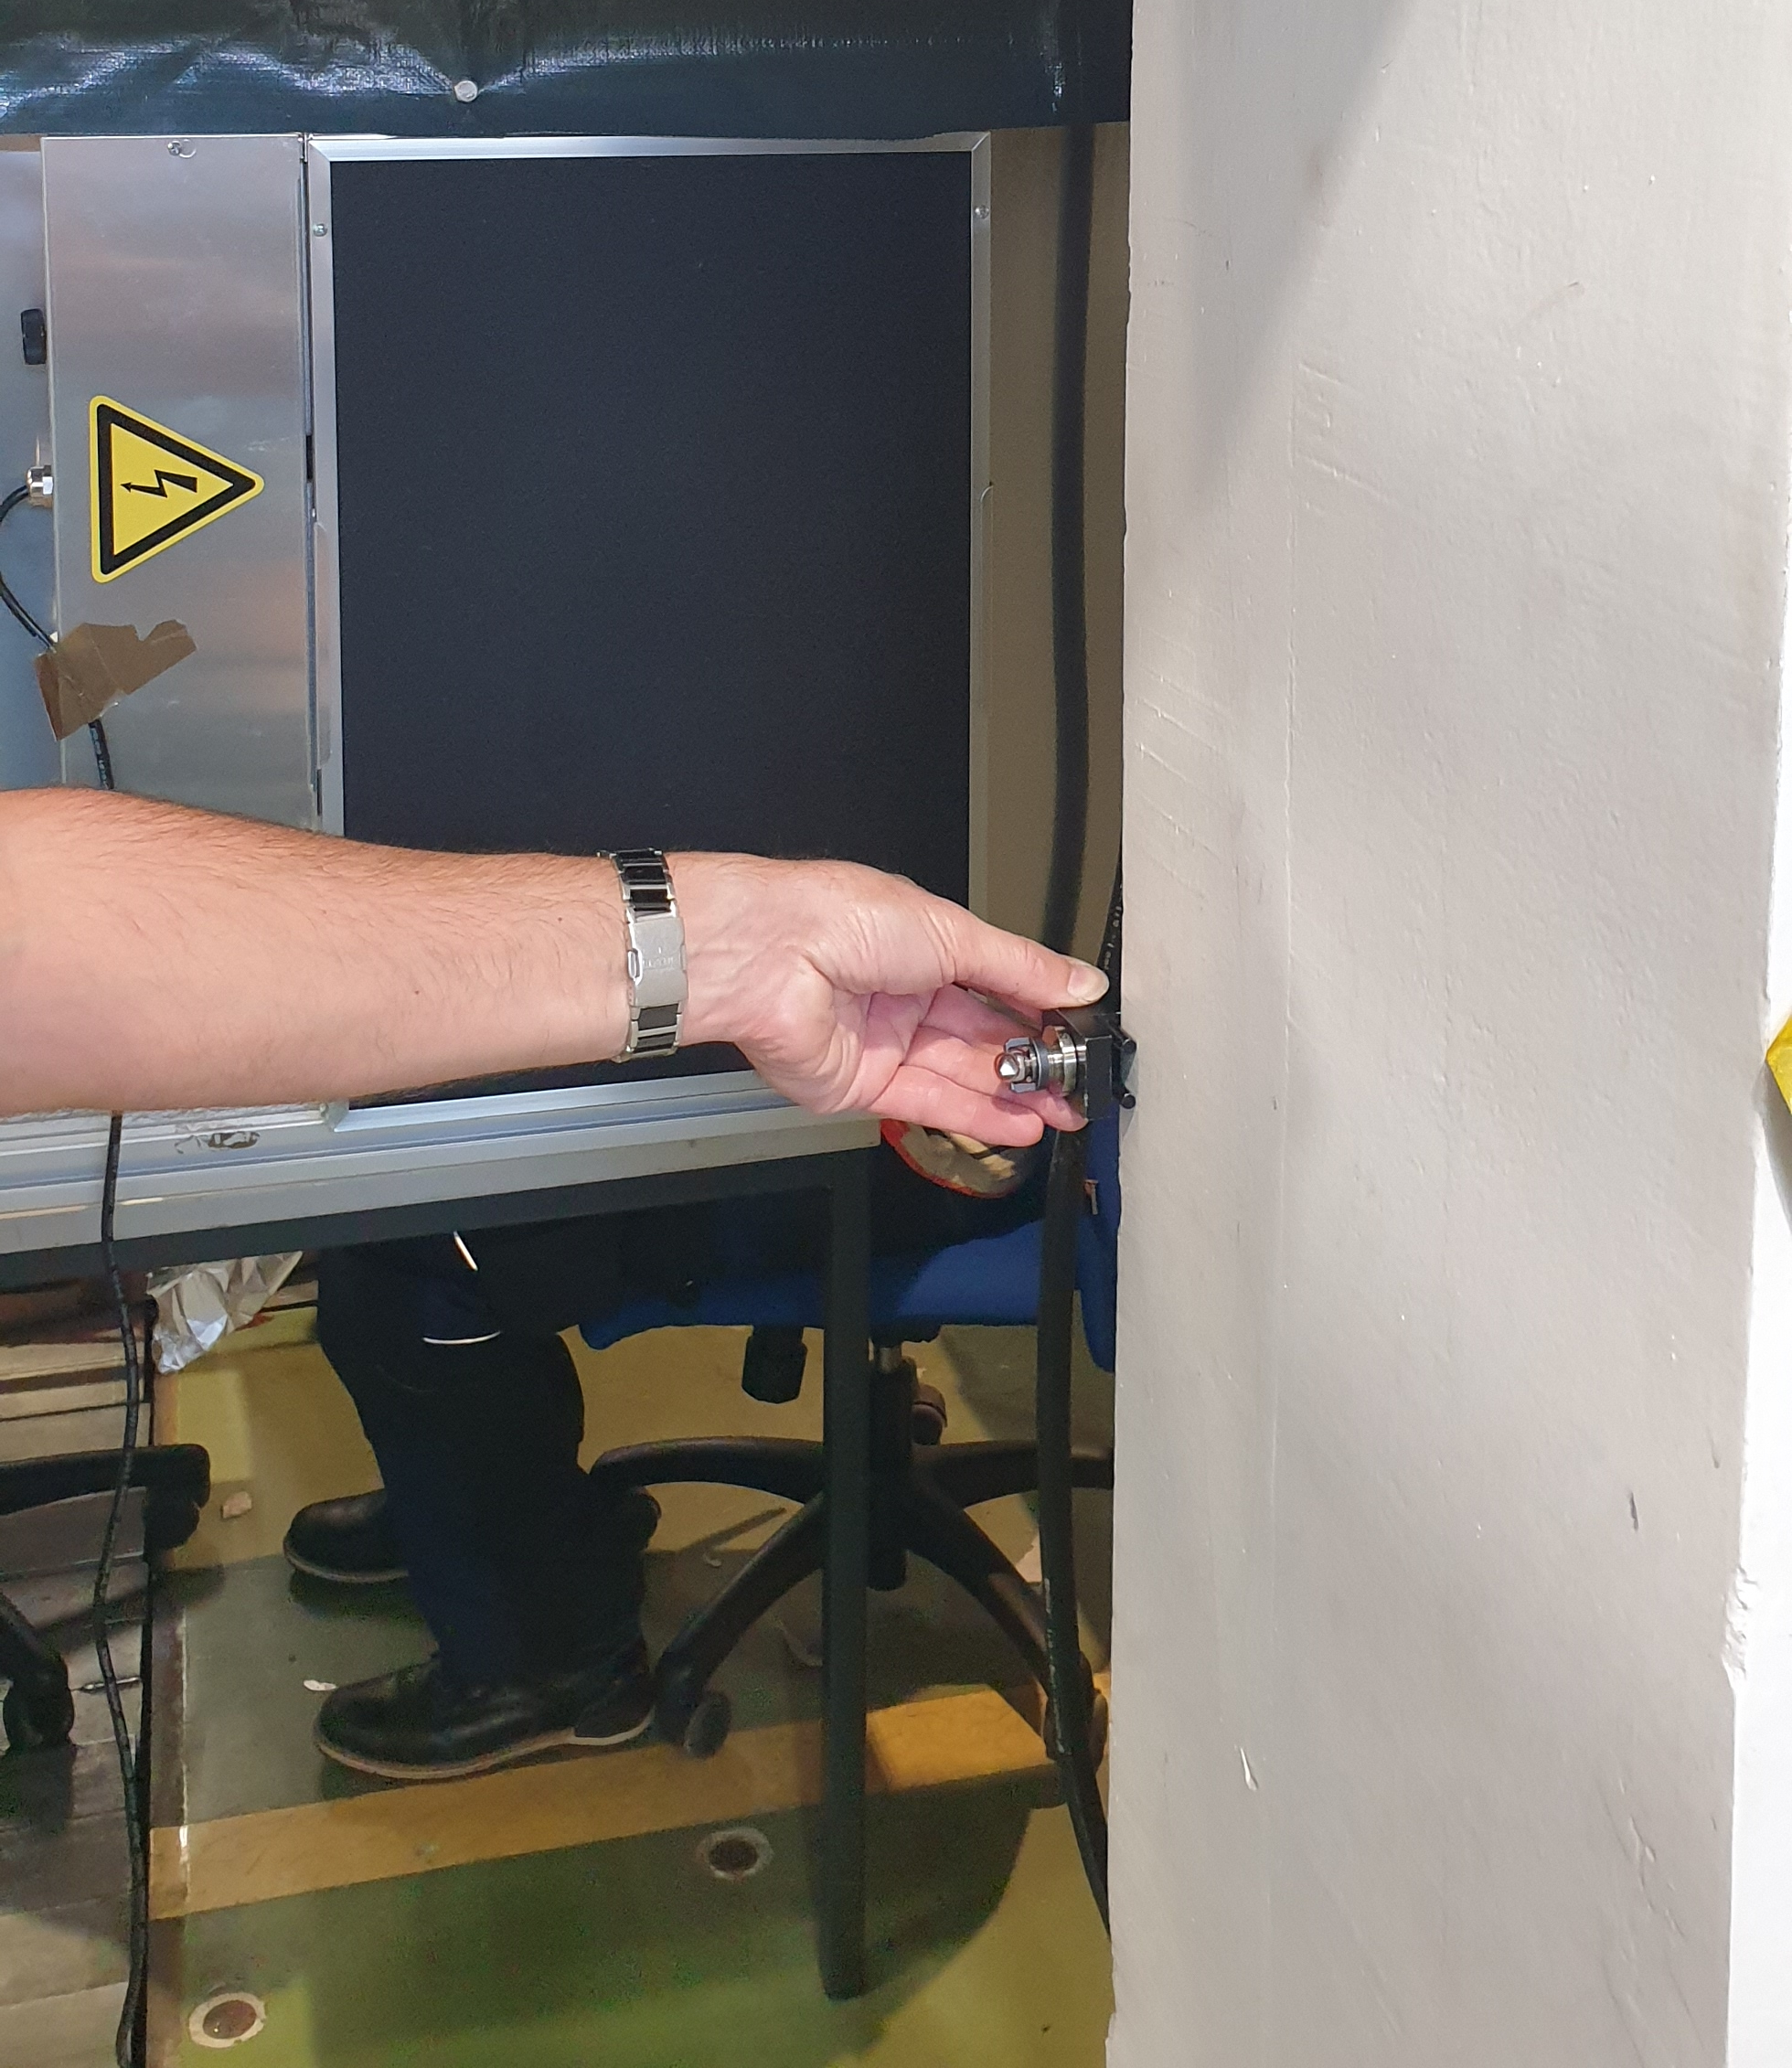
Wall cut-out

Slide 3
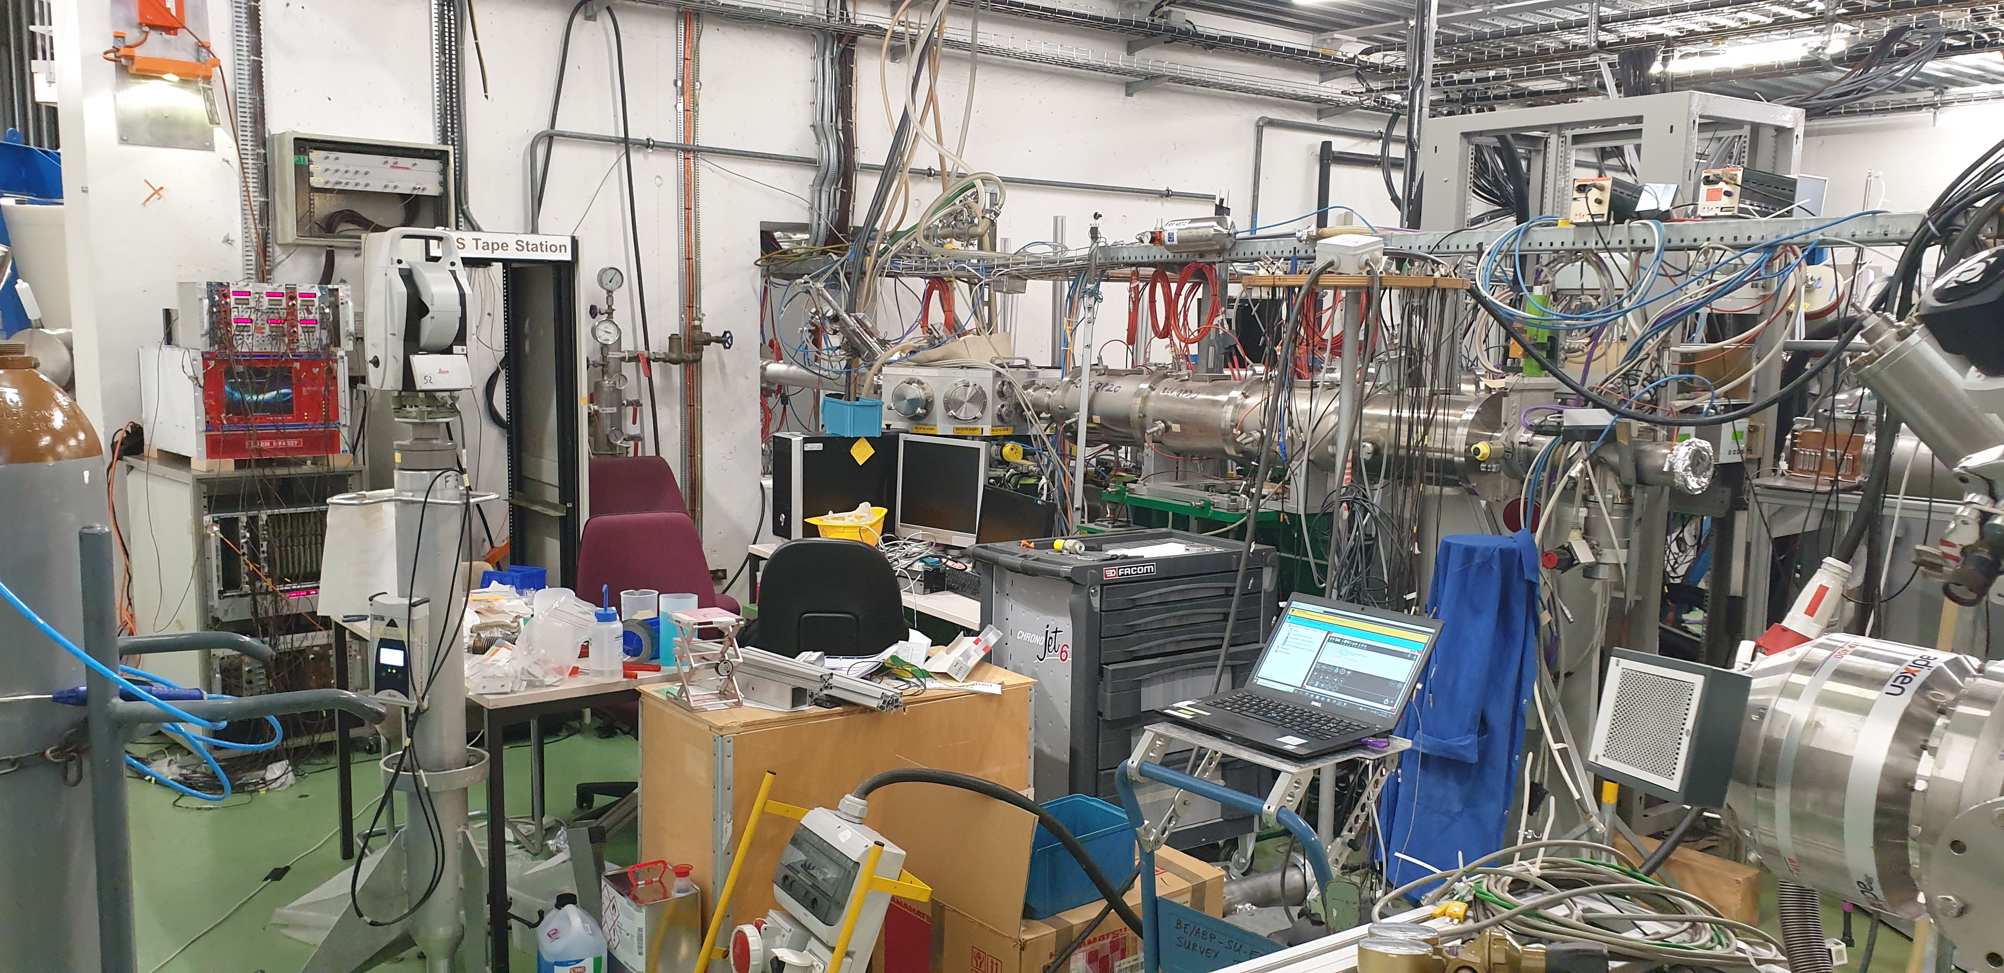
Crowded Area
Beam Scanner
/ Switchyard
Quadrupoles

Slide 4
Beamline upstream of PUMA
Beam Scanner
Quadrupole
Quadrupole
Switchyard
Quadrupoles
RC2.QP20
RC2.QS40
RCX10
RC6.QP20
RC6.QP30
Wall
Beamline

Slide 5
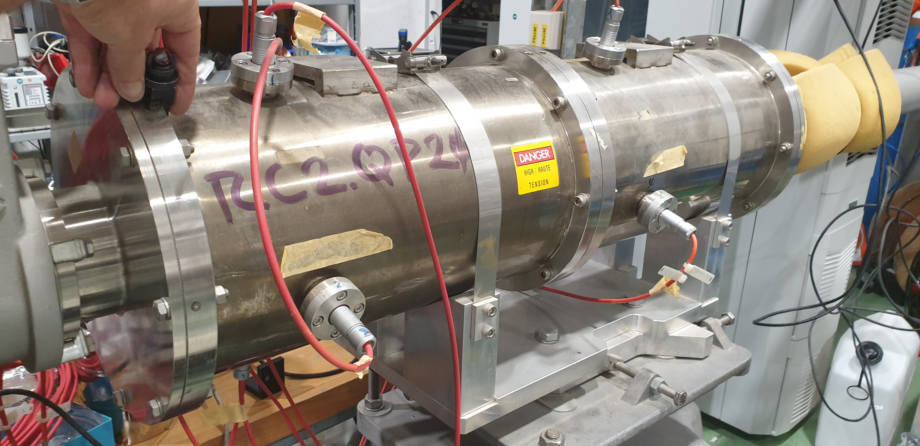
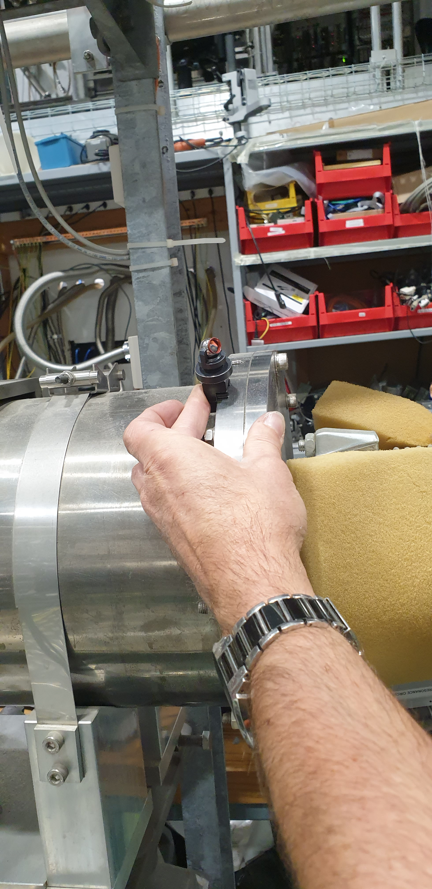
Quadrupole

Slide 6
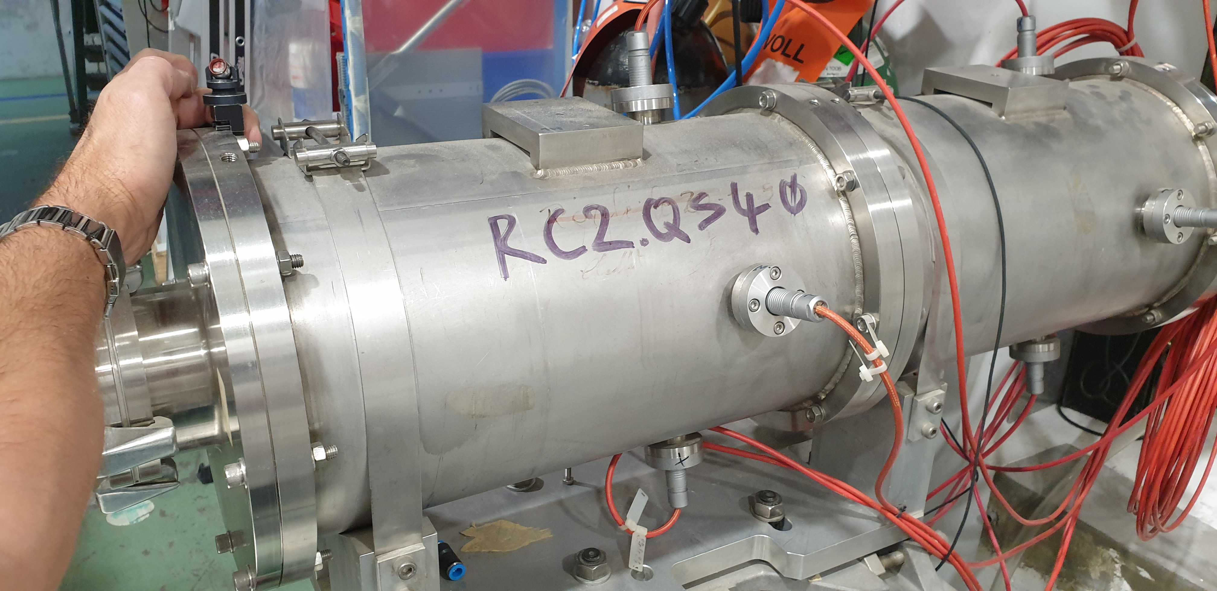
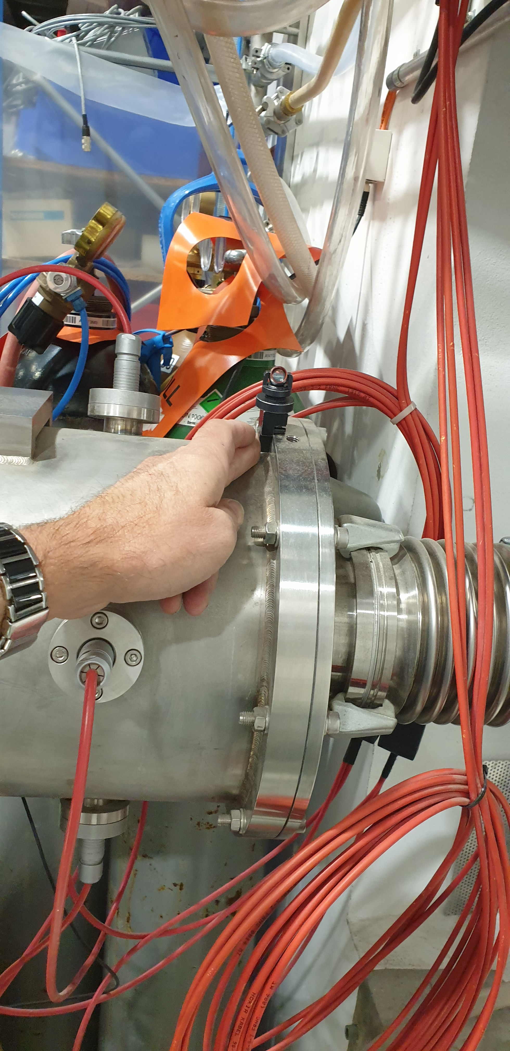
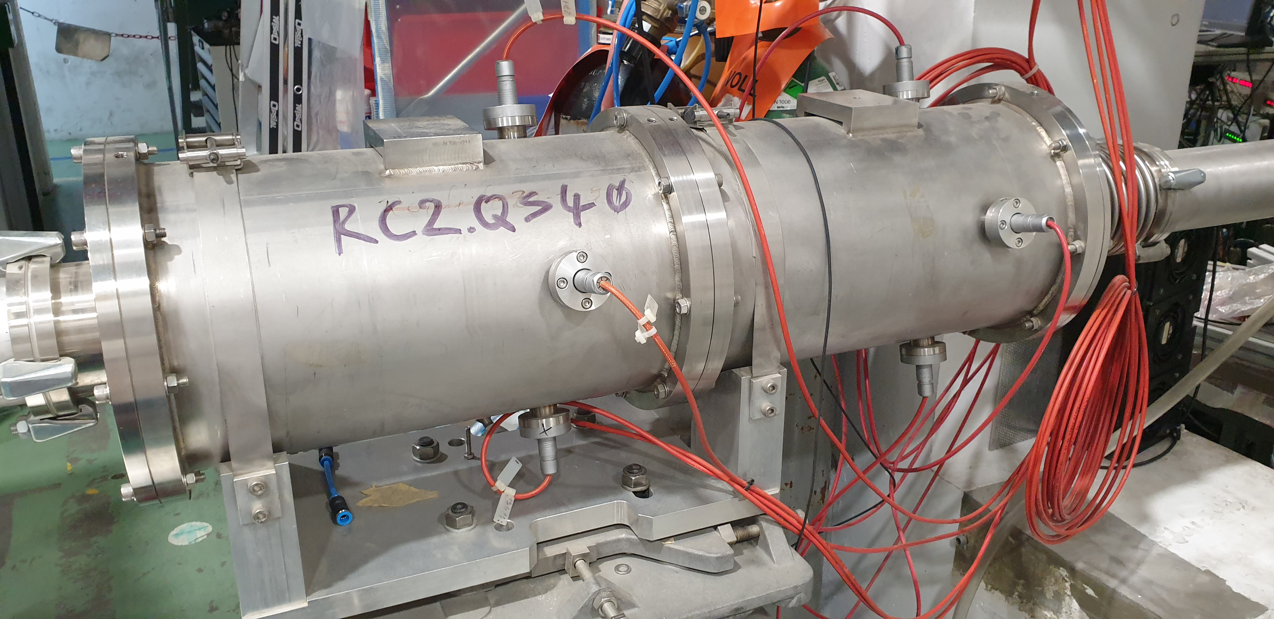
Quadrupole

Slide 7
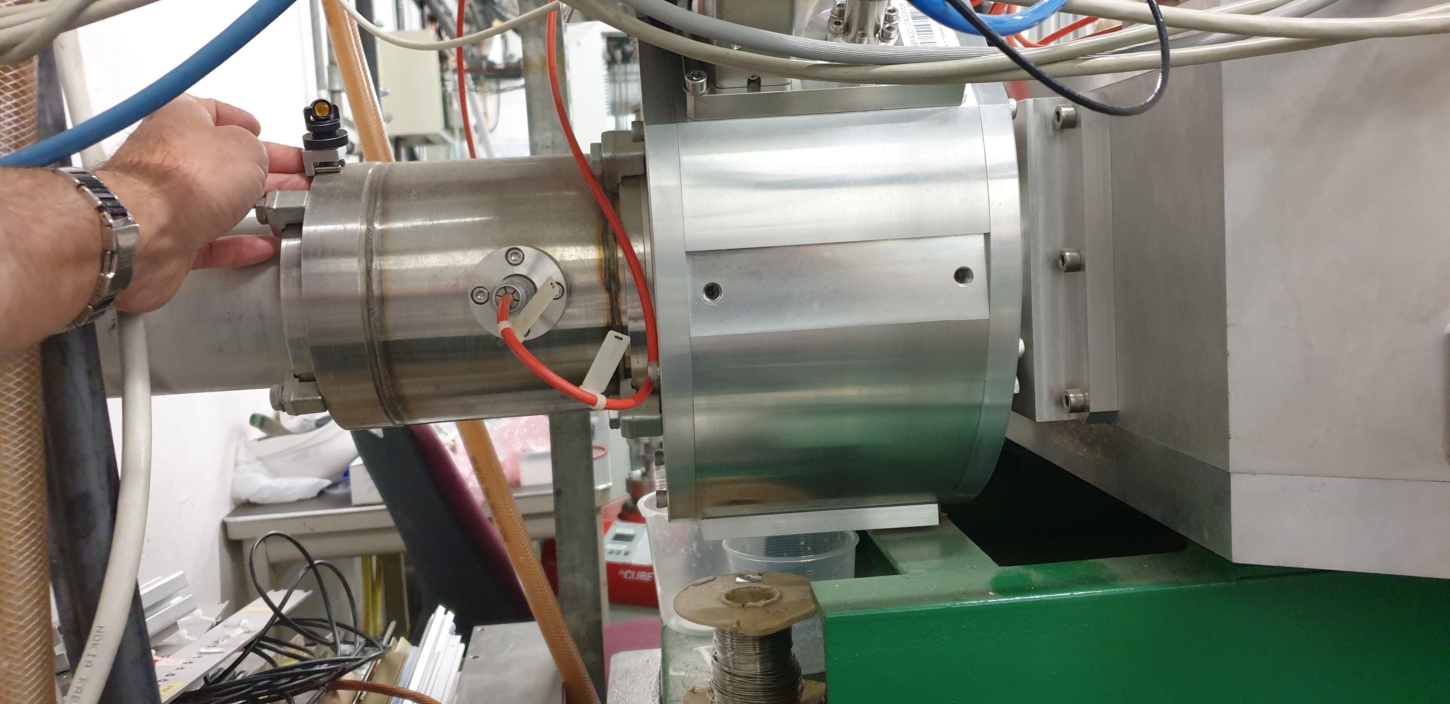
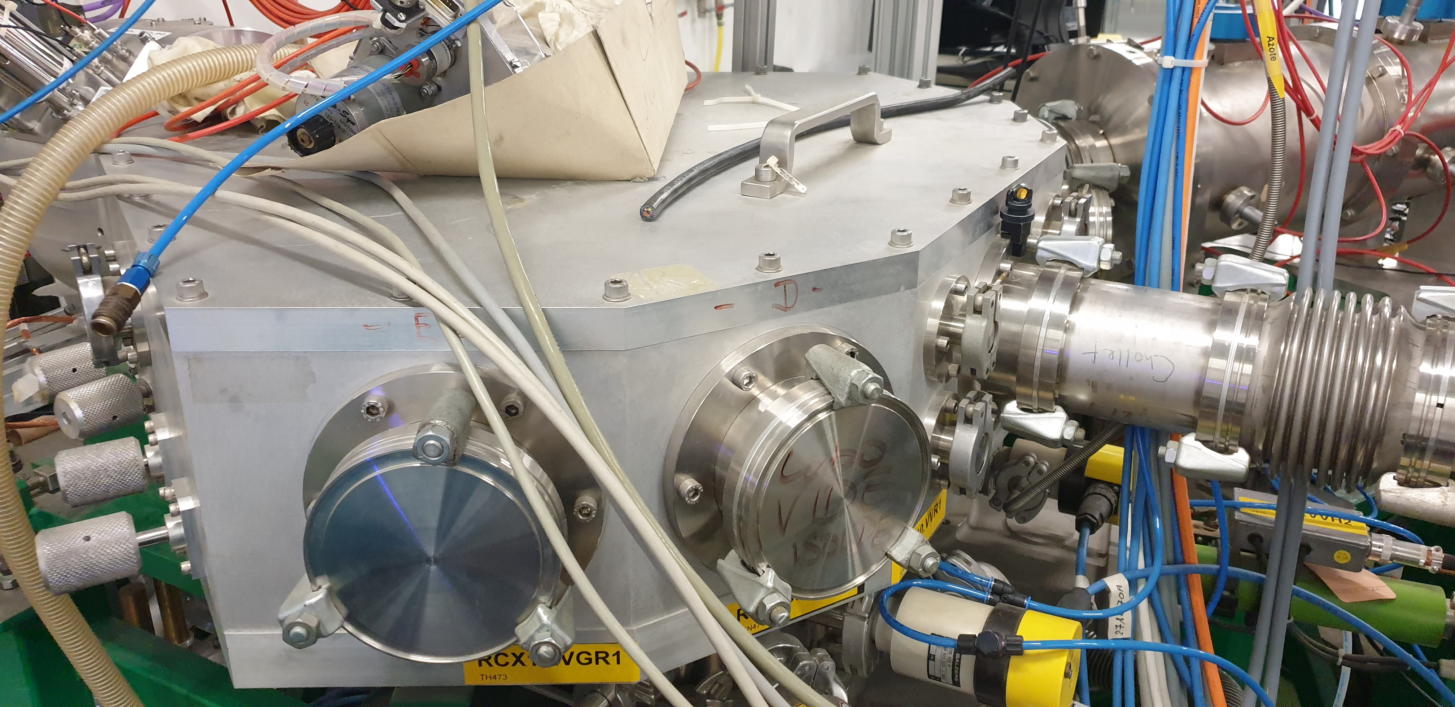
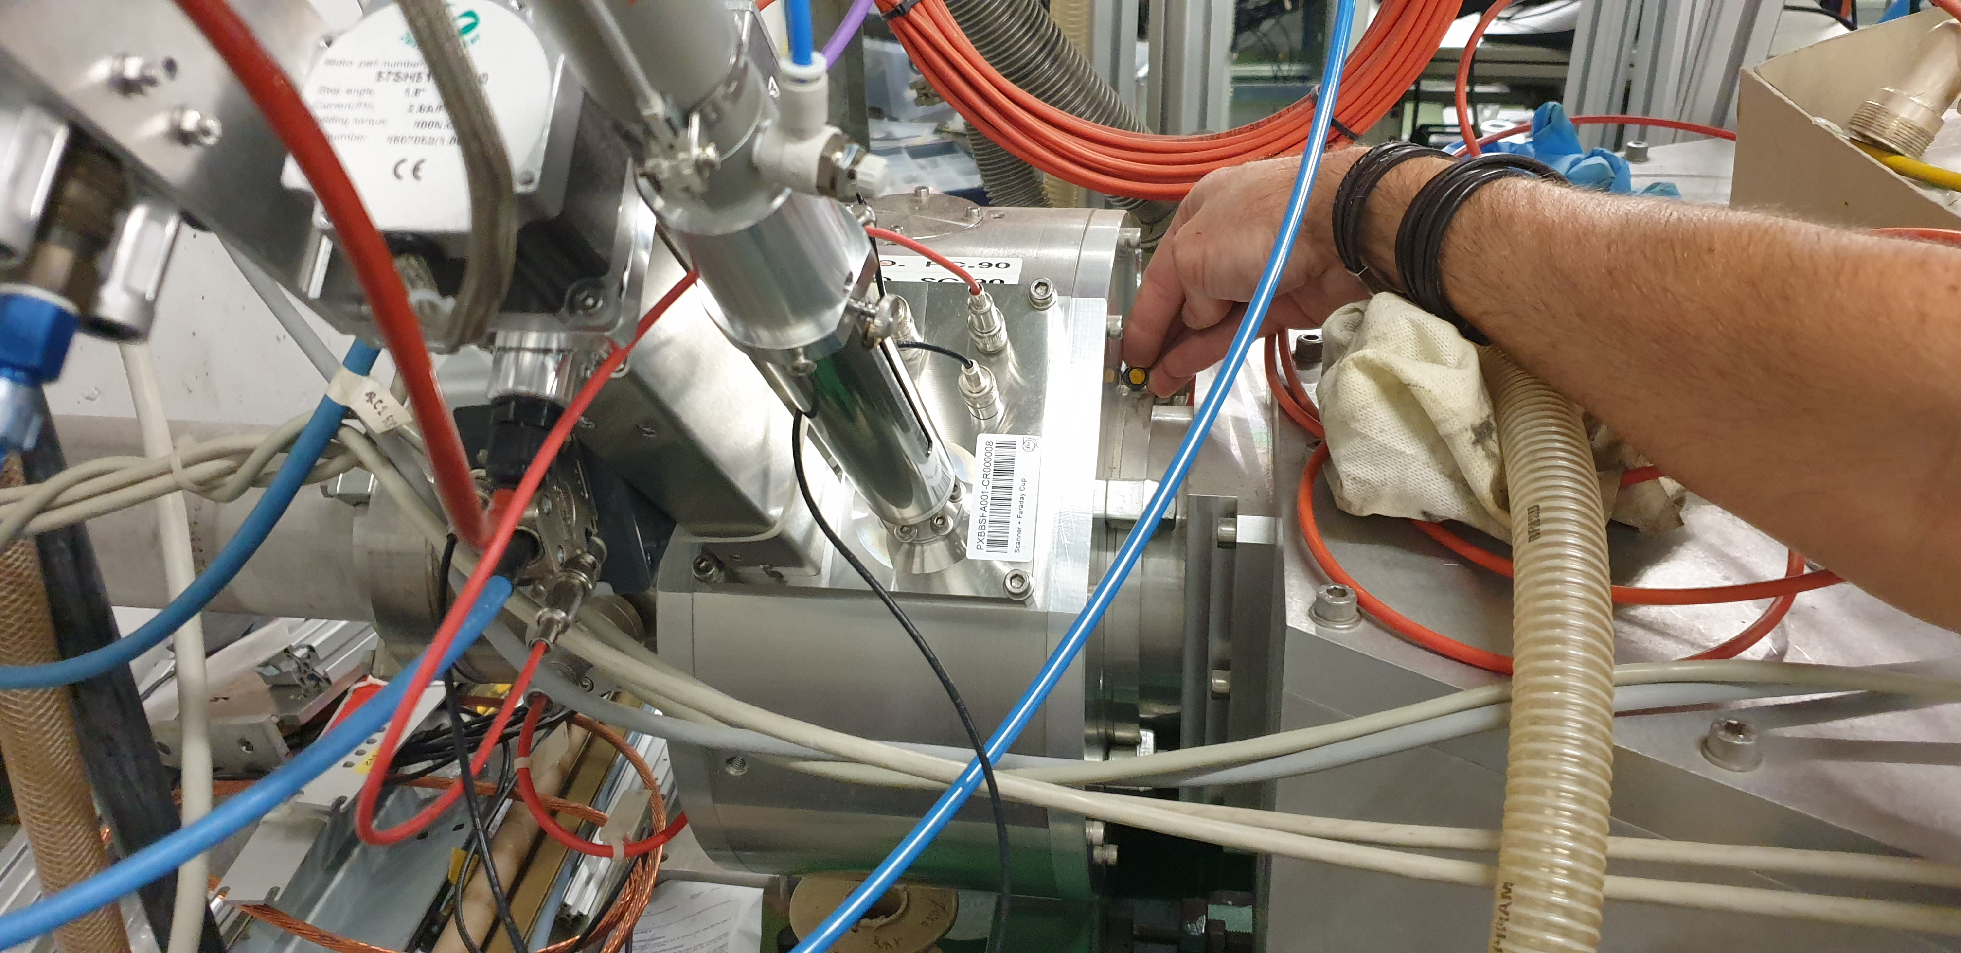
Beam Scanner / Switchyard

Slide 8
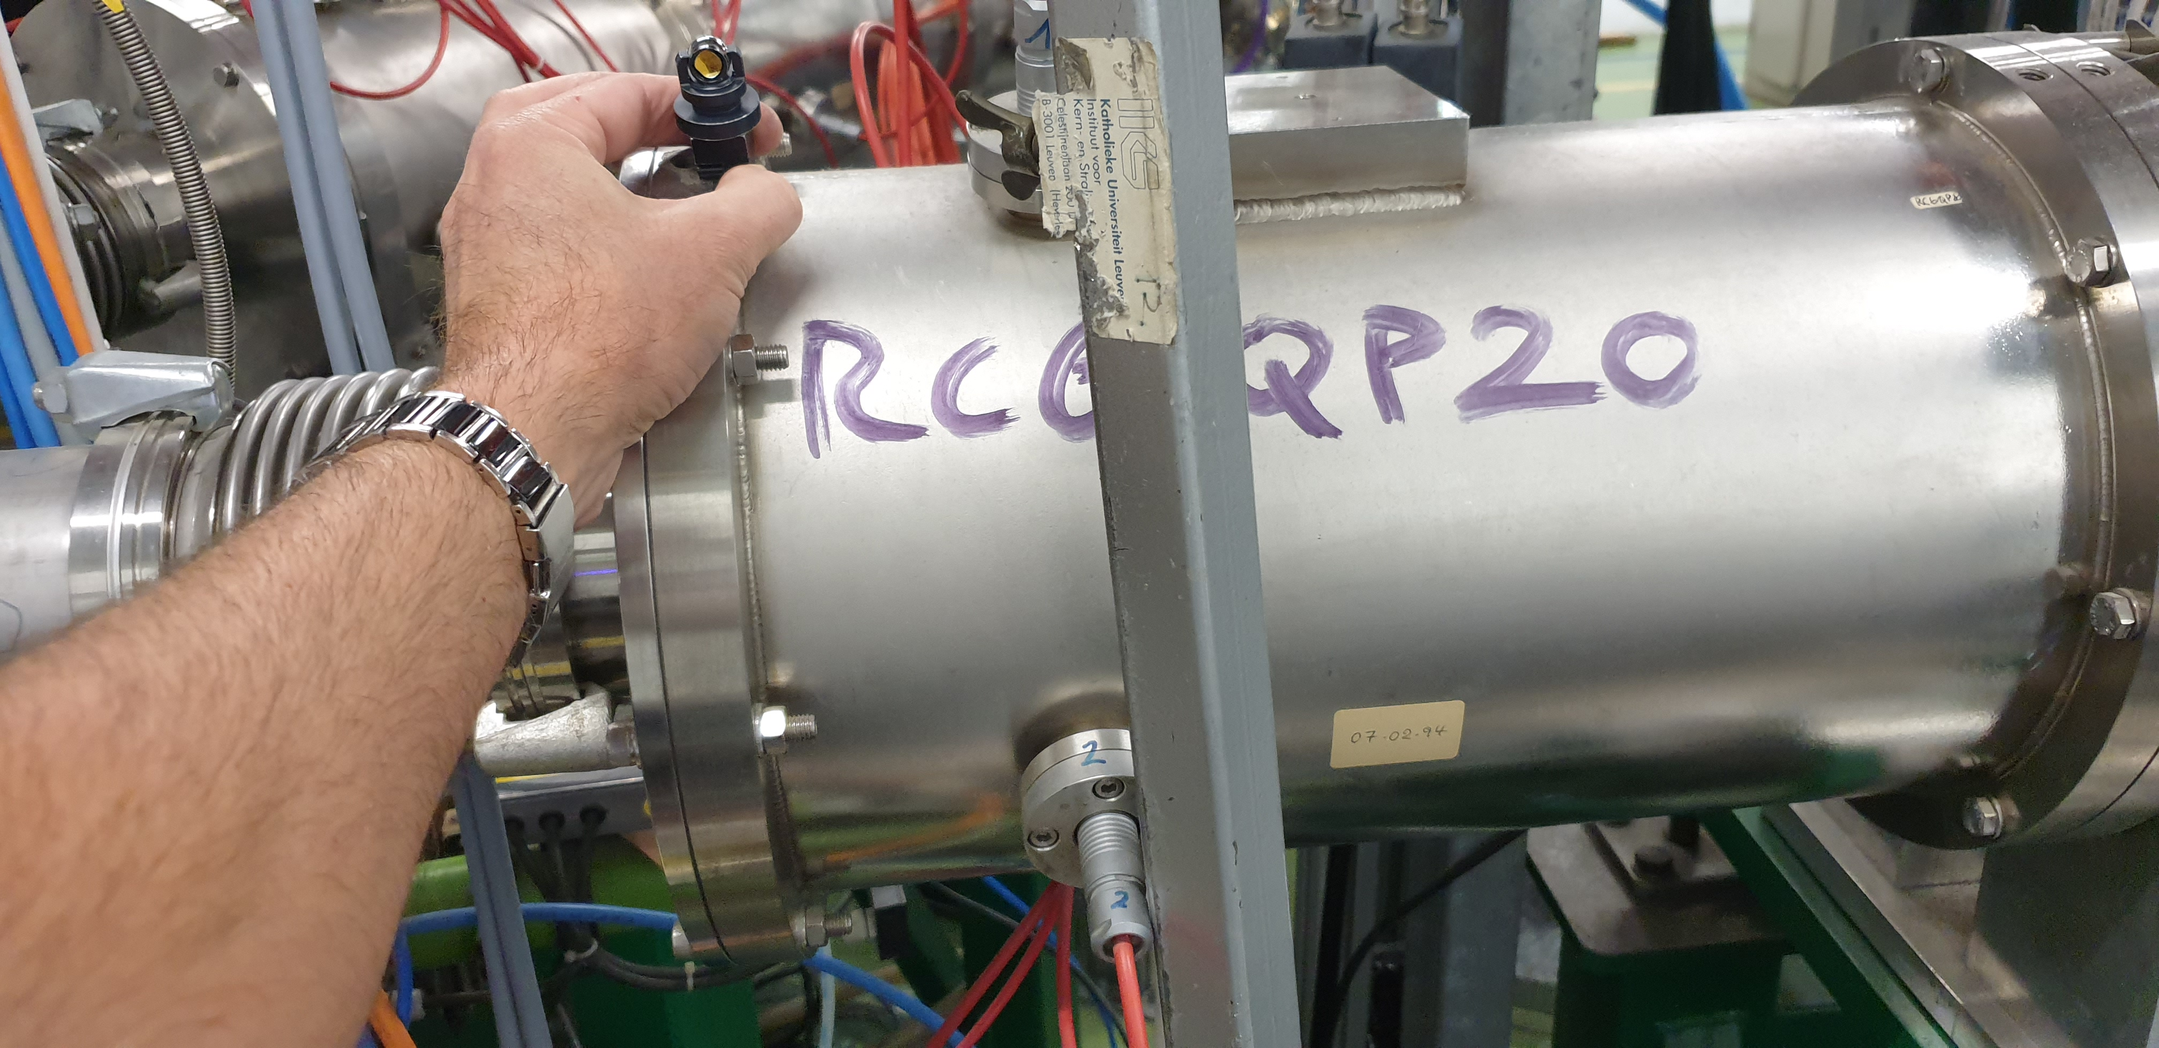
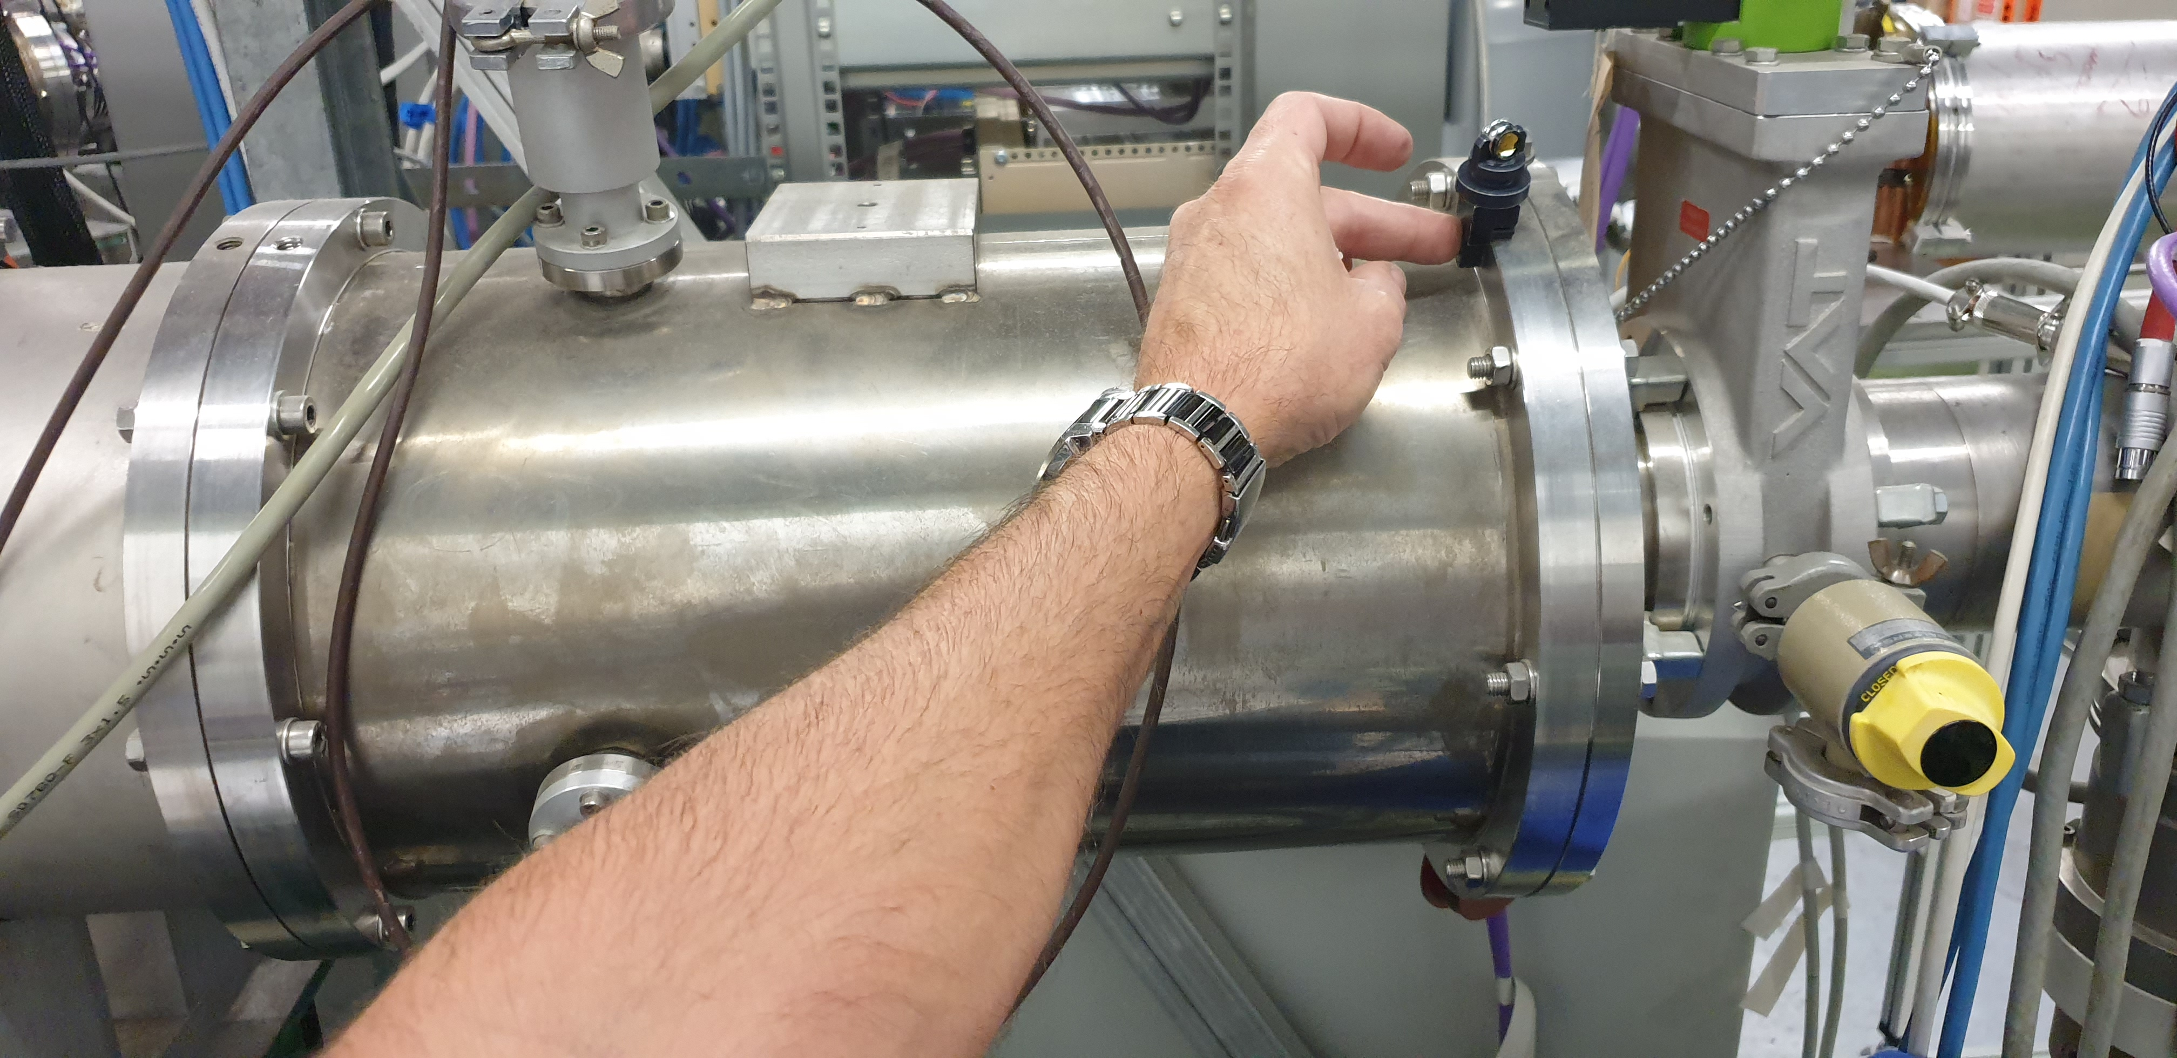
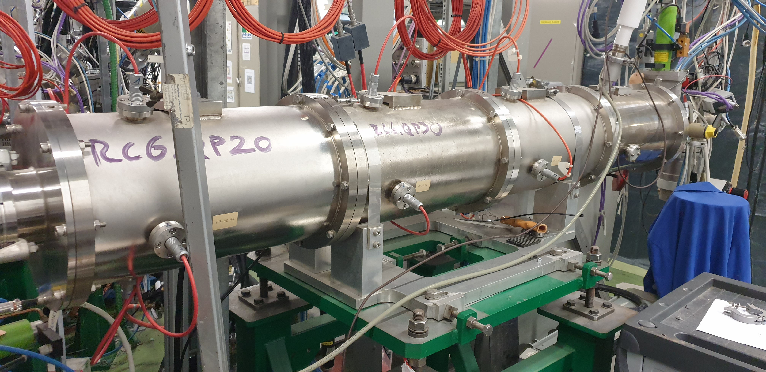
Quadrupoles

Slide 9
Results to mean line
Beam scanner
/ Switchyard
Beamline
Coordinates in CCS will be sent within report on EDMS.

