Slide 1
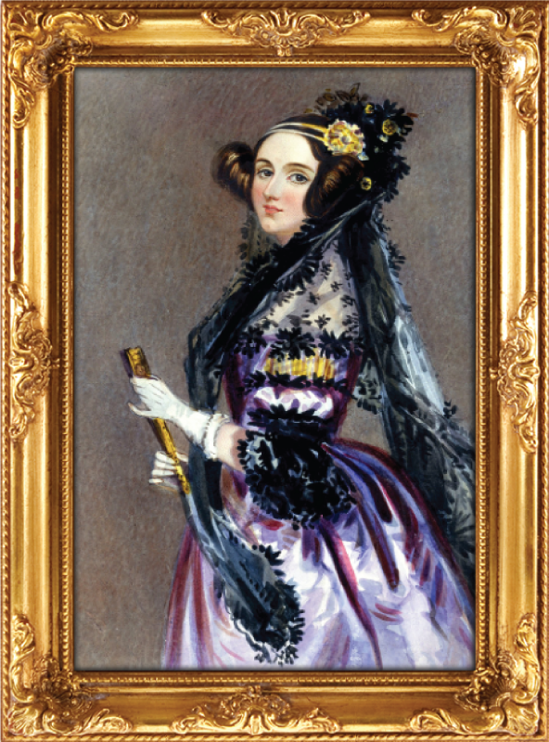
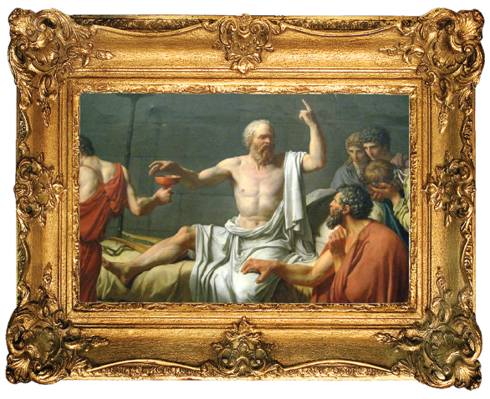

Technology is not neutral
So What? Now What?
Stephanie Hare @hare_brain

Slide 2
INTRODUCTION
WHAT IS TECHNOLOGY ETHICS?
  Mission (im)possible
  Ethics refresher
  Progress, negativity, neutrality?
THE DEBATE
  Technology is neutral
  Technology is not neutral
FROM DIAGNOSIS TO SOLUTION
  So what? Now what?
  Crash test dummies, chips

Slide 3
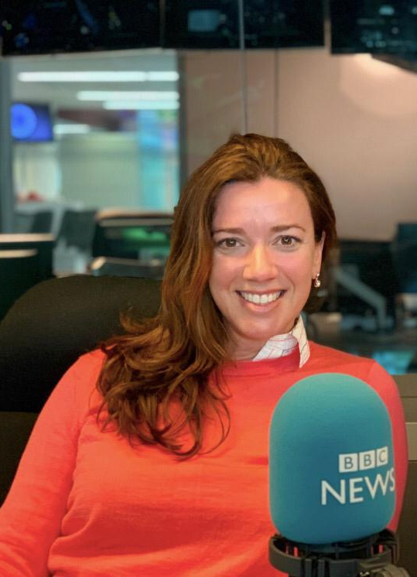




SPEAKER
EXPERIENCE
Researcher, broadcaster, author
Principal Director, Accenture Research
Strategist, Palantir
Visiting Fellow, St Antony’s College, Oxford
Senior Analyst, Oxford Analytica
Consultant, Accenture
EDUCATION
PhD, International History, LSE
MSc, Theory and History of International Relations, LSE
BA Liberal Arts and Sciences, University of Illinois at Urbana Champaign/ la Sorbonne
INFLUENCES
Notes:
https://www.harebrain.co/books

Slide 4
Our 2-day AGENDA
Technology ethics explores a question that no one has been able to answer to anyone's satisfaction: how can we create and use technologies that maximise benefits and minimise harm? This two-day lecture series will demonstrate how philosophy is a powerful tool that we can use to make and use technology more ethically.
On day 1, we will consider the question "Is technology neutral?" and examine a debate between various experts who take different sides on this question. Our aim is not to agree with them (or even with each other!) but rather to map out the different ways we can answer the question and apply it to our lives.
On day 2, we will practice putting technology ethics into action by considering technologies that are used today for their undeniable benefits -- yet which pose serious ethical problems that we cannot afford to ignore. We will diagnose their risks and opportunities and propose solutions, drawing on examples that range from the surprisingly straightforward to those which do not have one solution or cannot be solved only once.
Notes:
https://www.harebrain.co/books

Slide 5
INTRODUCTION
WHAT IS TECHNOLOGY ETHICS?
  Mission (im)possible
  Ethics refresher
  Progress, negativity, neutrality?
THE DEBATE
  Technology is neutral
  Technology is not neutral
FROM DIAGNOSIS TO SOLUTION
  So what? Now what?
  Crash test dummies, chips

Slide 6
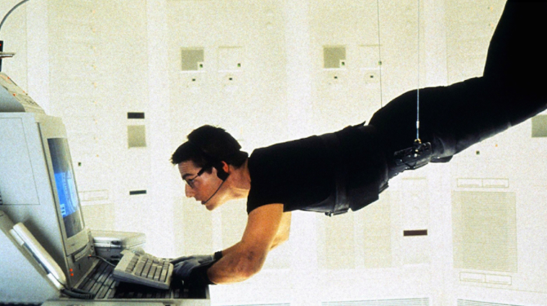
Mission (im)possible
How to create and use technologies so that they deliver
maximum benefit + minimum harm?

Slide 7

Philosophy As a Tool
Political Philosophy
Logic
Epistemology
Metaphysics
Philosophy
Aesthetics
Ethics

Slide 8
Philosophy as software of the mind
Philosophy
Metaphysics
Epistemology
Logic
Ethics
Aesthetics
Political Philosophy
Meta
Comparative
Normative
Applied
What does 'right' even mean?
What do people think is right?
How should people act?
How do we put ethics into action?

Slide 9

Progress, negativity, neutrality?
“
When you invent the ship, you also invent the shipwreck;
when you invent the plane you also invent the plane crash; and when you invent electricity, you invent electrocution...
Every technology carries its own negativity, which is invented at the same time as technical progress.
”
Paul Virilio, Politics of the Very Worst: An Interview with Philippe Petit, edited by Sylvère Lotringer, translated by Michael Cavaliere (New York: Semiotext(e), 1999, p. 89).

Slide 10
INTRODUCTION
WHAT IS TECHNOLOGY ETHICS?
  Mission (im)possible
  Ethics refresher
  Progress, negativity, neutrality?
THE DEBATE
  Technology is neutral
  Technology is not neutral
FROM DIAGNOSIS TO SOLUTION
  So what? Now what?
  Crash test dummies, chips

Slide 11
Experts who argue that technology is Neutral

Slide 12
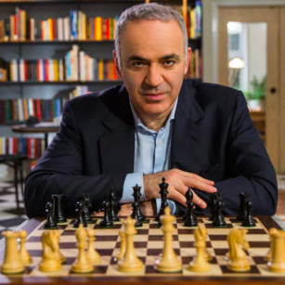
Gary Kasparov
Chess grandmaster + author of Deep Thinking: Where Machine Intelligence Ends and Human Creativity Begins
“
Tech is agnostic*, it amplifies us.
‘Ethical AI’ is like ‘ethical electricity’.
*By ‘agnostic’, Kasparov means that technology that works across any platform, protocol or device without requiring any adaptation.
”
Notes:
Garry Kasparov on Twitter, 16 January 2019: “AI ethics are human ethics. Tech is agnostic, it amplifies us. “Ethical AI” is like “ethical electricity”. Jake Smeester, “Agnostic Technology: Platform, Protocol, and Device”, blog for ThingLogix, 4 August 2015 < https://www.thinglogix.com/agnostic-technology/ >

Slide 13
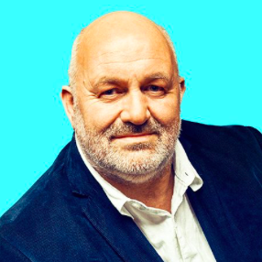
Werner Vogels
Chief Technology Officer @ Amazon
‘Mr Vogels doesn’t feel it's Amazon’s responsibility to make sure Rekognition is used accurately or ethically.
“That’s not my decision to make,” he tells me. “This technology is being used for good in many places. It’s in society’s direction to actually decide which technology is applicable under which conditions. “It’s a societal discourse and decision - and policy-making - that needs to happen to decide where you can apply technologies.”
He likens ML and AI to steel mills:
Sometimes steel is used to make incubators for babies, he says, but sometimes steel is used to make guns.
“
”
Notes:
-- “Amazon’s next big thing may redefine big,” BBC, 2019

Slide 14

Professor Daniela Rus
Director of the Computer Science and AI Lab @ MIT
“
I’m a roboticist. Now when I tell people what I do, I get one of two types of reactions. Some people get anxious. They make jokes about Skynet. And they ask me, ‘When will the robots take over my job?’ And then other people get very excited and ask me, ‘When will my car be self-driving?’
Well, I belong to the second group. But I believe it’s very important to understand the concerns of the first group and provide ideas and suggestions for how to see things differently.
And this starts with understanding that AI and robotics and machine learning are tools. They are just tools, by the people, for the people. They are incredibly powerful tools. But like any other tools, they’re not good or bad. They are what we choose to do with them.
”

Slide 15

Paul daugherty
Chief Technology + Information Officer @ Accenture
“
Is technology, and Artificial Intelligence, good or bad?
The answer is NEITHER. Technology is neutral, AI is neutral.
The way ‘we’, as humans, apply and use the technology is what defines if the impact is good or bad. [….]
Given the increasingly pervasive, and invasive, impact of technology on the way we work and live, ETHICS is no longer a peripheral issue in business, nor something you think about after the fact. The choices we make are critical.
Ethics must be core to a company’s strategy, culture, operations, and technology.
”
Notes:
Paul Daugherty, Chief Technology and Innovation Officer at Accenture, takes a similar view. In April 2019, while accepting on behalf of Accenture the award for the ‘Corporate Honoree for Ethical Leadership’ from the Fellowships at Auschwitz for the Study of Professional Ethics (FASPE), he said. Paul Daugherty, “A Call for Ethical Leadership in Technology and Business”, speech to accept on behalf of Accenture the ‘Corporate Honoree for Ethical Leadership’ award from the Fellowships at Auschwitz for the Study of Professional Ethics (FASPE) 16 April 2019 < https://www.linkedin.com/pulse/call-ethical-leadership-technology-business-paul-daugherty/ > All of the formatting (e.g. capitalization of ‘NEITHER’, bolding of The way) is in Daugherty’s original text.

Slide 16
Experts who argue that technology is nOT Neutral

Slide 17
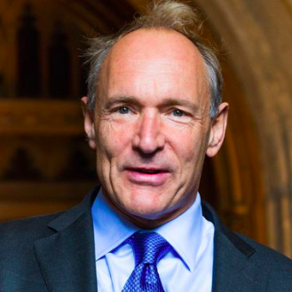
Sir Tim Berners-Lee
Creator of the World Wide Web
“
As we’re designing the system, we’re designing society. Ethical rules that we choose to put into that design [impact society]…
Nothing is self-evident. Everything has to be put out there as something that we think will be a good idea as a component of our society.
”

Slide 18

Caroline Criado Perez
Author of the prize-winning Invisible Women: Exposing Data Bias in a World Designed for Men
“
Technological innovation overwhelmingly ignores women at every stage, from the mainly male composition of the teams that fund and create technologies, to the absence (sometimes deliberate, often unthinking) of women’s data in data science, product design and implementation, and policymaking.
”
Notes:
Annoying: supposedly gender-neutral products that ignore the difference in average male and female hand sizes (e.g. smart phones) and voice and speech recognition technologies that function worse – or not at all – on women’s voices, which reduces the effectiveness of voice assistants.
Life-threatening: Voice recognition software in cars is meant to make driving safer, but it doesn’t work as well for women’s voices, which is a problem with the technology, not with women’s voices, a point we might think does not need making except that Tom Schalk, the vice president of voice technology system supplier ATX, said that women “need lengthy training” to use his company’s tool. Similarly, speech recognition software used by attending emergency physicians has higher error rates for women than men, which endangers the lives of everyone in their care.

Slide 19
Professor Sheila Jasanoff
Science & Technology @ Harvard, author of The Ethics of Invention
“
The same technologies can be found from Kansas to Kabul, but people experience them differently depending on where they live, how much they earn how well they are educated, and what they do for a living.
The ‘default human’ for whom most technologies and tools are designed is almost always a man, often a white, heterosexual man of a certain body shape and size, and assuming a globality that simply does not exist.
This matters, Jasanoff explains, because the difference in impact is not limited to how we individually experience technological innovation; it can also change our relationships with one another, and even with our environment.
”

Slide 20

Professor Safiya noble
Co-Director of the Center for Critical Internet Inquiry @ UCLA + author of Algorithms of Oppression: How Search Engines Reinforce Racism
“
Algorithms are not nameless, faceless bots … behind every algorithm are real people who bring their own biases to the inner workings of the web.
”
Notes:
https://www.vogue.com/article/safiya-noble
In the past, Noble writes, Google’s photo application automatically tagged African Americans as apes and animals, and Google Maps searches for the N-word directed users to the White House during the Obama presidency.
Florida’s Pasco Country sheriff’s office buying what Noble calls “snake oil software” intended to predict who would commit crime in the community, then harassing families and children based on its results, or ​​the algorithm employed by Stanford University’s hospital to guide its COVID-19 vaccine distribution that left out frontline workers.
racism and sexism are baked into algorithms, from H.R. software that screens out women and candidates of color for jobs to Facebook’s advertising platform, which allegedly enabled landlords to exclude women, people with disabilities, people of color, and other underrepresented communities

Slide 21
INTRODUCTION
WHAT IS TECHNOLOGY ETHICS?
  Mission (im)possible
  Ethics refresher
  Progress, negativity, neutrality?
THE DEBATE
  Technology is neutral
  Technology is not neutral
FROM DIAGNOSIS TO SOLUTION
  So what? Now what?
  Crash test dummies, chips

Slide 22
From diagnosis to solution

Slide 23
SO WHAT?
Situation: There is an infinite supply of problems.
Complication: Our means to solve problems are finite and usually constrained (time, energy, money, people, other resources, state of knowledge/capabilities).
Question: How can we determine which problems to solve?
Resolution: Prioritise according to mission (who cares?), means, incentives, penalties, etc.

Slide 24
now WHAT?
What is the problem we are trying to solve?
  Is this the most valuable problem?
What does success look like?
  How we will know when we have reached it? (metrics)
What action should be taken?
  Why take this action?
  Who should take this action?
  Who/what is in scope and out of scope? (Who is this action for, and who is ignored?)
  Who will be harmed by our solution and who will not be? (Impact)
Who, if anyone, is already doing this or thinking about it? (What can we learn from them?)
Who can advise/help test out our thesis?
How will we know if we are wrong?
Verdict: is this action worth taking? (Consider cost, ease of doing, is it a voluntary step or a legal requirement, etc.)

Slide 25
Agenda day 2
Technology ethics explores a question that no one has been able to answer to anyone's satisfaction: how can we create and use technologies that maximise benefits and minimise harm? This two-day lecture series will demonstrate how philosophy is a powerful tool that we can use to make and use technology more ethically.
On day 1, we will consider the question "Is technology neutral?" and examine a debate between various experts who take different sides on this question. Our aim is not to agree with them (or even with each other!) but rather to map out the different ways we can answer the question and apply it to our lives.
On day 2, we will practice putting technology ethics into action by considering technologies that are used today for their undeniable benefits -- yet which pose serious ethical problems that we cannot afford to ignore. We will diagnose their risks and opportunities and propose solutions, drawing on examples that range from the surprisingly straightforward to those which do not have one solution or cannot be solved only once.
Notes:
https://www.harebrain.co/books

Slide 26
Crash Test
DUMMIES

Slide 27
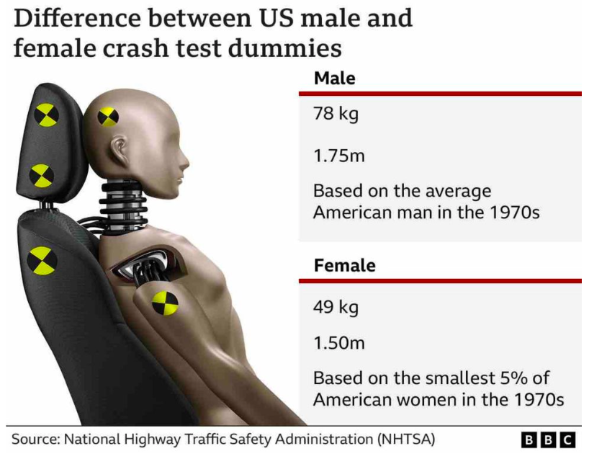
Physics + ethics
“
Since the 1970s, crash test dummies - mechanical surrogates of the human body - have been used to determine car safety.
Even today the most commonly used dummy is based on the average male build and weight.
Yet women represent about half of all drivers and are more prone to injury in like-for-like accidents.
Currently there is no legal requirement for car safety tests for rear impact collisions to be carried out on anything other than the average man.
”
Notes:
https://www.bbc.co.uk/news/technology-62877930?xtor=AL-72-%5Bpartner%5D-%5Bbbc.news.twitter%5D-%5Bheadline%5D-%5Bnews%5D-%5Bbizdev%5D-%5Bisapi%5D&at_custom2=twitter&at_custom3=%40BBCTech&at_custom1=%5Bpost+type%5D&at_campaign=64&at_medium=custom7&at_custom4=E297DB26-56B6-11ED-9DAF-6AEB4744363C
Annoying: supposedly gender-neutral products that ignore the difference in average male and female hand sizes (e.g. smart phones) and voice and speech recognition technologies that function worse – or not at all – on women’s voices, which reduces the effectiveness of voice assistants.
Life-threatening: Voice recognition software in cars is meant to make driving safer, but it doesn’t work as well for women’s voices, which is a problem with the technology, not with women’s voices, a point we might think does not need making except that Tom Schalk, the vice president of voice technology system supplier ATX, said that women “need lengthy training” to use his company’s tool. Similarly, speech recognition software used by attending emergency physicians has higher error rates for women than men, which endangers the lives of everyone in their care.

Slide 28
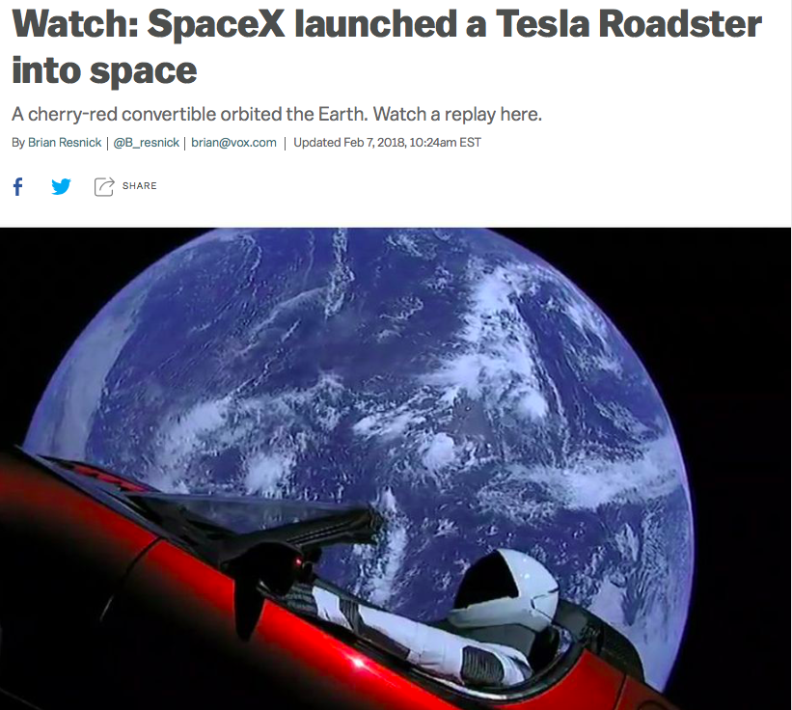
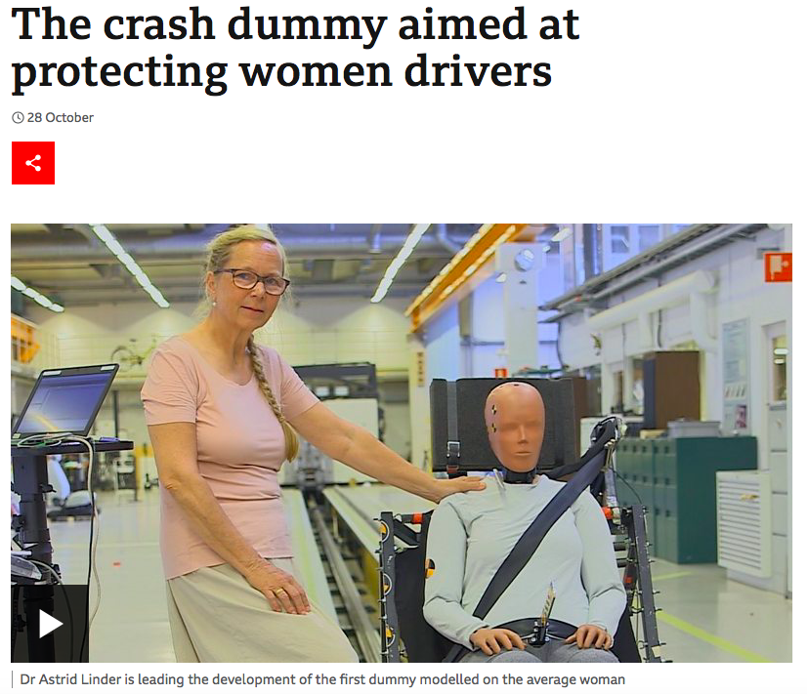
solving the most valuable problem
Notes:
https://www.bbc.co.uk/news/technology-62877930?xtor=AL-72-%5Bpartner%5D-%5Bbbc.news.twitter%5D-%5Bheadline%5D-%5Bnews%5D-%5Bbizdev%5D-%5Bisapi%5D&at_custom2=twitter&at_custom3=%40BBCTech&at_custom1=%5Bpost+type%5D&at_campaign=64&at_medium=custom7&at_custom4=E297DB26-56B6-11ED-9DAF-6AEB4744363C
Annoying: supposedly gender-neutral products that ignore the difference in average male and female hand sizes (e.g. smart phones) and voice and speech recognition technologies that function worse – or not at all – on women’s voices, which reduces the effectiveness of voice assistants.
Life-threatening: Voice recognition software in cars is meant to make driving safer, but it doesn’t work as well for women’s voices, which is a problem with the technology, not with women’s voices, a point we might think does not need making except that Tom Schalk, the vice president of voice technology system supplier ATX, said that women “need lengthy training” to use his company’s tool. Similarly, speech recognition software used by attending emergency physicians has higher error rates for women than men, which endangers the lives of everyone in their care.

Slide 29
Facial recognition technology

Slide 30
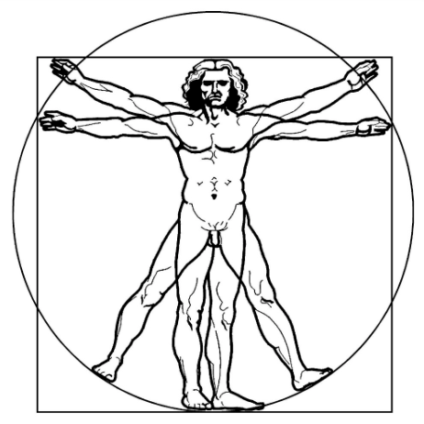
Biometrics = data about your body + behaviour
FIRST GENERATION
Specific regulation for police use only
No specific regulation for other branches of government or for private companies
DNA
Fingerprints
SECOND GENERATION
No specific regulation for anyone
May fall under general data protection laws but not challenged
Face
Eye (iris, retina)
Heartbeat
Emotions
Voice
Veinprint
Creepy Factor: MAXIMUM
Your face and emotions
can be captured without your knowledge
Footprints
Finger geometry
(size and position of fingers)
Behavioural
(e.g. typing patterns, walking gait)

Slide 31

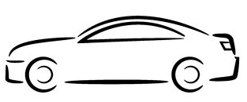



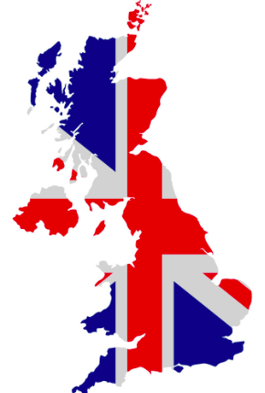
Biometrics --> the ‘Extended Self’
Smartphone
Microchip
(implanted in hand)
Social media/online
Wearable fitness device
(FitBit, Garmin, etc)
Home
Car
School
Workplace
City
Country
Notes:
Technology is creating new ways to access our biometrics…and creating new forms of biometric data about us

Slide 32
Biometrics technologies create + solve problems
Give citizens a digital identity | E.g. India’s Aadhaar system: face, iris, fingerprints | Solution in search of a problem: humans have existed until now without a digital identity – give citizens an ‘analog’ ID to avoid the increase of surveillance and privacy risks
Verify your identity | passports and visas use a facial biometric (photo), sometimes fingerprints driving licenses use a facial biometric (photo) EU identity cards to use facial biometric and 2 fingerprints by 2020 (proposal) | Mission creep: We are relaxed about photos, but now we are seeing fingerprints (used to just be when getting arrested!) and face (to access our phone). What next: DNA? Iris scan? Everything? After all, we must be secure! Increases risk of surveillance and destroys privacy
Identify you in a crowd | police use of facial recognition technology at football matches, in London, South Wales police use of DNA to determine suspects in an investigation or connections to suspects | FRT is highly inaccurate for people of colour and women. But even if we solve inaccuracy, this increases risk of surveillance and destroys privacy Chilling effect on civil liberties (e.g. freedom of expression, right to assemble)
Access something protected | physical premise: home, workplace (photo, iris scan, fingerprint) device: unlock smartphone with face, fingerprint, veinprint (1 billion x more accurate than a fingerprint) bank account (RBS now using fingerprint) | Security risk: Depends on how the biometric is stored: is it like on an iPhone (hashed, stored locally?) or would it be kept raw and/or on a server or in the cloud? Who else has access to this data?
Pay for things | face (China), fingerprint (RBS) | Security risk: Depends on how the biometric is stored: is it like on an iPhone (hashed, stored locally?) or would it be kept raw and/or on a server or in the cloud? Who has access to this data?
Airports | Facial recognition technology for check-in is already in use at Atlanta and Dulles, coming to 20 US airports) | Mission creep: airports (govts and private companies) now storing biometric databases of citizens and non-citizens alike. In the US, 4th Amendment infringement? In Europe, human rights infringement? Not regulated
Schools | UK: Use fingerprint to register, pay for lunch, borrow books from the library US: Use facial recognition/emotion detection to prevent school shootings??? | Mission creep aka where does it stop? Civil liberties/human rights violation as consent of child and parent not required in Scotland and Northern Ireland but is required in England and Wales; does not solve issue of kids bringing weapons to school; stressful for children to be monitored
Workplace | Wearables to encourage heath and fitness outcomes Emotion detection technology to flag fatigue, drunkenness, distraction, anger | Employees ‘health and emotions could be used against them Risk of privacy, civil liberties and human rights violations
Prisons | Face, iris, fingerprints used to track who is visiting prisoners in a UK prison | Collects data of innocent people (visitors), human rights violation; could deter them from visiting prisoners (human rights violation)
Refugees | Refugee camps: Accenture’s 2020ID scheme: face, iris, fingerprints | Replace lost ID documents, track aid, reduce fraud/corruption = human rights violation, these people have little power to refuse!
CAPTIVE AUDIENCE

Slide 33
semiconductors
(chips)

Slide 34

China produces 15% of all chips. These are mostly low-tech, but the industry is growing rapidly
South Korea produces
44% of all memory chips
8% of all processor chips
Japan produces 11% of all chips
Taiwan produces
41% of all processor chips and
more than 90% of the most advanced chips
Singapore produces around 5% of all chips
Malaysia

Slide 35
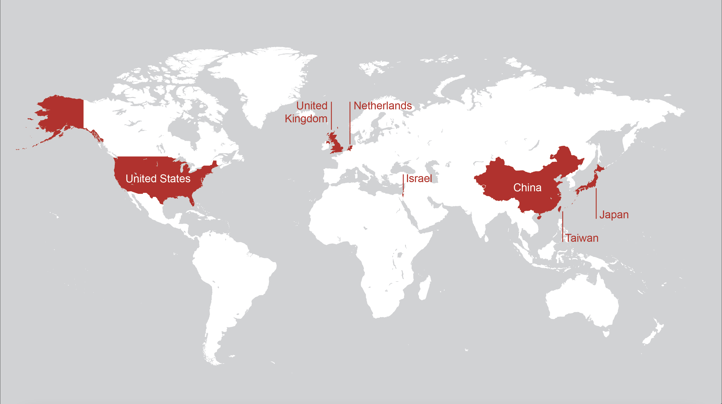

Slide 36


Political philosophy + ethics
“
World War II was decided by steel and aluminum, and followed shortly thereafter by the Cold War, which was defined by atomic weapons.
The next era, including the rivalry between the U.S. and China, is all about computing power.
”
Notes:
SOURCE: https://www.protocol.com/policy/chip-war-chris-miller

Slide 37
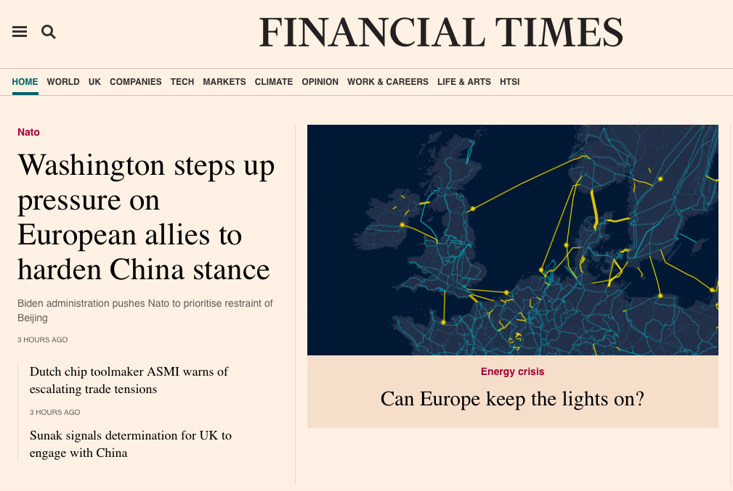
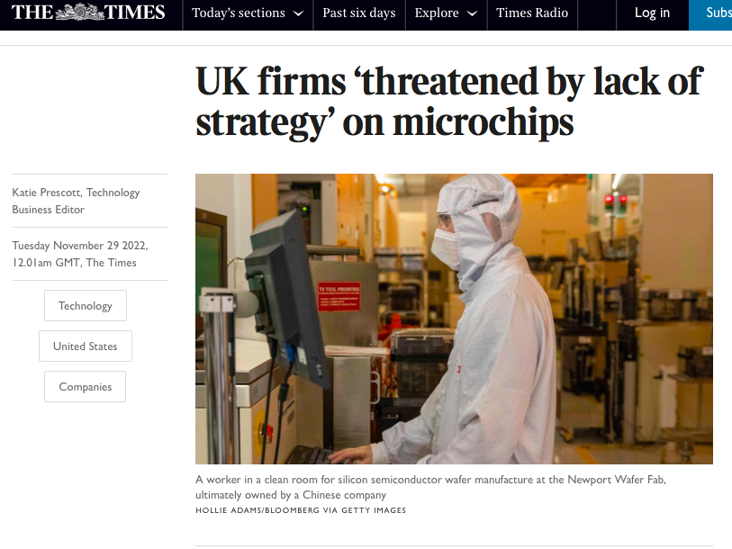
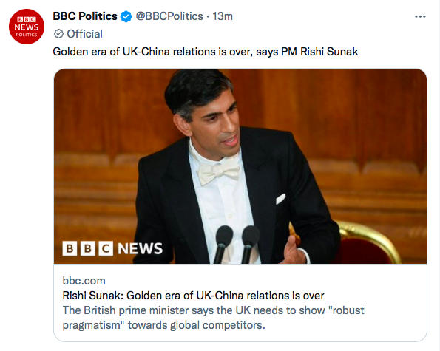
Not an ordinary news day…

Slide 38
THANK YOU
Stephanie Hare @hare_brain

