Slide 1


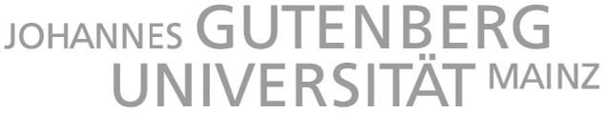







WP 3.1 Doping & Loading
DRD2 Community Workshop – online – 20/04/2023
Hans Steiger – Andrea Zani

Slide 2
Two main lines of research
This WP, as others, naturally drives us towards two parallel lines of research:
Cryogenic noble gases (CNG):
Liquid Argon
Liquid Xenon
Liquid Helium (future?)
Doping of liquid Argon with Xenon or more complex mixtures
Liquid scintillators (LS) (organic/water):
Solvents: LAB, DIN, PC, Xylene, …
Diluted Solvents
Slow Scintillators and Blended Solvents
Wavelength Shifters
Water Based Scintillators + Surfactants
Loading of scintillators with Gd, Te, Xe, Cd, B, Li, In …

Slide 3
Cryogenic Noble Gases
Liquid Argon (Z=18) & Xenon (Z=54) used in variations of the Time Projection Chamber Technology
Main use: targets/sensitive media for neutrino (precision) physics and Dark Matter searches
Emission of UV scintillation light (Ar->127 nm; Xe->178 nm) & ionization charge
Challenges:
ν – oscillations/cosmic
Very large volumes
Cryogenic operation
ν – 0νββ
Somewhat smaller volumes
Cryogenic operation
Extreme background/materials control
Dark matter
Somewhat smaller volumes
Cryogenic operation
Extreme background/materials control
Efficient light collection / wavelength-shifting (low-energy sensitivity)

Slide 4
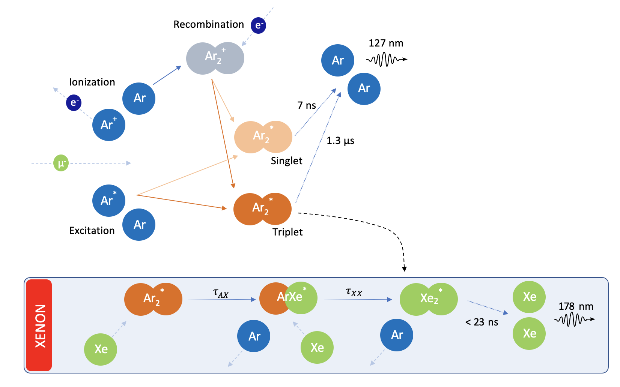
R&D interests - CNG
Main interest expressed by the community so far:
doping liquid Argon with Xenon
Very broad interest
Technological implementation
Stability & uniformity
Understanding in details physics of energy transfer
Light collection & detection
Applications: ν physics, DM

Slide 5
R&D interests - CNG
Why?
Xenon scintillation light is emitted at 178 nm, vs 127 nm from Argon
  Easier to detect, even without wavelength shifting
  Larger range (larger Rayleigh Scattering Length)
  Shorter pulse profile (smaller pile-up chance)

Slide 6
Foreseen deliverables, so far - CNG
Detailed characterization of Xe doping of liquid argon
  Doing more testing in liquid argon, large volume → studying stability in time, uniformity within volume
  Investigating high concentration, at small scale first
  Investigating other dopants (Xe-CH4 for neutron moderation, light-to-charge shift?)
  Using near-IR detectors to detect xenon light in doped liquid argon for triggering.
  Possibility to dope LAr with enriched 136Xe for 0νββ decay
    Most of these sub-deliverables would require multi-year research, because the technology is quite well demonstrated at small scale and the step forward requires to demonstrate stability and uniformity at very large masses/volumes (scalability, WP 4.3).

Slide 7
Inputs from the community - CNG
Contacted institutions | Answered | Interest in
INFN
Ciemat | ✓ | Implementation, physics, light collection and characterization with X-ARAPUCA detector. Large-scale ν detectors, enhancement for DM searches
U. Edinbourogh
CERN
Uchicago
Virginia Tech
Syracuse | ✓ | Broad interest in R&D. Large-scale ν detectors + LOS
Colorado State U
FNAL | ✓ | Broad interest in R&D. Enhance LArTPC physics reach; use of near-IR detectors to detect xenon light in doped liquid argon for triggering.
N.B.:
We know we did not contact yet all the interested parties, this is a starting effort.
We will broaden our reach, but we are fallible: please, if you want to contribute and have not been contacted yet, do reach out to us!
andrea.zani@cern.ch
hans.steiger@tum.de

Slide 8
Feedback from the community - CNG
Deliverables | FTE
Investigate higher Xe concentrations in LAr | 0.5
Investigate different dopants | 0.5
Study infra-red emissions | 0.25
Study long-term stability in large volumes | 0.5
General interest | 0.5
So far, limited detailed feedback, around 2 FTE total declared for the next three years
(FTE numbers above should not be simply summed, there is superposition)

Slide 9
Overlap & synergy with other WPs, DRDs - CNG
There is obviously a large overlap with WPs 3.3, 3.4, focused on light transport and physics of energy exchange
  As well, the group who responded clearly showed interest in all aspects of the doping, from the implementation to data analysis and physics deeper understanding
As most of future R&D will be related to scaling towards very large volumes, there will be a strong interface with WP 4.3, working on scalability & infrastructure.
We anticipate also a general interface of this DRD with DRD4 on PhotoDetectors (scintillation light detection technologies)

Slide 10
R&D Interests in LS and WbLS → C/S Separation also with Loading!
solvent (PC)
absorption
WLS (PPO)
absorption
Basic Idea
use near-UV/blue-ish part of
the Cherenkov spectrum
not absorbed by PPO
Discrimination of
Cherenkov/Scintillation
photons based on
timing (delay of scintillation)
angular distribution (cone)
(in principle: spectral filters)
Challenges
Cherenkov light
absorption and scattering
separation from the fast
scintillation component
WLS
emission
Cherenkov
emission

Slide 11
Overlap & synergy with other WPs, DRDs - CNG
There is obviously a large overlap with WPs 3.2, 3.3 & 3.4, focused on light transport and physics of energy exchange
As most of future R&D will be related to scaling towards very large volumes, there will be a strong interface with WPs working on scalability & infrastructure.
We anticipate also a general interface of this DRD with DRD4 on PhotoDetectors (scintillation light detection technologies)

Slide 12
Inputs from the community - LOS
Contacted institutions | Answered | Interest in
UCB & LBNL | ✓ | Slow-LS, WbLS
BNL | ✓
JGU Mainz | ✓ | Slow-LS, Te-loading, Xe-loading, WbLS
TUM | ✓ | Slow-LS, Te-loading, Gd-loading, Low-T loading, WbLS
MPIK
IHEP
Syracuse | ✓ | Interest in being involved in developing loading process + CNG
INFN | ✓
UC Davis (?)
N.B.:
We know we did not contact yet all the interest parties, this is a starting effort.
We will broaden our reach but we are fallible: please if you want to contribute and have not been contacted yet, do reach out to us!
andrea.zani@cern.ch
hans.steiger@tum.de

Slide 13
Feedback from the community - LS
Deliverables | FTE
C/S-Separation | 1
Slow Scintillators with Te-loading | 0.5
Slow Scintillators with Xe-doping | 0.25
WbLS loading techniques | 0.5
Blended cocktails with loading | 0.5
Purification of Co-Solvents | 0.5
Gd-loaded low T liquids | 1
So far, limited detailed feedback, around xxx FTE declared for the next three years

Slide 14
Where are we now, then?
Cryogenic noble gases
  Large interest in xenon doping of LAr, for astroparticle/rare events physics (ν, DM)
  Identified significant overlap with other WPs 3.x that could lead to a merger of deliverables.
  Still expecting quite some feedback, especially from the DUNE community.
Liquid organic scintillators
  Large interest in Te and Gd doping of LAB also at low T (e.g. TAO detector, JUNO Phase II?, SNO+)
  Identified significant overlap with other WPs 3.x that could lead to a merger of deliverables.
  Still expecting quite some feedback, especially from SNO+, LiquidO, JUNO (IHEP), ANNIE, …

