Slide 1
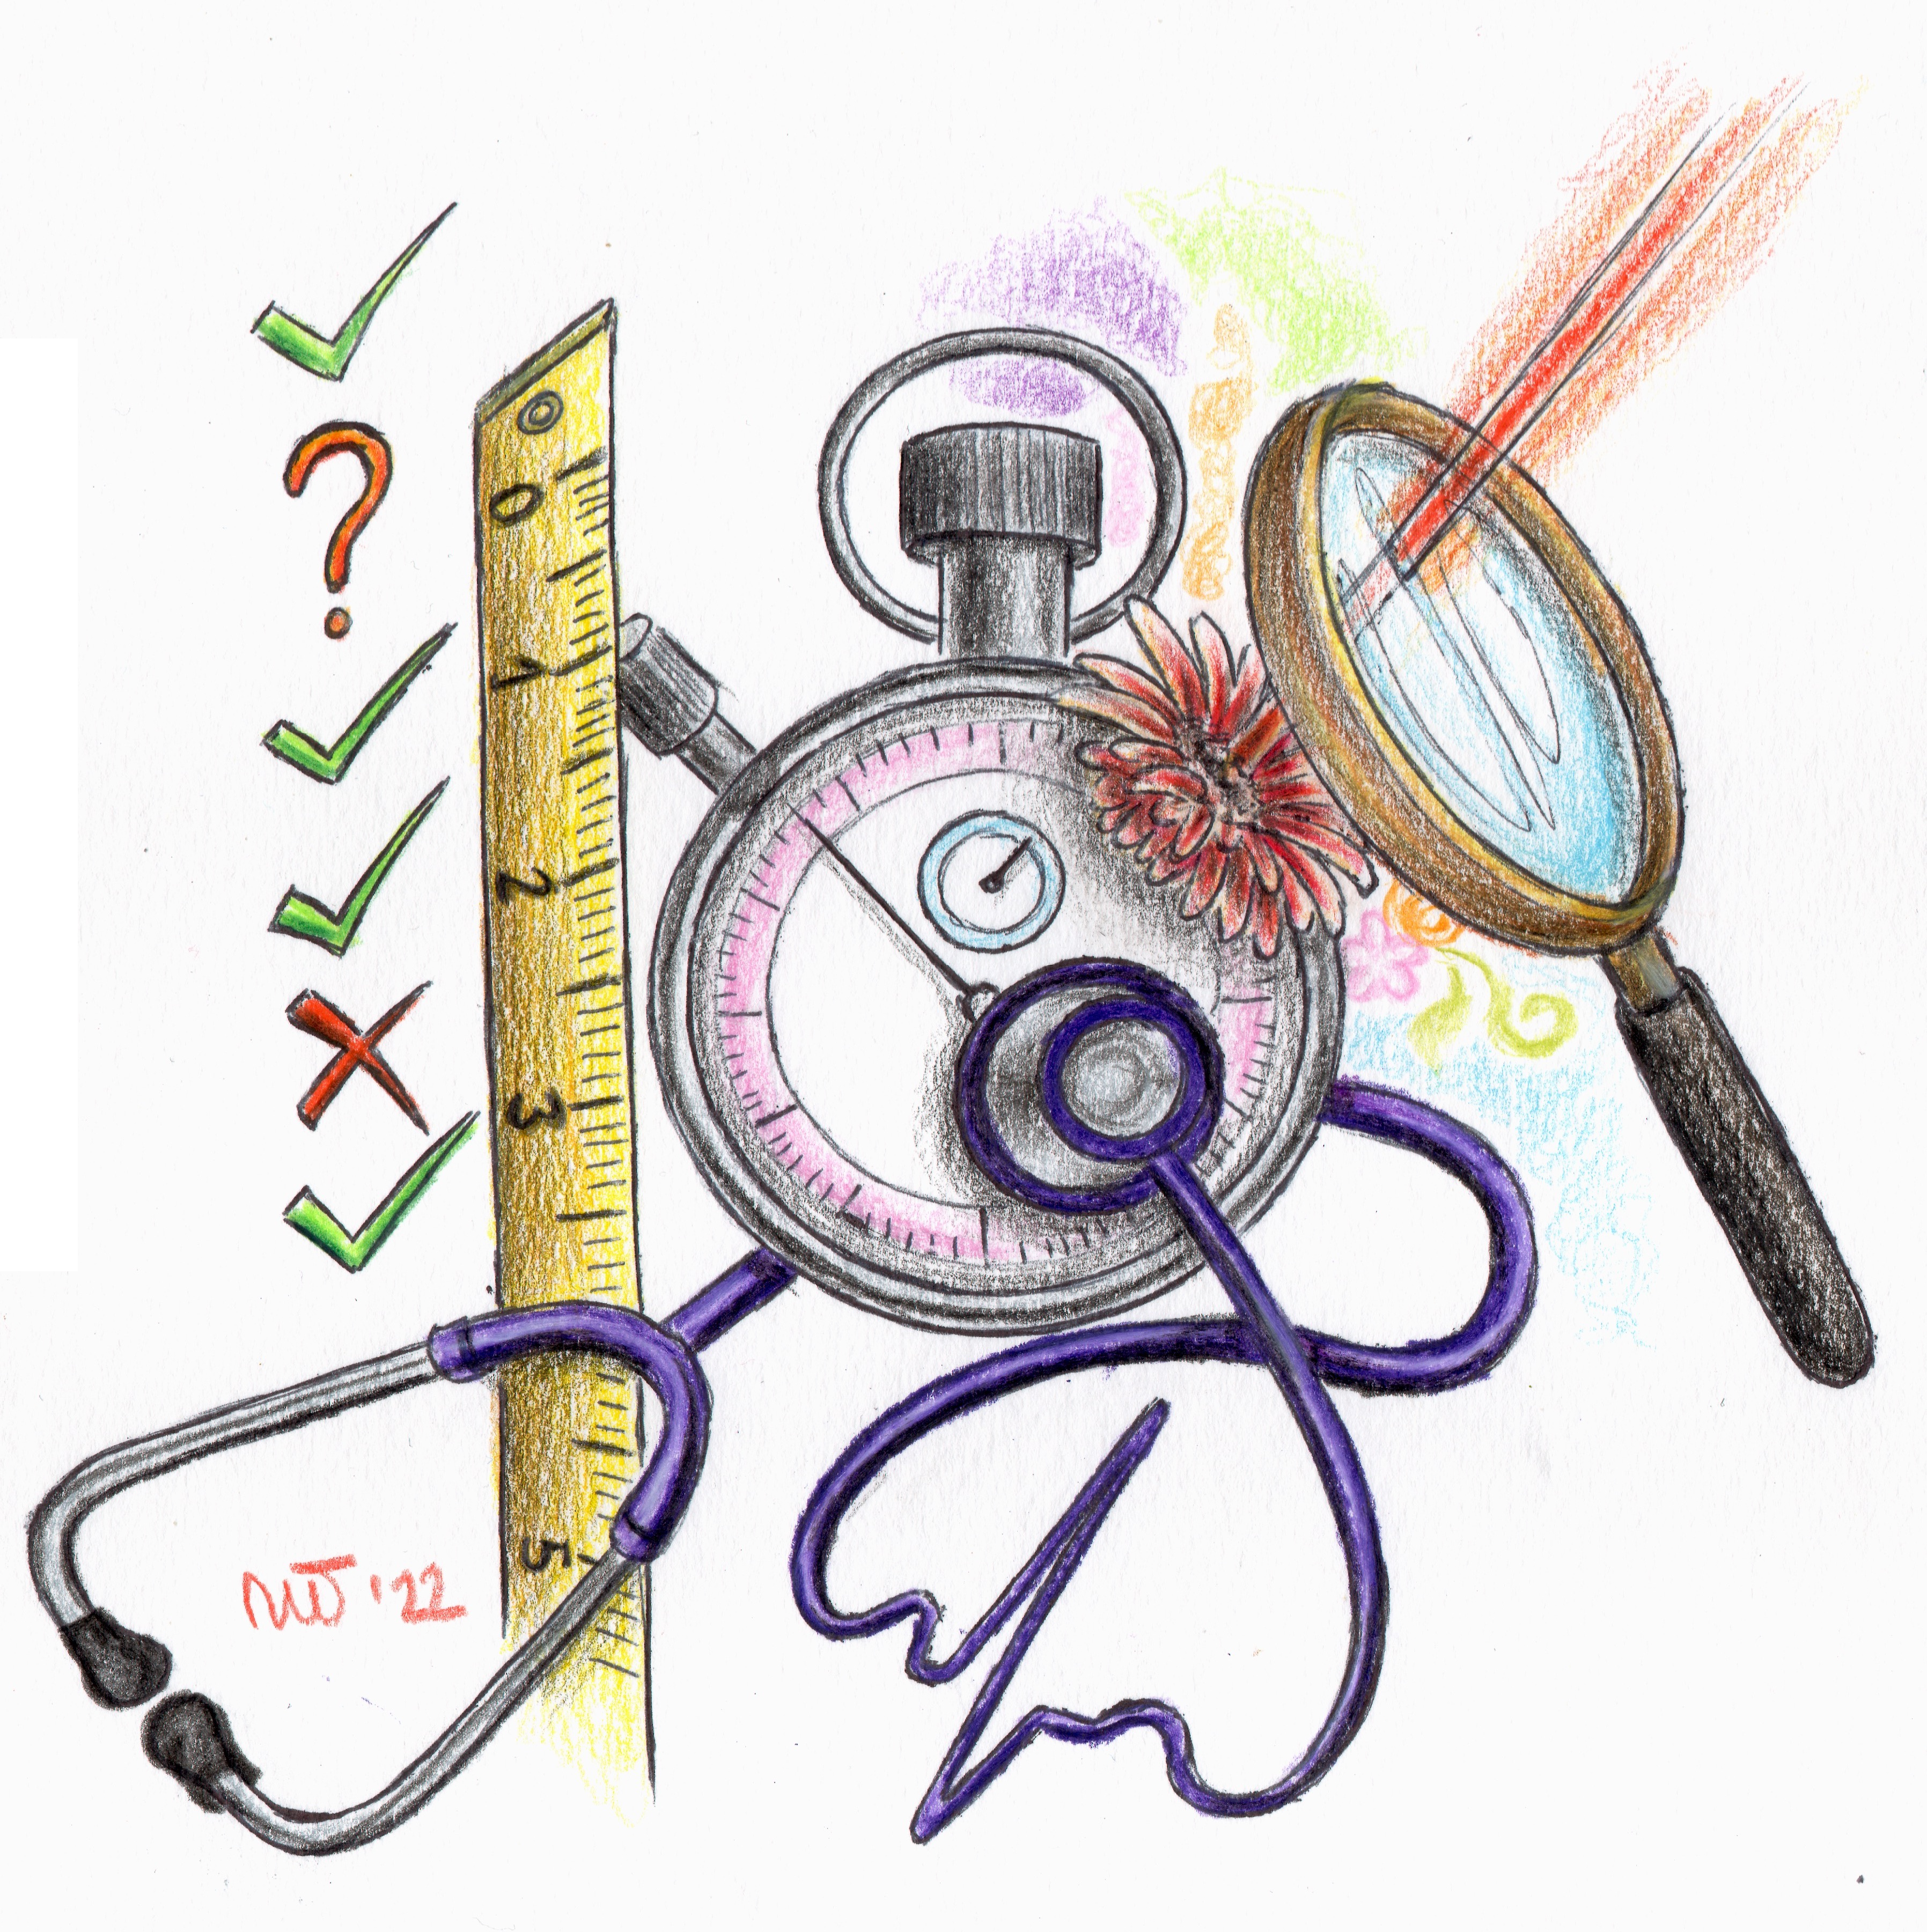
WG2: Solid-state sensors* for trackers and calorimeters
Community structure, interests, funding, and blue sky R&D
(questionnaires recevied in the last few days are not included)
Introduction to WG2
  (N. Cartiglia)
Sensors requirements for the next generation of trackers
  (C. Gemme)
Milestones and Costing
  (A. Macchiolo)
(*non MAPS)
N. Cartiglia, C. Gemme, A. Macchiolo
on behalf of the DRD3 proposal writing team

Slide 2
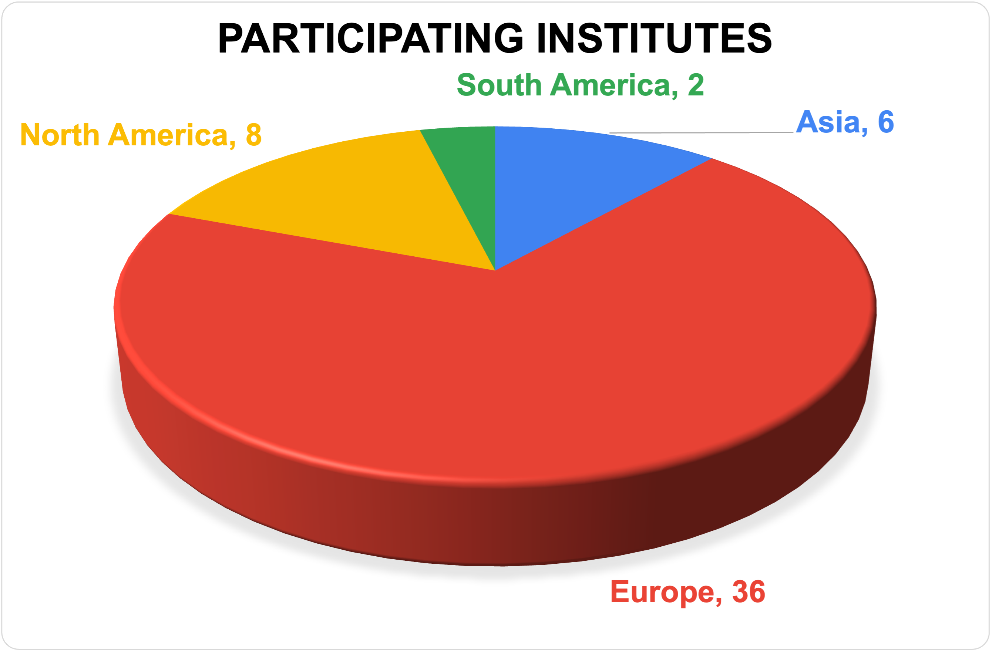
Community composition
52 institutes expressed interest in contributing to the WG2 activities.

Slide 3
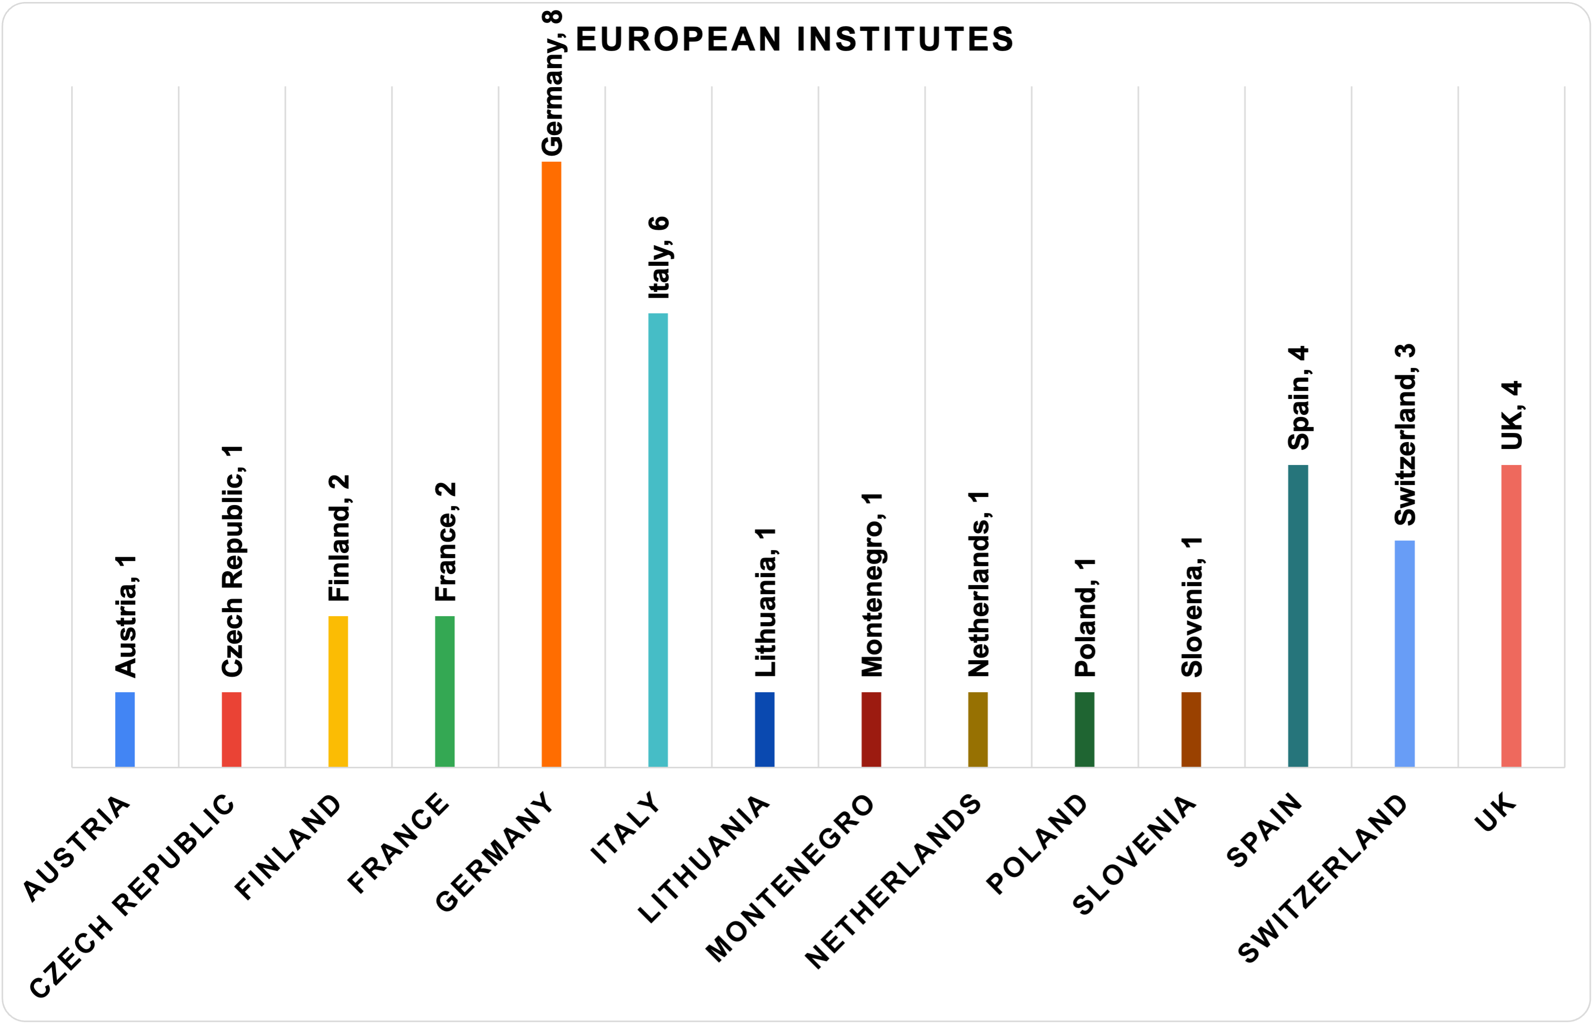
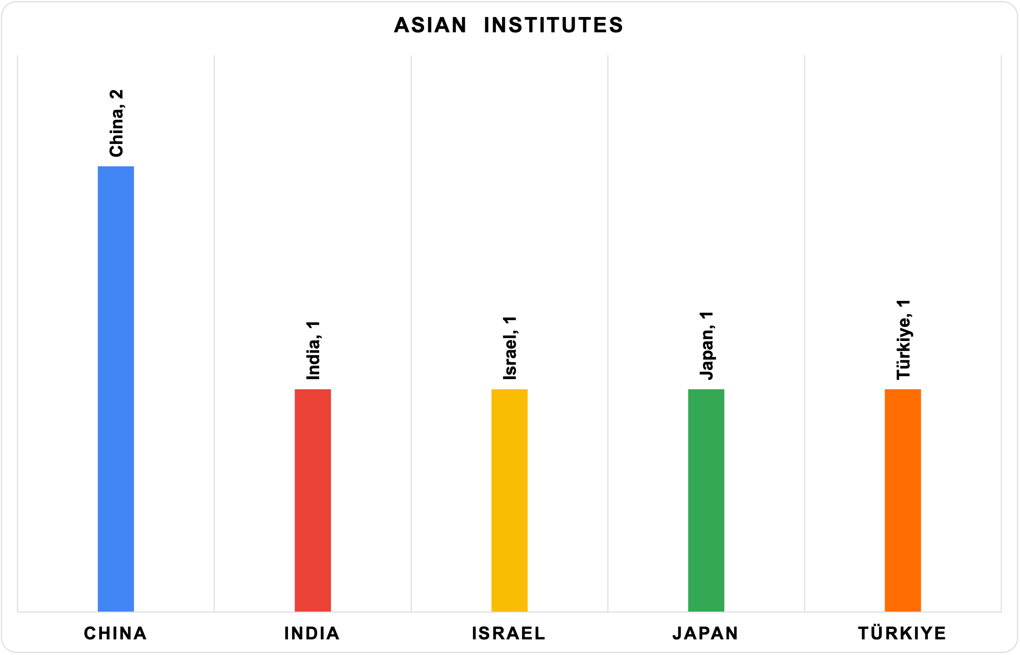
Community composition

Slide 4
Community interests - Table
53 institutes expressed interest in contributing to the WP2 activities.
Activity | # groups
R&D on LGAD, current and novel designs: TI-LGAD, AC-LGAD, rad-hard LGAD, iLGAD, 100% fill factor, reduced power dissipation, resistive read-out | 27
TCAD studies of LGAD/3D (in WG4): | 12
3D sensors (mostly silicon, a few diamond): | 12
4D tracking (general concept): | 9
4D demonstrator (upgrade of beam telescopes, for example, the EUDET family or similar): | 7
Edgeless: | 2
Impact ionization at very high fluence: | 2
New detector concepts (for example, saturated gain avalanche): | 2
Ultrathin sensor: | 2
Improvement of planar PIN design (pixel and strips): | 2
Passive CMOS (in WP1) | 4

Slide 5
Community interests - Topics
The development of 4D tracking is the main interest of the community
Various evolutions of the LGAD design are presently considered the most promising solutions
3D sensors are seek-out as the most promising solution for high-fluence area
The construction of 4D demonstrators has strong support, both as an addition to present beam telescopes and as a needed stepping stone for more complex systems
A better understanding of impact ionization attracts interest
Development of planar PIN design (strips, pixels, edgeless)
Missing activities:
Sensors for calorimetry
Large area sensors, > 8” wafer

Slide 6
Contact with other WG
WG1: Passive CMOS as an alternative to traditional strips
WG4: TCAD, has strong support

Slide 7
Forthcoming activities in 2024 - 2030
WG2
Blue sky R&D
Explore new ideas and techniques that might be of use in the future
Strategic R&D
(next two talks)
Develop technologies that solve well-defined problems of near-future experiments.

Slide 8
DRD3 WG2 Blue-sky R&D
One of the main goals of the DRDx program is to foster blue-sky R&D
Specifically, the R&D activities of DRD3 WG2 are characterized by the production of new sensors.
We propose to encourage R&D activities by using the same approach used by RD50:
if an idea finds enough support in the communities, about 50% of the cost will be covered using the common funds, while the other 50% will be split among the interested institutes

Slide 9
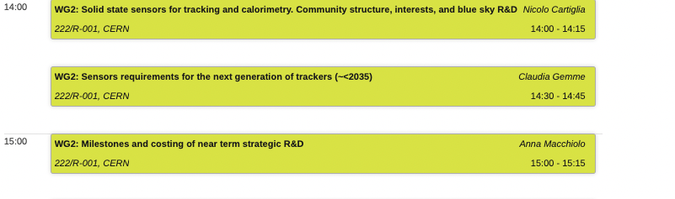
Agenda of WG2

