Slide 1
Challenges in designing ASICs for High Energy Physics Experiments
14 Mar 2023
Adithya Pulli

Slide 2
Outline
Verification: The key to unlocking quality and innovation in future ASICs for HEP experiments
Insights and observations on ASIC design and verification in HEP community and ideas to tackle some of the design verification challenges

Slide 3
Section 1
Verification: The key to unlocking quality and innovation in future ASICs for HEP experiments

Slide 4
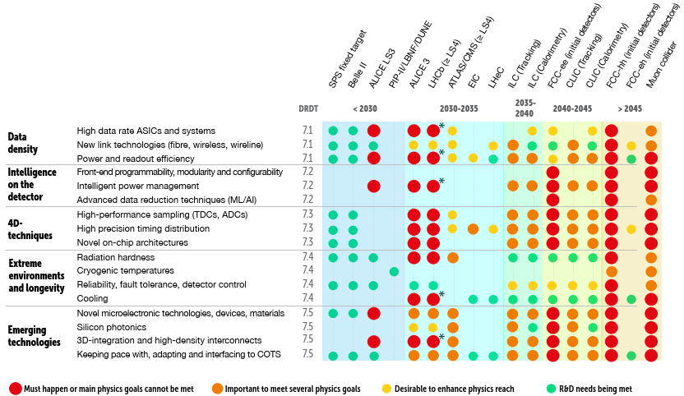
ASIC design trends in HEP research
Finer granularity in the detectors
  Precise timing
  More channels
  More data
Increasing digital complexity
  On-chip data processing to reduce data movement
Advanced technology
  28nm
  3D integration
Source: ECFA Detector R&D Roadmap Process Group (2020) The 2021 ECFA detector research and development roadmap. (Accessed: 13 Mar 2023).

Slide 5
ASIC prototyping in HEP community
Cost of prototyping will be higher in future
  Expensive mask-sets (28nm) and packaging (2.5/3D)
  Longer design cycle per prototype
  Increased engineering costs
Typically, 2 or more engineering runs before production
  In rare cases upto 6 engineering runs
Need to reduce the number of prototyping runs
  Ideally first-time silicon success
Source: CERN ASICs technologies and foundry services.

Slide 6
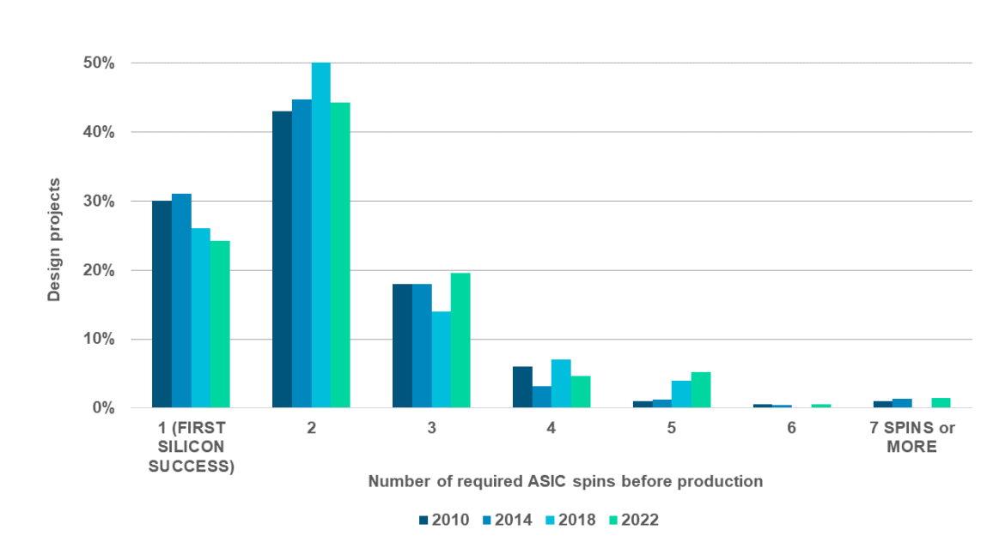
Trends from industry
Fewer first-time silicon successes over time
  >50% of re-spins are caused by “logic or functional flaws”
Complex designs will have complex bugs
Verification accounts to 70% of overall design costs
  Design to verification engineers ratio is 1:4
Source: Foster, H., 2022 Wilson Research Group IC/ASIC functional verification trends. White Paper. Wilson Research Group and Mentor, A Siemens Business. (Accessed: 13 Mar 2023).

Slide 7
Unlocking innovation in future ASICs for HEP
High design and prototyping costs for future ASICs set a higher quality bar for every tape-out
As the complexity of future ASICs increase, the current design practices will not guarantee same or better quality
Methodical and thorough verification will be one of the key enablers to first time silicon success

Slide 8
Section 2
Insights and observations on ASIC design and verification in HEP community and ideas to tackle some of the design verification challenges

Slide 9

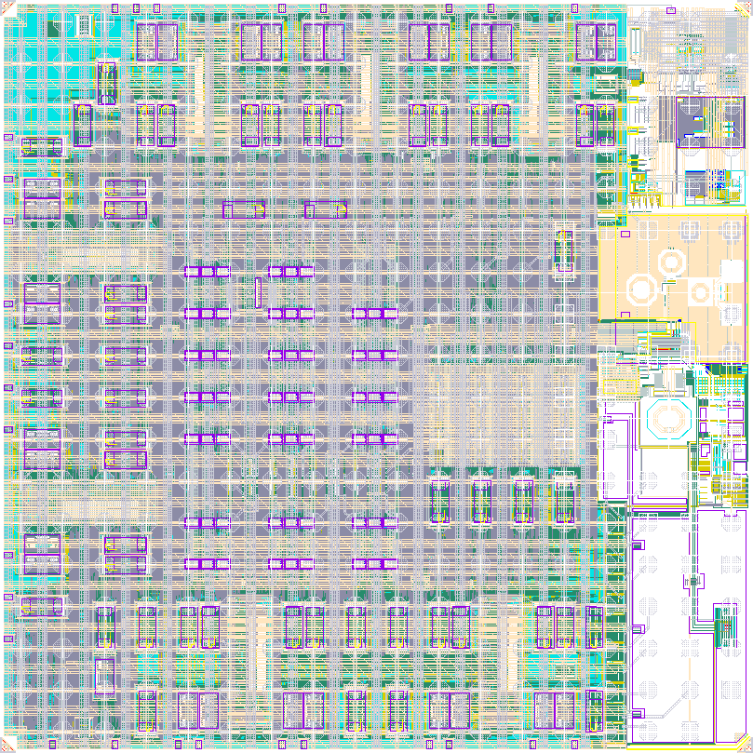


Project life cycle of ASICs for HEP experiments
Block1
Design
Top
Level
Design
Design Team
Block2
Design
Experiment
Verification
  Unclear specifications / use cases and therefore unclear verification goals
Prototyping
  Inefficient verification – no time spent on strategy and verification partitioning
  Taking shortcuts – lack of time, “silicon proven”
  Little feedback into usability of the chip (complex DAQ systems)
  When should verification start?
  At the same time as design is conceived

Slide 10


Project life cycle of ASICs for HEP experiments
Block1
Design
Top
Level
Design
Design Team
Block2
Design
Experiment
Block1
Design
Top
Level
Design
Design Team
  System level / architectural
Block2
Design
  Missed bugs
  Timing and SEE
  Logical
  Micro-architectural
  Cost of finding and fixing a bug increases drastically over time

Slide 11
Project life cycle of ASICs for HEP experiments
Design-space exploration /
Architectural verification
Block1
Design
Top
Level
Design
Micro-arch
Model
Archit-ectural Model
Block2
Design
Block1
Design
Top
Level
Design
Micro-arch
Model
  Missed bugs
Block2
Design
  Missed bugs
  Timing and SEE
  System level / architectural
  Logical
  Integration
  Micro-architectural

Slide 12
Architectural Modelling
Architectural and micro-architectural modelling should be approached with the same rigor as design and verification
  Models must be transaction/feature accurate
  E.g. SystemC-TLM, SystemC-AMS, SystemC-UVM and Virtual prototyping
  Combined effort between experiments and design teams
Addresses specification challenge
  Typically, requirements are clearer when they are written down and an architectural model serves as an executable specification
Design space exploration can be well formulated as a thesis topic for graduate students
  Some of the modelling skills are transferable to verification domain

Slide 13
Scalability of ASIC verification activities
Verification doesn’t scale linearly with design complexity
Verification is resource (personnel, tools and compute) intensive
Personnel
  Verification is not typically taught as a subject at university and there are limited research opportunities
  Verification engineers are typically in very high demand
Tools
  Verification relies heavily on commercial EDA tools
  Not all institutes have same level of access to tool
Compute
  Verification requires access to a stable compute cluster which is expensive to maintain for a small design team
  Irregular compute demands – e.g., requires more compute towards submission than during development
Processes
  Adherence to good engineering practices – version control, issue and bug tracking, reproducibility etc.
  Architecture, design and verification reviews

Slide 14
Strategic Verification Technologies
Formal verification technologies
  Model checking with commercial tools and open-source tools
  Formulating SEE verification as model checking problem – a potential research area with very high impact in HEP AISC verification
AMS and DMS verification
  Digital-on-top design methodologies enable efficient and thorough verification
  Digital-on-top designs must include real number models of analog components and use DMS verification techniques
  Enable reuse of digital verification content for AMS simulations
Open-source tools and technologies
  Track and potentially contribute to opensource simulation, model-checking and implementation tools
  E.g., verilator, yosys, symbi-yosys, icarus Verilog etc.
Design and verification reuse
  IP blocks for common features
  Uniform methodologies
Verification productivity tools
  Regression management
  Triage and debug

Slide 15
Summary

Slide 16
Summary
Future ASICs for HEP experiments will be more complex to design
Verification is the key enabler to design complex ASICs in acceptable timeline and budget for future HEP experiments
Verification must be well resourced and must start early in the design life cycle
Architectural and micro-architectural modelling must be approached with same rigor as design and verification to avoid major system level issues in future experiments
Verification doesn’t scale linearly with design complexity
Scaling verification activities in HEP community is challenging which must be addressed in strategic long-term planning

Slide 17
Backup

Slide 18
Verification - Introduction
What?
  Verification is one of the crucial steps of ASIC design process which ensures that the design specification is preserved in the actual design implementation
  It can consume as much as 70% of the total ASIC design time
How?
  Build a realistic world (AKA verification environment) around a design (AKA Design Under Test - DUT)
  Exercise the DUT in all possible ways* using the verification environment
  Check all the outcomes of the DUT are as expected
*Catch
  It is impossible to exercise DUT in all possible ways in a reasonable amount of time
  Algorithmically, verification is a PSPACE-complete problem

Slide 19
Verification - Introduction
What now?
  Rely on constrained random stimulus to maximize the design space exercised
  Use a methodology which supports efficient implementation of constrained random tests
  Use metrics to gain confidence in the verification effort
    Quis custodiet ipsos custodes? (Who will guard the guards themselves?)
    Coverage, regression testing, bug-rate etc.
Verification reduces the risk of finding a bug after fabrication. It cannot assure absence of any bugs

