Slide 1
TSI
Ivan Peric

Slide 2
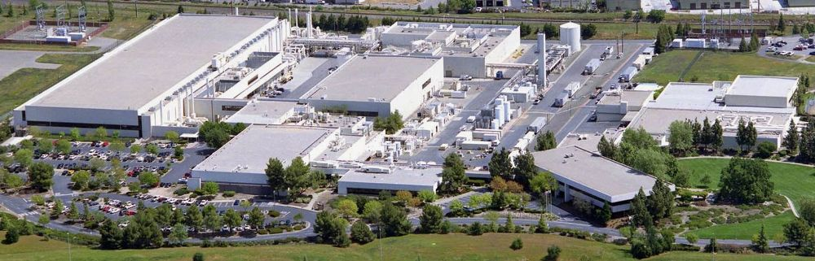
TSI semiconductors
https://www.tsisemi.com/
Roseville, California, USA
Notes:
TSI semiconductors is a foundry in Rosevelle near Sacramento, California

Slide 3
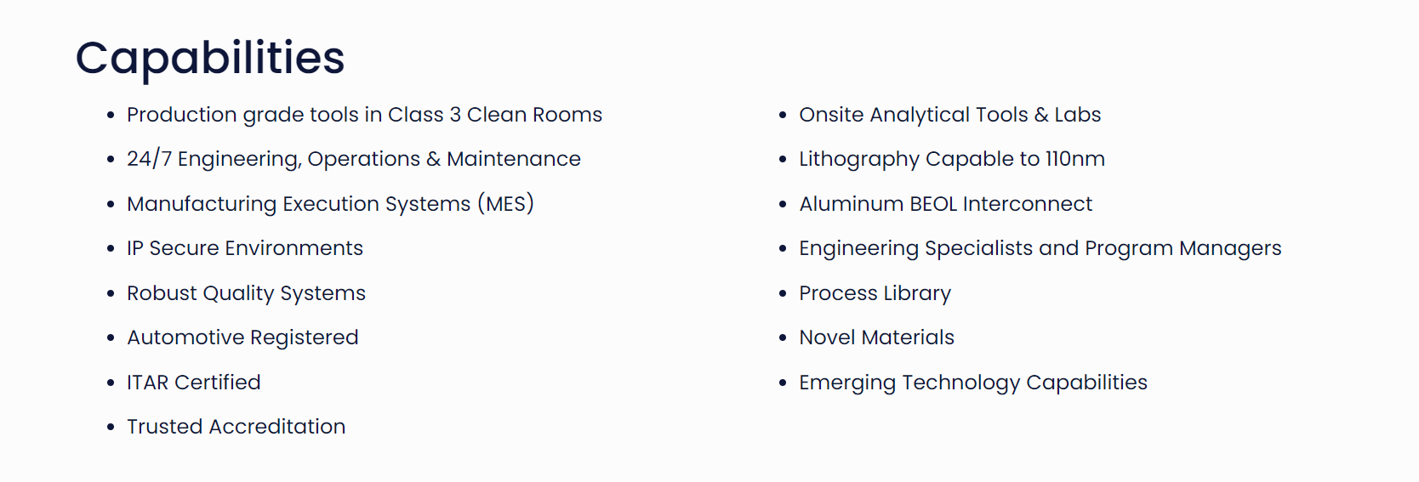
Notes:
This slide shows the table from the web page
I highlight that lithography is capable to 110nm

Slide 4
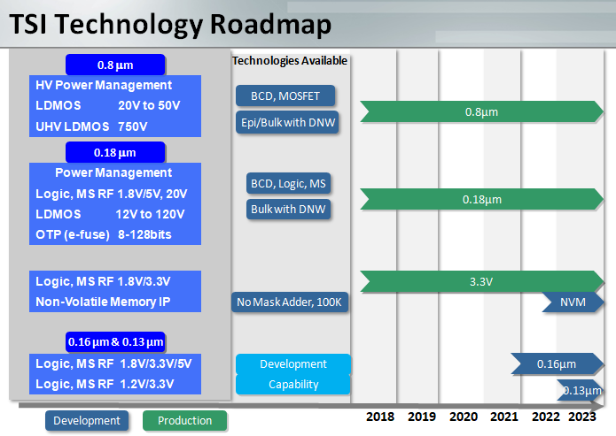
Technologies from 0.8µm – 0.13µm
My focus on: 180nm HVCMOS process
Notes:
This slide shows the list of TSI technologies
My focus on: 180nm HVCMOS process

Slide 5
The 180nm TSI HVCMOS process offers:
Low voltage CMOS transistors that are placed within n deep-nwell.
High deep n-well to p-substrate voltages possible (>500V according to TCAD)
NMOS
PMOS
PMOS
NMOS
n-well
p-well
n-well
n-well
p-well
deep p-well
Deep n-well
Deep n-well
Standard
With deep p-well

Slide 6
Several flavors of low voltage transistors: with regular and high, super high threshold, 1.8V, 3.3V, 5V…
High voltage transistors (NFET and PFET) that can have Vds up to 120V
In particular: 12V, 20V, 25V, 50V, 120V NFET/PFET transistors
Comment: There are several high voltage processes on the market but to my knowledge only very few processes with 180nm feature size offer devices with >100V Vds, one of them is the TSI process
Thin gate oxide*
HV- bipolar transistors, mim and dual mim capacitors, resistors, LV forward diodes
Largest reticle we produced: 20.7mm x 23.1mm
TSI process offers up to 7 metal layers. 6 Layers are small feature size layer and the last layer is (optionally) 4µm thick and has very low sheet resistance.
Never had issues with voltage drops in large matrices thanks to this layer

Slide 7
TSI offers to use customer’s substrates
Presently we use 18kOhm substrates from Topsil and 370Ohm substrates from Okmetic
Standard TSI-substrate is also suitable for HVCMOS sensors
TSI was ready to add additional implant to their process
Reticle stitching possible

Slide 8
The TSI design kit includes a standard cell library
TCAD models available on request

Slide 9
We started developing chips in TSI process in 2018
We had so far 8 engineering runs
We started also a production with 150 wafers for Mu3e
2018: Atlaspix3
2019: MuPix10
2020: Run2020, Atlaspix3v2
2021: Run 2021
2022: MuPix11, MightyPix/TELEpix, Astropix3, MuPix11 production

Slide 10
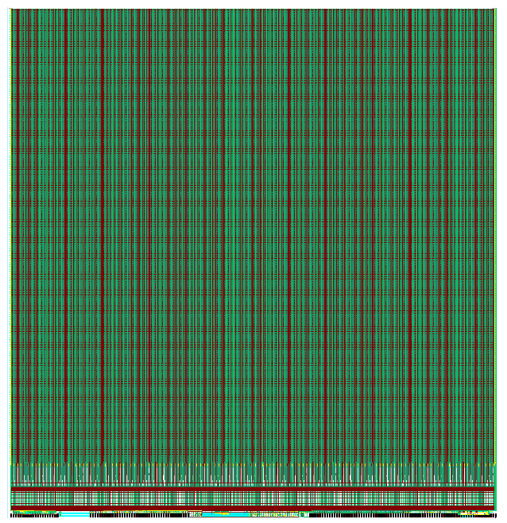
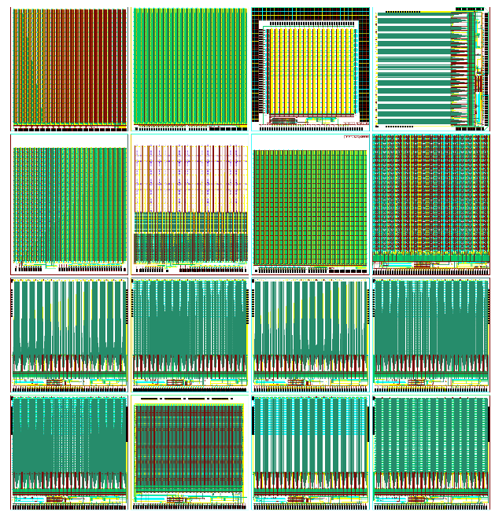
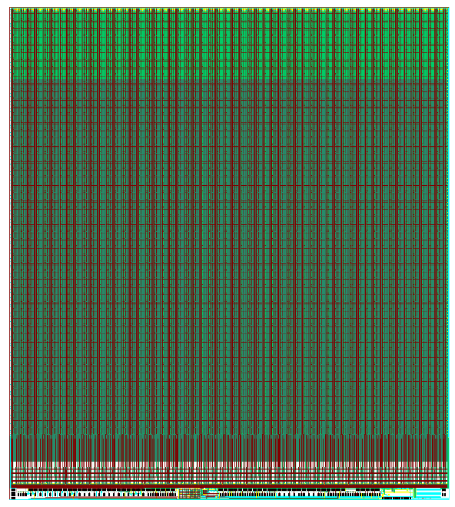
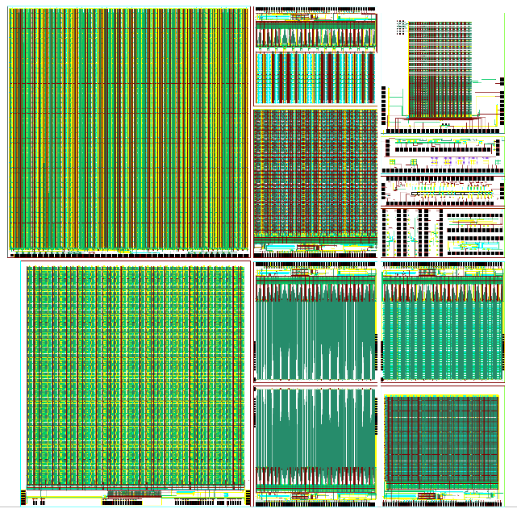
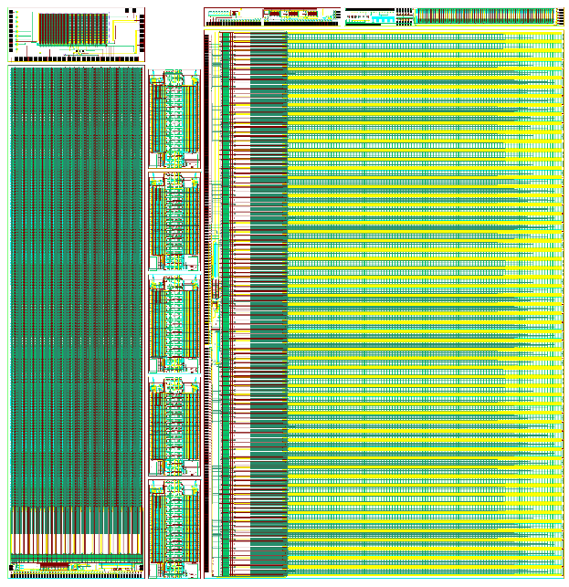
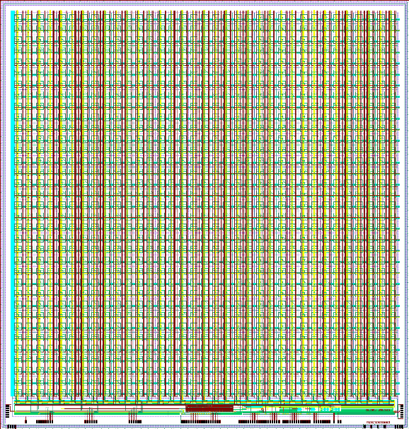
ATLASpix (2 runs)
Run2020
Mupix (2 runs)
Run2021
TELEpix
ASTROpix
MightyPix

Slide 11
Excellent yield 80% for large chips after dicing and bonding
Fast production time
TSI colleagues are highly competent, respond fast, excellent support, helpful
Engineering run costs were comparable to the costs in the case of UMC 180nm process
Production time was 3 months, recently increased by a few months

Slide 12
Before start: NDA and customer form
Engineering run
Tape out
The design is checked by TSI for errors
Design manufacturing form and waiver request form

Slide 13
Summary
Excellent technology for HVCMOS sensors
Features: Deep n-well, high resistivity substrates, deep p-well
High voltage FETs available, up to 120V – use thin oxide
Excellent for drivers, HV-generators, power regulation
Excellent support, highly competent team, helpful, quick in responding
Readiness to adjust and develop process according to customer needs
Use of customer's substrates possible
TCAD models shared
TSI: “Our flexible approach to development and manufacturing allows customers to develop with a broader range of materials than other foundries.”

