Slide 1
ECFA R&D electronics
DRDT 7.7 Technologies & Tools
15/3/2023 CERN
Conveners:
Mark Willoughby¹
Xavi Llopart²
Kostas Kloukinas²
¹RAL, STFC, UK
²CERN

Slide 2
Agenda
Introducing the challenges of collaborative work at HEP 10’
  Kostas Kloukinas, CERN
Access to advanced silicon technologies
for the HEP community via EUROPRACTICE 20’
  Paul Malisse, EUROPRACTICE IC service, IMEC IC-link, BE.
Access to modern EDA tools and IP block sharing
in HEP community via EUROPRACTICE 20’
  Mark Willoughby, EUROPRACTICE design tools service, RAL, STFC, UK
Challenges in designing ASICs for HEP Experiments 20’
  Adithya Pulli, CERN
Open Discussion 20’

Slide 3



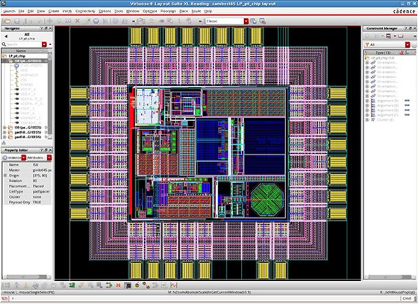
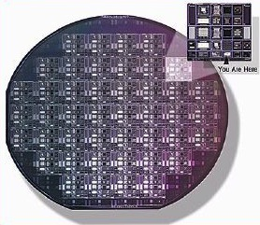
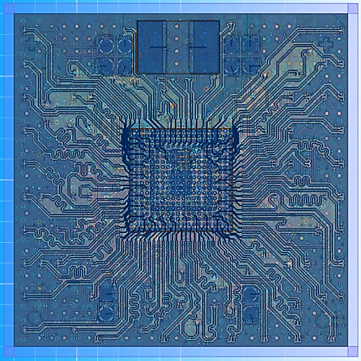
ASIC Design Support for HEP
Foundry
vendors
IP block
vendors
3rd party
Design Services
EDA tools
Manufacturing Services
CERN
common design platform
130nm, 65nm, 28nm
distribution & support
CERN & HEP design teams
asic.support@cern.ch

Slide 4
ASIC Design Platforms for HEP
  “Common ASIC design platforms” for HEP community
Develop and Provide:
  Design kits that support analog and digital designs
  Design Workflows that are standardized and validated
  using selected EDA tools
  Compatible Design Workflows across multiple silicon foundries
  Rad-Tol IP blocks
  Maintenance
  Technical Support
  Training
Timeline
  1997 IBM 250nm
  2009 IBM 130nm
  2014 TSMC 65nm & 130nm
  2020 TSMC 28nm
Foundry
Design Kits
Digital
libraries
EDA¹ workflows
Rad-Tol
IP blocks
CERN
Common Design Platform

Slide 5
Foundry Access Services
    Organize prototyping Multi Project Wafer runs, for sharing fabrication costs
    Coordinate Engineering & Production runs
CERN & HEP design teams
CERN
Foundry Services
EUROPRACTICE (IMEC)
Foundries
foundry.services@cern.ch

Slide 6
Technology evolution and HEP
28nm
RD53A & CMS MPA
prototype chips
2017 (65nm)
LHC ASICs
(250um)*
HL-LHC ASICs
(130nm, 65nm)*
CERN-HEP
Centralized services
Foundry Service
ASIC Support
CHIPS Design Services
?
* Only “mainstream” processes shown

Slide 7

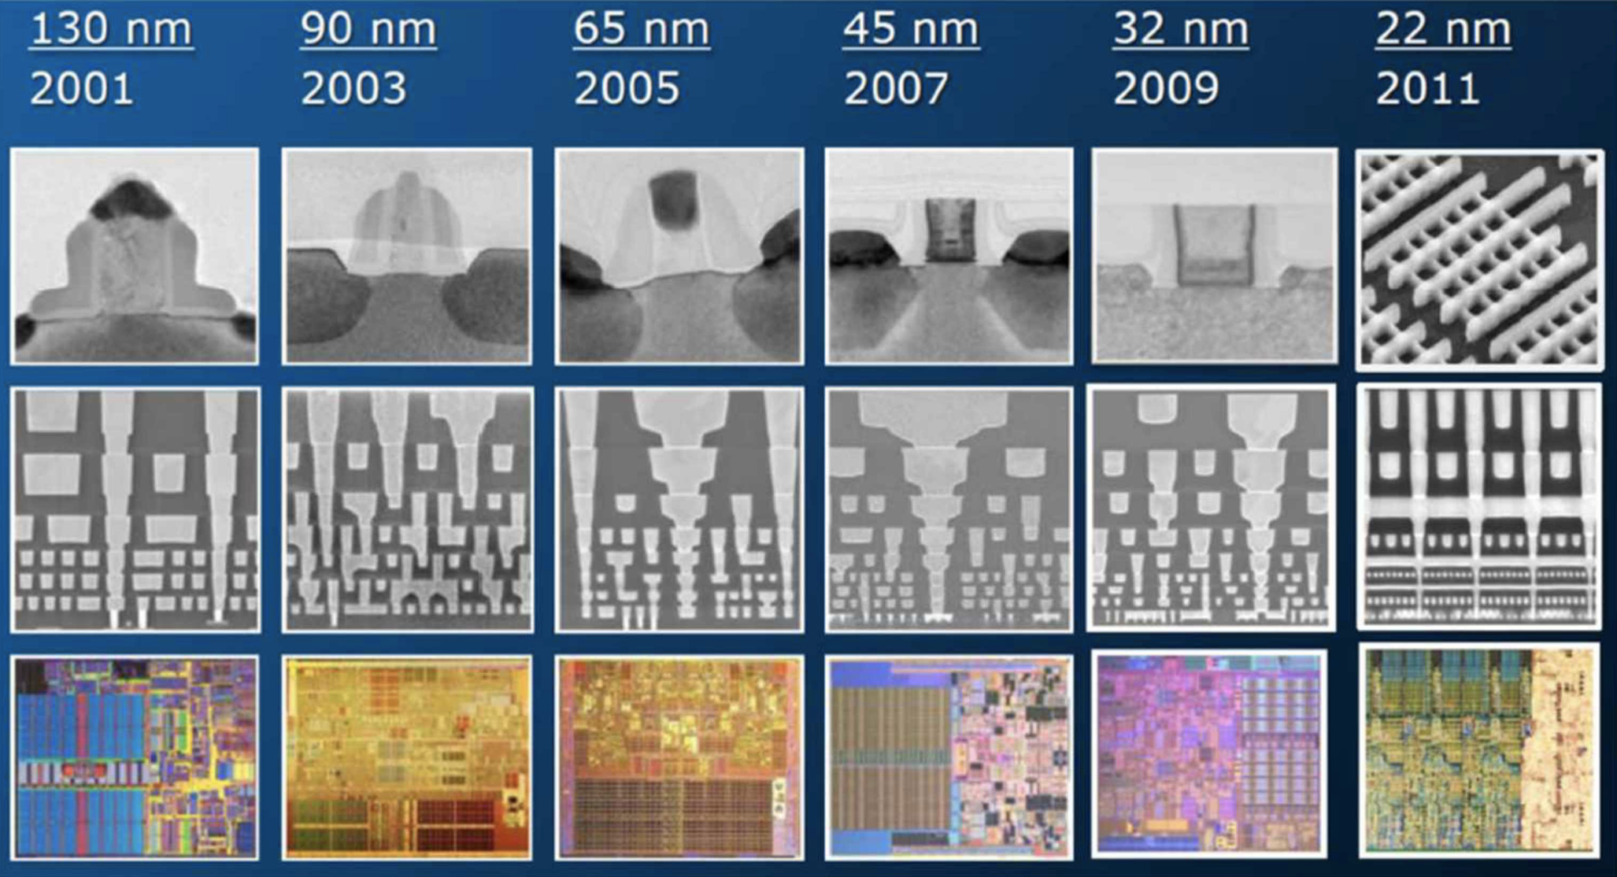
Challenges in ASIC design @ HEP
Technology Challenges
  Complex deep-submicron silicon manufacturing processes
  Powerful, Flexible but highly Complex EDA Tools
Design Challenges
  Designs of increasing complexity and size
  Novel designs for scientific instrumentation
  Radiation Tolerance
Productivity Requirements
  Large, fragmented, multinational design teams
  Designers with different levels of expertise
  Work on common design projects
  Costly technologies
  Importance of 'first-time-right’ designs !
EDA software Tools
Design Methodologies
90 nm
45 nm
14 nm
130 nm
65 nm
28 nm
Technology scaling
Notes:
After a couple of the years on the service I realized that the design teams (CERN and institutes) were facing significant challenges in their design work especially with the advent of HL-LHC electronics.

Slide 8
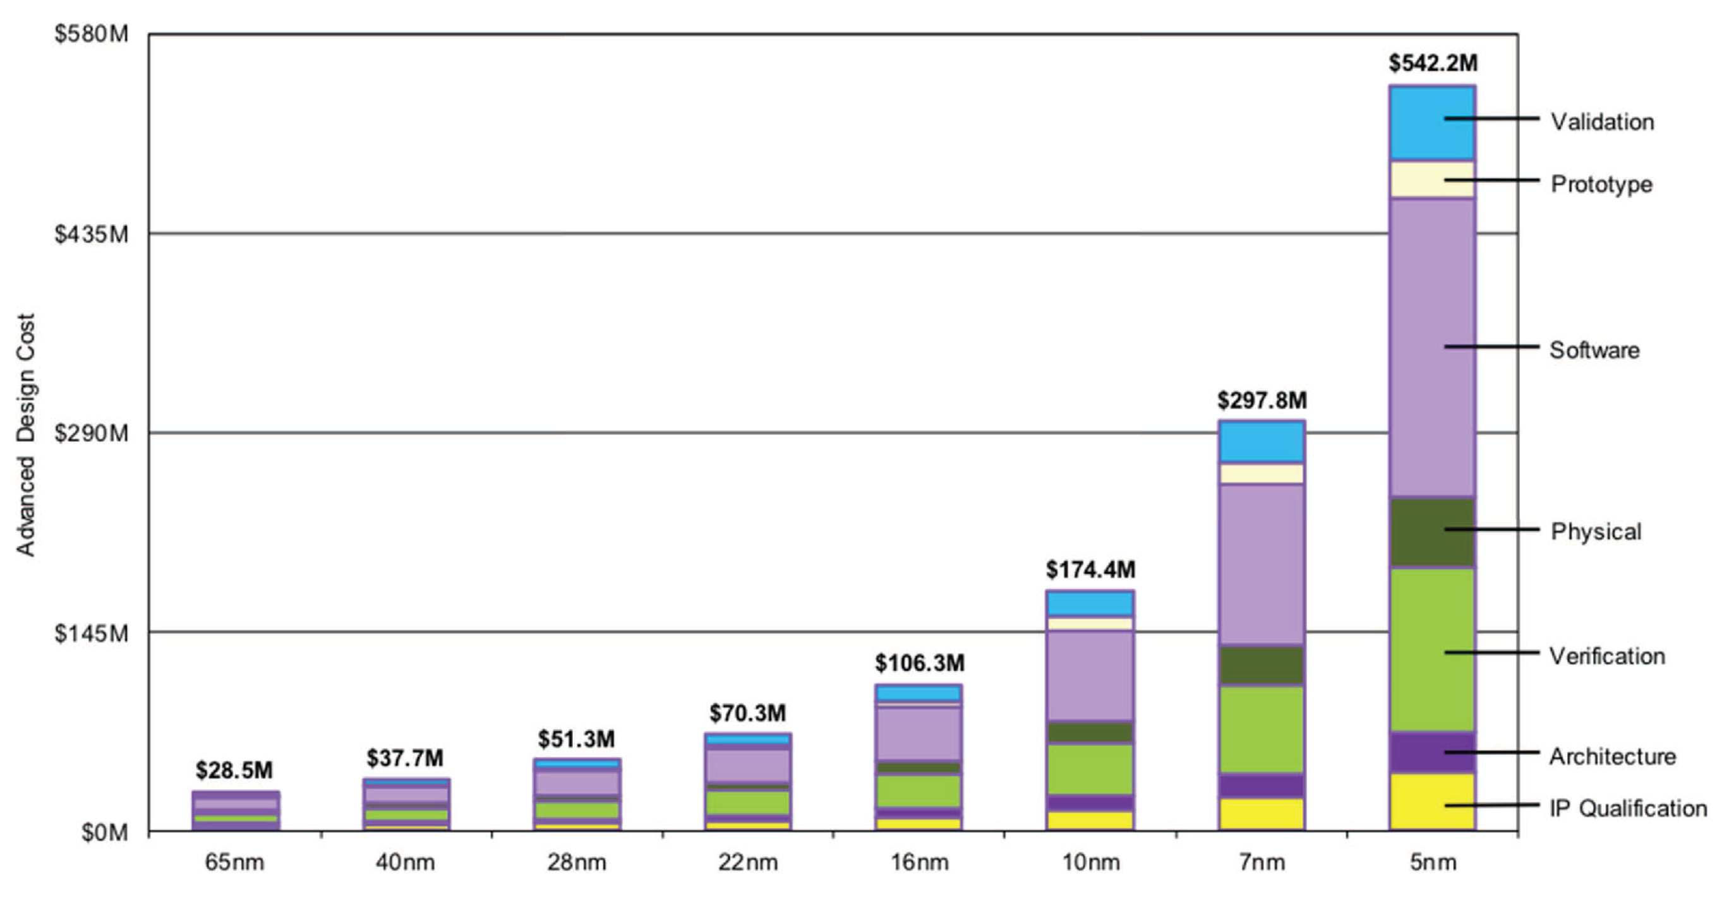
ASIC development costs
HL-LHC
designs
2004
2011
2015
2017
2019
Technology introduction year
Chip Design and Manufacturing Cost under Different Process Nodes: Data Source from IBS*
Steep investment for node sizes <16nm. But combine strong performance with lower power consumption
Design verification skills and effort are increasingly more important
Cost per transistor continues to fall even at 5nm, but this is relegated to those who have large wafer volume

Slide 9
Agenda
Access to advanced silicon technologies
for the HEP community via EUROPRACTICE 20’
  Paul Malisse, EUROPRACTICE IC service, IMEC IC-link, BE.
Access to modern EDA tools and IP block sharing
in HEP community via EUROPRACTICE 20’
  Mark Willoughby, EUROPRACTICE design tools service, RAL, STFC, UK
Challenges in designing ASICs for HEP Experiments 20’

Slide 10

Thank You

Slide 11
Addressing the Challenges
Technology Challenges
  Augment EDA Tools -> EUROPRACTICE
  Access to Advanced technologies -> EUROPRACTICE
  Integrate support for "More than Moore” technologies
    3D Interconnect & Advanced Packaging
    SiPh
    CMOS Imaging (monolithic sencors)
    Specialty embedded devices
Design Challenges
  System Architect role
  System Level Modeling and Simulations
  Design Verification at System Level and component level
  Establish & Conform to a Rad-Tol SoC infrastructure
Productivity Requirements
  Establish a Collaborative Work structure

Slide 12
Enablers for Collaborative Work
Technical Framework
  Comprehensive “common design platforms”
    Foundry PDKs & Foundry IP blocks
    Rad-Tol IP blocks and IP block repository
    Rad-Tol SoC infrastructure
    Design & Verification methodologies
  Access to common EDA tools
  Maintenance, Training & Support services
Legal Framework
  3-way NDAs with Foundries permitting technology data exchange
  Commercial Contracts with Foundries
  EULAs of EDA tool providers permitting IP block sharing
  IP block sharing agreements among design teams
  Export Control regulations

