Slide 1

Cooling
7.4: EXTREME ENVIRONMENT AND LONGEVITY
IMPLEMENTING DRD7:
AN R&D COLLABORATION ON ELECTRONICS AND ON-DETECTOR PROCESSING
Oscar Augusto de Aguiar Francisco
oscar.augusto@cern.ch

Slide 2
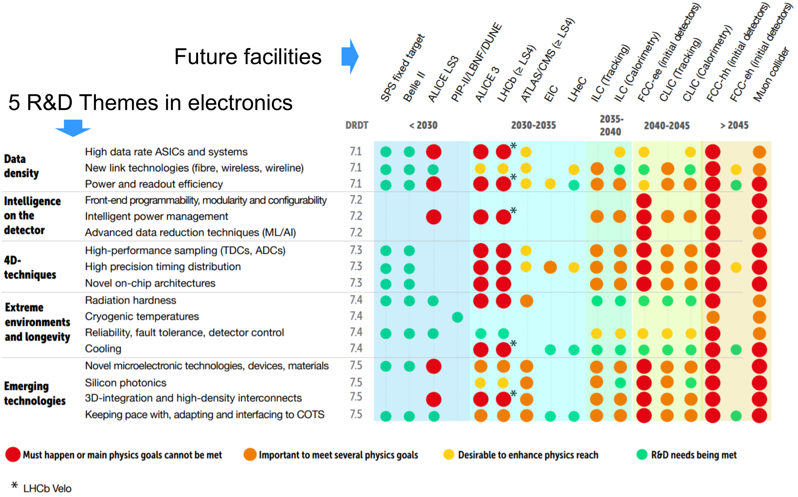

Slide 3
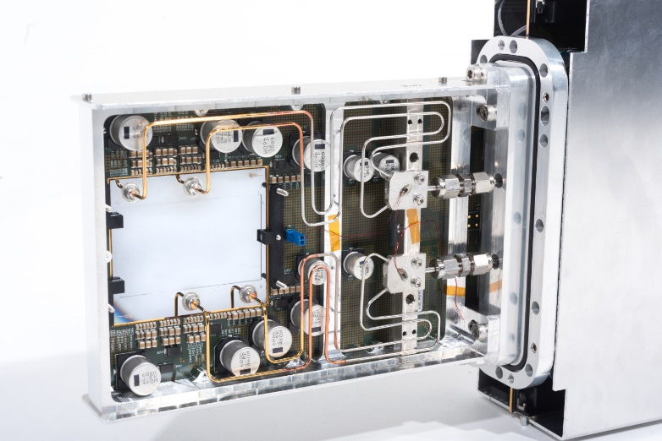
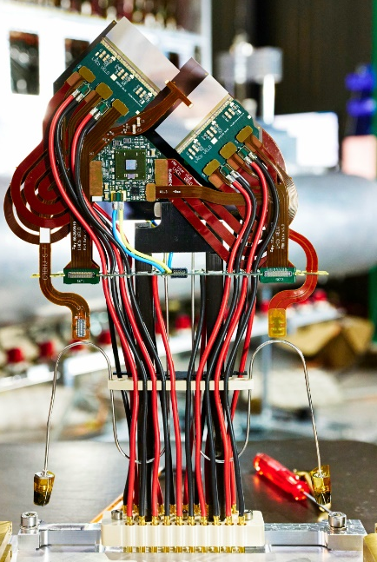
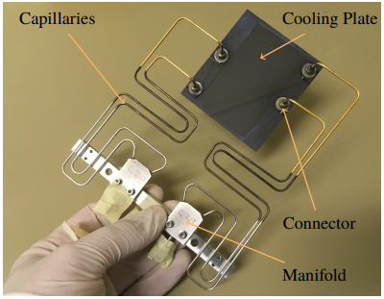
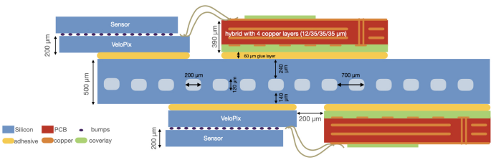
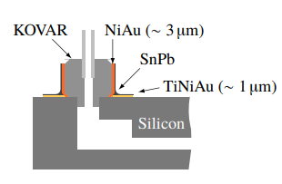
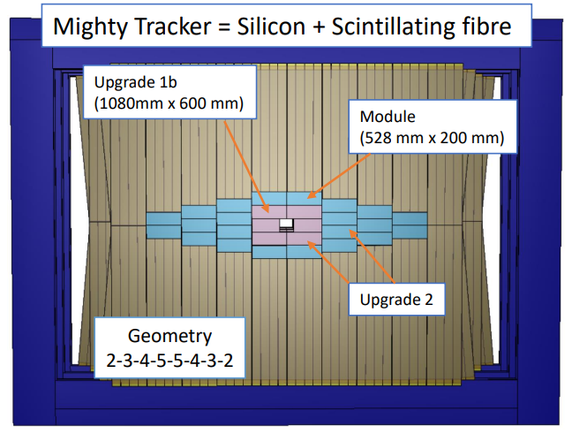
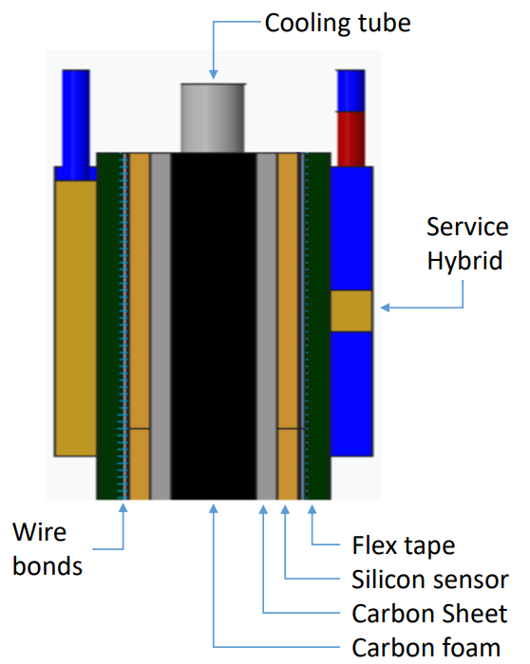
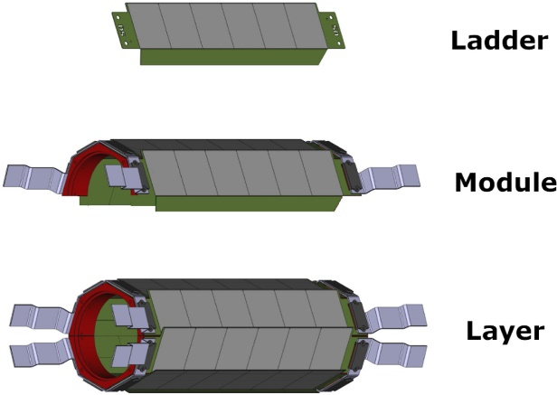
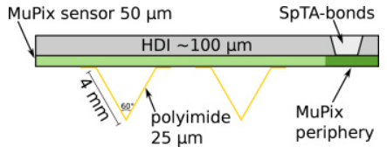


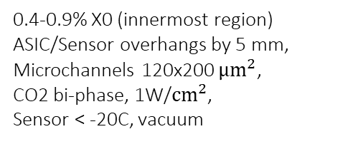
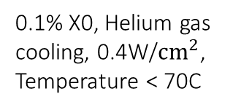
Cooling
NA62 GTK
LHCb VELO Upgrade
arxiv
Brice, Maximilien; Ordan, Julien Marius (CERN)
5 mm
arxiv
Bennett, Sophia Elizabeth (CERN)
Vacuum
Operating Temperature
0.4-0.9% X0 (innermost region)
ASIC/Sensor overhangs by 5 mm,
Microchannels 120x200 $μm^{2}$,
CO2 bi-phase, 1W/$cm^{2}$,
Sensor < -20C, vacuum
Material Budget
0.5% X0, 200 × 70 $µm^{2}$ micro-channels, C6F14 liquid coolant, 0.32 W/$cm^{2}$ in the pixel matrix, Sensor < 5C, Vacuum
Power density
Mu3e
SciPost Phys. Proc. 5, 020 (2021)
LHCb Mighty Tracker (2032)
FTDR
Thermal figure of merit
0.1% X0, Helium gas cooling, 0.4W/$cm^{2}$,
Temperature < 70C
Integration
Area/Cost
$18m^{2}$, 1-2% X0, Kapton tubes, Liquid cooling (Novec?), 0.3W/$cm^{2}$, Temperature $≤0C$

Slide 4
Remarks
Feel free also to contact the section 7.4 conveners if you have suggestions/comments
How to narrow down to fewer options?
Please fill this quick survey: here
New R&D will be required to push this limits observing the environmental restrictions (Krypton Cooling)
On the coolant side
$CO_{2}$ has an temperature operational limit ( -47C cooling plant ATLAS Baby demo, solidification at -56C)
CO_2 has an temperature operational limit ( -47C cooling plant ATLAS Baby demo, solidification at -56C)
No single solution for the cooling structure nor coolant
Invited talk: “On-detector cooling systems based on low-mass carbon dioxide evaporators” by Desiree Hellenschmidt

