Slide 2
Data Analysis Workshop
Beam Instrumentation Group
1st December 2022

Slide 3
Workshop Aims
Share the status of Data Analysis activities in BI
Collect a catalog of current and future BI Data Analysis activities
Cover from Online to Offline Analysis
The WS results will be used to
  Further collaborate within the group to built common libraries/tools
  Input for the development of new tools by CERN central teams
  Input for new CTTB taskforce for Controls Data Analysis Frameworks

Slide 4
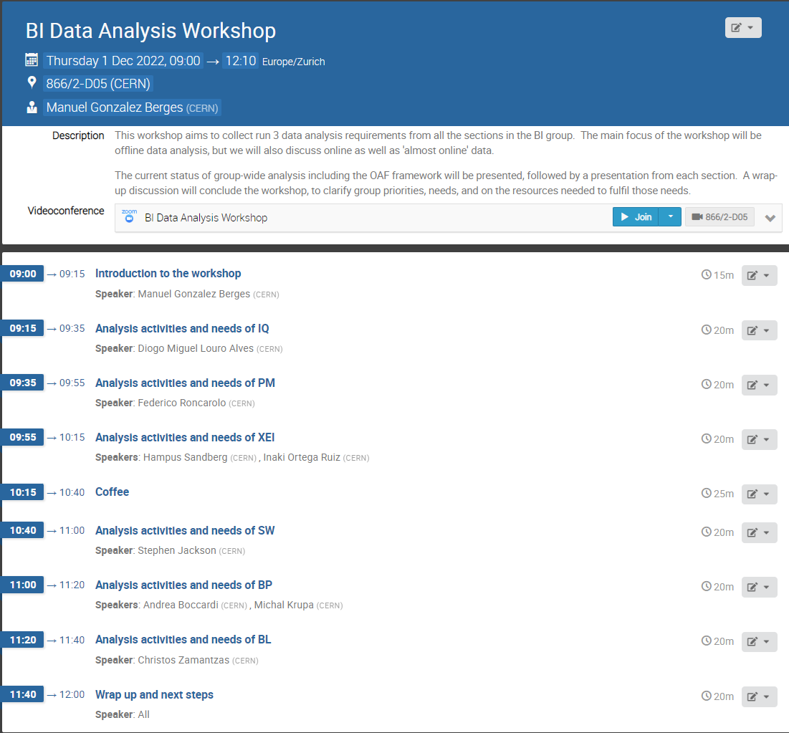

Slide 5
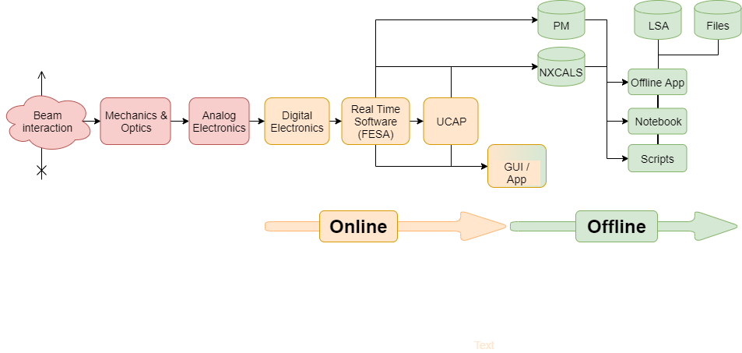
Instrument = Data Pipeline
Instrument Improvements

Slide 6
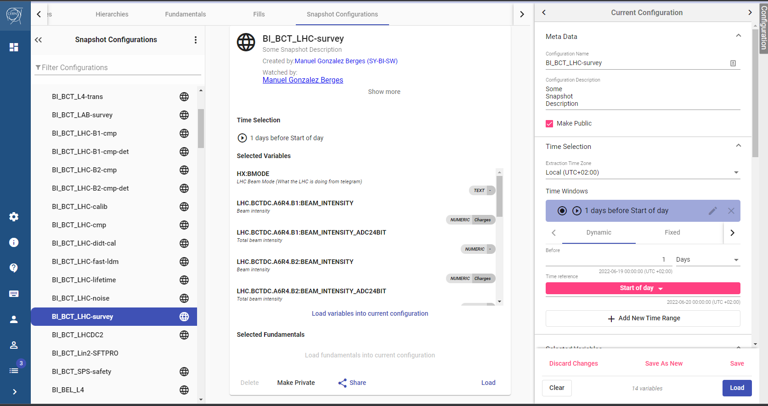
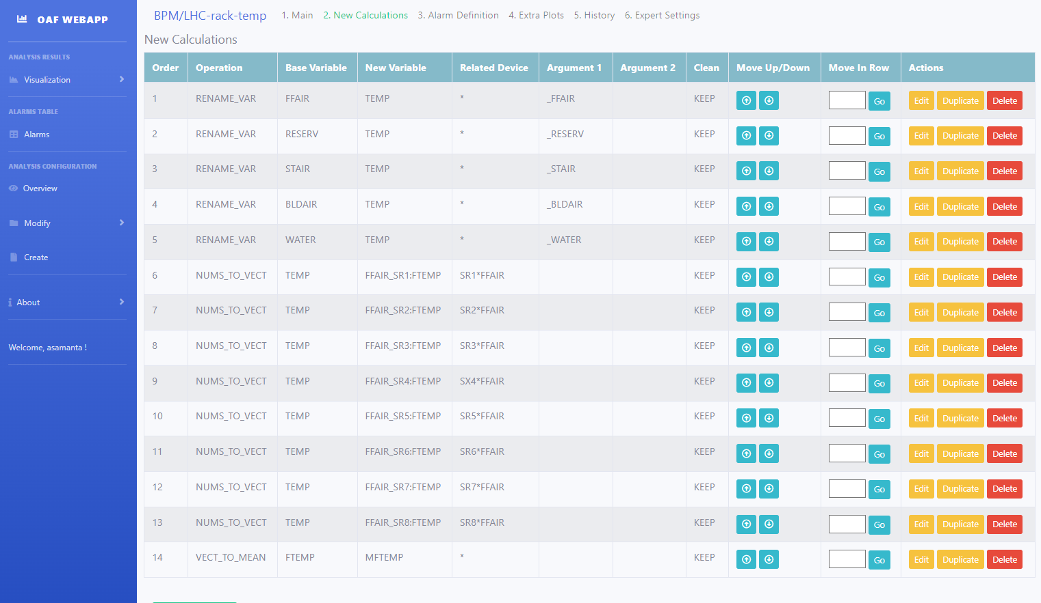
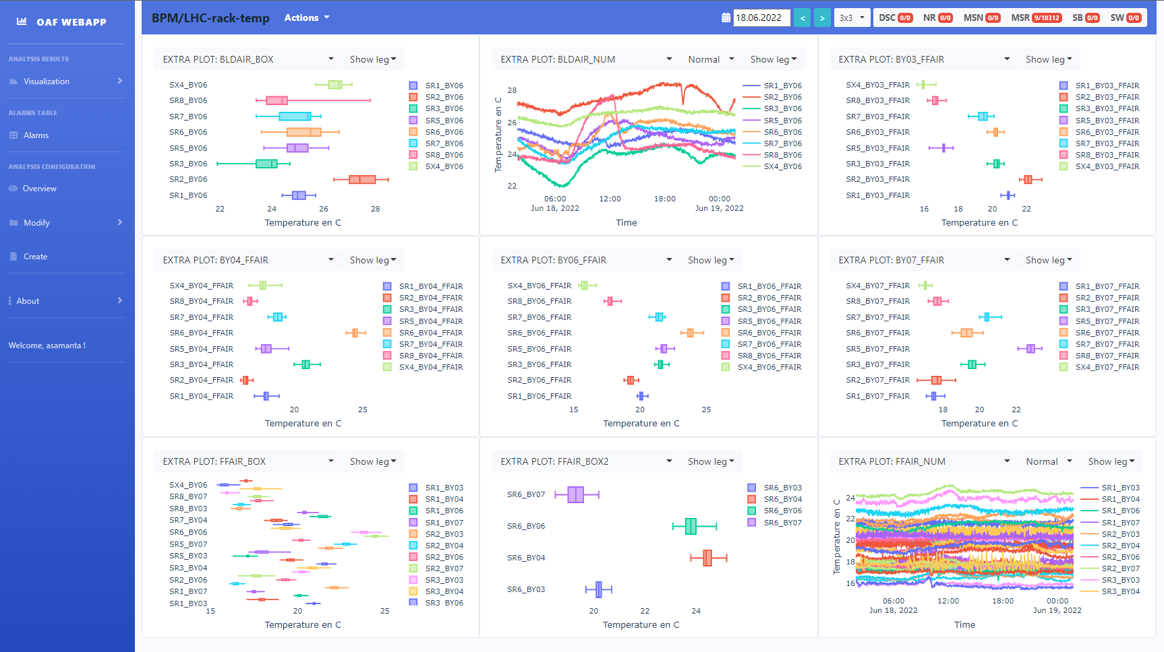
Systematic Offline Analysis: OAF
No Code Needed!
Calculations,
alarms & plots
Regular run (daily)
or on demand
Notifications &
Web visualization
Timber Snapshot
For complex analysis we can add:
Lambda functions
Custom Python Code

Slide 7












Exploratory Offline Analysis
“Non-linear” process
  Looking for the source of an issue, an optimization, MD, etc
  Quick modifications
Data analyst freedom
  Use more efficient/proficient tools
  Python + Notebooks preferred tooling?
Reproducibility can be an issue
  Should we do something in BI?
Timber
Etc…

Slide 8
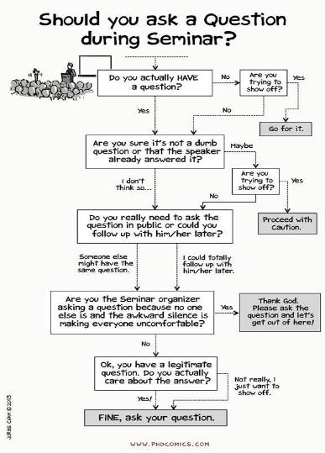
Any questions so far?

