Slide 2
Data analysis activities and needs of PM
F.Roncarolo, A.Goldblatt & al.

Slide 3
PM systems
BWS
SEM
BTV
BSRT
BSRA
BSRI
BRAN
ISOLDE and HIE-ISOLDE
Stepping Motors
Others

Slide 4
Solutions Developed in the Section (I)
In the past: cronjobs for BWS performance tracking and fault detection, derived from BLM’s cronjobs
Nowadays:
On demand access to NXCALS for issues solving, performance assessment, calibration
TIMBER
Python, w. or w.o. SWAN
some PyQT or other GUIs (e.g. to retrieve and process BTV images)
On-line or quasi-on-line data acquisition and processing
Python/PyQT: used by almost everyone to process data and ctrl
Via pyjapc or RDA (Specific RDA / GUI’s developed for BSRI, BTV)
LabView
For electronics boards validation and SEM systems ISTs (on demand checks). Mostly control, some analysis involved

Slide 5
Solutions Developed in the Section (II)
UCAP
BSRL
SPS NA SEM (George’s concentrator to collect SEM Data -> trajectory meas.)
H0H- monitors: peak detection of interlock signal on VME, ADC, logged to NXCALS
Fast spill monitors (spill intensity harmonics -> FFT), under development
FPGA data analysis done mainly by BWS and SEM FWs to:
Pre-process real time data (digital integration, filtering etc… ) to reduce data size/rate
Generate HW inhibits functions based on sensors measurements
Output error codes generation

Slide 6
UC#1: BWS measurement quality assessment
Data sources
NXCALS or on-line data via FESA or via direct access to drive or DAQ
Algorithms
Statistics, comparison, signal to noise, saturation effects ..
Performance required
No real time
Data size can arrive to few GB depending on number of scans and variables to be analyzed
Where it runs
SWAN
Results storage
On demand report (plots)
Results presentation/notification
Slides, emails, stored in indico or cernbox or edms
Tools used
python, notebooks
Status / criticality
Can be critical for operation (normally beam quality assurance only, not blocking)
Contact people: J.Emery et al.

Slide 7
UC#2: BSRI online analysis and logging
Applies to other R&D projects or test stands in the section
Data sources
NXCALS or on-line data via FESA and Python RDA servers
Algorithms
image processing / fit from standard Python libraries (scipy, numpy, opencv…)
Performance required
Real time, slow image acquisition implemented so far (~1 fps)
Where it runs
on FECs (servers for HW control) and on virtual machine (expert application for analysis)
Results storage
real-time plots and sent to NXCALS for later analysis
Tools used
python
Status / criticality
Development
Contact people: D.Butti et al.

Slide 8
UC#3: Fast Spill detector data
Under development for BI-PM monitor(s)
Applies ~like-in-this-slide to BI-BL servo-spill-BSI (but with different data size and rate)
Similarities to dBLMs (?)
Data sources
NXCALS or on-line data via UCAP (raw data from fast digitizer, combined to SPS BCT, BLMs et al))
Algorithms
Noise filtering, running average, harmonic analysis / FFTs (python: scipy, numpy, pandas)
Performance required
FFT around specific harmonics to be published in real time (but with seconds available between SPS cycles)
  possibly for feedforward to next cycles
Full spectrum analysis for spill quality tracking: off line
Spill = 5 sec, sampled from 500 MS/s (VME digitizers) to 5GS/s (picoscope)
Where it runs
Realtime on UCAP
Offline: NXCALS via python
Results storage
UCAP output to NXCALS and possibly to SPS control (INCA?) to feedforward EPC equipment
Spill quality to OP, Beam Performance Tracking
Tools used
Python, UCAP
Status / criticality
Development
Contact people: F.Roncarolo, S.Mazzoni, D.Belohrad, et al.

Slide 9
Existing Solutions Feedback
OAF: tested in the past, interfacing and report interpretation not very easy. Not tested recently
NXCALS:
TIMBER: very limited use for data analysis
SWAN limited in memory and speed
In general: easier python access would be welcome
  E.g. to send data to NXCALS without passing through CCDE and virtual devices
UCAP:
SET action missing
quite an effort for (initial) setup/ configuration
WRAP: too rudimental

Slide 10
Wishlist
Margin of improvement (with existing and/or new tools) for:
anticipate systems’ issues (i.e. before users call ! ) by ‘automatic failure detection’ (online and offline options can be studied/defined)
automatic performance assessment to monitor calibration drifts etc…
Examples:
SEM systems
  faulty channels detection
  BSI/XSEC calibration drifts (by comparing to ring BCT and BLMs)
  Automatic SEM ‘ISTs’ once a week (implies injecting test signals and log channel acquision, with no beam or detectors OUT)
H0-H- day by day tracking of signal vs L4 and PSB BCT (being implemented in Beam Performance Tracking BTP)
Stepping motor loosing steps
Increased friction on WS, reproducibility of motion profiles
No signal on BRAN during stable beams

Slide 11
Spare slides

Slide 12
BTV (presently)
Data:
  NXCALS:
    Used by users (ex HiRadMat)
    Used by expert for checks / problem solving (Python routines / expert GUI)
Data analysis / CTRL:
  Expert GUI’s: direct acces to card for problem solving
IST’s / Calibration:
  manual process, not possible to automate (camera can move slightly, aging of tubes, etc)

Slide 13
BTV (future)
New electronics deployed in ~2 years:
  measure motors and lamps currents -> automatic checks / failure prevention

Slide 14
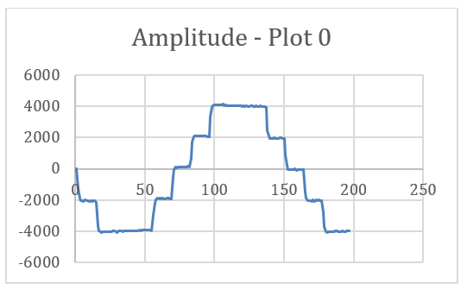
SEM Grids (presently)
Data:
  NXCALS, FESA, used for performance assessment online and offline
IST’s / Calibration:
  LabView GUIs (using API’s for FESA):
    Test signal injection on all wires and readout
      on amplifiers
      in vacuum
      different gain
    IN/OUT check
    Acquisition card testing and response curve (done once in lab before installation)
Readout of test signal injection

Slide 15
SEM Grids (future)
Automatic checks:
  Periodically, on demand

Slide 16
BSRI, BSRT (presently)
Data:
  NXCALS (Python)
  From hardware (FESA for operational devices + Python RDA servers for R&D projects)
Data analysis / CTRL:
  PyQt/GTK GUIs via FESA and RDA servers
  Results sent to NXCALS
IST’s / Calibration
  PyQt expert application for BSRT vs WS calibration
Remarks:
  UCAP not yet used because no set option, data processing performed within control application
  WRAP not used because too rudimental
  no performance tracking

Slide 17
BSRI, BSRT (?) (future)
automatic BSRT vs BWS performance tracking ?
  programming an automatic BWS-BSRT comparison report every time a wire flies
automatically diagnose common hardware issues (and fix them)

Slide 18
BSRA, BRAN (presently)
BSRA:
  Functional check performed automatically before every fill. When this fails the sequence cannot go ahead -> call from CCC. No need for more
  Calibration not automatic (in the past the LHC team was not so keen about this). To be discussed
BRAN:
  No alarms or automatic checks are implemented. Call from CCC when issues.
  The ultimate quantity is the total luminosity that should be ‘close enough’ to the one published by experiments. At times this is not available or it is uncalibrated, so a simple comparison will not work.

Slide 19
BWS Data analysis/decision levels (presently)
FW level
Data generation/processing and system condition status
Inhibits functions based on sensors measure
Error codes generation
=> Potential FW analysis & decision still open to automate IST.
Low level & local access directly on the HW (motion & acquisition)
=> for HW critical part of the IST.
=> if done at FESA level, this would imply low level ctrl on the HW.
FESA level
Config & Synchro of the system and services, HW error handling
Data processing & correlation between data sources (e.g. motion and PMT) & presentation
Tests & analysis with BI Navigator when
- testing new installation & interaction with external systems (e.g. LTIM)
- OP reports immediate issue with a system
Storage database level
NXCALS with Timber for quick manual check
NXCALS with SWAN for numerous health system checks, sensors data comparison, noise analysis, beam measurement analysis and correlation with machine parameters.

Slide 20
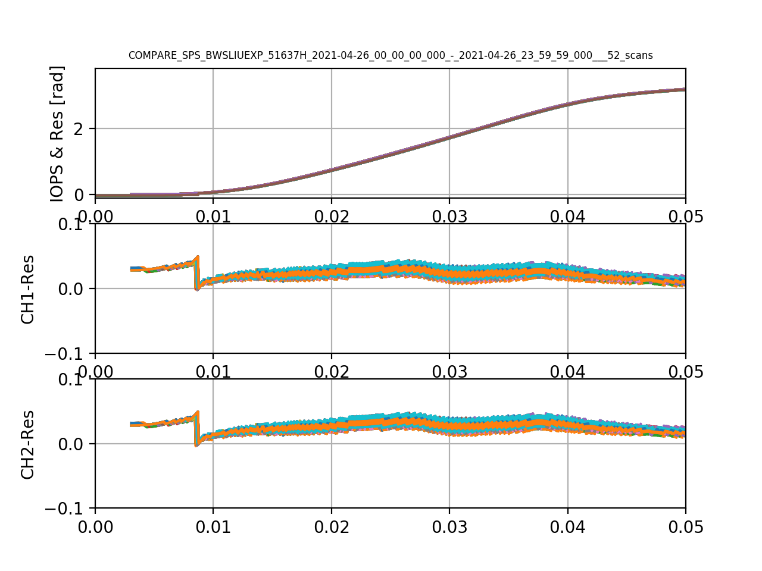
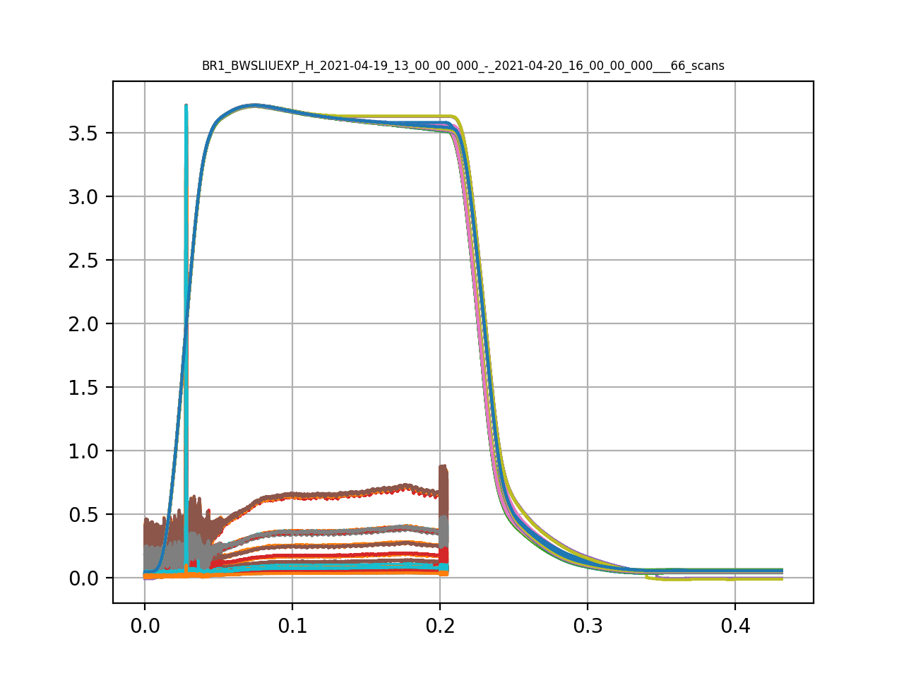
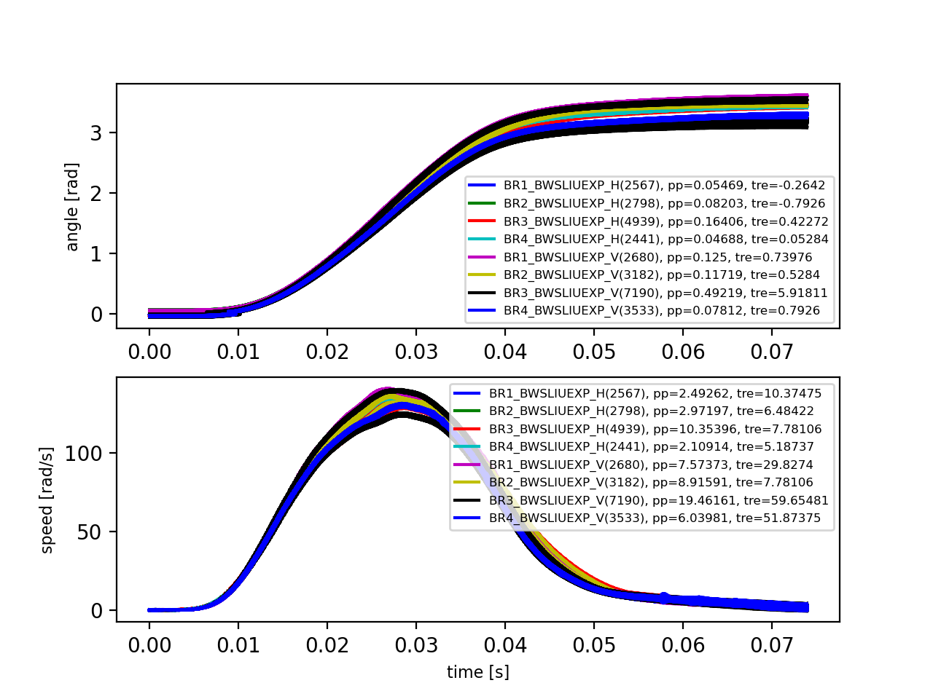
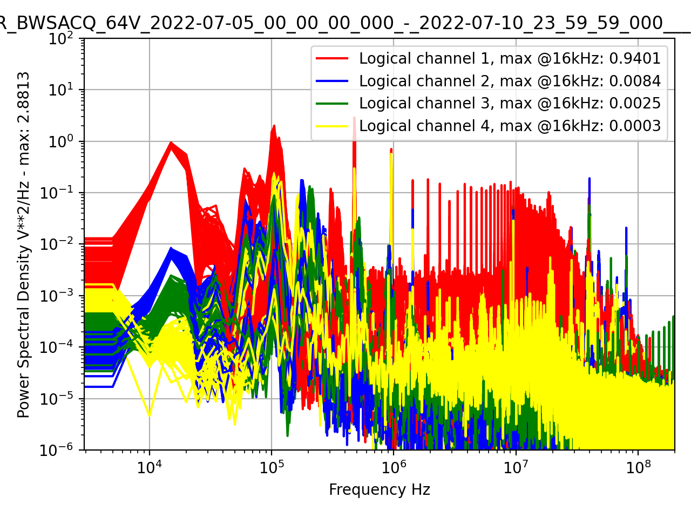
Missing beam size related analysis by
Salvatore & Federico’s
BWS Some SWAN Analysis (presently)
Compare angular encoders
Plot PMT and WIRE ANGLE
Trajectory reproducibility error
acquisition noise PSD

Slide 21
BWS Data analysis/decision (future evolution)
FW level
Partial IST automation (action/analysis/decision) for the driving side
System level streamline data analysis
combination of data vectors and status to determine the system health and operational status
(e.g. motion sensors, c-wire measure, PMT data)
-> Not yet defined at which level to be implemented and how decision will affect system’s operation / alarms (FESA or UCAP or ? )
Storage database level
A) Tracking the evolution of parameters (and aging) over many wire-scans and inform expert for future maintenance, link NXCALS data with INFOR HW data for preventive maintenance.
B) Wire-scan quality measurement index (as done with Cronjobs-2011 and OAF later on?)
(Determine if the quality of measure is acceptable and inform expert otherwise)

