Slide 2
Data analysis activities and needs
BI-SW

Slide 3
Data analysis in BI-SW? Really?
SW section delivers measurement data to be analysed
  Covered in other presentations today
But remember that BI-SW are an integral part of analysis (directly or indirectly)
  Assisting in gathering data, correlating data from multiple observables, common tools (OAF), qualifying systems/devices, etc.
  Design of the data API affects how easy it is to analyse later
    Grouping of online data in Properties for specific clients/use-cases
    Logging Properties with efficient NXCALS extraction in mind
  Also assisting in the measurement analysis itself
What about analysis of data not taken from the measurement?
  Non-physical data anomalies in Operations
  Hardware diagnostics & Software characterisation
  Online processing & analysis
  …

Slide 4
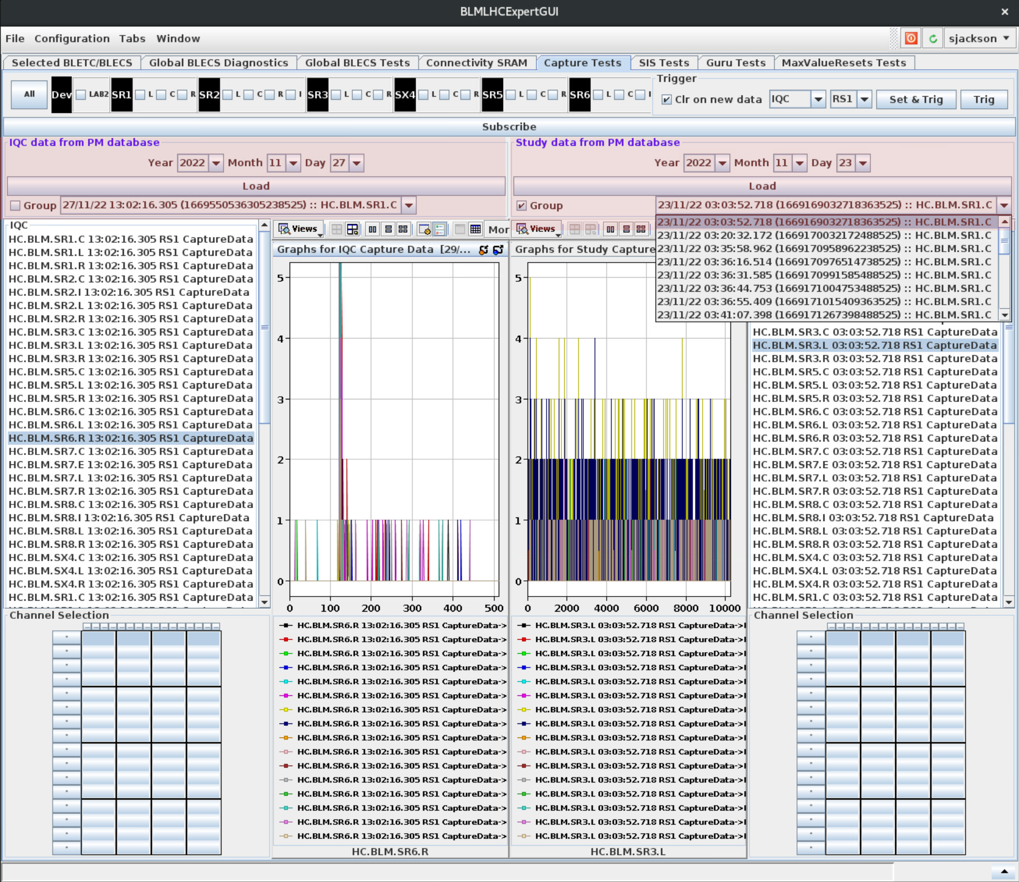
Non-physical data anomaly analysis in Operations
Example - Analysis of IQC and Study data for LHC BLM
Example of a visual analysis of non-physical data
Data source from PM database
  Result retrieval is quite slow
    Order of minutes for a day’s worth of data
  Data also in NXCALS, but that is even slower!
PM integration into existing Java Swing GUIs quite straight-forward
  Simple PM Extraction API
Scope for automating visual analysis in existing Java tools
  Or moving to scheduled Offline analysis?

Slide 5
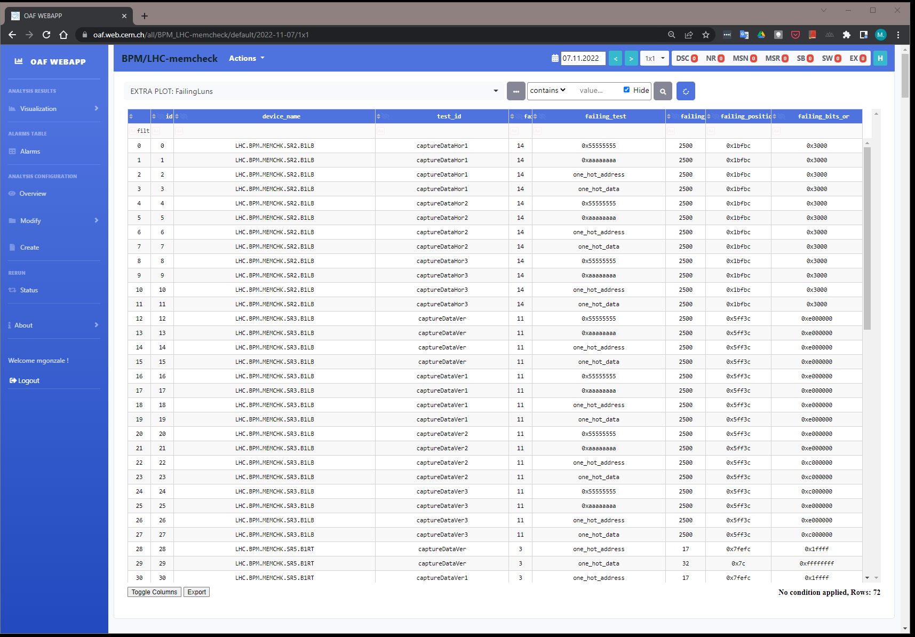
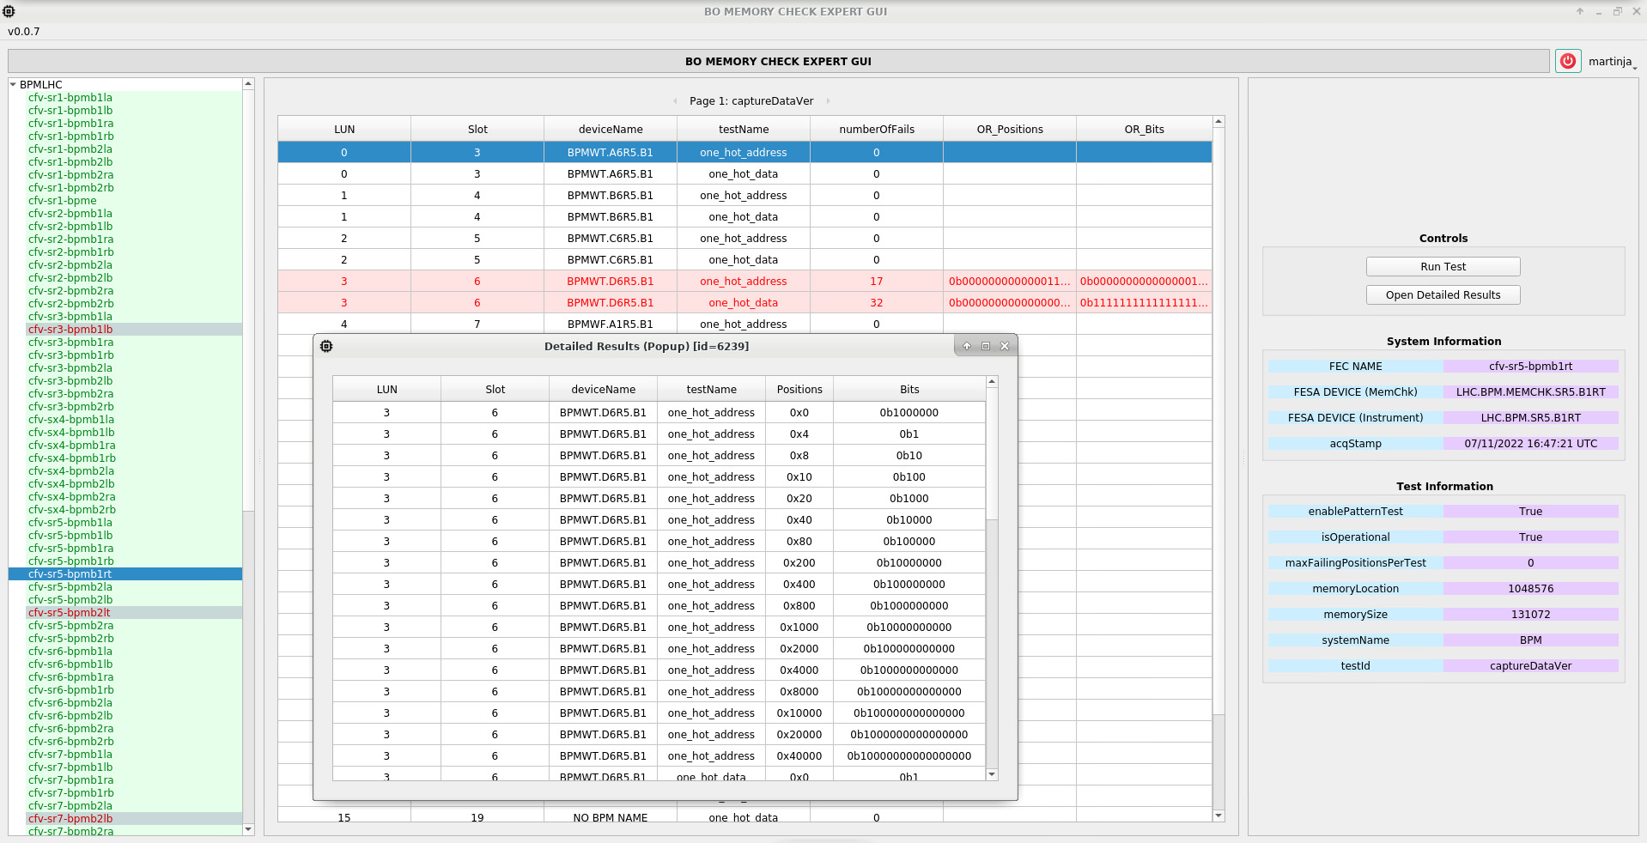
Hardware diagnostics analysis
Example - H/W Checking in Operations
Python scripts from BPM & BLM sections used to identify H/W problems in operational crates
  E.g. Write patterns to SRAM, then readback to check integrity
New solution made to be fully integrated with control system
  BOMEMCHK FESA class performs the same analysis (for the BLM and BPM cards)
  Results systematically stored on NXCALS
  Daily extraction to make OAF reports
  FESA device can be either triggered by
    the LHC sequencer (pre fill)
    dedicated PyQt GUI (for immediate check)
Check becomes systematic
  Not only reactive when a problem is reported

Slide 6
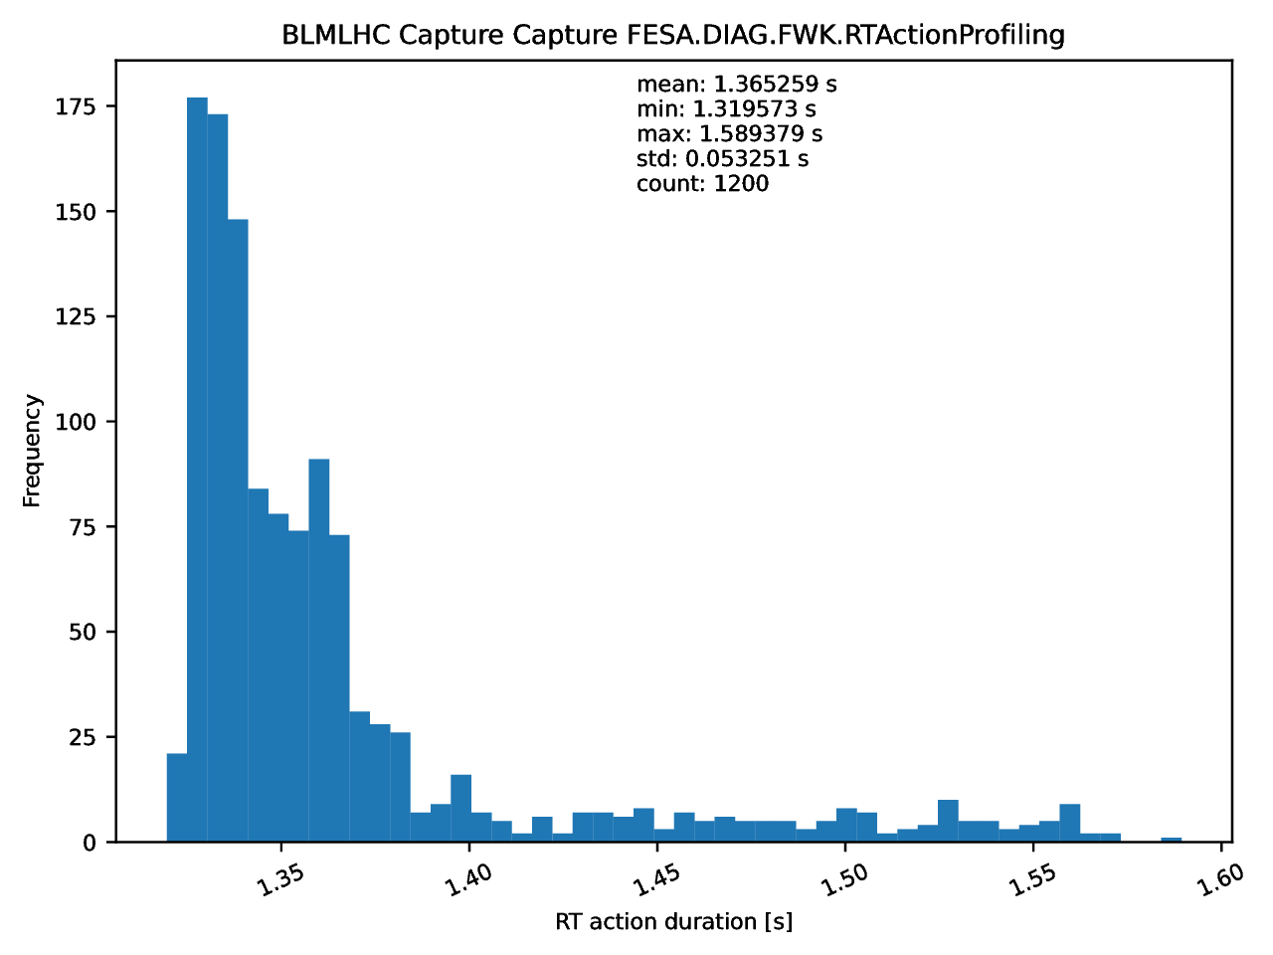
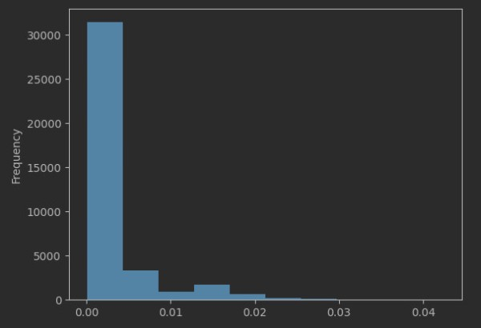
Software diagnostics analysis
Example - S/W Checking in Operations
Characterisation of FESA software behaviour
  FESA UDP Diagnostics captured over ‘n’ minutes
    Measures duration of real-time actions
    Plus optional custom ‘probes’ in software
      E.g. If we read 18 cards, how long for each card?
  Report of analysis currently made in PDF
    Mean, min, max, std-dev for RT actions and probes
How is it useful?
  Describes what is normal for the software
  Allows to see the effect of software or hardware upgrades
    FESA version, O/S, FPGA, CPU, CTR updates…
  Can identify a failing VME card for example
    Card 7 is taking 100 times longer to read than the others…
  In the future we can store a reference analysis per device
    Troubleshooting can then be done by re-running and comparing
      By the SW or the HW team

Slide 7
Online processing & analysis
Realtime Analysis Processing in FESA
Many FESA classes are processing data before publishing
  Fitting
    Pre-analysis can be done before deciding to fit to avoid fitting noise (= kills RT thread)
  FFTs
  Noise filtering
  Peak detection
  etc…
We tried to converge on using a group standard for libraries in C++
  Ana & Enrico – based on GSL
    We all try to use this wrapper
    But still have several ad-hoc solutions for other things
      E.g. fftw3

Slide 8
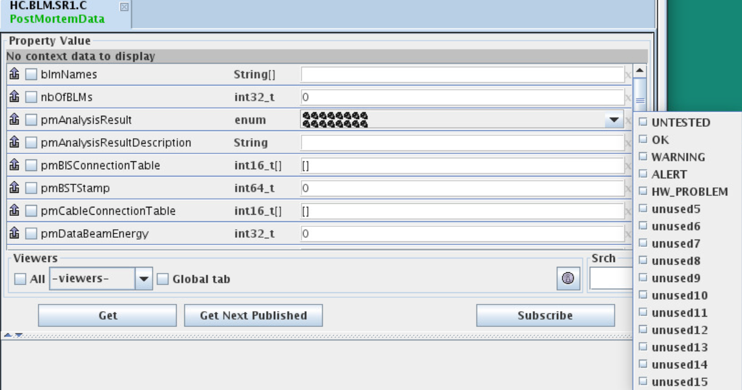
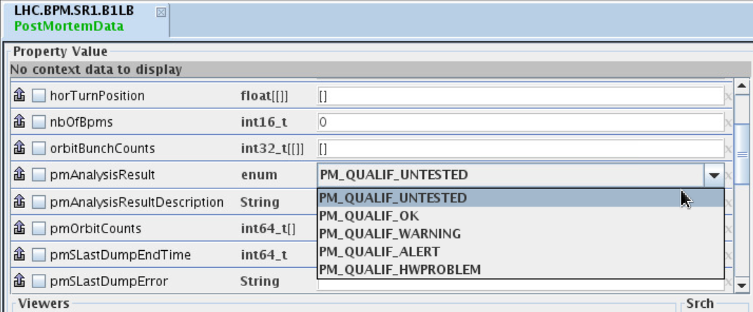
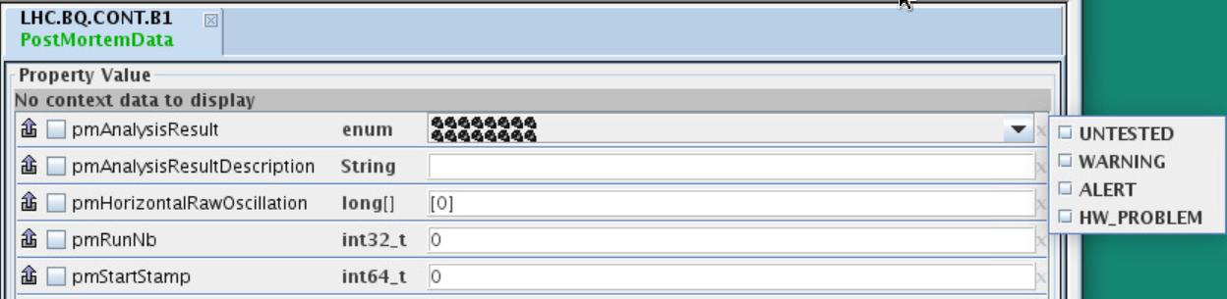
Online processing & analysis
Example - Data Analysis Flags in LHC PM Data
In many LHC systems, PM fields exist for hints on pre-analysis of data
  In most cases, there is little or no implementation
Discussion on whether we should make more use of these fields
  Simple analysis at the FEC level to identify anomalies
    E.g. Recognising a hardware issue
  Additional analysis of data by the FESA class
    Saturation, signal/noise, …
    Identifying source of interlocks, etc.
BLMLHC
BQLHC
BPMLHC

Slide 9
Existing Solutions Feedback
  OAF
    As a tool, we consider it usable
      Still with stability issues
        Often due to lack of custom config sanitizing
    But as a section we need to allocate time and resources
      Continuous resource needed (student, Origin/Quest), just to keep it alive
    Long term goal to synergize with sector
      But what about today?
  NXCALS APIs
    Not so intuitive and slow
      New release soon (?)
  Swan
    Not commonly used in the section, but we see clear potential
    Lacks TN access (at the moment) so limited to only Offline data
    Q - How are the various notebooks organised and stored at a group level though?

Slide 10
Wish-list
Better interfaces and speed with NXCALS
  Dependency resolution for Java is difficult
    And seems unstable
    So difficult to add to existing Java GUIs
  Python much better
Data storage limitations
  If it doesn’t fit in NXCALS, where can we store our data?
    PM database being abused in some cases!
Global analysis on state of all our FECs
  Years ago, we had a snapshot of status of all our FECs from a single webpage
    Could we make something similar in Grafana? (probably)
  We have lots (lots) of diagnostic information from FESA classes & LHC sequencer tasks
    Often going to syslog or bespoke FESA fields or logbooks
      Could we have a standard way to channel this information for online or offline analysis?

