Slide 1

Analysis activities and needs of BL
BI Data Analysis Workshop
December 2022
Christos Zamantzas on behalf of SY-BI-BL

Slide 2
Overview

Slide 3
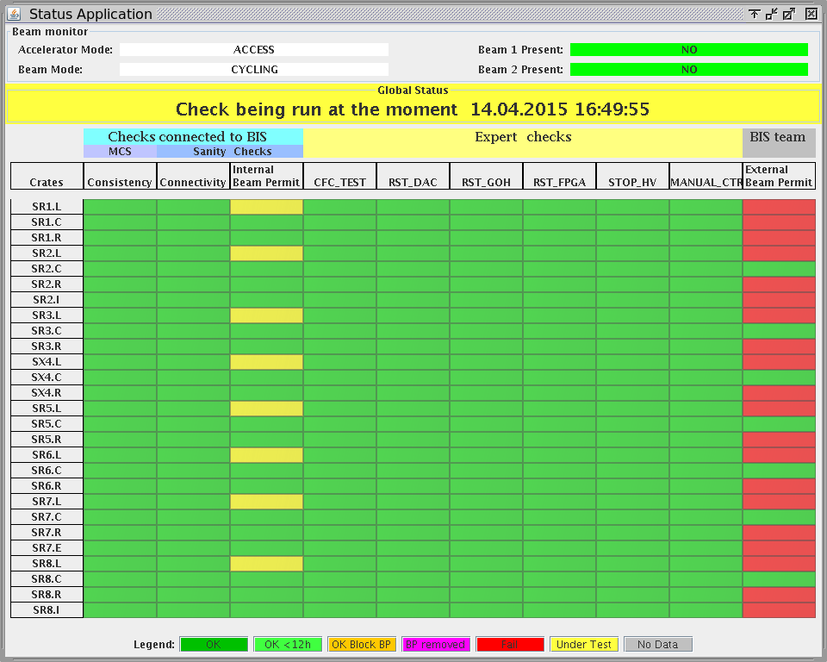
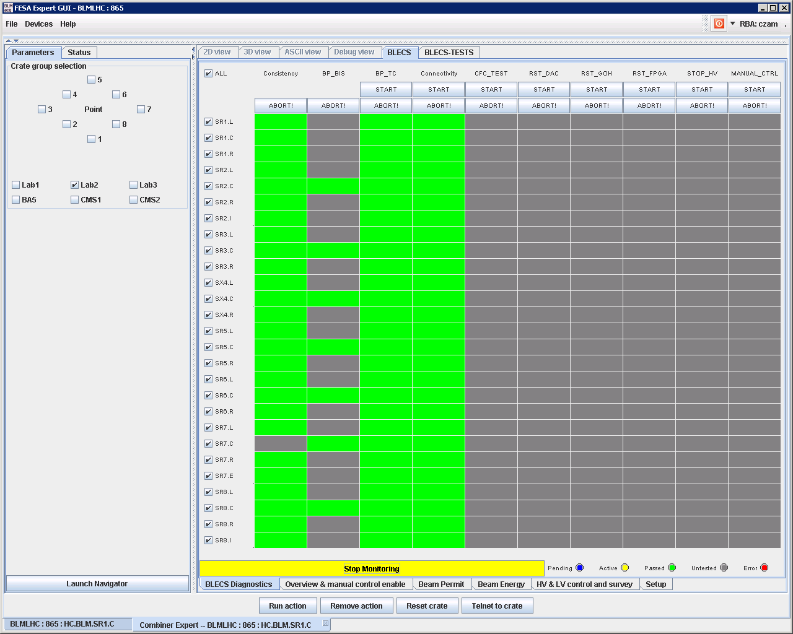
System Sanity & Expert Checks
Three groups of checks to validate at any time the system remotely:
Each group assigned to different teams, i.e.
Operations crew & System Expert
System Expert
Beam Interlock System team
1
2
3
Expert Application
Status Display
The Sanity Checks verify the consistency of the parameters, the connection & operation of all elements and ability to create interlocks
These can be executed by the LHC Sequencer or manually by a system expert
The BLM system ensures that this happens at least once every 24 hours.

Slide 4
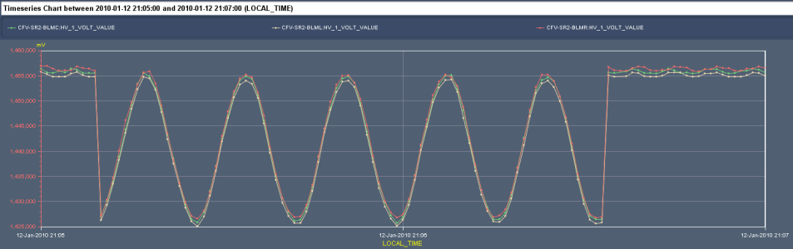
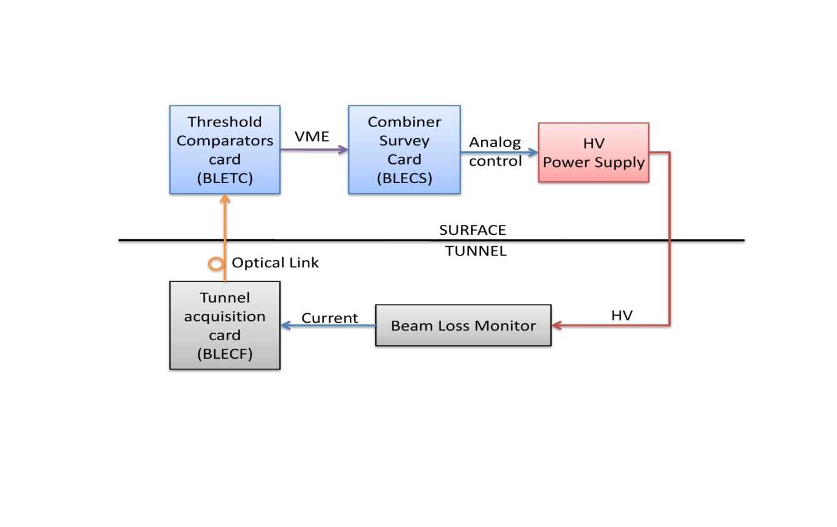
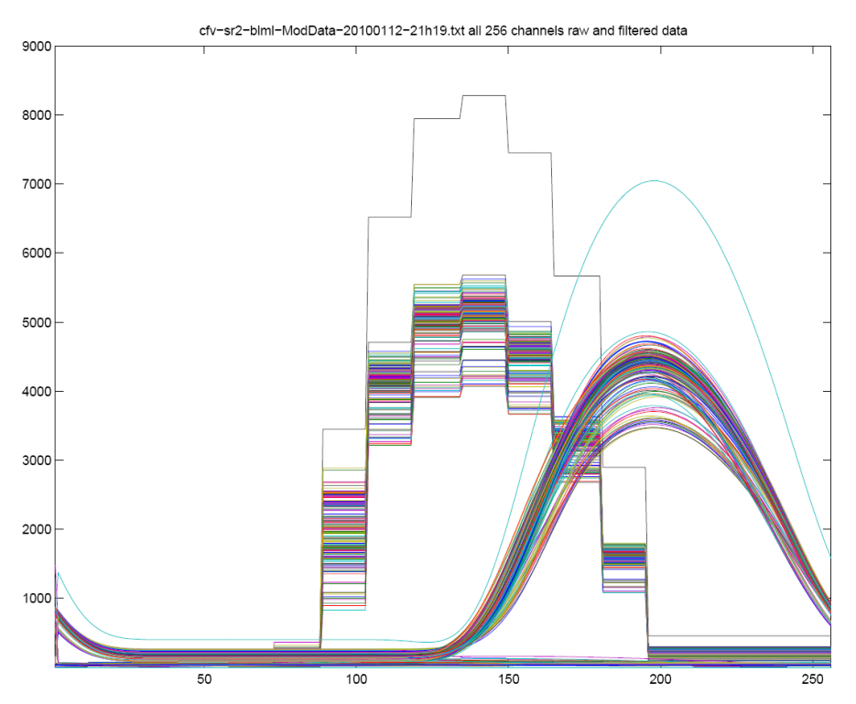
Modulation Check (1/2)
View on the LHC BLM system for the connectivity check.
The high voltage supply to the monitors is modulated with a 60mHz 30V sinusoidal signal.
A current on the monitors is induced by the HV modulation and can be measured by the normal BLM acquisition chain.
The Combiner & Survey module uses the running sum (RS_09) from the Threshold Comparator modules to determine the amplitude and phase of each monitor (256 channels per crate).
This results are compared to predefined limits to permit or block the next injection if a non conformity is detected.
The signals of each monitor is stored to the Logging DB and can be further analysed with the dedicated application.
The limits are unique for each monitor. They are calculated out of multiple measurements.
View of the SRAM data containing the original (stairs) and filtered RUNNING SUM 9 data of each channel (256 in total) of one crate. This plots represent one period of the modulation.

Slide 5
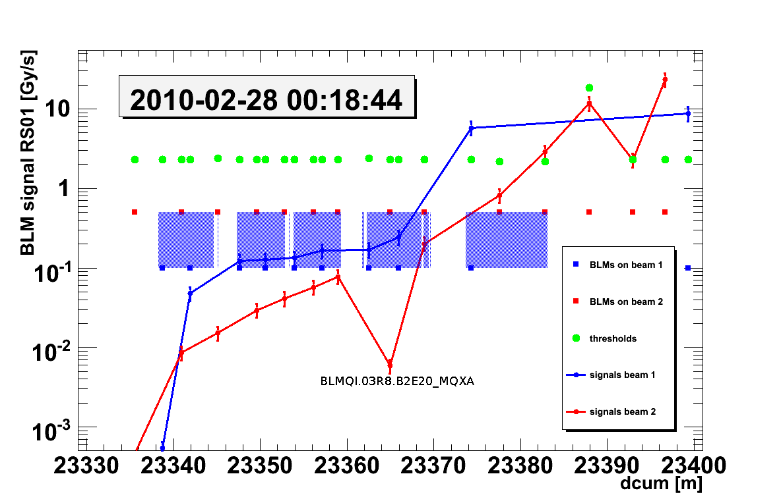
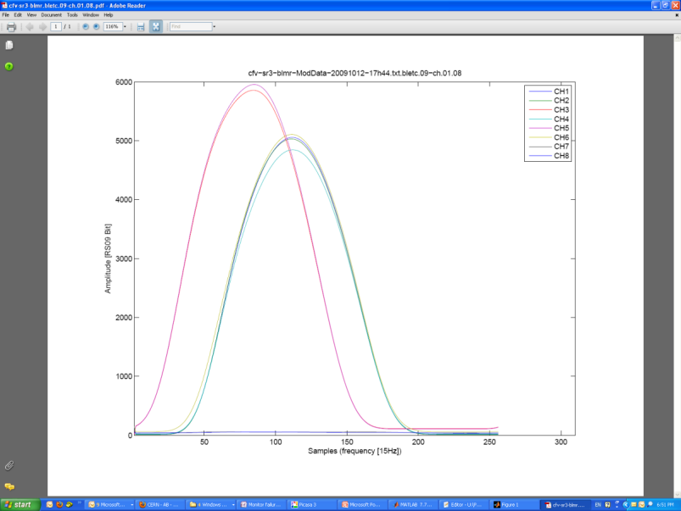
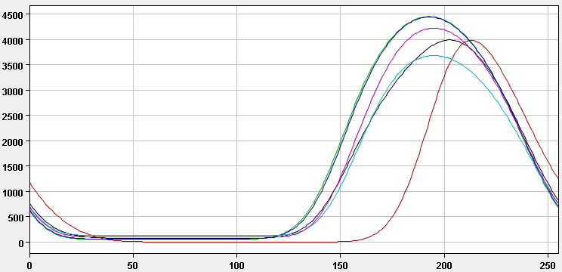
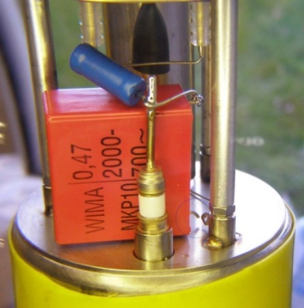
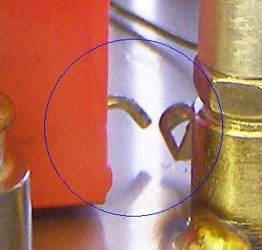
Modulation Check (2/2)
Main tool for checking the connection & performance of each detector
During operation/run: discovery of installation degradations
Type of non-conformities | Occurrences | Deviation from the expected behavior
Chamber filter disconnected or badly soldered | 27 | 9%-33%
Tunnel card (BLECF) non-conform behavior on one or more channel | 4 | 10%-30%
High voltage distribution box | 1 | Large
Connection of monitor on the wrong channel | 2 | Large
Monitor not supplied with high voltage | 4 | Large
Capacitor missing
or disconnected
Normal behaviour
Amplitude [RS09_Bit]
Samples
A sensitivity issue was noticed with beam and confirmed with the connectivity check measure.
Non-conformity discovered during commissioning (top).

Slide 6
Example: LHC BLM Data
NXCALS
  25 variables per detector (measurements & thresholds used)
  ~500 variables per crate (mostly arrays) for telemetry & diagnostics
  Total: > 120’000 variables logged at 1 Hz
LSA
  Relational DB with multiple tables & layers
  3.5 Million entries for thresholds
    multiple more if we track threshold parameters per family
  1.5 Million entries for system architecture
    Synced from LAYOUT
Similar situation for INJ BLM system
  Now ~ 50% of LHC in size and growing!
Smaller systems sometimes have large amount of data & also need monitoring, e.g. dBLM

Slide 7
System Checks

Slide 8
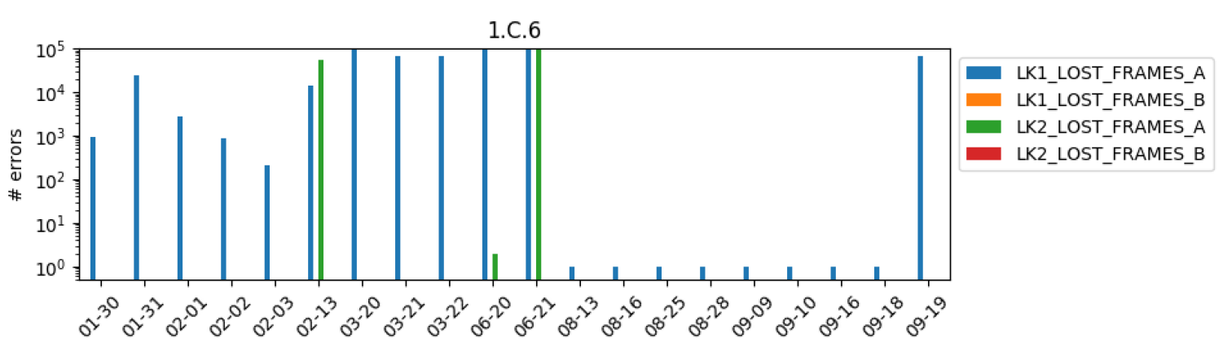
Daily reports: Optical Links
Daily checks introduced with the aim of detecting link degradation
  Experts refer to it to identify the location or piece of equipment failing
  Process can give ‘hints’ of upcoming issues and help also in predictive maintenance
Daily report on number of errors per Optical link
fix
Re-appearance
Re-appearance

Slide 9
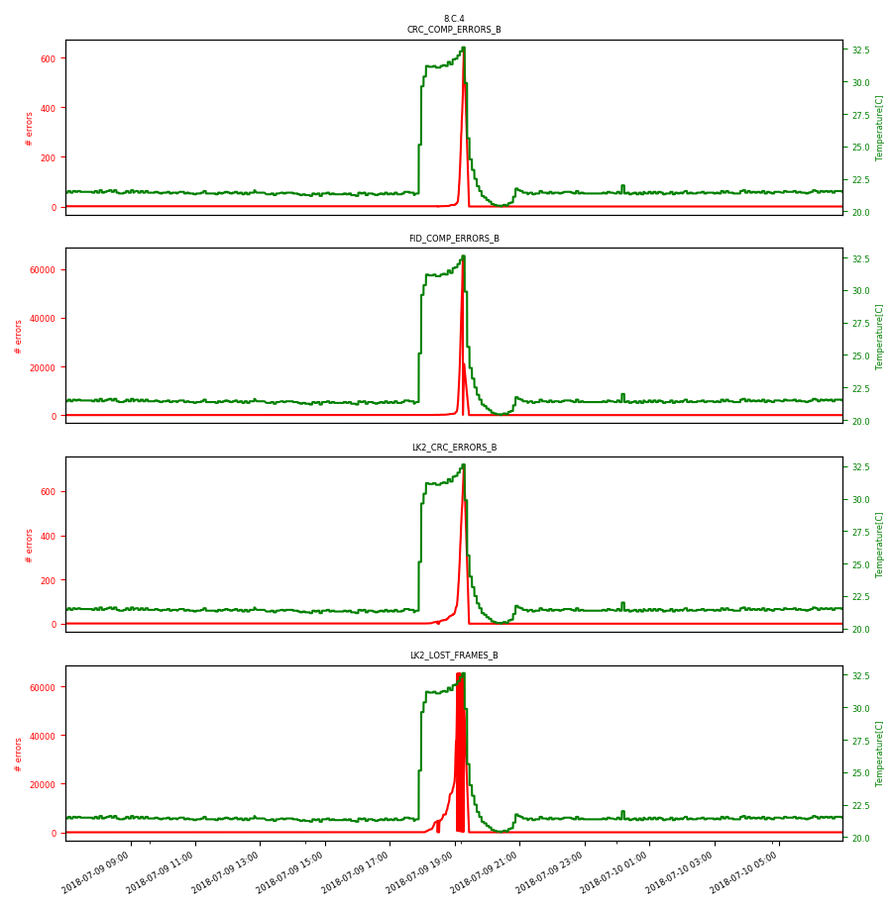
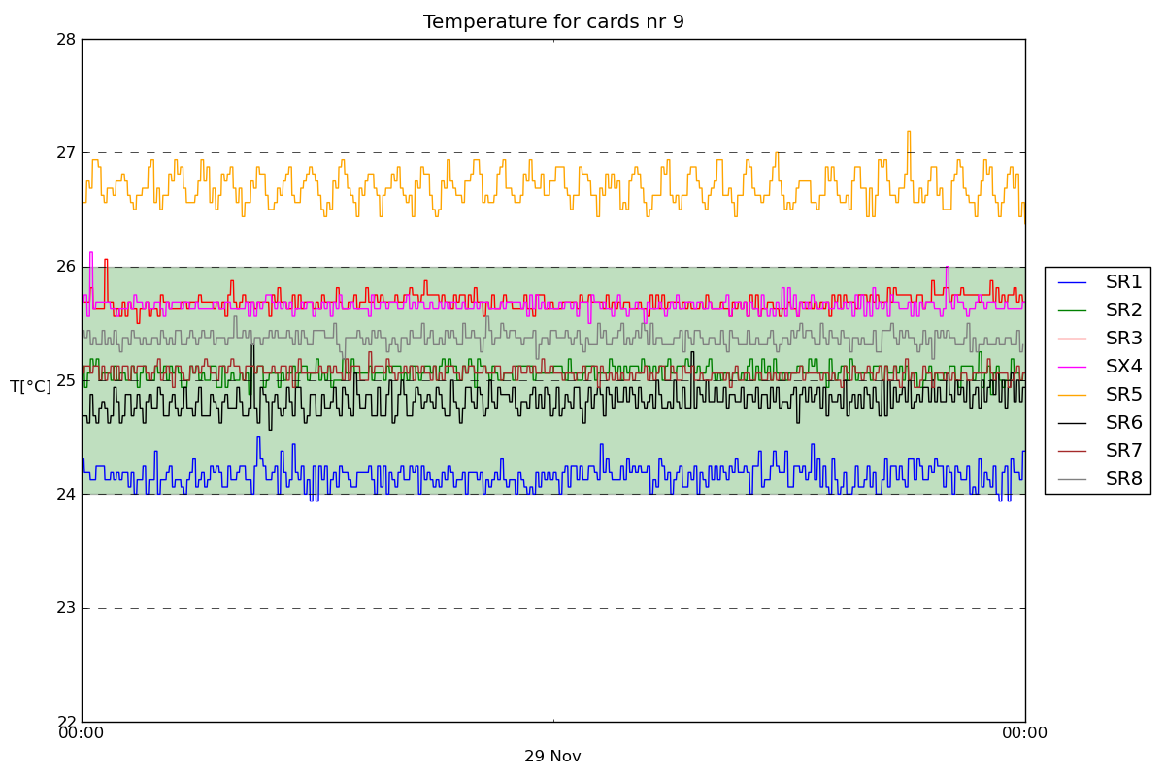
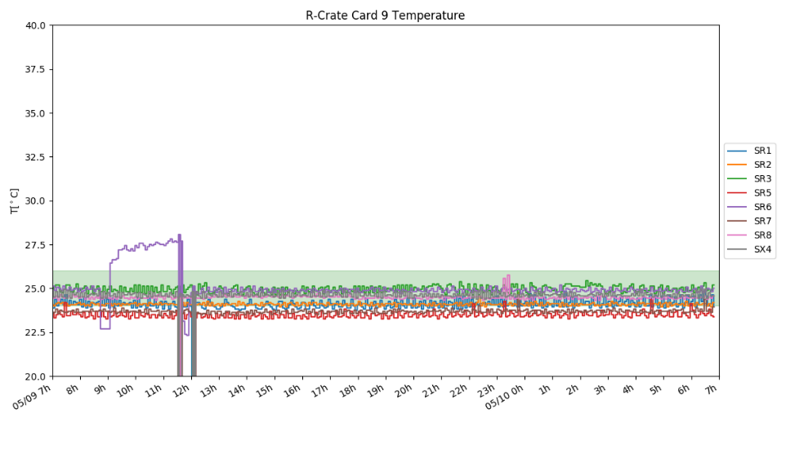
Daily reports: Rack Temperature
Daily (& weekly) reports showing the operational temperature of the electronic racks
  Stability of the temperature and configuration of the PID controller
  In some cases it can help to identify the root cause of an issue/fault
Some examples:
PID controller needs optimisation
Cooling system at fault
Module with link weakness

Slide 10
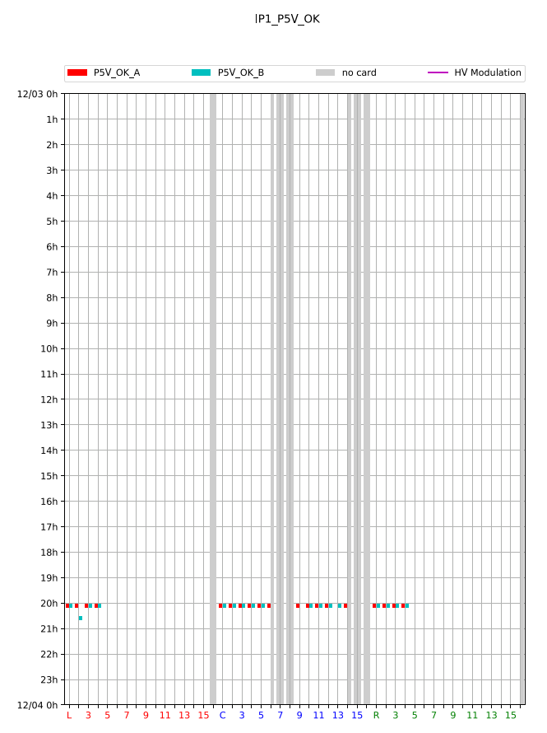
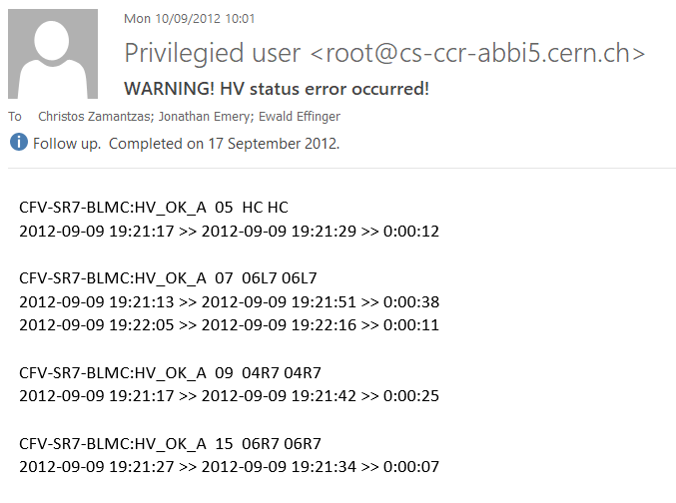
Daily reports: Power Supplies
Daily report showing instabilities of the of the LV and HV power supplies.
  Stability of the detectors’ bias is very critical
  i.e. drop of voltage for long periods can compromise protection
Profited from the long commissioning period to evaluate
best strategy to balance availability & reliability
  Finally, interlocked through the Software Interlock System
example: Evolution of reporting

Slide 11
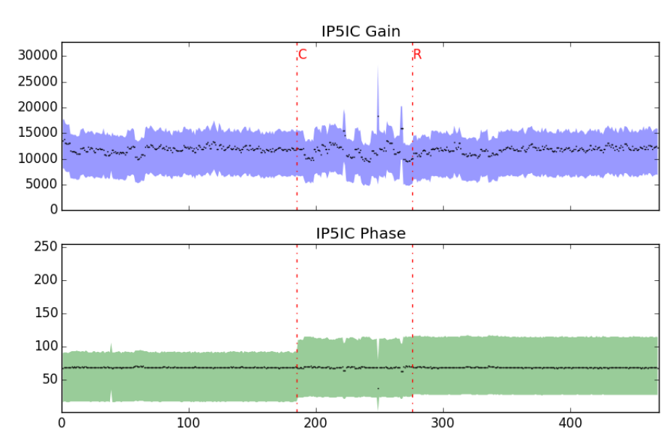
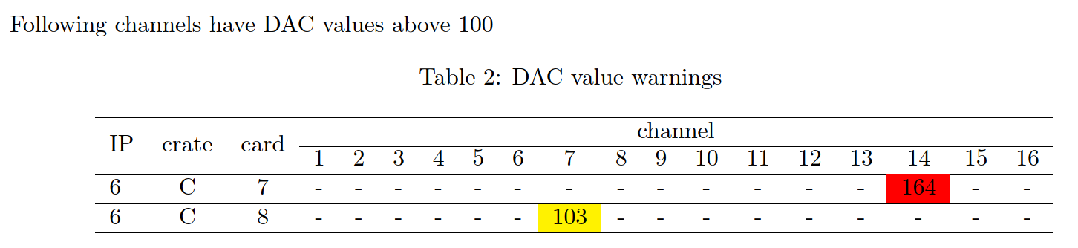
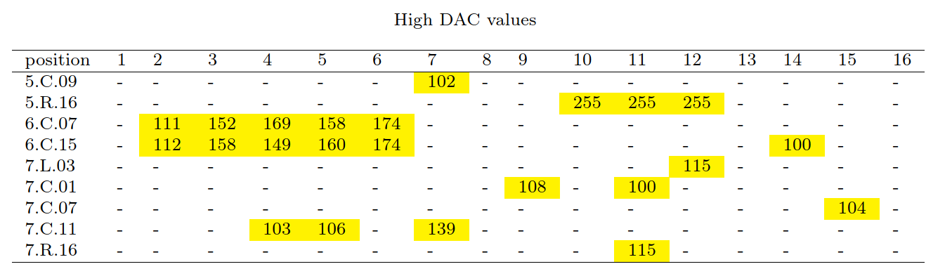
Daily reports: Measurement offset
An autonomous circuit at the acquisition card checks and injects a constant 10 pA current to monitor the connection
The DAC values (which injects the current) are recorded and last variations from day to day are reported

Slide 12
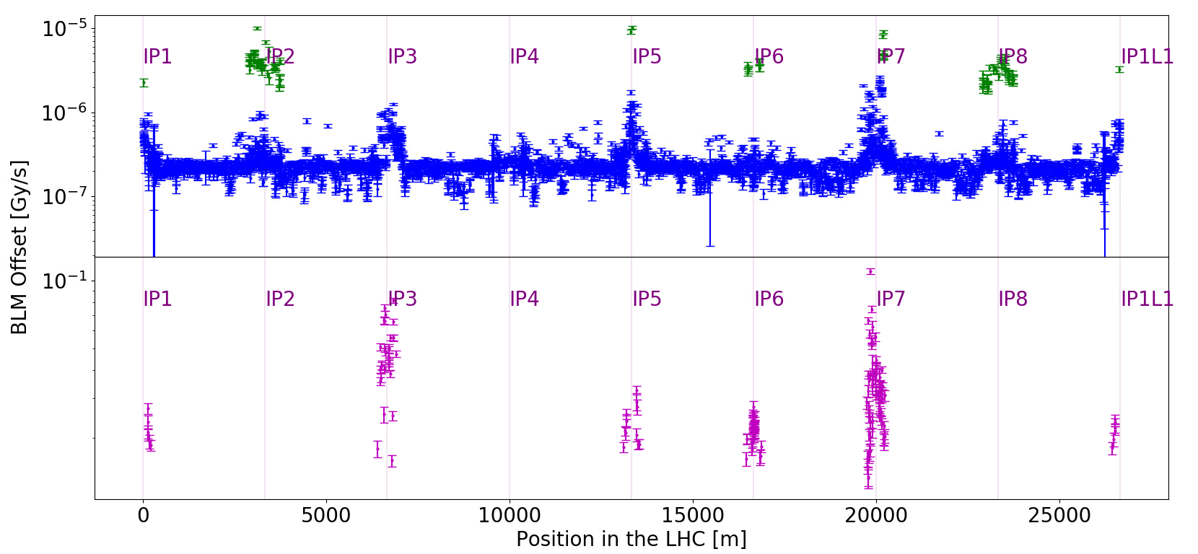
Daily reports: Measurement offset
Further analysis we have not yet automatised

Slide 13
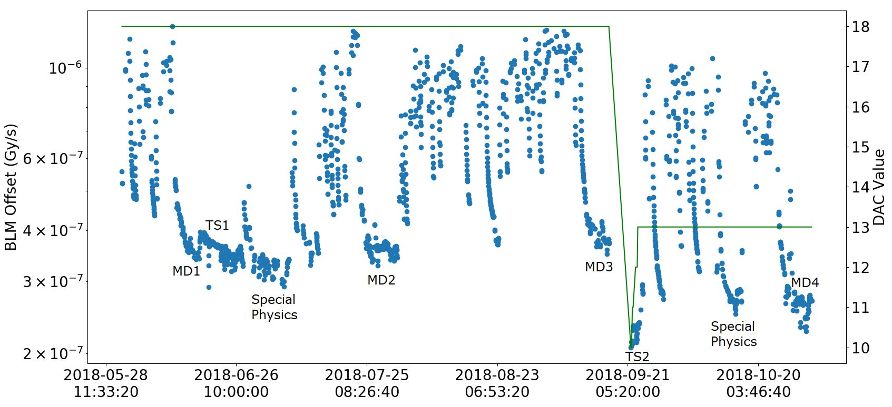
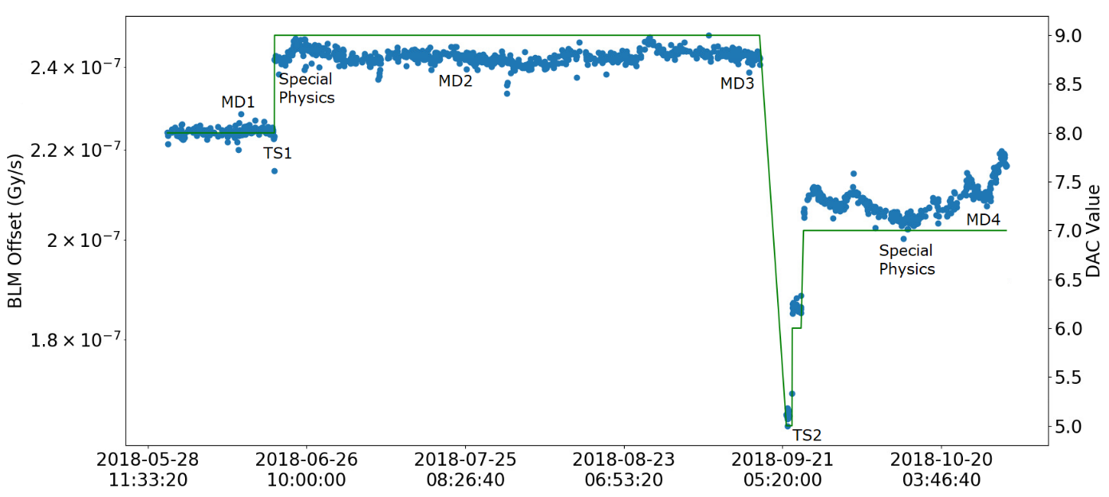
Daily reports: Monitoring of DAC values
Further analysis we have not yet automatised
Offset evolution in time of a BLM located in one of the LSS (receiving high dose)
BLM located in the arc

Slide 14
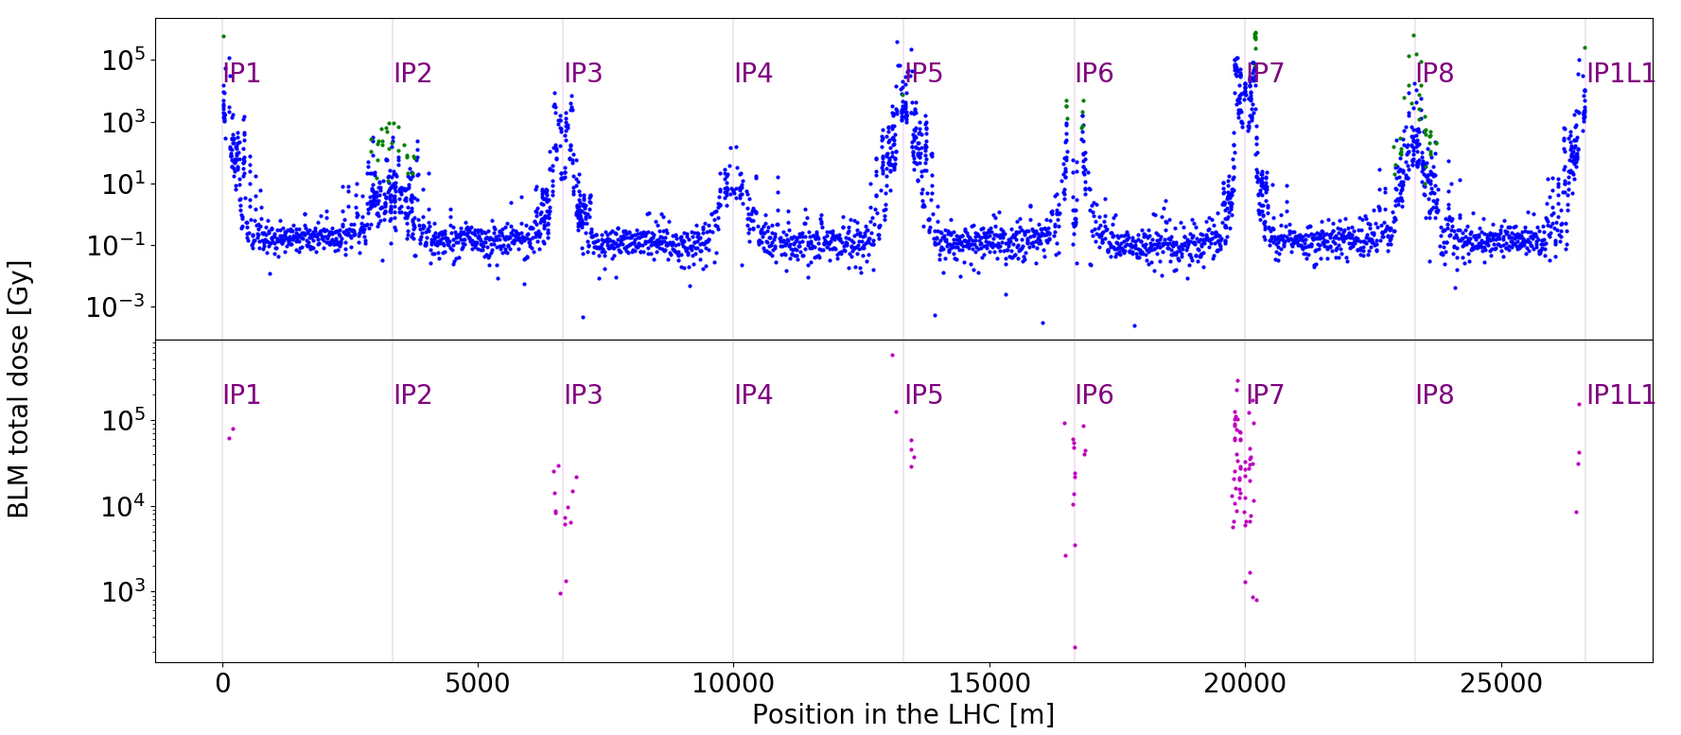
Daily reports: Accumulated Dose
Further analysis we have not yet automatised
Accumulated dose for IC (blue), LIC (green) and SEM (purple) detectors at LHC

Slide 15
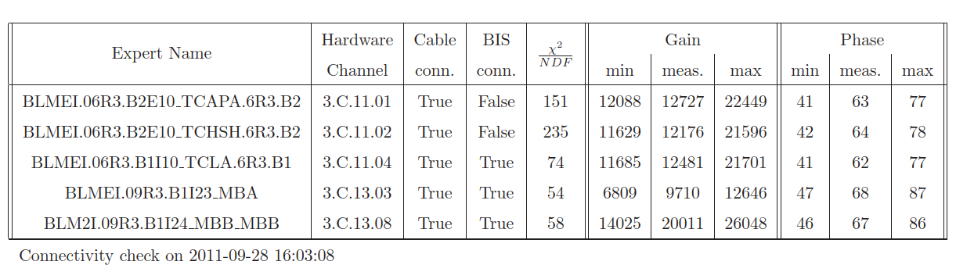
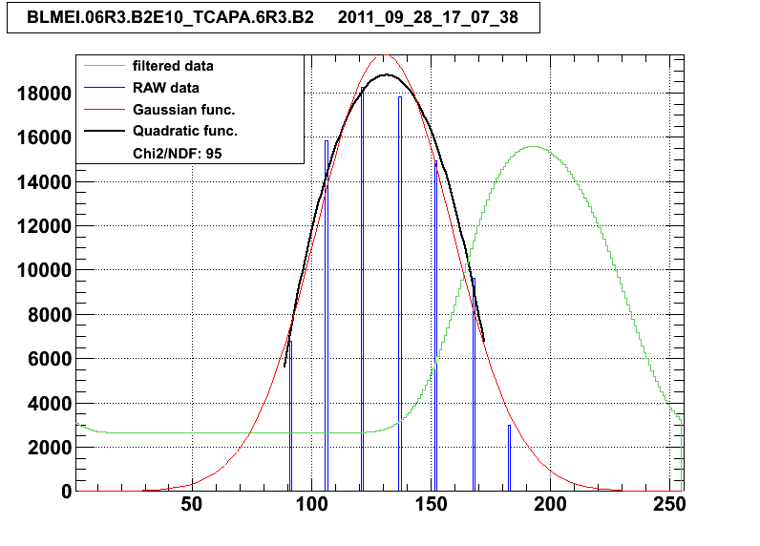
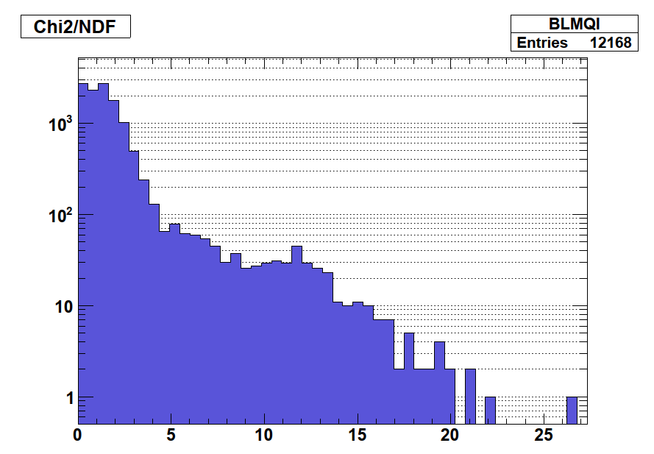
Daily reports: Detector Performance
Analysis not executed anymore (many changes in the system)
Monitor degradation of the detectors over time
Paramount to maintain the critical function of the system. Reliability analysis identifies this as one of the weakest part of the system.

Slide 16
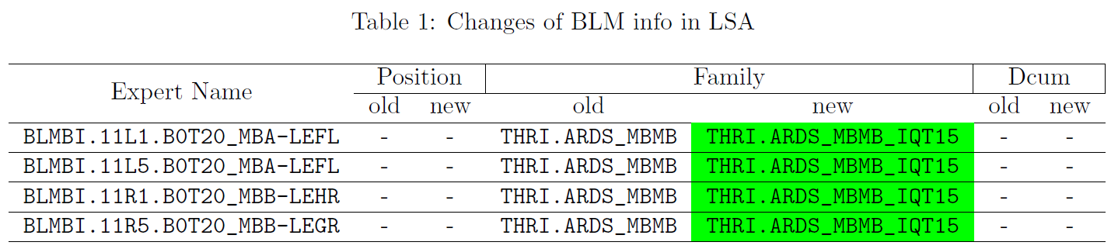
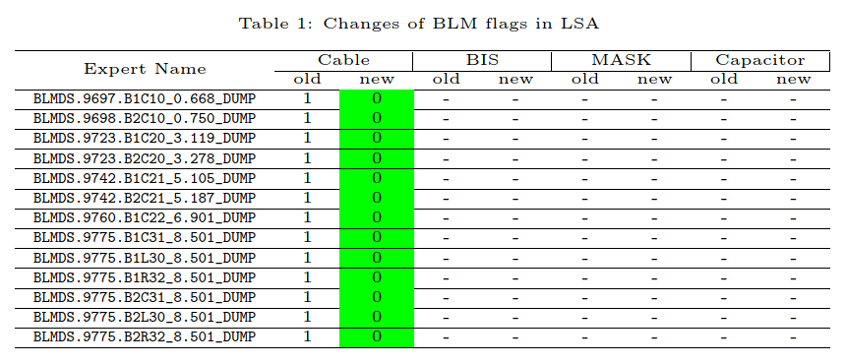
Daily reports: Threshold Values
Detailed view of any BLM Threshold changes
Dual functionality:
  Check by Threshold experts that only the changes foreseen has been applied
  Alerts On-call experts on the change and assists them to identify reasons of interlocks.
example: Change of threshold values
example: Disconnection of a set of monitors
Note: The system needs approx. 3.5 million threshold values to fulfil its specifications

Slide 17
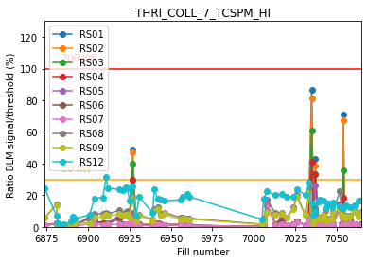
On demand: Measurements vs Thresholds
Comparison of new thresholds against past data – almost full year
Check all RS ratio (signal to dump) in order to asses if the proposed new thresholds might be limiting.
Daily report with summary of signal to dump for cases above some limit would be useful

Slide 18
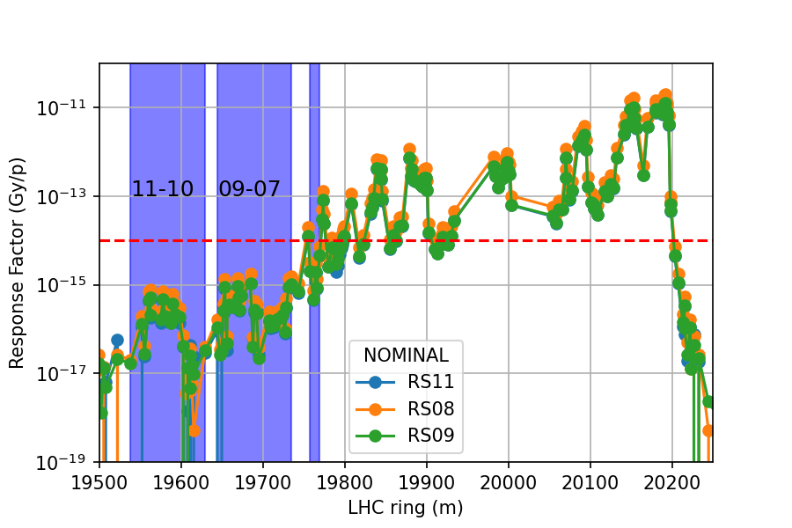
On demand: Respose Factors
Cross-calibration of BLM with BCT signal.
Calculation of calibration response factors (expected signal per proton lost) for individual BLMs.

Slide 19
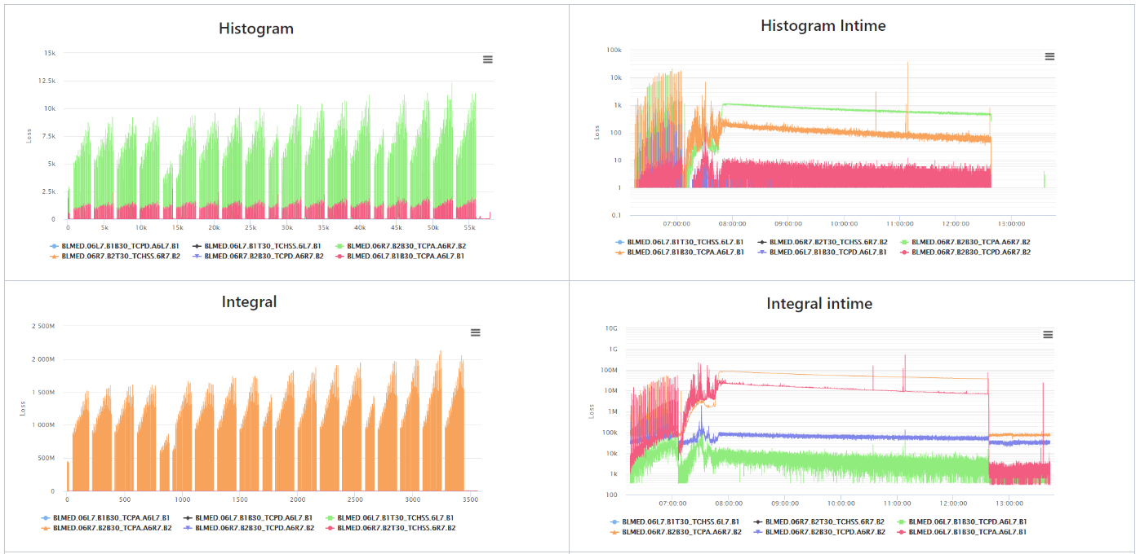
Daily reports: dBLM Measurements
Old https://nxdblm.web.cern.ch web provided with an easy visualization tool of dBLM data
  see also: documentation (wikis)
Currently not operational, necessary to have some replacement solution
Visualizing long arrays (like histograms, bunch distribution, etc) at 1 Hz is not possible on Timber webtool, only through custom scripts (Jupyter, local python, etc).
Accessing spark cluster for performant NXCALS extractions outside SWAN results complicated. SWAN makes that transparently for the user, however, has low memory and gets saturated often.
Now, working on UCAP nodes to provide FFTs of long capture buffers.

Slide 20
Desiderata

Slide 21
Summary of needs & proposals
Monitoring tasks to run continuously and provide summaries for performance, fault finding, and maintenance needs
  Webpage with summaries, i.e. avoid each team member to run analysis tasks
  Alarms (SMS/email) on major incidents or settings modifications
Case 1: Process and report Diagnostic data
  Data to be captured in transit, processed and stored in rolling buffers
  Any other solution will be limited by the DB read overhead
Case 2: Analyse measurements by (timing) event or beam mode
  The event received or mode change triggers the analysis task
  Monitor performance (offsets, dose, etc) and warn for beam loss location changes or reaching limits.
  e.g. Report summary of measurements for each injection, ramp, etc.
Tasks for monitoring databases integrity & changes to be developed and maintained by DB owners (e.g. BE-CSS, EN-ACE,…)
  Alarm and report on changes done in LAYOUT, LSA, NXCALS, etc
  LSA has ‘history of changes’ tables
Read Access to LSA from SWAN to allow reading the present BLM thresholds and use with measurements
For long analysis tasks, e.g. using yearly data, is unstable
  SWAN has troubles and gets frozen, having to re-start the process

Slide 22
Thank you

