Slide 1
MDI Summary – Detectors integration in the interaction region
Fabrizio Palla - INFN Pisa
On behalf of
M. Boscolo, A. Ciarma, F. Fransesini, S. Lauciani, and L. Pellegrino – INFN Frascati
F. Bosi – INFN Pisa
M. Dams – NBI Copenhagen
Detector Concept Meeting
CERN – 7 November 2022

Slide 2
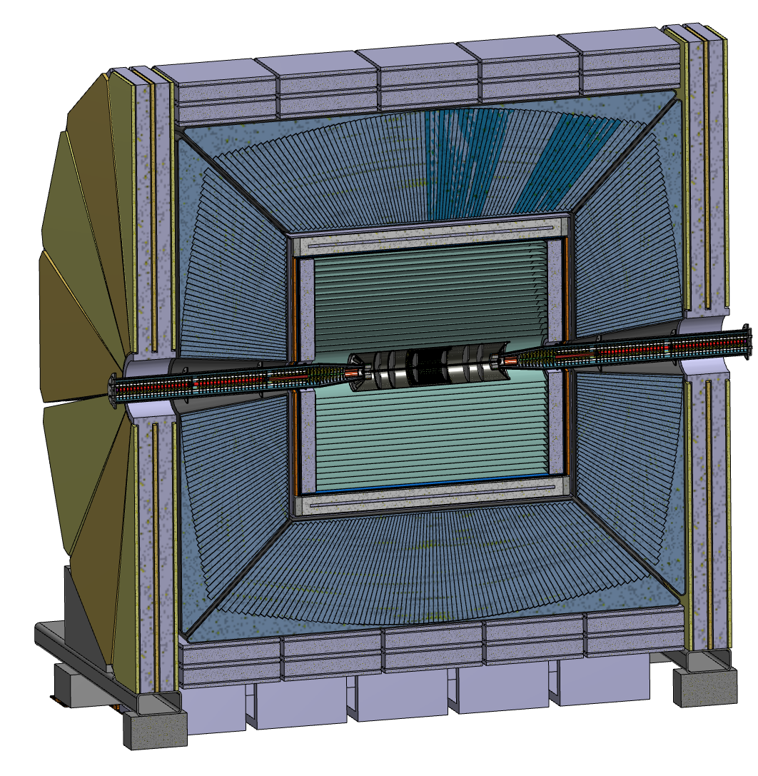
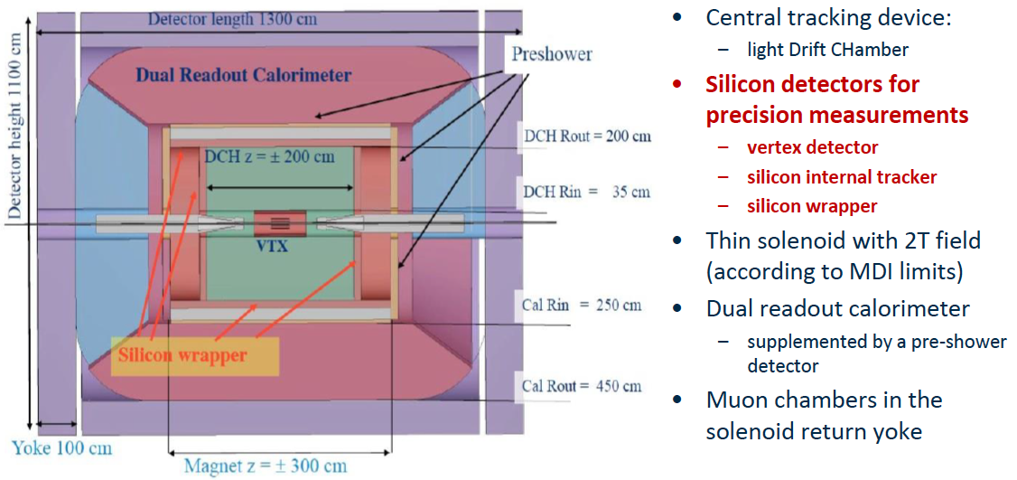
The IDEA Concept

Slide 3
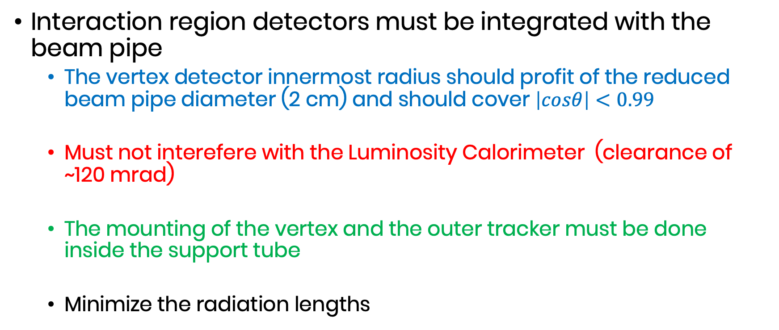
Requirements
Interaction region detectors must be integrated with the beam pipe
  The vertex detector innermost radius should profit of the reduced beam pipe diameter (2 cm) and should cover $\left|cosθ\right|<0.99$
  Must not interefere with the Luminosity Calorimeter (clearance of ~120 mrad)
  The mounting of the vertex and the outer tracker must be done inside the support tube
  Minimize the radiation lengths

Slide 4
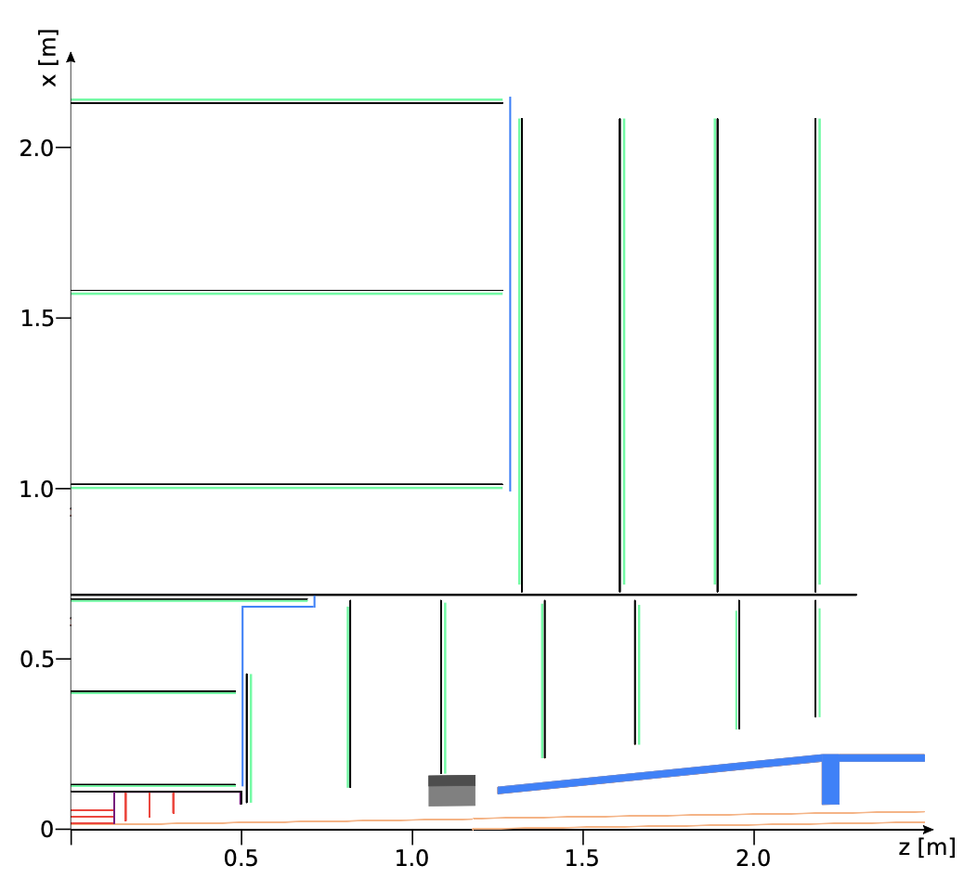
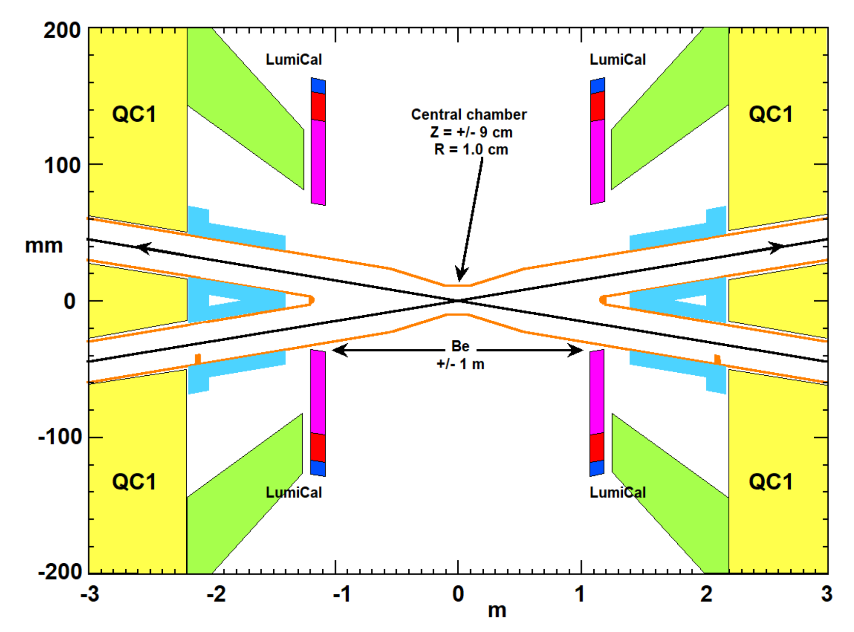
LumiCals
Challenge:
- MDI region is very busy, LumiCals pushed far inside detector volume
CLD Si Tracker

Slide 5
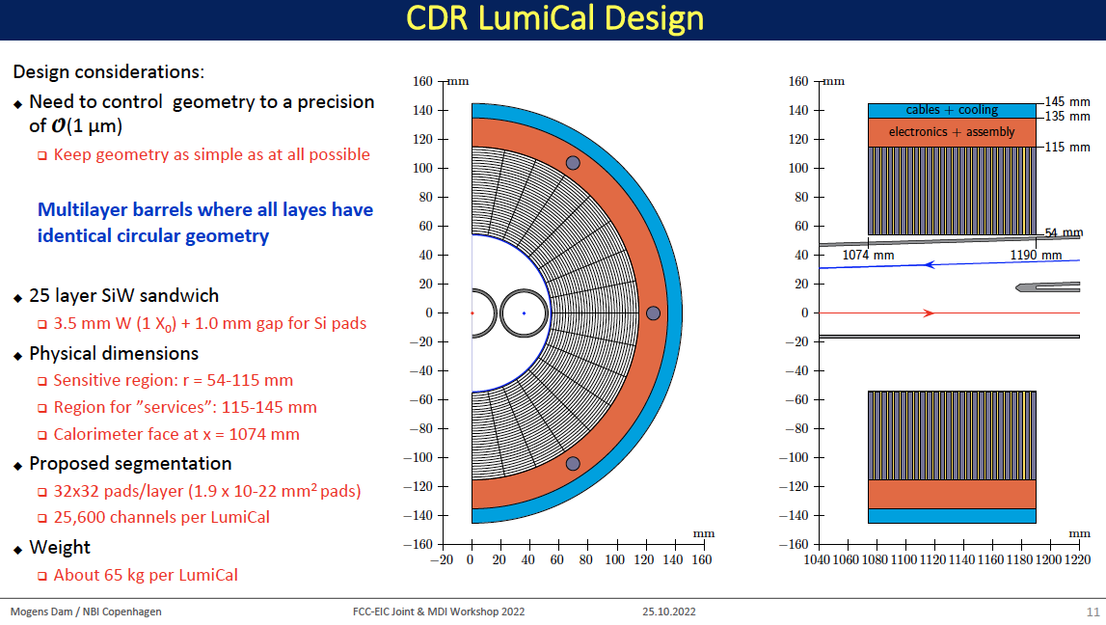

Slide 6
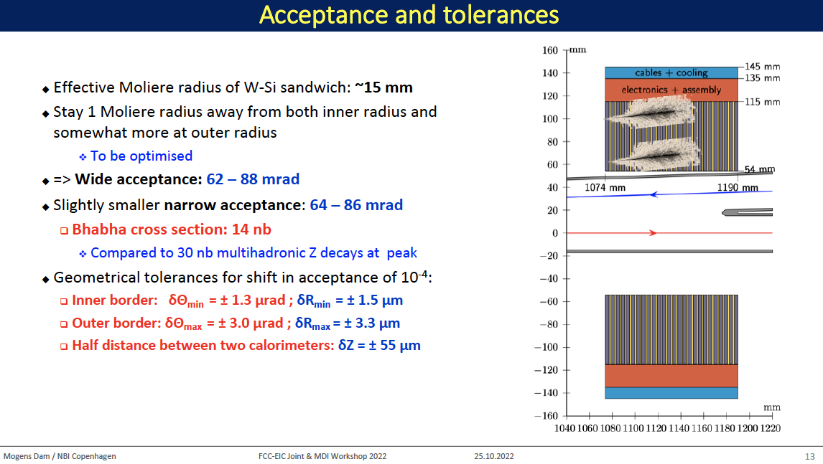

Slide 7
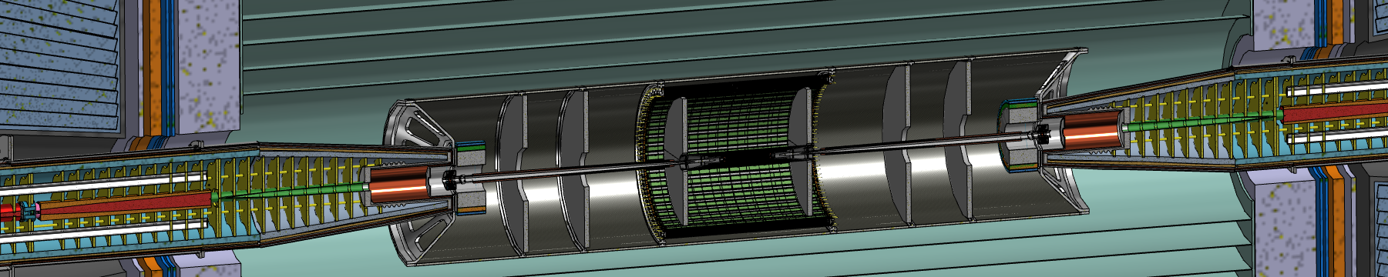
Vertex and Outer Trackers
Inside the same volume of the support tube that holds also the LumiCal
  Vertex detector supported by the beam pipe
  Outer Tracker (1 barrel and 6 disks) fixed to the support tube
Minimal number of detector module variants
  One module type only for the Vertex
  One module type only for the Outer barrel and disks

Slide 8
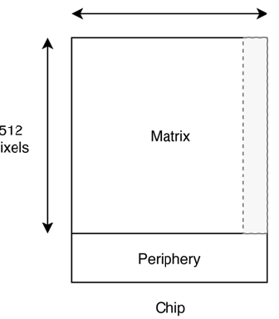
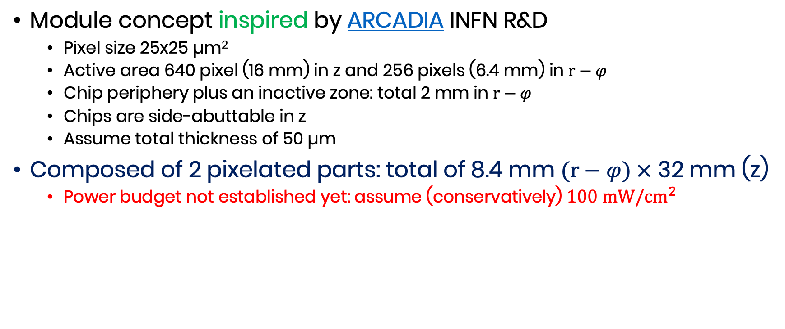
Vertex detector modules
Module concept inspired by ARCADIA INFN R&D
  Pixel size 25x25 µm²
  Active area 640 pixel (16 mm) in z and 256 pixels (6.4 mm) in $r−φ$
  Chip periphery plus an inactive zone: total 2 mm in $r−φ$
  Chips are side-abuttable in z
  Assume total thickness of 50 µm
Composed of 2 pixelated parts: total of 8.4 mm $(r−φ) ×$ 32 mm (z)
  Power budget not established yet: assume (conservatively) $100 mW/{cm}^{2}$
z 640 pixel
32 mm
Chip 1
Chip 2
R-phi 256 pixel
8.4 mm
Readout

Slide 9
Half-ladder layout – layer 1
96.5 mm
Chip 1
Chip 2
Chip 1
Chip 2
Chip 1
Chip 2
8.4 mm
0.2 mm
0.1 mm
z=0
Layer 1 ladders are placed at 12 mm radius

Slide 10
Half-ladder layout – layer 2
160.9 mm
8.4 mm
Chip 1
Chip 2
Chip 1
Chip 2
Chip 1
Chip 2
Chip 1
Chip 2
Chip 1
Chip 2
8.4 mm
0.1 mm
0.2 mm
z=0
Layer 2 ladders are placed at 20 mm radius

Slide 11
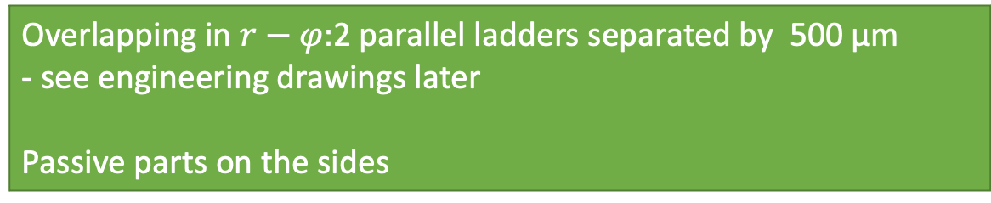
Half ladder layout – layer 3
257.5 mm
Chip 1
Chip 2
Chip 1
Chip 2
Chip 1
Chip 2
Chip 1
Chip 2
Chip 1
Chip 2
Chip 1
Chip 2
Chip 1
Chip 2
Chip 1
Chip 2
16.3 mm
Chip 1
Chip 2
Chip 1
Chip 2
Chip 1
Chip 2
Chip 1
Chip 2
Chip 1
Chip 2
Chip 1
Chip 2
Chip 1
Chip 2
Chip 1
Chip 2
0.2 mm
0.2 mm
0.2 mm
0.2 mm
0.2 mm
0.2 mm
0.2 mm
0.2 mm
z=0
z=0
z=0
Overlapping in $r−φ:$2 parallel ladders separated by 500 µm
- see engineering drawings later
Passive parts on the sides
Layer 3 ladders are placed at 32 mm radius

Slide 12
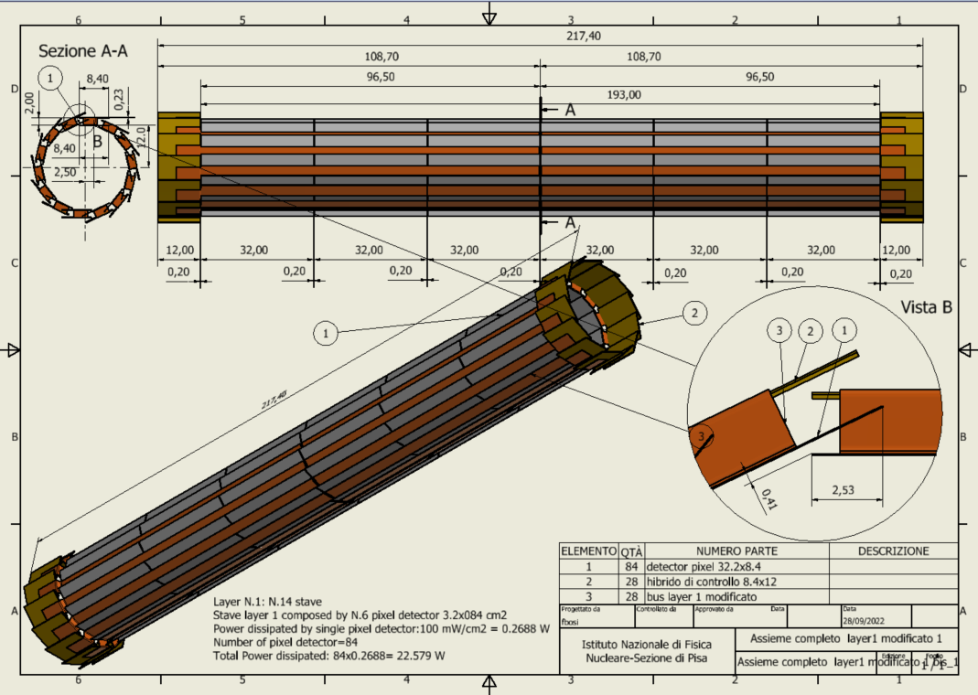
Layer 1
14 overlapping staves of 6 modules each
Power budget of the modules (only)
~23 W
Hybrids at higher radius (+2 mm wrt sensors), not to interfere with LumiCal clearence
Disclaimer
In this and the following we have made a study of a realistic mechanical geometrical layout, including hybrids and readout bus, but still missing the final module frame mechanical support

Slide 13
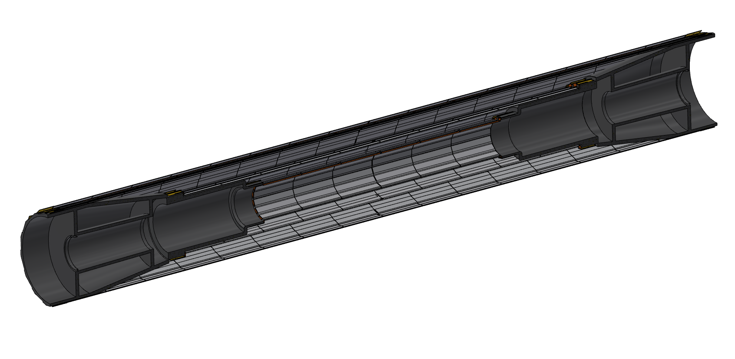
Vertex layer supports
Conical carbon fibre shaped structure, held by the beam pipe (see later)

Slide 14
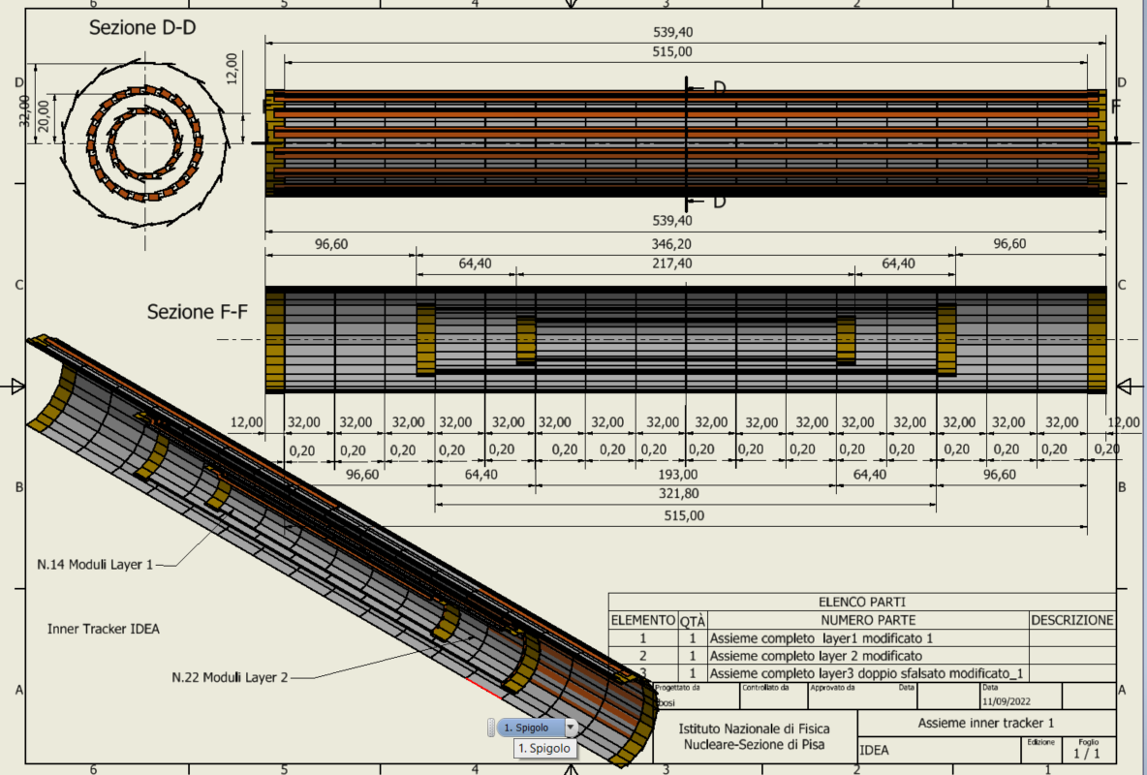
Vertex overall assembly
Total weight to be estimated, but far less than 100 grams
Air cooled

Slide 15
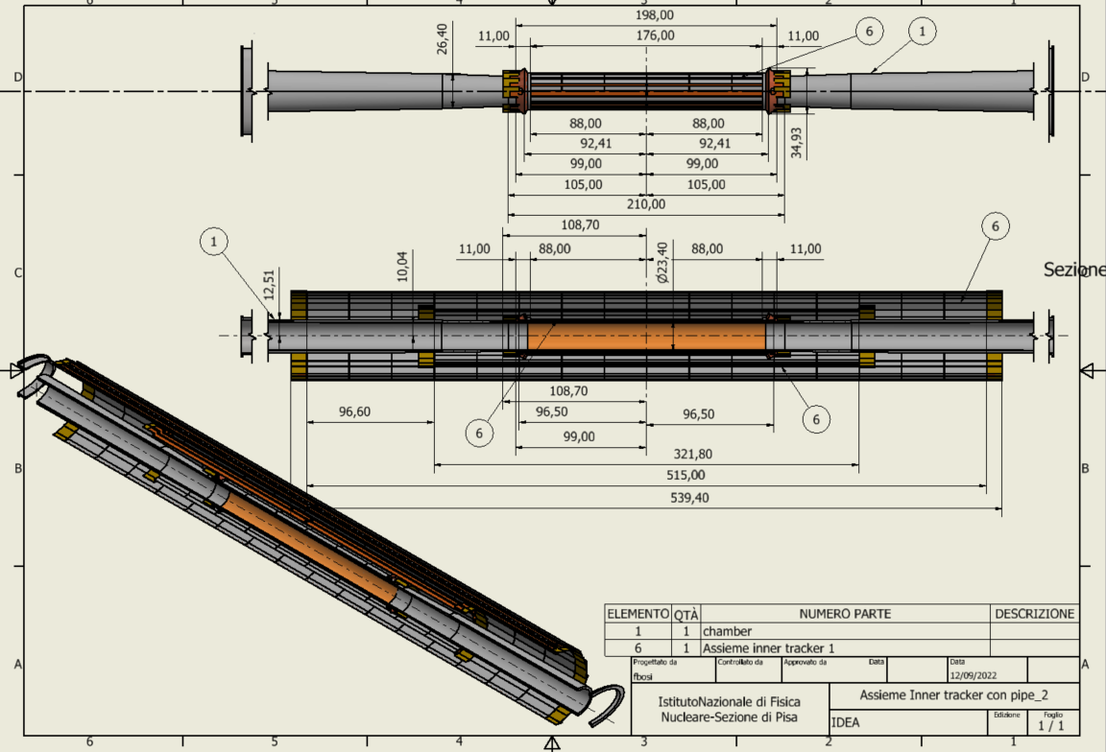
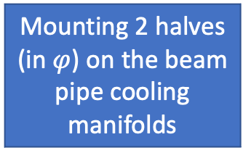
Mounting 2 halves (in $φ$) on the beam pipe cooling manifolds

Slide 16
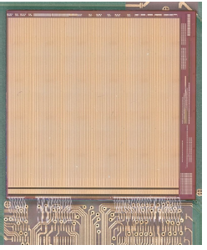
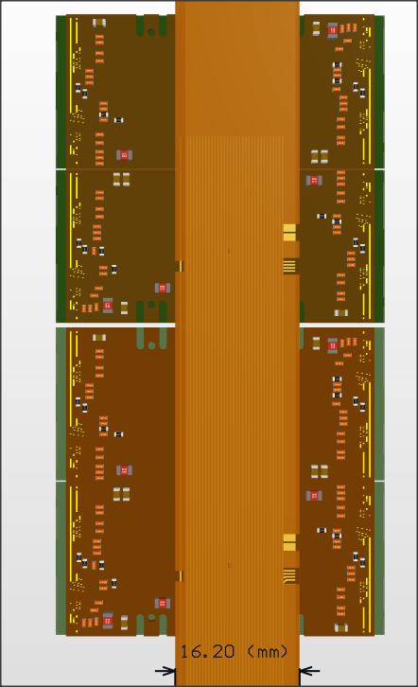
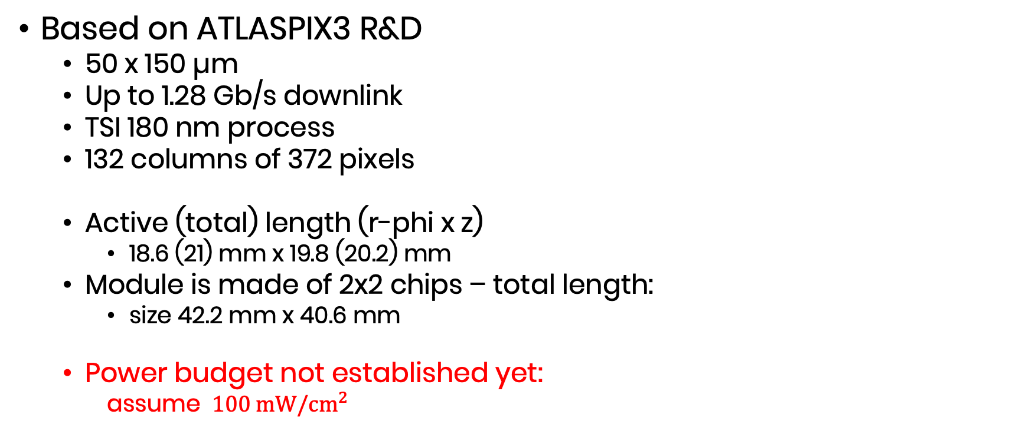
Outer layers modules
Based on ATLASPIX3 R&D
  50 x 150 µm
  Up to 1.28 Gb/s downlink
  TSI 180 nm process
  132 columns of 372 pixels
  Active (total) length (r-phi x z)
    18.6 (21) mm x 19.8 (20.2) mm
  Module is made of 2x2 chips – total length:
    size 42.2 mm x 40.6 mm
  Power budget not established yet:
    assume $100 mW/{cm}^{2}$
Power
HV
Data IN/OUT

Slide 17
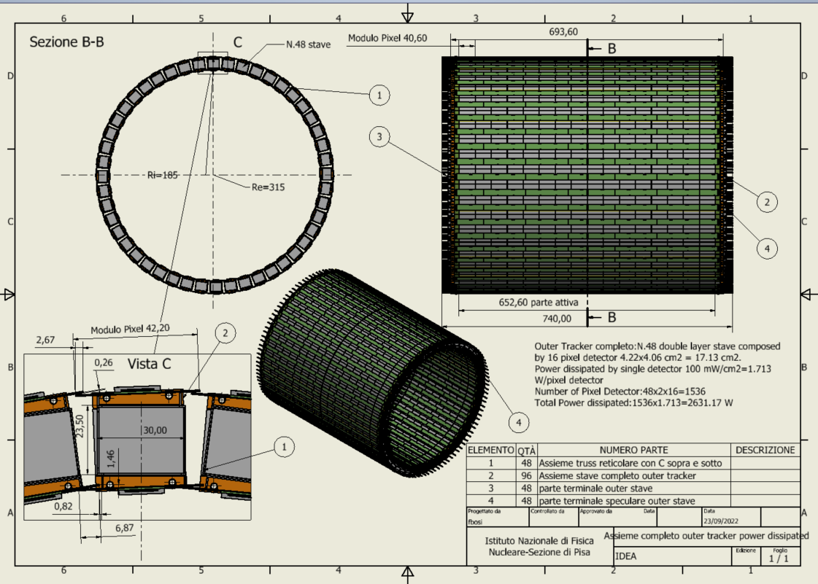
Outer Tracker Barrel
48 staves of 32 modules each (at different radii)
Power budget
~2.63 kW
Cooling using water 4 pipes (2 mm diameter) per stave

Slide 18
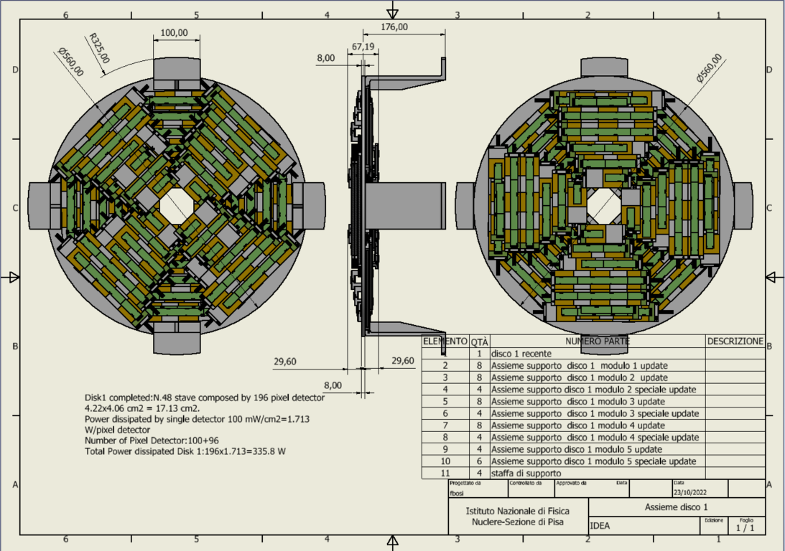
Outer Tracker Disk 1
2 sides (front and back) each with 4 petals.
One petal is made of different staves of overlapping modules in z.
Total modules per disk: 196
Power budget ~340 W
Cooling using 1 water pipe (2 mm diameter)

Slide 19
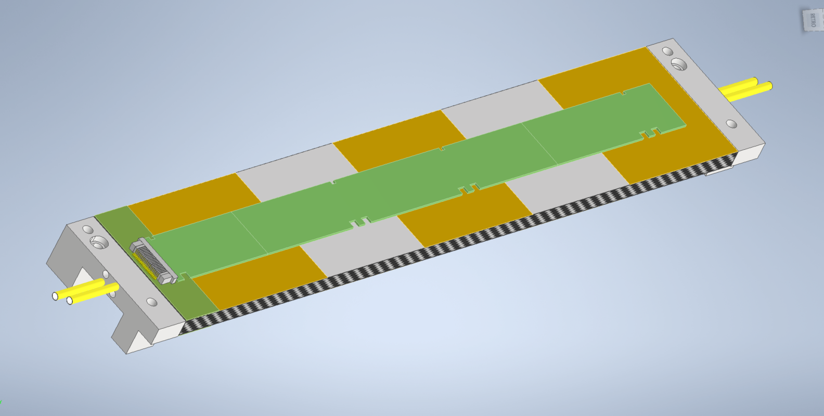
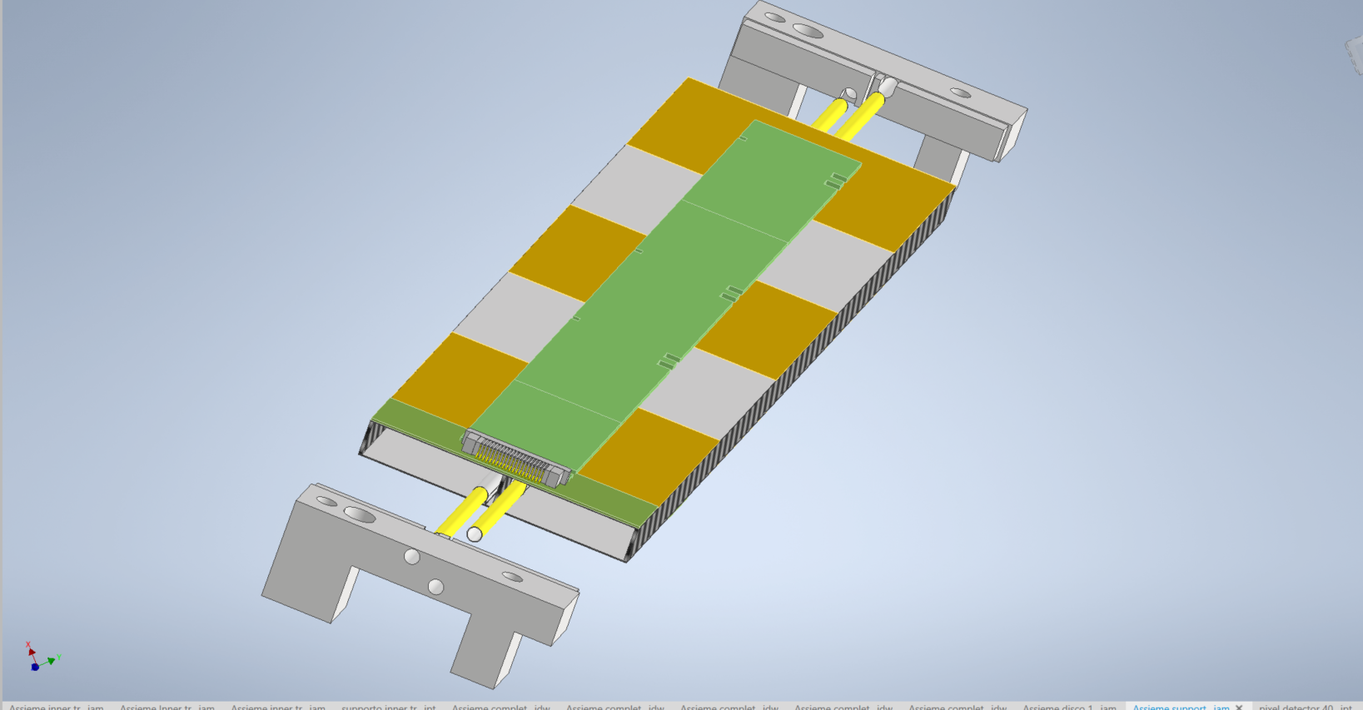
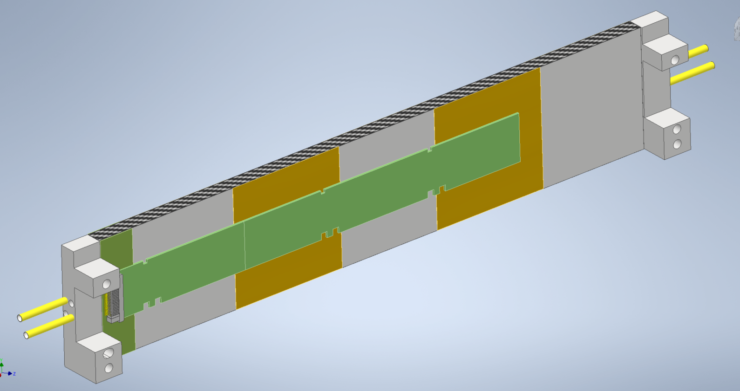
Typical module stave
Front
Upper modules
Electrical bus
Carbon fibre spacer
Cooling pipes
Lower modules
Carbon fibre pacers
Back

Slide 20
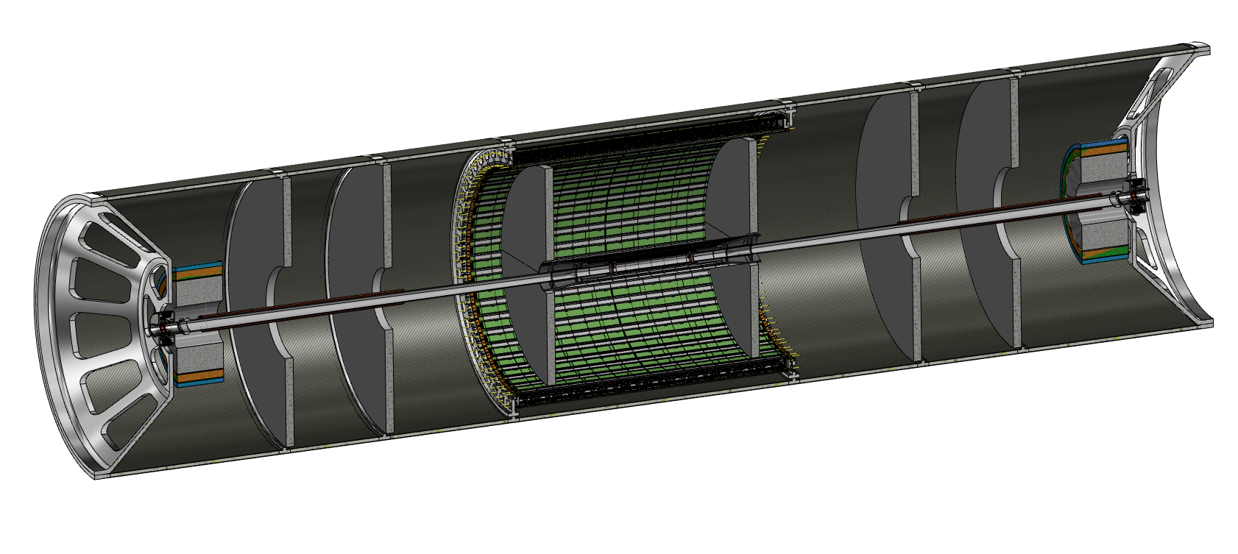
Support cylinder
All elements in the interaction region (vertex, Tracker and LumiCal) are mounted rigidly on a support cylinder that guarantees mechanical stability and alignment
  Once the structure is assembled it is slided inside the rest of the detector

Slide 21
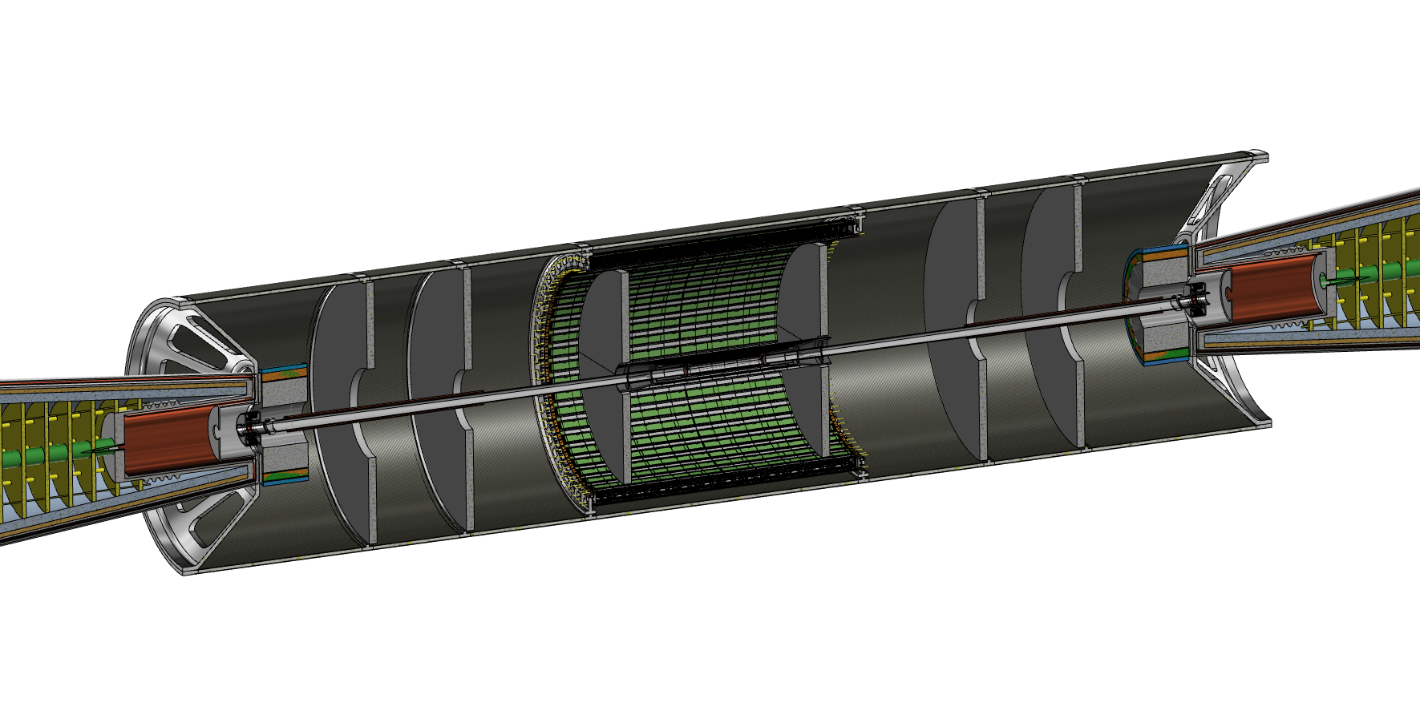

Slide 22
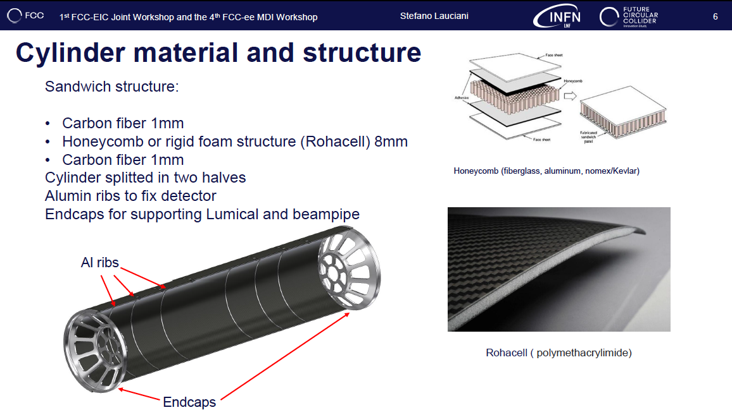

Slide 23
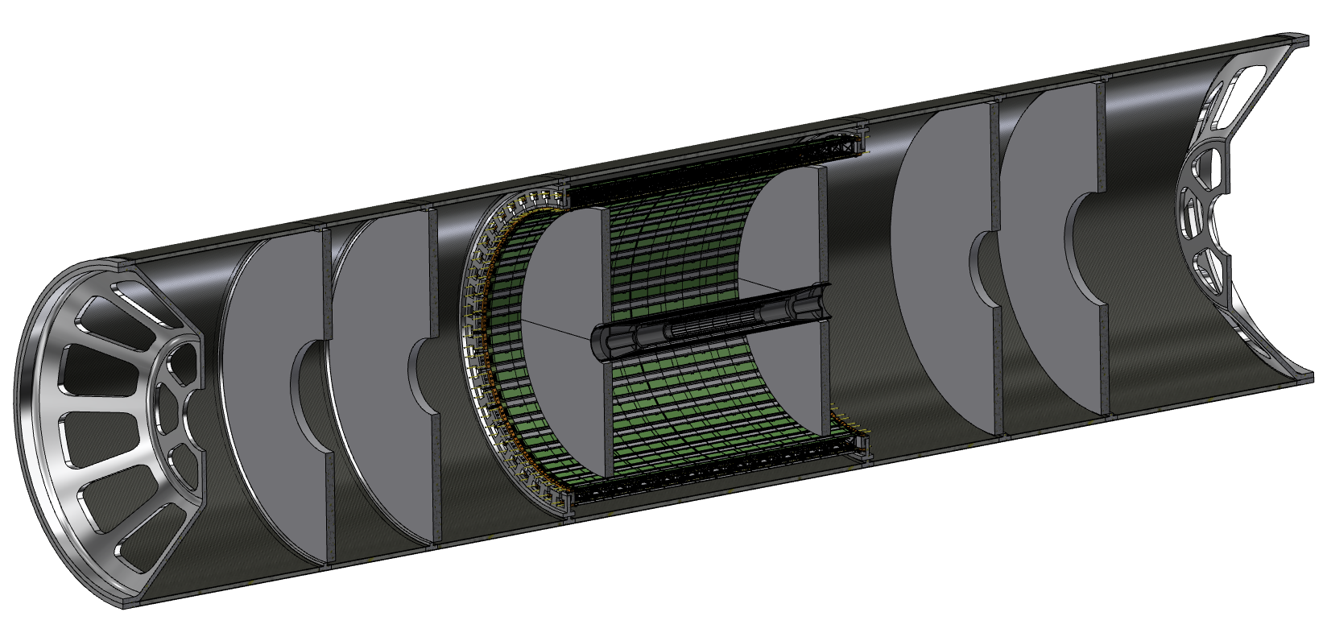
Outer barrel and disks
Barrel:
  a truss structure with 2 layers of modules (at radii of 31.5 cm and 28.5 cm)
  Fixed to the support tube
3 disks per side
  Fixed by the support tube

Slide 24
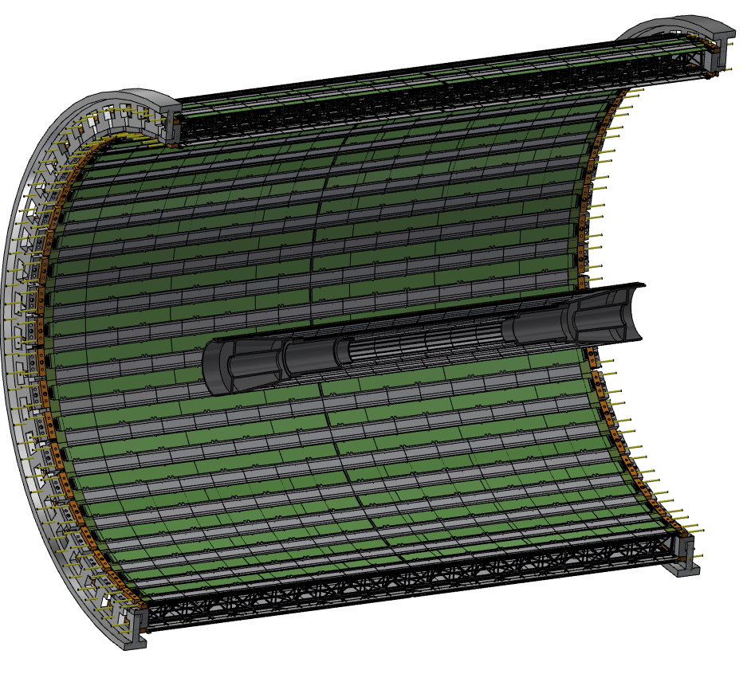
Overall layout

Slide 25
Is it feasible?
Mechanical stability of the support cylinder is not an issue

Slide 26
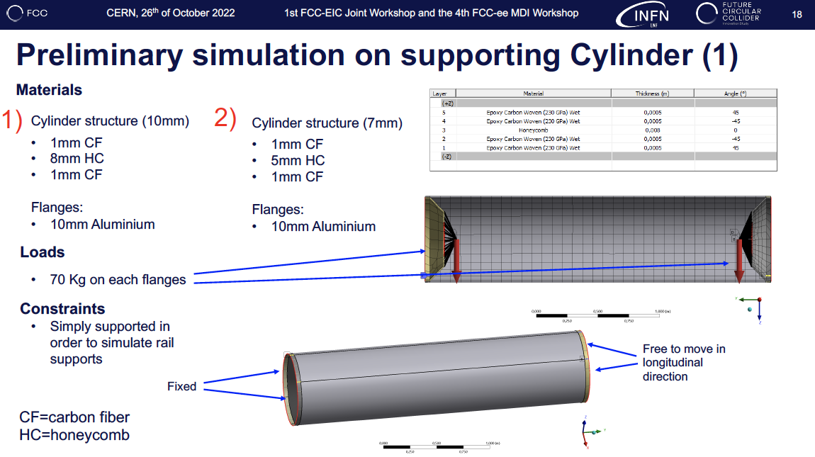

Slide 27
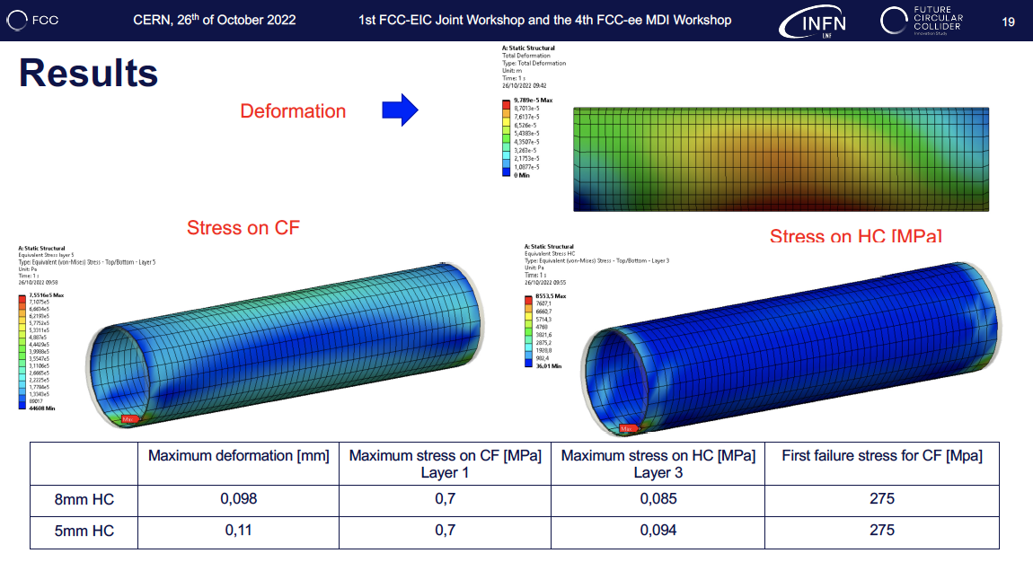

Slide 28
Is it feasible?
Mechanical stability of the support cylinder is not an issue
Vertex detector weight (<< 100 grams) on the beam pipe is well supported

Slide 29
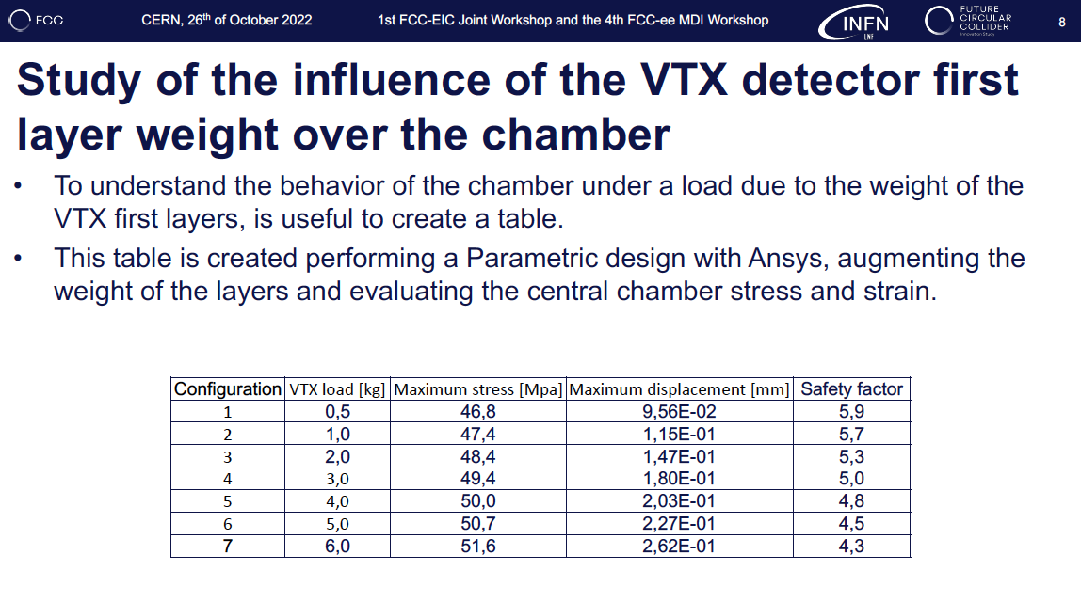

Slide 30
Is it feasible?
Mechanical stability of the support cylinder is not an issue
Vertex detector weight (<< 100 grams) on the beam pipe is well supported
Integration of the detectors is doable

Slide 31
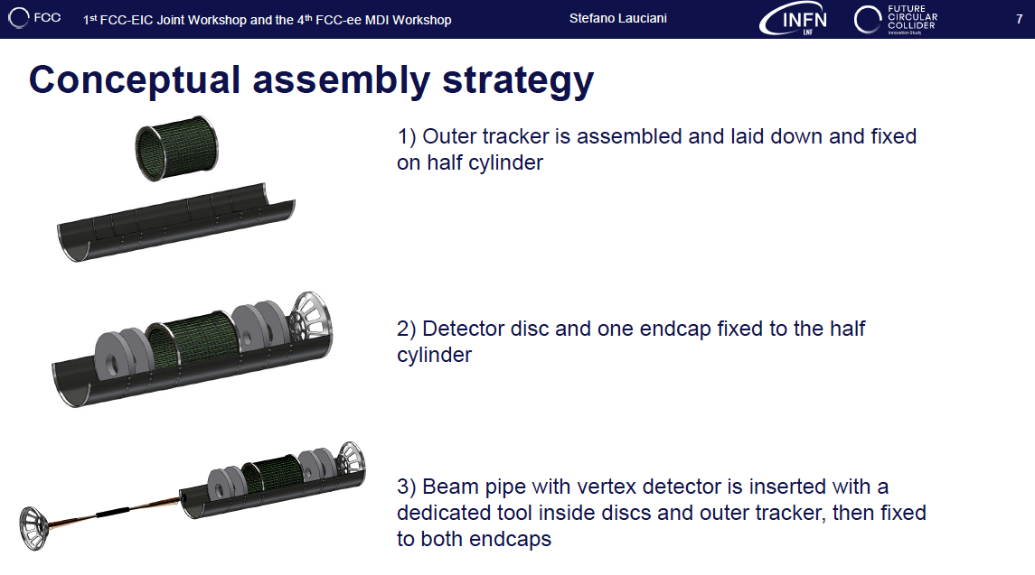

Slide 32
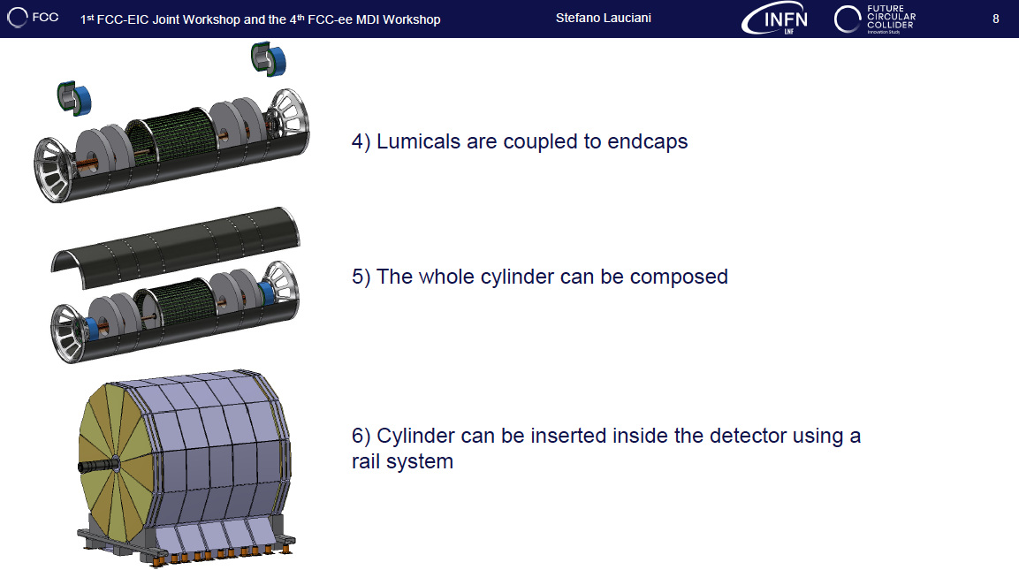

Slide 33
Is it feasible?
Mechanical stability of the support cylinder is not an issue
Vertex detector weight (<< 100 grams) on the beam pipe is well supported
Integration of the detectors is doable
  Open remaining issue to be investigated is whether or not LumiCal can be inserted as unique assembled structure or must be splitted due to 4 mm difference between the bellow and the inner LumiCal radius
    Ongoing design effort to reduce the bellow size

Slide 34
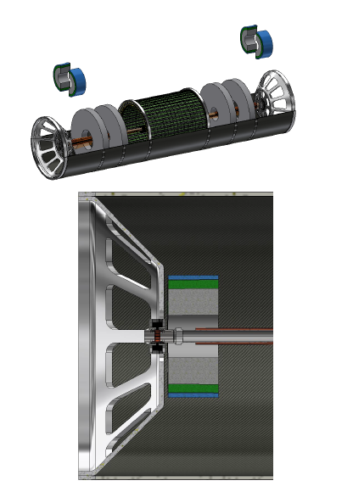
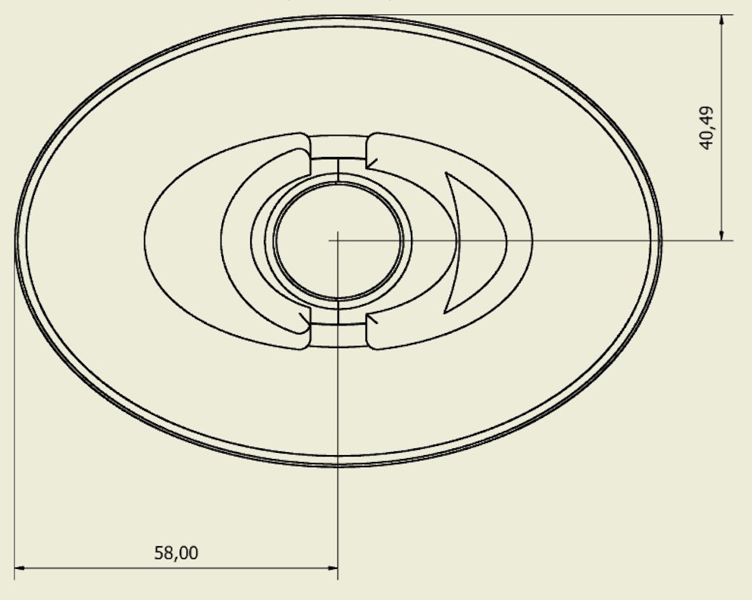
Needs tuning of the bellow size.
Study ongoing
54 mm
58 mm

Slide 35
Conclusions
A preliminary layout of the interaction region with LumiCal, vertex and outer tracker of the IDEA detector is being engineered
  Feasibility studies of vertex and track integration successfully made
  LumiCal conceptual integration done
Next steps:
  Vertex detector
    Ladders mechanical support design
    Study the feasibility of air cooling
    Study the routing of the services (readout and power cables)
  Outer Tracker
    Study the routing of the services (readout and power cables, cooling manifolds)
  Lumical
    Engineering and assembly
  Finalize detector assembly and its maintenance
  Insert the layout in the GEANT simulation

Slide 36
Thank you for the attention
Fabrizio.Palla@cern.ch

Slide 37
Backup

Slide 38
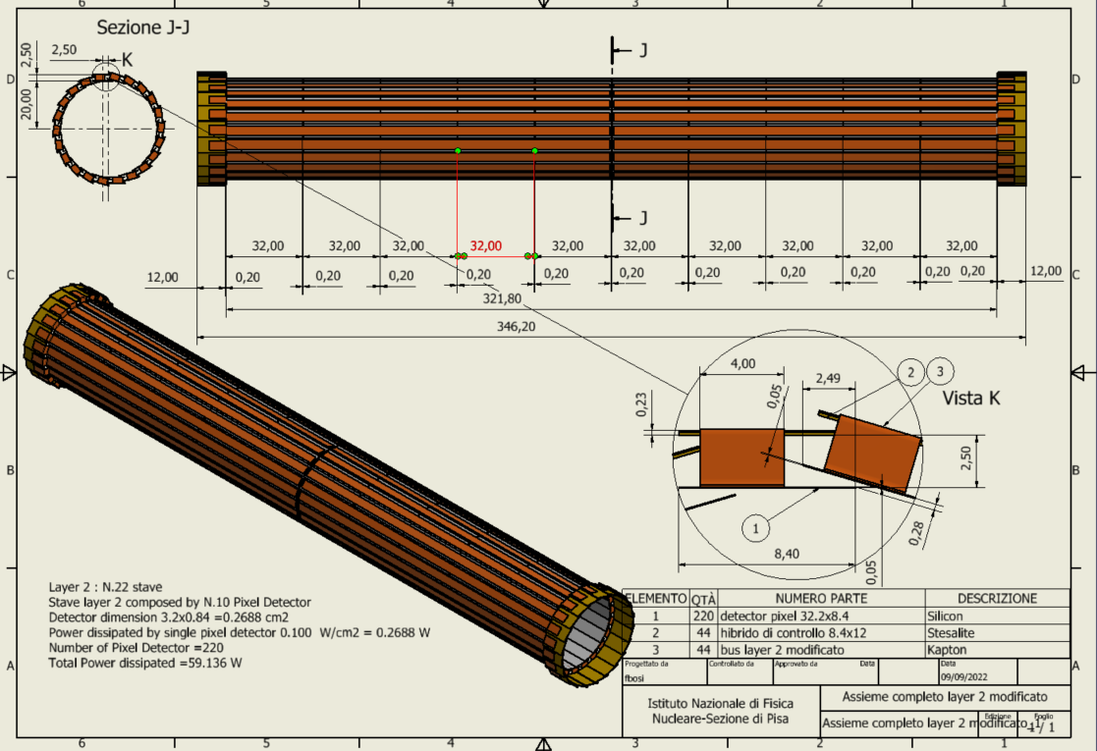
Hybrids at higher radius (+2.5 mm wrt sensors), not to interfere with LumiCal clearence
Layer 2
22 overlapping staves of 10 modules each
Power budget of the modules (only)
~59 W

Slide 39
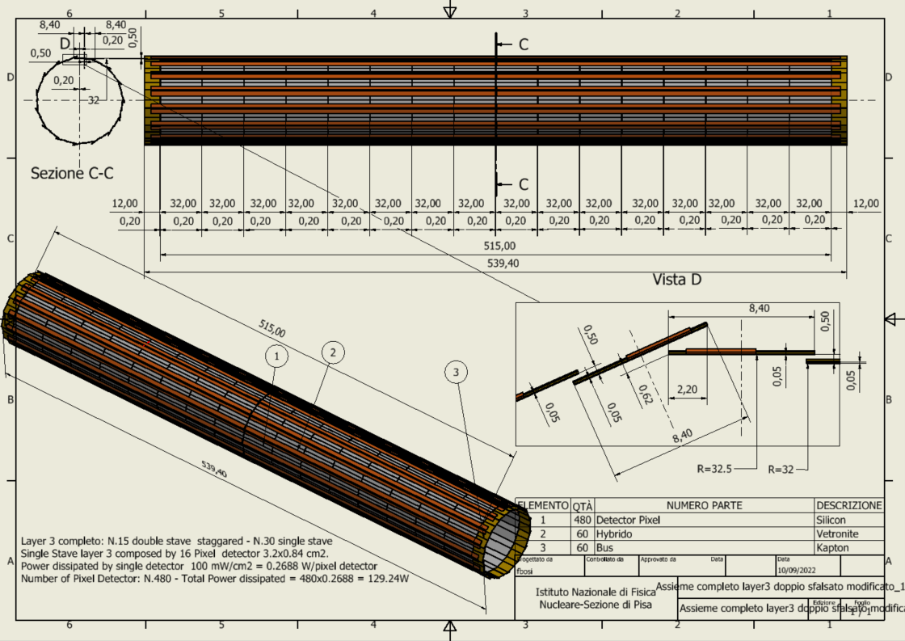
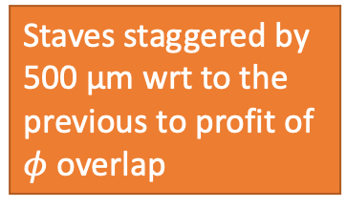
Staves staggered by 500 µm wrt to the previous to profit of $φ$ overlap
Layer 3
15 overlapping double staves of 32 modules each
Power budget of the modules (only)
~130 W

Slide 40
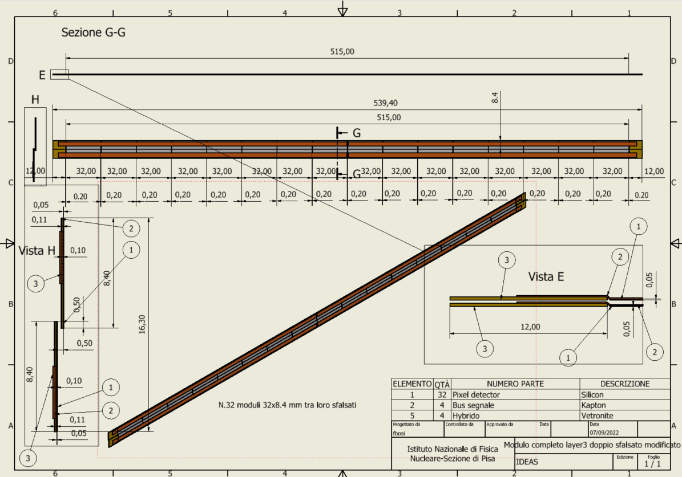
Double stave
2 parallel strings of detectors overlapped by 500 µm

Slide 41
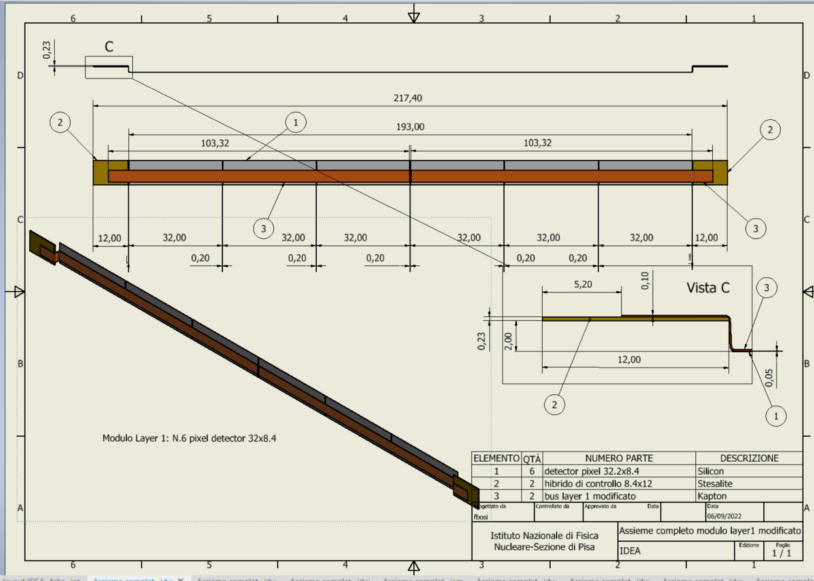
Stave Layer 1

Slide 42
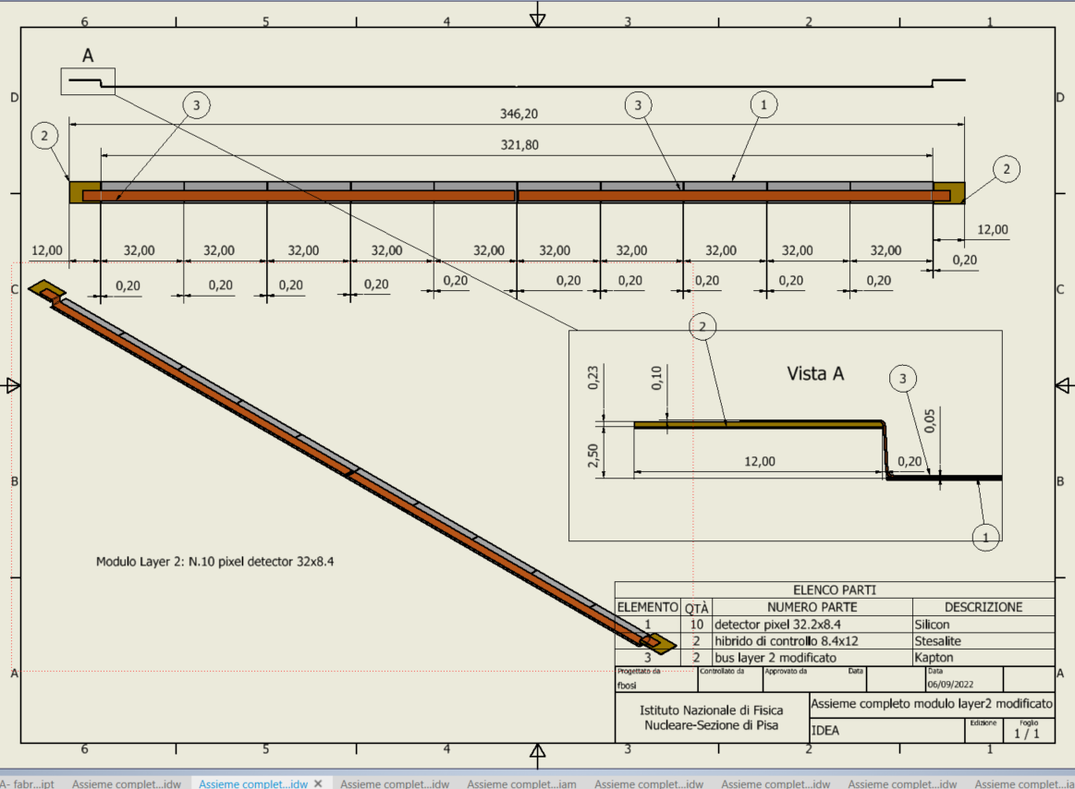
Stave Layer 2

Slide 43
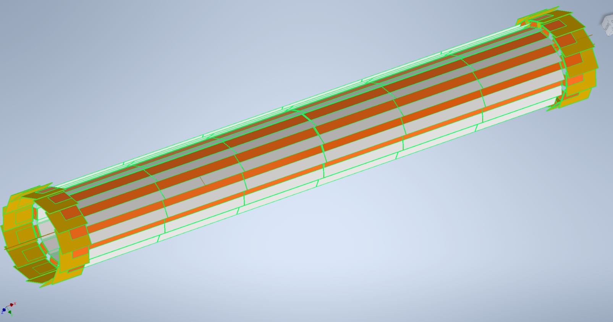
Layer 1

Slide 44
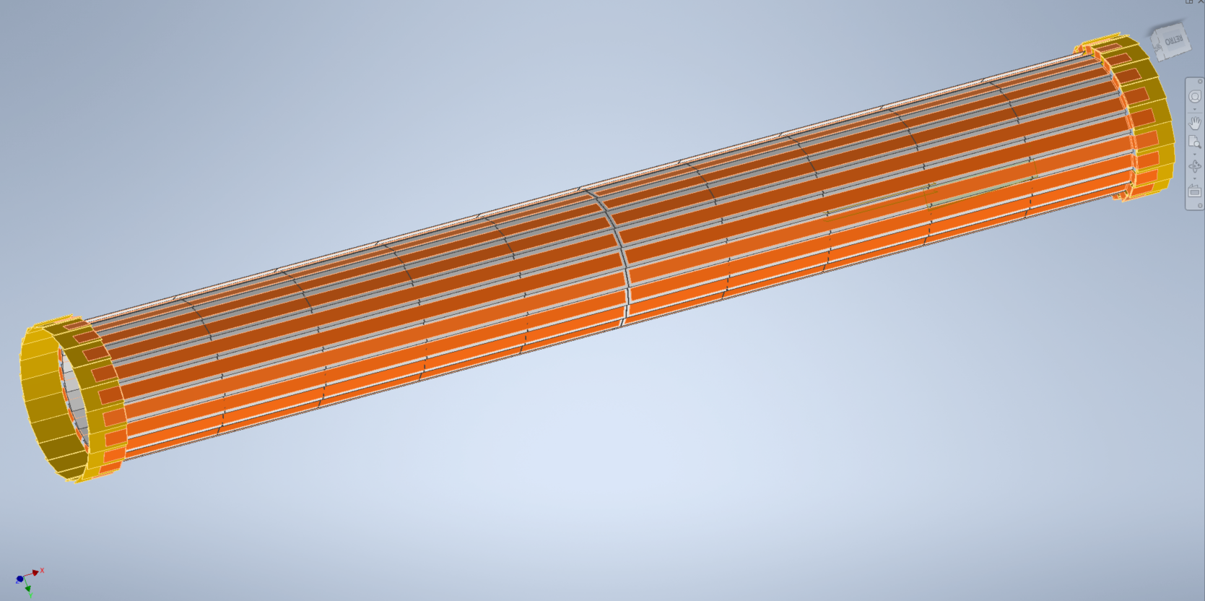
Layer 2

Slide 45
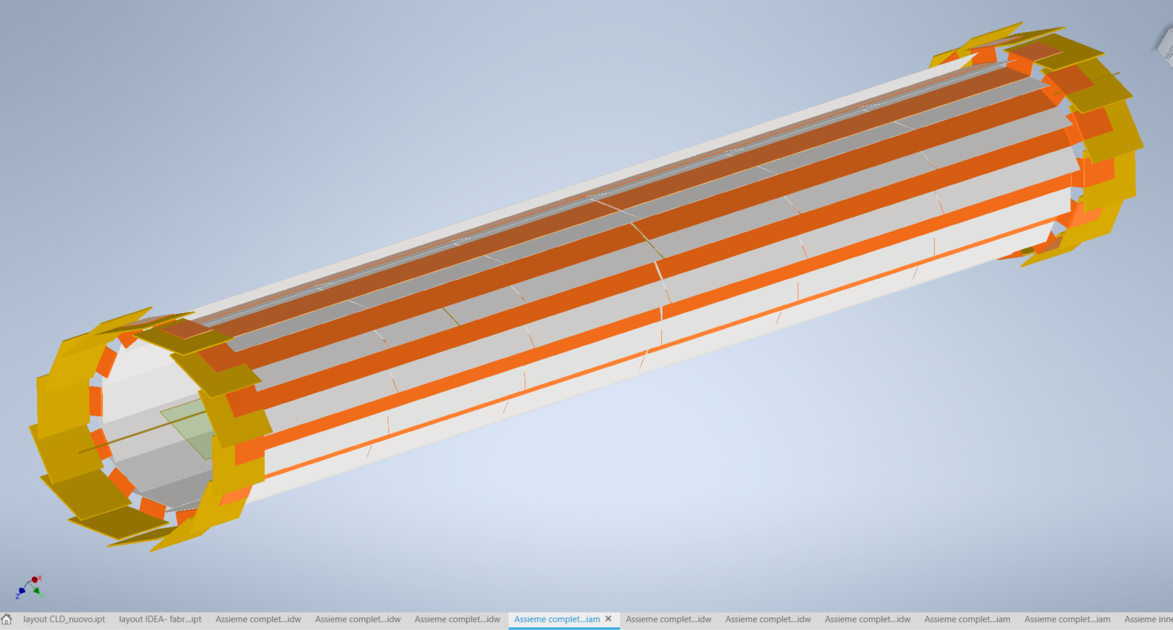
Layer 3

Slide 46
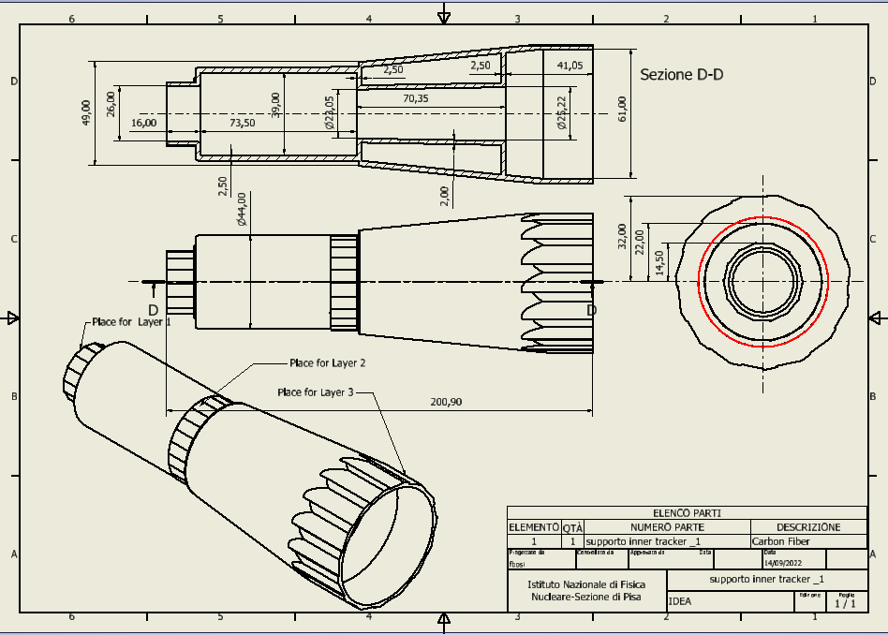
Support Carbon Fiber
Superseeded by the conical shape

Slide 47
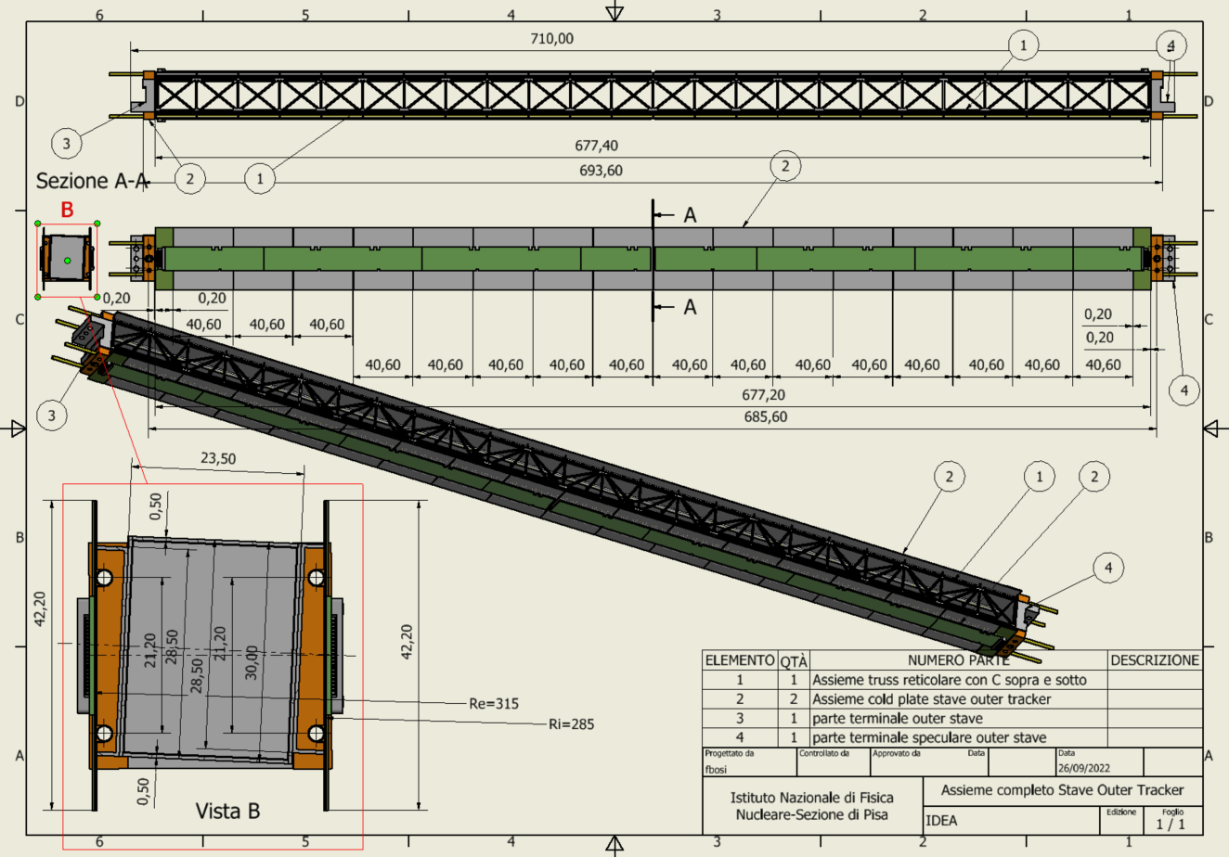

Slide 48
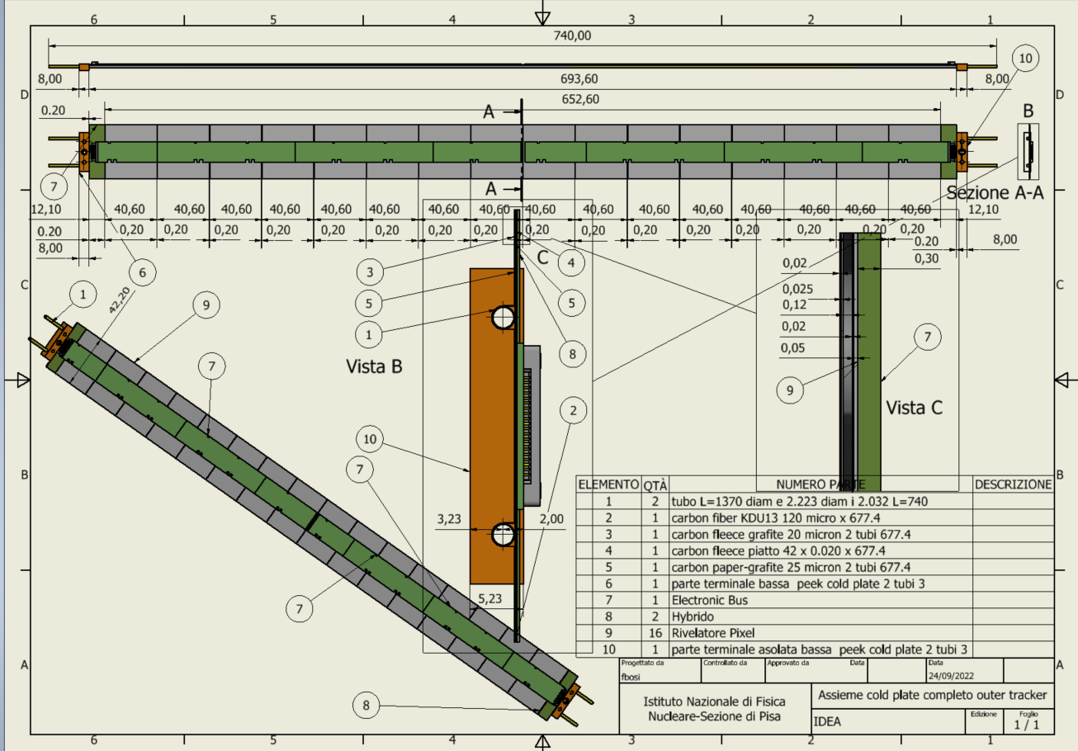
Cold stave

Slide 49
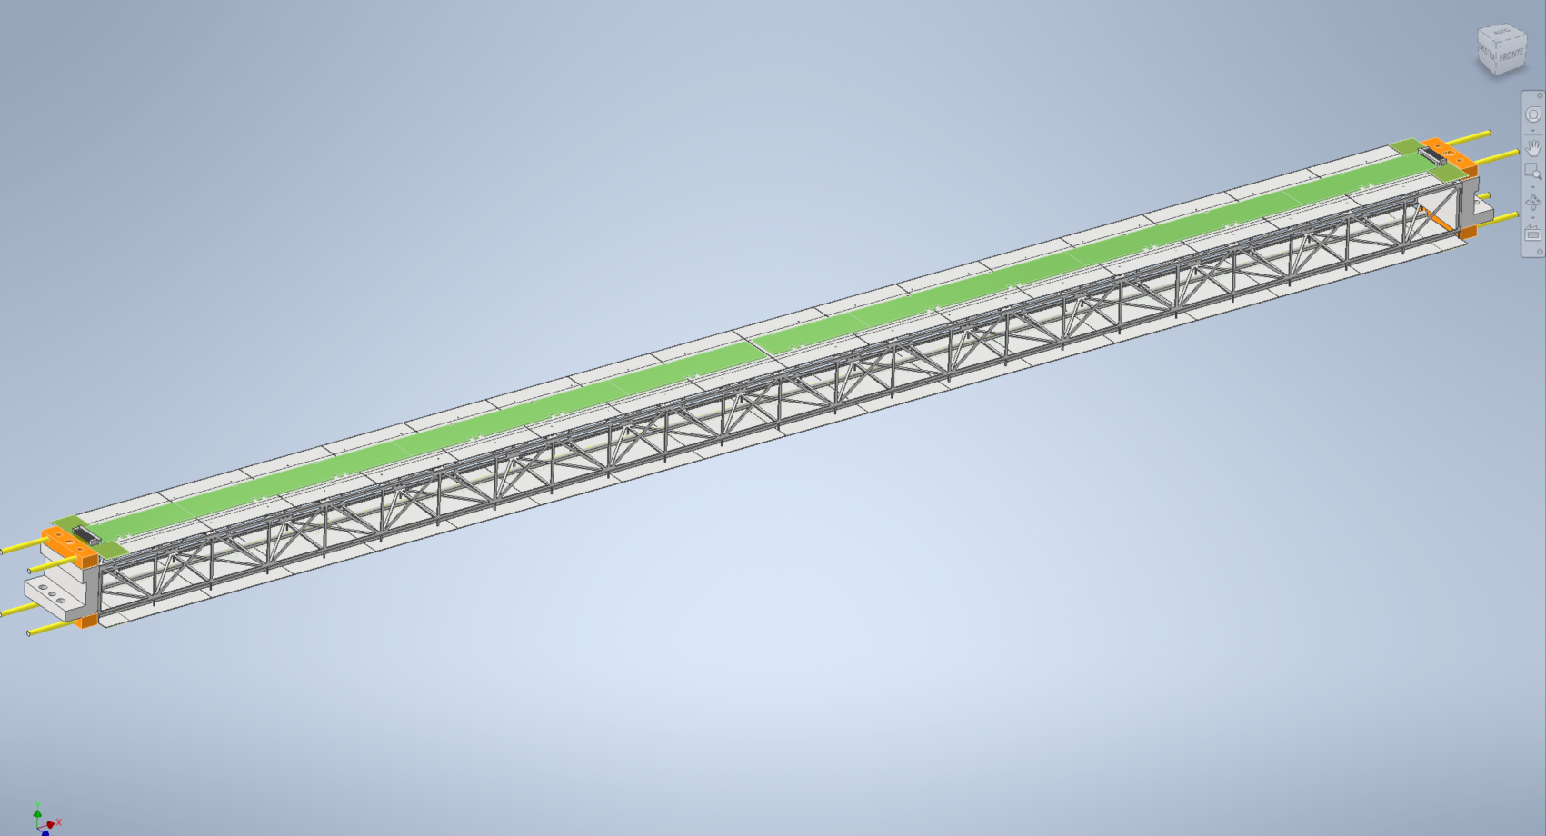
Stave Outer Tracker
Double Pixel Stave
Upper Cold Plate with pixel sensor
Terminal part to fix to the flange

Slide 50
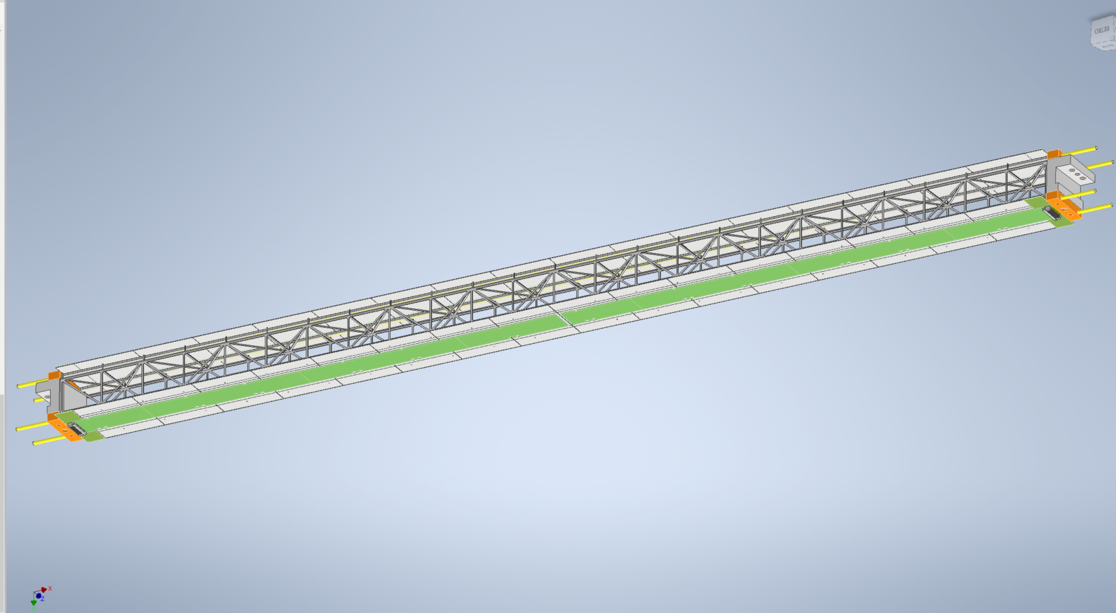
Stave Outer Tracker
Double Pixel Stave
Lower Cold Plate with pixel sensors
Terminal part to fix to the flange

Slide 51

Truss Structure
Plate Truss Structure glued together
All Material Carbon Fiber MJ46
Plate Truss upper-lower truss structure th=0.5 mm side 1mm
Plate Truss lateral truss structure th=0.5 mm side 1mm
C carbon Fiber profile supporting cold plate

Slide 52

Truss Structure

Slide 53

Cold Stave
Kapton Tube
Bus Circuit
Pixel Detector
Terminal Part to fix to the Truss structure

Slide 54

Outer Tracker
N.48 Double Stave

Slide 55


Inner disk with conceptual mechanical support structure

Slide 56


