Slide 1
Summary of Review on Civil Engineering and Techinal Infrastructure Requirements for FCC Experimental Sites
October 3-4
Detector Concept Meeting
7 November, 2022
Mogens Dam, Niels Bohr Institute

Slide 2
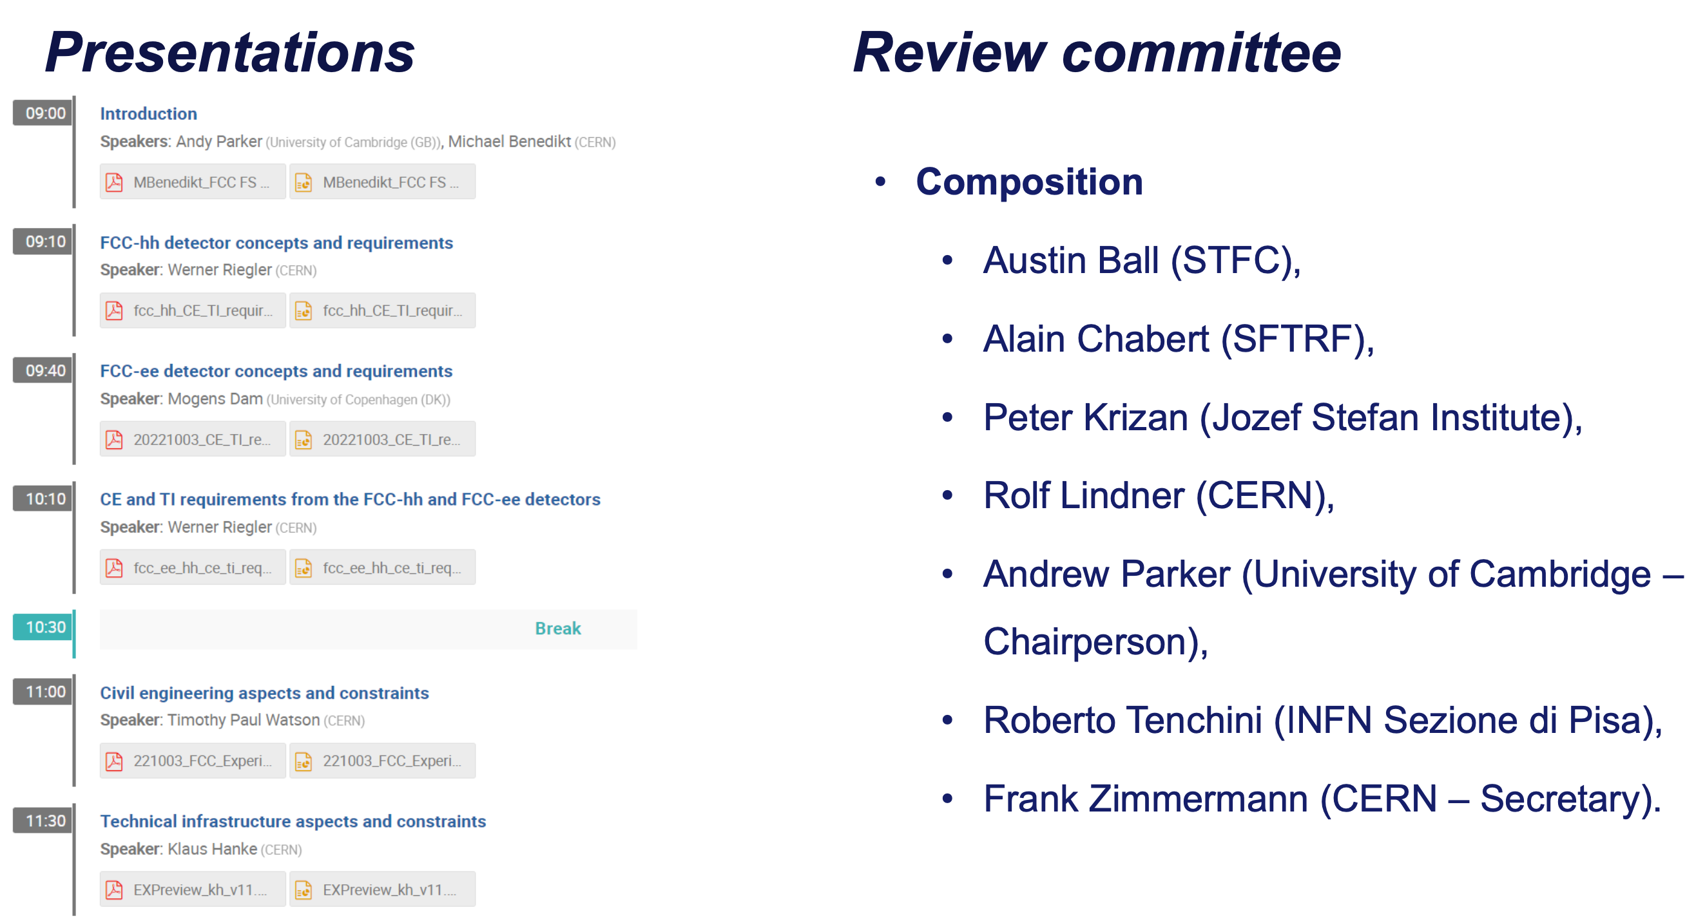
The Review 3-4 October

Slide 3
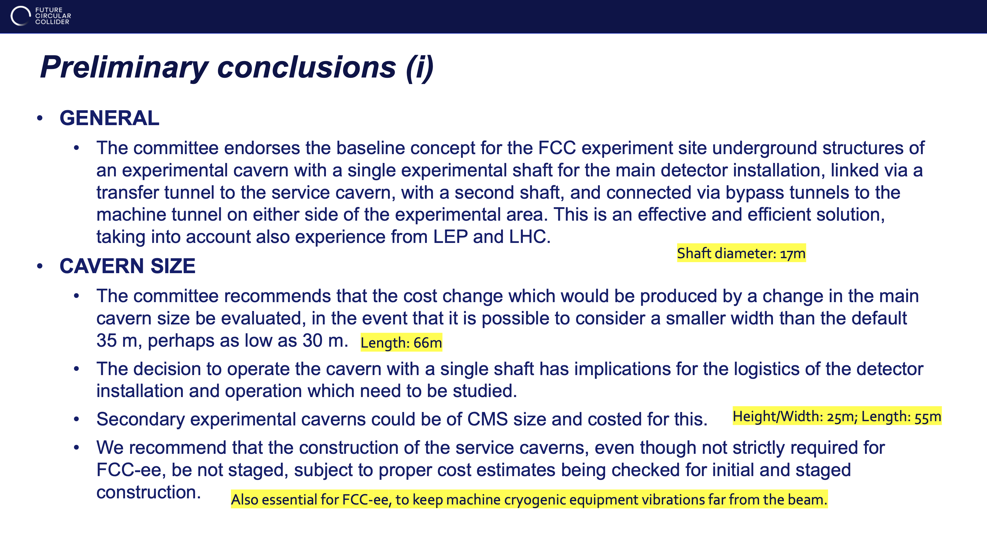
Michael Benedikt, October 7th

Slide 4
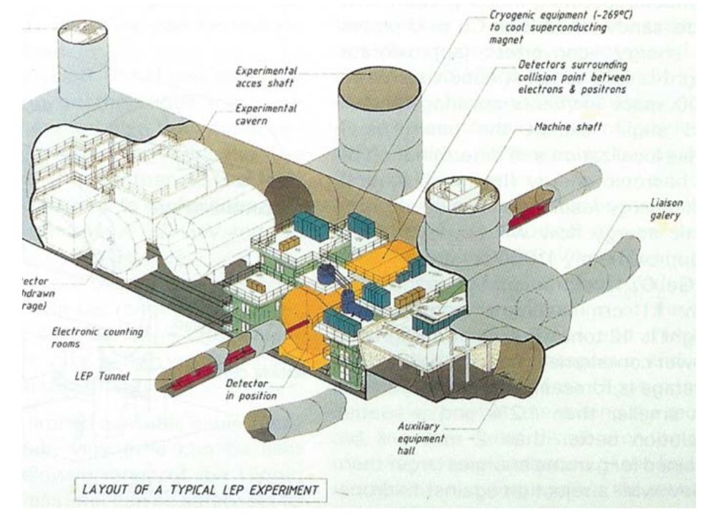
LEP Cavern Layout of the three typical Detectors
MD
Baseline is that FCC-ee detetors will be assembled under ground as at LEP.
With similar sizes, FCC-ee detectors would fit into a typical LEP underground area
Cavern: 70m long, 17m wide, 18.5 m high
A single shaft of 10.1 m diameter
Main cavern with enough space for detector, including barracks for electronics, cryogenics, services, and even empty space to move the detector into garage position (never used)
No service cavern used by experiments
Length direction perpendicular to beam direction
H.Schopper: ”Lord of the Collider Rings”

Slide 5
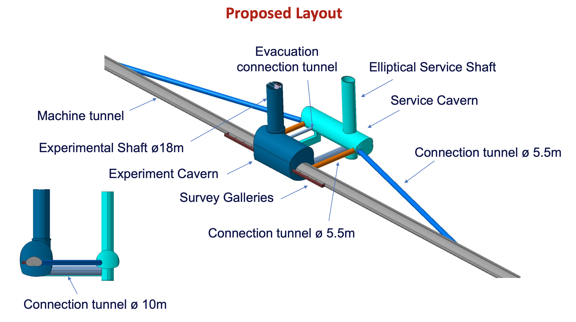
Werner Riegler

Slide 6
Werner Riegler

Slide 7
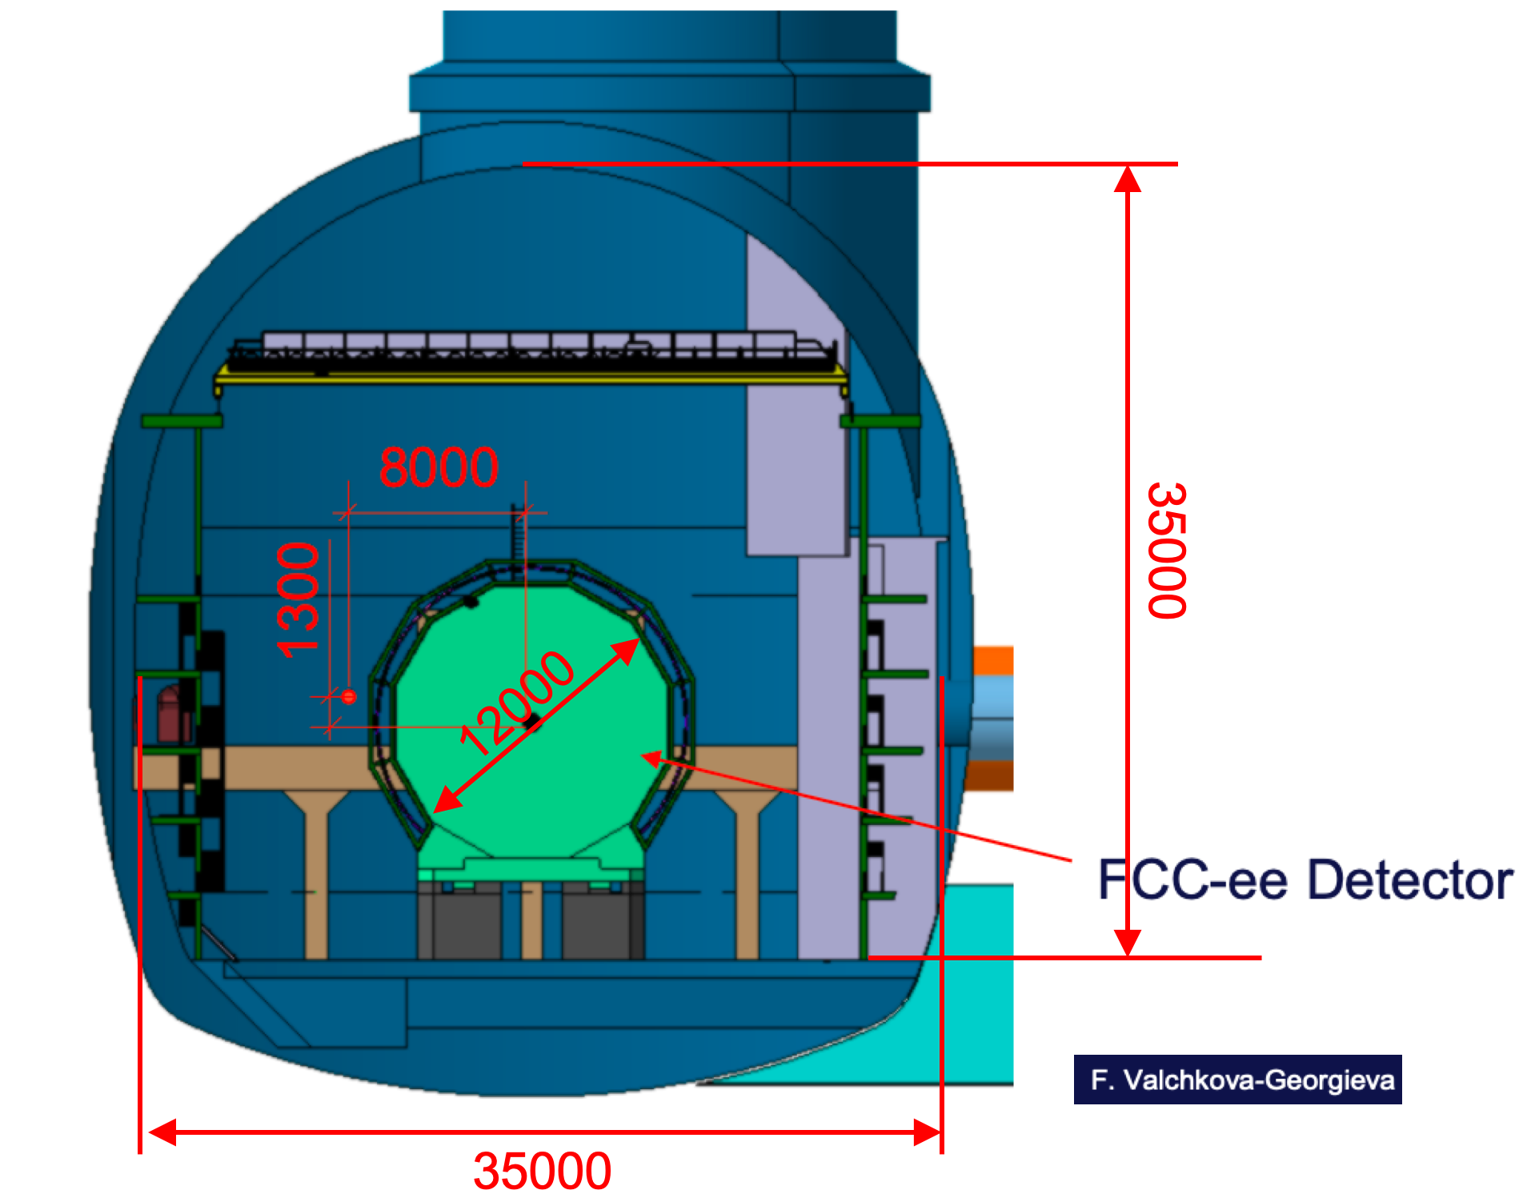
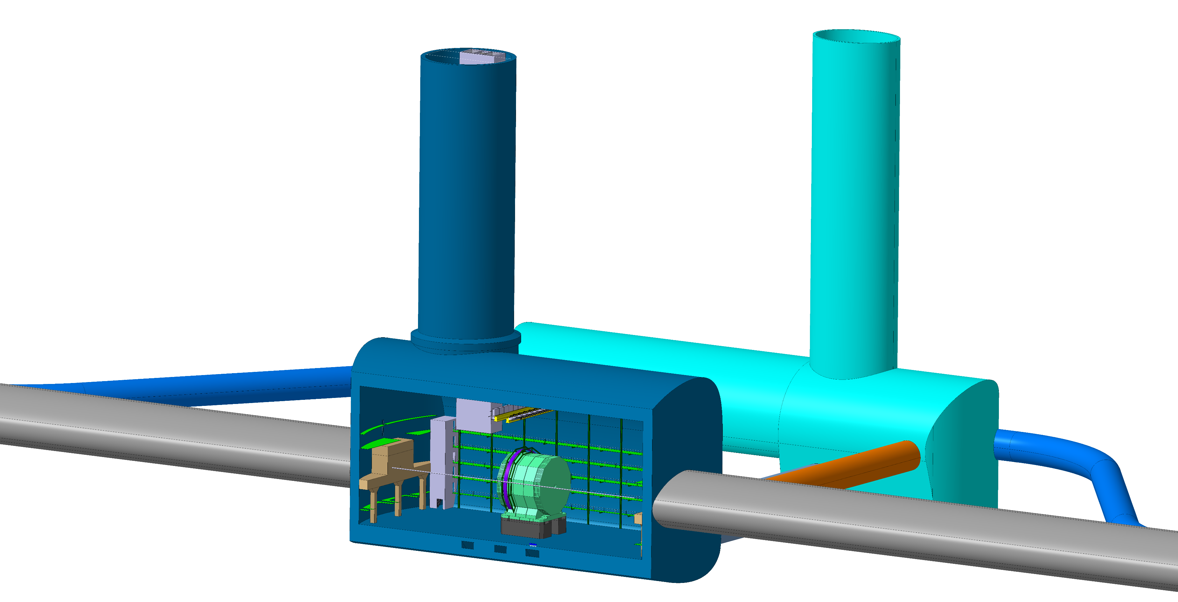
FCC-hh Experiment Underground Structure
MD
With FCC-ee detectors being considerably smaller than FCC-hh detectors, a baseline FCC-hh cavern works perfectly for the housing of a FCC-ee detector including all services
cooling plants, cryo cold box, gas systems, electronics barracks
A FCC-ee detector would also fit well inside a somewhat smaller CMS-like cavern of size 53x25x25 m³.
A shaft of 10m diamater is sufficient

Slide 8
Michael Benedikt, October 7th

Slide 9
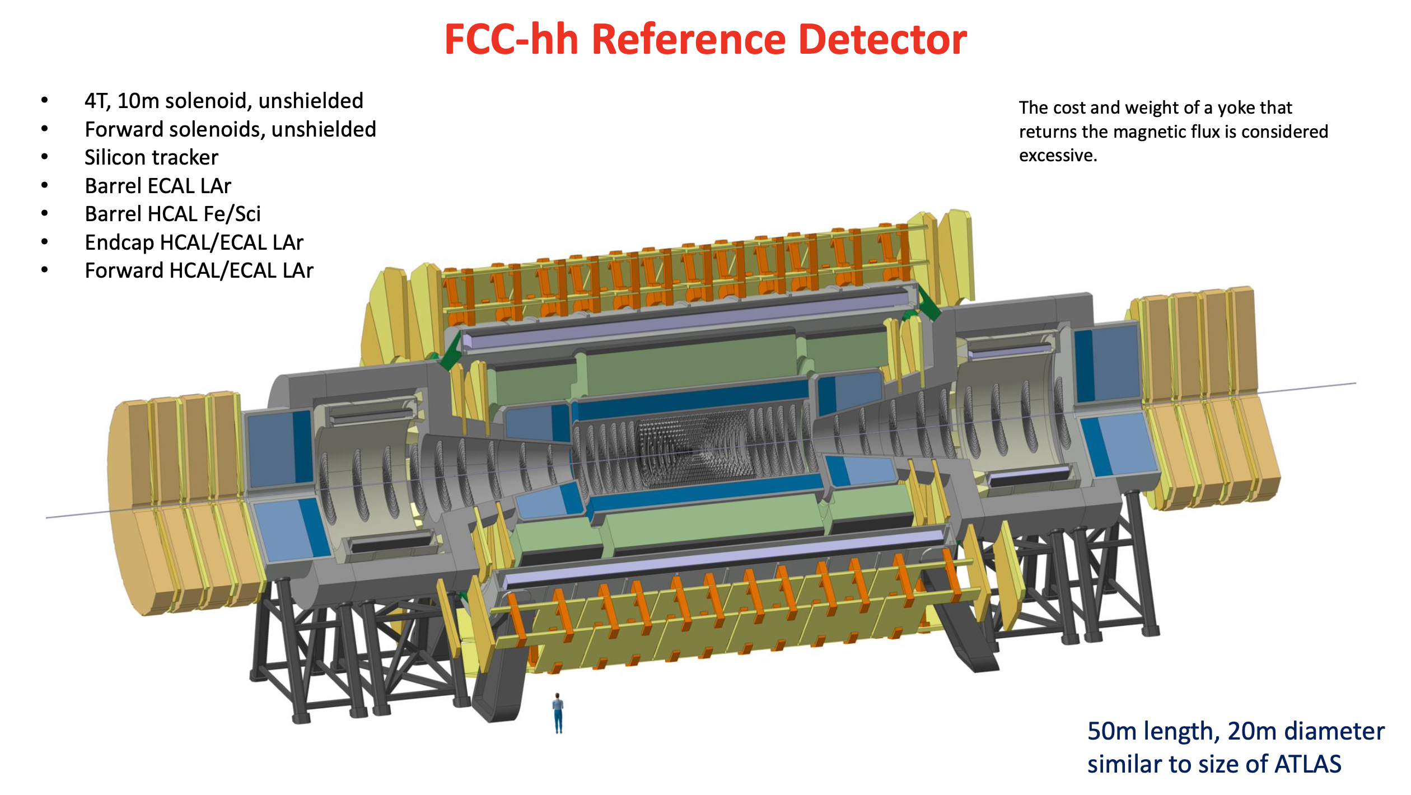
Werner Riegler

Slide 10
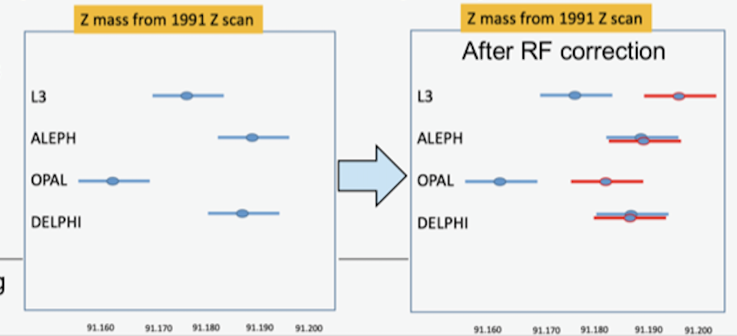
The case for four Interaction Points
MD
One of the many advantgages of circular colliders: can serve several IPs
Overall gain in luminosity, in luminosity/MW, and importantly in luminosity/kg CO₂ equiv
  Many measurements are statistics limited – some are tantalizingly close with only 2 IPs
    E.g., Higgs self-coupling, search for Heavy Neutral Leptons, Flavour anomalies, Electron Yukawa coupling, etc.
Variety of detector requirements may not be satisfied by one or even two detectors
  E.g., high precision, high granularity, high stability, geometric accuracy, PID
    Having four IPs allows for a range of detector solutions to cover all FCC-ee opportunities
Four IPs provide an attractive challenge for all skills in the field of particle physics
Redundancy is invaluable in uncovering hidden systematic biases or conspiracy of errors
  E.g., m_{z} discrepancy at LEP in 1991
    Found to be an effect of RF phases and voltages
      Correction of ~+19 MeV for L3 and OPAL
  Could have remained unnoticed for ever with
    only ALEPH and DELPHI, or
    only L3 and OPAL
2208.10466

Slide 11
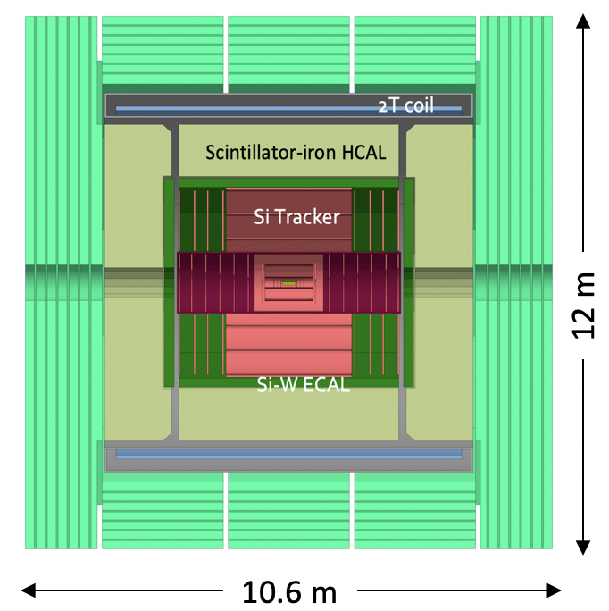
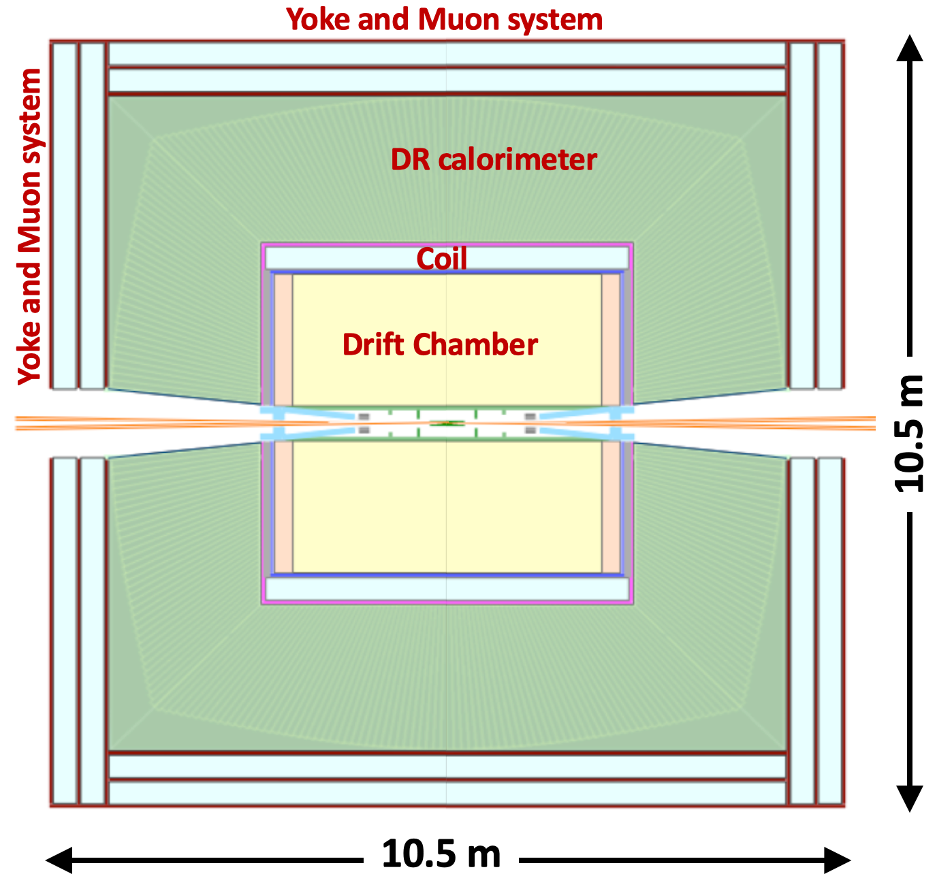
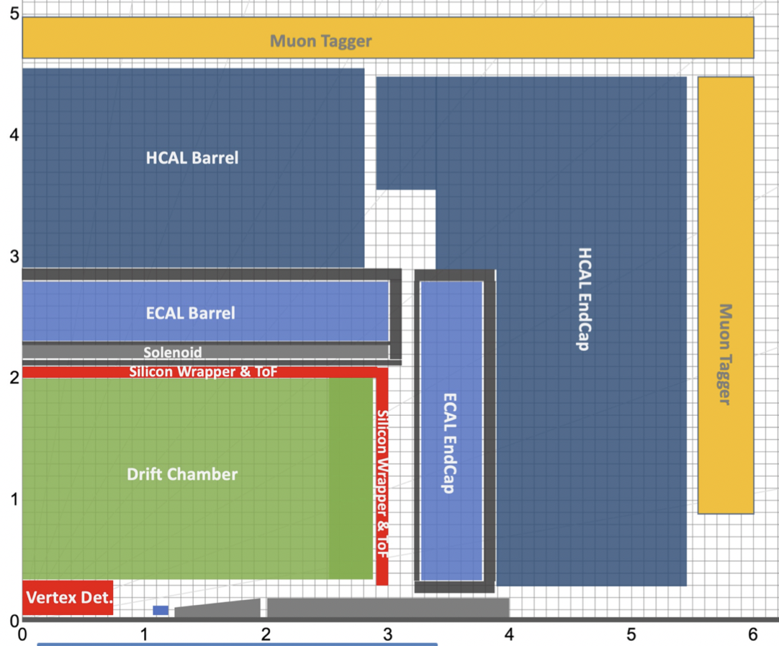
Developing Landscape of FCC-ee Detector Concepts
CLD
IDEA
Noble Liquid ECAL based
new
CDR
Full Silicon vertex detector + tracker;
Very high granularity, CALICE-like calorimetry;
Muon system
Large coil outside calorimeter system;
Possible optimization for
  Improved momentum and energy resolutions
  PID capabilities
Si vertex detector;
Ultra light drift chamber w. powerfull PID;
Monolitic dual readout calorimeter;
Muon system;
Compact, light coil inside calorimeter;
Possibly augmented by crystal ECAL in front of coil;
High granularity Noble Liquid ECAL as core;
  PB+LAr (or denser W+LCr)
Drift chamber (or Si) tracking;
CALICE-like HCAL;
Muon system;
Coil inside same cryostat as LAr, possibly outside ECAL.

Slide 12
Michael Benedikt, October 7th

Slide 13
CLD
IDEA
Noble Liquid ECAL based
5 m
6 m
Cryostat:
Outer diameter: 8.55 m
Length : 7.4 m
Cryostat:
Outer diameter: 4.8 m
Length : 6.0 m
Cryostat:
Outer diameter: ~6 m
Length : ~6 m
All concepts fit inside 12x12 m envelope
Tentatively, assume that largest single piece (undismountable) is coil/cryostat
Assume that coil/cryostat dimensions allow remote production with transportation to site
  CLD has the largest coil/cryostat with dimensions similar to that of CMS:
    length x outer diameter = 7.4m x 8.55m [CMS: 12.5m x 7.2m]

Slide 14
Werner Riegler

Slide 15
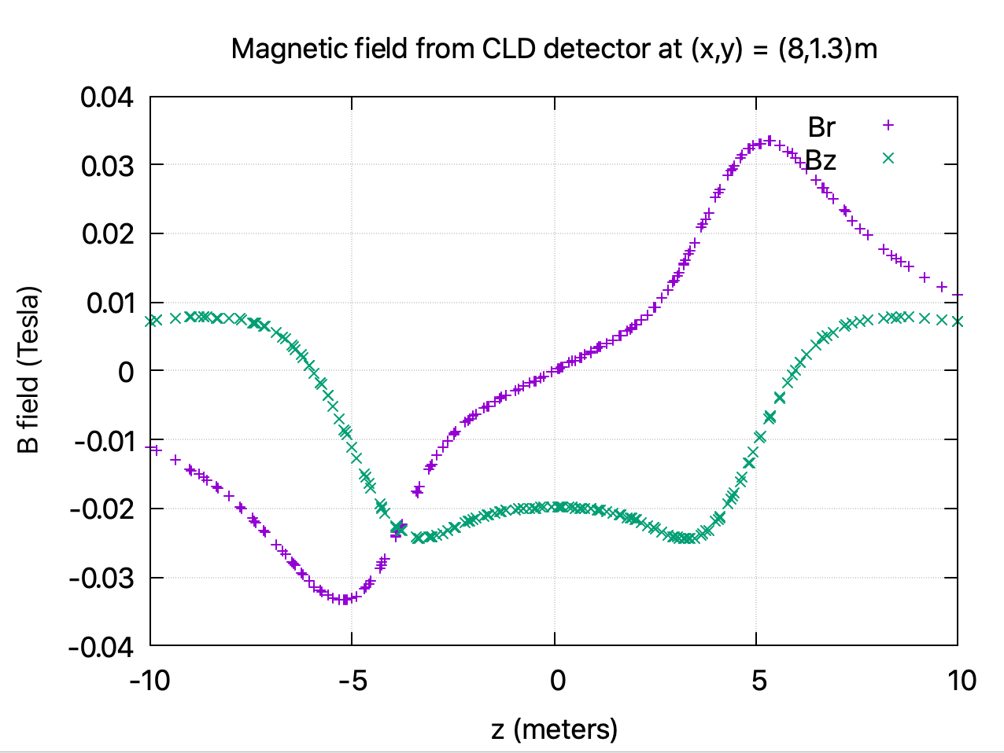
A side issue: Position of the booster ring
Booster position may have consequences on the tunnel layout around the IP
For this study, booster ring passes through cavern outside detector volume at [x, y]= [8.0, 1.3]m
Detector stray field at the booster location is up to ten times stronger than the 3 mT dipole field strength at injection
  Needs to be corrected for
Data from the CERN magnet group Nikkie Deelen
A solution for shielding and/or correction has to be developed
The booster location must be such that there is at least 1 m free space around the detector envelope with the shielding/compensation in place
The shielding/compensation must not sizeably affect the magnetic field of the detector.

Slide 16
Extras

