Slide 1
WG Fusion - contributors
Chris Grovenor: Oxford University (convenor)
Neil Mitchell: ITER (convenor)
Joe Minervini: Novum Industria
Min Zhang: Strathclyde
Beth Evans: UKAEA
Seungyong Hahn: Seoul National University
Nanna Heiberg: UKAEA
Greg Brittles: Tokamak Energy
Zack Hartwig: MIT
Ioannis Katramados: UKAEA
Susie Speller: Oxford University

Slide 2
WG FUSION – Formulating the Grand Challenge
For the fusion community, one could state the grand challenge as
The 10 – 100 – 1000 challenge Within 10 years achieve 100 MW for 1000 seconds
What must the superconductivity community contribute to this?
Starting position:
  The performance of commercially available Nb₃Sn and REBCO is already good enough (production needs to be ramped up and a reduction in cost helpful, but not critical)
  Focus needs to be on components – for simplicity TF, CS and PF magnets.
Several key themes
  Superconductor choice and supply
  Quench protection
  Cryogenics
  Mechanical reinforcement
  Insulation
  Sensors and sensing
  Simulation tools
  Demountable joints?

Slide 3
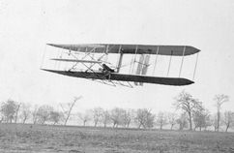
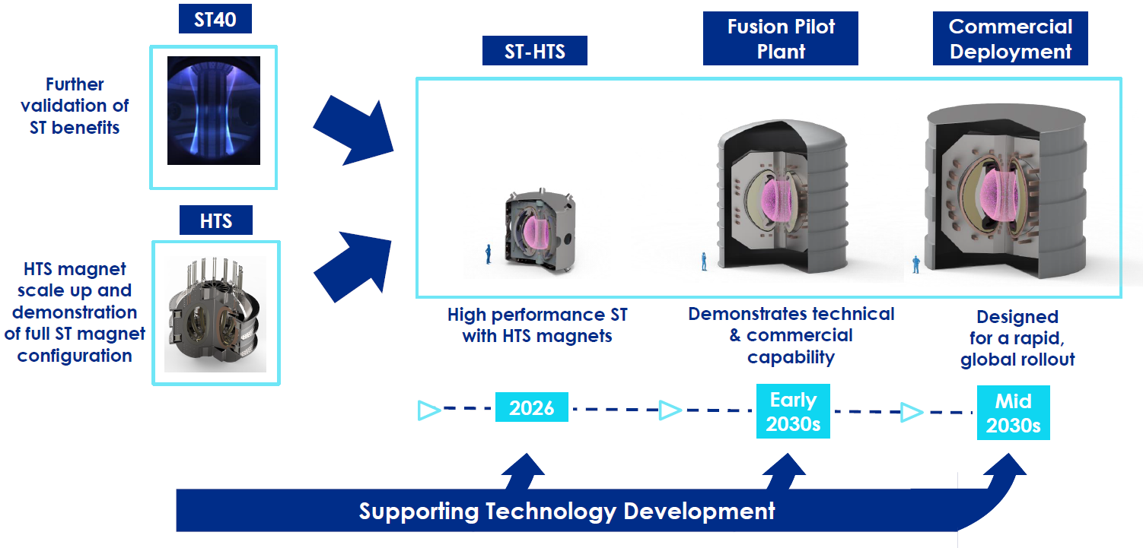
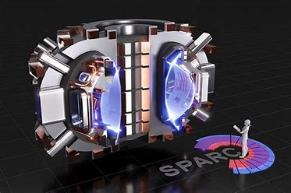

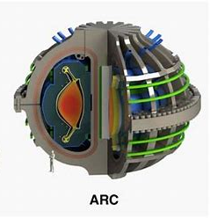
WG FUSION – Outline for a 10 year Strategic roadmap focusing in delivering end user products impacting our future
Guided by how we take Superconductivity from a frontiers technology to a mainstream technology
Stage 1: The first magnets for small fusion devices will be built without all the engineering data being well known – ‘learn by mistakes’ The Kitty Hawk Flier approach
2025 - 2030
ST-HTS and SPARC
If all goes OK, there will come a stage where magnets for commercial fusion devices will have to be manufactured, and by then the full engineering data will be required.
Mid 2030s

Slide 4
WG FUSION – Formulating the status of critical aspects involving superconductors for the 10-100-1000 Grand Challenge
Theme/component | TF | CS | P
Quench protection
Cryogenics
Mechanical stability
Insulation
Demountable Joints*
Simulation tools
Sensors and Sensing
With joints
Without joints
Superconducting wire/tape
* These may not be needed for the 10-100-1000 challenge, but must be developed at some stage so should start now?

Slide 5
WG FUSION – (slightly less grand) Challenge #2
Demonstration of capability and key performance data
If 10-100-1000 seems too ambitious, is there a plan B?
Two major steps forward delivered by the superconductor community within 10 years
  Fully demountable TF magnet demonstrator
  Full characterisation of wire/tape performance J_{c}(T, B, θ/ψ, ε and n)
n is irradiation (neutrons and γ)

Slide 6
WG FUSION: Case study
Several organisations, many of them private, are working on their own designs for magnets for small fusion machines. All of them have decided that they will have to use REBCO coated conductors to achieve their engineering targets.
Magnet designs will be proprietary with embedded IP making it unlikely that the detail needed for a joint programme of work on magnet design and construction could be shared.
However, what everybody might be willing to share is the results of work on underlying common themes – of which the most obvious is data on the performance of the tapes/cables/joints in fusion-relevant conditions.
Starting premises
(i) Nb₃Sn magnets for ITER are already a reality
(ii) Commercial REBCO coated conductors are ‘good enough’ in their basic performance for demonstration devices
(iii) What the community needs to bring forward the reality of REBCO-based magnets in small fusion reactors is to qualify REBCO conductors for use under fusion-relevant conditions
This case study is thus focussed on the need for a test and qualification activity (and facility) for fusion magnet materials that could accelerate the development of successful prototypes.

Slide 7
WG FUSION: Case study
Primary requirements
Transport measurements of critical current in tape and cable as a function of
magnetic field (preferably up to 25-30 T)
temperature (4K - 77K)
strain in both tape and conductors
full range of angles of the magnetic field
Ability to handle radioactive samples after neutron-irradiation
Currents of several kA (10s kA for cables)
Large enough bore to test cables and joints
(Ability to transfer samples cold from a cold irradiation facility?)
This would be a world class, unique test facility, with a strong overlap with the requirements of the superconductors for power theme.

Slide 8
WG FUSION: Case study
Aims
[1] The qualification of the materials we have now
Provide engineering data to allow comparison of the performance of conductors from different vendors under fusion-relevant conditions.
Could offer to curate a database of standardised I_{c}(B,T, e, ṅ) data - add some additional data to NZ database on different available conductors, across a wider parameter space.
[2] Designing the next generation of superconducting materials
To advance the scientific understanding of the effects of the fusion environment on magnet materials, which will in turn support the longer term design and development of improved materials specifically for fusion. This is an area where the research community are uniquely placed to support the engineering projects.
Although Nb₃Sn & REBCO appear to be the de facto current choice for demonstration level power plants, we should not lose sight of other potential candidate materials (Bi and Fe-based families perhaps) that may in the next 10-15 years be developed to offer competitive performance.
[3] Other materials
High-field REBCO magnets also contain other materials that have to perform under the same conditions, including insulators and structural alloys. Testing modern resins for cost, fabrication challenges, toxicity and radiation resistance at cryogenic temperatures may be key. If we already have facilities for cryogenic irradiation and (electro)-mechanical characterization of REBCO, we should expand the remit to cover key non-superconducting materials to the maximise impact of the facility on the fusion community.

