Slide 1
Superconductivity for
Greener, Healthier, Prosperous and Sustainable Future (ScFuture)
WG Theme : Renewables, Energy and Transportation
WG Conveners: Sastry Pamidi, Michael Parizh
WG Members:
Cristian Boffo, Emiliano Frulloni, Umberto Gambardella, Luis Garcia-Tabares Rodriguez, Seungyong Hahn, Walid Abdel Maksoud, Joe Minervini, Xiaoze Pei, Jan Plecháček, Loïc Quéval, Bruce Strauss, Pascal Tixador, Min Zhang, Kiruba Haran, Peter Cheetham
Location: Hawaii
Date: 23 October 2022

Slide 2
WG energy & transport - Status
Technology demonstration
  Commercial: Shinkansen maglev (Japan), transmission FCL (SuperOx, Russia) – small volume so far
  Feasibility Demo: wind generators, rotating machinery, SMES, FCL, T&D cables, transformers, power convertors, etc.
Typical advantages (system): scalability, operation at higher power, higher efficiency, compact size, lower weight
  Root cause of the advantages: higher magnetic field at the operating location, low or zero losses
Unique, limited-time opportunity: multi-billion market in off-shore wind that needs high-power units
  The same technology may be used in large-size SC motors such as ship propulsion
Challenges (commercial)
  Not enabling: other solutions are possible in most applications. Example: FCL vs dual feeder
  Compete with conventional, mature technologies: rotating machinery, transformers, cables, transportation, etc.
  Must meet strict cost requirements while delivering superb performance
  Significant initial investments in technology, unpredictable ROI
  Difficult to introduce new technologies in conservative energy and transport markets
High capital cost
  Life cycle cost may be competitive

Slide 3
WG energy & transport – Grand challenges
Commercial
Compete with other technologies: performance and cost. Uncertain ROI. High cost of failure
Difficult to penetrate to mature, conservative markets
Design
Very large-size devices, often beyond SC industry experience. No standards for the SC devices
Technical approaches yet to be selected and qualified
Challenging system interfaces
Need scalable, standardized approaches and components
Closed loop cryogenic system. Fast cool down and ramp up
For many applications: quench protection, high-voltage insulation for high power commercial units
Manufacturing and test
Develop supply chain. Need multiple sources. Supply chain for HTS: volume, dual vendors deliver same form/fit/function.
No proper size manufacturing facilities: make coils, cryogenics systems (cryostats), etc
No comprehensive system facility to test SC device or even SC components at full scale
Operation
Operation in harsh environment
System reliability. Low maintenance including cryogenics. Long life cycle >20 yrs
Significant power support even when SC unit in standby mode
Network operator needs good understanding of SC technology, needs education

Slide 4
Ambitious idea
Build superconducting power industrial park(s)
Objectives:
Integrate and test full-size SC units for different power and transport applications
  Test facility: system and SC components, cryo infrastructure. Long-duration test capability
  Option: Manufacturing of SC components
Ability to evaluate SC components in combination with other novel technologies such as hydrogen technology
Research center – equipment and personnel to support industry needs
Education and Training – Workforce development, Ph.D. students and and Post-docs can come to use and get trained in advanced facilities
Challenge
Versatility. Shall not be limited to a single technology/component

Slide 5
Outline
Power generation: several 25 MW units, continuous operation
Link from generation to transmission
  Transformers, converters, FCL, Cable, Storage (?)
  Link to actual transmission grid
Test SC motors for transportation and aviation: 50 MW
Cryogenic Hydrogen generation/storage/distribution
Manufacturing facility, ~300 employees
  Units up to 12 m diameter, 10 m long
  High quality welding
  Overhead crane 100+ ton
  Balancing and other support units (rotating machines)
  ? Facility to winding superconducting coils for multiple applications and approaches
Test facility
  Cryogenic testing – fast cooldown, support and auxiliary services,
  High power load torque testing
  Large Vacuum facility up to 10 m diameter
Hydrogen production and storage on site
Research center, ~100 employees
  Diverse research field and applications (superconducting and non-superconducting technologies)

Slide 6
Other requirements
Next to seashore
Highway access
Power requirements
  Access to transmission grid
  Power substation on-site, 1 MW continuous power
  Allow flexibility of voltage (5 kV minimum) and current (several kA)

Slide 7
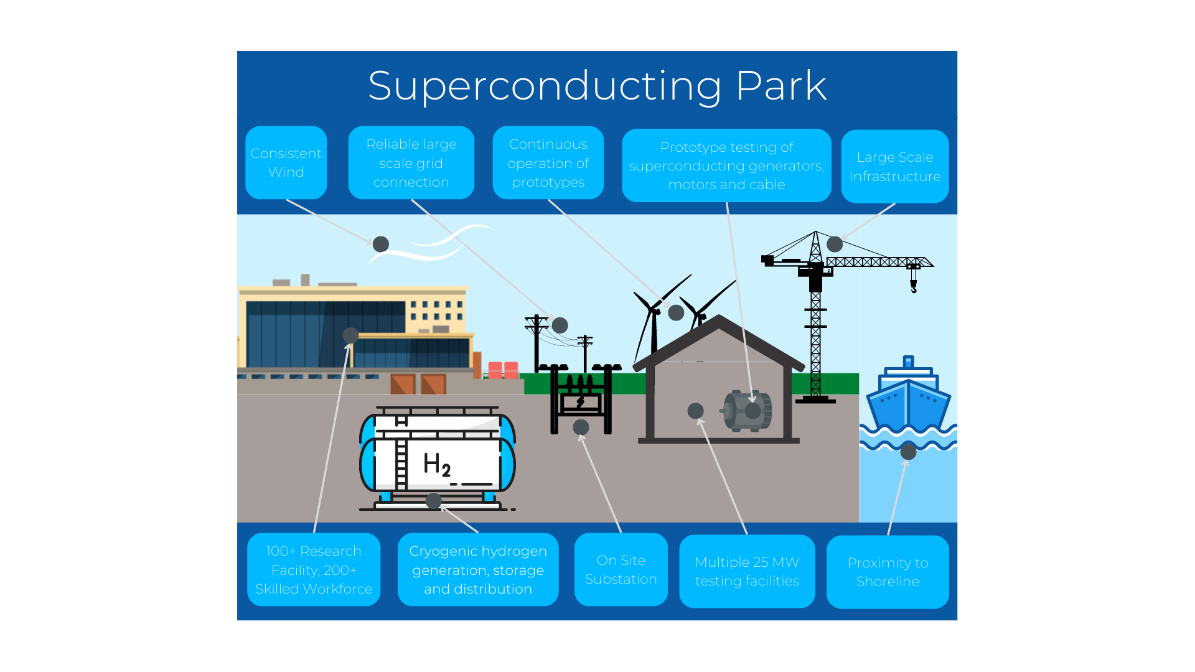

Slide 8
Sponsors
Private-government partnership
Support: Nat’l Lab(s), university

Slide 9
WG energy & transport – Grand challenges
Commercial
Compete with other technologies: performance and cost. Uncertain ROI. High cost of failure
Difficult to penetrate to mature, conservative markets
Design
Very large-size devices, often beyond SC industry experience. No standards for the SC devices
Technical approaches yet to be selected and qualified
Challenging system interfaces
Need scalable, standardized approaches and components
Closed loop cryogenic system. Fast cool down and ramp up
For many applications: quench protection, high-voltage insulation for high power commercial units
Manufacturing and test
Develop supply chain. Need multiple sources. Supply chain for HTS: volume, dual vendors deliver same form/fit/function.
No proper size manufacturing facilities: make coils, cryogenics systems (cryostats), etc
No comprehensive system facility to test SC device or even SC components at full scale
Operation
Operation in harsh environment
System reliability. Low maintenance including cryogenics. Long life cycle >20 yrs
Significant power support even when SC unit in standby mode
Network operator needs good understanding of SC technology, needs education

Slide 10
WG energy & transport – Known Market data
Application | Market data | SC units in 10 yrs | SC use in 10 yrs
SC wind generation | Installed base: 825 GW (2021), Annual growth rate: 13% Competes with other technologies. Competitive SC units: >10 MW Figure of merit: LCOE | 1-10 GW power/yr | 10-20 MAmp-km per 1 GW
Large rotating machinery | Large size motors, >30 MW | 10 units/yr | 1-5 MAmp-km
SMES | Grid stabilization, 30-50 MJ / 10 MW units HTS only Competes with other storage technologies (batteries, capacitors) | 10 units/yr | 0.3-0.5 MAmp-km
FCL | HTS only | 20 units/yr | 0.3 MAmp-km
T&D cables | HTS only T&D losses: 2% to 6% at nominal load, up to 8% at high load
Maglev | HTS or LTS Constraint: high construction cost | 10 cars/yr, ~200 coils | 0.2-0.3 MAmp-km
Electric aircraft |  | Prototype | 0.1 MAmp-km

Slide 11
SC Power Park – 10 year schedule
Phase 1 --- Concept, approvals, funding, design --- Years 1 - 3
Identify SC Power Park requirements. Identify partners. Select several sites
Proposal to funding sources and government agencies
Obtain approvals and funding
Conceptual design. Design review
Phase 2 --- Detail design and construction --- Years 3 - 7
Select site
Detail design of the facility, with expansion possibility
Build infrastructure
Facility construction
Build cryogenic support components
Research center in operation
Phase 3 --- Initiate SC component qualification and testing --- Years 5 - 10
Cryogenic facility in operation
Stage 1 manufacturing and cold test facilities available
Year 6-7: First full-scale tests are done
Note timing overlap between phases.

Slide 12
WG energy & transport – Identify Parentships/Consortia
Who are the influential decision-making people to be invited?

Slide 13
WG energy & transport – Concluding remarks
Unique, limited-time opportunity: multi-billion market in off-shore wind that needs high-power units

Slide 14
Backup

Slide 15
Contents
  WG -Status
  WG - TRL
  Shortlist Grand challenges (Initial thoughts)
  Known Market data
  Outline for a 10 year Strategic roadmap (Initial thoughts)
  Develop a statement Benefits related/linked to the 17SDG’s
  Shortlist individuals/bodies need to be invited to the summit or approached for initial consultation
  Identify funding required to enable delivering the Strategic Rmap (Initial Thoughts)
  Identify Parentships/Consortia (Community, Gov, Big Funders, Big Industries) that need to be developed to deliver on the Strategi Rmap (Initial Thoughts)
  Concluding remarks

Slide 16
WG energy & transport - Members and affiliations
Name | E-mail | Affiliation
Cristian Boffo | crboffo@fnal.gov | FNAL, USA
Emiliano Frulloni | emiliano.frulloni@supernode.energy | Supernode, Ireland
Umberto Gambardella | gamba@sa.infn.it | INFN, Italy
Luis Garcia-Tabares Rodriguez | luis.garcia@ciemat.es | CIEMAT, Spain
Seungyong Hahn | hahnsy@snu.ac.kr | Seoul University, Korea
Walid Abdel Maksoud | walid.abdelmaksoud@cea.fr | CEA, France
Joe Minervini | jvminervini@novum-industria.com
Michael Parizh | parizh@ge.com | GE Research, USA
Sastry Pamidi | pamidi@eng.famu.fsu.edu | FSU, USA
Xiaoze Pei | xp290@bath.ac.uk | Bath University, UK
Jan Plecháček | jan.plechacek@can-superconductors.com | Can Superconductors
Loïc Quéval | loic.queval@centralesupelec.fr | CentraleSupélec, France
Bruce Strauss | nbti@aol.com
Pascal Tixador | pascal.tixador@neel.cnrs.fr | CNRS, France
Min Zhang | min.zhang@strath.ac.uk | University of Strathclyde, UK
Kiruba Sivasubramaniam Haran | kharan@illinois.edu | University of Illinois Urbana-Champaign
Peter Cheetham | cheetham@eng.famu.fsu.edu | FAMU-FSU College of Engineering &Center for Advanced Power Systems

Slide 17
WG energy & transport – large size SC unit TRL
1 | Basic principles / ideas
2 | Technology concept application formulated
3 | Proof of concept demonstrated
4 | Component validation in laboratory environment
5 | Component validation in relevant environment
6 | System/subsystem demonstration in a relevant environment
7 | System demonstration in an operational environment.
8 | Actual system completed and qualified through test and demonstration.
9 | Actual system proven through successful mission operations.
 | LTS |  |  | HTS
TRL level | Now | 5 yrs | 10 yrs | Now | 5 yrs | 10 yrs
Conductor | 8 | 9 | 10 | 4 | 5 | 7
Manufacturing: coils, interconnects, other SC components | 4 | 7 | 9 | 2 | 4 | 7
Electric components, quench protection, control | 4 | 8 | 9 | 2 | 5 | 7
Structural components | 4 | 7 | 8 | 4 | 5 | 7
Cryogenic system | 4 | 7 | 8 | 5 | 6 | 8
Vacuum vessel, thermal shield | 4 | 7 | 8 | 4 | 6 | 8
SC system integration | 3 | 7 | 8 | 3 | 6 | 8
System integration | 3 | 7 | 8 | 3 | 6 | 8
Performance test | 4 | 7 | 8 | 4 | 6 | 8
Maintenance | 5 | 7 | 9 | 4 | 6 | 8
Assumptions
Full-scale Prototype HTS: 7 years
Volume production: 10 years (HTS), less for LTS
Significant technology development and manufacturing investments

Slide 18
WG energy & transport – A 10 year Strategic roadmap
Phase 1 --- Technology development --- Years 1 - 5
Identify system requirements where SC component is a sub-system
Conceptual design of required performance, commercially-competitive units
Identify promising technologies including conductor options
Technology development. Risk retirement
Phase 2 --- Prototype --- Years 3 - 7
Design and build representative sub-scale Demo if advantageous
Design, build and test full-scale prototype
Design manufacturing facilities, Build test facilities
Develop multi-source supply chain
Phase 3 --- Towards volume production --- Years 5 - 10
Design systems with SC sub-component
Modify SC subsystem based on Phase 2 experience
Remote monitoring and control of SC sub-systems
Build manufacturing facilities
Accumulate system operation data. Initiate development of the next generation cost-effective SC sub-system
Note timing overlap between phases.

Slide 19








WG energy & transport – statement Benefits (17 UN goals)
Application | Market data
SC wind generation
Large rotating machinery
SMES
FCL
T&D cables
Maglev
Data center support

Slide 20
WG energy & transport – Shortlist individuals/bodies need to be invited/approached for initial consultation (initial thoughts)

Slide 21
WG energy & transport – Identify funding required to enable delivering the Strategic Rmap
Application | Funding | Deliverable
SC wind generation | $300M | High power (≥10MW) offshore turbine with SC generator
Large rotating machinery | $300M | High power (≥30MW) on an actual ship
SMES | $200M | 10 MW SMES in the grid. Includes switches, convertors, etc
FCL | $200M | Commercial transmission-size (200 kV, 1 kAmp) FCL similar to SuperOx’s
T&D cables | $200M | Commercial high-power cable, >1 km
Maglev | >$3,000M Infrastructure investments | 50 km line, 3 trains similar to SC Shinkansen
Data center support | $100M | ?

