Slide 1







Project North Area Consolidation
Identification TT81-TT85 for YETS 2023-2024
EHN1
Enguerrand DUMONT
BE-EA-PR
November 09th 2022

Slide 2

Summary
Status of cable lists to be identified
Possible intervention periods

Slide 3
Status of cable lists to be identified
N° | Group | Group name | Link Person | Cable list | Pre-DEC | DEC - approved on EDMS | # of cables | Length [m] | DEC Final
1 | BE-CEM | Controls Infrastructure | Ioan Kozsar (Mickael Azevedo) | In progress | Not started | Not started | 1202 | ??? | Not started
2 | EN-AA | Access & Alarms | Jean Ramos | In progress | Not started | Not started | 873 | ??? | Not started
3 | EN-CV | Cooling & Ventilation | Frederic Juban | In progress | Not started | Not started | 771 | ??? | Not started
4 | EN-EL | Electrical Engineering | Marcin Szewczyk | Not started | Not started | Not started | 771 | ??? | Not started
5 | HSE-RP | Radiation Protection | Guillaume Michet | Not started | Not started | Not started | 864 | ??? | Not started
6 | IT-CS | Communication Systems | Maryse da Costa | Not started | Not started | Not started | 884 | ??? | Not started
7 | SY-BI | Beam Instrumentation | Stephane Deschamps | Not started | Not started | Not started | 2722 | ??? | Not started
8 | SY-EPC | Electrical Power Converters | Yves Gaillard | Not Concerned | Not Concerned | Not Concerned | 0 | 0 | X
9 | TE-CRG | Cryogenics | Thomas Barbe | Not Concerned | Not Concerned | Not Concerned | 0 | 0 | X
10 | TE-MPE | Machine Protection | Mathieu Favre | Not started | Not started | Not started | 771 | ??? | Not started
11 | TE-MSC | Magnets, Superconductors and Cryostats | Philip Schwarz | Not started | Not started | Not started | 2406 | ??? | Not started
12 | TE-VSC | Vacuum, Surfaces and Coatings | Abel Gutierrez | Not started | Not started | Not started | 775 | ??? | Not started
13 | BE-EA |  | Francesco Devito & Enguerrand Dumont | Not started | Not started | Not started | 2595 | ??? | Not started

Slide 4
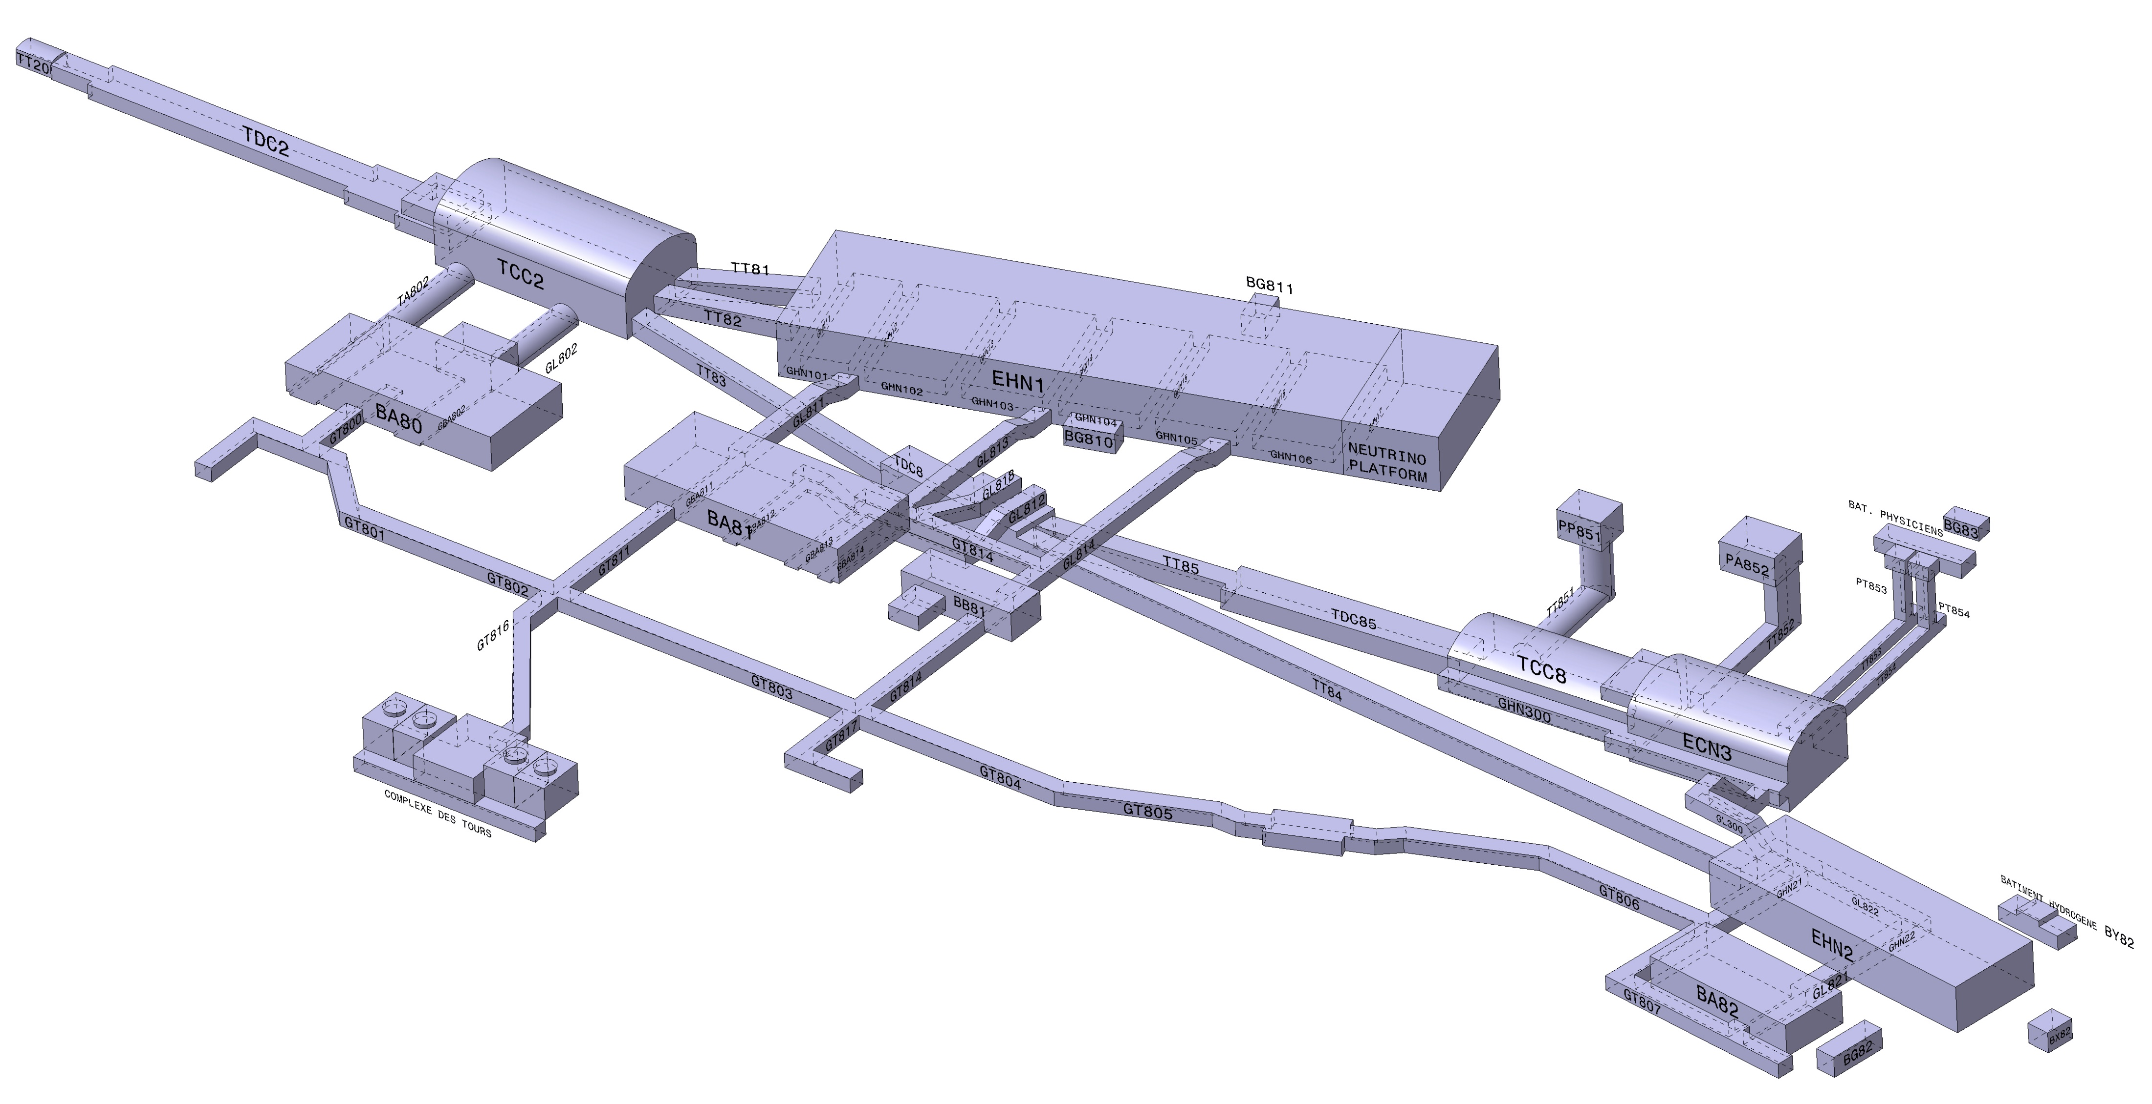
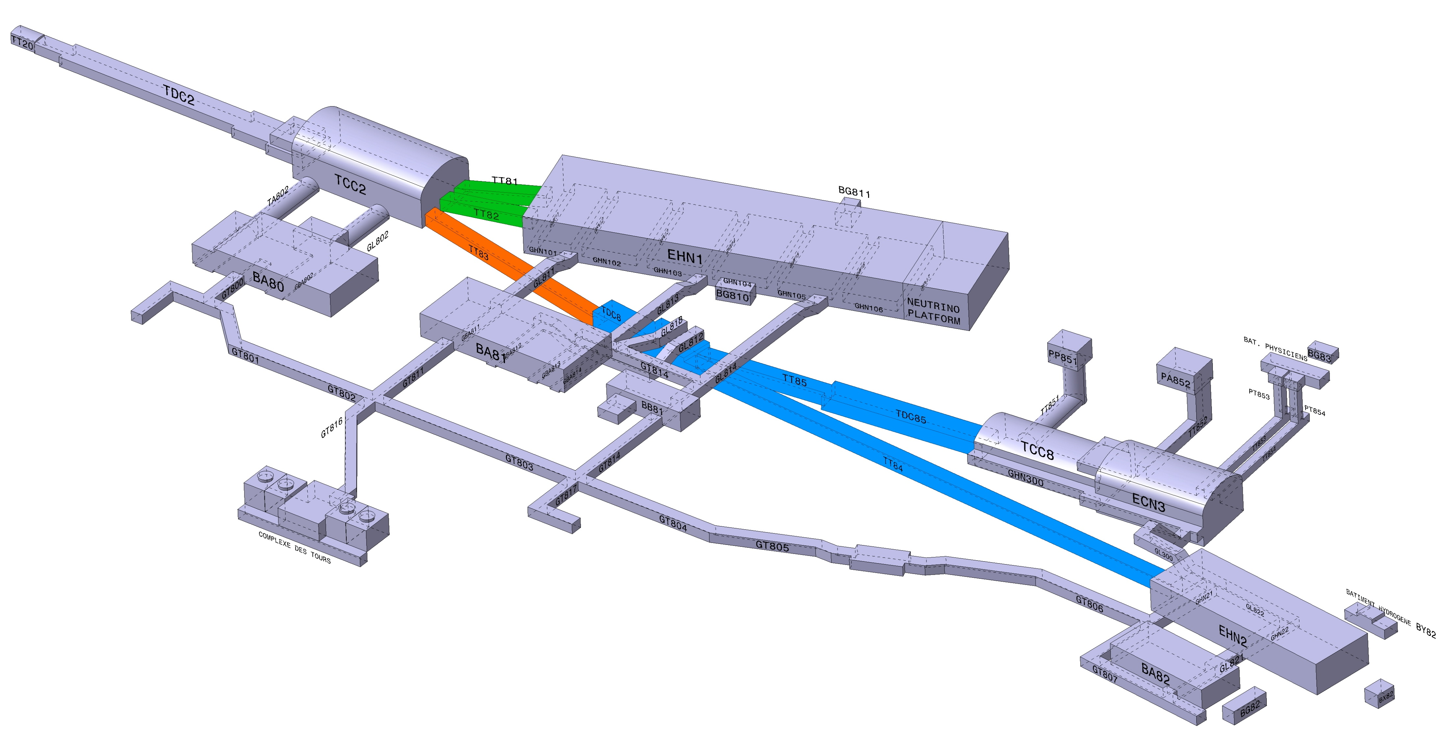
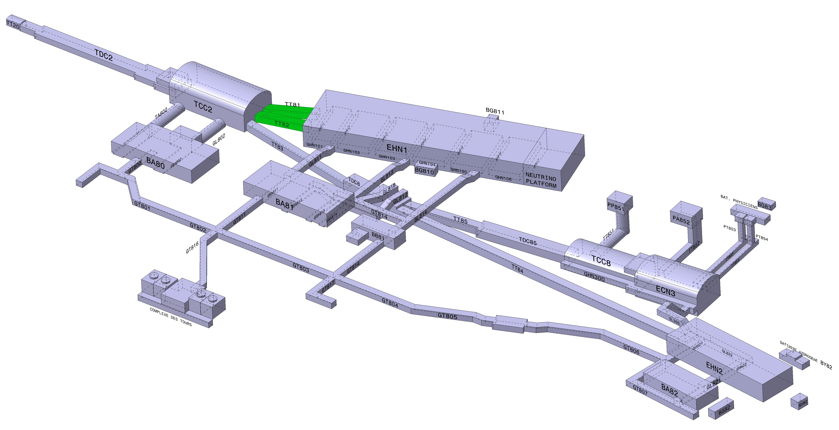
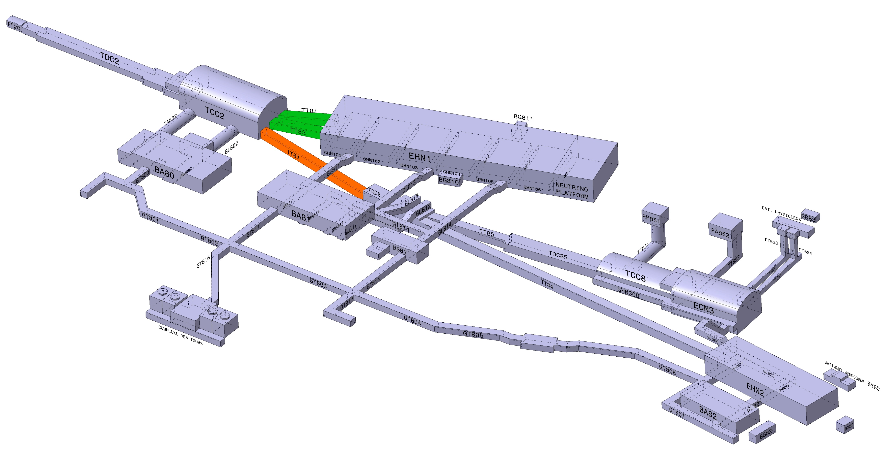
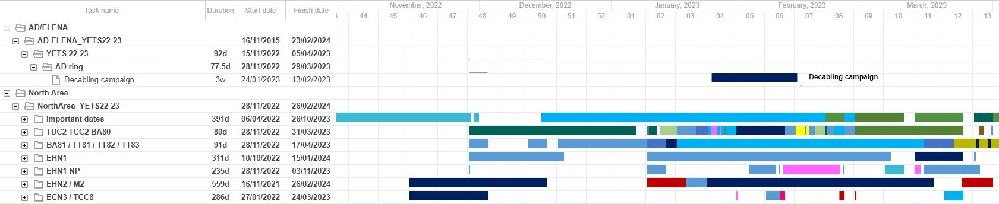
Possible intervention periods
TT81 and TT82:
-> From 29-11-2022
-> To 21-01-2023
-> Restart 5-01-2023
-> To 27-02-2022
TT83:
-> Start 5-01-2023
-> To 27-02-2023
TT84 ; TT85 ; TDC8 and TDC85:
-> Start 5-01-2023
-> To 13-03-2023
Supervision for decabling campaign AD
Closure CERN

Slide 5


Thanks you for your attention

