Slide 1




North Area Consolidation
Decabling Working Group
Meeting #14
9th of November2022
Michael JECKEL
on behalf of NA-CONS
BEAMS
DEPARTMENT

Slide 2
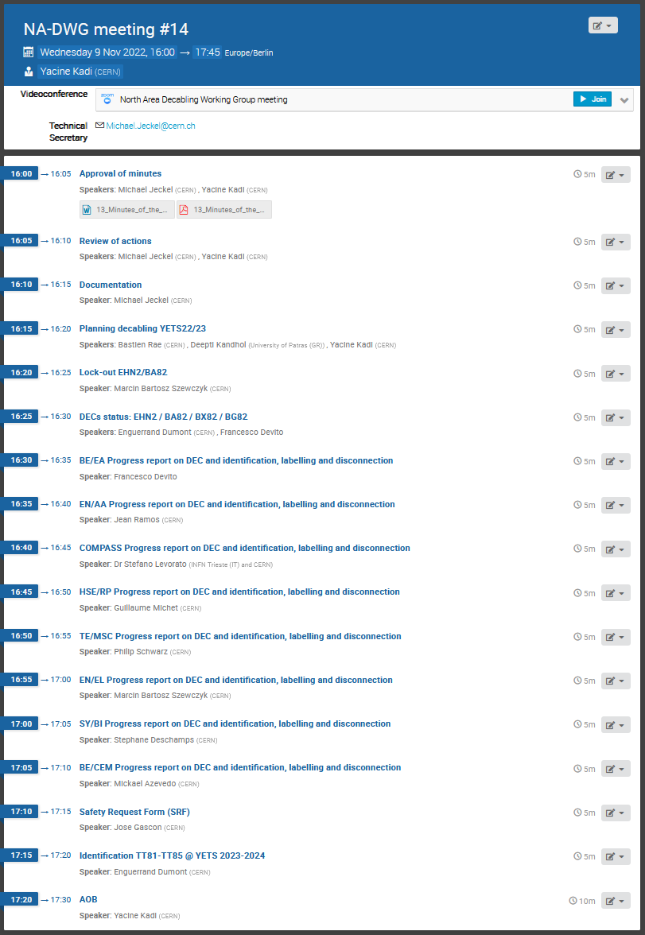
Agenda:

Slide 3
Approval of minutes

Slide 4
Review of actions
Action | Description | Responsible | Status
1 | ECR to remove SPS INTERCOM & PAGE 1 TV systems in the NA | I. Kozsar | In progress
2 | Collect DECs from different groups | M. Jeckel | In progress
3 | Prepare list of systems together with corresponding electrical circuits that need to remain operational | S. Levorato | Done
4 | Prepare list of systems together with corresponding electrical circuits that need to remain operational | M. Szewczyk | Done
5 | Prepare list of systems together with corresponding electrical circuits that need to remain operational | T. Barbe | Done
6 | Prepare list of systems together with corresponding electrical circuits that need to remain operational | J. Ramos | Done
7 | Prepare list of systems together with corresponding electrical circuits that need to remain operational | F. Juban | Done
8 | Investigate on Liquid Krypton control cables from ECN3 | F. Duval | Done
9 | Investigate on SPS-EPO DATAPLEX | Y. Gaillard | Done
10 | Investigate on power needs for the gas system (BG82) | D. Jaillet | Done
11 | Prepare identification, labelling and disconnection procedure for obsolete cables in EHN2/BA82 during YETS22/23 | M. Jeckel | Done
12 | Prepare Safety Request Form (SRF) for decabling in EHN2/BA82 during YETS22/23 | M. Jeckel | In progress
13 | Prepare ECR for decabling in EHN2/BA82 during YETS22/23 | A. Charalambous | In progress
14 | Prepare Lockout procedure for EHN2/BA82 Decabling during YETS22/23 | M. Jeckel | In progress
15 | Prepare workplan for EHN2/BA82 Decabling during YETS22/23 | M. Jeckel | Done
16 | Check access conditions for decabling (if it’s necessary to use scaffolding to access cables at height) | M. Jeckel | Done
17 | Label all fire and gas detection cables to be removed until 1st December. | J. Ramos | In progress

Slide 5
Actions reminder
N. Broca Label all Gas Detection cables to be removed with a “privat” cable number NB01-NB49
P. Durand Label all Fire Detection cables to be removed with a “privat” cable number PD01-PD88
All Link Persons Prepare “proper” DEC latest by 1st of December including column M, X,AI & AJ
Ideally: M = AD: Evalué, à déposer X & AI: DOV: Trouvé- obsolete-deconnecté-violet
AJ: Cable length

Slide 6
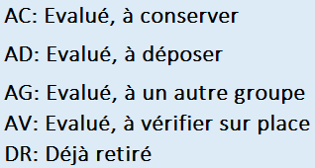
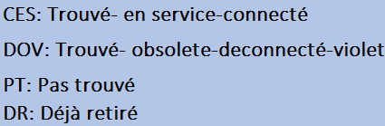
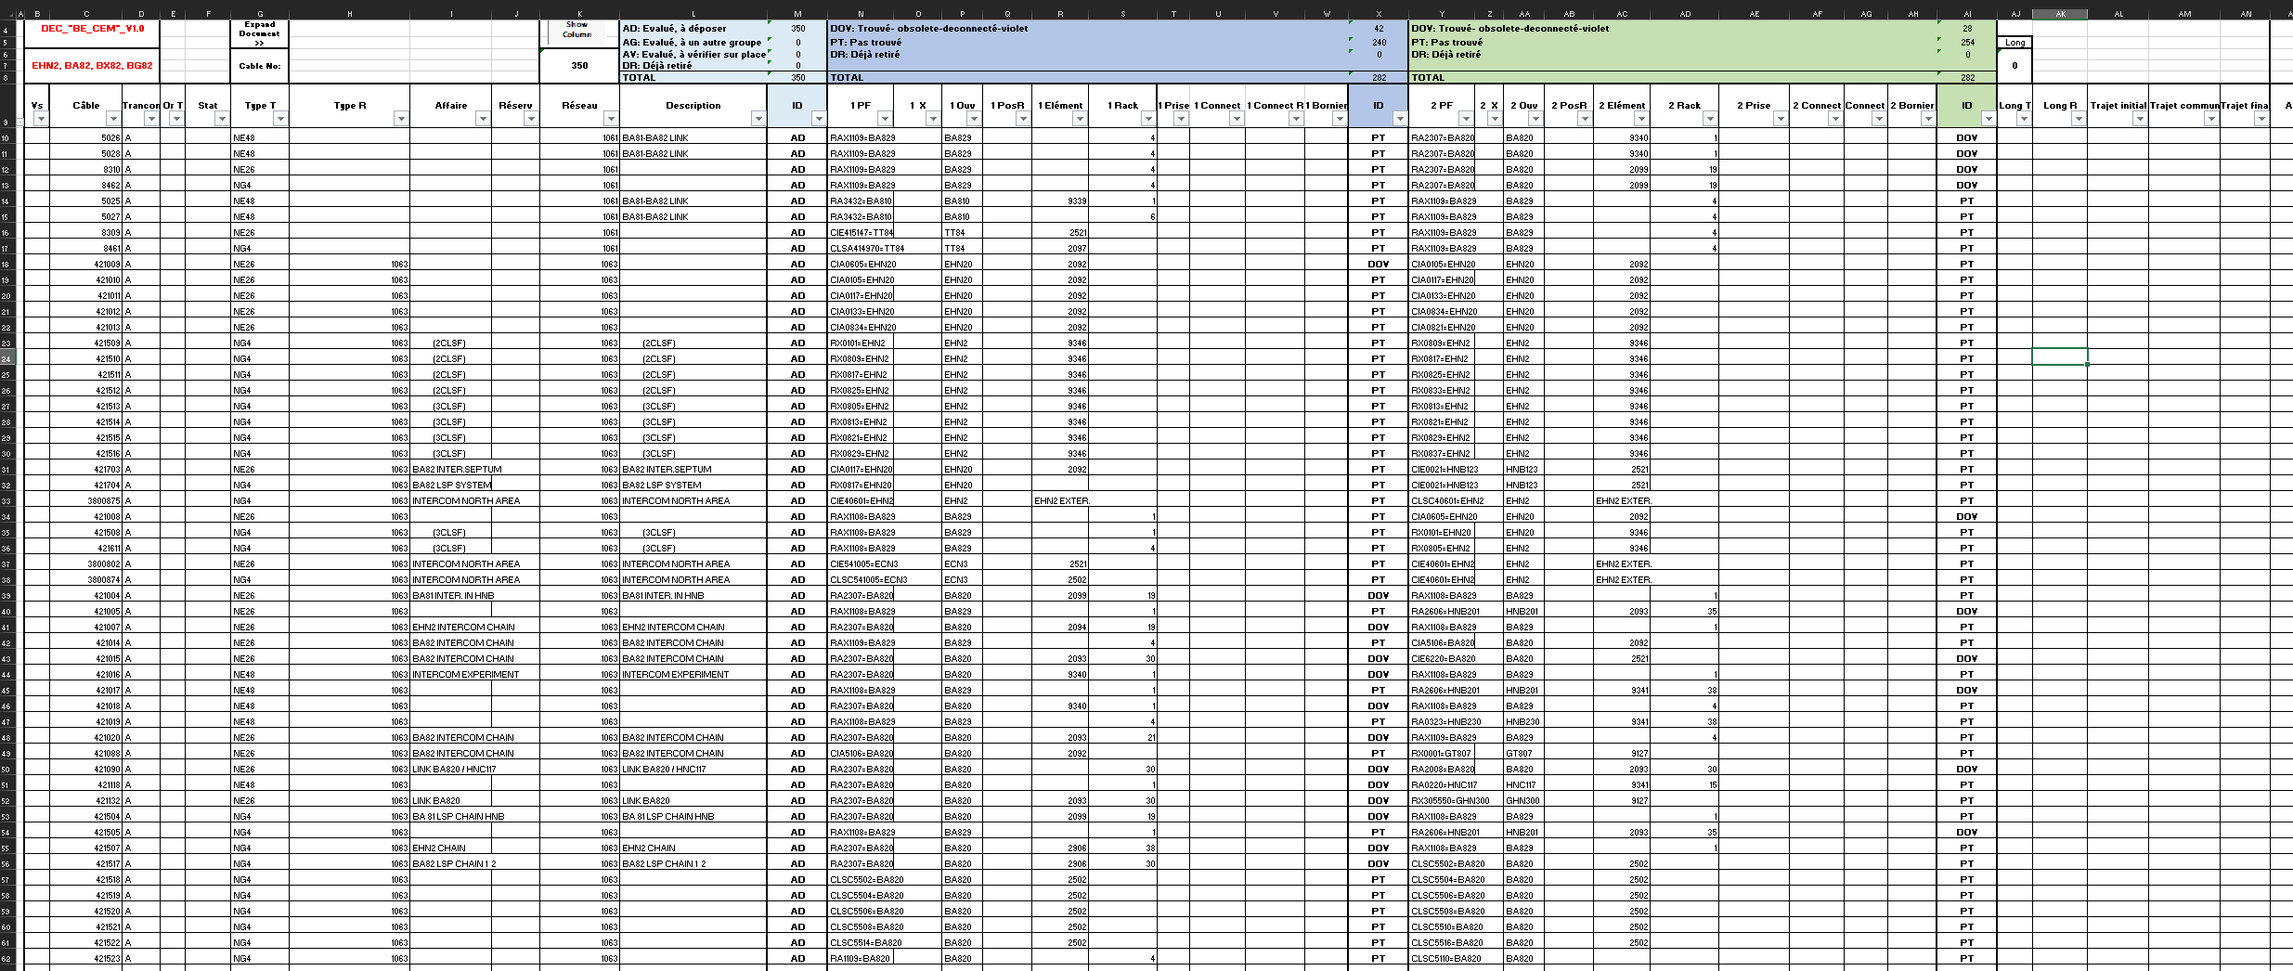
DEC Demande d’Enlèvement de Câbles
Cable
length
M
X
AI
AJ
DOV only when it is disconnected and labeled !

Slide 7
Summary
Deadline to provide „proper“ DEC is 1st of December 2022
N° | CC | Responsible | Group | System | Cables | Total [m] | DEC
1 |  | Mickael Azevedo | BE/CEM | Intercom | 350 | 30.916 | Not ready
2 |  | Guillaume Michet | HSE/RP | ARCON | 81 | 9. 036 | Not ready
3 |  | Nicolas Broca | EN/AA | Gas Detection | 64 | 6.400 | Not ready
4 |  | Pierre Durand | EN/AA | Fire Detection | 96 | 9.600 | Not ready
5 |  | Jean Ramos | EN/AA | Alarm | 12 | 269 | Not ready
6 |  | Didier Vaxelaire | EN/AA | Access | 23 | 7.879 | Not ready
7 |  | Yves Gaillard | SY/EPC | Power Converters | 206 | 28.716 | EDMS
8 |  | Philip Schwarz | TE/MSC | Magnets | 68 | 4.754 | Not ready
9 |  | Marcin Szewczyk | EN/EL | Eletrical | 34 | 2.147 | Not ready
10 |  | Stephane Deschamps | SY/BI | Beam Instrumen. | 169 | 21.596 | Not ready
11 |  | Francesco Devito & Enguerrand Dumont | BE/EA | Beam Instrumen. | 570 | 31.452 | Not ready
12 | NA | Stefano Levorato | EP/SME | COMPASS | 95 | 11.740 | Not ready
13 | NA | Francesco Devito & Enguerrand Dumont | EN/EA | ORPHAN CABLES | 23 | 2.046 | Not ready
14 |  | Frederic Juban | EN/CV | Cooling Ventilation | 4 | 400 | Not ready
 |  |  |  | Total | 1.795 | 166. 951
Ideally: DOV disconnected and labeled in column X & AI in the DEC

Slide 8
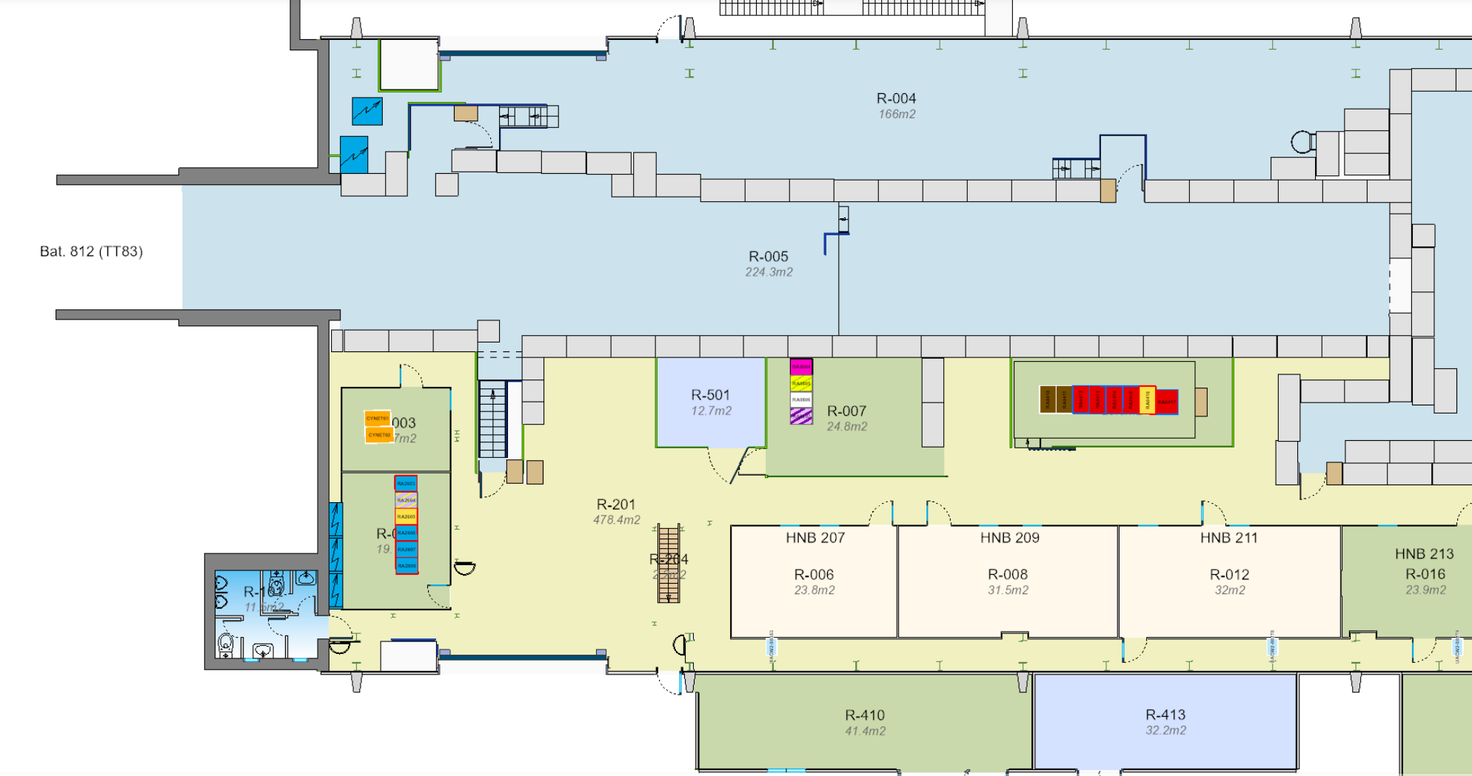
Access condition: scaffolding & cherry picker

Slide 9

Documentation for EHN2
NACONS - PROCEDURE IDENTIFICATION, ETIQUETAGE ET DECONNEXION DES CABLES OBSOLETES Deadline 2022-11-16 EDMS: 2788834
ECR De-cabling Campaign EHN2 YETS 2022/23 Ready EDMS: 2775911
Lock out procedure for EHN2 decabling Ready EDMS: 2790872
Safety Request Form (SRF) - Decabling activity in EHN2 In progress EDMS: xxxxx
DECs on EDMS for approval by Group Leader
In progress EDMS: 2778127
SY-EPC Deadline 2022-11-16 EDMS: 2794715

Slide 10
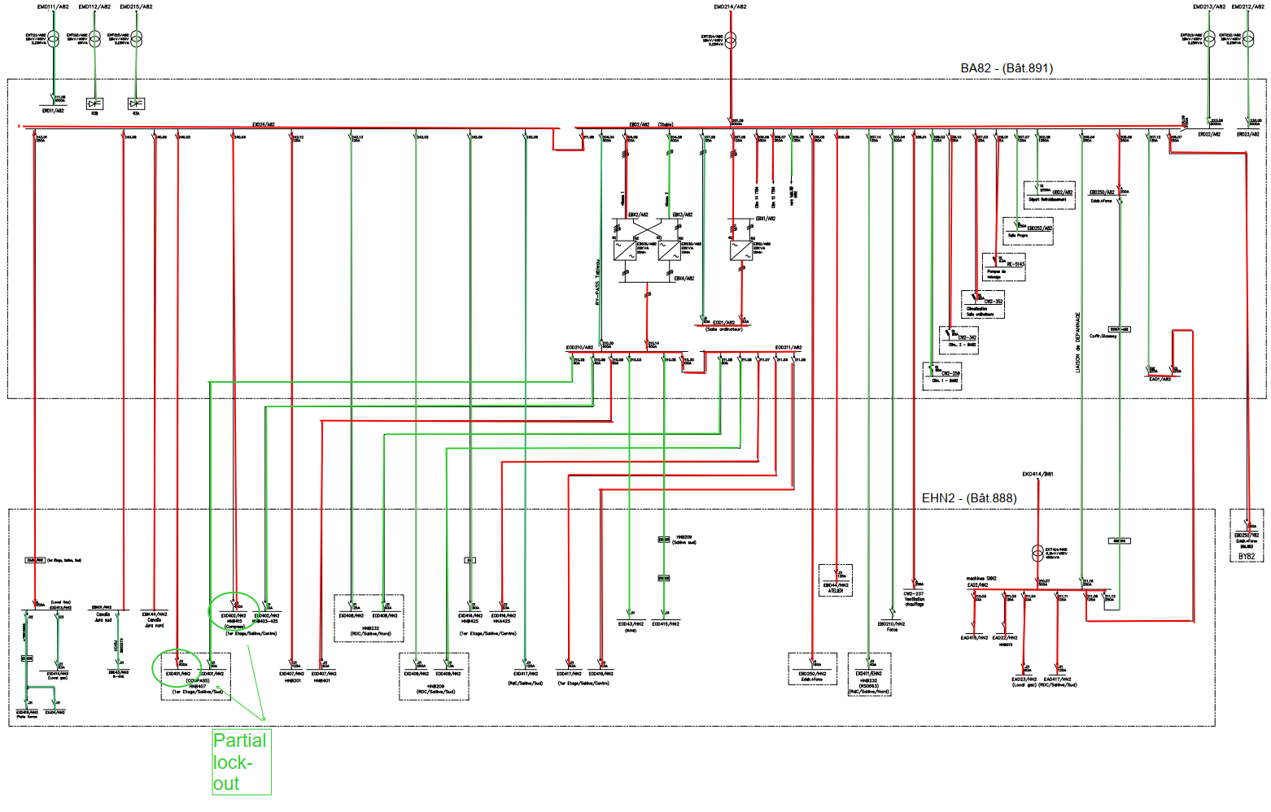
Lockout EHN2 & BA82
Marcin Szewczyk

Slide 11
Lockout EHN2 & BA82
Marcin Szewczyk

Slide 12
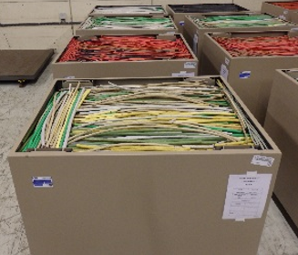
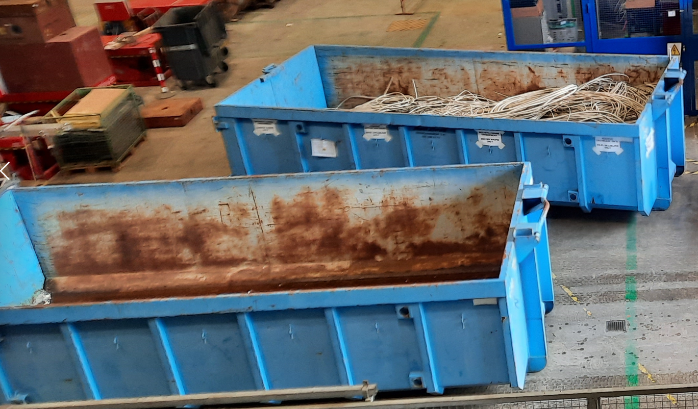
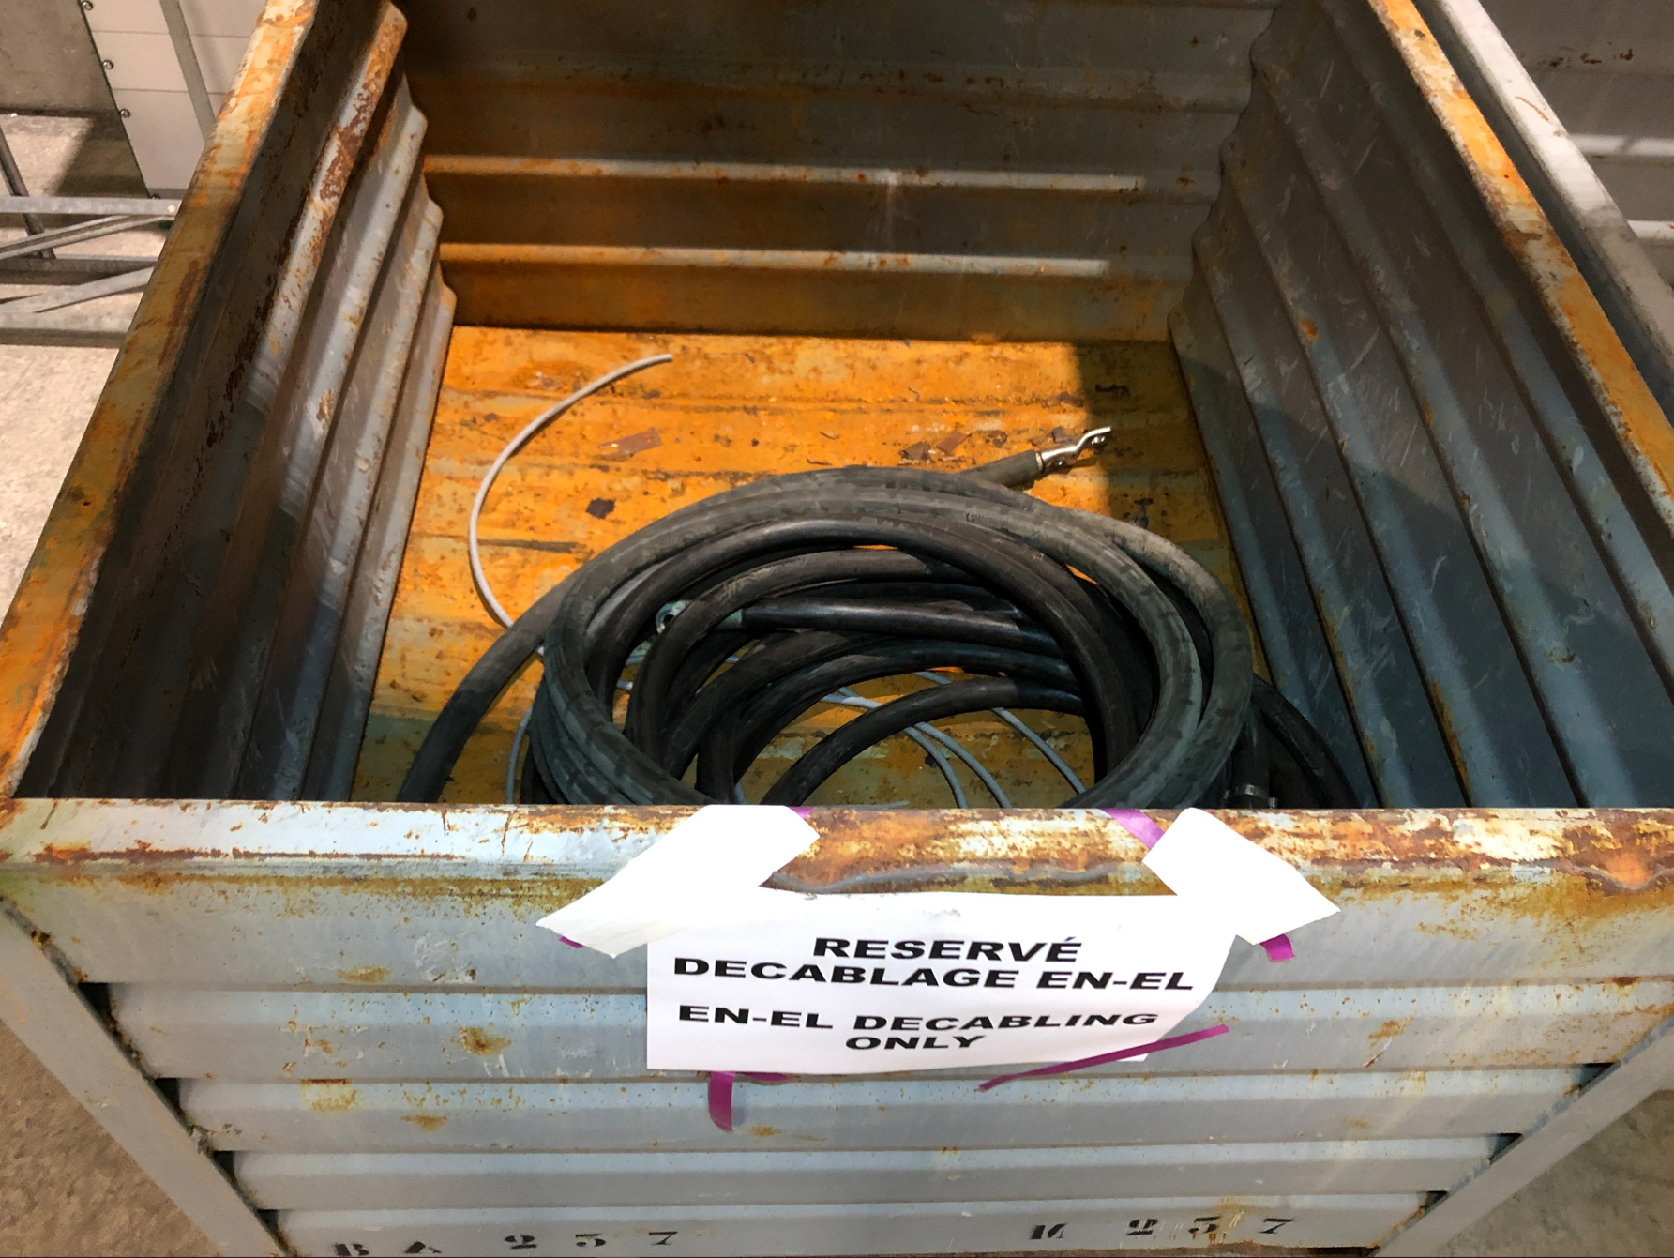
Skips & ANDRA containers

Slide 13

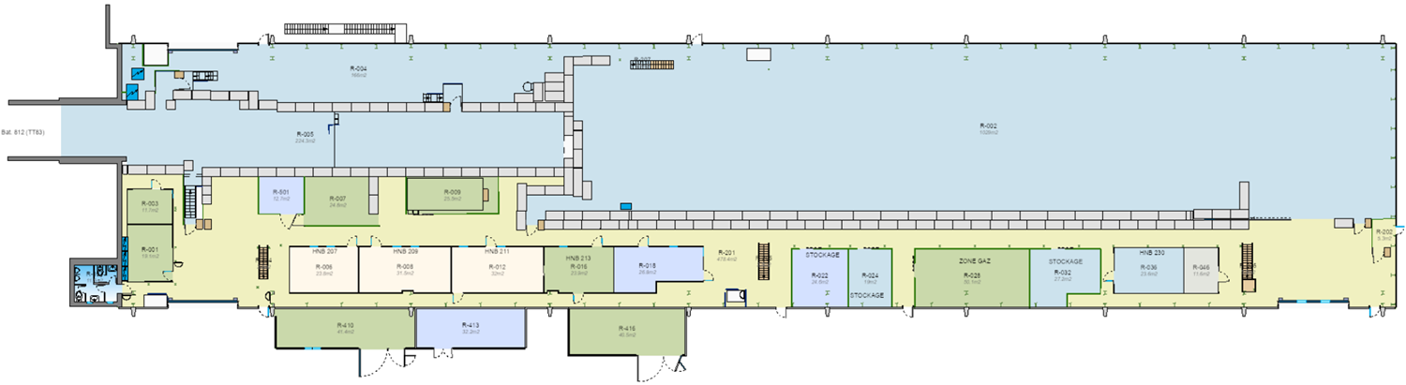
Skips & ANDRA containers
ANDRA containers
Skip 15 m³
Container 1m³

Slide 14
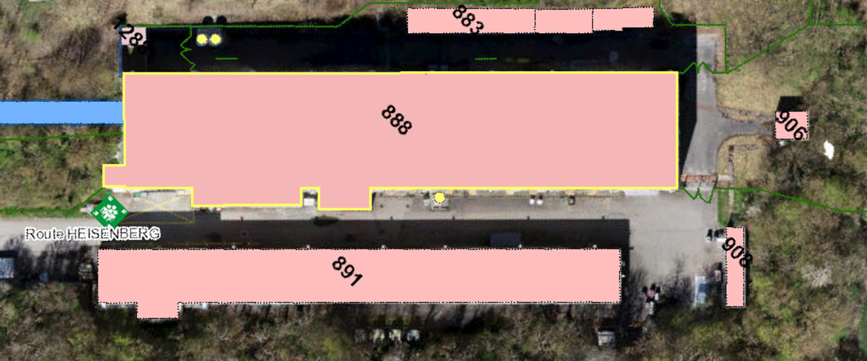
Skips & containers
Skip 7 m³
Container 1m³

Slide 15
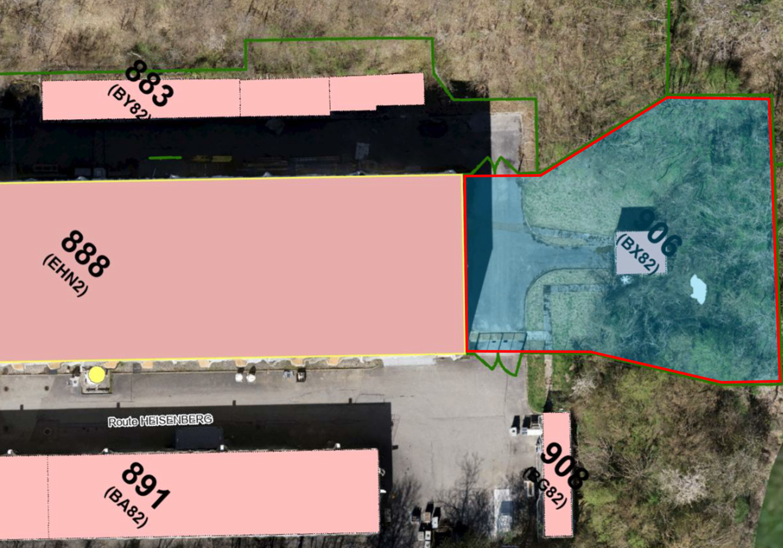
Downstream EHN2
Removed cables from the area downstream EHN2 are considered as conventional waste

Slide 16



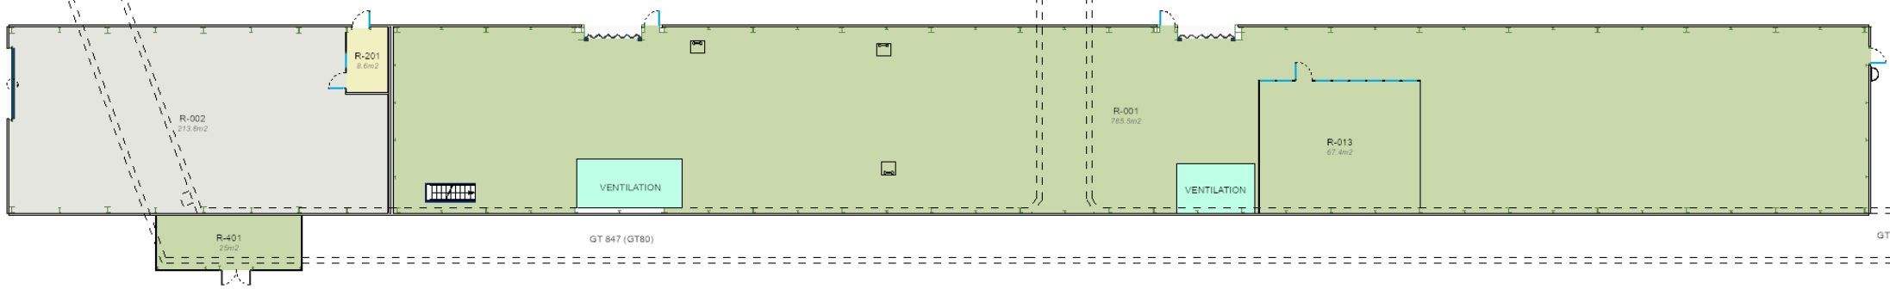
RP supervised area EHN2 & BA82
Removed cables from the supervised area in EHN2 & TT83 are considered as
non-conventional waste and must be collected in ANDRA containers
inside the supervised area
Supervised Area
Supervised Area
Supervised Area

Slide 17
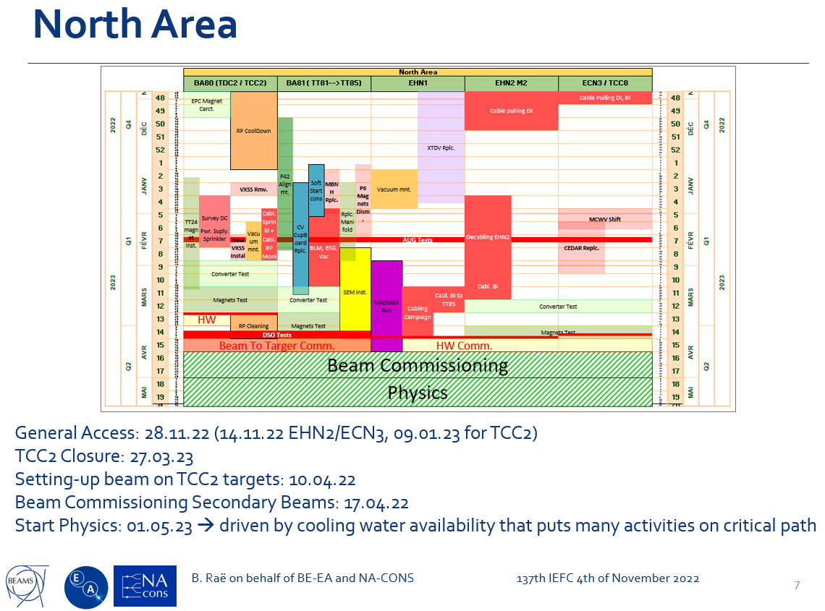
AUG Test 14.02.23 – 15.02.23

Slide 18
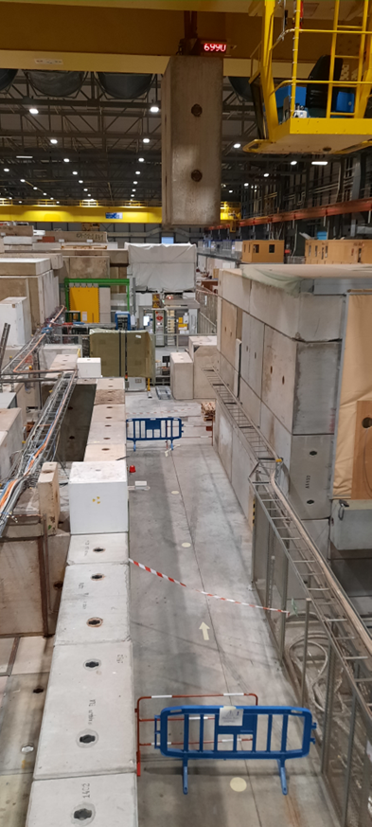
No crane in EHN2 & BA82
The crane in EHN2 & BA82 will be
NOT operational during the entire
decabling campaign
23.01.-07.03.2023

Slide 19
Next NA-DWG Meeting
Wednesday 30th of November 2022

Slide 20
Thank you for your attention !
Questions ?

