Slide 1
Latvia - CERN: state-of-play
Prof. Toms Torims, Representative of Latvia at CERN
Dr. Kārlis Dreimanis, CMS Latvia Team Leader, Director of RTU HEP@AT center
CERN Baltic Group General Meeting, 21.11.2022

Slide 2
Latvia is reliable and honest partner of CERN
Latvia – CERN Strategy

Slide 3
Latvia - CERN strategy
Government approved – consensus based - stakeholders and ministries
Overarching goals:
Meaningful and coordinated participation of Latvia at CERN in the Associate Member state status
To become Full Member state within 2-3 years
4

Slide 4
Meaningful and coordinated participation of Latvia at CERN
Tasks for associate membership
To benefit from the opportunities at CERN – in the best possible way and at all levels
To provide sustainable contribution in attaining the State priorities in education, science, economic development and R&D
To foster environment of the scientific excellence and industrial leadership
To concentrate available and to attract new human resources / to use strategically available financial instruments
Within the next years to achieve “well balanced country” status and to ensure 60/40 proportion for scientific HR / industrial return
4

Slide 5
Benefit from the opportunities at CERN
– in the best possible way and at all levels

Slide 6
Scientific/research portfolio
Based on the bottom-up initiatives / balance & diversity / strategic approach
CERN based experiments and collaborations
CMS as a HEP flagship project (RTU+LU)
MEDICIS (RTU+LU)
AEgIS (LU)
ISOLDE/LIEBE (LU)
Crystal Clear Collaboration (LU)
Development of new projects and technologies at CERN
Accelerator & Technology Sector /ATS-DO
Engineering and Technology Departments
FCC
EU funded projects CERN coordinated/associated
Riga Technical University (RTU)
I.FAST
HITRIplus
HERTIS
NIMMS
University of Latvia (UL)
PRISMAP
QuantHEP
+ Muon Collider Collaboration
4

Slide 7
Latvia @ CERN
Personal based long term @CERN: USER, COAS, PJAS, DOCT, FELL
- snapshot at 21/11/2022
CMS-Latvia HEP group
Users (rec. COLA) 100% at CERN
1. Senior researcher PhD in HEP – CMS Team leader
2. Senior researcher PhD in HEP – Top physics analysis group
3. PhD student – Technical Integration
4. PhD student – Higgs physics analysis group
Latvia Accelerator Technology group
PJAS and COAS 100% at CERN
5. Senior researcher – COAS / ATS-DO
6. Senior researcher – PJAS / ATS-DO
7. PhD Student AT – COAS / ATS-DO+CMS
8. PhD Student AT – DOCT /ATS-DO paid by NIMMS
AD-Antihydrogen Experiment
9. PhD Student Atomic physics - USER / AEgIS+CMS
CERN-Latvia doctoral programme
10. PhD Student AT – DOCT / ATS-DO+CMS
11. PhD Student MEDICIS – DOCT/SY-STI-RBS+CMS
12. PhD Student Top physics – DOCT / EP-CMG+CMS
CERN Doctoral Programme
13. PhD Student Top physics – DOCT / EP-CMD+CMS – only DOCT paid by CERN
14. PhD Student AT – DOCT / ATS-DO so far paid by Latvia
With no link to Latvia scientific community
15. CERN Fellow - FELL / EP-DT-EO - only FELL paid by CERN
+ numerous short (2-3 months) term stays @CERN paid from the Latvian budget
4

Slide 8
To continue capacity and competency building in HEP and AT
To maintain strong CERN related scientific institute with multidisciplinary research team and presence at CERN

Slide 9
Institute of Particle Physics and Accelerator Technologies
@Riga Technical University Faculty of Materials Science and Applied Chemistry
100% CERN related research
Elected academic staff - vision
1. Prof. Yuri Dokshitzer - HEP
2. Asoc.prof. Kārlis Dreimanis – HEP
3. Dr. Markus Seidel – HEP lecturer, PhD supervisor
4. Prof. Toms Torims - AT
5. Asoc.prof. Andris Ratkus - AT
Research staff
Elected HEP and AT Senior researchers / researchers / scientific assistants - 12 in total
+ admin staff.
Leading and running CMS-Latvia HEP group
Executing State Research Programme in HEP and AT
Running Doctoral Programme (jointly with University of Latvia) in HEP and AT
Institutional partner of CMS, FCC, Muon Collider
Collaborator and contributor to I.FAST, HITRIplus and NIMMS projects
Leader of HERTIS project
Leader of CMS Tier2 center project
Representing RTU in CERN Baltic Group
+ Supervisory role of HEP and AT students at CERN
4

Slide 10
Dedicated doctoral programme
In collaboration with CERN Baltic Group – designed by CBG Study Programme Working Group
Students in programme: 3rd year – 1; 2nd year 6; 1st year 5
Students are co-supervised by CERN staff
Strong presence of international students
Executed in Latvia with mandatory term at CERN
World class lecturers: Latvia, CBG, CERN, PSI
Balance between HEP and AT
International Study Program Council
Relevant master programme is being developed
4

Slide 11
CERN research in Latvia
Other institutes carrying out CERN related research and projects
University of Latvia
Institute of Chemical Physics – Prof. Elina Pajuste group - CMS and MEDICIS
Faculty of Physics, Mathematics and Optometry - Prof. Mārcis Auziņš group – AEgIS
Faculty of Medicine – Prof. Maija Radziņa group – MEDICIS/PRISMAP
Institute of the Solid State Physics – Dr. Anatoli Popov group- Crystal Clear Collaboration
Institute of Physics – Dr. Kalvis Kravalis group – ISOLDE / LIEBE
Quantum Computing group of Prof. Andris Ambainis - QuantHEP
Riga Technical University
Department of artificial intelligence and systems engineering - Prof. Agris Ņikitenko group – I.FAST + Mechatronics, Robotics and Operations section at CERN
Institute of technical Physics – Prof. Arturs Medvids group – I.FAST
Institute of Industrial Electronics and Electrical Engineering – Prof. Pēteris Apse-Apsītis group - ARIES
Students of Institute of Mechanics and Mechanical Engineering - I.FAST and HITRIplus
High Performance Computing (HPC) Centre – Tier2 project at CMS
4

Slide 12









State Research Programme
Strengthening the development of the Latvian scientific community in the field of high-energy physics and accelerator technology in cooperation with the CERN
Develop world-class
knowledge
Develop human capital
& technologies
Programme call (2020-2022)
to be finalized 31.10.2022
Project leader:
900 000 EUR
Create products & services
Project partners:
Involve scientific & academic staff, students, PhD applicants & young scientists
Programme call (2022-2026)
to begin implementation
Autumn 2022
Eligible participants of the open call:
Research organizations, public organizations. Several partners must be involved
Ensure the programme’s continuity
1 500 000 EUR
Foster research capacity

Slide 13
Outreach activities in Latvia
Integral part of the Latvia – CERN strategy / boosting interest in STEM
Latvian National Library
- permanent CERN exposition and classroom for children and general public – CERN as a centre of excellence for technology and innovation
Latvian Physics Teachers Association
Participation in events, lectures of Latvian scientists @CERN and CERN staff / selection of teachers for the CERN visits
School of the Young Physicists of Latvia
Virtual and in-person lectures + events
Job shadowing at CERN
- Every year 4-5 school children come to CERN to shadow Latvian scientists and engineers with preparatory and post-events in Latvia
+ many other events and activities
4

Slide 14
Latvia - CERN Stakeholders Group
Encompassing all relevant stakeholders - platform for engagement and exchange
https://indico.cern.ch/category/11669/
10 regular meetings since Nov 2019
Organised by CERN National Contact point
All relevant research institutions, business entities and associations, related ministries and agencies, CERN Council Delegates and ILO
Informing the stakeholders about the relevant CERN-based and CERN-related activities
Directly supporting the stakeholders’ engagement with CERN
Managing the information exchange and collaboration vis-à-vis CERN and the stakeholders
4

Slide 15
Geneva/CERN based ILO
To ensure meaningful Latvian business participation @CERN
CERN as priority
- ILO KPI’s are directly based on industry engagement
Knowledge Transfer
Technological and knowledge return to Latvia by engaging R&D capable companies
Well-balanced industrial return
To ensure fulfilment of the current ‘quota’ ∼ 400 000 CHF
To prepare industrial portfolio for the full-membership @CERN
To closely collaborate with Latvian scientific and engineering community at CERN
4

Slide 16
Latvia – CERN Strategy
Full membership at CERN

Slide 17
Full membership at CERN
Tasks - liaison with decisionmakers and stakeholders
To ensure support of the CERN Management and Member states
To actively participate in the work of the CERN Council and its committees – inter alia to cultivate positive attitude towards Latvia's full membership
To coordinate Latvia's position at Council meetings and its committees
To facilitate coordination among the Baltic States: at CERN Baltic Group and Baltic Assembly level – to foster joint position vis-à-vis CERN
To ensure continuous support from the Government, Parliament, scientific community, entrepreneurs, other partners and society at large
4

Slide 18
Full membership at CERN
Tasks – scientific and technical measures
To ensure stable financial framework for CERN activities in Latvia – ensuring 50/50 principle – where proportion of the national funding is gradually exceeding CERN membership
To continue capacity and competency building in HEP and AT: to maintain strong CERN related scientific institute with interdisciplinary research team and presence at CERN; to run master level programme in HEP and AT
To facilitate industrial return and engagement with CERN; including ILO organised dedicated events in Latvia
To cultivate positive image of Latvia – CERN cooperation #LatvijaCERN
4

Slide 19
Proposed timeline for full membership
2023 1st half
2023 1st half
2023 2nd half
2024
2025
March Council
Government letter of intent to become associate member in pre-stage to the full membership - to the President of CERN Council and DG
June Council
Favourable CERN Council decision and invitation to apply for the associate membership in pre-stage to full membership
- subsequently
application is submitted
Sept Council
CERN Council Decision to form the Task Force
Task Force visit to Latvia
December Council
CERN Task Force report is evaluated and DG is mandated to negotiate agreement
Agreement negotiations
Cabinet of Ministers decision
Signature of pre-stage Agreement
Ratification procedure
prospective time when Latvia becomes associate member in pre-stage to the full membership at CERN
3

Slide 20
To ensure stable financial framework for CERN activities in Latvia

Slide 21
Membership payments
Currency | 2023 | 2024 | 2025 | 2026 | 2027
 | Associate Member | Associate member in pre-stage to full membership | Associate member in pre-stage to full membership | Full member | Full member
CHF | 1 024 850 | 1 281 250 | 1 793 750 | 2 494 000 | 2 494 000
EUR | 1 019 553 | 1 274 588 | 1 784 423 | 2 481 032 | 2 481 032
4

Slide 22
CERN experiments and programmes
Activity | 2023 | 2024 | 2025 | 2026 | 2027
CMS* | 222 084 | 350 000 | 360 000 | 450 000 | 450 000
MEDICIS | 40 000 | 50 000 | 80 000 | 100 000 | 100 000
Teacher programme | 12 000 | 12 000 | 12 000 | 12 000 | 12 000
Student programmes | 6 000 | 6 000 | 9 000 | 9 000 | 9 000
Total EUR | 280 084 | 418 000 | 461 000 | 571 000 | 571 000
* 3->4 authors; 2->3 students at CERN; 3->4 senor scientists
+ Phase II upgrade
4

Slide 23
CERN National Contact Point
@ Science Council of Latvia
Activity | 2023 | 2024 | 2025 | 2026 | 2027
Staff and admin costs | 88 435 | 88 800 | 112 800 | 112 800 | 50 400
Communication & PR | 8 000 | 8 000 | 8 000 | 8 000 | 8 000
Outreach – visits to CERN | 20 000 | 20 000 | 20 000 | 20 000 | 20 000
Network events with CERN | 5 000 | 5 000 | 5 000 | 5 000 | 5 000
Total EUR | 128 935 | 139 300 | 163 300 | 163 300 | 100 900
+ 99 000 EUR/per annum to cover living costs Latvia’s Representative at CERN
4

Slide 24
National CERN activities
 | 2023 | 2024 | 2025 | 2026 | 2027
State Research Prog. in HEP and AT | 300 000 | 700 000 | 1 000 000 | 1 000 000 | 1 200 000
Tier 2 Center | 260 000 | 100 000 | 100 000 | 100 000 | 100 000
Total EUR | 560 000 | 800 000 | 1 100 000 | 1 100 000 | 1 300 000
4

Slide 25
Proposed Latvia - CERN budget until 2027
Ensuring 50/50 principle – where proportion of the national funding is gradually exceeding CERN membership

Slide 26
Participation in Accelerator Projects
By Latvia Accelerator Technology Group at CERN
Leader Dr. Andris Ratkus

Slide 27
Research directions
Innovation and development of accelerator technologies
Accelerator medical applications
Accelerator environmental applications

Slide 28
Accelerator Technology Group in Latvia and at CERN

Slide 29
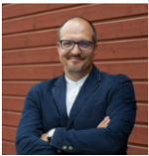
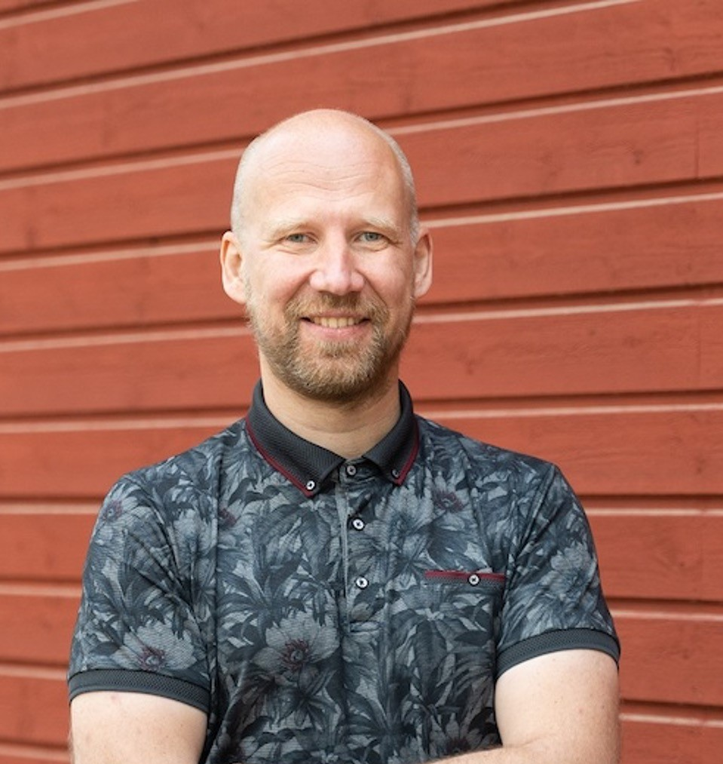
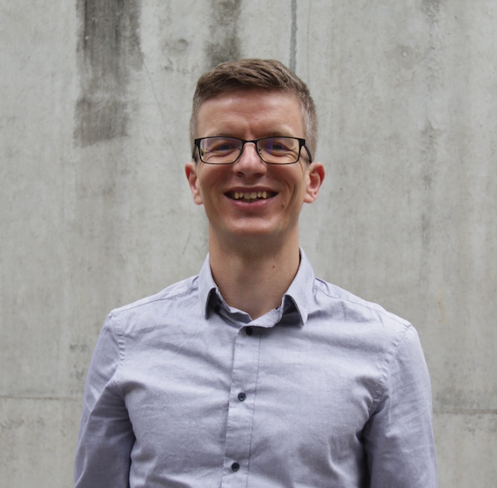
Accelerator Technology Team
Before Latvia's Associate Member State at CERN
  Toms Torims
  Guntis Pikurs PhD student
  Andris Ratkus

Slide 30
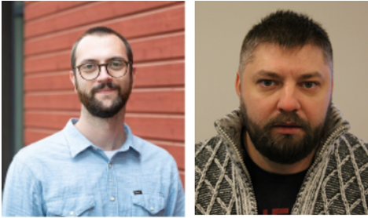
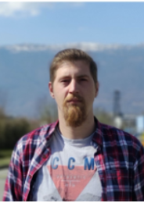
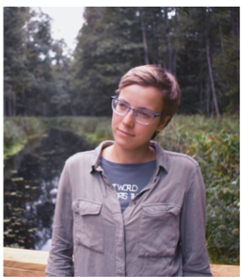
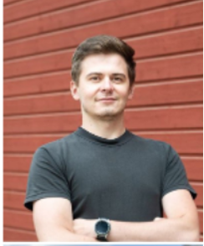
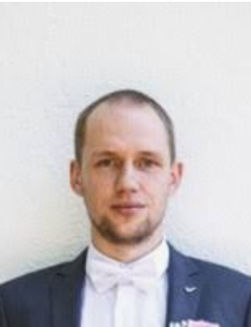
Accelerator Technology Team
After Latvia's Associate Member State status
  Jānis Vilcāns PhD student
  Luca Piacentini PhD student*
  Lazar Nikitovics PhD student*
  Dagnija Kroģere MSc student
  Kristaps Paļskis PhD student*
  Viesturs Lācis MSc student 2022 CERN summer school student
2021 Oct – Dec
2022 Feb – Mar
* Particle Physics and Accelerator Technologies study programme

Slide 31
Accelerator projects and Student thesis

Slide 32

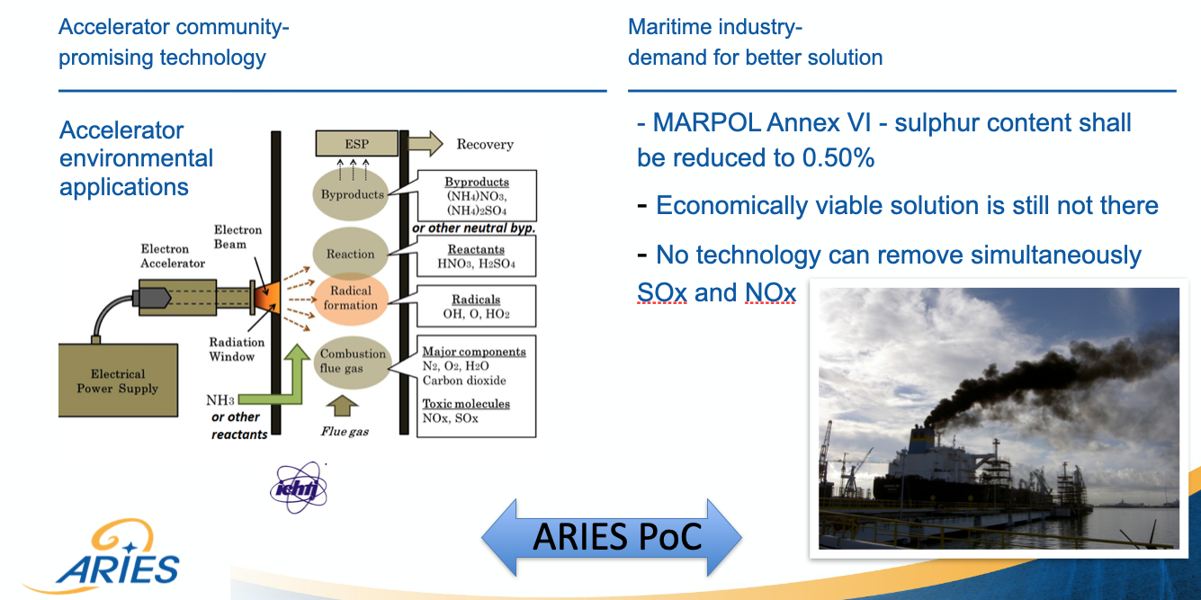
Accelerator research and Innovation for European Science and Society
Development of hybrid electron accelerator system for the treatment of marine diesel exhaust gases
(Finished)
Courtesey of T.Torims

Slide 33

Innovation Fostering in Accelerator Science and Technology
WP1: Management, coordination and dissemination
  Task 1.2: Information Flow Management and Cross-coordination (Task Leader RTU)
WP10: Advanced Accelerator Technologies (Coordinator RTU)
  Task 10.1: Coordination and Communication (Task Leader RTU)
  Task 10.2: Additive Manufacturing - Survey of applications and potential developments
  Task 10.3: Refurbishment of accelerator components by AM technologies (Task Leader RTU)
WP12: Societal Applications
  Task 12.1 sub task 3: Environmental applications of electron beam

Slide 34
Student thesis
Guntis Pikurs PhD thesis:
Research on performance improvement of accelerator and detector components by additive manufacturing
Dagnija Krogere MSc thesis (Defended) :
Research of additive manufacturing applications and strategies for repairing particle accelerator components
Viesturs Lācis MSc thesis:
Laser Polishing of Additively Manufactured RFQ Prototype

Slide 35
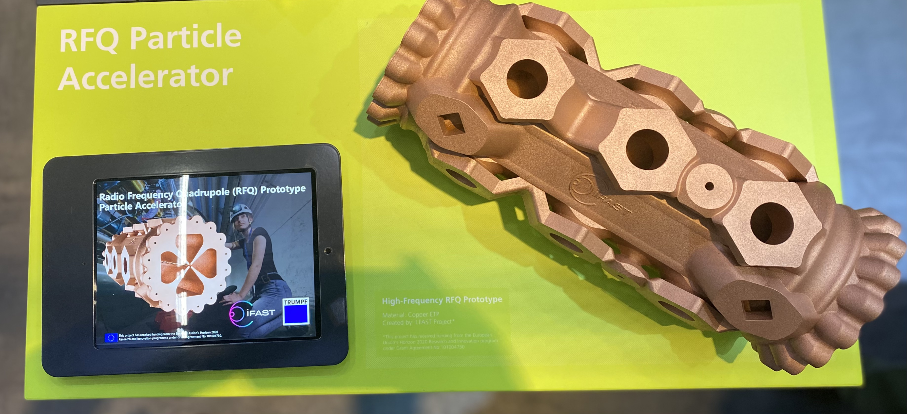
Formnext Frankfurt 2022

Slide 36


Hybrid Exhaust-gas-cleaning and Accelerator Technology for International Shipping
Based on promising results of the ARIES PoC
HERTIS Collaboration was established between multiple partners
objectives:
To foster multidisciplinary cooperation between Accelerator and Maritime Communities
To develop and maintain joint Strategy
To prepare and submit the Projects on behalf of the Collaboration.

Slide 37
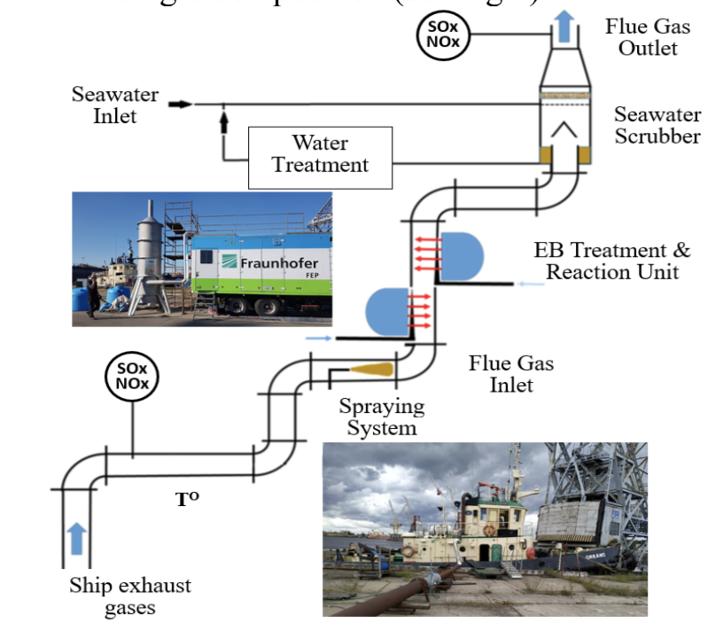
Student thesis
Ekaterina Tskhay MSc thesis (Defended):
Qualitative and quantitative analysis of the hybrid electron accelerator exhaust gas abatement technology impact to the selected maritime logistics aspects
Source: Aries Proof of concept

Slide 38
Heavy Ion Therapy Research Integration
WP 7: Advanced accelerator and gantry design
  Task 7.4: Injector Linac Design
  Task 7.5: Integration of an innovative superconducting gantry: optics, mechanics, beam delivery

Slide 39
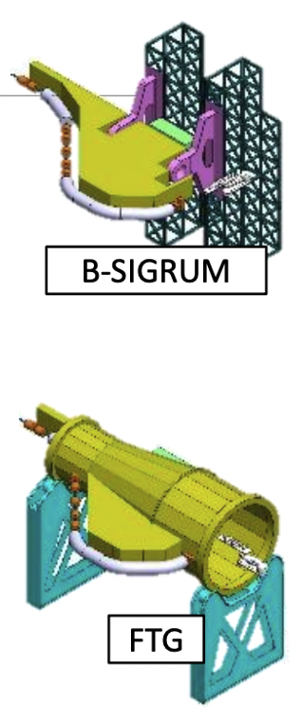
PhD Student thesis
Lazar Nikitovics thesis:
Design study of a high-frequency linear accelerator for the purposes of injection into a therapy synchrotron and parallel production radioisotopes
Janis Vilcans thesis:
Development of the rotational (mobile) cryostat system for the superconducting magnets in the hadron therapy installations
Luca Piacentini thesis:
Mechanical integration of systems, instruments and components of a carbon ion rotating gantry for medical treatments

Slide 40

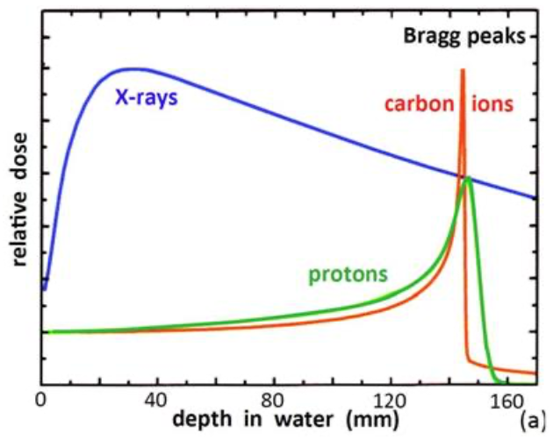
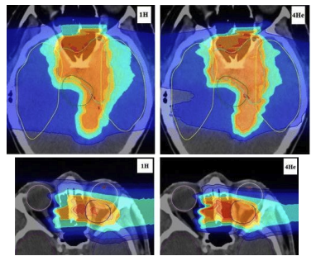
Next Ion Medical Machine Study
Developing new technologies for the future generation of accelerators for cancer therapy
Courtesy: M. Vretenar and K. Palskis

Slide 41
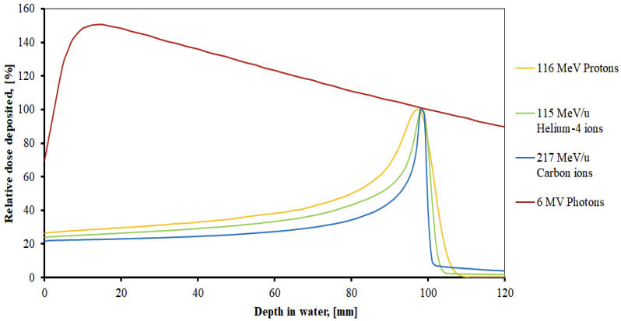
Student thesis
Kristaps Palskis PhD thesis:
Studies of different ion types and their use for radiation therapy, FLASH therapy aspects. Optimization of ion beam parameters for very high dose rate (FLASH) radiotherapy
Courtesy: K. Palskis

Slide 42
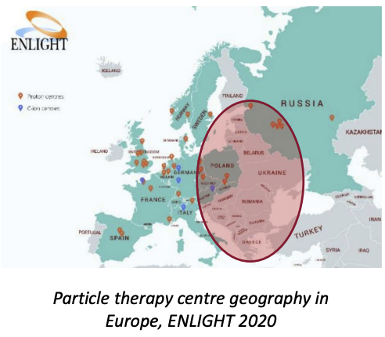
Accelerator medical applications
Courtesy: K. Palskis

Slide 51
Take away message
Latvia is reliable and honest partner of CERN
CERN – Latvia collaboration is yielding many mutual benefits
Latvia is ready to take the next step – to become full member of CERN
4

Slide 52
Thank you!
Research Latvia

