Slide 1


FCC-ee Pilot Sector and its
Technological Innovations
Sam Rorison
TE-VSC-DLM

Slide 2
Outline
1 – FCC-ee Introduction
2 – Vacuum Chamber Design, Mechanical
3 – Cold-Spray Utility
4 – Cold-Spray Validation
5 – Vacuum Chamber Bake-out
6 – Vacuum Chamber Design, Thermal
7 – Friction Stir Welding (FSW)
8 – Synchrotron Radiation Absorber (SRA)
8 – Interconnection Design (1)
9 – Interconnection Design (2)

Slide 3
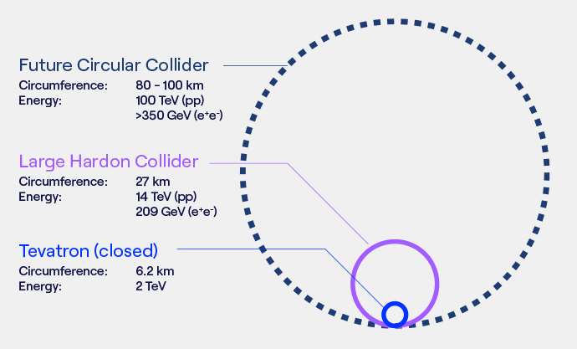
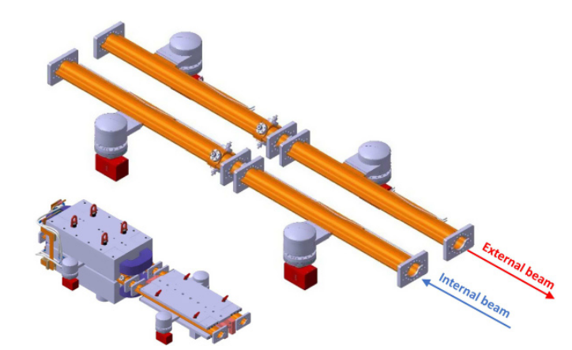
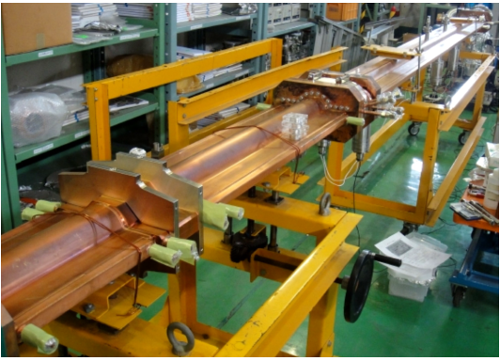
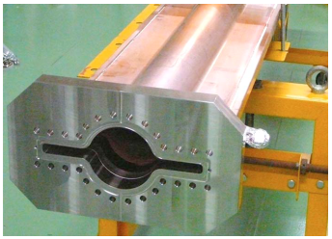
1 – FCC-ee Introduction
Undertaking mechanical design and research of innovative technologies for FCC-ee Interconnections and vacuum chambers in an Ultra High Vacuum (UHV) environment.
Concepts are being adapted from SuperKEKB, particularly for material choices and vacuum chamber design with a (as near as possible) continuous cross-sectional geometry.
SuperKEKB offers many similarities in design. However…the scale of FCC means an innovative approach to design philosophy is needed to maintain budget
FCC-ee arc vacuum schematic
Interconnections presents challenges in its design:
- Thermal expansion of chambers
- Thermal management of components
- Mechanical misalignment and stability
- Contributions to beam stability
Requirement to construct a mock-up cell as part of the current 5 year feasibility study (2021 – 2026).

Slide 4
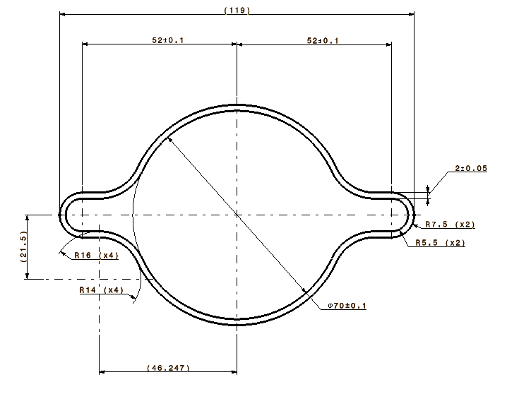
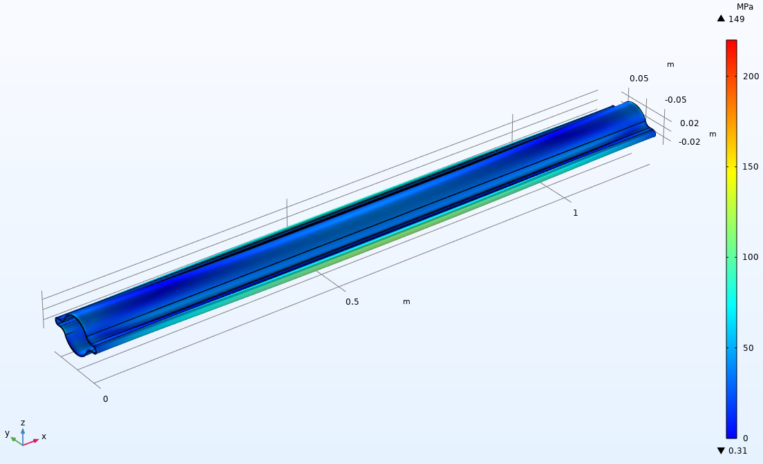
2 – Vacuum Chamber Design, Mechanical
Key-point: FCC-ee machines are high-luminosity and low-emittance colliders: Sensitive to beam degradations with regards to beam impedance (Resistive wall, internal geometries).
Cold-Extrusion to produce the chambers for prototypes.
Up-to 12m long sections
Project approach: Ease of manufacturing, cost-effectiveness and scalability (~182km of chamber required!)
Combine well-tested manufacturing methods with novel technologies
Chamber is copper alloy for:
Excellent thermal conductivity;
Low electrical resistivity;
Contributes to Synchrotron Radiation (SR) shielding.
Winglets:
Continuous cross-section throughout;
Housing of SR (photon) Absorbers, pumps.
Prototypes:
2m and 5m lengths under procurement by cold-extrusion. CDR calls for up-to 12m lengths in dipoles
Mechanical integrity tested under vacuum & bake-out conditions (230 - 250°C (COMSOL)
70mm internal diameter, 2mm uniform thickness
FCC-ee Information: FCC-ee: The Lepton Collider - CERN Document Server
Background of chamber design: FCC-ee vacuum chamber development // Renovation of the HPWR control system (20 September 2022) · Indico (cern.ch)

Slide 5
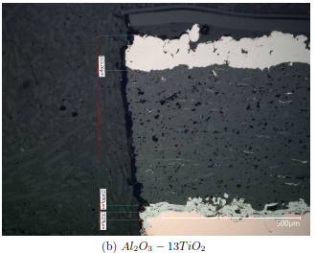
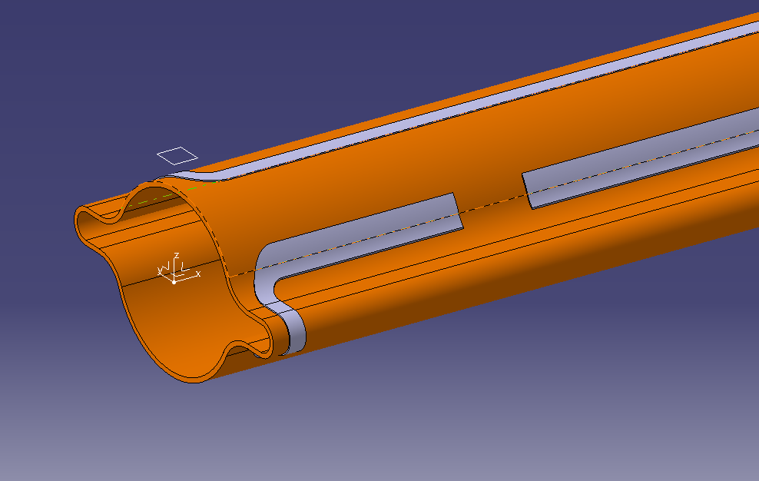
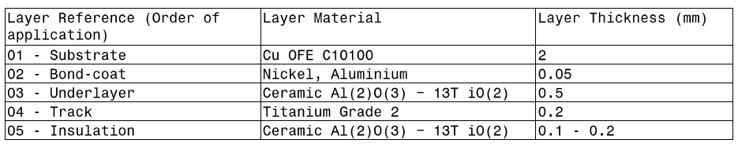
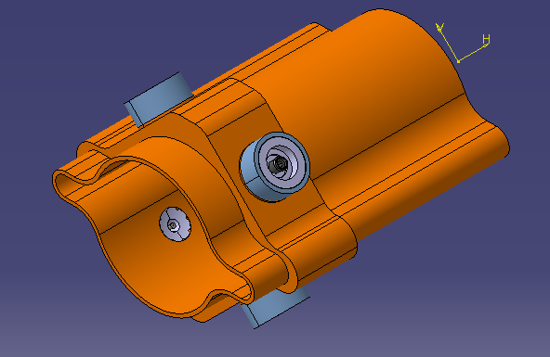
3 - Cold-Spray Utility
Additive manufacturing technique for rapid application of powdered materials to ductile surface
Integrated, permanent bake-out track for vacuum chambers. First design S-Type Track.
Remote operation possible
Spatially compact design
Homogenous temperature distribution
Courtesy: Adrien Didier
Microscopic analysis of Cold-Sprayed layers.
Build on previous studies to create practical uses for FCC-ee.
Another considered use is to build sufficient amount of material around the chamber for the Beam Positioning Monitor (BPM).
~4000 BPMs in 92km tunnel (+2000 for booster).
Novel solution to minimise geometric and structural interruption of the chamber
Localised coating for repairs
New material combinations possible (mixing powders)

Slide 6
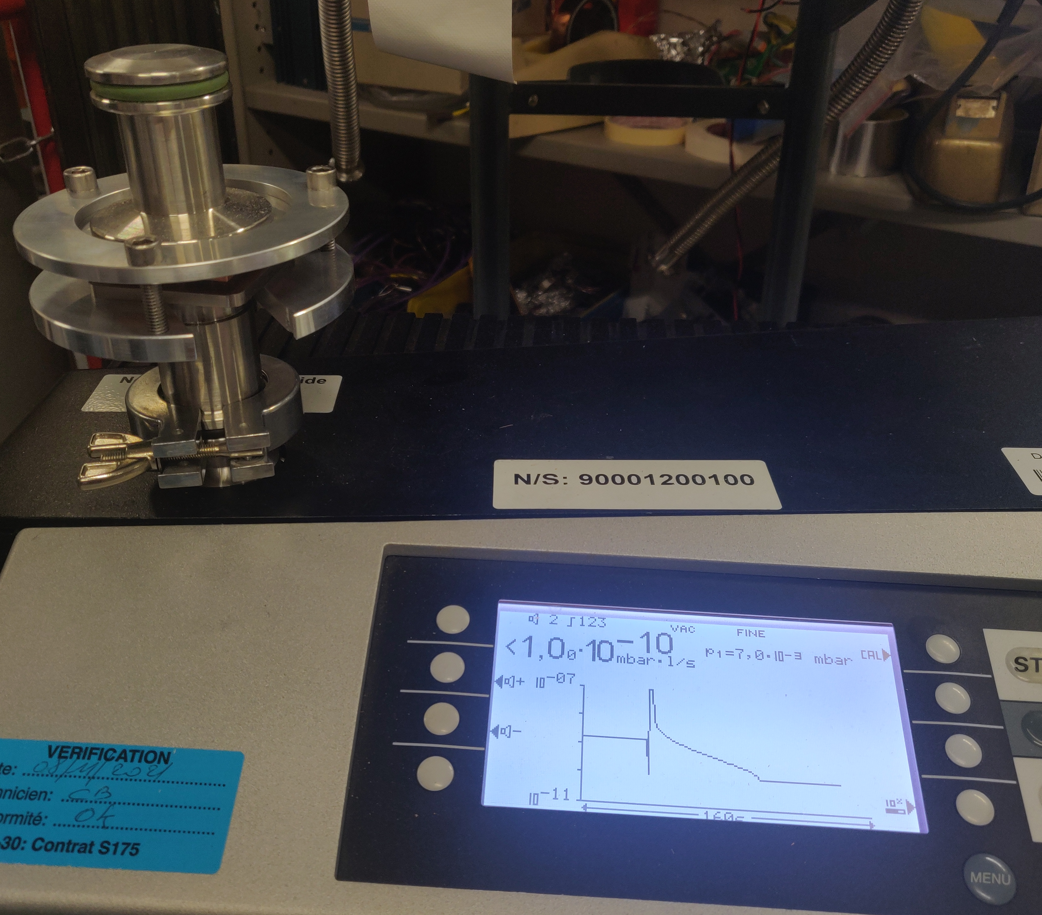
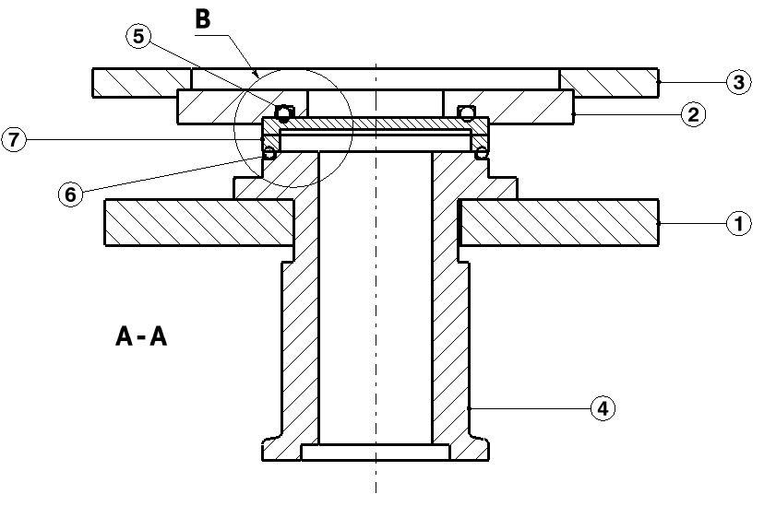
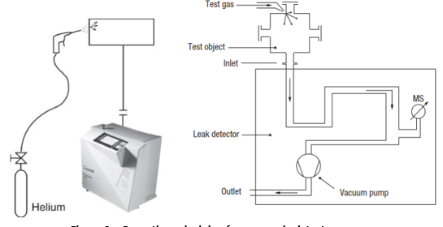
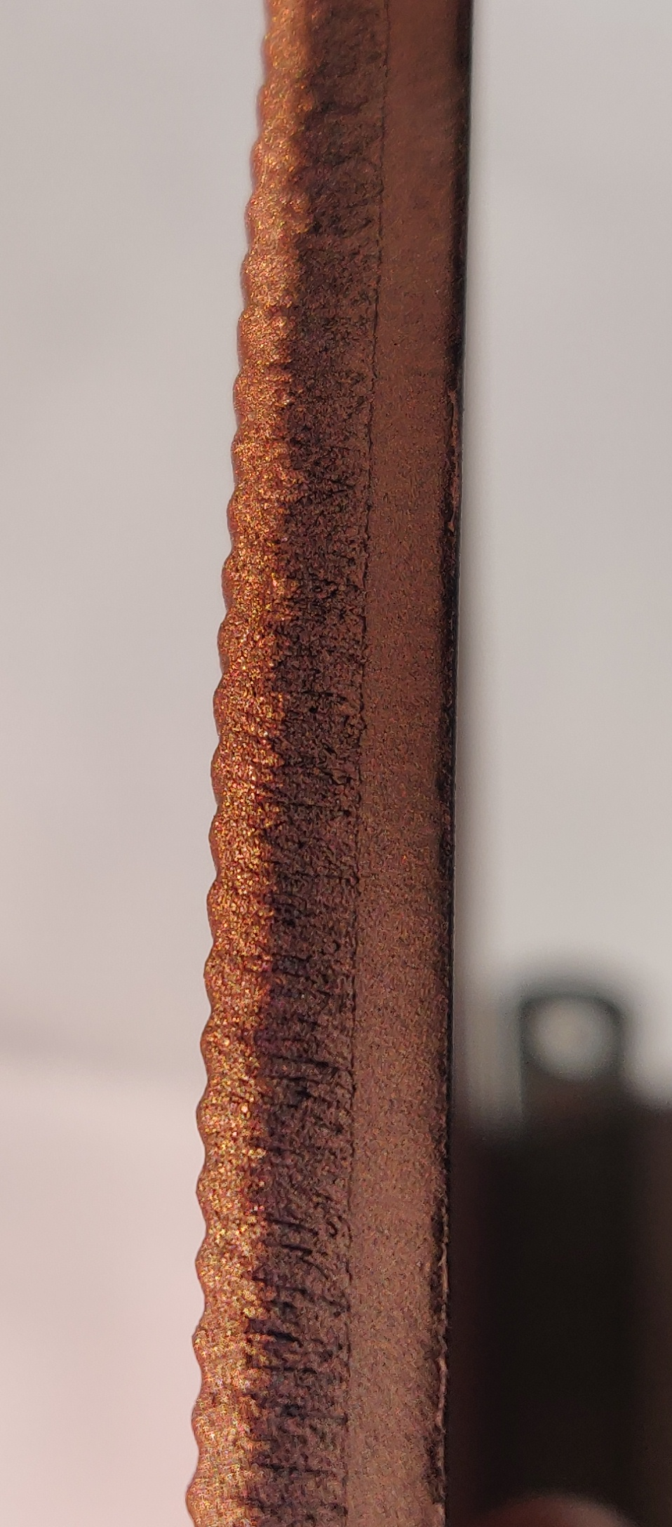
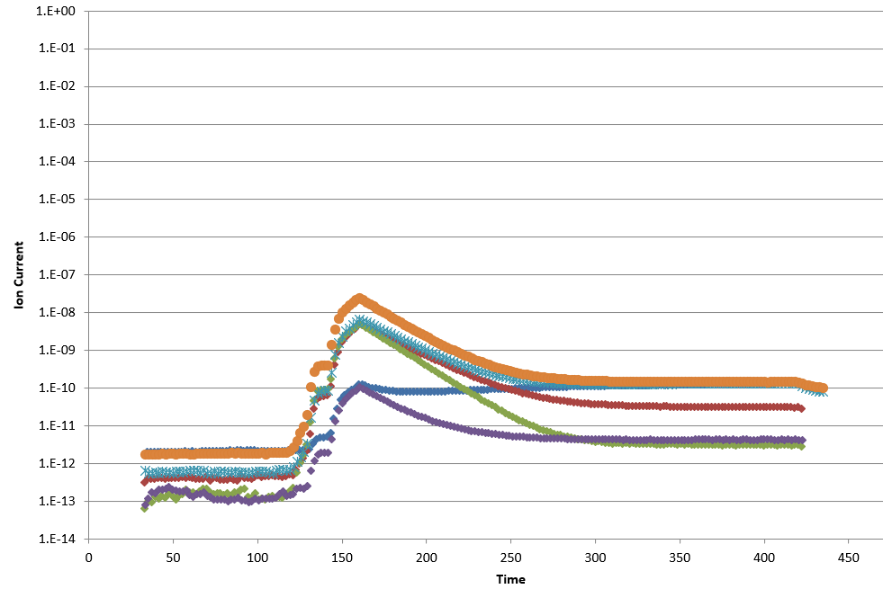
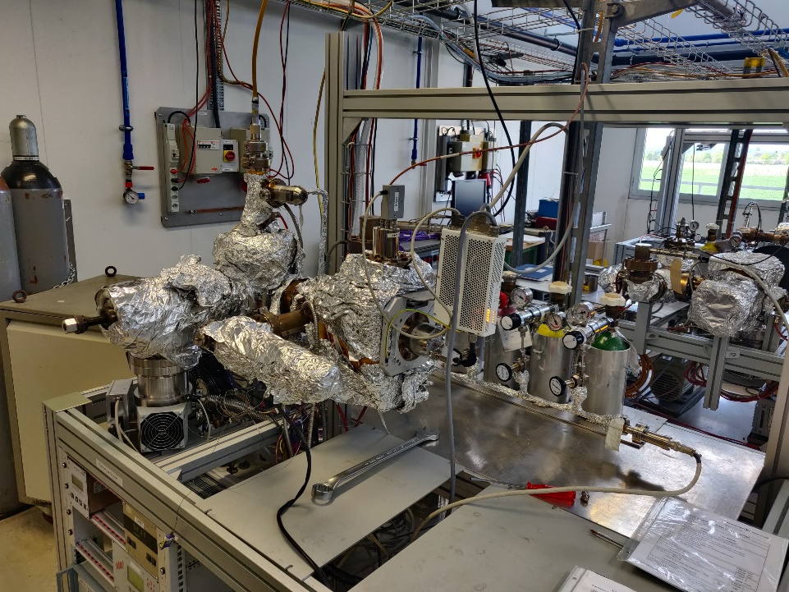
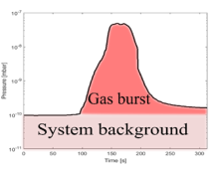

4 - Cold-Spray Validation
Cold-Spray must be validated for use in UHV
Currently two campaigns are on-going:
(1) Leak-Testing
Developed and manufactured leak-test tools (several variants).
Different testing conditions, now focused on finding the limit of cold-spray leak tightness capability
Operating principle of leak-testing with helium. Unit: $mbar∙l∙s^{−1}$
Leak testing: Deposit & Substrate successfully tested. Cyclic thermal shock testing also successfully completed
(2) Outgassing
Outgassing principle
Beginning to collect good results, with expected behaviour.
Outgassing setup

Slide 7
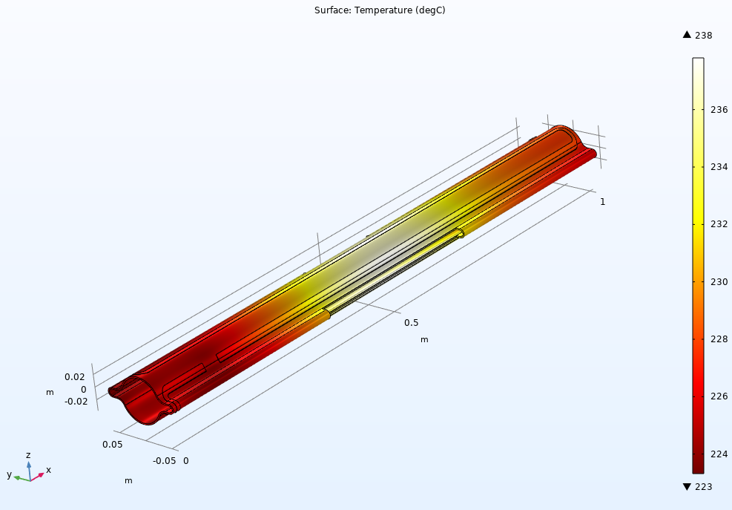
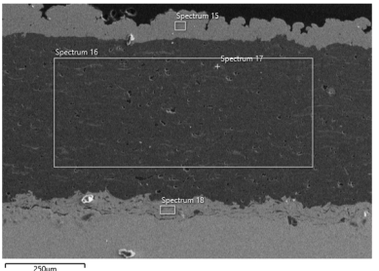
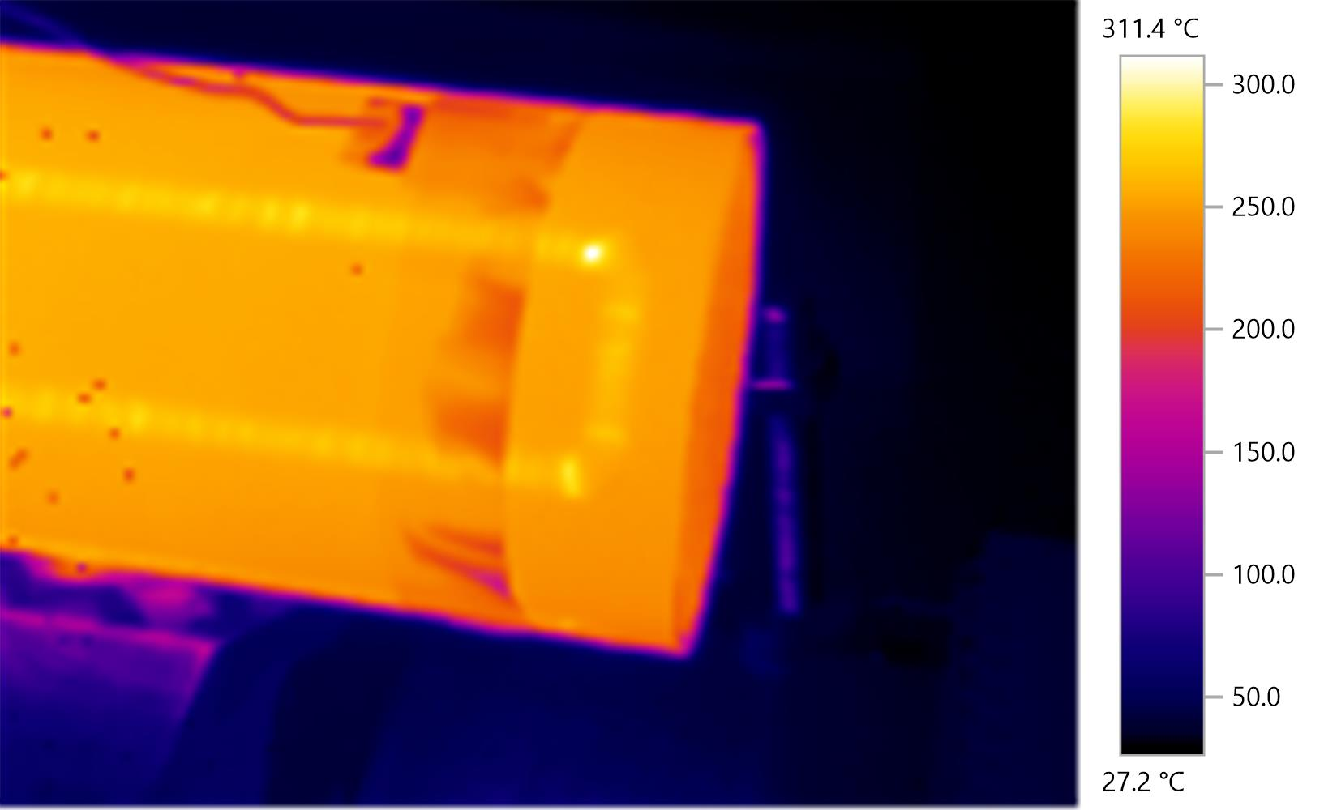
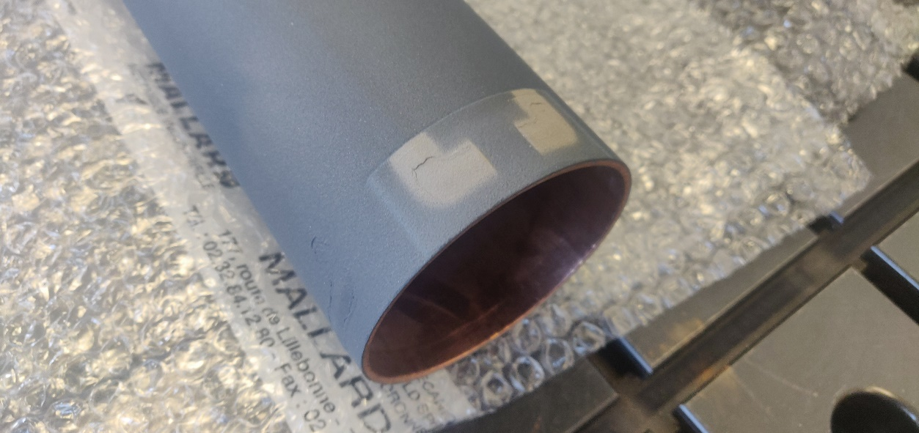
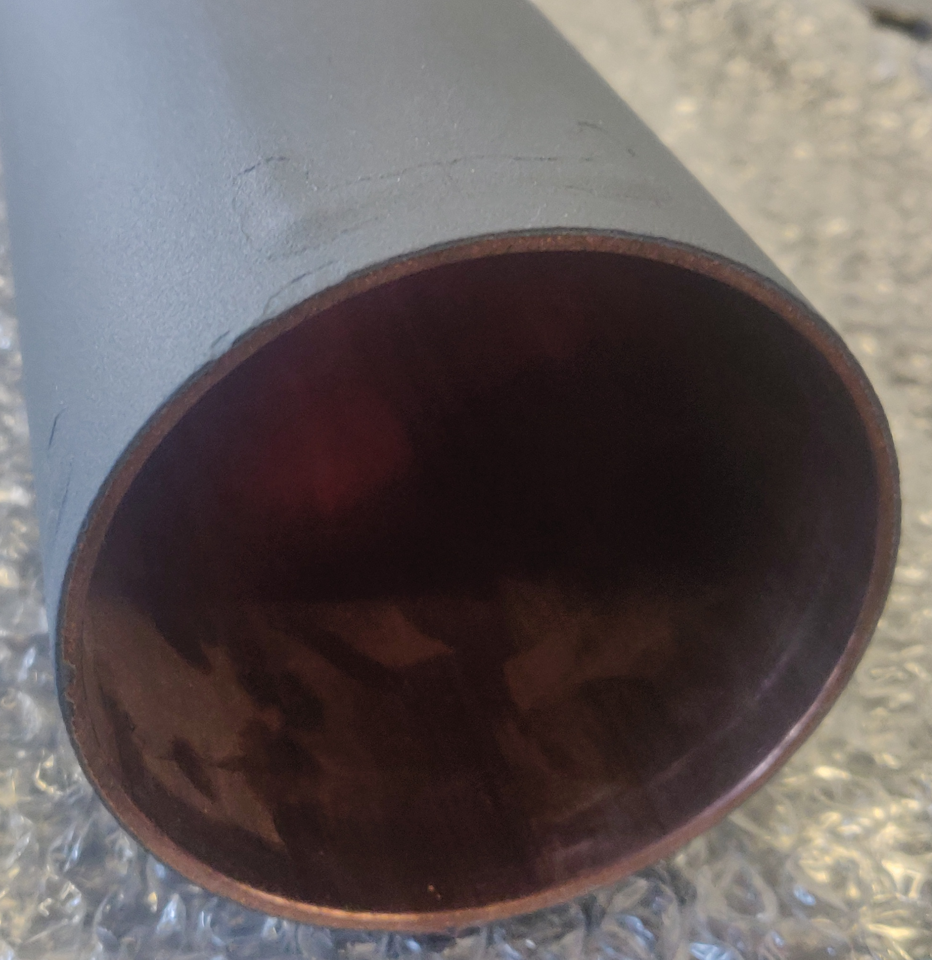
5 - Vacuum Chamber Bake-out
Ideal layer configuration for bake-out application to vacuum chambers has been previously studied. Thermal model developed to find baseline heat transfer coefficient (h)
Bake-out requirement:
230±10°C
Courtesy: Adrien Didier
Temperature distribution across first model version of vacuum chamber (S-Type track)
Bake-out test, thermal examination.
Higher temperatures correlate to areas of reduced titanium thickness.
Reasonably homogeneous temperature distribution.
Prototype tube developed and manufactured (0.5m) to validate the model and test the cold-spray layer configuration.

Slide 8
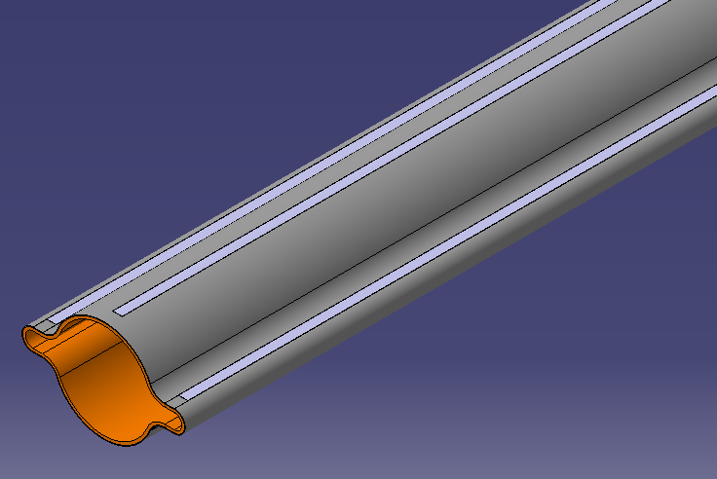
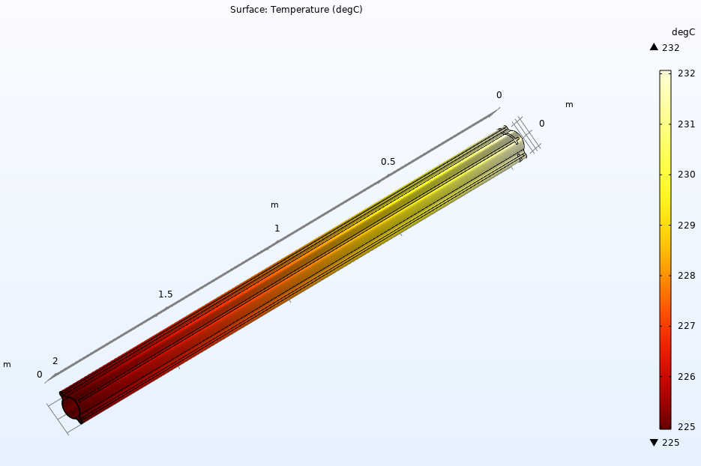
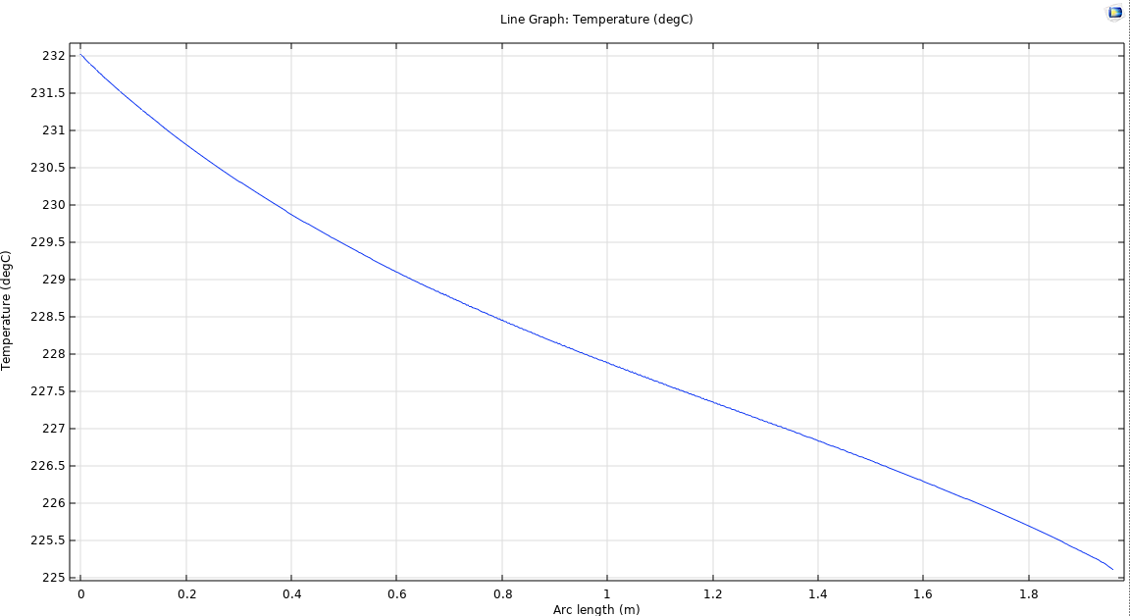
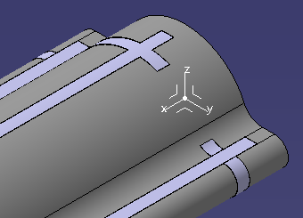
6 – Vacuum Chamber Design, Thermal
Using lessons learned from bake-out experimentation, new track design using a lattice approach were designed. Latest includes a redundancy feature with two potential differential connections.
Updated thermal model with new track design, indicates minimal change to min/max temperatures with same power input (~80W/m)
Temperature across length of track
Lattice track for ease & reliability of manufacturing

Slide 9
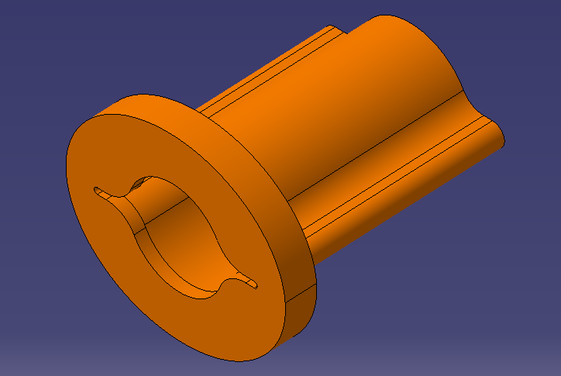
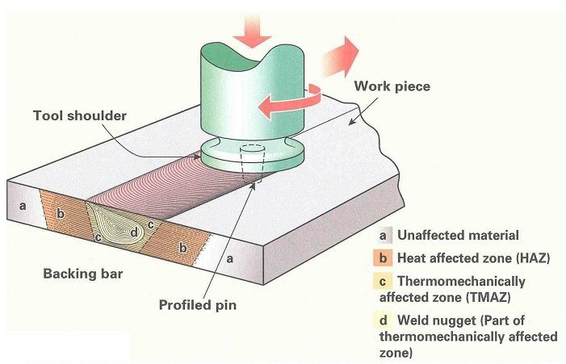
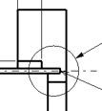
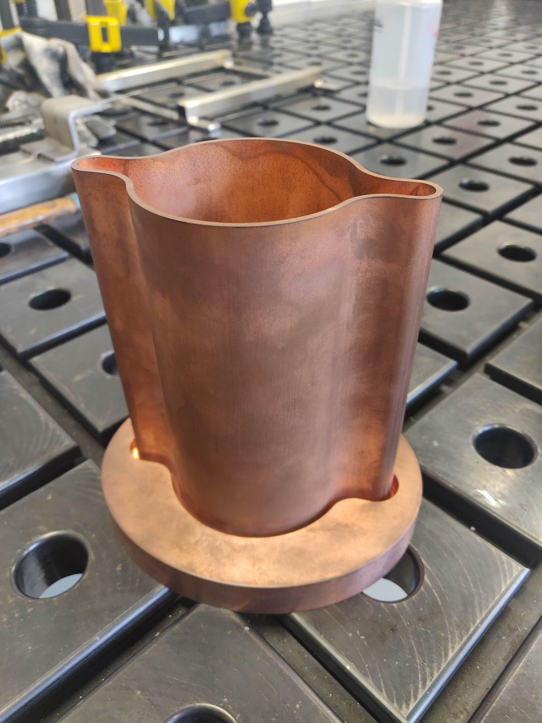
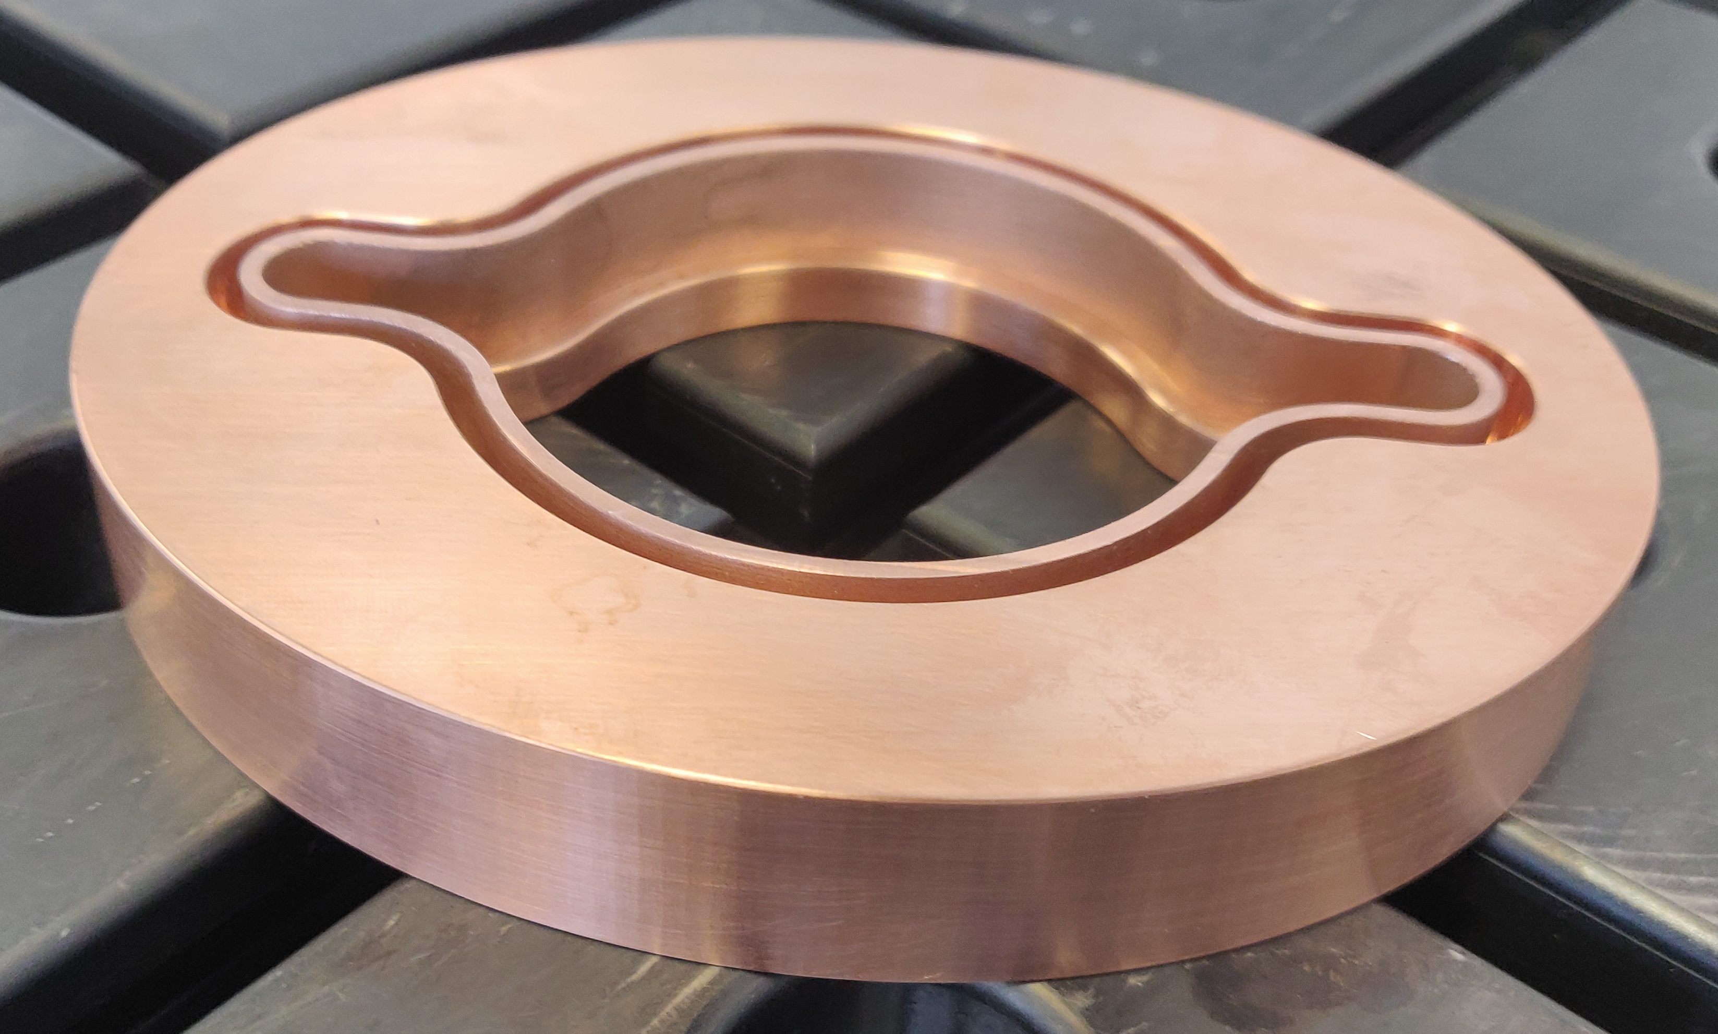
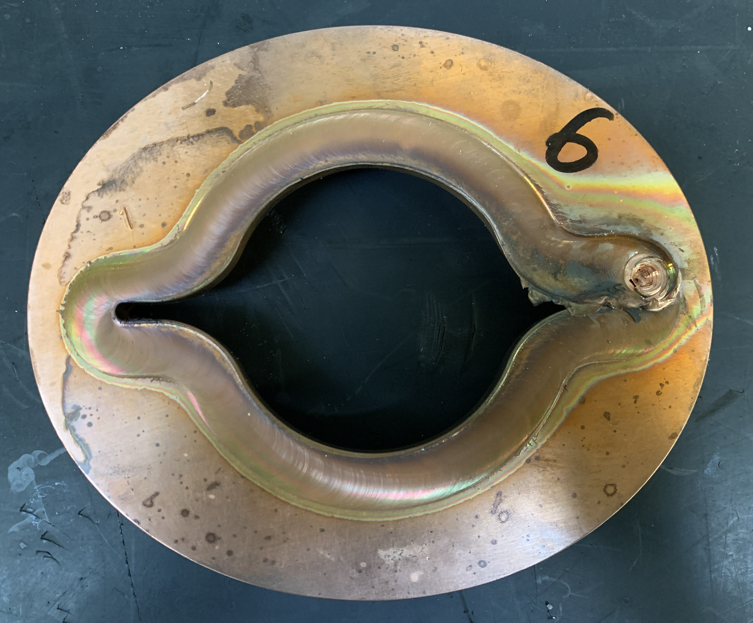
7 - Friction Stir Welding (FSW)
For FCC-ee interconnections, we are testing FSW to join the flanges to the vacuum chamber in a cost-efficient manner.
Flange
Vacuum Chamber
Solid state joining process. Mitigates many defects regarding melting and solidification in fusion welding.
Ease of manufacturing:
Automated, repeatable, no edge preparation & post-processing on same machine. Cheaper than MIG / TIG and energy efficient .
Phase 2 – joining of longer vacuum chambers (150mm) to qualify FSW for Ultra High Vacuum and for use in pilot sector prototype. FSW supplier chosen in collaboration with MME colleagues.
Phase 1 – destructive testing to determine optimal weld parameters, including clamp and tooling design.
Phase 1 complete, report from sub-contractor. Improvements to pre-weld flange design can be implemented
Further information: What is Friction Stir Welding (FSW)? - Process and Applications - TWI (twi-global.com)

Slide 10
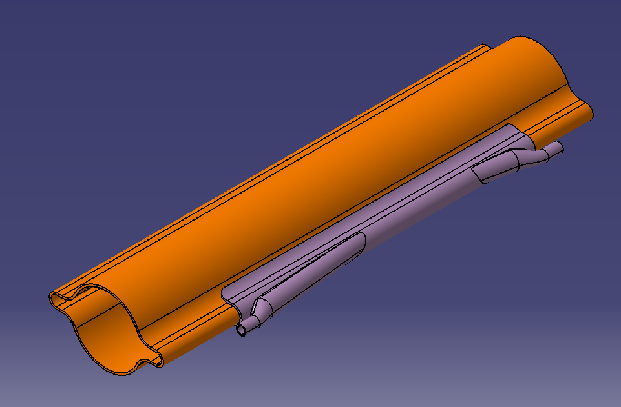
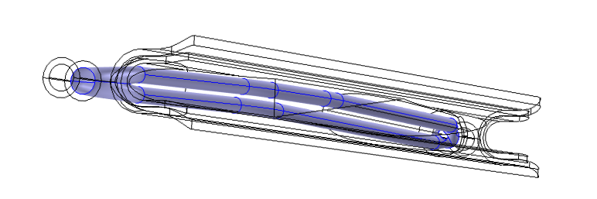
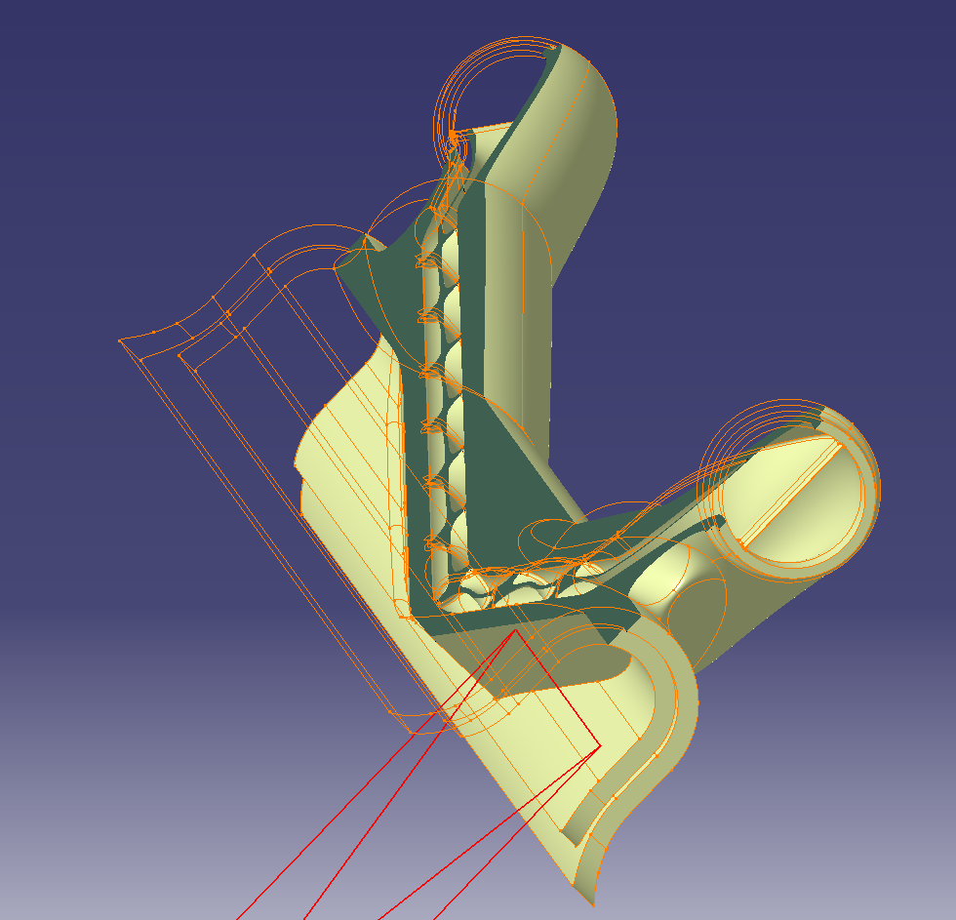
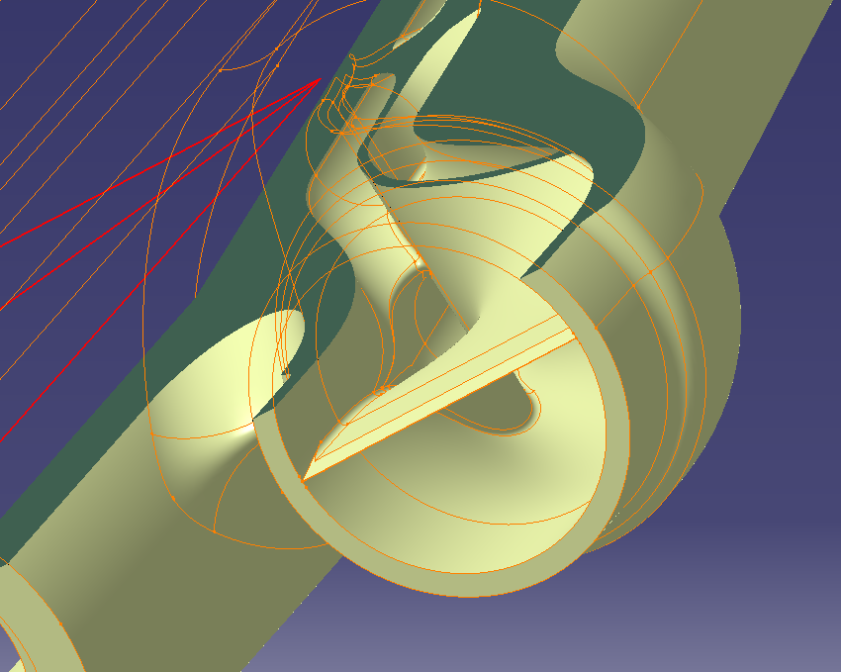
8 – Synchrotron Radiation Absorber (SRA)
FCC-ee with a high energy beam generates a narrow fan of Synchrotron Radiation.
SR is a significant source of heating and photoelectrons, as such, absorbers are required. In order to not affect Impedance, the winglets ‘capture’ the SR and are close to the chamber diameter.
These will be installed every ~5.6m to intercept the SR.
Need to intercept between 4 and 7 kW of power dependent on the location along the arc lattice.
“V-shape” ~300mm long. Material: CuCrZr.
Courtesy: Fabrice Santangelo
Ease of manufacturing:
Complex geometry, internal spiral (heat transfer enhancement).
Selective Laser Melting (SLM) additive manufacturing has been selected in collaboration with MME colleagues to manufacture the first prototypes.
Other samples using SLM are being procured for various qualification tests at CERN (Tensile, porosity, density etc).
Courtesy: Marco Morrone

Slide 11
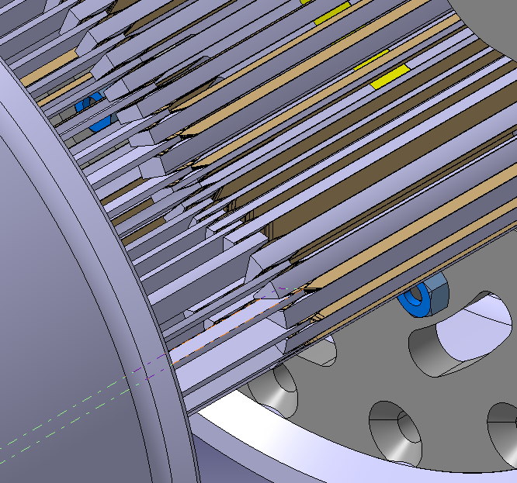
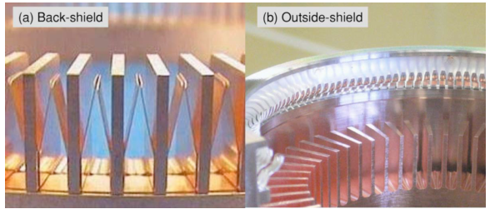
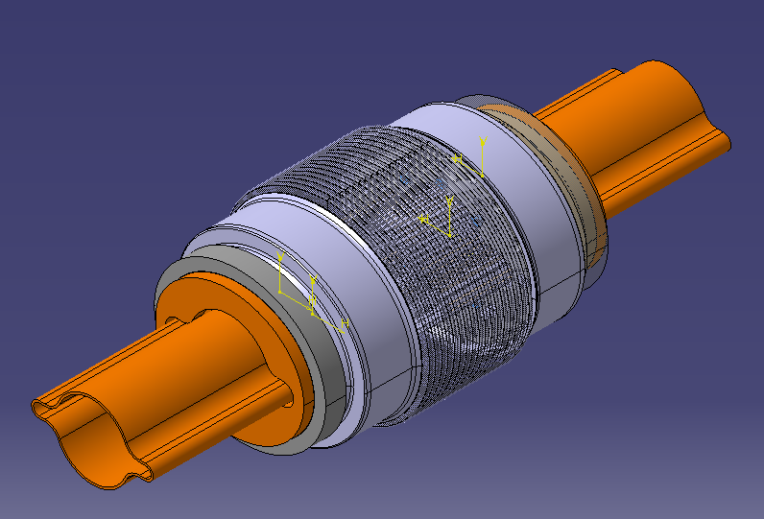
9 - Interconnection Design (1)
Honey-comb type fingers for FCC-ee
Two designs for the interconnection undergoing analysis
Adapting SuperKEKB, the ‘honey-comb’ RF ringers have been designed for FCC-ee.
Advantages:
Tests well in Impedance testing, contributing to beam stability
Proven design with SuperKEKB
Maintains geometric cross-section throughout the interconnection
Disadvantages:
Limited lateral misalignment and axial capability
Likely expensive to manufacture due to fine tolerances required and complex geometry
Interconnection design, showing associated bellows and flanges

Slide 12
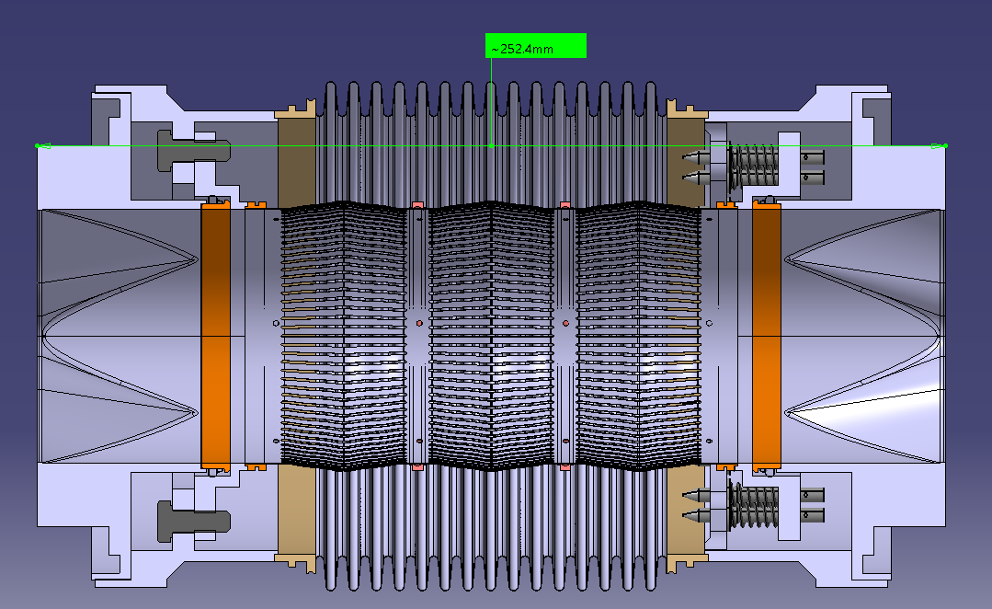
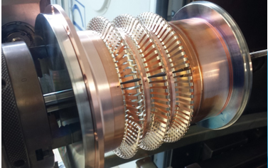
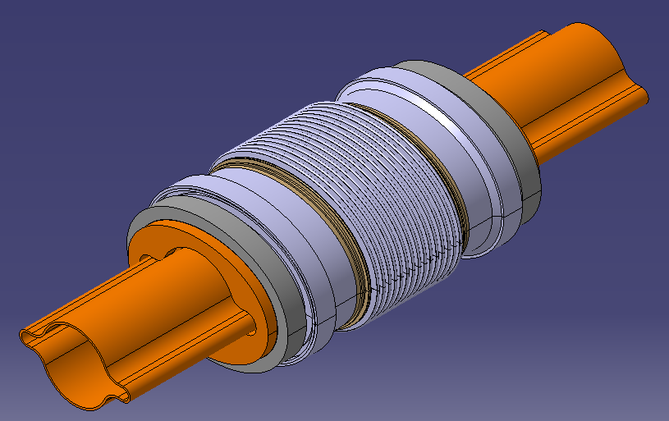
10 - Interconnection Design (2)
Existing connections utilise ‘Deformable RF’ contact bridge.
Advantages:
Proven design for interconnections
Manufacturing costs expected less than honey-comb
Greater lateral misalignment
Interconnection cross-section with
DRF
Courtesy: Fabrice Santangelo
Disadvantages:
Greater contribution to impedance budget across lateral and transversal frequencies
Overall length of interconnection needs to increase to accommodate convolutions

Slide 13
Acknowledgements
Thanks for your attention!
A very big thanks to colleagues across CERN and beyond for their hard work and patience in this project so far:
C. Garion, F. Santangelo, M. Morrone, R. Kersevan, H. Kos, H. Rambeau, C. Duclos, F. Niccoli, J. Debeux, R. Gerrard .. And many more…

Slide 14
References
[1] R. Kersevan, C. Garion “Conceptual Design of the Vacuum System for the Future Circular Collider FCC-ee Main Rings”
[2] C. Garion, R. Kersevan “Design of the vacuum System of the FCC-ee Electron-Positron Collider”
[3] The European Physics Journal “FCC-ee: The Lepton Collider, Future Circular Collider Conceptual Design Report Volume 2”
[4] Cersullo. N “Vacuum characterization of coatings obtained by Cold Gas Dynamic Spray (CDGX) technique. Possible applications in high energy particle accelerators”
[5] EDMS No. 1752123 “Criteria for vacuum acceptance tests”
[6] EDMS No. 2757155 “FCC-ee Cold-Spray Thermal Shock Testing”
[7] Y. Suetsugu et al., “Application of a Matsumoto-Ohtsuka- type vacuum flange to beam ducts for future accelerators”, Journal Vacuum Science and Technology
[8] M. Migliorati, C. Antuono, E. Carideo, Y. Zhang and M. Zobov “Impedance modelling and collective effects in the Future Circular e+e- Collider with 4 IPs”
[9] Yusuke Suetsugu et al. “Development of bellows and gate valves with a comb-type rf shield for high-current accelerators: Four-year beam test and KEK B-Factory”

