Slide 1
Digital Twins
MME Current Activities
Marco GARLASCHE’
On behalf of MME-DT Working Group
S. Atieh, D. Smakulska, O. Sacristan, A. Perez, L. Baudin, G. Papazoglou
9th November 2022
TE-VSC | EN-MME Seminar

Slide 2
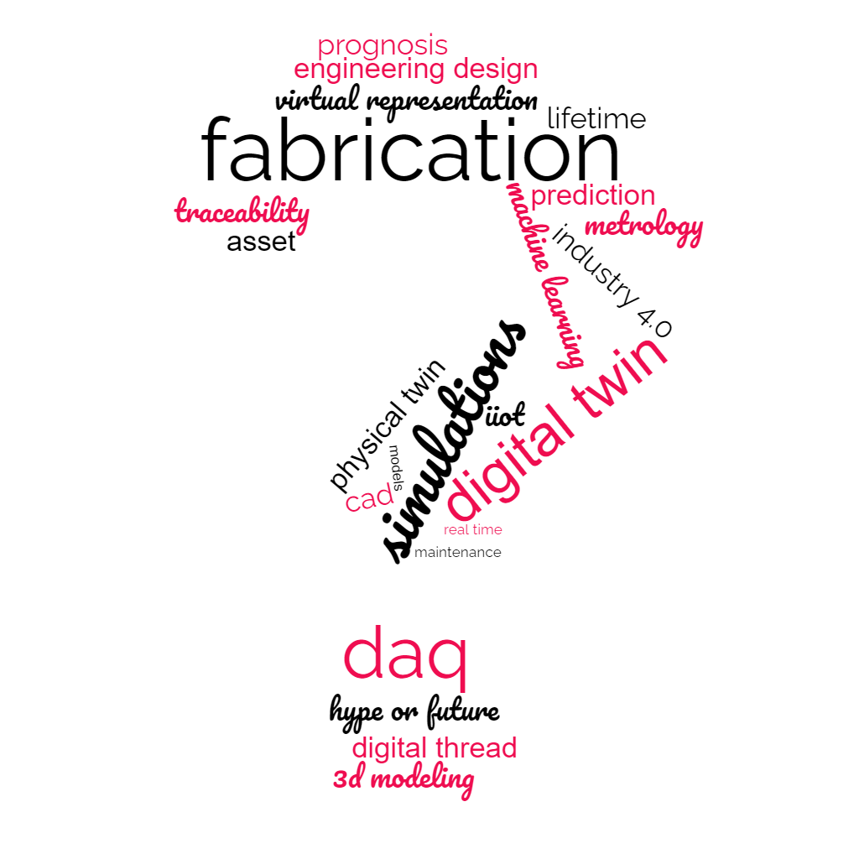

What is a Digital Twin
Where does MME Stand
Current MME DT Project

Slide 3
What is a Digital Twin - Definition
A digital twin (DT) is a virtual representation of the behaviour of an actual, physical asset in operation (physical Twin, PT)
The DT reflects the PT current condition. This involves :
relevant historical data about the asset
direct acquisition of asset data into tuning algorithms (models, simulations,…)
A DT can twin a component, a system of components, or a system of systems
Specific-asset oriented, evolving
DT is a twin for lifetime
Digital Twin IS SINERGY of
a set of models, simulations or formulas
historical data (datasheets, …)
live data acquisition & interpretation
Complexity of the system is tailored to the specific needs

Slide 4



Building Blocks
Data on PT History
physical asset in operation
component, a system of components, or a system of systems
DAQ
Remote, Real time
PT
DT
Complex ‘Transfer Function’
OUTPUT: Data about PT
Present & Future Measured & Modelled
virtual representation of PT
Specific-asset oriented, evolving. for lifetime
Models of PT
Multiphysics
SINERGY of
historical data (datasheets, …)
live data acquisition & interpretation
a set of models, simulations or formulas
Complexity is tailored to the specific needs

Slide 5
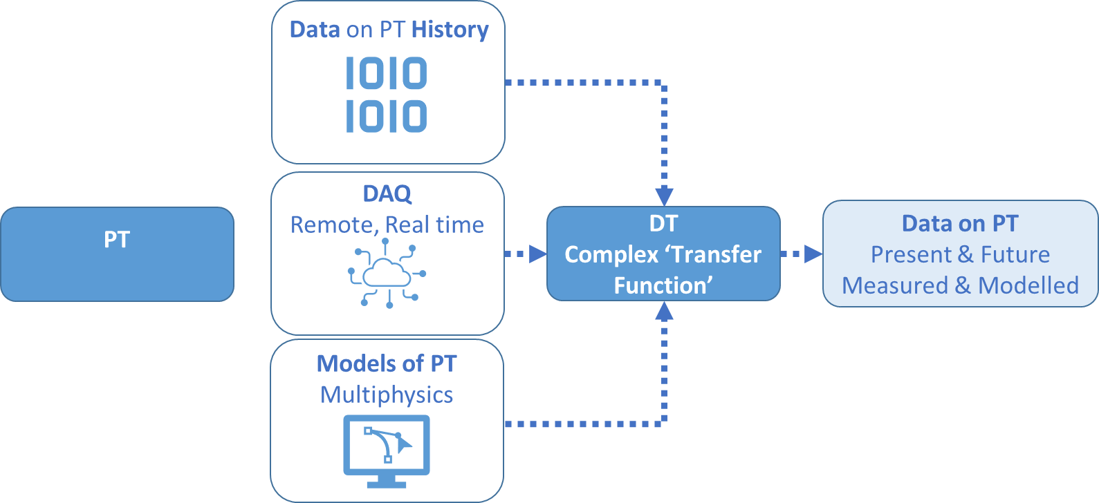
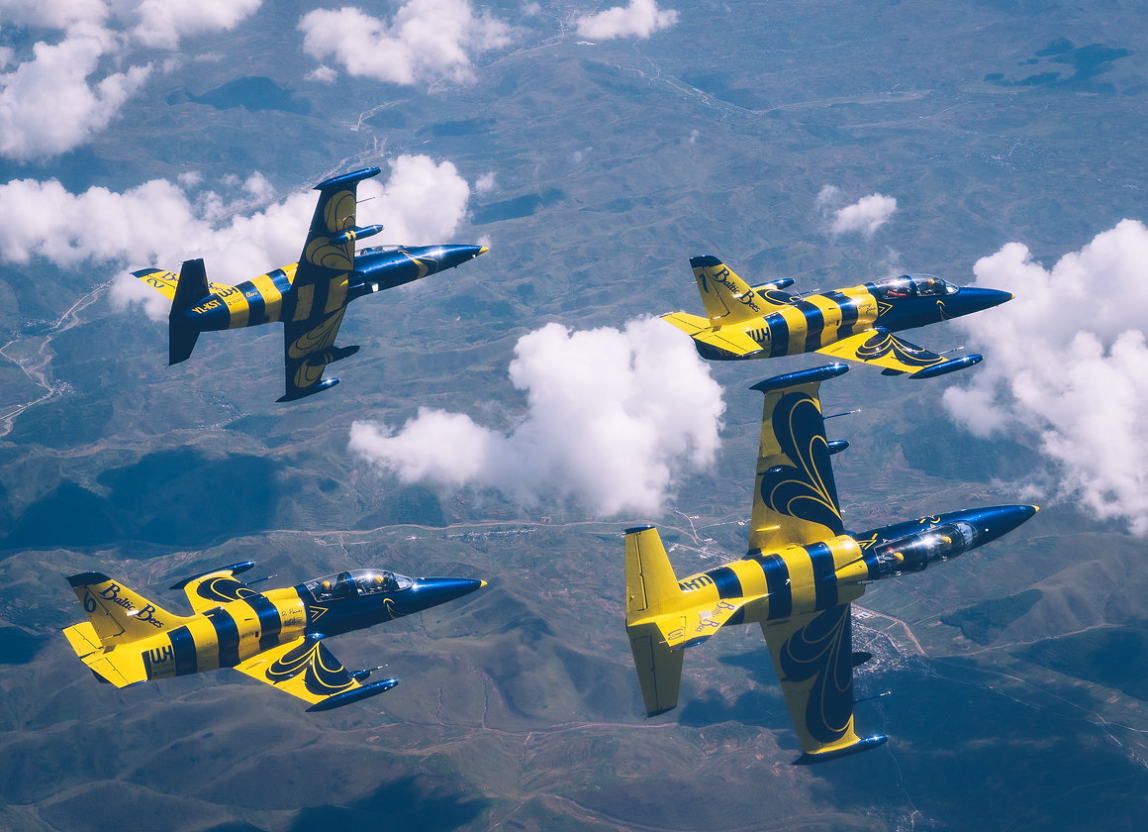
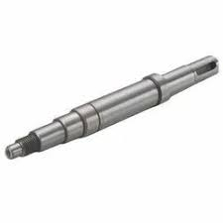
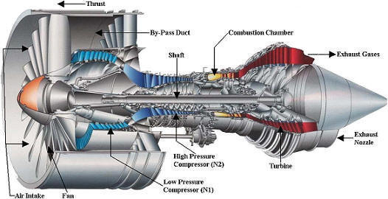
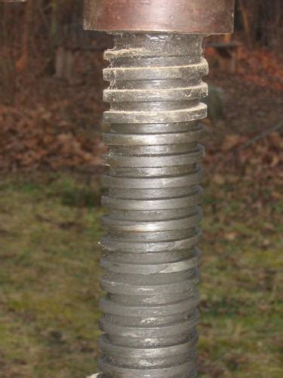
Physical Twin
Component
System of systems
LHC

Slide 6
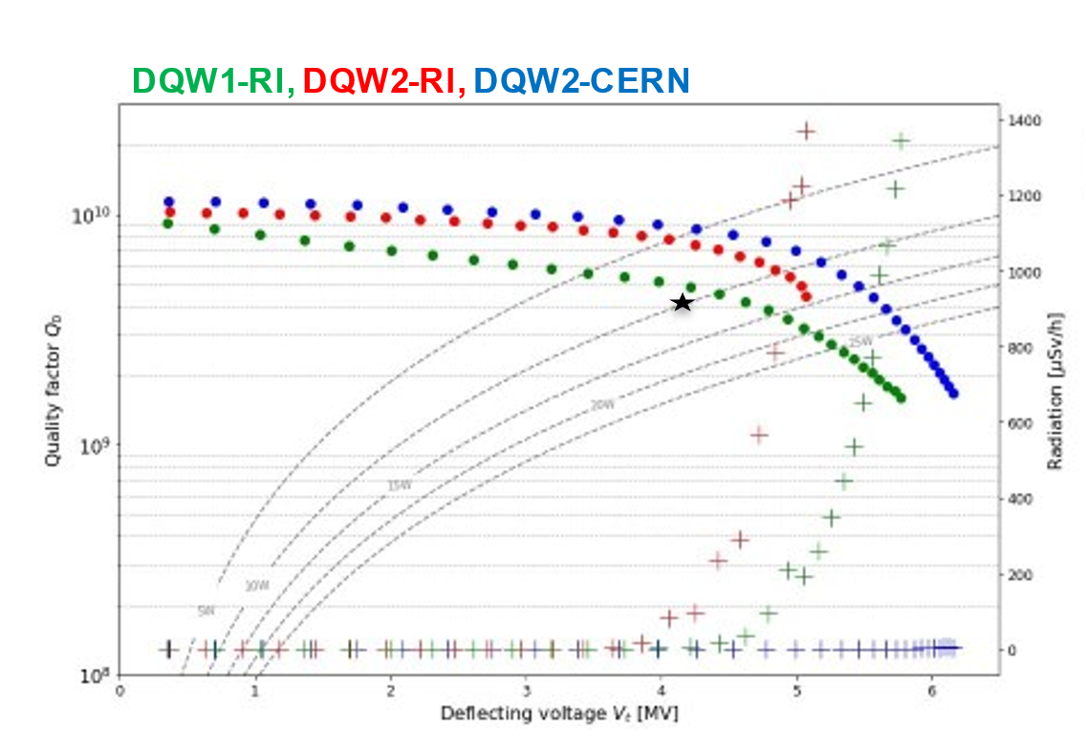
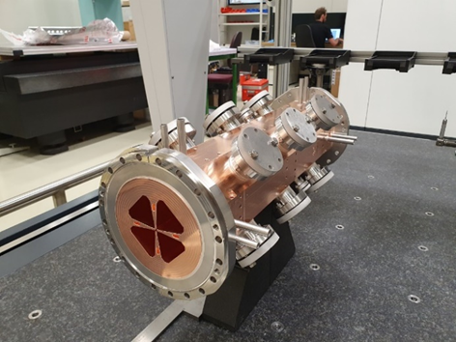
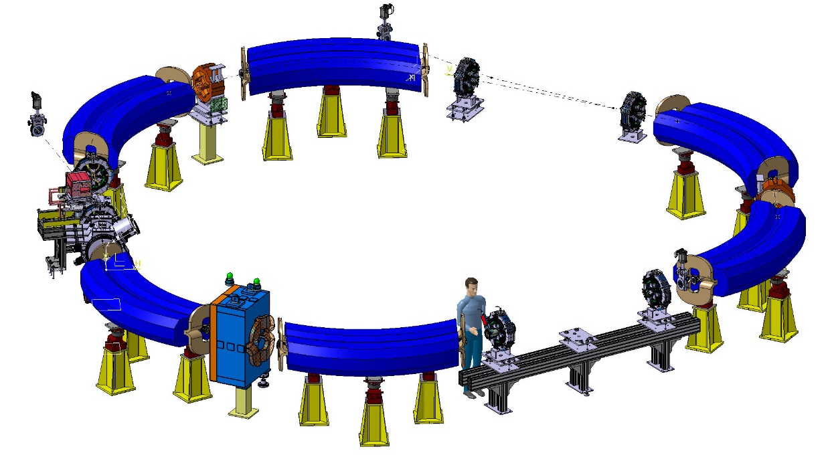

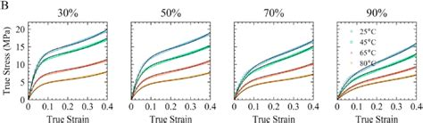
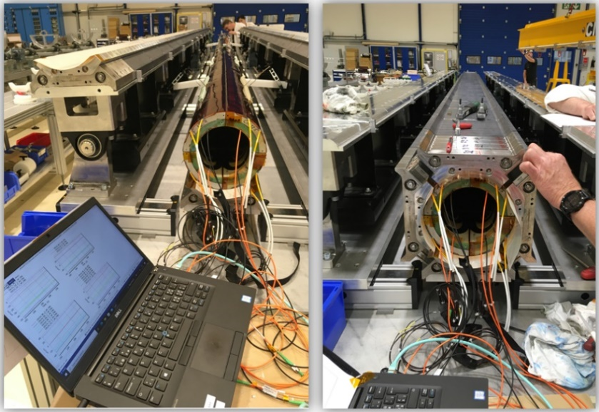
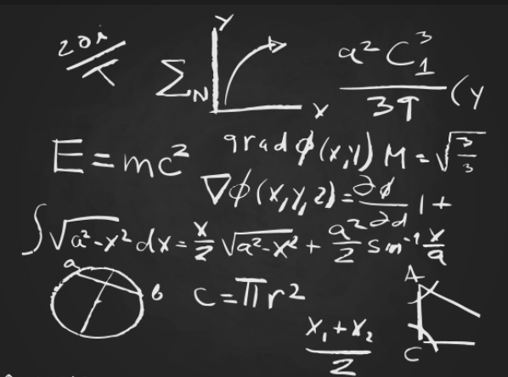
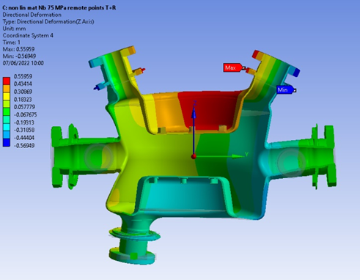
Digital Twin – Input Data
Tailored Complexity: only RELEVANT data is needed

Slide 7
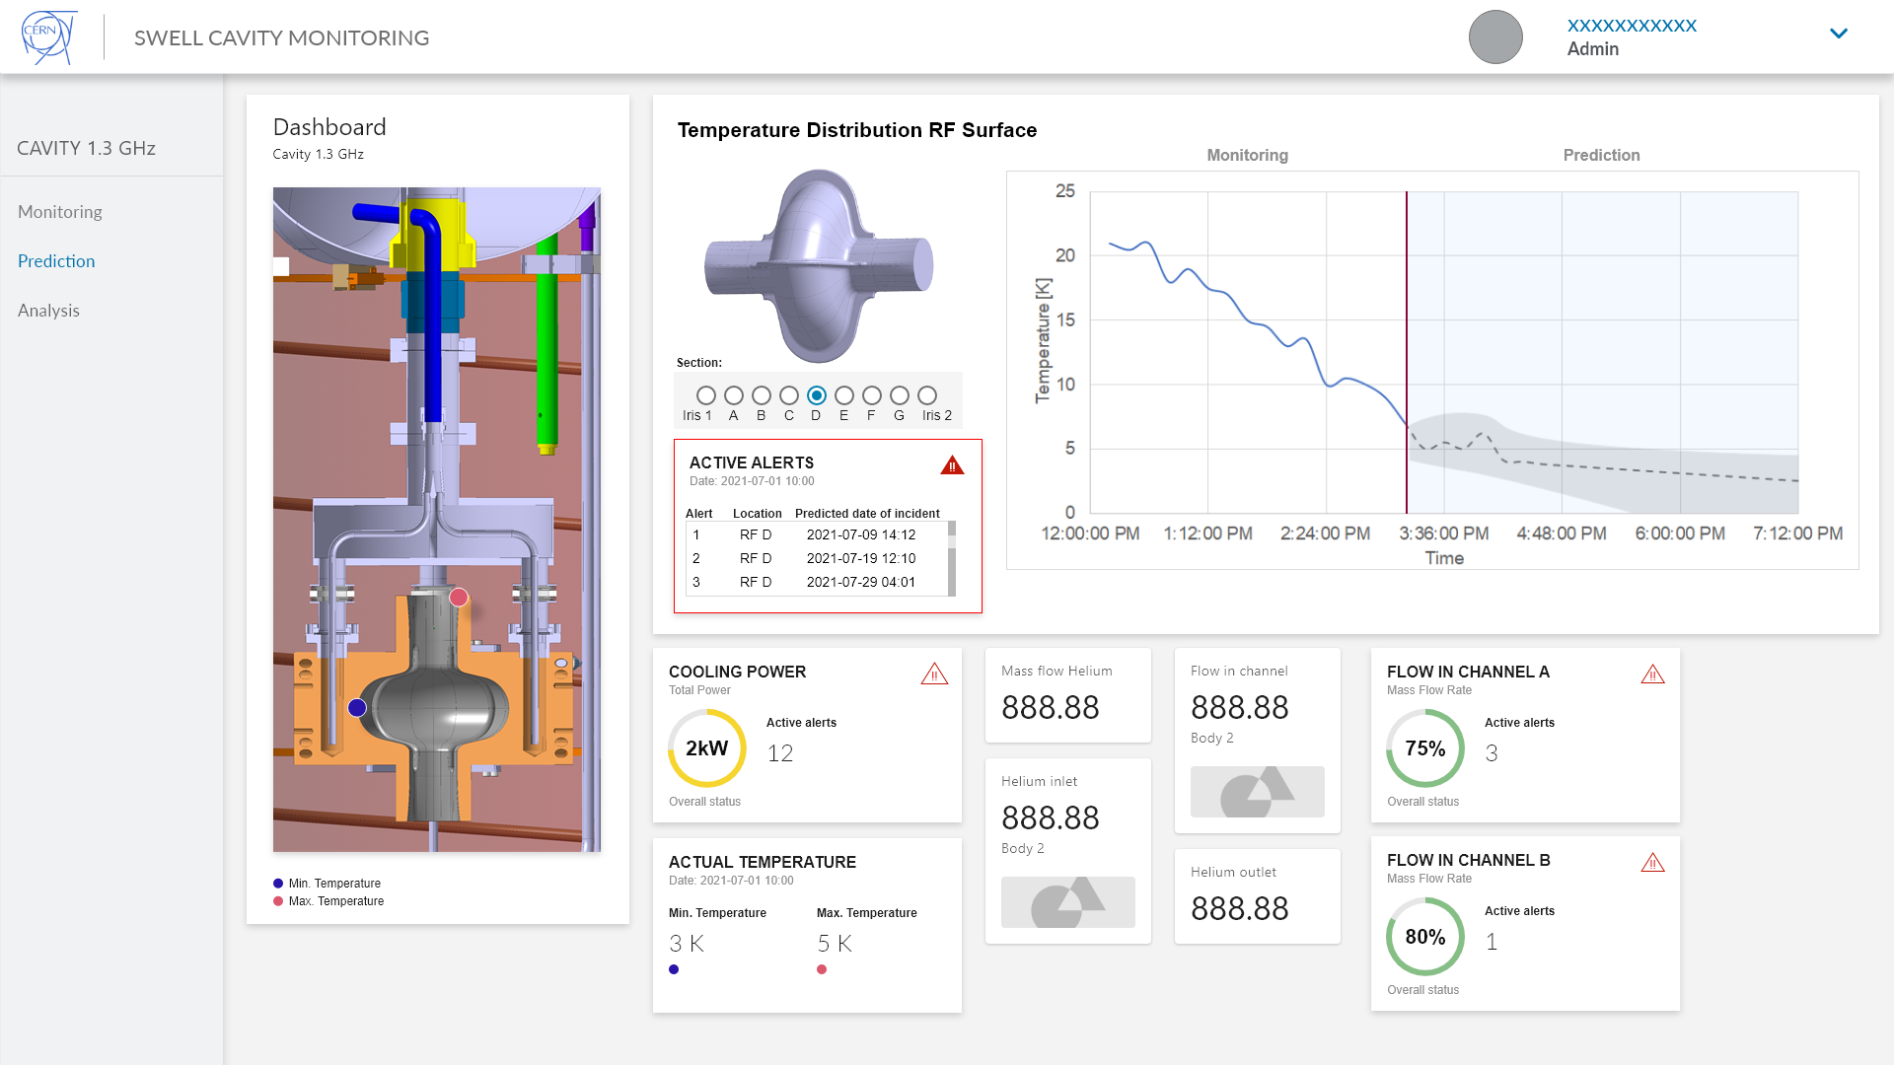
Digital Twin – Output
Output of current state of the PT, through integrated models and acquired data
Acquisition from ‘Virtual sensors’ : parameters conventionally unmeasurable, due to: accessibility, Multiphysics
(e.g., RF cavity EM field distribution from beam pipe strain values), cost (less sensors)
Anomaly detection: flags deviations of operational vs. expected behaviour
Breakdown Maintenance & Fault isolation: automatic simulations to isolate fault and identify root cause. Repair scenarios can be priorly analysed. Down-time may be reduced
Forecast of future state of the PT -> Tailor-made Predictive maintenance
What-if simulations to evaluate readiness or adjustments to current system set-points
(variables : ambient conditions, loads & design changes)

Slide 8
MME Current Activities: on What, Roadmap, Status, …

Slide 9
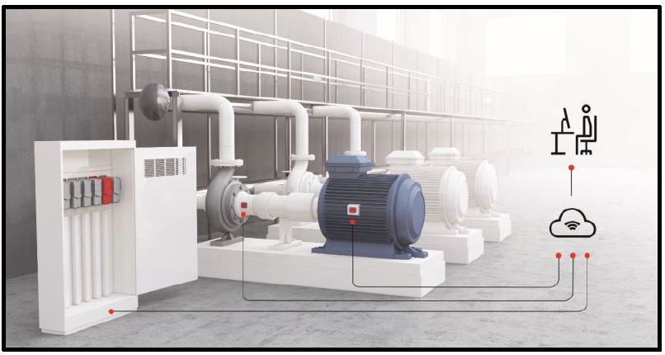
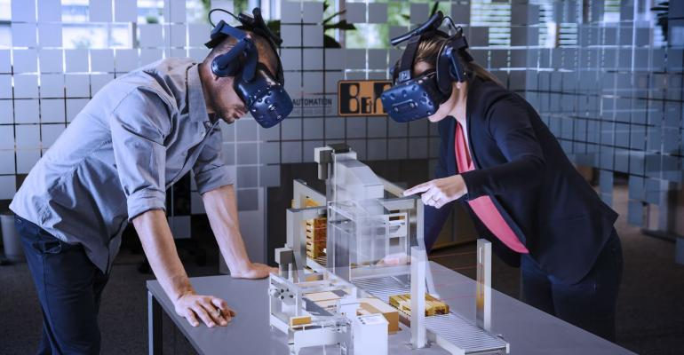
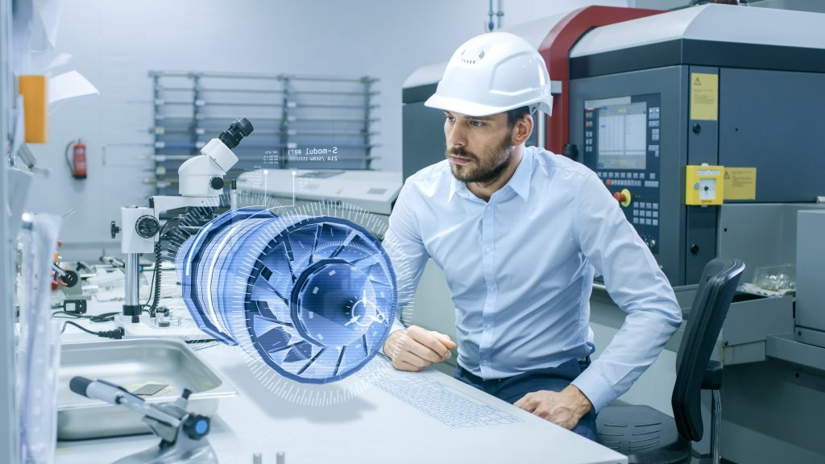
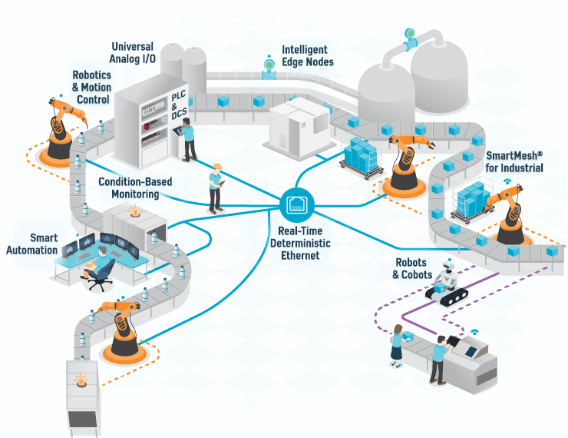
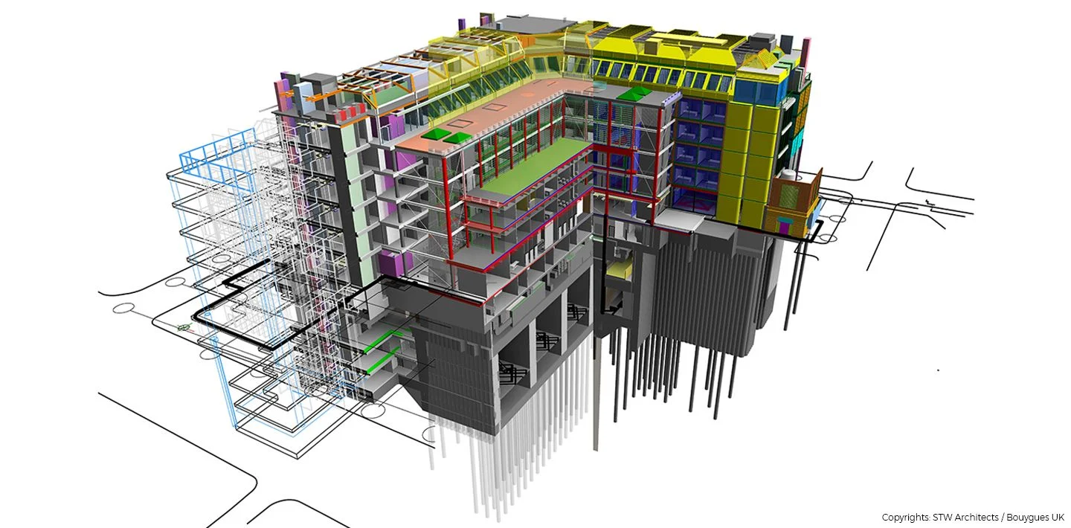
Physical Twin : MME Focus
DT of commercial off-the shelf equipment
Augmented Representation of infrastructure (system of systems)
DT of bespoke CERN components/systems
BIM

Slide 10
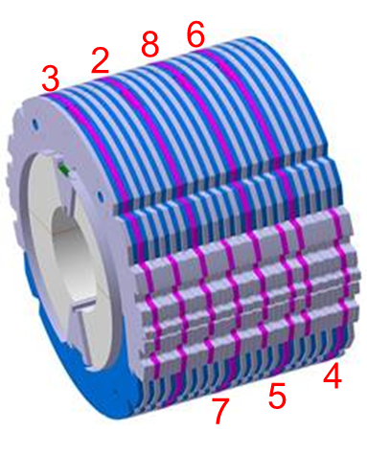
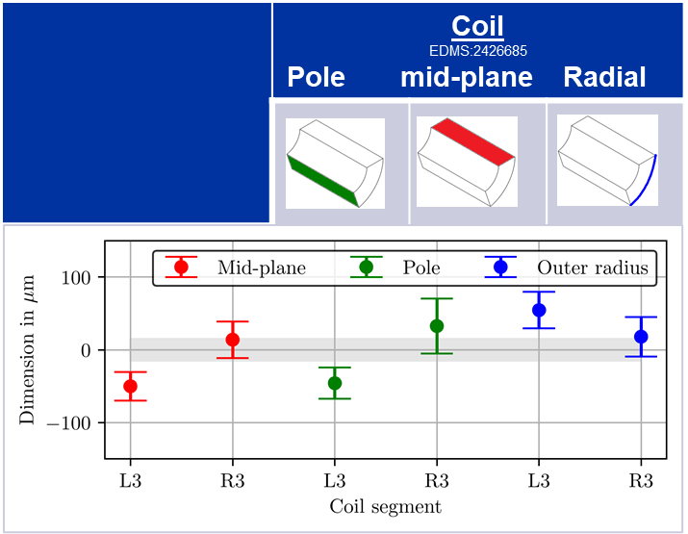
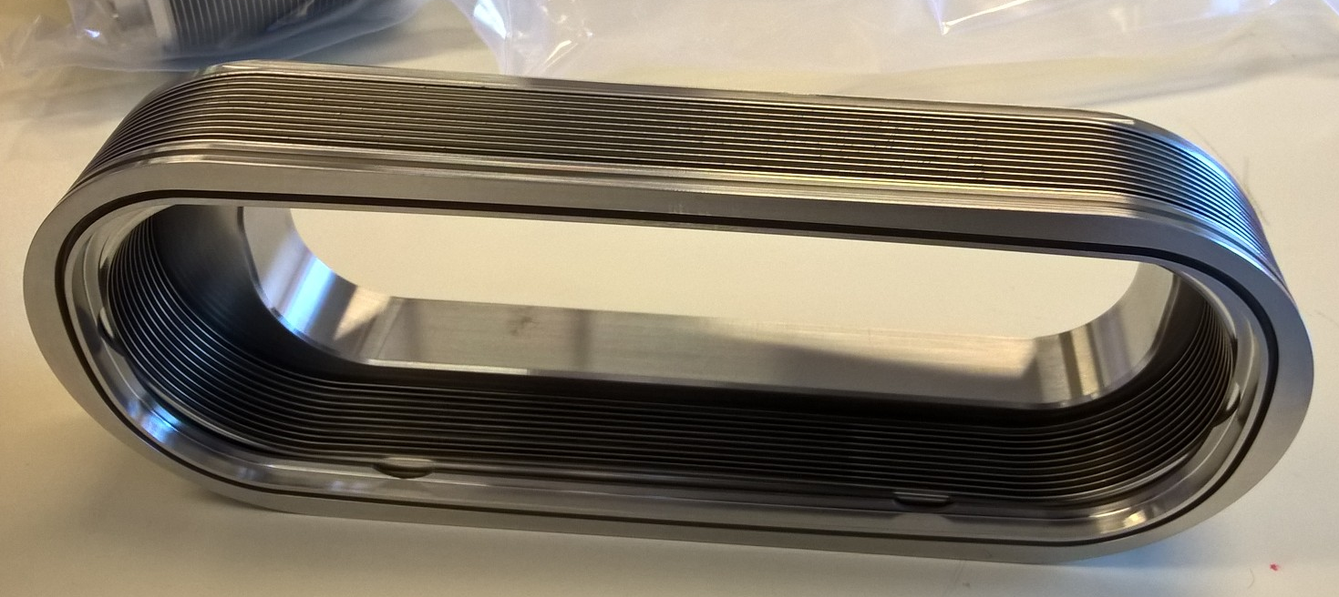
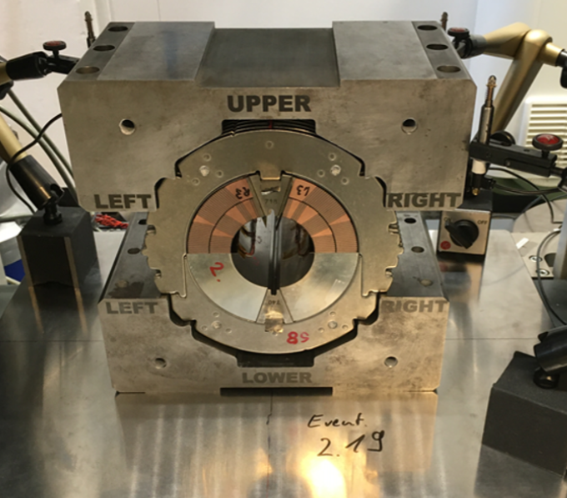
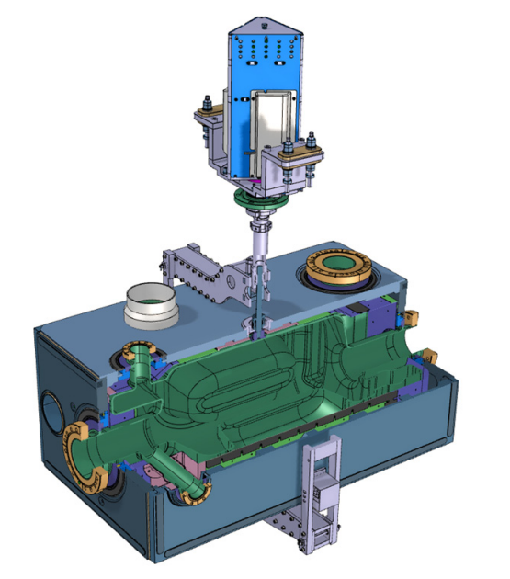
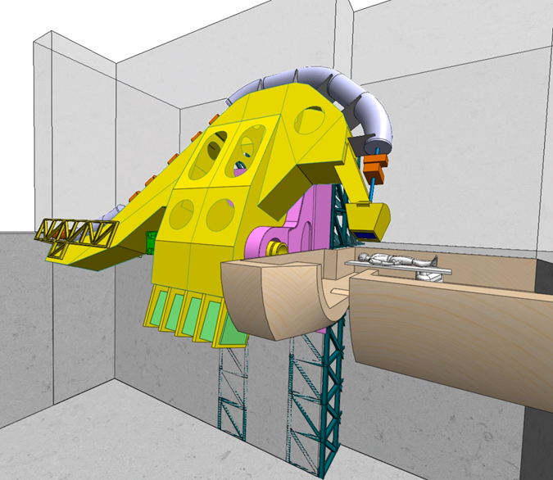
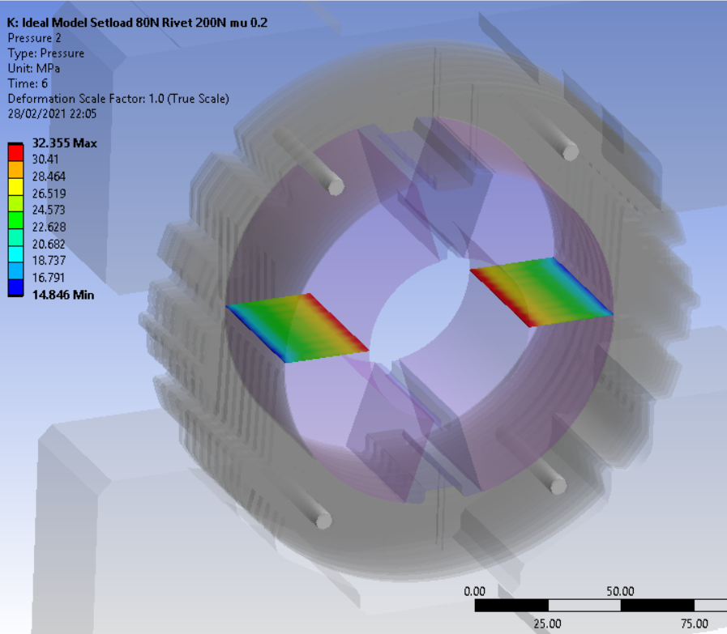
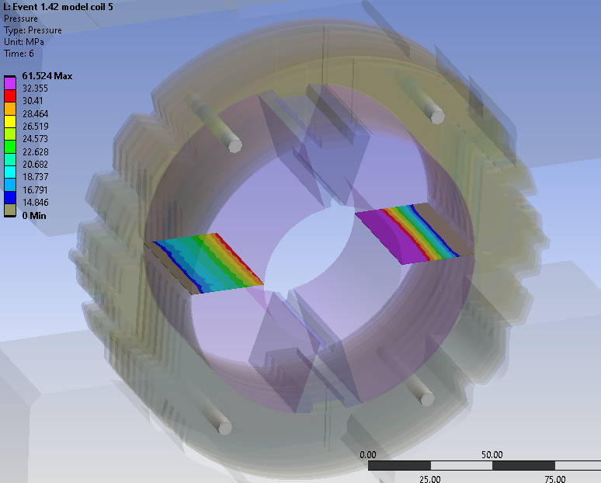
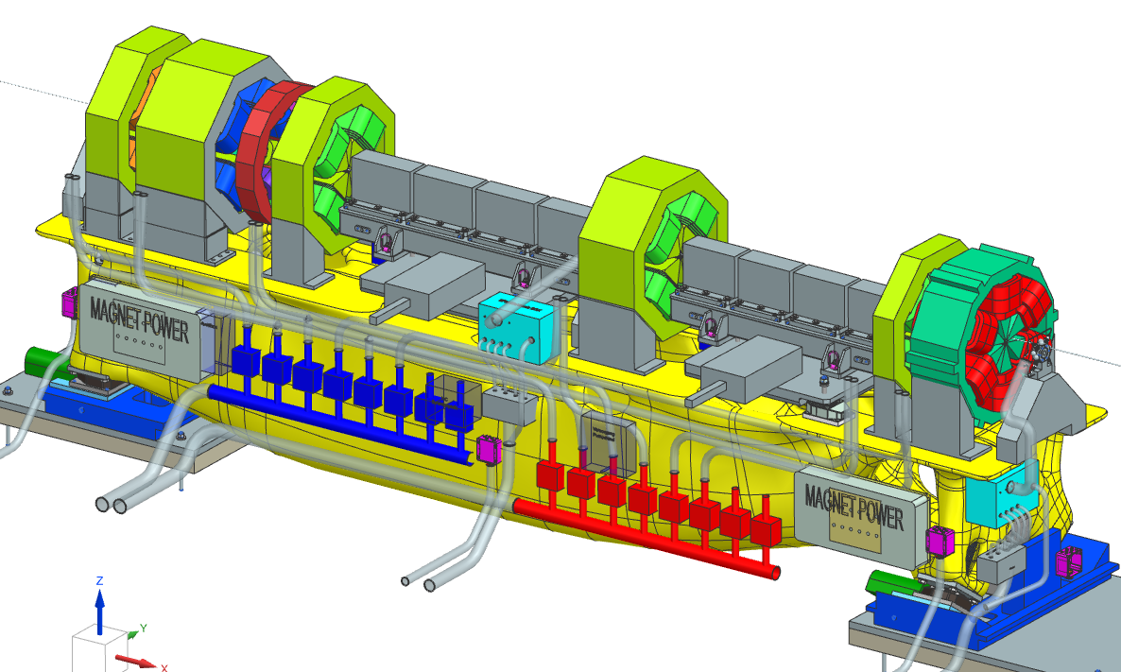
Interest for CERN Assets & Projects…
…When
PTs are complex, complicated to interpret
Or simple PTs.. but equipment failure is critical (expensive), also for a larger system
Difficult access (sensing, maintenance…)
Quick reaction is needed
Tailor-made loading scenarios
IDEAL
REAL
10

Slide 11
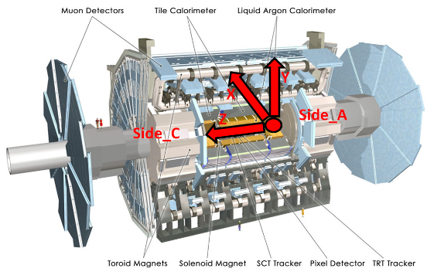
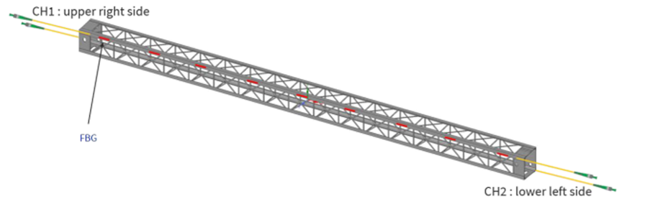
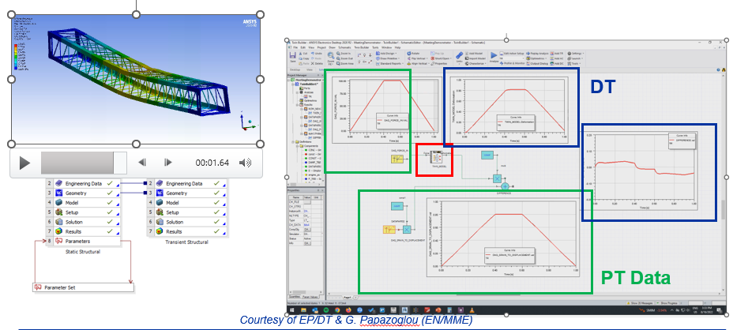
Current Activities : Roadmap
End Goal:
Readiness for collaborating and providing Digital Twins of bespoke mechanical systems for CERN users
Awareness and experience on DT break even point
1) Initial Trial on simple CERN component
  Test waters. Are core activities within capability?
2) Proof of Principle on more complex CERN component
  Fitness check. Steep learning curve
3) Demonstrator
  Readiness for providing DT
  DT demonstrator on CERN system of components
  Carbon Fiber Composite Truss

Slide 12
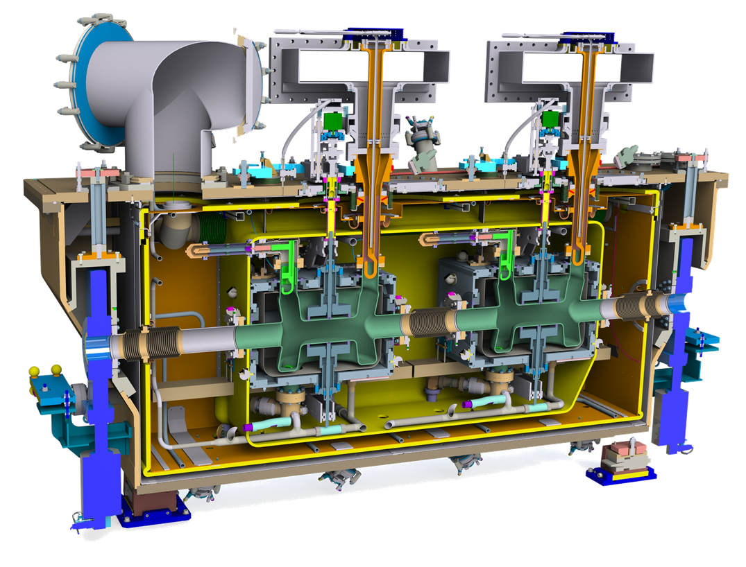
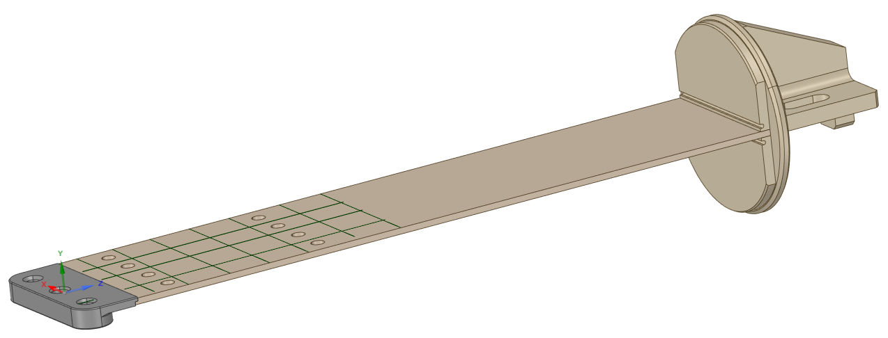
DT Proof of Principle : CRAB Cavity Support Blades
Still a simple component…
Fully mechanical
Known design, fabrication technologies, DAQ
→ Support Blade of the Crab Cavity Cryomodule
Critical for support and alignment of Crab Cavities
… but more complex level of DT implementation
  Full but lean DT model (data processing, transfer function accuracy)
  Live DAQ
  Output:
    real time information (no forecast)
    virtual sensors
Crab Cryomodule
Courtesy SY/RF

Slide 13
DT PoP : Experimental Setup
strain gauges
Supervised DT Training:
Load vs. strain vs. deflection
Strain profile & deflection (DIC)
Local strain (strain gauges)
Static load (Load Cells)
INPUTs – DAQ:
Real local strain (strain gauges)
Deployed DT OUTPUT:
Virtual load
Virtual deflection
Virtual local strain (@ complementary gauges)
DIC
Optimization study on:
Strain sensors: quantity, position
Load: values, quantity, position
Static Load

Slide 14
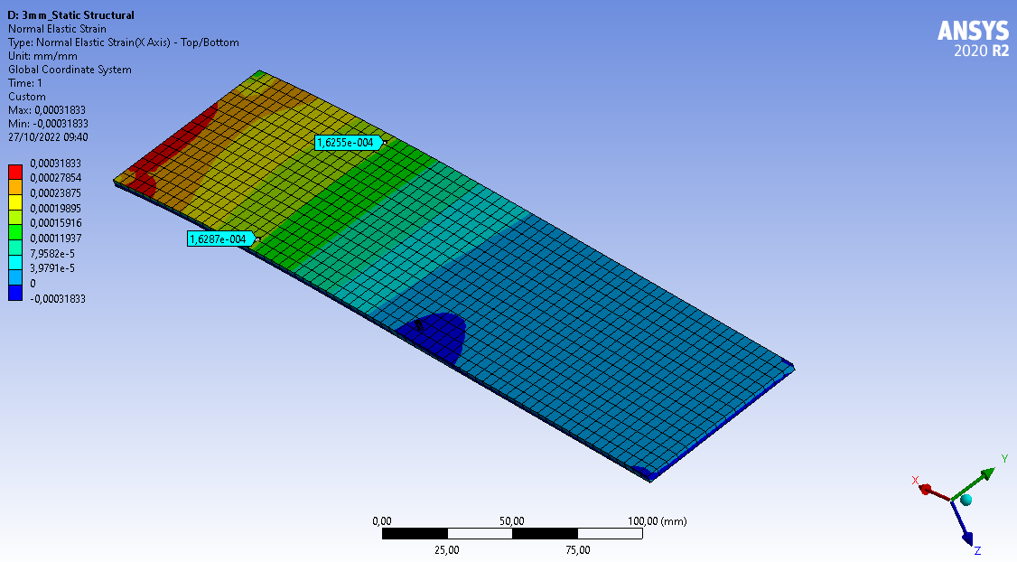
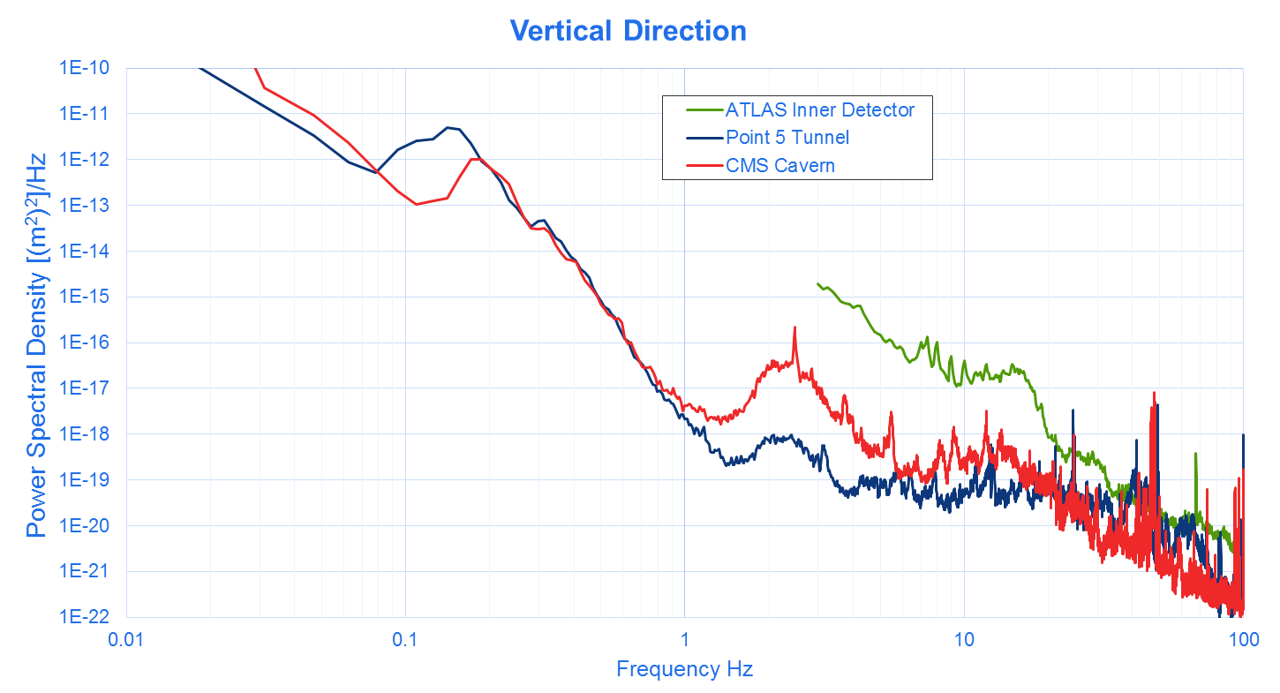
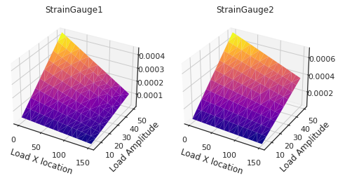
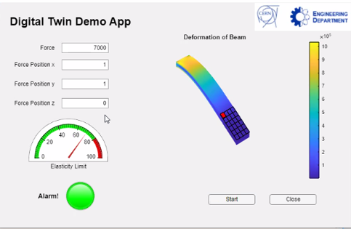
DT PoP : Experimental Setup
Training & Creation of DT Model:
Hybrid training: FEM Simulation, DAQ from test
Hybrid Software Algorithm: first steps in machine learning (regression) & neural network models
(parallel software developments)
STATUS:
Design of Experiment done
PT Fabrication & QA ongoing
DT ‘’Transfer Functions’’ ready

Slide 15
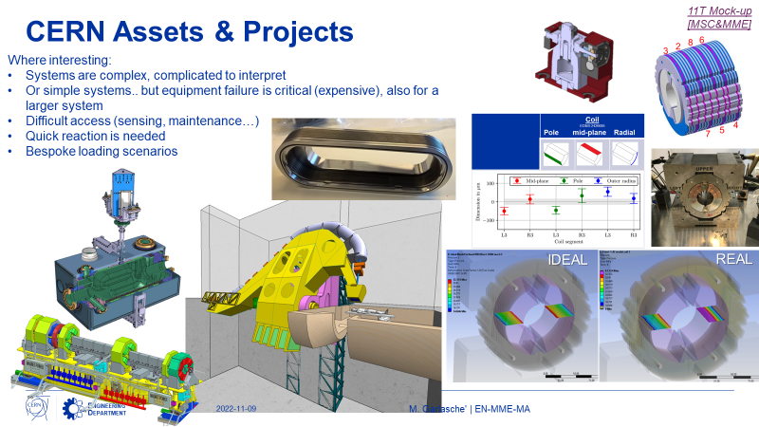
DT Demonstrator
On a full system of components
Based on lessons learned and collaborations defined at PoP stage
Added Features: Real time data on system’s transient state. Based on reduced sensors scenario. Forecasts
Installed in test environment (not in the accelerator chain/experiments)

Slide 16
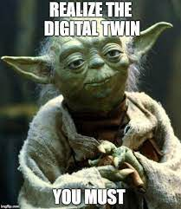
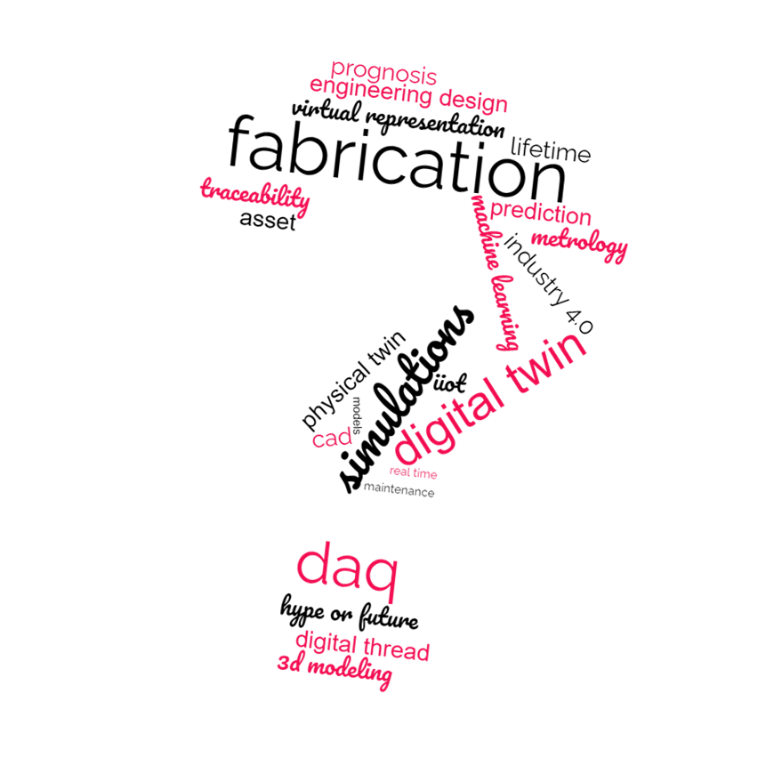
Conclusions
Digital transformation is happening. Instrumental for complex, large CERN projects
  Exciting! But also the near future…
We are well fit for the DT challenge
Trial → Core activities are manageable
PoP → Bringing MME competencies up to speed for DT
NEXT:
Finalise PoP → Demo
Interest by MME users is paramount for successful demonstrator

Slide 18
Digital Twin– a core
Based on the type and amount of data for a Digital Twin „core”, different approaches can be taken:
Machine Learning
Deep Lerning
Hybrid
Clear definition of features
Small dataset – when dataset is too big, there is a risk of overfitting the algorithm during the learning process which results in noise in the output data
Training time is relatively short
Eg. ScikitLearn library for Python
No need of features definition
Big dataset – when dataset is small, deep learning algorithms do not perform well
Training time is relatively long
Eg. Keras library for Python
Improving an empirical or semi-empirical models with gathered experimental data
Obtaining a correction factor for empirical formula based on collected data
Empirical formulas corrected with Machine Learning or Deep Learning

Slide 19



Digital Twin– Transfer Function – hybrid example
Output as a function of input
Data from simulation
Machine Learning
$$y=f{\left(x\right)}_{D}$$
Digital Twin model
output
$$f_{DT}=y+y_{NN}$$
Data from measurements
Deep Learning Neural Network
Correction factor
$$y_{NN}=NN(F{\left(x\right)}_{D})$$

Slide 20
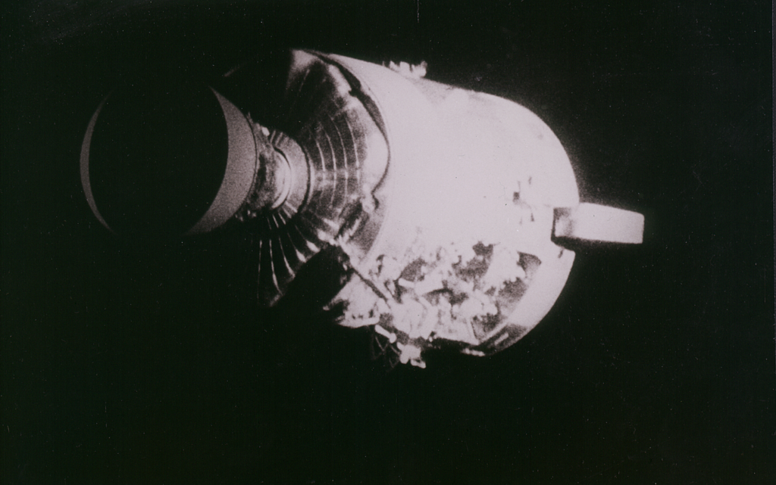
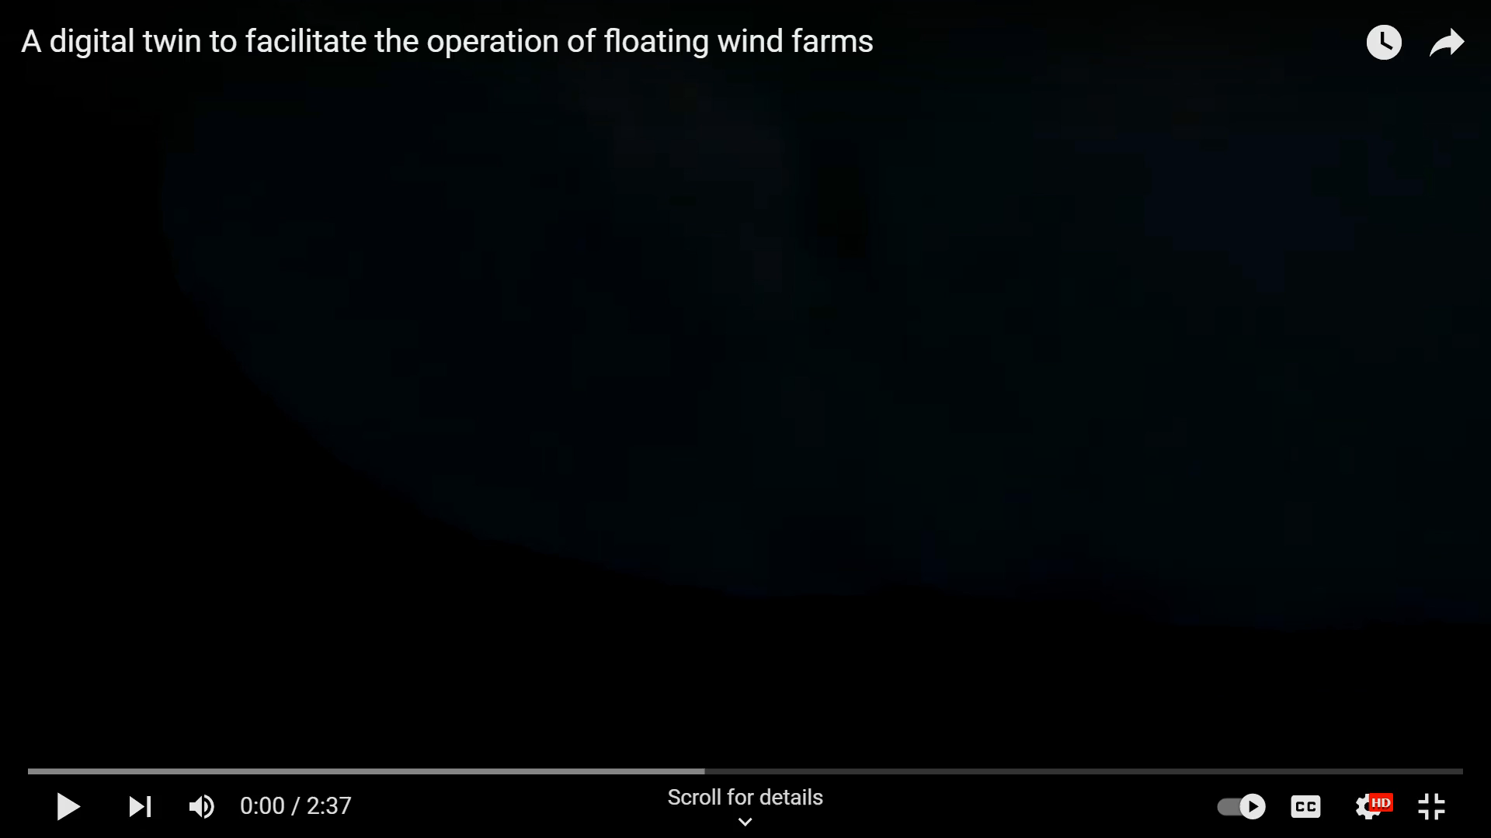
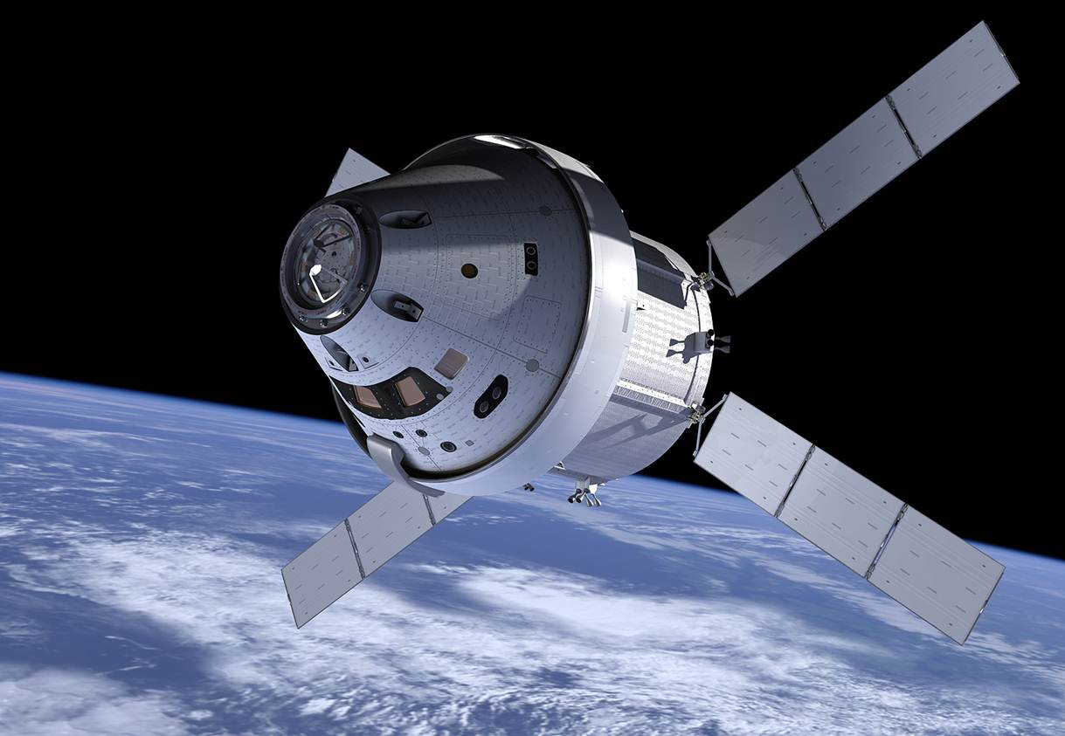
When is DT Useful?
On which Assets?
Expensive. Failure is highly critical, also, for a larger system
Quick reaction is needed
Difficult access for maintenance
Complex, complicated
(…or simple but still somewhat critical…)
Odyssey’s (Apollo 13) service module
ORION Spacecraft
Notes:
Advantages and benefits of digital twins
Better R&D
The use of digital twins enables more effective research and design of products, with an abundance of data created about likely performance outcomes. That information can lead to insights that help companies make needed product refinements before starting production.
Greater efficiency
Even after a new product has gone into production, digital twins can help mirror and monitor production systems, with an eye to achieving and maintaining peak efficiency throughout the entire manufacturing process.
Product end-of-life
Digital twins can even help manufacturers decide what to do with products that reach the end of their product lifecycle and need to receive final processing, through recycling or other measures. By using digital twins, they can determine which product materials can be harvested.
Digital twin market and industries
While digital twins are prized for what they offer, their use isn’t warranted for every manufacturer or every product created. Not every object is complex enough to need the intense and regular flow of sensor data that digital twins require. Nor is it always worth it from a financial standpoint to invest significant resources in the creation of a digital twin. (Keep in mind that a digital twin is an exact replica of a physical object, which could make its creation costly.)
On the other hand, numerous types of projects do specifically benefit from the use of digital models:
Physically large projects Buildings, bridges and other complex structures bound by strict rules of engineering.
Mechanically complex projects Jet turbines, automobiles and aircraft. Digital twins can help improve efficiency within complicated machinery and mammoth engines.
Power equipment This includes both the mechanisms for generating power and transmitting it.
Manufacturing projects Digital twins excel at helping streamline process efficiency, as you would find in industrial environments with co-functioning machine systems.

Slide 21
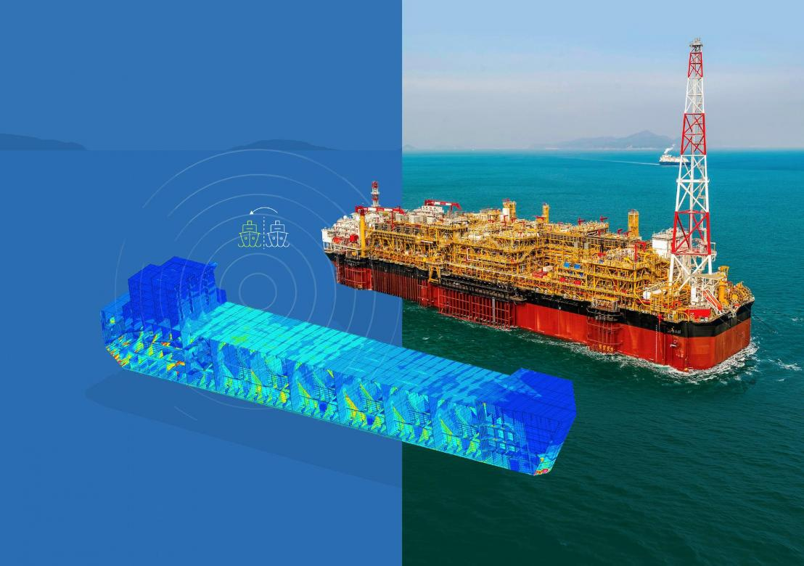
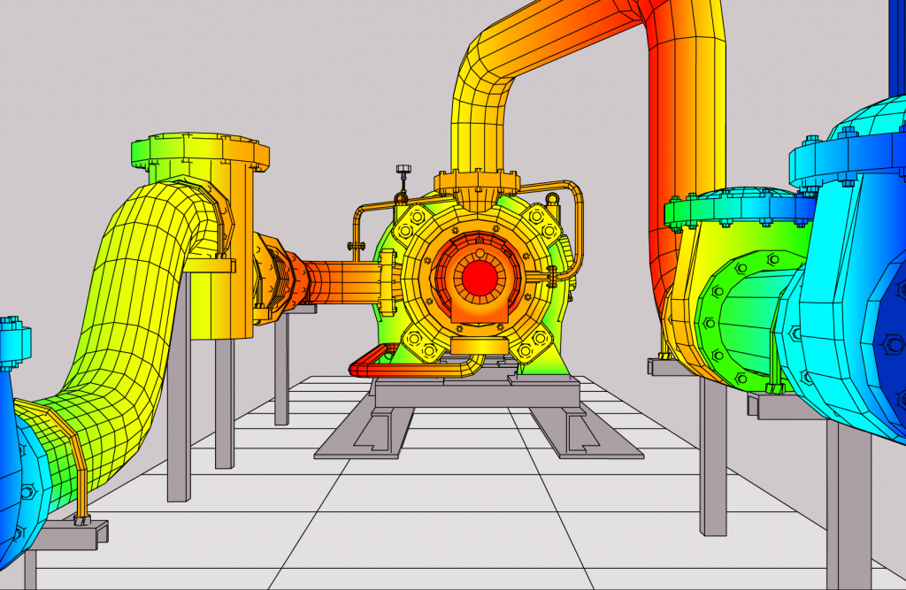
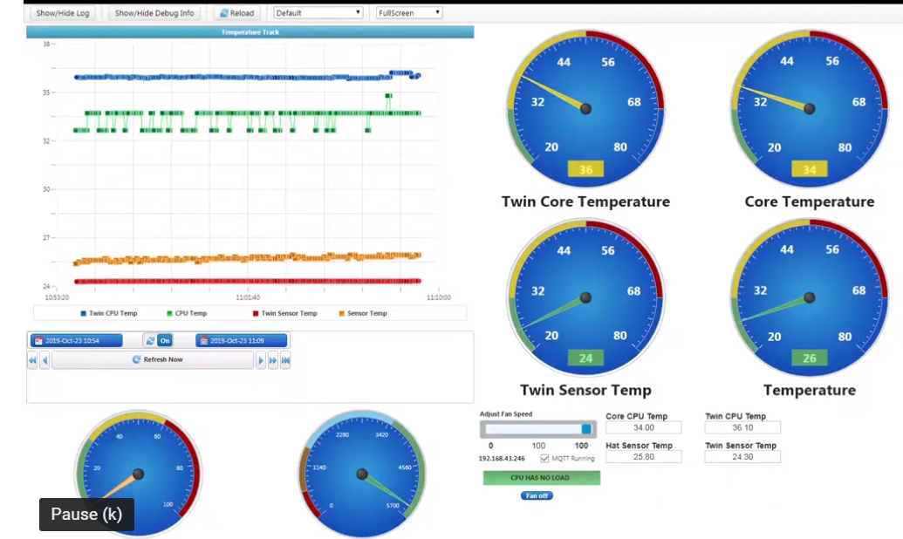
On Input Data…
Real Time Prognosis
Asset Representation
Data Acquisition
Physical Data-based Models
CAD
PLM
IIOT
4.0
Integrated FEA
Data Analysis
VR
AR
Machine Learning
Deep Learning
Digital Thread
Digital Twin

Slide 22
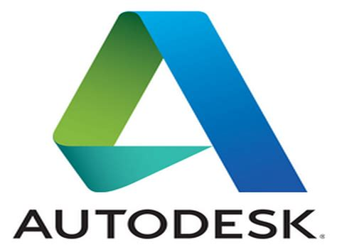










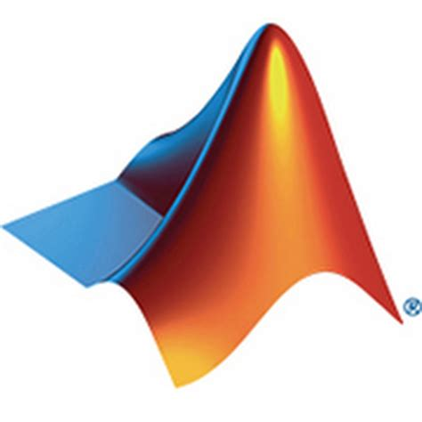
Not Shooting for the Stars
MME Interest and Know-How
Highly Concurrent Design (lifetime..)
Engineering & Calculations
Material properties & their evolution
Fabrication, Assembly, Maintenance
Controls & QA (Metrology, characterizations, DT & NDT,..)
Multiphysics Mechanical Measurements
… competencies held within MME DT WG
Notes:
Ability to well rooted interaction with Equipment owners

Slide 23
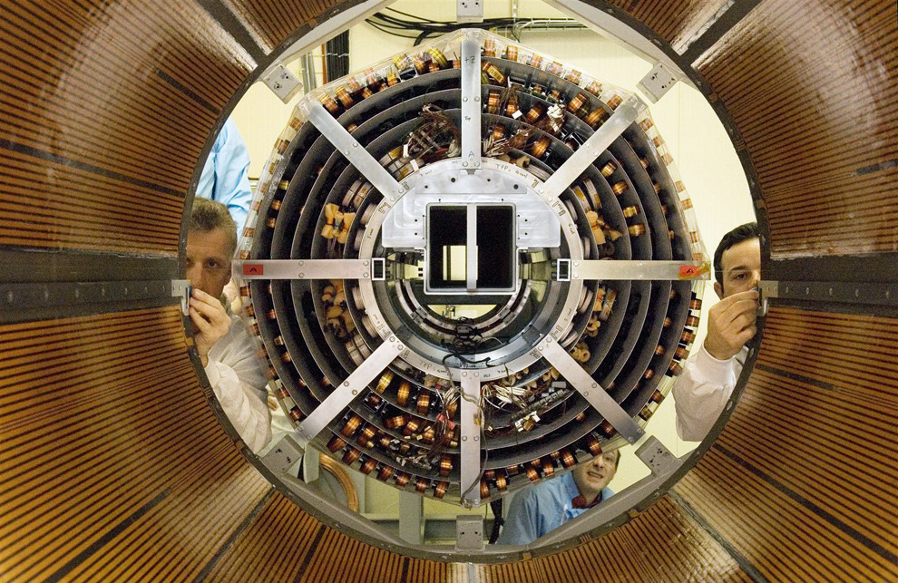
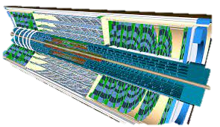
DT Demonstrator : ATLAS Inner Tracker Upgrade
  Vibration issues / Mechanical instabilities are a key element for the future of CERN equipment’s (LHC beam stability, Detectors, etc…) :
  Higher luminosity ➔ Smaller beam size ➔
  Higher mechanical stability

Slide 24







DT Demonstrator :
ATLAS Inner Tracker Upgrade
  Experimental Modal Analysis prior to the cavern installation
  Thermal expansion coefficient of several composite structures :

Slide 25



DT Demonstrator :
ATLAS Inner Tracker Upgrade
  Online ground motion measurements in the ATLAS cavern
  Online strain measurements based on optical fibre measurements (Bragg and/or Rayleigh Backscattering)
Lab Dashboard

Slide 26



DT Initial Trial: ATLAS Inner Tracker Truss
DT
PT Data
Courtesy of EP/DT & G. Papazoglou (EN/MME)

Slide 27

DT Initial Trial: ATLAS Inner Tracker Truss
STATUS
DONE. First successful implementation of all DT building blocks
Initial trial. Thus missing:
Live Data feed
DT-level asset representation (PLM, QA, …)
More structured Modelling
Representation of present, no forecast

