Slide 1
Surface contamination detection by FTIR and XRF spectroscopy
Benoit Teissandier – TE/VSC
Chemistry Lab. (10/R-015)
09/11/2022

Slide 2
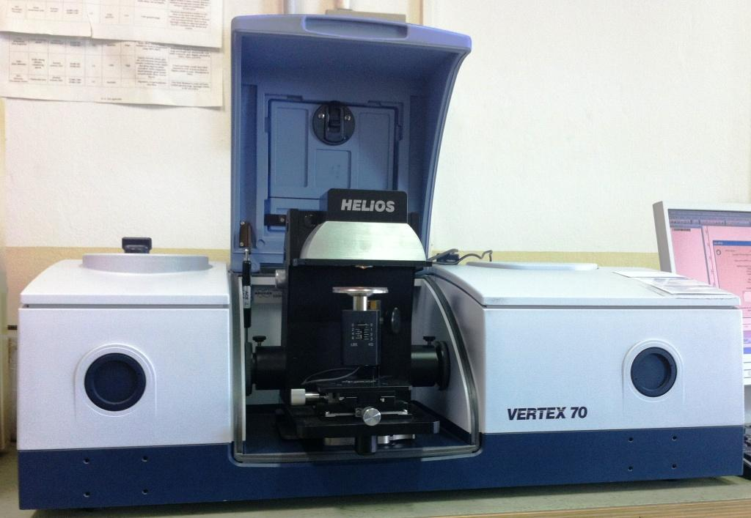
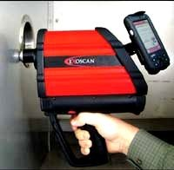
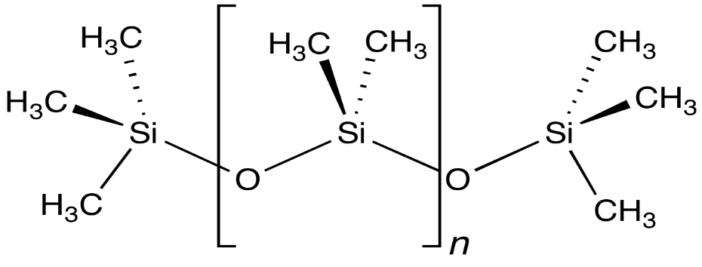


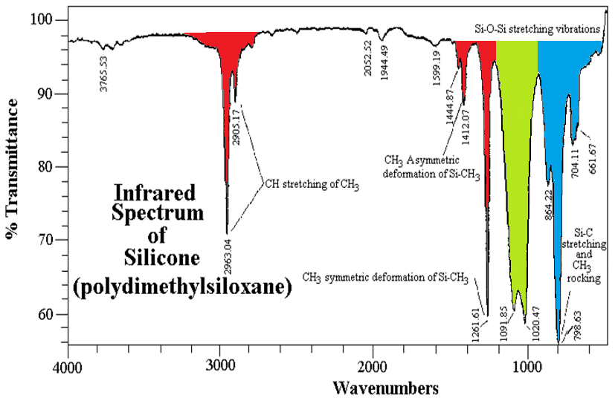
Analysis of organic compounds by infrared spectroscopy
e.g.: Silicone oil
Lab. Spectrometer : Bruker Vertex 70
Handheld : Agilent Exoscan 4100
ZnS Window
Polychromatic IR light
Identification / characterisation of solid, liquid and gas
  Source of contamination (e.g. UHV applications, gas system for detector, etc.)
  Polymers, cooling fluids and some gas
  Emissivity measurement of metallic substrates
Quantification to ppm level (after calibration)
  Cleanliness assessment for UHV applications or gas system detector
  Cooling fluids purity

Slide 3
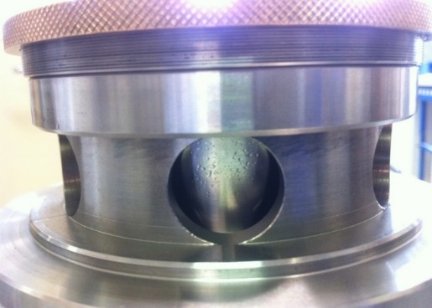
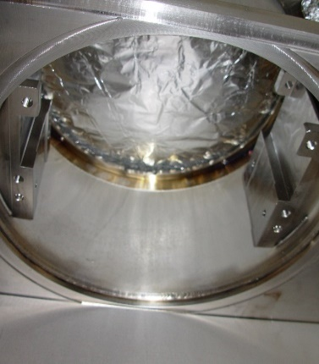
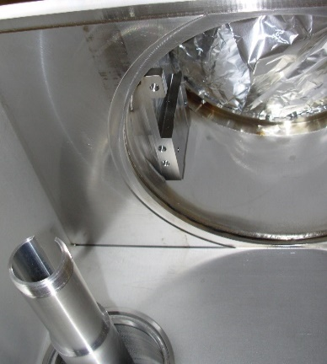
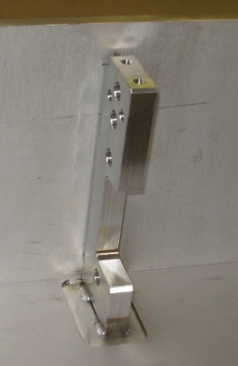
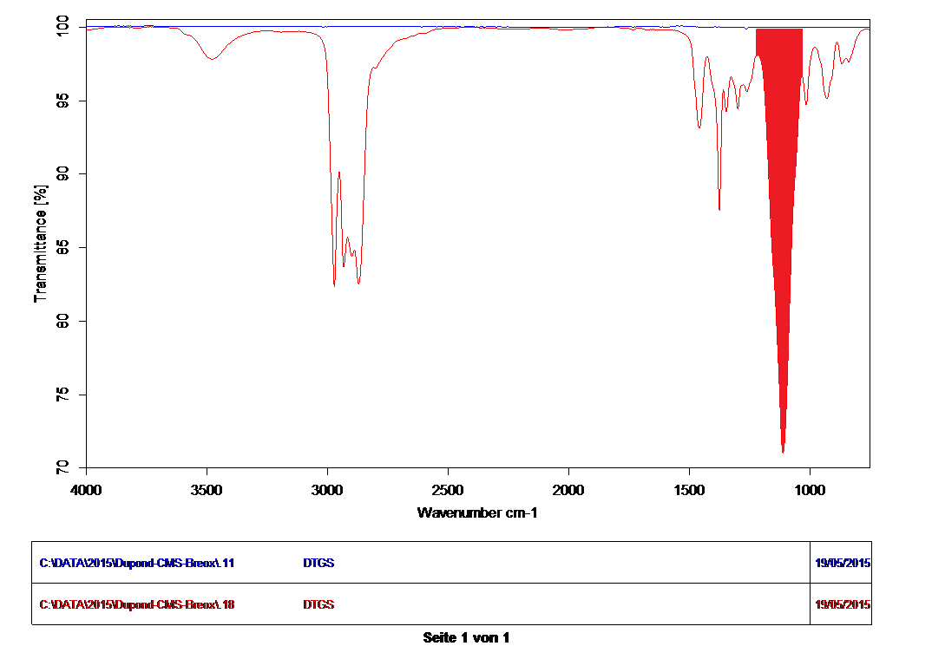
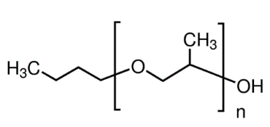
In situ sampling and FTIR identification
Sampling on CMS cryogenic turbine with PTFE membrane
Sampling on LHC collimator tank with PTFE membrane
Helium compressor oil
Breox B35
Oil from tungsten
machining

Slide 4
Quantification and detection limit
Detection limit of hydrocarbon contamination on stainless steel surface
Detection limit of Dimethylsiloxane on stainless steel surface
n ≈ 1235
0.1 µg/cm²
Référence Inox propre
2.3 µg/cm²
1.15 µg/cm²
0.46 µg/cm²
0.23 µg/cm²
0.115 µg/cm²
  CERN standard contamination :
  Cutting oil: Blasocut BC 35 LF SW (33 % v/v)
  Machine oil: Shell Vitrea 150 (33 % v/v)
  Bearing grease : Kluber Isoflex NBU 15 (33 % v/v)
Order of magnitude ≈ 1 molecular layer
EDMS N° : 1332721 & 347564

Slide 5
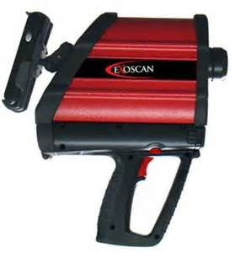
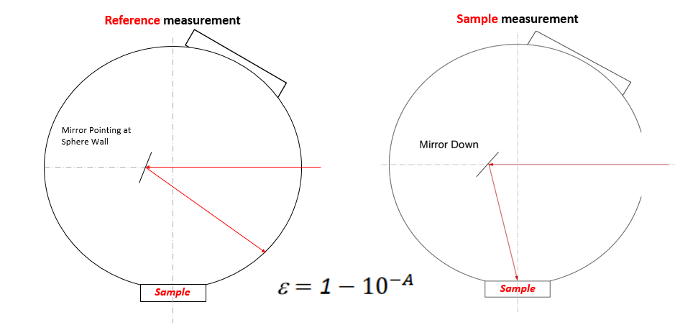
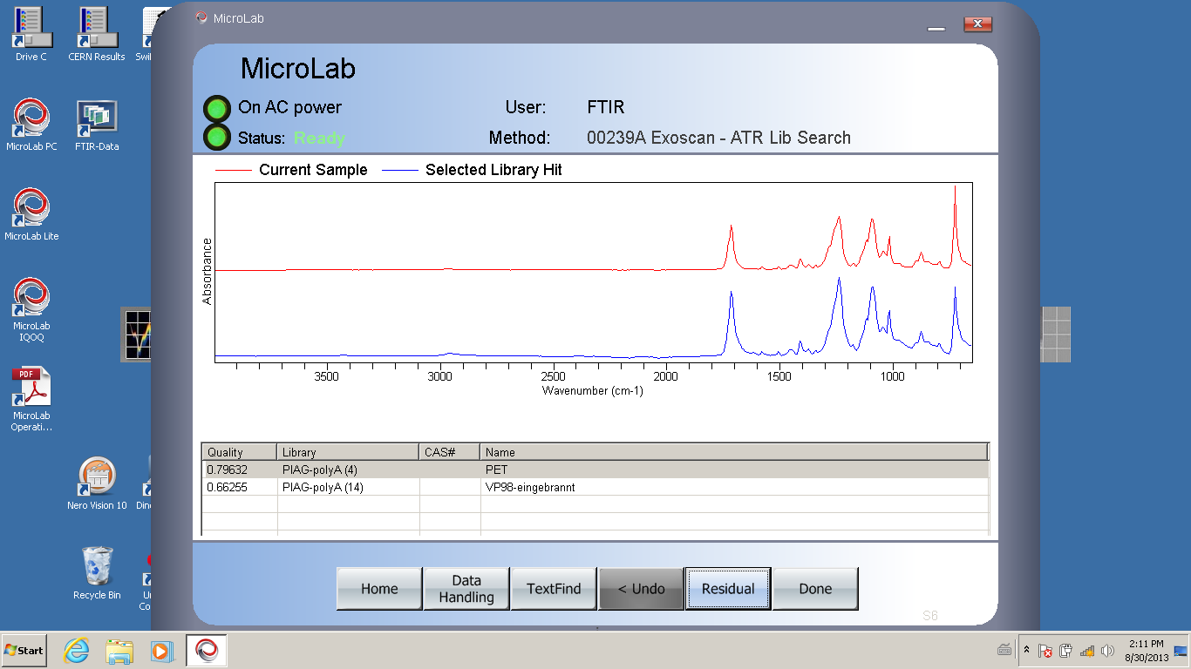
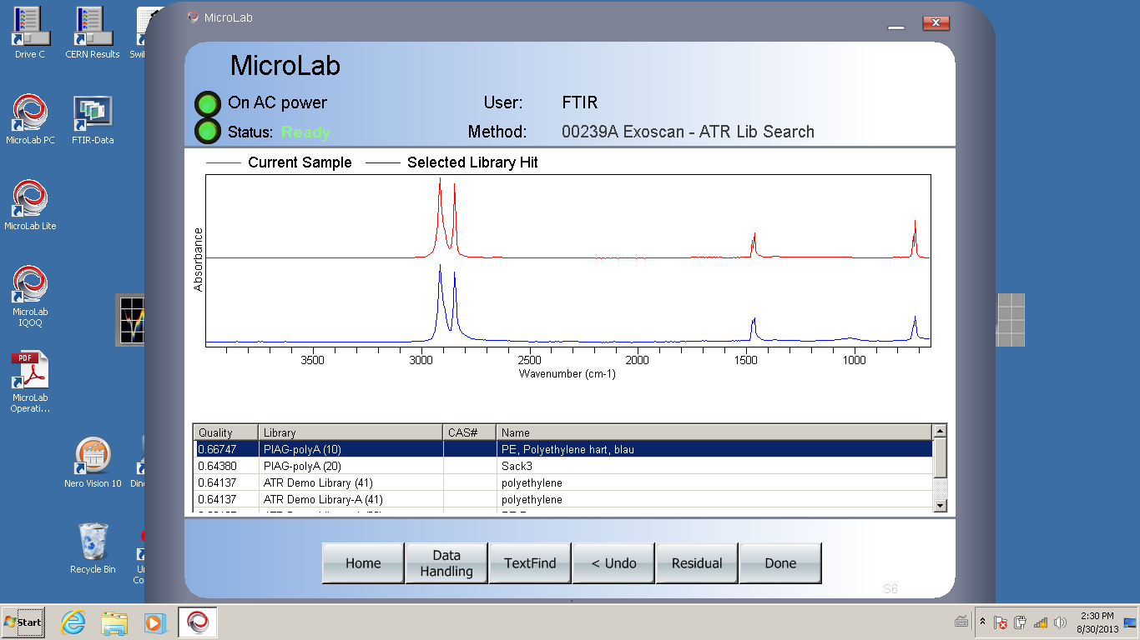
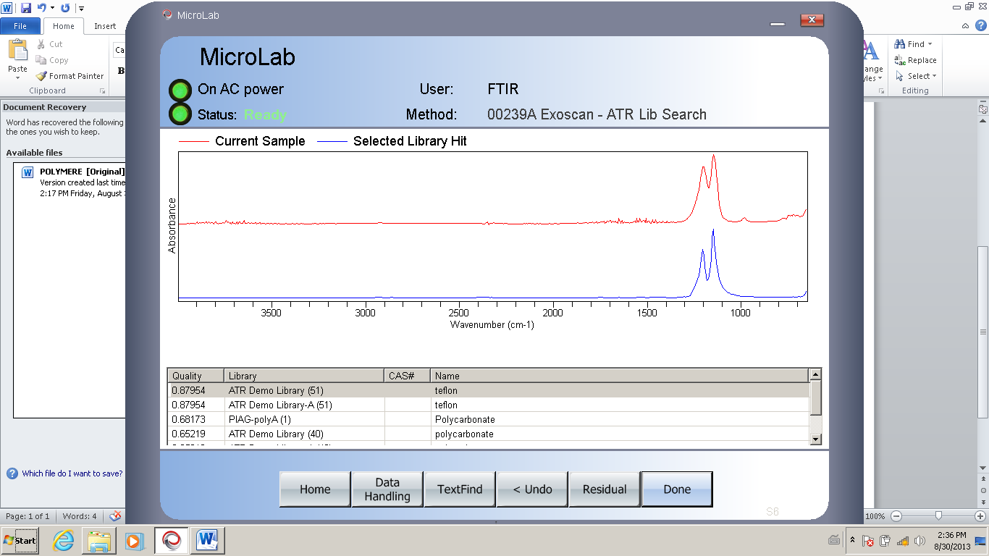

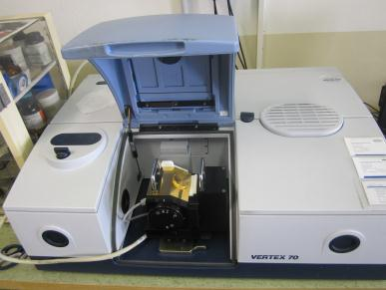
Others FTIR applications fields
Emissivity of metallic surfaces
Identification of polymers in situ
Polyethylene terephthalate (PET)
Polyethylene (PE)
Polytetrafluoroethylene (PTFE)
Ethylene-vinyl acetate (EVA)

Slide 6
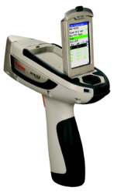
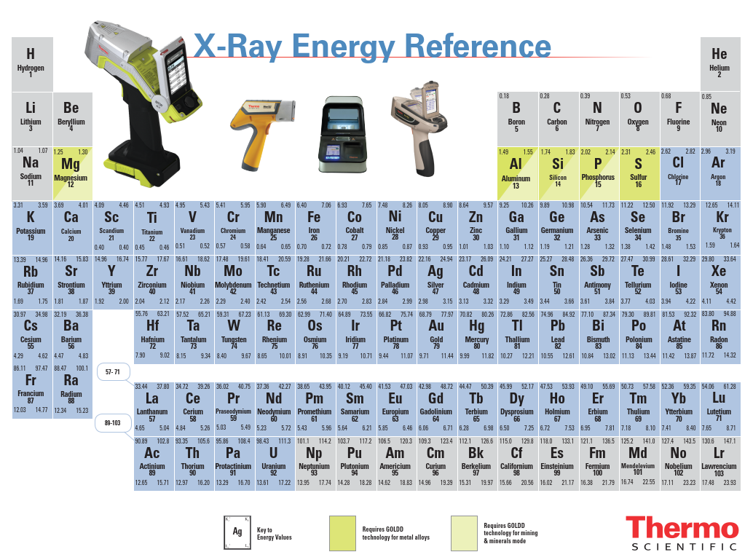
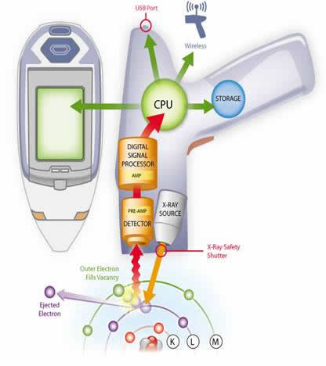
Analysis of inorganic compounds by XRF spectroscopy
Niton XL3t GOLDD+

Slide 7
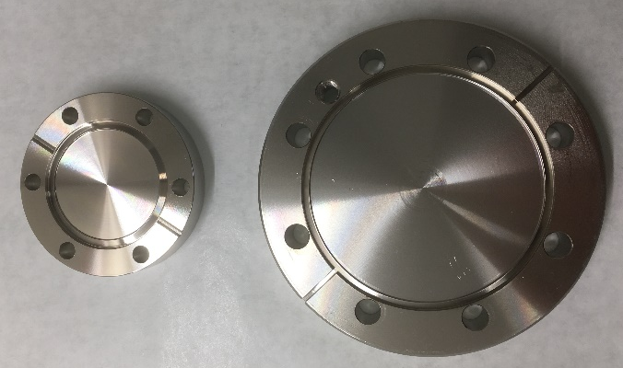
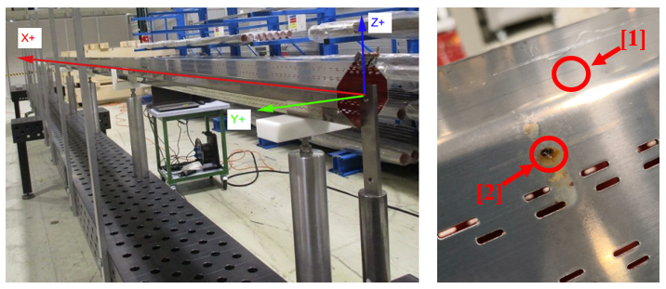
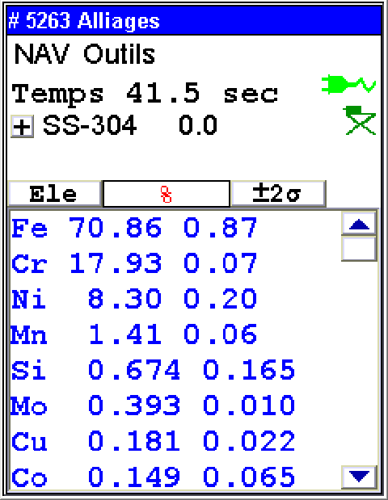
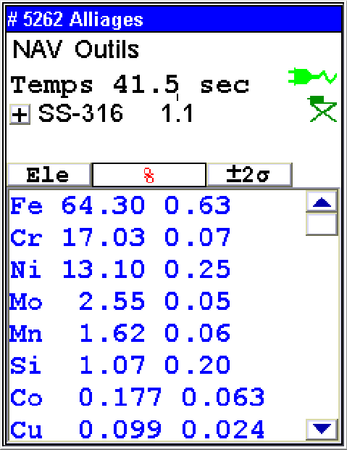
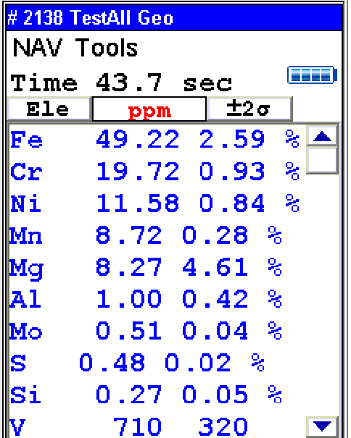
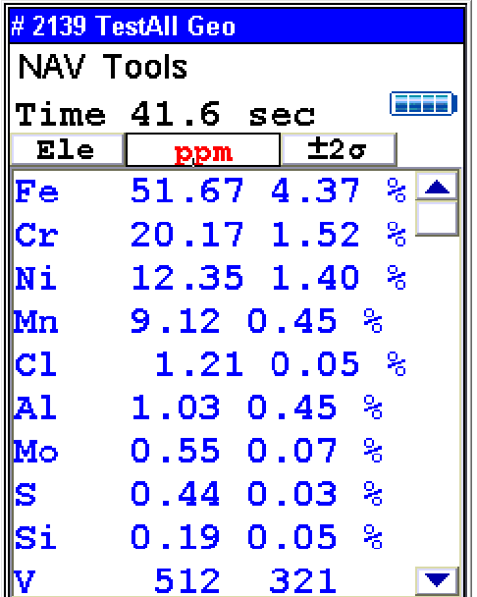
In situ XRF analysis
Alloy discrimination
Chlorine detection in corrosion point on HL-LHC beam screen
SS-304 or SS-316 ?
(presence of Mo in SS-316)
Discrimination in less than
2 seconds !
[1] – Normal part
[2] – Corrosion part

Slide 8
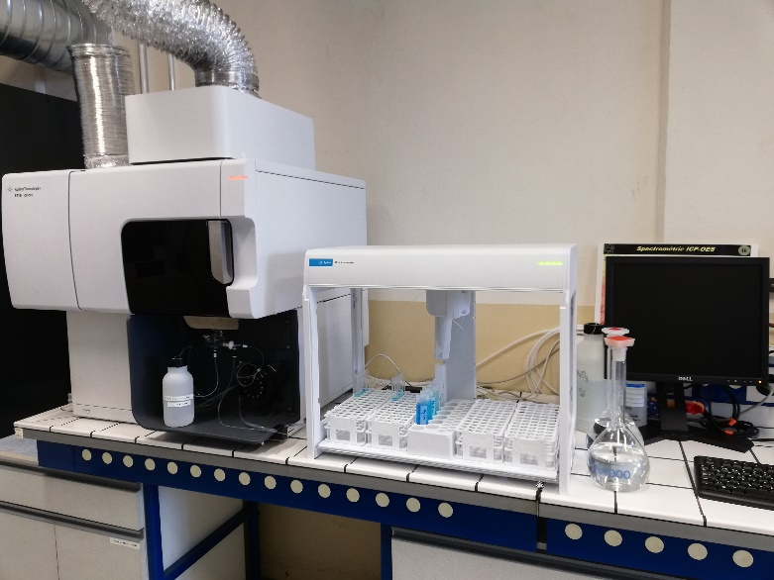
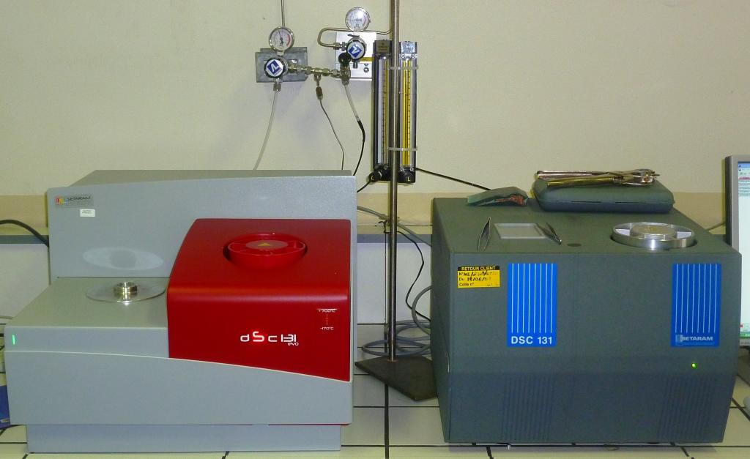
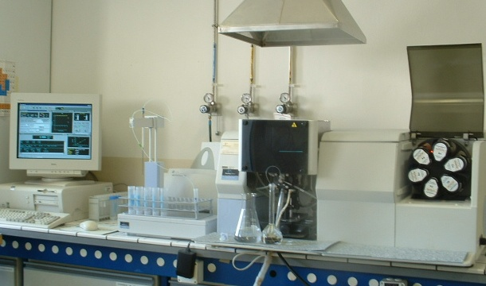


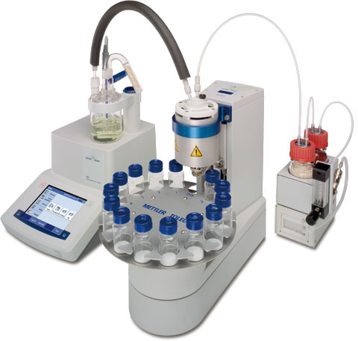
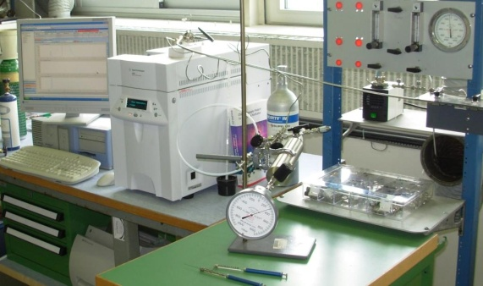
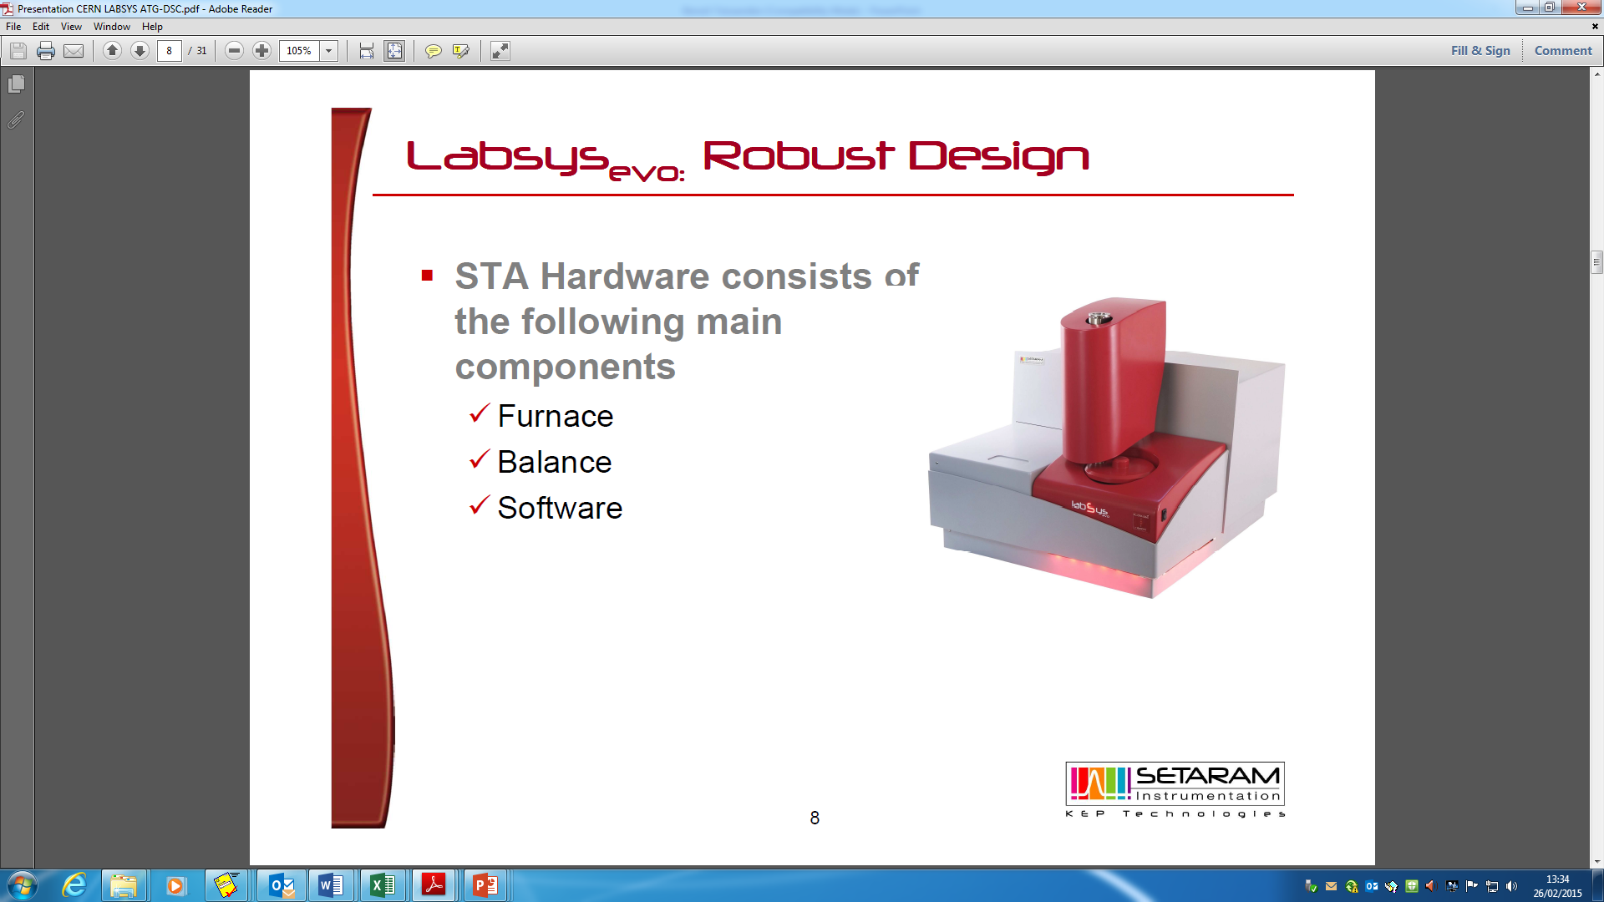
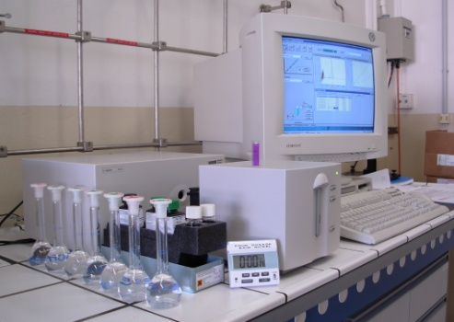
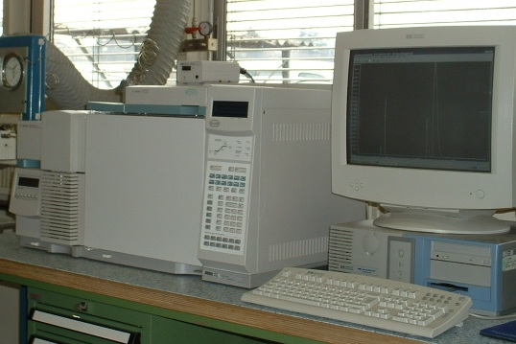
FTIR spectroscopy
Optical Emission Spectroscopy
Differential Scanning Calorimetry
Atomic Absorption Spectroscopy
Thanks for your attention !
For more information :
CERN Chemistry Lab. (10/R-015)
X-ray spectroscopy
Karl Fischer Coulometry
Gas Chromatography
Thermogravimetry
UV-Visible spectroscopy

