Slide 1
Detection of pollution by RGA
Jose A. Ferreira (TE-VSC)

Slide 2
Gas sources
Gas sources of an equipment under vacuum
Different processes produce gases that limit the achievable vacuum for a certain pumping speed
Pumping speed available define maximum acceptable gas load
The acceptance criteria stablishes goals to fulfil the required pressure in the accelerator complex
Bulk diffusion (i.e. water in polymers or H₂ in metals)
Virtual leaks
Thermal outgassing (i.e. water from metals)
Evaporation
Other sources
Leaks
Permeation (i.e. elastomer seals)

Slide 3
Which aspects need to be evaluated?
Criteria For Vacuum Acceptance Tests EDMS 1752123 Presented at IEFC and LMC in April and May 2017 (LCH insulation vacuum not concerned)
Leak tightness
Outgassing rate
Gas composition (contamination)
Virtual leaks

Slide 4
Gas composition (contamination)
Surface for UHV applications: Codification of surface cleanliness levels EDMS 347564.
Levels defined using XPS or IR-FT → Difficult implementation for complex instruments
Element | Analysis technique | Maximum allowed quantity on stainless steel
C | XPS¹ | ESCA5400: 40 at% | SPECS: 39at%
 | IR-FT | ˂ 0.02 AU **
Zn | XPS | Below detection limit (0.5 at%)
Cd | XPS | Below detection limit (0.5 at%)
Cl | XPS | 2 at%
F | XPS | 2 at%
S | XPS | 2 at%
Na | XPS | 2 at%
K | XPS | 2 at%
Ca | XPS | 2 at%
Others | XPS | Any additional element must be reported
Others specific for the application
 |  | The total amount of Cl, F, S, Na, K, Ca and additional elements should not be larger than 10 at%
Residual Gas Analysis as an alternative to study gas composition.
Sensible to volatile contaminants
Not sensible to low vapor pressure elements that should be avoided in the design and fabrication phase (i.e. Zn, Cd, etc.)
Sometimes difficult interpretation

Slide 5
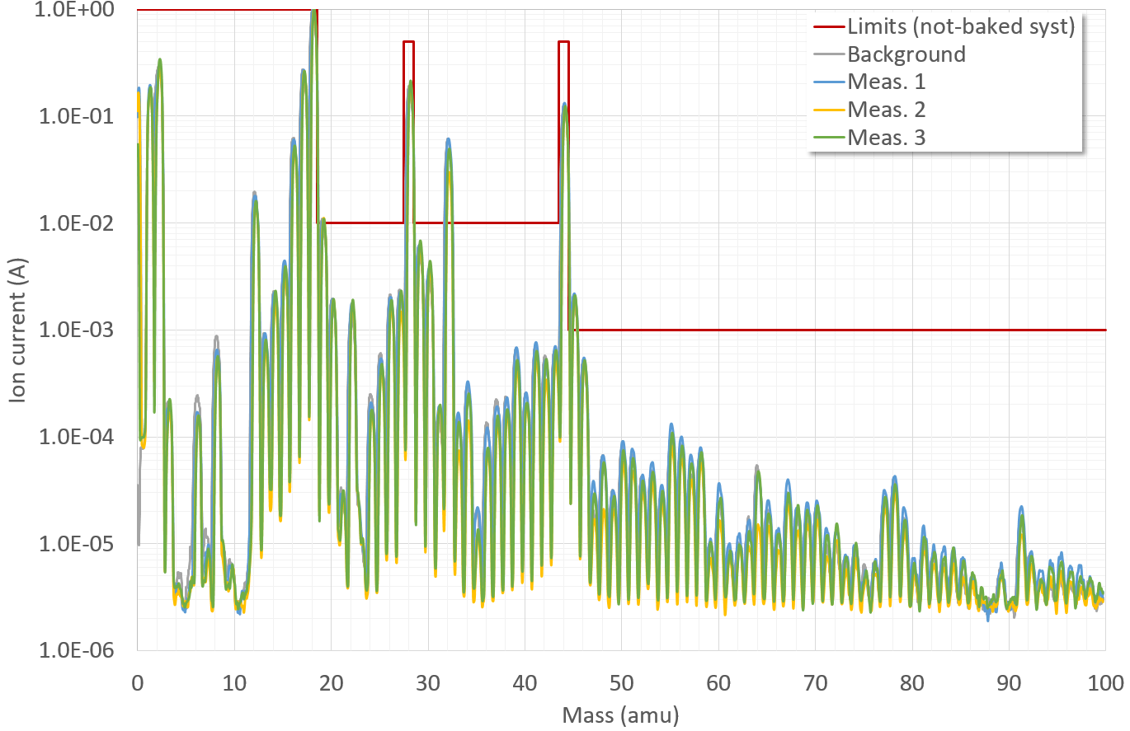
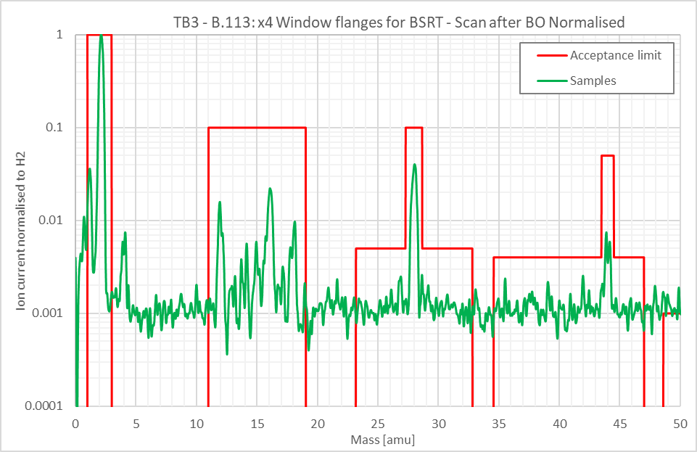
Gas composition (contamination)
Unbaked components:
Reference mass 18 (H₂O)
Masses 18-44 <100× H₂O (except 28 and 44)
Masses >44 <1000×H₂O
Baked components:
Reference mass 2 (H₂)
Masses 3-20 and 28 <10×H₂
Mass 44 <20× H₂
Masses 21-32 <100× H₂
Masses 33-45 <500×H₂
Masses >45 <1000×H₂

Slide 6
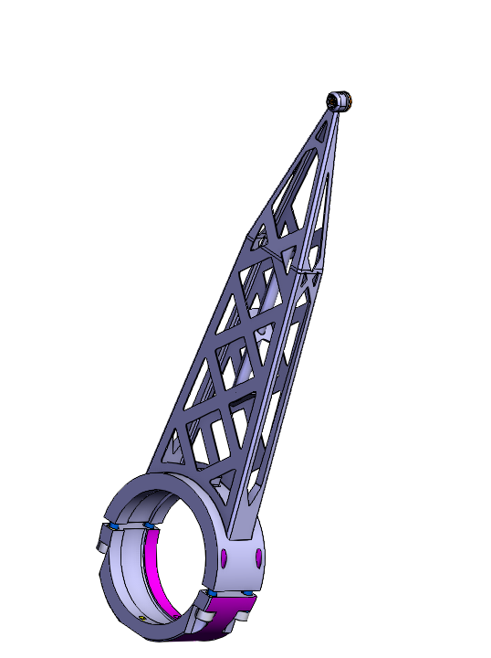
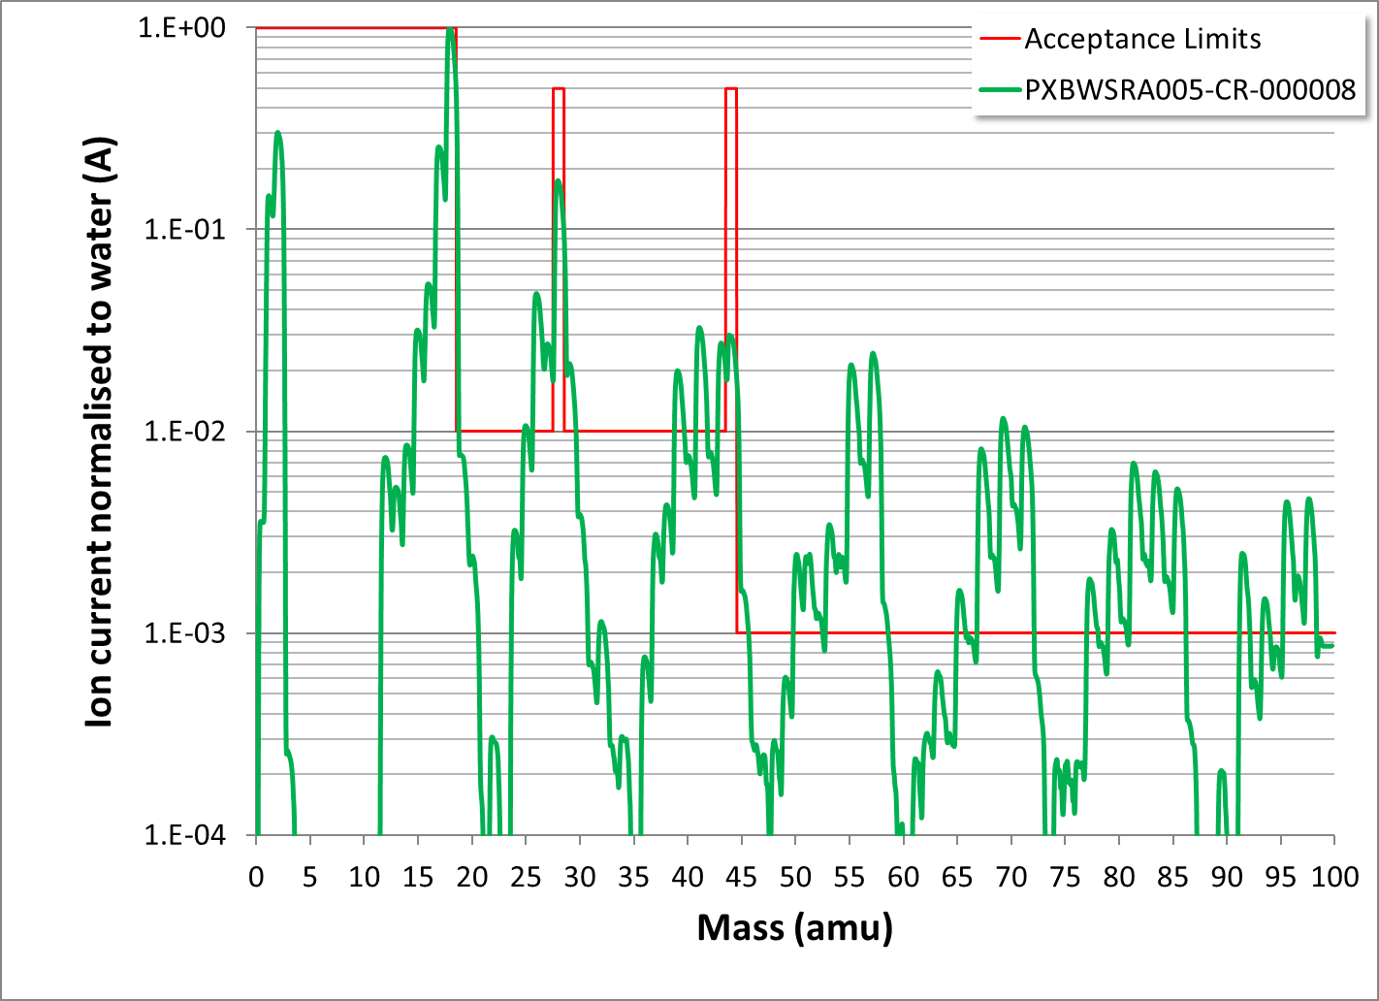
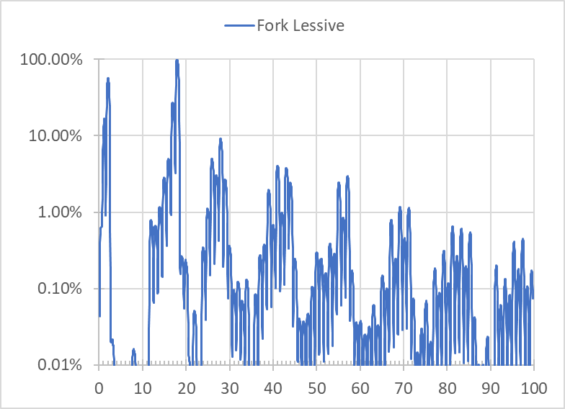
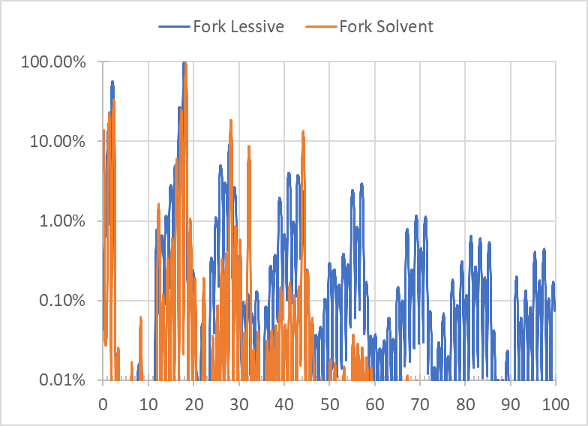
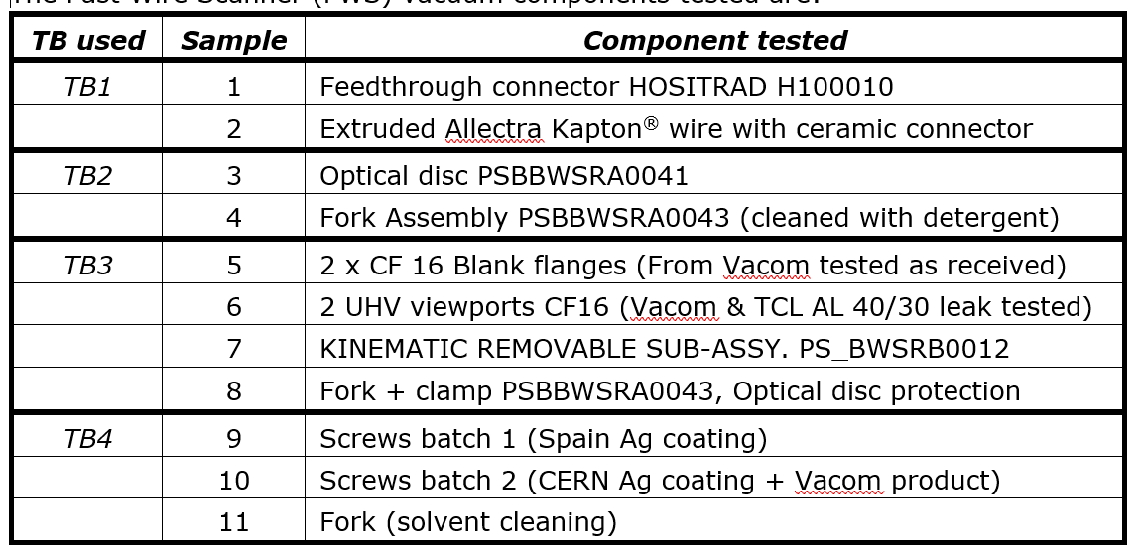
LIU wire scanner
3D printed Titanium
Roughness difficult to clean

Slide 7
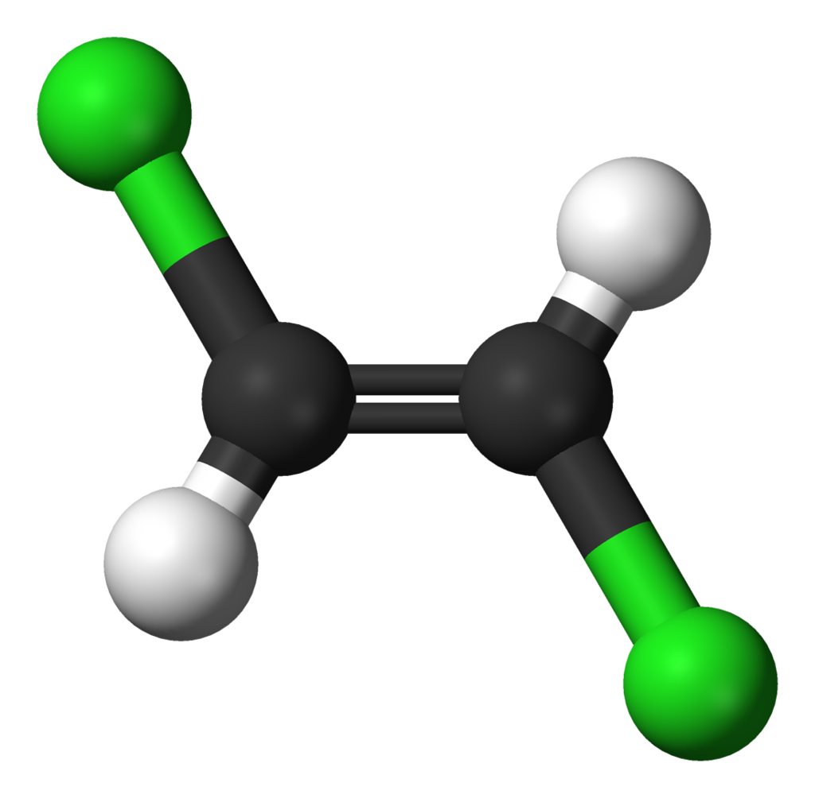
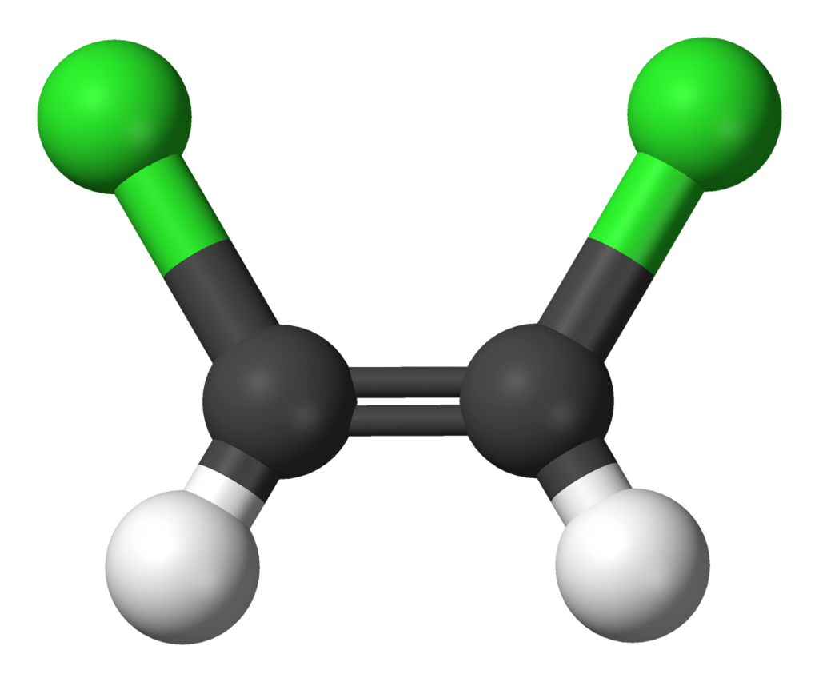
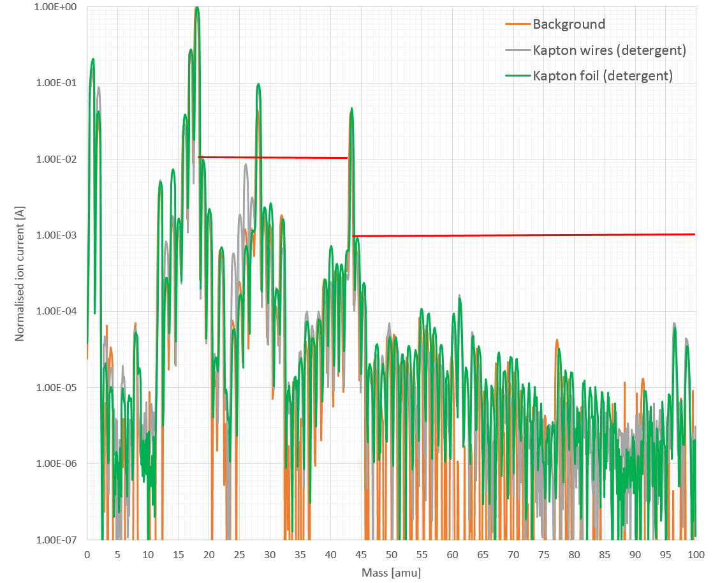
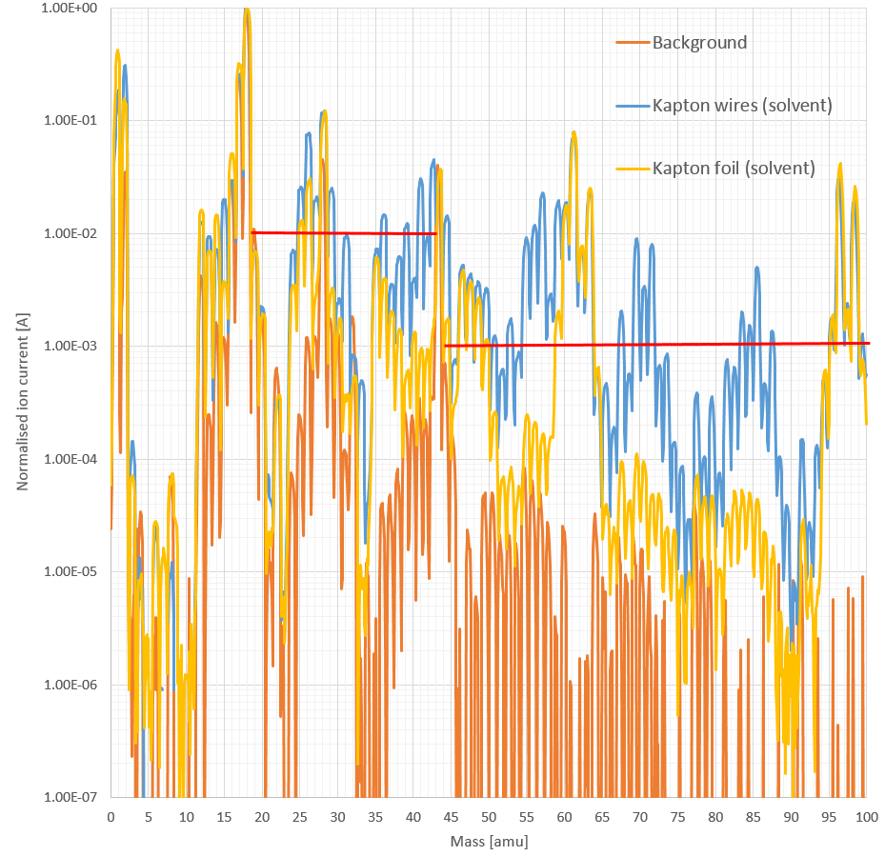
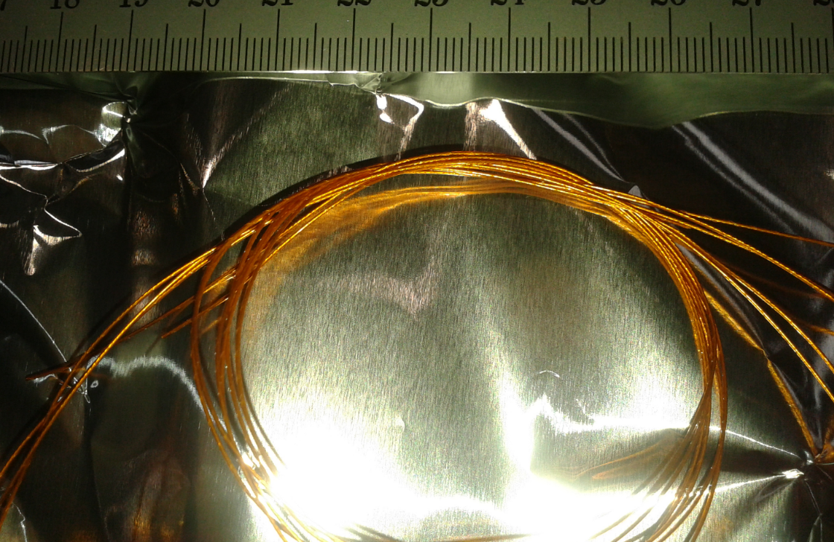
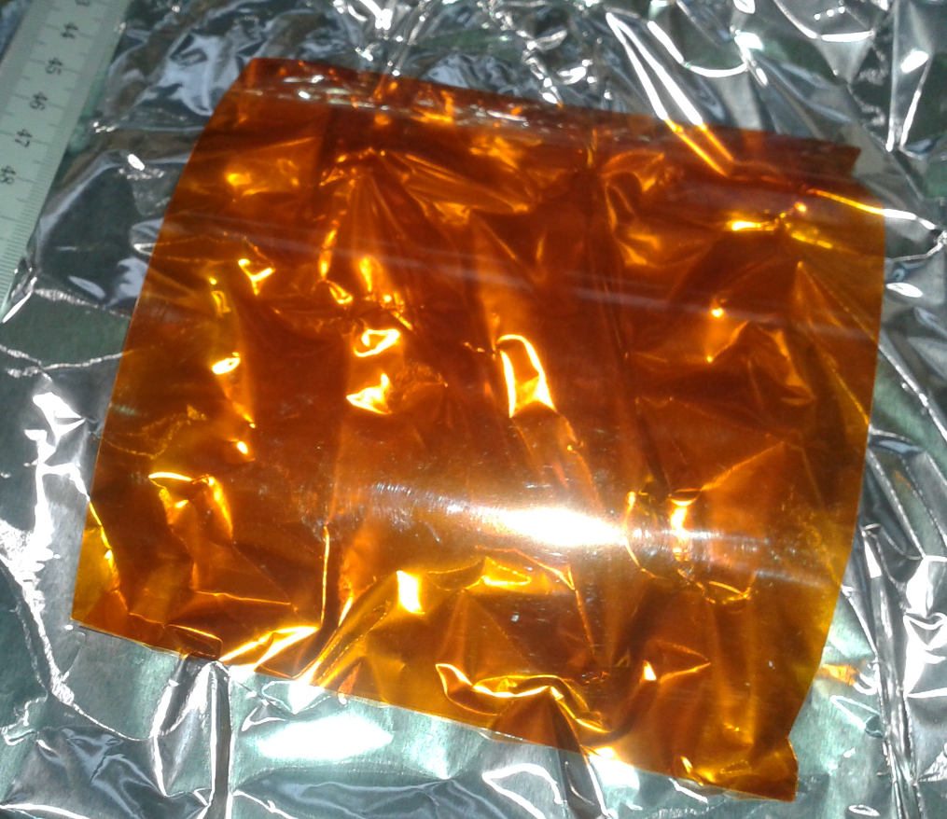
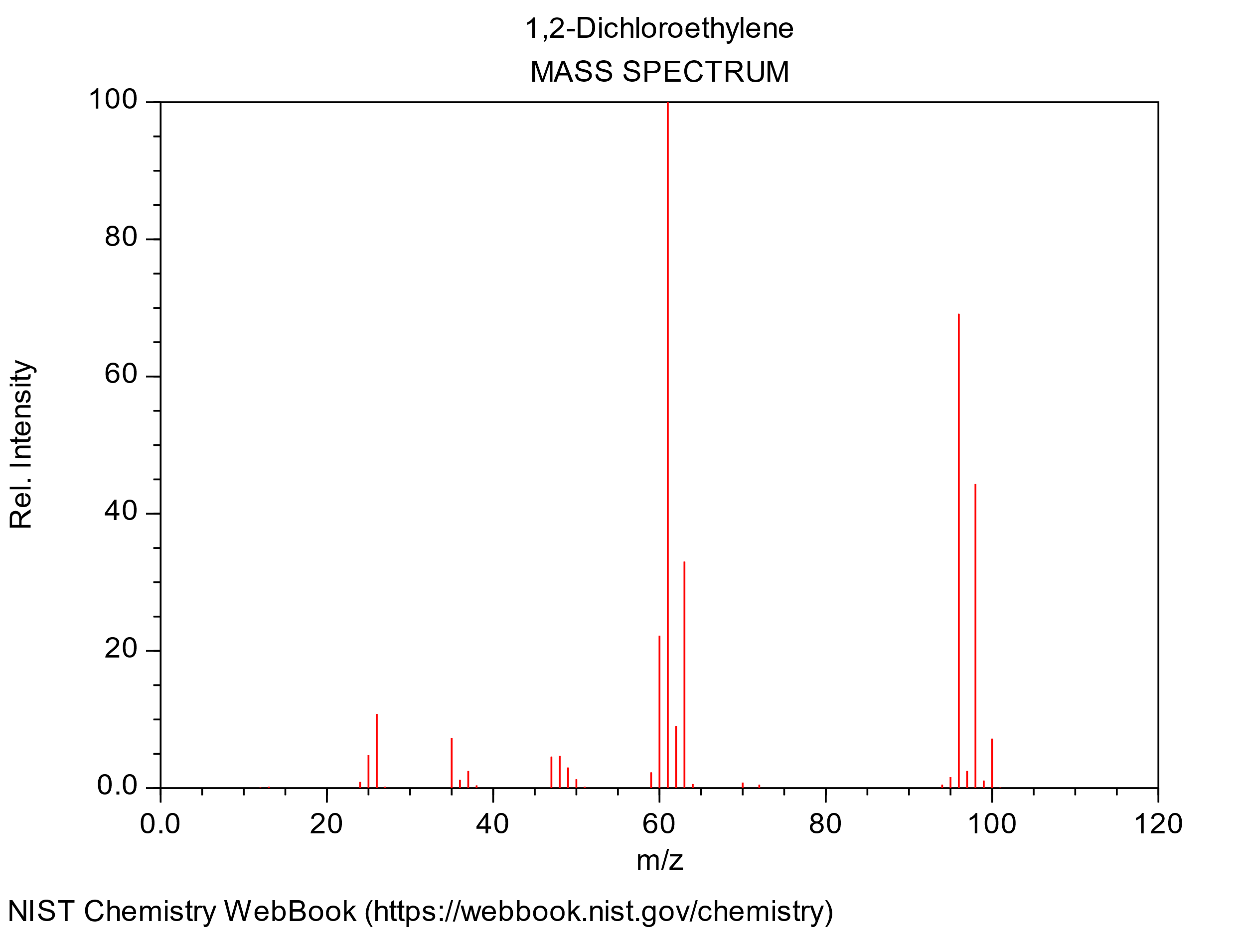
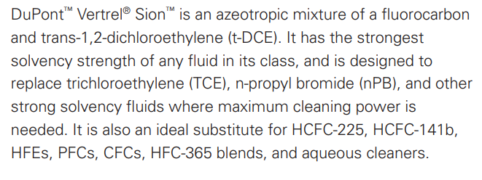
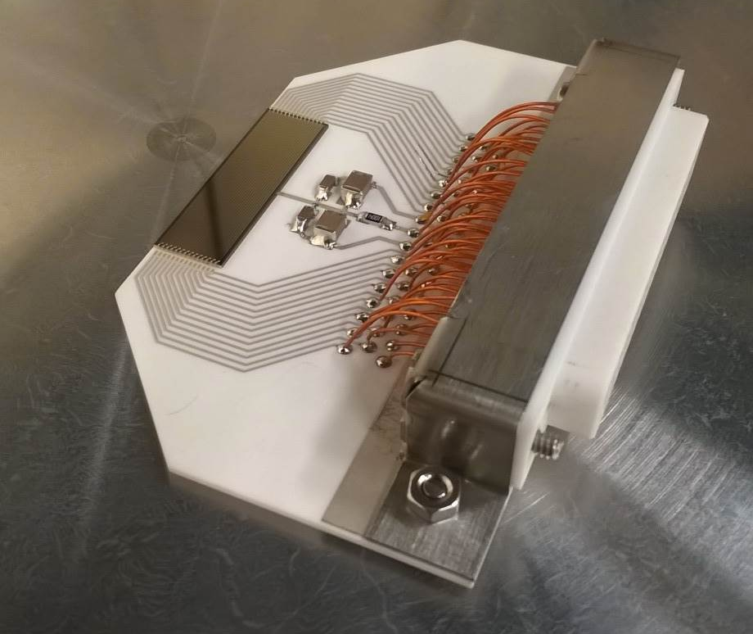
Kapton cleaning

Slide 8
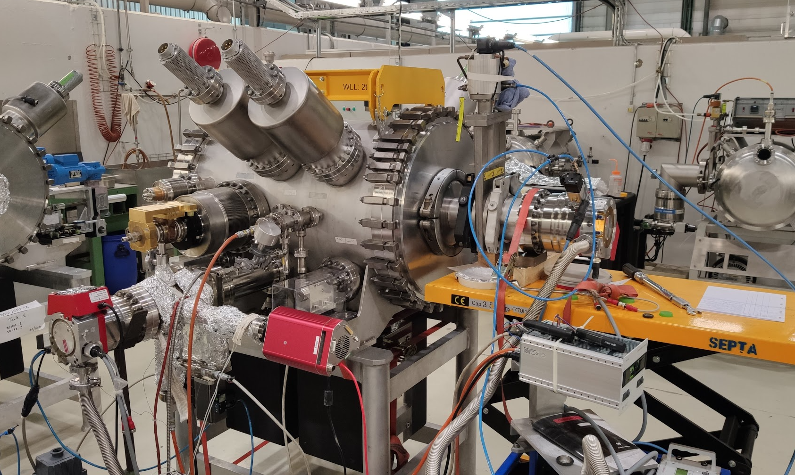
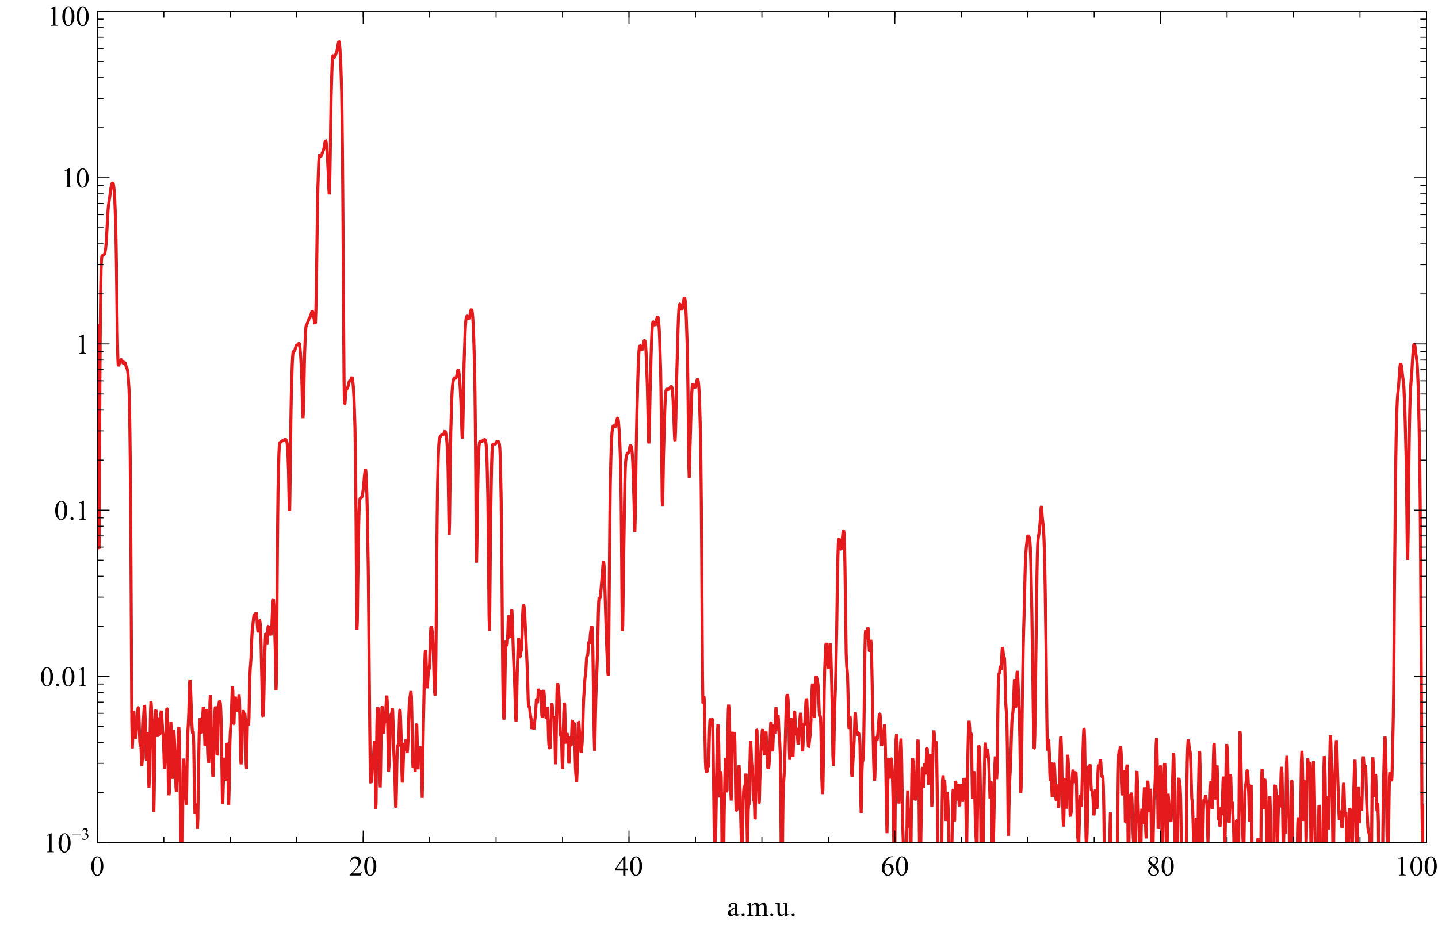
Example PR.SMH42
RGA showing contamination
Candidate molecule N-methyl-2-Pyrrolidone (NMP) → solvent for polyimide
Pyralin (polyimide base polymer) part of SMH42
Confirmation after testing sample
High vapour pressure → Completely removed after bakeout

Slide 9
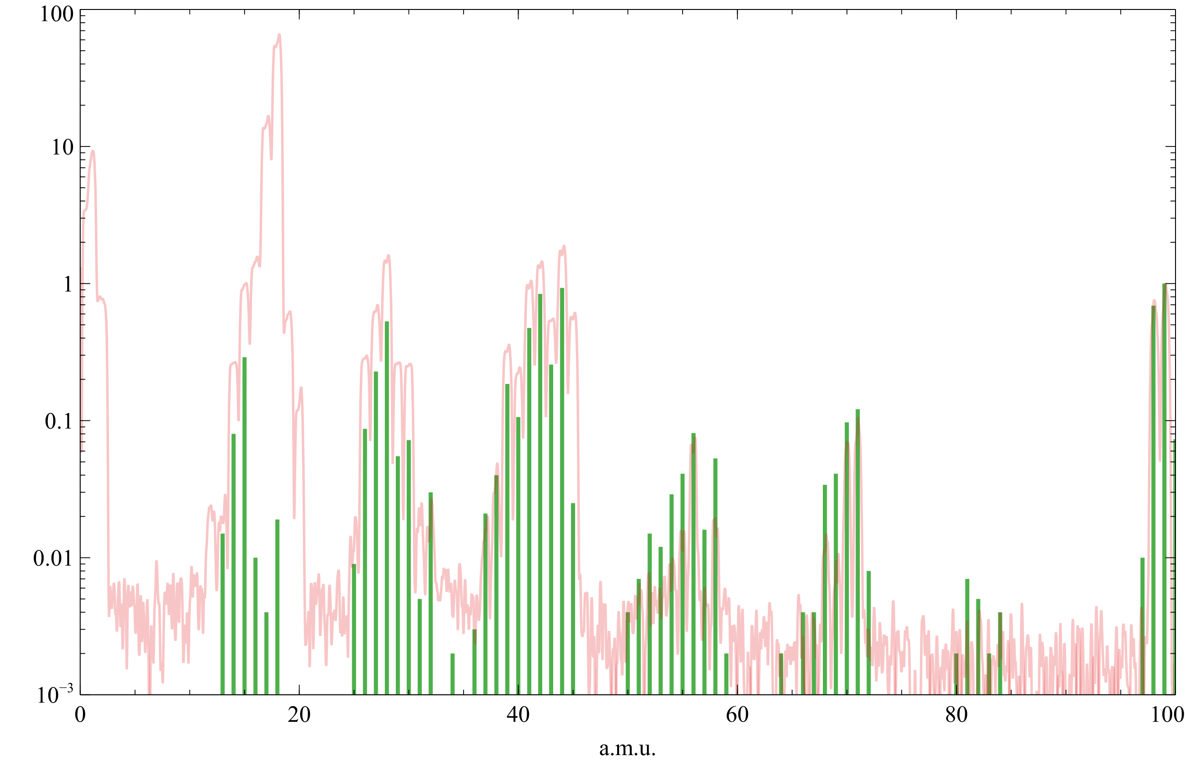
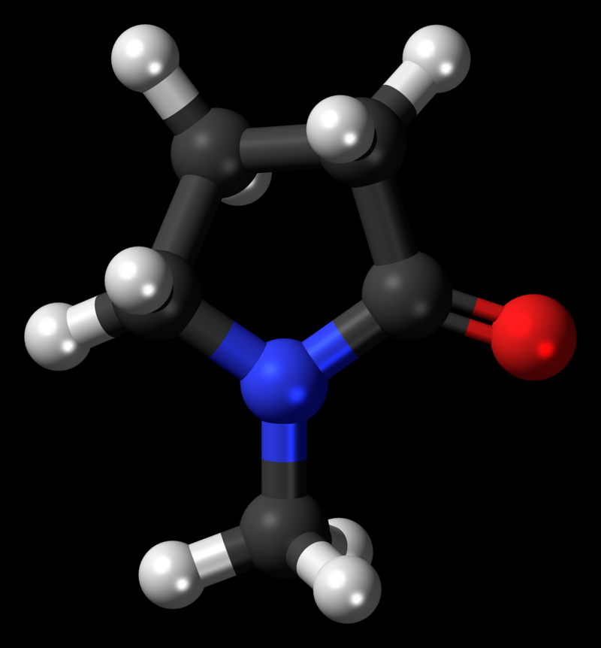
Example PR.SMH42
RGA showing contamination
Candidate molecule N-methyl-2-Pyrrolidone (NMP) → solvent for polyimide
Pyralin (polyimide based polymer) part of SMH42
Confirmation after testing sample
High vapour pressure → Completely removed after bakeout

Slide 10
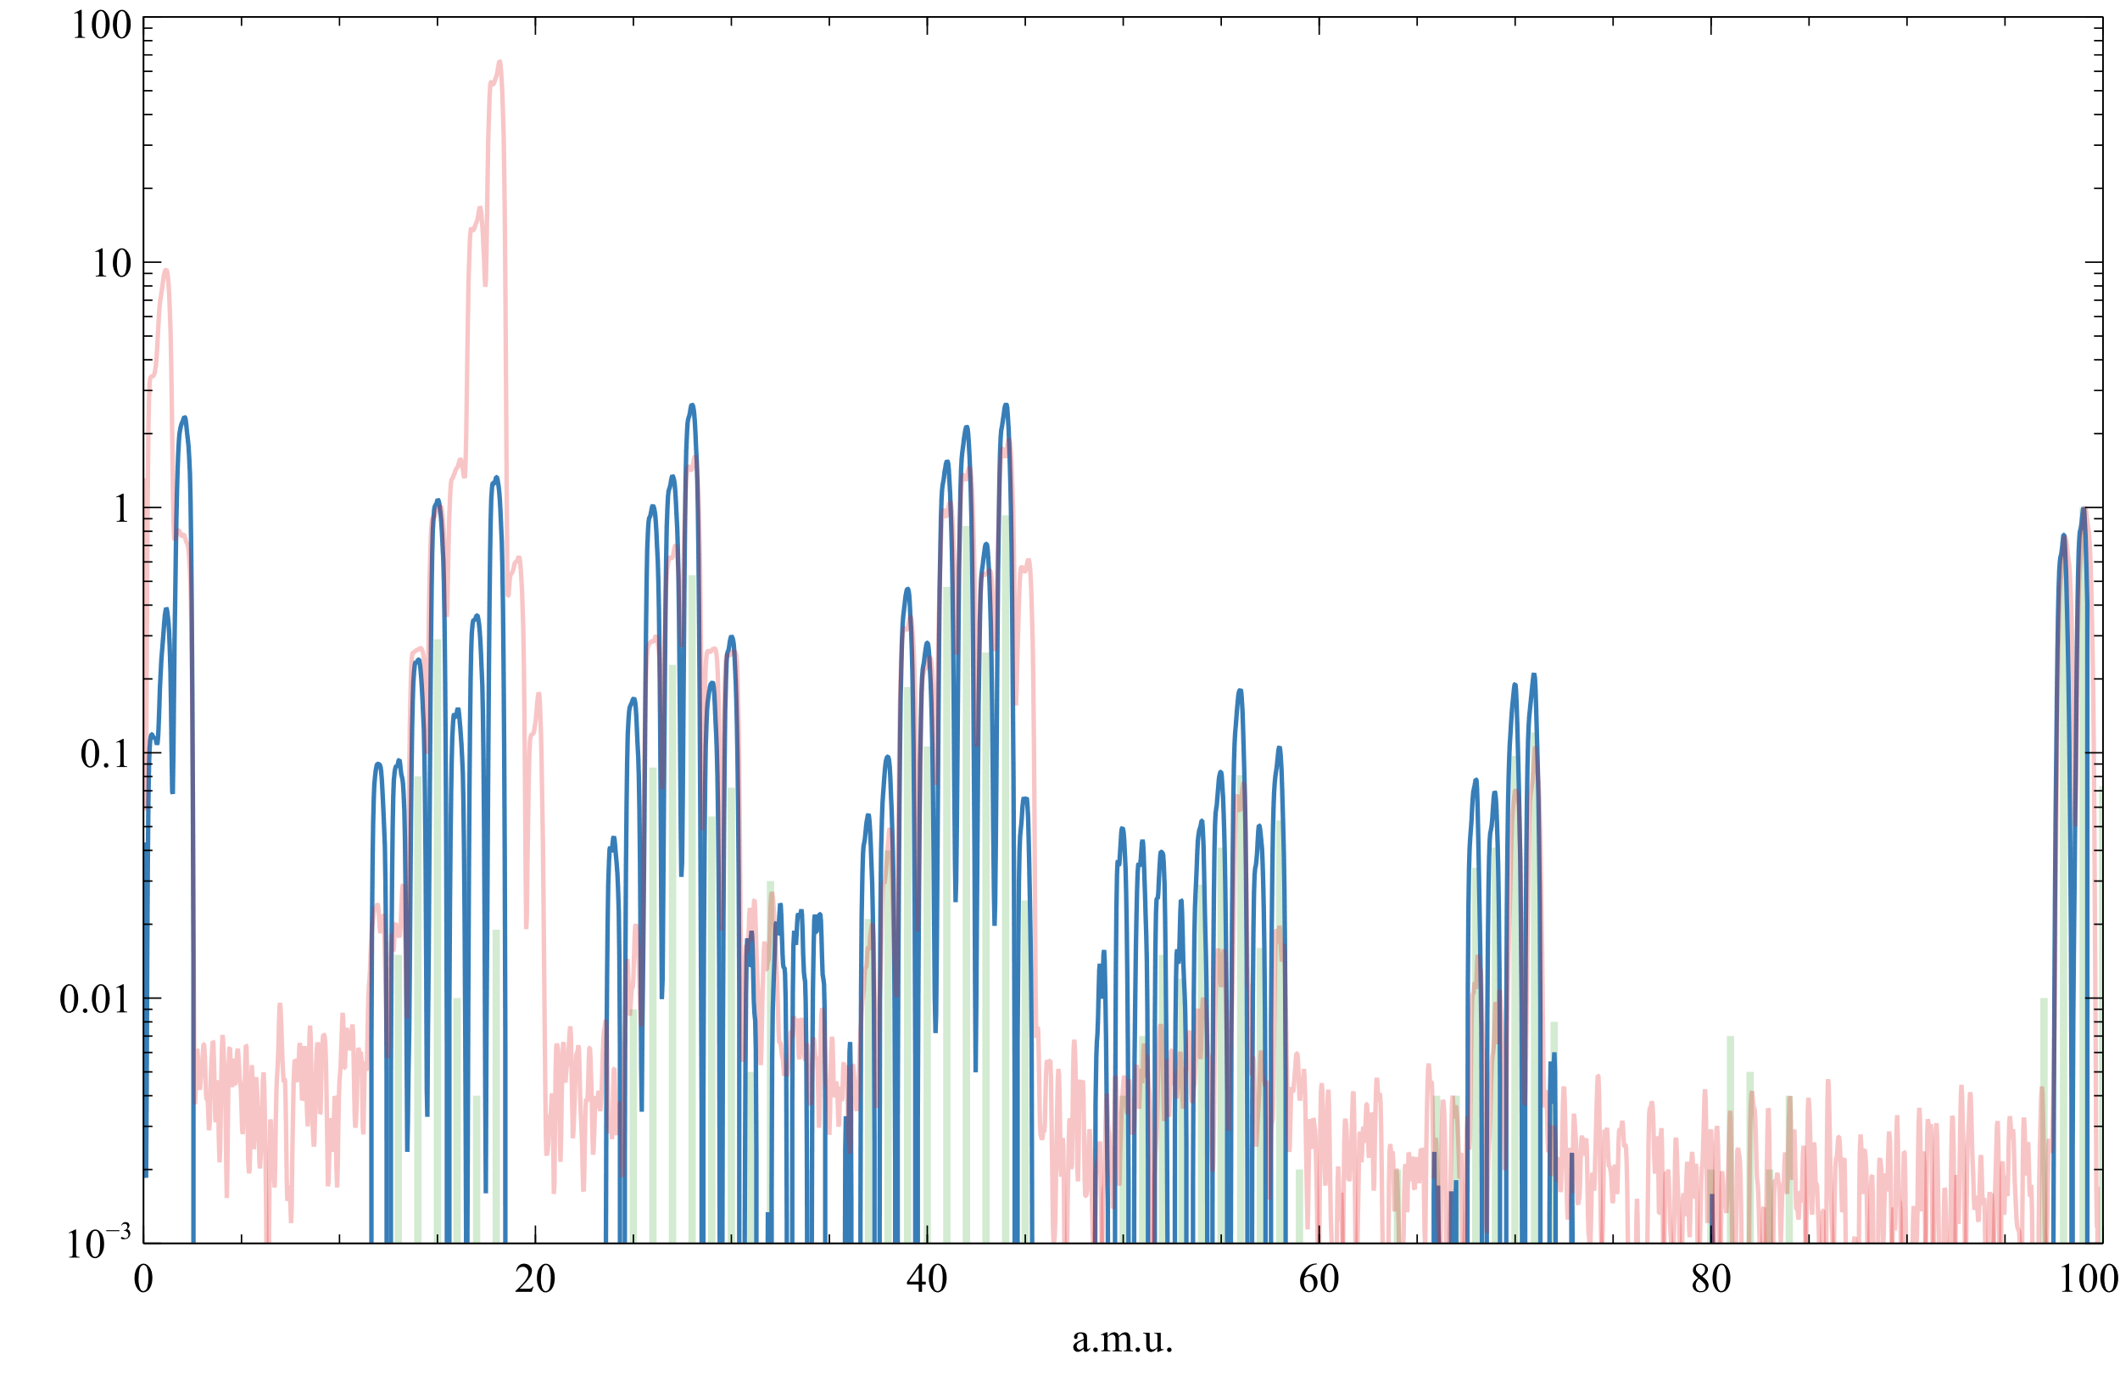
Example PR.SMH42
RGA showing contamination
Candidate molecule N-methyl-2-Pyrrolidone (NMP) → solvent for polyimide
Pyralin (polyimide base polymer) part of SMH42
Confirmation after testing sample
High vapour pressure → Completely removed after bakeout

Slide 11
Thank you for your attention!!

