Slide 1
Materials R&D for vacuum compatibility: case studies and perspectives
C. Accettura, with several contributions of A. Bertarelli, G. Bregliozzi, F. Carra, G. Cattenoz, J. Guardia, A. Perez
Joint Seminar TE-VSC and EN-MME
2022-11-09
https://indico.cern.ch/event/1216405/

Slide 2
Outline
Introduction to beam-intercepting devices
UHV properties of novel composite materials
  Machining
  Production process
  Post-production treatment
Outlook and future work

Slide 3
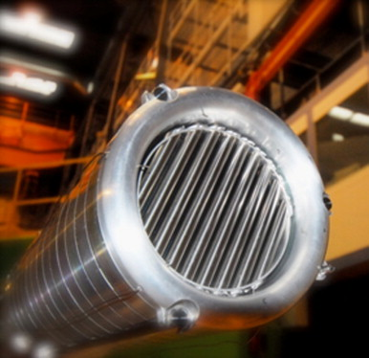
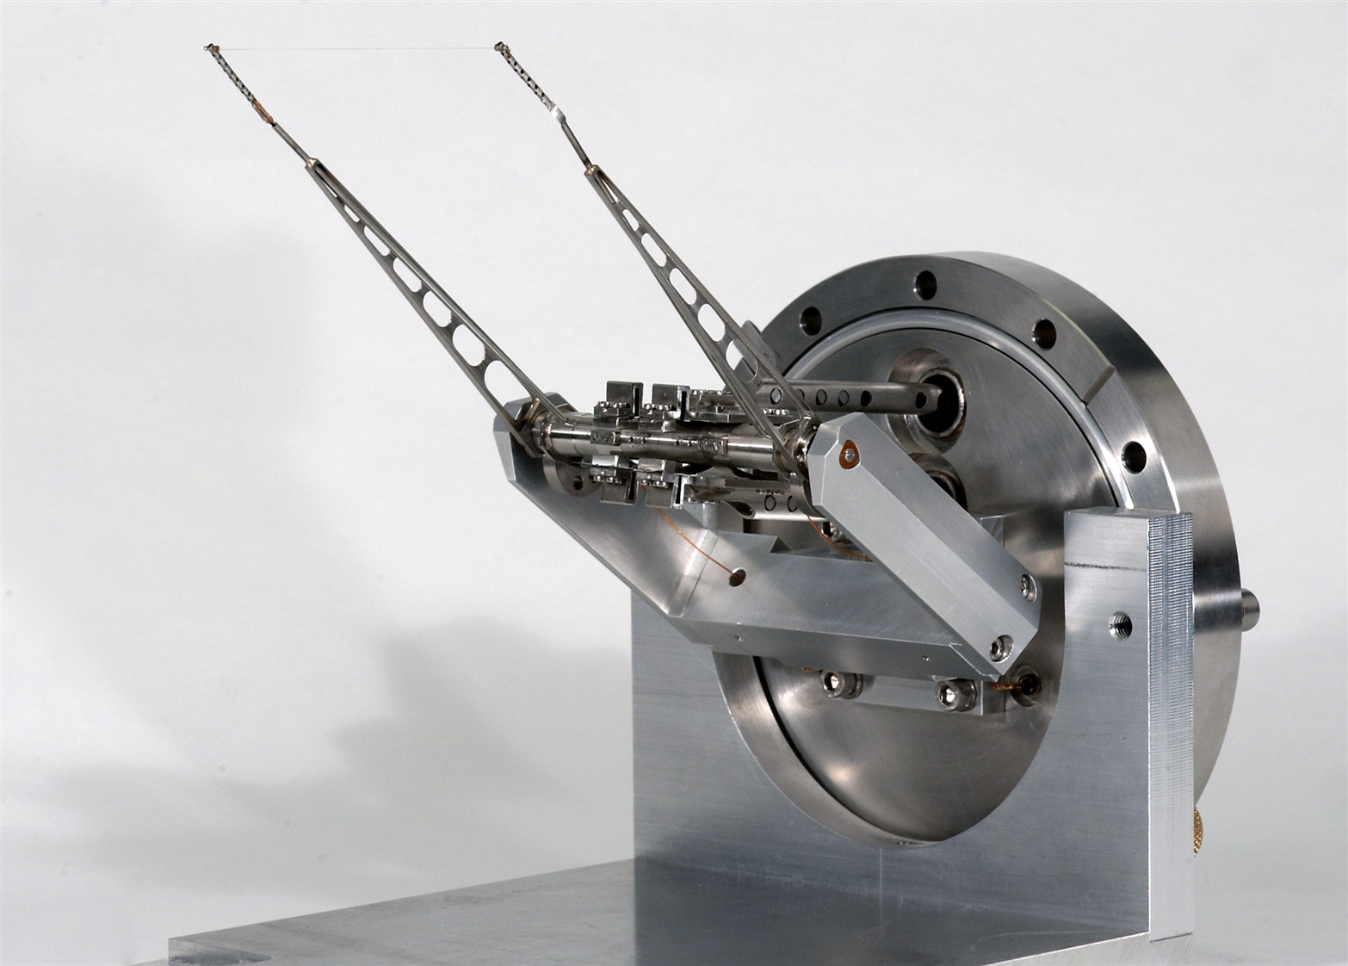
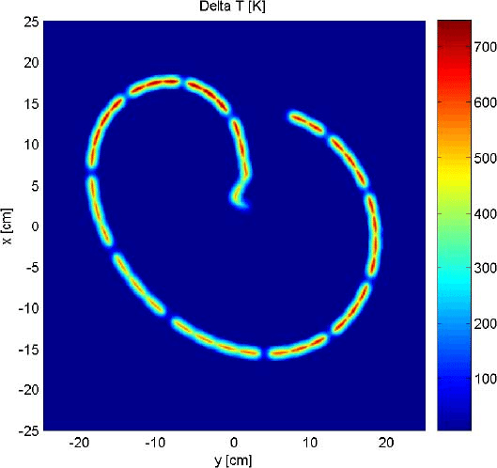
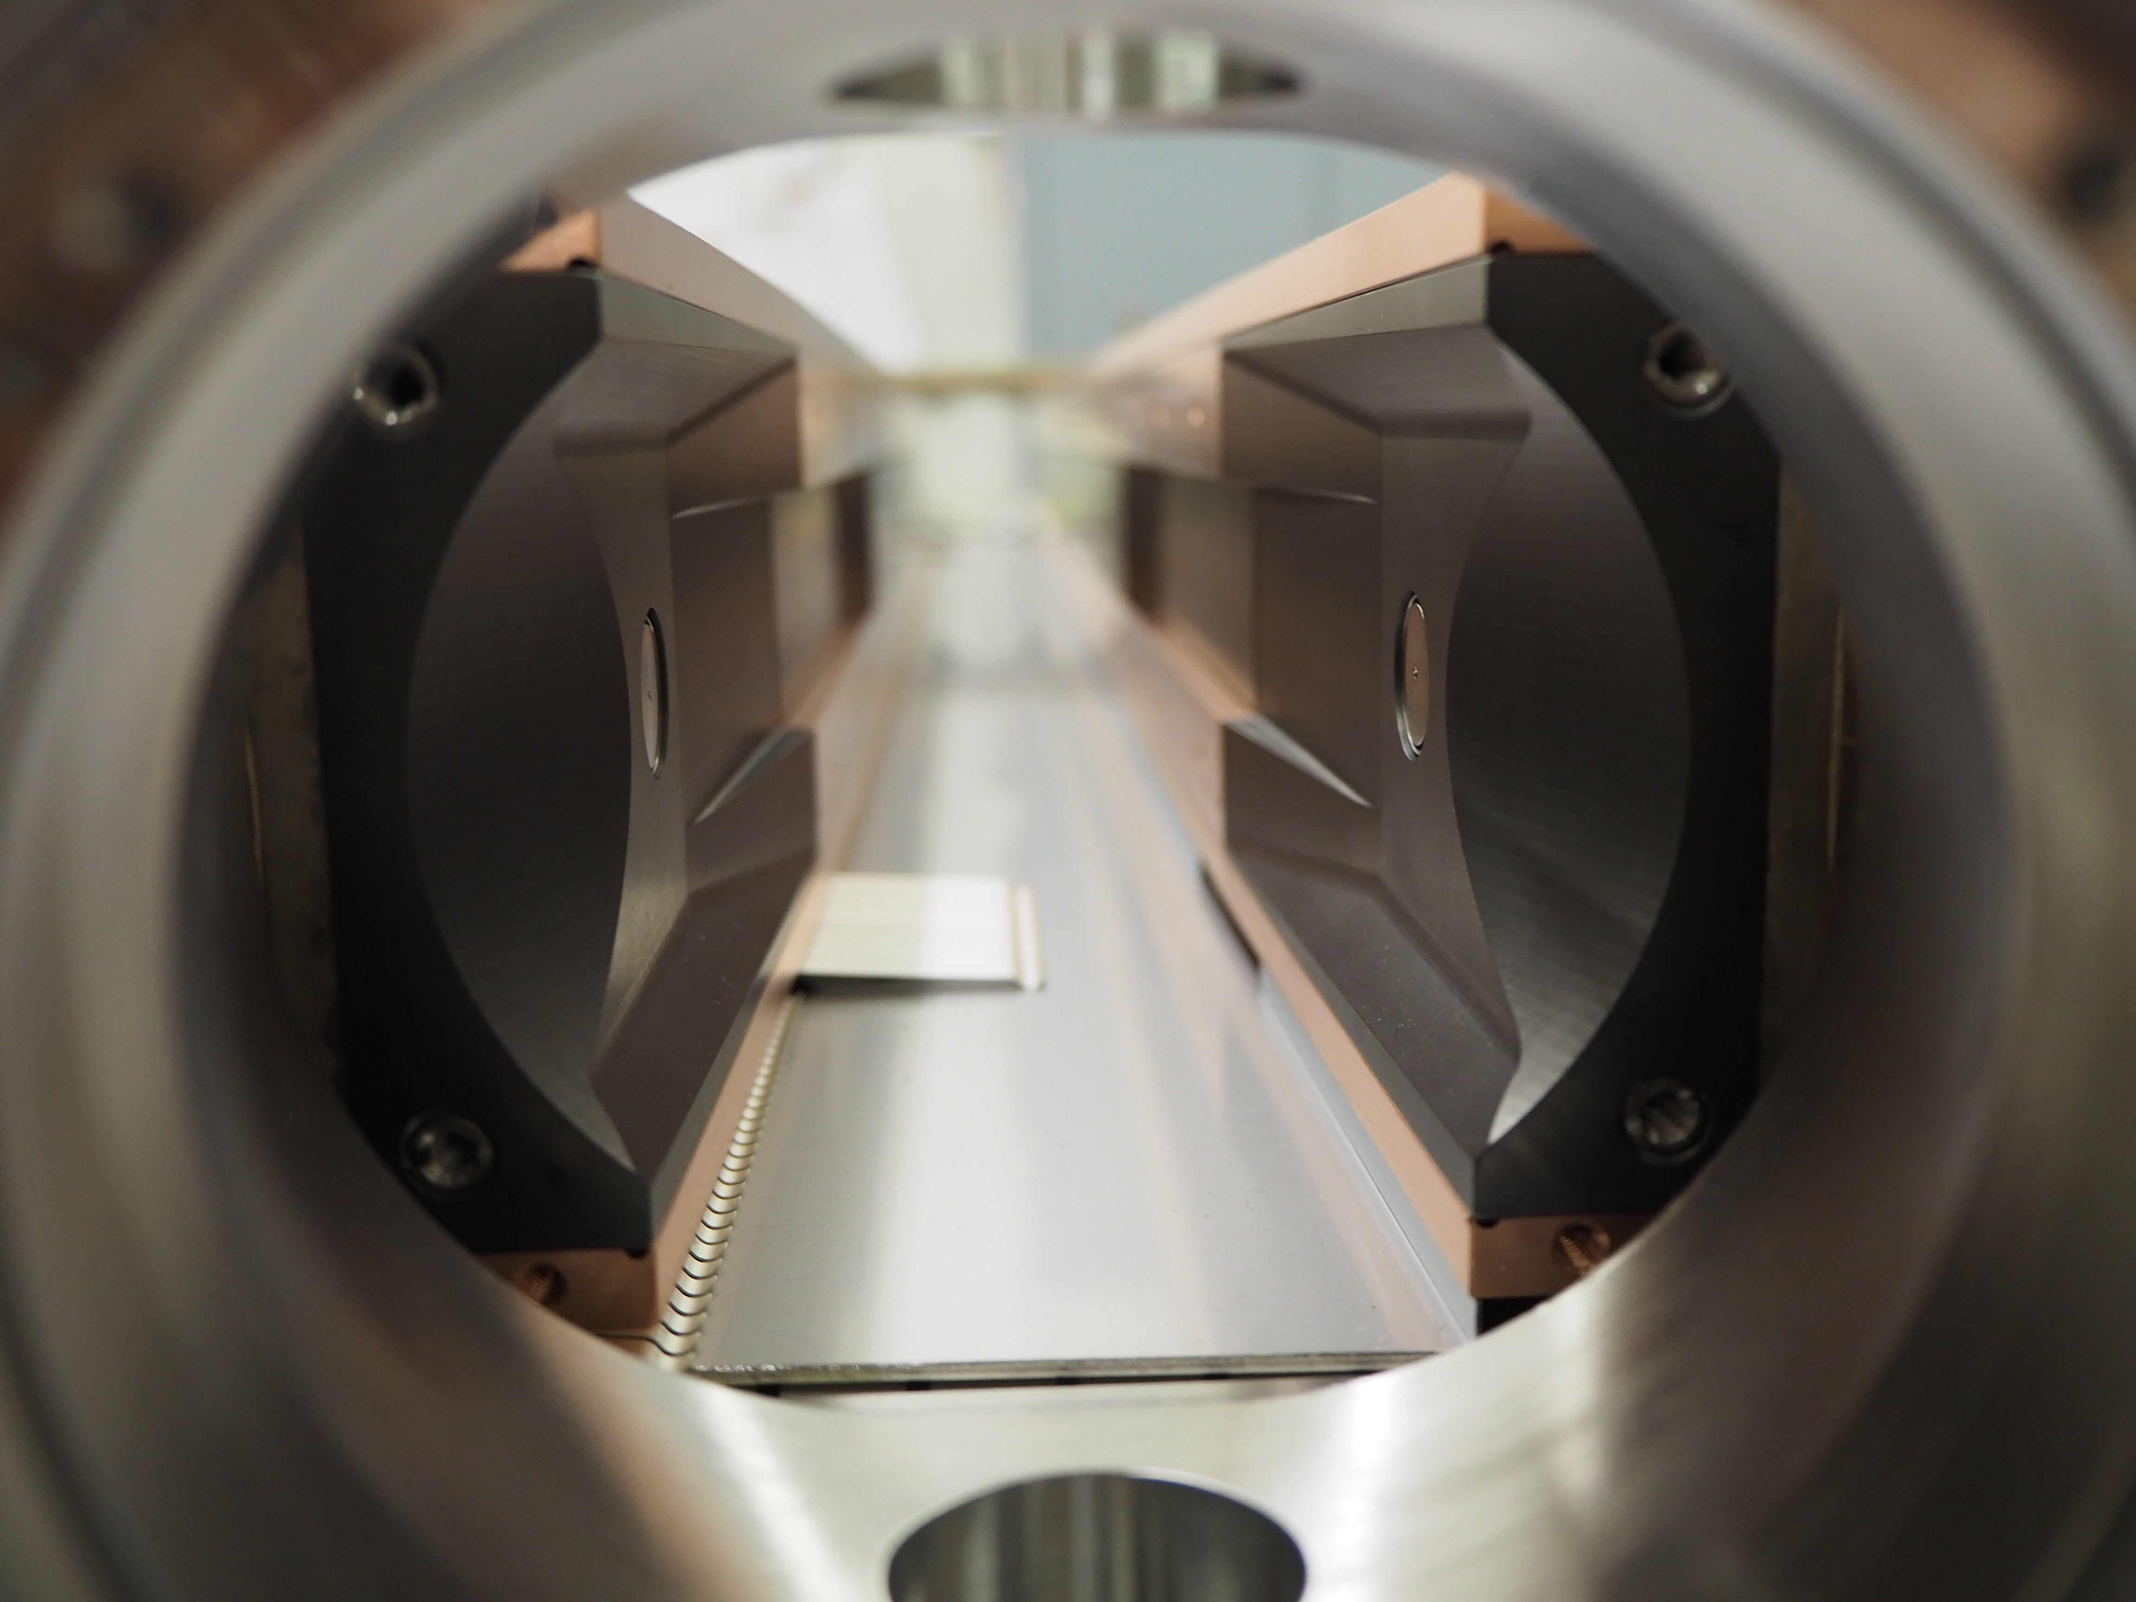
Introduction beam intercepting devices
Component at ‘loss point’, subjected to particle absorption:
Targets (W, Pb, C, Mg,…): production of secondary particles (some dpa/years)
Dumps: safety role (C-based)
Destructive beam diagnostic: monitoring of beam parameters
Collimators:
  Absorption of beam-losses
  Passive protection of delicate equipment
Sometimes not possible to identify commercial opportunities, need R&D
Targets
Beam wire scanners
Collimators
Dumps

Slide 4






Carbon-based composites R&D at CERN
2013-2017
2017-2022
2021-2025
Thermal management applications
AIM: Explore composites combining the properties of graphite or diamond (low ρ, high λ, low α) with those of metals.

Slide 5
Requirement of BIDs materials
Density: balance to limit peak energy deposition while maintaining adequate cleaning efficiency
Electrical Conductivity: limit resistive-wall impedance (beam instabilities)
Melting/Degradation Temperature: withstand high temperatures reached in case of accidents
Thermal Conductivity: maintain geometrical stability under steady-state thermal loads
CTE: increase resistance to thermal shock induced by accidental beam impact
Ultimate Strength: improve thermal shock resistance
Specific Heat: improve thermal shock resistance (lowers temperature increase)
Radiation-hardness: improve component lifetime under long term particle irradiation
Outgassing Rate: ensure UHV compatibility
Industrially feasible

Slide 6
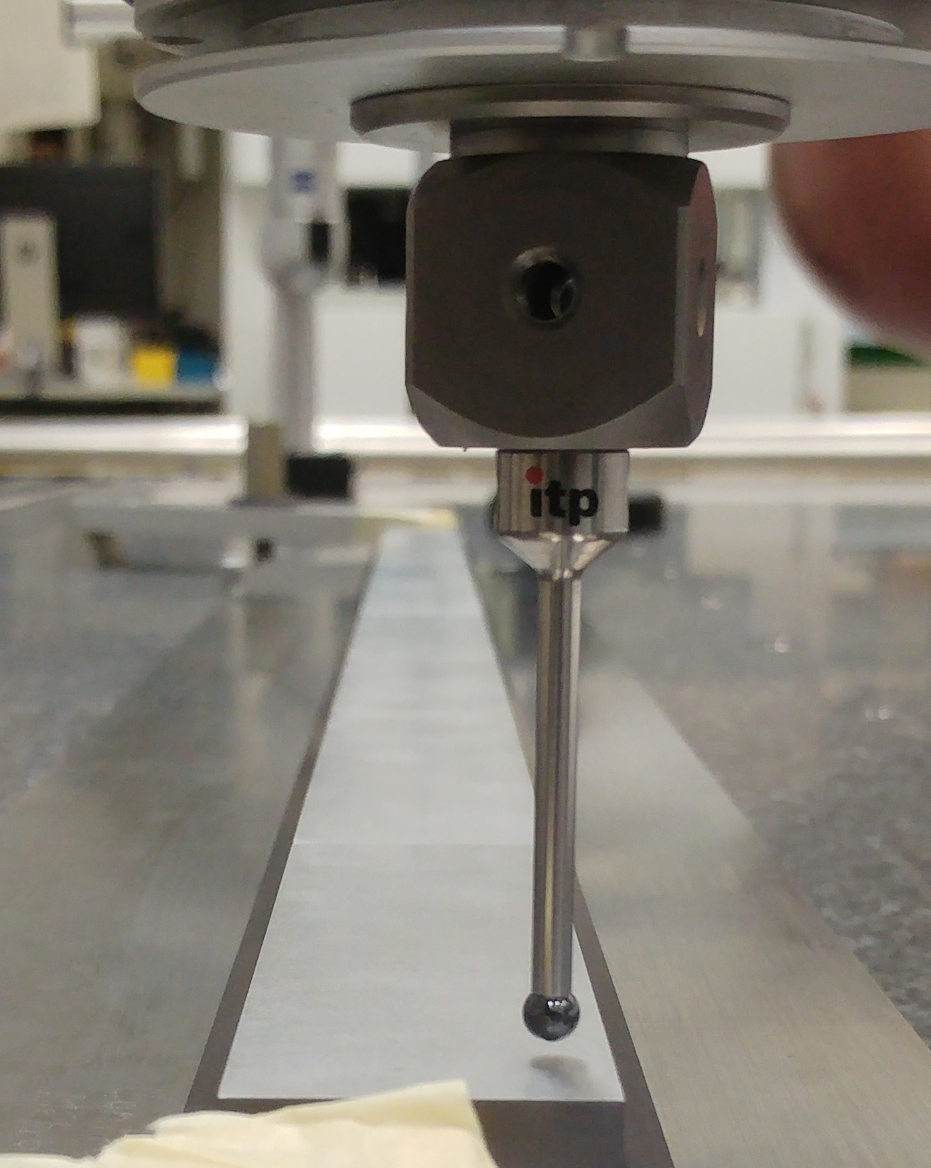
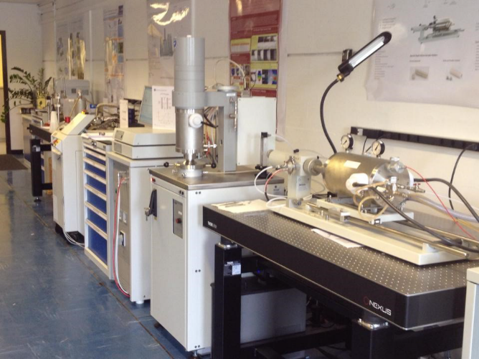
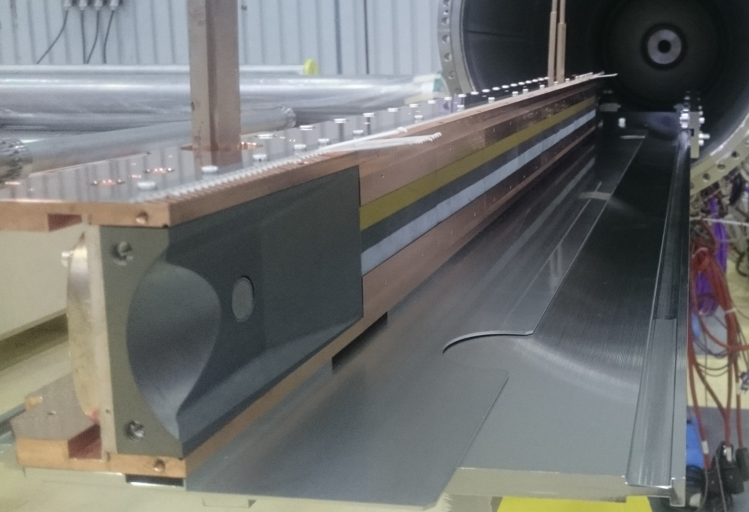
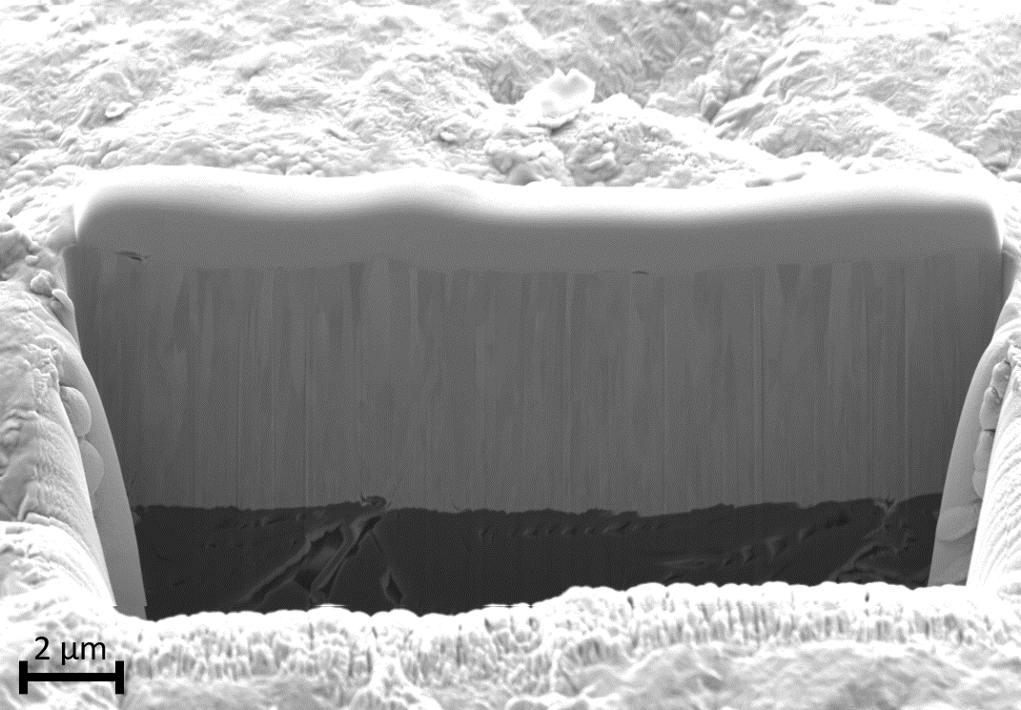
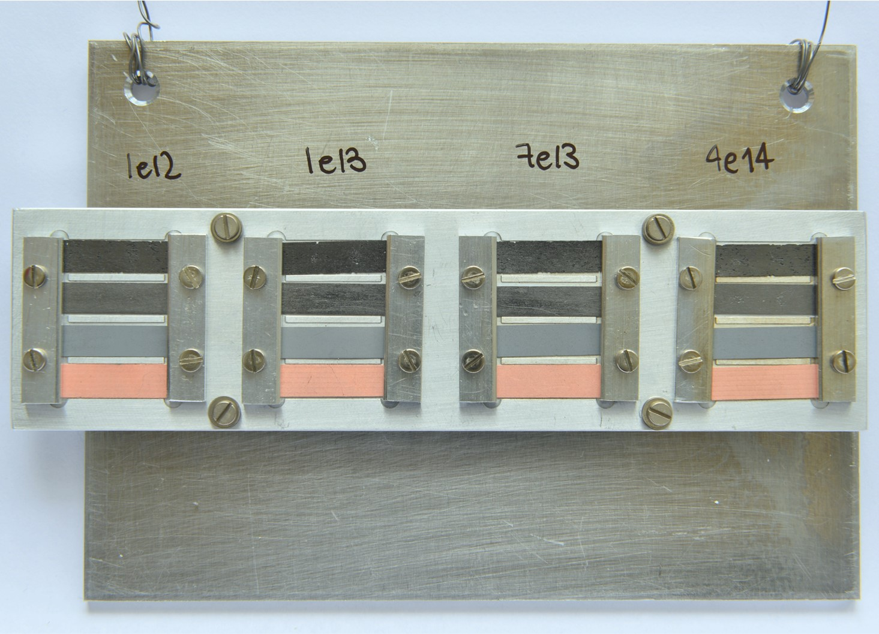
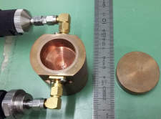
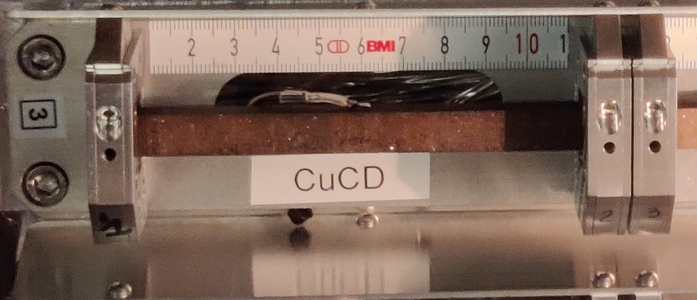
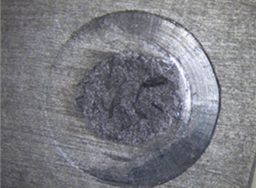
Overview of the tests needed for BIDs
Metrology (EN/MME)
Thermo-mechanical (EN/MME)
Outgassing (TE/VSC)
Microscopy (EN/MME)
Radiation damage (EN/MME, EuCARD, ARIES)
Impedance (BE/ABP)
Adhesion (TE/VSC)
Beam impact (EN/MME, BE/EA)

Slide 7
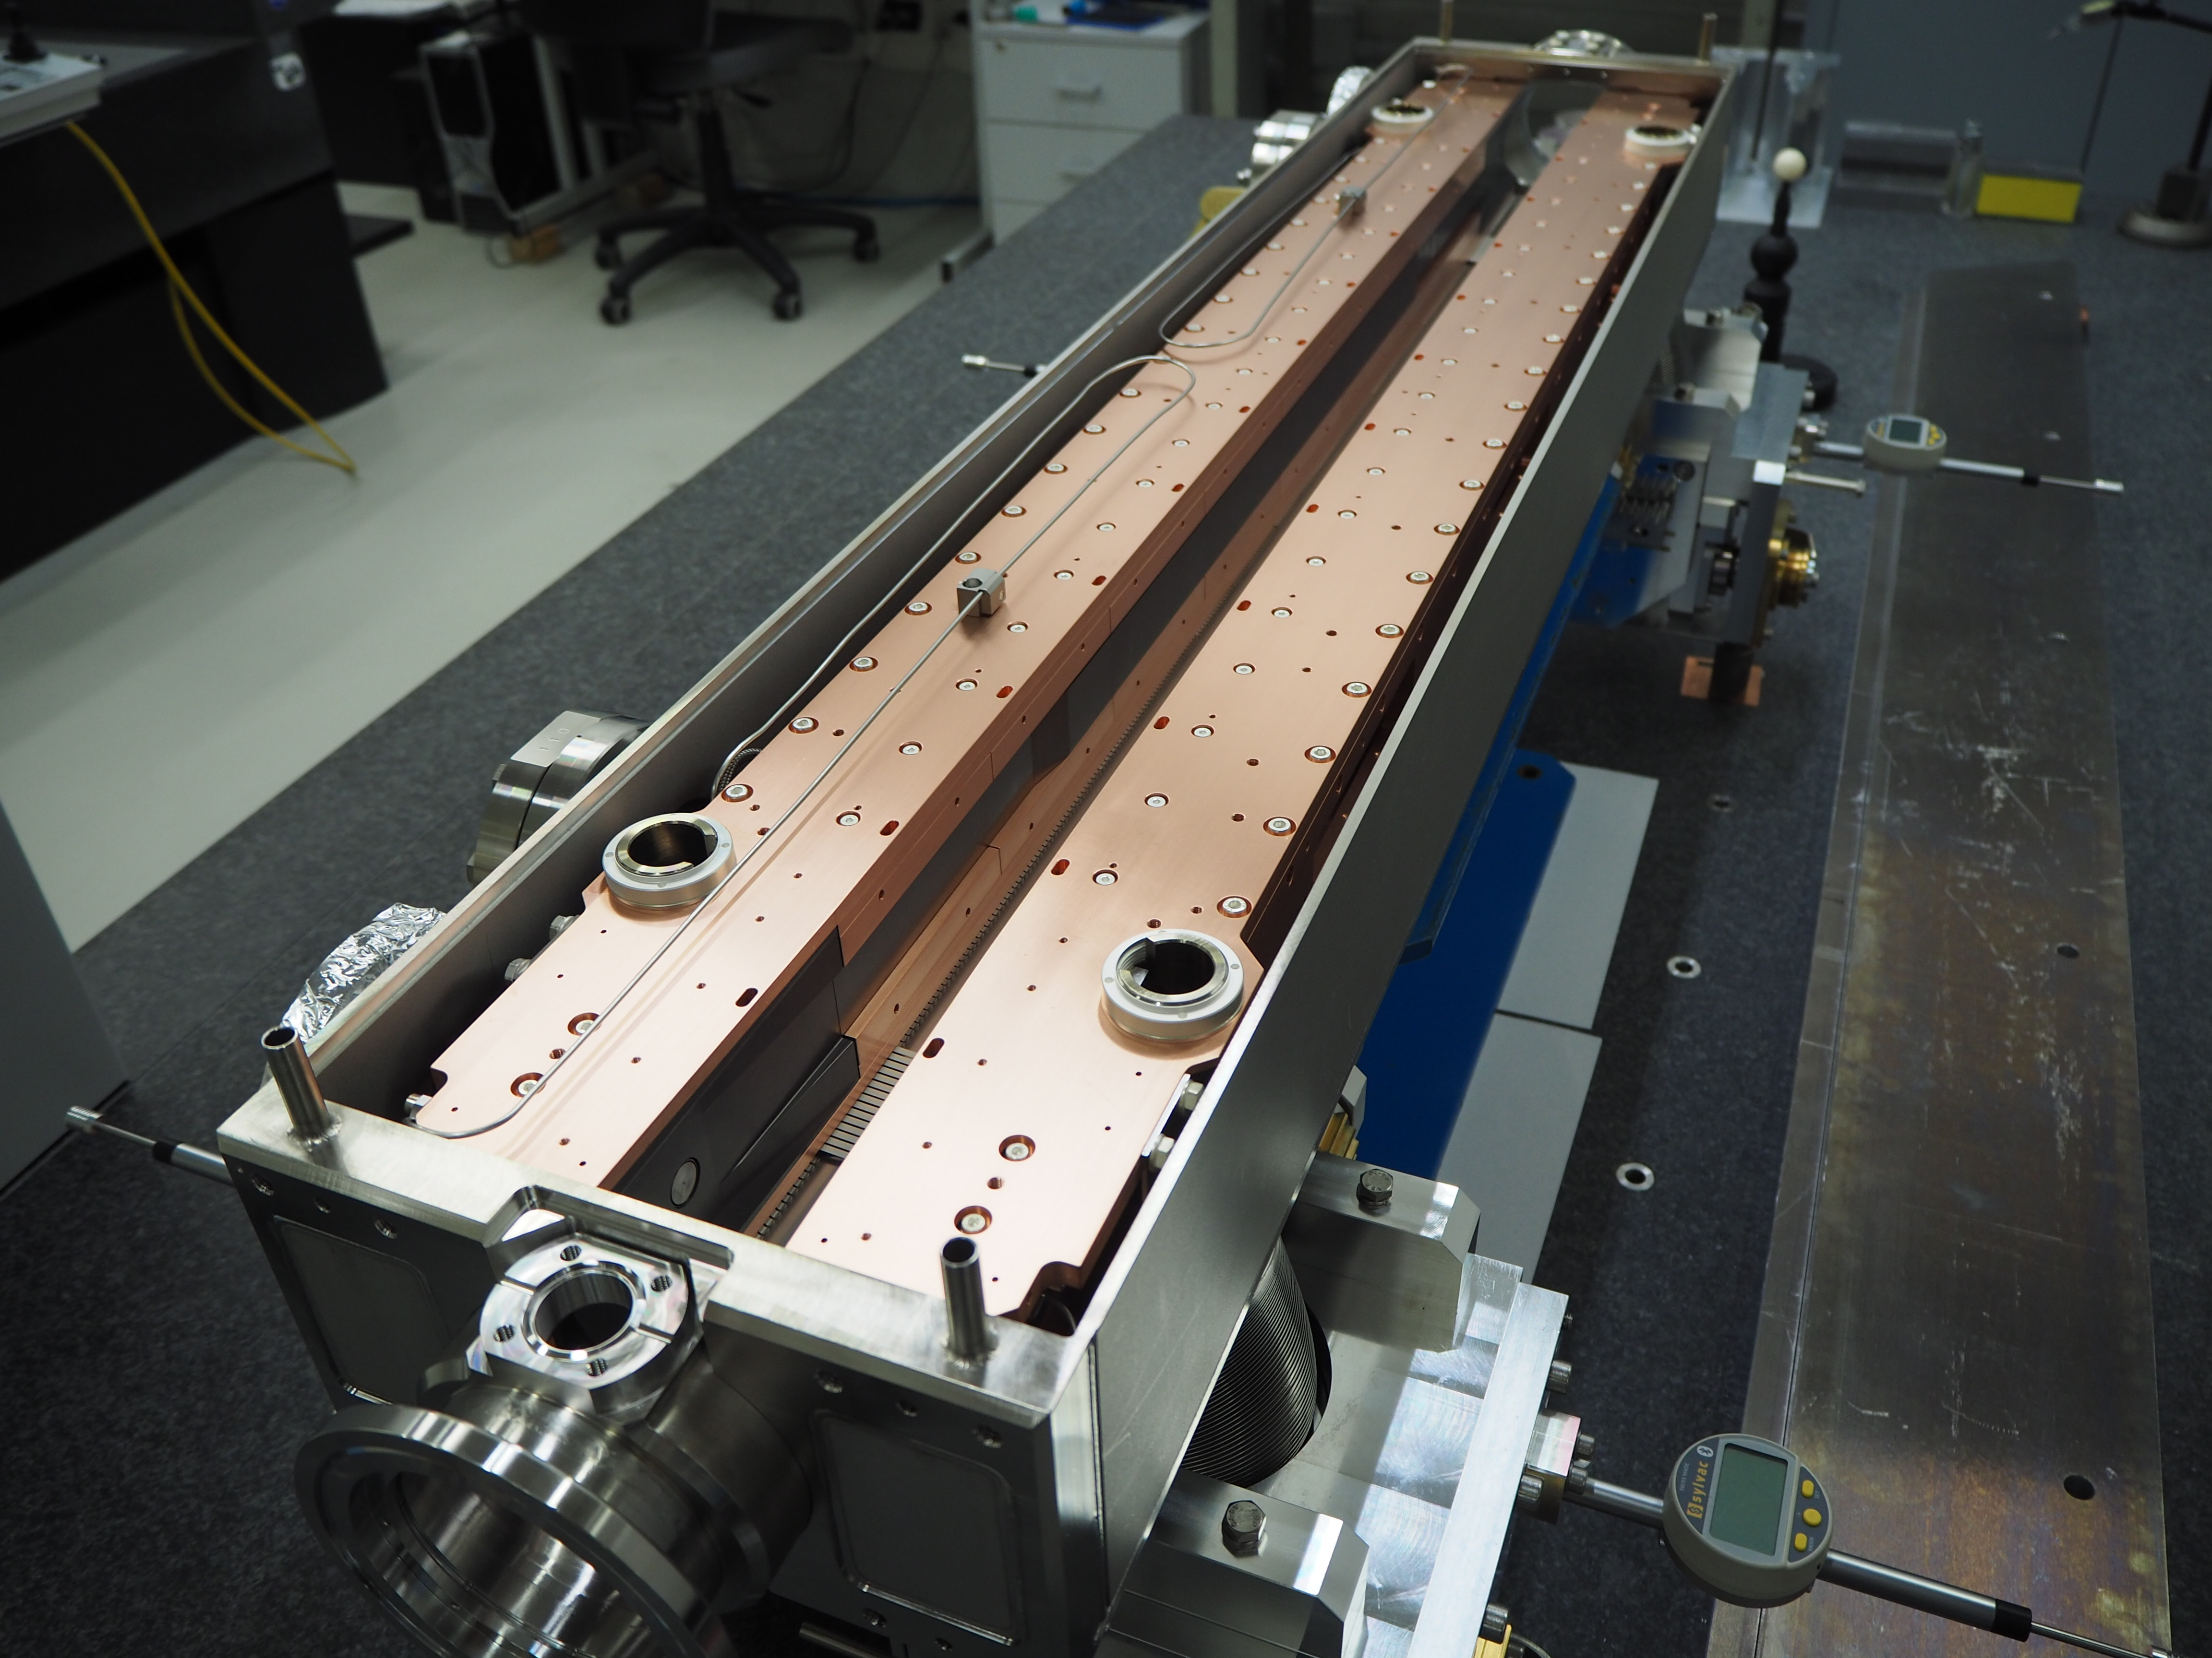
Overview of the tests needed for BIDs
EN, TE, BE, SY involved in the characterization and optimization→ 12 HL-LHC collimators installed during LS2 with Molybdenum-graphite absorber blocks (with Mo coating for secondary collimators)
Metrology (EN/MME)
Thermo-mechanical (EN/MME)
Outgassing (TE/VSC)
Microscopy (EN/MME)
Radiation damage (EN/MME, EuCARD, ARIES)
Impedance (BE/ABP)
Adhesion (TE/VSC)
Beam impact (EN/MME, BE/EA)

Slide 8
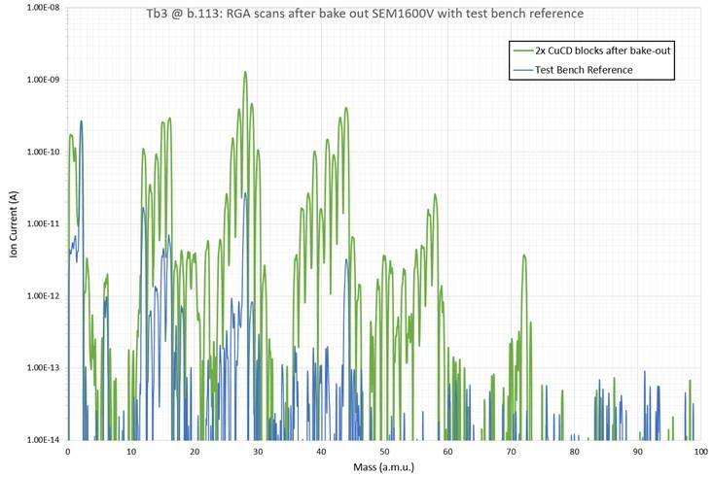
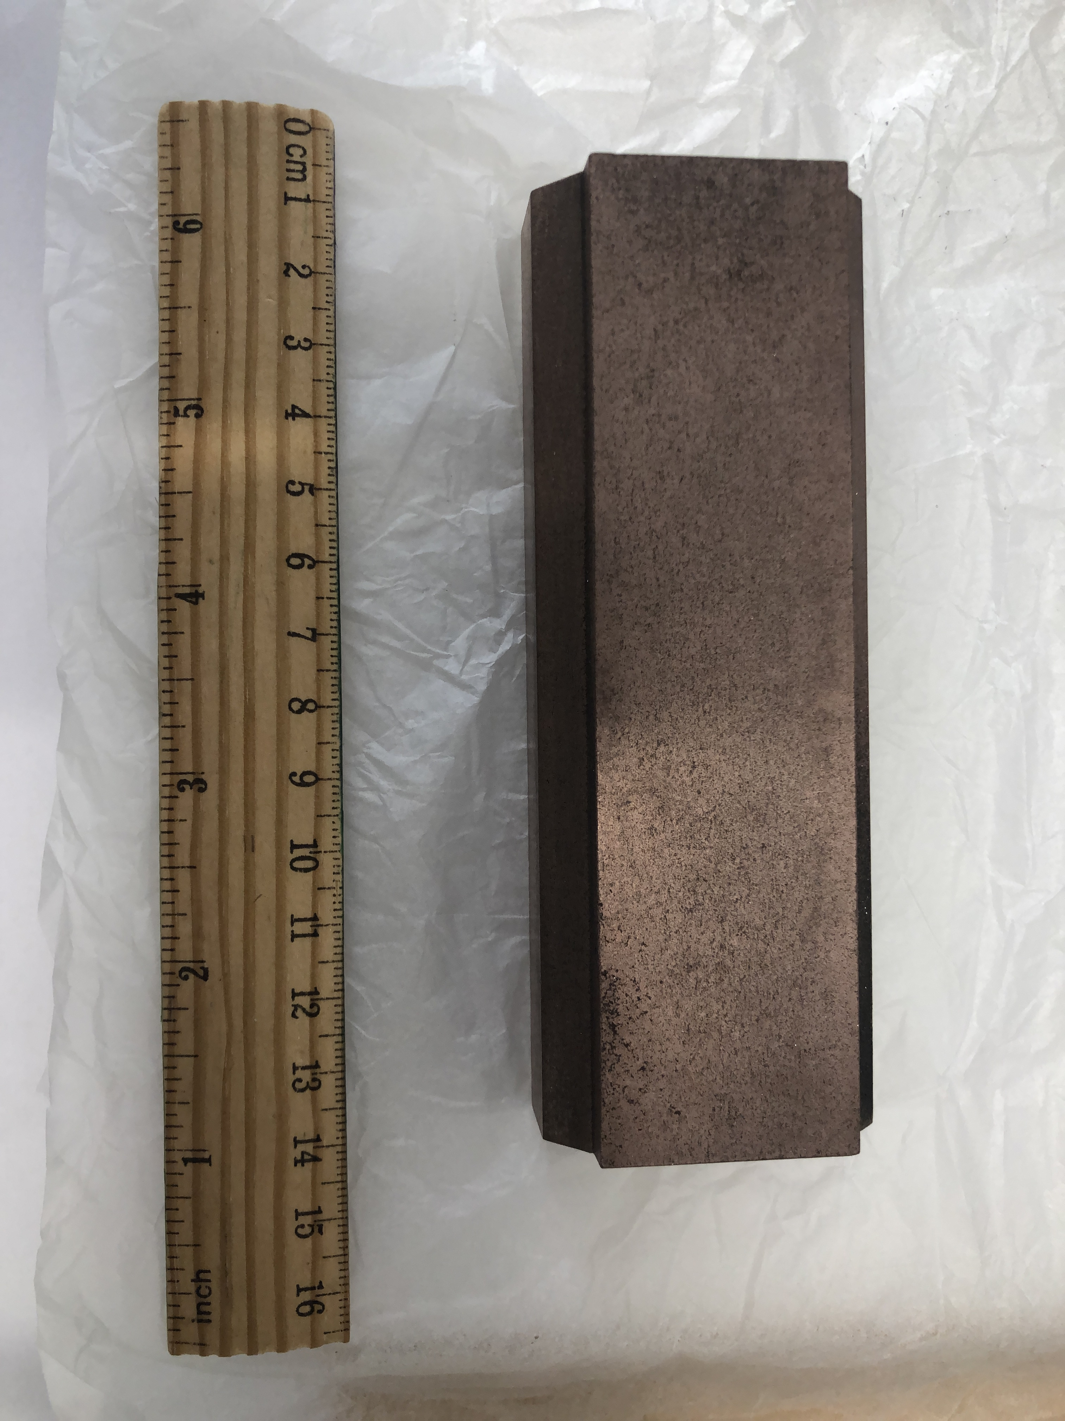
UHV compatibility of composite materials
Some problems are common to all the materials tested under UHV:
  Proper handling
  Dry and clean machining
But in same cases it may be very difficult…see dry machining of diamond!
A solution was found, but it required some work to achieve good tolerances
CuCD blocks for TCTPXH prototype
Courtesy of G. Cattenoz

Slide 9
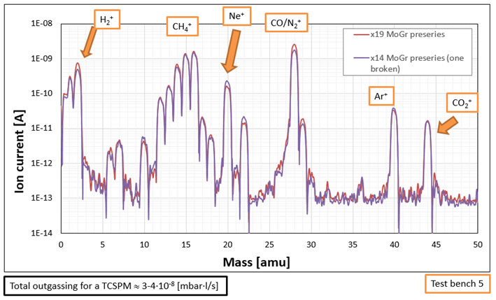
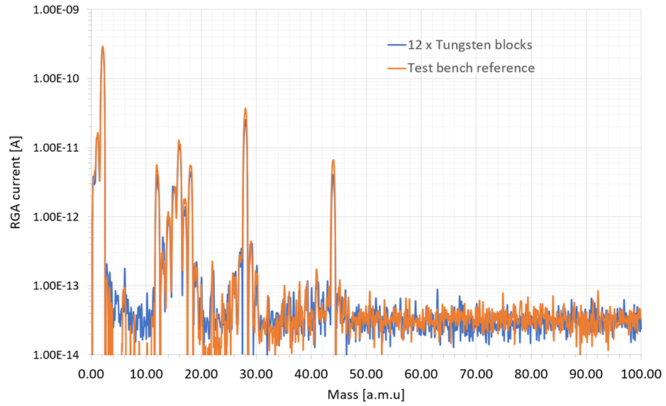
Metal vs Porous composite materials
For a metallic component after bake-out, the dominant outgassing species is H2
Graphitic materials can instead trap air in their porosities, that is than outgassed when the material is under vacuum (bigger channels)
Inermet block RGA
H₂
Courtesy of G. Cattenoz
G. Bregliozzi, International review of the HL-LHC collimation system
11th – 12th February 2019

Slide 10
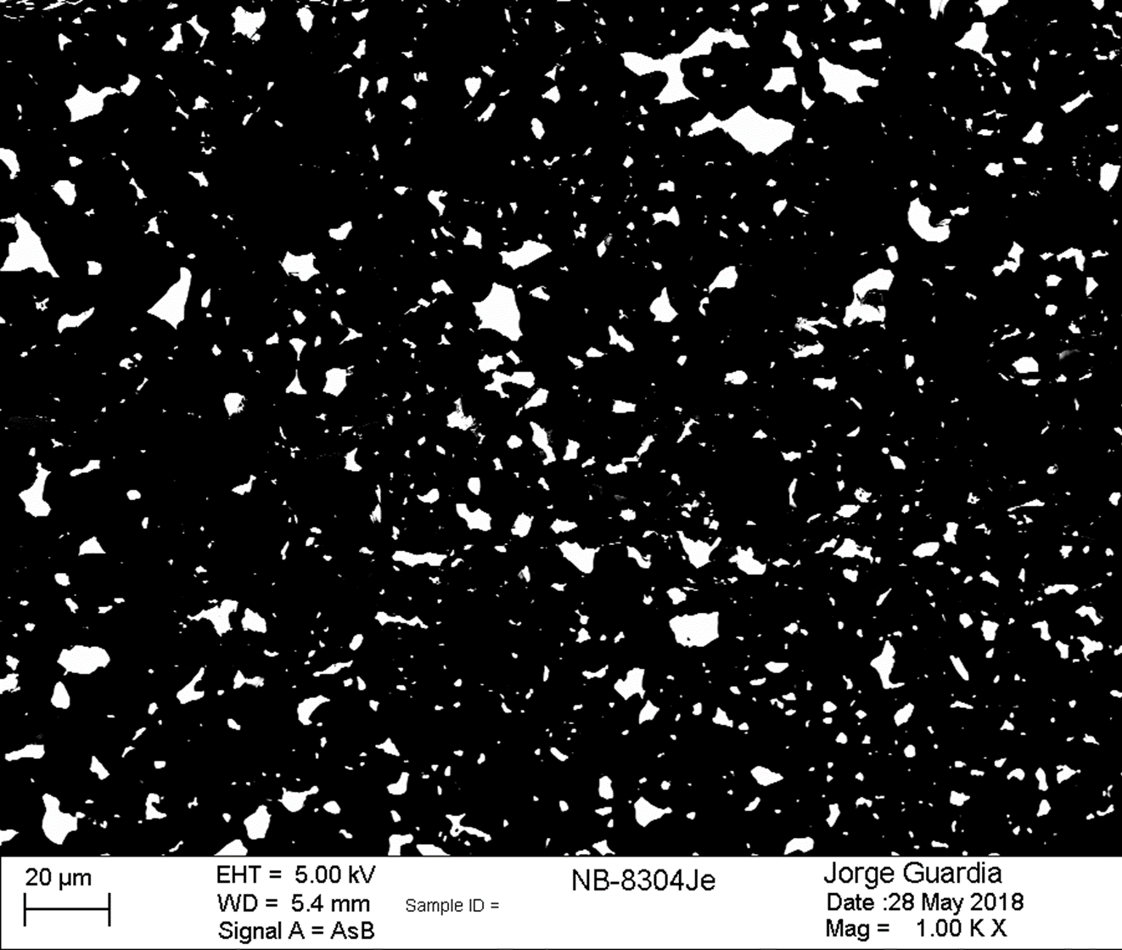
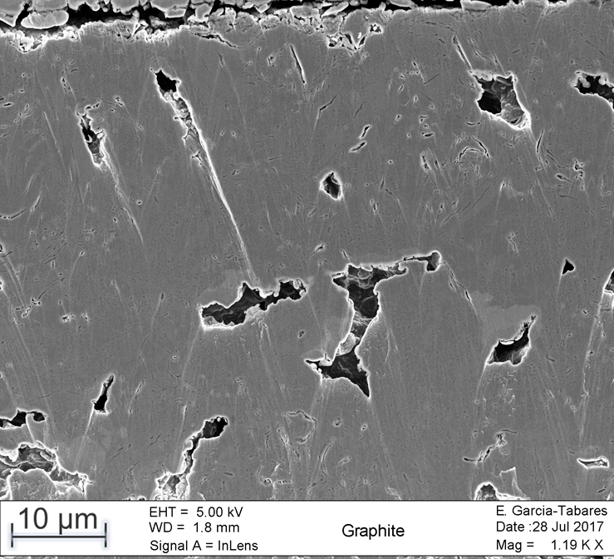
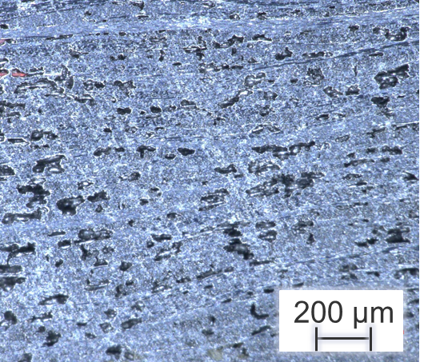
Outgassing vs Microscopy

Slide 11
Outgassing vs Microscopy
Outgassing [mbar·l/s·cm²] | Outgassing [mbar·l/s]
MoGr (72h firing) | Graphite (48h firing) | CFC (48h firing)
6·10⁻¹² | 8·10⁻¹³ | 2·10⁻¹²

Slide 12
Outgassing vs Microscopy
If the material is not ‘fully compact’ (e.g. metal), a higher porosities seems to lead to lower outgassing
Outgassing [mbar·l/s·cm²] | Outgassing [mbar·l/s]
MoGr (72h firing) | Graphite (48h firing) | CFC (48h firing)
6·10⁻¹² | 8·10⁻¹³ | 2·10⁻¹²

Slide 13
MoGr: comparison of different grades (same supplier)
 | NB8304Je | NB8304Le
Density [g/cm³] | 2.55 | 2.59
Qtotal/Qlimit | 1 | 50

Slide 14
MoGr: comparison of different grades (same supplier)
At the microscopic level, no differences detected→ how to easily predict the outgassing behavior?
 | NB8304Je | NB8304Le
Density [g/cm³] | 2.55 | 2.59
Qtotal/Qlimit | 1 | 50

Slide 15
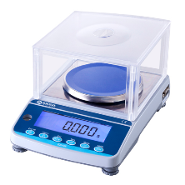
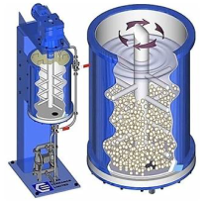
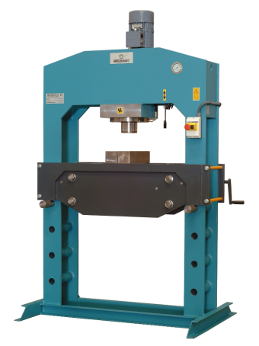
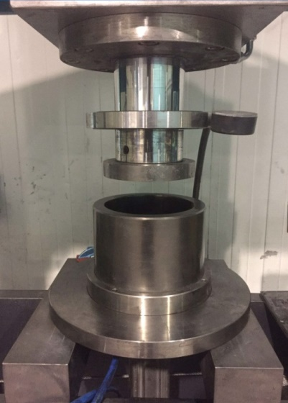
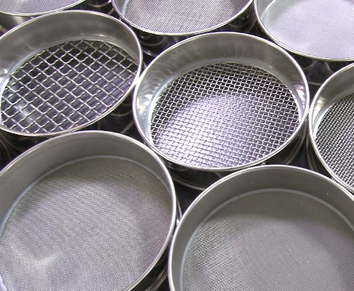
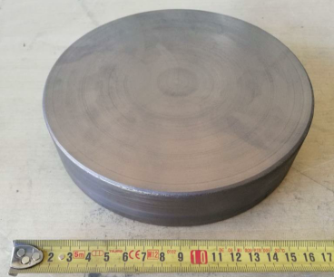
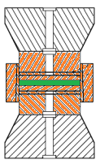
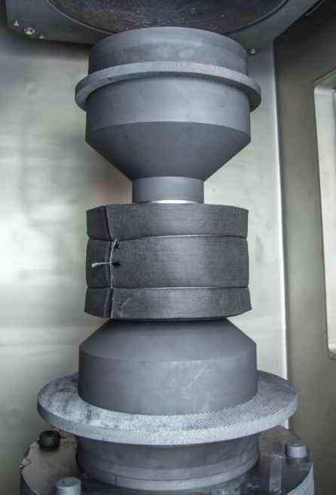
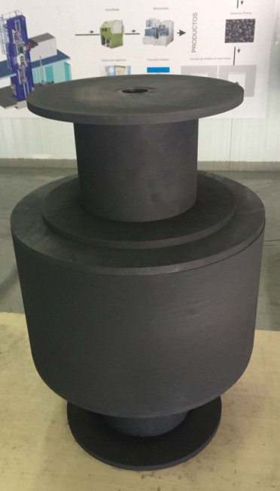
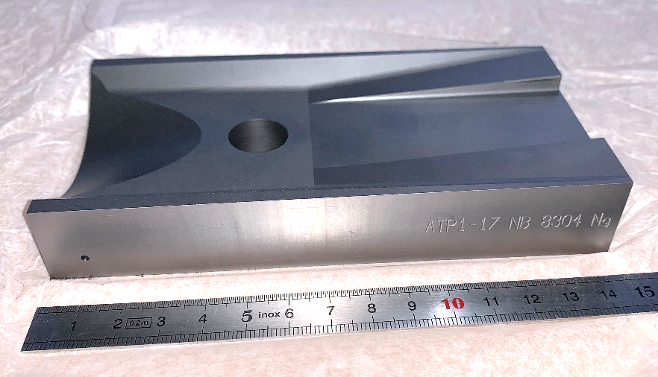
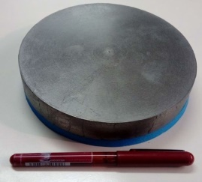
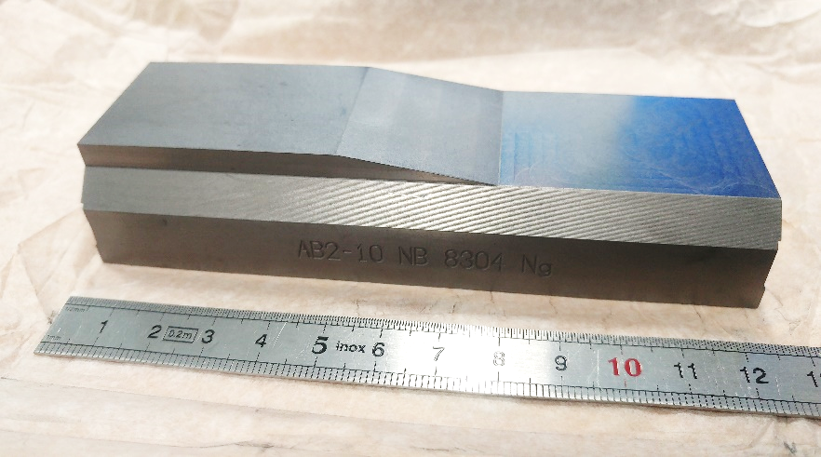
Production
Selection and sieving of the powders
Preparation of the desired composition
Mixing
Green body preparation
Currently
Ø 170 mm
Powder | Vol. %
Graphite | 93.9
Mo | 5.5
Ti | 0.6
Spark Plasma Sintering (SPS) >25 MPa, >2600 °C
Stress relieving thermal treatment 0 MPa, >2400 °C
Sintered CCM
Single-use mould elements (graphite)

Slide 16
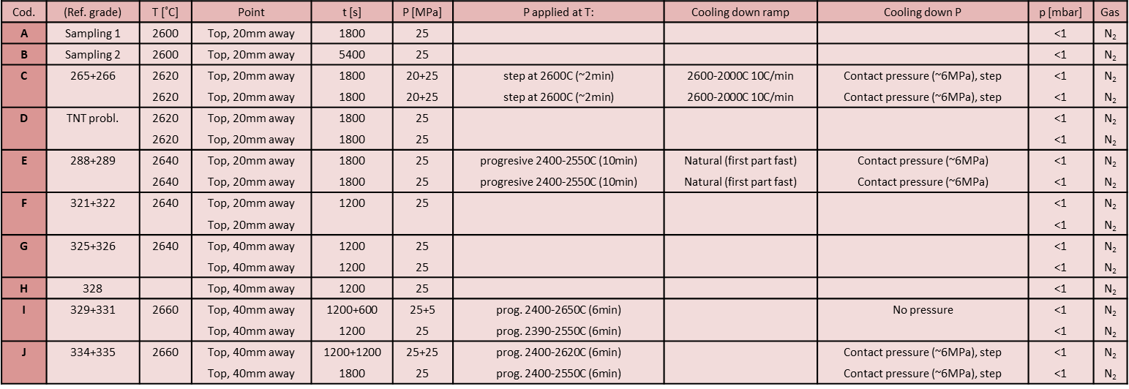
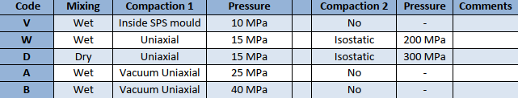
Analysis of the production process
Different pre-compaction, sintering, annealing→ no effect
Grade | Treatment | Total outgassing jaws [mbar*l/s]
Nd-7301Cb | VF 950°C 48h, Ar venting | 1·10⁻⁸
Nw-8301Ed | VF 950°C 48h, air venting | 1.4·10⁻⁸
Na-8304Gb | VF 950°C 48h, air venting | 1.2·10⁻⁸
Nb-8304Je | VF 950°C 48h, air venting | <1.1·10⁻⁸

Slide 17
Analysis of the production process
Grade | Treatment | Total Q [mbar*l/s] | #cycle | Tmax [°C] | Density [g/cm3] | El. Conductivity [MS/m]
Nb8304Le | 48h firing | 6.6·10 ⁻⁷ | 2+1 | 2680 | 2.59 | >1
Nb8304Ne | US+48h firing | 1.5·10 ⁻⁸ | 1 | 2640 | 2.58 | 0.89/0.98
Nb8304Je | 48h firing | 5.7·10 ⁻⁸ | 2+1 | 2620 2500 | 2.62 | 1/1.16
Nb8304Mg | 72h firing | ~7.2·10 ⁻⁹ | 1 | 2650 (2640 for the series) | 2.54 | 0.71/0.76
Observation:
Higher temperature (~20°C), higher outgassing (50 times)
Longer cycle (2+1), higher outgassing (~3 times)

Slide 18
Analysis of the production process
Grade | Treatment | Total Q [mbar*l/s] | #cycle | Tmax [°C] | Density [g/cm3] | El. Conductivity [MS/m]
Nb8304Le | 48h firing | 6.6·10 ⁻⁷ | 2+1 | 2680 | 2.59 | >1
Nb8304Ne | US+48h firing | 1.5·10 ⁻⁸ | 1 | 2640 | 2.58 | 0.89/0.98
Nb8304Je | 48h firing | 5.7·10 ⁻⁸ | 2+1 | 2620 2500 | 2.62 | 1/1.16
Nb8304Mg | 72h firing | ~7.2·10 ⁻⁹ | 1 | 2650 (2640 for the series) | 2.54 | 0.71/0.76
Observation:
Higher temperature (~20°C), higher outgassing (50 times)
Longer cycle (2+1), higher outgassing (~3 times)
The production processes which increase the compaction level of the material (higher T, double cycle) lead to a higher outgassing rate
A ‘threshold effect’ is detected when the temperature overcomes 2680°C→ observed also for another supplier
UHV compatibility and thermo-physical properties go in the opposite direction→ need to find a compromise
In this case, a significant decrease (factor of 30) of the outgassing rate is reached by loosing ‘only’ 15% of the electrical conductivity

Slide 19
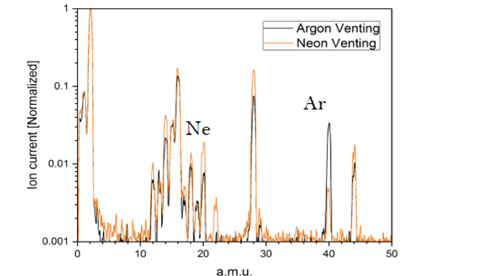
Post-production treatments
Optimization process was possible thanks to the interest and collaboration of the firm→ more difficult when dealing with commercial product and bigger companies!
Optimization involving surface preparation → repeatable and suitable for ‘series’ production
Conditioning of Molybdenum-Graphite for LHC collimators before and after coating EDMS 2067775 :
  Neon after thermal treatment to partially replace air

Slide 20
Outlook
New projects can profit of these developments (included R&D for high-conductivity coating-not treated here):
  SuperKEKB showed interest in MoGr for collimators
  FCC e⁺/e⁻ primary collimators
Lessons learn could be useful for the development of new materials→ IFAST (WP4.4-F. Carra):
  Increasing worldwide request for thermal management materials (high thermal diffusivity and specific heat, low density)
  Cost still high: CCM are limited to high-end applications (nuclear energy, particle physics, aerospace, …)
  Decrease of energy consumption, improvement of production cycle efficiency and sustainability are also a must
  In particle physics: very interesting for beam-intercepting devices and beam instrumentation, beam windows, etc.

Slide 21
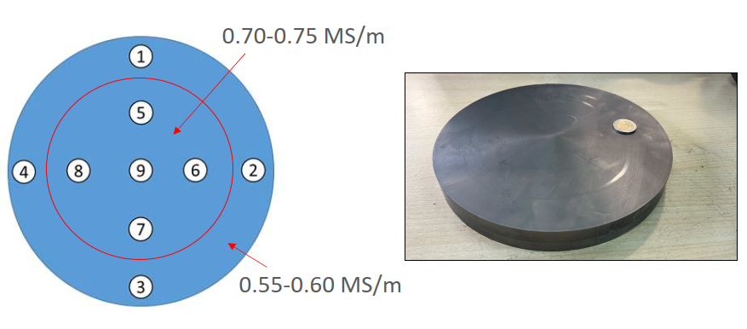
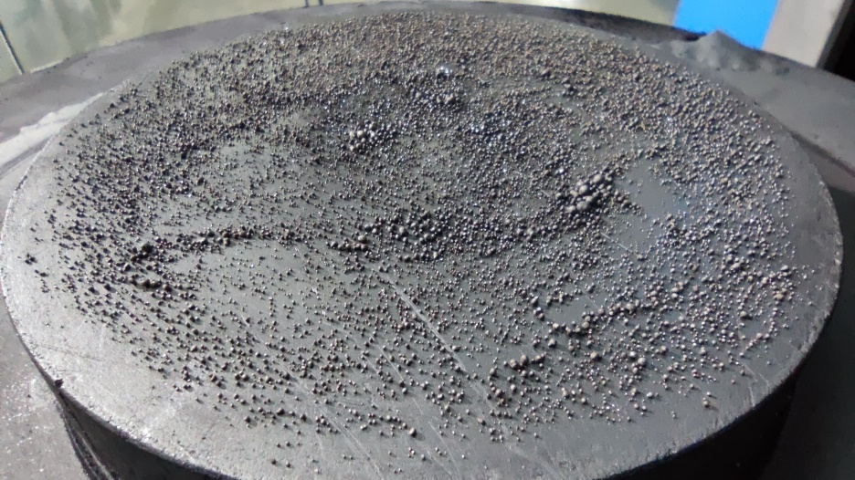
IFAST WP4.4
Increase the volume of the production plate of MoGr
Chromium-Graphite (sintered at 2000°C – 1.3x lower T)
  Concept proposed by Jorge Guardia within ARIES WP14 & WP17, technically was not demonstrated yet
Reusable Mold and Parts → Important Cost Reduction

Slide 22
Thank you for your attention!
The work presented in these slides is the result of contributions from many colleagues from EN/MME, TE/VSC, BE/ABP, SY/STI

Slide 24
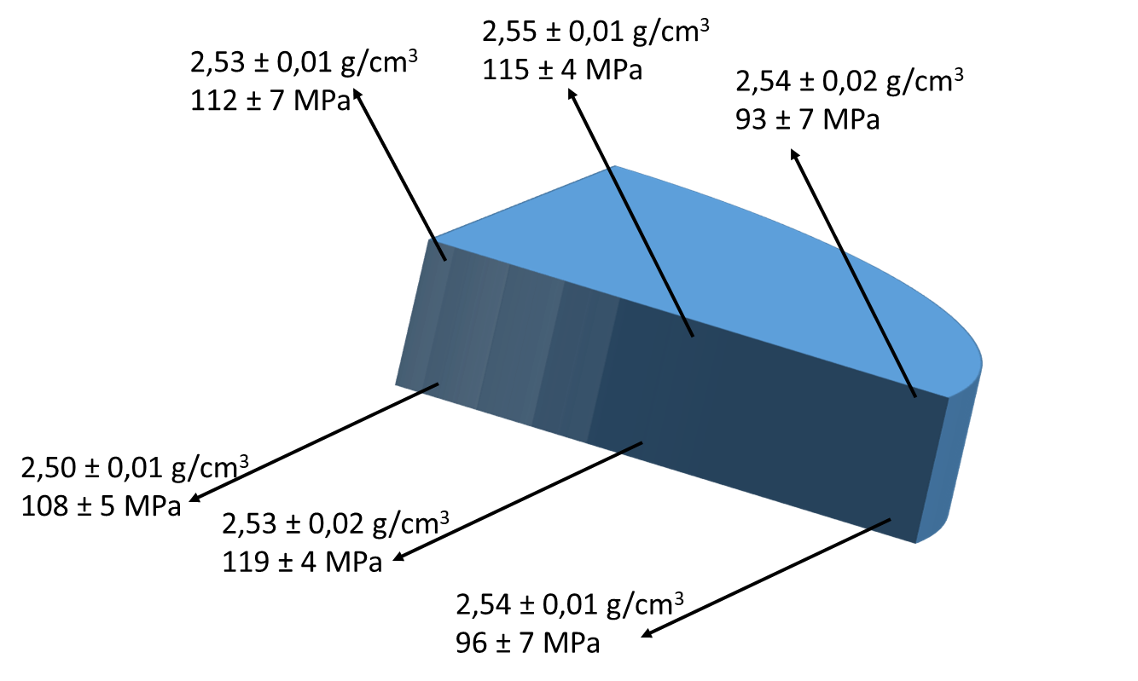
Year 1 – Increase of volume per cycle
Molybdenum-Graphite (sintered at 2640°C)
2 plates produced with 230 mm Diameter (2x bigger section than before IFAST)
Disk (230 mm diameter) | Density (g/cm³) | Electrical Conductivity (Mean values on each side) (MS/m)
Plate #1 (p=26 MPa) | 2,53 | 0,6 – 0,63
Plate #2 (p=40 MPa) | 2,60 | 0,65 – 0,68
Specification | 2,3 ÷2,6 | >0,8
Lower electrical conductivity values than in the 170 mm diameter disks
Pre-compaction of the green powder:
Maximum Applied Force Uniaxial Hydraulic Press ~ 900 kN
170 mm Ø → 40 MPa → 2,00 g/cm³
230 mm Ø → 21 MPa → 1,65 g/cm³
Next: increase the metal content, together with the higher sintering pressure

Slide 25
Year 1 – Decrease of sintering Temperature
Chromium-Graphite (sintered at 2000°C – 1.3x lower T)
Concept proposed by Jorge Guardia within ARIES WP14 & WP17, technically was not demonstrated yet (very poor mechanical properties)
3 plates produced with 170 mm Diameter
Disk (170 mm diameter) | Density (g/cm³) | Electrical Conductivity (MS/m)
Plate #1 | 2,30 | 1,00 – 1,07
Plates #2 & #3 | 2,30 | 0.75/0.81
Specification | 2,3 ÷2,6 | >0,8
Reusable Mold and Parts → Important Cost Reduction
Plate #1 produced in a single plate per cycle, very promising properties, decision for full characterization at CERN
Plates #2 and #3 double-plate per cycle, losing a bit in conductivity → composition and cycle to be optimized

Slide 26
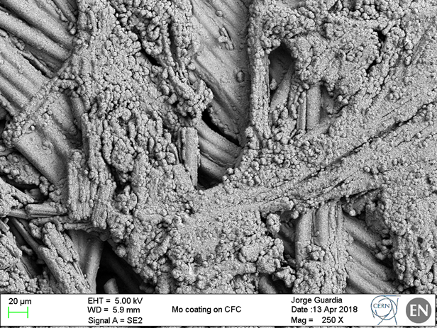
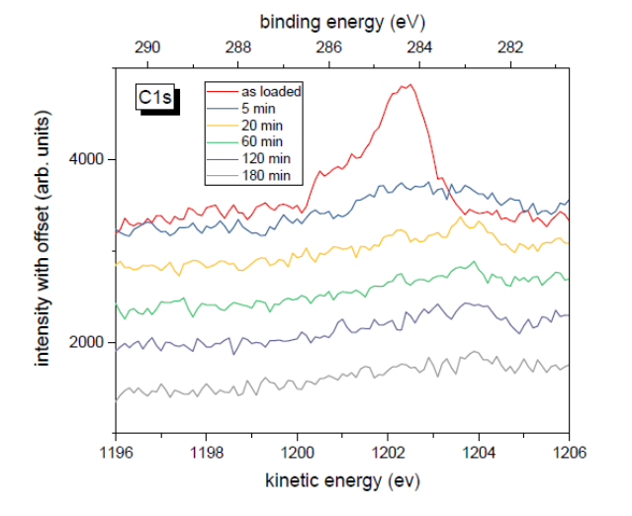
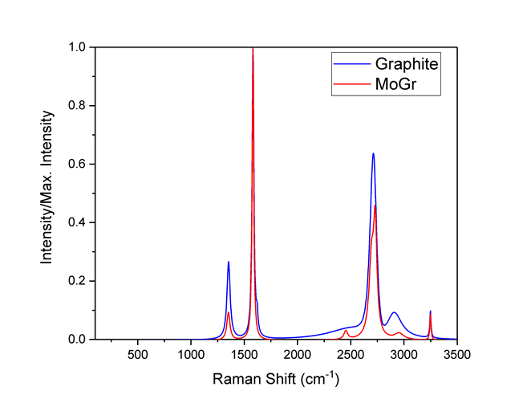
Standard sputtering (CERN)
Thanks to N. Biancacci and A. Kurtulus!
Material | Coating | # sample measured | Average σ [MS/m] | H011 cavity σ [MS/m] | Eddy current σ [MS/m]
MoGr Nb8304Ng | Mo CERN | 9 | 10 | 3* spoiled surface | 10÷12
CFC FS140 | Mo CERN | 11 | 2.5 |  | -
Graphite R4550 | Mo CERN | 10 | 3 | ~3 | -
Mo on CFC: Voids in the bulk are in the 1mm range → effects of the coating on the conductivity was not seen in the impedance measurements
Mo on graphite: surface status similar to MoGr, not clear the reason of the low Mo conductivity
XPS measurements reveal the presence of MoC in the coating→ lower conductivity
MoC formation: investigation ongoing→ related to lower graphitization?
Mo on MoGr
Mo on Gr
Thanks to M. Himmerlich

Slide 27
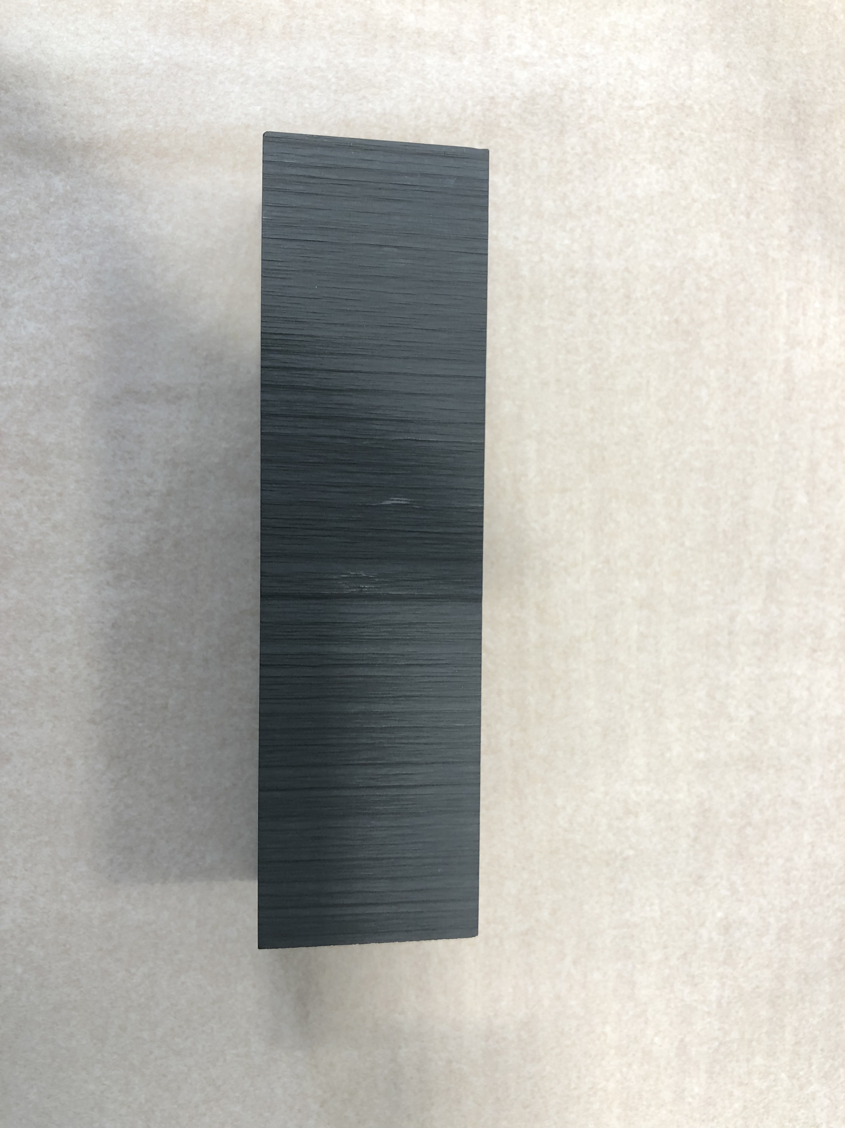
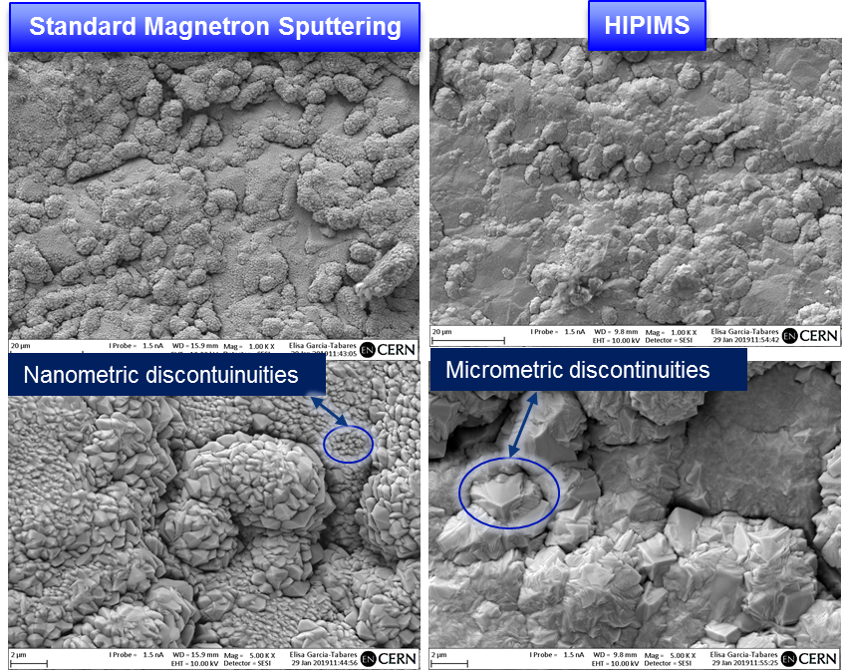
HiPIMS sputtering (DTI)
Material | Coating | # sample measured | Average DC σ [MS/m] | H011 cavity σ [MS/m]-16.8 GHz
MoGr Nb8304Ng | Mo DTI | 10 | 25 | ~18
 | Cu DTI | 8 | 43
Graphite R4550 | Mo DTI | 10 | 21 | ~10* wrong surface preparation
 | Cu DTI | 9 | 52 | 47
With HiPIMS Mo conductivity improve:
  2 times in MoGr→ bigger grain size
  ~10 times in graphite→ bigger grain+no carbide formation (?), XPS studies planned
  Coherent with the higher density measured (8 vs 10 g/cm³)

Slide 28
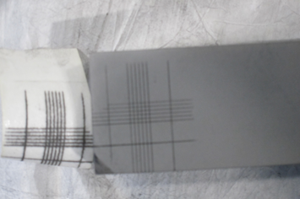
Coating validation in degraded vacuum
Aim of the test: investigate possible coating adhesion degradation induced by bad vacuum environment
  Bake-out: 1 night at 250 ºC with air-leak: P = 2*10⁻³ mbar→ No degradation in adhesion: no peel off observed with cross-hatch scotch test.
  Bake-out: 1 night at 250 ºC with air-leak: P = 1*10⁻² mbar→ No degradation in adhesion: no peel off observed with cross-hatch scotch test.
This block has already undergone 400°C, 6h thermal treatment

Slide 29
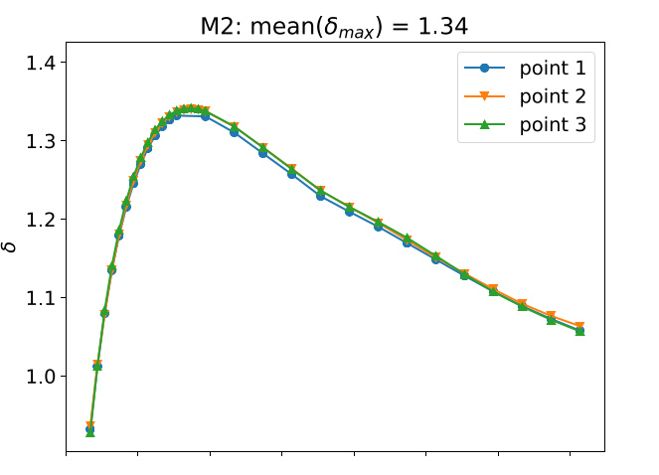
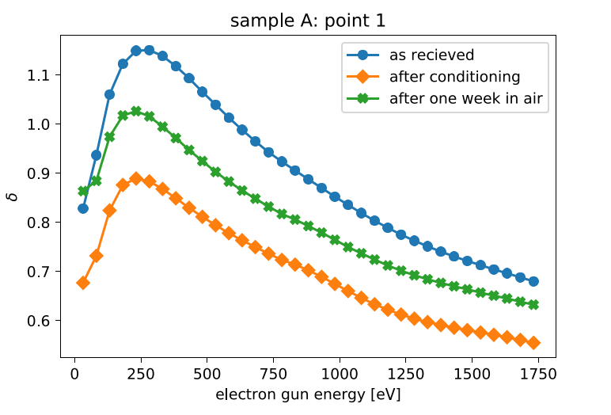
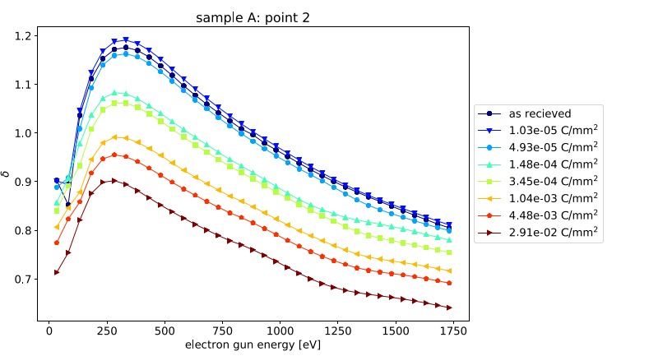
SEY Measurements
SEY Mo coating- Courtesy of D. Zanin (TE/VSC)
SEY MoGr Courtesy of D. Zanin (TE/VSC)

Slide 30
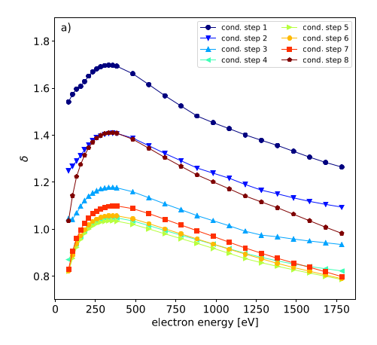
SEY Measurements
SEY CuCD Courtesy of D. Zanin (TE/VSC)
SEY Gr Courtesy of D. Zanin (TE/VSC)

Slide 31
Year 1 – CrGr Characterization
Full thermomechanical characterization done at CERN Mechanical Lab in April 2022
Very promising results, some parameters to be improved during the next years of the project. Mechanical strength increased by a factor of 5 wrt ARIES!
 | Specification |  | CrGr Plate #1
Property | ǁ* | Ⱶ | ǁ* | Ⱶ | Unit
Density at 20⁰C | 2.40 – 2.60 |  | 2.32 |  | [g/cm³]
Specific heat at 20⁰C | > 0.6 |  | 0.687 |  | [J/(g∙K)]
Electrical conductivity at 20⁰C | > 0.75 |  | 1.02 |  | [MS/m]
Thermal Diffusivity 20⁰C /at 300⁰C | > 350/100 | > 20/6 | 470/120 | 33/9 | [mm^2/s]
Thermal conductivity at 20⁰C /at 300⁰C | > 500/280 | > 35/20 | 750/350 | 52/27 | [W/(m∙K)]
Volumetric CTE 20-1000⁰C | < 7 |  | 6.7 |  | [10⁻⁶K⁻¹]
Coefficient of thermal expansion 20-1000⁰C | < 2.9 | < 15 | 4.0 | 12.0 | [10⁻⁶K⁻¹]
Young’s Modulus at 20⁰C | 35 < E < 75 | 5 < E < 8 | 46 | 3 | [GPa]
Flexural strength at 20⁰C | > 60 | > 10 | 58 | 8 | [MPa]
Flexural strain to rupture at 20⁰C | > 2500 | > 4000 | 3280 | 4200 | [µm/m]
Dimensional stability* | < 0.05 | < 0.25 | -0.05 | 0.45 | %

Slide 32
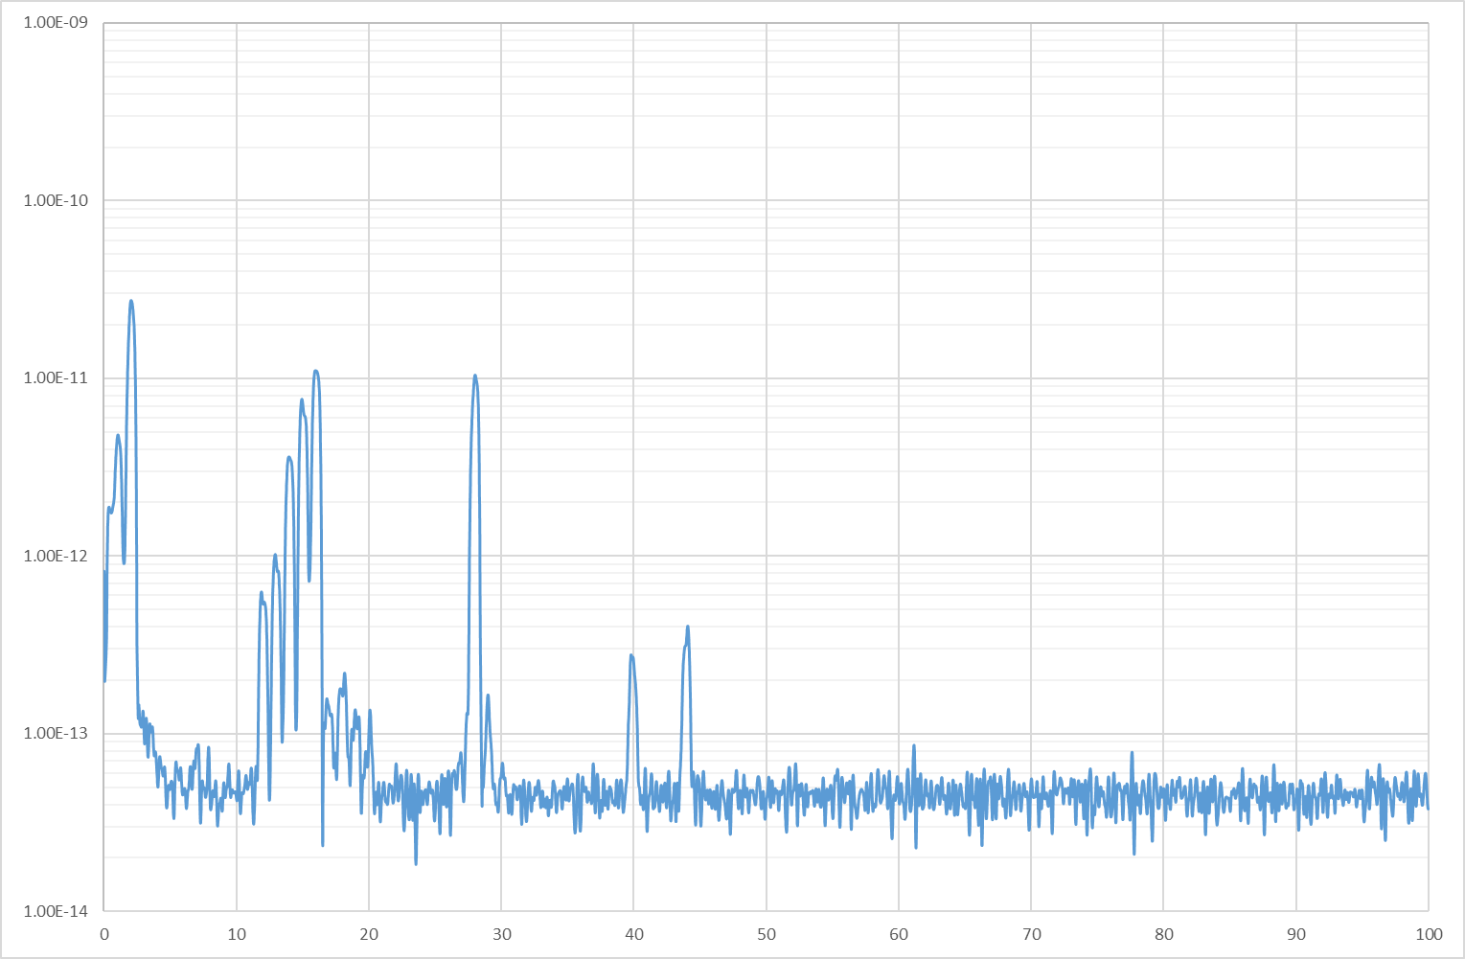
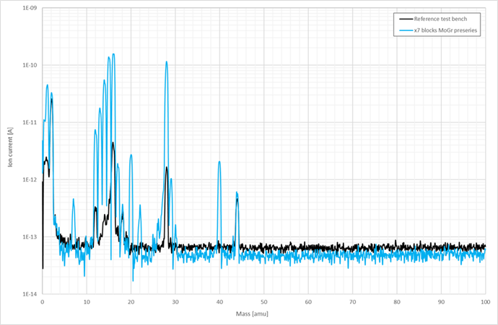
Outgassing features of MoGr-3
Negligible hydrogen outgassing: visible when we compare the RGA of 1 block and of 7 blocks
All the gases increase, but hydogen which comes from the background
Impossible to applicate the standard acceptance criteria based on hydrogen normalization→ dedicated simulation to assess compatibility confirm negligible effect on beamtime (EDMS 2061004)
1 block (29/05/2018)
7 blocks (17/07/2018)

Slide 33


LS3 secondary collimators
Focus on absorber material for TCSPM jaws: absorbers for 12 collimators should be produced (spare Mo-coated MoGr from LS2 ready to be eventually installed in 2 collimators)
Technical material assessment of studied options summarized in the collimator’s jaw’s materials table LHC-TC-ER-0008 v.1
Graphite with 3 µm Cu coating selected at the WP5 PSM on 12/07/2022 for the blocks (see F.-X. Nuiry, “Jaw materials option for LS3 collimators”, 162nd HL-LHC TCC , 14th September 2022)
  Good HiRadMat results (Multimat 2) (see J. Guardia, ‘Report on MultiMAT2’, ColUSM#153, 2nd September 2022)
  Cheaper (see F.-X. Nuiry, “Jaw materials option for LS3 collimators”, 162nd HL-LHC TCC , 14th September 2022)
  Good solution for impedance (see N. Mounet, “Impedance consideration in material master table”, WP5.2 Technical Meeting, 19th September 2022) if the coating conductivity is higher then 45MS/m (see next slide)
BLOCK (procedure confirmation)
BEST OPTION
It was recently pointed out that the tapering contribution to impedance is not negligible. Three options are opened:
  Graphite with copper coating→ request to investigate the feasibility
  MoGr
  Graphite
TAPERING (procedure development)
R&D for copper-coated are at different level of readiness→ the discussion and the tests foreseen are treated separately

Slide 34
Graphite-coated blocks: planning of tests
In view of these considerations, we ordered 6 blocks and 20 samples of graphite from SGL (R4550), that would be coated with copper.
These parts will be characterized in order to validate this option:
    6xBlocks tests (500x45x25mm):
        Metrology before/after coating
        UHV test before/after coating
        Impedance after coating
        Optional: Conductivity after thermal treatment (bake-out T?)
        Optional(destructive): Adherence after thermal treatment(bake-out T?)
    20xSample test (50x50x5mm)
        Impedance after coating
        Adherence
        Optional: microscopic observation
  These tests were discussed in a dedicated meeting https://edms.cern.ch/ui/#!master/navigator/document?D:101090376:101090376:approvalAndComments

