Slide 1

L’équipe du vide d’Einstein Telescope au CERN : objectifs et délivrables.

Slide 2
Today, when a strong gravitational wave reaches our planet, space and time distortion can be measured.
The measurement is possible thanks to laser interferometry.
A strong gravitational wave will produce displacements of the order of 10⁻¹⁸ meters - this is 1000 times smaller than the diameter of a proton.
This is equivalent to the measurement of an hair diameter (100 μm) variations in the Sun-Alfa Centauri distance (4.4 light years).

Slide 3
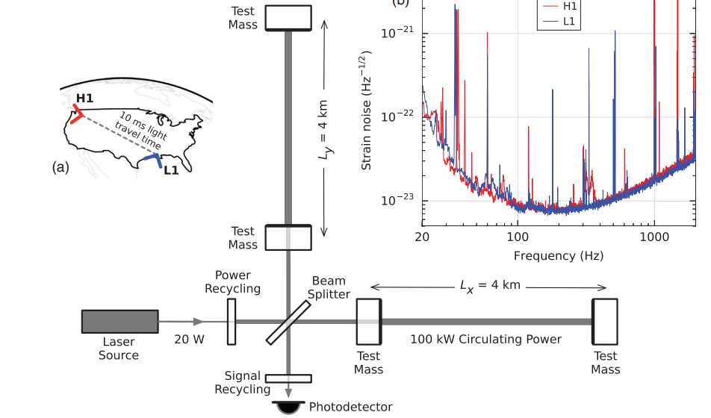
The sensitivity of the laser interferometer depends on the length of the Fabry-Perrot cavities.

Slide 4
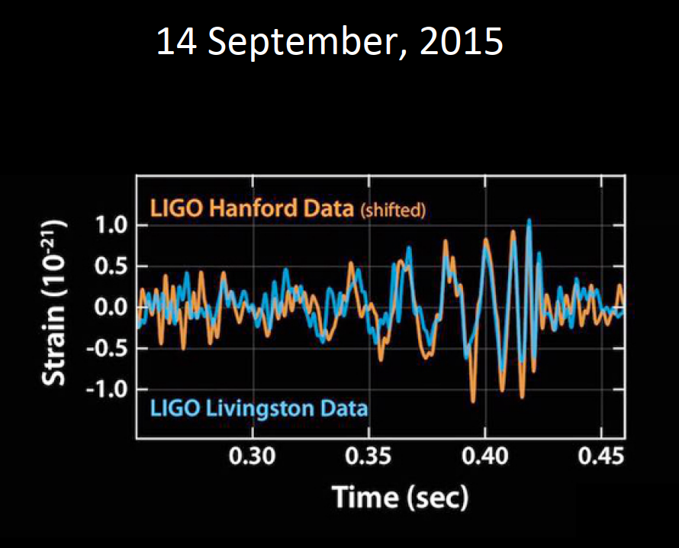
29 M☼ and 36 M☼ black holes 1.3 GLY away inspiral and merge, emitting 3 M☼ of GW energy.
Courtesy of:
Mike Zucker (LIGO Caltech & MIT)

Slide 5
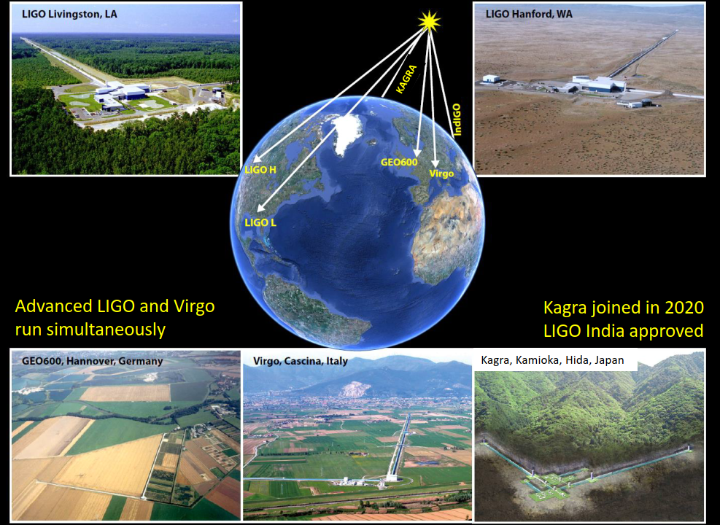
4 km
Source: Jo van den Brand, Einstein Telescope: vacuum considerations, July 15th, 2020
4 km

Slide 6
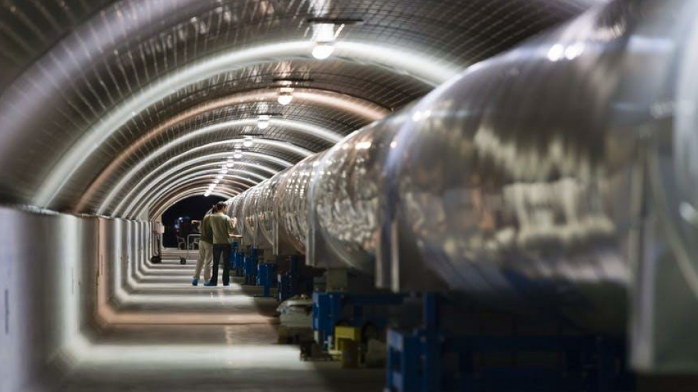
VIRGO
Source: Jo van den Brand, Einstein Telescope: vacuum considerations, July 15th, 2020

Slide 7
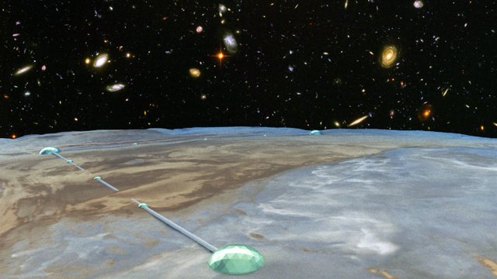
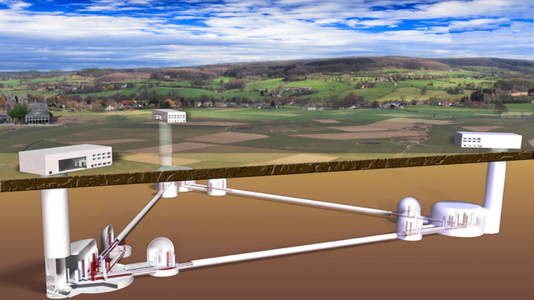
The future of GW telescopes: make the interferometer arms longer
Einstein Telescope: 120 km of ≈1.1-m diameter vacuum pipes.
Three possible sites: Sardinia (Italy), Dutch-German-Belgium border and Eastern Saxony (Upper Lusatia, Germany).
Cosmic Explorer: two installations 80x2=160 km of 1.2-m diameter vacuum pipes.

Slide 8
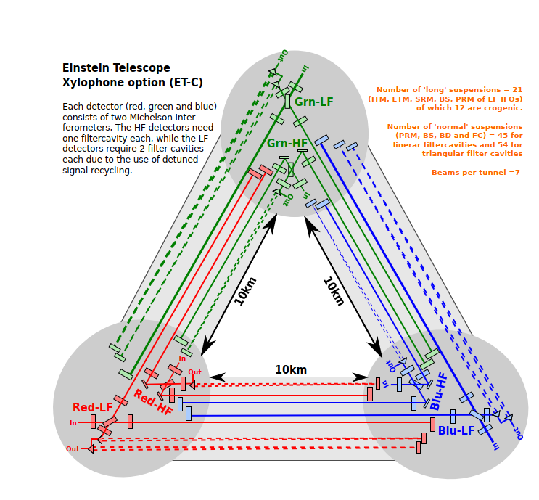
Einstein Telescope
• ~ 250-300 m underground
• Around 31 km of ~6.5 m inner diameter tunnel + caverns (30x30x60 m)
-> total excavation order of Mm³
• 6 interferometers arranged in triangular shape
• ~200 in-vacuum towers to host the seismic isolation systems
• Mirrors 200 kg
• Some part under cryogenics operation (~ 20 k)
• > 500 W ultra stabilized lasers
• Lifetime: 50 years
• Total cost ~ 1.7 G€ + R&D
Main specifications
About 1-m diameter
P_{H2}≈10⁻¹⁰ mbar
P_{H2O}<5*10⁻¹¹ mbar
P_{CxHy}<10⁻¹⁴ mbar (M>100 amu)

Slide 9
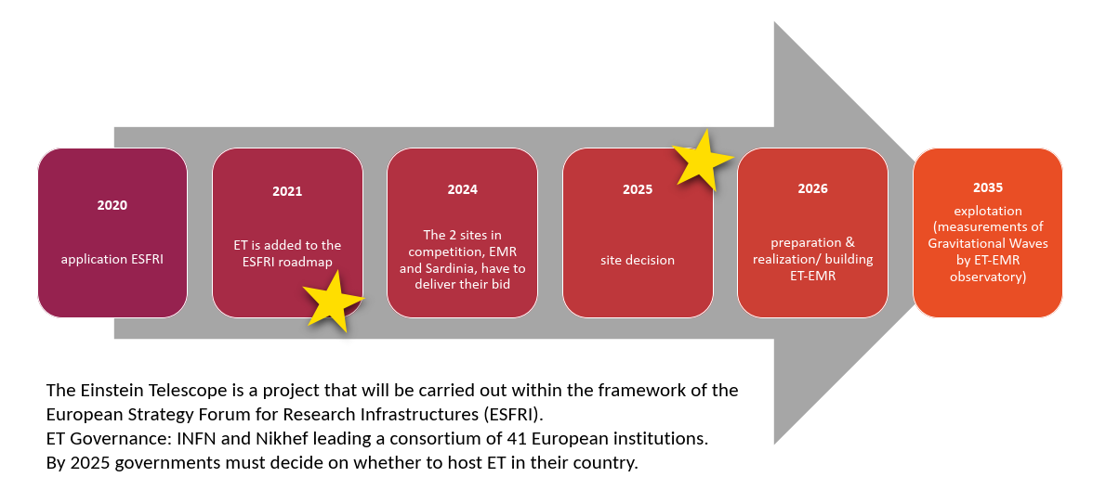

Slide 10
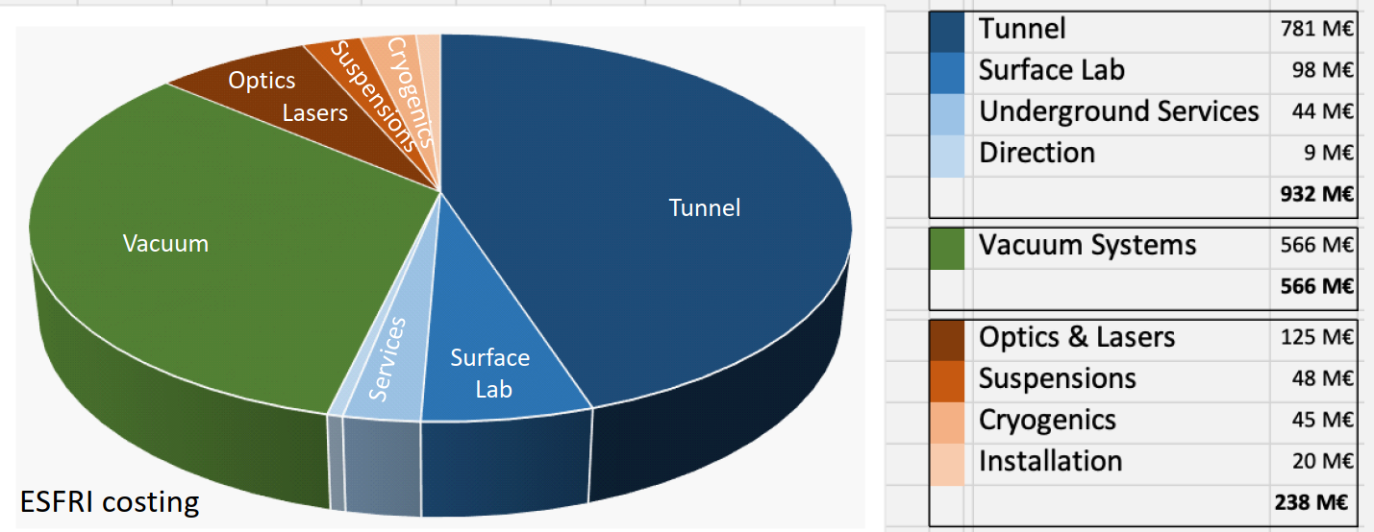
The ET beampipe baseline: cost estimation
It includes the vacuum of the towers in the corner stations.
Slide copied from: Andreas Freise, The current status of the Einstein Telescope 10.05.2020

Slide 11
The ET beampipe baseline: cost estimation
Scaling of the:
VIRGO vacuum costs to ET leads to 550 M€, 1/3 of the total proposed budget.
LIGO vacuum costs to CE leads to 650 M$, more that 50% of the total proposed budget.
Cost of gas pipelines of equal length (lowest envisaged cost):
250 M$ (estimation by Rainer Weiss)
Cost $
650 M
R&D in materials
and manufacturing
250 M

Slide 12
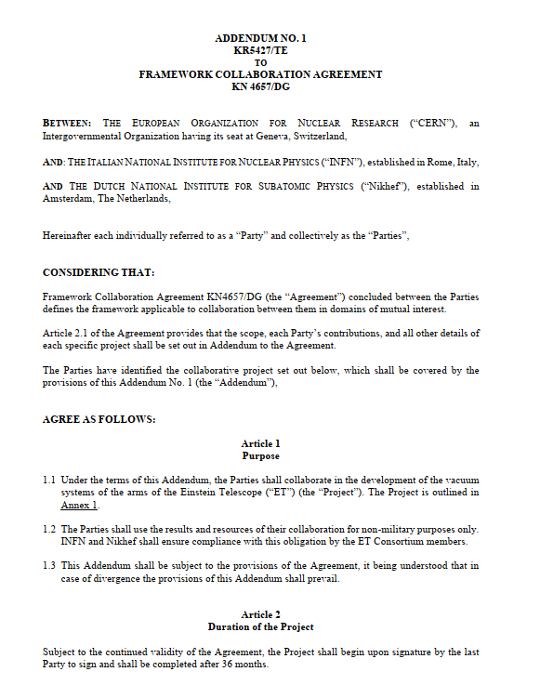
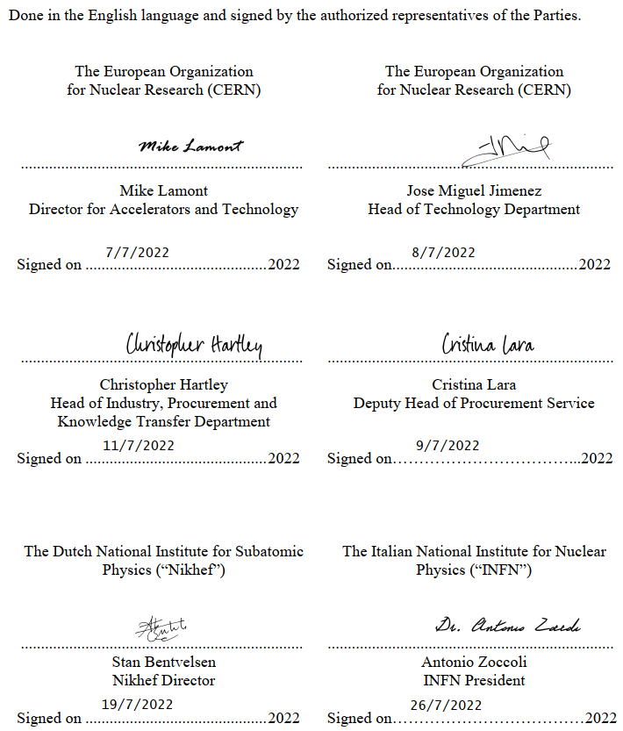
The agreement is formally approved

Slide 13
Main technical objectives of the addendum to the agreement
Re-evaluate the baseline solution (Virgo/LIGO and CDR) with minor modifications imposed by the new requirements.
Design and test technical solutions that fulfil the ET requirements and are less expensive than the baseline. The required technical infrastructure will be evaluated and optimized as well.
Manufacture, assembly and test a pilot sector.
Write the technical design report, including cost estimations.
Main coordination objectives of the addendum to the agreement
Coordinate the effort of ET collaborators interested in the same technical objectives.
Coordinate the contact and sharing of information with Cosmic Explorer in the field of vacuum technology.

Slide 14
WP1: engineering
WP2:
production
WP3:
treatments
WP4:
transport
WP5:
installation
WP6:
vacuum
Design and engineering of the vacuum chamber
Choice of materials and manufacturing technology
Choice of post-manufacturing treatments
Handling and logistics
Installation procedure and interface with other systems
Choice of vacuum pumps and valves
WP7:
prototyping
WP8:
coordination
Installation and test of a pilot sector
Coordination of the different work packages and contribution of collaborators
Work-Breakdown Structure

Slide 15
WP1: engineering
WP2:
production
WP3:
treatments
WP4:
transport
WP5:
installation
WP6:
vacuum
G. Deleglise (LAPP),
B. Lieunard (LAPP),
C. Garion,
H. Havlikova, CNRS Fell
M. Martinez (UAB)
M. Andres (UAB)
S. Sgobba
T. Perez
G. Favre
M. Dakshina-murthy,
J. Espinos
N. Kos
C. Scarcia (U. Aachen)
L. Marques
C. Scarcia (U. Aachen)
M. Taborelli
B. Teissandier
M. Himmerlich
L. Scibile
C. Garion
J. Espinos
J. Chaure
G. Bregliozzi K. Owens
B. Lieunard (LAPP)
M. Martinez
(UAB)
G. Bregliozzi
J. Chaure,
G. Pigny,
J-A Ferreira,
C. Scarcia
(U. Aachen)
A. Pasqualetti (EGO)
WP7:
prototyping
WP8:
coordination
J. Hansen
G. Favre,
G. Bregliozzi, G. Pigny
K. Owens,
I. Wevers,
C. Scarcia,
G. Deleglise
IFAE team
P. Chiggiato

Slide 16
Formal approval
Kick-off meeting
Start up phase 1 by July
Availability of INFRA-DEV personnel
Functional specifications
Start-up phase 2
by September
Availability of CERN FELLs
Definition of the contributions from ET collaborators
Contact with the Industry
Review of the baseline costs
Alternative materials, processing and design for pipelines
Technical work
Contact with the Industry
Procurement of pilot sector
Tests with pilot sector
TDR
Pilot sector at CERN

Slide 17
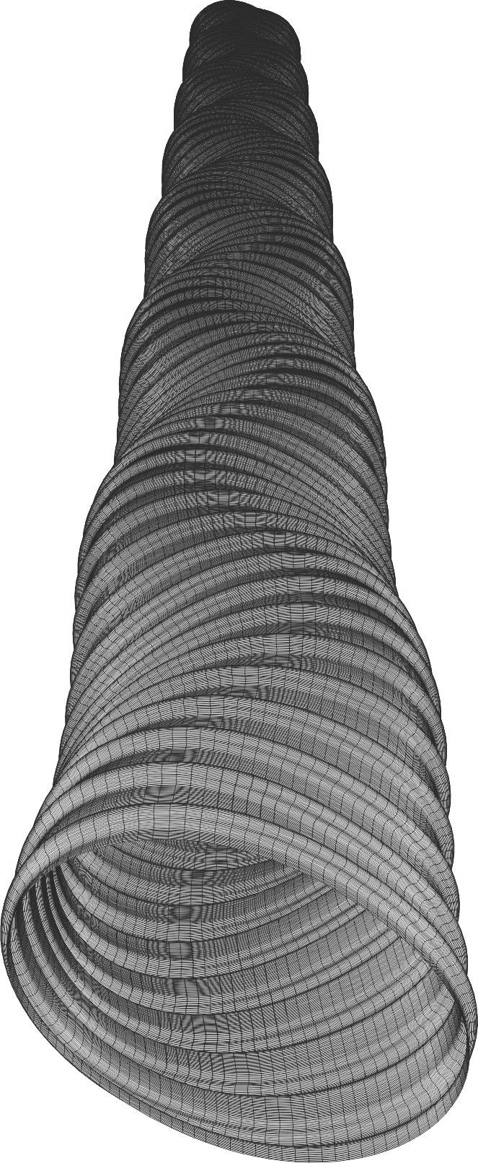
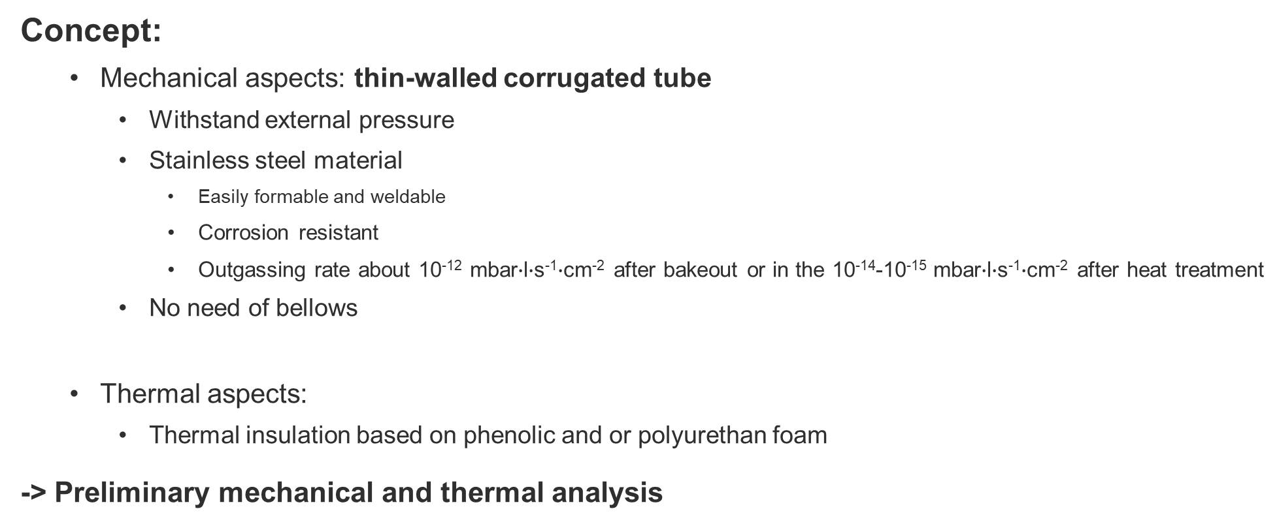
Design inputs and concept
Concept:
  Mechanical aspects: thin-walled corrugated tube
    Withstand external pressure
    Stainless steel material
      Easily formable and weldable
      Corrosion resistant
      Outgassing rate about 10⁻¹² mbar$∙$l$∙$s⁻¹$∙$cm⁻² after bakeout or in the 10⁻¹⁴-10⁻¹⁵ mbar$∙$l$∙$s⁻¹$∙$cm⁻² after heat treatment
    No need of bellows
  Thermal aspects:
    Thermal insulation based on phenolic and or polyurethan foam
-> Preliminary mechanical and thermal analysis

Slide 18
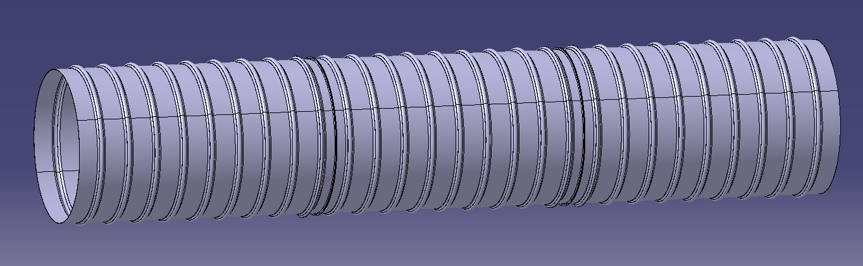
Measurement planning: road to the test pilot
In the following months, we planned to produce (at the Main Workshop) DN400 – 2m long corrugated chambers.
304L
AISI 430
Mild steel
Courtesy of Hana
Purpose: test bench for the forming, welding and cleaning technology as well as outgassing measurements.
Knowledge transfer for the test pilot sector.

Slide 19
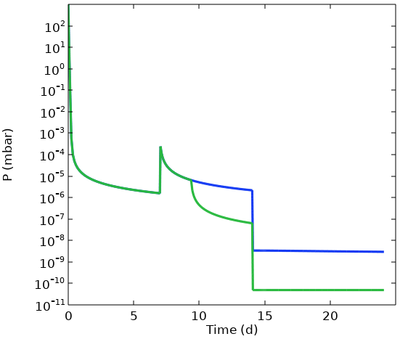
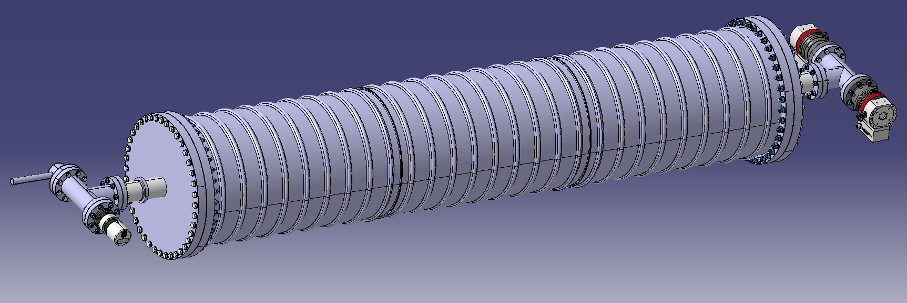
Measurement planning: road to the test pilot
Calculations on ET vacuum conditions (Jose) based on low temperature bakeout together with NEG pumping.
-> Selections of vacuum instrumentation and effective pumping speed in order to establish similar conditions.
Expected pressure evolution during vacuum conditioning
C
C
Vacuum instrumentation layout

Slide 20
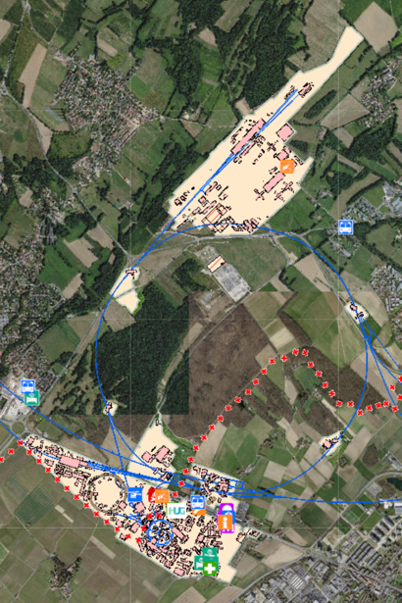
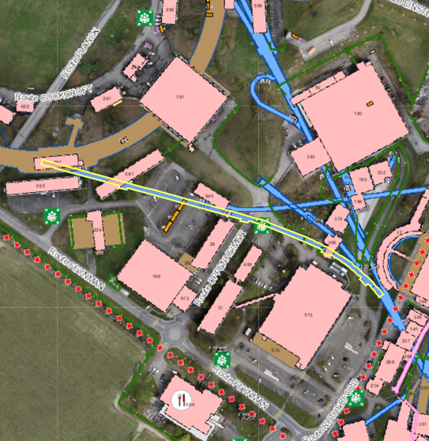
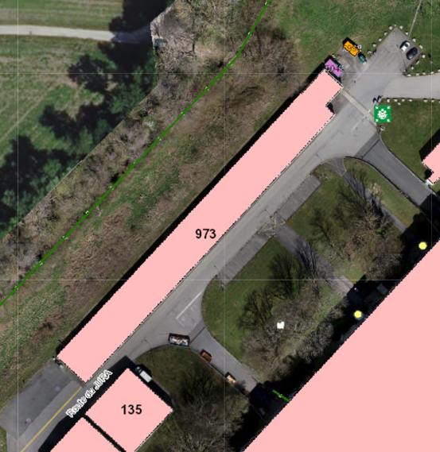
Identification of area for pilot test sector
Two areas have been identified for installation of the pilot as potential locations.
TT1 tunnel
Bulding 973

Slide 21
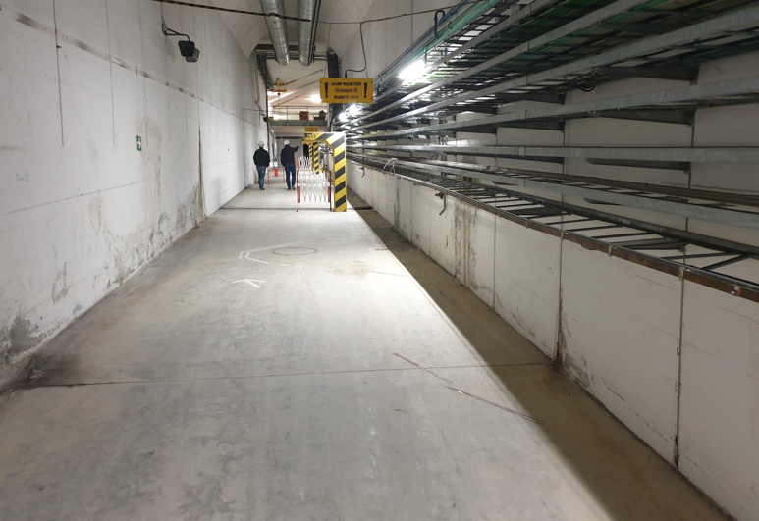
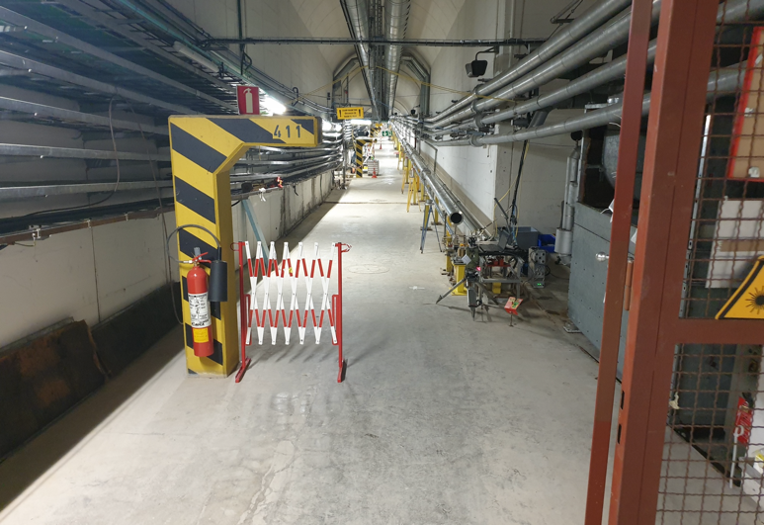
Identification of area for pilot test sector
TT1 tunnel:
  Advantages: almost constant environmental conditions, synergy with alignment team.
  Disadvantage: difficult access and transport (feasibility to be done), no ventilation in the tunnel.

Slide 22
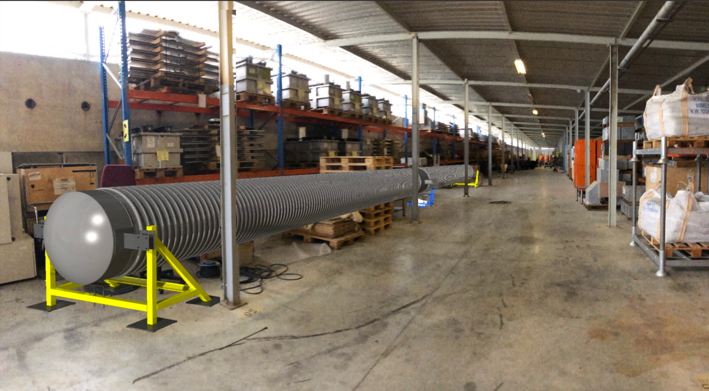
Conceptual integration models
Conceptual model integrated in the B973

Slide 23
Web site
All info will be soon available at:
etvacuum.web.cern.ch
The web site is being prepared by Andre Rocha.
Workshop
Vacuum in GWD (EU, US, JP) at CERN (B.30)
27-28-29 March 2023
I am expecting your enthusiastic participation.

